Slide 2
VPN basic introduction
Set up a dedicated VPN service
The Most common connection issues
NAS VPN client advanced using scenario

Slide 3
What is VPN? (Virtual Private Network)
UNENCRYPTED
ENCRYPTED
ANONYMOUS

Slide 4
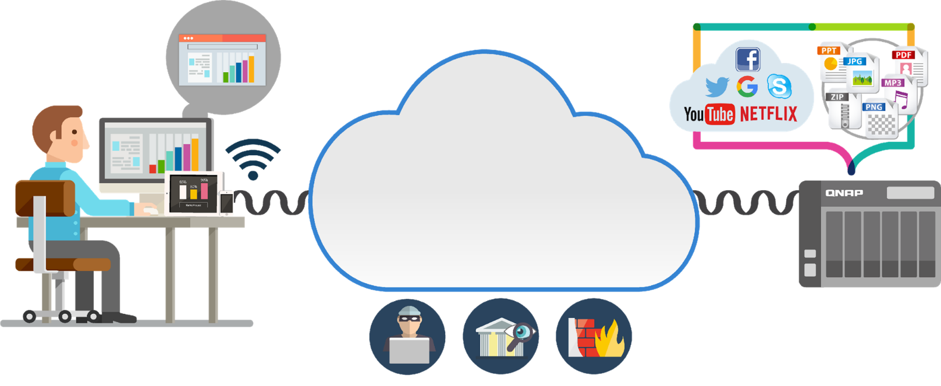
The general Internet structure
Internet

Slide 5
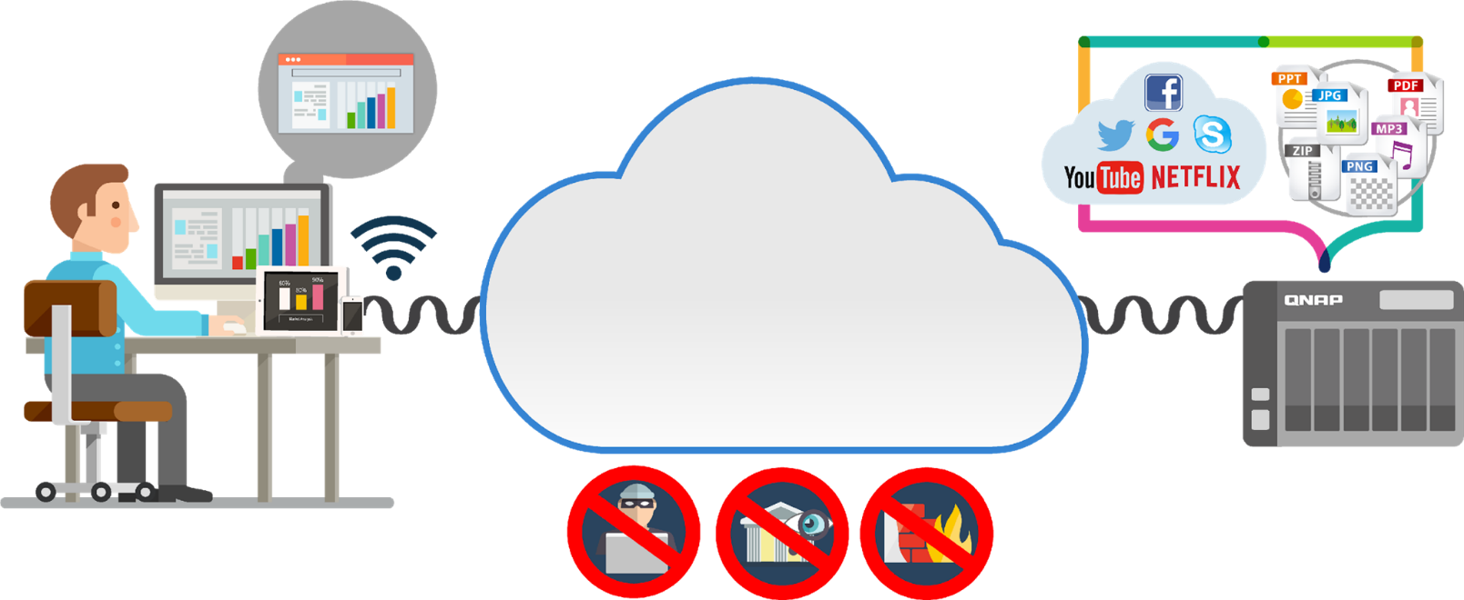
When you connect through the VPN
Internet in Tunnel

Slide 6
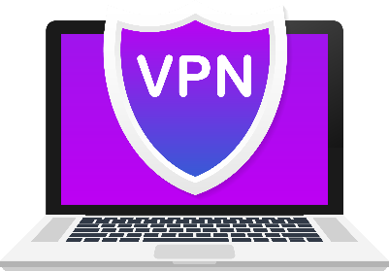
Who needs the VPN service
Business Users
Multinational businesses
(Sending and backing up files)
Sensitive data
(Financial transactions)
Home Users/ Gamers
(Regional restrictions)

Slide 7
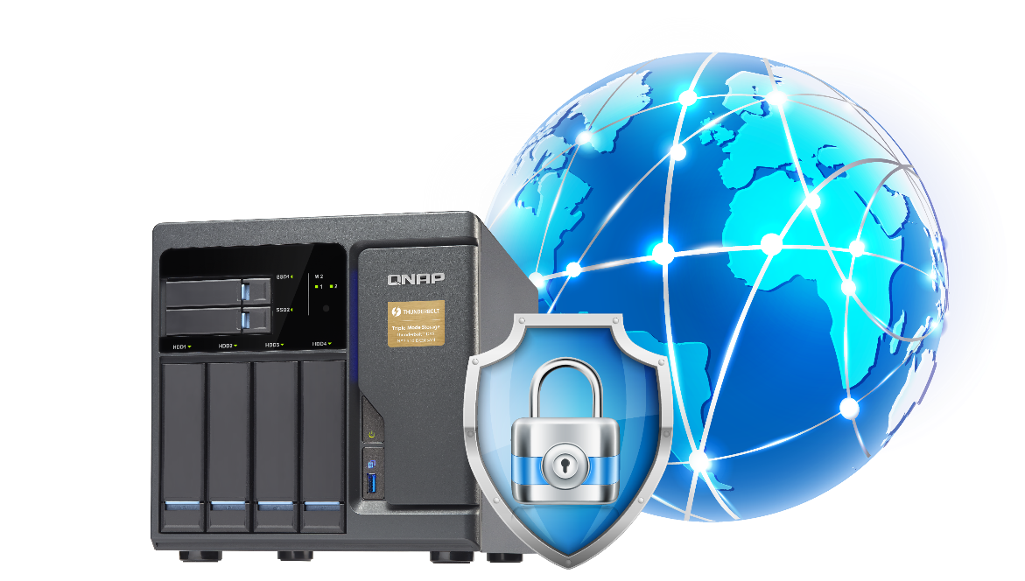
VPN makes you feel secure
Offers the flexibility for employees to take advantage of the company's Intranet over an existing Internet connection. (It can also be the case between student and school)
Secure communication is easier
Privacy protection
Reduces business travel costs
Access to geo-blocked contents

Slide 8
QVPN Service Set up a dedicated VPN service

Slide 9
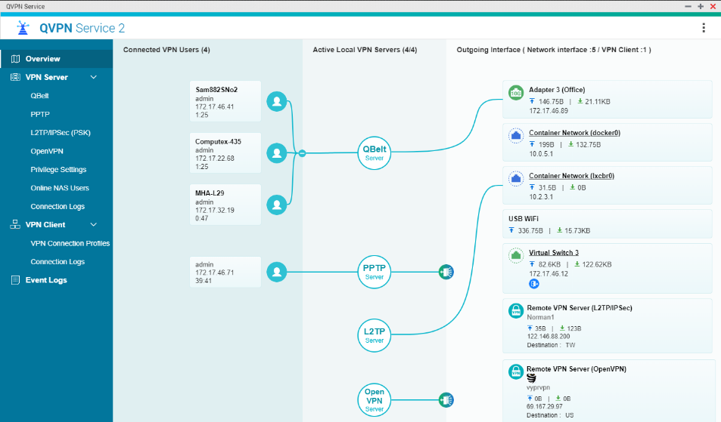
QVPN Server 2.0

Slide 10
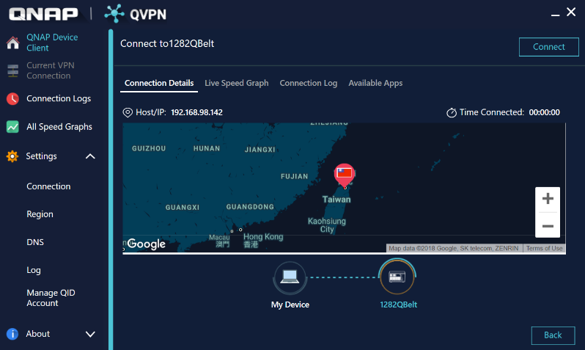
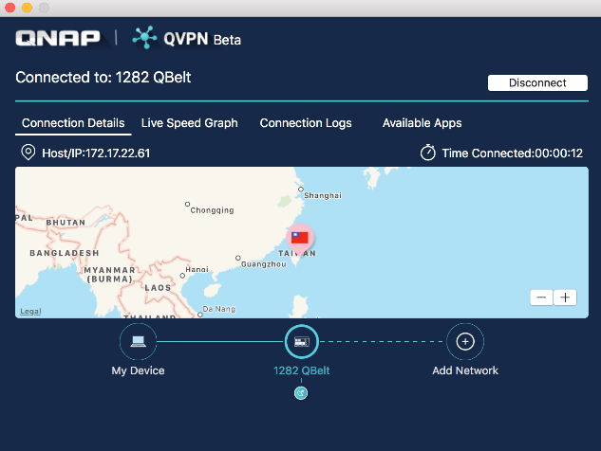
QVPN Device Client 1.0 – Windows/ Mac
Widows
Support protocol: PPTP, L2TP, OpenVPN, QBelt
Mac
Support protocol: L2TP, QBelt

Slide 11
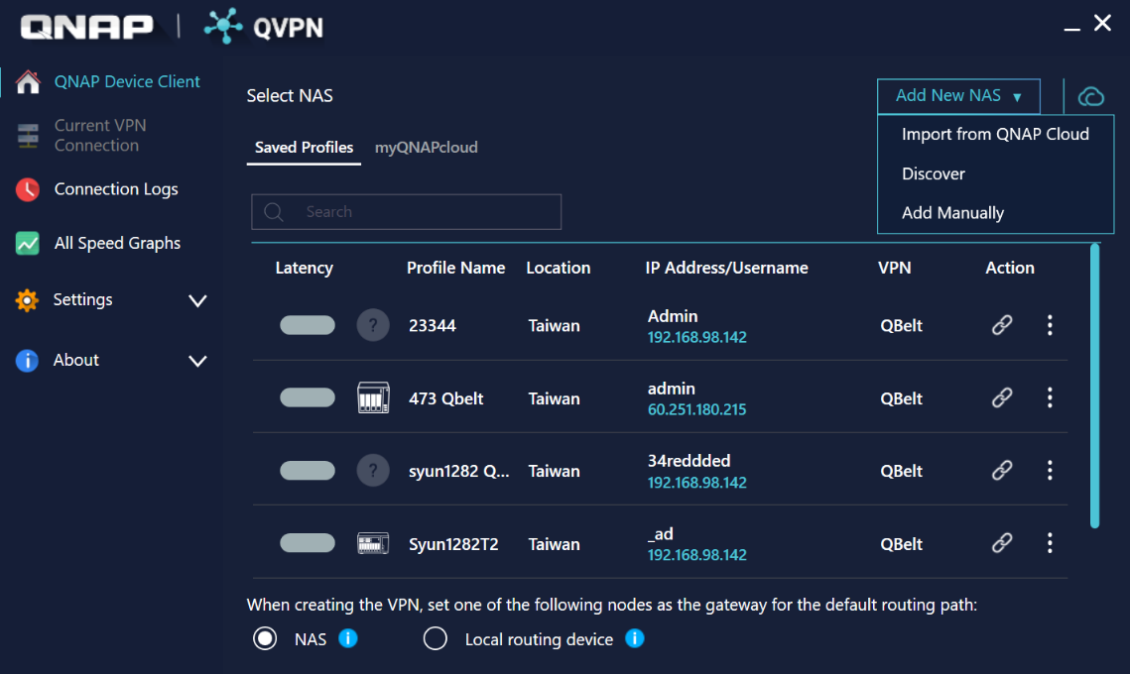
QVPN Device Client : Windows
1
Add New NAS

Slide 12
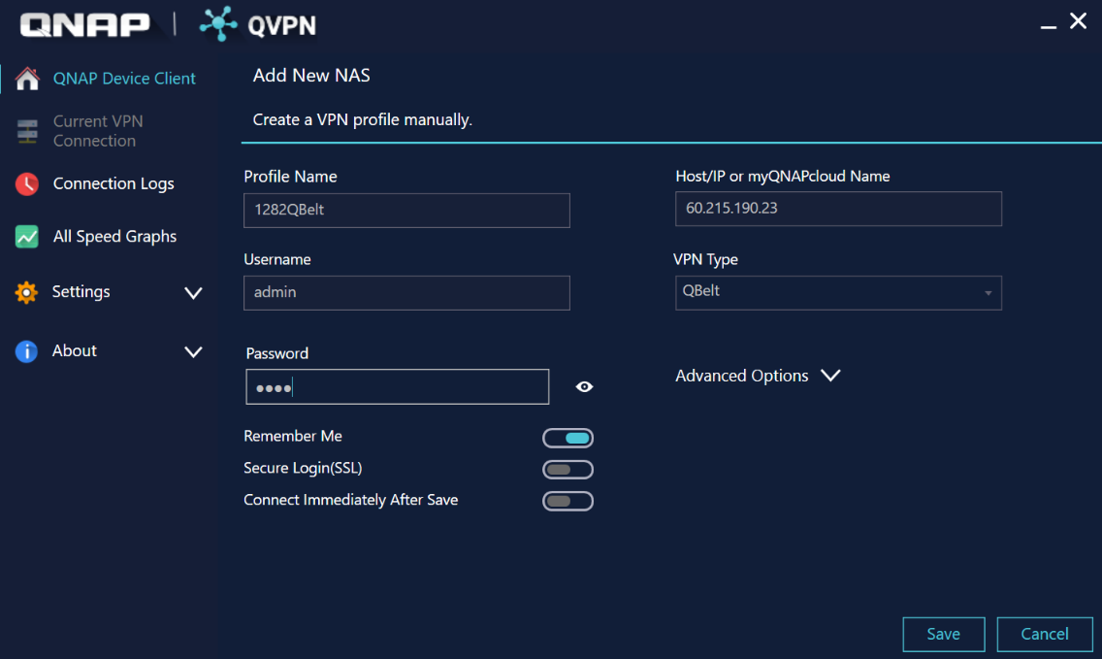
QVPN Device Client : Windows
1
Add New NAS
Enter VPN profile field, admin user automatically obtains VPN Port and pre-shared key
2

Slide 13
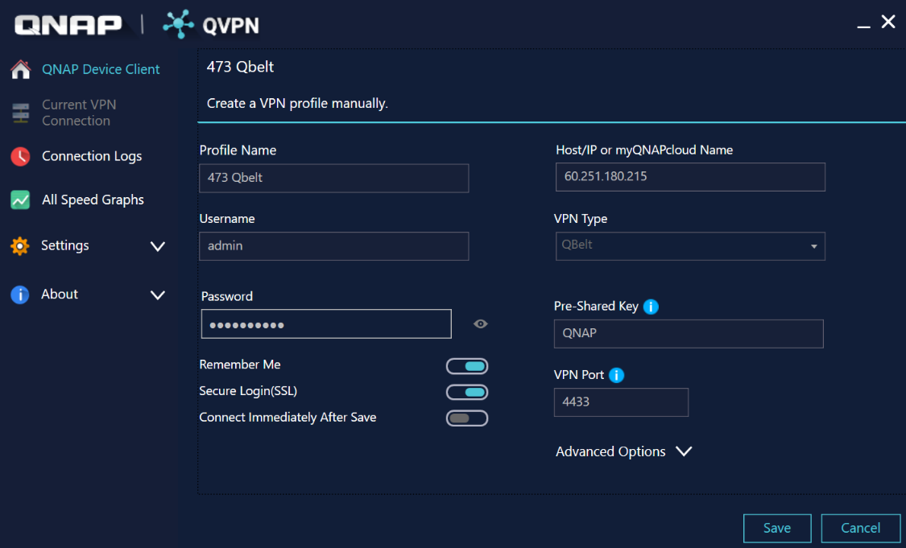
QVPN Device Client : Windows
1
Add New NAS
Enter VPN profile field, admin user automatically obtains VPN Port and
pre-shared key
2
3
If it is not an admin user, or if it fails to automatically get the information, you need to enter it manually

Slide 14
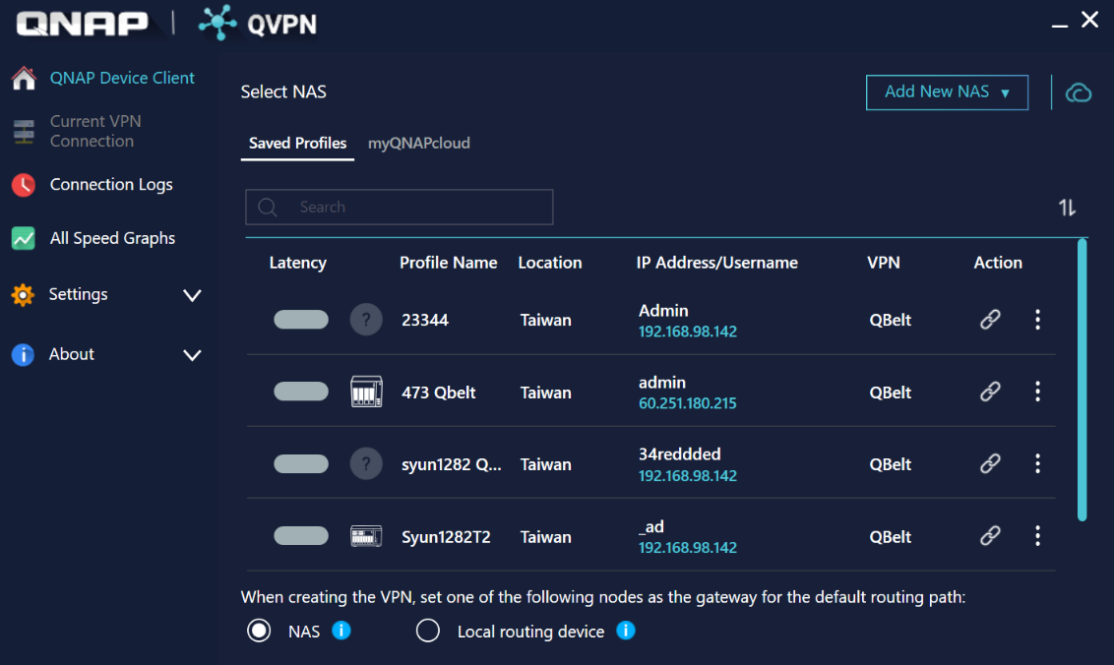
QVPN Device Client : Windows
1
Add New NAS
Enter VPN profile field, admin user automatically obtains VPN Port and
pre-shared key
2
If it is not an admin user, or if it fails automatically get the information, you need to enter it manually
3
4
Click Connect

Slide 15
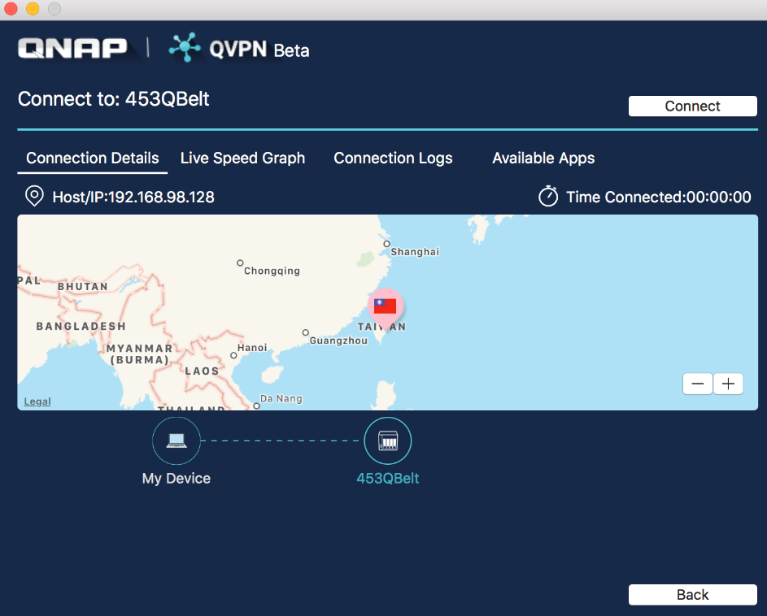
QVPN Device Client : Mac
1
Add New NAS
2
Enter VPN profile field, admin user automatically obtains VPN Port and pre-shared key
If it is not an admin user, or if it fails automatically get the information, you need to enter it manually
3
4
Click Connect

Slide 16
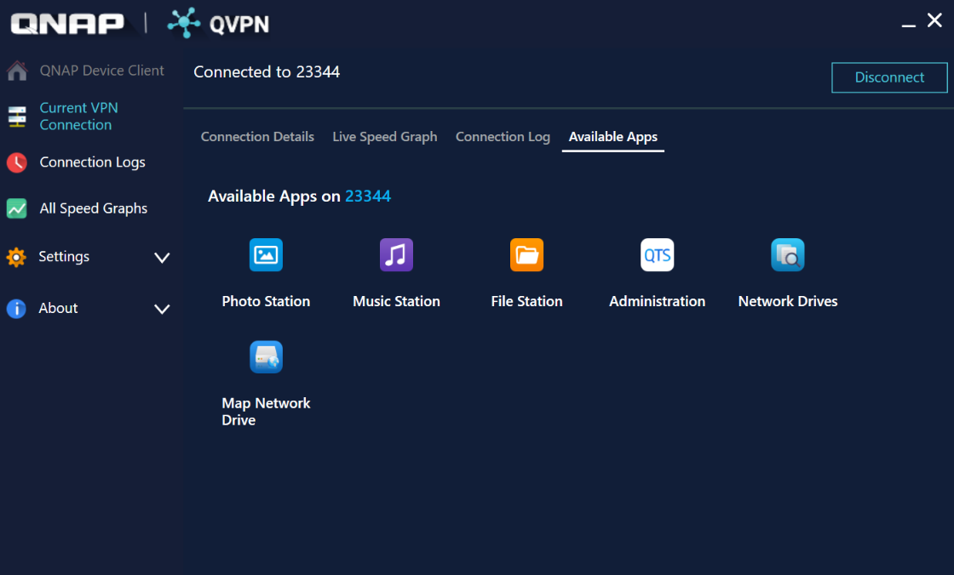
QVPN Device Client advanced features
Utility advanced features :
QTS administration web
Network drives(windows)
Map network drives
Open App directly
- File station
- Music station
- Photo station

Slide 17
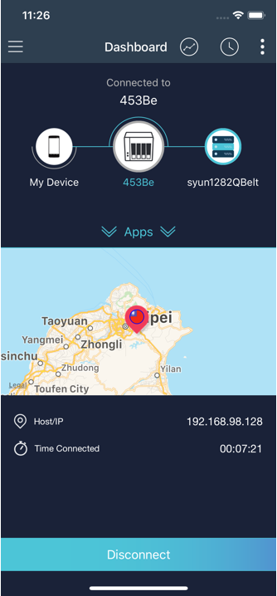
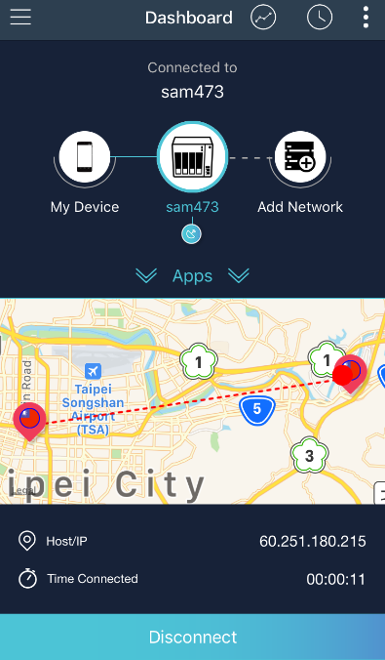
QVPN Device Client 1.0 – Android / iOS
Android
iOS

Slide 18
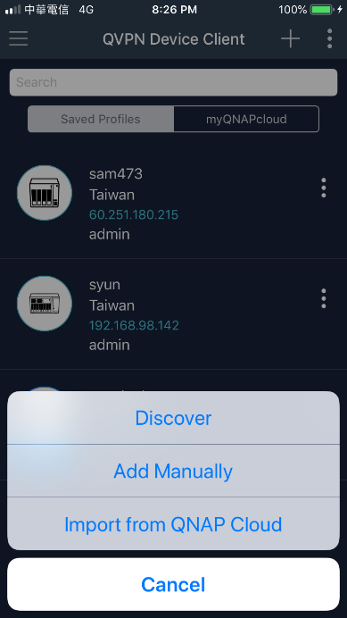
QVPN Device Client : iOS
1
Add New NAS

Slide 19
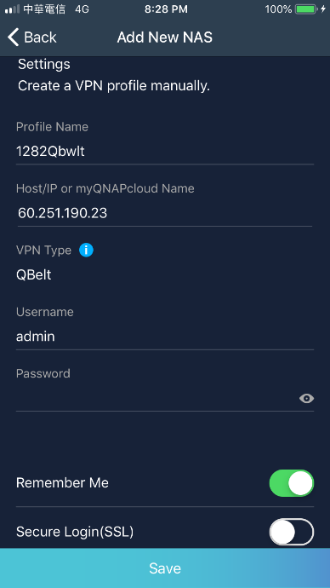
QVPN Device Client : iOS
1
Add New NAS
2
Enter VPN profile field, admin user automatically obtains VPN Port and pre-shared key

Slide 20
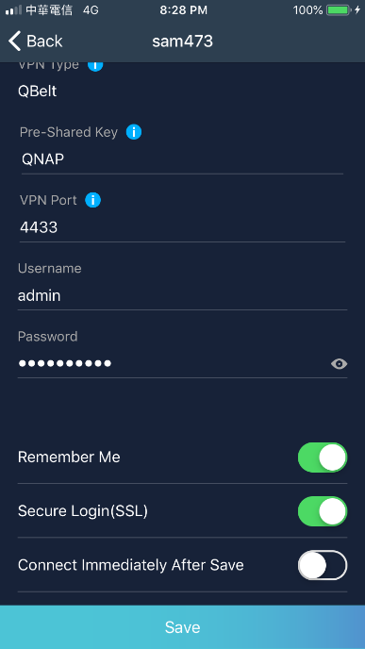
QVPN Device client : iOS
1
Add New NAS
2
Enter VPN profile field, admin user automatically obtains VPN Port and pre-shared key
3
If it is not an admin user, or if it fails automatically get the information, you need to enter it manually

Slide 21
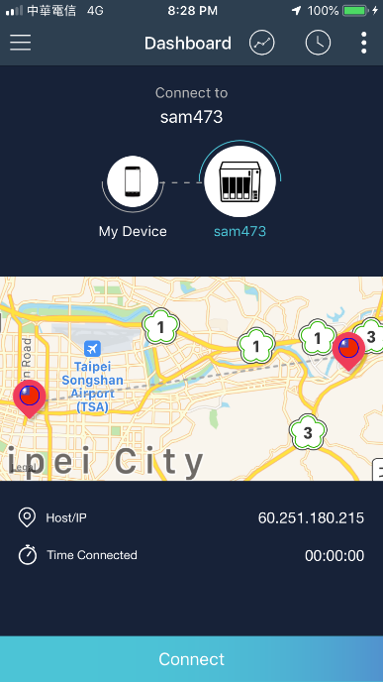
QVPN Device Client : iOS
1
Add New NAS
2
Enter VPN profile field, admin user automatically obtains VPN Port and pre-shared key
3
If it is not an admin user, or if it fails automatically get the information, you need to enter it manually
4
Click Connect

Slide 22
QVPN Device Client : Android
1
Add New NAS
2
Enter VPN profile field, admin user automatically obtains VPN Port and pre-shared key
3
If it is not an admin user, or if it fails automatically get the information, you need to enter it manually
4
Click Connect

Slide 23
The Most common connection issues

Slide 24
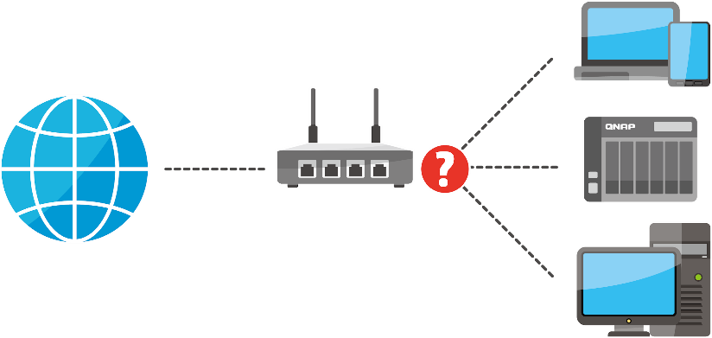
The most common issues
The router does not know which device to relay the traffic to
?
The connection is blocked by the firewall
!

Slide 25
Manually set up the router
QBelt Comment issue : UDP Port
Port
Forwarding
DMZ
Control everything yourself
Super easy
Supported by most routers
Set the port to be forward
1. Set the forwarding IP
More secure
(only open the required port)
2. All ports/packets forwarded
Security Concern => all ports exposed
Enabled VPN passthrough
too many steps and complicated
Notes:
VPN passthrough?

Slide 26
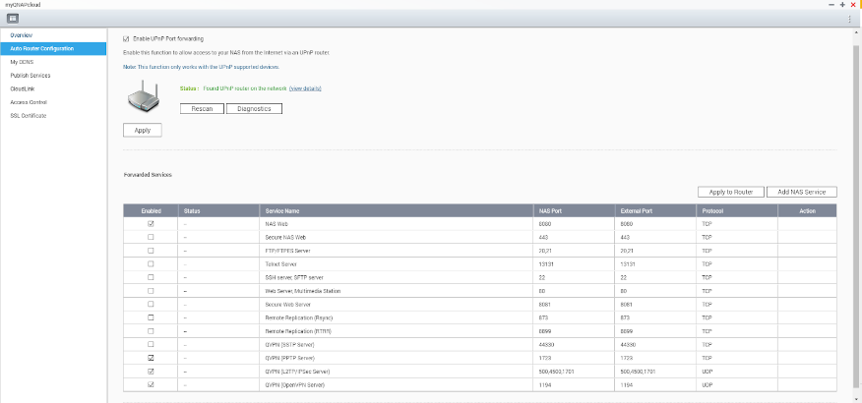
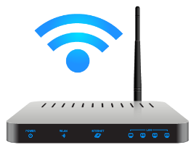
UPnP auto enables VPN port forwarding
Common issue: Some routers preload some of the same functions of the VPN, they will hold the VPN port first, so the UPnP will not be transferred normally. It is recommended to use Port Forwarding to adjust the detailed settings.
myQNAPcloud will take care of it!
Sets automatically
UPnP router required

Slide 27
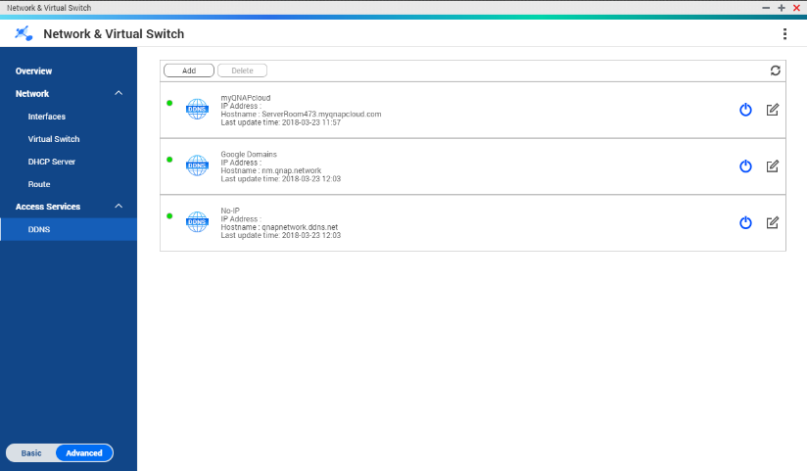
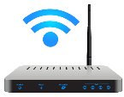
The best tool when the IP address is not fixed
QNAP NVS DDNS
(Include myQNAPcloud)
UPnP (Auto Router Configuration)
port
NAS Web
自動設定路由器
port
FTP Server
port
VPN Server
LAN IP1
port
…………….
LAN IP2
xxx.myqnapcloud.com:port

Slide 28
DEMO:
Start QVPN Service
Set up Port forwarding
QVPN Device Client connection

Slide 29
How to set up client devices to connect to NAS via VPN

Slide 30
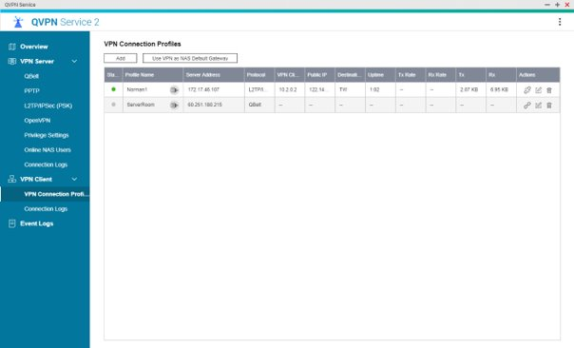
Your NAS is reachable almost anywhere
Your NAS can connect to another VPN easily. (Yours / shared NAS from your friend / public VPN server)
QBelt (QNAP only)
PPTP
L2TP / IPsec
OpenVPN

Slide 31
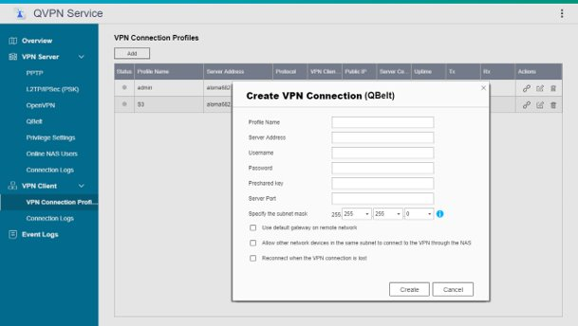
Supports versatile VPN client modes
Set the necessary VPN parameters
QBelt
PPTP
L2TP
OpenVPN
Allows other local networked devices to connect to the same VPN connection

Slide 32
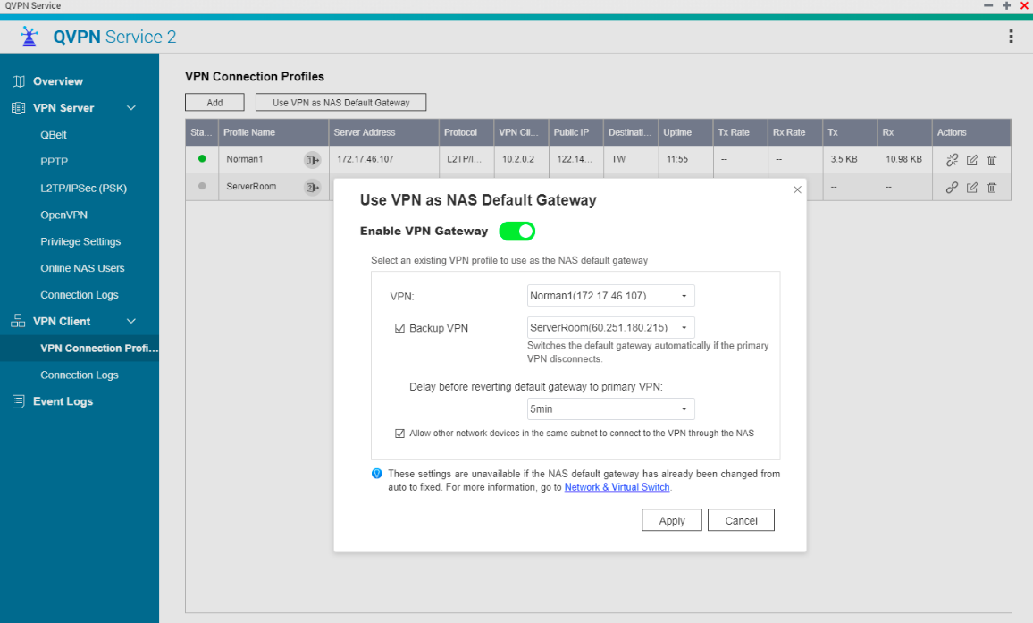
Set VPN as a NAS default gateway with failover support
VPN = NAS gateway
Set the secondary VPN as redundant one

Slide 33
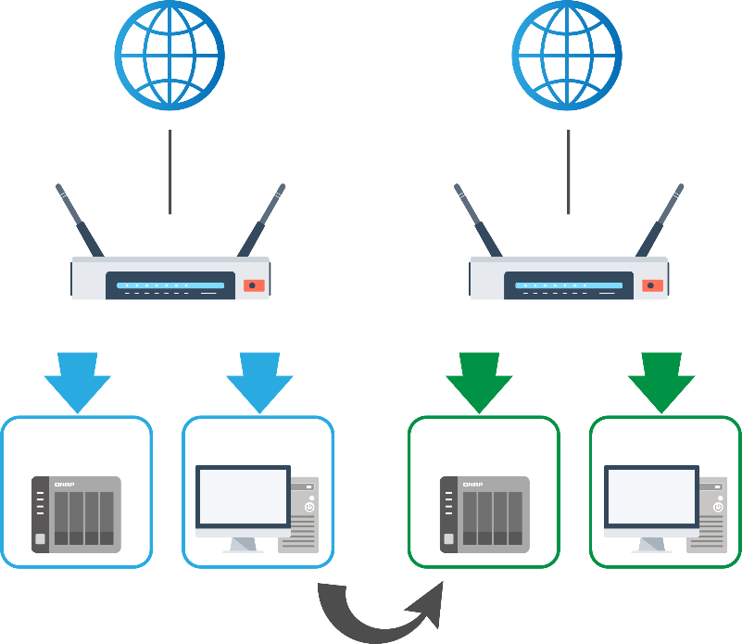
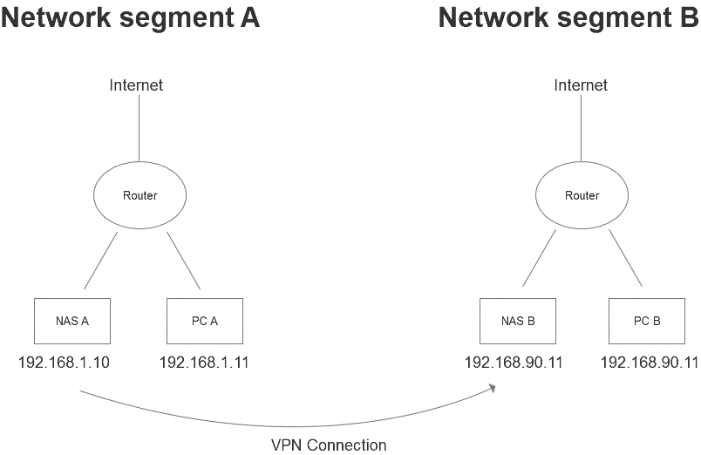
Through NAS VPN connection, reach the other network segment
Network Segment A
Network Segment B
Internet
Internet
Key:
QVPN is a point-to-point VPN connection, not Site to Site
PC A can reach PC B by NAS A VPN connection.
Router
Router
NAS A
PC A
NAS B
PC B
192.168.1.10
192.168.1.11
192.168.90.11
192.168.90.11

Slide 34
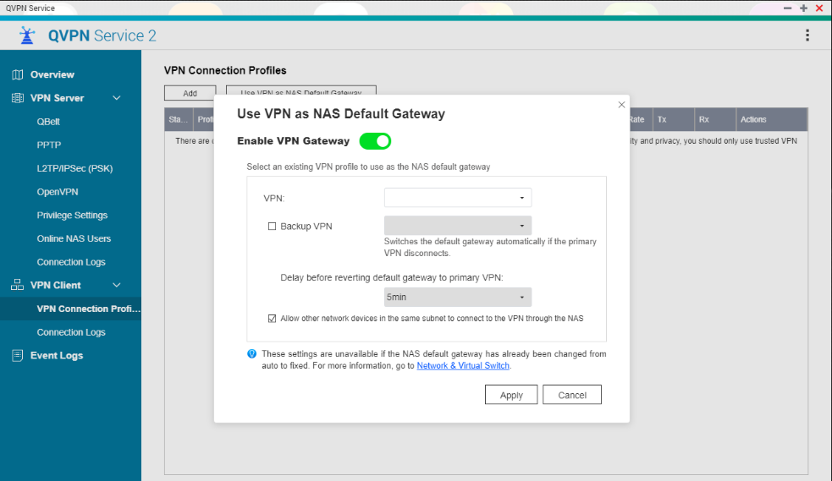
Through NAS VPN connection, reach the other network segment
Steps:
NAS A connect to NAS B by VPN connection
NAS A enable
Use VPN as NAS Default Gateway
Allow other network devices in the same subnet to connect to the VPN through NAS

Slide 35
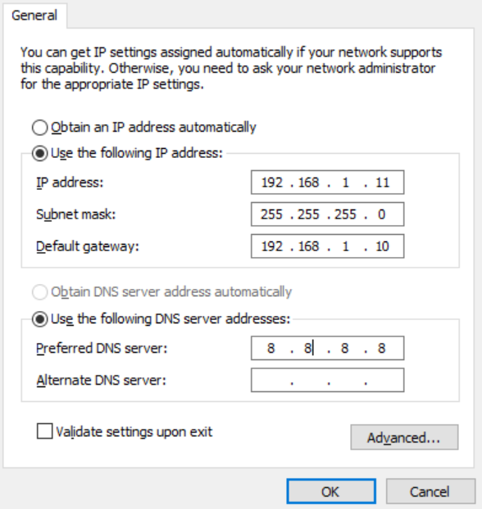
Through NAS VPN connection, reach the other network segment
Steps:
3. Set PC‘s default gateway to NAS A
4. PC A can connect to 192.168.90.x/24 network segment

Slide 36
Copyright © 2019 QNAP Systems, Inc. All rights reserved. QNAP® and other names of QNAP Products are proprietary marks or registered trademarks of QNAP Systems, Inc. Other products and company names mentioned herein are trademarks of their respective holders.

