Slide 2
QRM+ Introduction How to Use QRM+ with QGD-1600P QRM+ Application Instructions: Using QGD-1600 as a server and manage end-devices
One-key Installation,
Complete Your
Management
Requirement of
End-devices ​

Slide 3
“ How to Monitor Various Computer Facilities and Cloud Virtual Machine Status Immediately when You are Not Beside the Machine Room？ ”
— IT Manager

Slide 4
Market Comparison Analysis
 |  | Data Center SNMP-based CMS | Cloud CMS
Product | QRM+ | Teamviewer/Spiceworks/SolarWinds/ | Spiceworks/WhatsUp Gold
Support end OS | Windows/Linux/IPMI | Windows/Mac OS X/Linux /Unix | Windows/Linux
Price | Free | Free/By year | Free/By device number
Operation | One key-press, Friendly user interface, Easy to use | Commercial advertising, Complicated user interface | Easy to setup
Control Center | Private | Private | Public

Slide 5
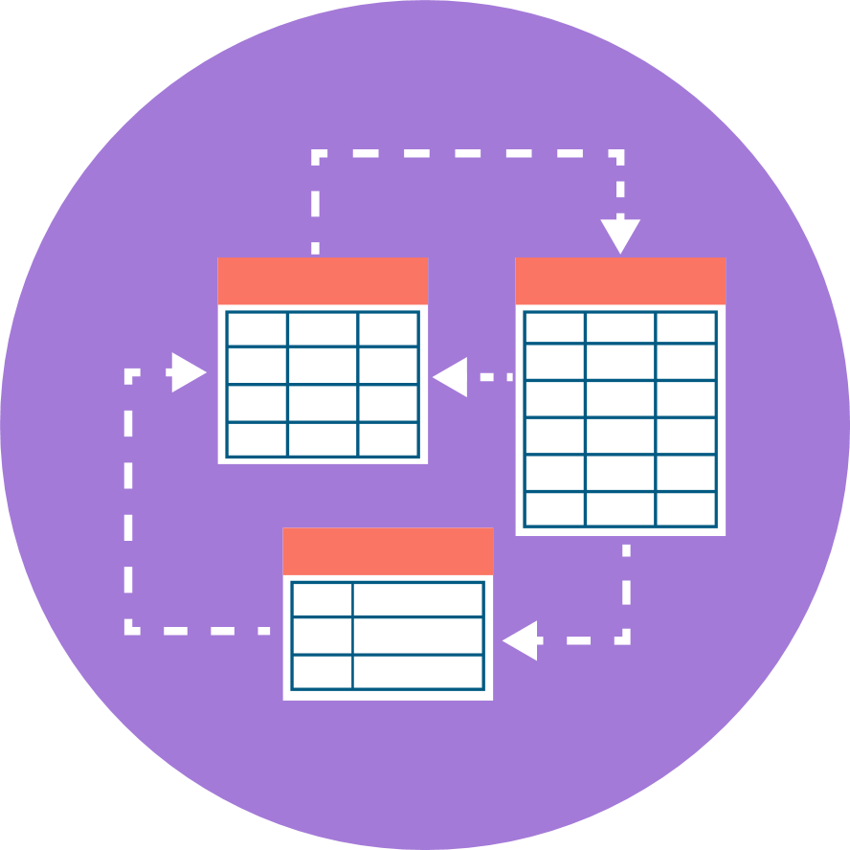
QRM+ Solve Your Requirement
of Managing Devices
Remotely manage devices
CPU usage
Memory usage
Hardware usage
Network usage
Power state control
Data collection & analysis
Collect problems
Root cause analysis
Problem analysis
Crash recovery
On-site maintenance
Preventive maintenance
Equipment improvement
Notes:
這麼多問題，那該怎麼解決呢？

Slide 6
QRM+ Introduction

Slide 7
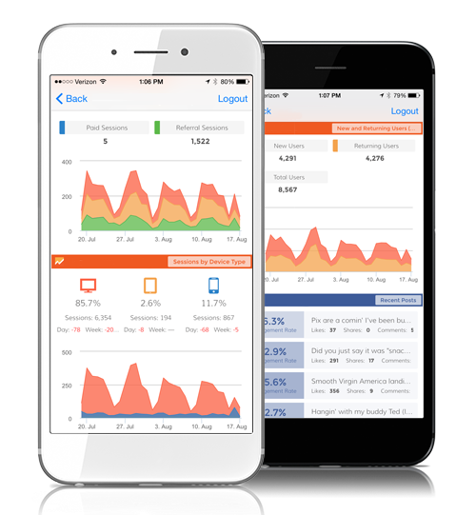
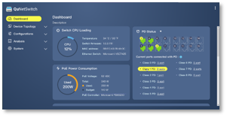
Using QRM+ Operator Can Control Multiple Clouds & Devices
Azure,
AWS, ...
VM
VPC
VM
Powered Devices
Ethernet
QRM+ Mobile
Machine room 1
Ethernet
Powered Devices
Machine room 2
Internet
QGD-1600P
IT Manager
Powered Devices
Machine room 3

Slide 8
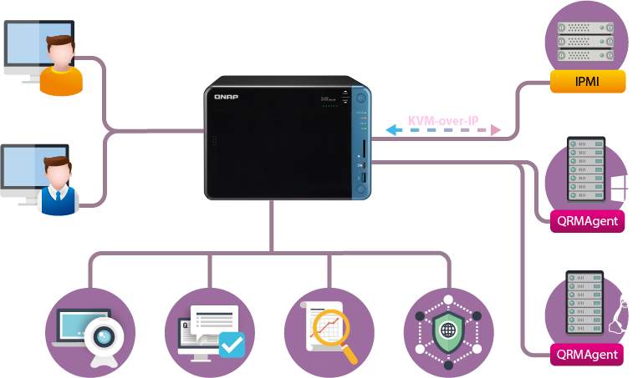
What is Centralized Management (QRM+)?
Servers with
IPMI
System Administrator
Agentless Monitoring
按一下以新增文字
Windows
Server
Operator
Agent-based Monitoring
Linux
Server
Agent-based Monitoring
Tracking
Trobleshooting
Analysis
Issue prevention
Notes:
IT人員的設備管理工作流程是？
QRM+ 是終端設備的集中管理方案
協助裝置管理者搜尋與監控您網路所有重要的裝置
三大好處：
直覺、圖型化操作
迅速回復系統正常運作、避免工作延遲
IT 與成員工作效率極大化

Slide 9
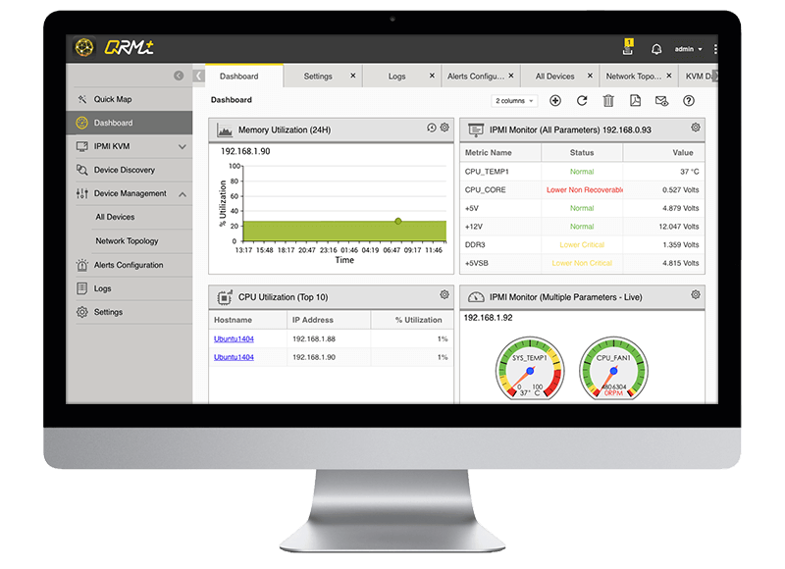
QRM+ Simplifies Your Devices Management Workflow
Comprehensive QRM+ Device Monitoring
Add devices
Continuous Monitoring
Troubleshooting
Analysis
Issue Prevention
• Data collection
• Dashboard
• Network topology
• Support IPMI
• Web-based
remote access
• Historic data
• Remote recording and playback
• Alert and notification
• Log Management

Slide 10
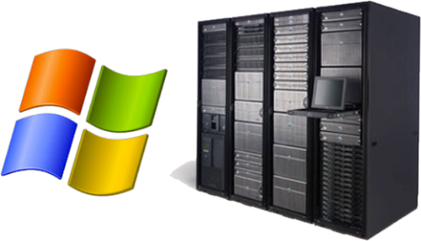
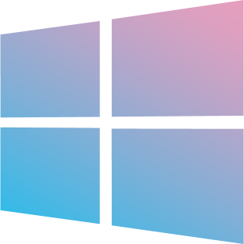
Management of Different Equipment
Windows 7, 8, 10
Windows Server 2003, 2008, 2012
Windows Vista
Windows XP
All platforms
Ubuntu
CentOS
Debian
Support IPMI 1.5/2.0
Support KVM over IP
- Supermicro IPMI
- IEI IPMI
Notes:
IPMI的部份可以特別跟我們說明下嗎？

Slide 11
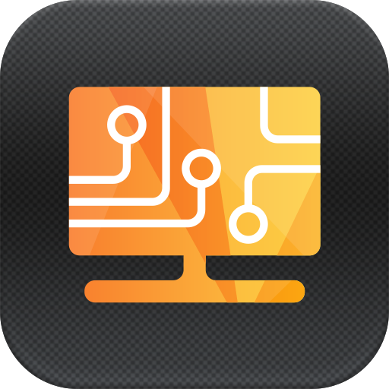
Lightweight Agent - QRMAgent
QRM+ server monitors and controls all the devices with QRMAgent
Provides convenience and security for automatic deployment or remote configuration
Supports Windows and Linux devices
支援 Windows 及 Linux 裝置
Notes:
這個Agent有哪些功能作用呢？

Slide 12
Supported Versions of QRMAgent
HW Architecture / OS | Supported versions
x86 - Windows | Windows XP/Vista/7/8/8.1/10, Windows Server 2003/2008/2012
x86-64 - Windows | Windows Vista/7/8/8.1/10, Windows Server 2003/2008/2012/2016
x86-64 - Linux | Ubuntu 12/14/16, Debian 8, CentOS 6/7

Slide 13
How to Use QRM+ with QGD-1600P

Slide 14
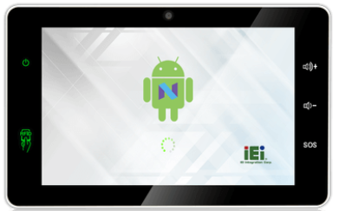
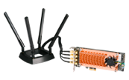
QGD Solves Deployment
Requirement of Your Terminal-equipment
QRM+ mobile
Centralized Management
Terminal/virtual equipment
Industrial Panel PC
QGD-1600P
QRMAgent
QRMAgent
QRMAgent
Cloud
QRMAgent
VM
Notes:
支持的平台及版本有哪些？

Slide 15
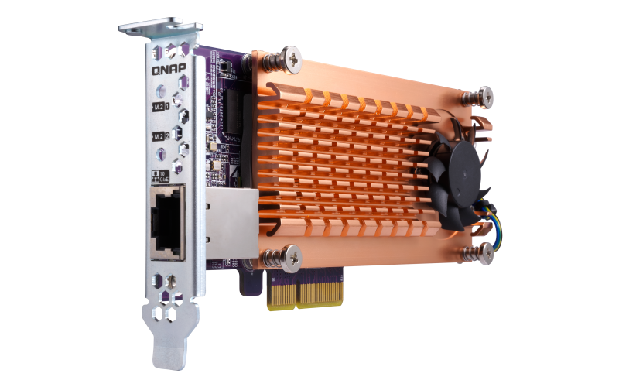
What is Guardian QGD-1600P?
QTS
Network Switch System
Cloud manager
Cloud Agent
Guardian Network Switch Manager
PoE power management
Apps
Mobile Apps & utilities
VM management
(KVM & Docker)
Managed switch
App store
QNAP
App Store
Storage management
User management
Device management
System management
Basic OS
15

Slide 16
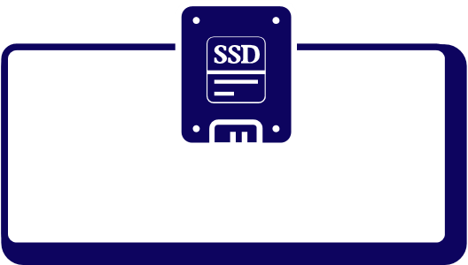
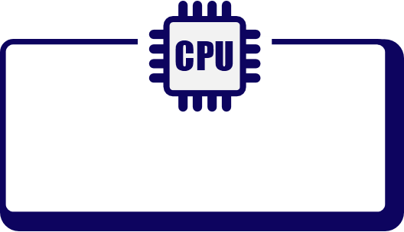
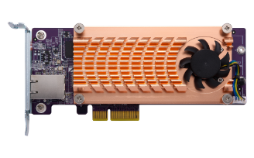
Guardian QGD-1600P- Hardware Diagram
System power button (rear)​
QTS
System Power ​
Max: 50W/40W​
Power Supply Total: ​
460W/280W​
System power controller​
PoE Power Max: ​
410W/240W​
2 x 2.5" SSD
Intel J4105
4GB/8GB RAM
PCIe Interface
Host power controller
2 x PCIe 2.0 x2
2 x LAN GbE
Switch
HDMI 2.0
USB 3.0
USB 2.0
2 x GbE
Microchip VSC7425
PoE
Controller
x 1
x 1
x 2
16-port GbE
Host power button​
16

Slide 17
Advantages of Using QRM+ & QGD-1600P
Unrestricted device location
Strengthen management of network equipment (IP camera) and powered device (Panel PC)
Reduce the risk of power supply
Reduce cost of operational maintenance
Suitable for a variety of places (factories, hospitals, machine rooms) and other network management complex areas
Through QRM+
to monitor
• Integrates NAS, managed switch, and Power over Ethernet (PoE)​
• Support various QNAP applications
IEEE 802.3bt
- Power level up to 90W
Powered devices

Slide 18
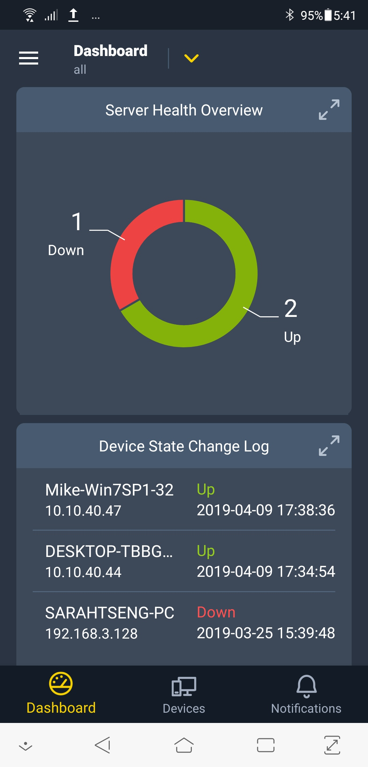
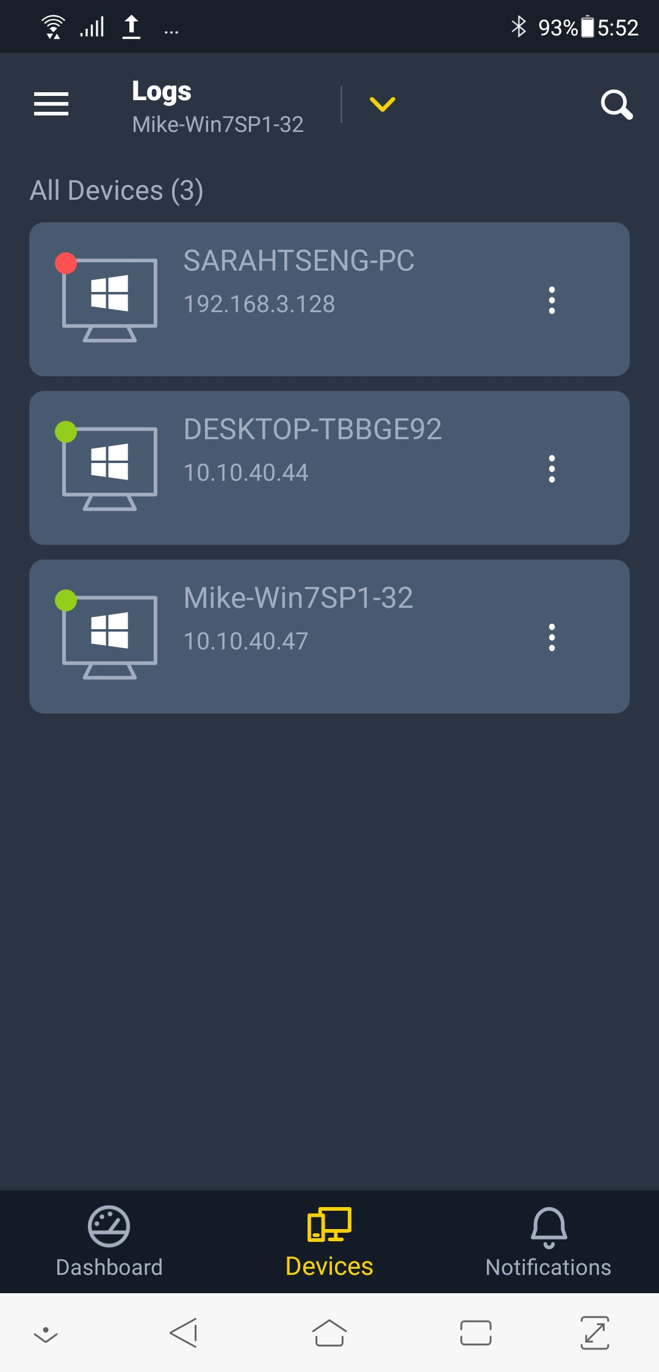
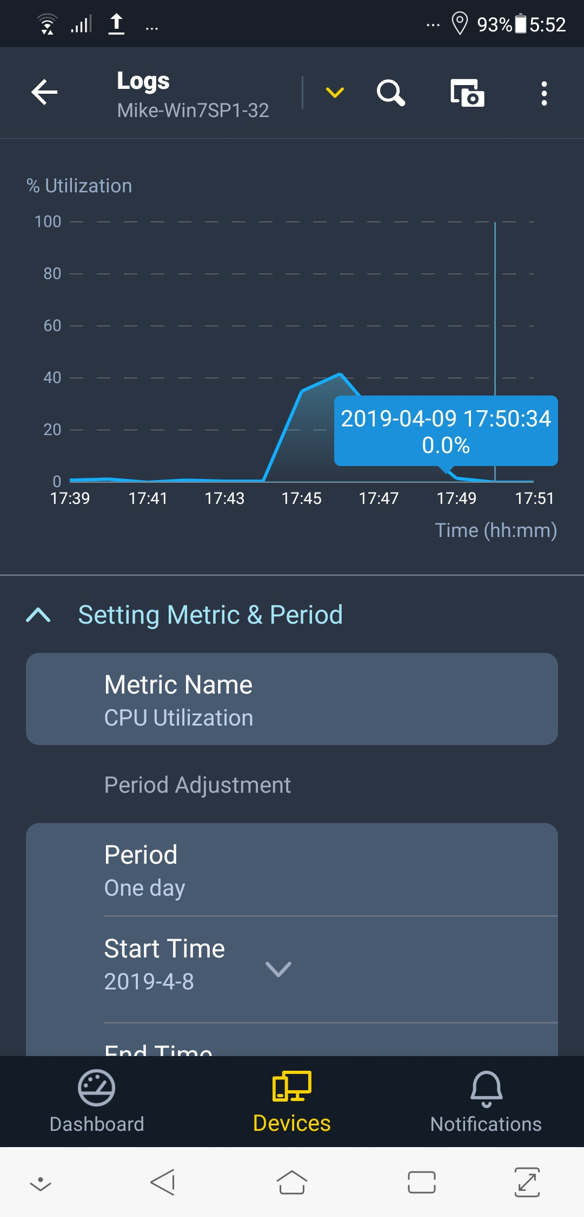
QRM+ Mobile
QRM+ Mobile is a centralized remote management application that allows you to manage and monitor networked devices using your mobile device.

Slide 19
QRM+ Application Instruction Using QGD-1600P as a server and manage end-devices
Live Demo

Slide 20
Install QRM+ in QGD-1600P
QNAP QTS System
Intel® Celeron® J4105 Processor
4GB RAM
USB 3.0 x 1
USB 2.0 x 2
Two SATA 2.5-inch drive bays
PCIe slot x 2 : Supports QM2 expansion and wireless cards​
HDMI x1: View live recordings via HDMI-out​
Install QRM+ in QGD-1600P with QNAP QTS 4.4.1

Slide 21
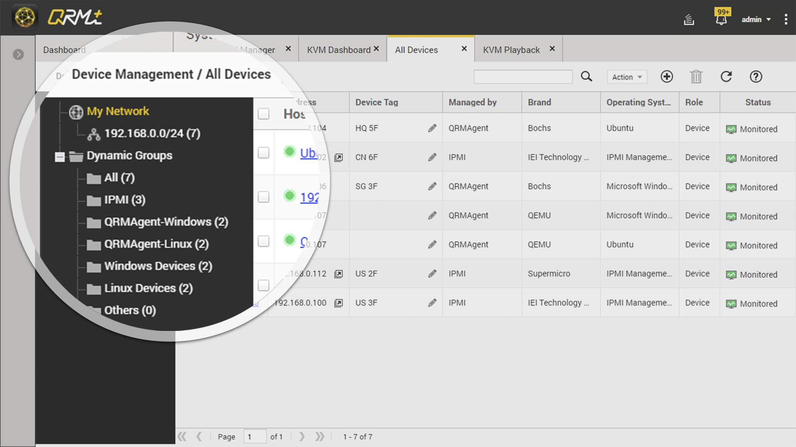
Add Devices to QRM+
To scan a specific IP range and add devices to QRM+

Slide 22
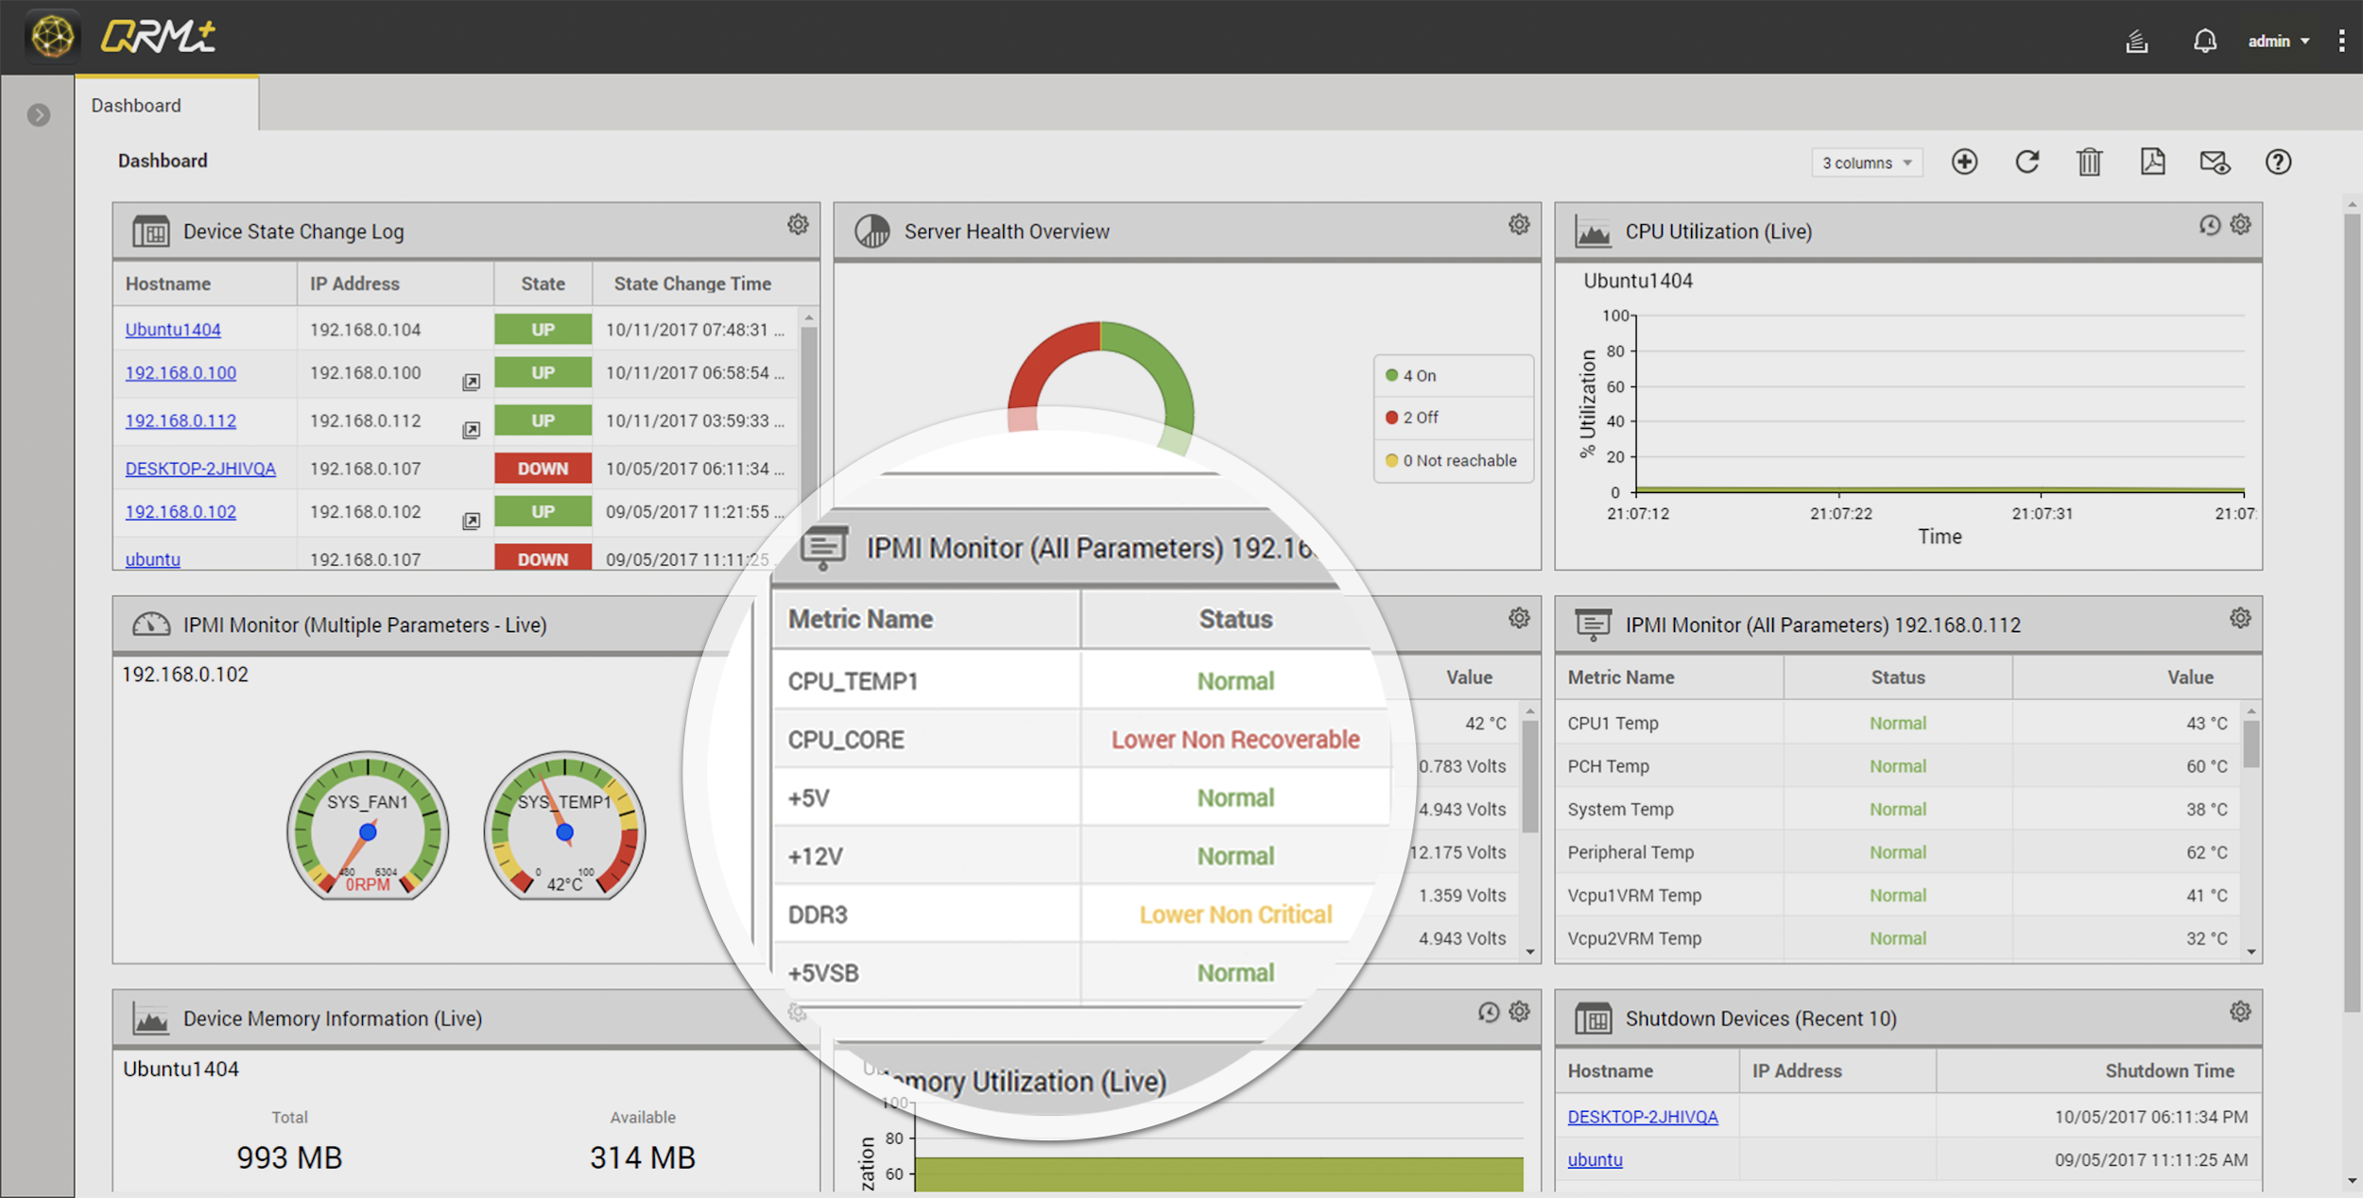
Device Data Collection
Manager install QRMAgent to your device first, agent can filter data before sending back.
Using Dashboard to overview the device status.

Slide 23
QRM+ Mobile, Speed Up Management Devices
Manager install QRM+ mobile and add NAS to monitor your devices immediately.

Slide 24
QRM+ Requirements
X86-based NAS (Intel and AMD processor)
requires a minimum of 4 GB RAM and QTS 4.3.x
(or later).
ARM-based NAS (64-bit)
requires a minimum of 4 GB and QTS 4.3.4 (or later).
Notes:
支持的平台及版本有哪些？

Slide 25
QRM+ Centralized Management Solution Solve Your Machine Room Devices by Single Clicking
Install QRM+ to Start
Your Remote Management
QRM+
QRM+ mobile

