Slide 2
Summary:
1. An Introduction of LDAP
2. JumpCloud’s Directory-as-a-Service
3. The Demo of integrating JumpCloud’s service into QNAP NAS

Slide 3
LDAP Introduction

Slide 4


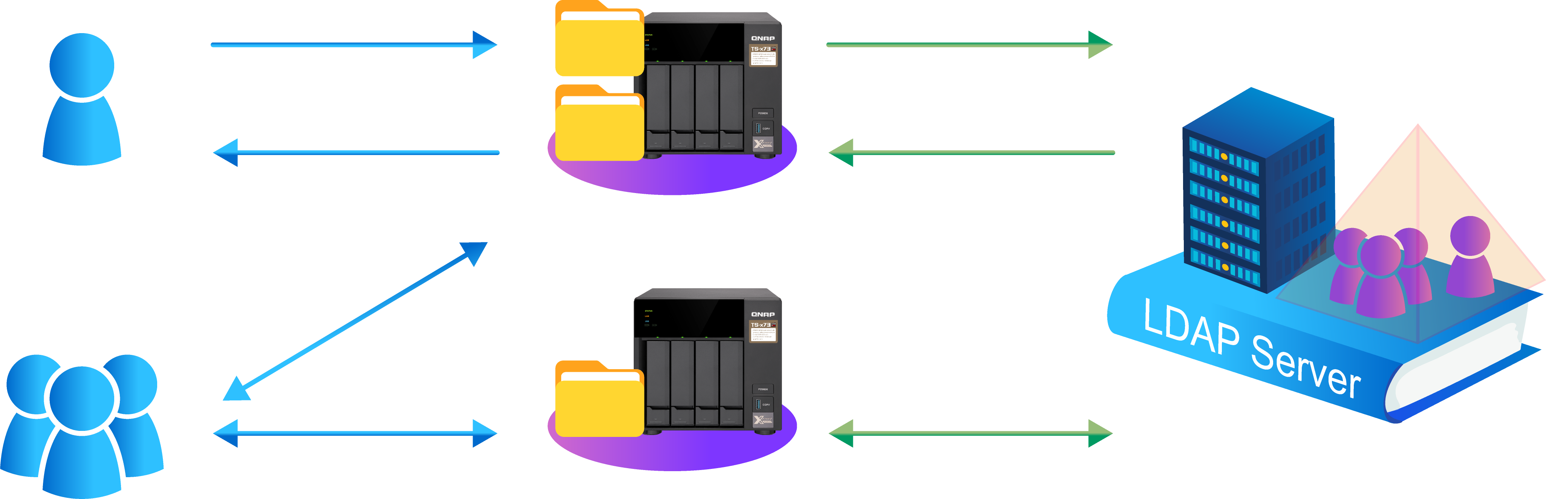
What Does LDAP Do?
LDAP, Lightweight Directory Access Protocol-- a service to manage user’s and group‘s usernames and passwords. Users and the groups in the domain can use the same usernames and passwords to access office equipment, or local web services.
User Access
LDAP Authentication
1.Ask for access
2.Password verification
4.Access granted
3.Password is correct

Slide 5
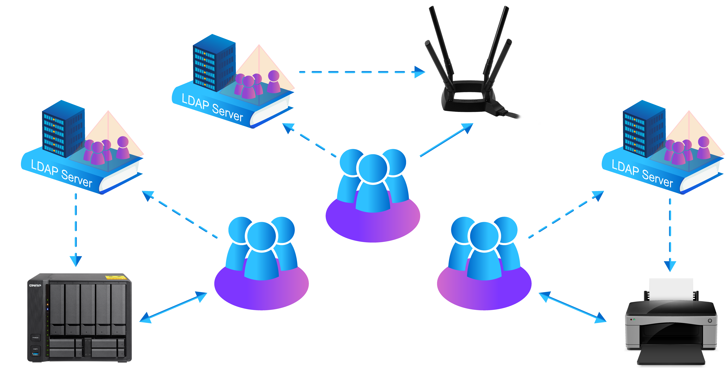
User Scenarios: Each Office Needs a LDAP Domain
In a business environment, each local office needs to have a local LDAP server to form a domain to allow domain users to access local equipment and services.
All users in each office need to join the LDAP domain, so that they can use the local equipment and services.
Taipei
Shanghai
LA

Slide 6

The Business LDAP Market Share
Major Applications:
IoT/Small Business/
Education/Service/
none Windows Environment
Source: https://discovery.hgdata.com/product/openldap
OpenLDAP, 23%
Microsoft AD, 77%
Notes:
https://discovery.hgdata.com/segment

Slide 7
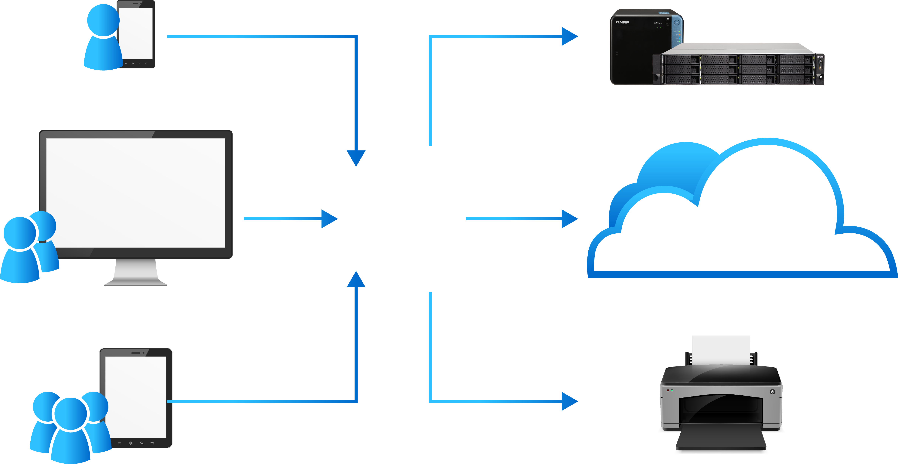

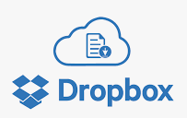


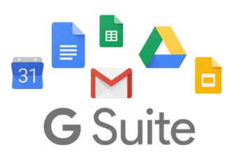

Using Both Public and Private Cloud Services, How Can One Account and its Password Have Access to all?
Challenges
As companies start using mixed cloud services, some public and some private cloud, and data are also stored locally, or over the cloud. IT staff needs to manage all kinds of cloud and local account and passwords. Each user also hopes to use one account and password to access all services…
Shanghai
QNAP NAS
LA
All Sorts of Cloud Service
Office Equipment
Taipei

Slide 8


A Comparison of All Current Directories Services
 | LDAP Server | Windows AD Server | RADIUS Server | JumpCloud (LDAP as a Service) | Azure AD DS (AD as a Service)
Strengths | Open source. Linux /Unix compatible. | Windows compatible for big enterprise. | For network devices. | Intergrading AD, LDAP and RADIUS to the cloud. | A cloud service, but mainly for Azure services.
Weakness | Installed Locally. Need to know Linux. Compatibility with Windows. | Local install. Expense. Compatibility with Linux /Unix . | Installed Locally. Lack of none network device support. | When web service is down, depending on local cache. | Complicate setup. Cannot replace local AD.
Platform | Linux | Windows Server | AAA | Cloud-JumpCloud | Cloud-Azure
CAPEX & OPEX | HW/SW/Staff/NW/Server Rooms | HW/SW/Staff/NW/Server Rooms | HW/SW/Staff/NW/Server Rooms | Cloud service/ Flexible staff/NW | Cloud service/ Flexible staff/NW
Remark | QTS built in LDAP Server | QTS built in Domain Controller | QTS built in RADIUS Server | <10 ppl free, more $3~$9/account/ month | Suggest to keep local AD.

Slide 9
JumpCloud's Directory-as-a-Service®

Slide 10
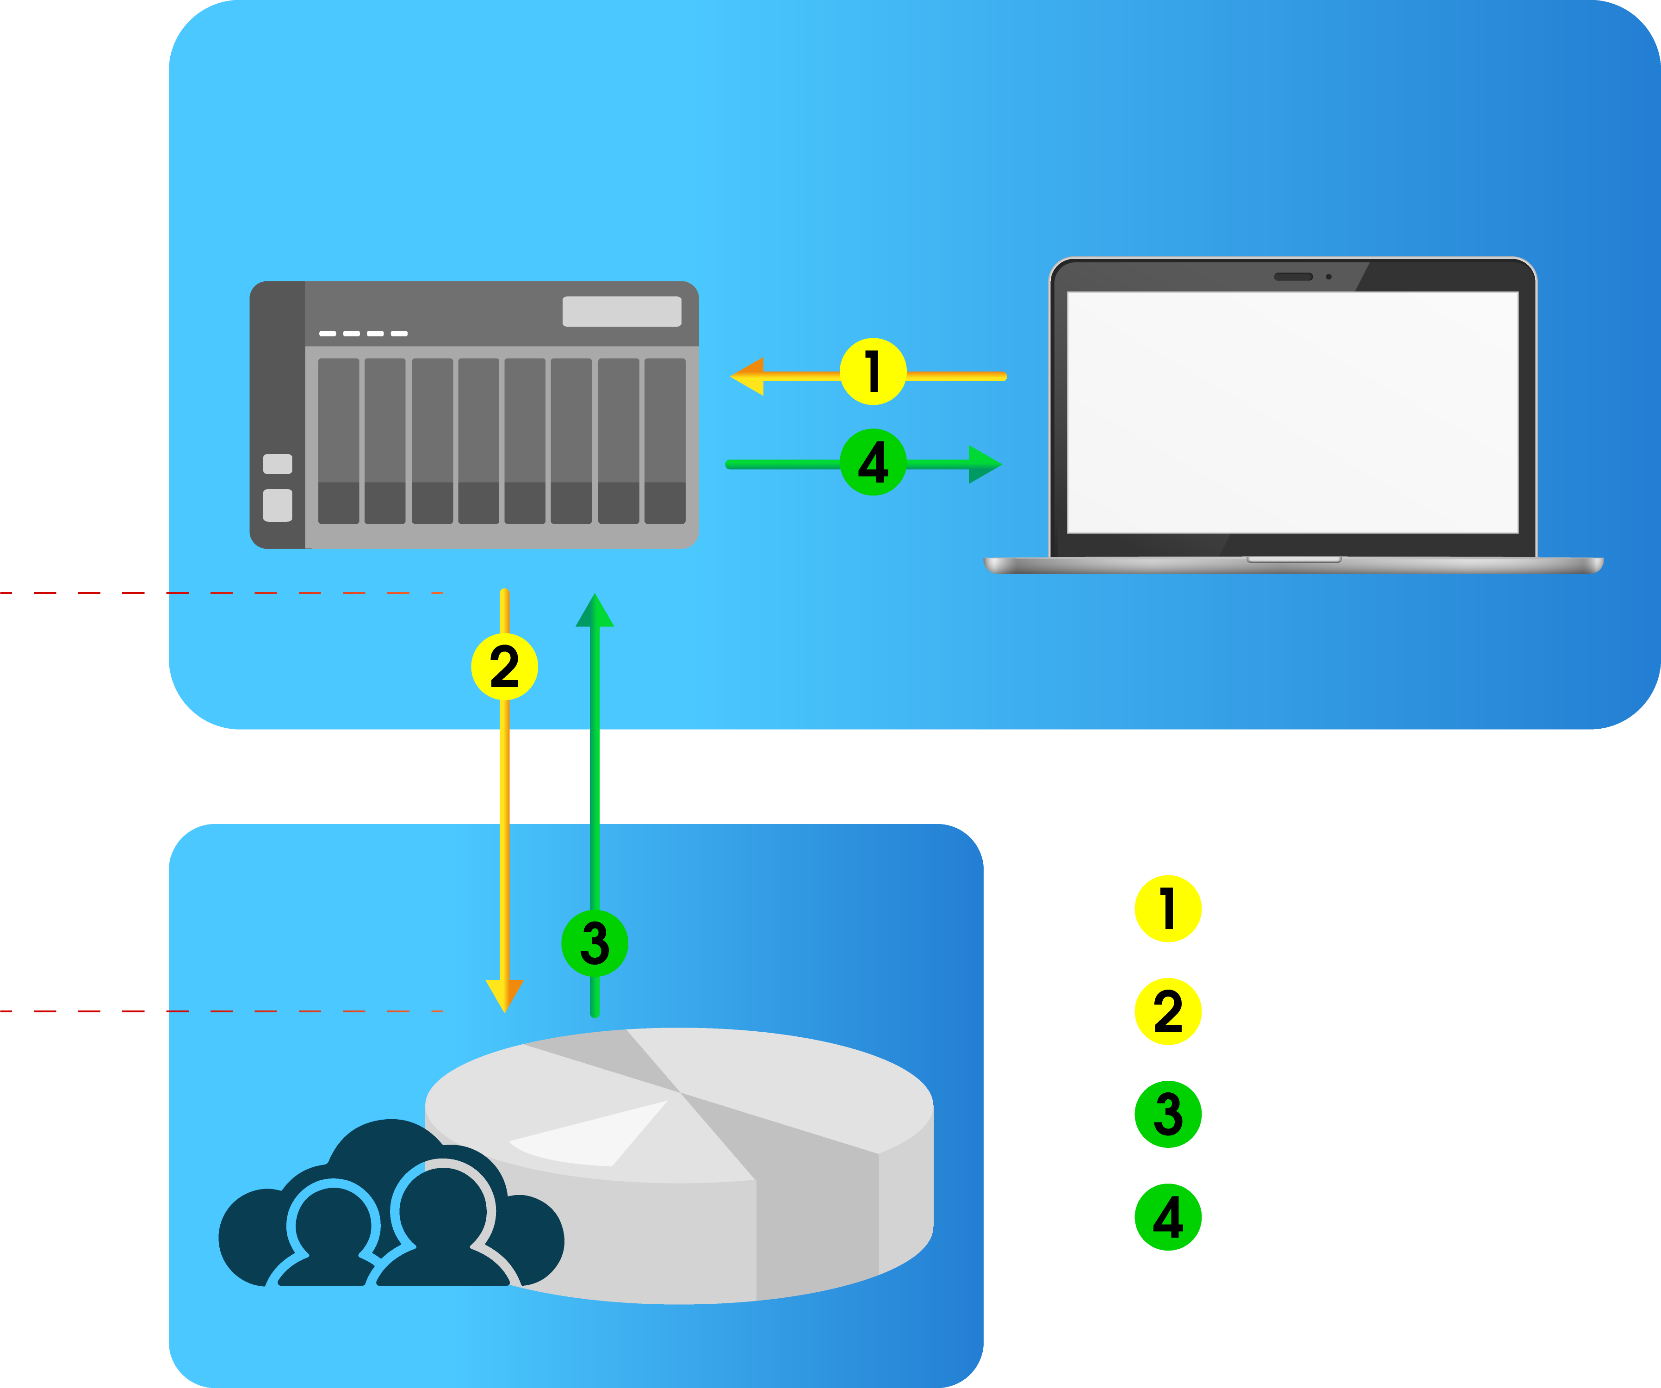
JumpCloud offers Cloud LDAP Service
Jumpcloud’s cloud service centralizes all local LDAP service in a cloud. From Jumpcloud’s website, one standard LDAP service can be setup. No need to have various local services by different local IT staff.
Customer Network
NAS/Samba server
Win/Mac/Linux client
LDAPS/Start TLS
INTERNET
SMB asks request
LDAP authenticates SMB data request
JumpCloud
Cloud-based
LDAP
LDAP responses SMB with authentication
SMB receives responses

Slide 11
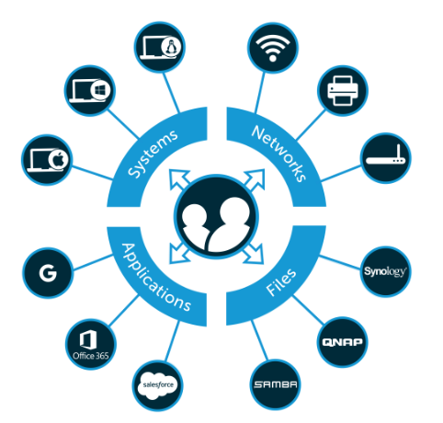
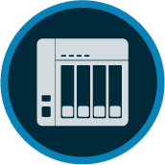
JumpCloud's Directory-as-a-Service
JumpCloud's Directory-as-a-Service allows users to use one set of account and password to single sign on various cloud and local services, or local office equipment, like NAS, printers, or WIFI services.

Slide 12
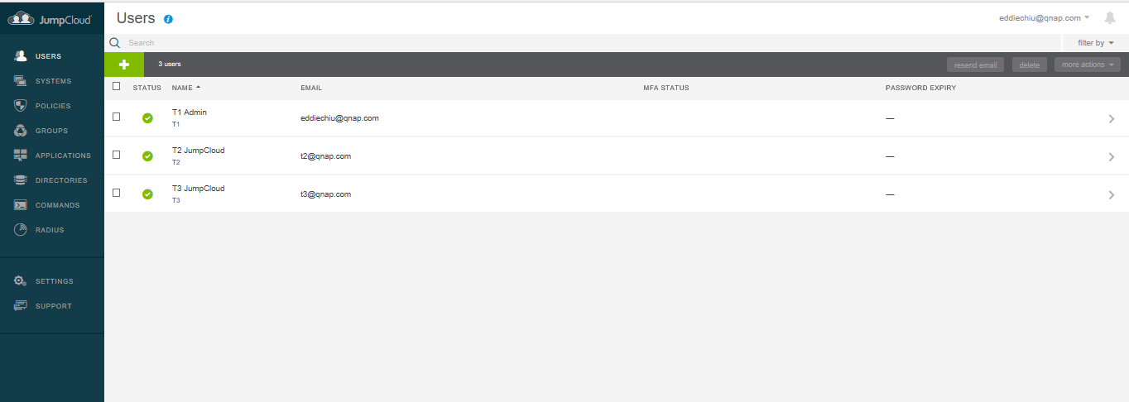
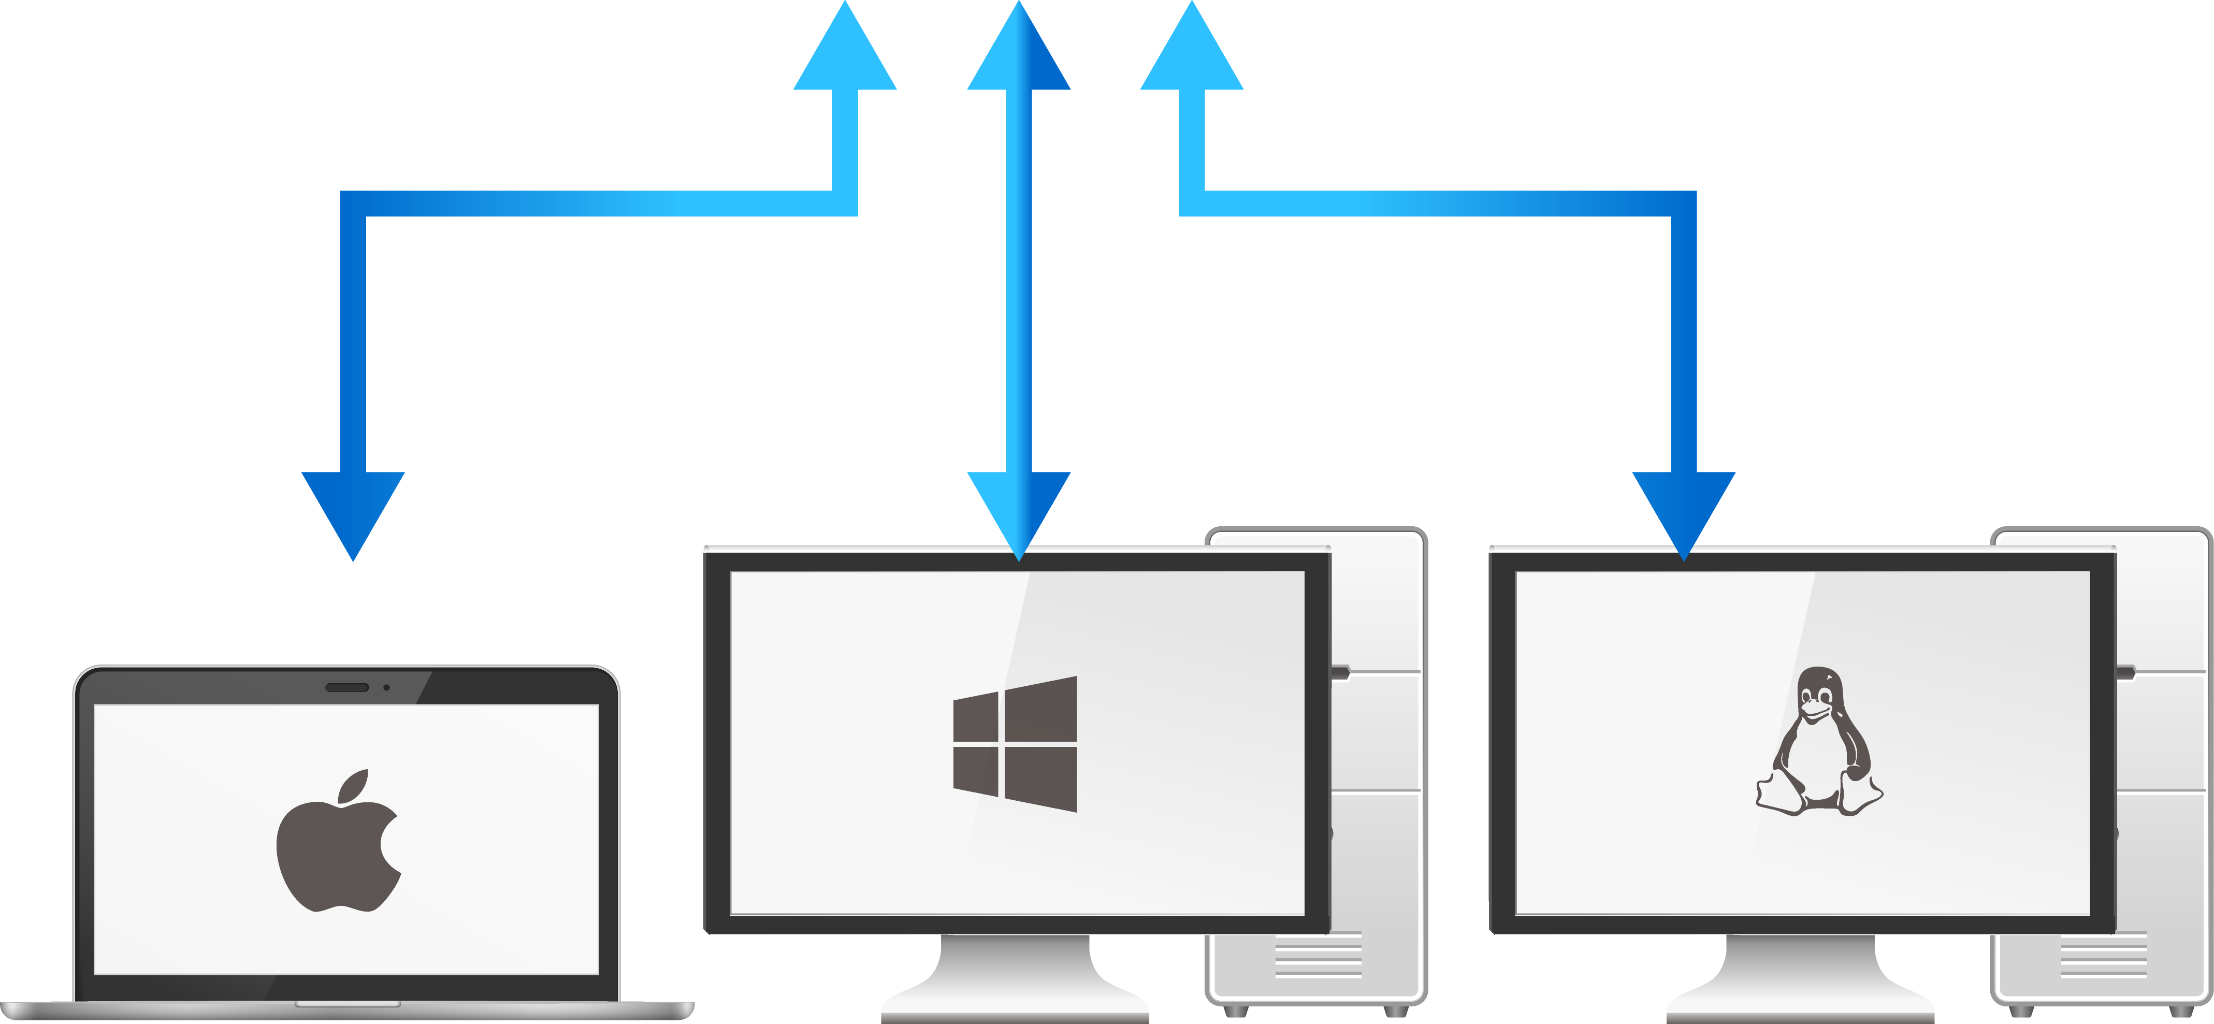


Centralized LDAP Management from The Cloud
Jumpcloud’s centralized LDAP management also allows access control for devices, with various access protocols, like Apple/AFP, Windows/SMB, or Linux/NFS.
AFP
SMB

Slide 13
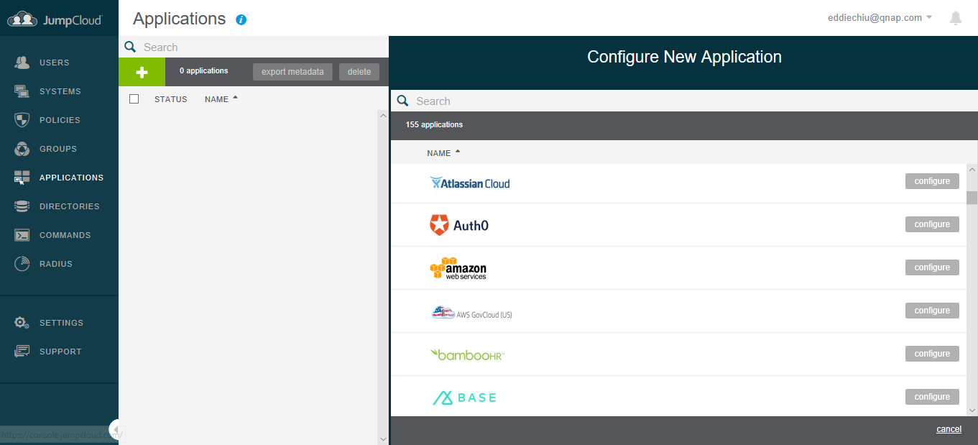
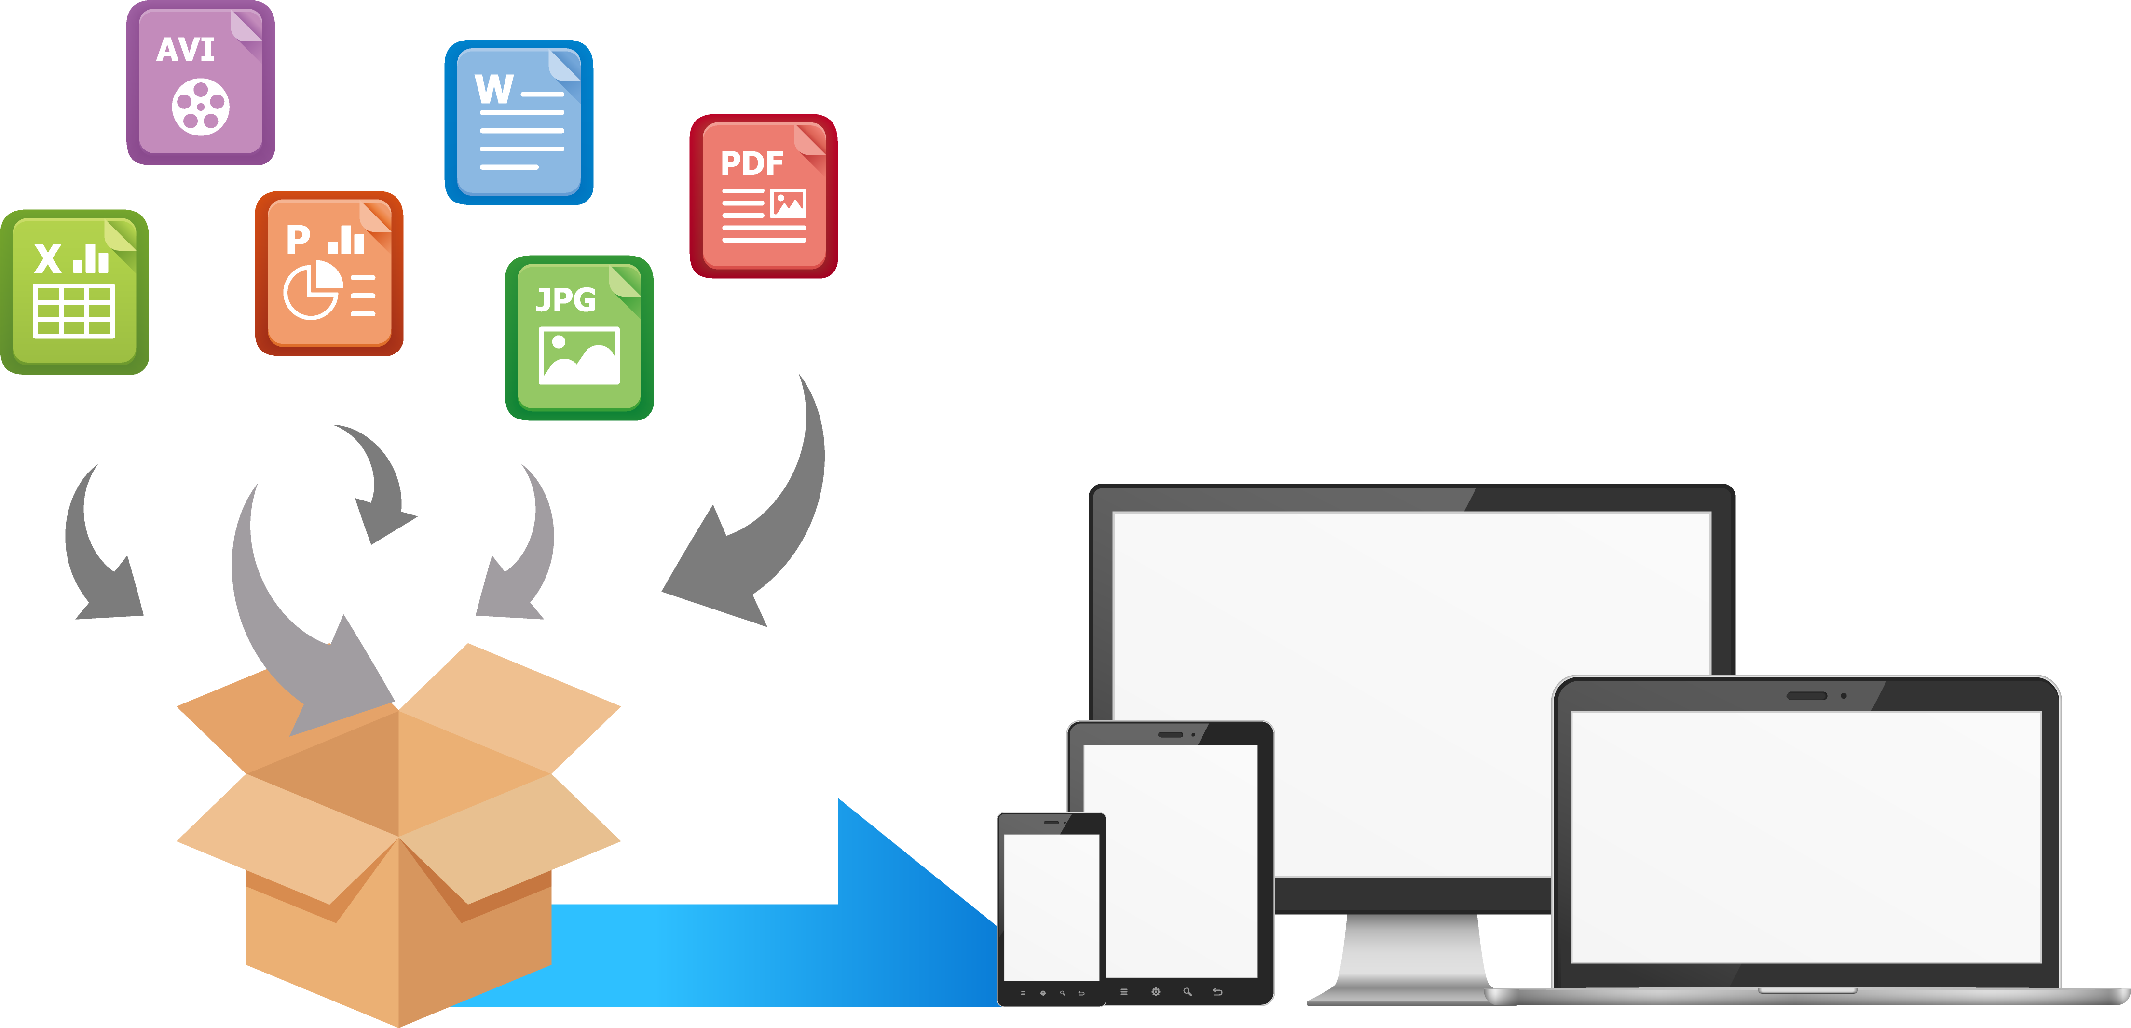
Jumpcloud’s DaaS Supports More Than 100 Cloud Services
Jumpcloud’s DaaS service supports more than 100 cloud services, including Office 365, Amazon AWS, and Google’s G suites. The Jumpcloud accounts also allow access to local cloud, or even local WiFi services.

Slide 14
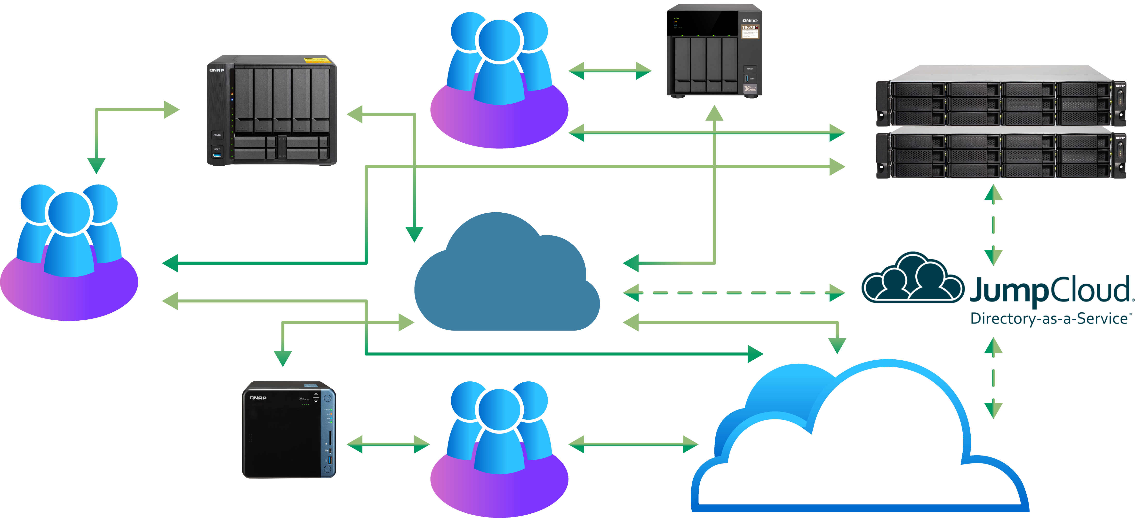
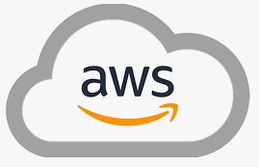
QNAP NAS Supports JumpCloud’s Single Sign On to Cloud and Local Services
All the small and medium businesses can use JumpCloud’s LDAP services to access various cloud services and different local NAS. QNAP NASes also allow all staff over the world to use one set of password to access different NASs and shared folders!
Taipei
LA
Internet
Shanghai

Slide 15
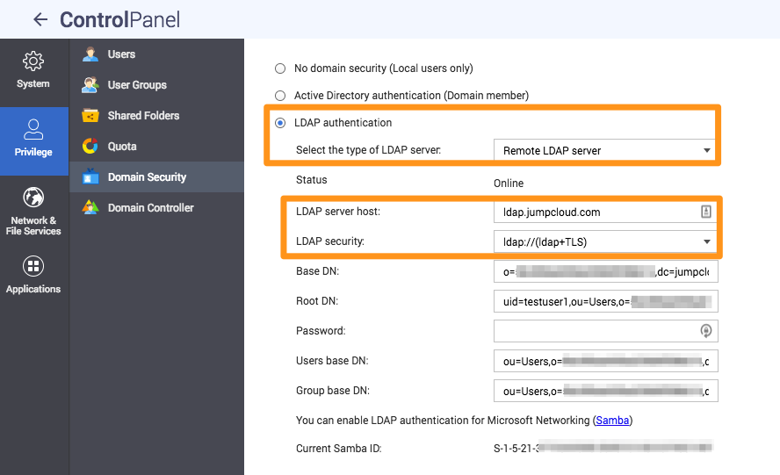
Use Domain Security in The QTS to Join JumpCloud
Only need to key in some parameters from the JumpCloud to the Domain Security in the QTS, in order for the NAS to join JumpCloud’s cloud service.

Slide 16
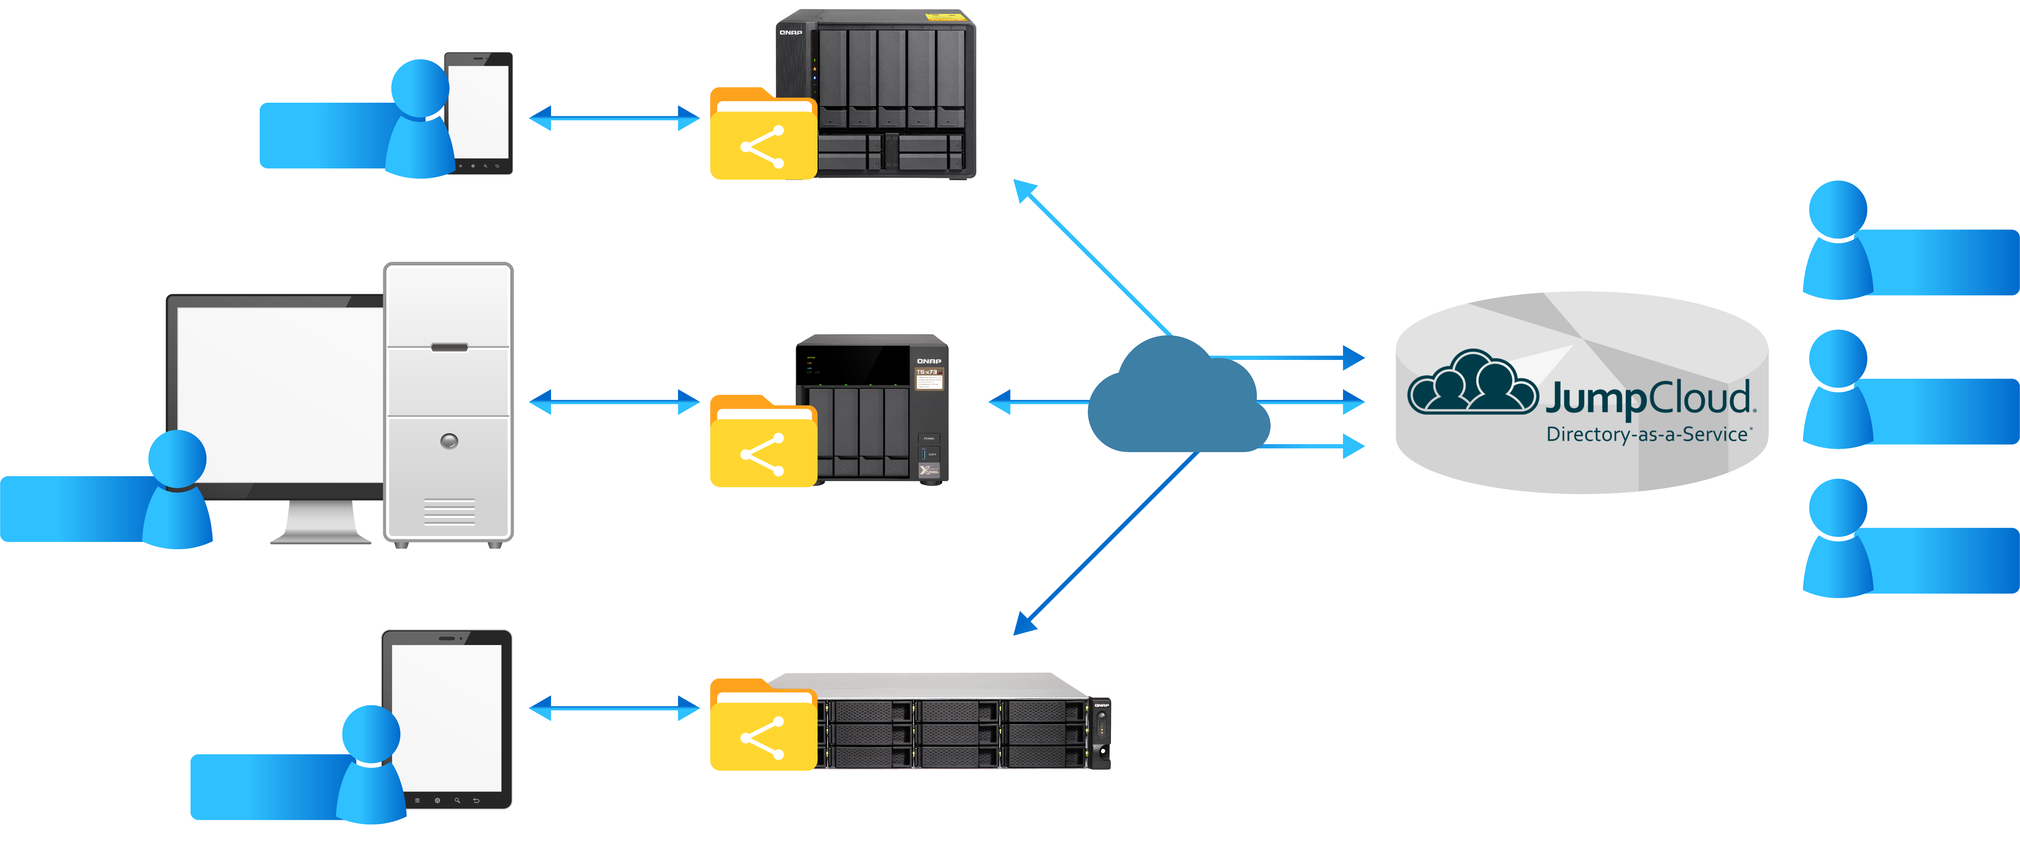
JumpCloud Centralizes All the Access to QNAP NAS
Jumpcloud’s LDAP Services can manage global users in one cloud space.
Alan
Shanghai
\Public
Alan
Internet
Bob
Bob
\Photo
Taipei
Charley
Charley
\Web
LA

Slide 17
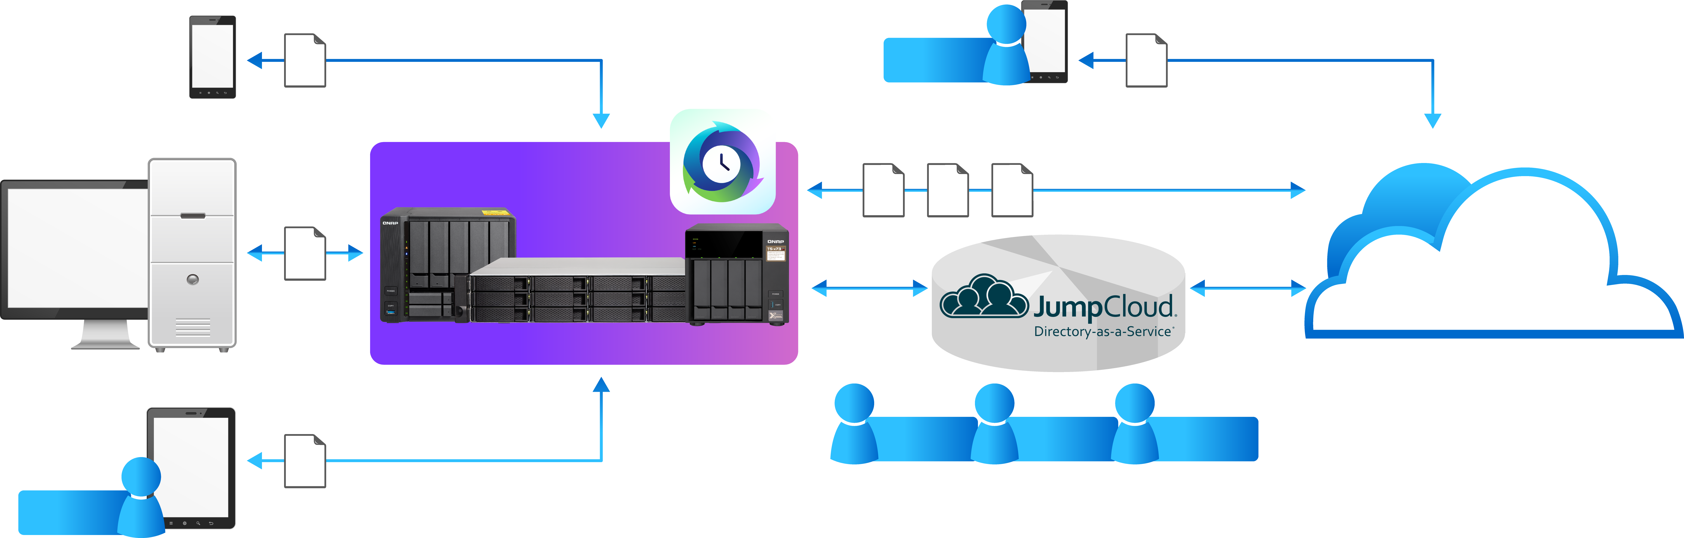
QNAP NAS: The Bridging Center For A Mixing Cloud Environment
With Jumpcloud’s DaaS service to fill in the missing link, the QNAP NASes in each local office can collect all the data streams from both local, or cloud services and become the bridging center between local and cloud services.
Hybrid Backup Sync
Bob
Shanghai
Shanghai
QNAP NAS
Taipei
All Kinds of Cloud Services
Alan
Bob
Charley
Charley
LA

Slide 18
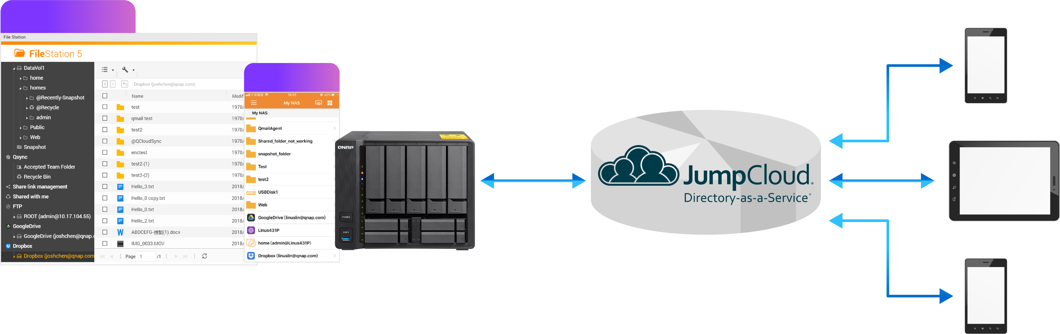
NAS’s Apps and Jumpcloud’s DaaS Service
Each BYOD, Bring Your Own Device, can, as well, utilize Jumpcloud’s DaaS Service and QNAP’s handy apps, like File Station and Qfile and many others to access QNAP NASes.
File Station
Qfile
QNAP NAS

Slide 19
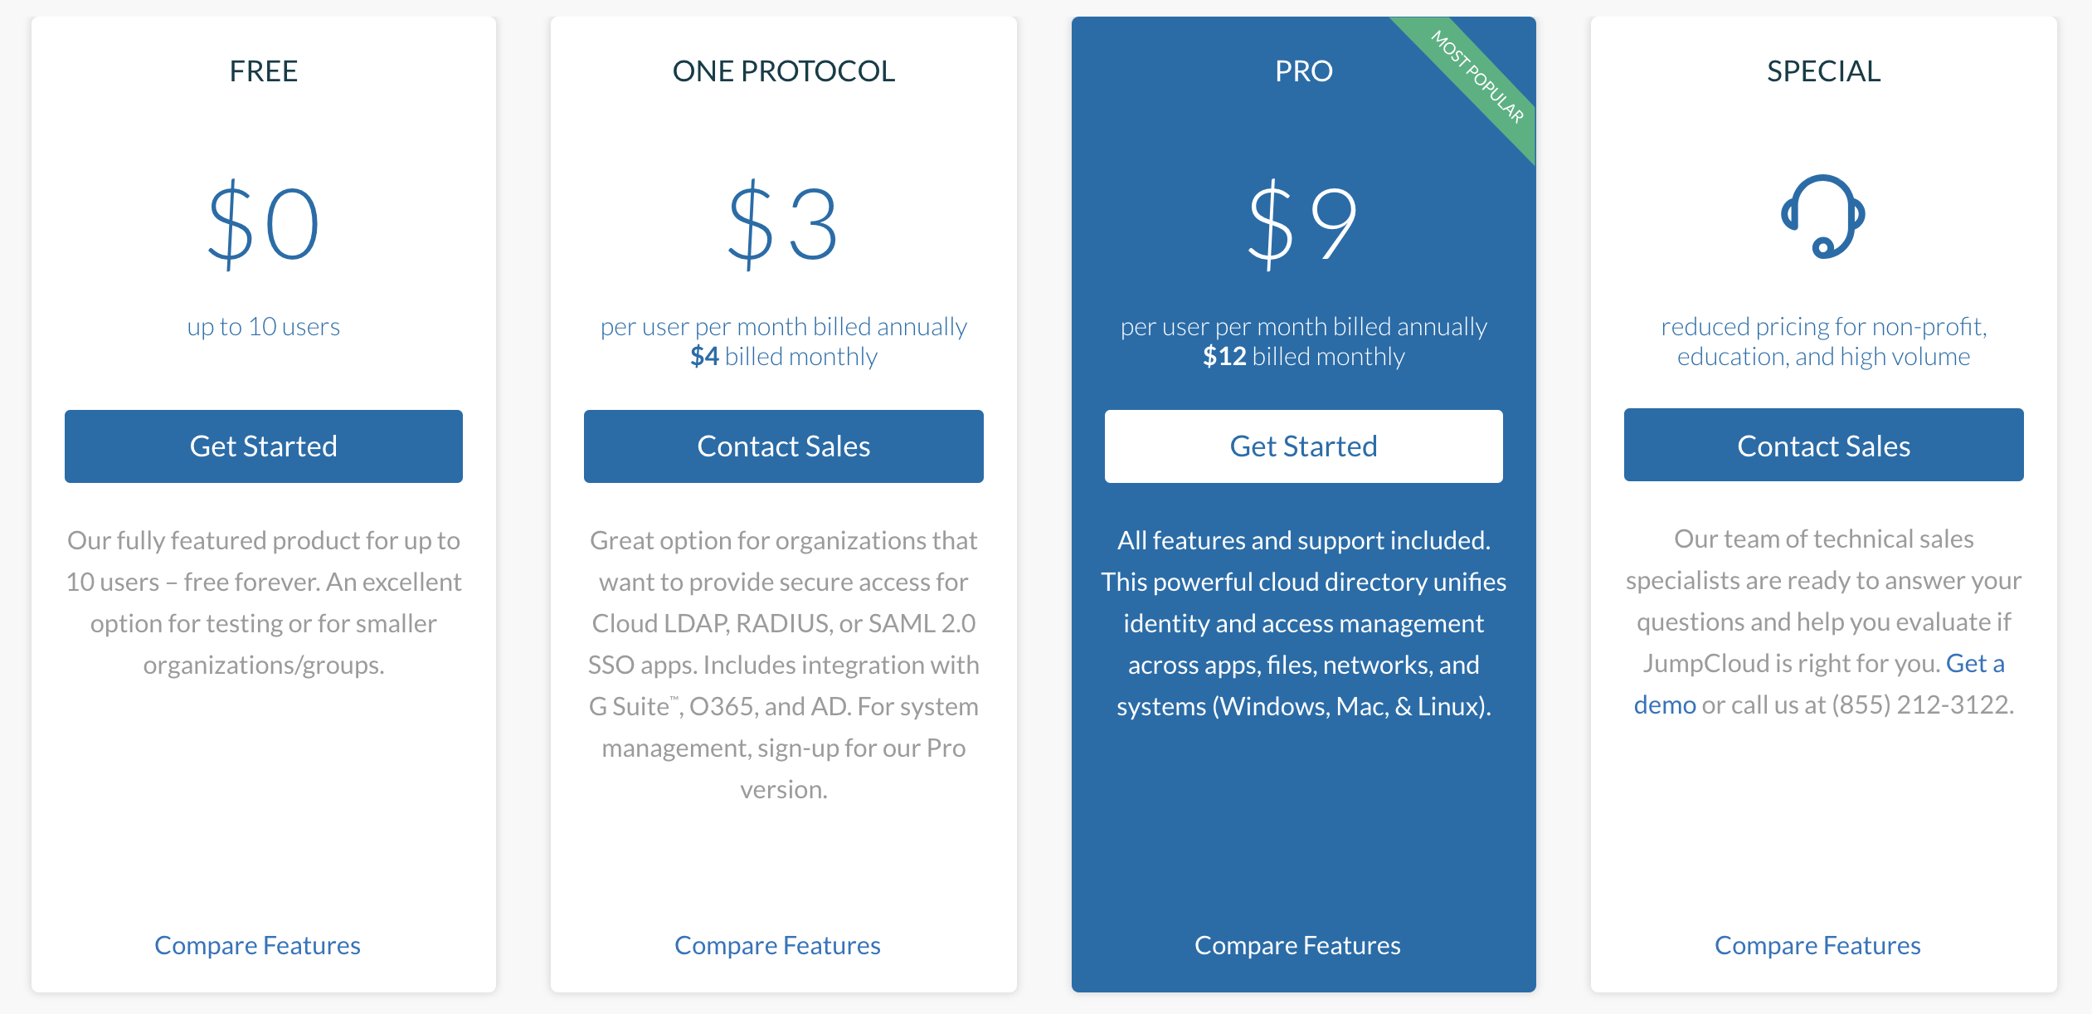
JumpCloud Pricing

Slide 20
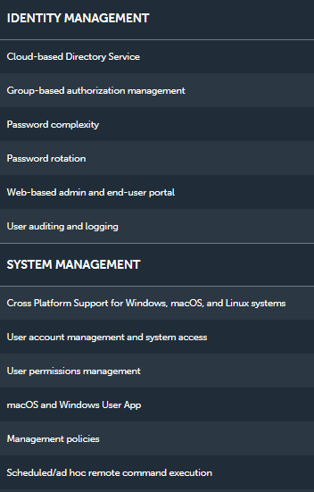
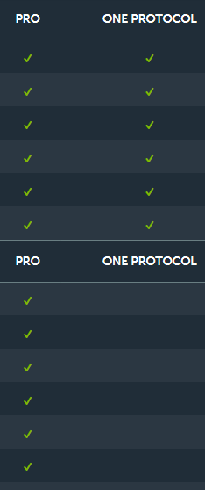
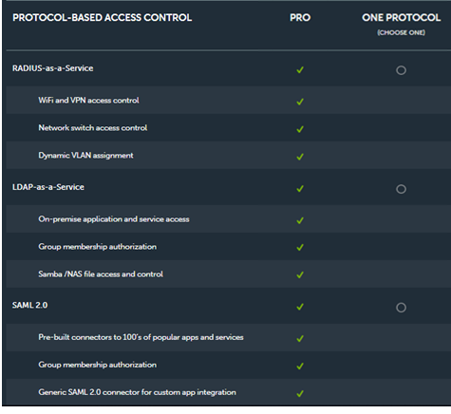
Comparison of Jumpcloud’s Different Price Package

Slide 21
A Demonstration of Using JumpCloud's accounts On QNAP NAS

Slide 22
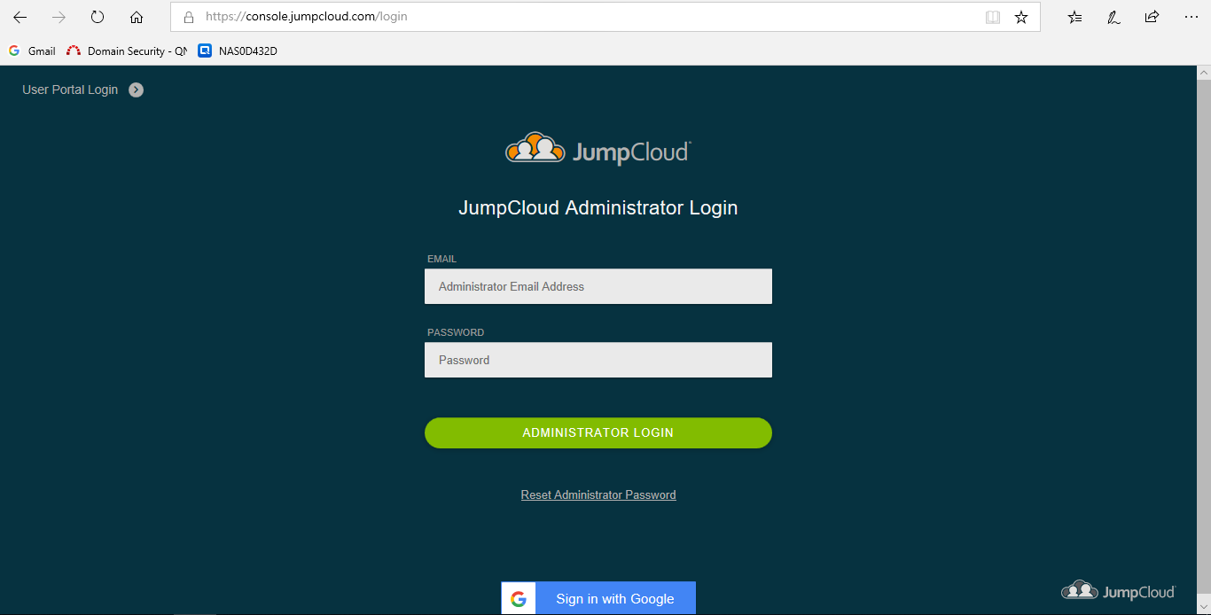
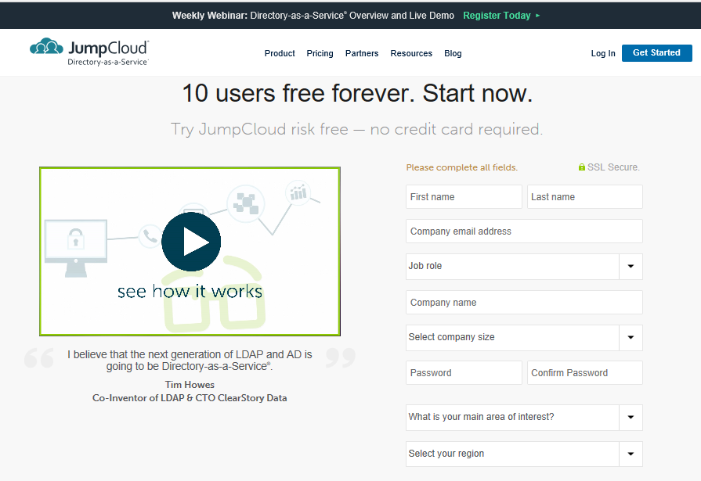
Apply For An Administrator Account with JumpCloud
Setp1
Need to apply an Administrator account with JumpCloud and log in with this account.

Slide 23
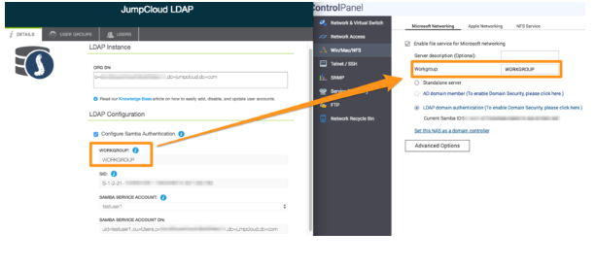
Identical Name of The Workgroup in QTS and JumpCloud
Step2
The most encountered problem is that the Admin must use identical name of the workgroup in QTS and JumpCloud Instance.

Slide 24
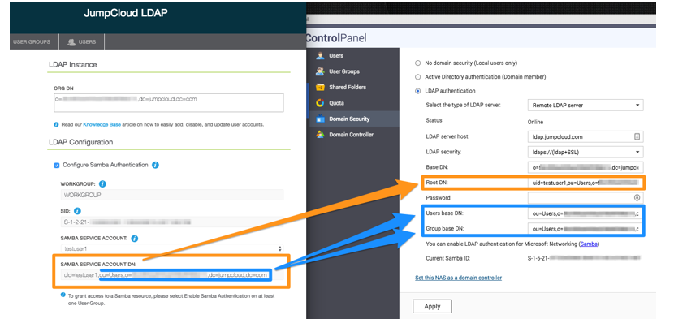
Connecting QTS to JumpCloud
Step3
In the Domain Security of QTS, some strings must be obtained from the JumpCloud instance, in order to join JumpCloud LDAP.

Slide 25
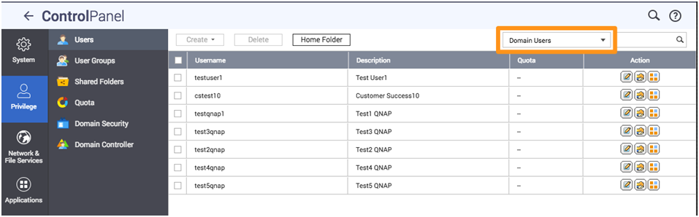
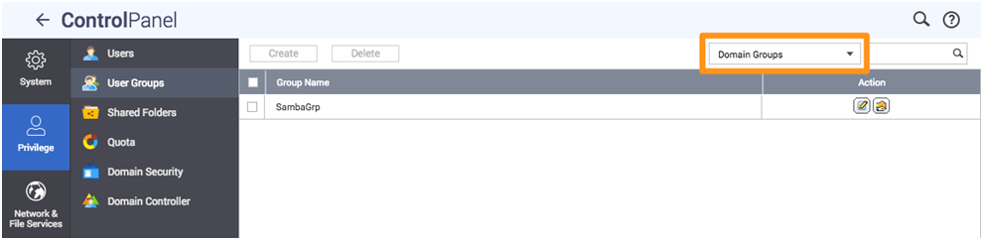
Importing Domain Users and Groups Into QTS
Step4
After connecting to JumpCloud domain, check domain users and domain groups in QTS to see JumpCloud users and groups imported to QTS.

Slide 26
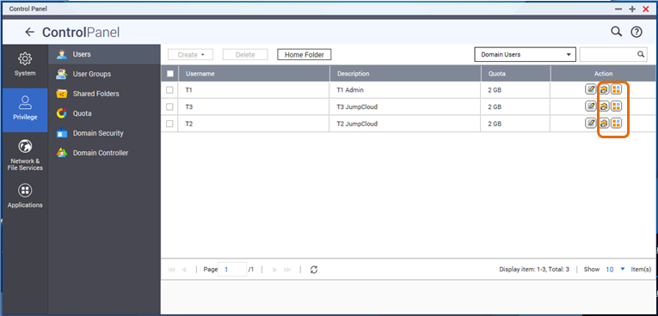
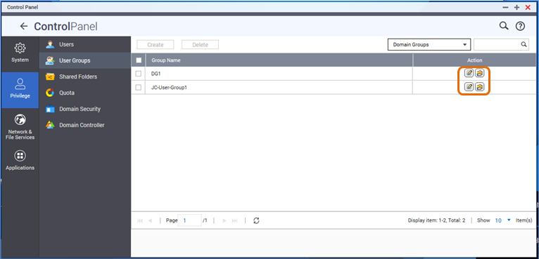
Set The Shared Folder Permission and Application Privilege
Step5
In the domain users and domain groups of QTS, configure the Shared Folder Permission and Application Privilege for each JumpCloud users, or groups.

Slide 27
A Tutorial for QNAP NAS to Join JumpCloud's LDAP-as-a-Service
How to join JumpCloud's LDAP-as-a-Service with a QNAP QTS NAS :
https://www.qnap.com/en/how-to/tutorial/article/how-to-join-jumpclouds-ldap-as-a-service-with-a-qnap-qts-nas

Slide 28
Live Demonstration

Slide 29
Summary
The enterprise today demands a hybrid cloud environment
Various Cloud Services
Data storage is both at local and cloud
QNAP NAS supports JumpCloud’s Directory-as-a-Service®
IT can centralize all the management of accounts and passwords
Users can use single set of account and password to access all cloud services and QNAP NAS.

Slide 30

Your Best Choice!
QNAP NAS
JumpCloud
Copyright © 2019 QNAP Systems, Inc. All rights reserved. QNAP® and other names of QNAP Products are proprietary marks or registered trademarks of QNAP Systems, Inc. Other products and company names mentioned herein are trademarks of their respective holders.

Slide 31









使用 JumpCloud 管理雲端目錄服務權限
各地的辦公室，不論人數多少，都可以有JumpCloud 的雲端目錄服務，並且可中央化管理全球各辦公室的“在地”及“雲端”服務權限。
上海
越南
辦公室設備
台北
QNAP NAS
各類雲端服務
洛杉磯
柏林

