Slide 1
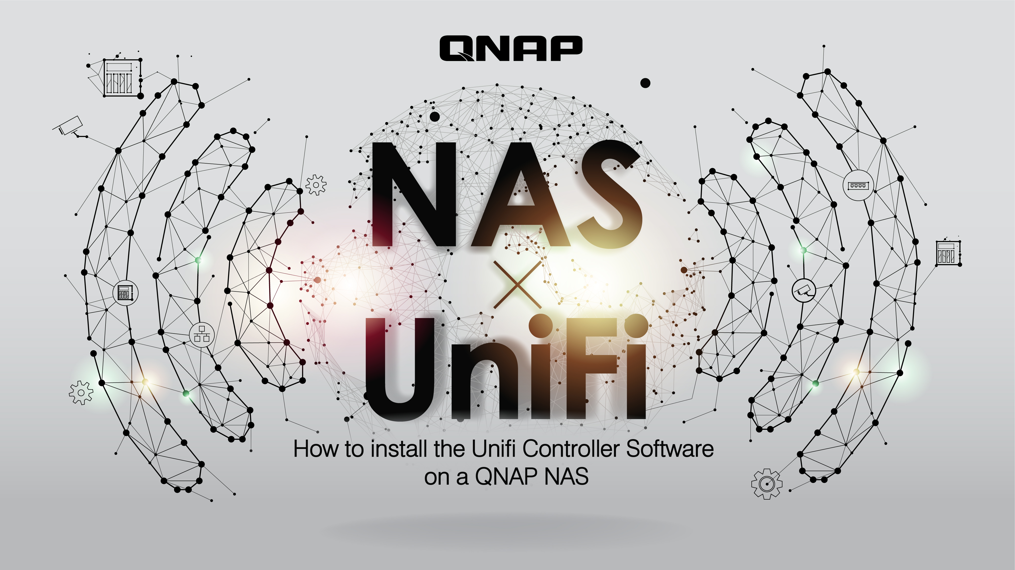

Slide 2
How to Conveniently Configure the Network with QNAP NAS
Ubiquiti Networks Introduction
Features of UniFi Controller on QNAP NAS
How to Build UniFi Controller on QNAP NAS
Demo
Notes:
How to Configure Network Conveniently with QNAP NAS

Slide 3
Ubiquiti Networks
Introduction

Slide 4
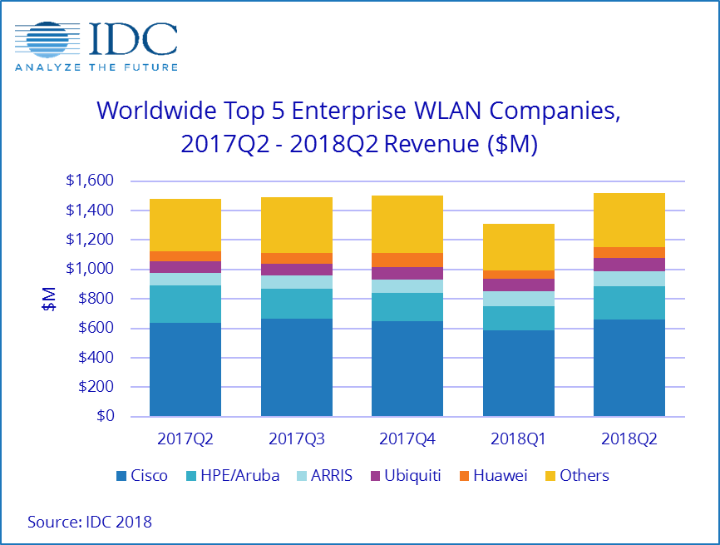

Ubiquiti Networks
Ubiquiti Networks, Inc. founded in 2003
Headquarters in New York
Provide network products and solution, including AirMax System, Wireless AP, etc.
Notes:
Ubiquiti Networks, Inc.(UBNT.US)成立於2003年，總部設在加州的San Jose，前稱為Pera Networks，於2005年更為現名，為一家在全球提供網路產品和解決方案服務企業，包括AirMax系統、無線電通信設備和天線等。Ubiquiti Networks服務產品平台：主要提供固定無線寬頻、無線回傳系統以及路由給電信商網路基礎設施用，以及提供無線局域網(LAN)基礎設施、視訊監控產品、VOIP電話、開關和機器對機器的通信元件。產品和解決方案方面，包括高性能無線電、天線、軟體、通信協議和管理工具，目的在提供運營商和企業級無線寬頻接入和其他主要在未經許可的RF頻譜的服務。技術平台方面，如AIRMAX平台，包括專有協議、內含讓信號噪聲降到最低的技術。EdgeMAX方面，則為一個破壞性的軟體和系統路由平台；AirFiber：點對點無線電系統。此外，還提供UniFi 企業Wi-Fi系統，包括具有基於軟體的管理控制器的Wi-Fi認證硬體；UniFi視訊H.264百萬像素IP攝像機/UniFi視訊管理軟體控制器則用來管理多個視訊UniFi H.264 IP攝像機和數位錄影設備。UniFi VOIP電話方面，目的在融入企業的UniFi系統，UniFi切換提供性能、交換、PoE +支援給企業網路、MFI，包括硬體感應器、電力設施、管理軟體允許透過Wi-Fi讓設施被監控和遙控；嵌入式無線電波產品、安裝支架、電纜和乙太網的供電適配器。

Slide 5
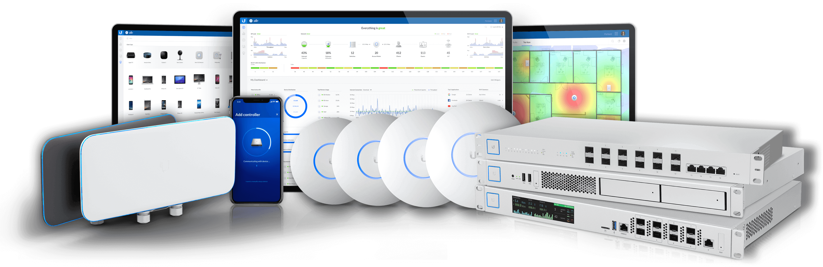
Ubiquiti Emerge
Unique and innovative "Fast Roam" techonology
Central Management covering versatile UniFi products
Free Software - UniFi Controller
Competitive price of project construction
Notes:
http://www.e-digital.com.tw/product/ubiquiti-networks
強大的硬體
UniFi AP採用了最新的無線802.11a/b/g/n/ac MIMO技術 - 能夠達到1300Mbps的速度範圍可達至400ft。
無限擴展
無限的擴展能力。創建您的無線網路，並延展到數千個無線AP。
https://www.ithome.com.tw/review/99715
https://www.interwave.com.tw/images/ubiquiti/UniFi-AP-datasheet_tw.pdf

Slide 6
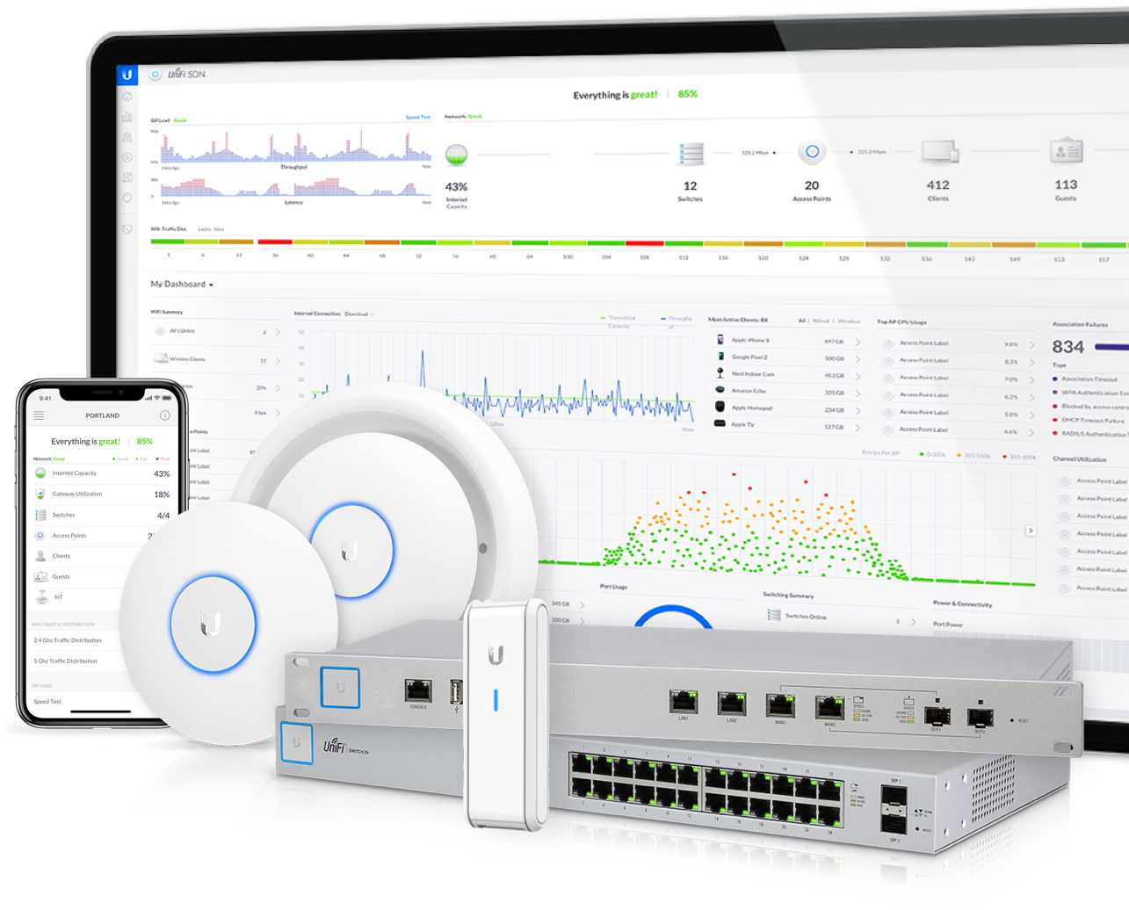


High Applicability Control Center
UniFi Controller
Network Management
Intuitive and strong UI
Allow you to configure and monitor network simultaneously
Notes:
https://hkitblog.com/第四篇-毋需購買-ap-授權：軟件中央無線控制器節省/

Slide 7
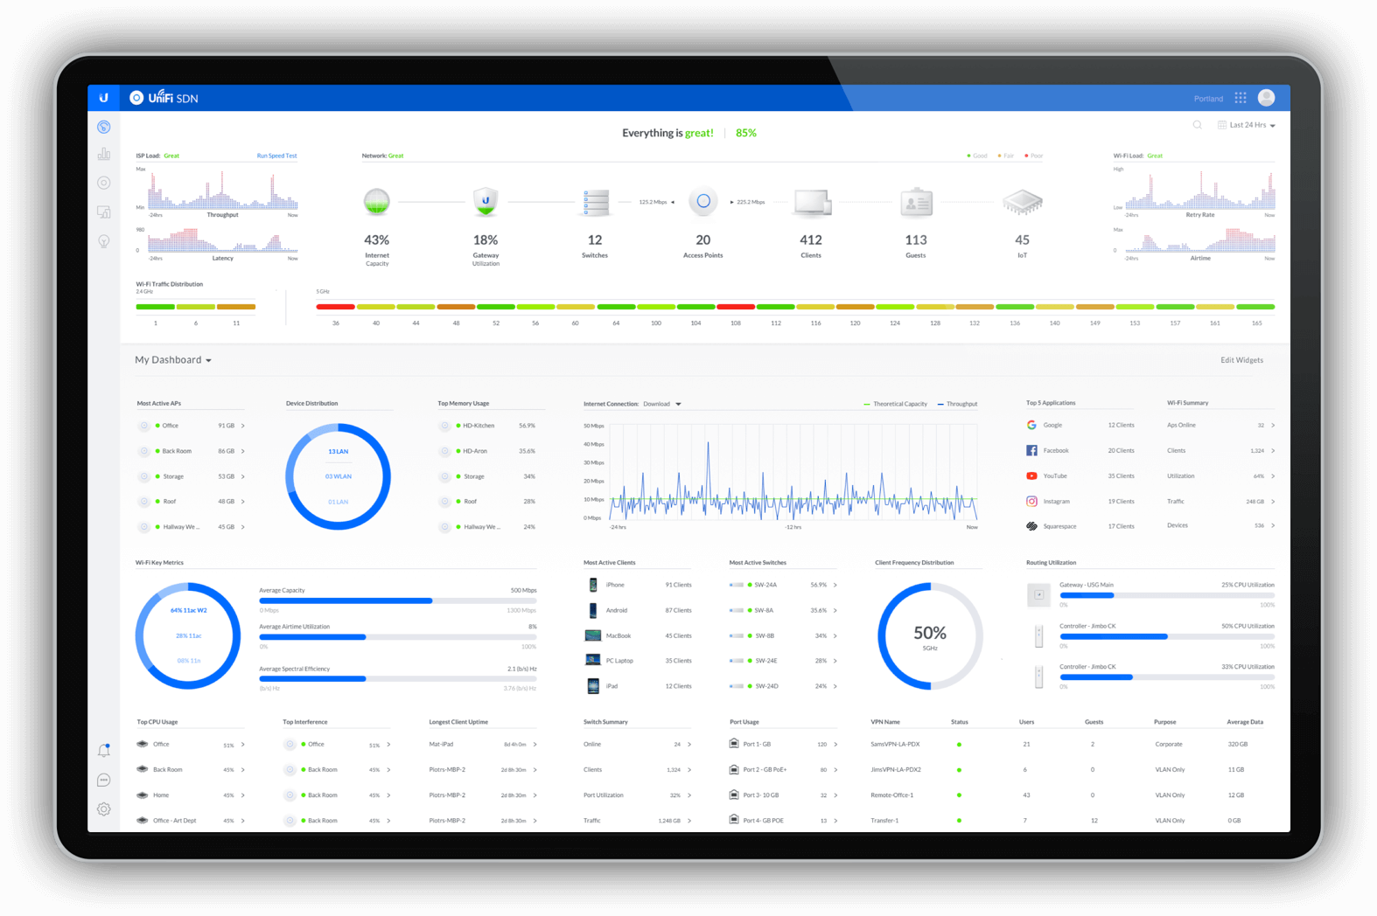
Strong Features with Multiple Settings
A single manager platform
Concentrating all cross-district UniFi products
Supports:
  UniFi fast roaming
  Guest network with customized portal.
  Scheduled access policy for each SSID
Notes:
UniFi fast roaming
Guest network with customized portal.
Scheduled access policy for each SSID

Slide 8
UniFi Supports Fast Roaming
Allows users to switch their connection from one AP to another quickly, to get stronger Wi-Fi signal and improve on-the-go performance.

Slide 9
Features of UniFi Controller on QNAP NAS

Slide 10
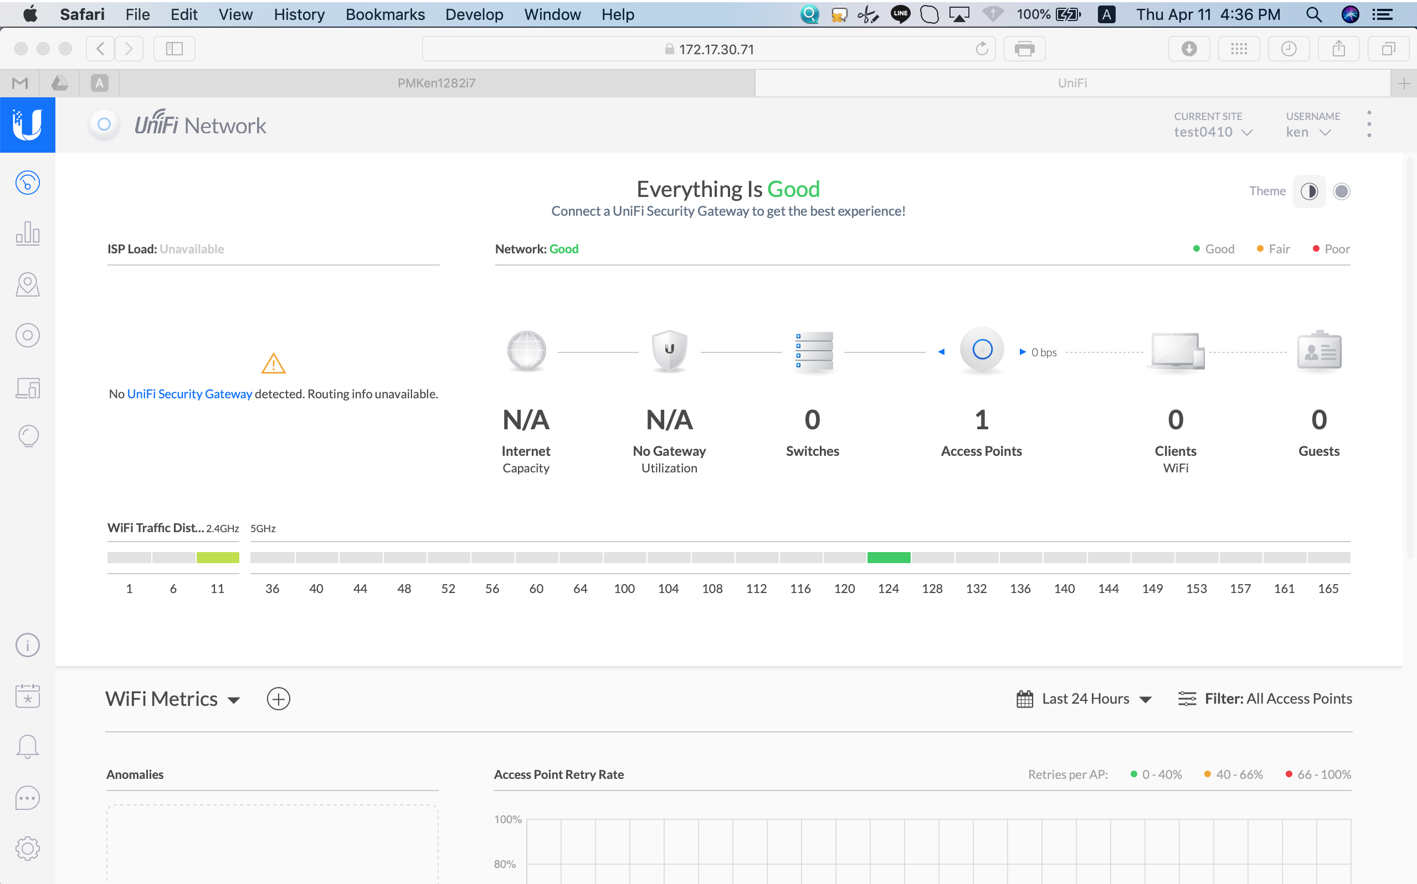

Why NOT to install UniFi Controller in PC ?
Not always online
Less flexible on the numbers of devices used
Cannot give permissions to other users

Slide 11
Advantages of building UniFi Controllers on QNAP NAS
Multiple Hardware specifications
Versatile Building Approach
4 Advantages
Supports Remote Connection
Online Stability 24/7

Slide 12
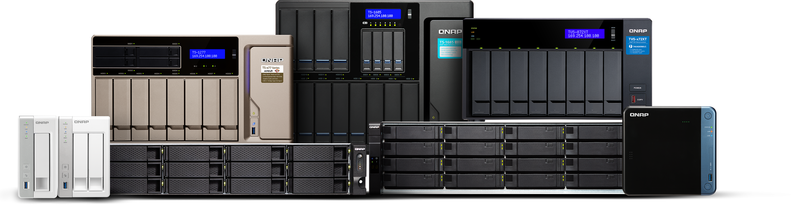
Multiple Hardware specifications
Built with 1 to 30 bays, tower to rackmount form factors, and intended for businesses to workgroups to home users; QNAP have a comprehensive selection of NAS solutions to meet a wide range of user requirements

Slide 13
Online Stability 24/7
QTS, the platform for UniFi Controller, is a stable OS and rare offline server. You can connect from anywhere and anytime.

Slide 14

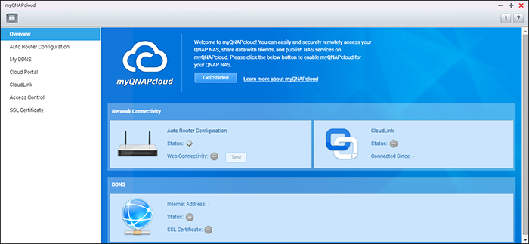
Free Cloud Services
QNAP NAS supports myQNAPcloud to remotely connect , you don't need to purchase additional Ubiquiti cloud service.

Slide 15
How to Build UniFi Controller on QNAP NAS

Slide 16



Versatile Approach to Build UniFi Controller on QNAP NAS
Through QNAP Container Station
Through QNAP Virtualization Station
Download 3rd paty QPKG on Club

Slide 17
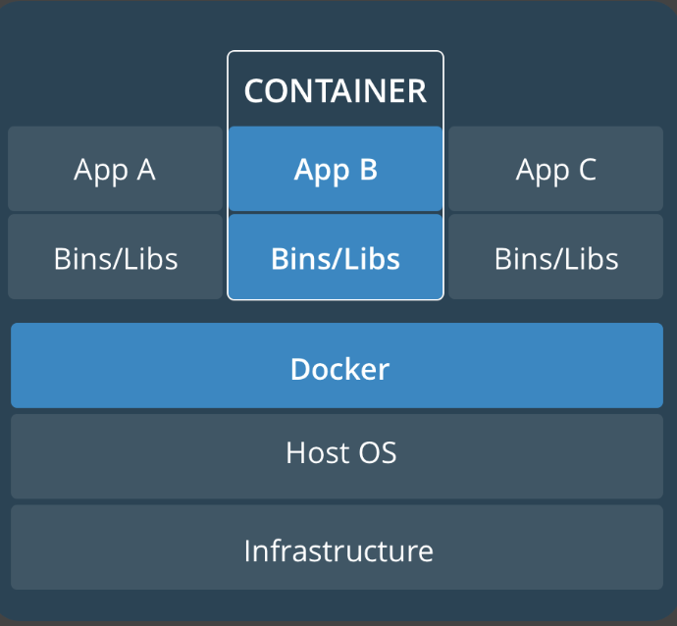
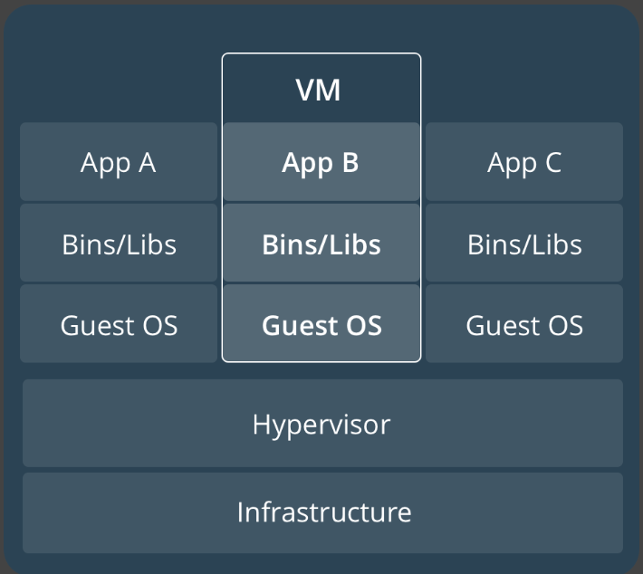

Container vs. Virtual Machine
Container | Virtual Machine
No additional Guest OS | Need Guest OS, consuming more resource
Smaller image (hundreds of MB) | Larger image ( GBs to dozens of GB)
Strong Transferability | Weak Transferability
Initialization for seconds | Initialization for minutes
Notes:
https://blog.yowko.com/container/

Slide 18
Building on QNAP
Container Station

Slide 19

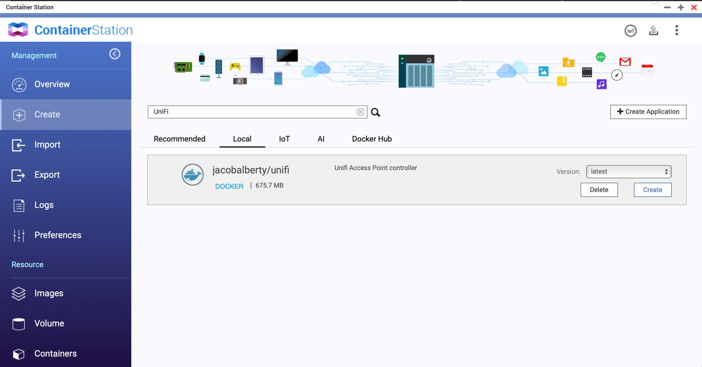
Building on QNAP Container Station
Open Container Station and search "UniFi" to create a container

Slide 20
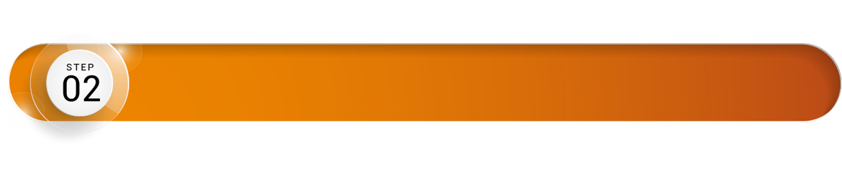
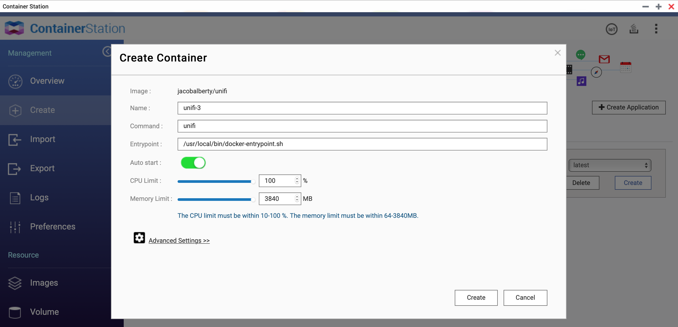
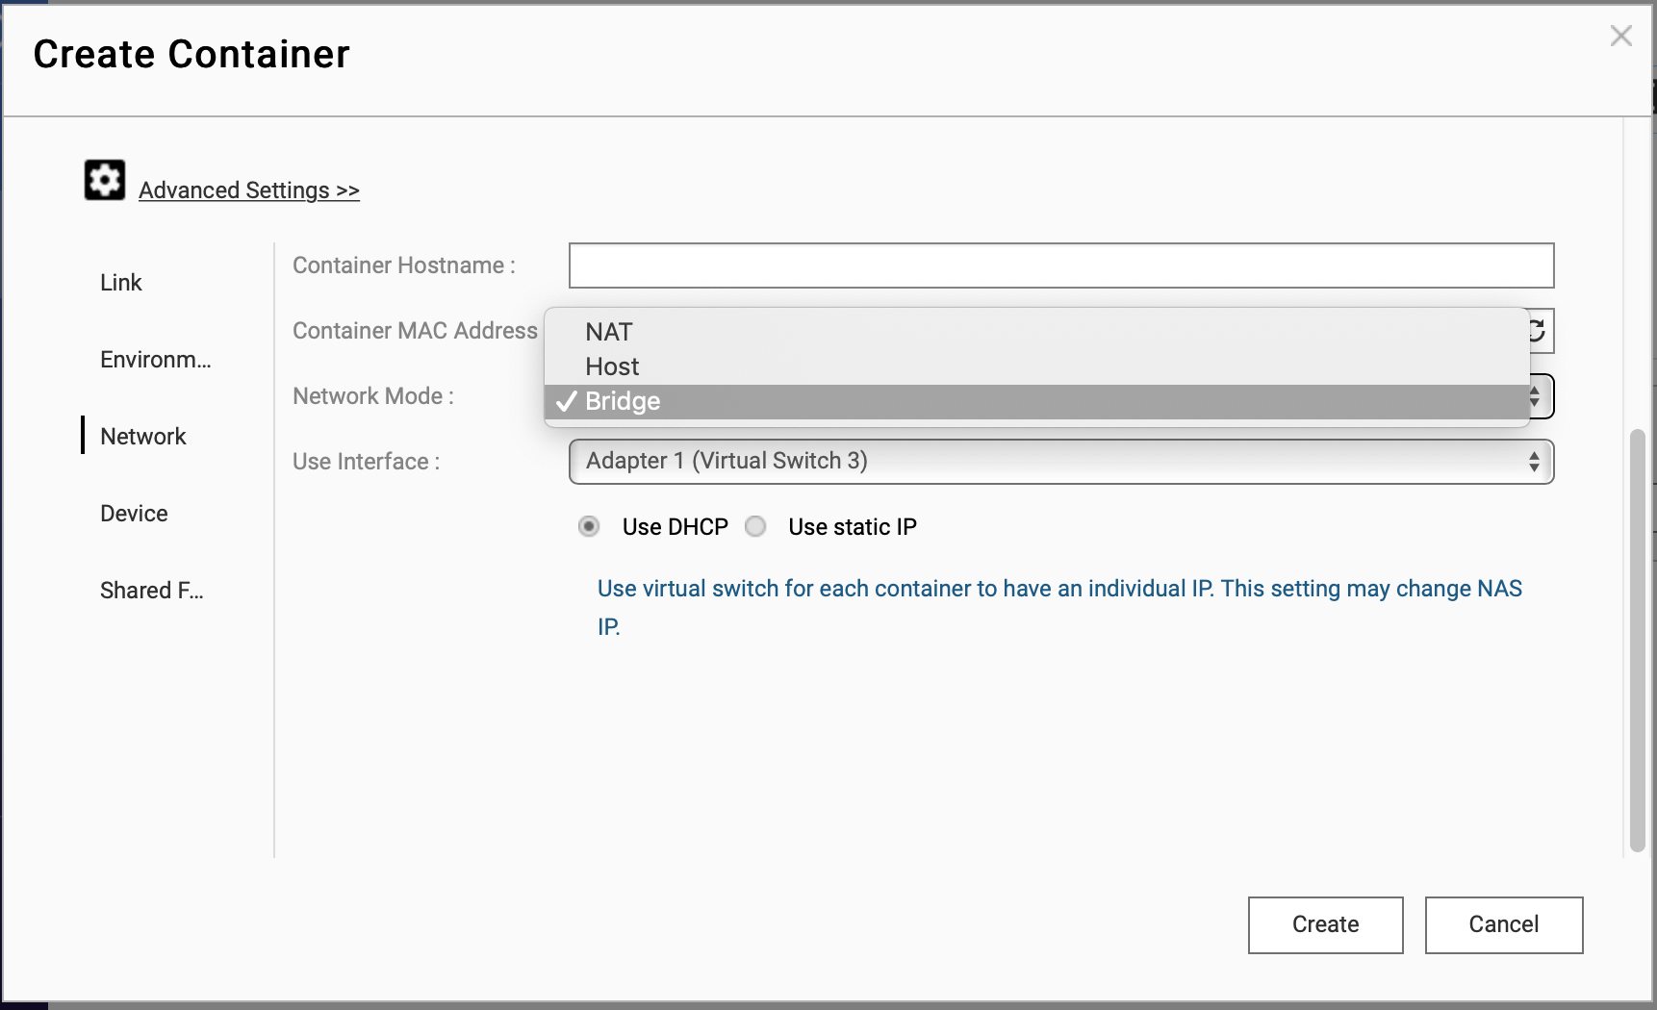
Building on QNAP Container Station
Set network to "Bridge" mode

Slide 21

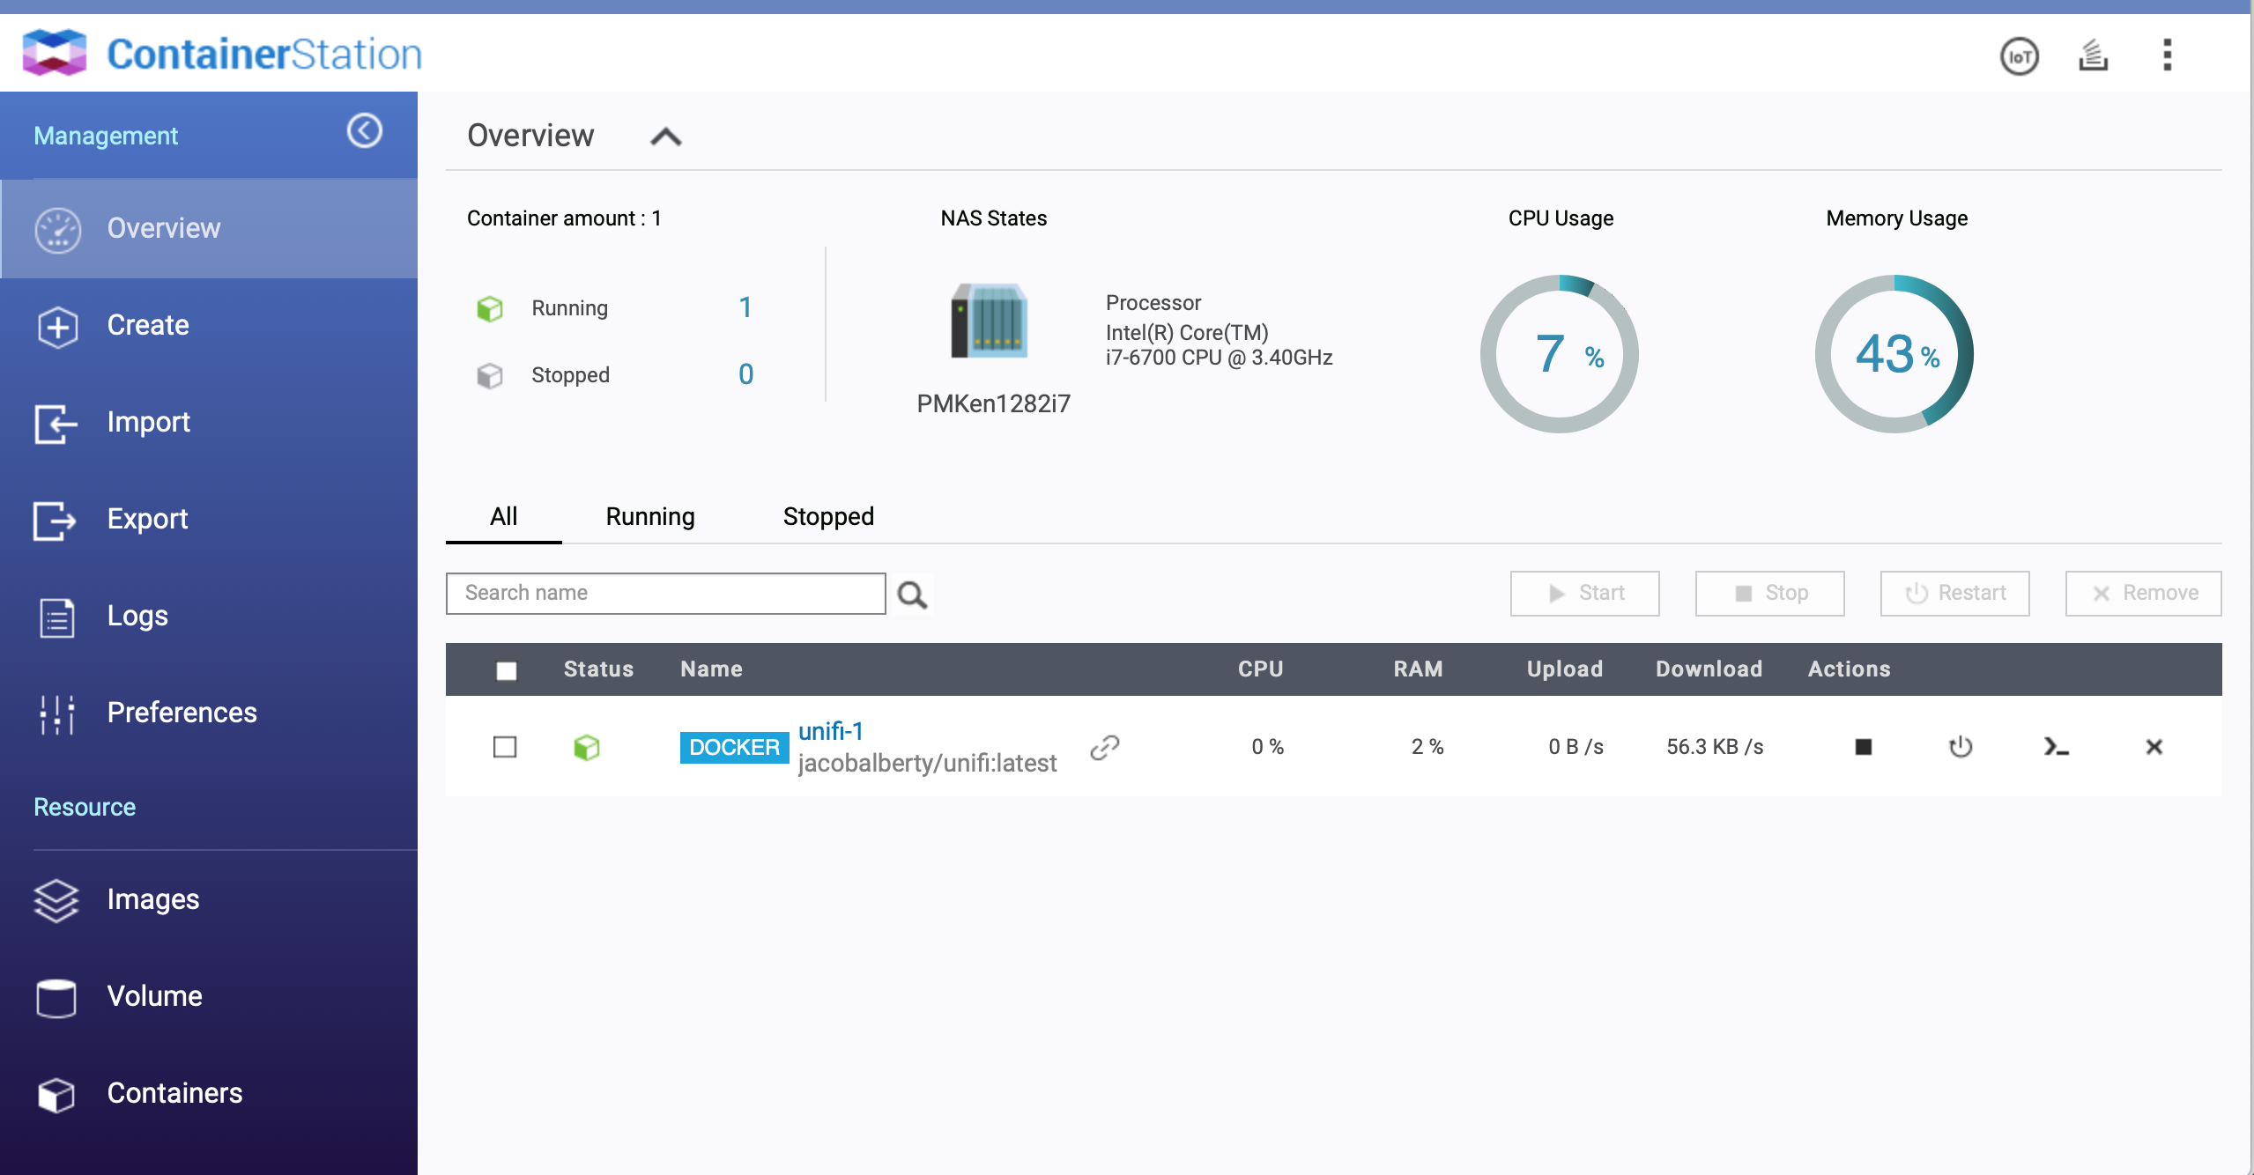
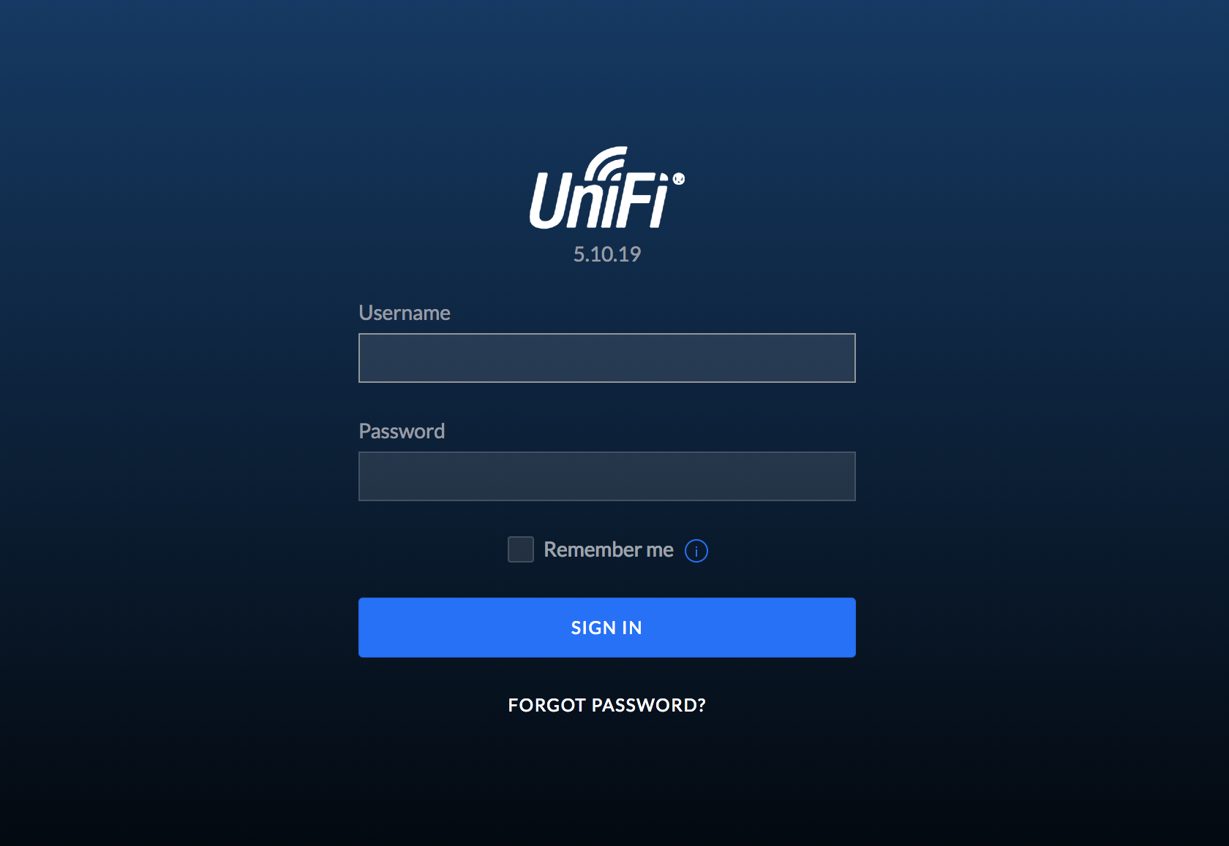
Building on QNAP Container Station
UniFi Controller container has been established

Slide 22
Building on QNAP
Virtualization Station

Slide 23

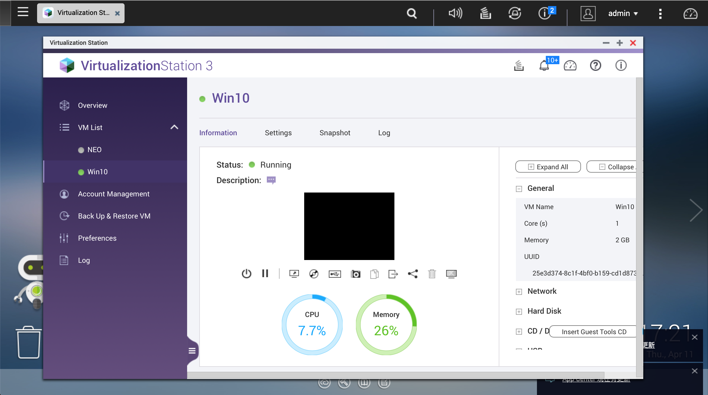
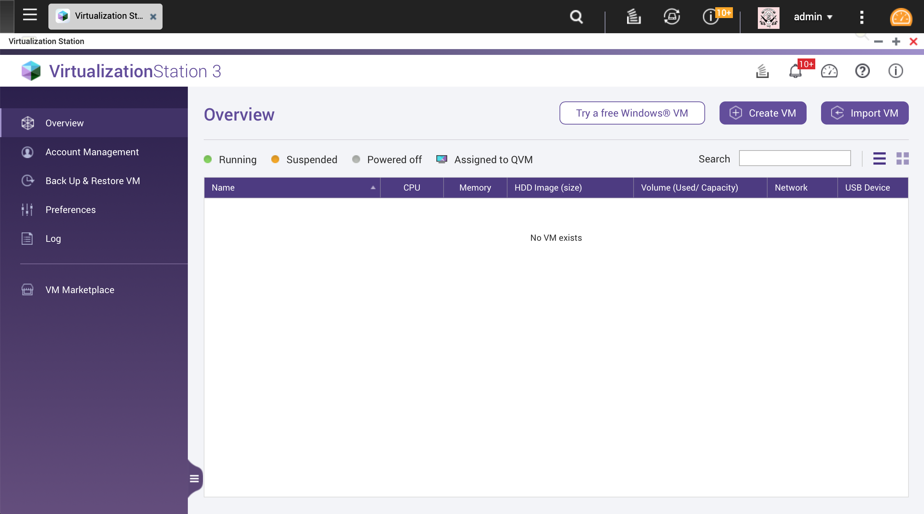
Refer to Virtualization Station Tutorial to build VM
QNAP Virtualization Station
https://www.qnap.com/go/solution/virtualization-station/

Slide 24
Download 3rd party QPKG from QNAP Club

Slide 25
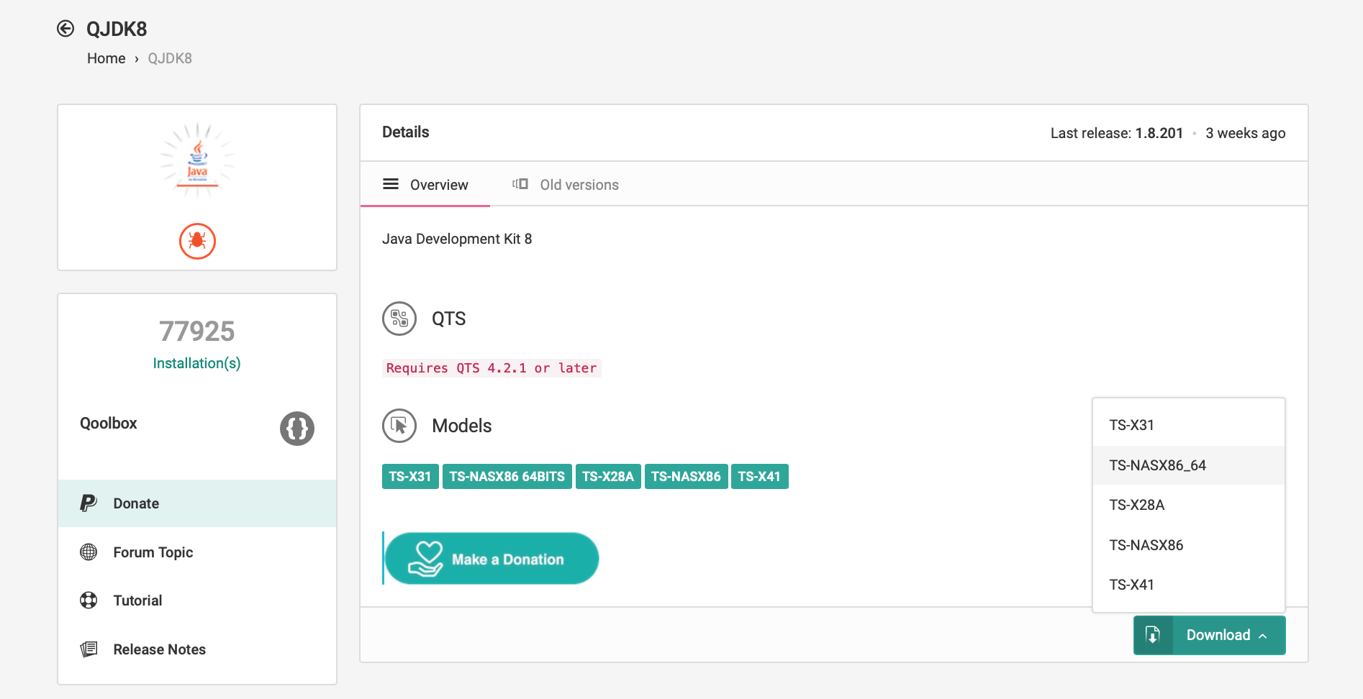
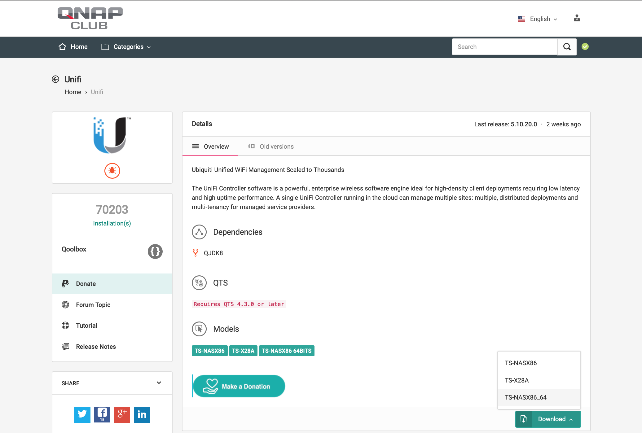

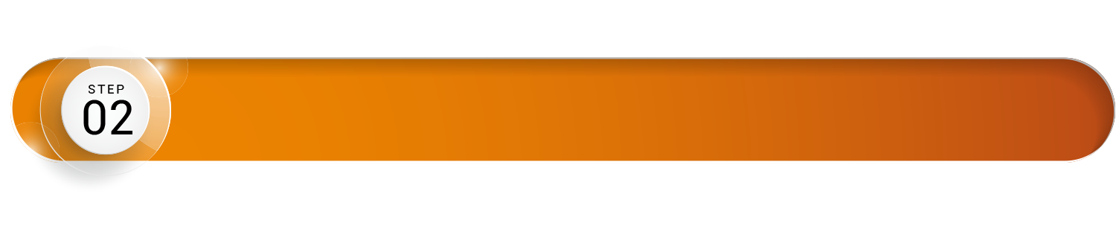
Download 3rd party Application form QNAP Club
Install dependent app in advance：QJDK8
Download compatible version to NAS

Slide 26
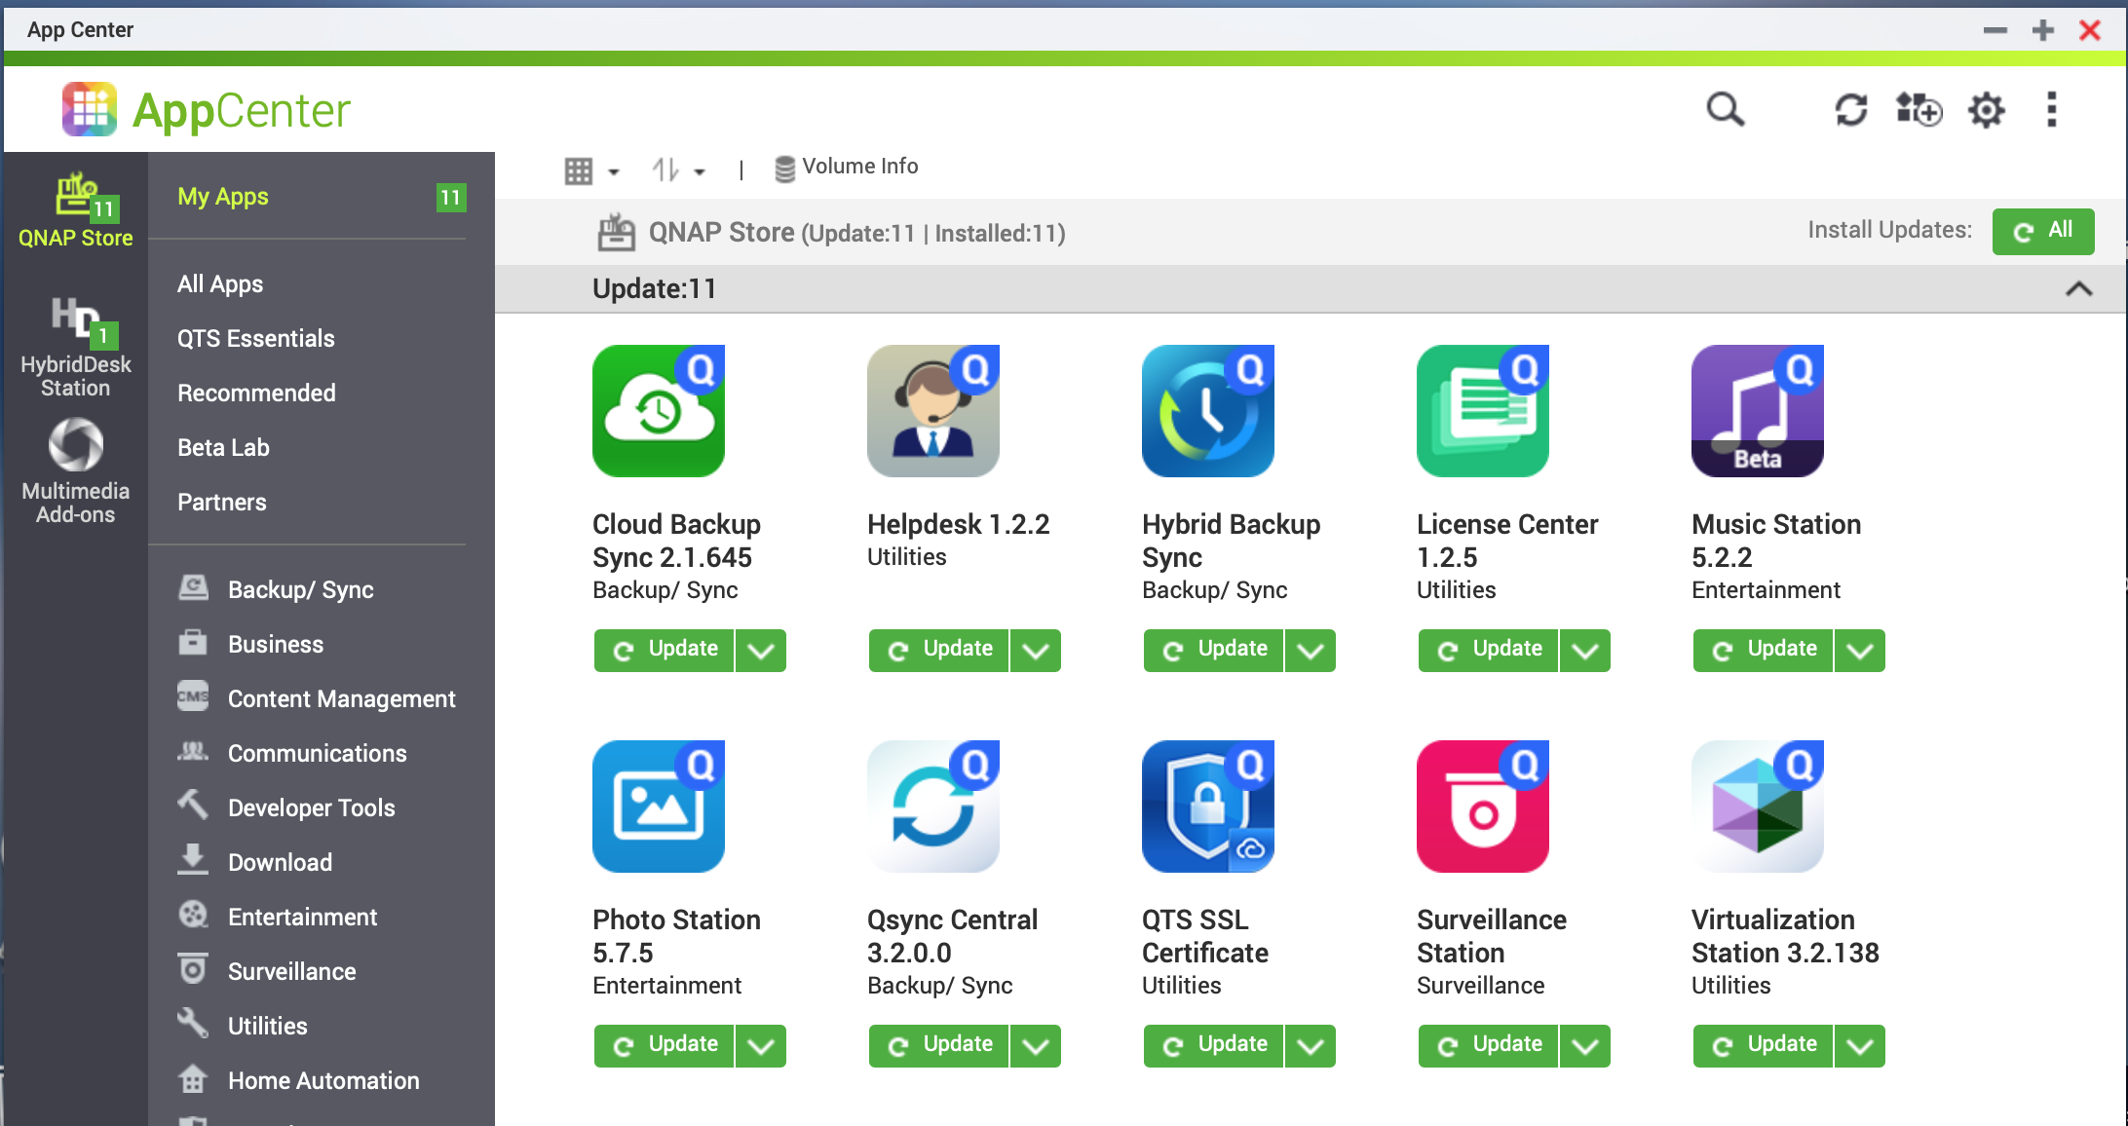
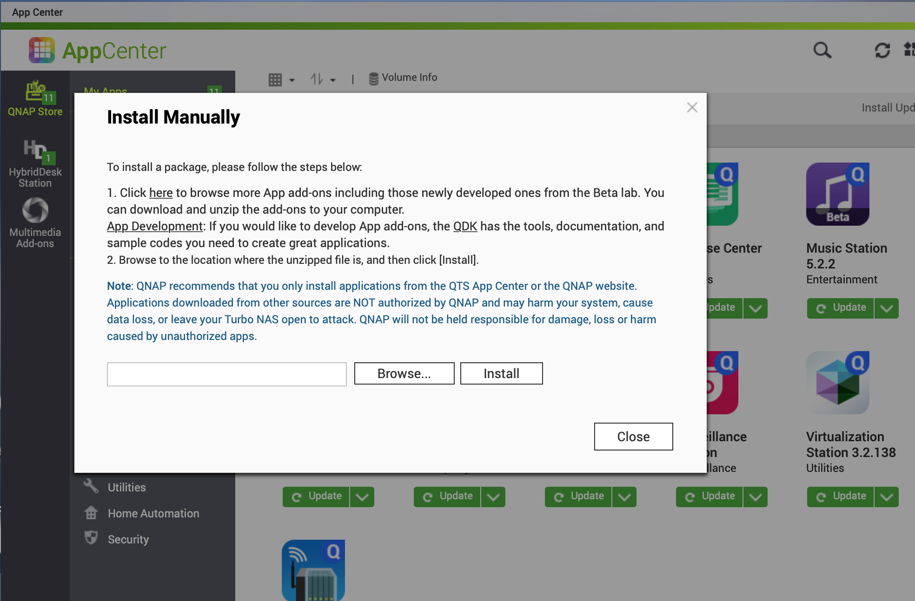
Manual Installation through AppCenter
Upload qpkg in App Center and install

Slide 27
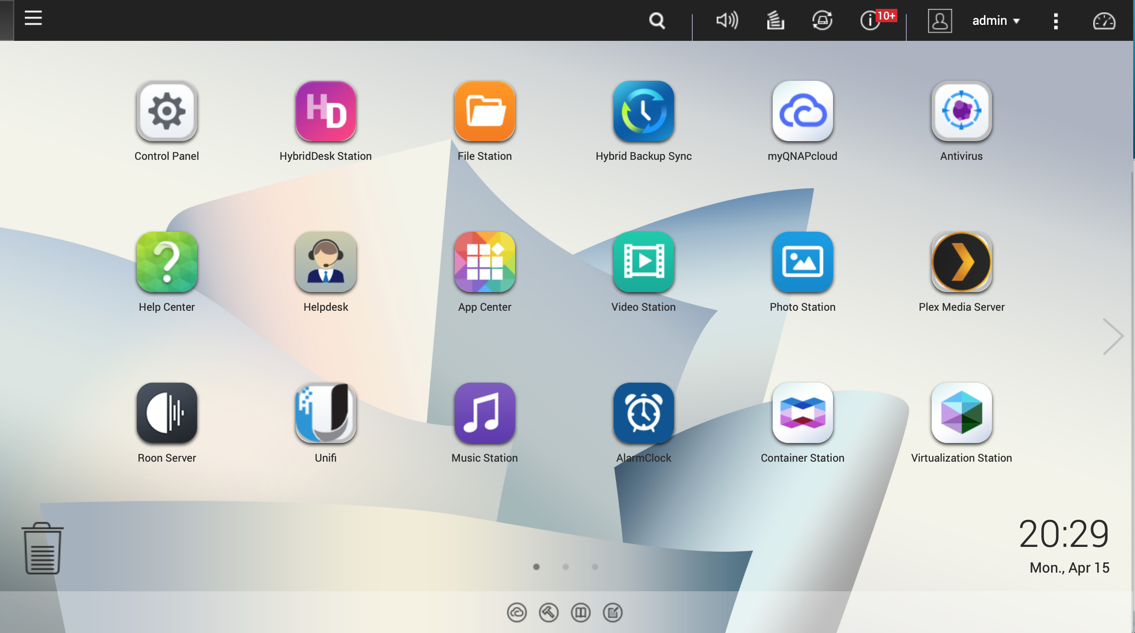
UniFi Controller has been Installed
App entrance is displayed in desktop

Slide 29
Your Best Choice
Copyright© 2019 QNAP Systems, Inc. All rights reserved. QNAP® and other names of QNAP Products are proprietary marks or registered trademarks of QNAP Systems, Inc. Other products and company names mentioned herein are trademarks of their respective holders.​​​​

