Slide 2
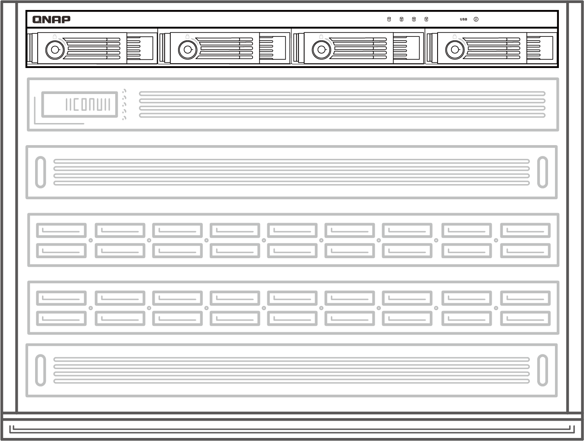
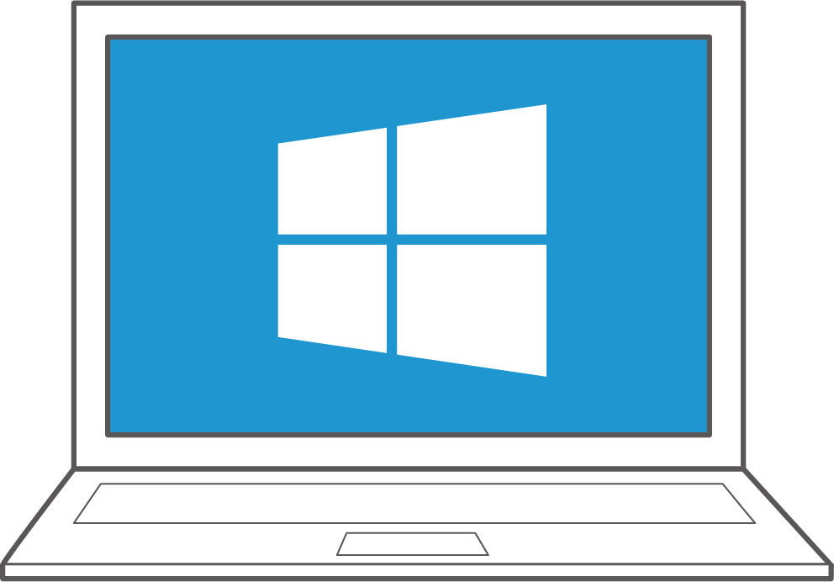
Easily expand server and NAS capacity for a maximized investment
Quickly expand or backup server data in rackmount environment: TR-004U overview
QNAP External RAID Manager for Windows & macOS easily creates and manages RAID
Add capacity to NAS or data migration

Slide 3
TR-004U
Overview

Slide 4

Your challenges, our solutions
The NAS and/or server storage are not enough; how can I upgrade once and expand it all?

Slide 5
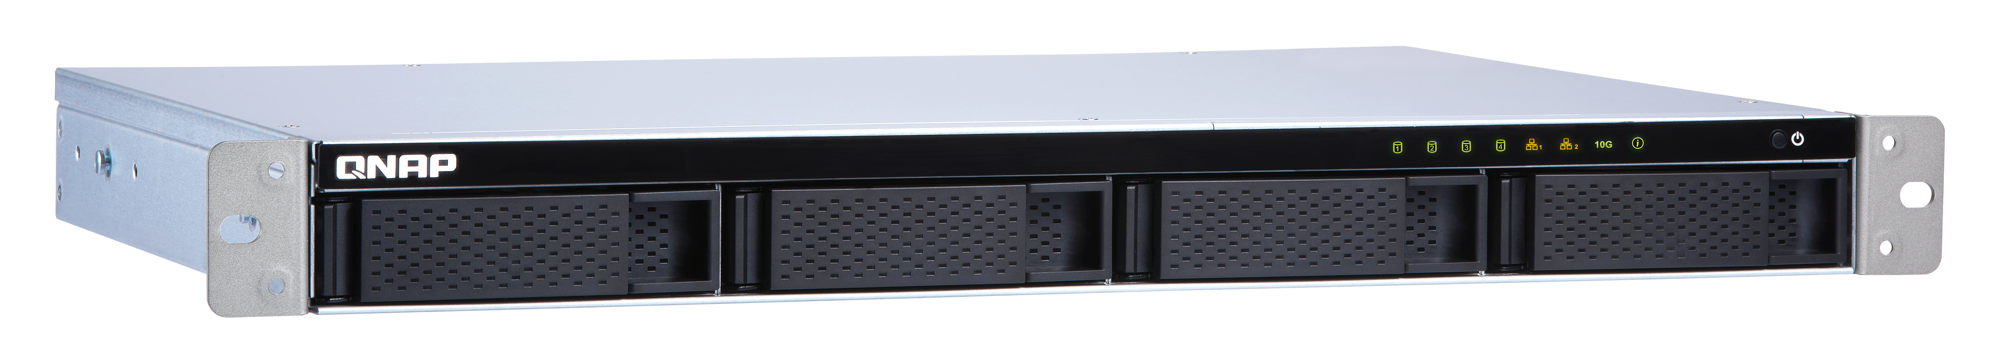
Can it be more affordable to expand or backup server data?
While business data is growing on both server/pc and NAS, the storage space of a single device is no longer enough.
Is it possible to expand the capacity without
re-configuring the whole system?
TS-431XeU

Slide 6

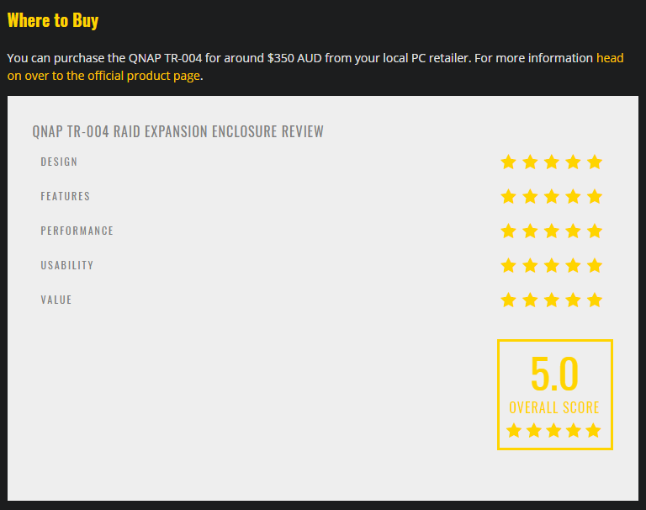

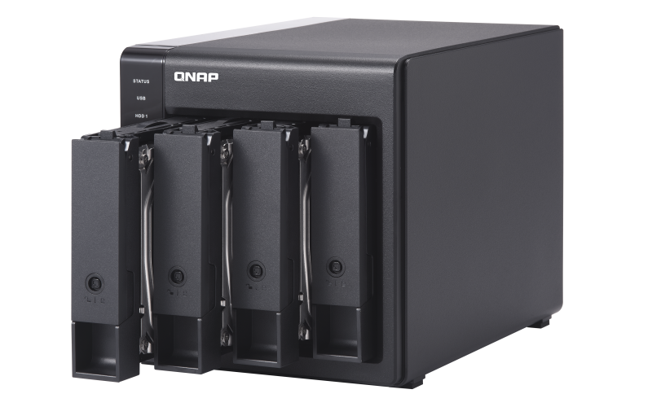
TR-002/TR-004 are going strong
Why TR
Easy to use with polished QNAP utility and NAS support
QNAP TR hardware RAID units are perfect for:
HDD swap & archive
Expand capacity
Cross-platform file sharing
Backup and recovery
https://www.thestreamingblog.com/qnap-tr-004-raid-expansion-enclosure-review/

Slide 7



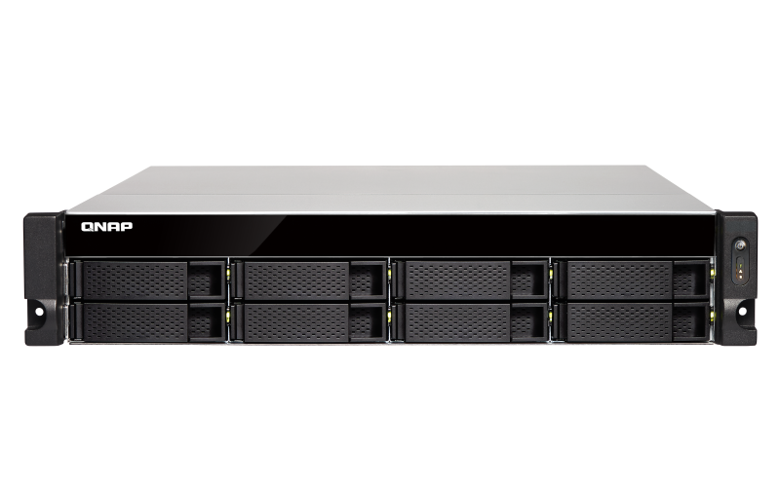


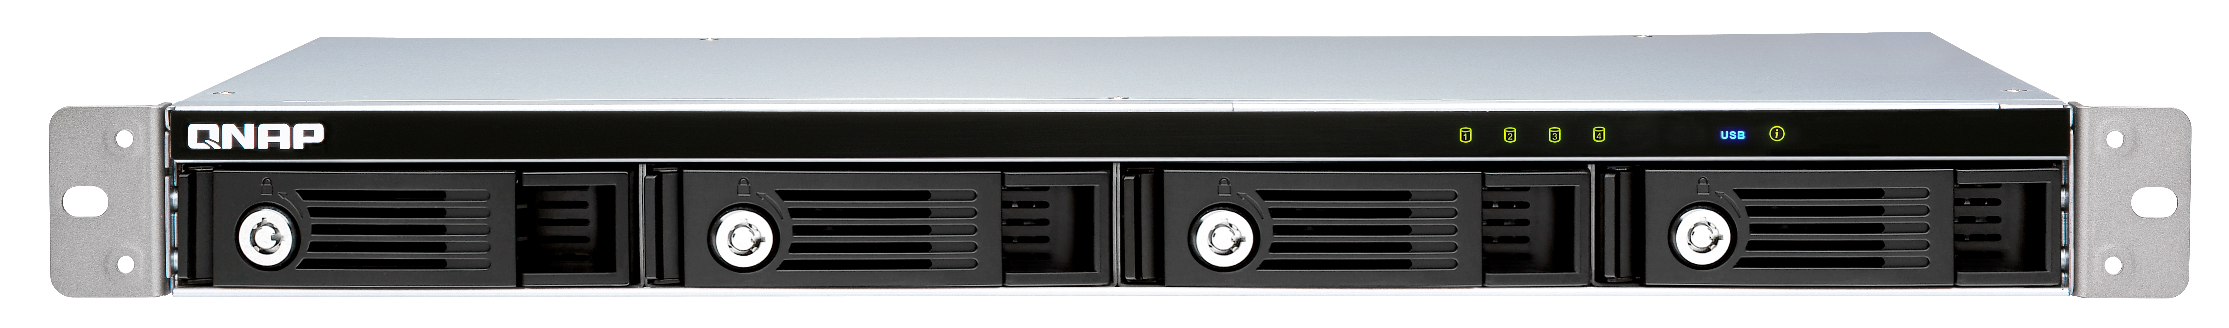
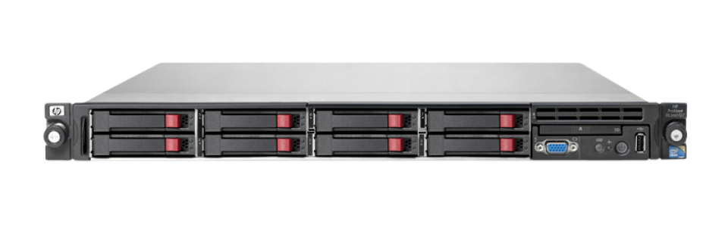

TR-004U external RAID device
One plus one
QNAP knows! TR-002 & TR-004 are getting good reviews and sales so we want to continue this.
The new 1U 4-bay short-depth rackmount TR-004U:
1. Windows/macOS/Linux external storage mode
2. QNAP NAS storage expansion mode to use as an QNAP NAS expansion unit!
USB 3.0
(3.1 Gen1)
USB 3.0
(3.1 Gen1)
TR-004U
External device
Storage pool
NAS
Each NAS supports 2 x TR-004U units.

Slide 8
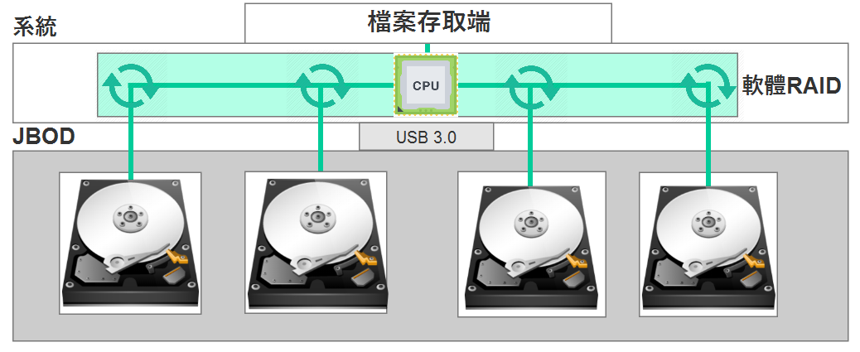



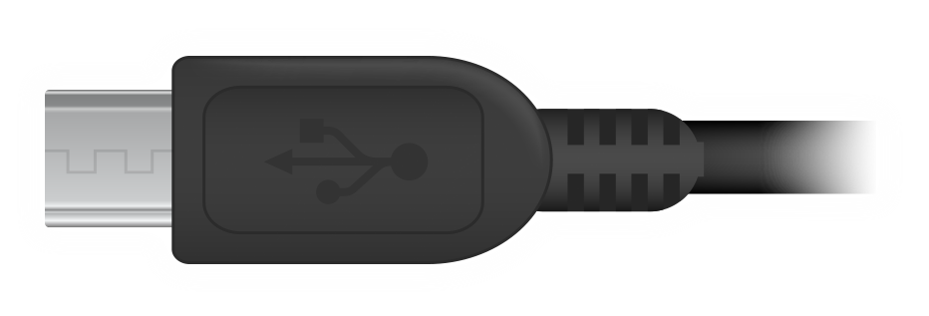
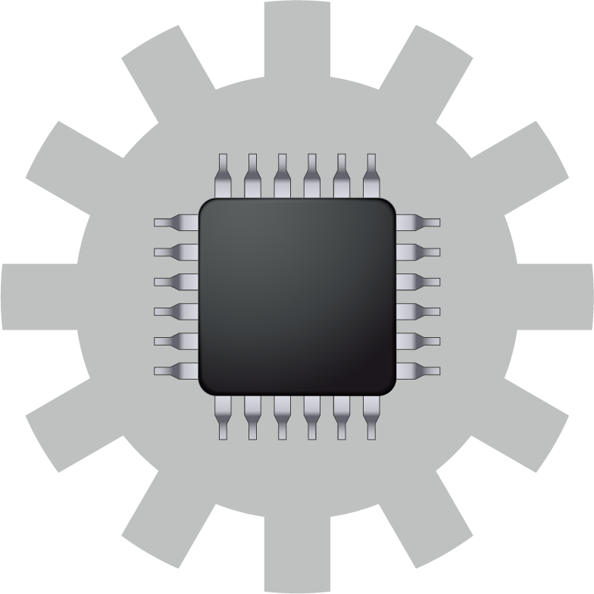
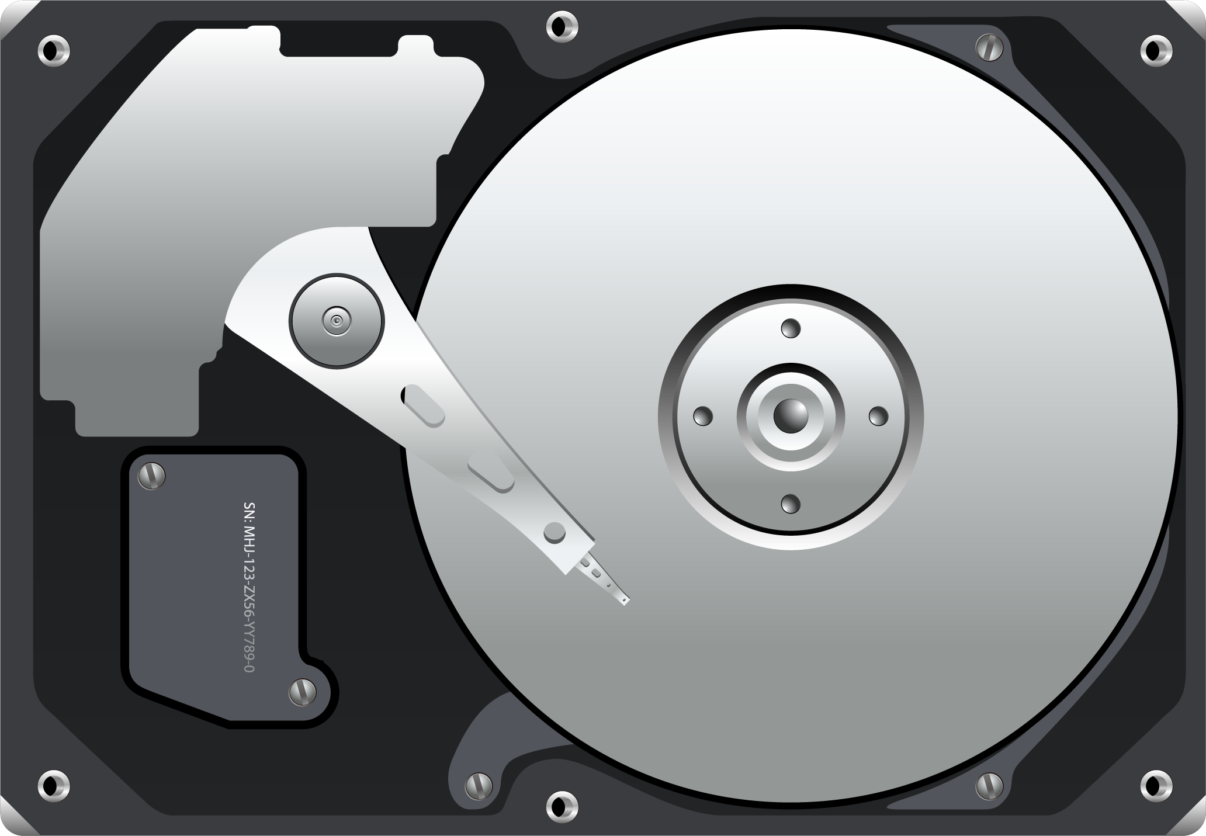
What is external (hardware) RAID ?
A software RAID uses CPU resources to distribute the IO on different disk to form a RAID protection. The operation of such RAID cannot go beyond the main system.
An external (hardware) RAID is working independently of CPU, offloading the CPU and allowing operations in different platform.
Client
Client
System
System
CPU
Software RAID
CPU
Single disk
USB 3.0
USB 3.0
JBOD
TR-004U
Hardware RAID as a single disk

Slide 9
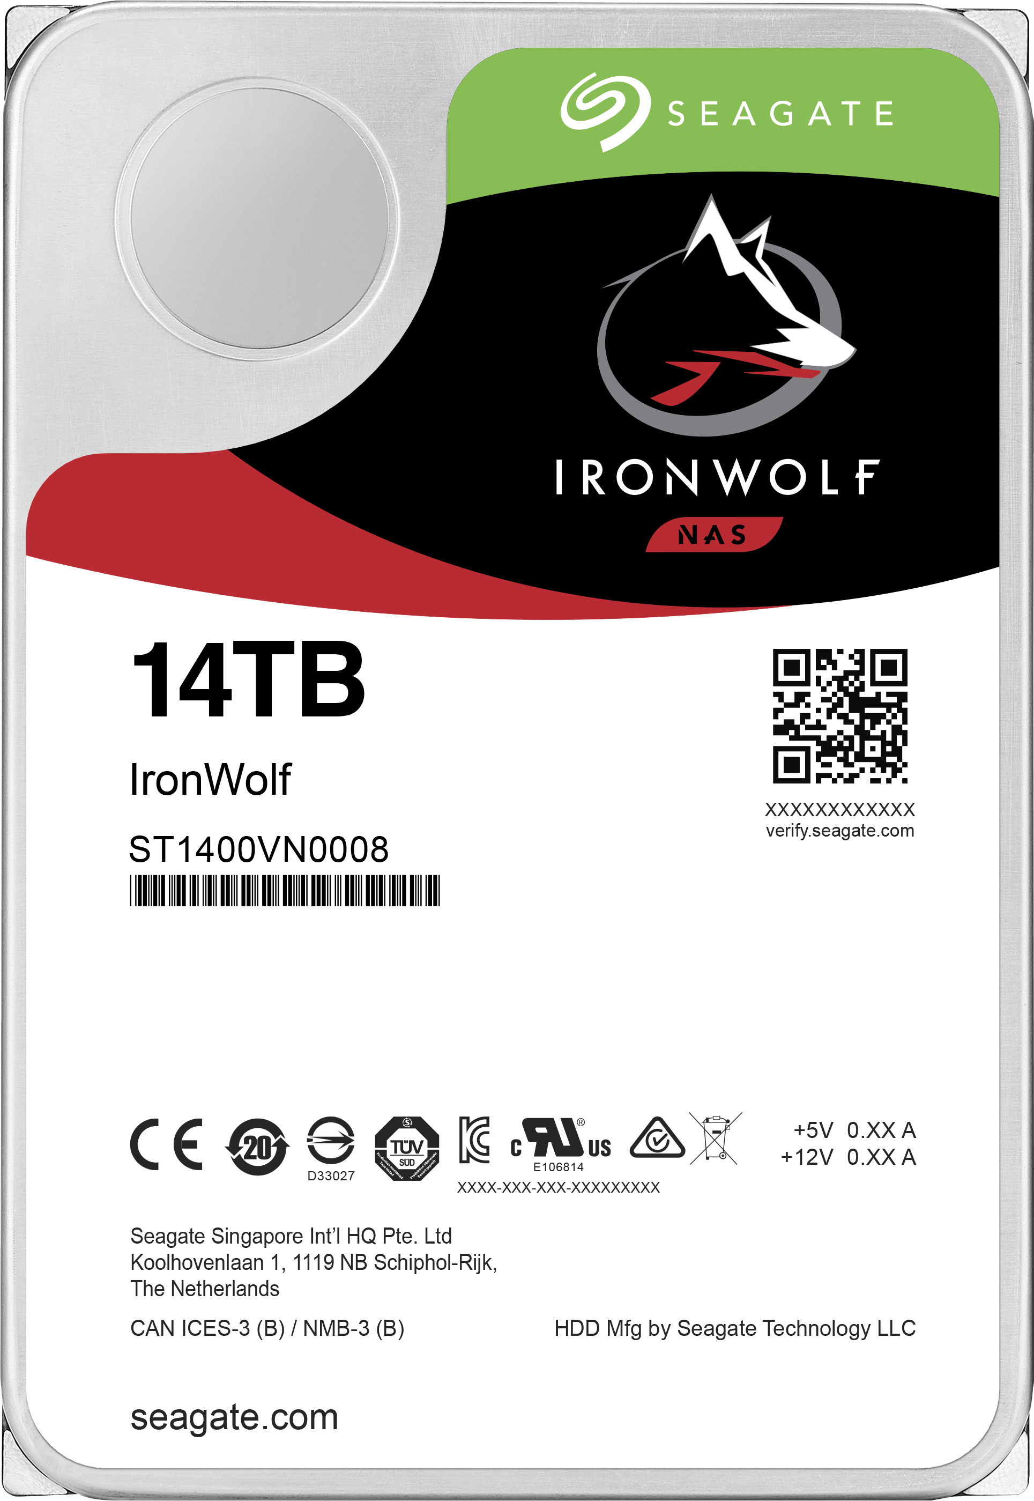


QNAP goes beyond NAS for your needs
The TR-004U 4-bay USB 3.0 RAID expansion enclosure supports RAID 5 acceleration and protection to replace your existing USB 3.0 & USB 2.0 single-disk external drives.
Same compatibility standard as NAS to support large capacity HDD.
TR-004U supports
14TB HDDs!
USB theoretical speeds
USB 3.1 Gen2
10 Gbps
USB 3.1 Gen1 (USB 3.0)
5 Gbps
USB 2.0
0.48 Gbps
Source: https://usb.org

Slide 10
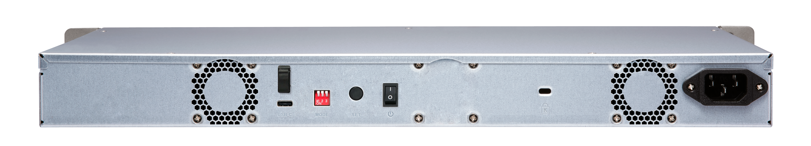
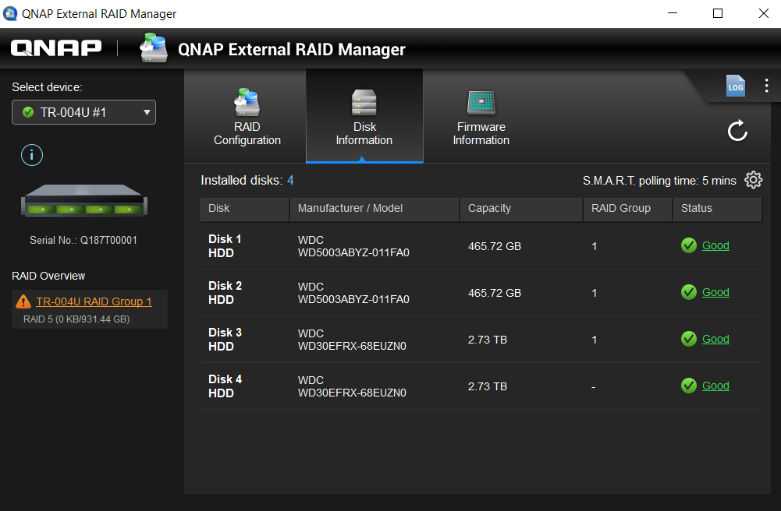
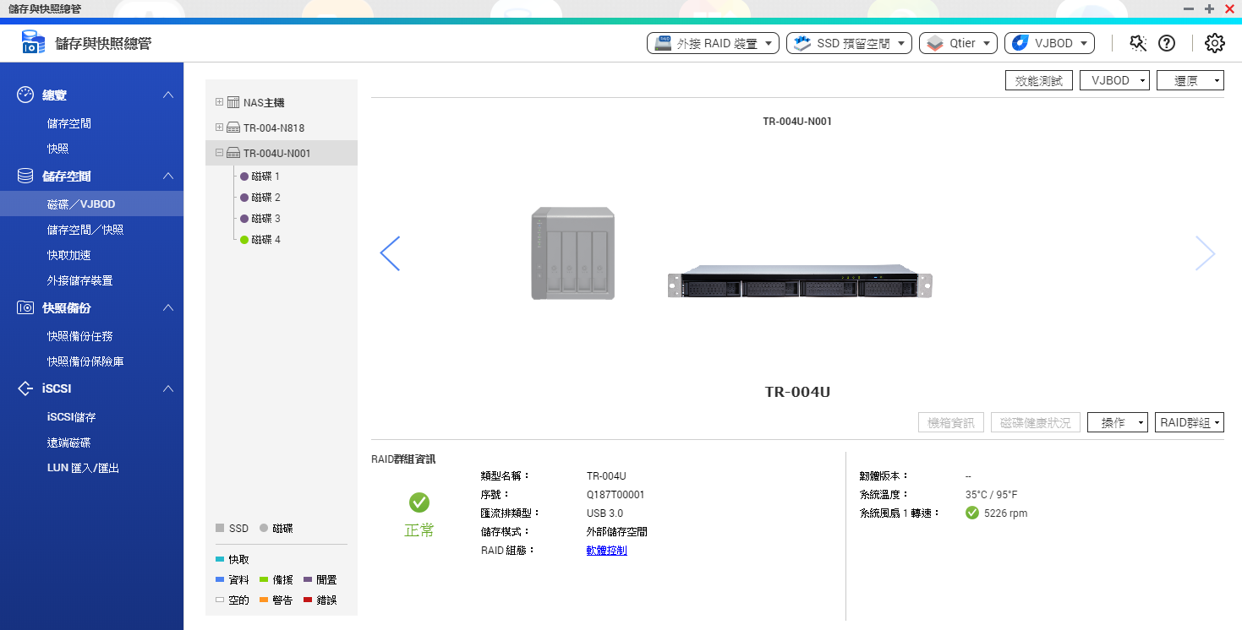
QNAP goes beyond NAS for your needs
Traditional RAID devices can only switch between modes via a hardware switch
QNAP unique External RAID Manager allows software-managed
Single/JBOD/RAID 0/1/5/10 modes and disk health
Integrated with QTS Storage & Snapshot, in NAS storage mode
TR-004U supports storage pool creation, snapshot, Qsirch and more!

Slide 11
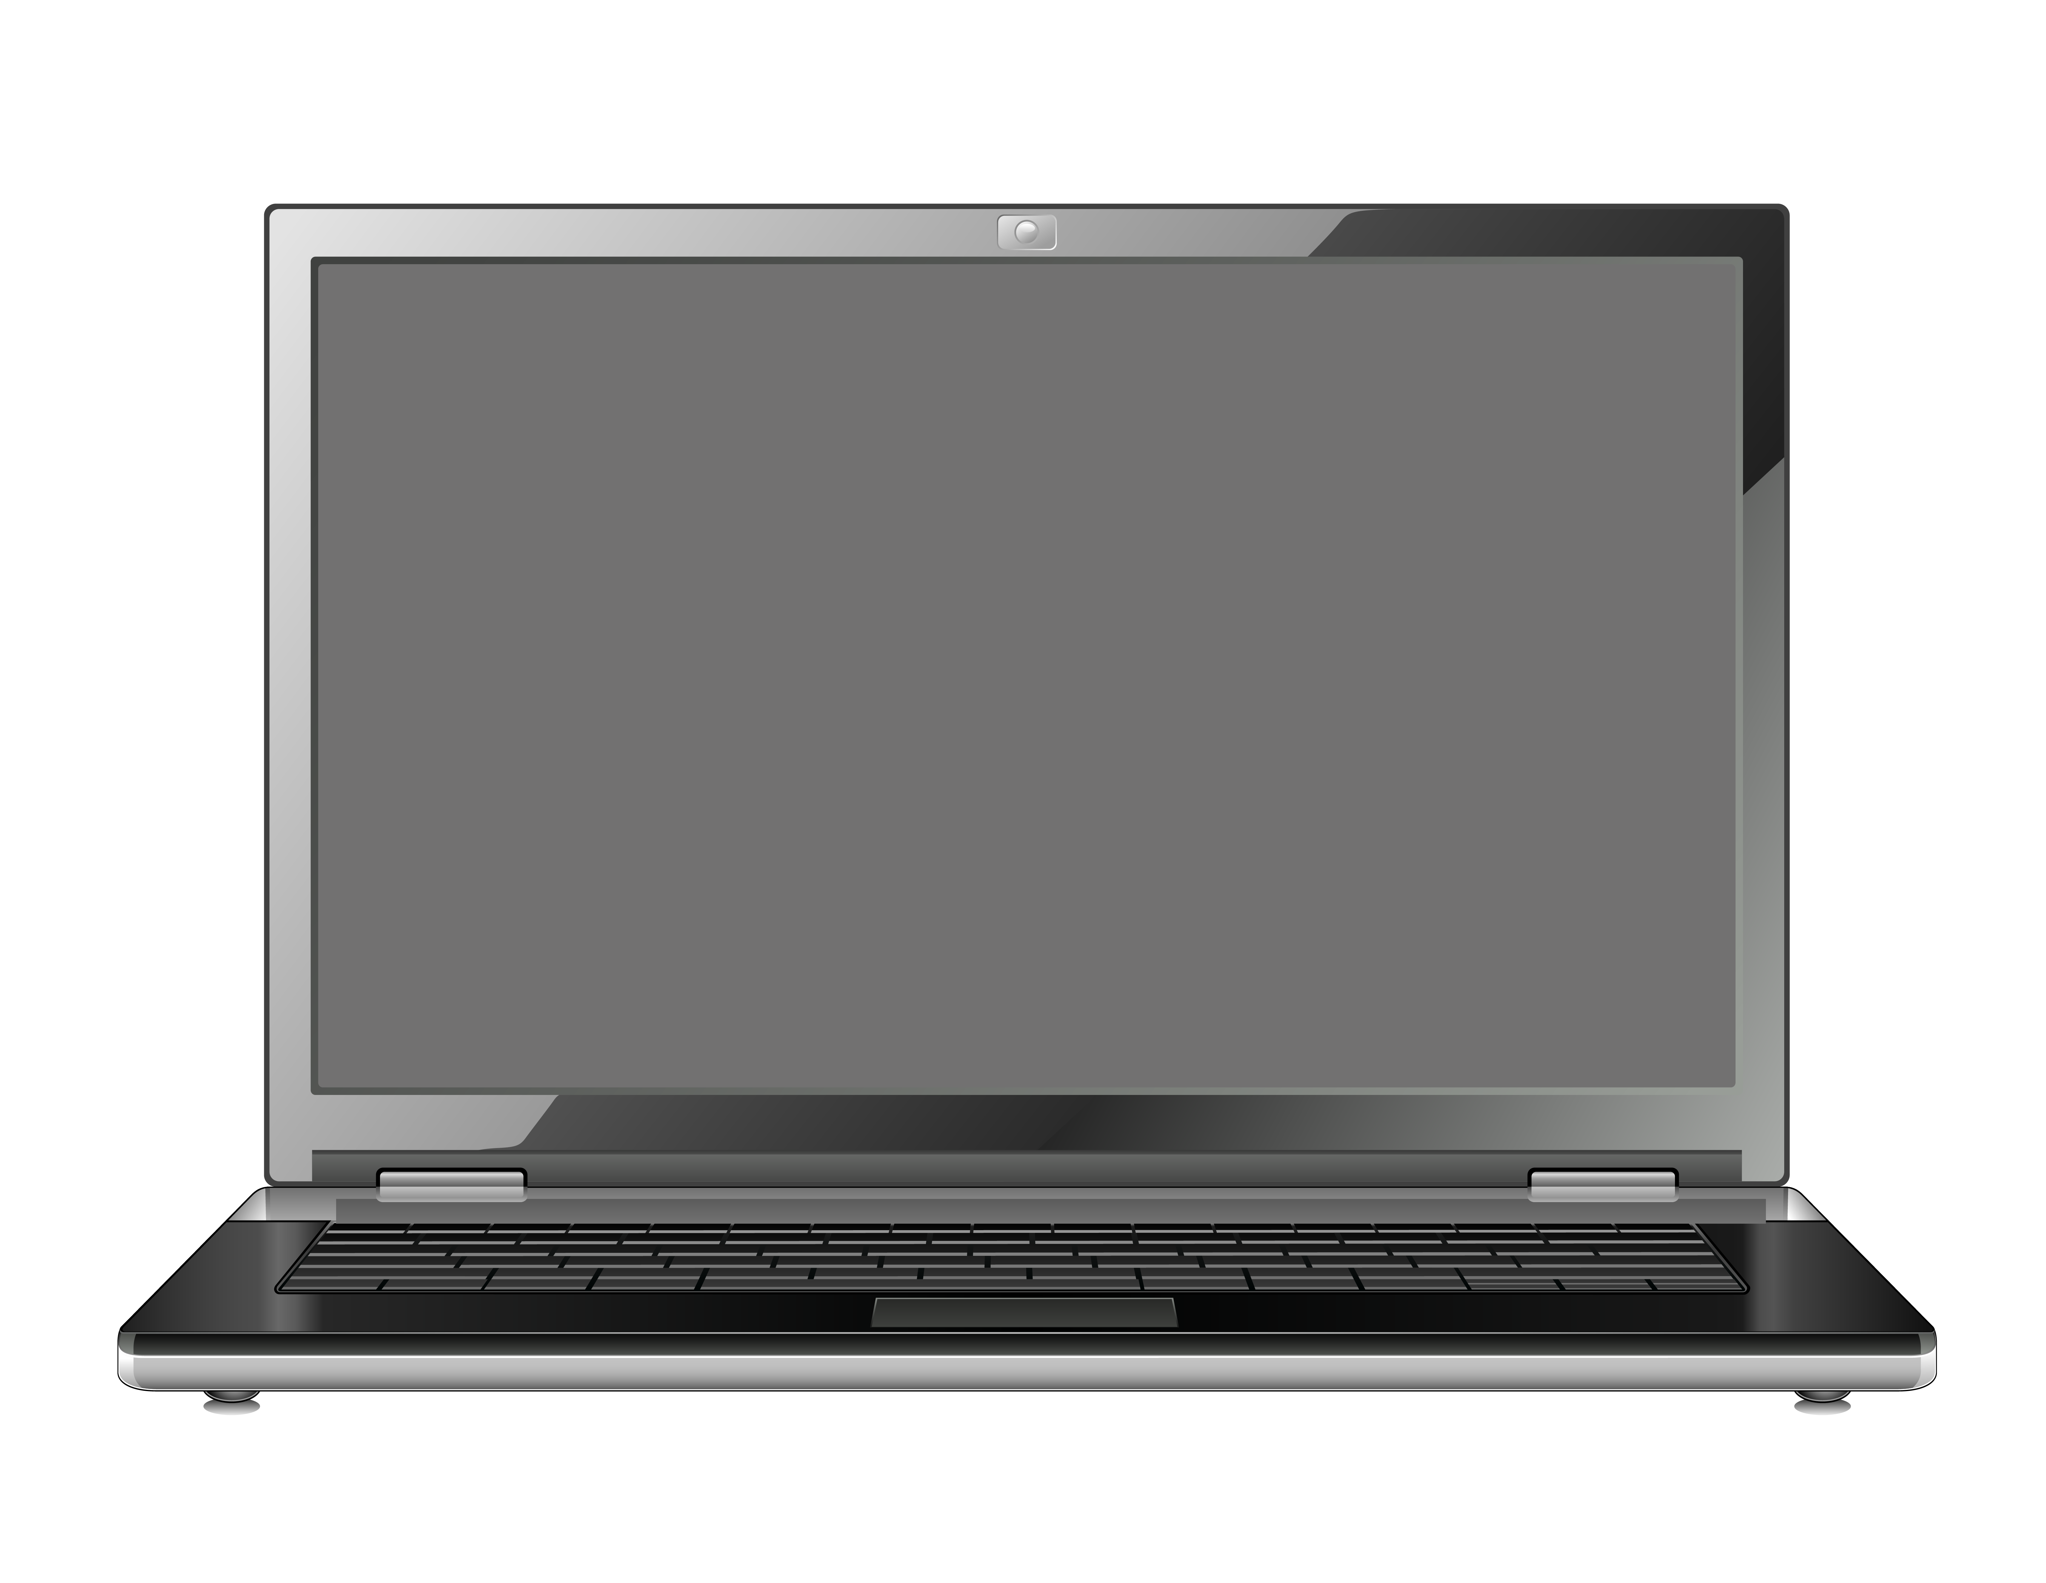



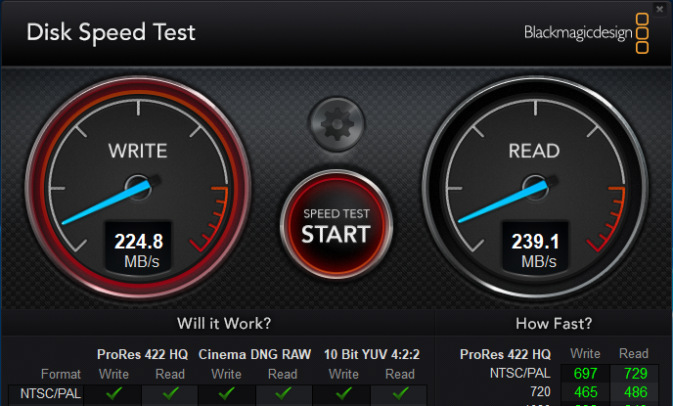
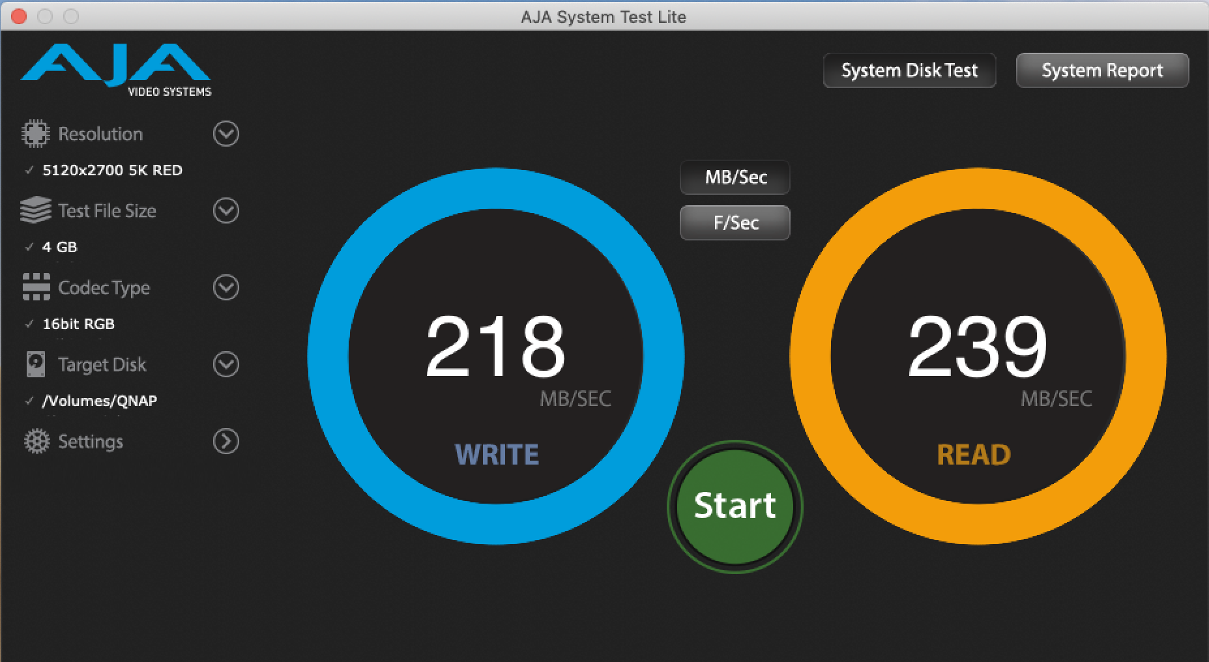
TR-004U Windows / Mac performance
Windows
Mac
Tested in QNAP Labs. Figures may vary by environment.
Test environment:
TR-004U: Volume type: RAID 5; 4 x 1TB Seagate ST1000NM0033 HDD
Client PC: 1. Intel Core i7-6700 3.4 GHz, 64 GB RAM, USB 3.0, Windows 10 home (1809), Blackmagic Desk Speed Test
2. MacBook Pro, Core i7 2.9 GHz, 16GB, macOS 10.14.3, AJA System test
Notes:
測試於 QNAP 實驗室。數據會因實際環境而有所不同。
測試環境: TR-004U: 4 x 1TB HDD (Seagate ST1000NM0033), RAID 5, NTFS/HFS+
客戶端電腦: 1. Intel Core i7-6700 3.4 GHz, 64 GB RAM, USB 3.0, Windows 10 home (1809), Blackmagic Desk Speed Test
2. MacBook Pro, Core i7 2.9 GHz, 16GB, macOS 10.14.3, AJA System test

Slide 12
TR-004U Hardware

Slide 13

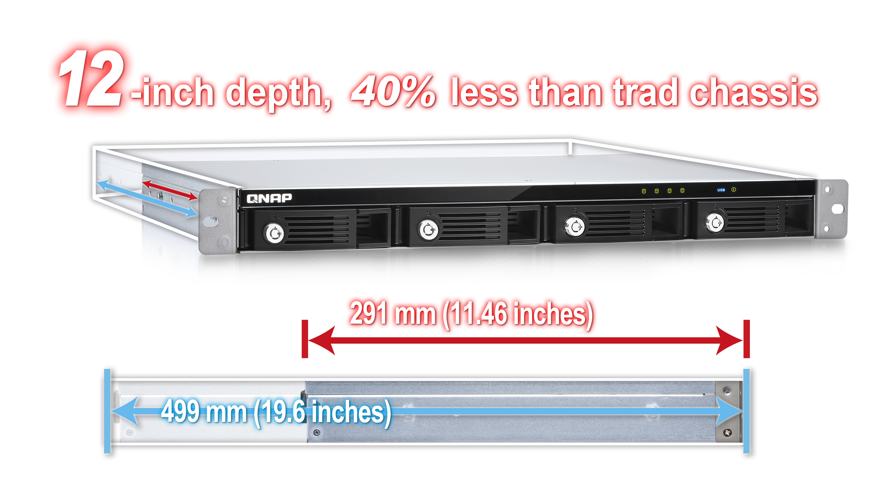
Deployable short-depth chassis TR-004U
Compatible with standard ANSI/EIA-RS-310-D
19-inch rack
With optional
RAIL-B02 Rail Kits

Slide 14
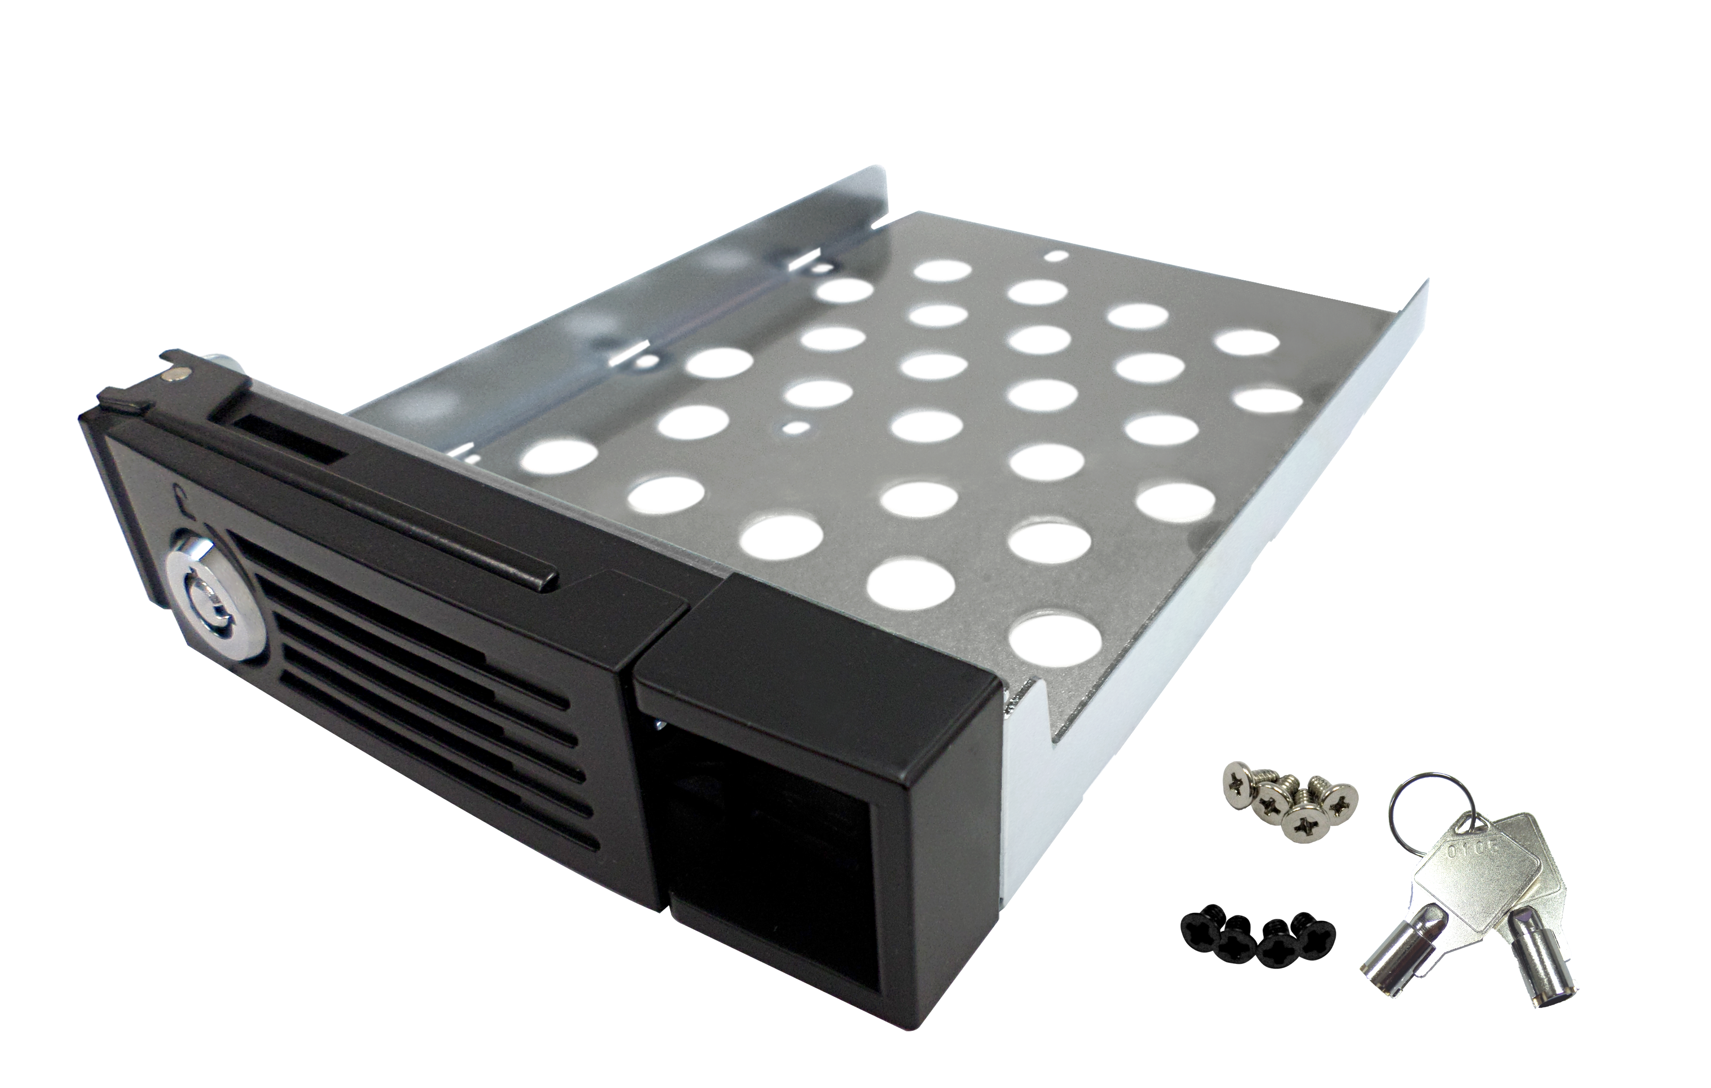

TR-004U front view
4 x 3.5”/ 2.5”SATA 3Gb/s HDD/SSD
with lockable tray design
(Compatible with SATA 6Gb/s HDD/SSD)
HDD 1~4 LEDs
USB link LED
Status LED
2 x tray keys

Slide 15



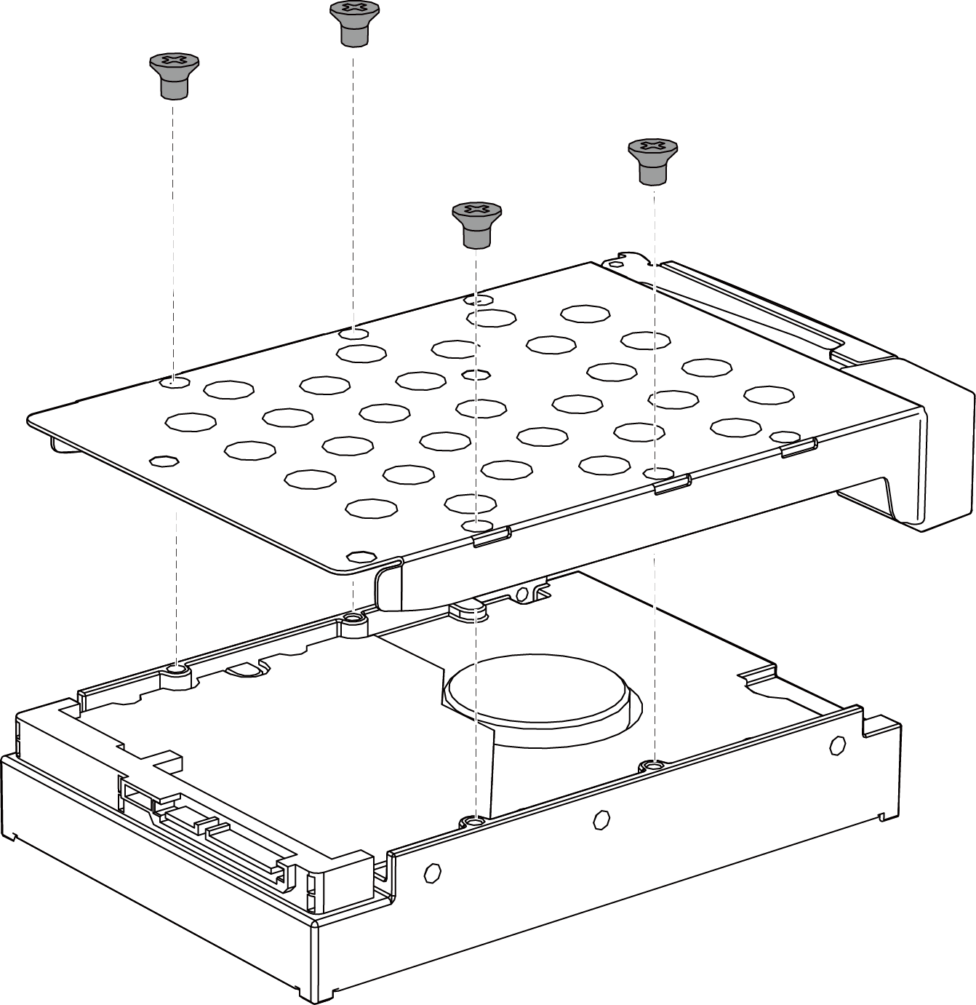
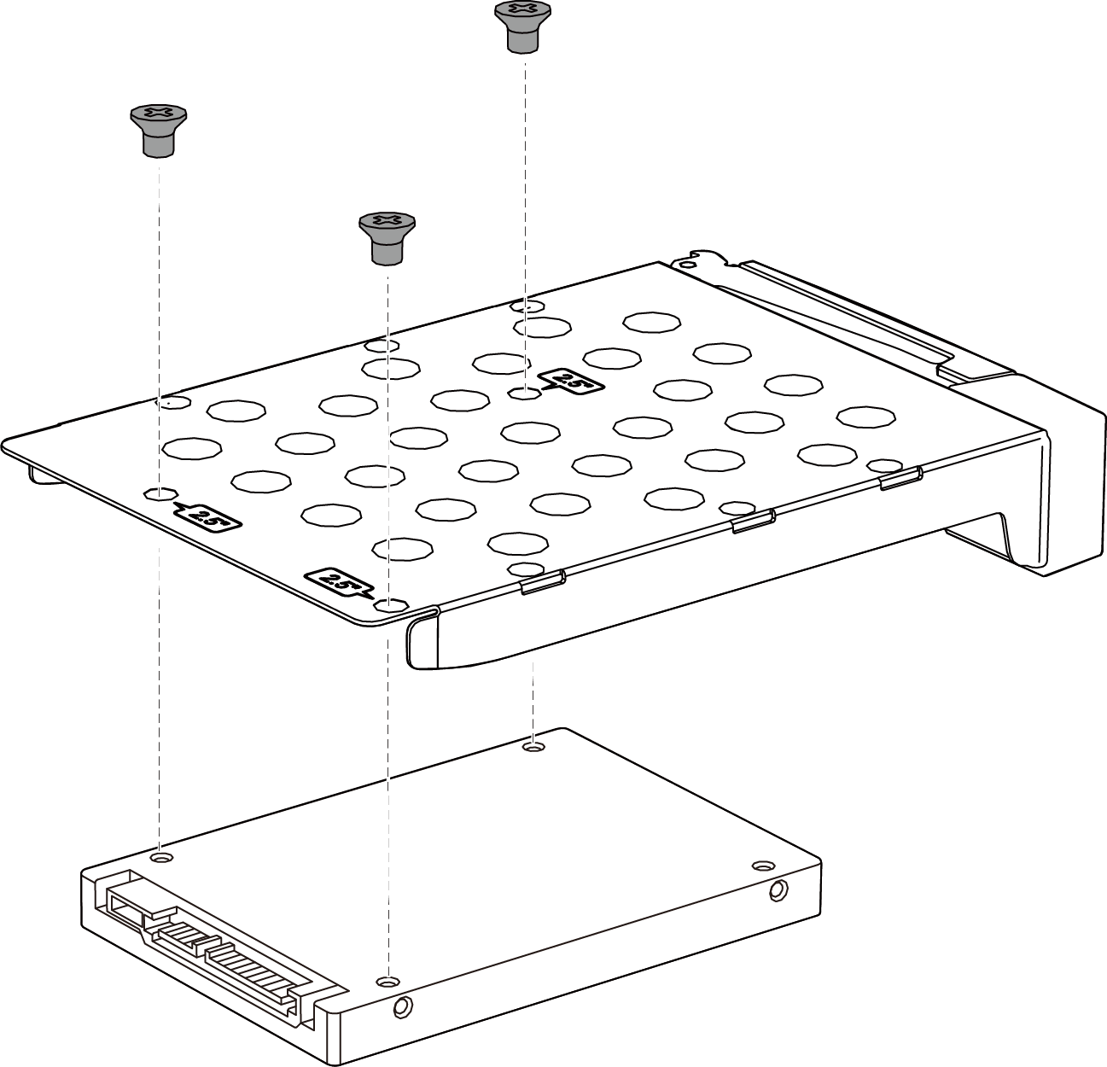
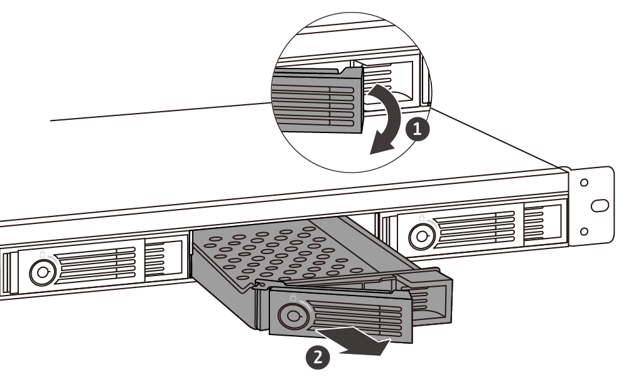
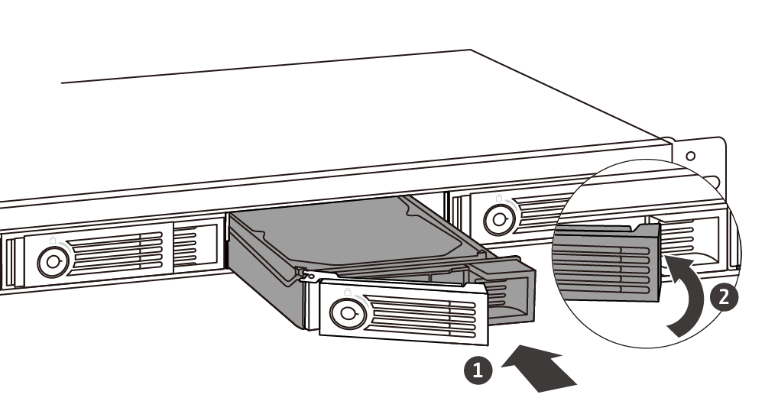
HDD/SSD installation
01
02
03
01
3.5-inch HDD
2.5-inch HDD / SSD

Slide 16
TR-004U rear view
2 x 4CM smart fan
5-speed automatic fan control based on drive and system temperatures
Disk mode DIP switch
Individual, JBOD, RAID 0/1/5/10,
Software Control (default)
SET/Confirm button
Press ‘n hold for 3 seconds until a beep and wait for about 15 seconds to switch between modes
AC 100~240V
Power input
USB 3.0
(3.1 Gen1)Type-C
For USB-C or USB-A host
USB cable clip
Self-installation with included clip
Power switch
Kensington
security slot

Slide 17
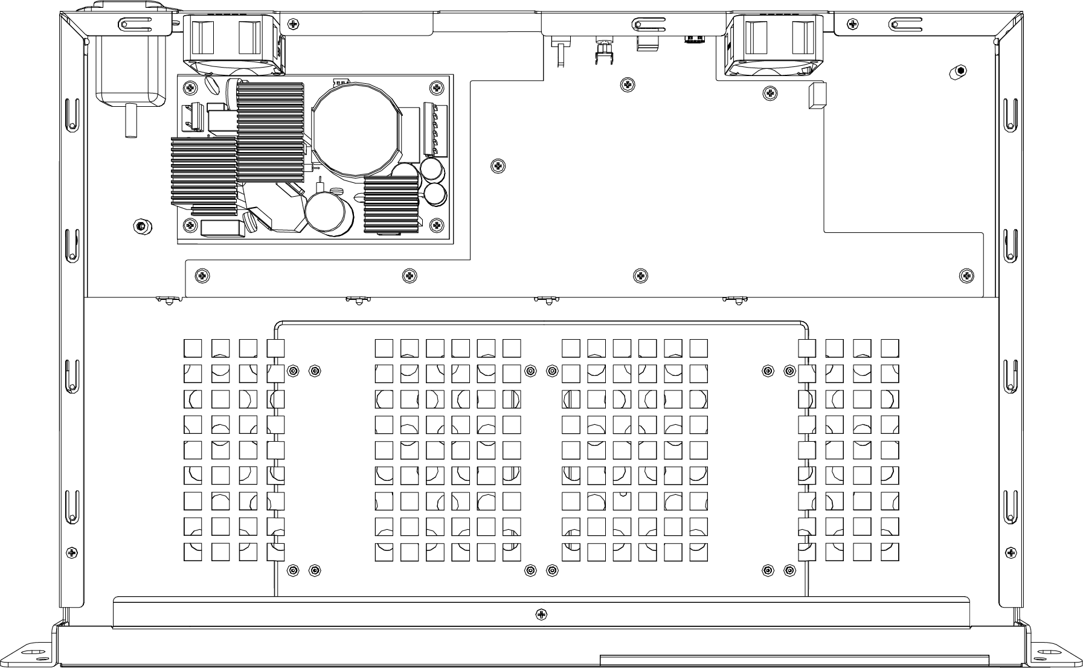
Low power consumption and lesser noise sound
Built-in 100W open frame power supply. Fanless and silent
2 x 4cm smart fan
Operating
HDD sleep
Power consumption
18.90 W
4.79 W
36.99 W *
22.43 W *
*(1U NAS reference)
23.1 dB(A)
Noise
Level
37.7 dB (A)*
*(1U NAS reference)
Power consumption test environment：4 x 1TB HDDs
Noise level test environment: 4 x 2TB HDDs. Refer to ISO 7779; Maximum HDD loaded; Bystander Position; Average data from 1 meter in front of operating NAS.
(1U NAS reference data is based on TS-431XU)

Slide 18

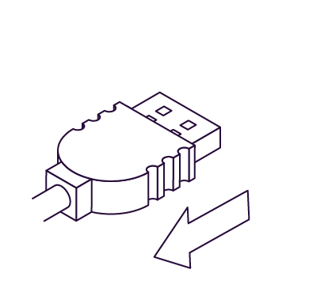
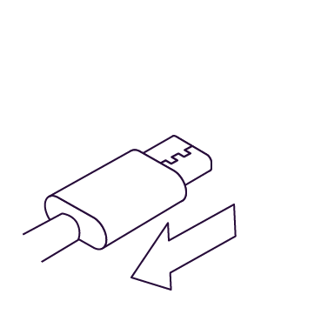
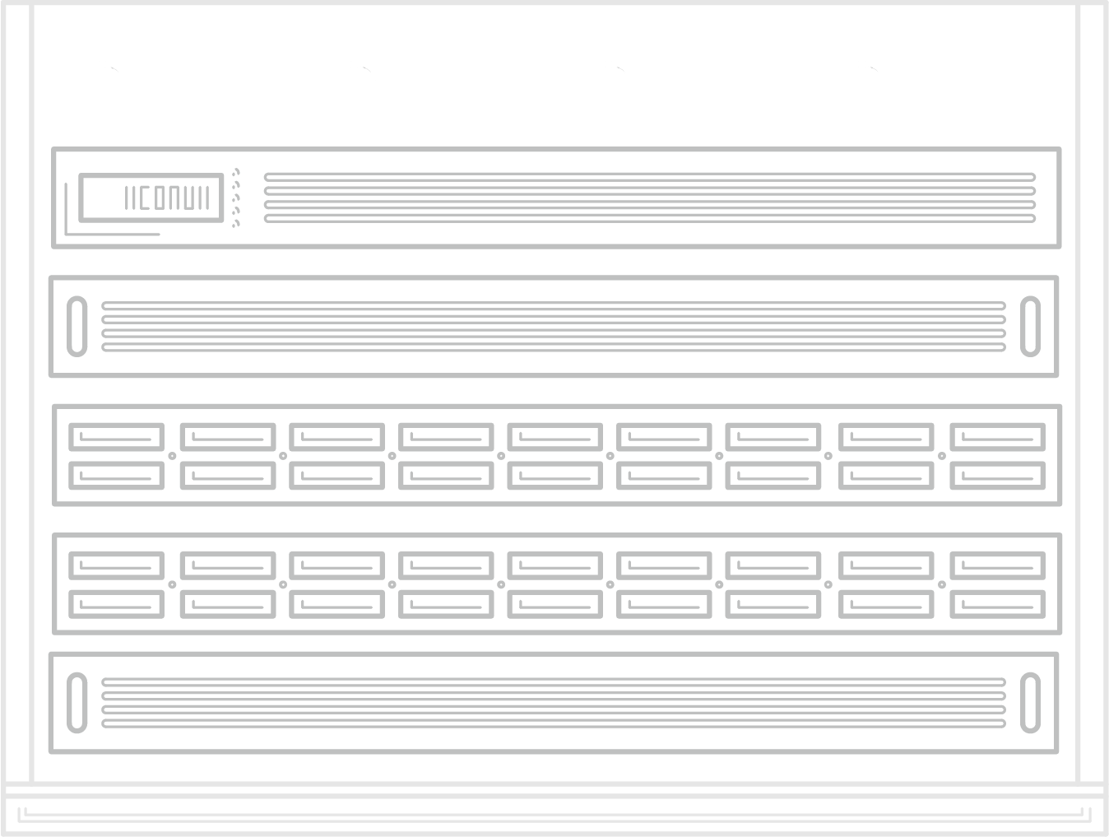


Save energy & reduce noise with sleep mode
TR-004 can enter the sleep mode with just 4.79 watts when these occur:
TR-004U
or
USB cable removal
The host enters sleep/hibernation*
*depends on host support
The host is shut down
Note: Sleep mode also pauses the RAID rebuild process.

Slide 19
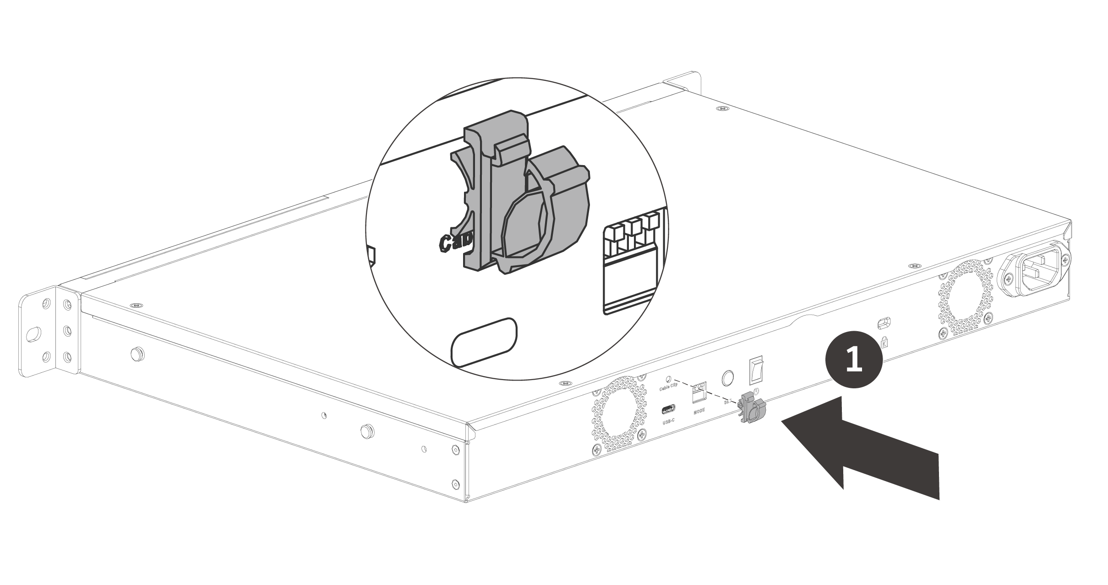
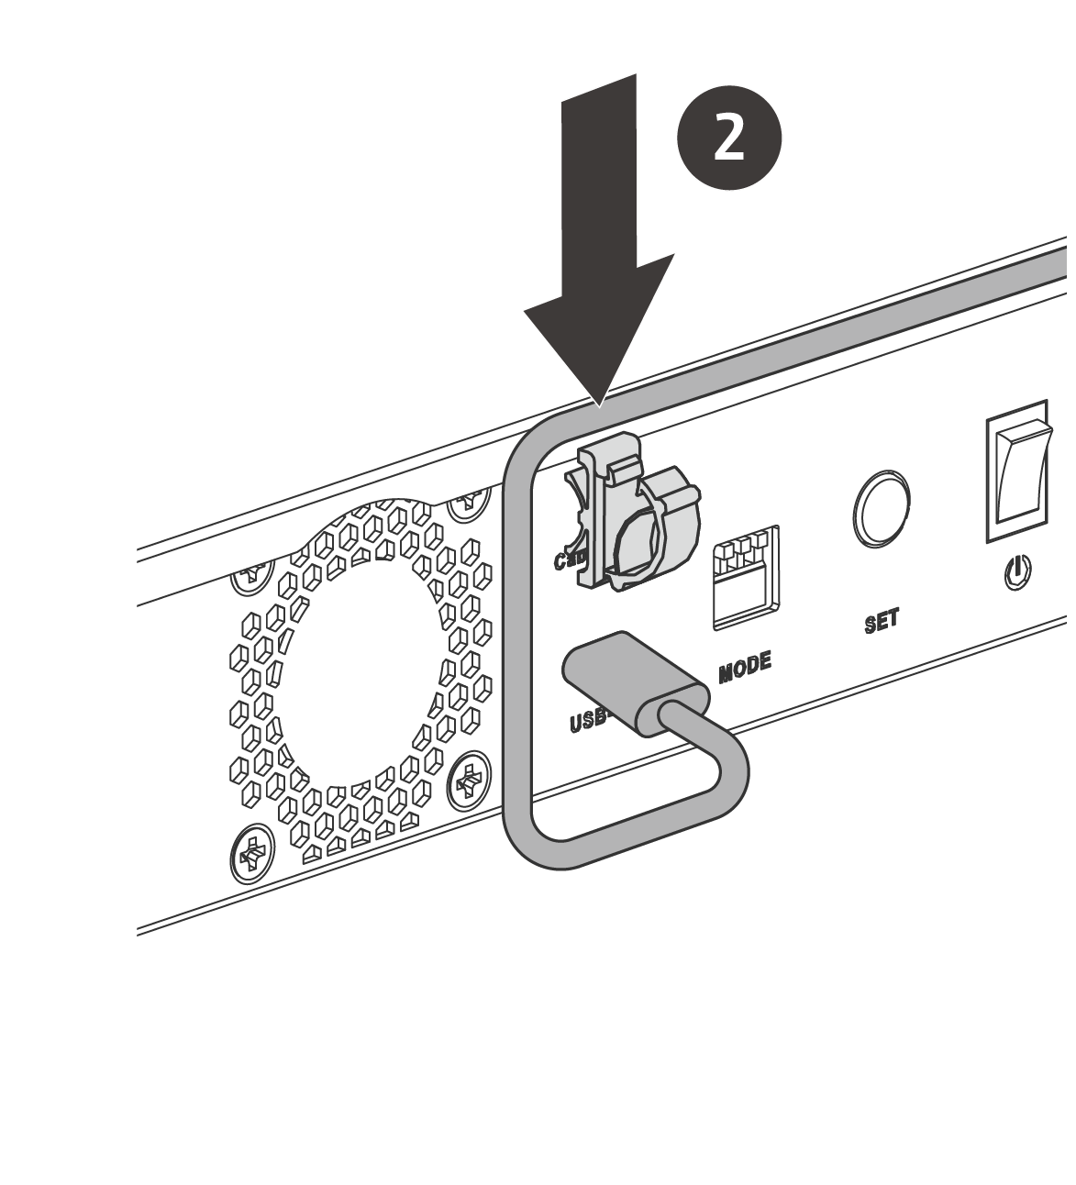
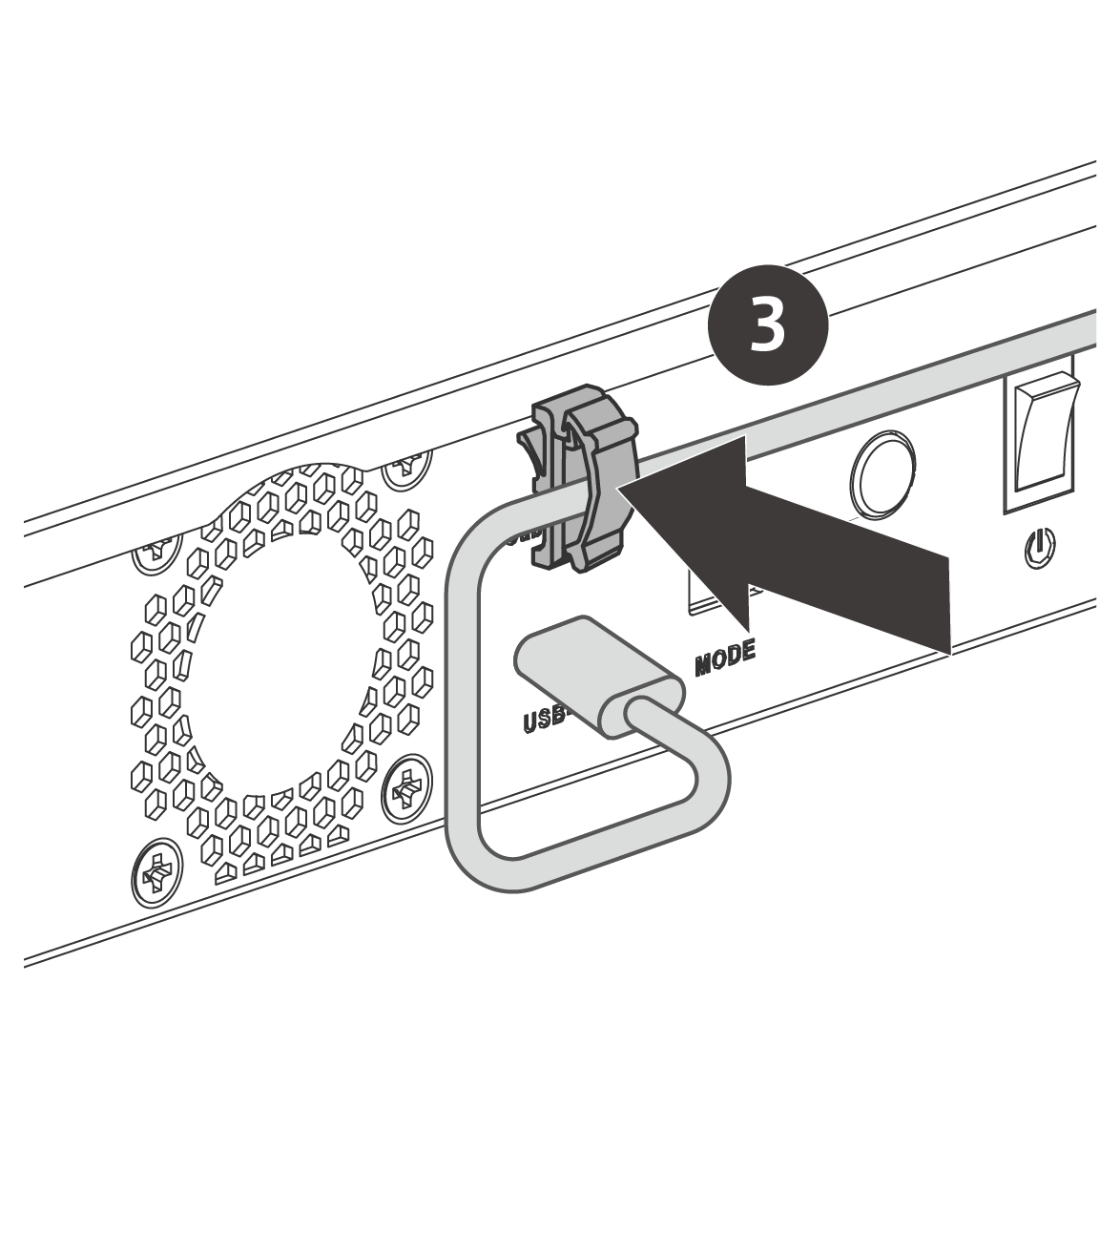
Installing the USB cable clip
01
02
03
Note: The clip is not intended to be removed after attaching it to the RAID enclosure.

Slide 20
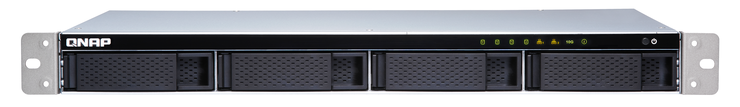
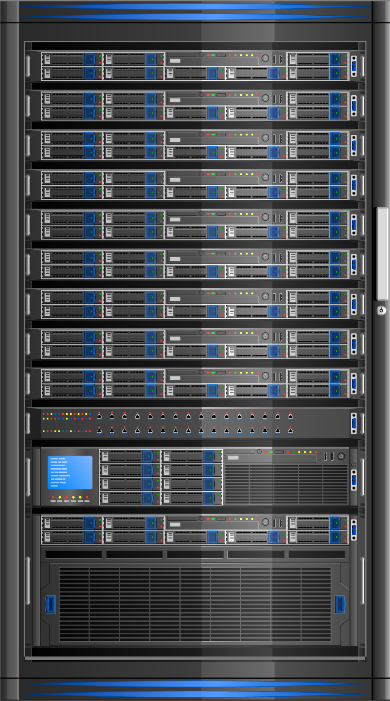
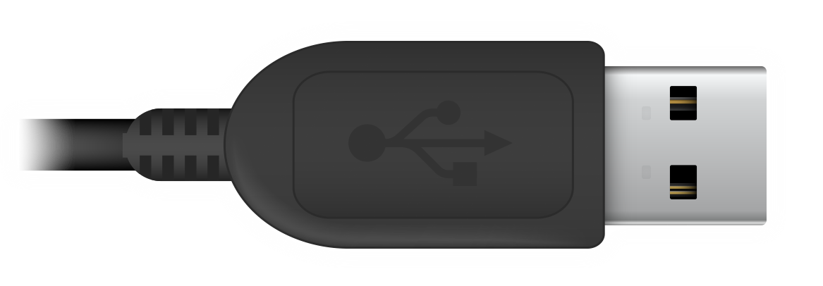
USB Type-C supporting more host types
TS-431XeU
1-meter (3-foot) USB 3.0 C to A cable included
Windows PC
TR-004U
Optional USB-C to USB-C
cable for USB-C host
MacBook Pro

Slide 21



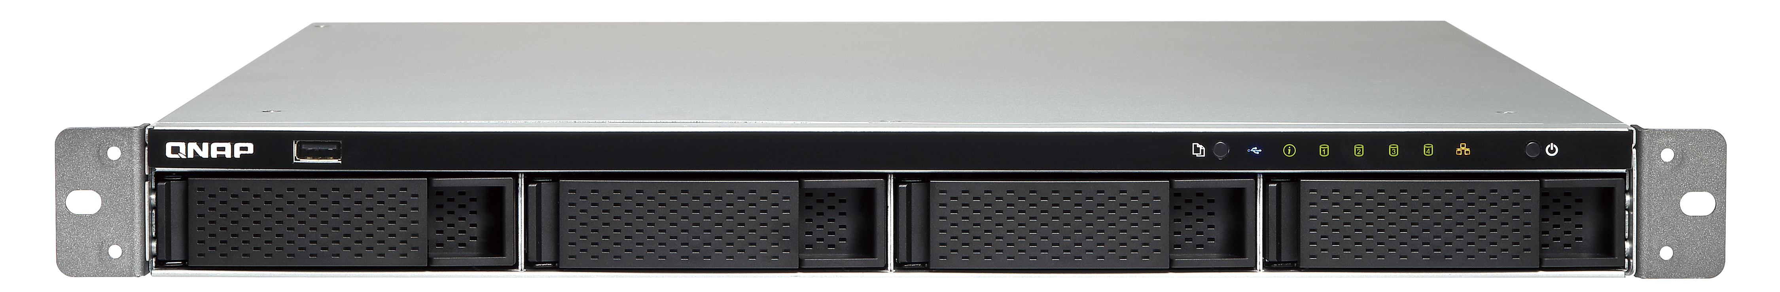
Backward compatible with USB 2.0 port
TR-004U can be used via a USB 2.0 port on NAS or computers!
TS-463XU
Windows PC
TR-004U

Slide 22







Switching between modes (with DIP switch)
Individual
JBOD
RAID 0
● Any number of drives
● Each drive capacity separated
● Minimum two drives
● Combined capacity but no fault tolerance
● Minimum two drives
● Combined capacity, best performance
but no fault tolerance
Unplugging any drive resulting in USB reconnection.
Software Control
(Factory default)
RAID 1/10
RAID 5
● Minimum two drives
● RAID 1: (2 drives)
Losing 1-drive capacity
for redundancy
RAID 10: (4 drives)
Losing 2-drive capacity
(1 for each group) for redundancy
● Minimum 3 drives
● Losing 1-drive capacity for redundancy,
enhanced performance
● Any number of drives
● Allows QTS & Windows/macOS
utility to control the configuration

Slide 23





Switching disk modes from factory default
Change mode with the DIP switch
To change the disk mode with QTS/the utility, the switch needs to remain in the Software Control mode.
Press and hold the “SET” button for 3 seconds until a beep and wait for about 15 seconds to switch the mode*
*All data on drive(s) will be erased
The factory default mode is Software Control
Software Ctrl
(Factory default)
MODE
Individual | JBOD | RAID 0/1/5/10

Slide 24




Switching between modes (with DIP switch)
In any mode other than the “Individual” mode (Factory default is Software Control)
Change the dip switch mode to the “Individual” mode
Press ‘n hold the “SET” button for 3 seconds until a beep to switch the mode to individual (reset)*
*All data on drive(s) will be erased
Change the dip switch mode to any other mode
Press and hold the “SET” button for 3 seconds until a beep to switch the mode*
*All data on drive(s) will be erased
MODE
Individual
MODE
To change the disk mode with QTS/the utility, the switch needs to remain in the Software Control mode.

Slide 25
Using TR-004U on a personal computer
With Windows/macOS utility QNAP External RAID Manager

Slide 26
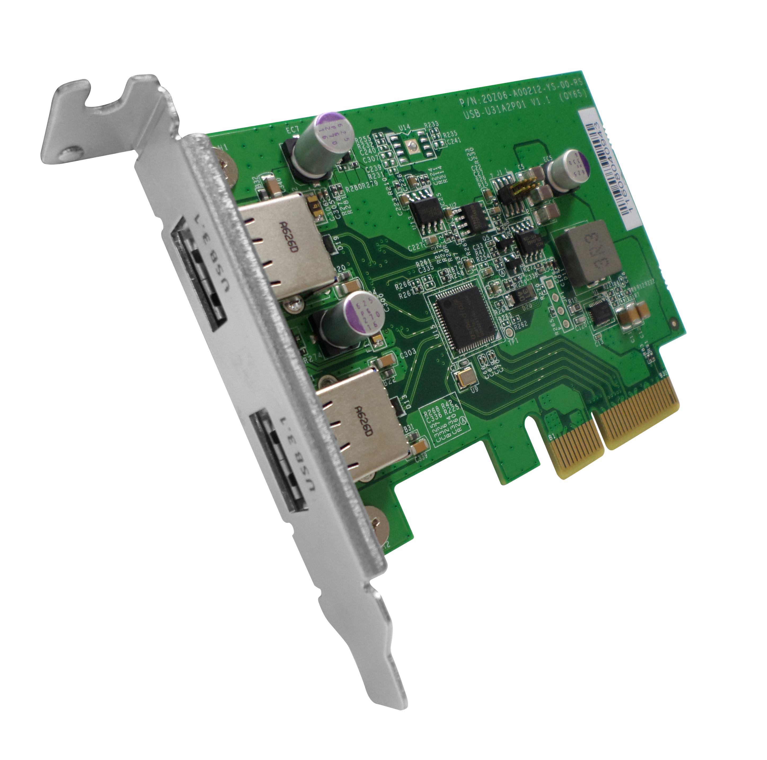
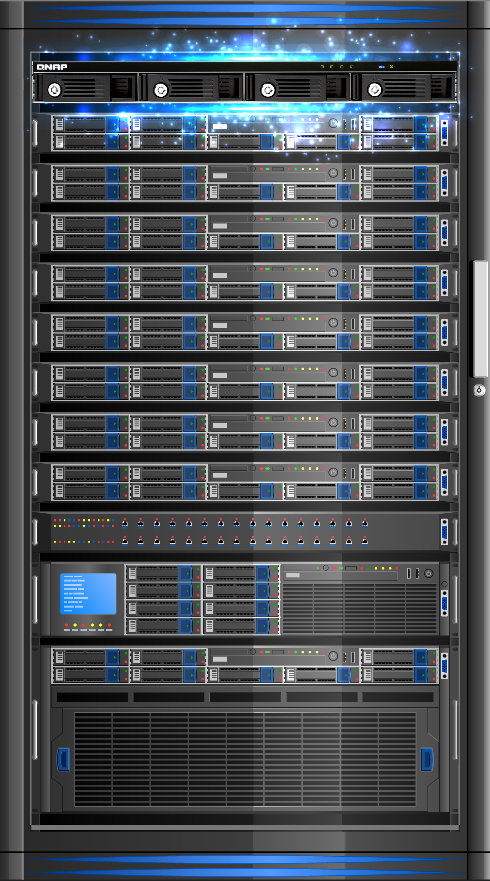
Add dual USB 3.1 Gen2 ports to PC & NAS
Dual-port USB 3.1 Gen2 PCIe adapter for dual USB devices up to 10Gbps, allowing you to transfer large data more quickly.
Ordering P/N:
USB-U31A2P01
2 x USB 3.1 Gen2 Type-A
PCIe Gen2 x2
Includes brackets for all NAS models and PC
TR-004U
Windows Server

Slide 27
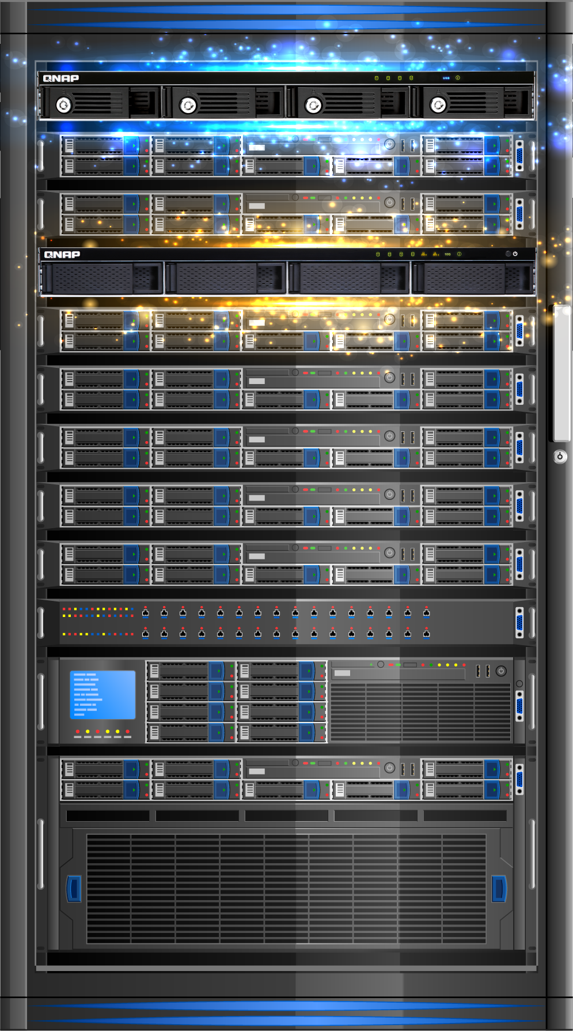
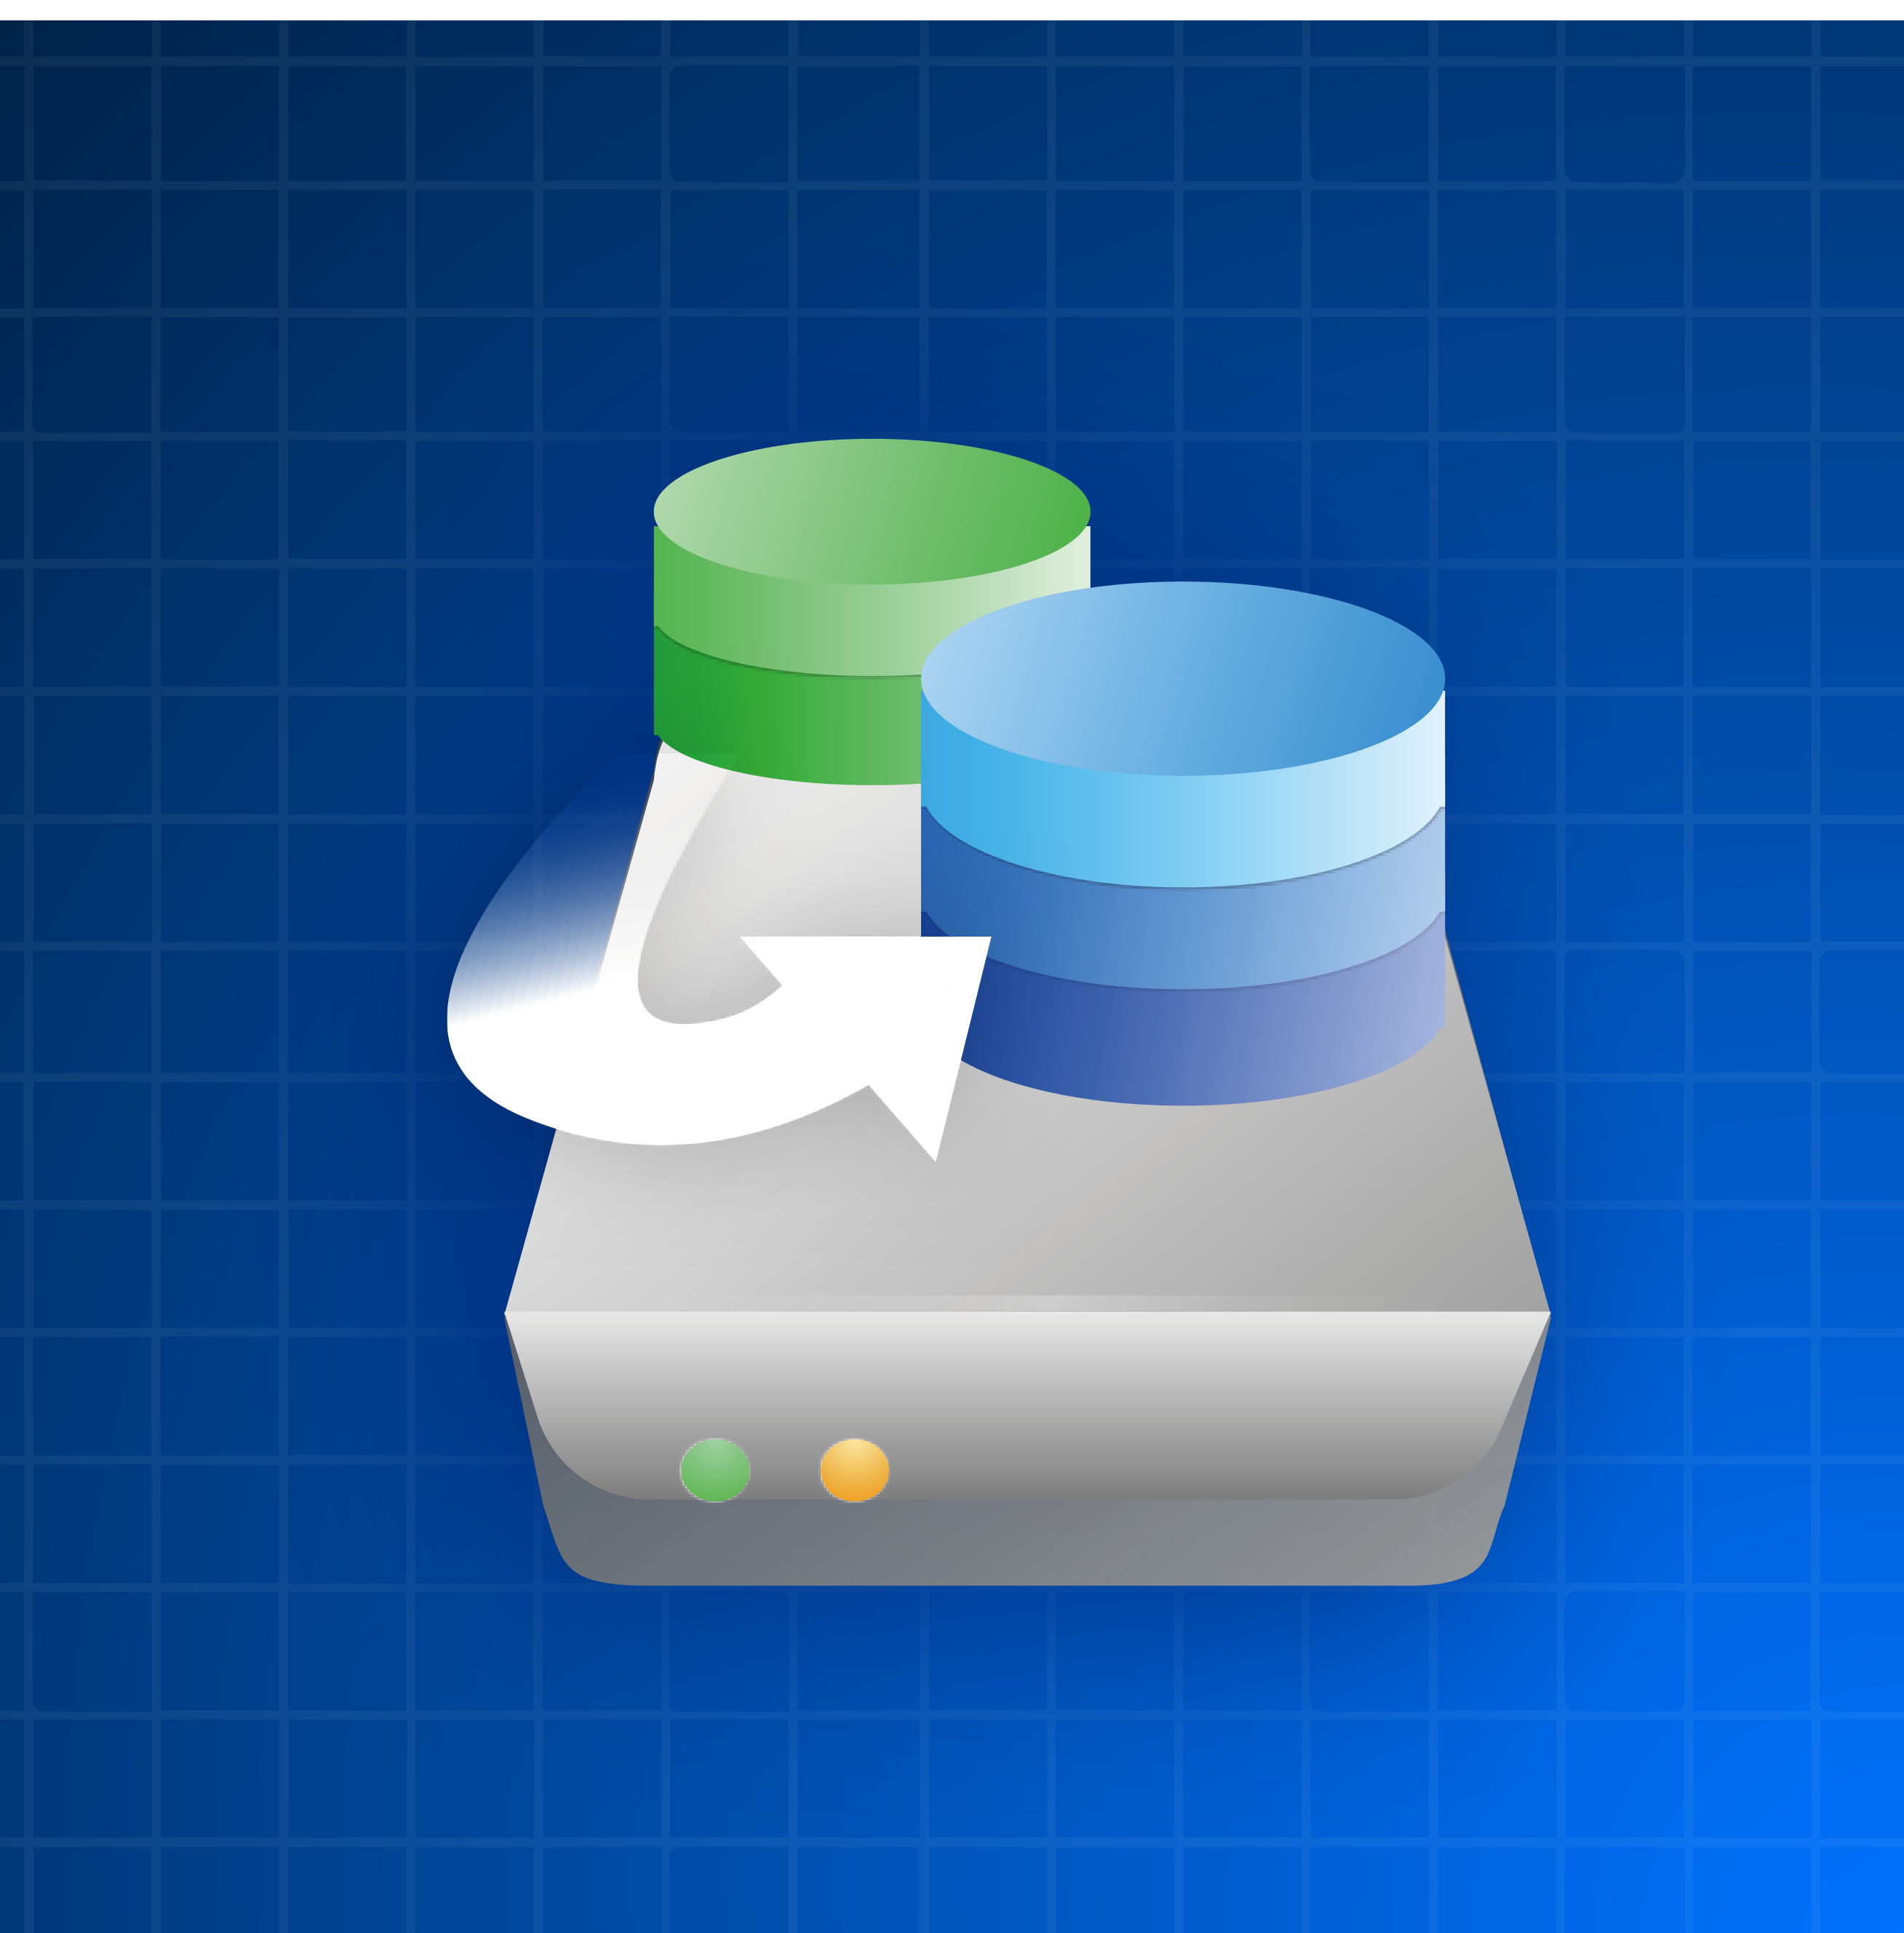
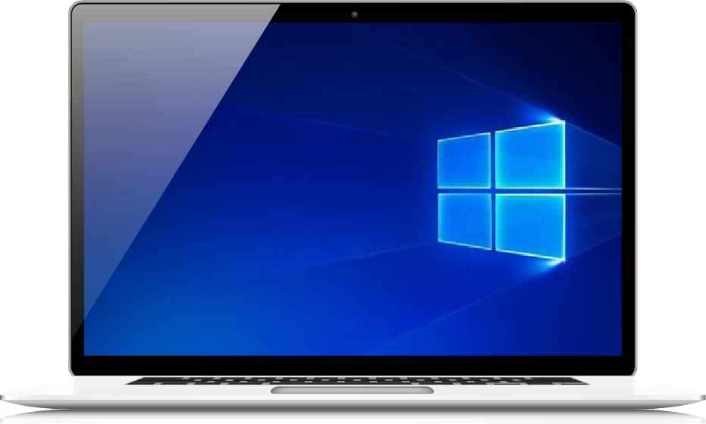
Configure your TR-004U on Windows/macOS -
QNAP External RAID Manager
Supported platforms and OS version
Windows: Windows 7 (or later),
Windows Server 2012 R2 (or later)
Mac: macOS 10.13 (or later)
TR-004U
TS-431XeU
With TR-004U, you can create a disk array by the hardware DIP switch or the QNAP External RAID Manager utility on your PC/Mac.
Monitor TR-004U, RAID and disk status with this utility
Mac/
Windows

Slide 28

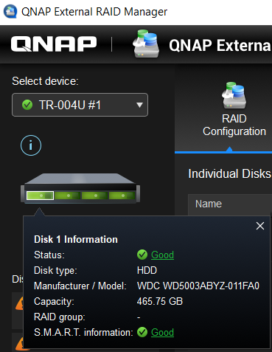
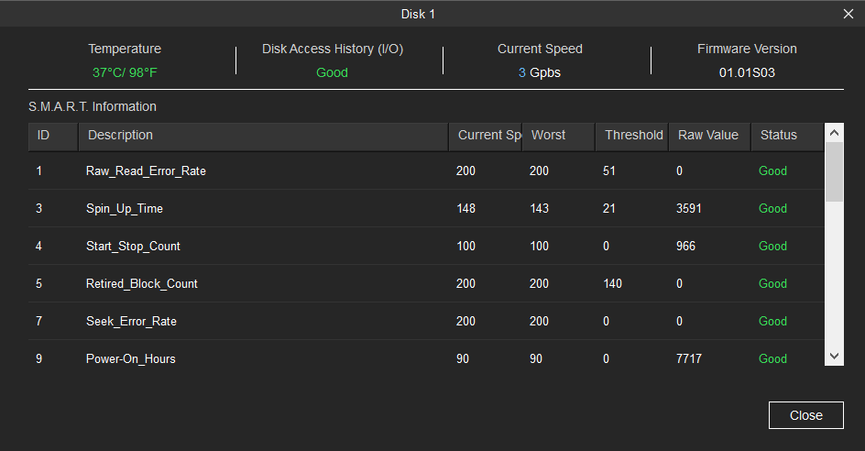
Monitor disk health
Quick overview
Check information
The disk color on the TR device shows disk's status. Click on any of them to check the disk information
Show all disks in "Disk Information". Click status to get the details of disk's S.M.A.R.T information.

Slide 29
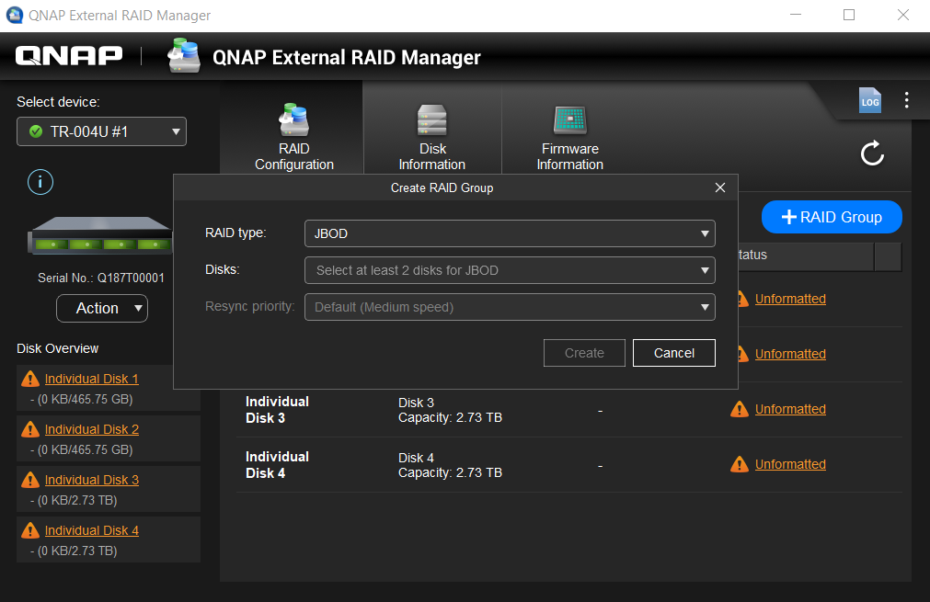

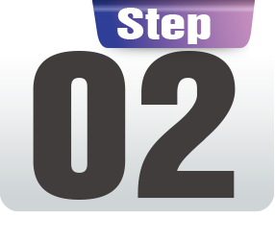
Creating RAID group in two steps
Various RAID types for users to create, multiple RAID are also available in QNAP External RAID Manager
Intuitive settings: create RAID group in just two steps
In "RAID Configuration" page,
click "+RAID Group" to start
Choose RAID type, disks you want to use, and resync priority
RAID types:
JBOD, RAID 0, RAID 1, RAID 5, RAID 10
Disks
Resync priority:
Service First, Default, Resync First

Slide 30
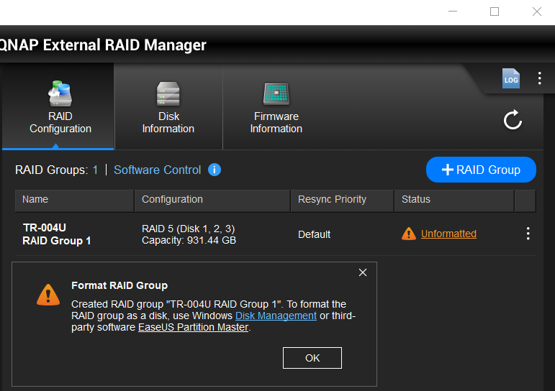
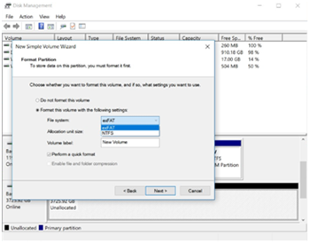
Format RAID group
Once the RAID is set up, format the RAID to begin storing files to the disk
Choosing exFAT file system allows your files to be exchanged between Windows, Mac & NAS without problem!
Direct to operating system
interface for formatting
Windows: Disk Management
Mac: Disk Utility
Note: to use TR-004U in exFAT format with QNAP NAS, optional exFAT license is required.

Slide 31
How to choose the TR-004U file system?
File system support status on different platforms:
File System | QNAP QTS | Windows | macOS | Linux
exFAT | V (License needed) | V | V | V (Manually install needed)
NTFS | V | V | V (Read-only) | V
APFS | - | - | V | -
HFS+ | V | - | V | -
EXT4 | V | - | - | V
FAT32 | V (4GB file limitation) | V (4GB file limitation) | V (4GB file limitation) | V (4GB file limitation)
*It is possible for an OS to install third party software to recognize unsupported file systems

Slide 32

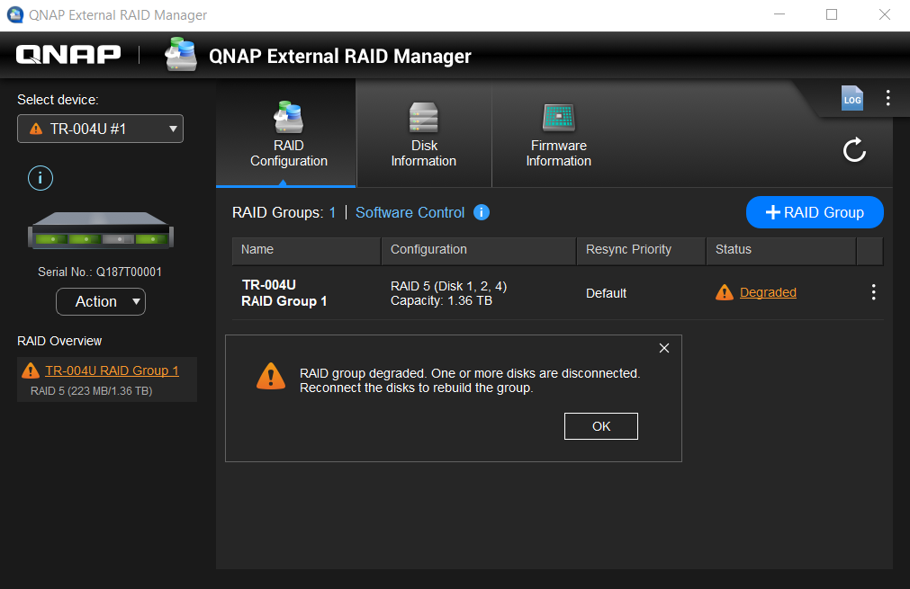

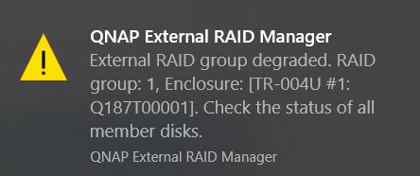
Instant notification when RAID is abnormal
When RAID is degraded or hasfailed, users will be notified by the UI, with desktop notification and with device beep.
TR-004U

Slide 33
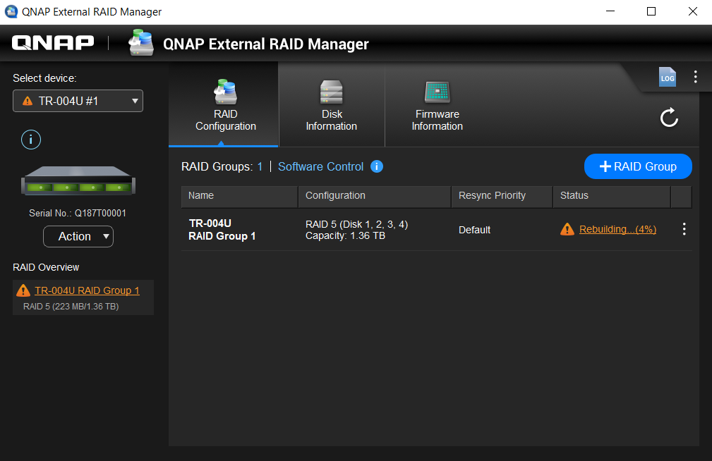

RAID protection mechanism with system events logs
Same as NAS, when RAID is degraded, insert new disk to start rebuilding and rebuild progress is shown
Logs are independent from the operating system, quickly know and export events

Slide 34




Notification for new version of firmware and utility
Check utility and firmware versions
When there is a new version, pop-up notifications will inform users

Slide 35






Flexibly expand server storage capacity
Scenario 1
TR-004U can be used as a small server's expansion and backup space
When connected to the computer, it can expand the available space by using external RAID with QNAP External RAID Manager, or using the backup application in server to backup files to TR-004U
As a storage expansion to save files
As a backup location for server’s data

Slide 36
Use External RAID Manager on Windows

Slide 37


Advantages of QNAP External RAID Manager
Intuitive and easy
System events for troubleshooting
Creating RAID group in two steps
Record all device events and find out the information by filter or typing the keyword
Overview device, disk and RAID information and status
Export to .csv file
Instant notification, quick control
RAID rebuild, data protection
Desktop notification to inform abnormal status.
When RAID is degraded, insert new disk to rebuild RAID
Notification for new firmware and application version updates.
Show the progress percentage of rebuilding

Slide 38
Using TR Series
On a QNAP NAS
Use QTS Storage & Snapshot
• Format External Storage Space
• Create Storage Pool

Slide 39





Official external RAID device provide better protection
When using third party external RAID device to expand NAS, the disk health cannot be monitored.
Disks can be monitored in Storage & Snapshot for the best protection.
Functions:​
- QTS Disk monitoring​
- External RAID monitoring​
- Disk S.M.A.R.T. ​
- Customized temperature alert​
- Notification Center​
​
​

Slide 40


Create a Storage Pool with TR series
3 steps
The TR External RAID Configuration Wizard allows you to expand NAS storage space in 3 steps
01
Storage & Snapshot >
Go to External RAID Wizard
02
Follow the wizard to create
an external RAID
03
Select to create a storage
pool or use as external storage
When configuring the external RAID type with QTS, the hardware DIP switch needs to be switched to software control first.

Slide 41

Manage External RAID on the NAS
With QTS integration, an independent management interface for the external RAID devices.
- Monitor external RAID status
- Delete external RAID group
- Update external RAID device
firmware.
An external RAID can only be removed when its associated storage pool and volume are removed.

Slide 42




Affordable snapshot backup solution
Scenario
The QNAP TR-004U can be used to create storage pool.
With the storage pool, the TR-004U besides supporting the application in QTS, it can be further used as a backup destination for the host.
TR-004U
TS-863XU

Slide 43



Continue to use the replaced disks
Scenario
HDD Capacity is continuing to grow each year.
The QNAP NAS supports "Replace Disk One by One" to retire smaller disk and expand the NAS capacity.
The replaced disk can still be used to expand NAS capacity with TR-004U!

Slide 44
Connect a TR-004U to NAS

Slide 45
Use TR-004U to expand NAS capacity
Function | QNAP TR-004U | Other external RAID
Connectivity​ | USB3.0 | Varies by device
Number of bays​ | 4​ | Varies by device
Supported O.S.​ | QNAP QTS, Windows, Mac, Linux etc...​ | QNAP QTS, Windows, Mac, Linux etc
QTS Heath Monitoring​ | Yes​ | No
Hardware RAID​ | Yes​ | Yes​
Create storage pool​ | Yes​ | No​
RAID Migration, Capacity expansion | No​ | Varies

Slide 46


2-bay and 4-bay hardware RAID units
TR USB RAID
 | TR-002 | TR-004 | TR-004U
Drive | 2 x 3.5”/ 2.5” SATA 6 Gb/s | 4 x 3.5”/ 2.5” SATA 3 Gb/s
USB | USB 3.1 Gen 2 Type-C | USB 3.0 Type-C
RAID 0 | Supported
RAID 1 | Supported
RAID 5 | --- | Supported
RAID 10 | --- | Supported
JBOD | Supported
Software control | Supported
Utility | Windows & macOS External RAID Manager
Not supporting migrating the drives on NAS or QDA-A2AR/QDA-A2MAR to the TR units and keep the data.

Slide 47
TR-004U
4-bay 1U USB 3.0 External RAID Enclosure
Copyright © 2019 QNAP Systems, Inc. All rights reserved. QNAP® and other names of QNAP Products are proprietary marks or registered trademarks of QNAP Systems, Inc. Other products and company names mentioned herein are trademarks of their respective holders.

