Slide 2
Find a suitable platform: Linux Station transforms NAS into personal Ubuntu computer
Advantages of Linux Station
Application sharing & Demo

Slide 3
Which platform is suitable for me?
Container Station
What are the differences? Which one to use?
HD Station
Virtualization Station
Linux Station

Slide 4
What do you need for your applications?
Choose platform per application requests.
Just to simply manage QTS and some applications?
Development jobs are highly correlated with Kernel versions?
Need to manage Ubuntu and QTS simultaneously?
Quickly deploy multiple applications?

Slide 5
Features of each platform
Choose between different LTS Ubuntu versions and Install full Ubuntu system in one click without any parameter settings. Remote desktop and audio streaming with abundance applications are ready right after installation.
Easy desktop operation with one-click installation of multiple application level QTS management, such as File Station HD and Photo Station HD. Provide browser (ex, Chrome), communication kits (ex,Skype), file tool (ex, LibreOffice) and quick installation of multimedia kits (ex, OceanKTV).
Supports on mid to high end NAS. Suitable for developments that requires certain kernel version, snapshot functions, system restore, user authorization management or independent hardware resource.
Supports almost all x86, armhf and arm64 NAS. Let you deploy mass amount of applications in seconds. This application is the most suitable platform for AI related training by combining NAS large storage with graphic cards resources on container.
Linux Station
HD Station
Virtualization Station
Container Station

Slide 6
Difficulty and flexibility comparison
Technical knowledge
Container Station
Virtualization Station
Linux Station
Flexibility
HD Station

Slide 7
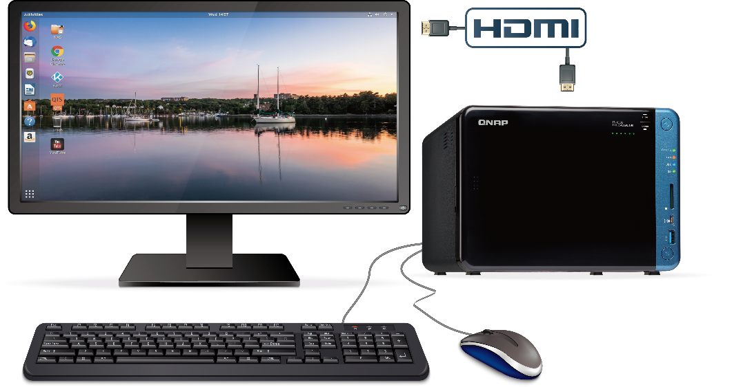
Transform the NAS into a personal Ubuntu computer
NAS becomes a host computer
Use Ubuntu OS on NAS

Slide 8
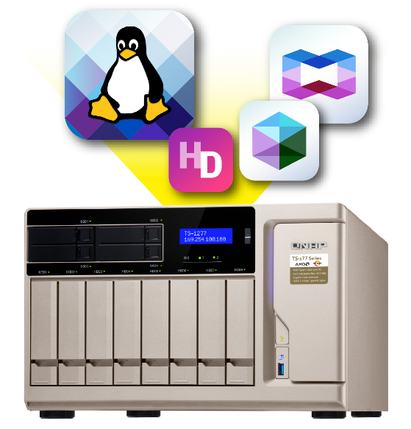
QNAP is the only NAS provider to integrate Ubuntu
QNAP cooperates with Ubuntu to provide Linux Station that allows installing the Ubuntu OS on NAS in just one click.
Enjoy all four platforms: HD Station, Linux Station, Container Station and Virtualization Station in one NAS.

Slide 9
Advantages of Linux Station
QTS & Ubuntu dual system
Install multiple Ubuntu versions in one click
QTS App Center and Ubuntu Software Center
Manage Ubuntu settings through Linux Station
Remote desktop and remote desktop streaming
Read data from and write data to blu-ray device via Ubuntu
External graphic card support for HDMI display and file processing

Slide 10
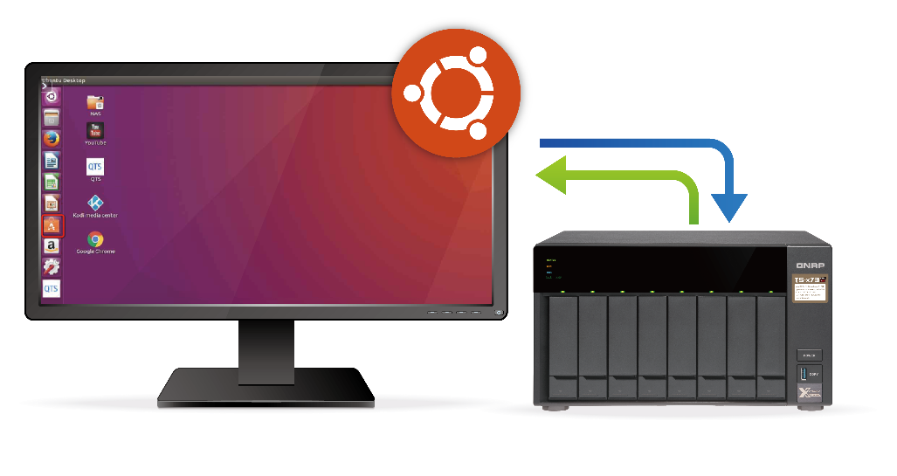
QTS & Ubuntu Dual System
Use Linux system for programming and store your code on NAS.
Data is transferred through internal network. Quick data access and storing.
Best environment for development and data storage.
Data security.

Slide 11
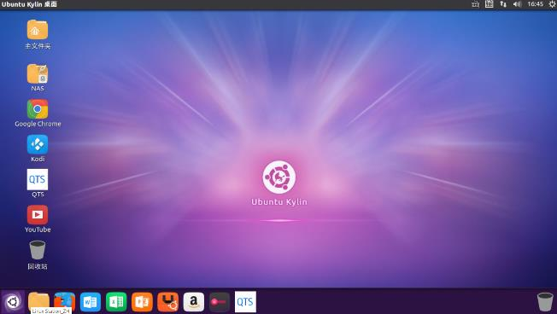
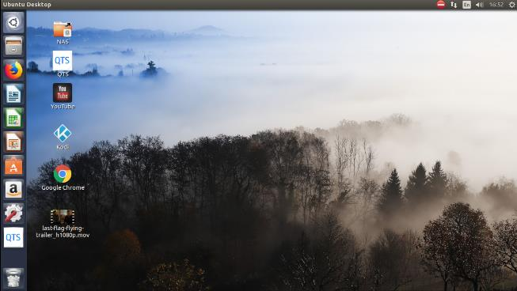
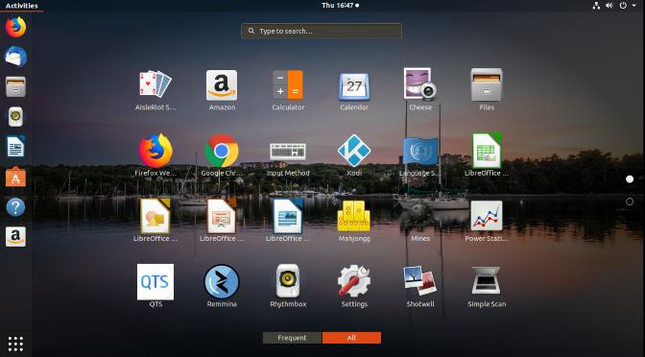
Install Multiple Ubuntu versions in one click
Ubuntu 16.04 LTS
Ubuntu 18.04 LTS
Special support for Ubuntu Kylin (Chinese version)
* Only one version of Ubuntu can be enabled at a time.

Slide 12
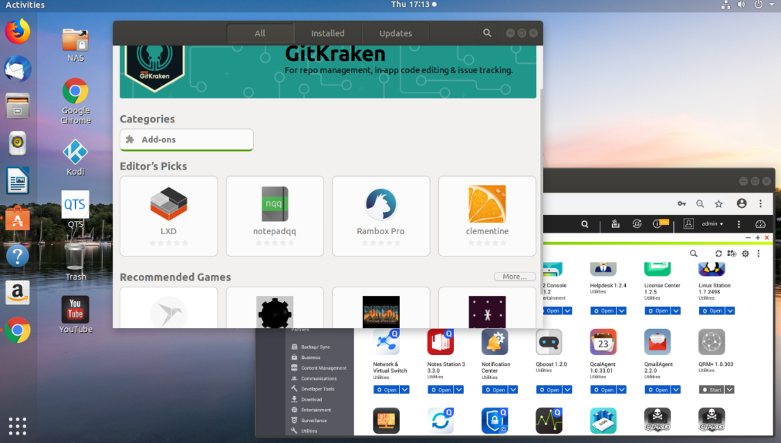
QTS App Center and Ubuntu Software Center
Abundant applications.
Miscellaneous ways of applying them.

Slide 13
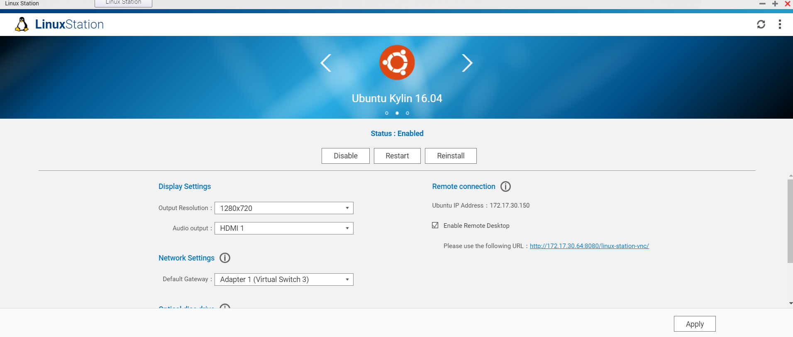
Manage Ubuntu settings through Linux Station
Enable and disable Ubuntu.
Set display resolution just like managing your PC.
Adjust default gateway network settings.

Slide 14
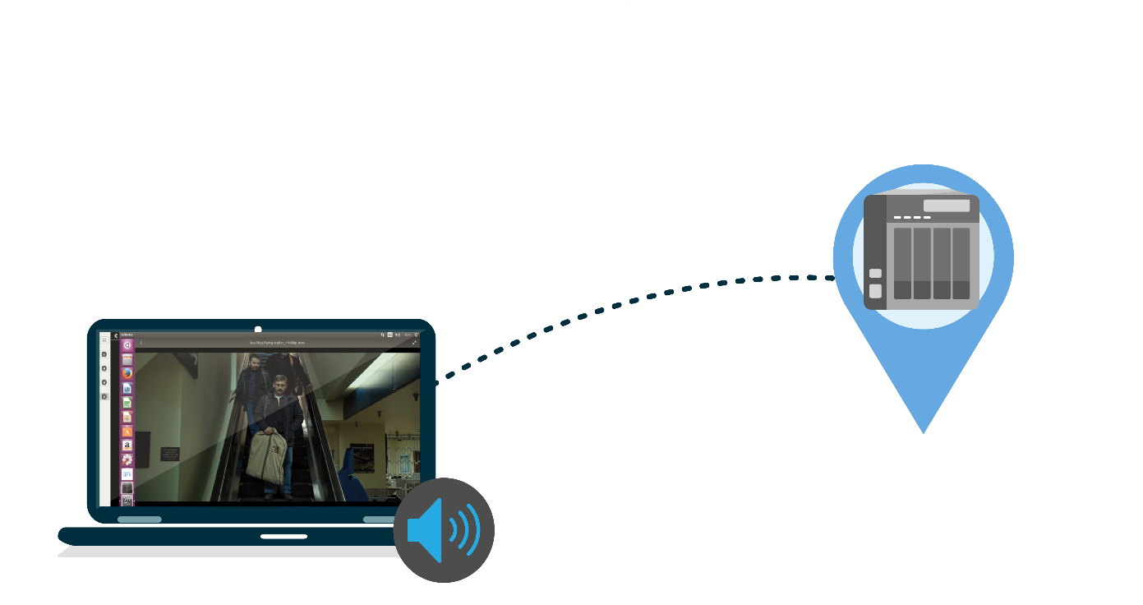
Remote Desktop and Audio Streaming
Access to QTS & Ubuntu dual system anywhere in the world.
Just like using Linux Laptop.
Audio output through remote computer desktop.

Slide 15
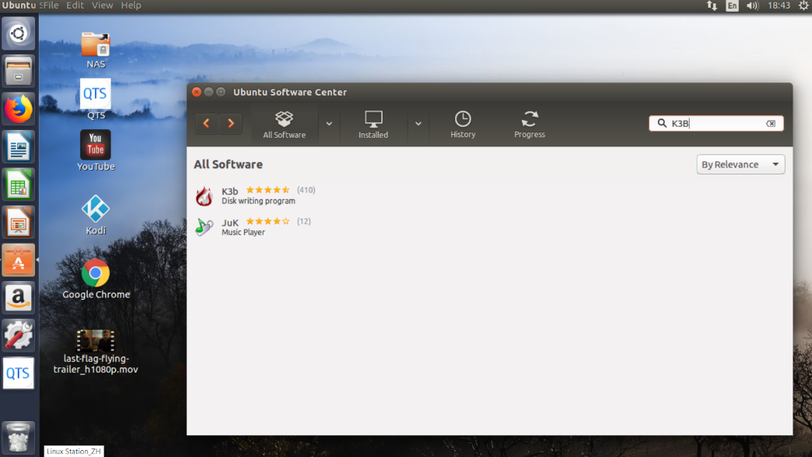
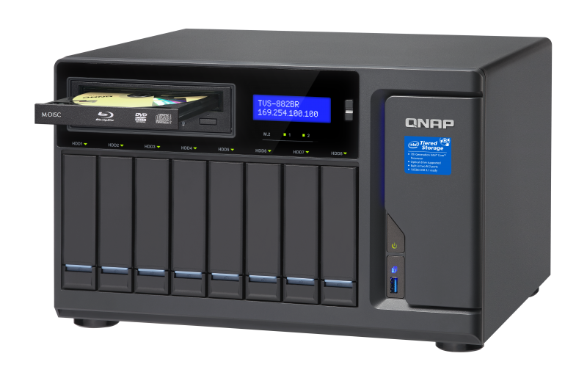
Read data from and write data to blue-ray device via Ubuntu
You can backup files from optical disc to NAS or store partial NAS data to optical disc.
Applications can be found easily in Ubuntu software center for disc read write functions.

Slide 16
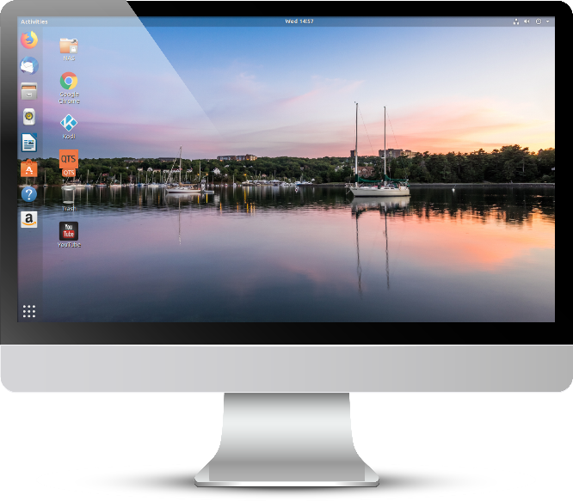
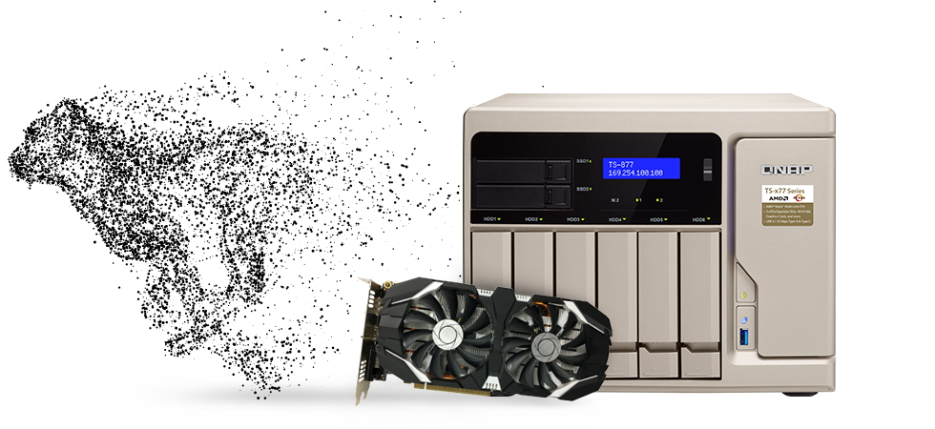
External graphic cards support
Linux Station can display via external graphic card or use it for large media file processing.
* Without graphic card, only the remote desktop function can be used.

Slide 17
Application Sharing ＆ Demo

Slide 18
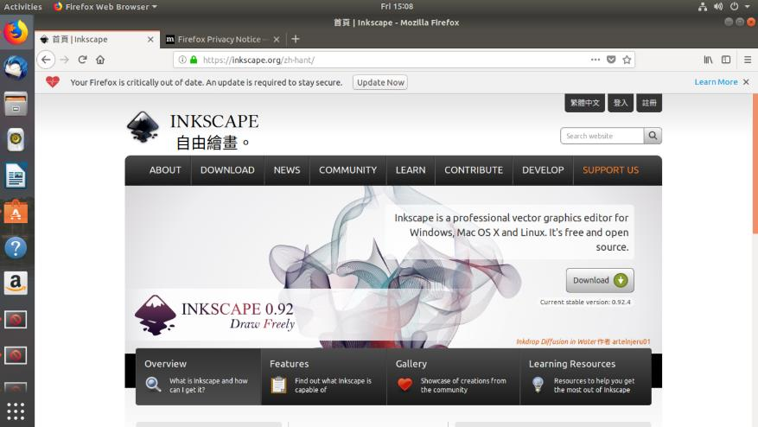
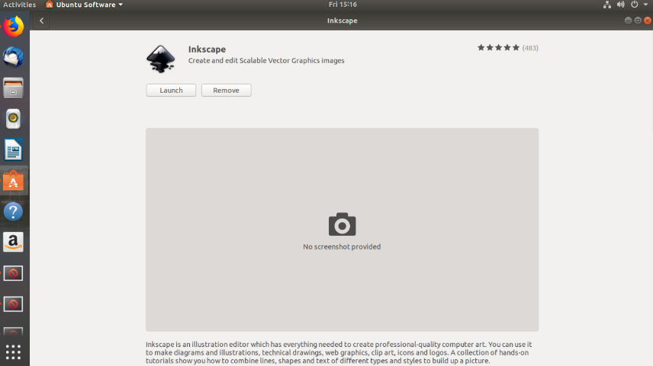
Designer’s good partner: Use Inkscape in Linux Station
Application Sharing
The vector drawing software Inkscape can be quickly installed on Linux Station. Inkscape is a vector drawing design software for Linux. It is a must-have for professional designers who are used to working with Linux. It is not only powerful, but also has many tools and functions for vector drawing and poster creation. Can be an alternative to Adobe Illustrator, Photoshop and Illustrator.

Slide 19
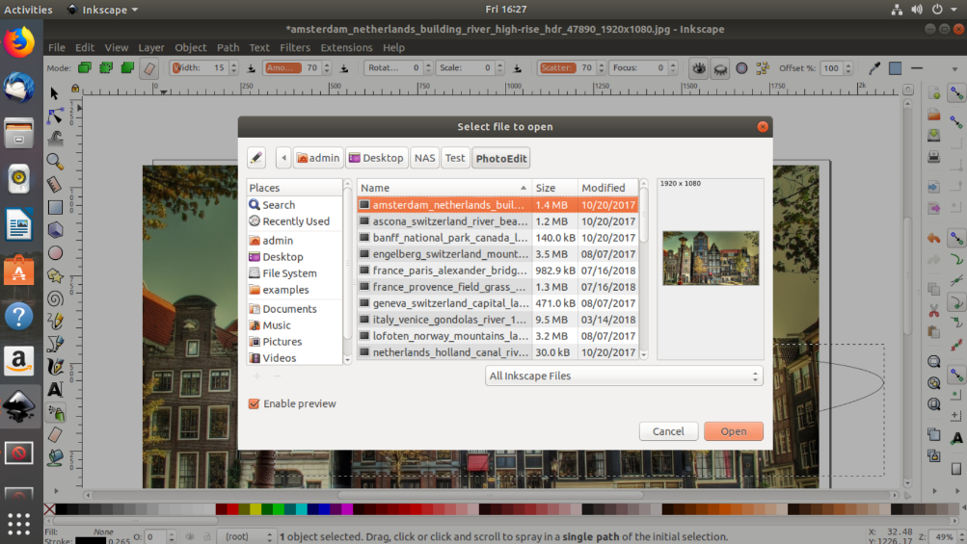
Application Sharing
Designer’s good partner: Use Inkscape in Linux Station
Just install Inkscape in the Ubuntu Software Center and then you can edit the millions of images stored in the NAS and save the newly created vector drawings to the NAS! Convenient and safe!

Slide 20
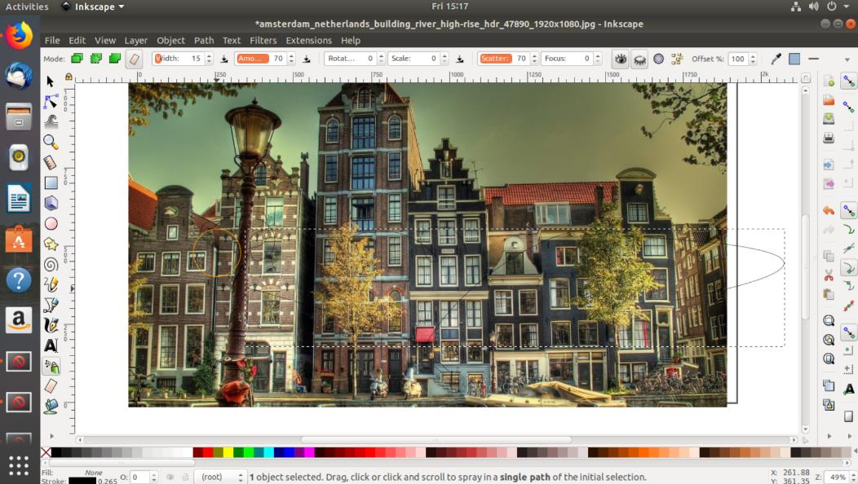
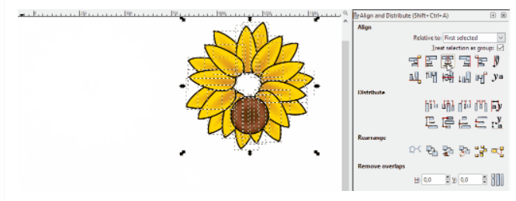
Application Sharing
Designer’s good partner: Use Inkscape in Linux Station
Linux Station makes it easy for you to continue record your creativity and inspiration around the world!

Slide 21
How to use Linux Station
Demo
Install Container Station and Linux Station in App Center
Start Linux Station choose one Ubuntu version to install
Connect NAS and monitor via HDMI connection
Connect mouse and keyboard to NAS and transform your NAS to Ubuntu personal computer.
* HD Station and Linux Station cannot be opened at the same time.

Slide 22
Q & A
01
When to support Ubuntu 18.04 LTS?
Ubuntu 18.04 LTS is supported on Linux Station 1.7.
02
What are some future plans for Linux Station?
Linux Station will renew application GUI.
Notification shortcut settings will be provided in Linux Station.
03
Will other Linux distro be on Linux Station?
We are currently evaluating Debian and CentOS.

Slide 23
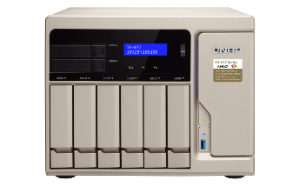
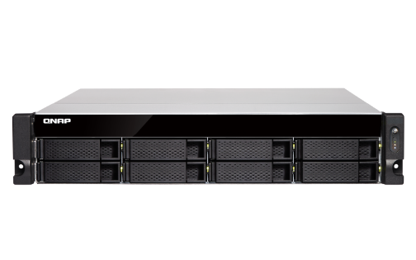
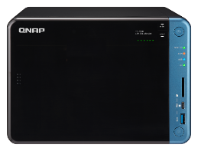
Supporting Models
TS-1279U, SS-1879U, SS-2479U, TS-870U, TS-470U, TS-470, TS-670, TS-870, TS-879,
TS-879U, TS-1079, TS-1679U, TS-x51, TS-x51A, TS-x51B, TS-x51U, TS-xA51, TS-x53, ss-x53, TS-x53II, TS-x53B, TS-x53BU, TS-x53D, TS-x53U, TS-x63U, TS-x73, TS-x73U, TS-x77U,
TS-x77, TS-x80U, TS-x82, TS-x82s, TS-x82U, TS-xA82, TS-x85, TS-x85U, TS-x89U, TS-x63, TS-x71, TS-x71U, TS-xA73, TS-x72, TS-x72U, TS-x83U, TS-x88, VIRTUAL QTS

Slide 24
Copyright © 2019 QNAP Systems, Inc. All rights reserved. QNAP® and other names of QNAP Products are proprietary marks or registered trademarks of QNAP Systems, Inc. Other products and company names mentioned herein are trademarks of their respective holders.

