Slide 2
High Availability
The key to Enterprise Storage

Slide 3
What if The Following Systems Stop Working
CCTV camera for schools / communities / hotels
Not only cause the loss of money
But might endanger the lives and social security of the general public
Hospital X-ray scanning and medical record systems
Critical data and daily operation systems in companies
Various financial services of banks
Notes:
各種監控的應用, 例如學校, 社區, 賭場, 飯店, 若是IT系統停機造成資料無法寫入, 影響的可能是社會的安全.
若是IT系統停機造成,醫療的病例檔案跟影像資料無法寫入, 有可能延遲醫療的診斷, 更糟的是造成關鍵的誤判, 影響健康的安全.

Slide 4
We Have Also Received the Feedback From Customers for a Long Time ...
"We need highly reliable storage systems, able to maintain 24-hour operation without disruption, to ensure smooth manufacturing process." … Quote Taiwan XXX machinery manufacturing factory.
"The development platform must support the cooperation of cross-border software teams under the IT architecture without singe node of failure" … Quote US YYY software technology company.

Slide 5
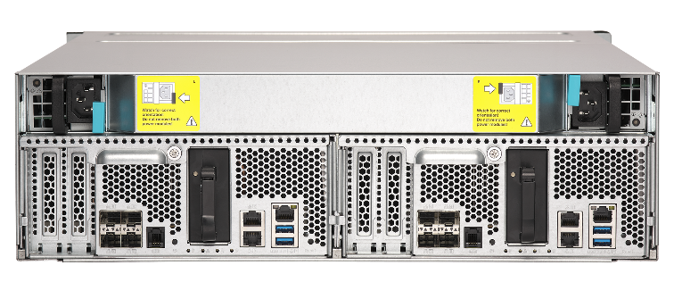
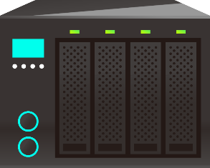
Common High Availability Storage Architecture
Active-Standby
Active-Active
Twice HDD and system cost
Unbalanced system load
Data loss when power outage
Network becomes a risk
Dual standby path
Active path
Dual active path
Standby path
Sync data
Active
Standby
Active
Active
Notes:
active standby 的圖要修一下
直接標註贏的特點
Failover 有時間

Slide 6
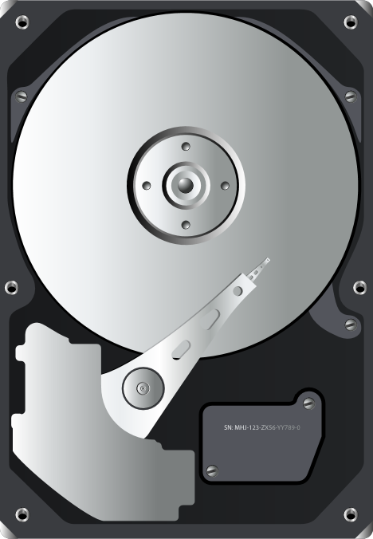
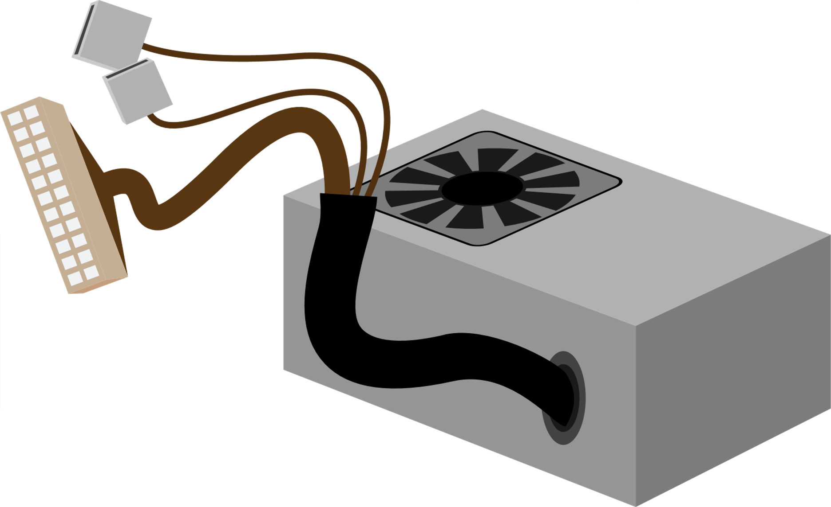
Active-Standby HA is Actually Not Worthwhile
All you need is a set of HA system, but it is twice the price.
+
Active path
Standby path
x2
...
Sync data
+
Active
Standby

Slide 7
Active-Standby HA is Load Imbalance
Bought two systems, but only one system can be accessed simultaneously.
The overall IT architecture is greatly reduced in effectiveness.
Active path
Standby path
The load is processed only on the active system.
Sync data
Active
Standby

Slide 8
Network is The Bottleneck of Active-Standby HA
If the network is disconnected
Unable to sync data
HA architecture is invalid
Sync data
Standby
Standby path
How much bandwidth should be used?
1Gb? 10Gb?
Or maybe fiber channel?
Active path
Sync data
Active
Standby

Slide 9
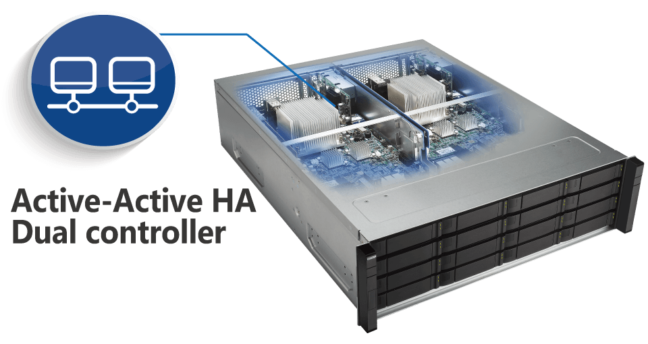
All New ES1686dc - High Availability Storage Systems
Dual-active controllers
Highly available storage that maintains non-stop operations
C2F for power failure
Dual path SAS interface
Hot swappable components
Active-Active HA Dual controller
Multipath and multi-ports

Slide 10
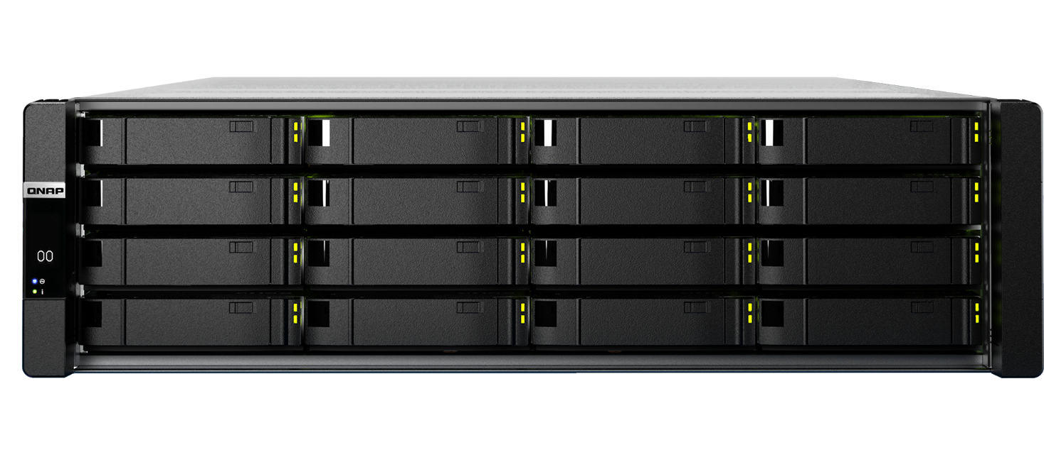
With QNAP Warranty Up to Five Years

Slide 11
ES1686dc
vs
ES1640dc v2

Slide 12
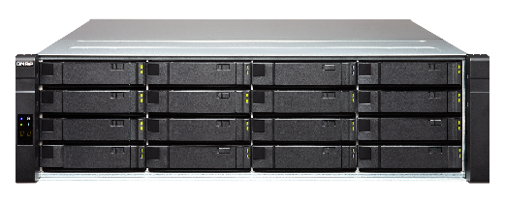
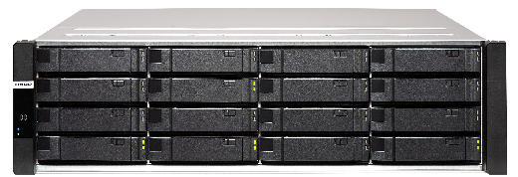
More Cost-Effective Dual-Controller Storage Systems
We are determined not to compromise the stability and effectiveness of the system.
But we are committed to providing a more cost-effective storage system
ES1640dc V2
CPU: Intel Xeon 6-core E5
RAM: 96GB
ES1686dc-2123IT-64G
CPU: Intel Xeon D 4-core
RAM: 64GB
ES1686dc-2142IT-96G
CPU: Intel Xeon D 8-core
RAM: 96GB
ES1686dc-2142IT-128G
CPU: Intel Xeon D 8-core
RAM: 128GB

Slide 13
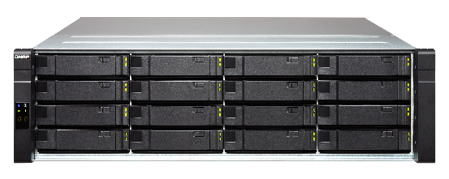
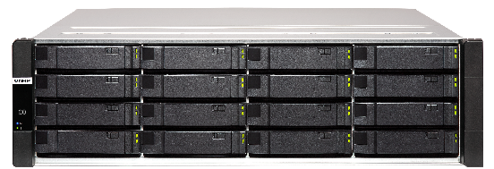
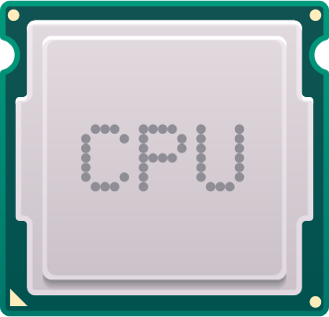
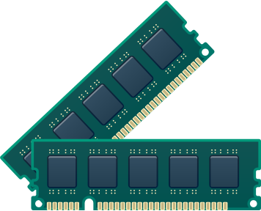
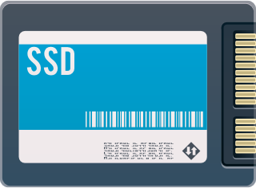
ES1686dc versus ES1640dc
ES1686dc: Low power CPU
ES1640dc V2
ES1686dc
Intel 4 & 8-core CPU
Better performance
lower power consumption
Intel 6-core CPU
16x DIMM slots
Superior data service
6x DIMM slots
SSD Cache
Must occupy the front slot
SSD Cache

Slide 14
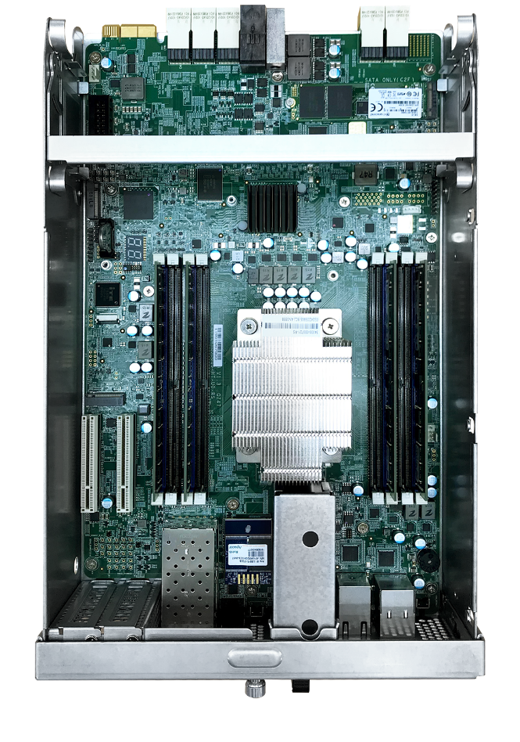
Supports More Memory Slots
64GB M.2 for Battery Backup Storage
(under the fan module)
Model | ES1640dc V2 | ES1686dc
DIMM Slot | 3 (1 for C2F) | 8
Max. Size | 48GB | 512GB
8 x DDR4 RAM Slot
Max. 512GB

Slide 15
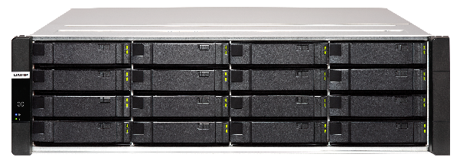
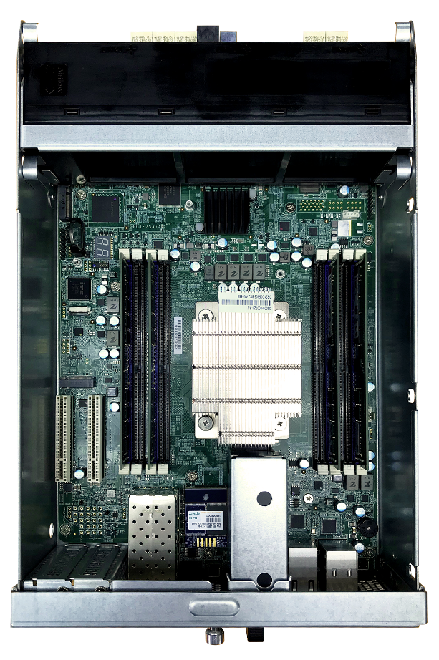
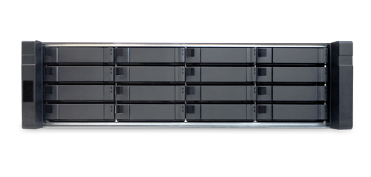
Maximize Storage Space and Performance
ES1686dc
2 x NVMe M.2 ports
PCIe Gen3 x4
SATA 6Gb/s
M.2 NVMe SSD installed for cache.
=> boost the performance
=> save the space
ES1640dc V2
To use flash as cache acceleration, you need to use the front 4 hard disk slots

Slide 16
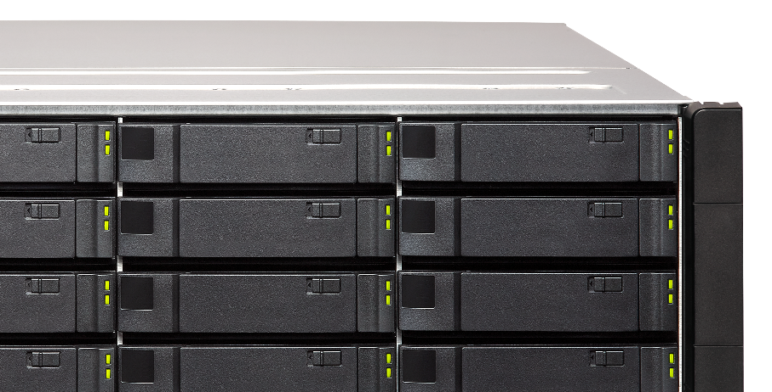
Choose Your ES1686dc
ES1686dc-2123IT-64G
Intel D-2123IT 4-core/8 thread, 2.2 GHz (Max. 3.0GHz)
64GB DDR4 RAM(32GB per controller)
ES1686dc-2142IT-96G
ES1686dc-2142IT-128G
Intel D-2142IT 8-core/16 thread, 1.9 GHz (Max. 3.0GHz)
96GB/128GB DDR4 RAM(48GB/64GB per controller)

Slide 17
Cost Effective HA Storage
Application Scenario for simple HA requirements
(compression or deduplication is not a MUST)
ES1686dc-2123IT-64G
Intel D-2123IT 4-core, 2.2 GHz
64GB DDR4 RAM
Surveillance
Backup
Working group

Slide 18
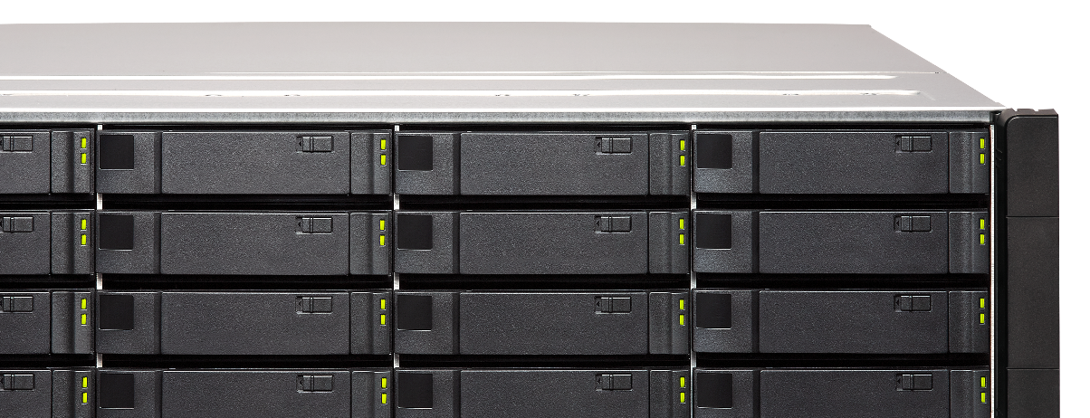
But if You Want to Be Safe, Efficient and Faster
ES1686dc-2142IT-128G
Intel D-2142IT 8-core, 1.9 GHz
128GB DDR4 Memory
(Coming soon)

Slide 19
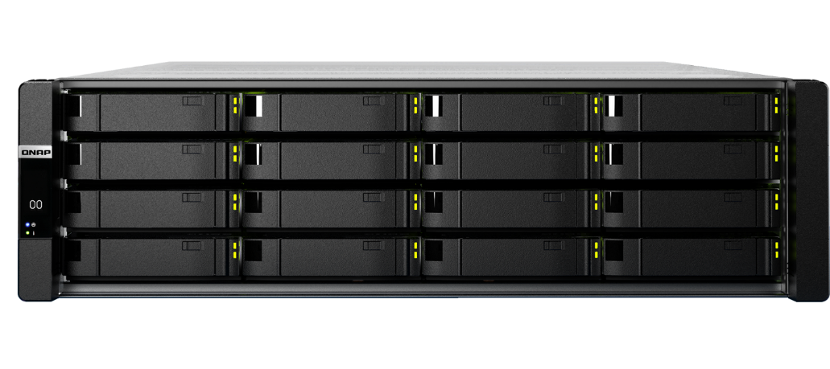
Tailored for Intensive Virtualization and VDI With Dedup + Flash + Plugin
Various technologies such as Dedup and compression make virtualized storage more efficient
High-speed read and write performance supported by flash makes business operations smoother
Support multiple plug-ins for VMware / Hyper-V to make management easier

Slide 20
ES1686dc With FC support can be used in ...
Video editing
Healthcare
Database

Slide 21
ES1686dc
Specifications

Slide 22
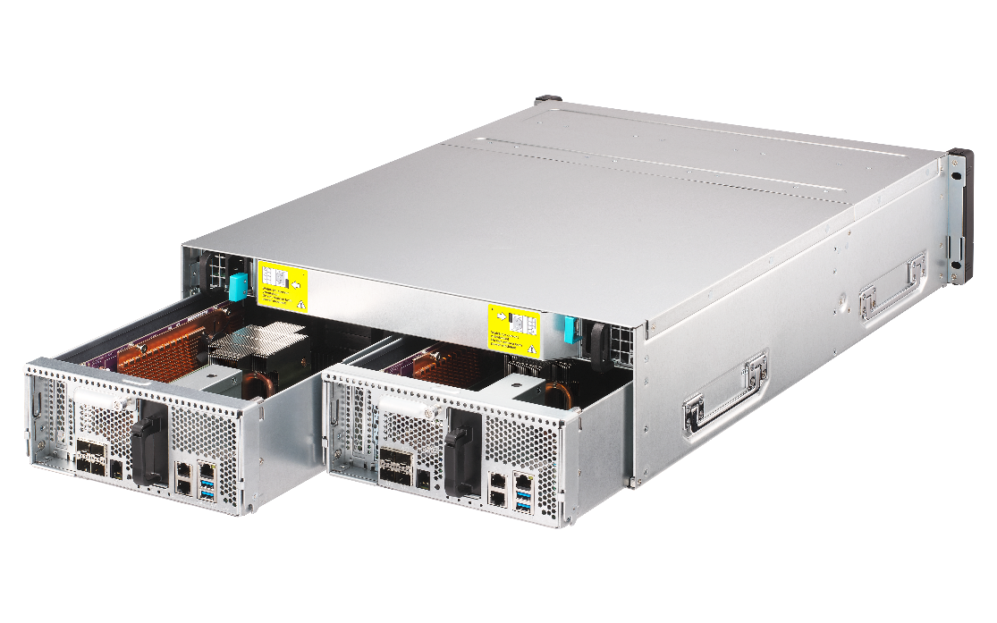
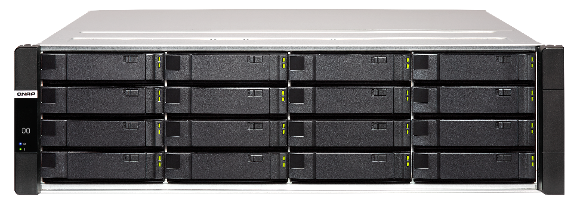
ES1686dc 雙控高可用性企業級NAS
雙控制器
多I/O介面
雙電源
QES 作業系統
韌體滾動式更新 (Rolling Update)

Slide 23
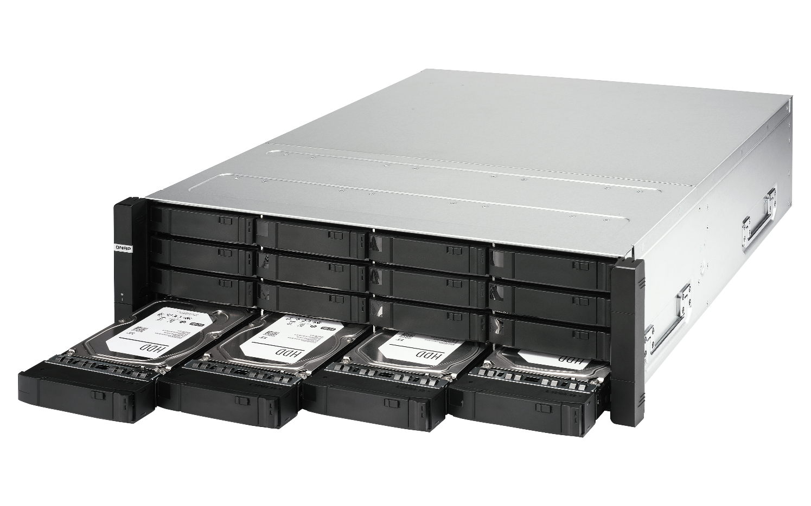
Front View
Tray latch
OLED Module
HDD Status LED
Handle
16 x 3.5”/2.5”HDD Tray

Slide 24
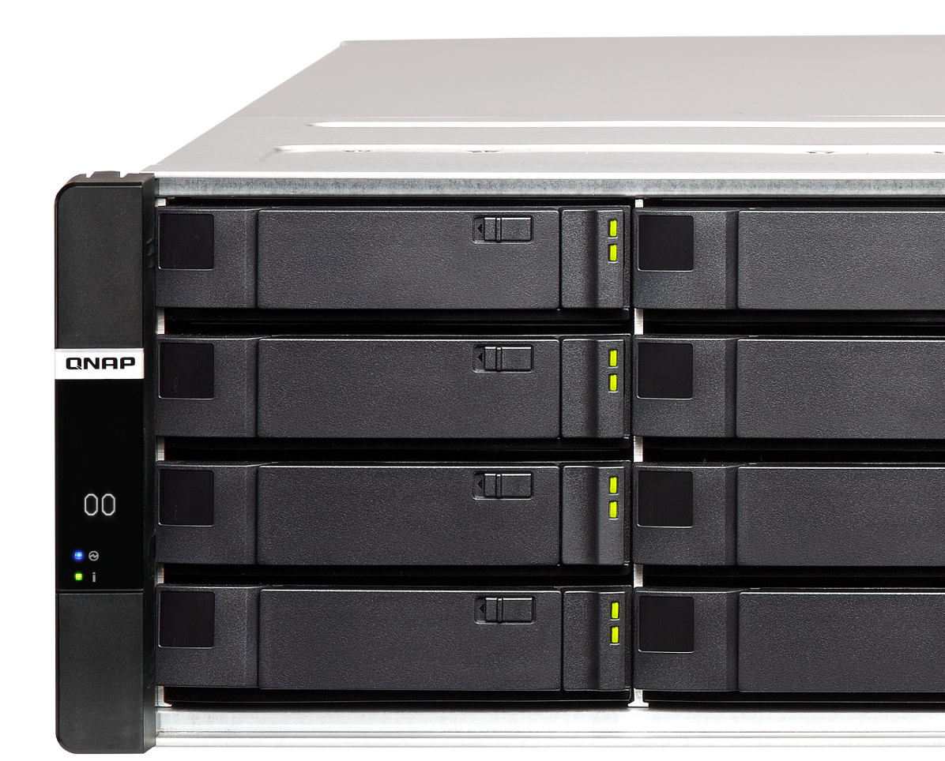
Clear Information with OLED Indicator
Provides system status for each controller
OLED ON/OFF Button
Power Status
Fan Status
Battery Status
HA Status
NAS ID

Slide 25
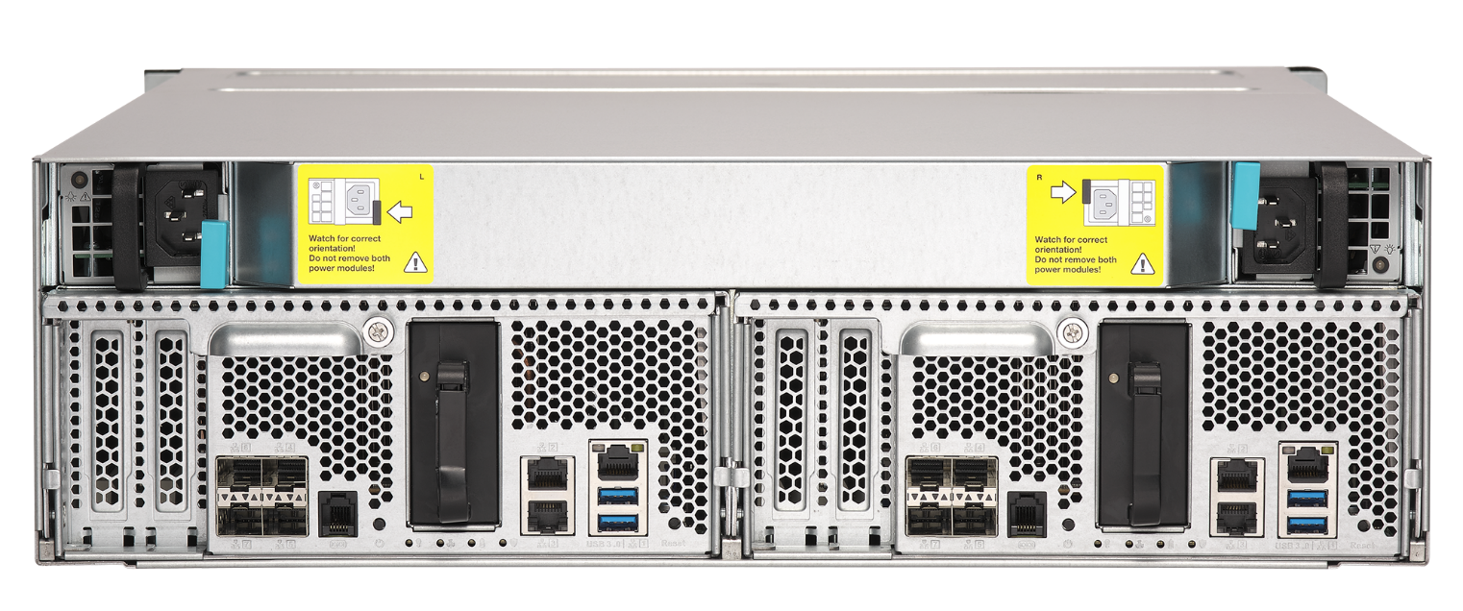
Rear View
770W Redundant PSU
1 x 1GbE Management port
PCIe Gen3 x8 Slot
4 x 10GbE SFP+ LAN Port
Power Button
Battery Module
2 x 1GbE LAN Port
2 x USB 3.0
Reset Button

Slide 26
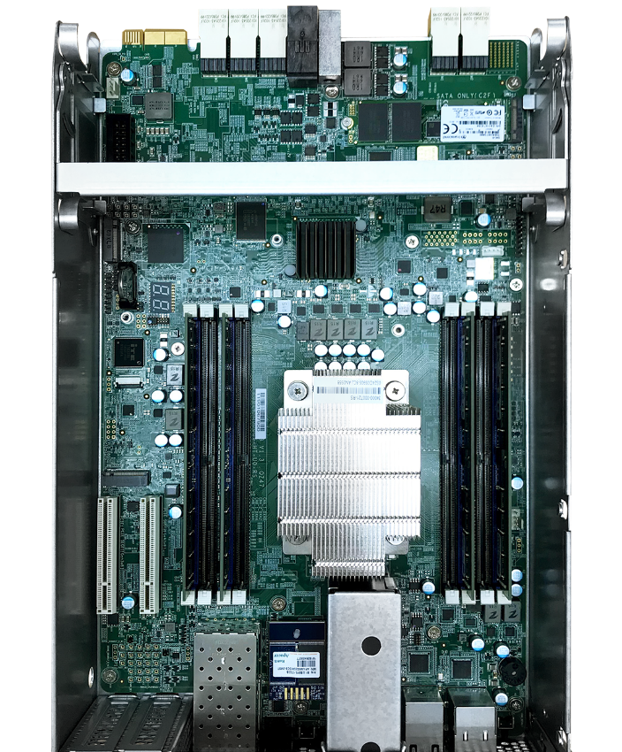
Inside the Controller
Fan Module
(3 x 6cm 16000rpm)
M.2 for Battery Backup Storage
(under the fan module)
8 x DDR4 RAM Slot
Max. 512GB
Intel Xeon CPU and Heat Sink

Slide 27
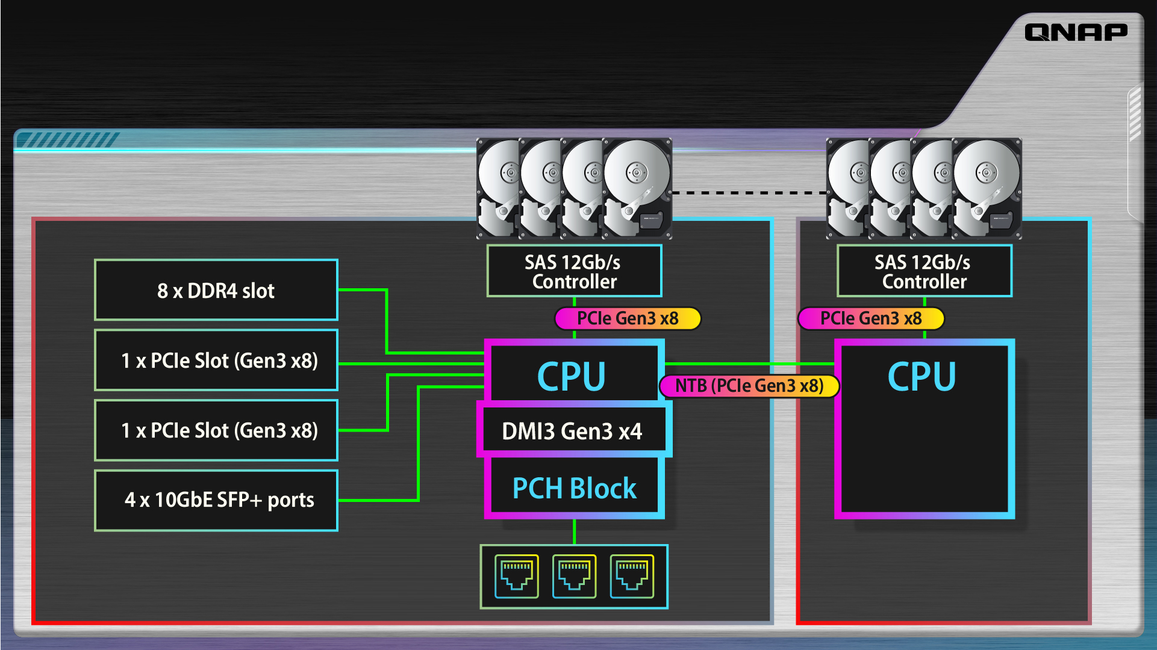
Optimize System Design
…................
SAS 12Gb/s Controller
SAS 12Gb/s Controller
8 x DDR4 slot
PCIe Gen3 x8
PCIe Gen3 x8
NTB (PCIe Gen3 x8)
CPU
CPU
1 x PCIe Slot (Gen3 x8)
1 x PCIe Slot (Gen3 x8)
DMI3 Gen3 x4
PCH Block
4 x 10GbE SFP+ 埠
Controller 1
2 x M.2(Gen3 x4 or SATA)
Controller 2

Slide 28
Intel Xeon 企業級處理器
Intel Xeon D-2142IT (或同等級)
8 核心/16執行緒
1.9 GHz (Max. 3.0GHz)
Intel Xeon D-2123IT
4 核心/8執行緒
2.2 GHz (Max. 3.0GHz)

Slide 29
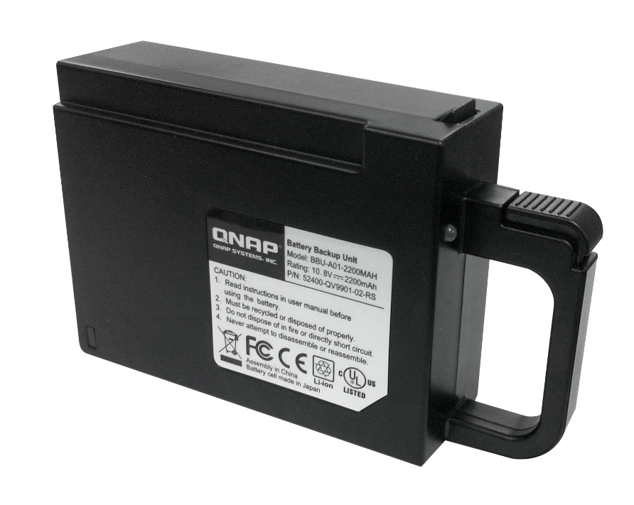
Battery Backup Unit (BBU)
確保意外斷電時資料的正確與一致性
Model: BBU-A01-2200MAH
Battery type: LI-ion
Rating: 10.9V 2200mAh
Dimension (H x W x D): 118 x 79 x 32 mm
Weight: 218 g

Slide 30
Accessories

Slide 31
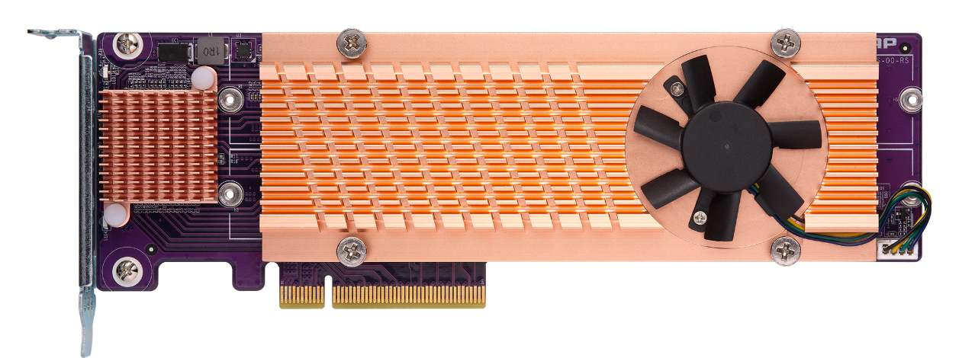
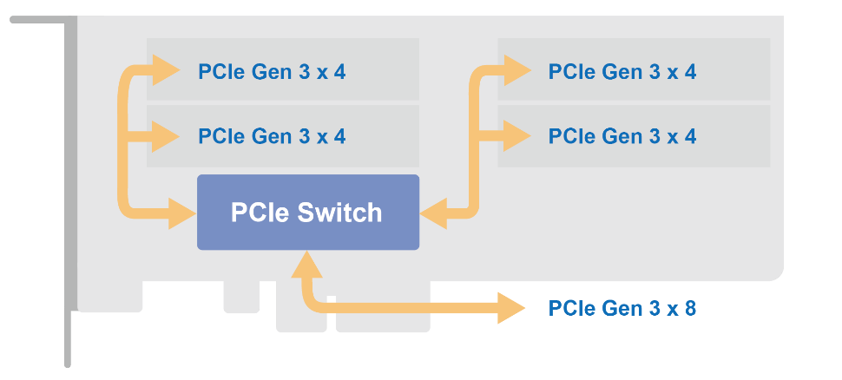
Optional Purchase M.2 Cache Adapter
Four NVMe Gen3 x 4 M.2 SSD port
Burst QES reading performance
QM2-4P-384

Slide 32
QDA-SA 6Gbps SAS/SATA adapter
Enterprise dual-controller ZFS NAS Series can flexibly install SATA 6Gbps SSD or HDD to save costs.

Slide 33
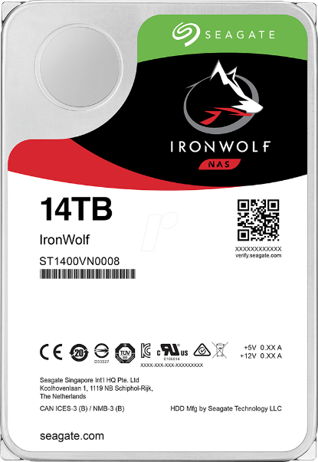
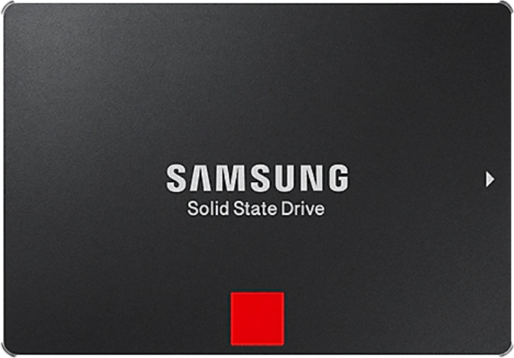
How to use affordable and many choices of SATA HDD/SSD?
High-speed &
large-capacity
SATA SSD
High-capacity
SATA HDD

Slide 34
Full-duplex data transfer and dual-port
Controller 1
Controller 2
Controller 1
SAS drives are dual-port
Designed for high-availability(HA) architecture
SATA drives are single-port
Not for high-availability (HA) architecture
Channel 1
Channel 2
Channel 1
SAS drives
SATA drives

Slide 35
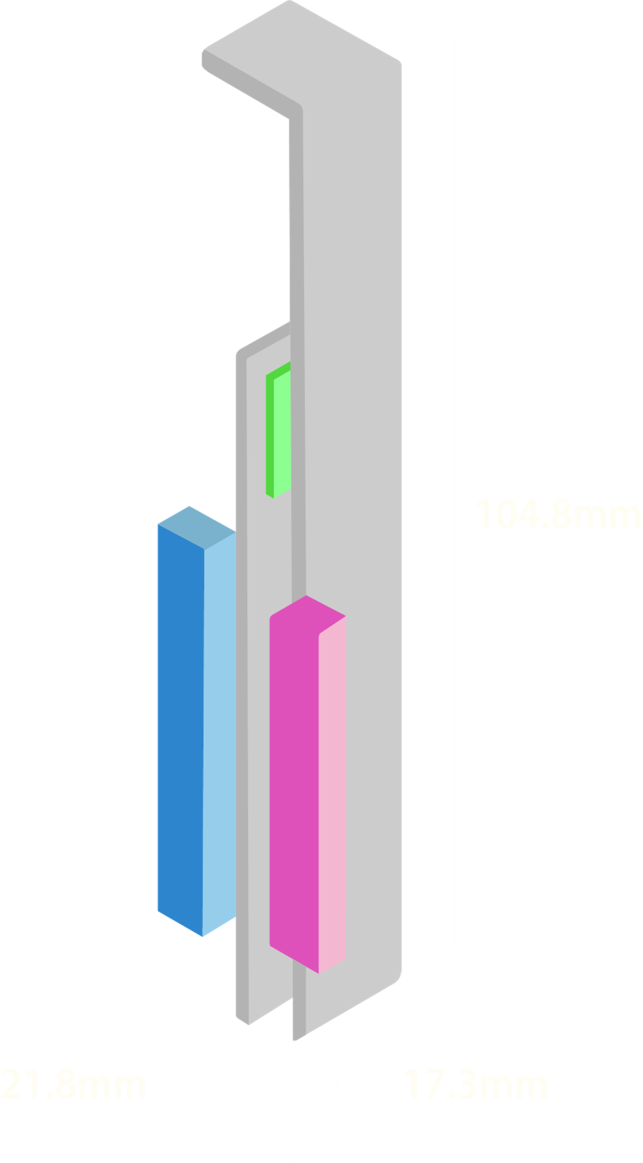
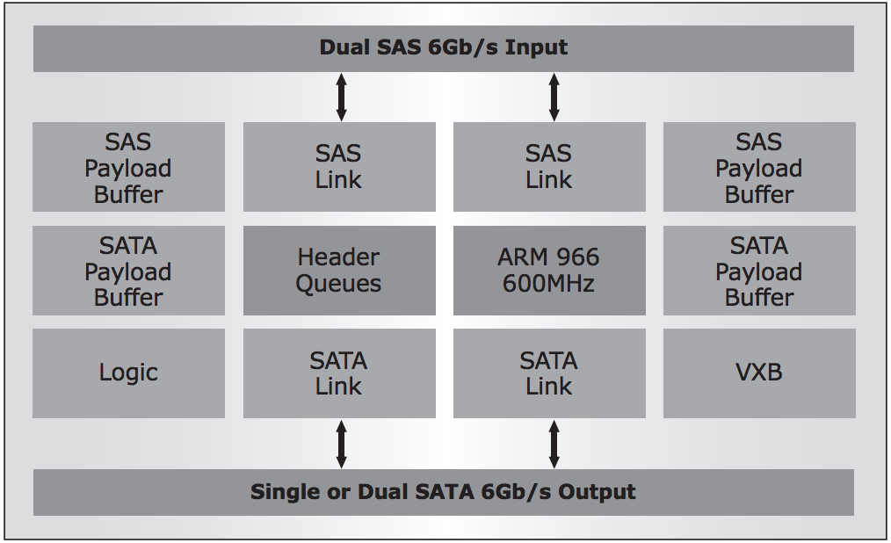
QDA-SA 6Gb/s SAS to SATA adapter
Optional Accessory
Ordering information: QDA-SA-4PCS (4 units)
Marvell 9110 6Gb/s SAS to SATA bridge IC
SAS 6Gb/s
SATA 6Gb/s
SAS 6Gb/s
SATA 6Gb/s
Marvell 9110 600 MHz
processor

Slide 36
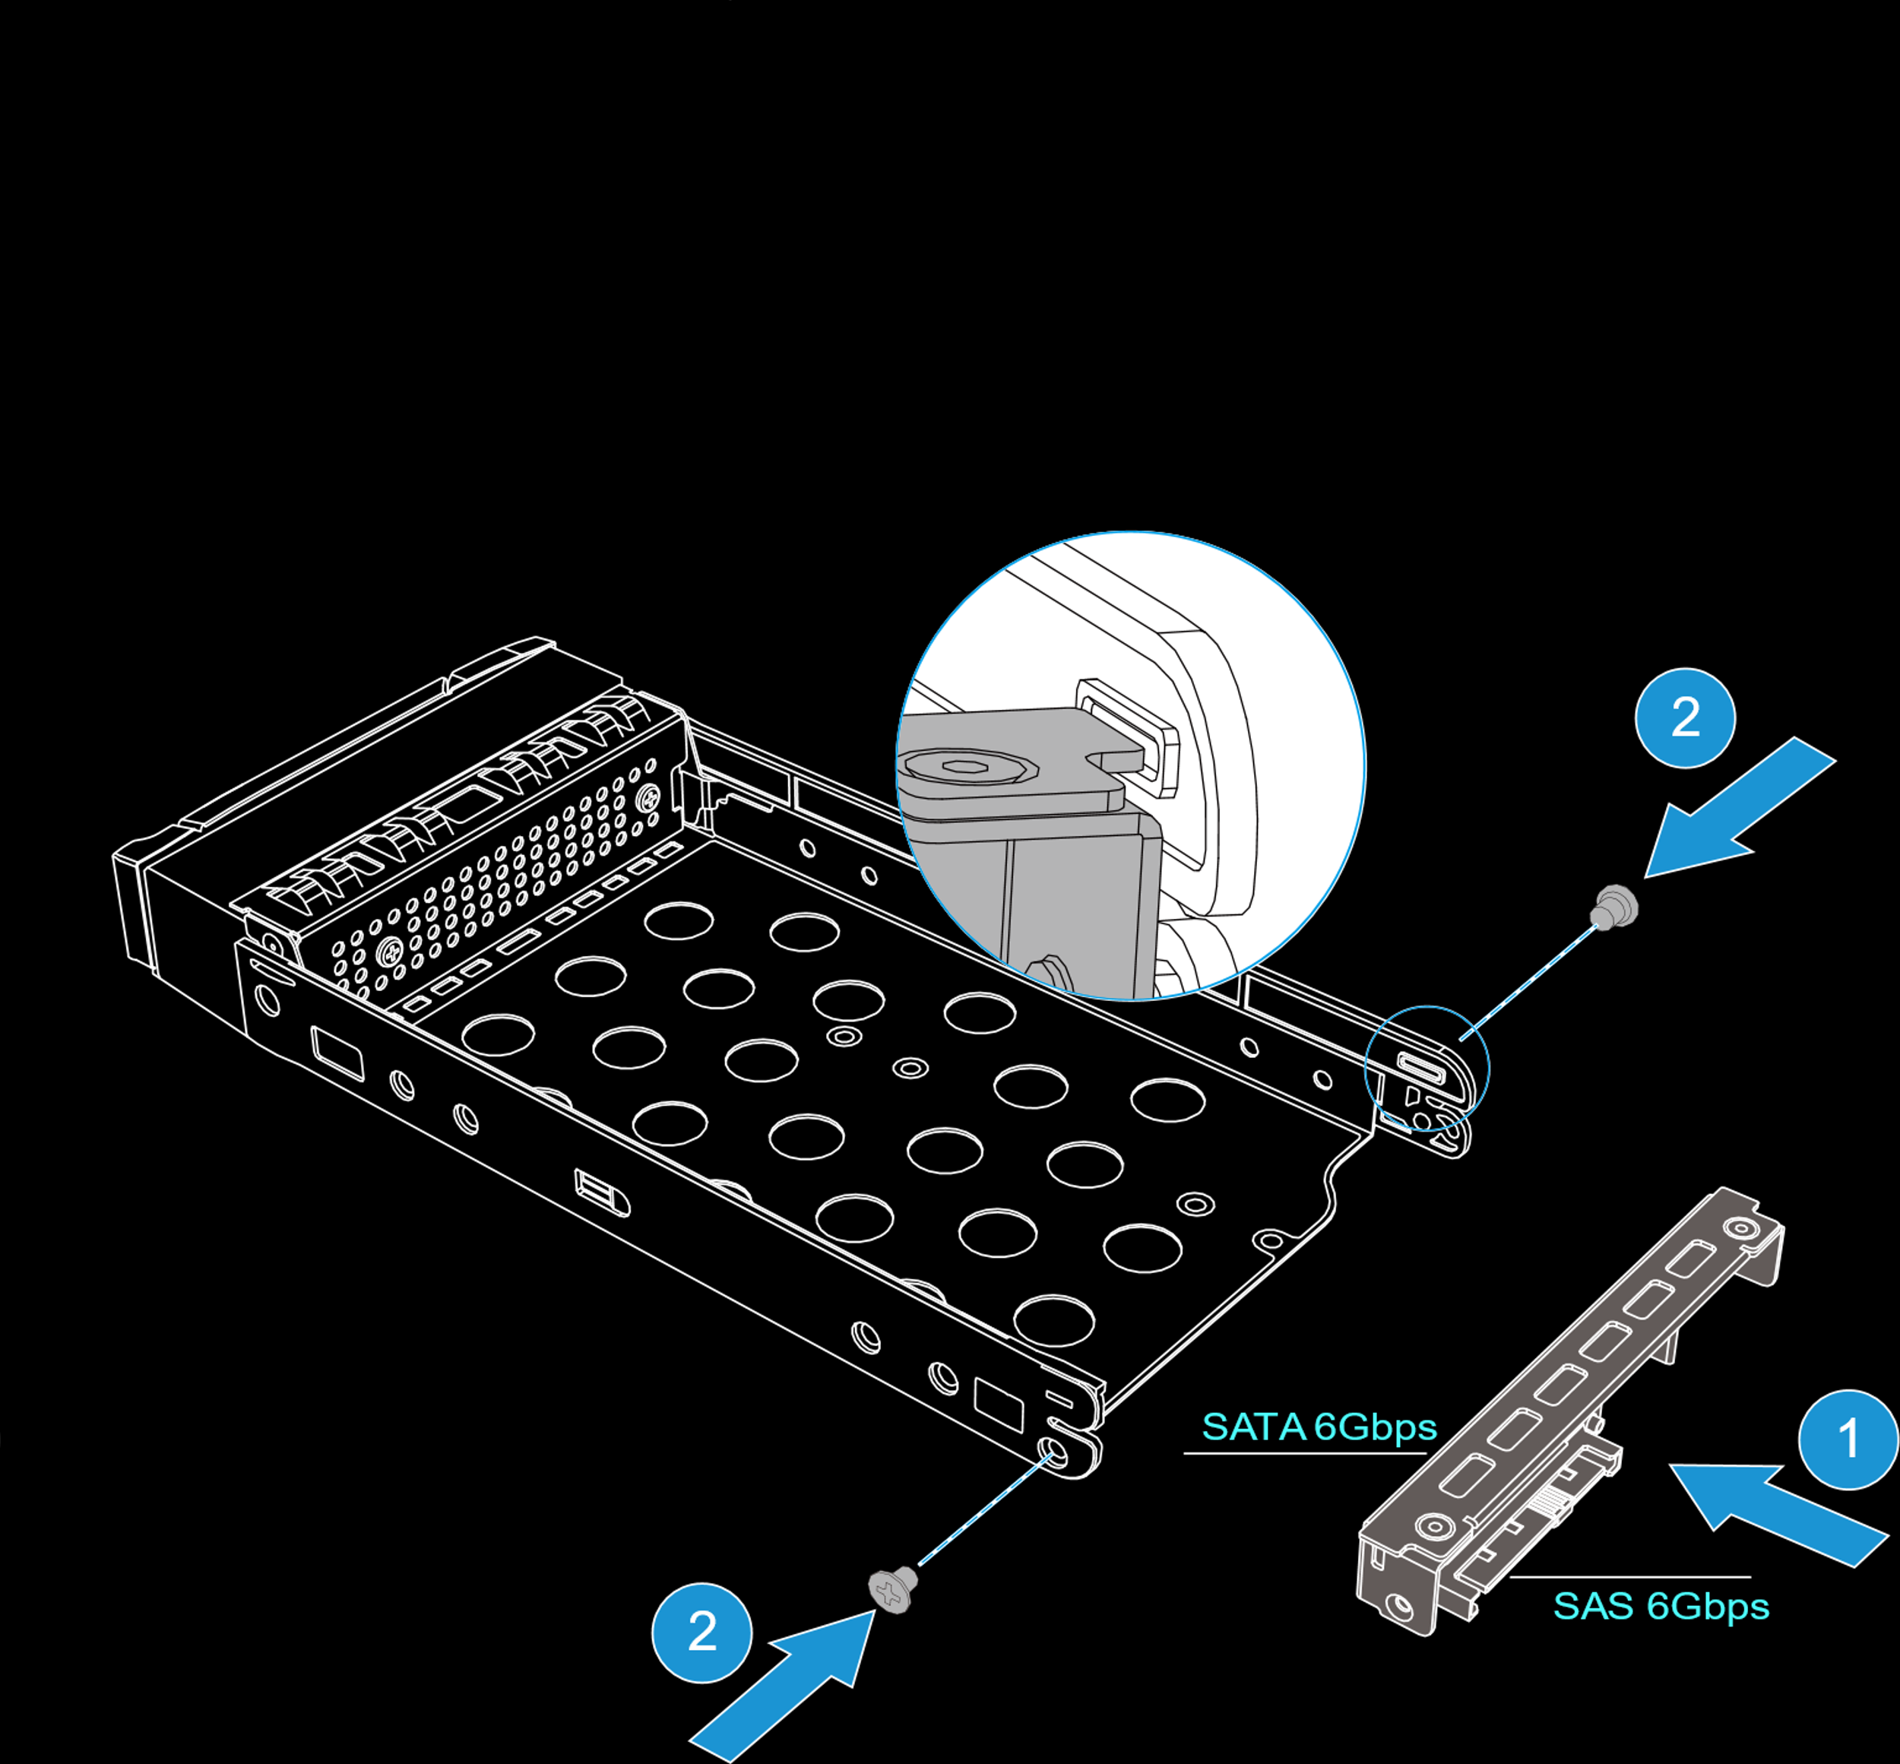
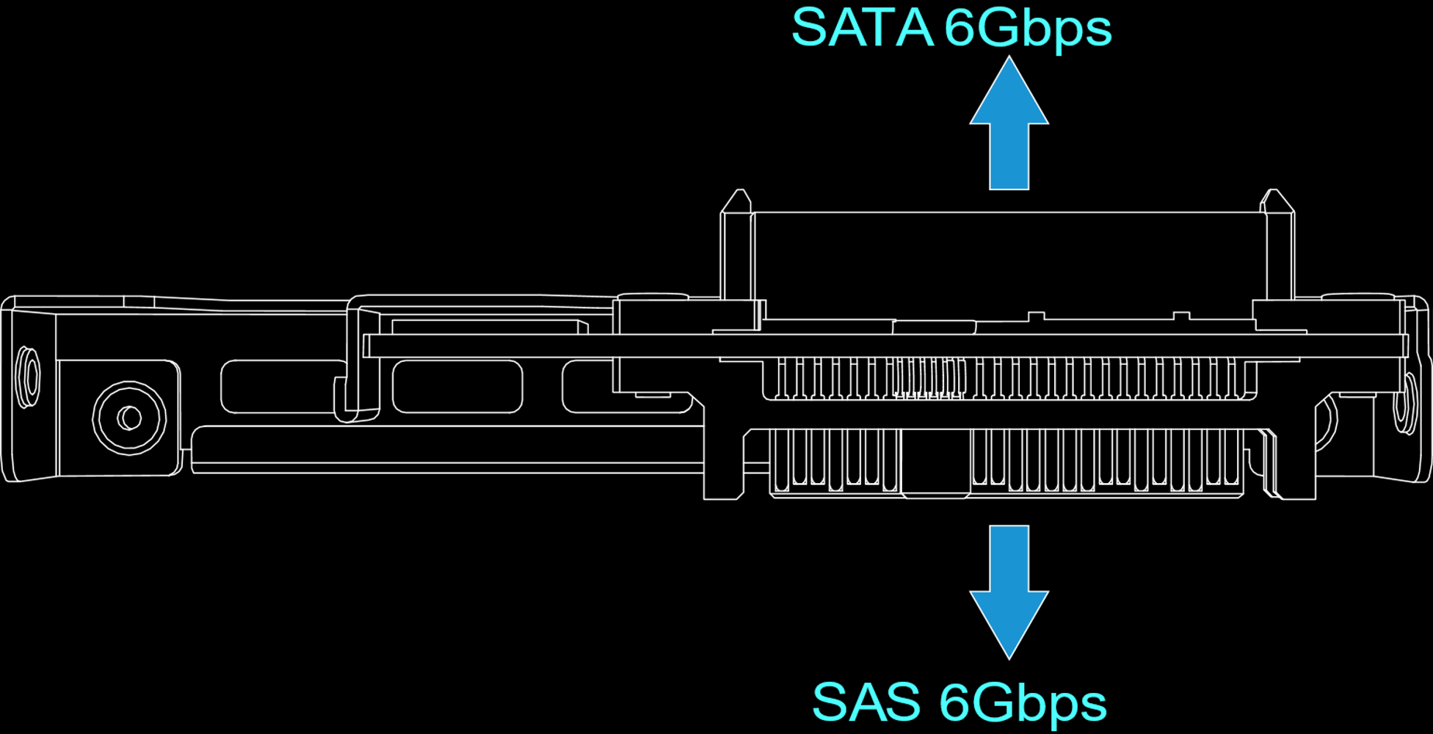
Compatible with Enterprise ZFS NAS 3.5”drive trays
ES NAS 3.5” drive tray
Ordering information:
SP-ES-TRAY-WOLOCK

Slide 37
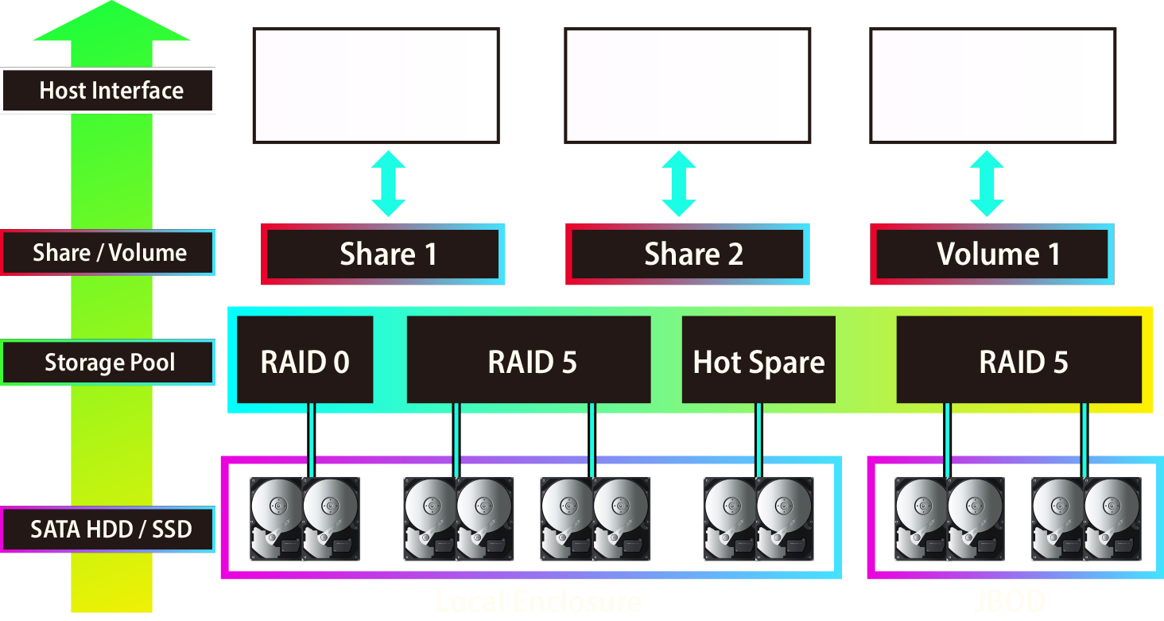
SATA HDD/SSD can be used in Storage Pool

Slide 38
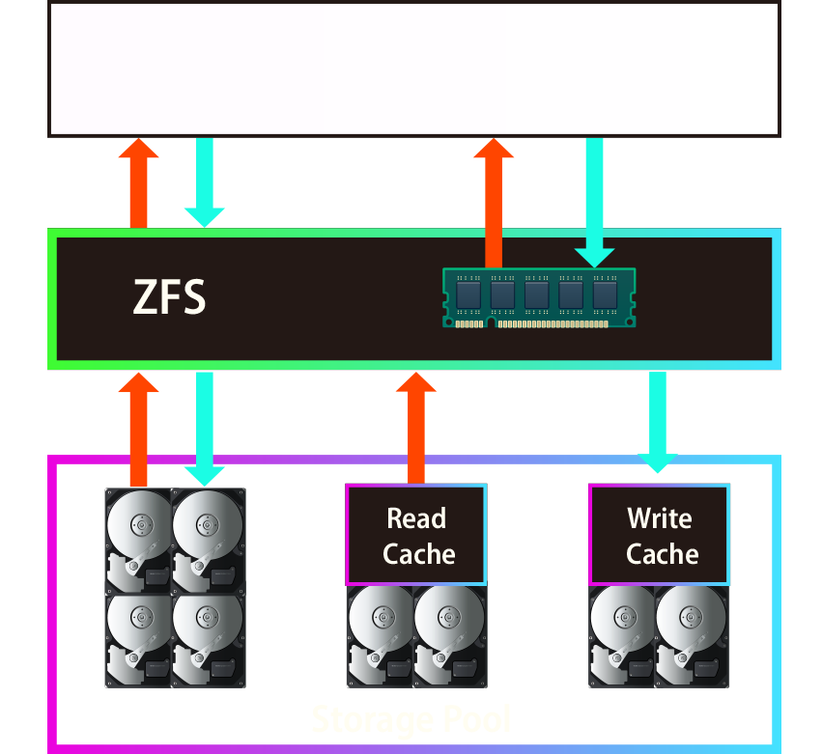
SATA SSD can be used for SSD Cache
Improves random read IOPS
Accelerate file and block access performance
Support multiple SATA SSDs
Hot-swappable drive in SSD cache

Slide 39
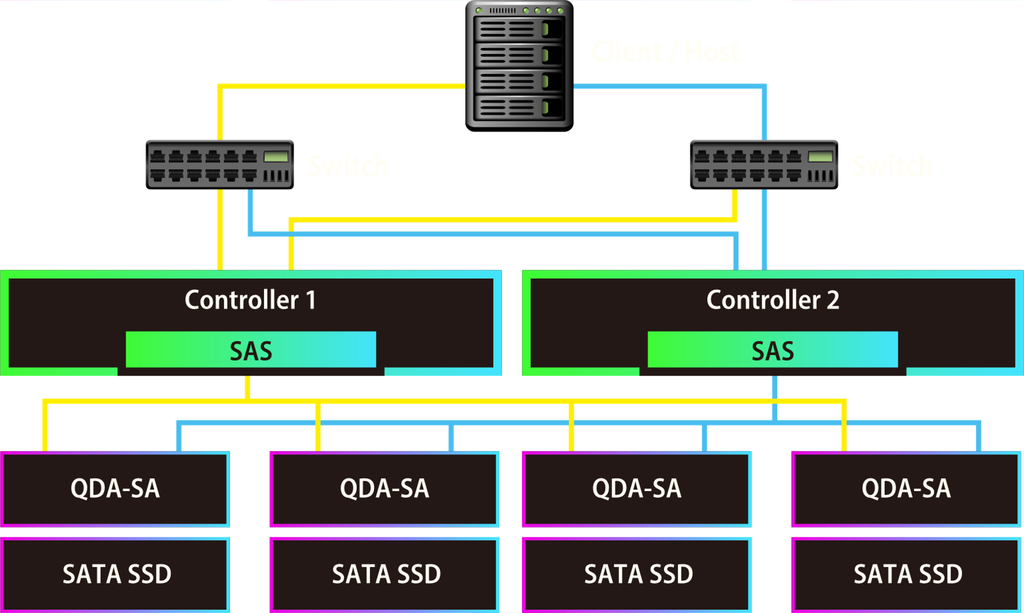
Support HA in dual-controller

Slide 40
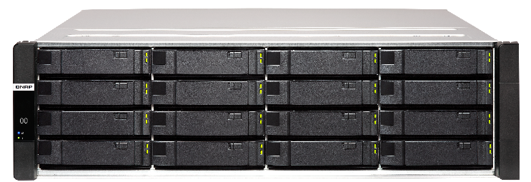
ES1686dc Redefines All-Flash and Hybrid Array
SATA SSD
All SATA SSD Configuration
Optimal balance of storage performance and cost
NVMe SSD
New Generation Hybrid Array
Take the advantage of ultra-high performance NVMe
SATA / NL-SAS
SATA SSD
The Most Cost-Effective Flash Array
SATA SSD plus the cost optimization of the hard drive
SATA / NL-SAS

Slide 41
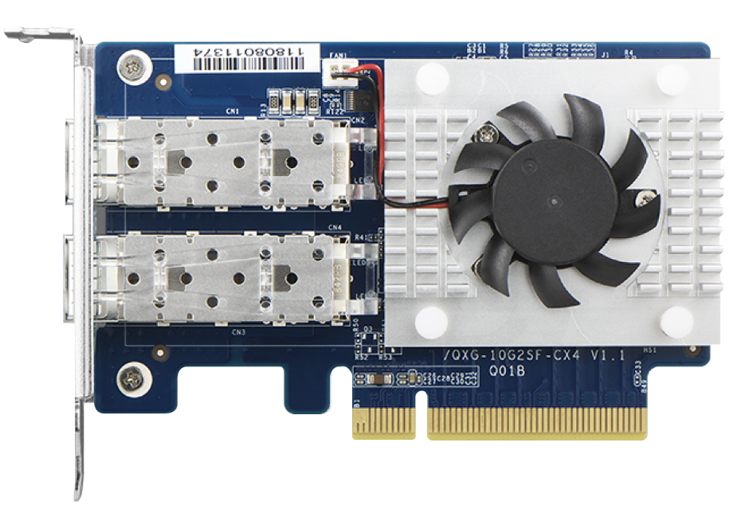
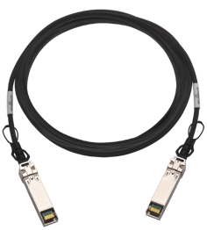
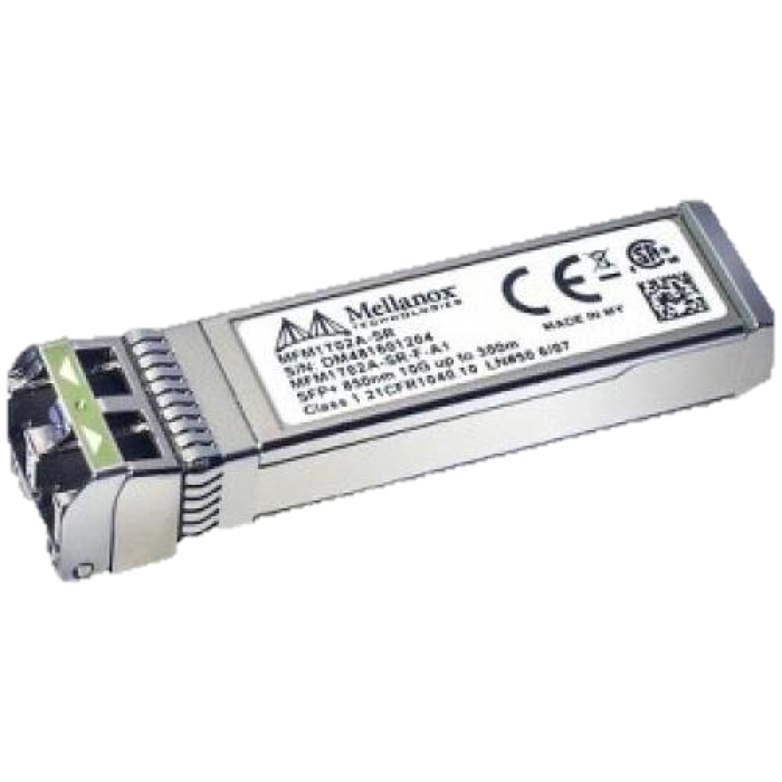
QNAP Dual-port 10GbE NIC
QXG-10G2SF-CX4
Mellanox ConnectX®-4 Lx NIC
2 x 10GbE SFP+ port
Supports iSER/RoCE Hardware Offload
Cooling system
Accessory SFP+ 10GbE DAC cable or TRX-10GSFP-SR-MLX optical transceiver
Notes:
QNAP 雙埠25GbE 擴充卡
QNAP Dual ports 25GbE NIC
採用Mellanox ConnectX®-4 Lx 網路晶片
Mellanox ConnectX®-4 Lx ethernet chip
2 x SFP28 ports
Supports 25GbE/10GbE
Supports iSER/RoCE hardware offload
需搭配SFP28 25/10GbE網路線
Compatible cable
SFP28 25/10GbE DAC cable
2019 一月上市
Soon to market on January/2019
晶片散熱模組
Cooling system

Slide 42
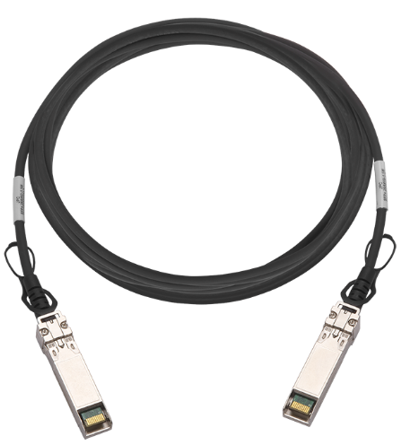
QNAP Dual-port 25GbE NIC
QXG-25G2SF-CX4
Mellanox ConnectX®-4 Lx NIC
2 x SFP28 ports
Supports 25GbE/10GbE
Supports iSER/RoCE Hardware Offload
Cooling system
Compatible cable
SFP28 25/10GbE DAC cable
Notes:
QNAP 雙埠25GbE 擴充卡
QNAP Dual ports 25GbE NIC
採用Mellanox ConnectX®-4 Lx 網路晶片
Mellanox ConnectX®-4 Lx ethernet chip
2 x SFP28 ports
Supports 25GbE/10GbE
Supports iSER/RoCE hardware offload
需搭配SFP28 25/10GbE網路線
Compatible cable
SFP28 25/10GbE DAC cable
2019 一月上市
Soon to market on January/2019
晶片散熱模組
Cooling system

Slide 43
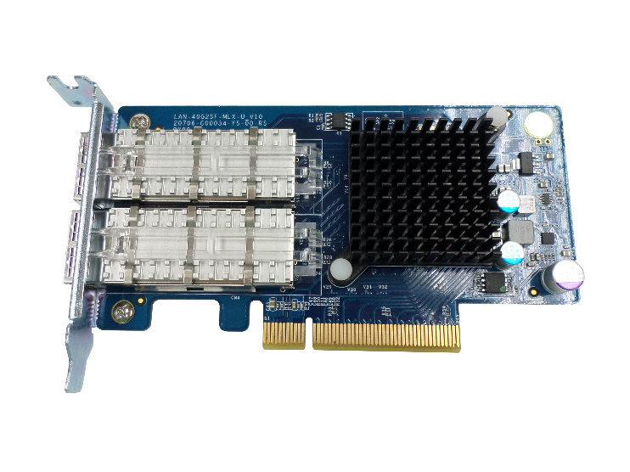
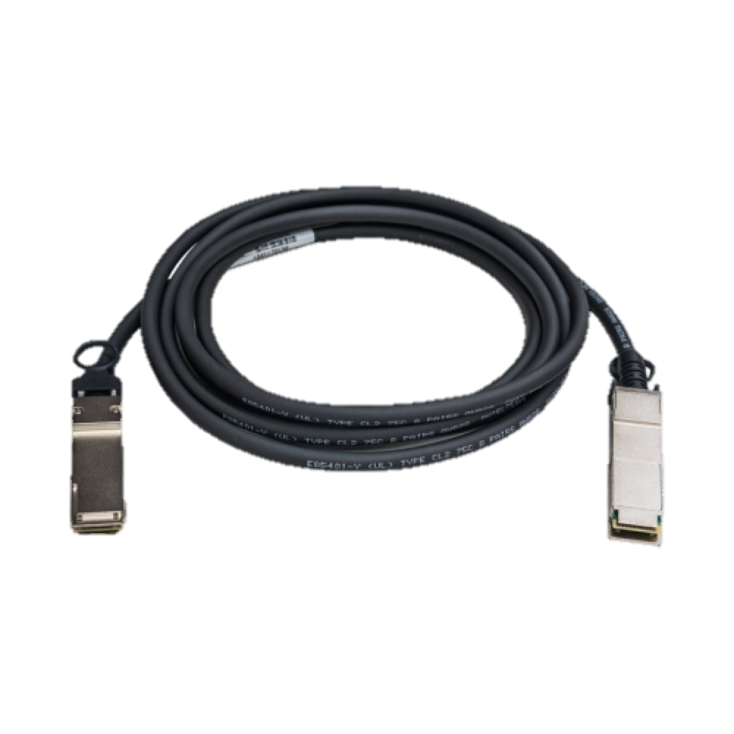
QNAP Dual-port 40GbE NIC
LAN-40G2SF-MLX
Mellanox ConnectX®-3 Pro NIC
2 x 40GbE QFP+ port
Supports iSER/RoCE Hardware Offload
Cooling system
QSFP+ 40GbE DAC cable
Notes:
QNAP 雙埠25GbE 擴充卡
QNAP Dual ports 25GbE NIC
採用Mellanox ConnectX®-4 Lx 網路晶片
Mellanox ConnectX®-4 Lx ethernet chip
2 x SFP28 ports
Supports 25GbE/10GbE
Supports iSER/RoCE hardware offload
需搭配SFP28 25/10GbE網路線
Compatible cable
SFP28 25/10GbE DAC cable
2019 一月上市
Soon to market on January/2019
晶片散熱模組
Cooling system

Slide 44
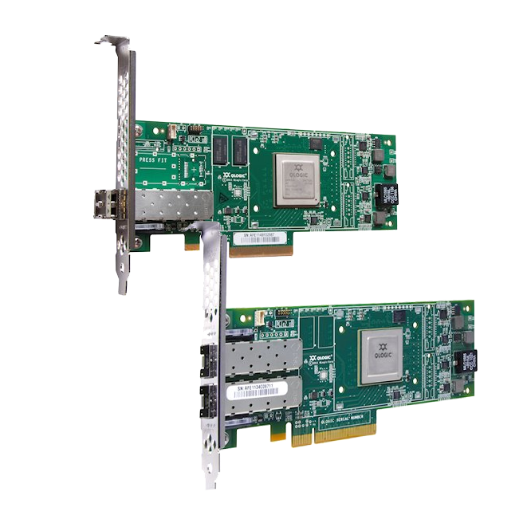
FC 32Gb/16Gb
Single port
It's coming in H2, 2019.
Dual ports

Slide 45
Build up HA Storage in Business

Slide 46
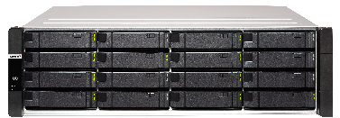
IT Infrastructure With No Single Point of Failture
Primary Site
DR Site
App
App
App
App
App
App
App
App
OS
OS
OS
OS
1 m to 50 km of separation
OS
OS
OS
OS
Failover data path

Slide 47
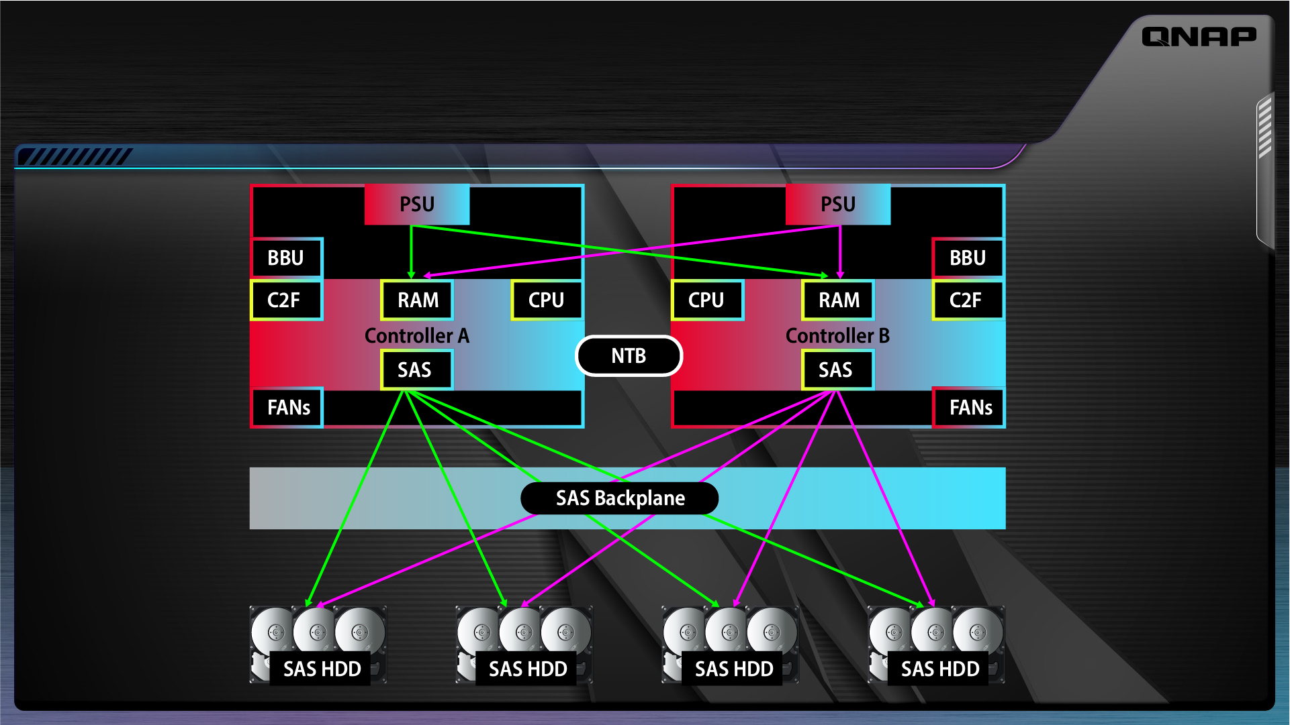
The Architecture of ES1686dc - Tolerates Single Point of Failure

Slide 48
Copy to Flash - Achieve Zero Risk of Power Failure
Each controller is installed a 64GB SATA M.2 Disk as C2F
Write data
Write Cache
64GB SATA M.2 Disk
Copy To Flash
BBU

Slide 49
C2F運作機制
正常供電
快取資料備份
BBU供電
意外斷電
資料寫回記憶體
資料寫回儲存池
恢復供電
記憶體快取資料
儲存池
儲存池
儲存池

Slide 50
Dual-Path Mini-SAS Expansion
SAS-12G2E
SAS 12Gb/s Expansion Card
EJ1600 v2
SAS 12Gb/s Dual-Controller Expansion
Avoid single point of failure
Cascade up to 7 JBODs
48Gb/s high-speed transmission

Slide 51
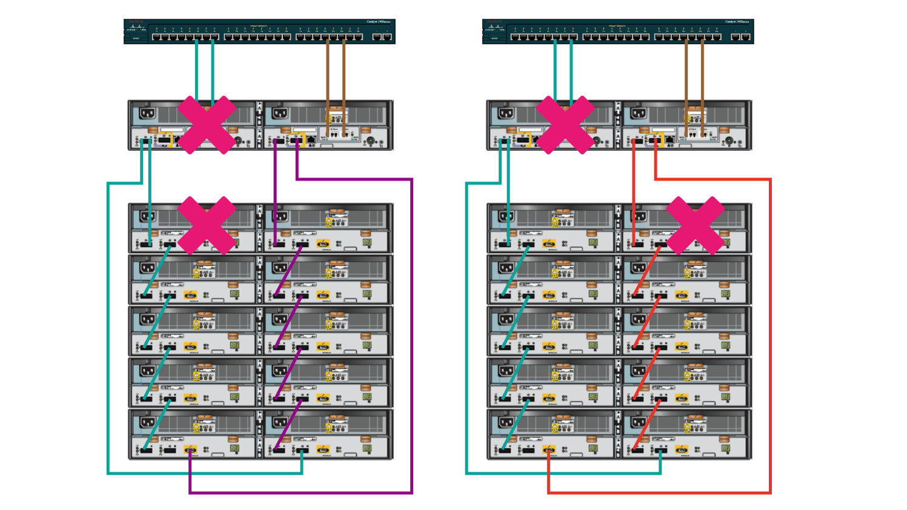
Fault Tolerance - Dual Controllers and Dual-Channel Backup
Switch
ES1686dc
ES JBOD

Slide 52
Design with Hot-Swappable Components
Easy maintenance even without the system shutdown

Slide 53
MPIO & Trunking Provide Fault Tolerant Network Service
Even if the device on any network fails, the host can still access the data on the storage system.
Avoid interruption of access when a single physical channel is interrupted
HBA 1
HBA 2
Switch 1
Switch 2
Network Port 1
Network Port 2
iSCSI LUN / Share Folder
Notes:
https://www.ithome.com.tw/node/51926
https://www.ithome.com.tw/tech/96900
https://statemigration.com/microsoft-multipath-io-mpio-users-guide-for-windows-server-2012/

Slide 54
QES 2.1
Flexible, Safe and Efficient

Slide 55
QES OS Combined with ZFS File System

Slide 56
Data Storage

Slide 57
ZFS Robust RAID-Z Data Protection
ZFS RAID-Z outperforms traditional RAID technology with better protection when power fails.
QES supports following RAID
RAID 0, 1, 5, 6, 10, 50, 60
RAID TP (Triple Parity)
Triple mirror

Slide 58
Large-Capacity HDD and SSD are Becoming Popular
With the rapid increase in HDD and SSD capacity
RAID-6 has gradually failed to meet the reliability needs
128TB
64TB
32TB
16TB
20 - 40TB
Disk Capacity (TB)
10TB
2015
2016
2017
2018
2019
2020
Source: https://focalstyle.wordpress.com/2016/03/19/toshiba-announced-ssd-solid-state-disk-roadmap-2018-capacity-up-to-128tb/
Notes:
https://www.storagereview.com/seagate_announces_64tb_nvme_ssd_new_nytro_ssds_at_fms

Slide 59
RAID-TP Dramatically Increases Reliability and Security
RAID-TP supports the protection with three parities
The storage system can tolerate the failure of up to three disks
RAID Stripe
D1
D2
D3
P
Q
R
Notes:
RAID-6 is increasingly unable to meet reliability requirement.
The addition of another level of parity mitigates increasing RAID rebuild times and occurrences of latent data errors.
https://cacm.acm.org/magazines/2010/1/55741-triple-parity-raid-and-beyond/fulltext

Slide 60
Hierarchical Checksum Prevent Silent Data Corruption
Pointer
Pointer
Checksum
Checksum
Separate checksum and data
Validate the entire I/O path
Detect any form of silent data corruption
Pointer
Pointer
Checksum
Checksum
Data
Data

Slide 61
Copy on Write Ensures End-to-End Data Integrity
1. Initial block tree
2. COW some blocks
Always on-disk consistent
Immune to power failure
3. COW indirect blocks
4. Rewrite uberblock (atomic)

Slide 62
Self Healing, Automatically Recover Data from Silent Corruption
Checksum can detect silent data corruption and automatically recover this error.
Application
Application
Application
ZFS RAID 5
ZFS RAID 5
ZFS RAID 5

Slide 63
Data
Management

Slide 64
QES Pool Over Provisioning Provides More Stable Performance
By Decelerating The Space Fragmentation
A
B
C
D
A
B
C
D
Pool Free Space
Pool Free Space
Reserved Space
Legacy
Pool Over Provisioning
E
E
E
E
EX.
B
Data E is put discretely
Remove Data B and write Data E
A
E
B
E
C
E
D
A
B
C
D
E
Pool Free Space
Pool Free Space
Reserved Space
Notes:
QES 2.1提供2層過度配置，第1層在池級別，另一層在SSD級別。當池非常滿或非常分散時，會發生性能下降。如果池已經攜帶了大量數據，則很容易理解，可能會獲得大量小區域的空閒塊，而不是少量大區域。如果系統需要分配2 MB的空間，它將開始讀取和評估所有適合的空間，以找到合適的block存放數據或將2 MB分解為更小的塊。這當然需要一些時間並降低性能。
因此，通過池級過度配置，系統可以通過為文件系統保留部分空間來快速找到適當的寫入空間。
另一方面，所有SSD都為這些額外的寫入操作以及SSD本身的firmware和壞損的block替換保留了一定的空間。 SSD製造商保留7.37％的空間作為GC等後台活動的配置。因此，即使SSD似乎已滿，它仍將具有7.37％的可用空間，以便繼續運行並執行寫入。
事實上，SSD的性能在達到約50％滿後開始下降。不同的超額配置百分比會影響SSD性能和耐用性。這就是為什麼除了內置的7.37％之外，QES還提供了不同超額配置百分比的設置。借助QES過度配置解決方案，用戶可以使用簡單的UI設置評估實際工作負載並相應地配置過度配置空間。它們具有自由度和靈活性，可以優化配置SSD，具有7％，14％，28％或任何百分比的OP空間，以實現最佳性能和耐用性。
通過使用戶能夠根據實際需求配置OP設置，QES動態過度配置解決方案可最大限度地提高SSD的性能和使用壽命，從而提高生產力並提高運營效率。

Slide 65
Compaction Improves Ineffectiveness With Deduplication and Compaction
QES makes storage more efficient
In-line Deduplication
In-line Compression
In-line Compaction
Notes:
首先，除了inline dedup和inline compression之外，在QES 2.1中，我們添加了一種稱為inline compation的功能。它是對我們是對重複數據刪除和壓縮技術在資料儲存效率的加強.
邏輯上，隨著數據進入存儲控制器，以下是存儲效率過程的工作原理：首先是inline dedup發生。當數據進入控制器內存時，將對數據進行比較和重複數據刪除。接下來，我們將數據塊壓縮成一個或多個4KB block。
我們做的最後一件事是compaction。通過inline compression的任何數據或小於4KB且無法壓縮的數據都有資格進行compaction。compaction過程將這些塊中的兩個或多個配對並裝配到單個4KB物理塊中，然後將該塊發送到存儲器。壓縮率越高，文件越小，compaction rate越高。
通過在寫入閃存SSD之前對數據進行壓縮，重複數據刪除和壓實，QES不僅能夠通過最大限度地減少寫入來延長SSD的使用壽命，而且還可以節省存儲空間方面的重大突破。
在高數據複製或大量小數據訪問（如事務日誌或數據庫）的情況下，增加SSD空間使用的好處尤為顯著，使閃存存儲系統更具成本效益。

Slide 66
Write Coalescing
Speed up data access
Extend flash lifespan

Slide 67
QoS Ensures Workloads are Well Serviced
Maximum IOPS
Workload 2
Maximum IOPS
Workload 1
Workload 2
Minimum IOPS
Minimum IOPS
Workload 1
Noisy neighbor)
QoS protects against noisy neighbor
Notes:
限制噪聲鄰居效應的一種方法是確保應用程序僅通過將資源移動到其他工作負載來接收必要的資源。設置限制可以控制每個工作負載接收的資源量。因此，沒有一個應用程序擁有太多資源並且阻礙了其他應用程序的性能。
QES的OoS允許用戶設置最小和最大目標。當系統具有公平資源時，最小值可確保性能。另一方面，最大值禁止應用程序超出此級別並影響其他應用程序。
在此示例中，由於工作負載2需要太多資源甚至超過目標最大IOPS，因此工作負載1無法將其服務級別維持在最小IOPS之上。但是，通過QoS設置，系統將在最大設置下控制工作負載2的性能，並將資源切換到工作負載1，因此兩個工作負載都可以將其服務維持在預期的性能級別。
基於QES的QoS旨在獨立於容量控制性能，並在單個存儲系統中為多個應用程序提供可預測的性能。

Slide 68
Data Security

Slide 69
Volume-based & Shared Folder Encryption Comprehensive Data Security Solution
Data encryption and control ensure companies not to worry.
Volume
Cryptographic Key
Encrypted Data
File

Slide 70
WORM (Write Once, Read Many) Assist Corporates to Follow Regulatory Regulations
Once the data is written to the folder, only the data can be read during the scheduling period to prevent the important data from being accidentally or maliciously deleted.
Delete
Notes:
對於法規遵循要求企業做到的資料長期保存（Data Retention）， QES也推出了相關的特色，例如支援WORM（Write Once, Read Many）的儲存，可將檔案的存放維持在無法修改的狀態，以符合公司外部的法律，以及產業治理的規定
例如，因應美國證券交易委員會提出的SEC Rule 17a-4法令時，企業可運用WORM的功能，將儲存系統設定為嚴格的遵循模式（Compliance mode），此外，SnapLock還提供了較為寬鬆的企業模式（Enterprise mode）選項，能用於內部的數位資產保護。

Slide 71
Data Backup

Slide 72
Nearly Limitless Snapshots Help Quickly Restore Large Amounts of Data
12:50
13:10
13:30
14:00
14:30

Slide 73
Highly Efficient Snapshot and Clone to Further Save Storage Space Requirement
No additional space is required for copy-on-write, record only difference data
Before Snapshot
After Snapshot
After Modification
Original Copy
Snapshot
Original Copy
Snapshot
Original Copy
A
B
C
D
A
B
C
D
B
D
A
X
C
D

Slide 74
Snapsync Provides a Simple and Quick Backup Mechanism
Support file-level and block-level differential backup, leading DR space usage to be more efficient
Primary Site
DR Site
iSCSI | SMB
iSCSI | SMB
TES-3085U
TES-1885U
Snapsync
ES1686dc
ES1686dc
TDS-16489U R2

Slide 75
Enterprise Application

Slide 76
Petabyte-Level File Services
ES1686dc supports
High availability
Data protection
Efficient storage
Suitable for the following
Media & entertainment
Data center
Manufacturing factory
Financial institute
Medical center

Slide 77
Remote Data Backup
QES Snapsync

Slide 78
Advanced to Disaster Recovery in Different Places

Slide 79
Virtualization Storage Services
Suitable for
Virtual desktop
Virtual server
ES1686dc supports
Accelerate data access
Efficient storage
Performance optimization for SSD

Slide 80
Virtualization Integration

Slide 81
QNAP VAAI Plug-in Accelerates VM Clone
VMware Server
QNAP NAS VAAI Plugin
Read Copy
Write Copy
Copy
VM
VM
VM
VM
QNAP Storage Pool
QNAP Storage Pool
w/o VAAI
with VAAI

Slide 82
QNAP Storage Replication Adaptor Enables VMware DR Just In Time
Supports high availability for offsite applications in a private cloud environment
Site Recovery Server
VMware vCenter Server
VMware vCenter Server
Site Recovery Server
VM
VM
VM
VM
VM
vSphere Replication
VM
VM
VM
VM
VM
SRA
SRA
QNAP QES NAS
QNAP QES NAS
SnapSync
SnapSync can replicate iSCSI LUN & shared folder snapshot

Slide 83
QNAP Snapshot Agent Provides VMware / Microsoft VSS Consistent Snapshot Protection
ES1686dc supports VM snapshots on
VMware®
Microsoft® Volume Shadow Copy Service
Before taking snapshots, the Snapshot Agent notifies VMware® or Microsoft® VSS to stop accessing iSCSI LUNs. This ensures data integrity and reduces system overhead.
C:\ VM_1
C:\ VM_2
Memory_1
Memory_2
VMware vSphere
Memory_1
Snapshot Agent
Memory_2
VMDK_1
VMDK_2
ES1686dc

Slide 84
QNAP vSphere Web plug-in Assist Virtualization Experts to Centrally Manage QES Storage Systems
VMware ESXi host

Slide 85
QNAP SMI-S Provider Combined with Microsoft SCVMM to Simplify QNAP Enterprise Storage
SCVMM enable users to manage ES1686dc through SMI-S Provider.
SCVMM Server A
App
App
App
App
SCVMM Server B
OS
OS
OS
OS
SCVMM Management
Data Path
QNAP SMI-S Provider Server

Slide 86
ES1686dc Works with Veeam to Properly Backup VM
TES-3085U
TES-1885U
ES1686dc
ES1686dc
TDS-16489U R2
QNAP NAS can reduce data access and transfer
Also dynamically scales to meet high corporations' demands

Slide 87
Openstack Ready
QES supports OpenStack® Cinder and iSCSI Cinder Node drivers, and provides block-level storage space to virtual machines.

Slide 88
Exclusive Tools

Slide 89
QNAP Offers a Wide Range of Utilities
Qfinder Pro
Snapshot Agent
SMI-S Provider
vSphere Web/Client Plugin
Assist in finding a storage system that can be connected
Ensure that VMs can estabilish point-in-time snapshots
Manage QES storage systems through Hyper-V UI
Manage QES storage systems through vSphere UI
VAAI Plugin
SRA for VMware SRM
OpenStack
Cinder Driver
OpenStack Manila Driver
Offload VMware ESXi server workloads
Offload VMware ESXi server backup job to QES Snapsync
Provision iSCSI LUN to Openstack by Cinder driver
Provision CIFS/NFS share to Openstack by Manila driver

Slide 90
is ​Your Best Choice​
Copyright© 2019 QNAP Systems, Inc. All rights reserved. QNAP® and other names of QNAP Products are proprietary marks or registered trademarks of QNAP Systems, Inc. Other products and company names mentioned herein are trademarks of their respective holders.​​​​​

