Slide 1

Search by People in
Photos with the
Brand-new Recognize Engine of
Photo Station
Coming Soon with QTS 4.4.1

Slide 2




Photo Station 6.0 with the Brand-new Recognize Engine
PhotoStation 6.0
Search for People
With
QuMagie Core
• Proactively exclude
invalid Faces
• Re-recognize after
upgrade
With
Multimedia Console
• Set content source
• Integration before
and after upgrade
With Qphoto
• Enjoy precious
memories anytime,
anywhere.
• Get rid of “Not
enough space”
with Instant Upload

Slide 3
Search for
People
PhotoStation 6.0

Slide 4


In the vast sea of people, is there a person who you remember his face, but forgot his name?
PhotoStation 6.0
He could be your classmate.
He could be your distant relative.
He could be your business partner.
Let Photo Station “Search for People"
help you find him.

Slide 5




How to Use
“Search for People”?
PhotoStation 6.0
Step 1
Click
Search for People
Step 2
Upload a photo
Step 3
Select the face you want to search for in the photo
Step 4
Click Search to find People albums with a similar face

Slide 6
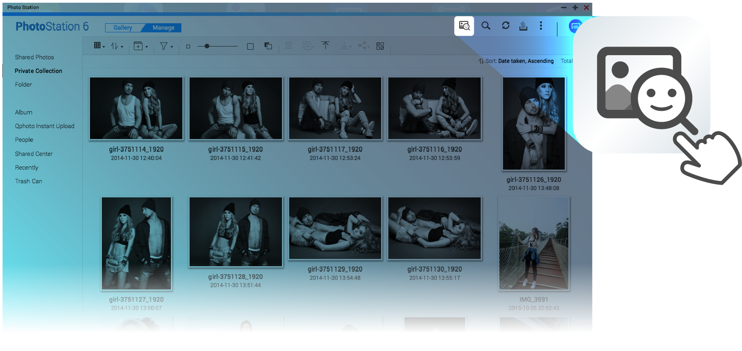
Step 1
Click “Search for People”
PhotoStation 6.0

Slide 7
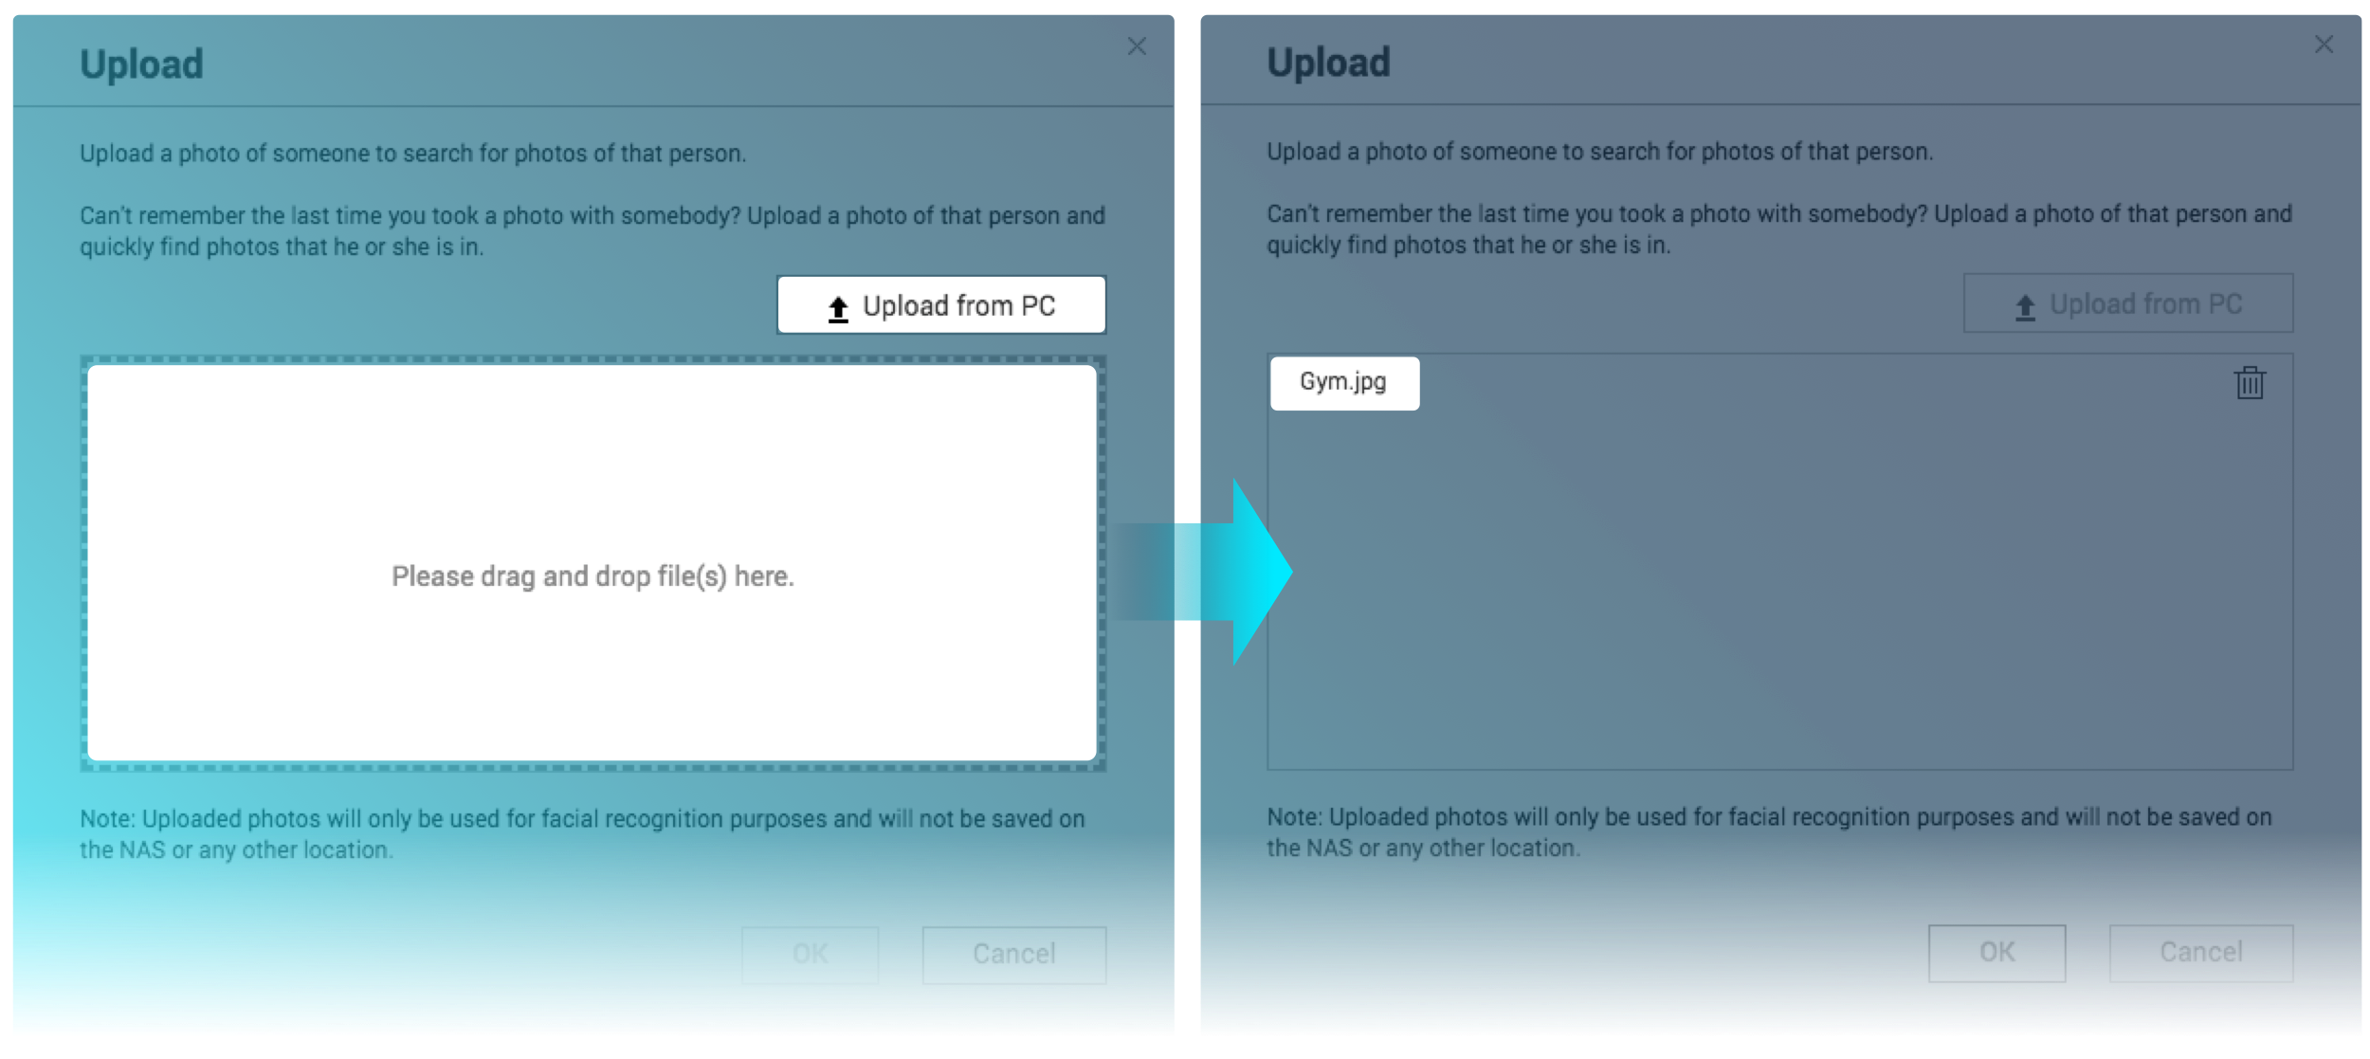
Step 2
Upload a Photo
PhotoStation 6.0

Slide 8
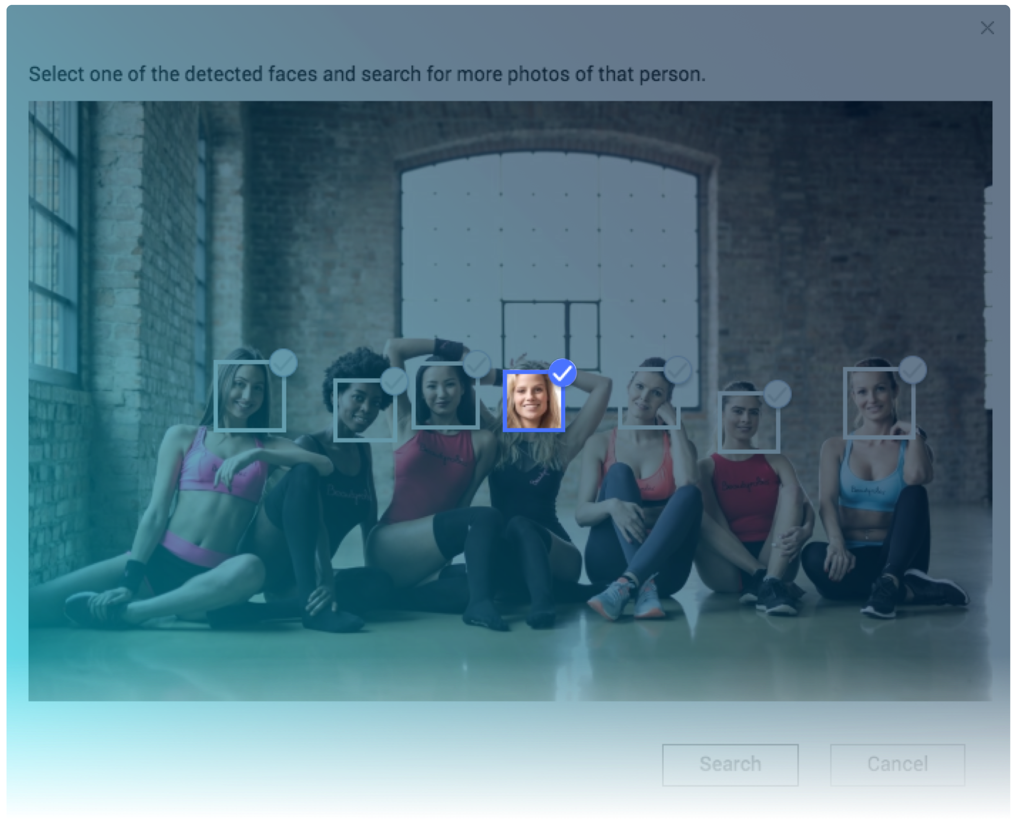
Step 3
Select the Face You Want to Search for in The Photo
PhotoStation 6.0

Slide 9
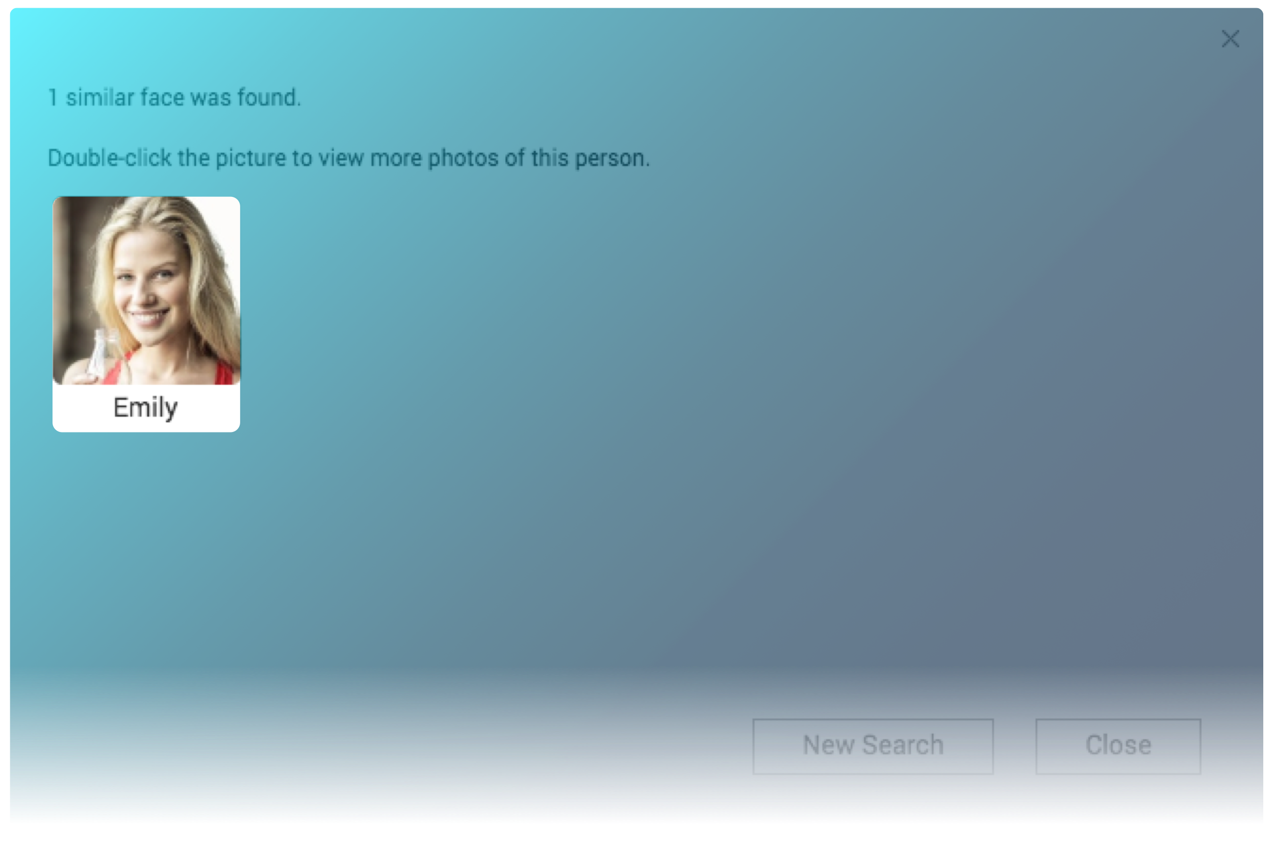
Step 4
Find People Albums with a Similar Face
PhotoStation 6.0

Slide 10
PhotoStation 6.0
Demo
Search for People

Slide 11
PhotoStation 6.0
With
QuMagie Core
The brand-new recognize engine

Slide 12

QuMagie Core
The Brand-new Recognize Engine
PhotoStation 6.0
Support QTS 4.4.1 and later
Support QNAP NAS with Intel, AMD and ARM 64 CPU
Recommended to use with more than 4GB RAM
Must enable "Multimedia Services" before it is installed
Container Station will be installed automatically
Note: More than 4GB RAM is necessary for NAS with ARM 64 CPU.

Slide 13
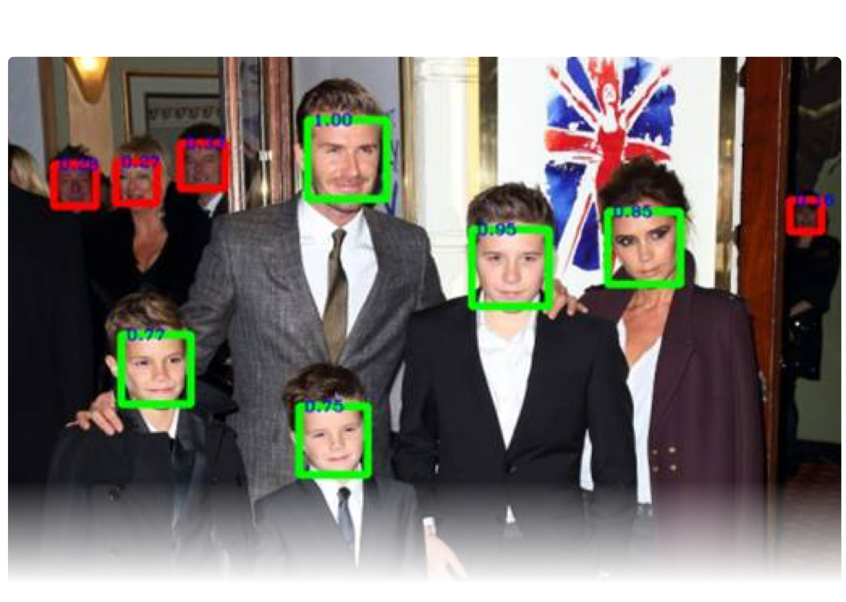

Proactively Exclude
Invalid Faces
PhotoStation 6.0
Strangers ╳ Side Faces ╳ Mis-recognition
Exclude Strangers
Avoid Mis-recognitions

Slide 14
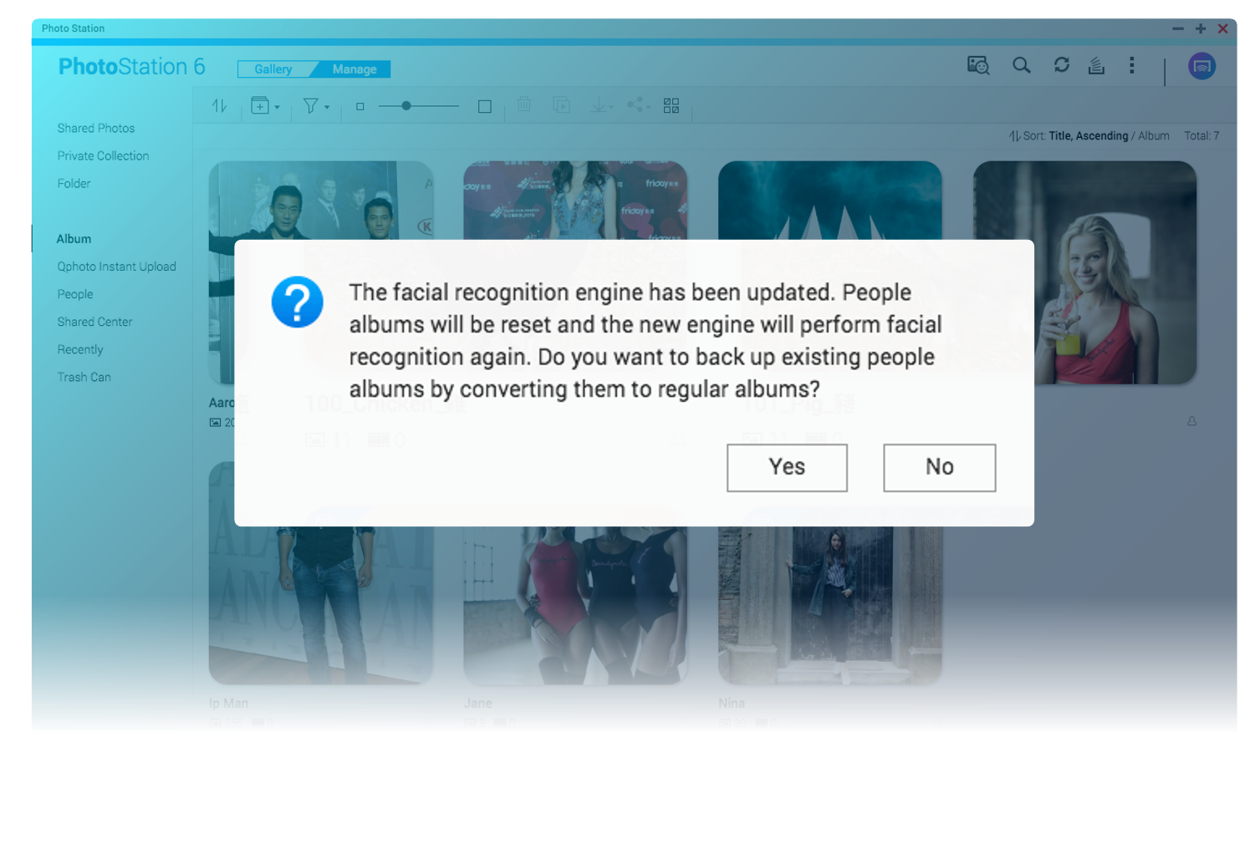
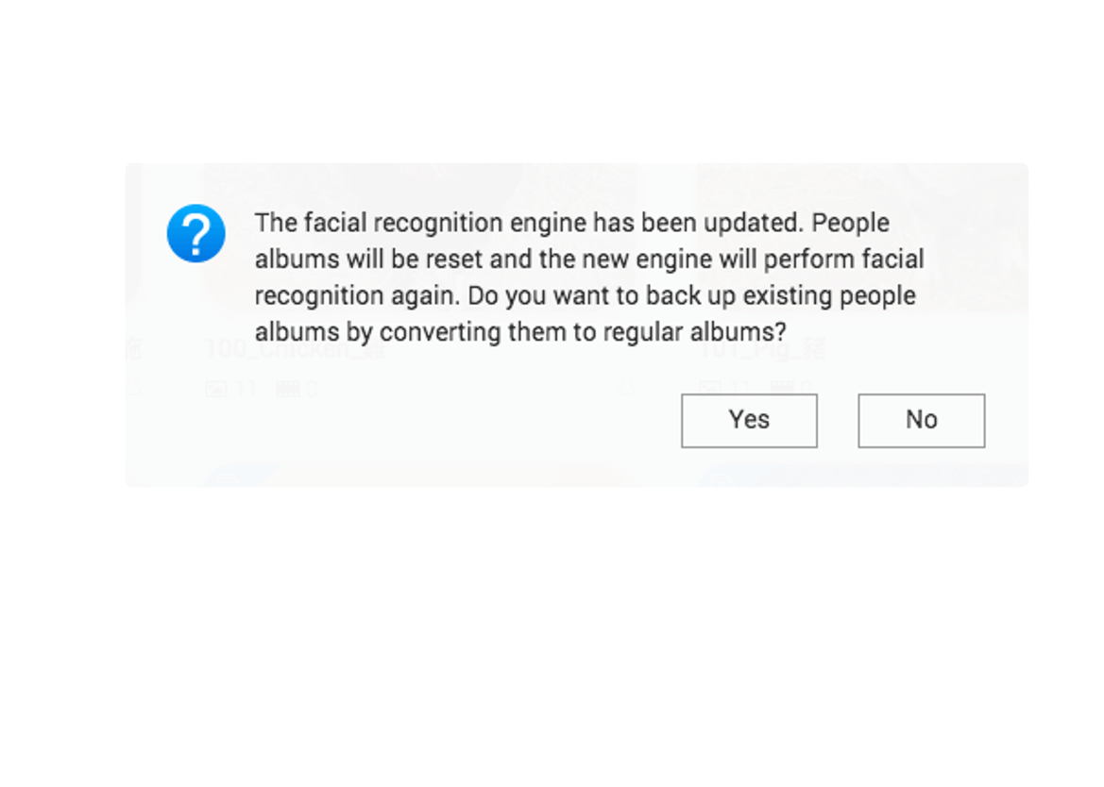
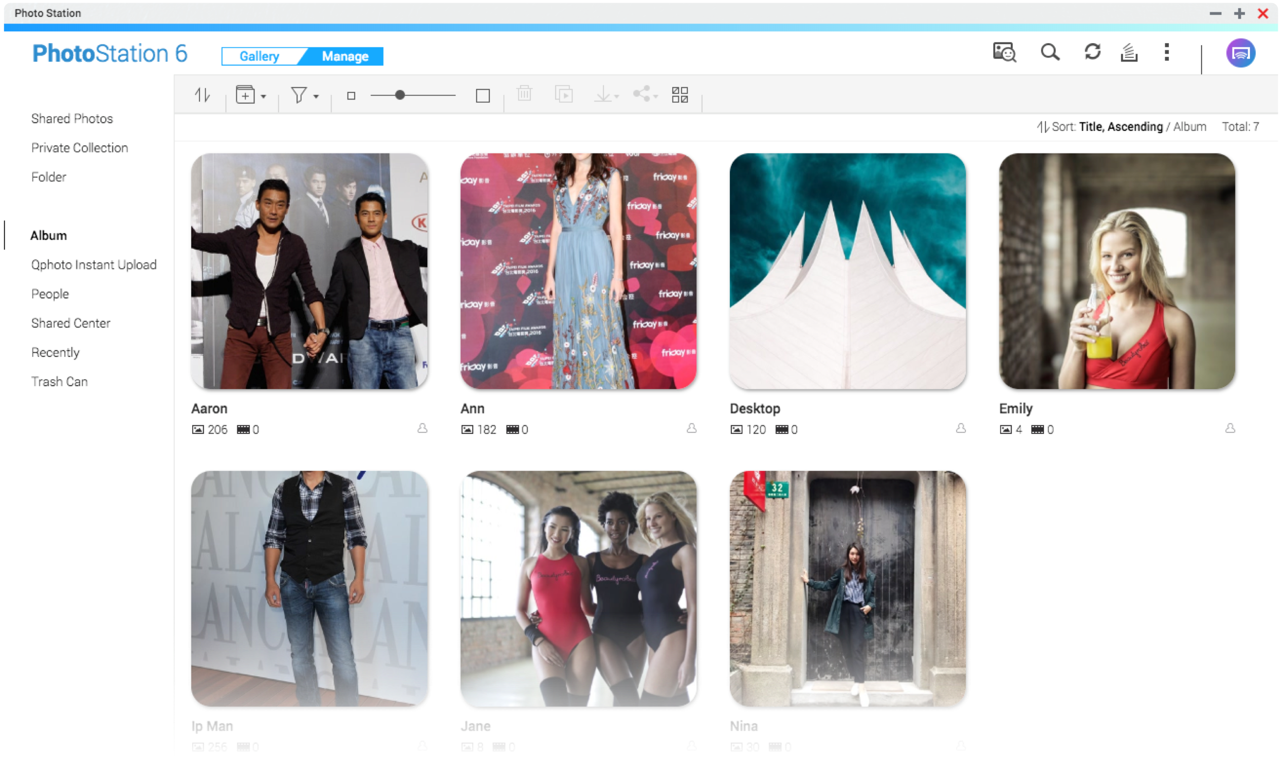
Re-recognize after Upgrade
PhotoStation 6.0
To reach the best recognition, the facial recognition will be performed again with QuMagie Core.
The original People album will be converted to regular albums.

Slide 15
PhotoStation 6.0
With Multimedia Console
Control all multimedia services

Slide 16

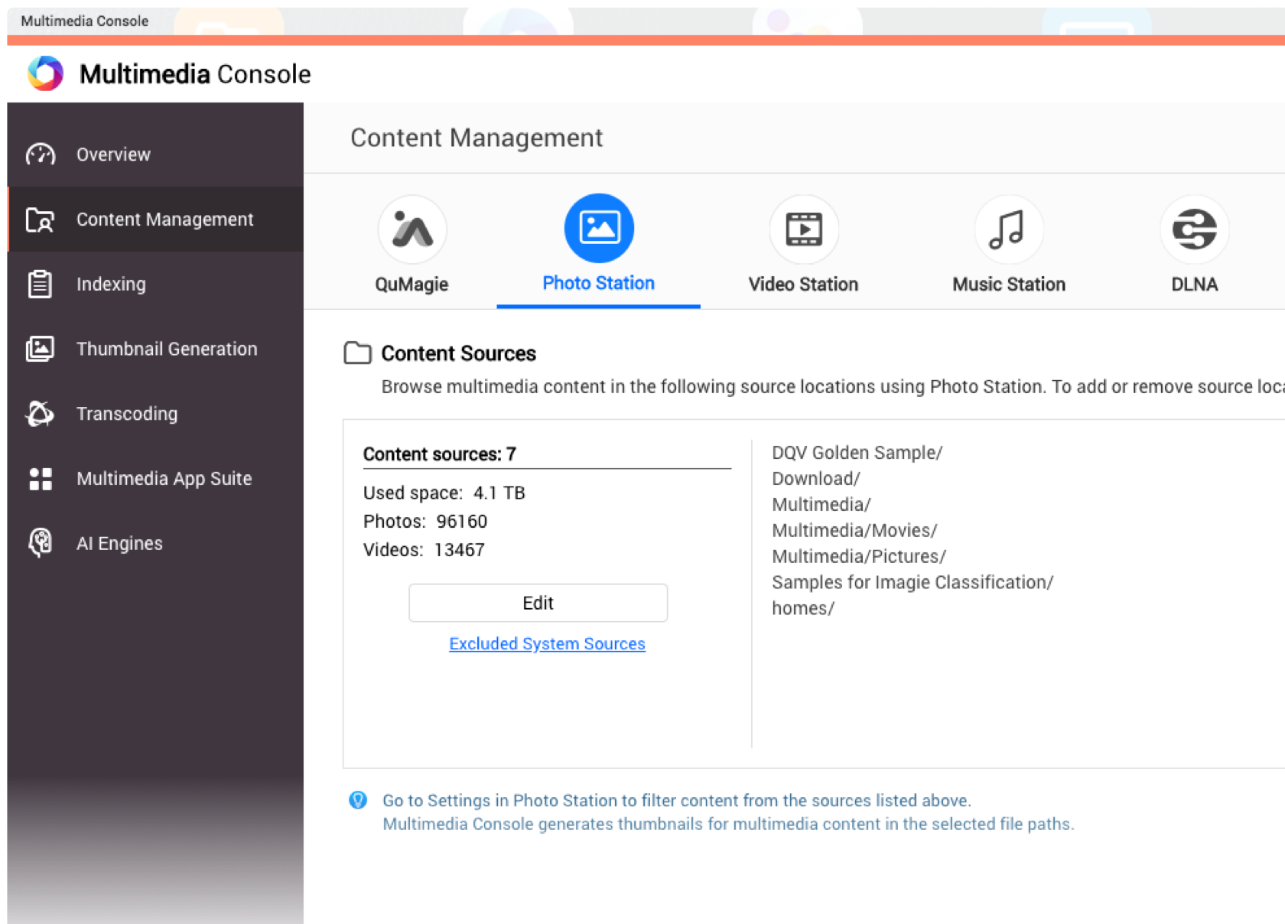
Set Content Sources
PhotoStation 6.0
Step 1
Go to Multimedia Console > Content Management and select Photo Station.
Step 2
Assign folders as content sources, and you can browse photos or videos in Photo Station.

Slide 17






Integration Before and After Upgrade
PhotoStation 6.0
Upgrade to QTS 4.4.1
Upgrade to content sources for each application based on folder properties
QuMagie
Photo Station
Video Station
Music Station
DLNA

Slide 18



Browse Photos in Google Photos with Photo Station
PhotoStation 6.0
CacheMount
Google Photos
Photo Station

Slide 19
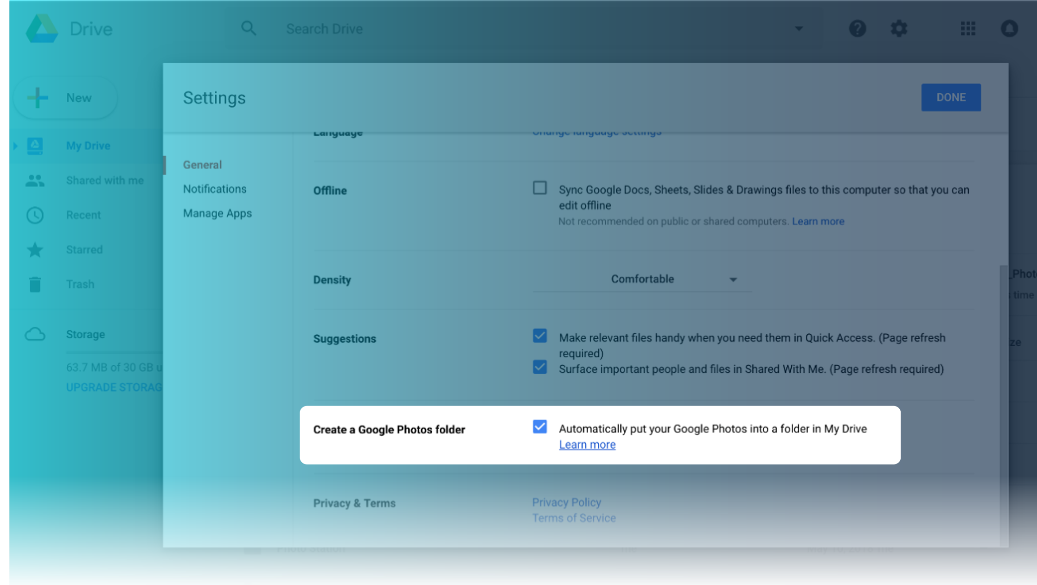
Browse Photos in Google Photos with Photo Station
PhotoStation 6.0
Step 1
Go to Google Drive settings
Step 2
Enable Google to automatically put Google Photos into a folder in My Drive

Slide 20
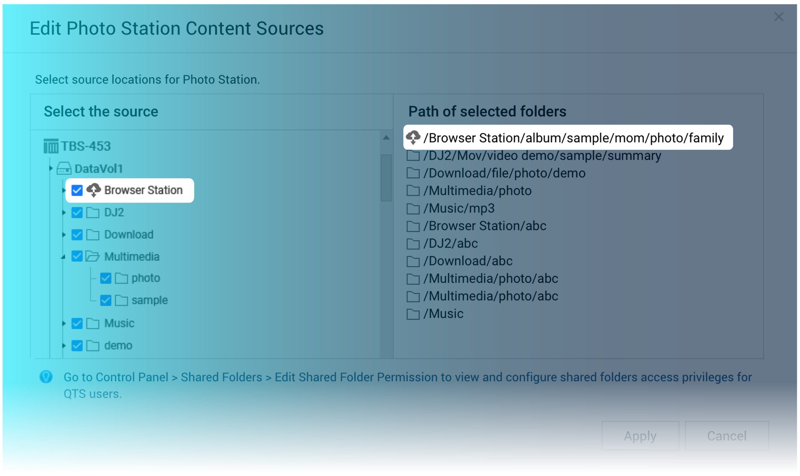
New Feature
Multimedia Console + CacheMount
Set Google Drive as a Content Source of Photo Station
PhotoStation 6.0
CacheMount can cache part of files in cloud drives, improving performance for commonly-used files.
Set the CacheMount Volume as a content source, and you can browse contents on the cloud in multimedia applications.

Slide 21
PhotoStation 6.0
With Qphoto
Browse photos freely and easily

Slide 22
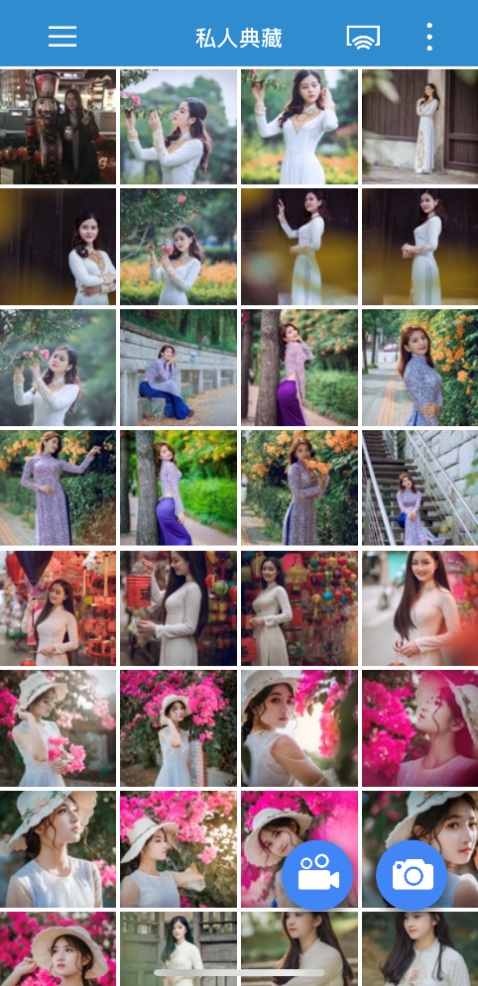
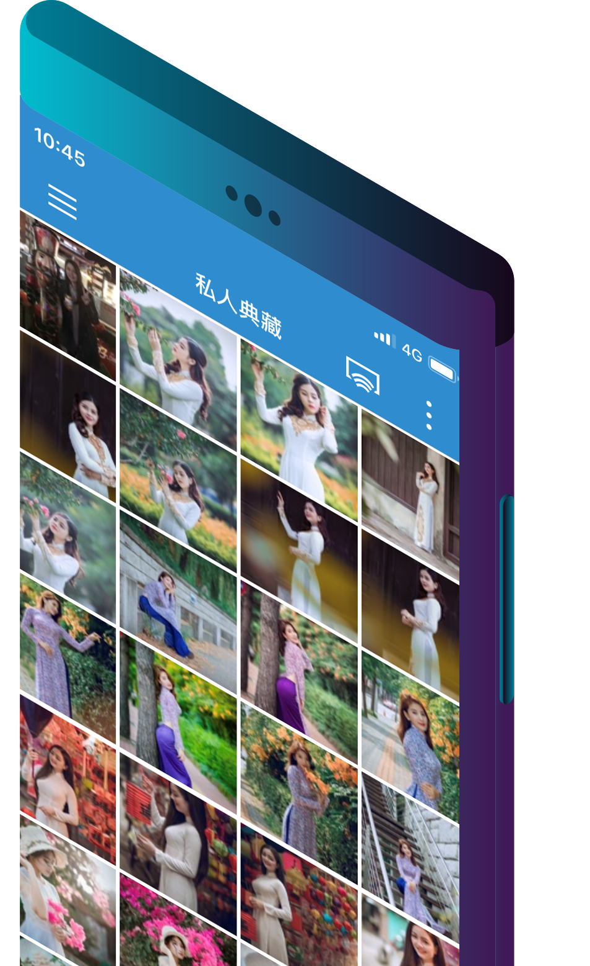




Enjoy precious memories anytime, anywhere
PhotoStation 6.0
Browsing photos and videos stored in NAS with mobile devices
Support iOS and Android

Slide 23


Get Rid of "Not Enough Space" with Instant Upload
PhotoStation 6.0
Instant Upload in 1 Tap
Upload the photo to NAS right after it is taken, without wasting your storage.
Free local storage
Take Photo
Upload to NAS

Slide 24
Highlight
PhotoStation 6.0
Search for People
With
QuMagie Core
• Proactively exclude
invalid Faces
• Re-recognize after
upgrade
With
Multimedia Console
• Set content source
• Integration before
and after upgrade
With Qphoto
• Enjoy precious
memories anytime,
anywhere.
• Get rid of “Not
enough space”
with Instant Upload

Slide 25
Photo Station 6.0
Coming Soon with QTS 4.4.1
Copyright © 2019 QNAP Systems, Inc. All rights reserved. QNAP® and other names of QNAP Products are proprietary marks or registered trademarks of QNAP Systems, Inc. Other products and company names mentioned herein are trademarks of their respective holders.

