Slide 2
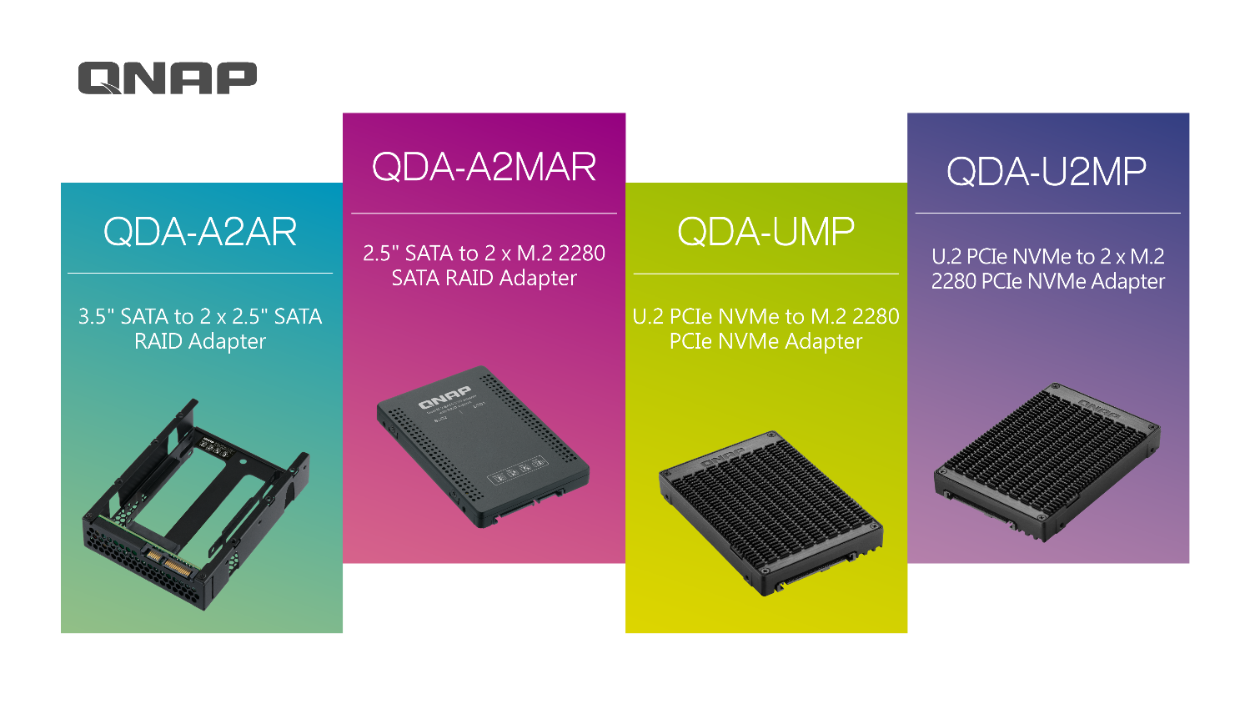

Slide 3
Let PC & NAS perform better and excel on reliability.
Overview on QDA product series
Use Windows utility QNAP External RAID Manager to check the RAID and disk status
Add dual disk drives to a NAS drive slot

Slide 4
QDA series

Slide 5
PC with a single drive only
Out of storage
space
Running slow

Slide 6
Drive has failed and had no data backup?
SSD/HDD
failed

Slide 7
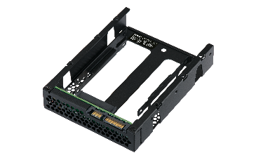
3.5”SATA to dual 2.5” SATA adapter
QDA-A2AR
2 x 2.5” SATA 6Gb/s
SATA 6Gb/s
SATA 6Gb/s
Supporting
7mm & 9.5mm
2.5” HDD/SSD
3.5” SATA 6Gb/s
Disk mode switch
Jmicron JMS562
SATA port multiplier
(RAID 0/1, JBOD, individual)
JMS562
Supporting
7mm & 9.5mm 2.5”HDD/SSD
25.9mm
SATA 6Gb/s
138.2mm
101.6 mm

Slide 8
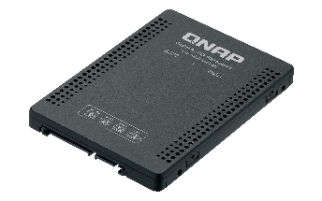
2.5” SATA to dual M.2 SATA adapter
QDA-A2MAR
Jmicron JMS562
SATA port multiplier
(RAID 0/1, JBOD, individual)
SATA 6Gb/s
SSD 2
SATA 6Gb/s
Disk mode switch
M.2 2280 SATA 6Gb/s SSD
9.5mm
SSD 2
SSD 1
SATA 6Gb/s
JMS562
SSD 1
2 x M.2 2280 SATA 6Gb/s
M.2 2280 SATA 6Gb/s SSD
100.5mm
69.9mm
SATA 6Gb/s

Slide 9
Hardware RAID controller, reducing host CPU resources
QDA-A2AR/A2MAR
Individual
(Port multiplier)
RAID 1
(Default)
RAID 0
JBOD
Any number of drives. Each drive capacity separated​*.
2 drives​ but losing 1-drive capacity ​for redundancy​.
2 drives with combined capacity, best performance but no fault tolerance​.
2 drives​ with combined capacity but no ​fault tolerance​.
* Make sure your system supports port-multiplier in order to detect both drives in the Individual mode.

Slide 10
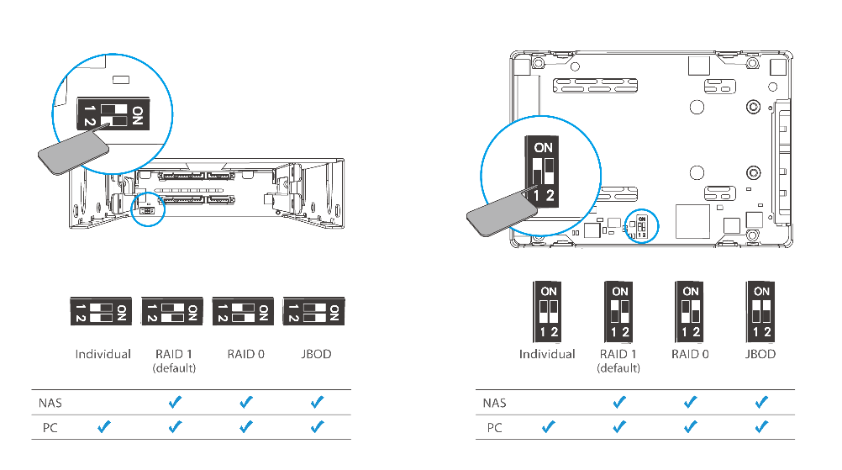
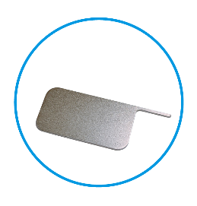
QDA hardware RAID disk mode switch
Creating or deleting RAID is only supported by the hardware-based disk mode switch.
QDA-A2AR
QDA-A2MAR
Disk mode switch tool included.

Slide 11
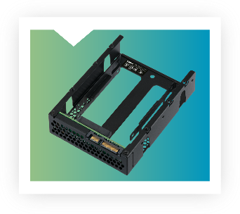
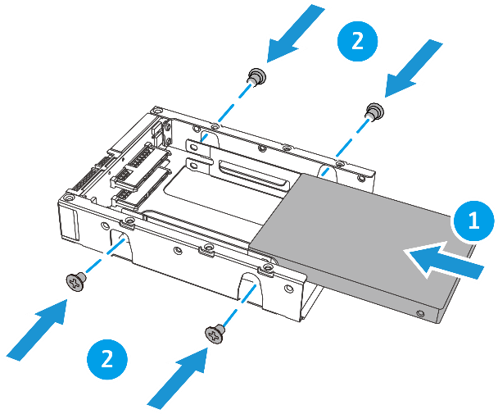
QDA-A2AR 2.5” SATA HDD/SSD installation
Use Phillips #2 screw driver

Slide 12
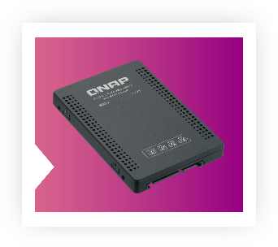
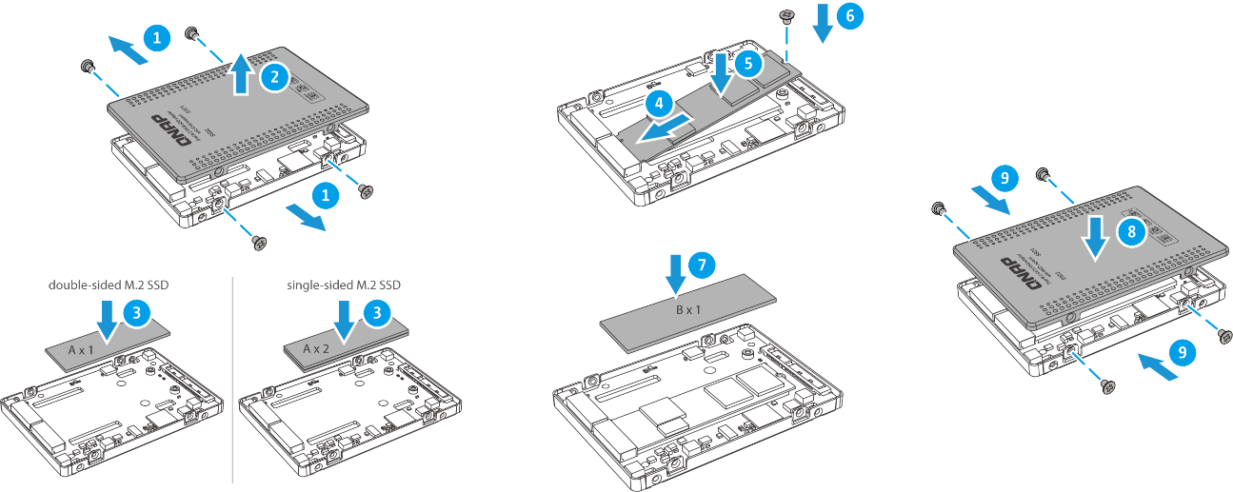
QDA-A2MAR M.2 SATA SSD installation
Use
Phillips #1
screw driver
Use supplied thermal pads

Slide 13
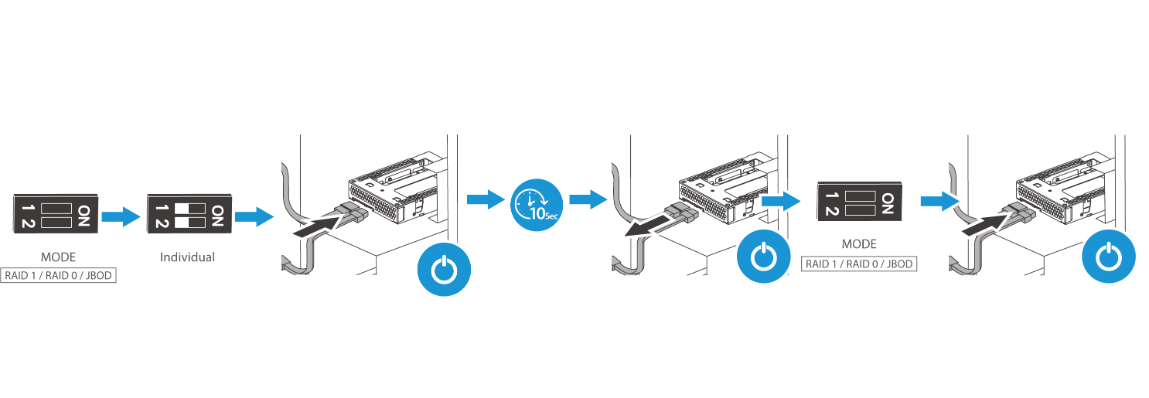
Switch the disk mode on a PC
1
Switch to Individual mode first (Port Multiplier mode)
Connect QDA to the SATA data and power ports
After 10 seconds, remove the QDA
4
Switch to another disk mode
Connect QDA to the SATA data and power ports
2
5
3

Slide 14
Switch the disk mode on a NAS

Slide 15
Standard 3.5” and 2.5“ sizes for the best compatibility
QDA-A2AR/A2MAR
Compatible with 3.5” & 2.5” drive space in a computer
Compatible with 3.5” & 2.5” USB enclosure
Compatible with QNAP NAS drive trays

Slide 16
U.2 NVMe Adapters
QDA-UMP: U.2 to M.2 NVMe
QDA-U2MP: U.2 to 2 x M.2 NVMe

Slide 17
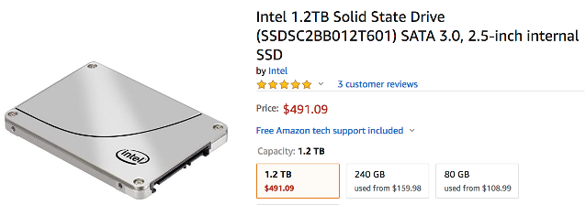
U.2 NVMe SSDs are fast and cool, why are they not popular yet?
U.2 was named SSF-8639, and supports up to 32Gbps (PCIe NVMe Gen3 x4) speed
U.2 SSDs come in 2.5” drive form factor, thus better heat dissipation compared to M.2 SSDs
Fewer brands
U.2 SSDs cost more than M.2 SSDs
Source: 2019/03/21 Amazon.com

Slide 18
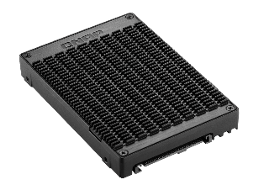
U.2 NVMe to M.2 NVMe adapter
QDA-UMP
U.2 PCIe NVMe
Gen3 x4
M.2 2280
PCIe NVMe
Gen3 x4
U.2 PCIe NVMe
Gen3 x4
15mm
M.2 2280
PCIe NVMe
100.4mm
69.85mm
Notes:
Linux utility for QDA

Slide 19
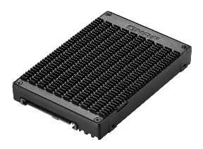
U.2 NVMe to dual M.2 PCIe NVMe adapter
QDA-U2MP
U.2 PCIe NVMe Gen3 x4
Asmedia 2812
Gen3 PCIe switch
SSD 2
2 x M.2 2280 PCIe
NVMe Gen3 x4
M.2 2280
PCIe NVMe Gen3 x4
15mm
SSD 2
SSD 1
SSD 1
U.2 PCIe NVMe
Gen3 x4
ASMedia
2812
M.2 2280
PCIe NVMe Gen3 x4
100.4mm
69.85mm

Slide 20
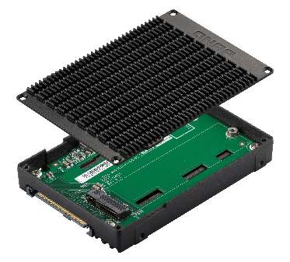
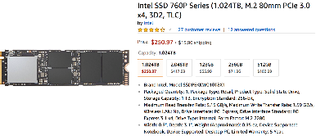
Let hosts with U.2 interface use affordable and high capacity M.2 SSD
PowerEdge R6415 server
Up to 10 x 2.5”U.2 NVMe SSDs
Asus ROG RAMPAGE VI EXTREME OMEGA
Up to 1 x 2.5”U.2 NVMe SSD
Source: 2019/3/21
https://www.dell.com/en-us/work/shop/povw/poweredge-r6415
Amazon.com

Slide 21
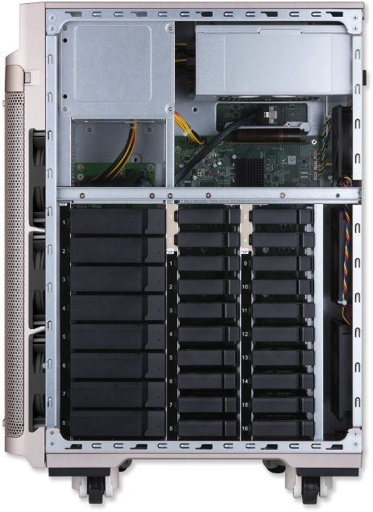
Free up NAS PCIe slots and add M.2 NVMe SSDs
8 x 3.5”/2.5” SATA 6Gb/s HDD slots
4 x 2.5”U.2 NVMe Gen3 x4 SSD slots
- Use QDA-UMP or QDA-U2MP to add up to 8 x M.2 2280 NVMe SSDs
16 x 2.5” SATA 6Gb/s SSD slots
QNAP TS-2888X

Slide 22
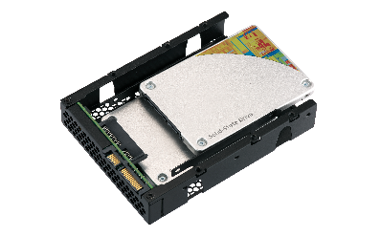
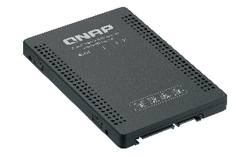
High quality metal construction for better heat dissipation
QDA-A2AR
QDA-A2MAR
QDA-UMP & QDA-U2MP
The included M.2 SSD thermal pads and aluminum-alloy metal frame provides excellent heat induction and keeps the SSDs cooler.
Aluminum-alloy top frame
SGCC
(Steel Galvanized ColdRolled Coil)
M.2 SSD thermal pads included
SGCC bottom frame
Aluminum-alloy bottom frame

Slide 23
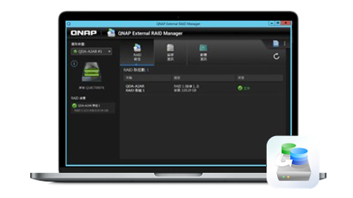
Using QDA on PC / Servers

Slide 24
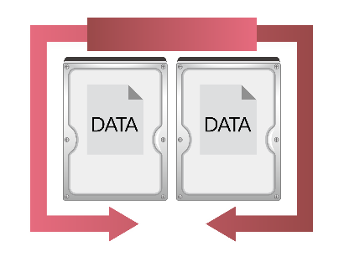
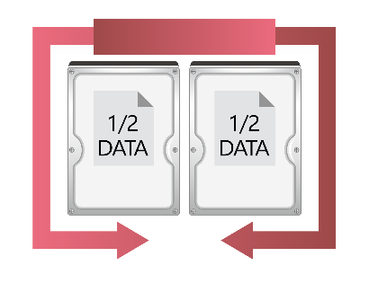
Low cost and easy to use! Rapidly enhance performance or data protection
QDA-A2AR/A2MAR
Using on PC/Servers: Enjoy higher performance or data protection
Easily configure RAID 0 to get faster transferring speed, or create RAID 1 to enhance data protection.
RAID 0 Performance
RAID 1 Protection
2TB
2TB
2TB
2TB
4TB
2TB

Slide 25
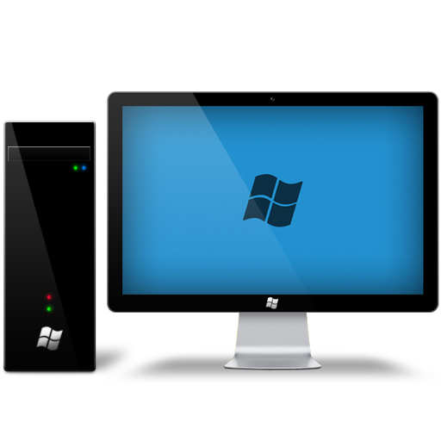
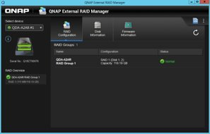
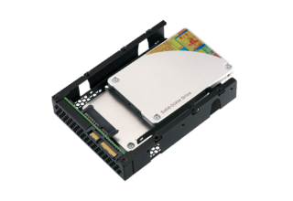
Use QNAP External RAID Manager
to check QDA series information
Install QNAP External RAID Manager, you can:
Check QDA series device, RAID, disk information and status
Update firmware
Support QDA-A2AR/A2MAR, but can not mix TR and QDA series devices together. Including:
Install QDA-A2AR in TR series devices
Install QDA-A2MAR in QDA-A2AR
Supported platforms and OS version
Windows: Windows 7 (or later), Windows Server 2012 R2 (or later)
Please consult your system provider and Install the latest driver for your SATA controller
* Creating or Deleting RAID by software is not supported, it is only supported by the hardware-based disk mode switch.

Slide 26
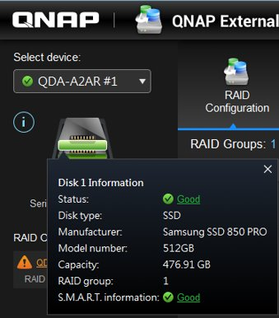
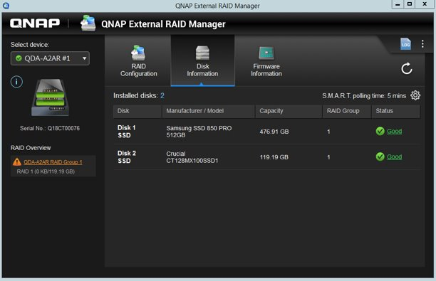
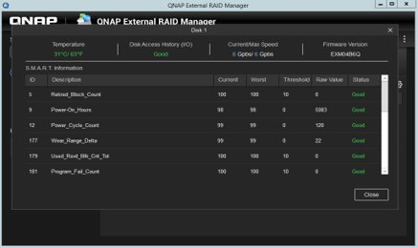
Monitor Disk Health
The disk color on the device shows disk's status. Click on any of them to check the disk information
Show all disks in "Disk Information". Click status to get the details of disk's S.M.A.R.T information.
Quick overview
Check information

Slide 27
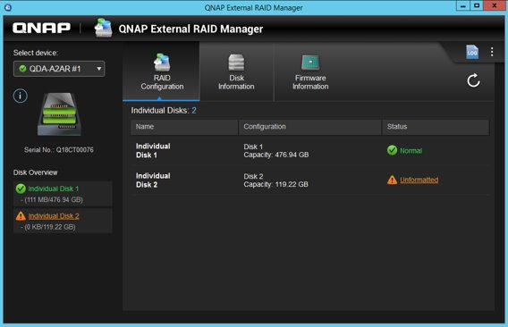
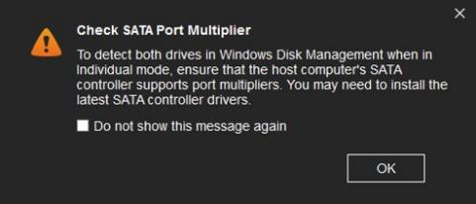
Individual Mode
Use the dip switch on QDA-A2AR/A2MAR to set it on Individual Mode. The utility will show two independent disks, after formatting the disk, you can start to use it.
Note: Check whether your PC supports SATA Port Multiplier when you switch to Individual Mode. If so, system can detect both drives in Windows Disk Management.

Slide 28
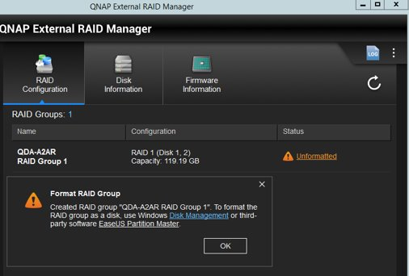
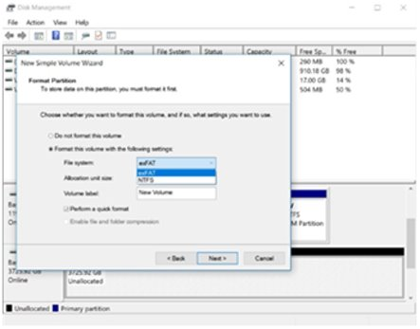
Format the external RAID group in advance to be able to use it.
After setting the RAID type through Hardware dip switch, QNAP External RAID Manager will guide users to operating system interface for formatting.
Direct to Windows Disk Management
for formatting

Slide 29
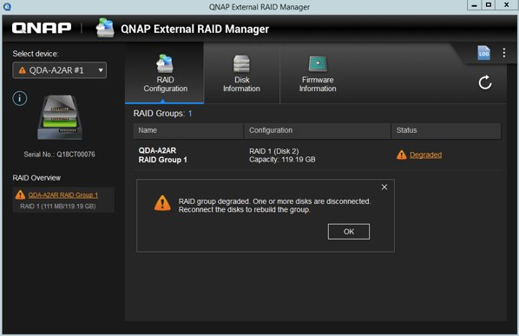
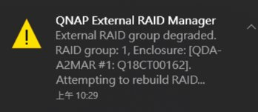
Instant notification when external RAID is abnormal
When the RAID is degraded or has failed, users will be notified by the UI as well as desktop notification

Slide 30
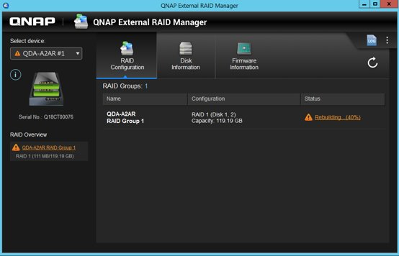
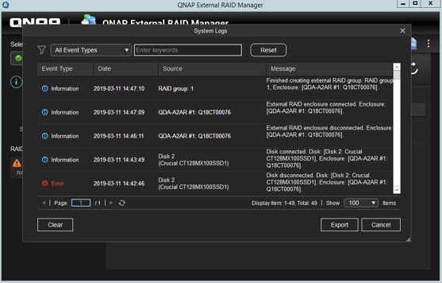
External RAID protection mechanism with system event logs
Same as the NAS, when RAID is degraded, change a new disk to start rebuilding and rebuild progress is shown
Logs are independent from operating system, quickly know and export events

Slide 31
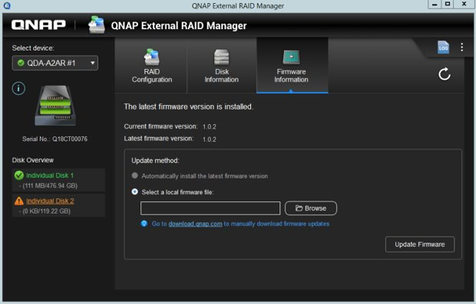
Firmware Information and Updates
Can check the current and latest firmware version in Firmware Information page
When there is a new version, pop-up desktop notification will inform users

Slide 32
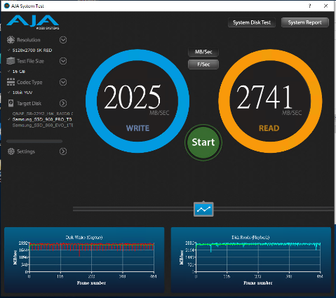
Use affordable and high-capacity M.2 NVMe SSD in U.2 NVMe host computers
QDA-UMP/U2MP
Samsung 960 Pro M.2 NVMe SSD on QDA-UMP can still maintain high performance

Slide 33
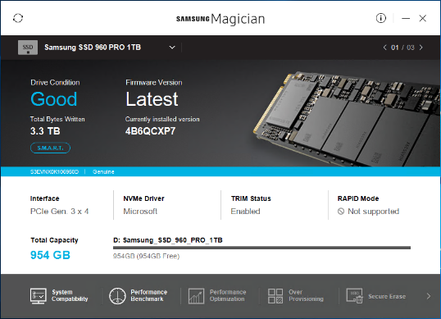
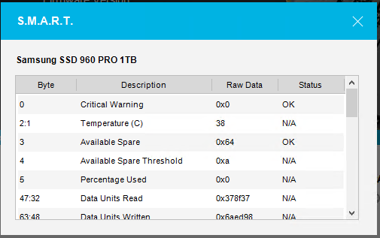
Use SSD vendor tool to know NVMe SSD status
QDA-UMP/U2MP
Download Samsung Magician from https://www.samsung.com/semiconductor/minisite/ssd/download/tools/

Slide 34
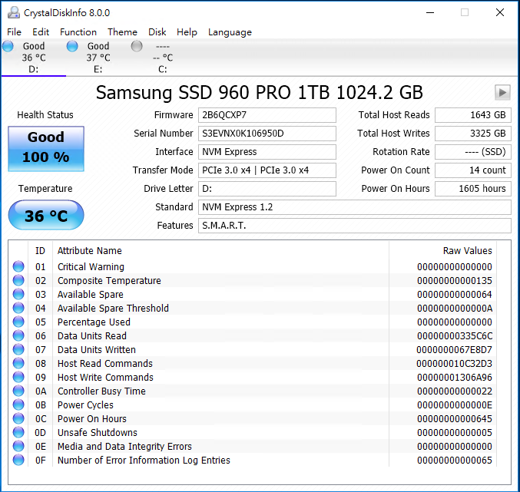
Use 3rd party tool to monitor NVMe SSD status
QDA-UMP/U2MP
CrystalDiskInfo
https://crystalmark.info/en/software/crystaldiskinfo/
O.S.：Windows 10/8.x/7/Vista/XP (32 & 64 bit)

Slide 35
PC usage & performance demo

Slide 36
QDA On QNAP NAS

Slide 37
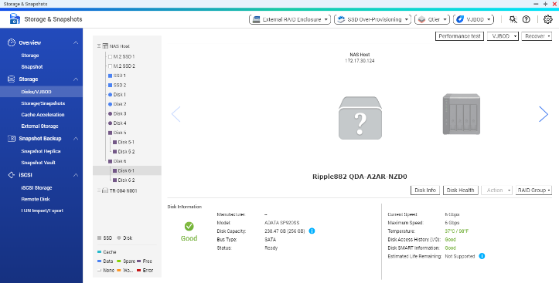
The QDA can also be used on the NAS
The QDA can also be utilized on all QNAP NASs.
Same as TR series device, QDA series stand up with its combabilities with the NAS to support disk monitoring for data protection.
Functions: - QTS Disk monitoring - External RAID monitoring
- Disk S.M.A.R.T.
- Customized temperature alert - Notification Center

Slide 38
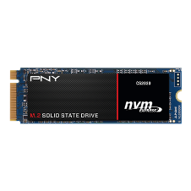
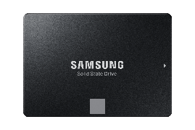
How does QDA combine hardware & software RAID
The QDA-A device have hardware RAID 0/1 for the 2.5 or M.2 disk inserted.
The hardware RAID will be recognized as a single virtual disk on the QNAP NAS to create storage space independently or combine with other disks.
Software RAID 5
Virtual Disk
Virtual Disk
2.5 Inch SSD
QDA-A2MAR
RAID 0
QDA-A2MAR
RAID 0
*QDA-A does not support use management interface to control RAID. The QDA-A device cannot be set as Individual at the NAS.

Slide 39
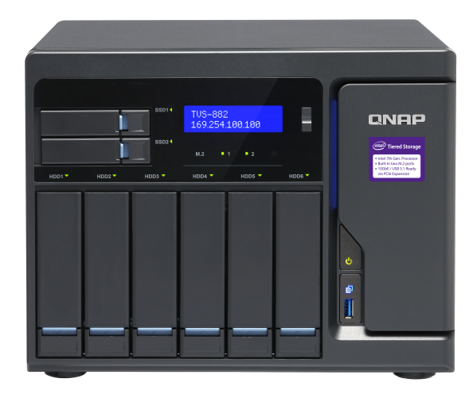
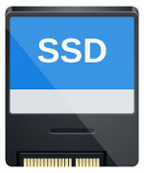
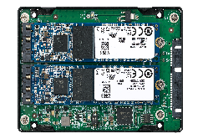
Use multiple QDA devices for storage expansion
Scenario
All the QDA Devices, with SSD, support both SSD Cache and Qtier.
For General Server and QNAP NAS, multiple QDA Devices can be used to create larger storage space with limited slots.
2*256 GB RAID 1
= 256 GB Cache
2*256 GB RAID 0*2
= 2*512G RAID 1
= 512 GB Cache
VS
Note: TR-002/004 do not support QDA-A2AR & QDA-A2MAR; QDA-A2AR does not support QDA-A2MAR.

Slide 40
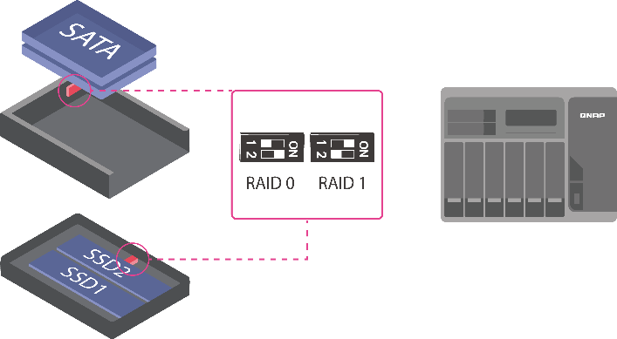
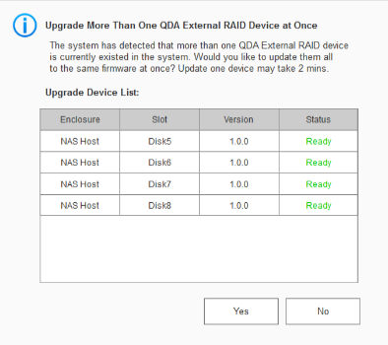
Manage the QDA devices in the NAS
Change multiple QDA-A device with Hardware RAID 0 and use software RAID to gain the maximum device potential on the NAS.
To change the QDA-A Device RAID type, use the dip switch on the device.
It is possible to upgrade multiple QDA device firmware's at once.
QDA-A2AR
QDA-A2MAR

Slide 41
NAS Demo

Slide 42
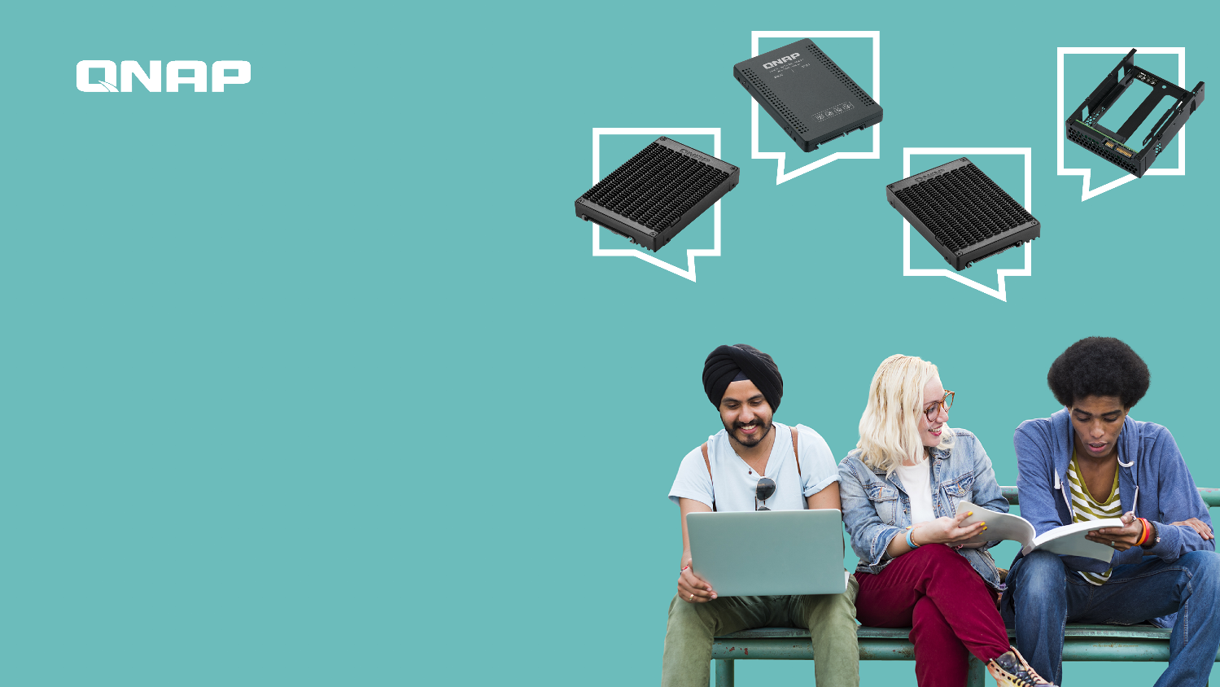
QDA series adapters In & out for quick setup and conversion
Copyright © 2019 QNAP Systems, Inc. All rights reserved. QNAP® and other names of QNAP Productsareproprietary marks or registered trademarks of QNAP Systems, Inc. Other products and company names mentioned herein are trademarks of their respective holders.

Slide 43
