Slide 2
Cinema28 Multi-zone Playback System - The Wonder of your life
The pain point of using video streaming in traditional way
Cinema28 brings whole new solutions
Cinema28 use cases with tutorial & Live Demo

Slide 3
The pain point of using video streaming in traditional way

Slide 4
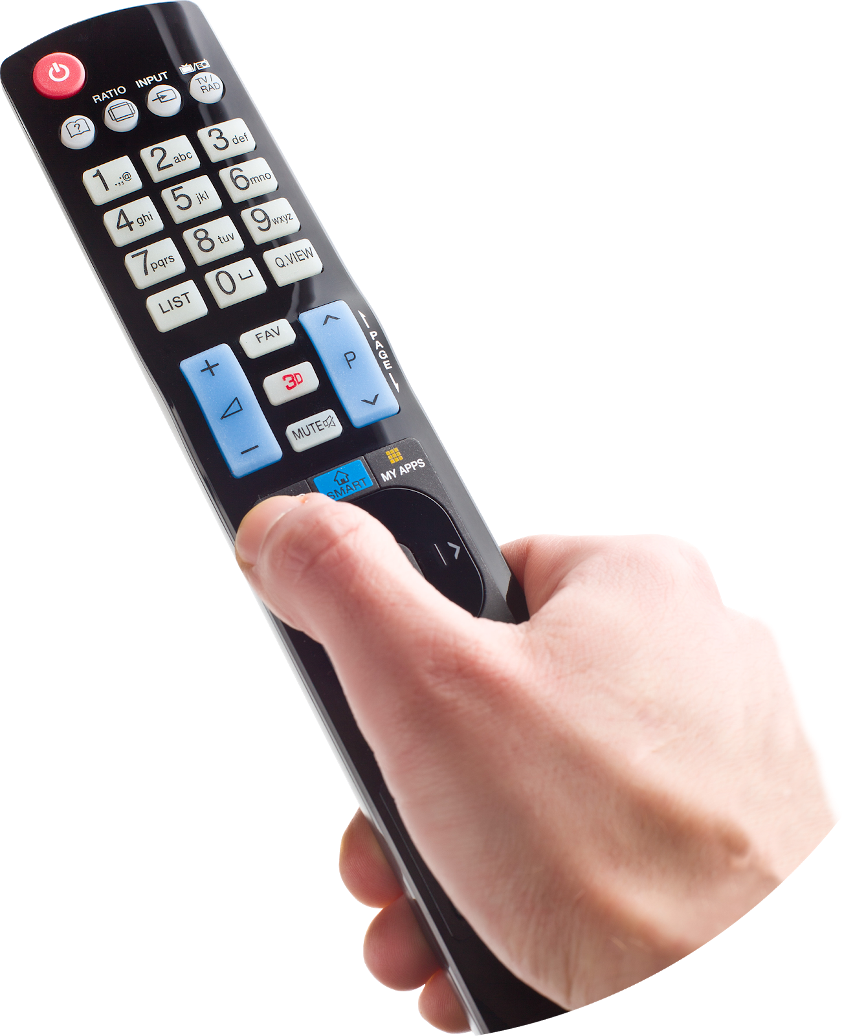
Have you ever had trouble with these video streams in the past?
Each streaming device setting interface is different, so it is difficult to use!
Willing to set up the video streaming device, but the environment is messed up!

Slide 5
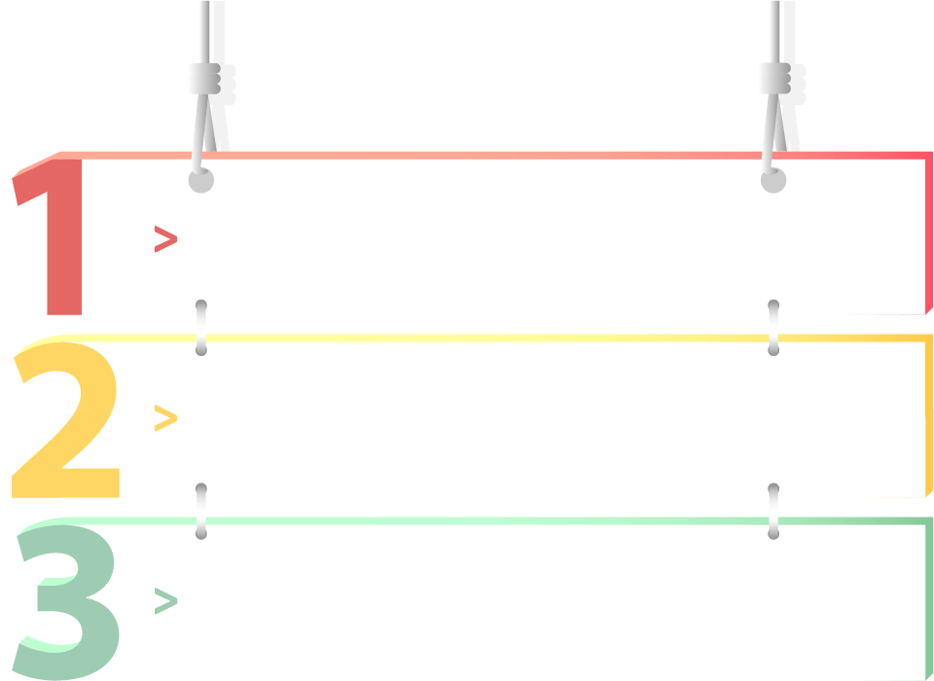
The trouble of traditional video streaming...
Cannot clearly grasp the status of devices
Device operation management and setting are not easy
Likely to cause equipment usage conflict

Slide 6
Cinema28 brings whole new solutions

Slide 7
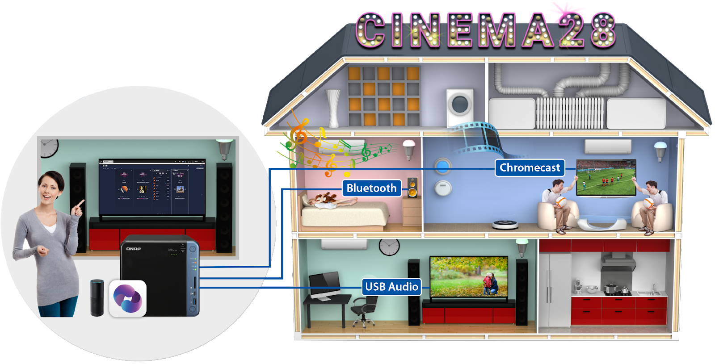
Cinema28 Multi-Zone Playback
Integrate multiple streaming devices and streaming protocols into a single interface for centralized management, allowing users to easily stream digital multimedia files to audio/video devices in every corner of the house.

Slide 8
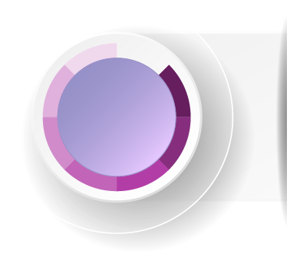
Four Major Features of Cinema28
1
One interface monitors all device states
2
Intuitive stream operation and device setup
3
Supports up to eight types of streaming protocols
4
Complete support for three types of multimedia files

Slide 9
Support for up to eight types of streaming protocols
Audio Output
Video Output
HDMI-Audio
Line Out
HDMI (HD Player)
Chromecast
USB
Bluetooth
Airplay
DLNA
From the point of view of operating different audio and video devices, Cinema28 aims to enhance your multi-room streaming experience. Cinema28 can also stream files to eight different streaming protocol devices.

Slide 10
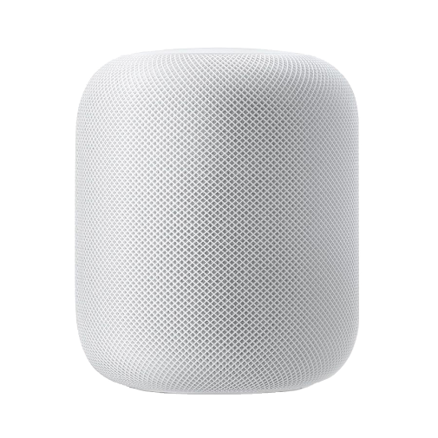
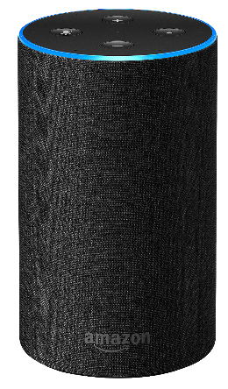
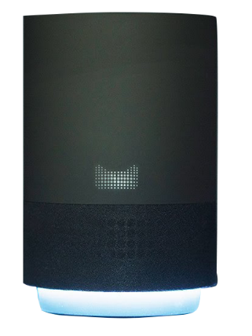
Support your major mainstream speakers
Cinema28 supports major wireless streaming protocols such as Bluetooth, Airplay, and DLNA to stream music to your various audio devices.
Google Home
Amazon Alexa
Apple Homepad
Tmall Genie

Slide 11
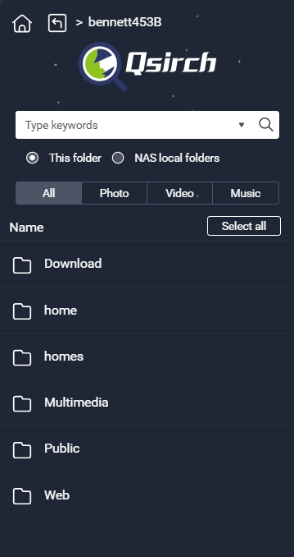
Qsirch support, finding files quickly and easily
Filter by file type (Music, Video, Photo)
Search by singer information
Full or limited folder search
Search by keywords
Search by file modification date

Slide 12
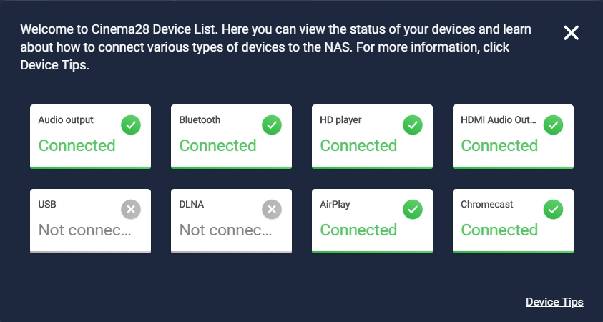
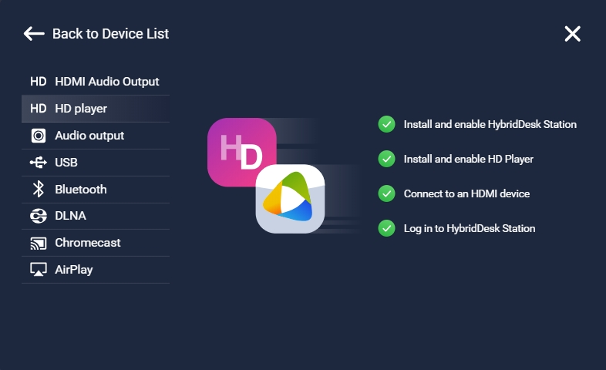
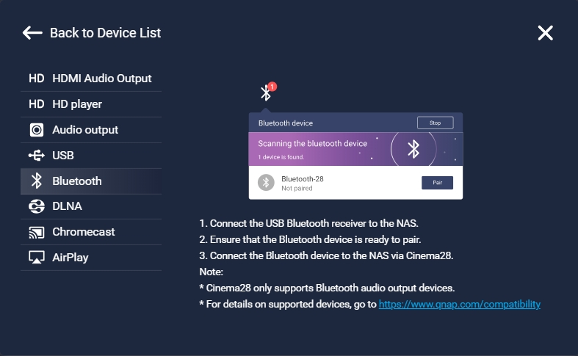
Cinema28 Device Wizard
Each device setting step guide
Display whether each type of device is successfully connected, and provide installation guidance mechanism to solve your various device settings troubles

Slide 13
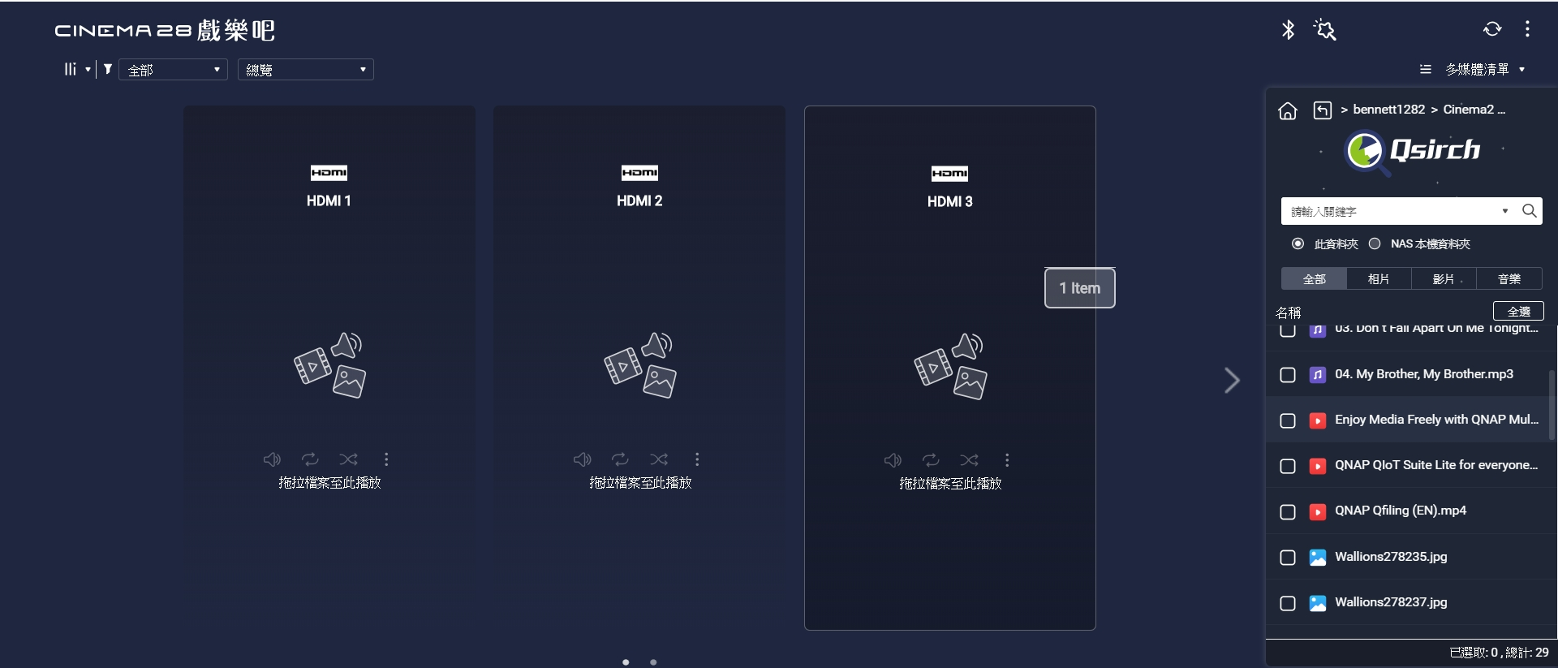
Quick drag and drop operation, easy to enjoy video streaming
Folder browsing mode, drag and drop the files and broadcasted, easy to operate!

Slide 14
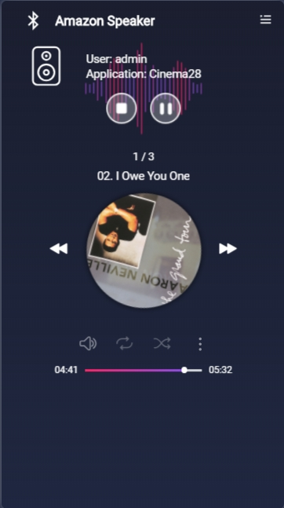
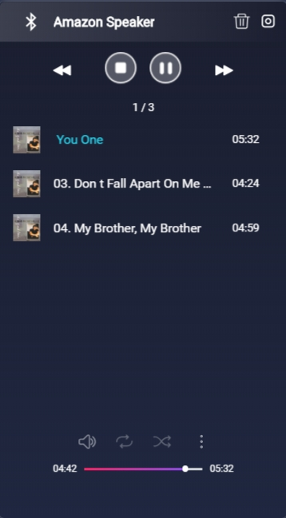
An interface to easily monitor all the multimedia devices in your home
Device name
User and application info
Playlist status, sorting and management
File info
Operation
Volume adjustment
Loop/Repeat
Shuffle Playback
Stream to another device
Device info

Slide 15
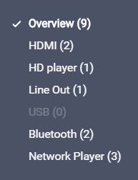
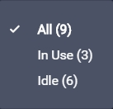
Quickly switch with one button to monitor the status of each device
Two Mode display
Filter by device type
Filter by device status

Slide 16
Cinema28 use cases with tutorial &
Live Demo

Slide 17
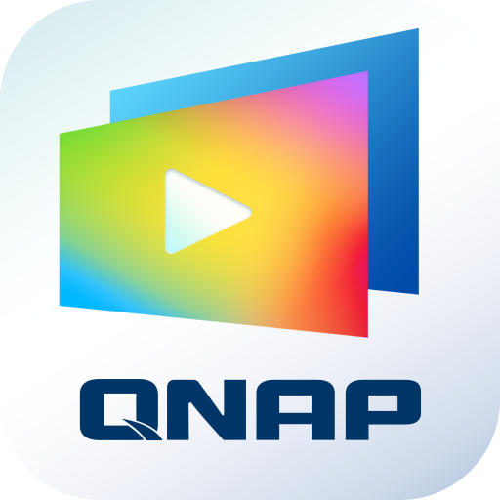
Simple three-step, easy streaming audio and video files
Please Install Cinema28 & Media Streaming Add-on on App Center.
Open device wizard in the Cinema28 to make sure the devices are connected
Find the file you want to play from the multimedia list and drag it onto the multimedia device.

Slide 19
Quickly Review Four Major Features of Cinema28
1
One interface monitors all device states
2
Intuitive stream operation and device setup
3
Supports up to eight types of streaming protocols
Cinema28
4
Complete support for three types of multimedia files

Slide 20
Copyright © 2019 QNAP Systems, Inc. All rights reserved. QNAP® and other names of QNAP Products are proprietary marks or registered trademarks of QNAP Systems, Inc. Other products and company names mentioned herein are trademarks of their respective holders.

