Slide 2
MediQPACS Patient Information and Medical Images
Definitions and Abbreviations – PACS, DICOM, AE, Modality
User Stories – Pain points and solution
MediQPACS – AE management, Patient Search, and DICOM viewer
Live Demo – Backup from PACS server, search and view

Slide 3
Definitions
What is DICOM?
What is a PACS server?
What is a modality & AE?

Slide 4
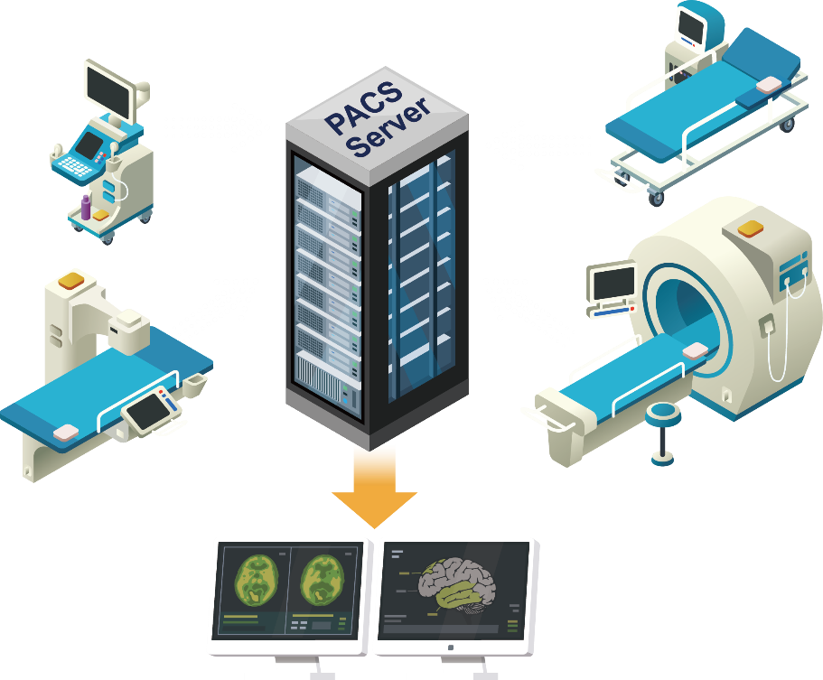
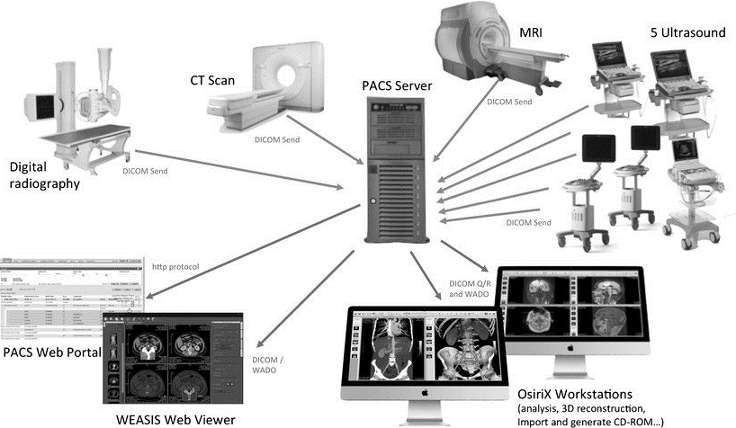
What is PACS Server?
A data server in the picture archiving and communication system (PACS)
Central storage for most of the Hospital / Clinical / laboratory data for the patients' images from CT scan, X-ray, MRI, and other modalities

Slide 5
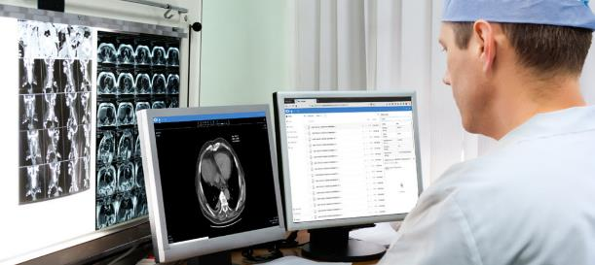
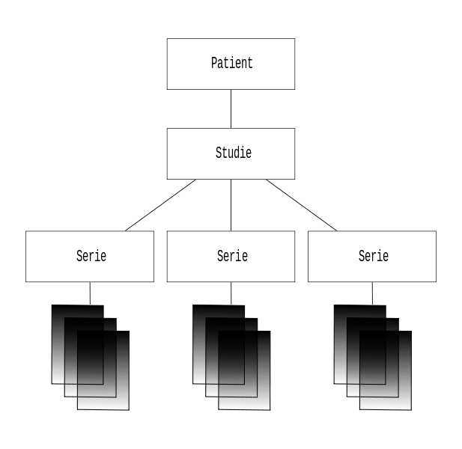
What are the DICOM files?
Digital Imaging and Communications in Medicine (DICOM) is a file format for patient information and medical images
DICOM files are 4 layers of patient information:
Patient information
Studies
Series
Instances (DICOM images)
1
2
3
Series
Series
Series
4

Slide 6
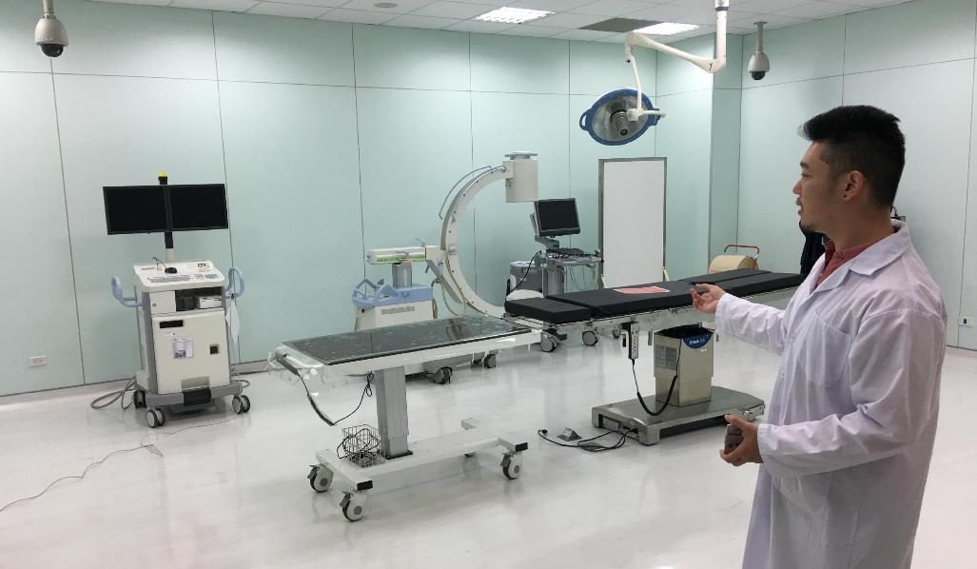
More definitions
Modalities
Modalities are the type of AEs that capture the images of the patients and creates DICOM files. The modalities could be X-Ray , CT , MRI, etc.
Application entities (AE)
Application Entities are the components in a Hospital network (or clinical / laboratory) which can receive or transfer DICOM files. PACS server and Modalities are Application Entities

Slide 7
User Stories
Why QNAP NAS a mini – PACS server?
Why MediQPACS was built?

Slide 8
MediQPACS Users
MediQPACS is primarily meant for:
Doctors / Radiologists / experts
System Integrators
Researchers and scientists
Other healthcare professionals
Target Institutions to have QNAP NAS
Clinics
Hospital (small to medium scale)
Research laboratories

Slide 9
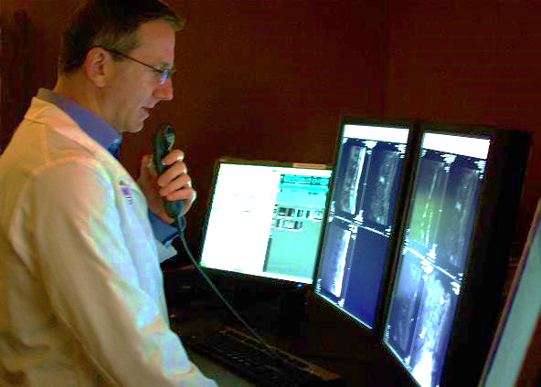
Doctors , Radiologists and experts
Pain points
Store in their computers
Huge DICOM files , limited storage
Backup to public clouds – time consuming
Difficult to share with patients
Need to travel to clinic
Emergency call from patients
Immediate assistance
Need expert opinions in critical cases
Radiologists / Experts are not available at one location
Sending patient information over the internet is unsafe
Notes:
Doctors of small clinics store medical images and patient information in their computers
DICOM files are huge, storage is limited
Backing up time on the cloud takes a lot of time
Difficult to show and discuss with patients
Need to visit clinic for analysis, if emergency arise
call from patients when at home
Situations that needs immediate assistance
Doctors in small clinics or even hospitals sometimes need expert opinions in critical cases
Radiologists and Experts are not always available at one geographic location
Sending patient information over the internet is prone to hacking and lacks security

Slide 10
System Integrators (SI's)
Pain points
SI's need to propose solutions
For Clinics and Hospitals
Needs a light-weight solution
Design and implementation is time consuming
Backup is required for DICOM files
Potential threats from viruses and malwares
Disaster recovery if DICOM files are corrupted or erased
Security concerns with public cloud servers

Slide 11
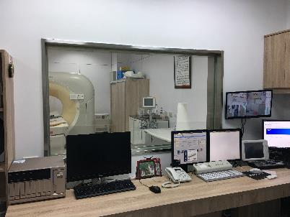
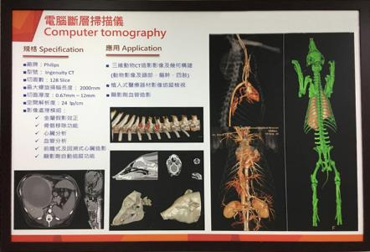
Researchers and Scientists
Pain points
Too many Medical image sources
Difficult to store and manage efficiently
Need for a secure backup
Manually exporting images to send them as a CD for 3D printing - QNAP customer
Public cloud storage is less secure

Slide 12
Solution - MediQPACS on QNAP NAS
Backup all medical images and patient information
Benefits of QNAP NAS:
Store huge DICOM files, storage is almost unlimited
Lesser Importing time
Private to the clinic / hospital / lab
Easy to show and discuss with patients and radiologists / experts
Using tablet or iPad or a cell phone
Share using myQNAPcloud/cloudlink with the experts and radiologists
TS-1277
This Photo by Unknown author is licensed under CC BY-NC-ND.

Slide 13
Solution - MediQPACS on QNAP NAS
Easy and intuitive to use interface
Connect application entities in the network seamlessly
Advanced DICOM viewer and tools
Quick analysis for experts
Privacy and security
highly secure private cloud for all the DICOM files
Safe from the threats of viruses, trojans and malwares
For 3D printing, easy sharing of files, less clutter of CDs
Data Scientists can use data from MediQPACS in QuAI platform
TS-1277

Slide 14
Convert your QNAP NAS to PACS server
Already have a QNAP NAS?
Install MediQPACS in your QNAP NAS as a PACS server for your Clinic, hospital or your research laboratories
Add Application entities and integrate your network
Already have a PACS server?
Purchase QNAP NAS for more secure backup PACS server on your own private cloud
Install MediQPACS for easy import and easy access of all DICOM files
Boost productivity with other NAS apps
TS-1277
This Photo by Unknown author is licensed under CC BY-NC-ND.

Slide 15
MediQPACS App
AE Management page
Patient search page
DICOM viewer

Slide 16
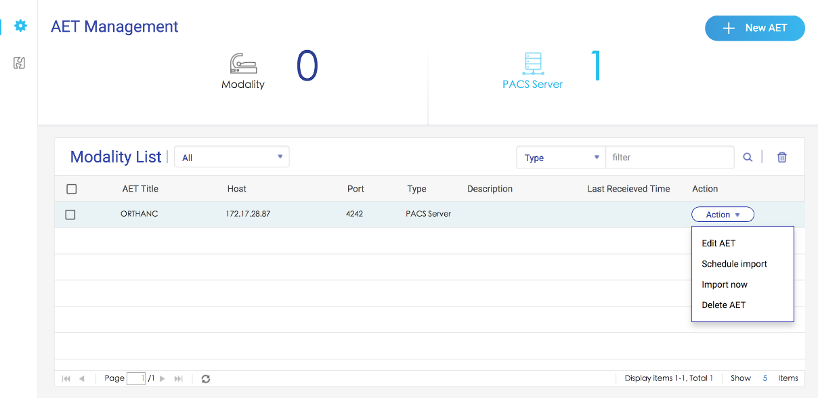
AE (Application entity) Management
Application Entities:
Modalities
PACS servers
Adding New AE
Removing an AE
Scheduling backup and immediate import

Slide 17
AE management page
PACS server to MediQPACS in QNAP NAS backup
Scheduled Import and immideate import
DEMO

Slide 18
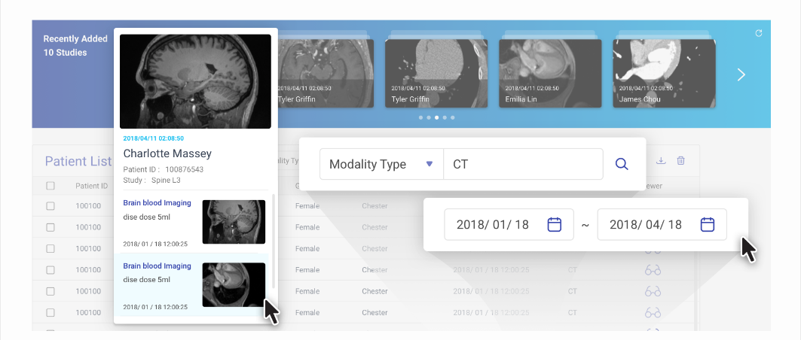
Patient search ( Query and retrieve)
User needs to choose from the connected PACS server
Search and Filter by
Patient Name
Patient ID
Date of Birth
Age
Gender
Study ID
Description
Modality type
Accession number
Search Results table
Suggestions panel for recently added
Go to DICOM viewer

Slide 19
Patients search page
Search and add filters to the search
Search between dates
Recently added suggestions panel
DEMO

Slide 20
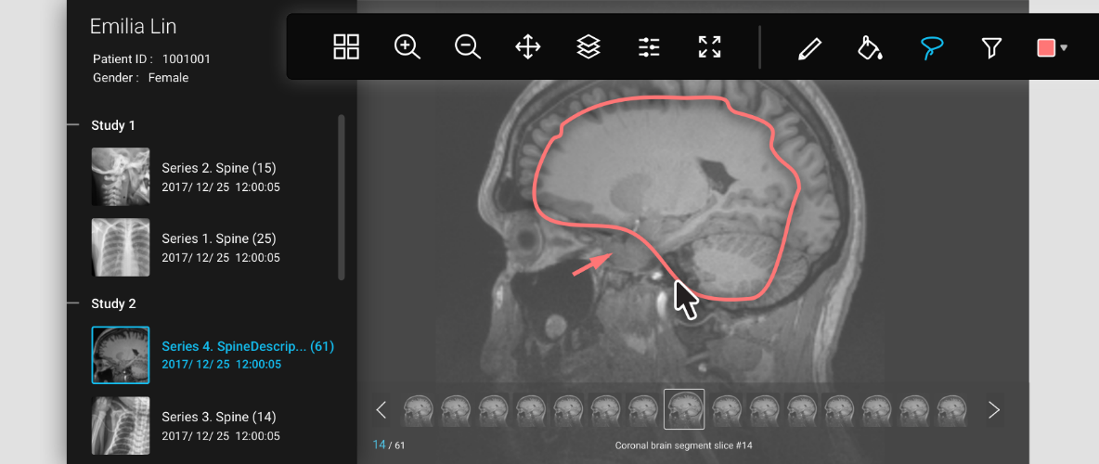
DICOM viewer
View instances from the Series
Layering and Draw over tools
View and search all DICOM tags

Slide 21
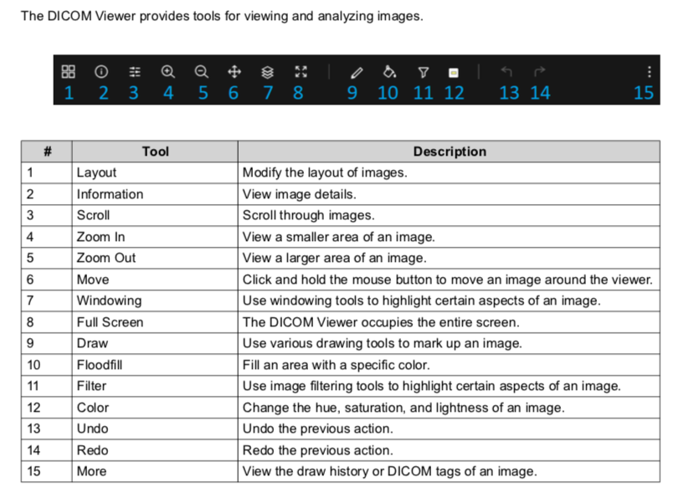
DICOM viewer
DEMO
Overall DICOM viewer
DICOM viewer tools

Slide 22
Demo
Working demo for PACS server backup
Searching & Viewing the medical images
DEMO
Notes:
Searching the imported DICOM files and DICOM tags
Viewing the series and instances in DICOM viewer

Slide 23
Copyright © 2019 QNAP Systems, Inc. All rights reserved. QNAP® and other names of QNAP Products are proprietary marks or registered trademarks of QNAP Systems, Inc. Other products and company names mentioned herein are trademarks of their respective holders.

