Slide 1
Explore
Virtualization Station 3.2
PCIe pass-through support and improved VMware®
VM import compatibility

Slide 2
大 綱
What PCIe device pass-through can do for you
Explores PCIe devices
pass-through
VM import compatibility for VMware®
Offload CPU computing
Directly connect external equipment to reduce network traffic
Advanced environment for VM applications
GPU – accelerates image processing
SAS / Fibre Channel –manages data efficiently
USB – Stable streaming and offload CPU computing resource
VMware ESXi, VMware WorkStation
VirtualBox

Slide 3
Explores PCIe Devices
Pass-through

Slide 4
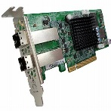
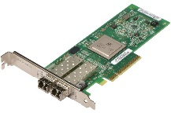
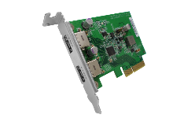
VM Applications Not only GPU pass-through but much more
VM Applications / Guest OS
Virtualization Station
KVM / VFIO
…
SAS 12G adapter
Fibre Channel adapter
USB 3.1 expansion
Discrete GPU
Attached PCIe Devices
Past
GPU
Pass-through
Now
PCIe Devices
Pass-through

Slide 5
3 Reasons for Using PCIe Devices Pass-through
Offload CPU computing resources to evaluate devices in VMs.
Directly connected to external equipment to reduce network traffic and boost efficiency of data transfer.
Provides hardware acceleration for applications running in VMs.

Slide 6
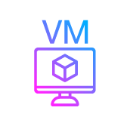
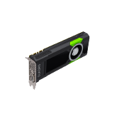
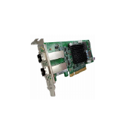
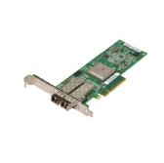
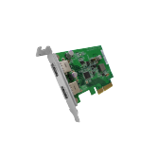
Explores More Applications managing NAS data efficiently
Connected storage equipment throughout SAS / Fibre Channel adapters
Connected screen capture device throughout USB interface
Discrete GPU
Transcoding (e.g. Adobe Premiere)
AI model training (e.g. TensorFlow, Caffe..)
Directly access data from storage equipment
Leverages CDM (Copy Data Management) application to snapshot/copy LUN stored in the NAS and results in network traffic reduce.
Offload CPU computing resource and use NAS storage capacity to save data.

Slide 7
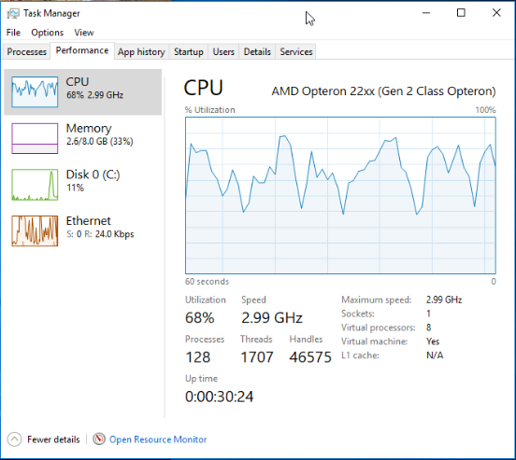
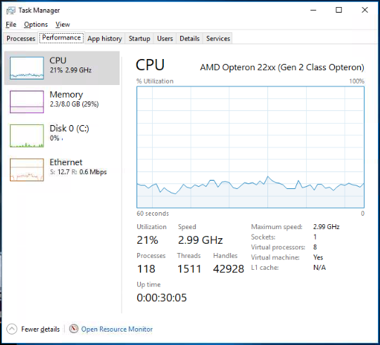
PCIe Pass-through Discrete GPU
During image processing or transcoding without GPU:
With GPU：
1. RAW file processing
2. AI Model Training
3. OpenGL, DirectX
Good for
68%
21%
CPU heavy loading
Offload CPU and utilize GPU

Slide 8
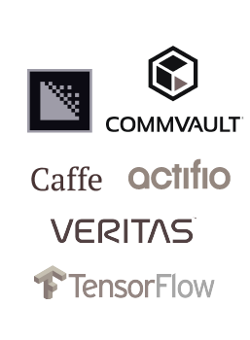
PCIe Pass-through SAS / Fiber Channel adapters
Server
LUN
NAS
SAS
FC
Directly connected
Virtual
Switch
Storage Equipment
PC
Folders
Data store via iSCSI LUN, SAMBA or NFS.
Accesses NAS data efficiently throughout Virtual Switch and uses applications installed in VM to process data or communicate with external equipment.
Directly access / store data in the connected equipment as well as DAS.

Slide 9
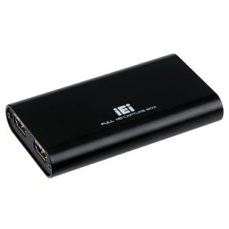
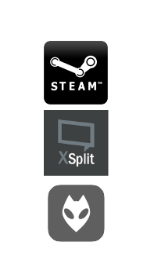
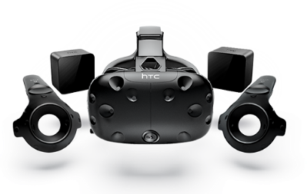
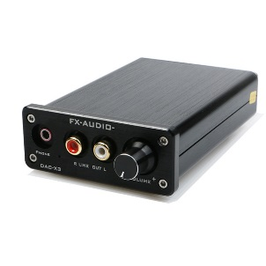
PCIe Pass-through USB 3.1 expansion card
LUN
NAS
USB
Directly connected
Virtual
Switch
Folders
Runs applications installed in VM and save the data throughout Virtual Switch.
Streaming data transferred through USB 3.1 card to offload CPU loading and keep the stability.

Slide 10
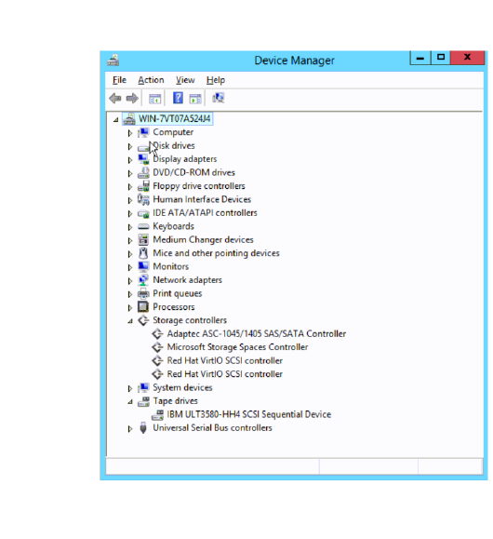
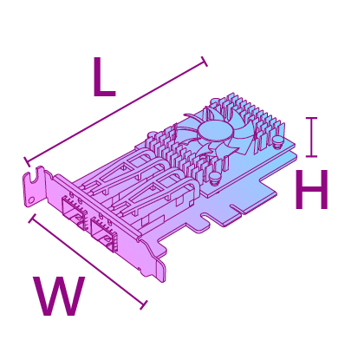
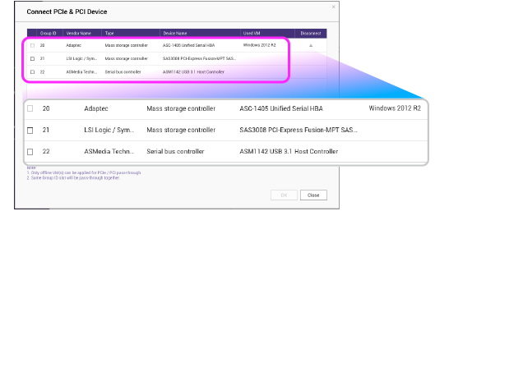
How to？
Ensure PCIe devices can fit it in the NAS
Select a PCIe device in Virtualization Station
Launch VM and install a device driver

Slide 11
DEMO
Connect tape backup equipment to SAS/Fibre Channel adapter
Connect iEI HDB 301 capture box to USB 3.1 expansion card

Slide 12
Improved VMware® VM import compatibility

Slide 13
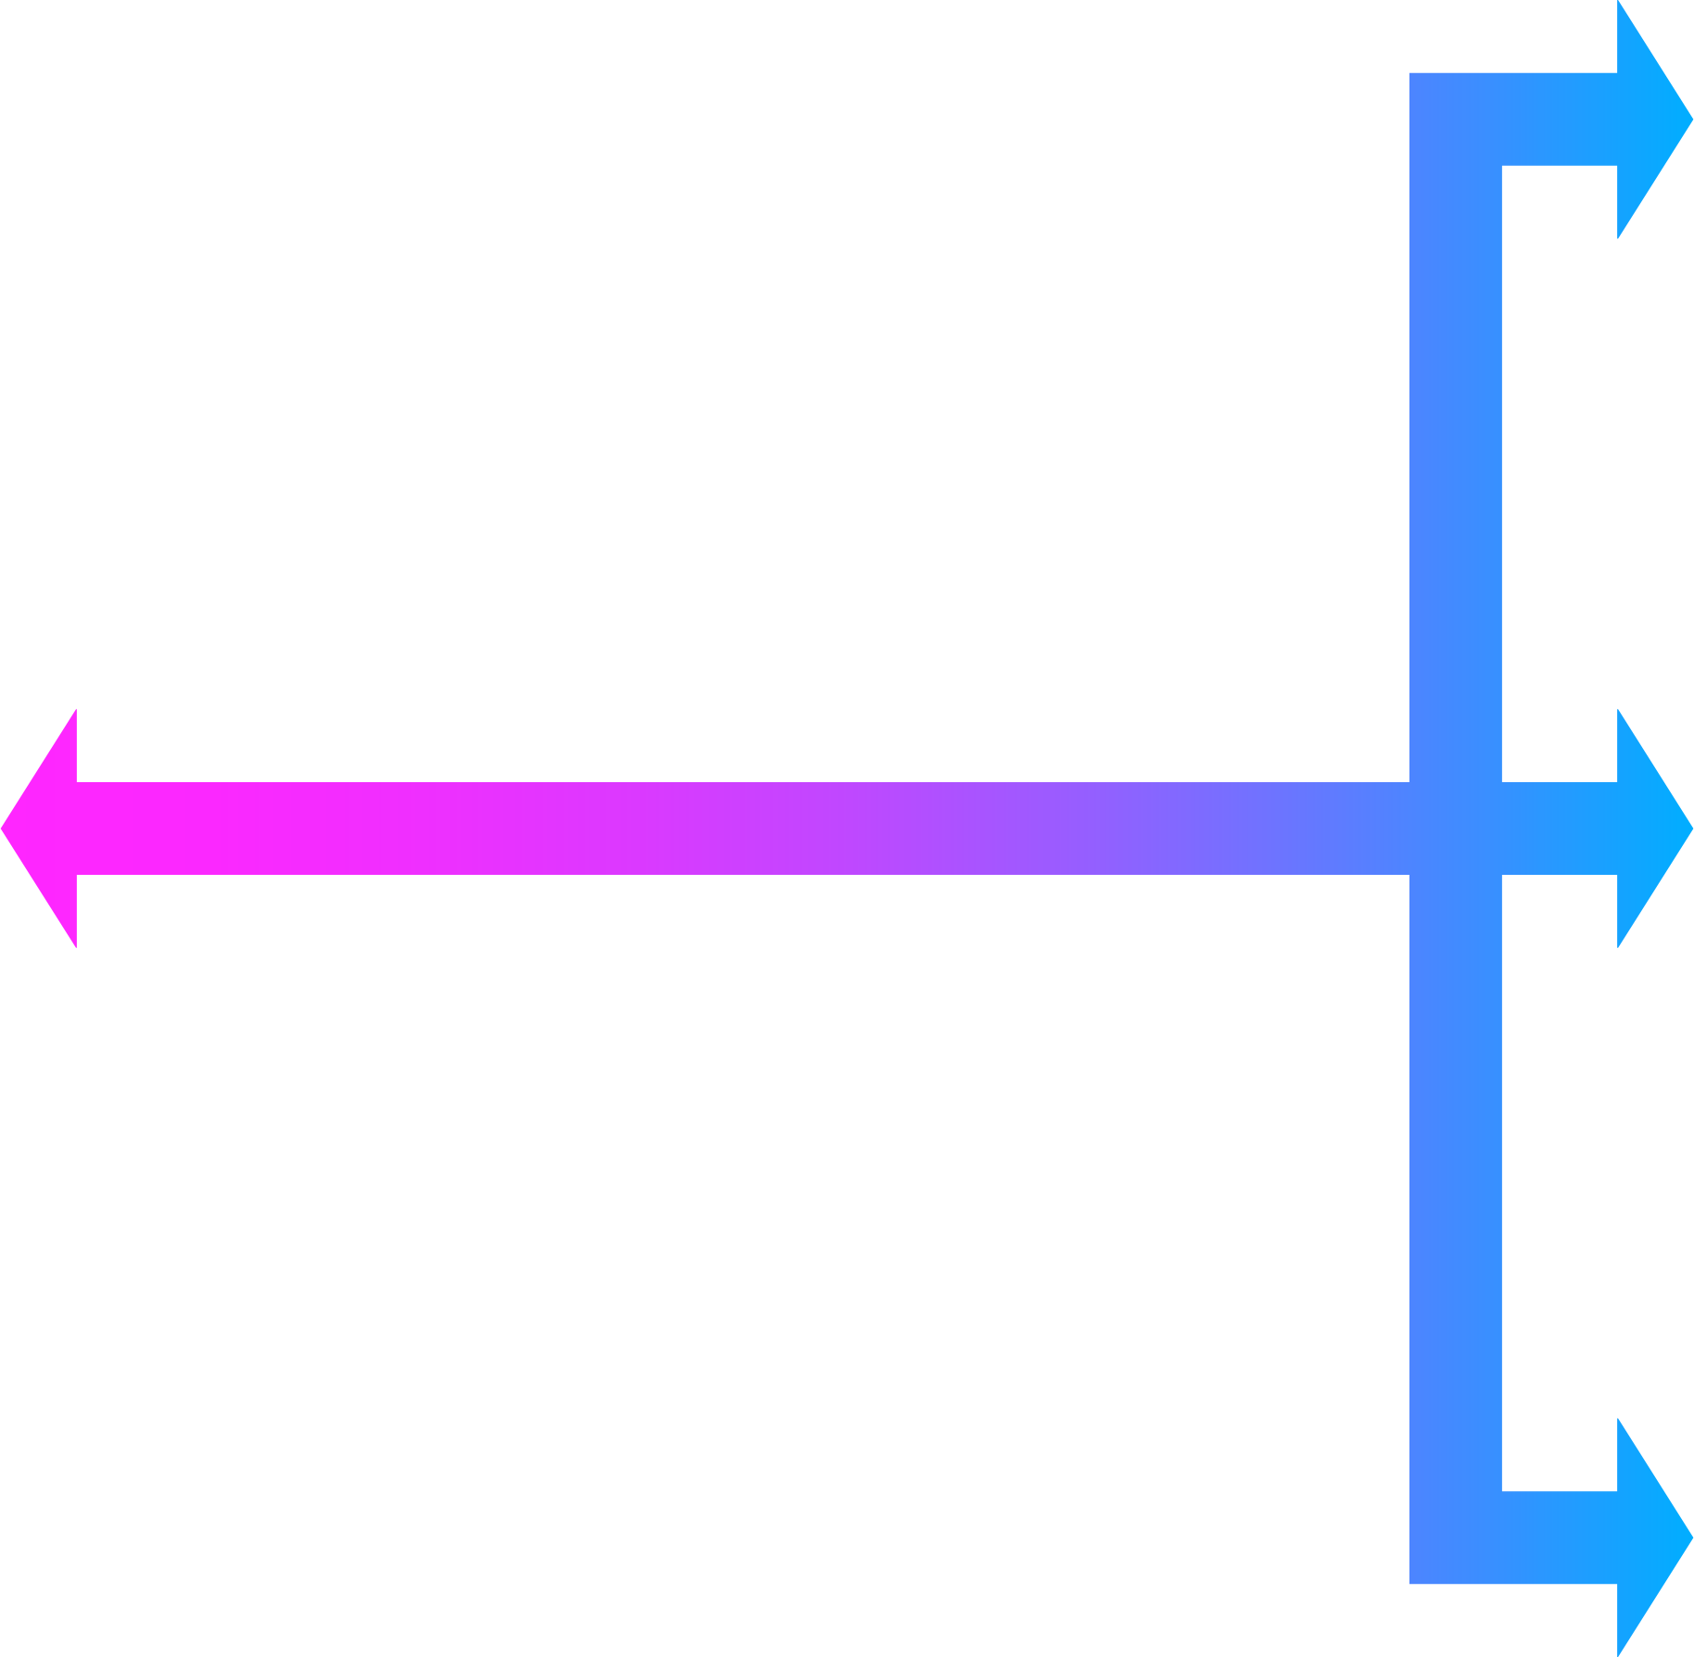
Virtual-to-Virtual (V2V)
VMware WorkStation Pro
Import / Export VMs to / from different hypervisors.
Import & Export
VMware vSphere 6.x
Virtualization Station
VirtualBox 5.x

Slide 14
Improved Compatibility!
Before
Now
VMware vSphere 5.0 and below
VMware WorkStation 8, 9 ,10
VirtualBox 4.x
The latest version:
VMware vSphere 6.x
VMware WorkStation 15
VirtualBox 5.x
Reason
Improved
Supports Legacy BIOS only
Proprietary HDD drive image format upgrade (*.vmdk)
Supports Legacy BIOS and UEFI
Upgraded QEMU version

Slide 15
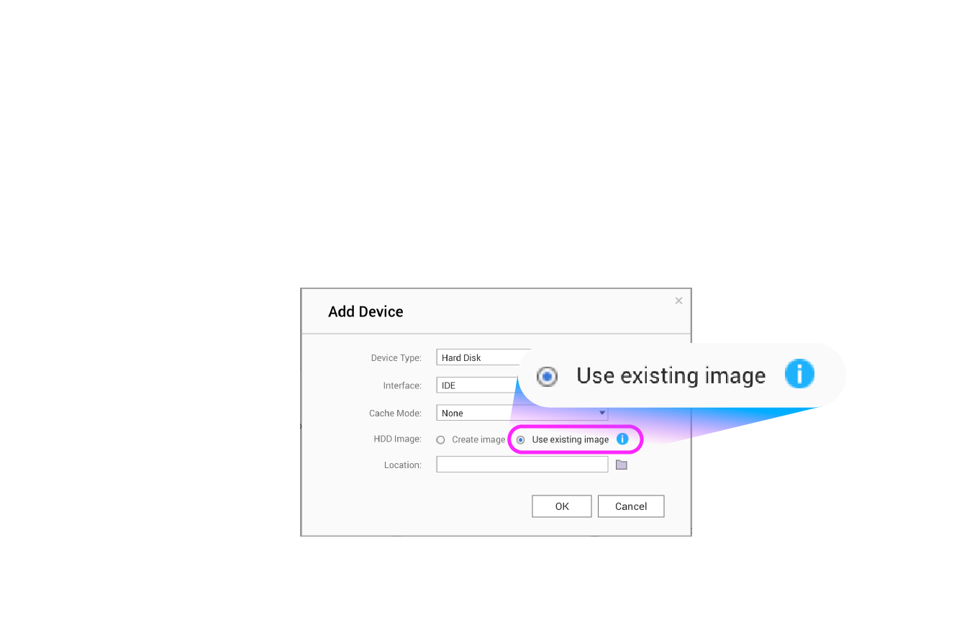
More VM image convert for Virtualization Station used
Supports *.vmdk, *.vhd, *.vhdx and *.vdi formats
Mount the converted VM images to existing VMs

Slide 16
DEMO
Import VMware ESXi / WorkStation VM to Virtualization Station
Convert HDD images and use them in existing VMs

Slide 17
Recap
PCIe devices pass-through
Improved VM import compatibility
Supports converting image formats
Managing NAS data throughout SAS / Fiber Channel
Streaming data to NAS via USB 3.1 expansion card
VMware ESXi 6.x
VMware WorkStation Pro 15
VirtualBox 5.x
*.vmdk
*.vhd, *.vhdx
*.vdi

Slide 18
Notice
Virtualization Station 3.2
Caution
Before purchasing PCIe devices, ensure your NAS is capable for install such as extra power required.
Ensure there is a correspondent driver of PCIe devices for your guest OS.
Associated with QTS 4.4.0 or above
Available in April

Slide 19
Virtualization
Station 3.2 is Your Best Choice!
Copyright © 2019 QNAP Systems, Inc. All rights reserved. QNAP® and other names of QNAP Products are proprietary marks or registered trademarks of QNAP Systems, Inc. Other products and company names mentioned herein are trademarks of their respective holders.

