Slide 2
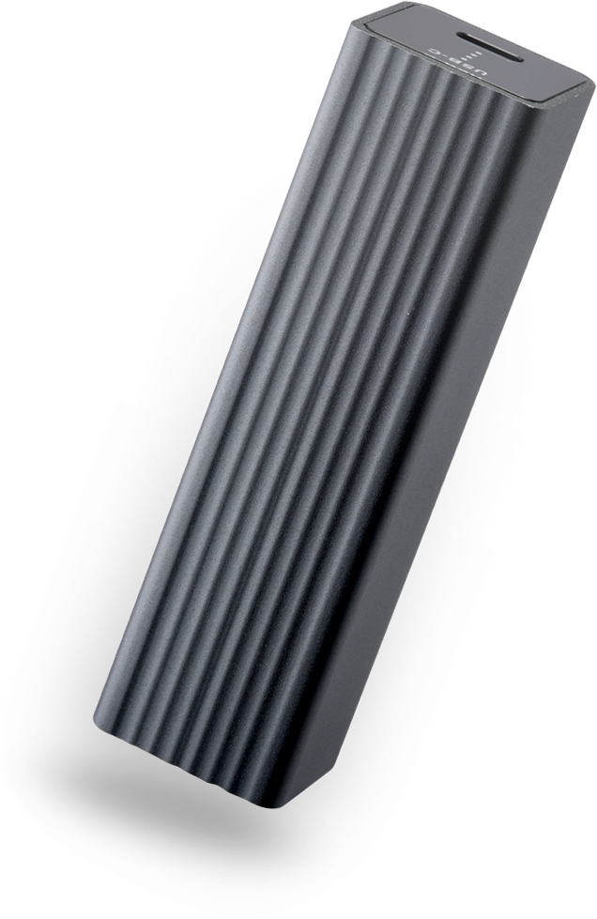
1
Enough speed?
2
Specs and applications
3
Add 5GbE to NAS

Slide 3
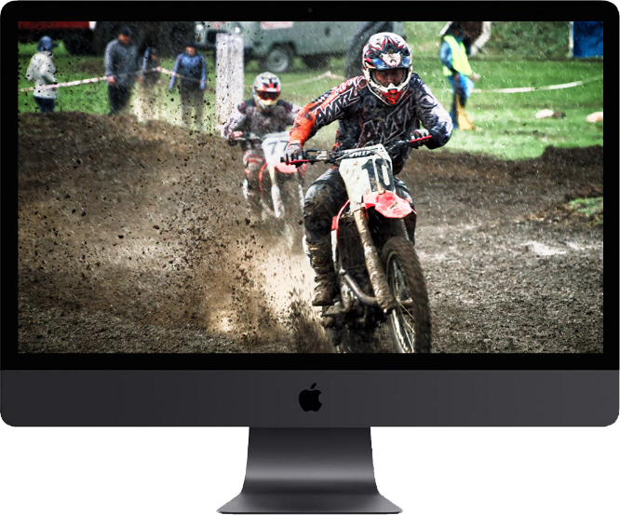
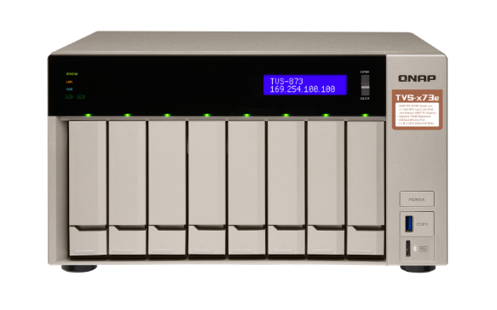
How slow is the 1GbE actually?
How to reduce the time？
How long does it take to copy 300 GB of videos?
1GbE
50 minutes
10GbE
1GbE
5GbE
2.5GbE

Slide 4
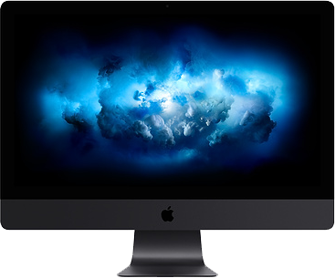
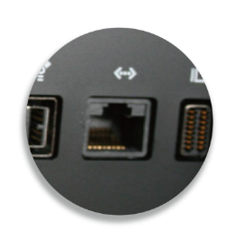
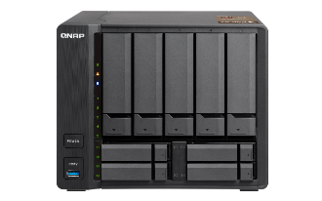
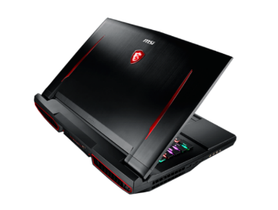
10GbE is no longer data center only
NAS and computers
Routers and switches
10GBASE-T or 5GBASE-T
10GBASE-T or 5GBASE-T
10GBASE-T
Apple iMac Pro
QNAP TS-963X
Netgear Nighthawk AX12
QNAP QSW-804-4C
MSI GT75VR
How can your computer effectively connect to the 5GbE and 10GbE environment?
Source：Netgear.com; Aquantia.com & QNAP.com

Slide 5
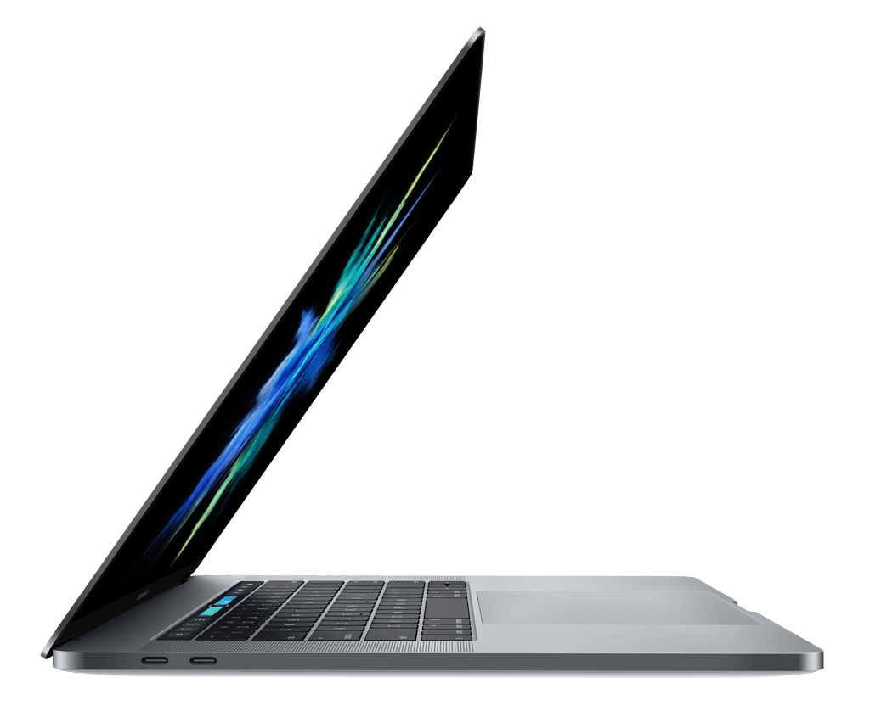
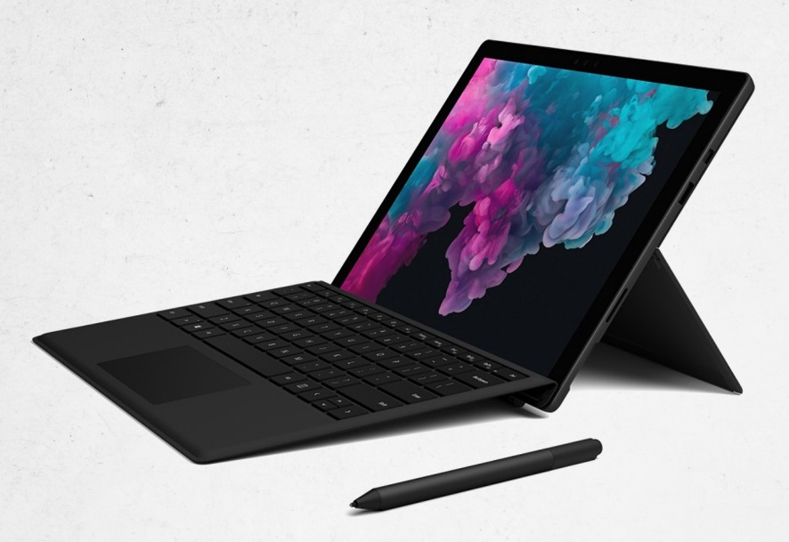
Wired LAN port is being removed
Ultra-portable computers no longer have a wired LAN port and can only rely on wireless network. However, a USB port is still being preserved for connecting peripherals.
MacBook Pro
Surface Pro 6

Slide 6
Weak signal or need authentication in WLAN?
Wi-Fi signal is too weak or the speed is too slow when connected
You need credentials for wireless network while the wired network does not require it.

Slide 7
USB 3.0 Type-C to 5G/2.5G/1G
Overview and applications

Slide 8
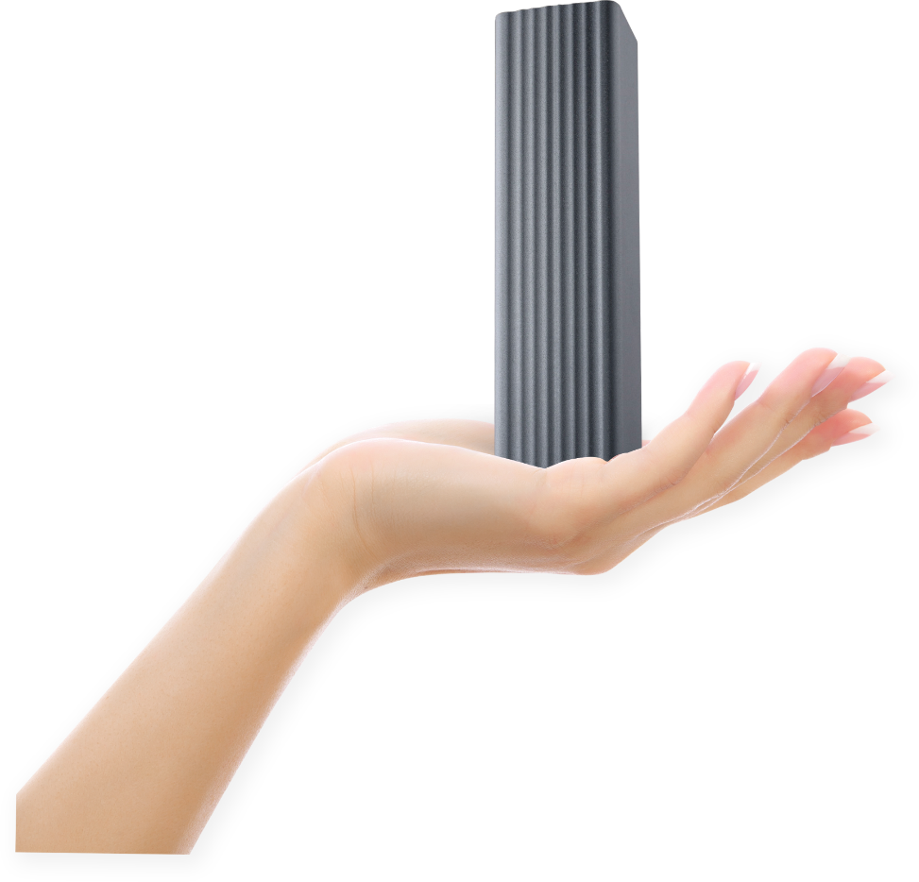
Small investment to go beyond 1Gbps
尺寸要上, 標長寬高
QNA-UC5G1T
USB 3.0 Type-C to 5GbE network adapter
Effectively use computer’s USB 3.0 port for high-speed wired network
2.8 cm (1.10 inch)
5Gbps
5000Mbps
2.8 cm
(1.10 inch)
2.5Gbps
2500Mbps
9.98 cm
(3.93 inch)
111 g
(0.25 lbs)
1Gbps
1000Mbps
0
1000
2000
3000
4000
5000
Aluminum alloy housing and fanless;
Quiet and just slightly warm during transfer

Slide 9
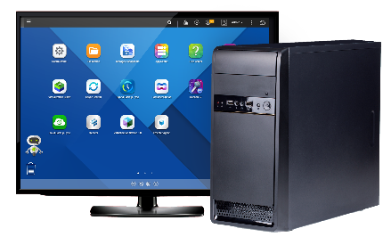
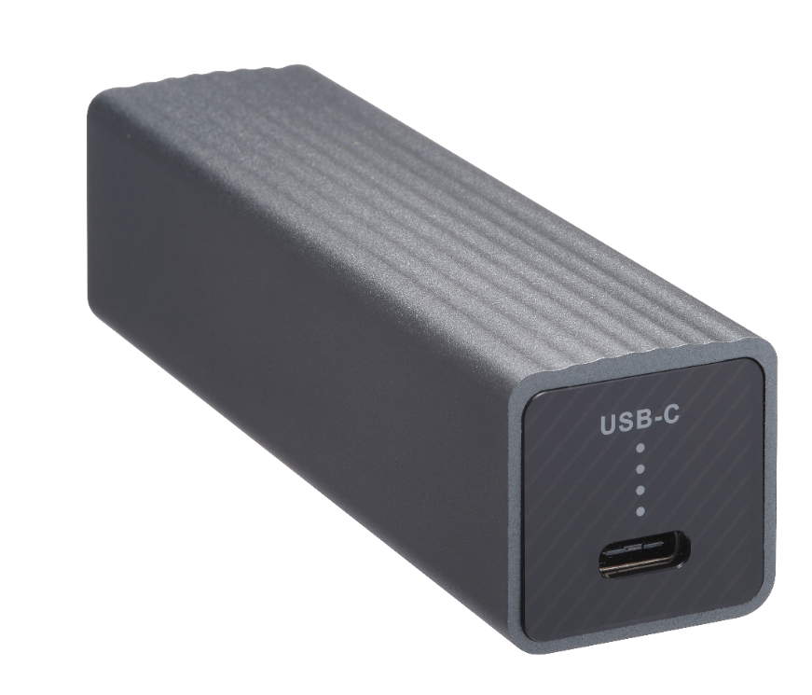
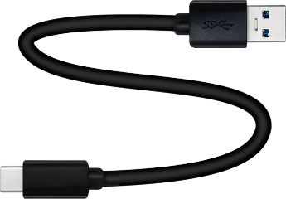
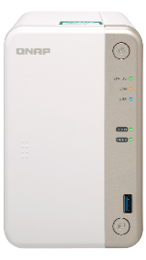
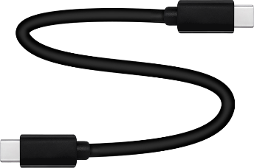
USB 3.0 Type-C for easy installation
Includes 20cm (0.66 ft.) USB 3.0
Type-C to Type-A cable
Windows PC
MacBook Pro
Optional USB Type-C to
USB Type-C cable
QNAP NAS

Slide 10
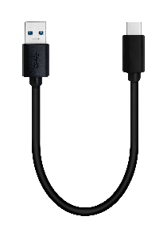
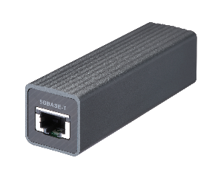
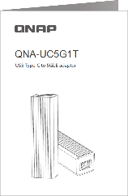
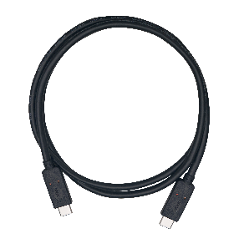
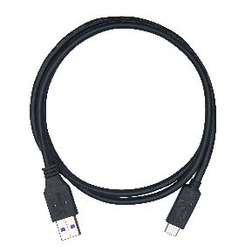
Package contents and accessories
Included
Optional
QNA-UC5G1T
USB 3.0 to 5G/2.5G/1G/100M network adapter
20cm USB 3.0 Type-C to Type-A cable
Ordering P/N：
CAB-U35G02MAC
Quick installation guide (QIG)
100cm USB 3.0 Type-C to Type-A cable
Ordering P/N：
CAB-U35G10MAC
100cm USB 3.1 Gen2 Type-C to Type-C cable
Ordering P/N：
CAB-U310G10MCC

Slide 11
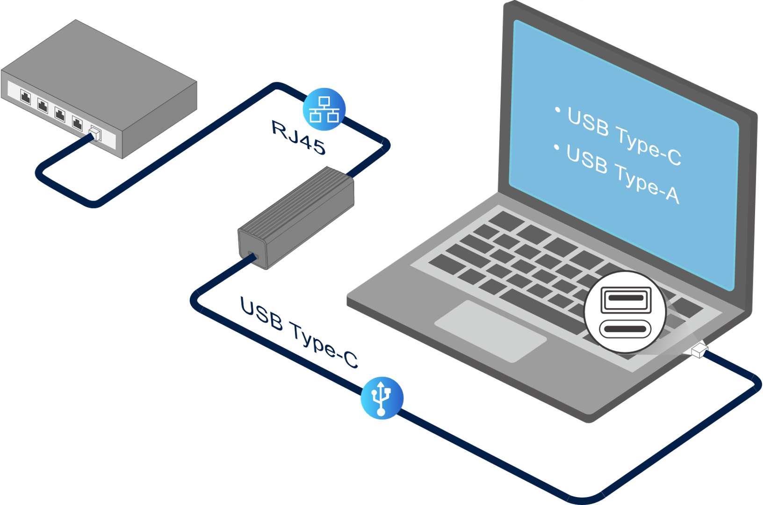
No extra power supply needed
QNA-UC5G1T
USB 3.0 to 5GbE
Save cost and easily build 5GbE/2.5GbE environment
Portable size for productivity anywhere
Clean design to fit in any environment

Slide 12
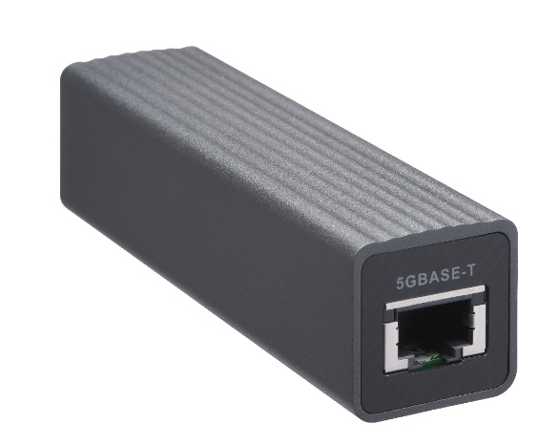
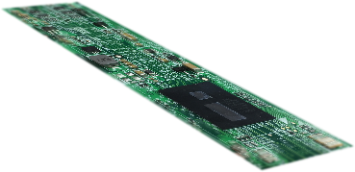
AQC111U：USB and 5G single chip solution
Software Driver
NBASE-T Alliance
Host
USB 3.1 Gen 1 PHY
SMBus
USB3.1 Controller
Multi-Gig supporters
UC
Instr.RAM
RX DMA
TX DMA
Data.RAM
RX Offloads
TX Offloads
SPI
Packet Filter
Ethernet MAC
5G/2.5G/1G/100M
4-Speed Ethernet PHY
GEN3
PHY
Network
Source https://s3-us-west-1.amazonaws.com/aquantia-staging/wp-content/uploads/2018/06/Product-Brief-AQC111U-AQC112U-June-1-2018.pdf

Slide 13
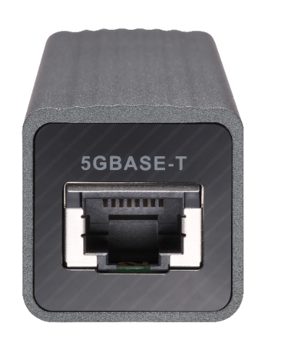
Upgrade to 2.5G & 5G with existing cable wiring
No need to re-wire your cables, the existing wiring already support up to 5Gbps.
Your existing cables already support
Multi-Gigabit NBASE-T standard
Speed:
5G = Green
2.5G/1G/100M = Amber
Link/Act LED
 | CAT 5e | CAT 6 | CAT 6A
100M | ✔ | ✔ | ✔
1G | ✔ | ✔ | ✔
2.5G | ✔ | ✔ | ✔
5G | ✔ | ✔ | ✔

Slide 14
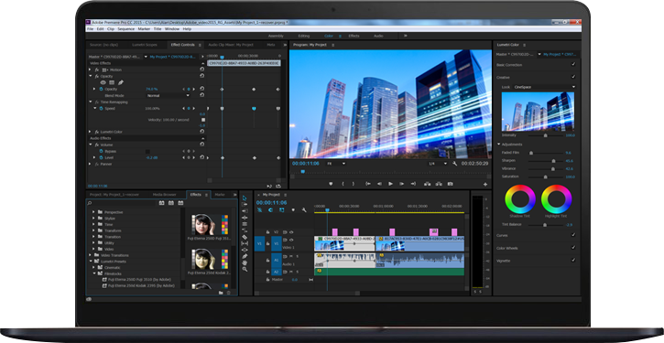
Application: USB to 5GbE backup
Backup to
QNAP 10GbE NAS
Video editing PC
Backup files over 5GbE
QNAP 10GbE NAS
TS-963X
10GbE
USB 3.0
5GbE
TS-332X

Slide 15
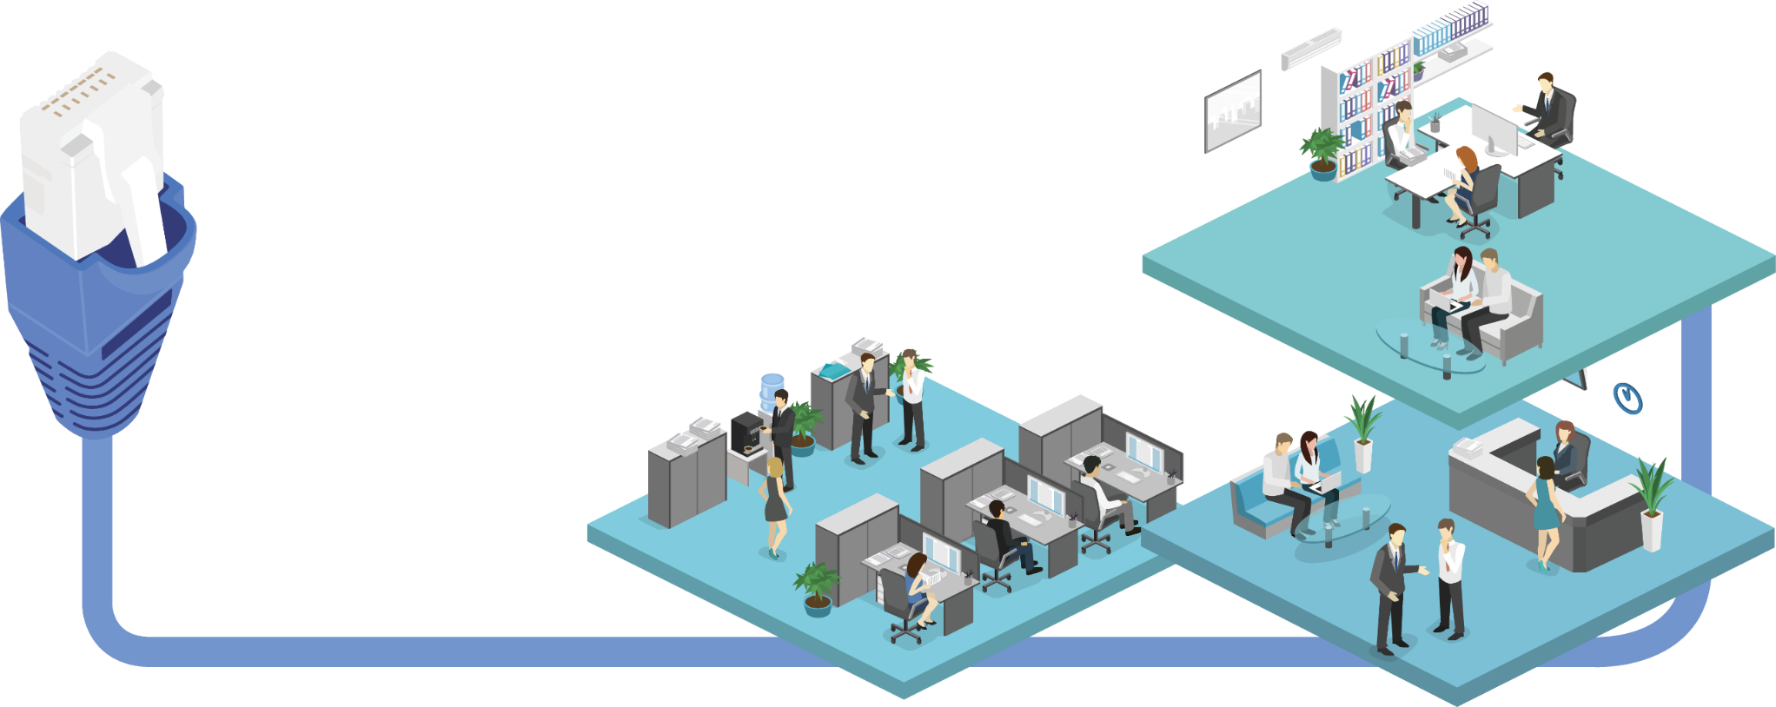
Up to 100M long distance at 5GbE
40 °C (104 °F)
Up to 100M cabling
May also depend on the switch capability.

Slide 16
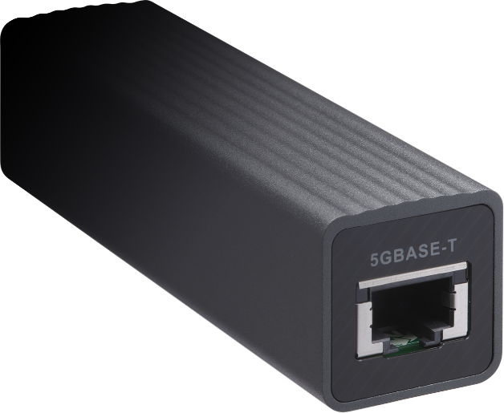
Get your LAN party started fast and easy
Low latency
High bandwidth
Source: Geforce.com

Slide 17
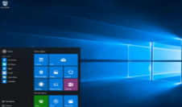
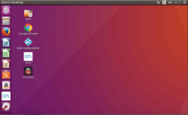
Support Windows, macOS, Linux OS.
Windows® 10, 8.1, 8, 7 (32/64 bit)
Install QNAP driver
macOS X with native support
Coming soon from Apple! Follow QNAP product page for official support status
Linux kernel 4.4, 4.2, 3.12, 3.10, 3.2

Slide 18
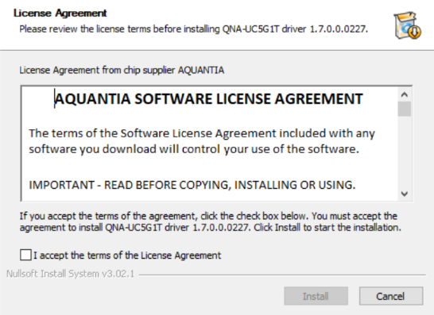
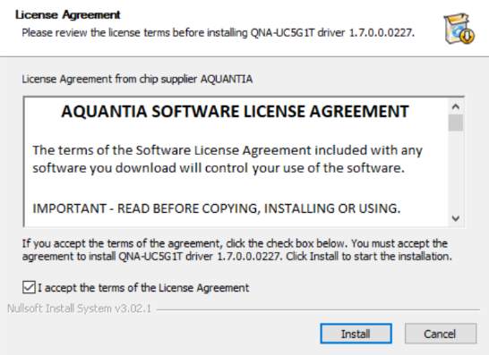
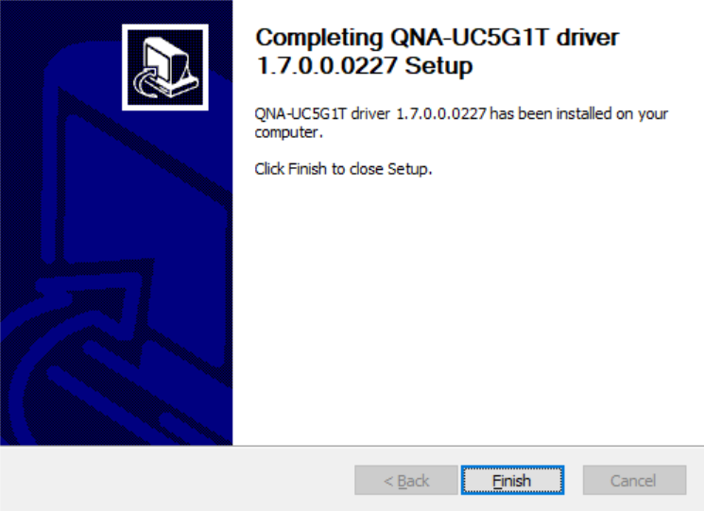
Windows PC installation
Windows® 10, 8.1, 8, 7 (32/64 bit)
When connecting the QNA-UC5G1T to a computer that has no driver, the Windows File Explorer will show a virtual CD-ROM device which contains the driver installation program. You can download the latest driver file from https://download.qnap.com
1
View the software
license agreement
2
Agree to the software license
3
Finish driver installation

Slide 19
Linux PC installation
Download the AQC 111U Linux driver from Aquantia website
Linux kernel 3.2, 3.10, 3.12, 4.2, and 4.4
https://www.aquantia.com/support/driver-download/
Source：Aquantia.com
Notes:
\

Slide 20
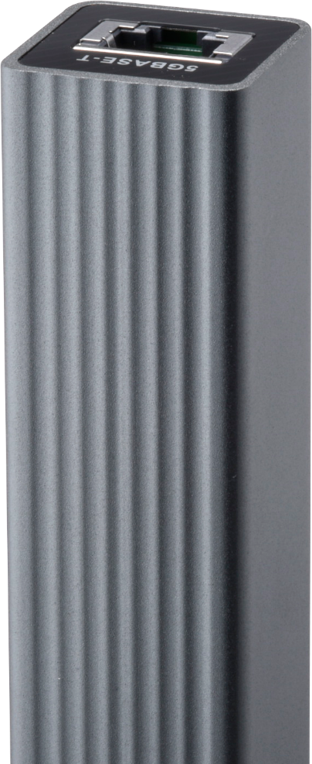
4 times faster than 1GbE
Windows file transfer
Windows Download
428 MB/s
Windows Upload
422 MB/s
MB/s
* Please set the Jumbo Frame to be MTU 9000 for the best performance
Test environment：
Two Windows PCs with QNA-UC5G1T Client PC: Windows 10 Pro, Intel Core i7-6770 3.40GHz, 64GB RAM, QNA-UC5G1T USB adapter, MTU 9000

Slide 21
Demo
Performance test
with 5G PC to
10G NAS

Slide 22
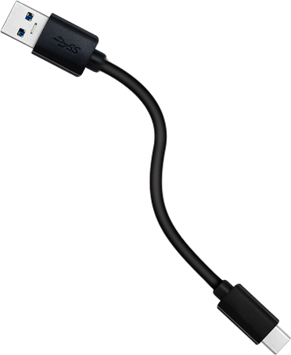
Older Mac gets 5GbE via the QNA-UC5G1T
Older Mac with Thunderbolt 2
Install QNA-UC5G1T on a USB 3.0 port to break the 1GbE barrier
macOS X will soon support it
Follow the QNAP product page for the latest announcement

Slide 23
How to get high speed for Mac with Thunderbolt 3
MacBook Pro
4 x Thunderbolt 3 ports
Video editing
iMac
2 x Thunderbolt 3 ports

Slide 24
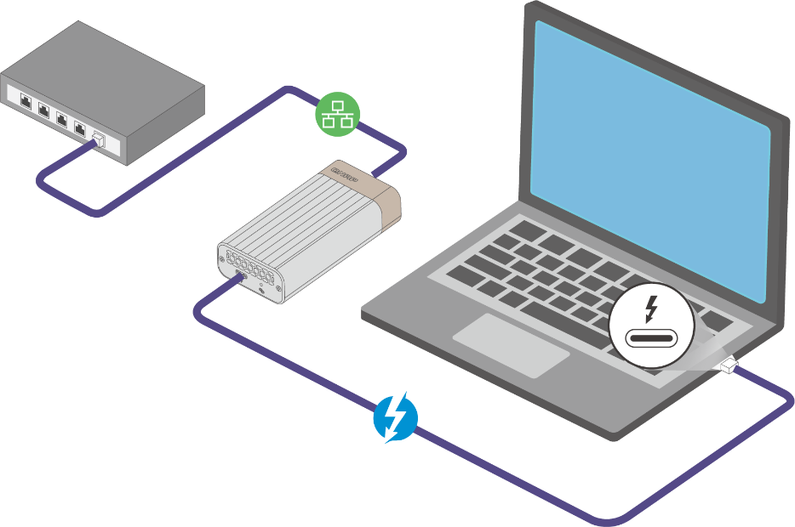
Thunderbolt 3 to 10GbE is here
QNAP Thunderbolt 3 to 10GbE adapter
QNA-T310G1T
QNA-T310G1S
Cost-effective Thunderbolt 3 to 10GbE adapter that empowers your Mac® or Windows® computers with blazing-fast 10GbE network connectivity using a Thunderbolt 3 Type-C port
Reduce the cost for building 10GbE environment
Portable design meets the flexible working conditions
Sleek design
QNA adapters will not work when connected to PC/mac via Thunderbolt 2 to Thunderbolt 3 adapters.

Slide 25
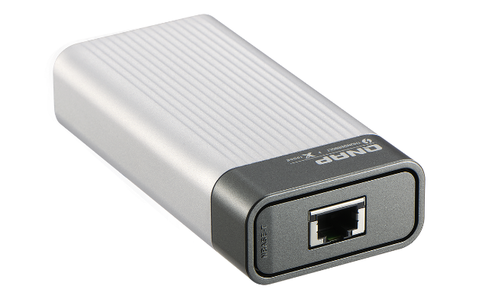
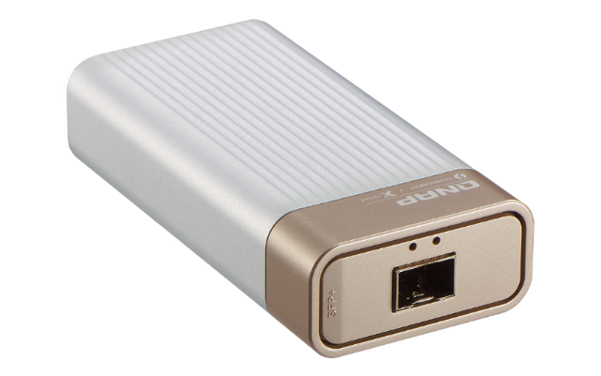
Thunderbolt 3 QNA series for 10GbE
10GbE NBASE-T RJ45 port
10Gbps/5Gbps/2.5Gbps/1Gbps/100Mbps multi-gigabit
10GbE SFP+ port
10Gbps

Slide 26
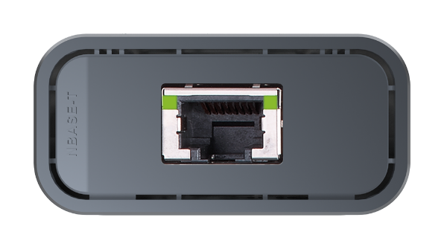
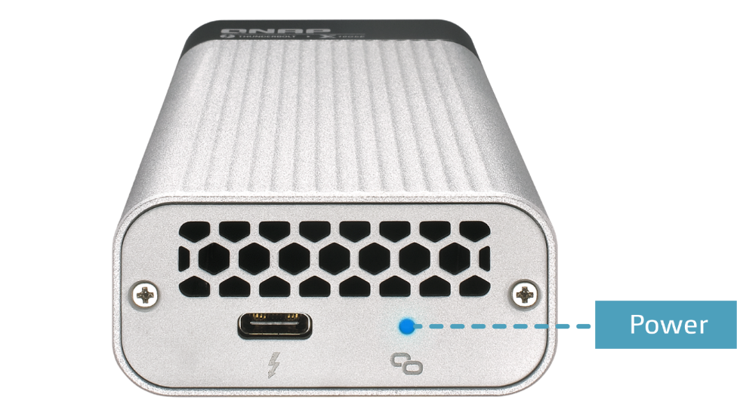
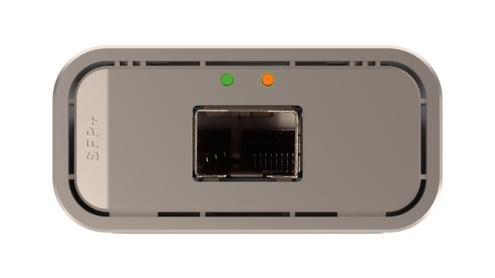
Power and speed indicators
Speed:
10G = Green
5G/2.5G/1G/100M = YLW
Link/Act LED
Speed:
10G = Green
Link/Act LED

Slide 27
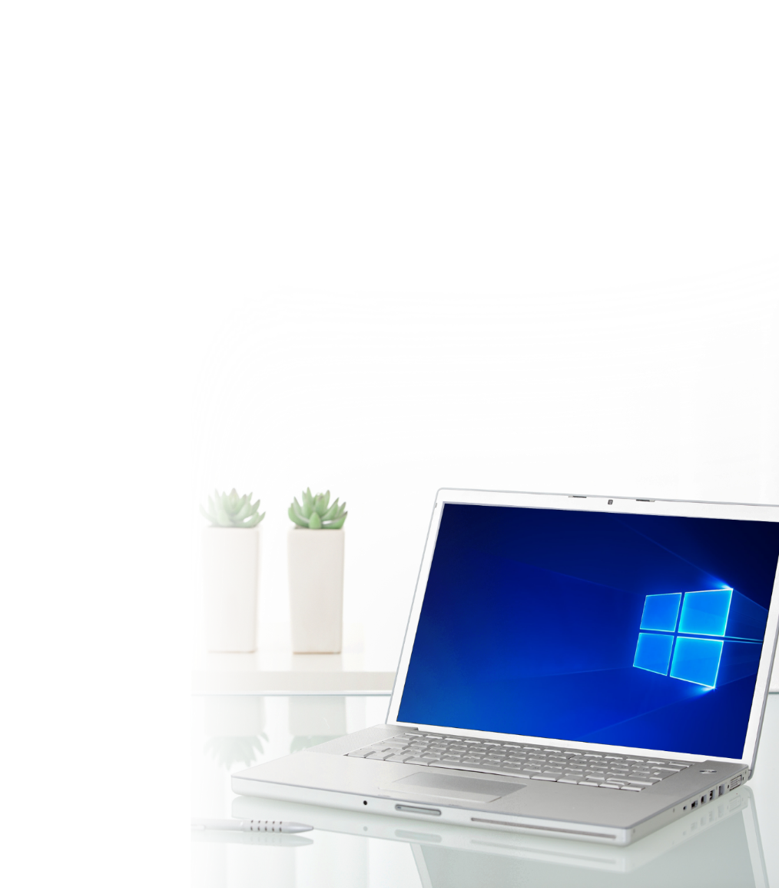
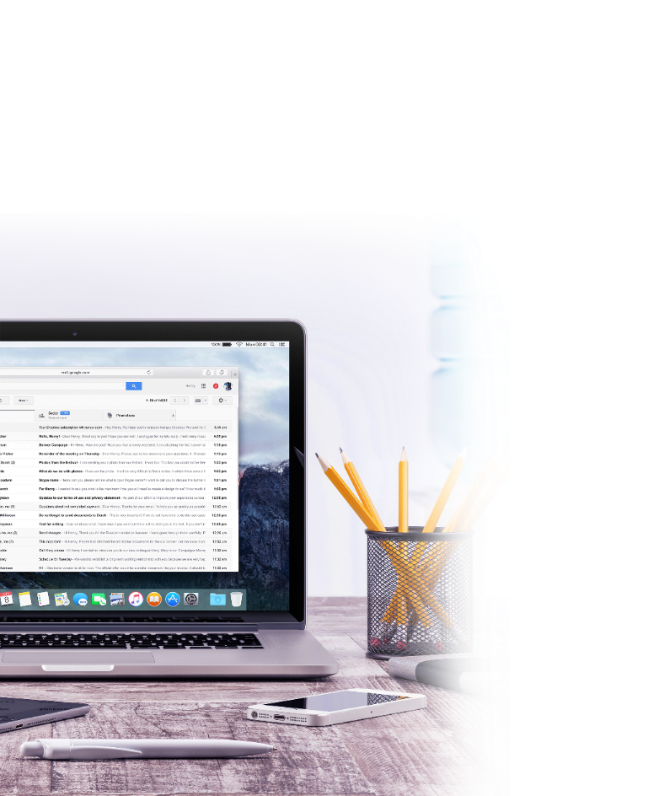
Driver built-in for macOS - plug & play
macOS 10.13.3 (or later)
Built-in driver for plug & play
MacBook Pro
Driver installation required
QNA-T310G1T: AQC107
QNA-T310G1S: AQC100
Windows
* QNAP NAS with QTS 4.4.1 will officially support the QNA series.

Slide 28
Enable blazing-fast 10GbE connectivity
File transfer (1 x 10GbE)
Windows Download
1068 MB/s
Windows Upload
1069 MB/s
* Please set Jumbo Frame to MTU 9000 for optimal performance.
10GbE Transfer Test environment： Server NAS：TS-677, QTS 4.3.4, , AMD Ryzen 5 2600, 3.40 GHz, 8GB RAM, RAID5, Samsung SSD 850 PRO 512GB *6, QXG-10G1T & LAN-10G2SF-MLX,
Ｃlient PC：Windows 10, Intel Core i7-4770 3.40GHz, 32GB RAM, LAN: Thunderbolt 3, MTU9000

Slide 29
High speed transfer with NAS
NAS to NAS application
VJBOD (iSCSI JBOD)

Slide 30
Upgrade PC & NAS to 10GbE with QNAP PCIe adapters
PCIe slot
NAS with PCIe slot
QM2-2S10G1T (2 x M.2 SATA SSD port)
QM2-2P10G1T (2 x M.2 PCIe NVMe SSD port)
2-port M.2 2280 SATA/NVMe SSD with
1-port 10GbE adapter
QXG-10G1T
1-port 5-speed 10GbE adapter
(10G/5G/2.5G/1G/100M)
PC
TS-1277

Slide 31
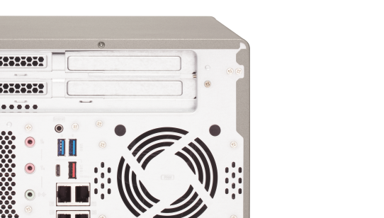
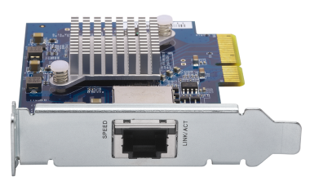
Easy to install a 10GbE PCIe adapter
1
Confirm the bracket type
2
Change the bracket
3
Install QXG-10G1T to NAS
E.x. TS-x77 series PCIe slot 1 requires a full-height bracket

Slide 32
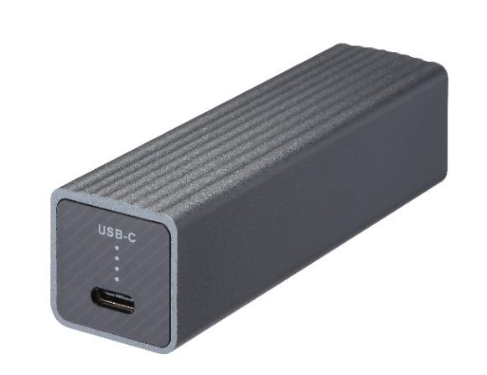
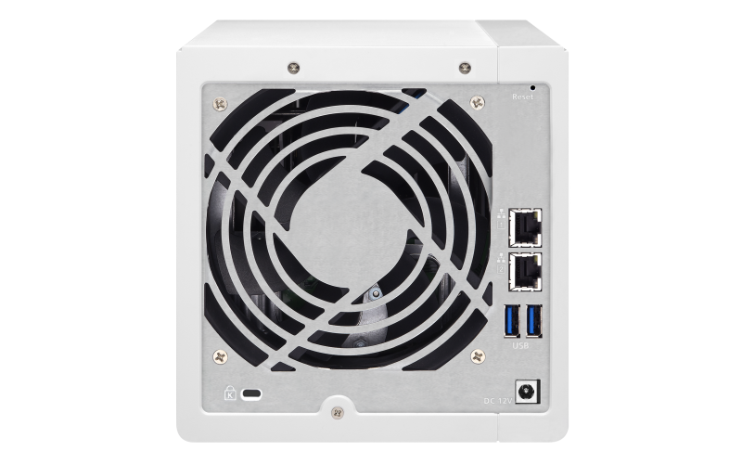
Support all NAS with USB 3.0 and QTS 4.3.6
View the complete list of supported NAS models https://www.qnap.com/en/product/eol.php

Slide 33
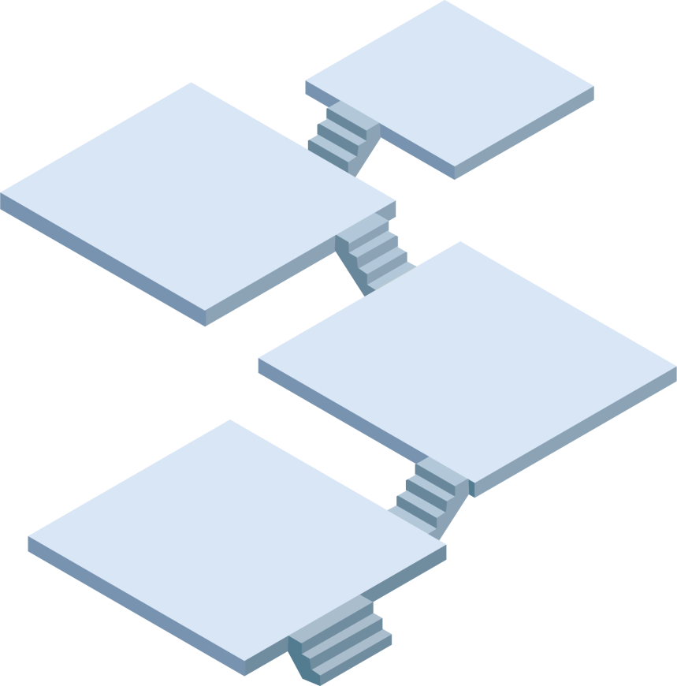
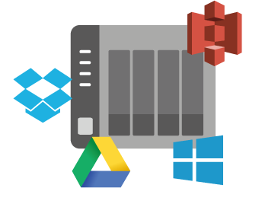
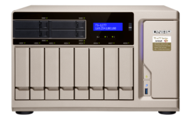
Speed up file sharing between workgroups
TVS-872XT
TS-451+ & QNA-UC5G1T
Collaboration
QSW-1208-8C
Share/Backup
TS-963X
10GbE switch
Server room
TS-1277 & QXG-10G1T

Slide 34
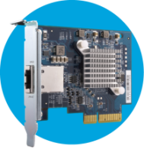
Mount huge storage space with VJBOD
Use VJBOD to mount other NAS's LUN as local disk
QXG-10G1T
2 x QXG-10G1T
10GbE
High speed
Virtual pool 1
QNA-UC5G1T
RAID
5GbE
TVS-882
Virtual pool 2

Slide 35
Business-grade 5GbE disaster recovery solution
High-speed
Backup
Hybrid
Backup Sync
Restore
TS-451 + & QNA-UC5G1T

Slide 36
Connect PC and NAS with QNA-UC5G1T
1
Modify interface settings
2
Use Qfinder Pro

Slide 37
Manage multiple NICs in Network & Virtual Switch
1
Check the topology in Network & Virtual Switch
2
X 2
Edit each NIC directly
QTS does not support the following functions when a QNA device is connected:
Port trunking
DHCP server
RADVD server
Static route

Slide 38
Upgrade from 1G to 5G with the minimum cost
TVS-473e
1GbE
Cat 5e
10G/5G/2.5G/1G/100M switch
1GbE
Cat 5e
QNAP 10G 8C switch
NAS + QXG-10G1T
PC + QNA-UC5G1T
1GbE
Cat 5e
QXG-10G1T
or QNA-UC5G1T
TVS-473e
QXG-10G1T
or QNA-UC5G1T
5GbE
Cat 5e
5Gb
5GbE
10G/5G/2.5G/1G/100M switch
Cat 5e
5GbE
Cat 5e
QNAP 10G 8C switch
Same cabling
Same cabling

Slide 39
10GB file transfer on NAS
QNA-UC5G1T
(1 x GbE)
(1 x 5GbE)
Windows PC with
QNA-UC5G1T
430
409
113
112
MB/s
Download
Upload
Download
Upload
NAS + QNA-UC5G1T
Test environment NAS: TVS-1282, QTS 4.3.6
Volume type: RAID 0 w/ 2 x Samsung 860 Pro 512GB SSD
Client PC: Intel® Core™ i7-6770 3.40GHz CPU; 16GB RAM; QNA-UC5G1T NIC ; Windows® 10 Pro 64-bit; 10GB file transfer by Robocopy

Slide 40
Demo
Performance test
with NAS

Slide 41
QNA series for 5GbE and 10GbE
QNA-UC5G1T
QNA-T310G1S
QNA-T310G1T
Host with USB 3.0
Host with Thunderbolt 3
Host with Thunderbolt 3
5G/2.5G/1G/100M 4 speeds
10G/5G/2.5G/1G/100M 5 speeds
10G speed
RJ45 NBASE-T connector
RJ45 NBASE-T connector
SFP+ connector

Slide 42
Get USB 3.0 high again
USB 3.0 Type-C to 5G/2.5G/1G/100M
Multi-Gigabit network adapter

