Slide 1
Notes:
Target Audience
(CIO, IT admin who would like to purchase storage for VMware environment)

Slide 2
VMware Application
1
Virtual Server
Stable & Comprehensive
2
3
Backup &
Disaster Recovery
Modern Application
File & Service Backup
Performance & Space
QTS (Basic Plan) /
QES (Advanced Plan)
High-availability, Pool over-provisioning, Assistance kit, SnapSync, SRM, Qtier,
Data saving, iSER (RDMA)
Notes:
How our QNAP build up Virtualization-aware storage for our VMware users
The primary challenge in storage for virtualization at most of our customers is simple question
That is, you've got an ever-increasing workload from the virtual infrastructure.
Whenever IT have budget to replace physical servers in the data center. You can image that the new server is much more powerful, so much more CPU memory capacity. And then you upgrade the hypervisor and it becomes much more scalable and is able to run many more virtual machines more efficiently, and the density of the VMs that you want to put on your storage continues to increase much faster than your storage. The bandwidth and I/O capacity is increasing.

Slide 3
The trend of virtualization storage Enterprise storage – The fundamentals of digital transformation
You might encounter …
Slow
Complex
Pause
Needs for new app
A lots of VMs grow
Data increases rapidly
I/O bottleneck
Non-flexible configuration
Complicated operation
Non-available design
Failure to recover service
The megatrend of enterprise storage is moving toward high availability, flash and integration with virtualization.
Notes:
Managing storage for virtual environments can be a difficult task.
Virtualizing servers requires storage administrators to understand both the storage and the virtualization infrastructure.
Furthermore, virtualization randomizes sequential I/O, which can cause a lag in performance.
This makes the ability to properly size storage and report storage statistics for virtual environments critical to the efficiency of the infrastructure.

Slide 4
Apart from data protection, IT professionals also care ...
Simple Management
High Availability
IT
Maintain business continuity through the five cores of this infrastructure.
Disaster Recovery
High Efficiency
Consistent Performance

Slide 5
VMware Virtual Server
VM Storage
Snapshot
Offload
Service Non-interrupt
Management

Slide 6
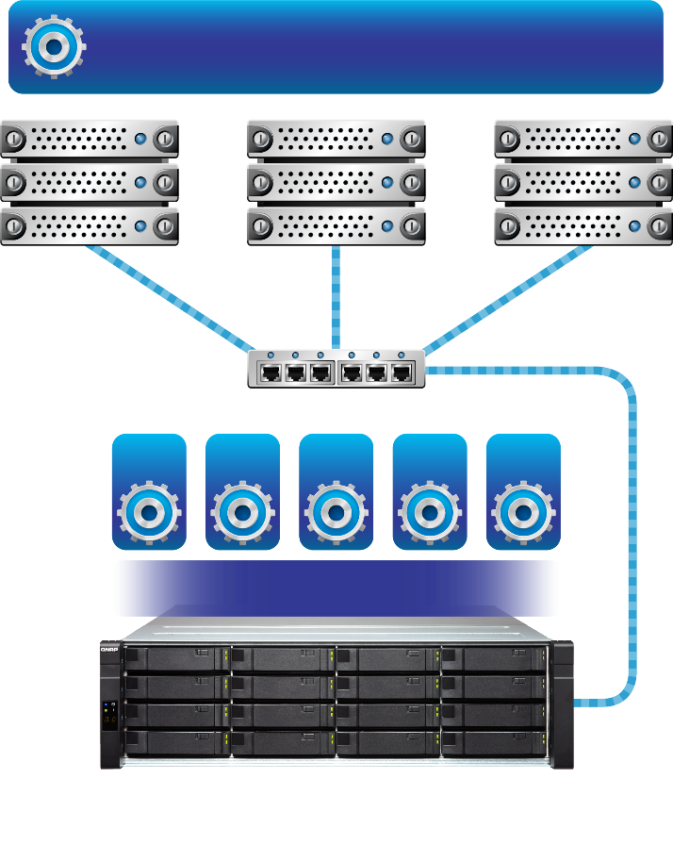
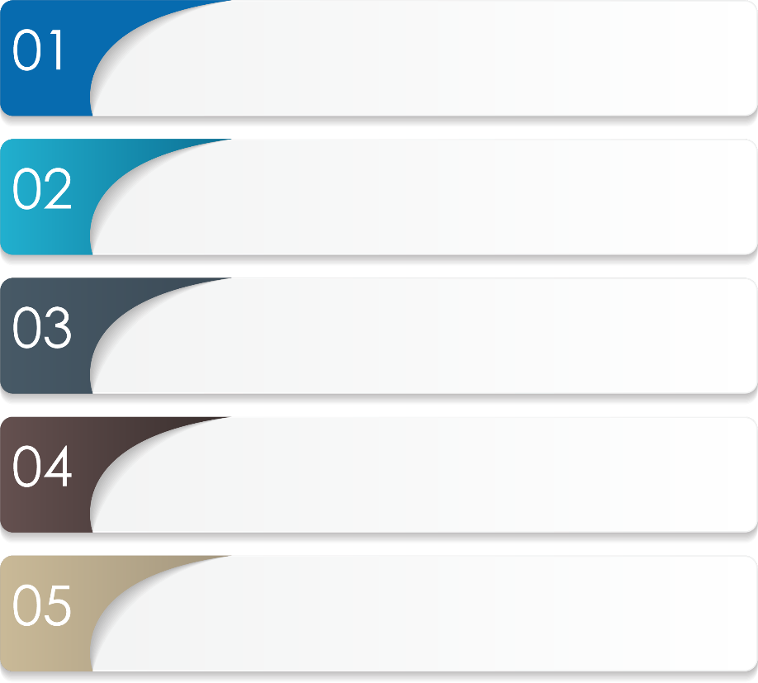
Case study – virtual server The basic architecture of virtual servers with QNAP storage
Production Hypervisor
VMware vSphere
Up to 50TB VMware datastore for web-server / exchange
24x7 continuous and stable services
ESXi
ESXi
ESXi
Switch
Snapshot backup scheme
VM
VM
VM
VM
VM
vSphere centralized management
QNAP Datastore
Storage device offload
QNAP Highly Available Storage

Slide 7
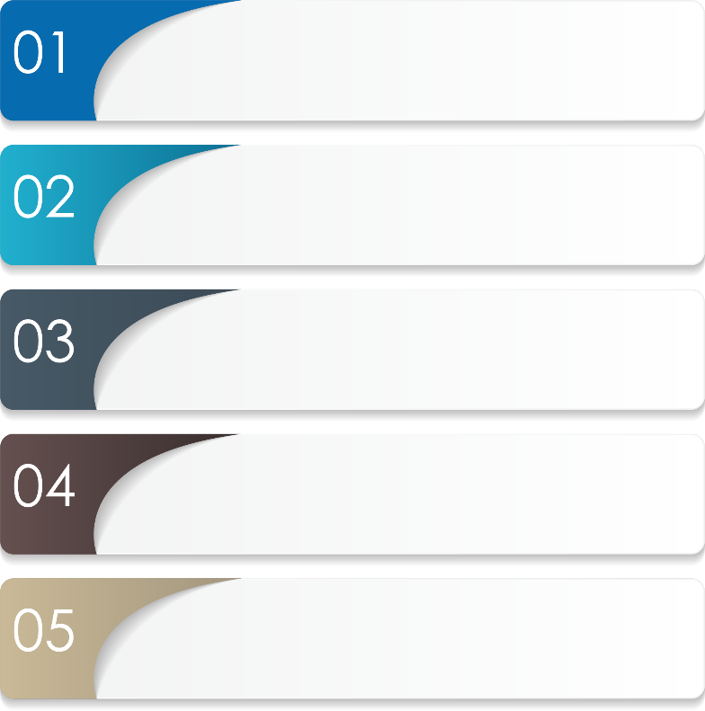
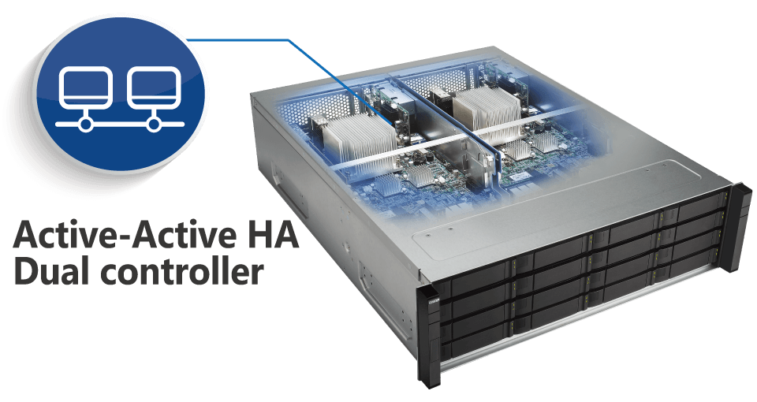
Highly available design for non-disruptive services QNAP ES1640dc - for critical applications on VMware
BBU & NVRAM cache protection
Dual-path mini-SAS link
Built-in 10GbE interface
111111
Port trunking / Multipath
ZFS end-to-end integrity

Slide 8
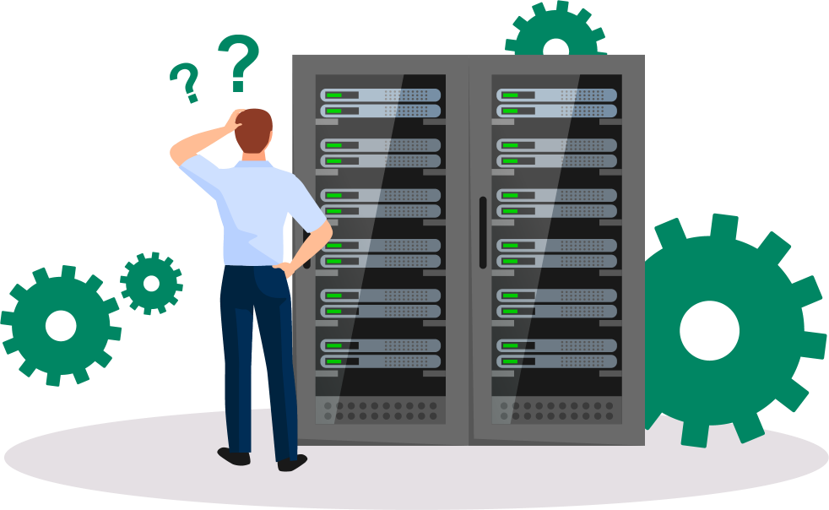
The glimpse of the performance of storage Why is my storage device slowing down?
Why is the system getting slower and slower?
Is the service starting to slow down?
Why did the NAS slow down after a while?
Notes:
長時間使用的儲存系統會有資料破碎化的問題
儲存空間一旦破碎了會導致效能變慢
需要做資料搬移來解決

Slide 9
Provide a more stable performance QES pool over provisioning decelerates the space fragmentation
A
B
C
D
A
B
C
D
Pool free space
Pool free space
Reserved space
In general：Not enough space to put Data E
Over provisioning：No space for Data E
E
E
E
E
EX.
B
Data E is put discretely
Remove Data B and write Data E
C
D
A
EX.
C
D
A
E
B
E
E
B
E
Pool free space
Pool free space
Reserved space
Notes:
儲存空間寫太滿的狀態時 同時刪除、寫入，導致儲存設備變慢

Slide 10
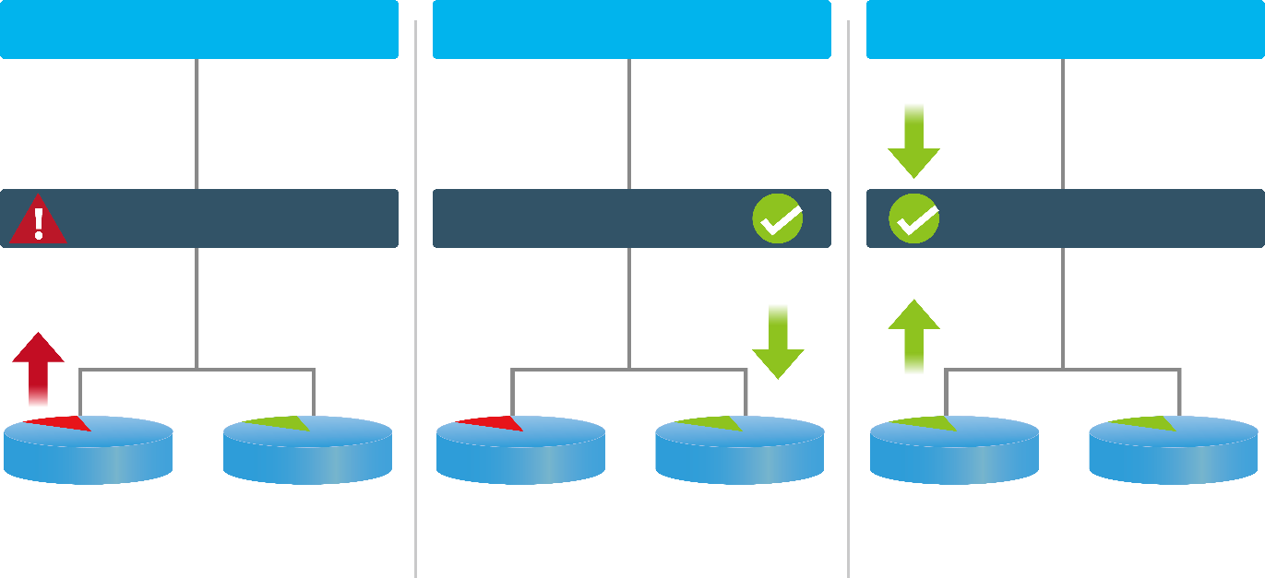
QES no-worry data protection
Checksum ensures data correctness by
detecting error & repairing damage
Data integrity
Application
Application
Application
Silent data corruption is not an issue anymore
ZFS RAID
ZFS RAID
ZFS RAID
Detects an error on disk
Returns the data from mirroring blocks
Repairs the damage block

Slide 11
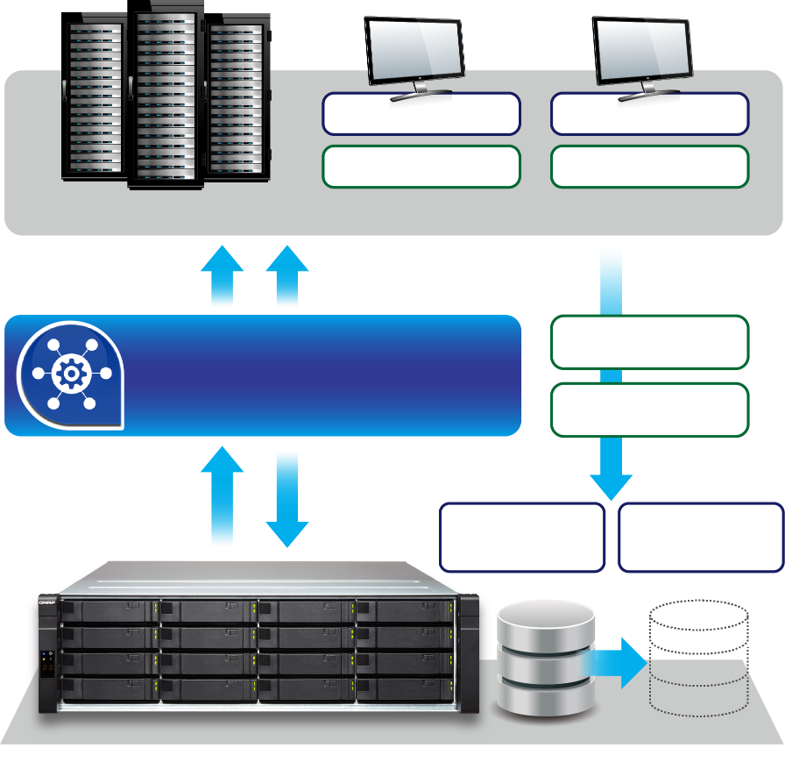
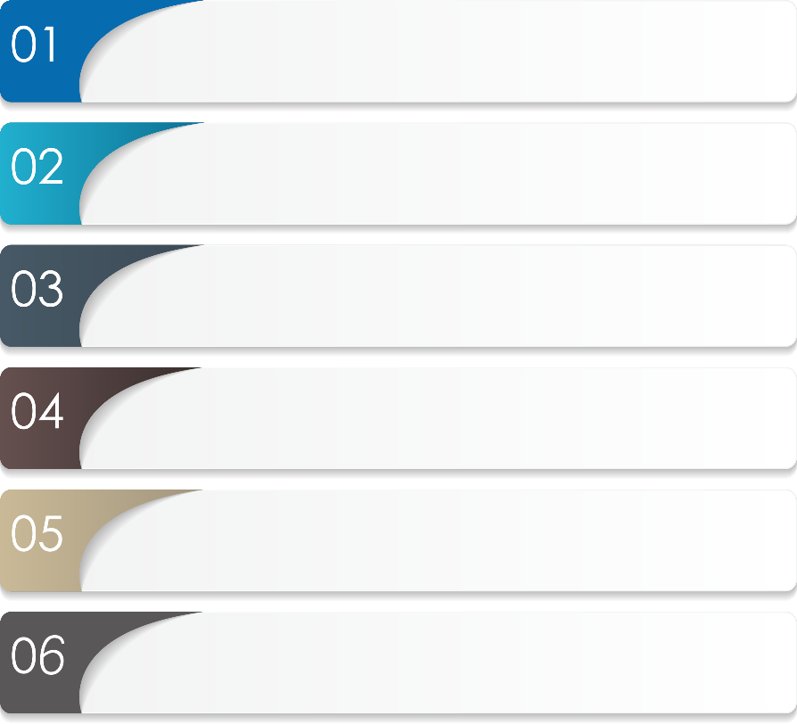
Backup tool – Snapshot Agent Provide VMware point-in-time backup to ensure the consistency
NAS initiates the request and notifies Snapshot Agent to create the snapshot
C:\ VM_1
C:\ VM_2
Memory_1
Memory_2
Snapshot Agent notifies VMware server to stop any I/O transaction
VMware vSphere
2
6
3
Flush application data from cache to NAS
Memory_1
Snapshot Agent
Memory_2
Snapshot Agent asks NAS to create the snapshot
1
4
QNAP NAS
VMDK_1
VMDK_2
NAS snapshot is created
5
Applications are free to resume writing data
Notes:
https://www.qnap.com/zh-hk/how-to/tutorial/article/%E4%BD%BF%E7%94%A8-qnap-snapshot-agent-%E5%BB%BA%E7%AB%8B-vmwarewindows-%E4%B9%8B%E4%B8%80%E8%87%B4%E6%80%A7%E5%BF%AB%E7%85%A7/

Slide 12
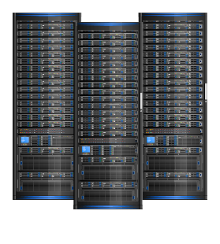
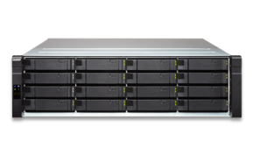
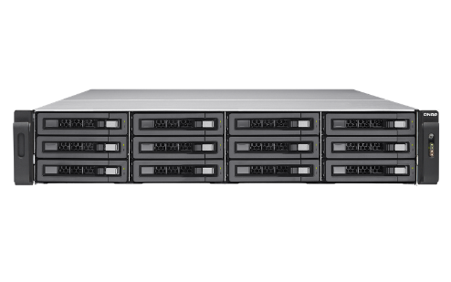
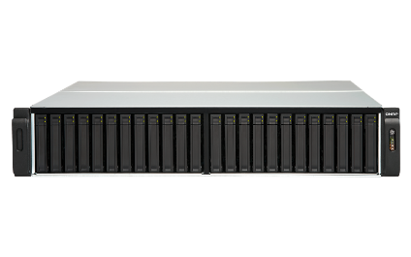
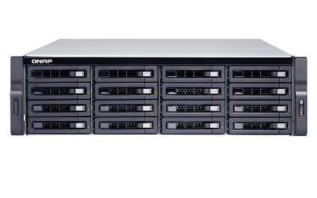
Storage management QNAP vSphere Web Plug-in helps you to manage storage devices
QNAP
vSphere Web Plug-in
manage and operate together all in one place
VMware
ESXi host
QNAP Storage
Notes:
It's not uncommon for storage admins to have difficulty with certain aspects of managing storage for virtual environments.
Tasks such as dealing with a growing infrastructure, managing storage I/O capacity and effectively
QNAP vSphere Web Plug-in is developed for VMware admins can easy to manage all their QNAP storage through vSphere environment.

Slide 13
QNAP vSphere Web Plug-in Single interface for server and storage management
Create / Remove Datastore
(iSCSI / NFS)
Mount / Unmount
Datastore
Link / Unlink
Datastore
Manage
QNAP NAS

Slide 14
Demo vSphere Web Plug-in (Conveniently Manage QNAP Storage device)

Slide 15
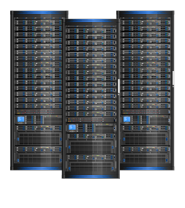
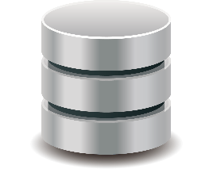
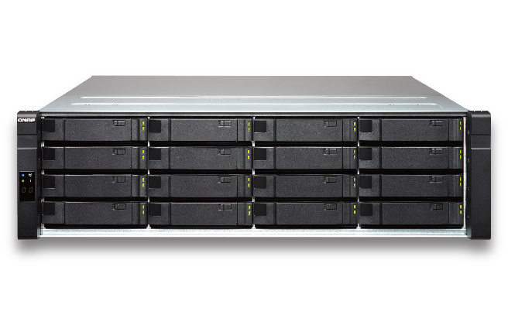
Do your storage devices integrate with virtualization? vStorage APIs for Array Integration – VAAI fast clone VM
VMware Server
QNAP NAS VAAI Plugin
Copy
Readcopy
Write copy
VM
VM
VM
VM
QNAP Storage Pool
QNAP Storage Pool
w/o VAAI
with VAAI

Slide 16
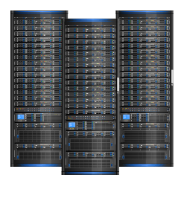
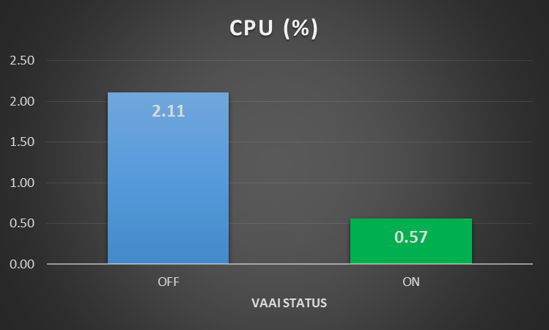
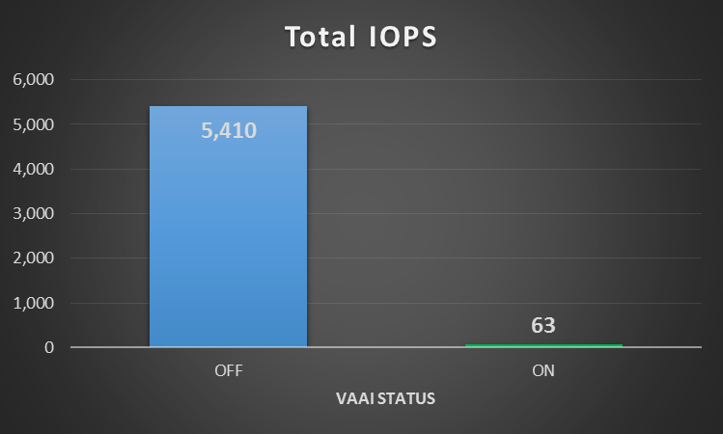
VAAI is a good partner (QTS/QES)
ESXi completely clone VMs of 40GB
Save 73% computing
6,000
2.5
5,000
5,410
2.0
2.11
4,000
1.5
3,000
1.0
2,000
0.5
0.57
1,000
63
0
0
OFF
ON
OFF
ON
CPU (%)
Total IOPS

Slide 17
An arsenal of VMware integration tools
vSphere (Web) Client Plug-in
QNAP
Snapshot Agent
QNAP VMware vStorage API for Array Integration (VAAI)
Admin can directly manage datastores on QNAP NAS by vSphere (Web) Client.
Admin can create consistent snapshots of iSCSI LUN on QNAP NAS.
Admin can optimize the performance when deploying virtualization.

Slide 18
VMware And QNAP ES series Comprehensive fault tolerance
Application
VMware vSphere Fault Tolerance ensures continuous availability for applications in the event of server failures.
Server
VMware vSphere High Availability (HA) protects your virtualized environment from failures at the server and OS level.
Storage
QNAP ES1640dc ensures data availability of VMware application at the storage level.

Slide 19
Backup Solution
Basic Data Replication
Advanced Service Replication

Slide 20
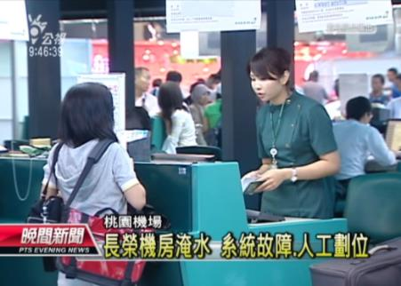
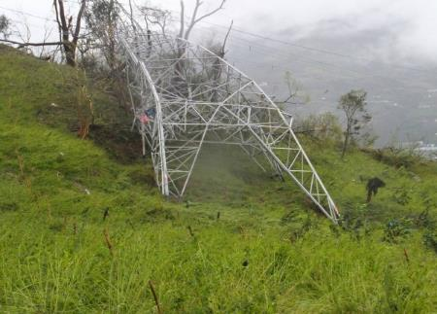
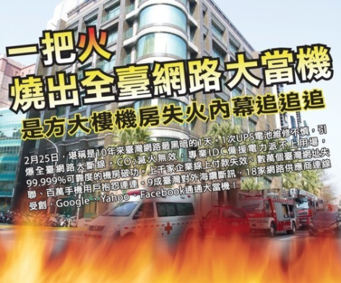
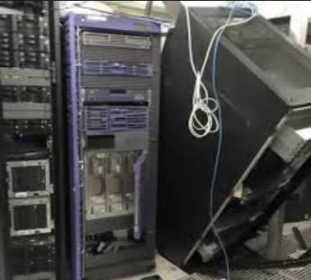
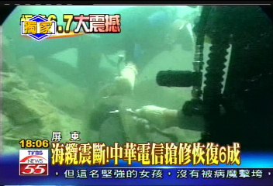
Tragedies happen!
Computer system failure / fire / flooding ...

Slide 21
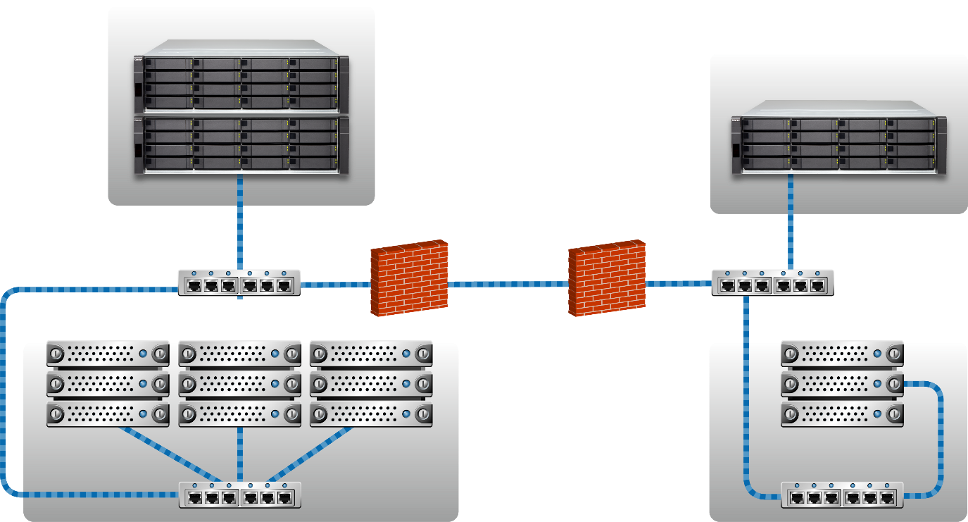
Case Study – Disaster Recovery
Storage in protected group
Storage in recovery group
Storage in protected group
Storage in recovery group

Slide 22
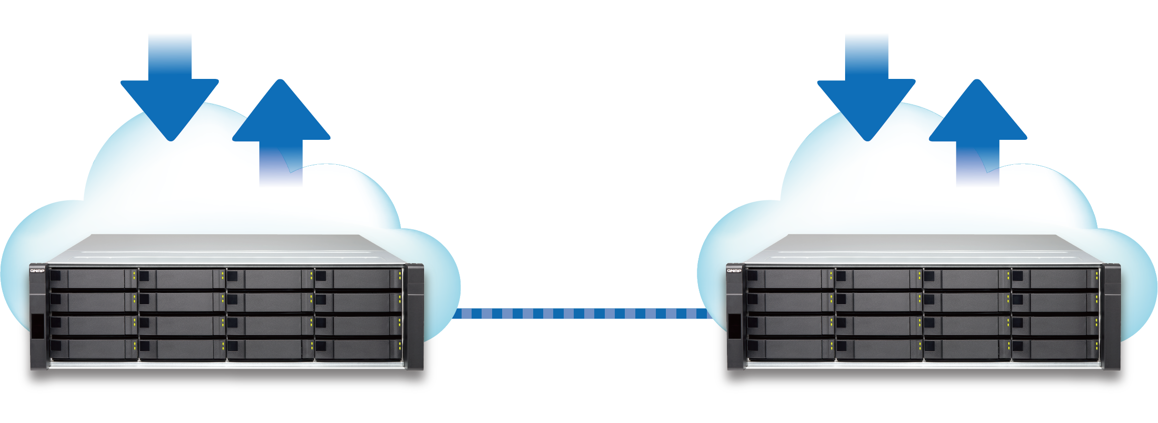
SnapSync Breakthrough data replication
Easy and fast data replication
Server
Server
iSCSI | NFS
iSCSI | NFS
Snapsync
(Block Level)
Primary Storage
Backup Storage

Slide 23
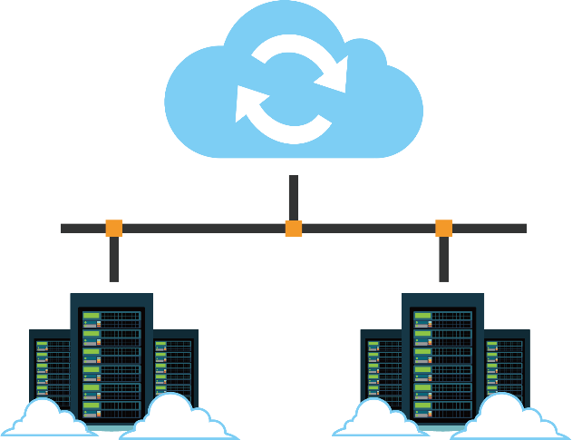
VMware Site Recovery Manager (SRM) QNAP VMware Storage Replication Adapter
+
QNAP VMware Storage Replication Adapter (SRA)
QNAP QES SnapSync
Integrating with VMware SRM to protect mission critical service
QES block level LUN / shared folder remote replication

Slide 24
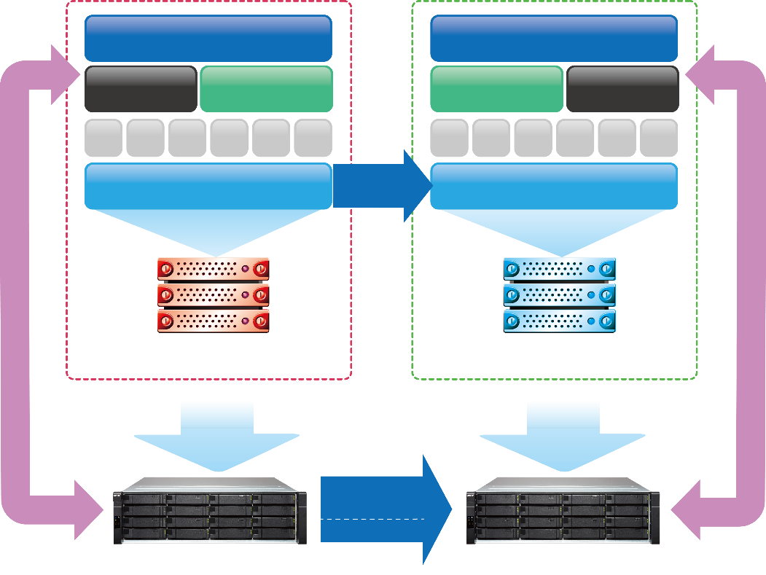
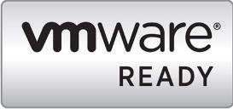
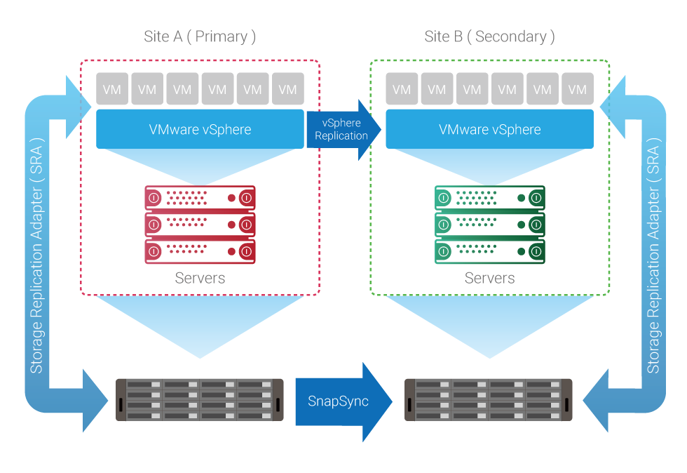
Comprehensive VMware DR solution Enable your service in recovery site just in time
Protected Site
Recovery Site
Exchange Server
Exchange Server
QNAP Storage Replication Adapter (SRA) integrate with VMware Site Recovery Manager (SRM) to enable Array Based Replication through QES SnapSync.
Site Recovery Manager
VMware vCenter Server
VMware vCenter Server
Site Recovery Manager
VM
VM
VM
VM
VM
VM
VM
VM
VM
VM
VM
VM
VMware vSphere
vSphere
Replication
VMware vSphere
Certified
QNAP SRA certify to VMware SRM 6.5
Storage Replication Adapter ( SRA )
Storage Replication Adapter ( SRA )
Servers
Servers
Array Based
Replication
SnapSync
ES1640dc v2
ES1640dc v2

Slide 25
Modern Application
VDI application
Performance & Capacity
SSD utilization
iSER network boosting

Slide 26
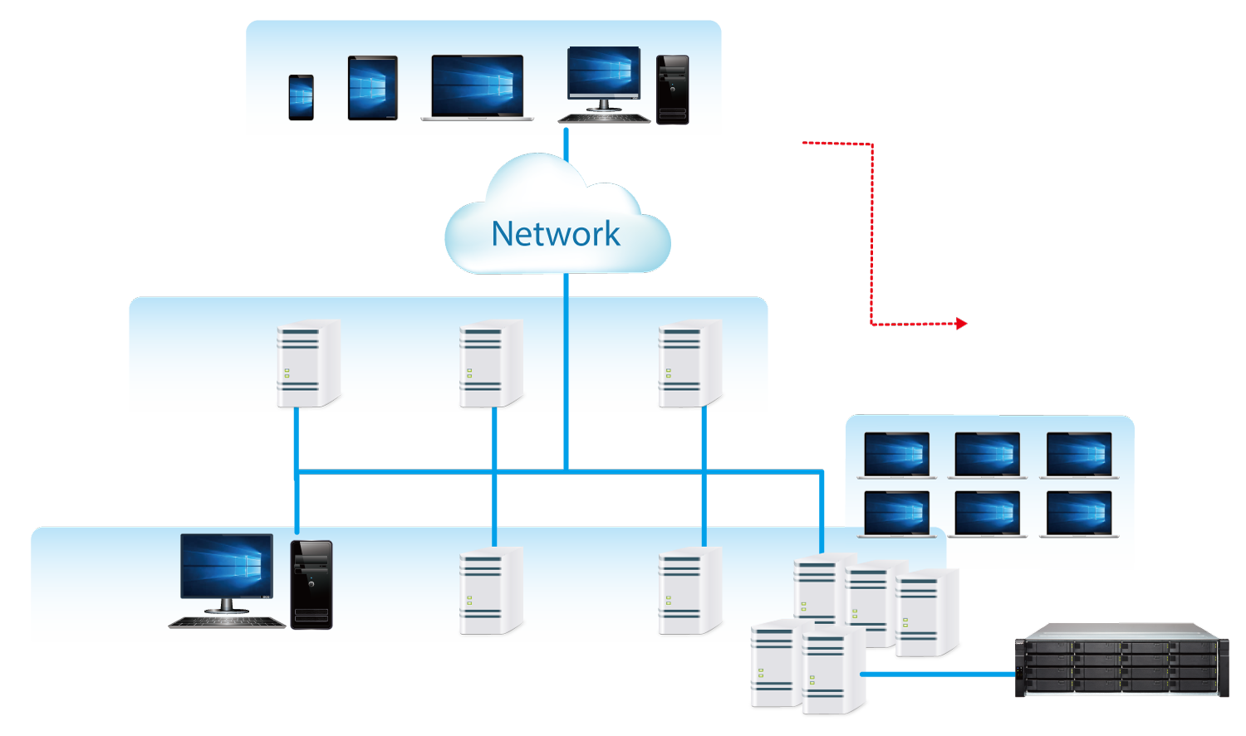
Case Study – Modern Application Storage virtualization, performance and capacity efficiency
View
Client
Client Devices
RDP
Virtual
Server
Desktop
PCoIP
View
Agent
SQL
Database
Server
ERP
Server
EIP
Server
Desktop OS
Domain
Controller
CRM
server
vCenter
Server
ESXi
hosts
ES1640dc v2
View
Agent

Slide 27
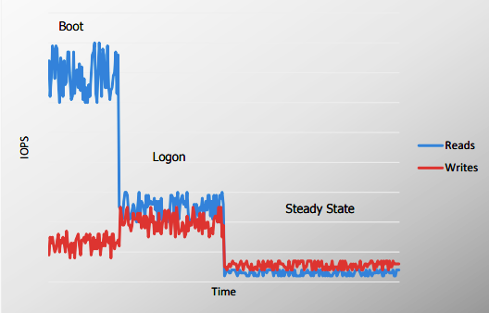
About Performance…
Virtualization is all about
User experience.
IOPS requirement for VDI
Must provide similar (or better) user experience than a traditional desktop.
A normal desktop/laptop or physical server can provide an average of 150 IOPS.

Slide 28
Without Compromise Virtualized Storage
Performance
Capacity efficiency
IOPS Application Requirement
Latency User Experience
Compression shrinking your space
Deduplication keep purely data

Slide 29
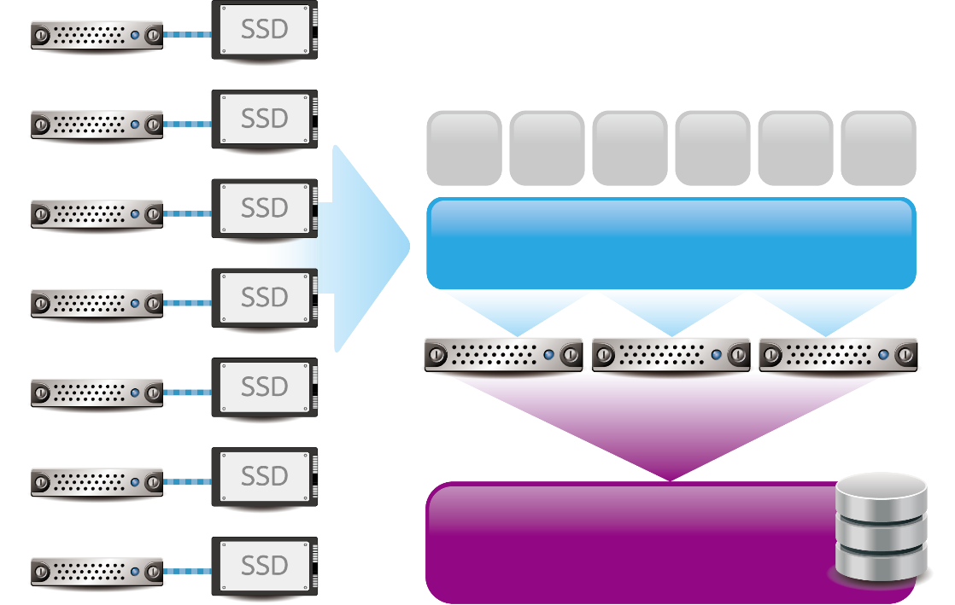
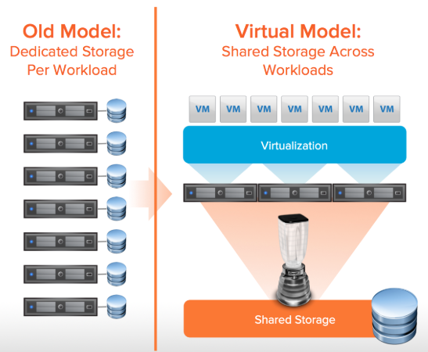
Sharing All Flash array for VMware
Old Model：
Dedicated Storage Per Workload
Virtual Model:
Shared Storage Across Workloads
Virtualize 100% of applications
Run a fully-shared infrastructure
Virtualization speed bumps
Storage contributes to the space and power savings
VM
VM
VM
VM
VM
VM
VMware ESXi
All Flash
Shared Storage
Notes:
https://blog.purestorage.com/solving-vmware-storage-shenanigans/

Slide 30
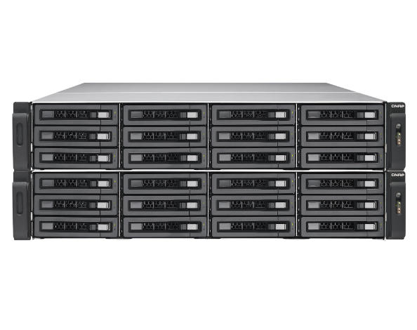
Well configuration in your storage
SATA / NL-SAS
Full of SATA or NL-SAS HDD
With high capacity but limited I/O performance.
SATA / NL-SAS
SSD
Hybrid SSD and HDD
Combine SSD and HDD drives advantage for capacity and performance.
SATA / NL-SAS
SSD
Full of SSD
Maximum I/O for extremely performance scenario.
SSD

Slide 31
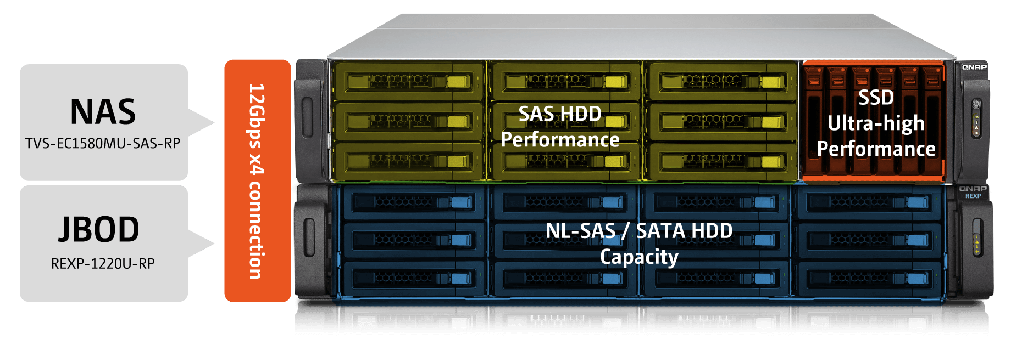
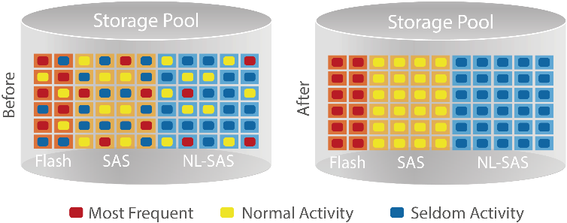
SSD, produce the best performance results
How to fully utilize SSD？
Cache (QTS / QES)
Qtier (QTS)
Cached data
Cache space
HDD space
Reading data
Writing data
File metadata
Data in HDD
Cached data
Reading data
Writing data
File metadata

Slide 32
Not only performance, but more efficiency QES Deduplication makes the storage space efficient
Deduplication can save up to 95% space in the environment of 500 VDI deployment.
QES NAS
Deduplication
VMware ESXi Server

Slide 33
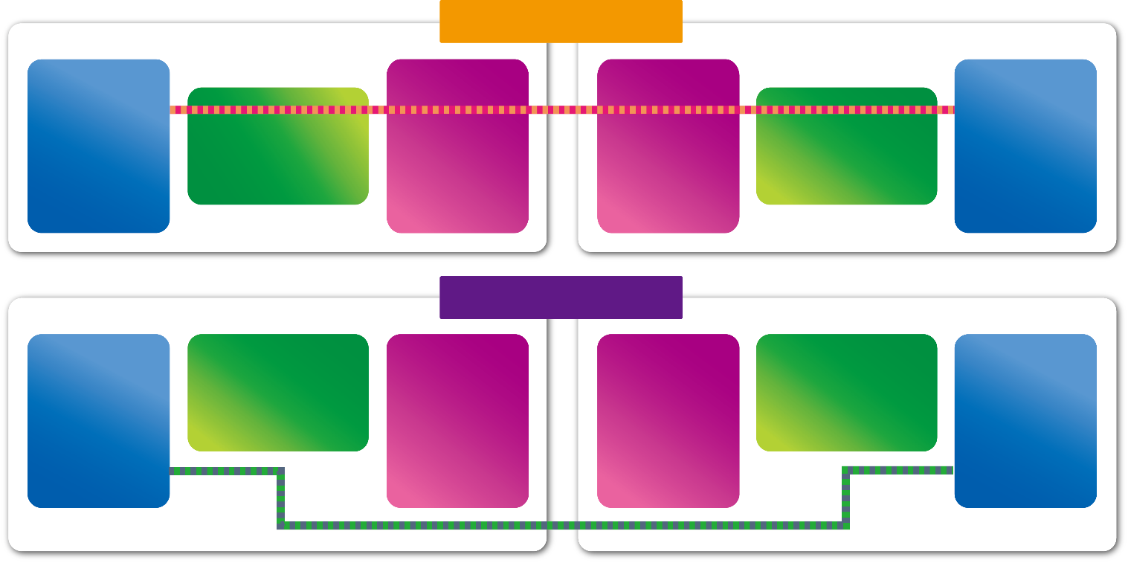
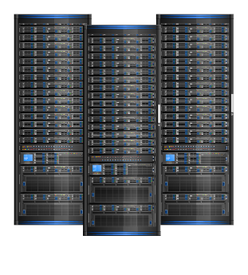
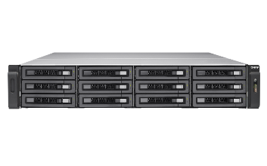
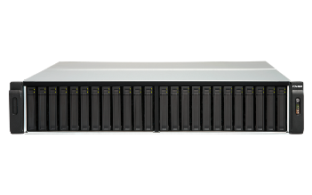
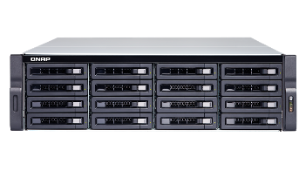
Boosting network Stack, RDMA (QTS/QES)
Without iSER
Memory
Socket Layer and Network Drivers
Ethernet
Socket Layer and Network Drivers
Memory
Ethernet
VMware
Server
QNAP
Storage
With iSER
Socket Layer and Network Drivers
Socket Layer and Network Drivers
Memory
Ethernet
Ethernet
Memory

Slide 34
VMware Certified QNAP Storage
More on compatibility information please refer to QNAP web-site or VMware HCL list as follow:
VMware Hardware Compatibility (HCL)
NAS Series | VMware Ready 6.7 |  |  |  | SRM 6.5 | FW version
 | iSCSI | NFS | VAAI iSCSI | VAAI NFS
ES1640dc Series | yes | yes | yes | yes | yes | QES 2.1.0 VAAI 3.0-2 SRA 5.5.248
TES-x85 Series | yes | yes | yes | yes | yes | QES 2.1.0 VAAI 3.0-2
TS-x32XU | yes | yes | yes | N/A | N/A | QTS 4.3.5
TS-x77XU | yes | yes | yes | N/A | N/A | QTS 4.3.5
TS-x83XU | yes | yes | yes | N/A | N/A | QTS 4.3.5
TS-x72XU | yes | yes | yes | N/A | N/A | QTS 4.4.0

Slide 35
VMware Certified QNAP Storage
Ready to certify
NAS Series | VMware Ready 6.7 |  |  |  | SRM 6.5 | FW version
 | iSCSI | NFS | VAAI iSCSI | VAAI NFS
TDS-16489U R2 QES | Complied by 2019/03 | Complied by 2019/03 | Complied by 2019/03 | Complied by 2019/03 | Complied by 2019/03 | QES 2.0.0 VAAI 3.0-2 SRA 5.5.248
TDS-16489U R2 QTS | Complied by 2019/04 | Complied by 2019/04 | Complied by 2019/04 | N/A | N/A | QTS 4.3.5
TS-2888X | Complied by 2019/05 | Complied by 2019/05 | Complied by 2019/05 | N/A | N/A | QTS 4.3.5
ES-1648dc | Complied by 2019/06 | Complied by 2019/06 | Complied by 2019/06 | Complied by 2019/06 | Complied by 2019/06 | QES 2.2.0 VAAI 3.0-2 SRA 5.5.248

Slide 36
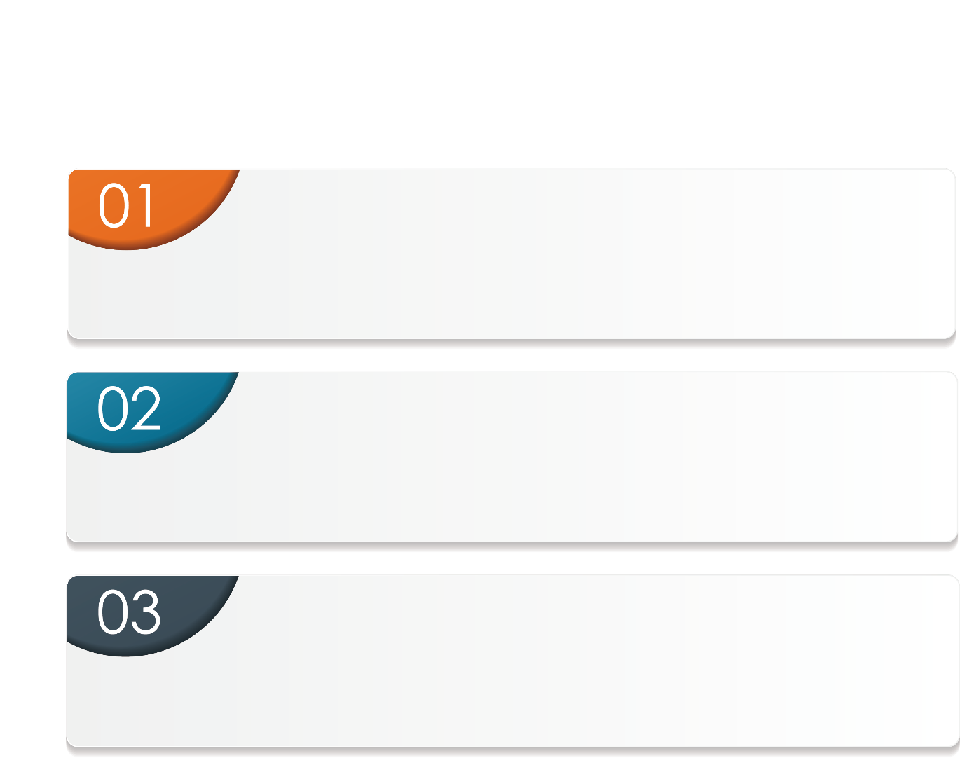
QNAP NAS makes VMware safe and easy
HIGH AVAILABILITY
Hardware and software technologies enable IT systems durable and likely to operate continuously without failure for a long time.
CONSISTENT PERFORMANCE
Software design to scale the service and access the data by multiple machines without impacting production SLA.
DISASTER RECOVERY
The process related to preparing for recovery or continuation of IT infrastructure after a natural or man-made disaster.
Notes:
這頁當結論

Slide 37
Copyright © 2019 QNAP Systems, Inc. All rights reserved. QNAP® and other names of QNAP Products are proprietary marks or registered trademarks of QNAP Systems, Inc. Other products and company names mentioned herein are trademarks of their respective holders.

