Slide 2
Easily Recreate the Qtier SSD Tier
1
SSDs Need To Be Upgraded
2
Re-create Qtier SSD Tier
Demo
3
Remove Qtier SSD Tier
4
More Scenarios and Recap

Slide 3
SSDs Need To Be Upgraded
SSD Evolution Trend
Change Qtier SSD Tier

Slide 4
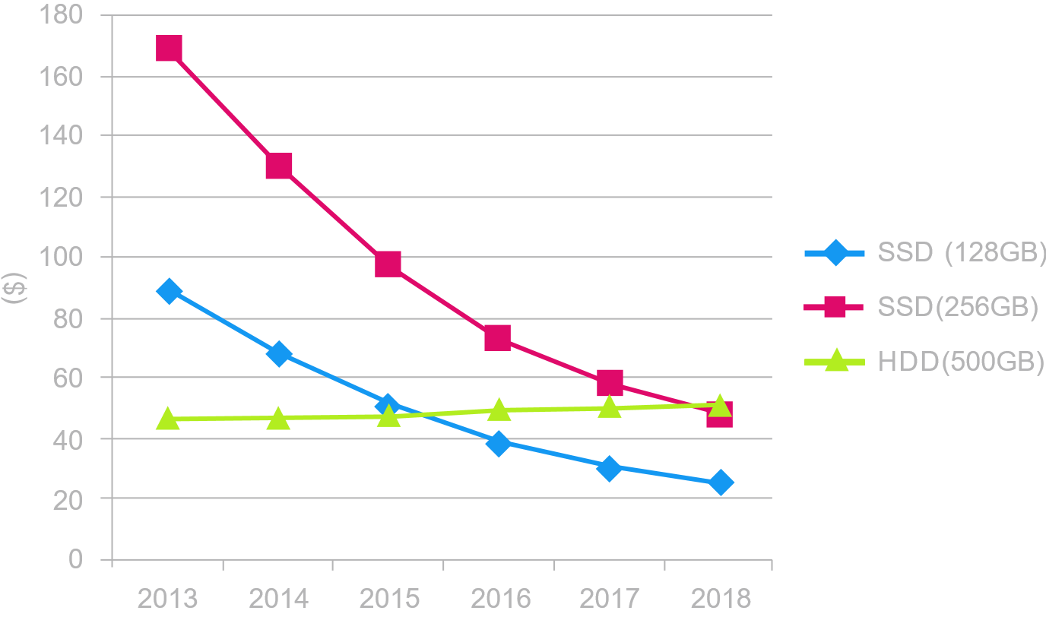
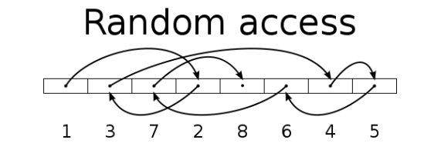
SSD Evolution Trend
With modern applications it is required higher storage performance, SSD is becoming more popular and is being widely used.
As the SSD price keeps falling, smaller SSDs that have been purchased in the past can be replaced with larger SSD.
Disk Type | SW (MB/s) | RW (IOPS)
HDD | 100 | 350
SSD | 300 | 60000
https://www.sandisk.com/business/datacenter/resources/white-papers/the-ssd-enabled-pc-total-cost-of-ownership

Slide 5
SSD EVOLUTION TREND
Since the SSD already has high performance, the SATA Port and AHCI Interface still post a limitation to the SSD.
The NVMe Interface, PCIe, M.2, U.2 SSD, and latest technologies such as SSD Over-provisioning and Intel® Optane™ are all continuously contributing to the SSD evolution.
Bus Type | SATA 3 | M.2 | U.2 | PCIe
Speed | 6Gbps | 10/32Gbps | 32Gbps | 20/32Gbps
IOPS | 60,000 | 100,000 | 300,000 | 1,000,000
Interface Standard | AHCI | NVMe | NVMe | NVMe
2.5 inch
M.2
PCIe card
SATA
SATA
NMVe
NVMe (U.2)
NVMe
IOPS performance is evaluated based on products spec existed on the market.
http://www.2cm.com.tw/2cm/zh-tw/magazine/-MarketTrend/F26FE52365E548DFB150B39173AED7D3
https://www.xfastest.com/thread-167519-1-1.html

Slide 6
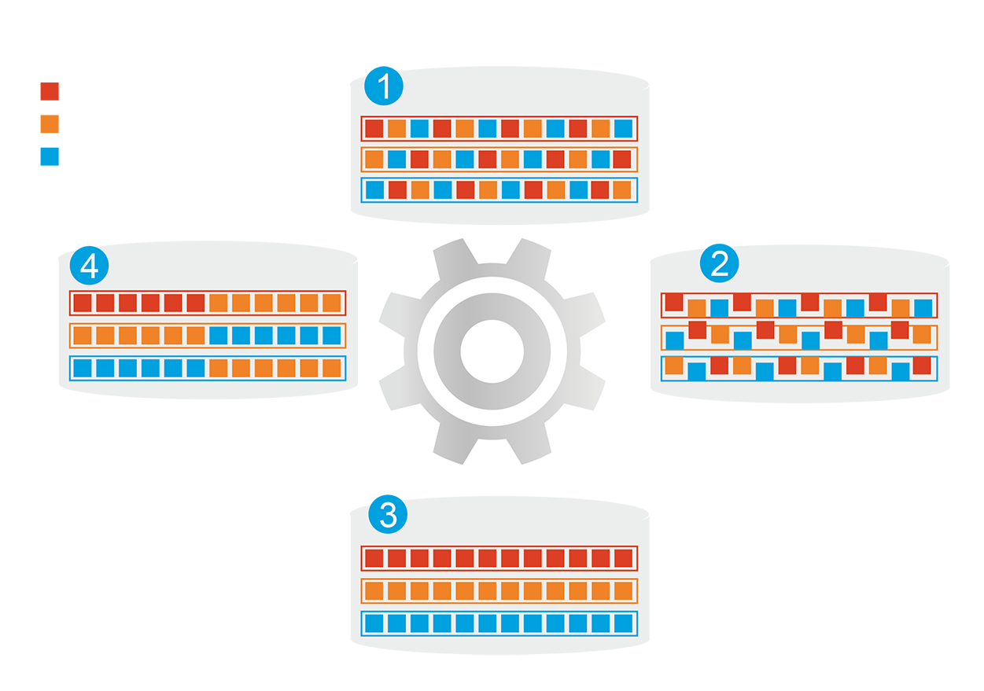
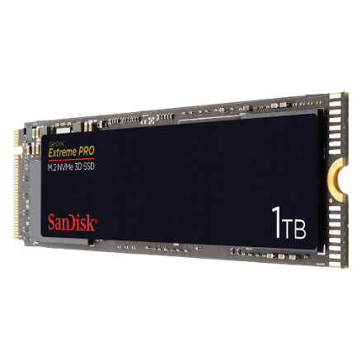
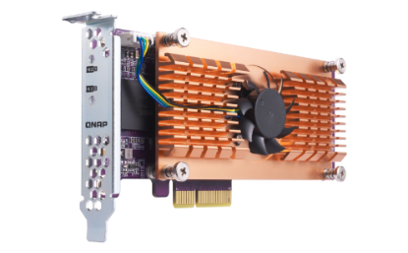
Change Qtier SSD Tier
1
Before Tiering
QNAP allows the combination of SSD and HDD RAID into the same pool and migrate data automatically based on accessing pattern.
Hot Data
Warm Data
Cold Data
4
Data Access Pattern Changed
2
Start Tiering
Support SATA, SAS, M.2, QM2 and U.2 SSD.
Qtier
Engine
Provide higher capacity as SSD can be used to store data
3
After Tiering
On QTS, PCIe NVMe SSD can only work as SSD Cache currently.

Slide 7
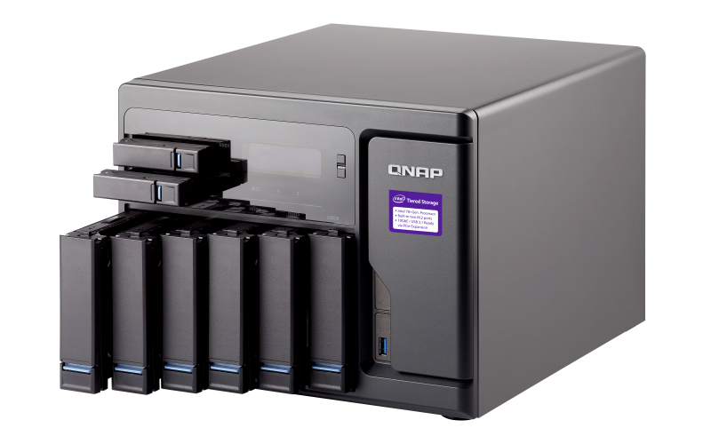
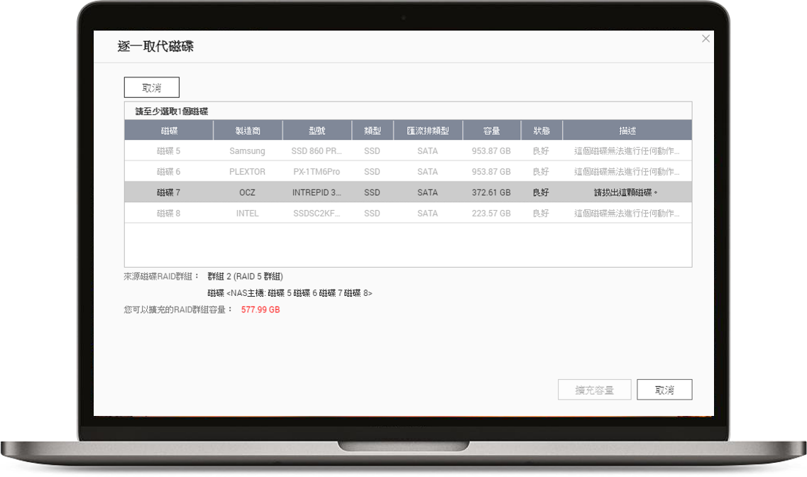
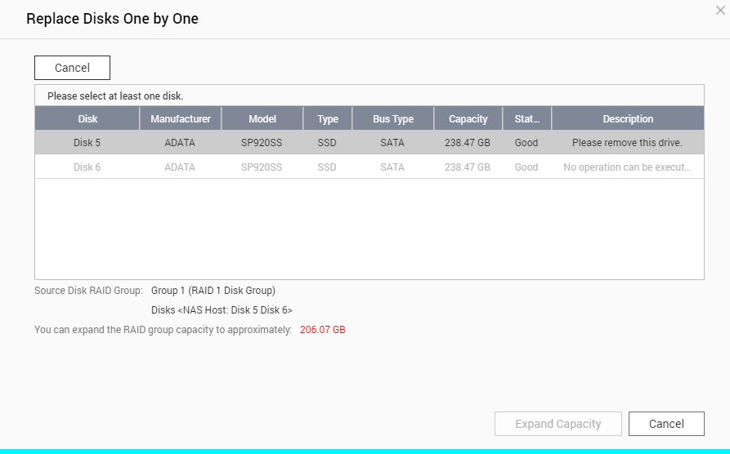
Change Qtier SSD Tier
As SSD price continues to fall, larger SSDs can be purchased, but how to replace the SSD quickly?
Challenges
QTS system has "Replace disk one by one" but such operation requires multiple resync to be completed.
Notes:
32258279

Slide 8
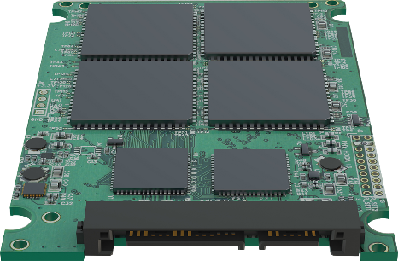
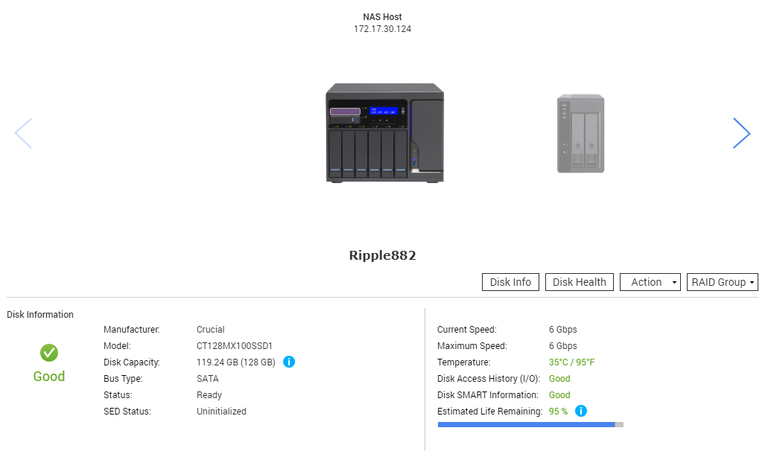
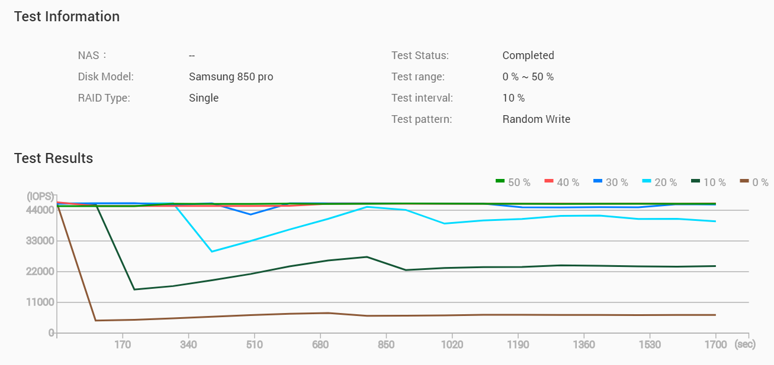
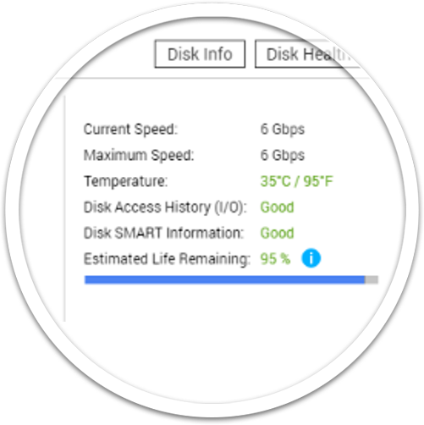
Change Qtier SSD Tier
After upgrading the QTS to 4.3.6, the new feature of SSD Over-provisioning cannot be applied on the existed Qtier SSD Tier?
Challenges
Test Information
Test Result
QTS 4.4.1 will also support monitoring the SSD endurance along with Over-provisioning
Notes:
32258279

Slide 9
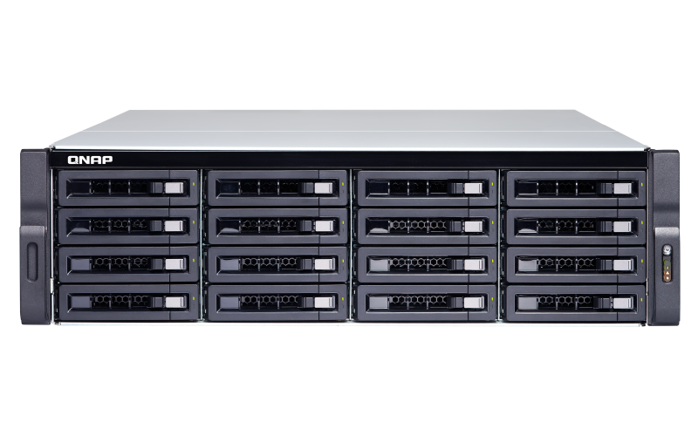
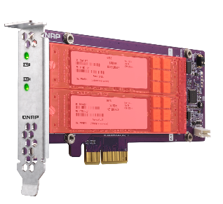
Change Qtier SSD Tier
While SSD Tier is already created with SATA Disk, how can I replace it with QM2 to expand the NAS while improving the SSD Tier performance?
Challenges
SSD RAID 5
HDD RAID 6
HDD RAID 6
SSD RAID
SSD RAID
Notes:
32258279

Slide 10
Re-create
Qtier SSD Tier
Remove Qtier SSD Tier
Recreate Qtier SSD Tier

Slide 11
Remove Qtier SSD Tier
QNAP QTS 4.4.1 supports remove Qtier SSD Tier, the users can remove then re-create SSD tier as required.
When removing the SSD tier, all the storage pool data will be retained as data on SSD only to be moved to HDD.
Storage Pool Space:
SSD RAID Usage
Pool Metadata
SAS HDD RAID Usage
SSD RAID Usage
Pool Metadata
SATA HDD RAID Usage
SSD RAID Usage

Slide 12
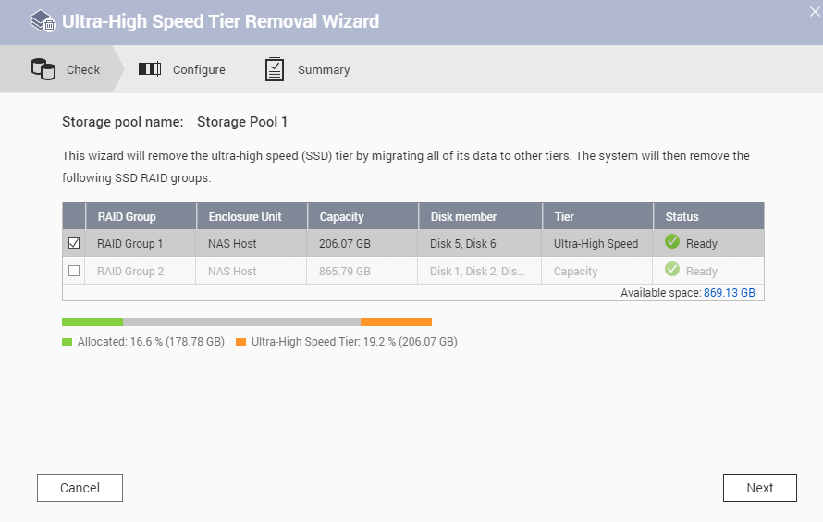
Remove Qtier SSD Tier
Remove SSD Tier in 3 steps.
Storage Pool Management >
Remove > Remove SSD Tier
1
It is required that all RAIDs in Qtier Pool are normal and HDD tiers have enough capacity to store all data.
Check if all the RAIDs Group are
ready and have enough space.
2
User confirm to stop the pool’s
service to start the operation.
3

Slide 13
Remove Qtier SSD Tier
The time required to remove Qtier SSD tier is depending on the data size that stored in SSD.
For example, remove 2 250 GB SSD will consume 20 mins.
QTS only remove the SSD tier when data migration is completed.
Active Wizard
Check Status
Stop Service
Start Migration
Migration Completed
MetaData 64G Rebuild
Power Off or Disk Failure
Reboot or Rebuild
Power Off NAS or Disk Failure
Remove SSD Tier
Reboot or Rebuild
Completed

Slide 14
Demo

Slide 15
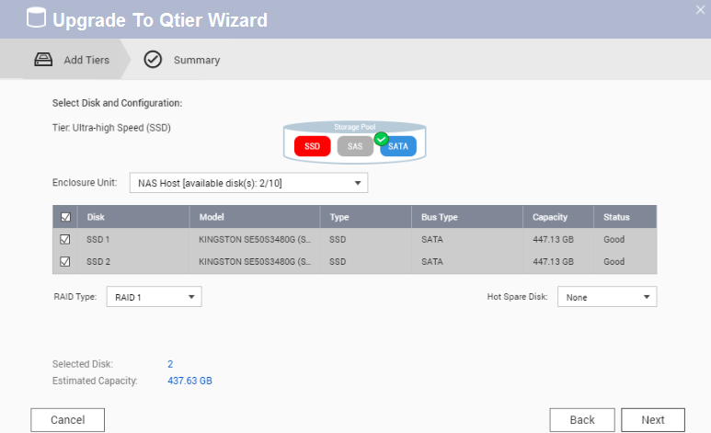
Re-create Qtier SSD Tier
Once Qtier SSD Tier is removed, the Storage Pool will become Normal Pool or remain to be Qtier Pool based on if second tier existed. User then can upgrade or expand the pool accordingly to add SSD.
Step 1
Step 2
Insert new SSD and Open Storage & Snapshot.
Choose “Upgrade” or “Expand” the Storage Pool.
Step 3
Following the wizard to add new SSD back into the Storage Pool.

Slide 16
Re-create Qtier SSD Tier
In QNAP Lab, 4 250 GB SSD need to be replaced with 500 GB SSD. The operation is conducted with both Replacing Disk & Remove SSD Tier
The time for removing and re-creating the SSD tier is almost 2 times faster than replacing disk.
Using TVS-1282T with 4 enterprise HDD for testing.
Notes:
35157436 Significant

Slide 17
Summary
More Scenarios
Function Summary

Slide 18
More Scenarios
The best SSD configuration may only be measurable once it is configured. The SSD Cache and Qtier have different advantages.
Sequential R/W (MB/s)
Random R/W (IOPS)
SSD Cache
Real Time Performacne Boost
1. For accessing with burst IO such as file syncing and video editing.
2. Can be changed to Read or Write only with bypass block size.
1400
80000
1200
70000
1000
60000
50000
800
40000
Qtier 2.0
600
Fully use SSD Capacity
1. For boosting IO with fixed pattern such as mail server.
2. With IO Aware Qtier can also support database operations.
30000
400
20000
200
10000
0
0
SSD Cache
Qtier
Write
SSD Cache
Qtier
Read
TVS-871T-i7-16G pair with QM2 2P expansion card and ADATA SX8000NP 512GB as SSD Cache and Qtier

Slide 19
More Scenario
With Qtier remove SSD tier functions, the IT manager can freely switch between the SSD Cache and Qtier to adapt to the best configuration.
Scenarios | File Server | Web Server | Video Editing | Virtualization Storage | Backup | Database
SSD Usage | Read-write Cache | Qtier | Read-write Cache | Qtier | Write-only Cache | Qtier
RAID Type | RAID 10 | RAID 10 | RAID 5 | RAID 10 | RAID 5 | RAID 10
SSD OP | 10% | 20% | 20% | 20% | 10% | 30%

Slide 20
Summary
Upgrade SSD capacity or types in an instant
SSD price is continuously falling, but performance is still increased with the new interface such as PCIe, M.2 and U.2.
QNAP Qtier Pool support remove SSD tier, can replace SSD or change RAID type instantly.
Data can be migrated to HDD tier automatically to prevent data loss.
Afterward SSD can be re-added through using upgrading or migrating wizard.

Slide 21
Copyright © 2019 QNAP Systems, Inc. All rights reserved. QNAP® and other names of QNAP Products are proprietary marks or registered trademarks of QNAP Systems, Inc. Other products and company names mentioned herein are trademarks of their respective holders.

