Slide 2

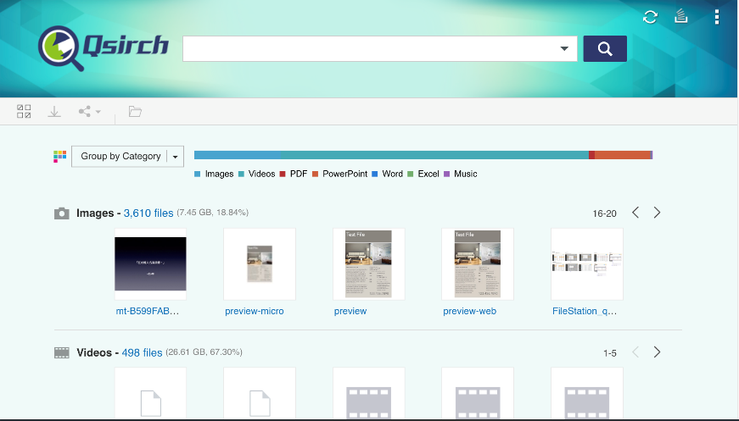
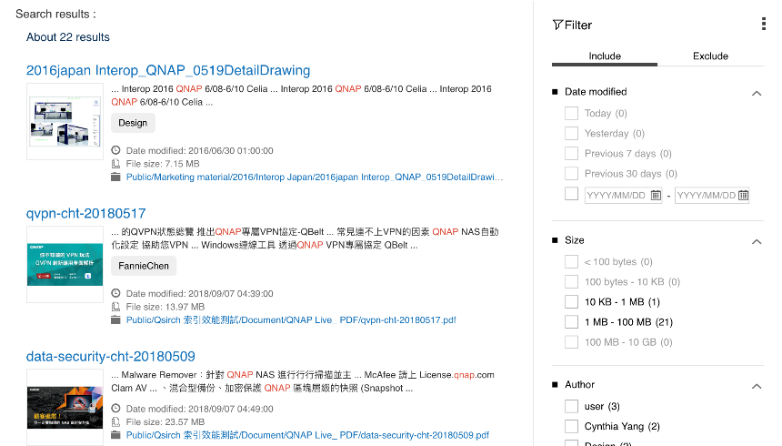
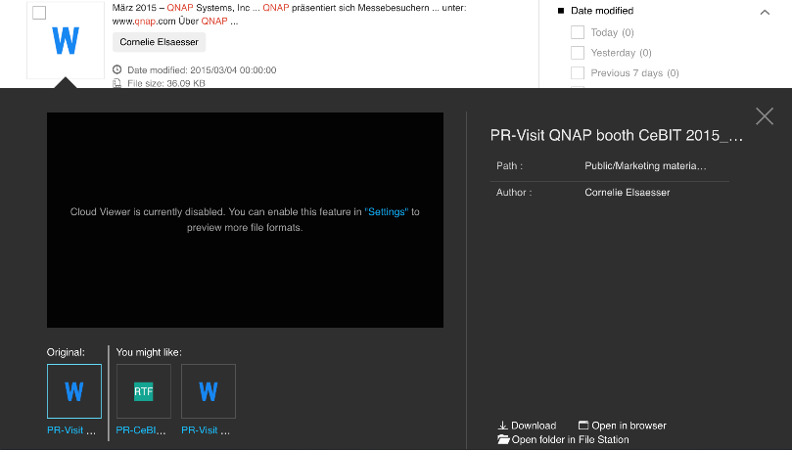
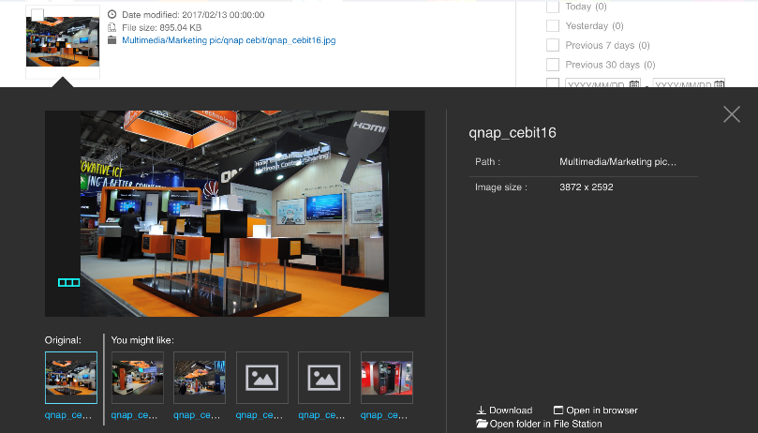
Before, when using Qsirch…
Rich functions in homepage, but I just want to quickly start searching.
It can only see a few search results at a time.
To see the contents of the files must to enable “Cloud viewer” function.
The preview window is too small to read the file.

Slide 3






Better than ever, Qsirch search tool is fully upgraded!
We heard your voice!
3
4
New features
Interface improvement
Brand new
Qsirch 4.0
Full-text search tool

Slide 4
Qsirch 4.0 Brand new features

Slide 5



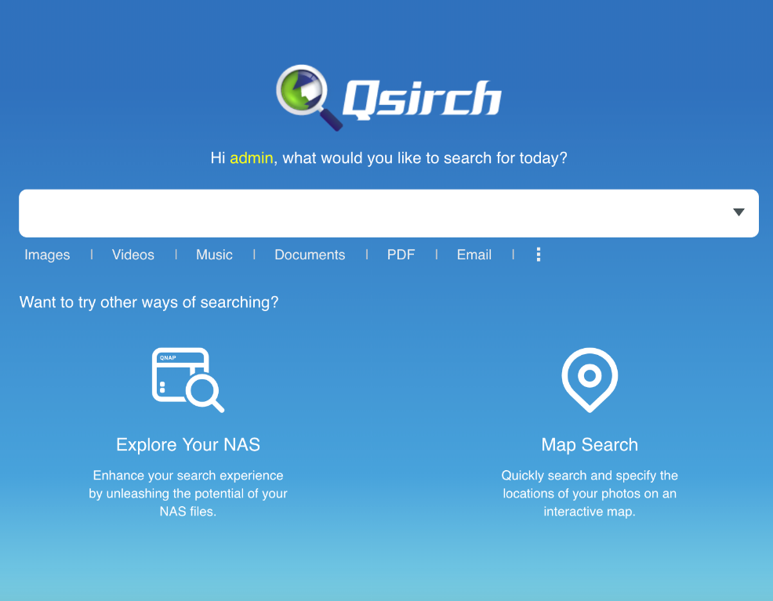
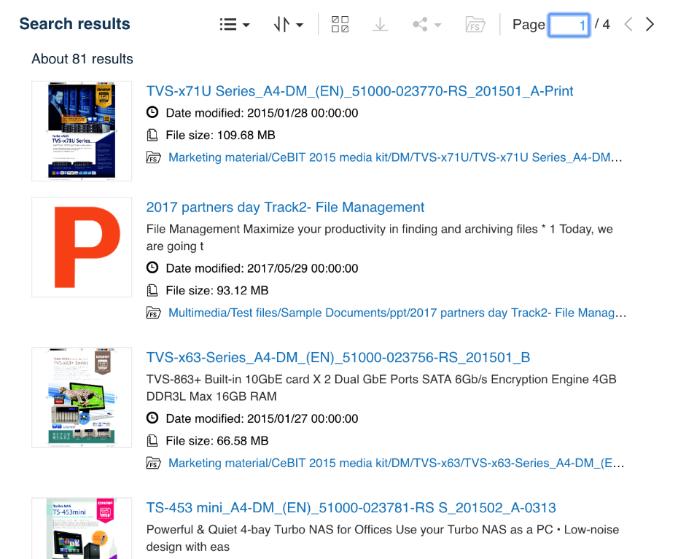
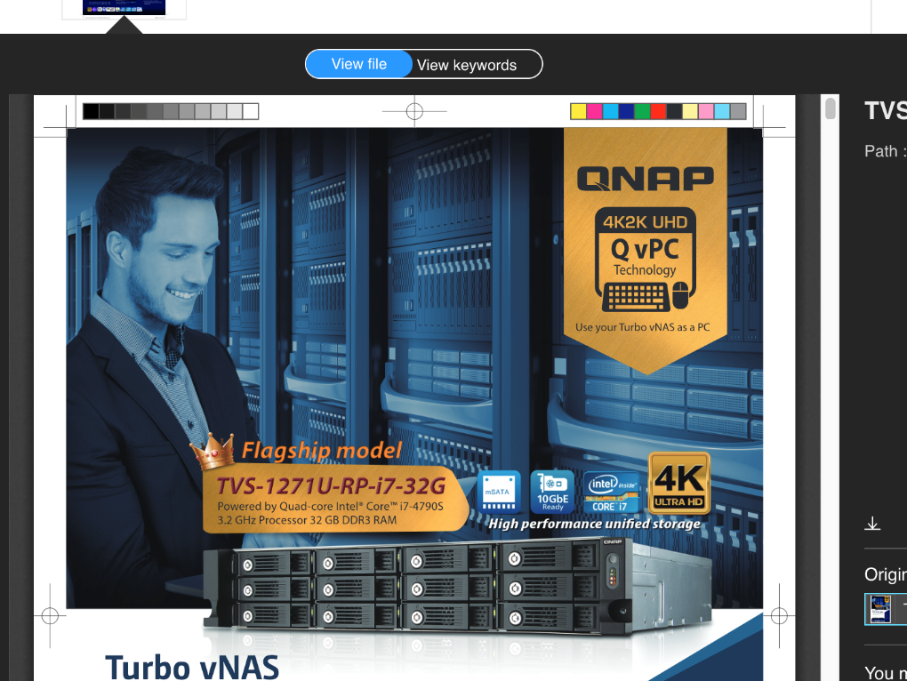
Qsirch 4.0 Revision.
3 optimizations of the interface to give you the best search experience
More concise homepage, required search tools at a glance
View more search results at once
Larger preview window for easier operation

Slide 6








Images, videos to documents, search tools fully upgraded
Explore NAS
Map Search
Get overview of the file types stored on the NAS and use the frequently-used tags to enhance your search experience.
Quickly search and specify the locations of your photos on an interactive map
View keywords
FPS
Preview directly after search and view the relevant paragraphs in the file that contain search keywords
New filter criteria to use FPS information to find a specific video
Qsirch 4.0 - 4 new features

Slide 7

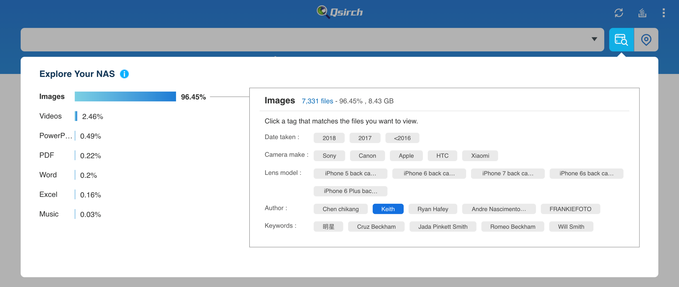


Explore NAS to master the potential features of NAS archives
Select tags to view files with common features.
Easy to view how your files are distributed in NAS.

Slide 8

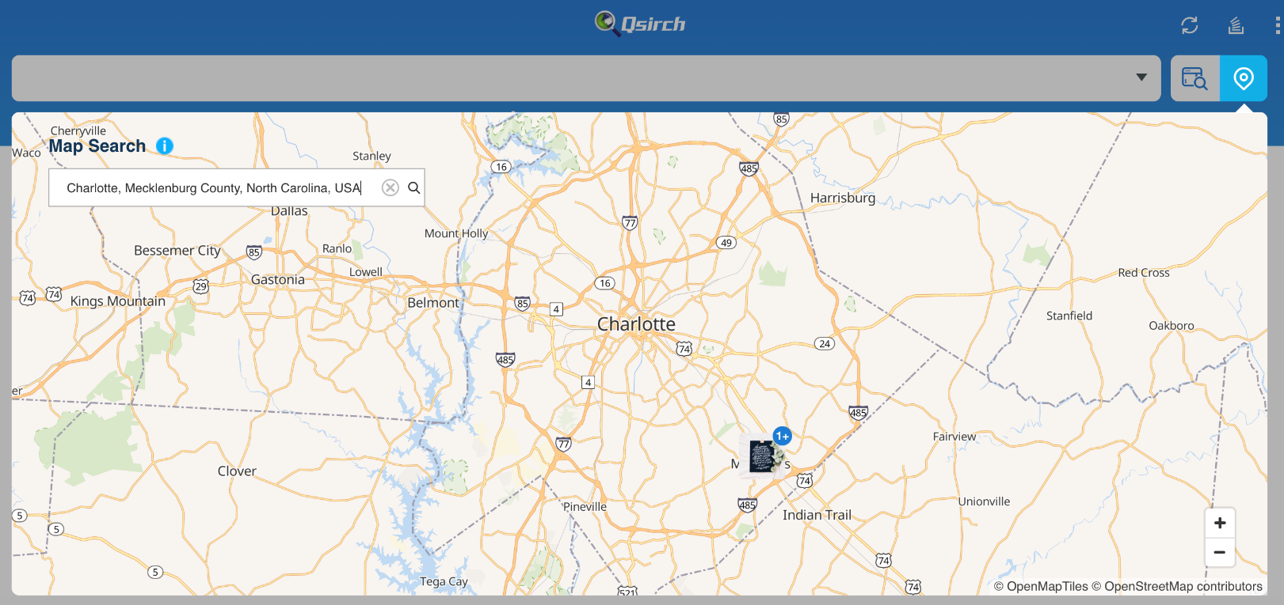

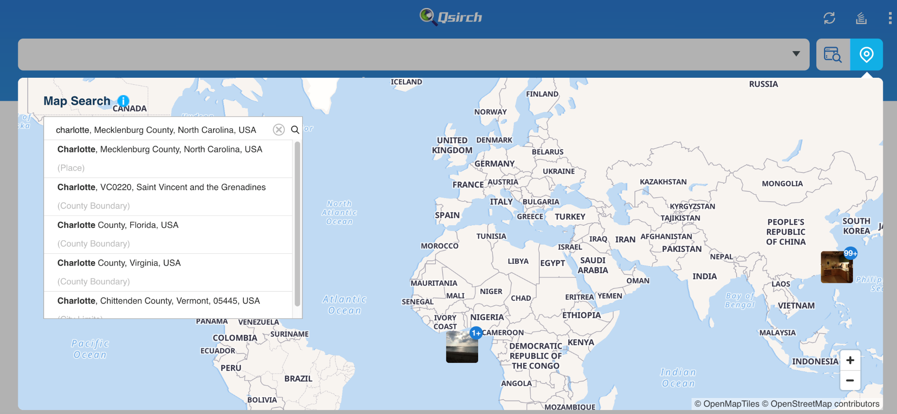
Map Search, Quickly find photos of a specific location
Categories present photos of the same location.You can also search, quickly view and specify locations/landmarks in the map!

Slide 9
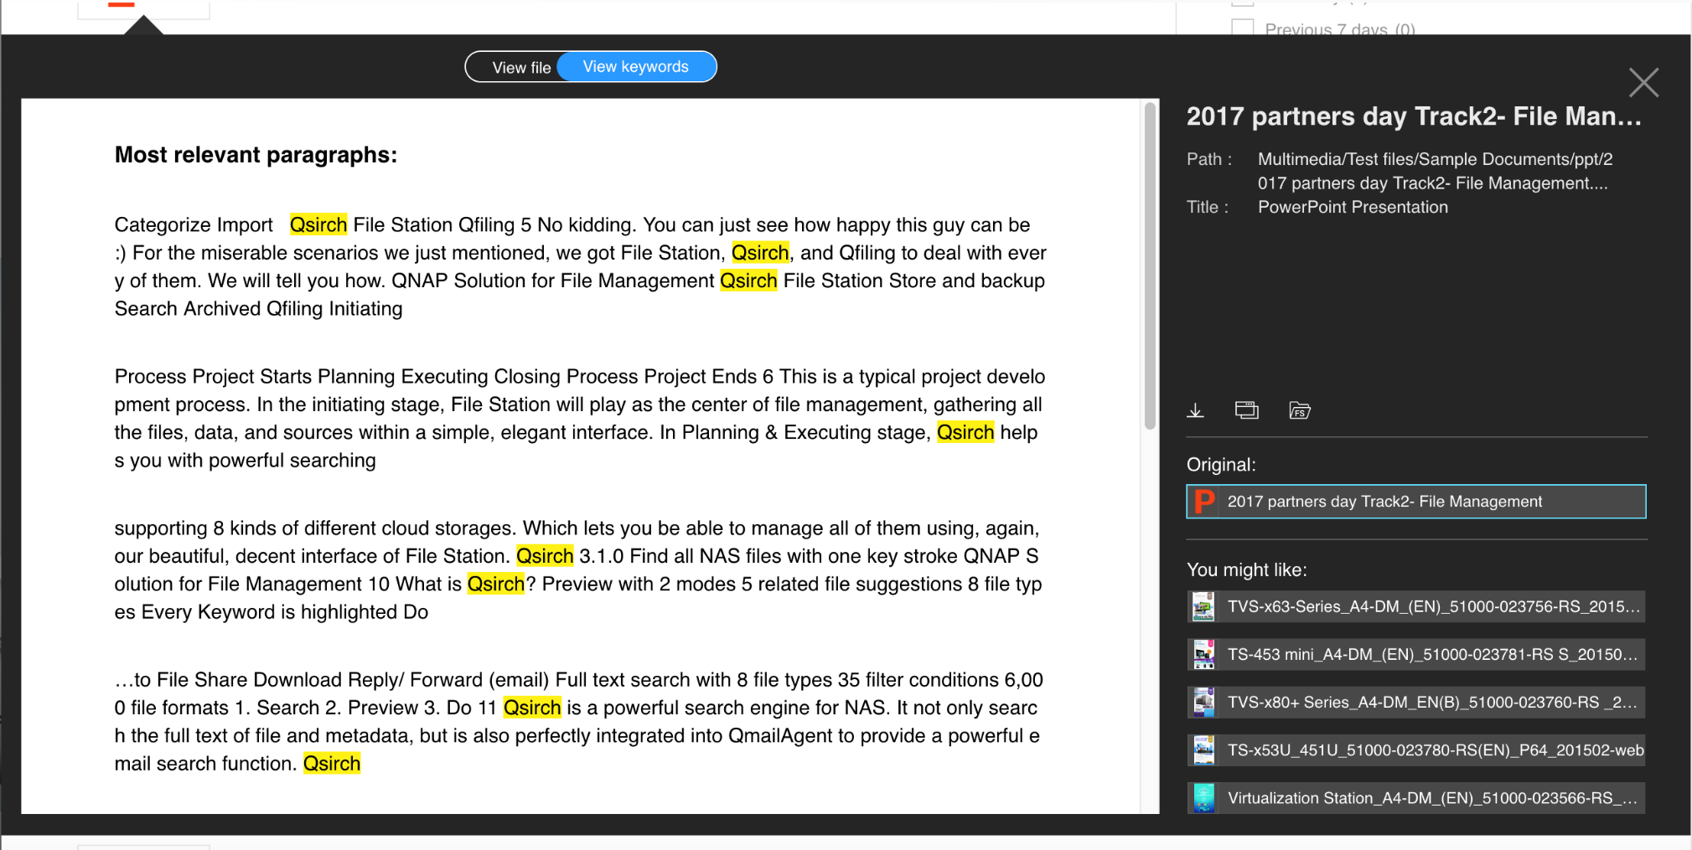
View keywords, Instant preview related paragraphs after searching
Quickly view key paragraphs, download or share the file after confirmed!
No need to install other kits, files can be viewed directly!

Slide 10
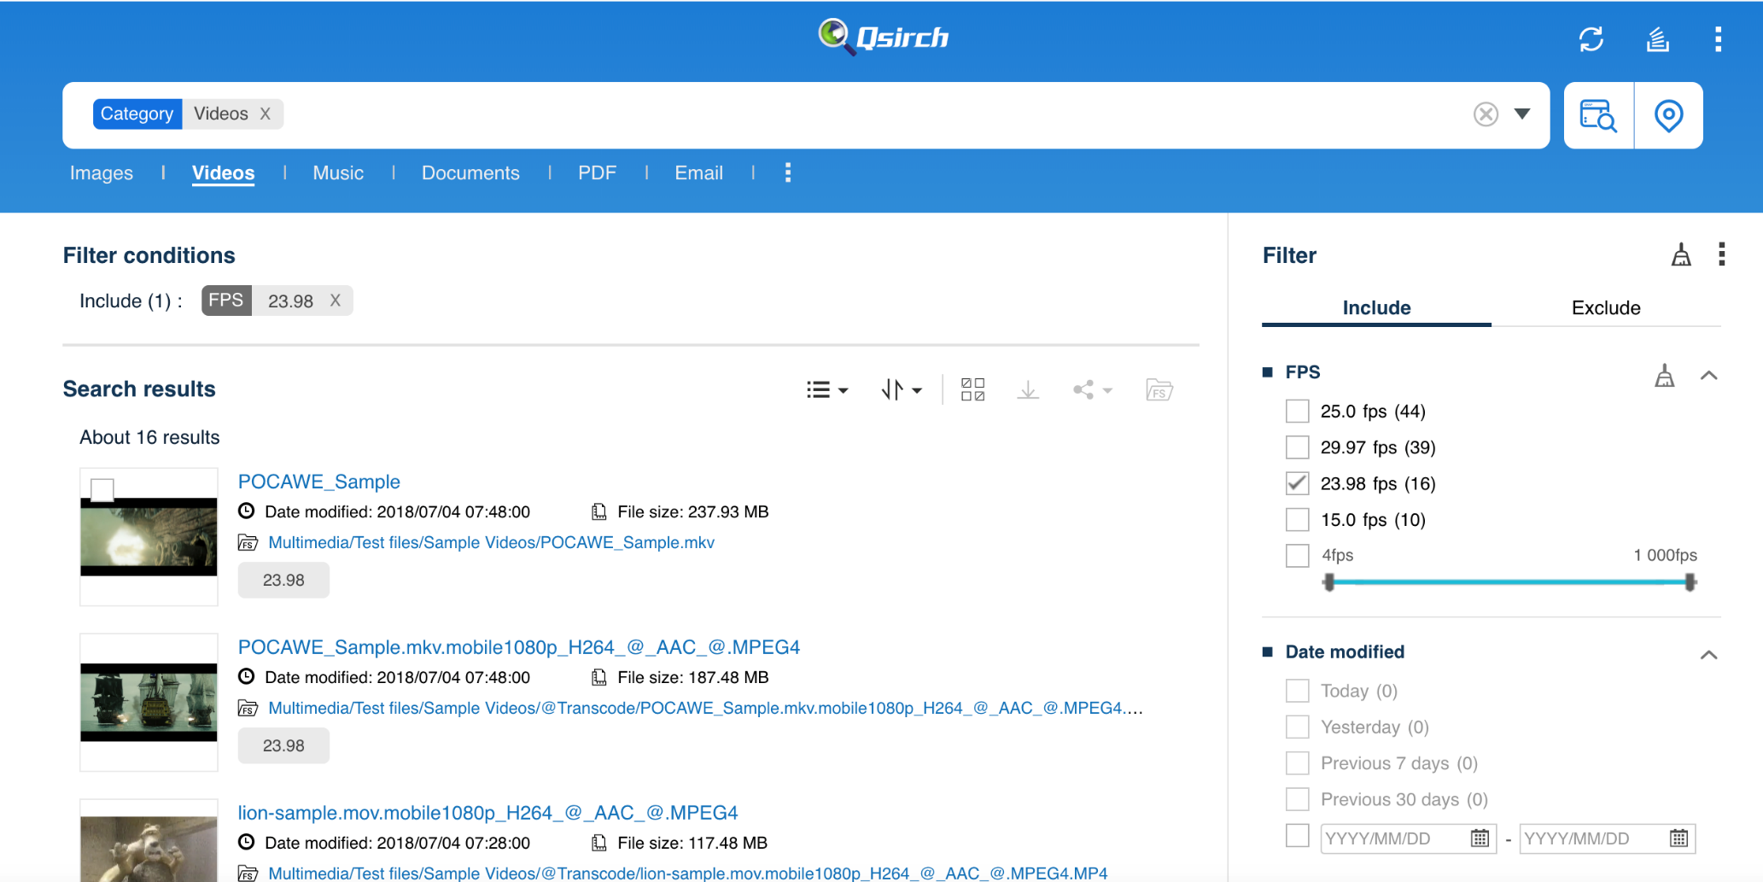
New filter criteria, FPS can also be searched
Tick specific FPS conditions, or find the video you need through range selection

Slide 12
Useful skills of Qsirch

Slide 13

Advanced search for complex keyword search
35+ powerful filter conditions
Easy steps from previewing to sharing
Search files anytime, anywhere in 4 ways
4 search tips to use Qsirch more efficiently

Slide 14
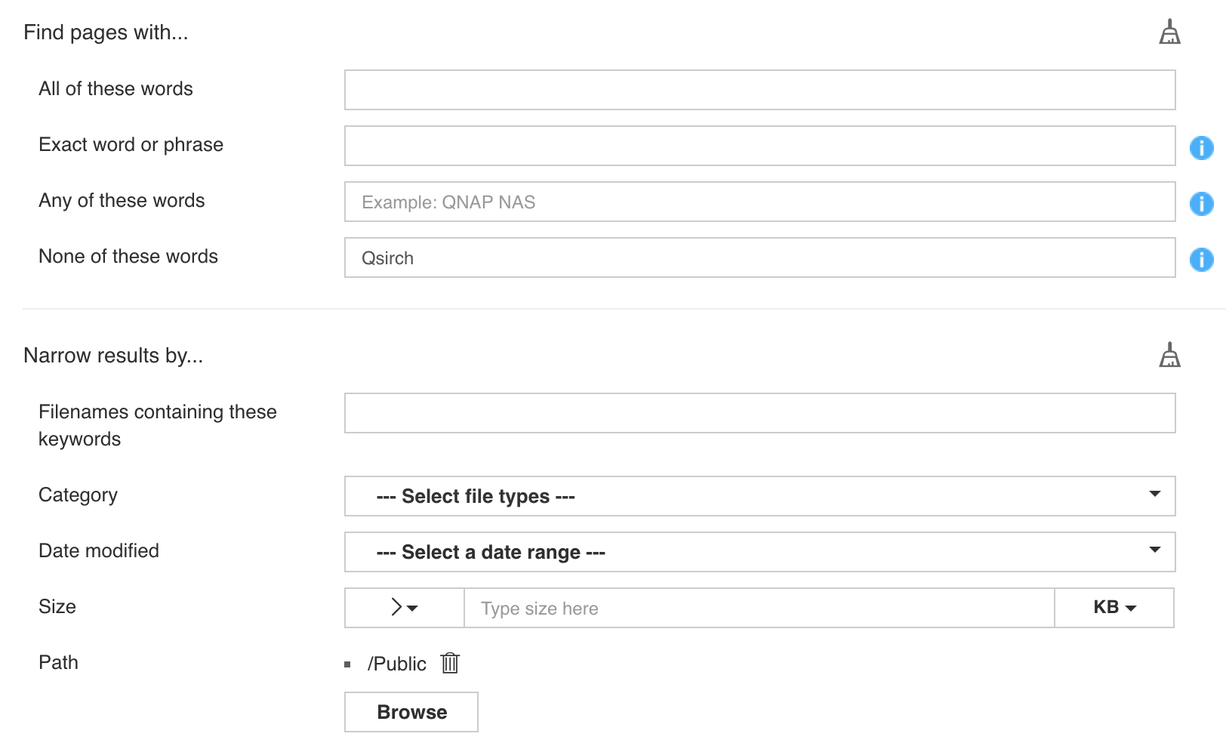
Advanced search for complex keyword search
With advanced search panel, you can search with complex keywords easily without understanding any syntax!
Five basic criteria to improve search accuracy!

Slide 15

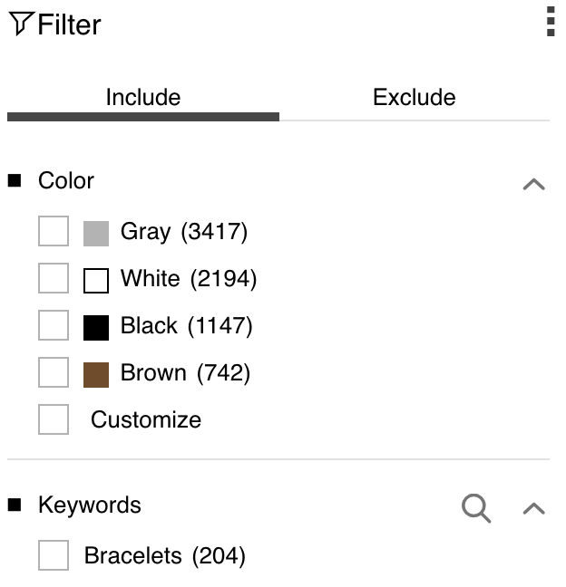
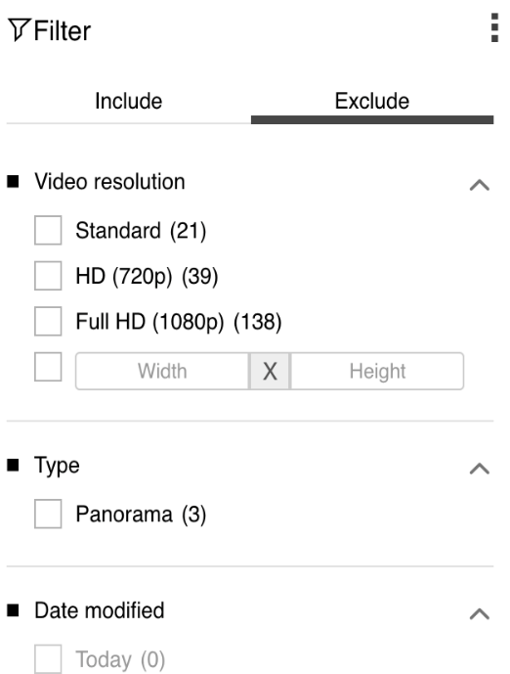
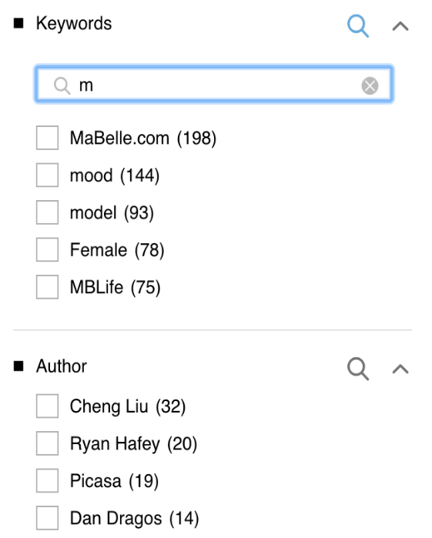
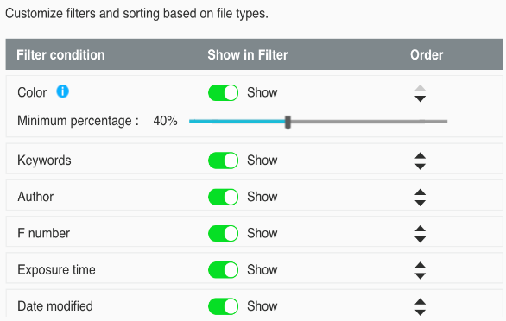
35+ powerful filter conditions
35+
filter conditions
Quickly Specify
Flexible
Customizable
New filter for images
Color filter
Include or Exclude
Depending on your needs
Search function for filter conditions
Adjust the order of filters by your preference

Slide 16







Easy steps from previewing to sharing
Preview
Share
Various Methods
PDF、Microsoft Office、Email
NAS user
Email
More media
Music, photo & video instant preview
Custom Domain
Smartshare
Custom domain
High flexbility
360 panoramic video/photo preview
Secured Sharing
Streaming to VLC Client
Valid date
Password
SSL Secured

Slide 17








Search files anytime, anywhere in 4 ways
1
2
3
4
Mac Finder
Web
Mobile app
Browser extension

Slide 18
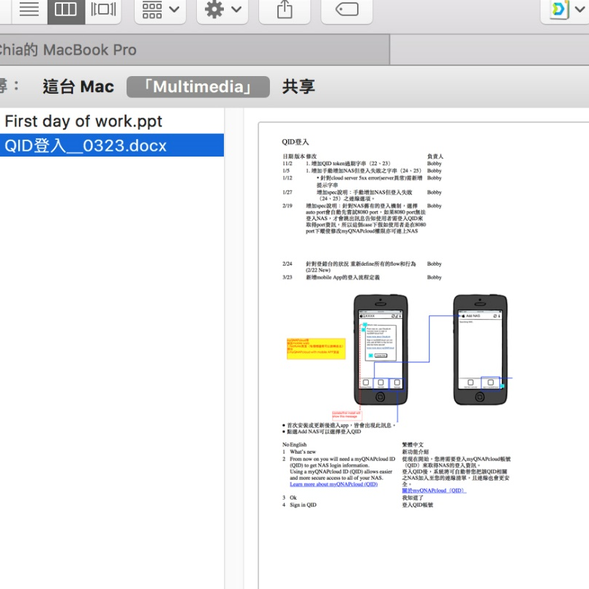
Integration with Mac Finder
Perform tasks in the way you're familiar with!
1. SMB folder
2. NAS/Local -
Full-text search at the
same time
3. Email/Image -
Metadata can also be
searched
Notice：This feature will be supported from QTS 4.3.5.
Notes:
https://www.pexels.com/photo/computer-desk-electronics-indoors-374074/

Slide 19
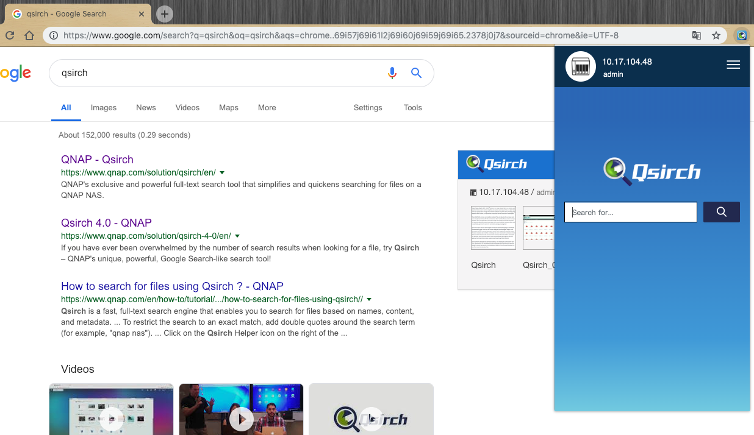
Qsirch Helper - Web Extension
1. QNAP ID Login
2. Search on both the
NAS and the internet
at the same time
3. Search on a single
interface
4. Chrome and Firefox
plugin

Slide 20



Search Based on Permission Settings
Decide Shared Folders to be Searched
API for Custom Search Applications
3 things NAS administrator must know

Slide 21
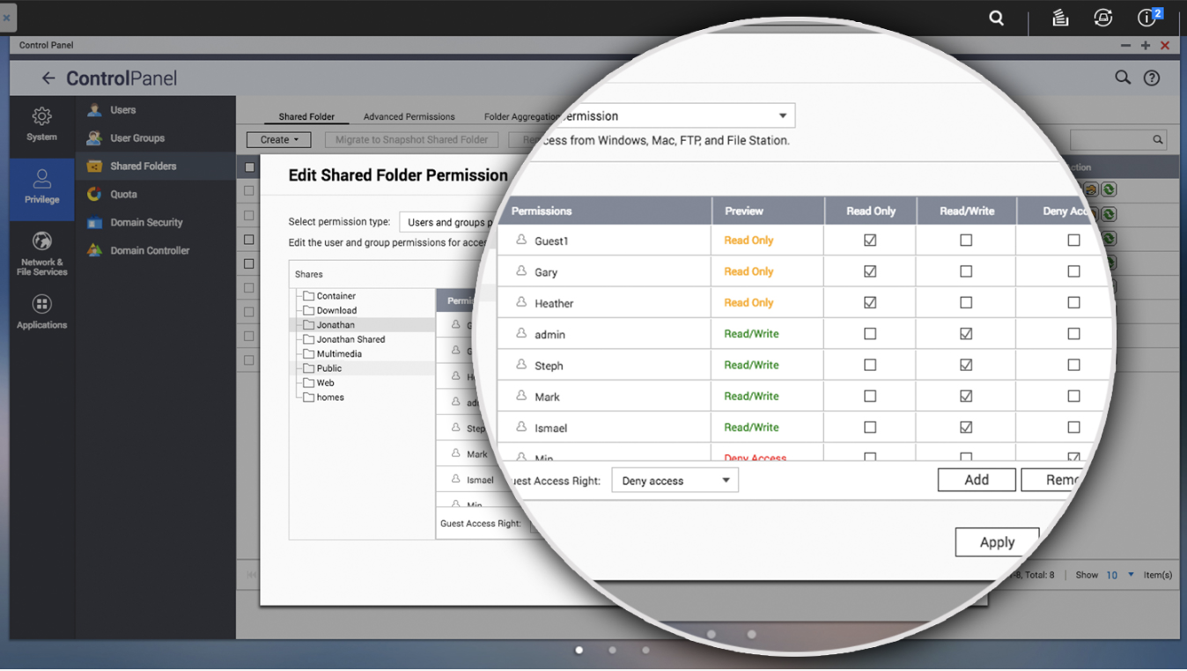
Search Based on Permission Settings
Qsirch works in line with user accounts & shared folder permissions of the QTS. It effectively protects data privacy and the search results will only return authorized files for each user.

Slide 22
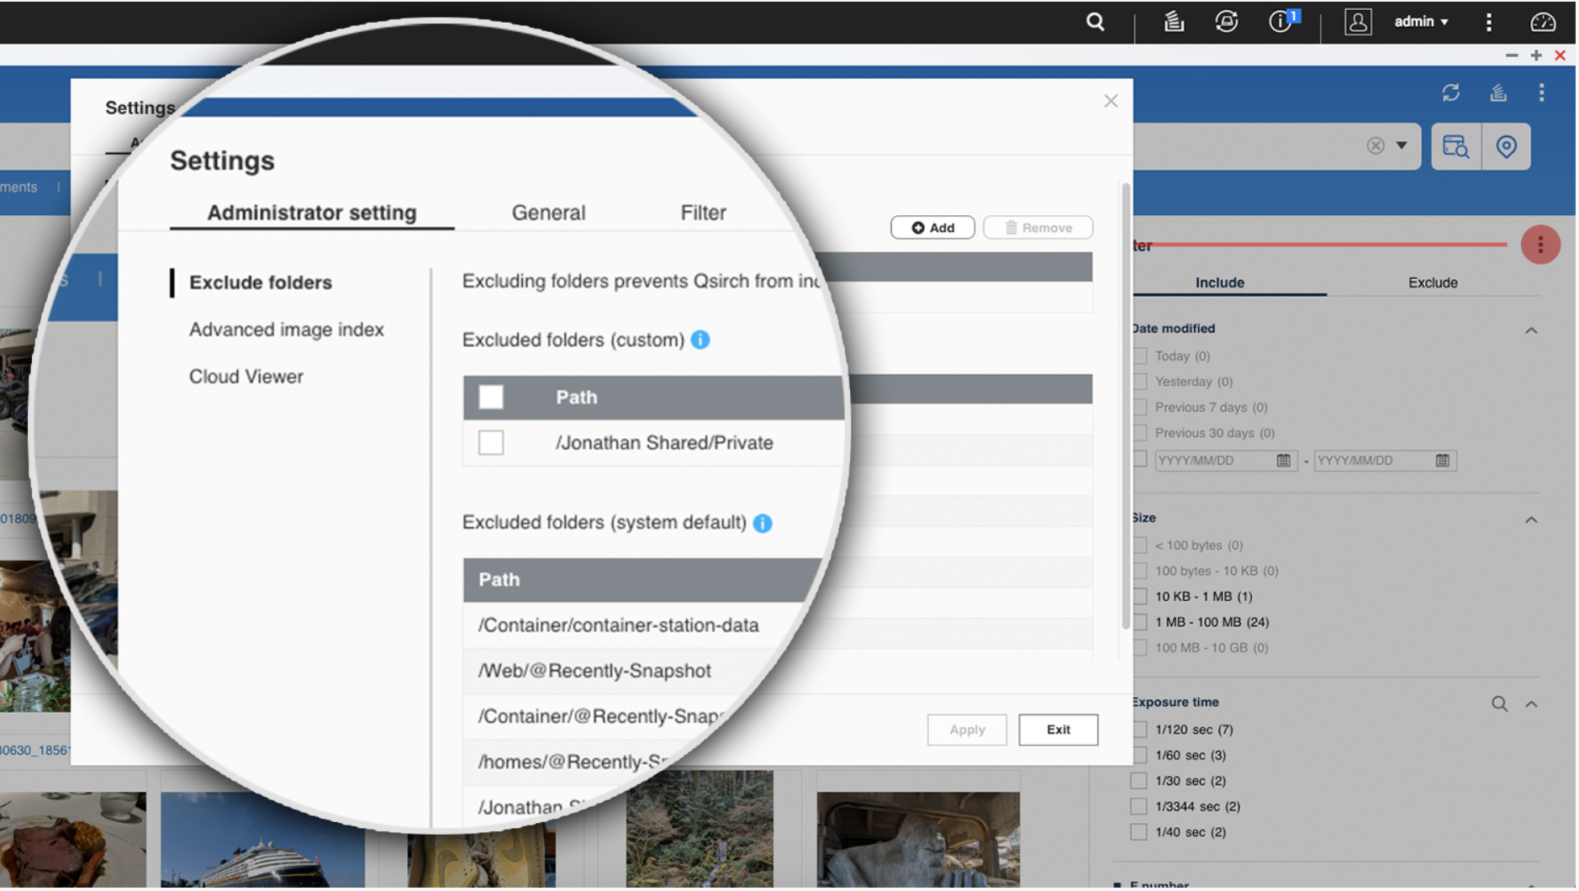
Decide Shared Folders to be Searched
Administrators can add & remove specific shared folders for Qsirch. Flexibly exclude shared folders from indexing to ensure data security.

Slide 23
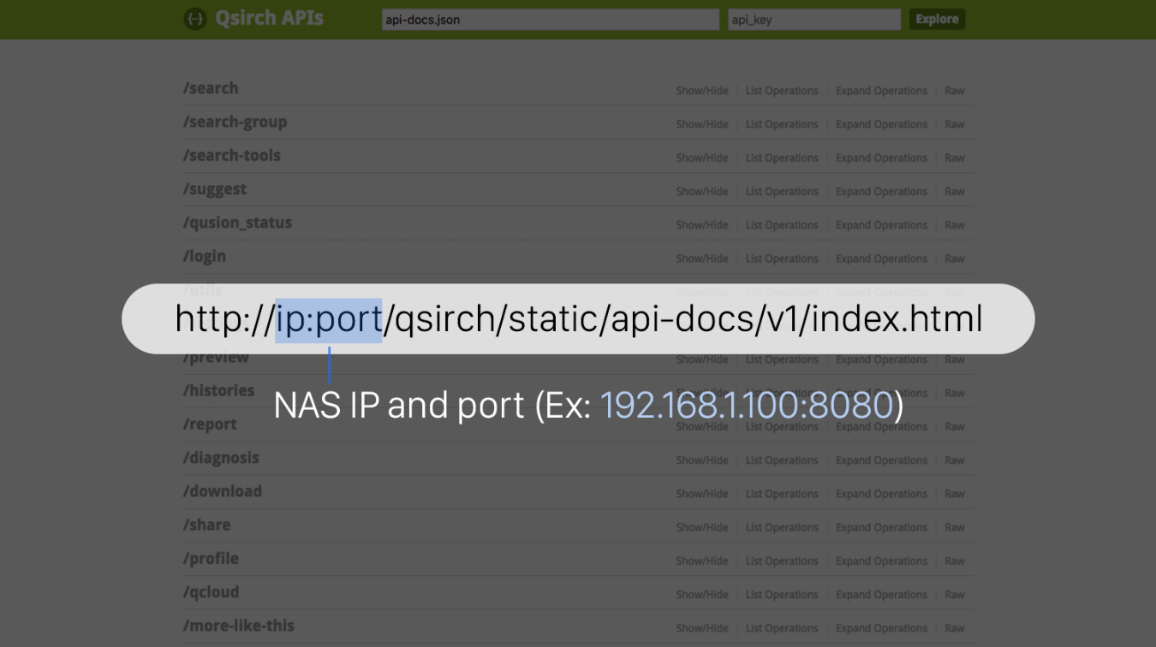
API for Custom Search Applications
The Qsirch API allows for third-party applications and system integration. Visit the following link in your web browser for the API documentation:
[http://ip:port/qsirch/static/api-docs/v1/index.html

Slide 25
Images, videos to documents, search tools fully upgraded
Explore NAS
Map Search
Get overview of the file types stored on the NAS and use the frequently-used tags to enhance your search experience.
Quickly search and specify the locations of your photos on an interactive map
View keywords
FPS
Preview directly after search and view the relevant paragraphs in the file that contain search keywords
New filter criteria to use FPS information to find a specific video
Qsirch 4.0 - 4 new features recap

Slide 26
is your best choice!
Copyright © 2019 QNAP Systems, Inc. All rights reserved. QNAP® and other names of QNAP Products are proprietary marks or registered trademarks of QNAP Systems, Inc. Other products and company names mentioned herein are trademarks of their respective holders.

