Slide 2
QNAP x Samsung SSD
Why should we use
Samsung SSD
Introduction of SED secure pool.
Step by step to show you how to use SED secure pool. Encrypt and protect data easily
Use SED secure pool to solve performance problem.
Demo of creating SED Secure Pool.

Slide 3
Why We Recommend
Samsung SSD

Slide 4
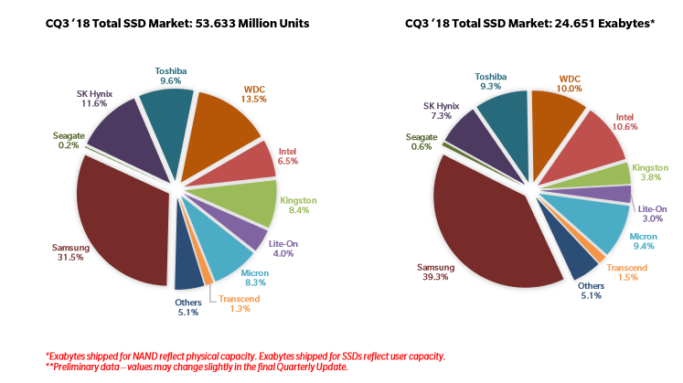
1. Market share of Samsung SSD
The SSD market survey
which is provided by
TRENDFOCUS
Market share
Of Samsung
SSD is near
40%!
資料來源: TRENDFOCUS, NAND/SSD Information Service CQ3 ‘18 Quarterly Update – November 15, 2018 Executive Summary

Slide 5
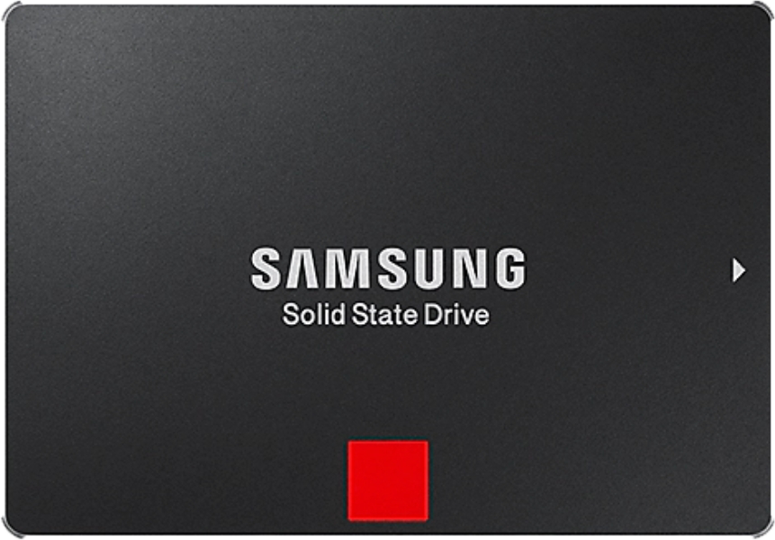
2. Samsung SSD Technology
Samsung SSD with security and performance!
Data Security
Level up Performance
AES 256-bit hardware-based encryption
Compliant with TCG Opal and IEEE 1667.
The latest V-NAND—which brings greater NAND performance and higher power efficiency
Enhanced performance
Reaches unrivalled sequential read/write speeds

Slide 6
3. Samsung SSD series support SED
We recommend the following SSDs for who pursues level up performance
Model | 860 QVO | 860 EVO | 860 DCT | 970 EVO Plus
Factor form | 2.5 inch | 2.5 inch | 2.5 inch | M.2
Interface | SATA 6Gb/s | mSATA, M.2 | SATA 6.0 Gbps | PCIe Gen 3.0 x4, NVMe 1.3
Sequential Read Speed | 1,000 GB, 2,000 GB, 4,000 GB | 250 GB, 500 GB, 1,000 GB, 2,000 GB, 4,000 GB | 960 GB, 1,920 GB, 3,840 GB | 250 GB, 500 GB, 1,000 GB
Sequential Read Speed | Up to 550 MB/sec | Up to 550 MB/sec | Up to 550 MB/s | Up to 3,500 MB/sec
Sequential Write Speed | Up to 520 MB/sec | Up to 520 MB/sec | Up to 520 MB/sec | Max. 3,300 MB/sec

Slide 7
The Encryption Method in previous QTS version
While we store
important files, we use
following method
Both methods use
software encryption
so that usage of CPU will be increased.
Create
Encrypted volume
Create encrypted
shared folder

Slide 8
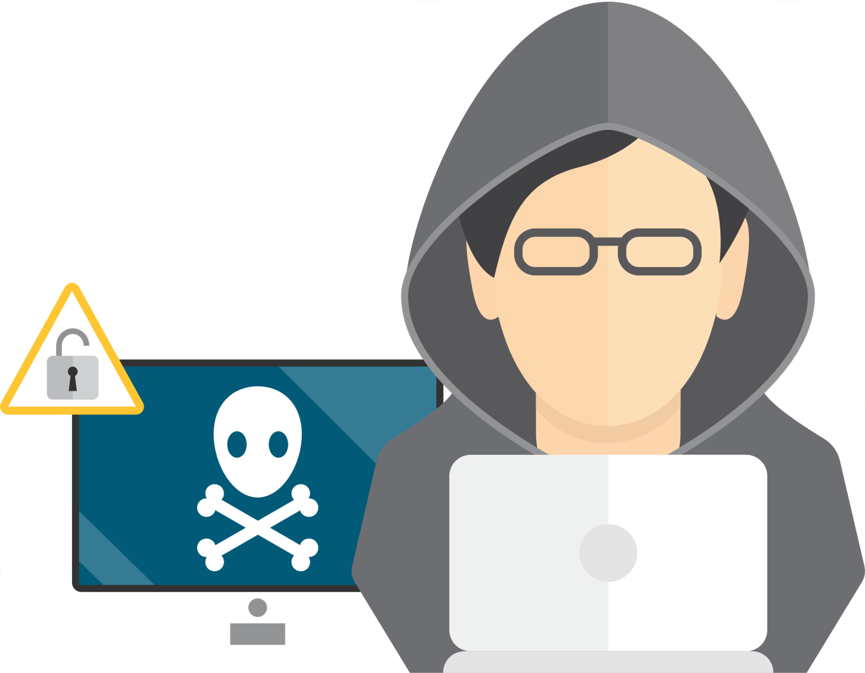
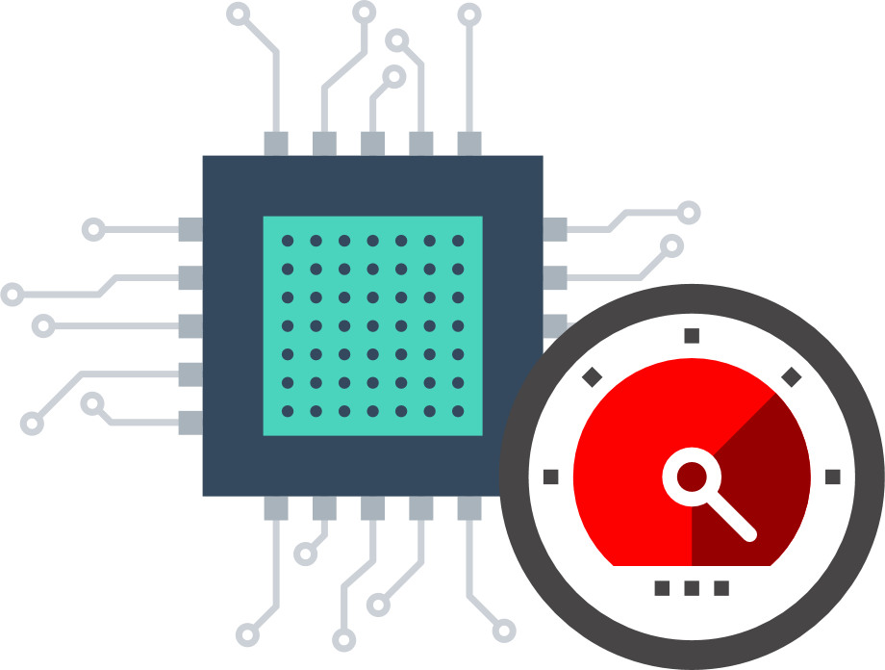
Software Encryption Method Cause Following Disadvantage.
Reduce performance
Vulnerable to
Brute-force attack
Because both encryption and decryption are completed by CPU, the CPU resource will be
occupied and reduce performance
Although the times of entering password could be
limited, the counter could be
reset to entering password
continuously.

Slide 9
QNAP Adopts the Advantage of Hardware Encryption to Protect Data.
The advantage of hardware encryption
Use AES 256
Prevent brute- force
attack
Erase data of the disks completely.
Controller with AES-256 advanced encrypting engine, encryption will be completed automatically without using CPU resources.
Such as bully attack and vicious code attack
Use PSID of SED disk to erase to prevent data erased incompletely.

Slide 10
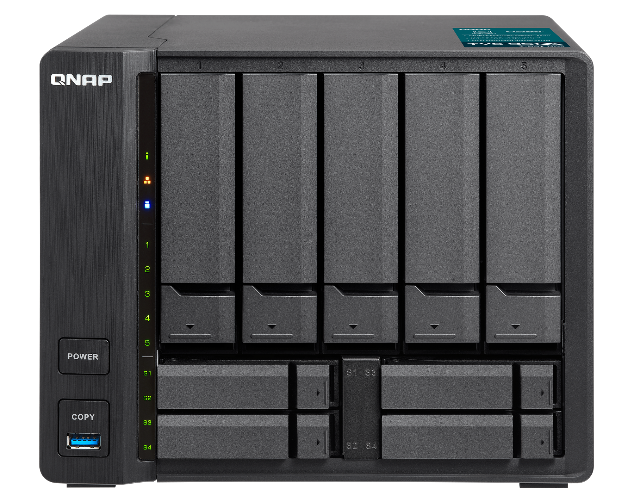
Integrate Samsung SSD, Encrypting File Without Degraded Read/ Write Performance
Select the Samsung SSD which has largest market share, all series with SED.
Use Samsung SSD and QNAP NAS to protect your data, The performance will maintain after system doing encryption.
Performance and Security

Slide 11
Introduction of
SED Secure Pool
Two Steps to Create SED Secure Pool

Slide 12
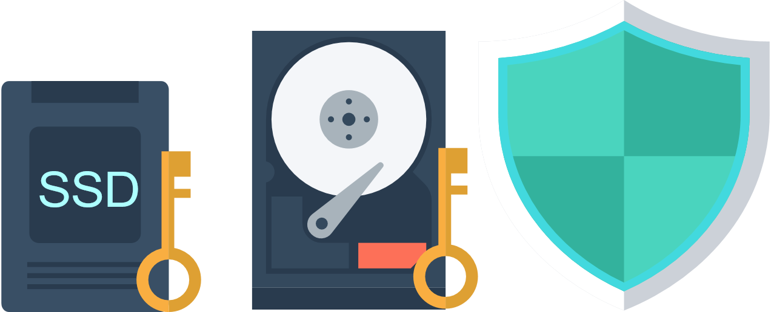
What is Self Encrypting Drive (SED)
The SED encrypting engine is in the ASIC controller, and each disk is with dedicated encrypting engine.
The management function is built in the disk, the encrypting key is in the disk all the time.

Slide 13
Why We need to Use QNAP SED Secure Pool
Because the chance of confidential data to be leaked and loss is increased.
The regulation of entire world such as GDPR makes some organization pay more attention on data security and need to use proficient way to keep data.
Notes:
來維持有效保護抵禦資料安全威脅避免財務以及法律影響
因此儲存裝置就顯得更重要，需具備更強大的資料保護安全機制

Slide 14
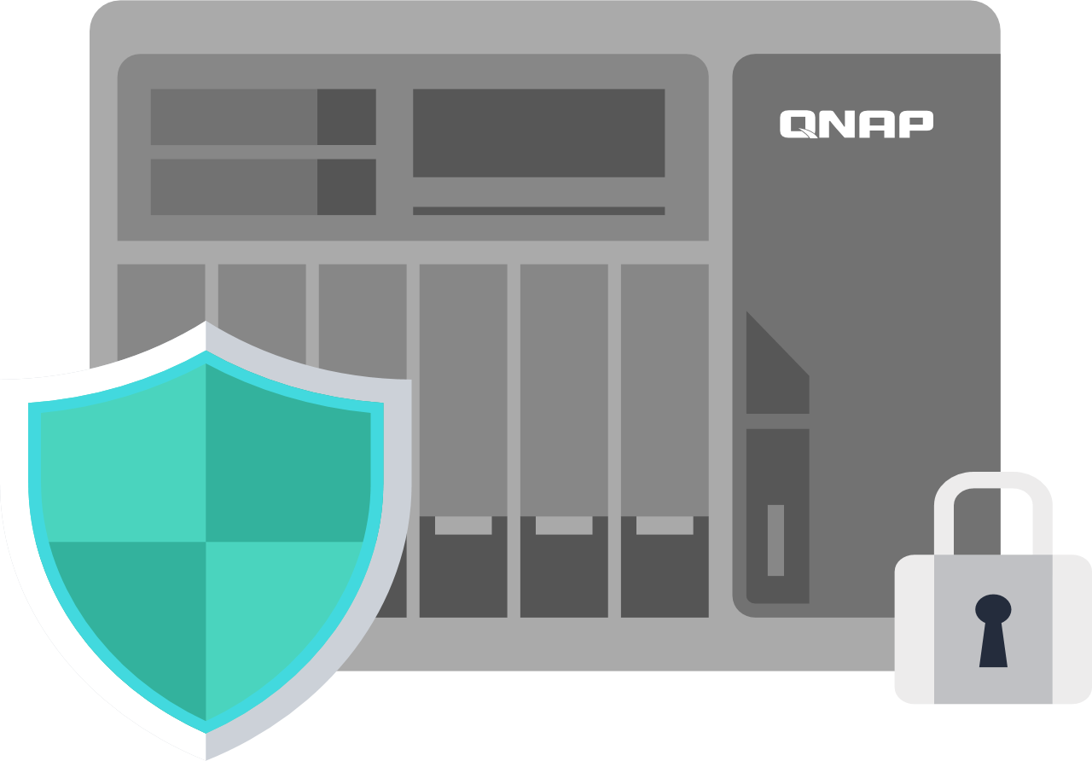
Use QNAP SED Secure Pool to Follow Regulation
Because of GDPR, the confidential data loss and leaked will cause loss of company. Managing personal data strictly is the trend now so the conscience of creating data protection is important.
QNAP meets the electronic requirements of HIPAA for storing PHI data by providing a base to protect the confidentiality and security of “individually identifiable health information”.
QNAP provides a full range and
variety of storage models
that can easily fit into different scales of deployment.
Choose based upon capacity,
performance, and price range to
fit the need of any type of environment.
Notes:
一些國家單位

Slide 15
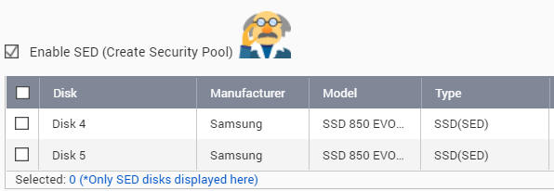
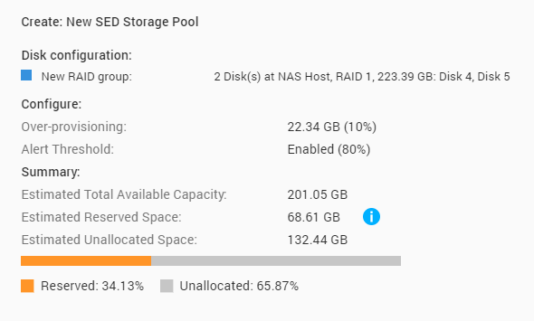
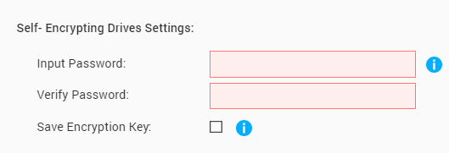
Easily Create SED Secure Pool by Two Steps
STEP. 01
Select Enable SED and choose SED disks
The SED disks of NAS will be filtered to let you select easily.
STEP. 02
Set password of SED pool
Completely creating SED secure Pool
The password is used to decrypt the SED secure pool. The locked pool could protect data to prevent others know the data of the pool.

Slide 16
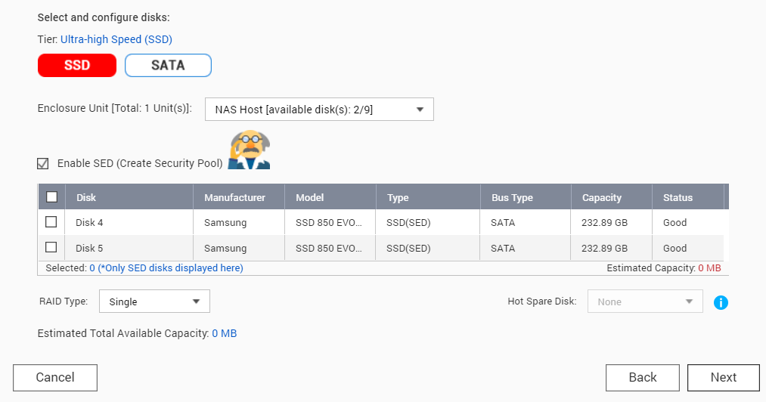
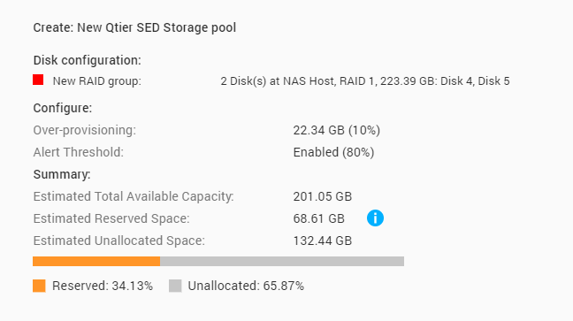
Enable Qtier and Support SED Secure Pool
STEP. 01
Enable Qtier and select enable SED then Selecting SED disks.
Enable Qtier to reach optimized performance and protect your data.
STEP. 02
Completely creating
SED secure Pool
Set password of SED Secure Pool

Slide 17
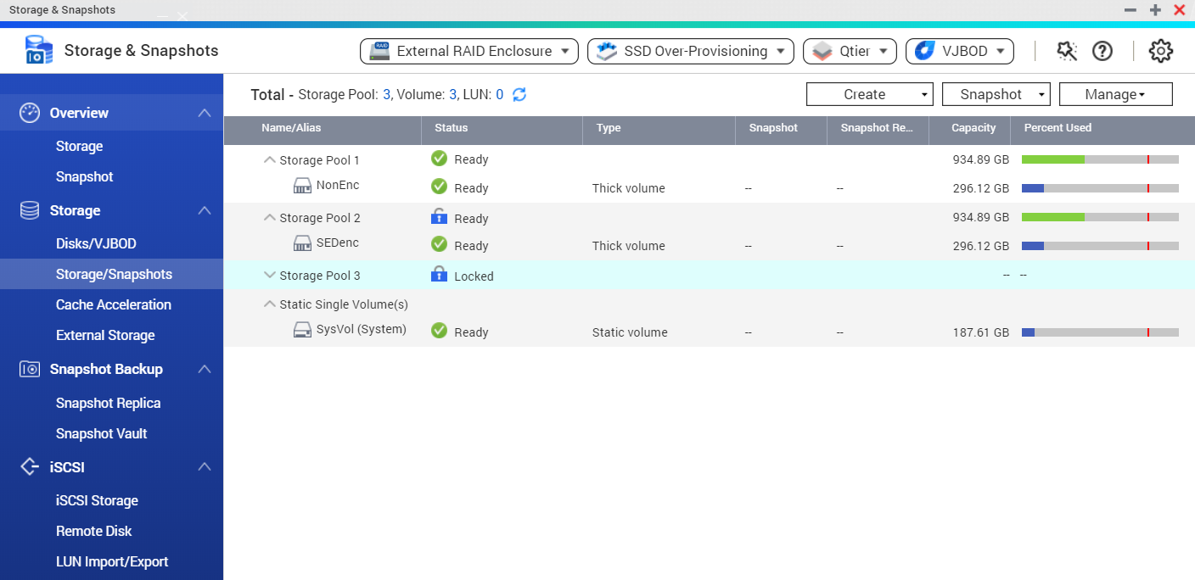
Obvious Status of Storage Pool
The status of
Locked SED Secure Pool is obvious.
Notes:
未上鎖、上鎖 紅框框住記

Slide 18
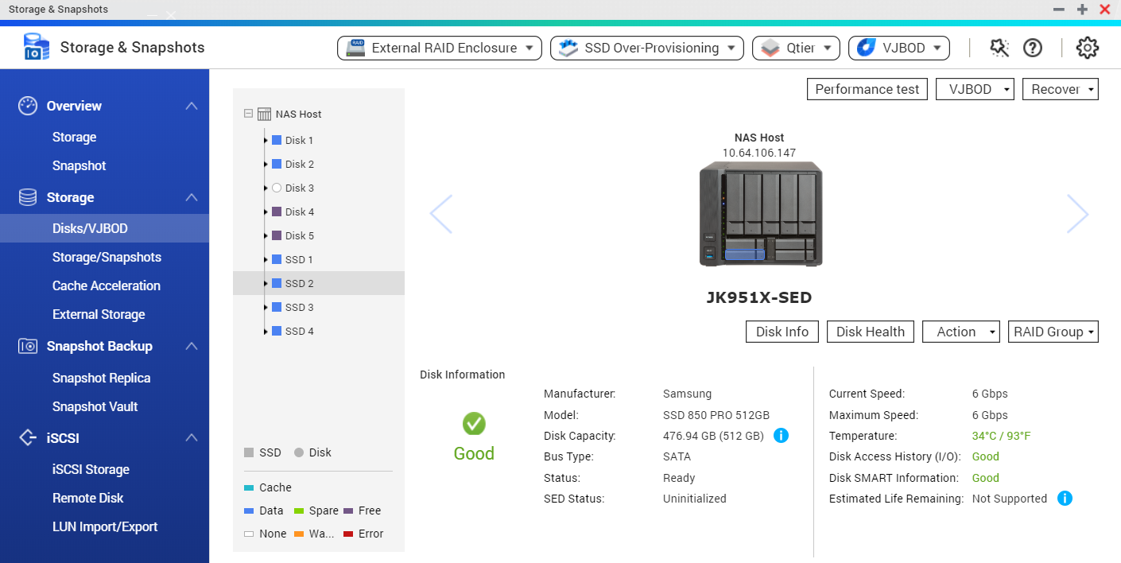
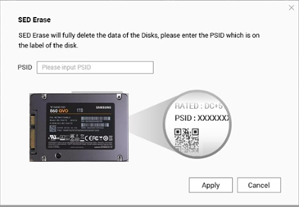
Status of SED and SED Erase Information
Use PSID of SED disk to erase the data, you don't need to worry the data is not erased completely.
Check the disk is SED disk or not
and the status of SED disks.

Slide 19
The Advantage of QNAP SED Secure Pool
Hardware encryption won't slow down the performance
You can decide not to use password to protect the SED pool.
PSID Erase make sure the data deleted completely.
Solve the problem caused by
software encryption
While the data is not important
anymore, you can stop
the password protection.
Solve the problem of
high costs
on deleting data.

Slide 20
The Difference Between Two Kind of
Encryption Ways in QNAP NAS
QTS 4.4.1 Encryption method
Before QTS 4.4.1 Encryption
Hardware encryption: Encrypt from Storage pool
Only Software encryption: Create encrypted Volume
or shared folder
Software encryption: ​ You can also create
encrypted Volume ​
or shared folder ​
If you don't have SED disks,
QNAP still help you to protect important data

Slide 21
Step by Step
To Create
SED Storage Pool

Slide 22
Performance Comparison

Slide 23
Comparison: CPU Usage
Use Samsung SSD 860 EVO to prove CPU usage decreased after using SED pool
Encryption method | Software Encryption | Hardware Encryption | Without Encryption
Encryption type | Volume | Storage pool
CPU usage
Sequential Write | 96 % | 94% | 93 %
Sequential Read | 65 % | 36% | 38%
Test environment：TVS-951X
F/W: 4.4.1
CPU: Intel(R) Celeron(R) CPU 3865U @ 1.80GHz (2 cores)
Tested SSD: Samsung SSD 860 EVO 1TB *2 ; RAID 0
RAM: 8 GB (4GB x 2)
Thick volume; Block-based LUN
10GbE NIC: On-board 10GbE
IOmeter Global Configuration: Maximum Disk Size: 67108864(NAS RAM*4) / Ramp Up Time: 30 seconds / Run Time: 3 Minutes Seq-Write/Read: 2-workers / 64-outstanding
CPU usage decreased after using hardware encryption

Slide 24
Comparison: Performance
Use Samsung SSD 860 EVO to prove performance maintained after creating SED pool.
Encryption method | Hardware Encryption | Without Encryption
Encryption type | Storage pool
Performance
Sequential Write | 726 MB/S | 722 MB/S
Sequential Read | 820 MB/S | 820 MB/S
Test environment：TVS-951X
F/W: 4.4.1
CPU: Intel(R) Celeron(R) CPU 3865U @ 1.80GHz (2 cores)
Tested SSD: Samsung SSD 860 EVO 1TB *2 ; RAID 0
RAM: 8 GB (4GB x 2)
Thick volume; Block-based LUN
10GbE NIC: On-board 10GbE
IOmeter Global Configuration: Maximum Disk Size: 67108864(NAS RAM*4) / Ramp Up Time: 30 seconds / Run Time: 3 Minutes Seq-Write/Read: 2-workers / 64-outstanding
Performance maintained after doing hardware encryption

Slide 25
SED Secure Pool Performance Test

Slide 26
Use SED Storage Pool From Now
Advantage of
QNAP SED secure pool
User scenario
Hardware encryption won't slow down the performance
Use QNAP NAS to follow the regulation of security in the company. Enterprise use NAS to build data center and the SED disk is needed. Enterprise could boost productivity.
PSID Erase make data deleted completely
Erase confidential data only need to use SED erase to delete data completely.
Password protection
User can use password to protect data to prevent data leak.

Slide 27
SED Secure Pool Integrate Samsung SSD is
Your Best Choice
Copyright© 2019 QNAP Systems, Inc. All rights reserved. QNAP® and other names of QNAP Products are proprietary marks or registered trademarks of QNAP Systems, Inc. Other products and company names mentioned herein are trademarks of their respective holders.​​​

