Slide 2
Reveal the truth about Multimedia Console
Want to browse photos, movies and music? Set a Content Source Folder!
Set content sources for all multimedia applications at once
Smoothly upgrade from Media Library to Multimedia Console
Want to know what NAS silently pays for you? Overview page tells you.
Overview indexing, thumbnail generation and transcoding status and settings
Want to control all the multimedia services? Go to App Suite page.
Installation and enablement
Access permission settings

Slide 3
We have heard these inconveniences from the past
Before QTS 4.4.1, did you have the following troubles?
How exactly should content management be set? Why doesn’t my video even appear on Video Station?
I want to let different people see different content, how to set it?
There are so many settings. What are the differences?
Media folder?
Folder properties? It confuses me!
I just want to keep my data on NAS. How can I disable all multimedia services at once?
What multimedia services can I use on QTS? Is there a list?
Why Photo Station can see the folder I assigned to Video Station?
Where are the multimedia management settings? They are too hard to find!

Slide 4
Now you can see the improvements
Media Library (Before QTS 4.4.1):
Multimedia Console (From QTS 4.4.1):
Media folders and folder properties are set separately. Too many options for content management. Setting pages are not obvious and scattered. Setting descriptions are difficult to understand. The main switch is hidden in many settings. Too many features to see at a glance. Permission settings are too complicated.
Set folders as content sources directly.
Simplified UI and content source setting flow. Collect in 1 single QPKG. Easy-to-understand descriptions. Move the main switch to an obvious place. Lineup all multimedia services in 1 page. Intuitive permission settings.
Scattered
Complicated
Collected
Simplified

Slide 5
Want to browse photos, movies and music? Set a Content Source Folder!
Set the folder as a content source so that multimedia content is no longer invisible.

Slide 6
Why don’t my photos appear in Photo Station?
Before QTS 4.4.1,
you have to choose 1 method
from the following 3:
From QTS 4.4.1,
you only need to go to
Multimedia Console:
Set the folder as a “Media Folder” in Control Panel.
Set the folder property as “Photo”, “Video”, or “Music” in File Station.
Set content sources in different applications.
Set content sources for all multimedia applications in Multimedia Console!

Slide 7
Set Content Sources for All Multimedia Applications
Go to
Content Management
Assign folders as content sources for each application.

Slide 8
Set Cloud Drives as Content Sources
Multimedia Console
+
CacheMount
CacheMount can cache part of files in cloud drives, improving performance for commonly-used files.
Set the CacheMount Volume as a content source, and you can browse contents on the cloud in multimedia applications.

Slide 9
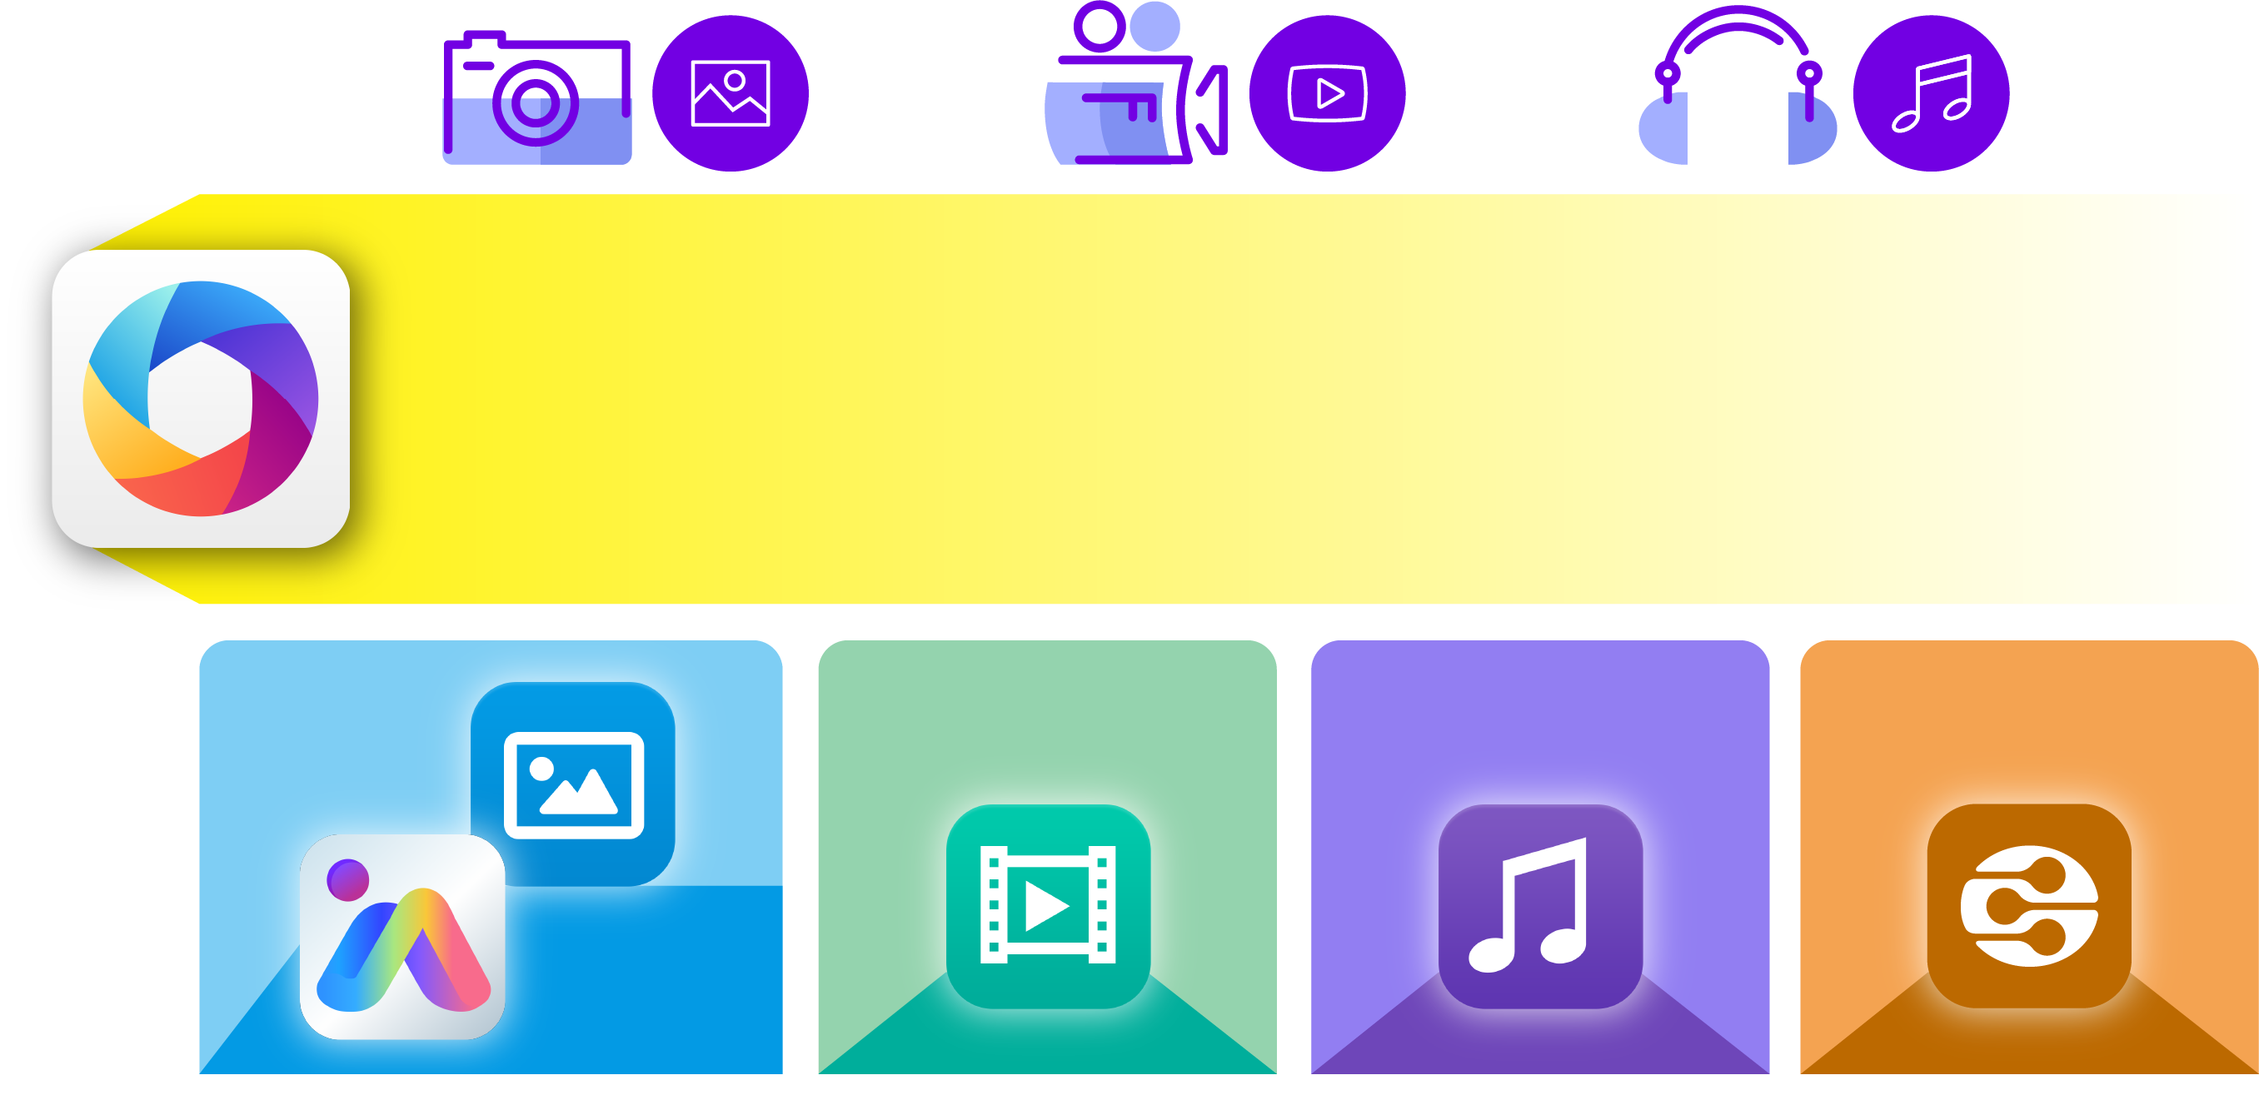
Smoothly Upgrade from Media Library to Multimedia Console
Upgrade to
Multimedia Console
Photo
Video
Music
Upgrade to content sources for each application based on folder properties.
Photo Station
Video Station
Music Station
DLNA
QuMagie

Slide 10
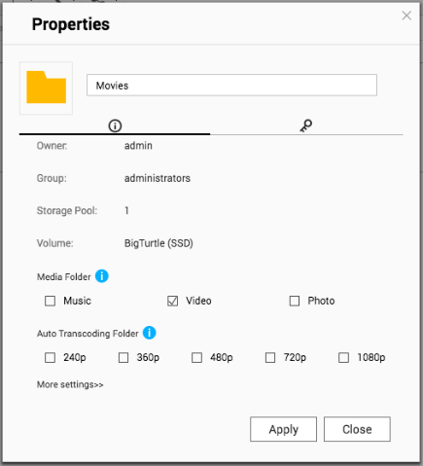
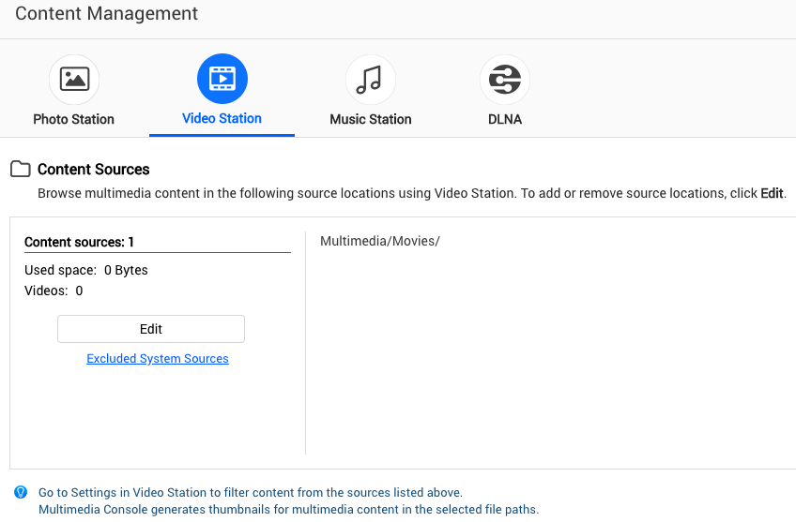
Smoothly Upgrade from Media Library to Multimedia Console
Before
After
Folder Properties: “Video”
Assigned as a content source for Video Station

Slide 11
Want to know what NAS silently pays for you? Overview page tells you.
Overview all multimedia background tasks.
Find settings in just 1 click.

Slide 12
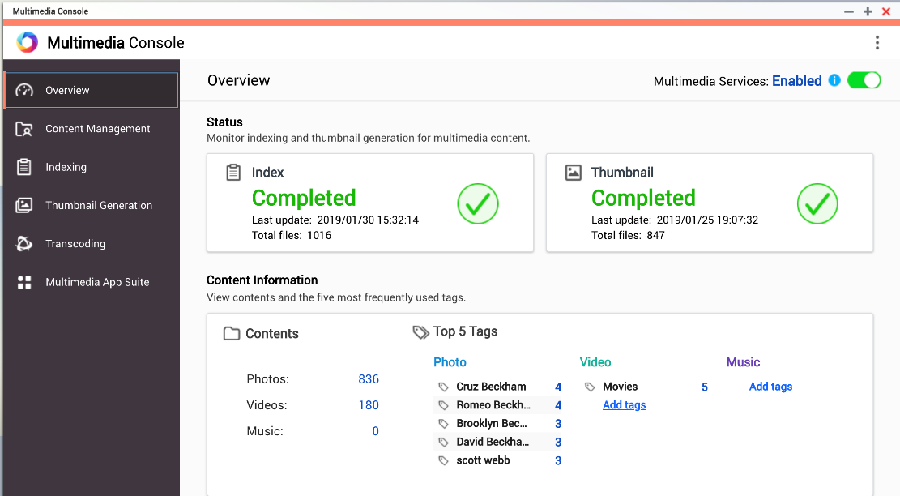
Status Overview at a Glance
Monitor indexing status, view composition of all multimedia contents.
Monitor thumbnail generation status, the key role that improves browsing experience.
The main switch for multimedia services. Control all in just 1 click.

Slide 13
Indexing: Keep Track of all the Multimedia Content
After indexing, Multimedia Console can generate thumbnails and transcode multimedia content to improve browsing and playback experience.
Priority: Adjust the priority of indexing among system tasks
Text Encoding: Set the text encoding when parsing Metadata

Slide 14
Thumbnail Generation: Improve Your Browsing Experience
With thumbnails, browsing multimedia content is even more exciting.
Monitoring and controlling thumbnail generation Scheduling for thumbnail generation Advanced Settings:
Make a large thumbnail
Exclude specified files from generating thumbnails

Slide 15
Monitoring and Controlling Thumbnail Generation
Generation progress
Pause / Resume generation
Total size of thumbnails
Remove / Regenerate all thumbnails

Slide 16
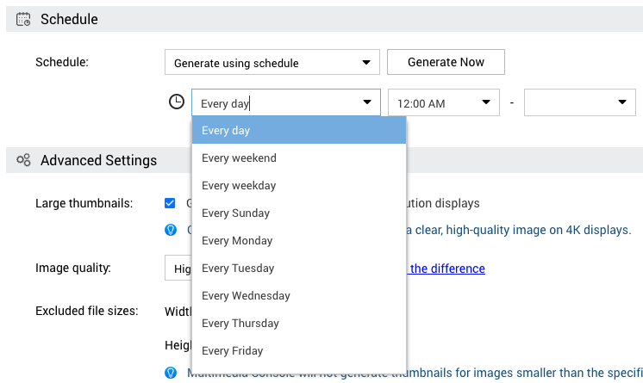
Scheduling for Thumbnail Generation
Generate in Real Time
Generate using Schedule
Generate Manually

Slide 17
Advanced Settings
Generate large thumbnails for high-resolution displays Thumbnail image quality Set files from generating thumbnails
Specific file size Specific file types

Slide 18
Transcoding: Improve Compatibility when playing videos
Convert various video formats to MPEG-4, so that they can be played on different devices.
Monitoring and controlling transcoding:
Background transcoding
On-the-fly transcoding
Transcoding settings:
Transcoding resources
Background transcoding folders

Slide 19
Choose different transcoding based on hardware specifications and usage
Background Transcoding
On-the-fly Transcoding
Assign Background Transcoding folders to transcode videos in advance. Transcoded videos are saved in “@Transcode” folder located in the original folder. Support transcoding from videos to audios. Suitable for users with sufficient storage space or slow on-the-fly transcoding performance.
Transcode videos in real time during playback. Suitable for users with fast on-the-fly transcoding performance, insufficient storage space, or infrequent video playback.

Slide 20
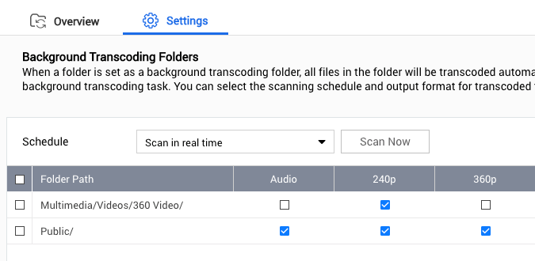
Video2Audio Transcoding
Designed for videos that could be “heard”:
Speeches, lectures, tutorials, etc.
Reduce the file size Can be played while driving or commuting
Usage：
Select “Audio” as the output format when setting background transcoding folders.
Transcoded audios are saved in “Video2Audio” folder located in the original folder.

Slide 21
Demo

Slide 22
Want to control all the multimedia services? Go to App Suite page.
Overview installation, enablement and permission settings of multimedia applications in 1 page

Slide 23
Complete Multimedia Solution on QTS
Managing and browsing photos, videos, and music :
QuMagie, Photo Station, Video Station, Music Station
Video and audio streaming：
Media Streaming Add-on, Cinema28, DLNA Server, iTunes Server

Slide 24
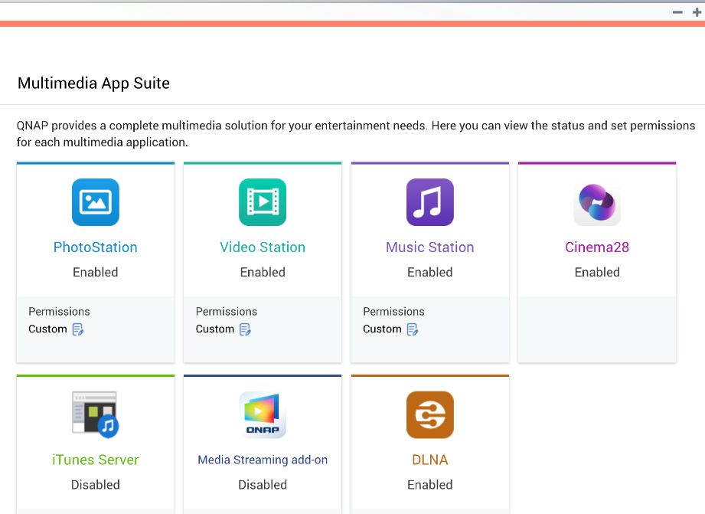
All Multimedia Services at a Glance
List the status of all multimedia services on QTS
Install and enable status Permission settings

Slide 25
Intuitive Permission Settings
Set permissions of different multimedia applications for local or domain users.

Slide 26
Highlight
Set the folder as a content source so that multimedia content is no longer invisible.
Set content sources for all multimedia applications at once
Smoothly upgrade from Media Library to Multimedia Console
Overview all multimedia background tasks. Find settings in just 1 click.
Overview indexing, thumbnail generation and transcoding status and settings
Overview installation, enablement and permission settings of multimedia applications in 1 page.
Installation and enablement
Access permission settings

