Slide 2
QuMagie: “Nice to meet you!”
Why do you need QuMagie?
How can QuMagie help you?
What is QuMagie
Makes a personal album
Brings you back into your memories
What is QuMagie Core
Makes a theme album
Finds your old memories
Share QuMagie With your family and friends
Notes:
你為什麼需要 QuMagie? P3~P9
QuMagie 可以怎麼幫你? P10~P26

Slide 3
What is QuMagie
What is QuMagie Core

Slide 4
We take a large amount of photos everyday
Except stock them in the drive,
What else can we do with these photos?
Children's photos, lovers' photos, travel photos, food photos
Without sharing or enjoying them again, these photos are just wasting your time and storage.
Notes:
// A user story as the opening

Slide 5
Let QuMagie bring your memories back to life
AI Photo Organizer：
Timeline view, taking you back to the day.
Facial recognition, gathering photos for each person.
Subject detection, classifying photos with different
themes.
Flexible search criteria
Notes:
//破題

Slide 6
Let QuMagie bring your memories back to life
With QuMagie
Without QuMagie
No organizing, no sharing, not enjoying them again, beautiful photos are just a waste.
QuMagie organizes People albums, Things albums automatically, bring your memories back to life.
Notes:
//Opening

Slide 8
QuMagie Core
Featured with Facial Recognition
and Subject Detection.
The core which makes QuMagie smart.
Support Intel, AMD, and ARM 64 CPU.

Slide 9
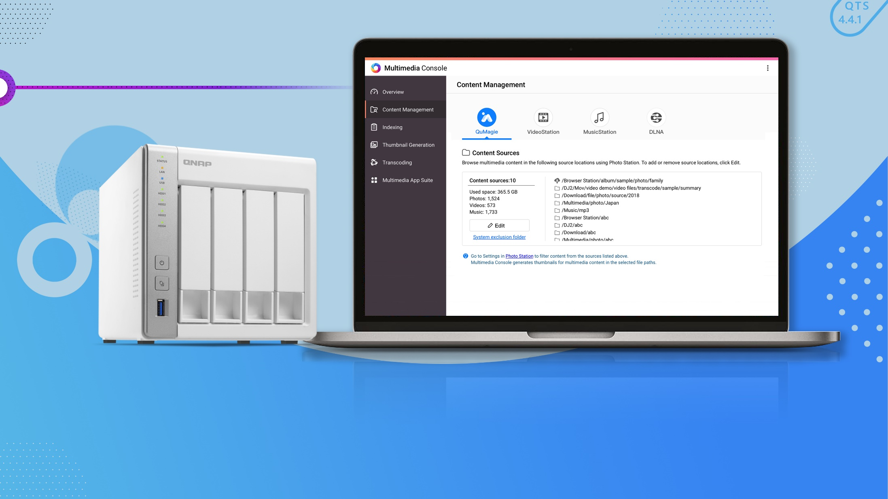
How to start?
1
Buy a QNAP NAS、Use QTS 4.4.1
Go to Multimedia Console,
Set content source folders.
3
Install QuMagie：Container Station and QuMagie Core are installed automatically
2

Slide 10
How can
Makes a personal album
Makes a theme album
Finds your old memories
Brings you back into your memories
Share QuMagie With your family and friends

Slide 11
Makes a personal album
Let AI help you find the right person

Slide 12
How to make a personal album?
Wedding Party
Farewell Party
Birthday and
Anniversary
Without QuMagie
With QuMagie
Find the photo one by one.
Find all in 1 click with Facial Recognition

Slide 13
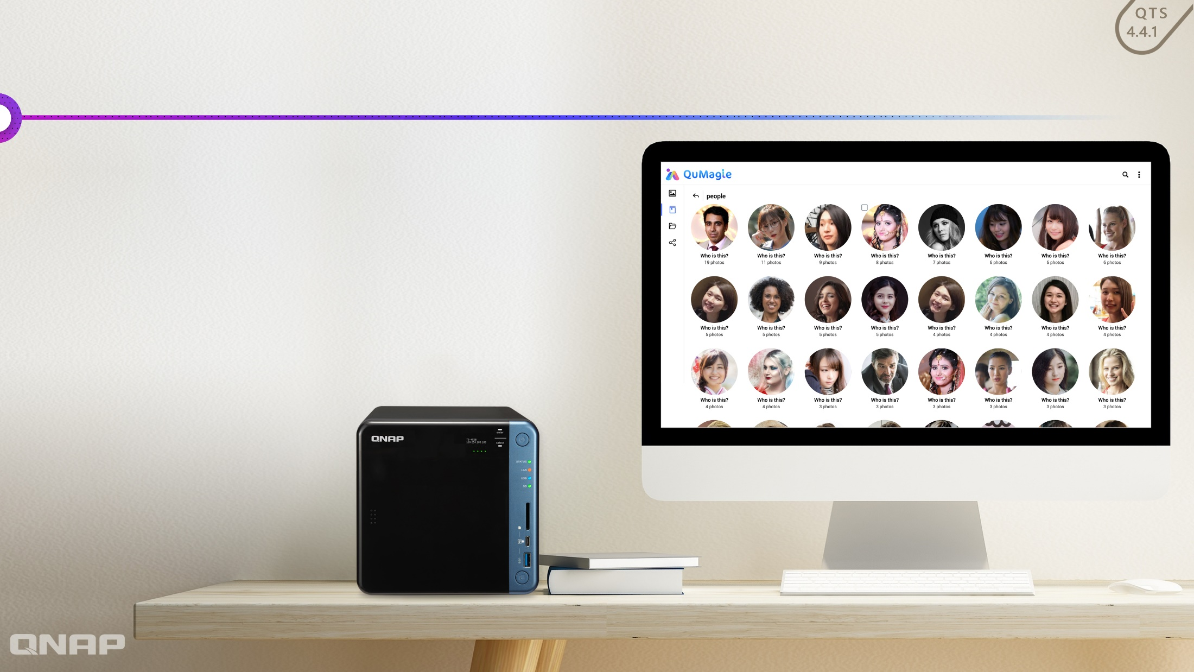
QuMagie People Album
Collect photos with similar face using Facial Recognition
Intuitive merge flow, gathering your different appearances.
Flexible editing option, easily creating your People's album.

Slide 14
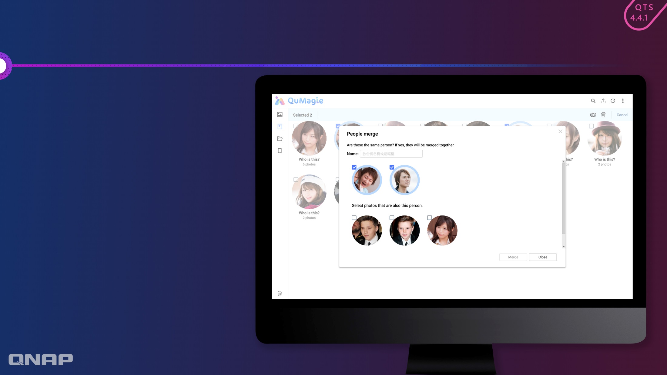
My different appearances are recognized as different people?
If a face with/without glasses are recognized as different people, merge them.
Choose different appearances and click “Merge”.
Name this person when merging.
QuMagie will suggest similar appearances, check them and merge them.

Slide 15
A wrong photo shows up?
If a wrong photo shows up, edit it.
Select the photo and click “edit”:
This is not a face : May be a poster.
I don't know this person：A stranger just passing by.
This is another person：Similar look.

Slide 16
Makes a theme album
Your own “Sorting Hat”
Classify your photos into different themes.

Slide 17
How to find every sunset you have seen?
Review every sunset
Find every good meal
Without QuMagie
With QuMagie
Organize right after you took photos.
Find all in 1 click with Subject Detection
Search one by one among all albums.

Slide 18
QuMagie Things Album
Classify photos into 400 different themes using Subject Detection：
Holidays：Halloween, Christmas, New Years Eve, etc.
Events：Parties, concerts, weddings, etc.
Scene：Lakes, forests, piers, etc.
Animals：Mouse, cows, tigers, rabbits, etc.
Foods：Ice cream, bread, fruits, etc.
Plants：Roses, pine trees, etc.
Carriers：Cars, planes, boats, etc.
Subjects：Ties, skirts, car plate, etc.
Sports：Basketball, baseball, ski, etc.
Instruments：Cello, saxophone, etc.
Notes:
12生肖除了龍沒有我們都有

Slide 19
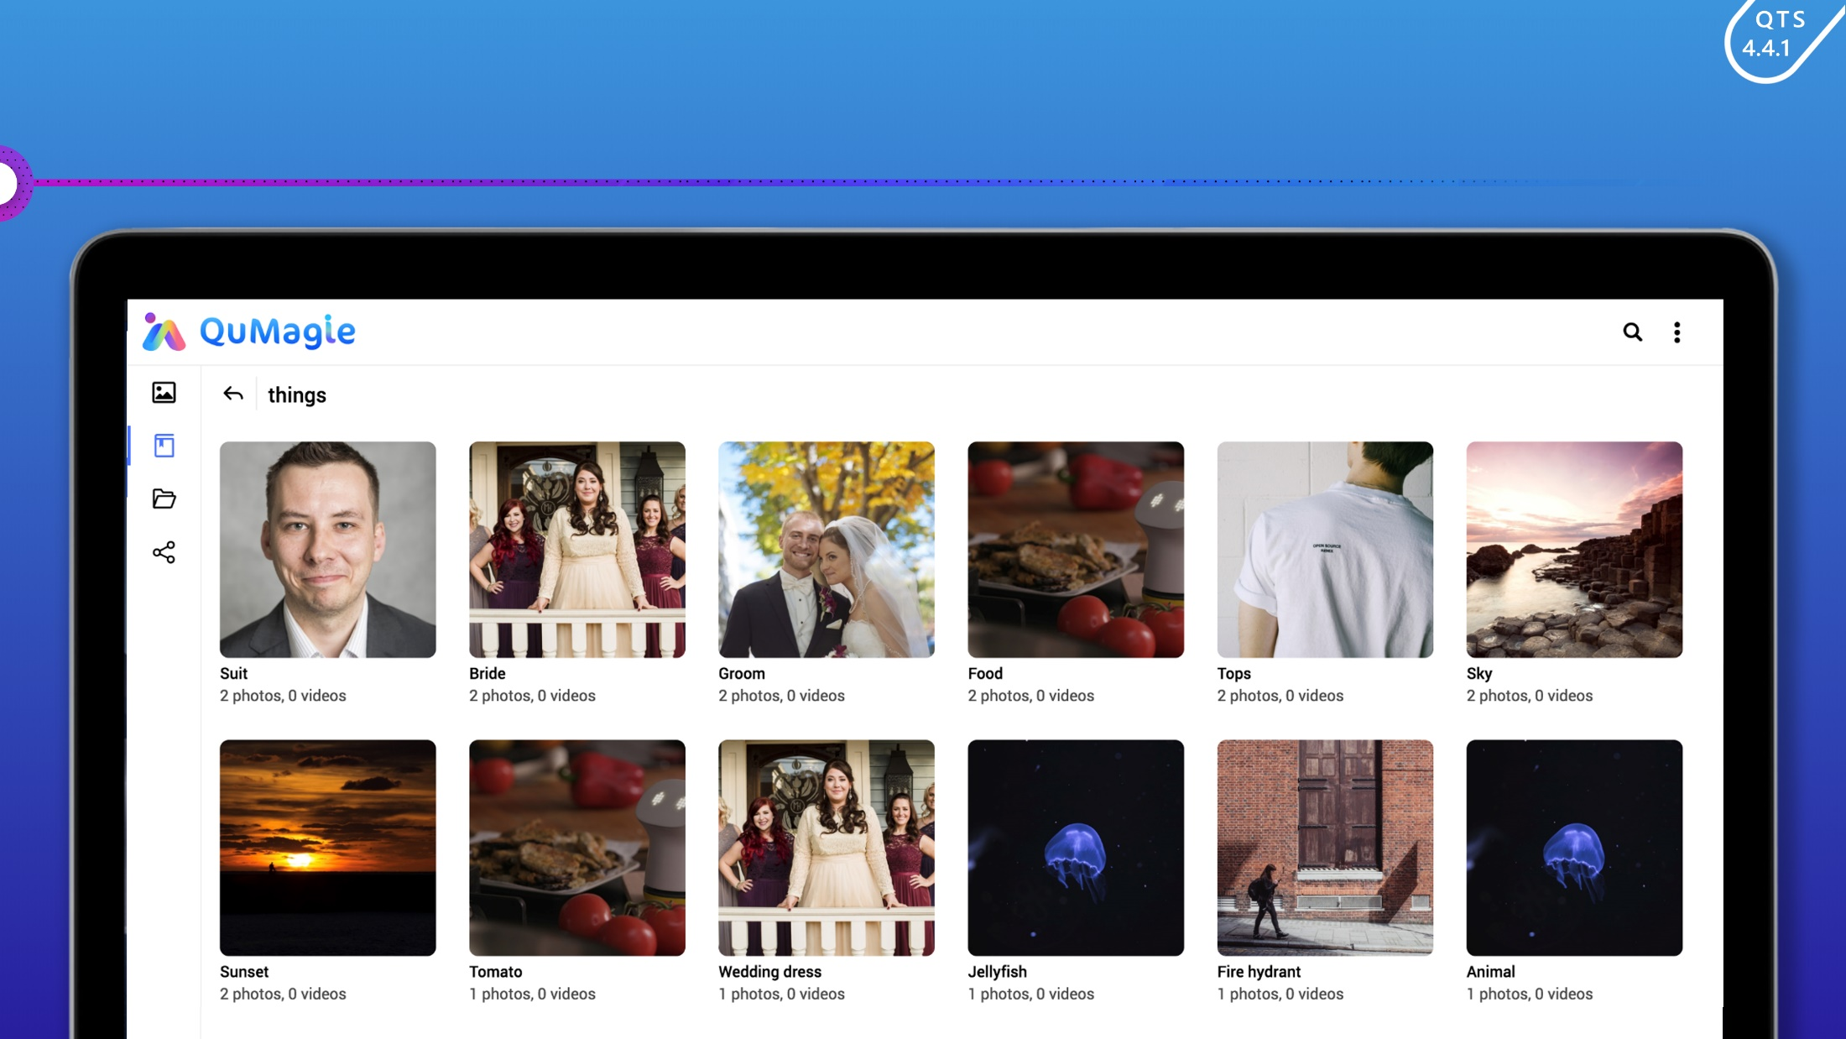
Let QuMagie find every sunset for you.

Slide 20
Finds your old memories
Flexible search criteria

Slide 21
Looking for a needle in a haystack?
Flexible search criteria in QuMagie:
2
1
2
3
1
People
Keywords
Date Taken
Include this person
Exclude that person
Satisfy all keywords
Satisfy any keywords
Specific period
3
Let QuMagie help you find photos in a haystack

Slide 22
Brings you back into your memories
2016/3/23
如時光機般的時間軸瀏覽模式
Timeline view, just like a time machine

Slide 23
Scroll back to the day in your history
Timeline view

Slide 25
Share
With your family and friends
Multimedia Console
Private Collections and
Shared Photos

Slide 26
Private Collections v.s. Shared Photos
Set content source folders in
Multimedia Console
"Home"：Private Collection
Shared Folders：
Shared Photos
Notes:
Multimedia Console:
- 多媒體服務管家
- 整合所有多媒體服務設定介面
- 輕鬆完成 QuMagie 的內容來源設定
- 索引、縮圖以及辨識進度一目瞭然

Slide 27
Organize with Albums and Folders
Folder View
Album View：
Albums and Smart Albums

Slide 28
Highlight
QuMagie:
AI Photo Organizer
People's Album
Things Album
Flexible Search
Timeline View
QuMagie Core：
The AI Engine of QuMagie
Multimedia
Console：
Integrated control interface for multimedia services

Slide 29
Copyright © 2019 QNAP Systems, Inc. All rights reserved. QNAP® and other names of QNAP Products are proprietary marks or registered trademarks of QNAP Systems, Inc. Other products and company names mentioned herein are trademarks of their respective holders.

