Slide 2


Discover the all-new Hybrid Backup Sync
Data deduplication technology QuDedup greatly reduces backup and restore time
Backup time spent is the key factor for multi-version backup
QuDedup Extract Tool makes your backup data visible and portable
Support TCP BBR to accelerate the cloud backup speed
Complete Support to Cloud Object Storage
Make the 3-2-1 backup strategy
Voice from enterprise users:
30 sets schedule settings and rate control per job

Slide 3


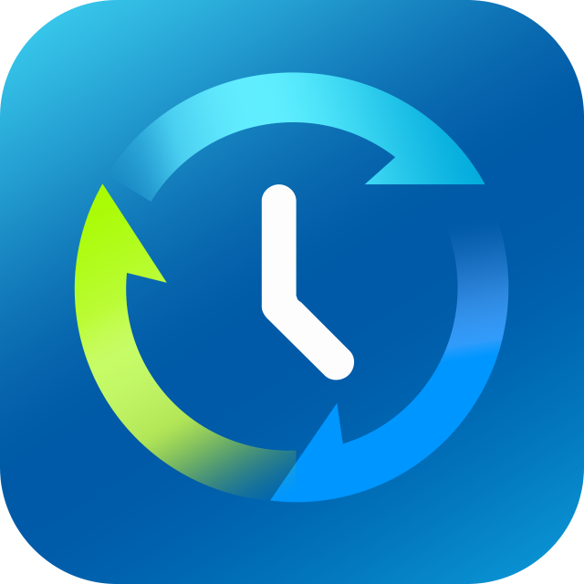

Affirmation from millions of users, and continuous evolution
 | Hybrid Backup Sync 2.1 | Hybrid Backup Sync 3.0
Cloud synchronization | Support 8 cloud providers | Support 22 cloud providers (continue increasing...), full support for synchronous, multi-version backup
Cloud backup | Support 13 cloud providers
QuDedup technology | N/A | Support source-side deduplication
TCP BBR technology | N/A | Support
Scheduler | Single schedule setting | Up to 30 schedule settings

Slide 4


Rapid data growth, data preservation would be a challenge
Issues you might encounter while backing up data...
Transmission time is too long and bandwidth resources are consumed for a long time.
Backup takes too long to achieve intensive backup cause data loss risk raising.
Slow internet transmission speed cause remote backup hardly to achieve.
Without data reduction pre-processing will cause increased storage costs
Notes:
放技術報告
https://www.ithome.com.tw/node/45228
https://www.ithome.com.tw/node/38018

Slide 5


Why we want to develop Hybrid Backup Sync 3.0?
Key：Backup files must be small, backup speed must be fast
Smaller backup data size
Faster backup speed
More backup versions
Smaller data loss risk
Smaller backup data size
Faster remote recovery speed
Smaller data loss risk
Faster internet speed
Faster cloud backup speed
Smaller data loss risk
Notes:
放技術報告
https://www.ithome.com.tw/node/45228
https://www.ithome.com.tw/node/38018

Slide 6

Data deduplication technology QuDedup greatly reduces backup and restore time

Slide 7
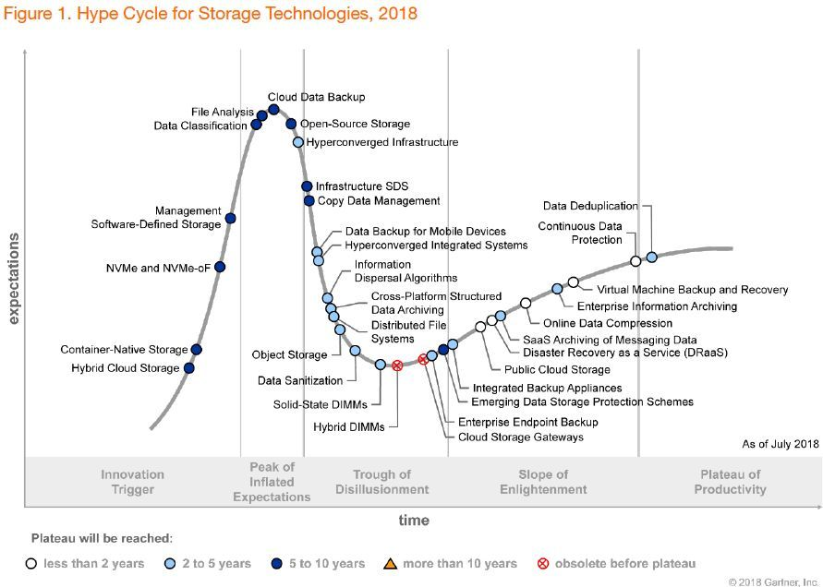
Gatner: Deduplication will be the transformational technology in near future
Technical Point
  ​Block level analysis and comparison, removing redundant data from finer levels.
  Cross-file comparison instead of single file compression.​
3 Major Scenarios
  Backup Application
  Virtual Tape Library(VTL)
  Storage Server
Image source:
Gartner 2018 Hype Cycle for Storage Technologies
Notes:
放技術報告
https://www.ithome.com.tw/node/45228
https://www.ithome.com.tw/node/38018

Slide 8
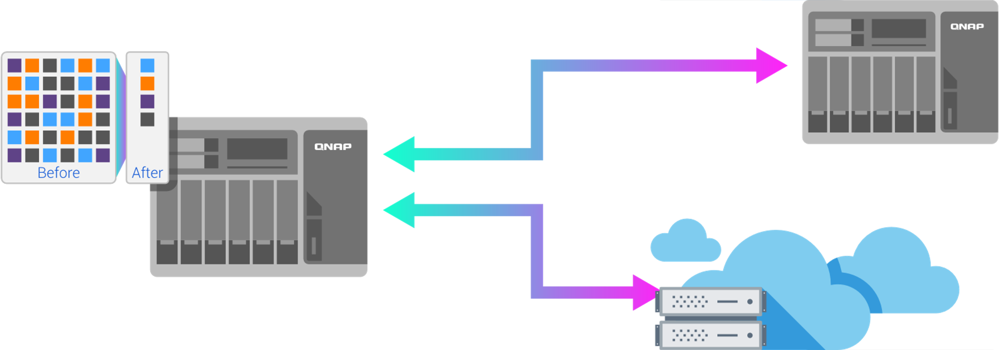



QuDedup Technology: Data reduction, small is fast!
Future highlights
Block level analysis and comparison
Source-side data deduplication framework
3 Advantages
  Bandwidth reduction,
  Space saving
  Support multiple cloud providers
VM Image Size | Deduped File Size | Compression Rate
15.48 GB | 7.59 GB | 2.04:1
Note: The compression ration of one VM image file.
01
Bandwidth Reduction
02
Space Saving
頻寬減量
03
Support multiple cloud providers
QuDedup support model: x86 / ARM 64 bit / ARM AL

Slide 9
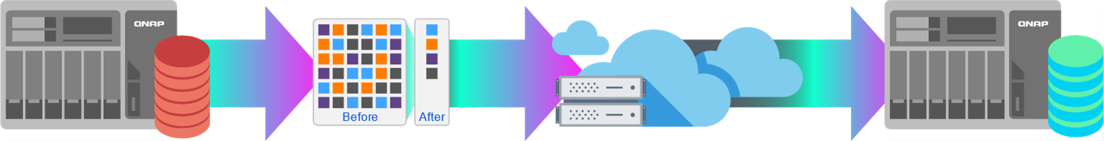
Source-side data deduplication technology is in line with modern enterprise needs
81% of enterprises have adopted the cloud solution, therefore source-side data deduplicated is more suitable for their needs.
Highly compatible with different backup destinations
Reduce backup storage space and data transmission bandwidth
Source-side Data Deduplicaiton Technology
Notes:
https://blog.csdn.net/liuaigui/article/details/5829083

Slide 10




High compression ratio, surpassing traditional data reduction technology
Category | File Compression | Single Instance Storage | Data Deduplication
Comparison Level and Scope | Byte / Single file | File / Specified disk area | Block / Specified disk area
Suiteable Scenario | Single file | Cross-files | Both single file and cross-files
Typical Data Compression Rate | 2:1 ~ 5:1 | 3:1 ~ 5:1 | 5:1 ~ 20:1

Slide 11
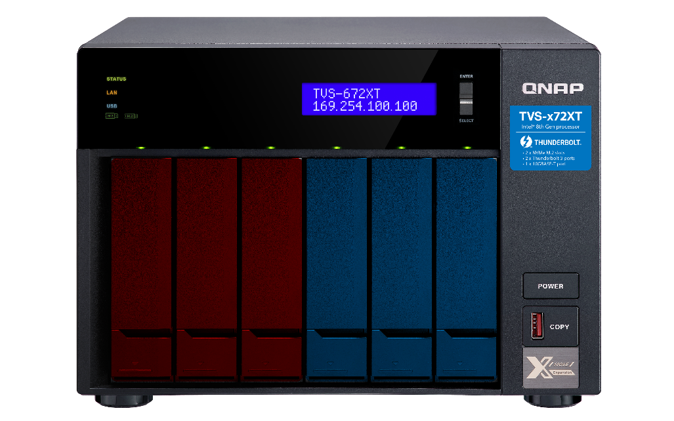



Use SSD to Speed up QuDedup
QuDedup requires a lot of file parsing and decomposition. If only the HDDs are used, the lower file access speed will make the network bandwidth use idle.
68.4 MB/s
HDD
HDDs
Cold Data
162.9 MB/s
SSD
SSDs
Hot Data
Notice: Data deduplication will consume more computing and memory resources. Please confirm that the NAS model has sufficient processing resources.

Slide 12

Bakcup time spent is the key factor for multi-version backup

Slide 13

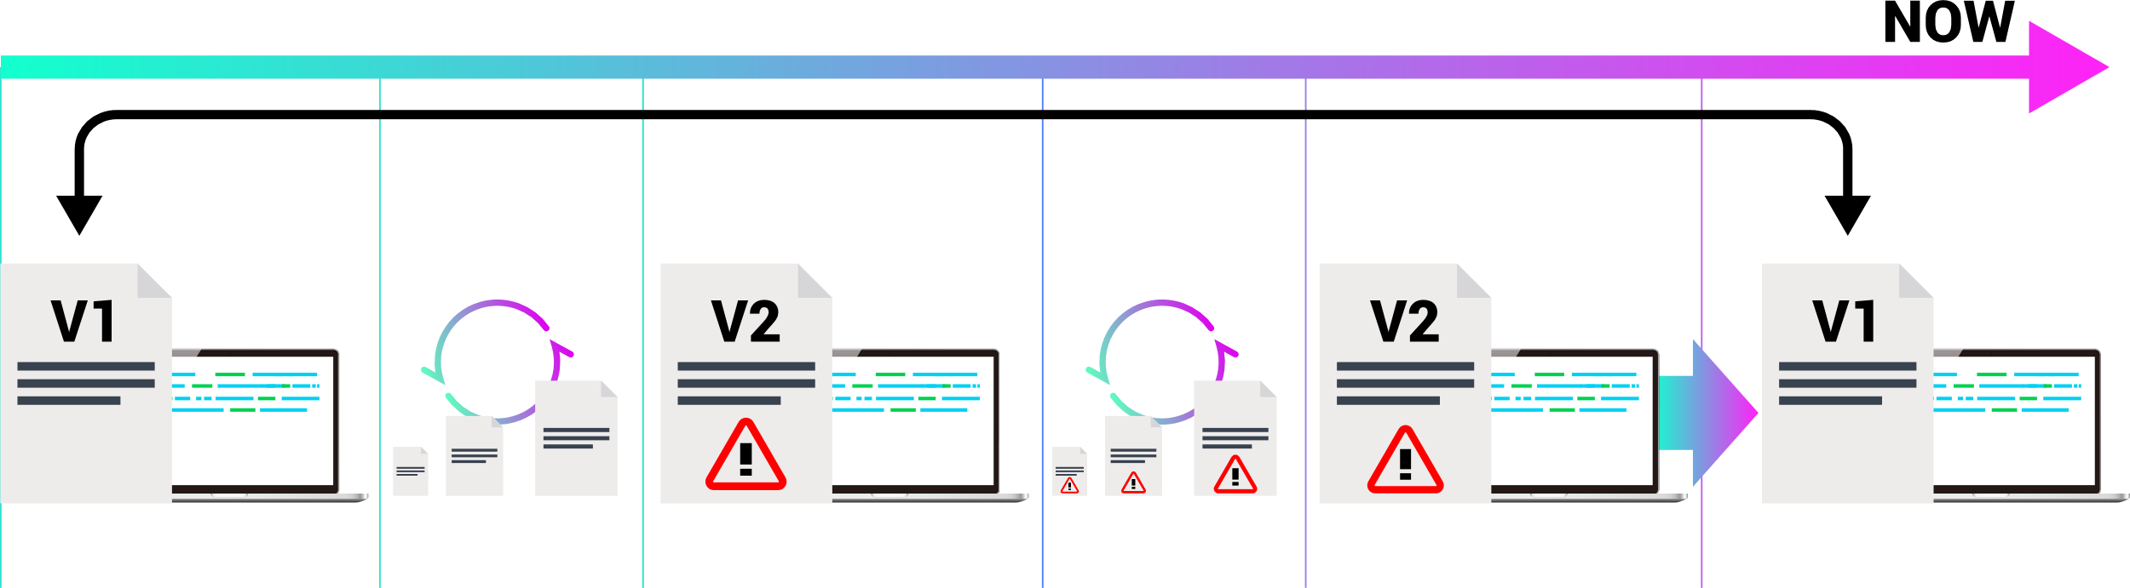

The more backup versions, the lower the risk
Multi-version backup can greatly increase the file availability from disaster recovery
  Free of damage caused by accidental alteration, damage or loss of files
  Intensive backup versions reduce the risk of missing business and personal data for enterprise and personal users
Don't ignore the hidden risk
When the data amount of the backup task is too large to be completed in time, the next scheduled task will be canceled.
Backup Job 1
Backup Job2
Code version 1
Execute normally
Code version 2
Failed to execute
Current Code
Failed to execute
Restore to Code version 1
The key is to speed up the execution of backup task.
Notes:
https://www.qnap.com/zh-hk/how-to/tutorial/article/qnap-smb-%E8%A7%A3%E6%B1%BA%E6%96%B9%E6%A1%88-%E4%BD%BF%E7%94%A8%E5%82%99%E4%BB%BD%E7%89%88%E6%9C%AC%E6%8E%A7%E5%88%B6%E8%AE%93%E6%82%A8%E7%9A%84%E4%BC%81%E6%A5%AD%E5%85%8D%E6%96%BC%E6%AA%94%E6%A1%88%E9%81%BA%E5%A4%B1%E7%9A%84%E9%A2%A8%E9%9A%AA/

Slide 14

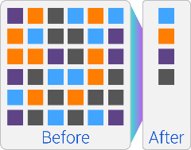

How to optimize the two indicators RPO and RTO?
tip1
tip2
Complete 10/25/40 GbE solution
Enable QuDedup technology for backup task
Utilize high-speed interfaces to speed up data transmission
Turn on data reduction to reduce transferred data amount
Data Backup Time
Disaster
System online
Recover Point Objective
Recover Time Objective
Notes:
高速資料傳輸加上減量後的備份資料將可減少備份及災備所需時間(RTO)
備份所需時間減少，因此可提高備份頻率，拉近還原點目標(RPO)

Slide 15

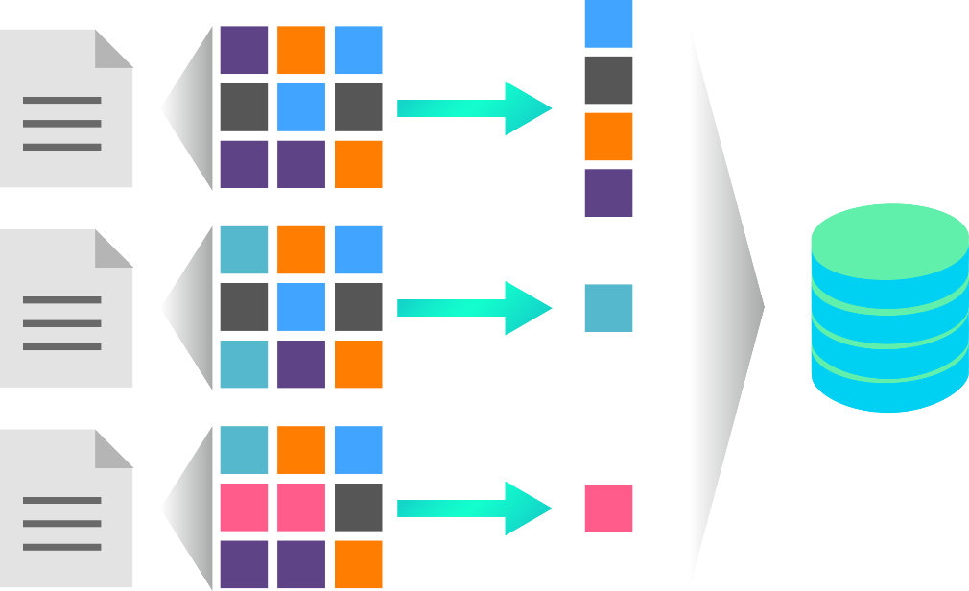


Backup needs data reduction, multi-version backup needs more
!
Multi-version backups consume lots of storage space after long term execution
tip
Use QuDedup for cross-files and cross-versions data deduplication, saving substantial time and space!
1st Backup
 | Source Size | Destination Size | Number of Versions
1st Backup | 15.48 GB | 7.59 GB | 1
2st Backup | 15.49GB | 7.82 GB | 2
QuDedup
2st Backup
1.03x
Note: Multi-version backup of the virtual machine image
3st Backup
Notice: Enable multi-version backup will enable the QuDedup option at the same time

Slide 16

Live Demo Part 1
Data deduplication and multi-version backup demonstration
Notes:
Demo 分成兩次
- TR004 DEMO
- 雲端dedup

Slide 17

QuDedup Extract Tool makes your backup data visible and portable

Slide 18

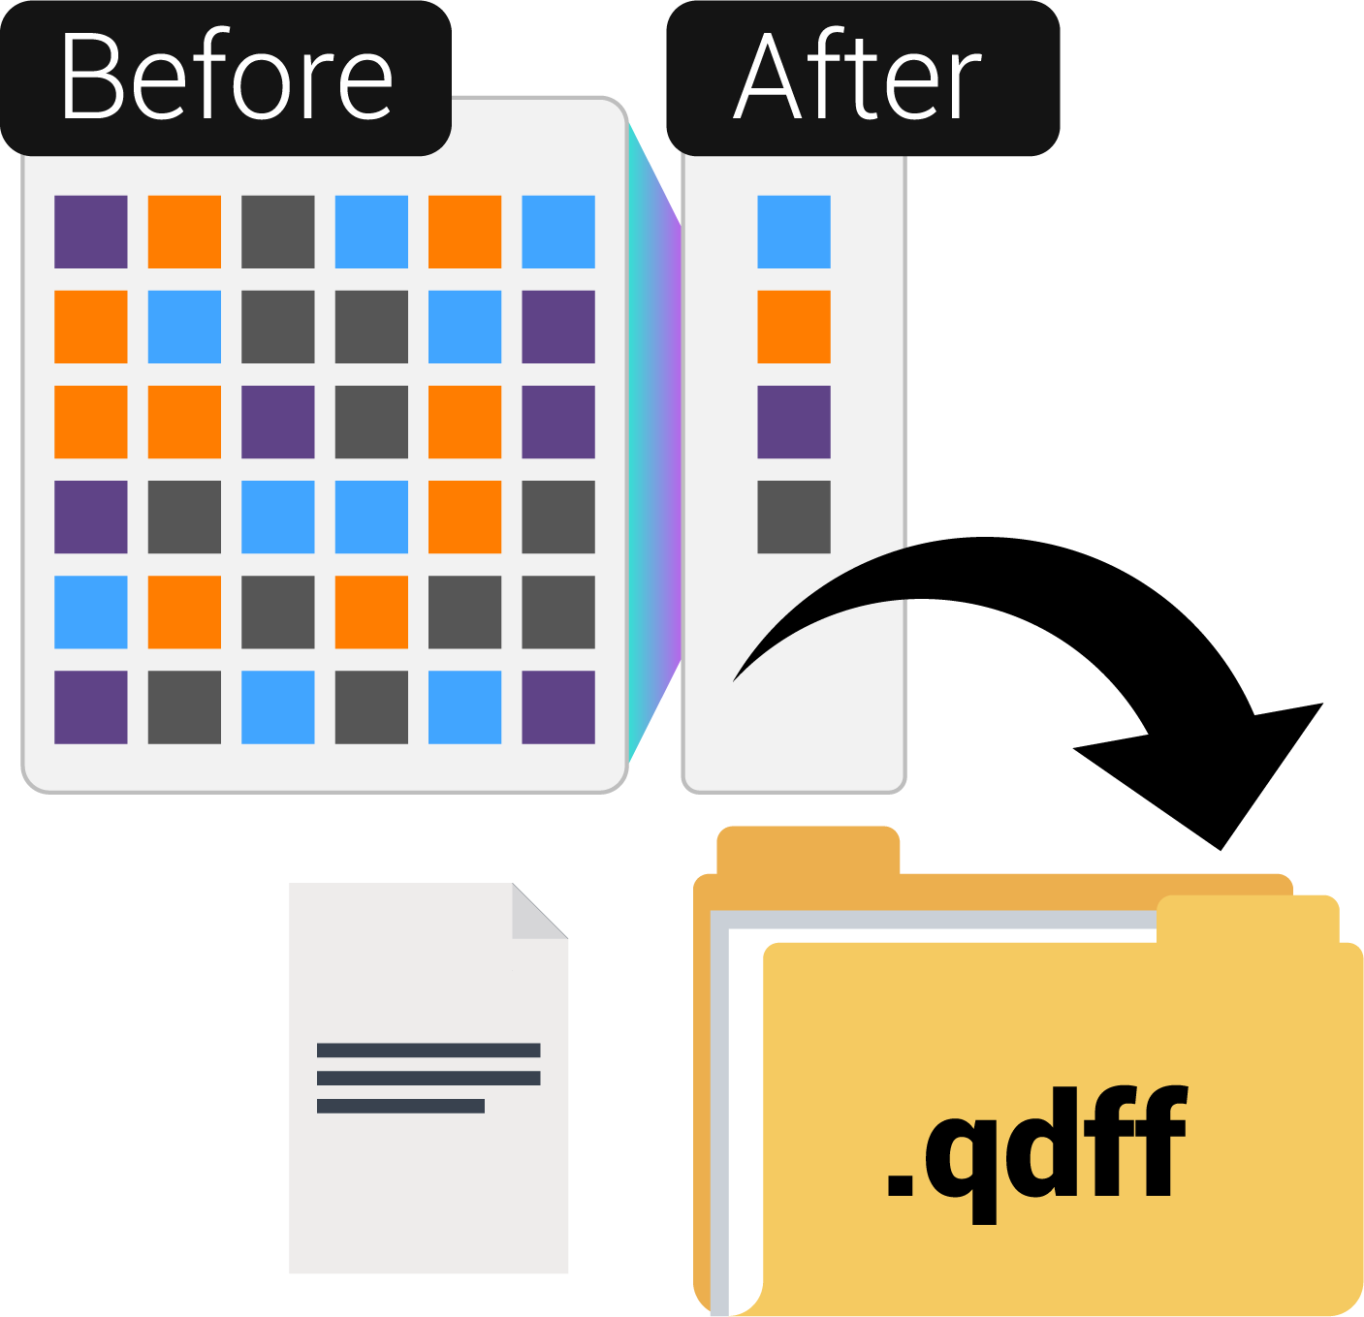
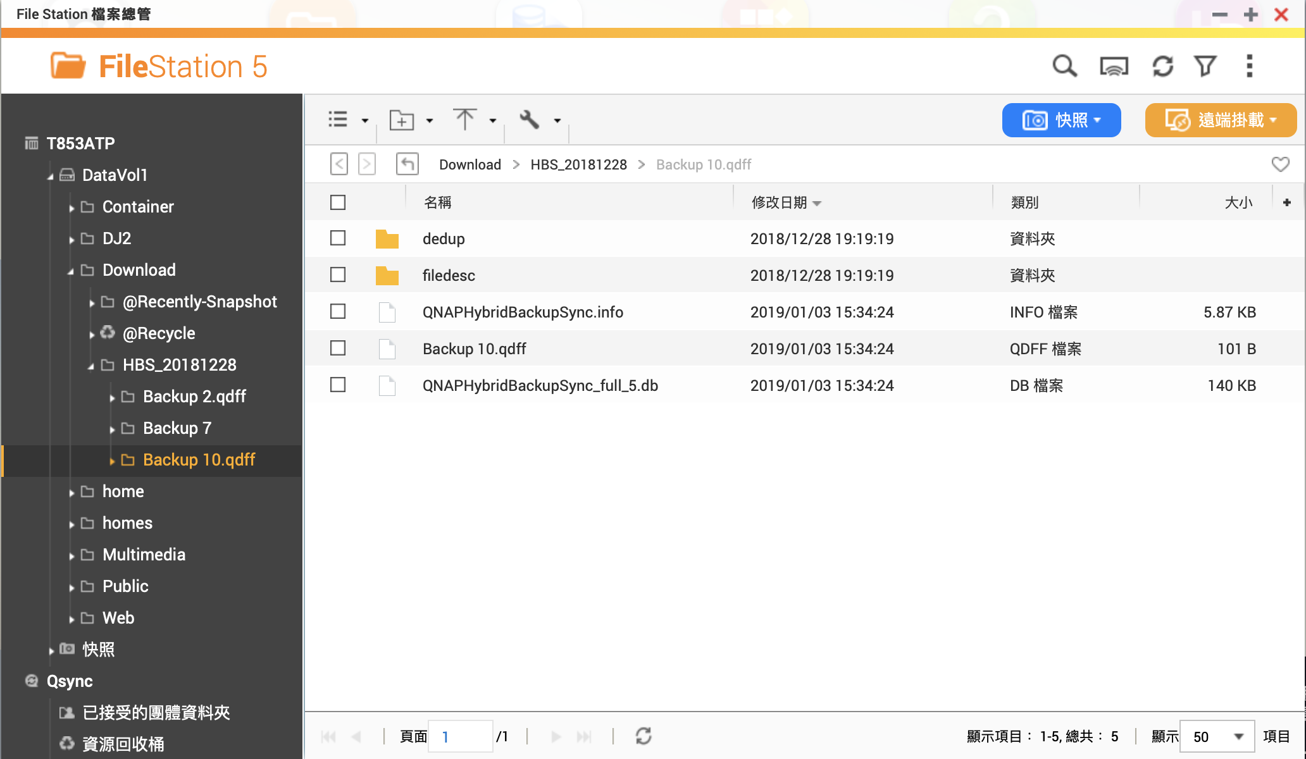
What is .qdff？
Backup Knowledge of .qdff
(QNAP Dedup File Format)
Storage format for deduplicated data
  Backup data is deduplicated in block level
Unable to see the file directory structure and file contents
File needs to be extracted before it can be accessed.

Slide 19


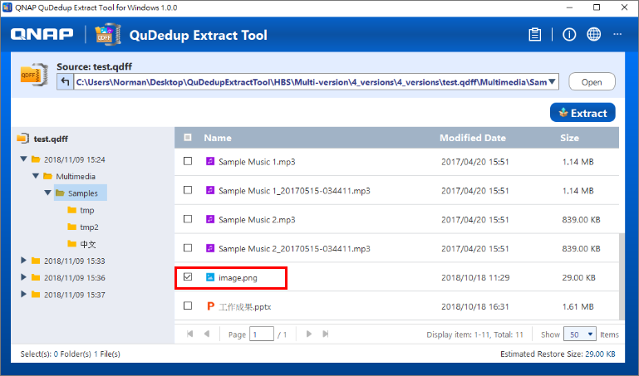
QuDedup Extract Tool makes .qdff restore without constraints
The after effect of data deduplication
Backup files cannot be viewed after deduplication.
Backup files need to be restored to the source before access.
All new QuDedup Extract Tool allows you to take TB-level file with you.
File Restore Anywhere
  Bakcup files can be resotred directly on multiple platforms(Windows / Mac / Linux(Ubuntu)
File Preview
  The backup file can be previewed before restoration to view the content differences in each version.
Fine Recovery
  Single folder/file restoration
Notes:
輕量化應用程式，佈署攜帶更便利
跨平台支援，讓備份資料便於隨處還原存取
Windows / Mac / Linux(Ubuntu)
簡單一致的使用者介面 跨平台使用更上手

Slide 20
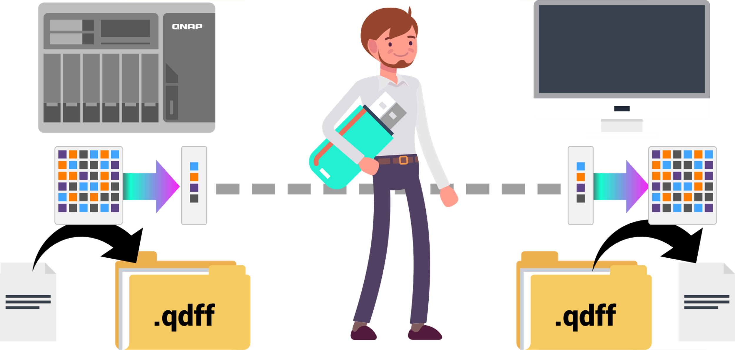
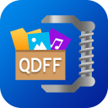
Bring your backup data by a single USB drive
10 TB
1~2.5 TB
1~2.5 TB
10 TB
Notes:
TR-004
NAS backup to TR-004
PC connect TR-004 w/ Extract Tool

Slide 21
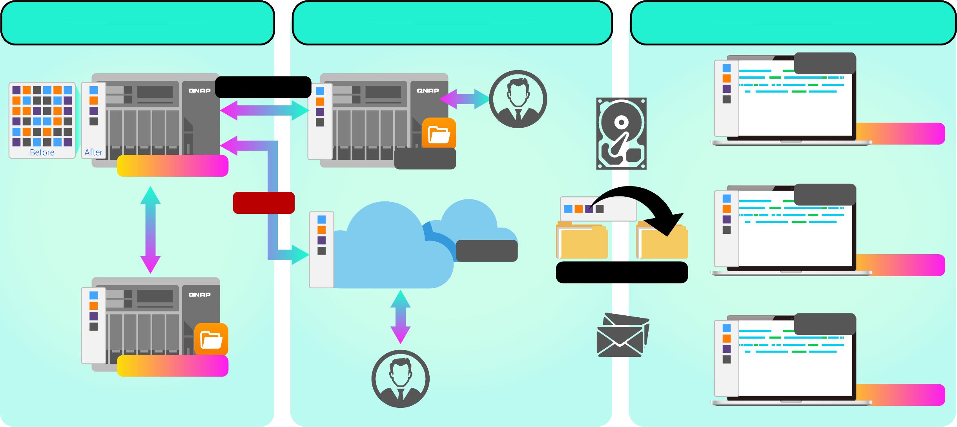

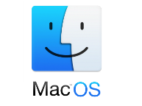

Backup data can be restored in different places and taken anywhere
Access from local NAS(via HBS)
Access from remote NAS (via File Station)
Carry and Use
.qdff
Backup/Restore
Tokyo
Taipei
.qdff
File Station with QuDedup, coming soon...
.qdff
TCP BBR
.qdff
CIFS / NFS / FTP
New York
.qdff
Taipei
File Station with QuDedup, coming soon...
Access from Cloud
Beijing
Notes:
Carry and use 在不同地點

Slide 22

QuDedup Extract Tool User Manual

Slide 23
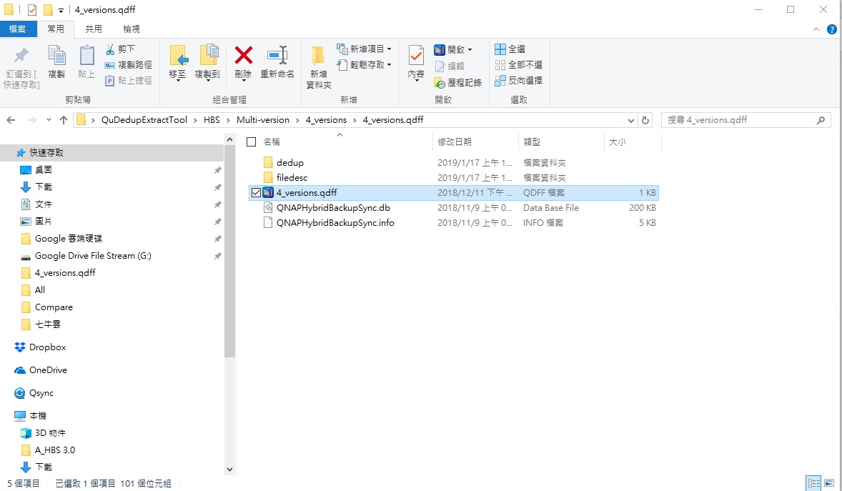
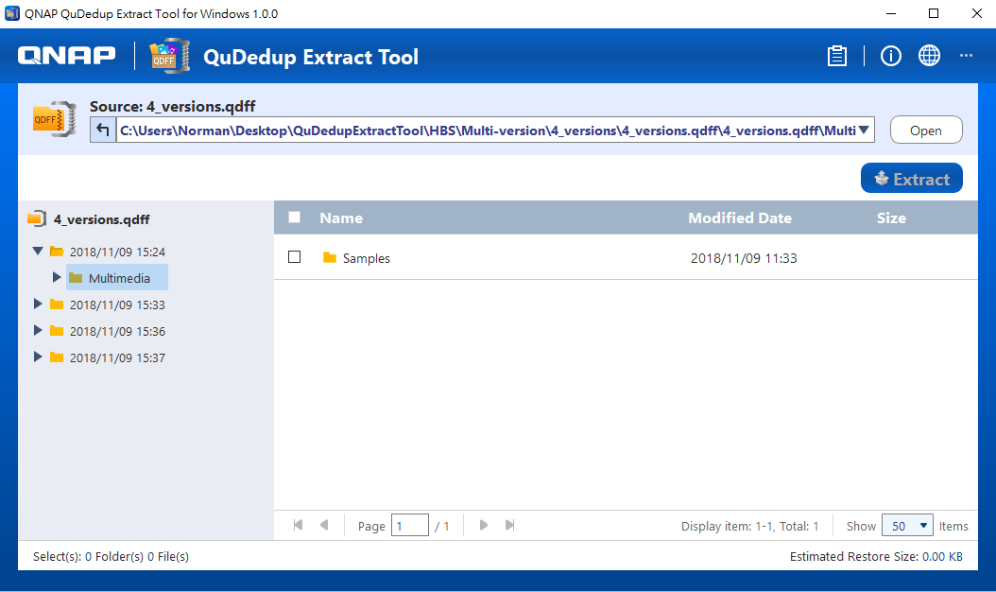


Import .qdff file
Import .qdff file by double click the .qdff file, you can also click "Open" button in QuDedup Extract Tool to import.

Slide 24
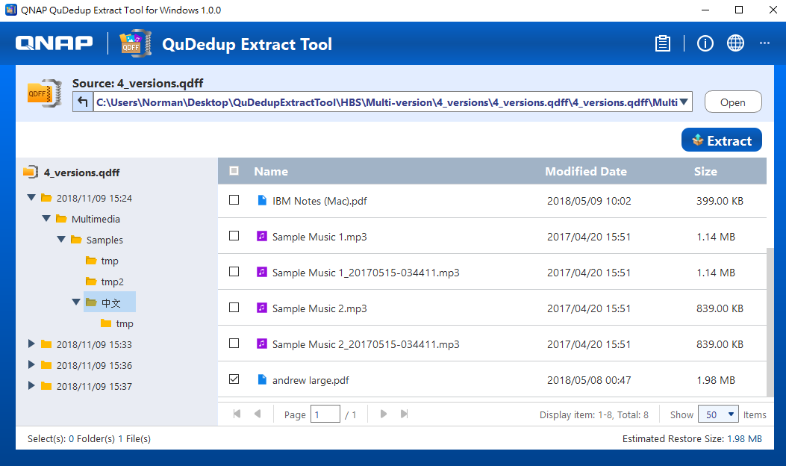
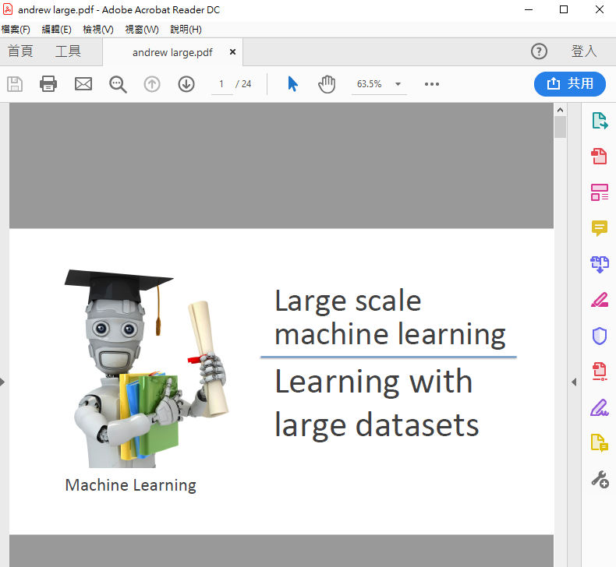


View multi-version and file content
Multi-version data will be displayed directly in the left window ordered by backup time.
Double click the file to preview.
All the backed up versions will be listed here

Slide 25

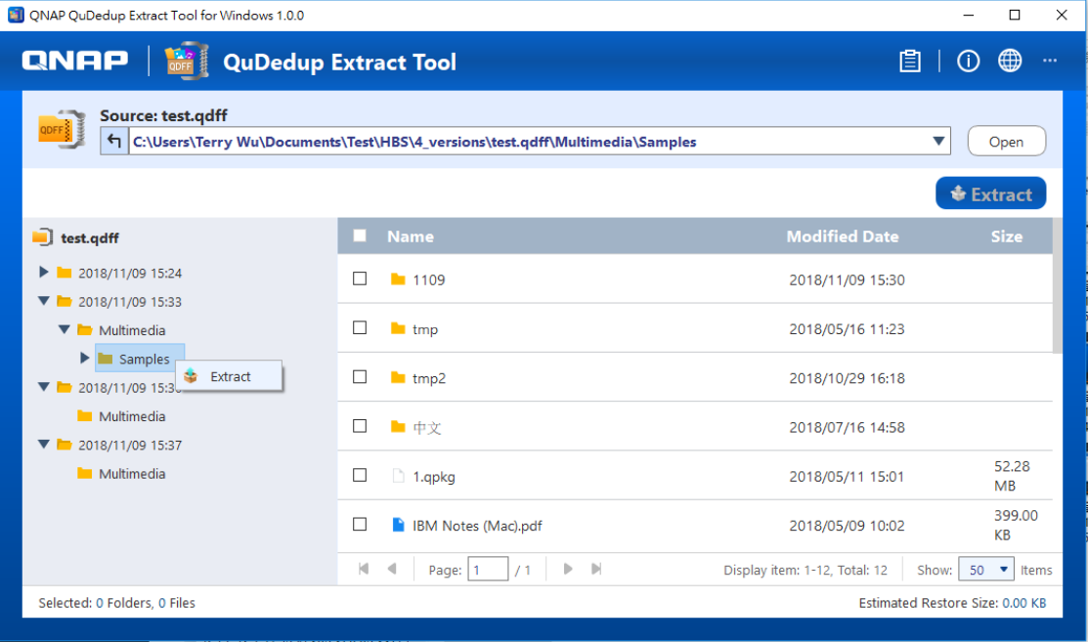
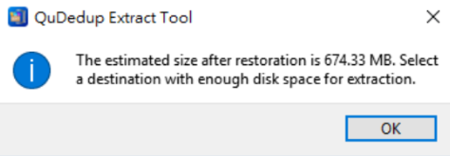

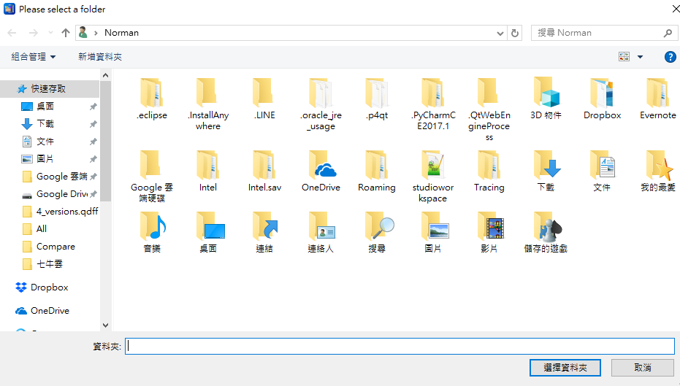
Arbitrarily select the file to be restored
Support to extract the whole .qdff
Support fine recovery, users can select some files/folders to restore according to their needs.
Intimate reminder: Estimated restore size

Slide 26
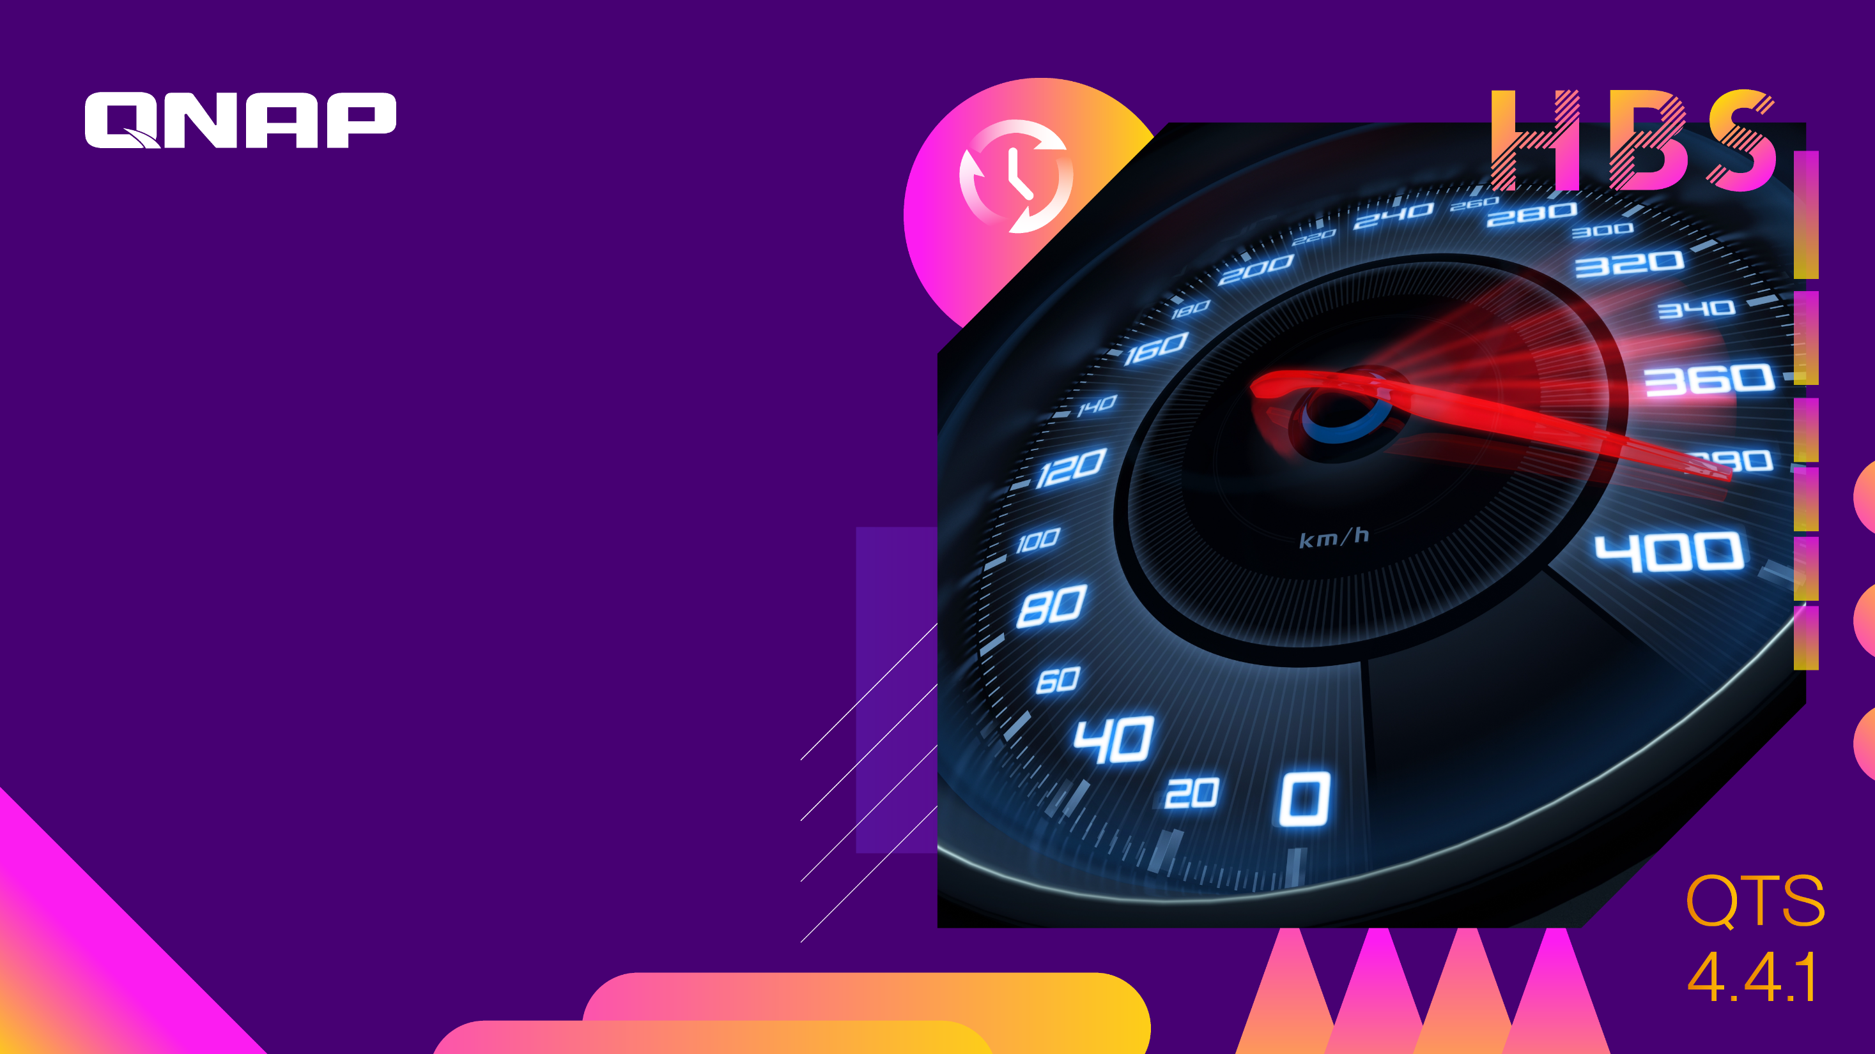
Support TCP BBR to accelerate the cloud backup speed

Slide 27
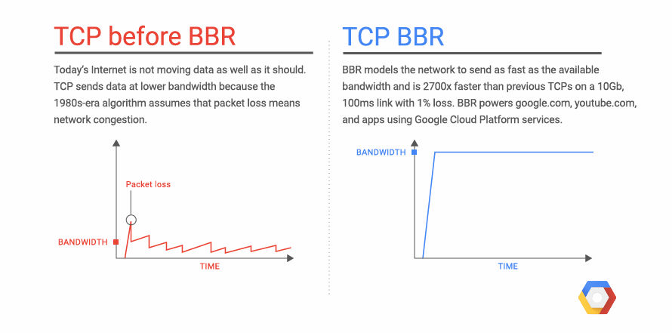
What is BBR
(Bottleneck Bandwidth and Round-Trip Time)
BBR is a congestion control technology suitable for modern network environment
BBR is Google's new congestion control algorithm designed for TCP
Supported by Linux kernel 4.9 and above
Fully improve bandwidth utilization in a network environment where the packet loss rate is too high
Notes:
https://cloud.google.com/blog/products/gcp/tcp-bbr-congestion-control-comes-to-gcp-your-internet-just-got-faster
https://notfalse.net/28/tcp-congestion-control

Slide 28
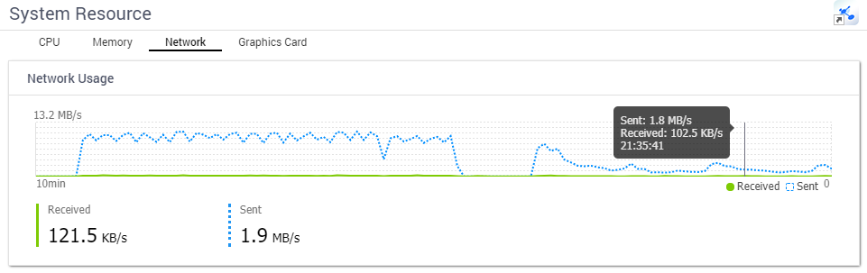

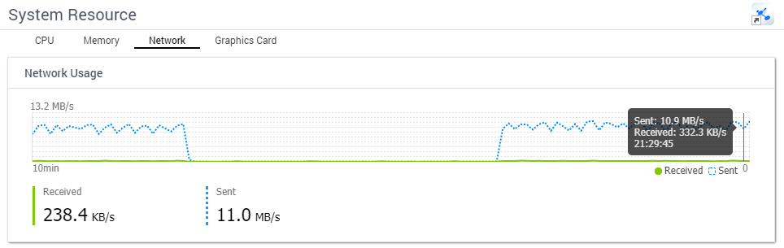

Network Speed Measurement of TCP BBR
Disable TCP BBR
Source: QNAP NAS in Taiwan
Destination: AWS S3 EU(London) Zone
Connect to the cloud service through the Heterogeneous network. Enable TCP BBR to improve the transmission efficiency!
4 ~ 5 times increase
Enable TCP BBR
Notice: TCP BBR is suitable for WAN, it will not have effect in network env. without packet loss(e.g. LAN).

Slide 29
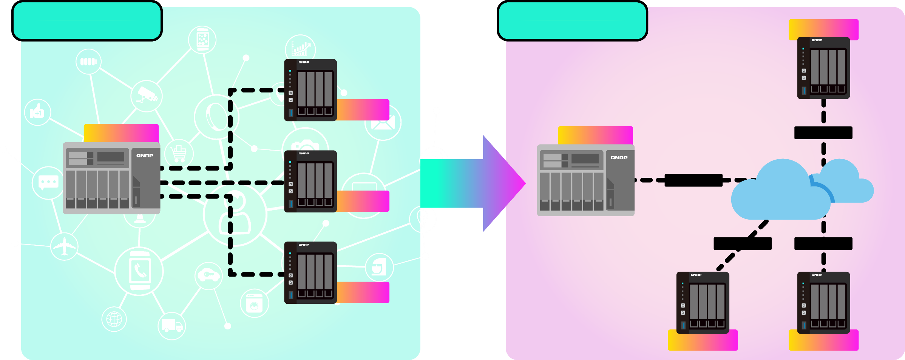
  TCP BBR makes enterprise hybrid cloud architecture robust
Robust and esay to deploy
Compared with traditional framework, which need to overcome complex network environments, enterprises simplify device deployment problems through public cloud services while maintaining stable transmission quality and speed.
Private Cloud Framework
Hybrid Cloud Framework
Tokyo
Tokyo
Taipei
Taipei
TCP BBR
TCP BBR
Public Cloud Service
New York
TCP BBR
TCP BBR
Beijing
Beijing
New York
Notes:
70%
穩定 起達到多點資料交換的目的
可高度相容於企業既有混合雲環境配置
不論企業採行何種混和雲架構，皆可透過TCP BBR提升網際網路連線的傳輸速度!

Slide 30

Complete Support to Cloud Object Storage

Slide 31
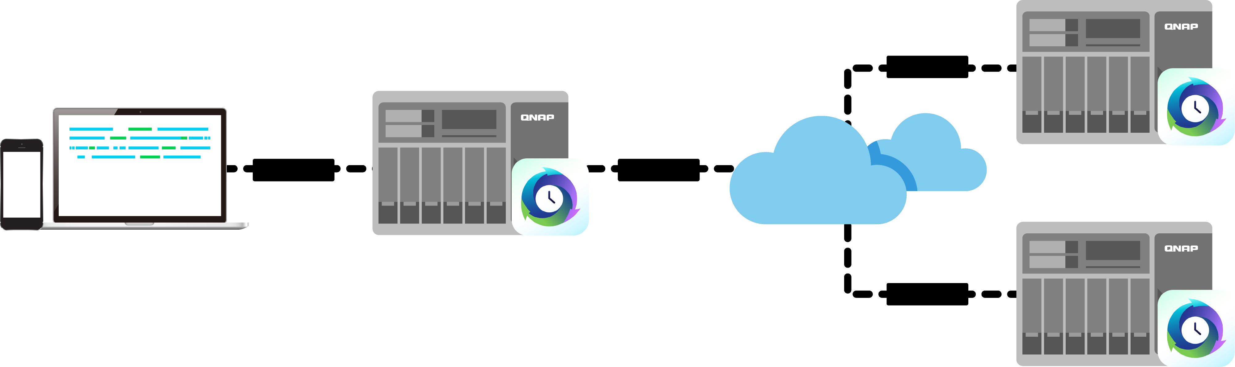



Use Hybrid Backup Sync to connect with Cloud Object Storage
Use QNAP NAS as the file storage gateway
Convert the local file to a cloud object, and the file directory structure is also saved in the cloud space.
Create a tight hybrid cloud storage architecture
Flexibly use cloud space to complete the backup strategy
Instantly synchronize multiple files with cloud architecture
File Sync
NFS / SMB
File Sync
Public
Cloud Service
Multi-site synchronizatio
File Access
Convert file to cloud object
File Sync

Slide 32


Completely Integrate File and Object Type Cloud Services
Already supports 22 public cloud service provider and continue increasing
Support both cloud synchronization and backup
Support multi-version backup
File Storage
Object Storage
Notes:
補上雲端服務ICON

Slide 33


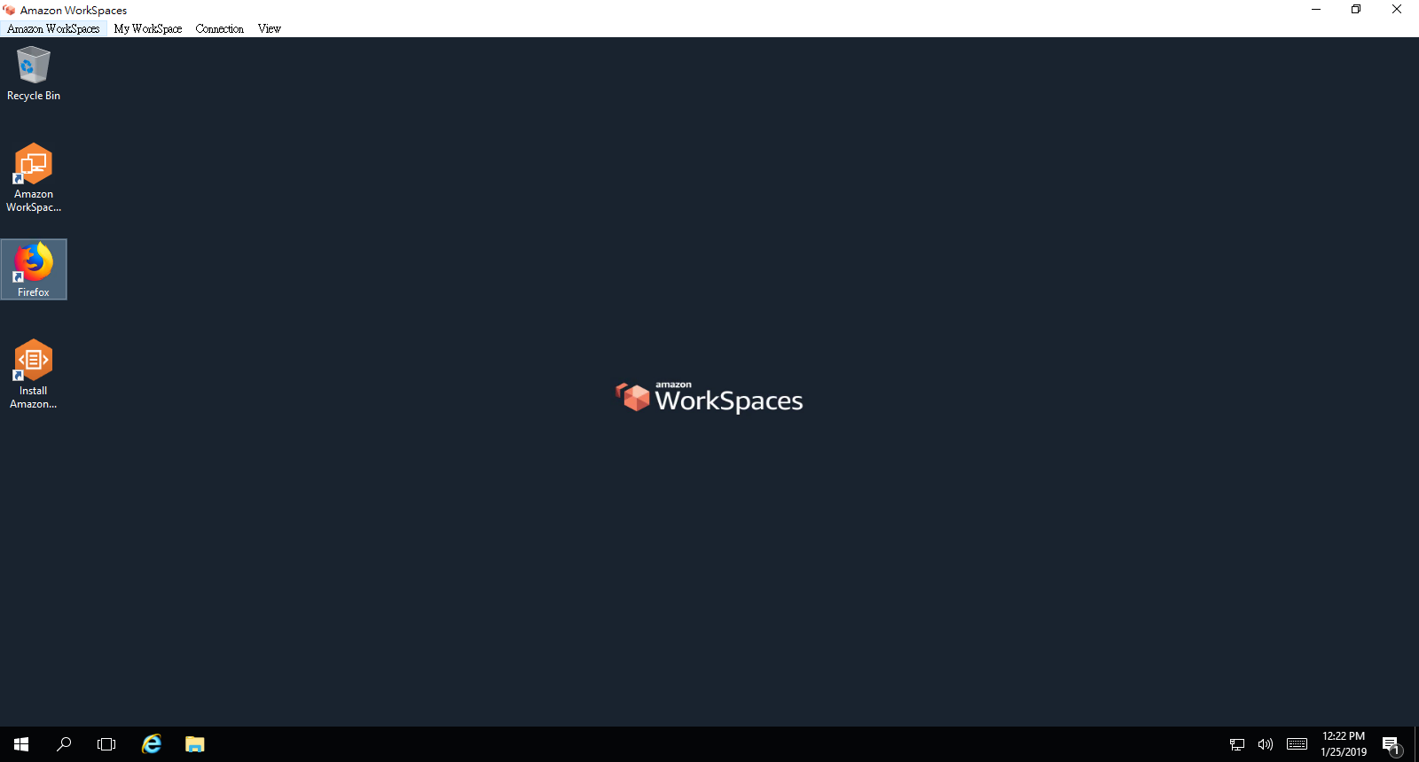
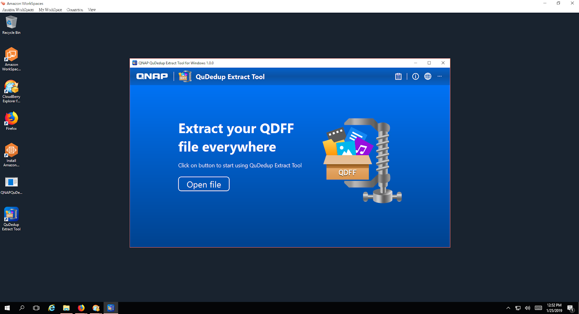
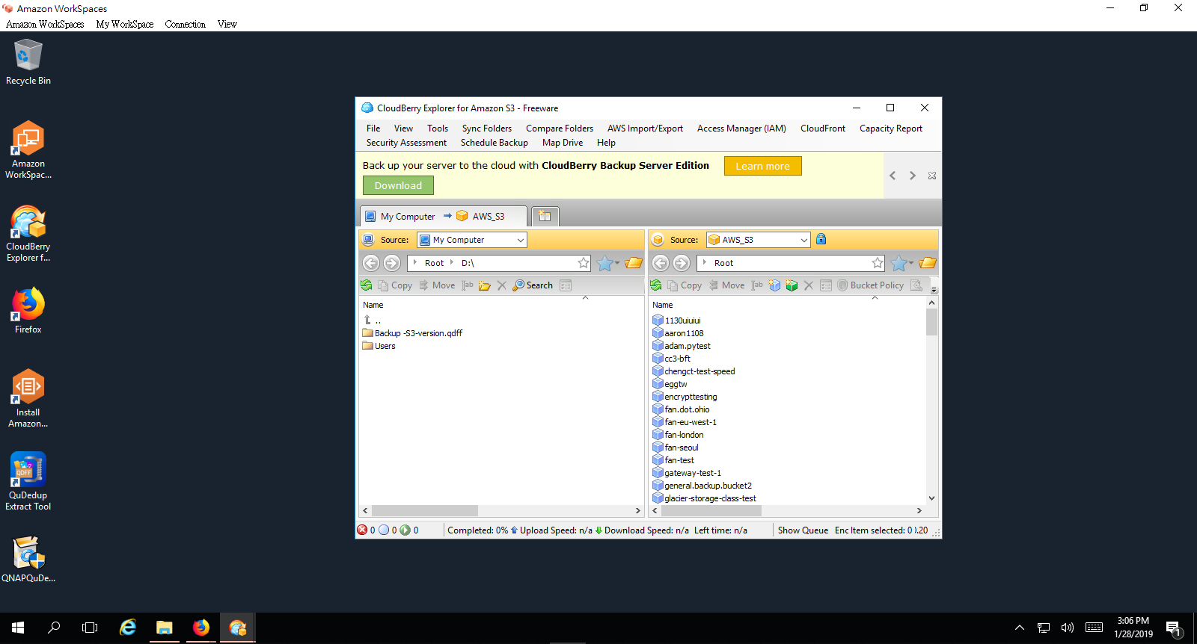

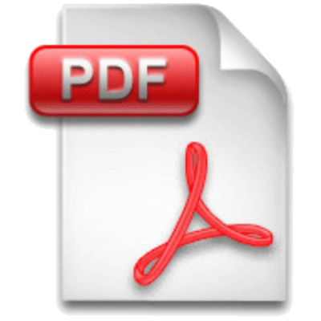
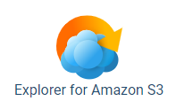


Quickly get backup files in the cloud
Step1 Deploy AWS WorkSpace
Step2 Download and install QuDedup Extract Tool from QNAP Download Center (Coming Soon)
Step3 Install third-party S3 client tools(e.g. CloudBerry) to access backup data located on AWS S3
tip
The commonly used application can store in the AWS S3 backup space, and copy to the AWS WorkSpace for installation and use when accessing the backup data (e.g Unzip tool, PDF Reader, Video Player...)
1
2
3

Slide 34
Live Demo Part 2
Cloud multi-version backup and restore with QuDedup Extract Tool
Notes:
Demo 分成兩次
- TR004 DEMO
- 雲端dedup

Slide 35

Make the 3-2-1 backup strategy

Slide 36

Best practice of hybrid cloud architecture
Adapt the backup strategy depending on the infrastructure and cloud services that the user already holds.
Easy to build offsite backup via private and public cloud.
Adjust the backup location according to the confidentiality of the backup data.
Adopt data deduplication technology to reduce bandwidth and storage space consumption for backup task

Slide 37

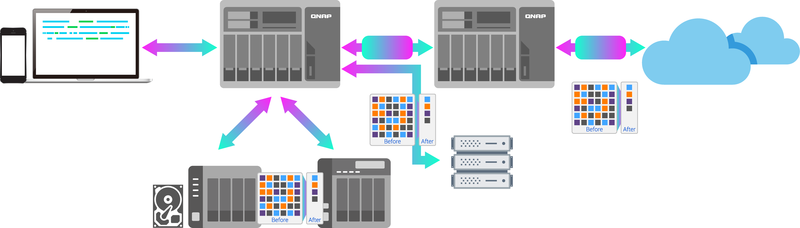
QNAP's Complete Data Protection Plan Complies with the 3-2-1 Principle
Local
Remote
Cloud
RTRR
Backup / Sync
TCP BBR
TCP BBR
Mac Time Machine
Netbak Replicator
File Storage
Object Storage
Rsync Server
CIFS / SMB Server
FTP Server
External Device / TR-004
VJBOD
Notes:
加上DEDUP/TR004/TCPBBR

Slide 38

Voice from enterprise users:
30 sets schedule settings and rate control per job

Slide 39
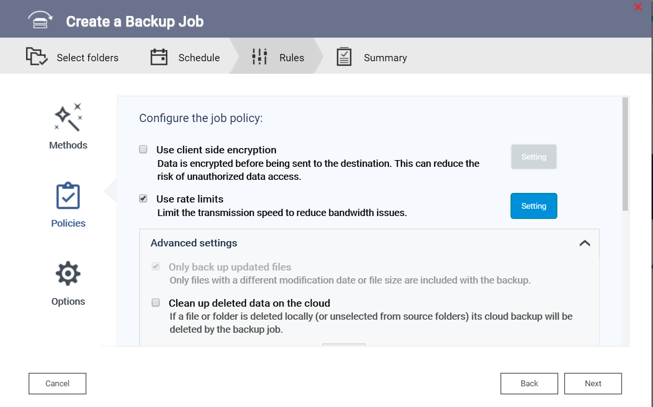
Advanced management to ensure the quality of enterprise network
Set the rate control for each task.
Plan backup task schedule according to enterprise demand elasticity

Slide 40
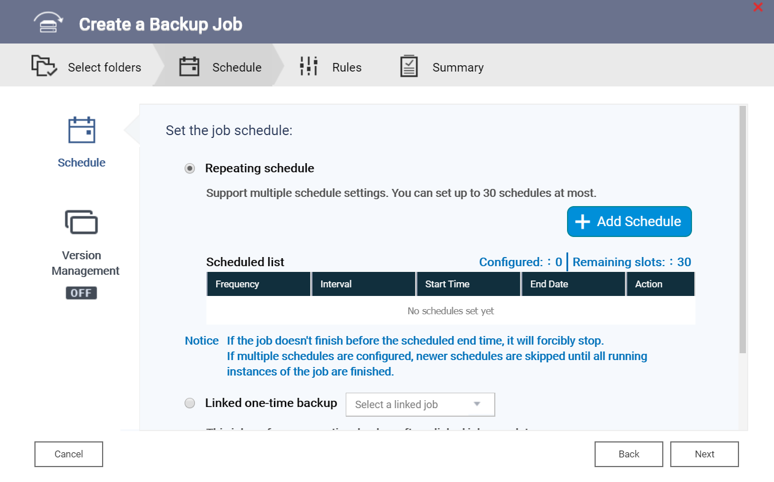
Flexible setting of task schedule can reduce disaster recovery RPO
Supports schedule types
    One-time
    Periodically(Monthly/Weekly/Daily/Hourly ...)
    Linked one-time backup
    Manually
Supports 30 sets schedule settings per-job
Supports schedule vaild interval setting

Slide 41
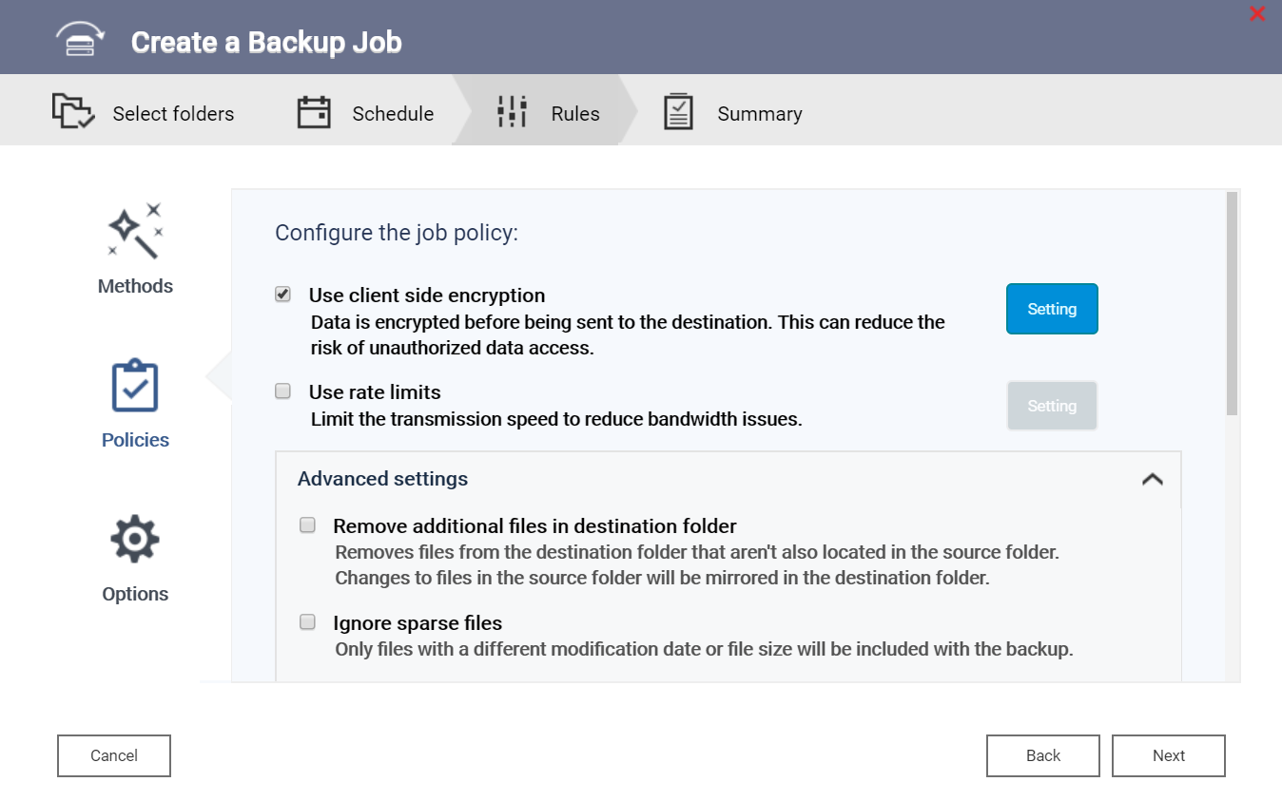
Enterprise Backup Data should more secure for Complying with GPDR
Backup data cannot be accessed by unauthorized personnel
Transmission encryption
  HTTPS
  SSL
  SSH
Data encryption
  Client-side encryption
  Server-side encryption

Slide 42

New Look of Hybrid Backup Sync 3.0

Slide 43

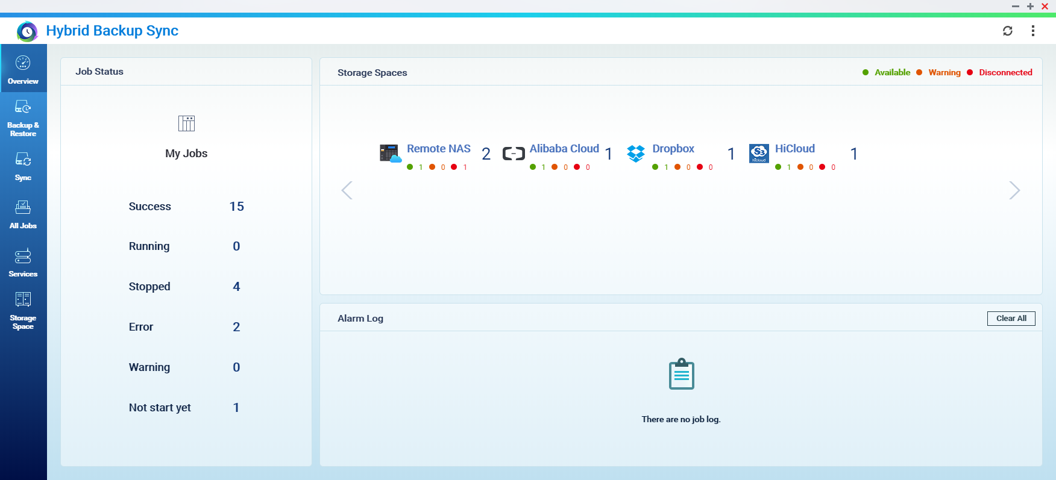
Intuitive operation design Improve backup management efficiency

Slide 44
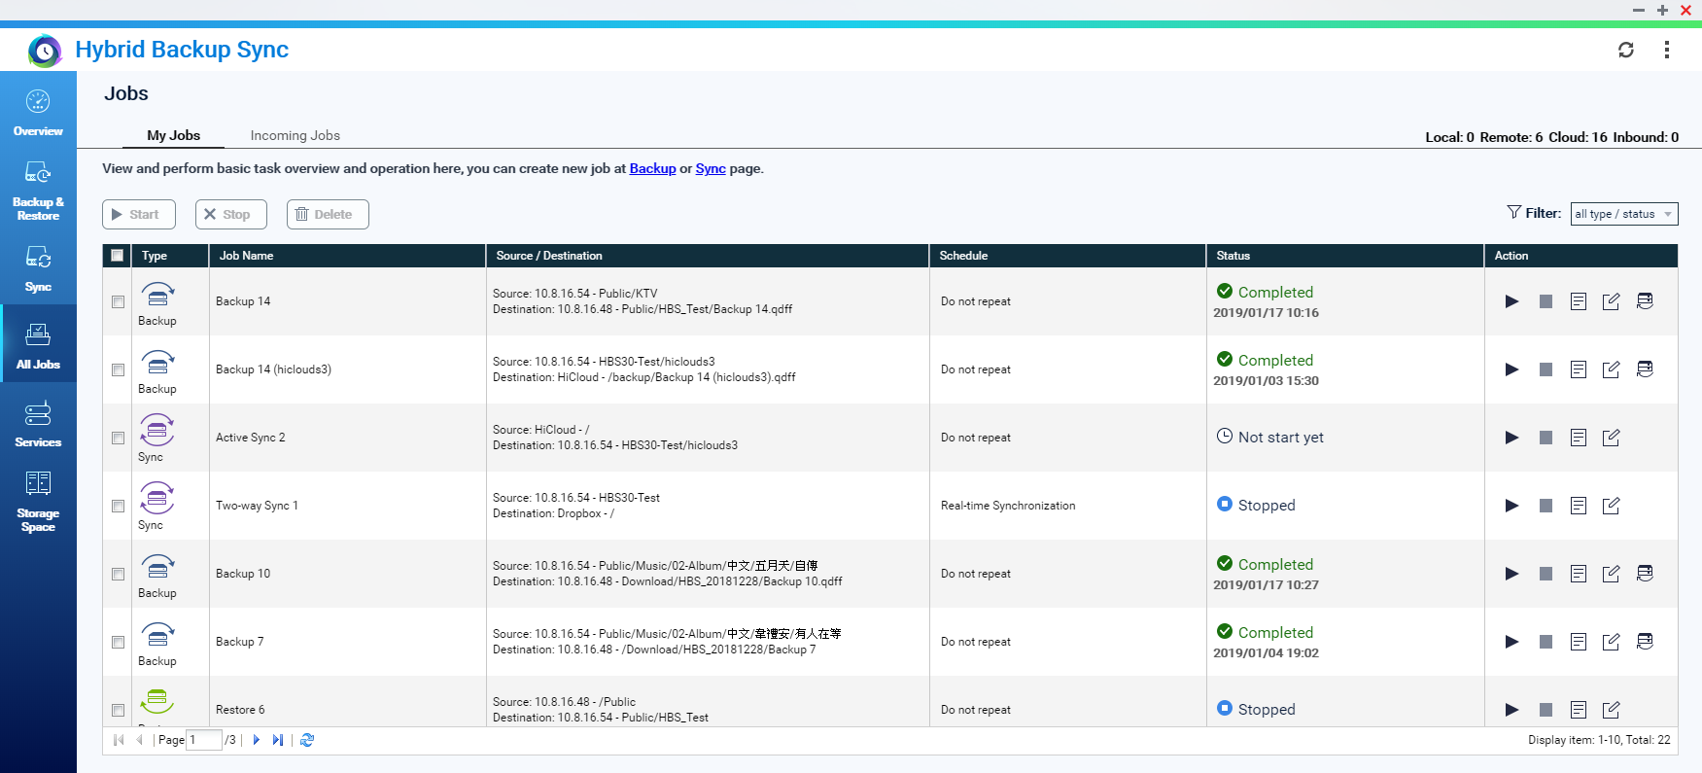
Task overview page Manage multiple tasks at once

Slide 45
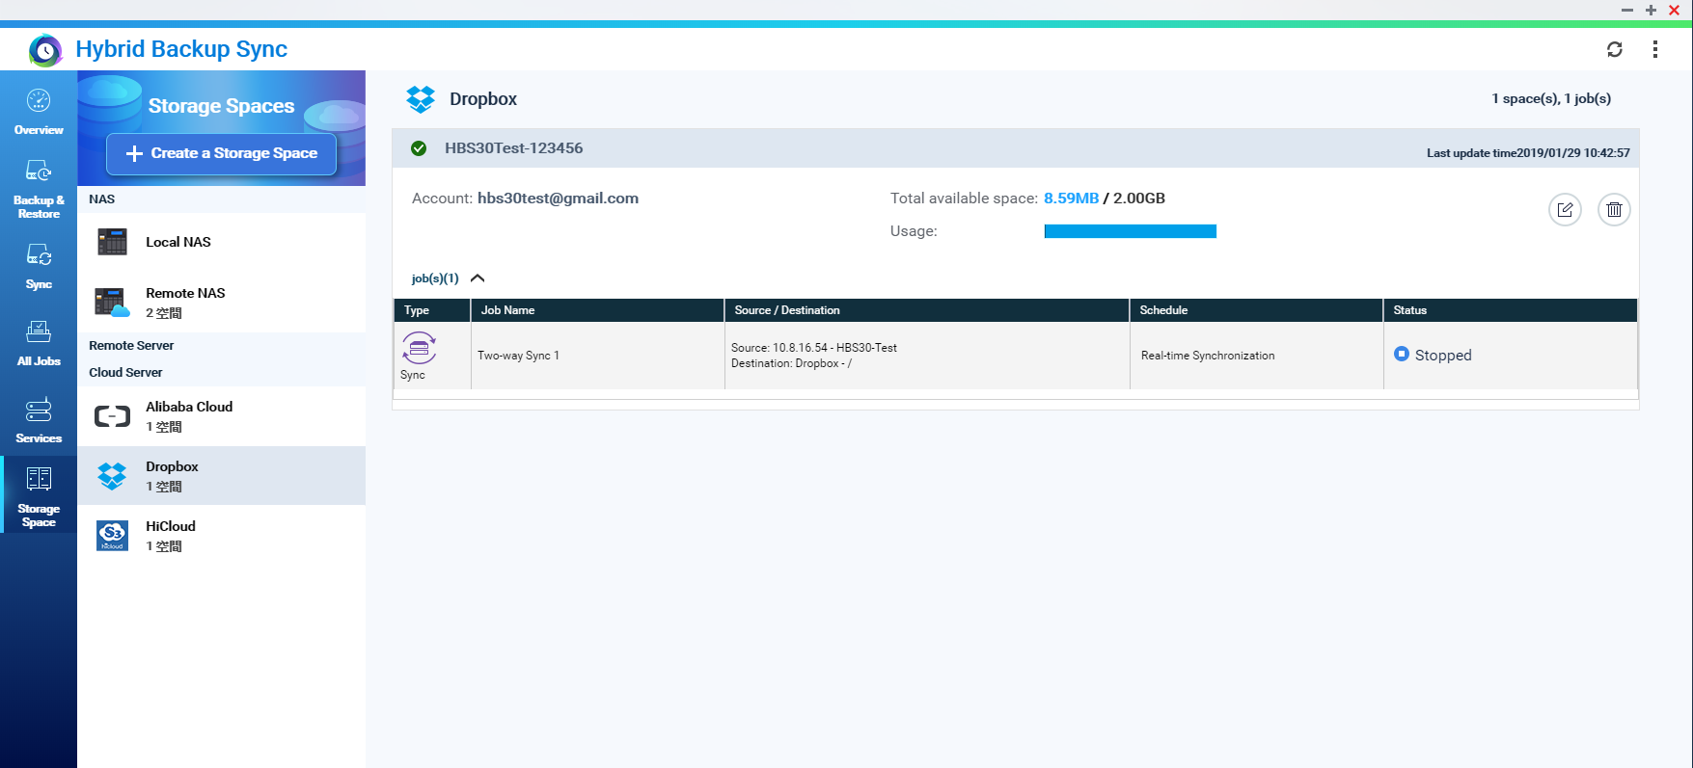
See all storage space status at a glance
Notice: Some of the cloud services do not support to show storage information.

Slide 46


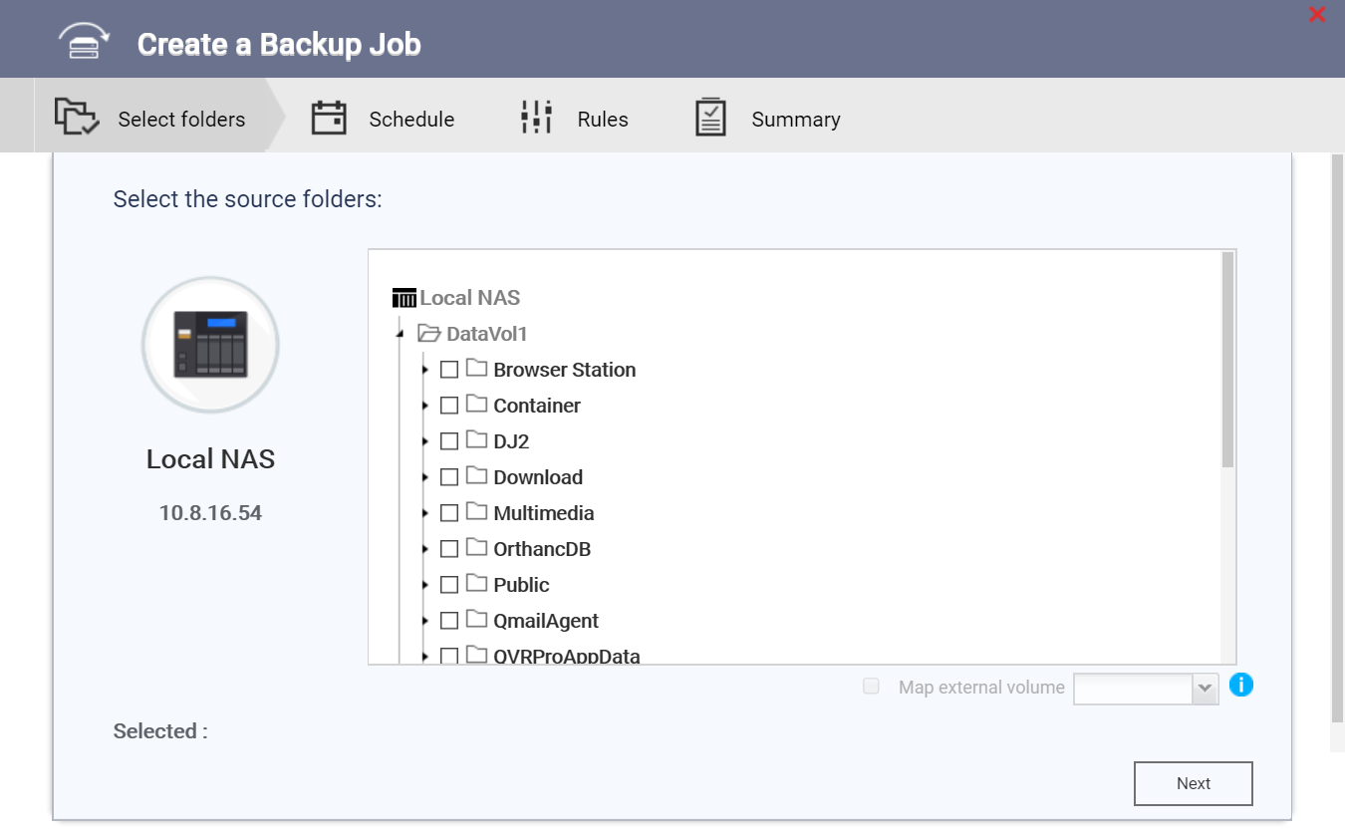
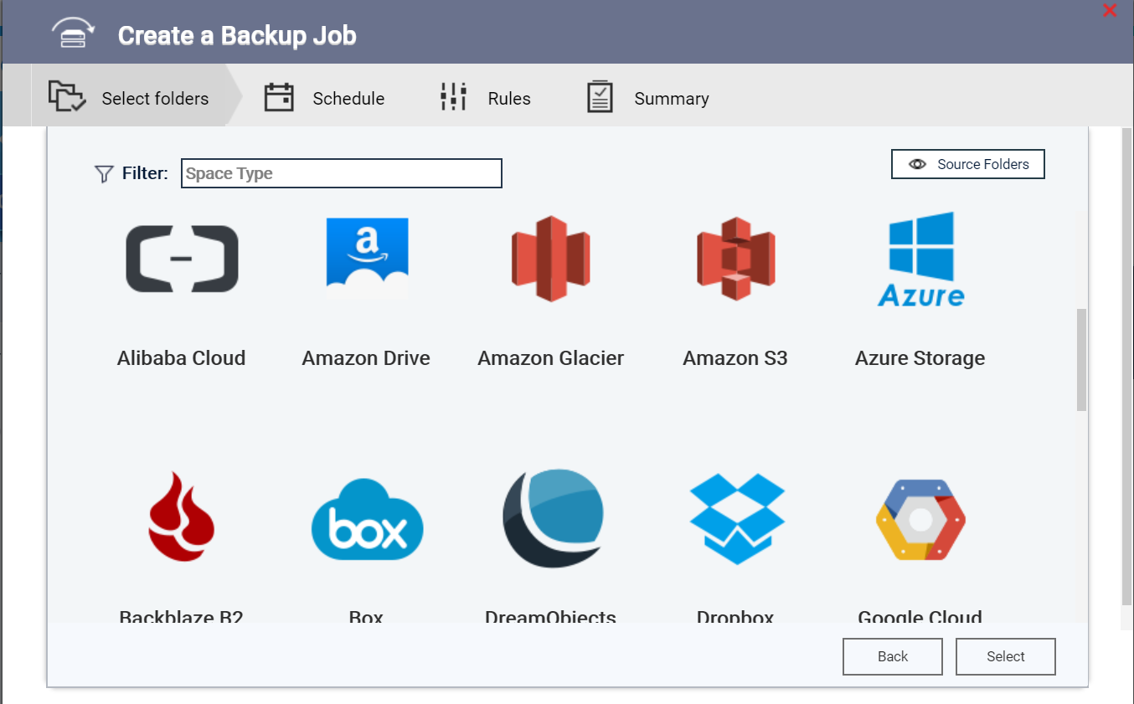
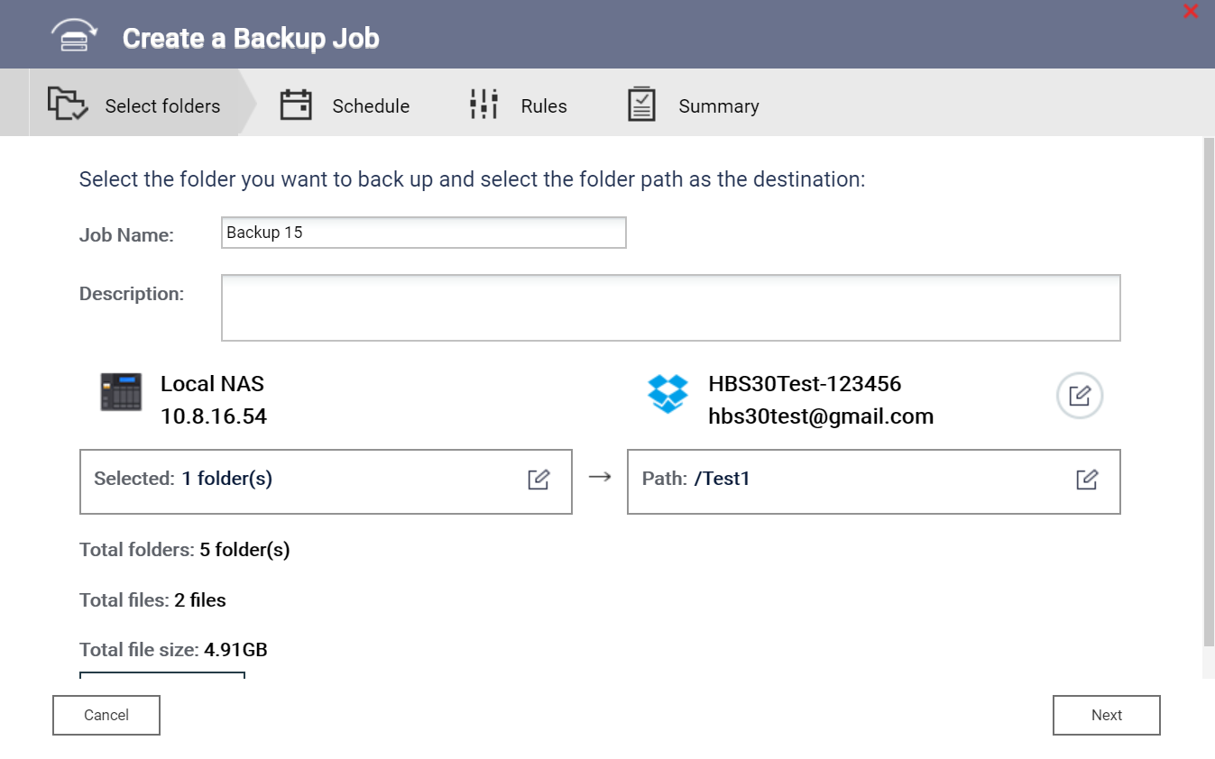
Task setup by wizard
Select Source
Select Destination
Complete the backup path setting

Slide 47
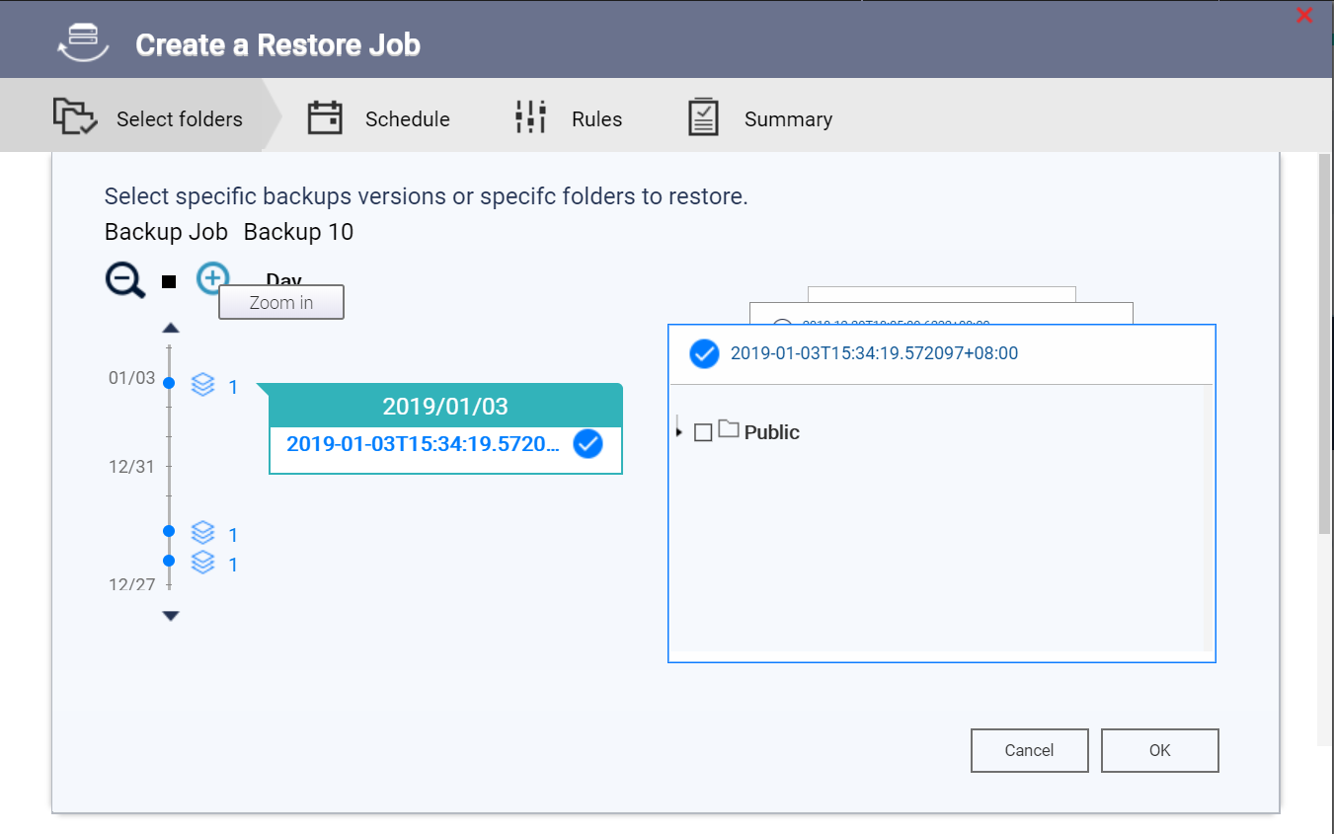

Version viewer helps you to select folder to restore by 3 steps
1
Select the date from timeline
Select version
Select folder to restore
3
2
1
2
3

Slide 48
Hybrid Backup Sync 3.0 Beta Program

Slide 49
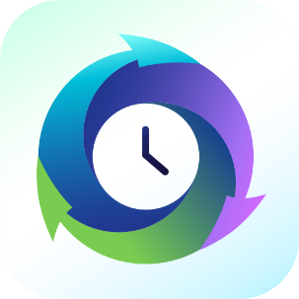
QNAP Hybrid Backup Sync 3
The best help for your hybrid cloud data protection
Copyright © 2019 QNAP Systems, Inc. All rights reserved. QNAP® and other names of QNAP Products are proprietary marks or registered trademarks of QNAP Systems, Inc. Other products and company names mentioned herein are trademarks of their respective holders.

