Slide 2
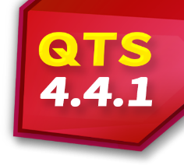
Discover the all-new CacheMount
1
Why CacheMount and what are its problem solving abilities
2
Cache function makes the hybrid cloud more efficient
3
The key of CacheMount: Cache Volume
4
User manual on how To Start The Cache Experience
5
Live demo

Slide 3
Issues you might encounter while using Private cloud
When out of office, it is too slow to access the data in the NAS due to network issues.
It is slow to synchronize data between different NAS in multiple site office.
Issues you might encounter while using Public cloud
It is too slow to access the data in the cloud due to network issues in different location.
It is slow to connect to the same cloud between in multiple site office.

Slide 4
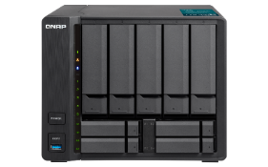
Hybrid Cloud Solution Embrace The Advantages of Both
Security​
Storage extension​
Access Speed​
Powerful computing​
Access anywhere
Taipei
Tokyo
New York
Hybrid cloud solution is one of the best choice of the enterprise!
Keep the old service investment and get the elasticity advantage!

Slide 5
The previous QNAP Hybrid Cloud
Solution is…
Mount the cloud storage through Connect to Cloud Drive.
You can not access data through SMB/ AFP!
Synchronize data through Hybrid Backup Sync.
You can access data through SMB/AFP,
but it takes same capacity as the cloud use in NAS!

Slide 6
Now QNAP gives you
A New Hybrid Cloud Solution:
CacheMount
Allocate a part of NAS storage to enjoy the hybrid cloud!
Enjoy QTS applications at the same time.
SMB/NFS/AFP

Slide 8
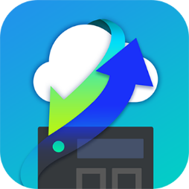
A New Hybrid Cloud Solution: CacheMount
CacheMount
Remote Mount
& Connect to Cloud Drive
NAS as the edge gateway device to the cloud
New service in QTS 4.4.1
After upgrading the firmware to QTS 4.4.1, CacheMount will replace Connect to Cloud Drive. Please install CacheMount in App Center.

Slide 9
CacheMount Cloud Gateway 5 features to increase cloud management
Support 2 types, 20 cloud providers.
Much more smoothly access cloud data.
Access through SMB/AFP. No need PC utility for cloud service anymore.
Share and manage files between multiple site office in time.
Horizontally integrate QTS applications to use the cloud data.

Slide 10
Support 2 types, 20 cloud providers.
Type I: File-base Storage
Type II: Object-base Storage
Storage data by the folder structure.
Pricing depending on the fixed capacity.
Storage unstructured data in the flat environment.
Pricing depending the actual storage usage.

Slide 11
File Cloud Gateway Help To Access Object Storage Service
CacheMount can transform the unstructured data into file structure for easy management of object cloud storage spaces
/a/b
/a
/a
/a/d
/a/c
Structure Transform
SMB/AFP
b
c
d
object cloud storage spaces
NAS
Devices

Slide 12
Why you should use object storage service?
Column
Data backup and disaster recovery
It enables you to store, back up, archive large amounts of data in the cloud and also help with disaster recovery.
Highly scalable and elastic
It can store enormous data and price by the actual storage usage.
Various computing service
Cloud vendors provide various computing such as big data analytics.

Slide 13
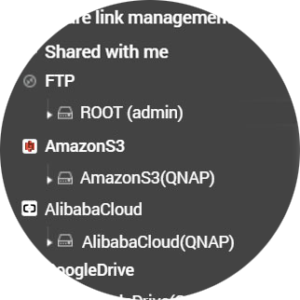
Smoother access to cloud data
Remote Mount-Basic Function
With CacheMount, you can…
Manage multiple cloud services in File Station.
Create a more compact hybrid cloud with smoother data access.
Access through SMB/AFP. No need PC utility for cloud service anymore.

Slide 14
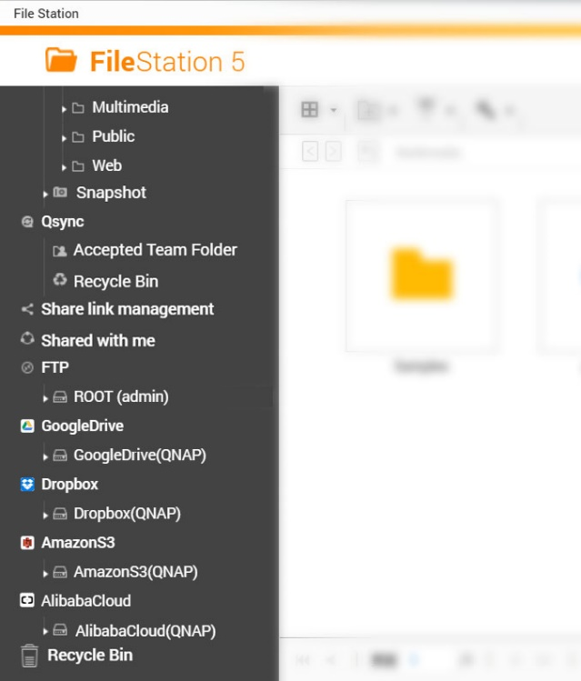
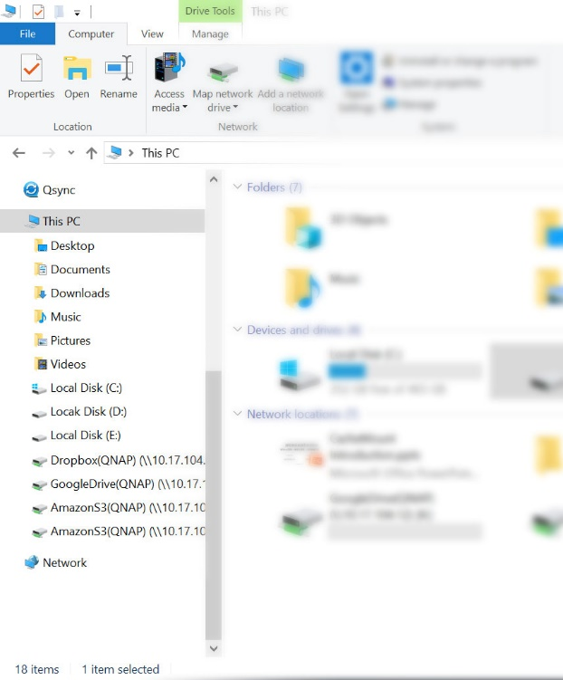
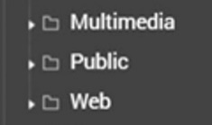
Access through SMB/AFP
File Station
PC
(mounting through Samba)
Local Storage
Remote NAS
Mount on PC by network protocol
Cloud Storage
Notes:
有了CacheMount，您將可以在QNAP NAS上，一個視窗一次管理您的所有空間，也可以透過遠端通訊協定將雲端空間掛載於PC，讓您更有效率的使用雲端檔案。

Slide 15
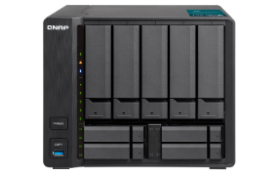
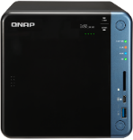
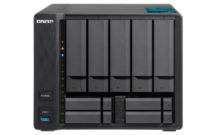
Share and manage files between multiple site office in time
Remote Mount-Basic Function
With CacheMount, you can…
No matter how large the file is, file transfer across NAS can be fast.
With using cloud service, files sharing and management between multiple site office can be on time.
CIFS/SMB,
FTP, WebDAV
Location A
Location B
Location C

Slide 16
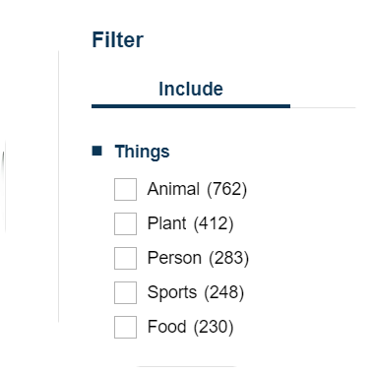
Horizontal integrate QTS applications to use the cloud data
Remote Mount-Basic Function
With CacheMount, you can…
File Station
The remote data can be managed only in File Station. Other application can not access data on the cloud.
Have a same multimedia experience of data in different cloud service.
Search enormous files on the cloud fast and easily .

Slide 17
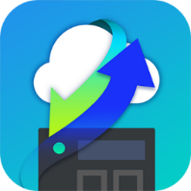
CacheMount Features Enable Cache To Have Batter Cloud Experience
Basic Functions
NEW!! Enable Cache
Remote Mount Remote Device: Through CIFS/SMB, FTP, WebDAV Cloud Service: 2 types, 20 cloud providers
Manage Remote Data Only be able to operate files in File Station
Manage Multiple Clouds
Access Files Smoothly Cache function let file access more smooth
Operate Cloud Data by PC PC can access cloud directly through SMB/AFP
Cloud data usage Enjoy various applications in QTS including file manager and multimedia services

Slide 18
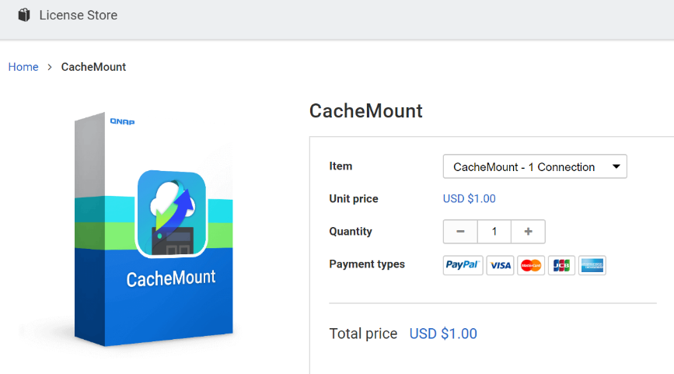
Purchase License for CacheMount Solution
Install CacheMount and Enjoy one free and perpetual license.
Bucket 2
Bucket 1
USD $19.9
Free Trial
US $19.9
Purchase
Free Trial
US $19.9
Purchase
USD $19.9
Item | Price
CacheMount – 1 connection /year | US $ 19.9
CacheMount – 4 connections /year | US $ 59.9
CacheMount – 8 connections /year | US $ 99.9
Taipei
New York
1 free trial. Purchase for more need.
To keep maintain and support every cloud services and provide you the best service.
We charge for more cache connection.
Notes:
CacheMount - 1 connection - 1 year
LIC-SW-CACHE-1CON-1YR-EI
USD $ 19.9 NTD $ 599
CacheMount - 4 connections - 1 year
LIC-SW-CACHE-4CON-1YR-EI
USD $ 59.9 NTD $1799
CacheMount - 8 connections - 1 year
LIC-SW-CACHE-8CON-1YR-EI
USD $ 99.9 NTD $ 2999

Slide 19
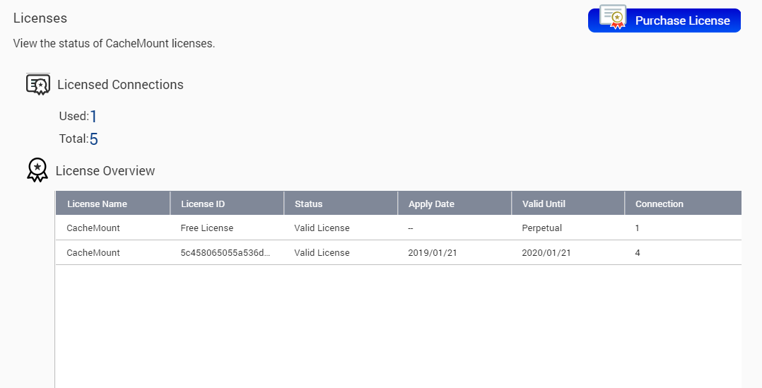
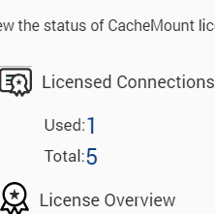
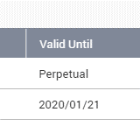
View License Status Anytime
View the usage of license
Note the valid time

Slide 21
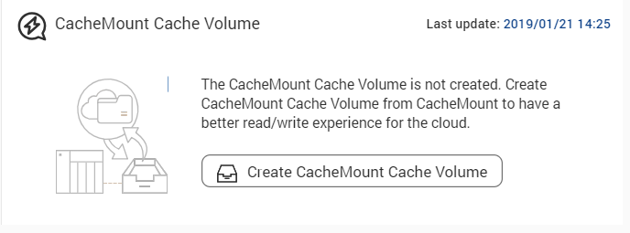
Create a Cache Volume To Smooth Access​​
Create a proper size of cache volume to help smoothly access unlimited cloud storage like local transferring.
First Step To Enable Cache:
Create a Cache Volume
Minimize space: 200GB

Slide 22
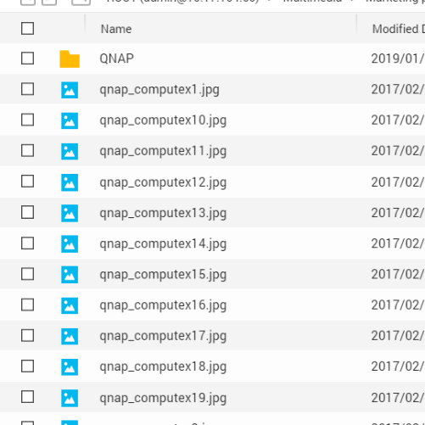
Sync Metadata To Read File List Fast
Mount and then use
With cache function, you can view all file list and operate files without download all cloud data to the local NAS.
NAS Cache Volume
File list synchronization
META
DATA
File-base storage service: synchronize anytime *HiDrive, Yandex and Sharefile will synchronize by schedule or manually.
Object-base storage service: synchronize by schedule or manually.
Create a file list by the metadata.
META
DATA
META
DATA
META
DATA
META
DATA
META
DATA

Slide 23
Accelerate When Reading Cached Files
1
When first reading, the file will be downloaded from the cloud to the local cache volume and kept.
NAS Cache Volume
1
Internet
2
When reading the cached files, it will read the files in local cache volume to avoid download again.
SLOW
2
LAN
META
DATA
META
DATA
META
DATA
META
DATA
FAST

Slide 24
Cache Uploading Files To Reduce Waiting Time
When uploading data to the cloud
NAS Cache Volume
Upload the files to NAS through LAN and then upload to the cloud in the background. It helps you reduce waiting uploading in front of your computer.
Internet
(In background)
SLOW
LAN
FAST
META
DATA
META
DATA
META
DATA

Slide 25
How Does The Cache Algorithm Work
When cache volume is full and there is more file space needed, the system will remove the least recently used file and only keep its metadata.
least recently used file will be removed
When downloading or uploading files
Cached data
Reading data
Writing data
File metadata
NAS cache volume

Slide 26
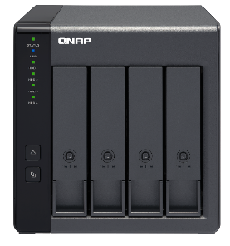
How To Configure The Cache Volume
TIP
1
Space
To meet upload / download request, you need to create at least 200GB cache volume.
Adjust space by your need. The larger space can store more cached data.
Expand your NAS storage by TR-004.
More Upload Request
More Download Request
A larger cache volume is needed to keep more uploading data.
Only need proper space. The space can be reused by removing the cached data.
Volume
Static Volume
Thick Volume
Create the file system directly on the disk to have better read / write performance (20% better than other volume type.
Create volume in the storage pool. The volume can be resize for elastic use.

Slide 27
Accelerate With Qtier And SSD Cache
TIP
2
SSD cost too much?
Use SSD and HDD with Qtier and SSD cache.
SSD Cache
Application Layer
Cache but not store data
Fixed bypass options
SSD
HDD
Sequential
Qtier 2.0
Random
Tier can store data.
IO Aware and Tiering On Demand
SSD Cache
Qtier 2.0

Slide 28
CacheMount As a Best Bridge To The Cloud
Cloud Service
CacheMount
Data Usage
User Interface
Object-base storage service
NAS Applications
File management, editing, multimedia services
Cache Volume
File System
File Transfer Agent
…
Sync Agent
Metadata
File-base storage service
Network Protocol Access
Samba, NFS, FPT, AFP, WebDAV
Authorization
Agent
Cached Data
Cache
Algorithm
…
Storage & Snapshot
User Interface

Slide 29
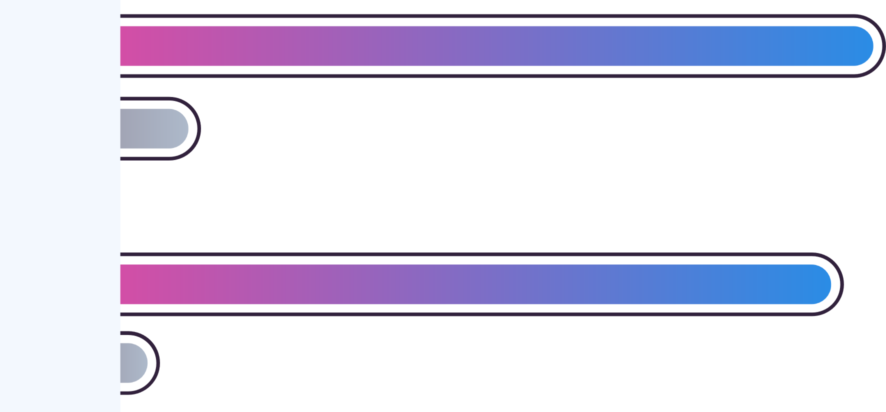
Test Result To The Cache Function
Speed of downloading a large file (511 MB)
Cached
32.38 MB/s
9.6 time faster
Not Cached
3.38 MB/s
More complicated process,
more significant effect!
Speed of download 500 small files (522 MB in total)
Cached
31.26 MB/s
34.7 time faster
Not Cached
0.90 MB/s
Test Condition:
NAS Model： TS-1685 (CPU: Intel(R) Xeon(R) CPU D-1521 @ 2.40GHz, RAM: 16GB)
200 GB Cache Volume: Thick volume in RAID 1 storage pool (HDD*2/SSD*1,enable Qtier)
Cloud Service：AWS S3
Test Method: Mount the same cloud bucket, and download the cached file and the file without cache separately.
* Test in QNAP LAB, the test result will differ based on the network speed and cloud services.

Slide 31
4 Ways To Enjoy Cache Experience
1
3 steps to create cache connections
2
4 tips to manage cache connections
3
Visible usage status of cache volume
4
User Whitelist for CacheMount

Slide 32
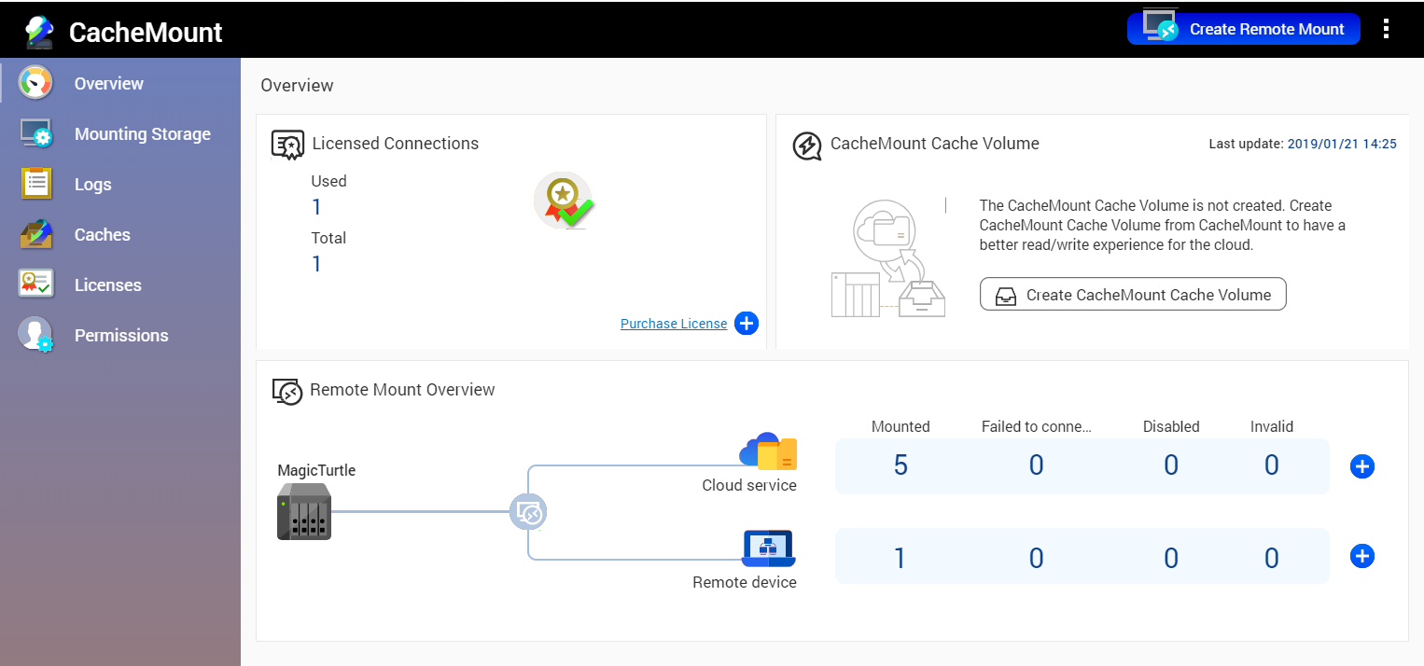
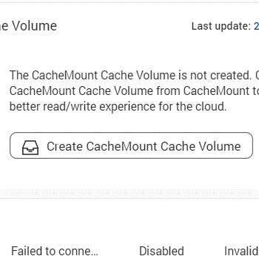
3 Steps To Create Cache Connections
1
Create cache volume

Slide 33
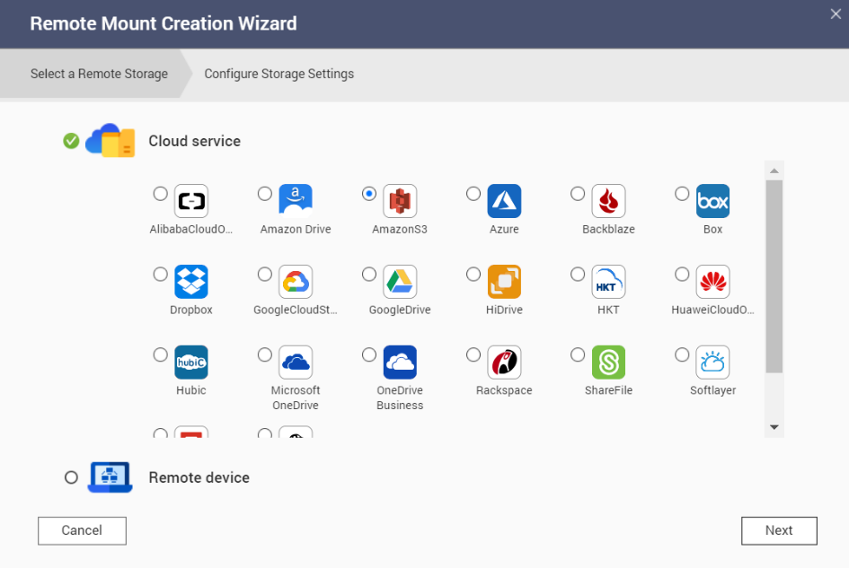
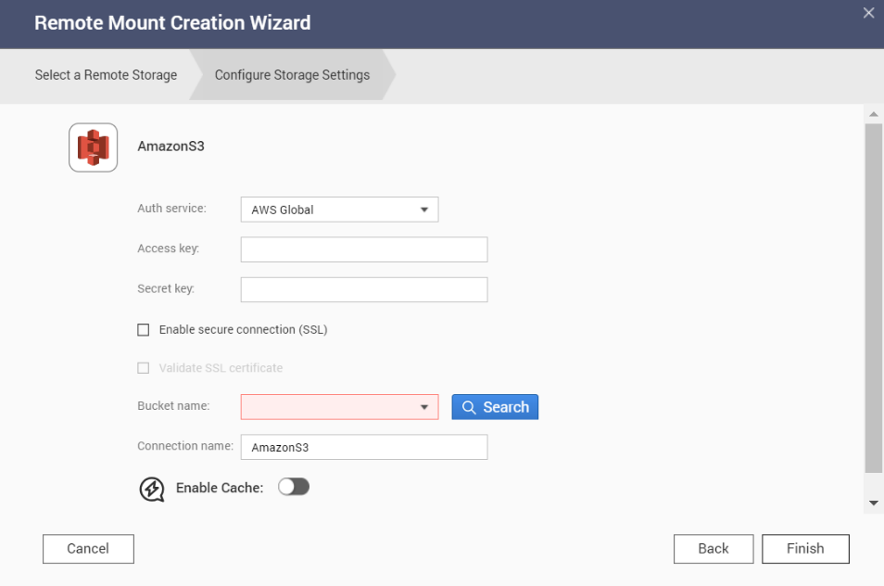
3 Steps To Create Cache Connections
2
Mount the cloud storage
Step1: Select a cloud provider (take AWS S3 as the example)
Step2: Make configuration
1. Enter account
information
2. Select a bucket

Slide 34
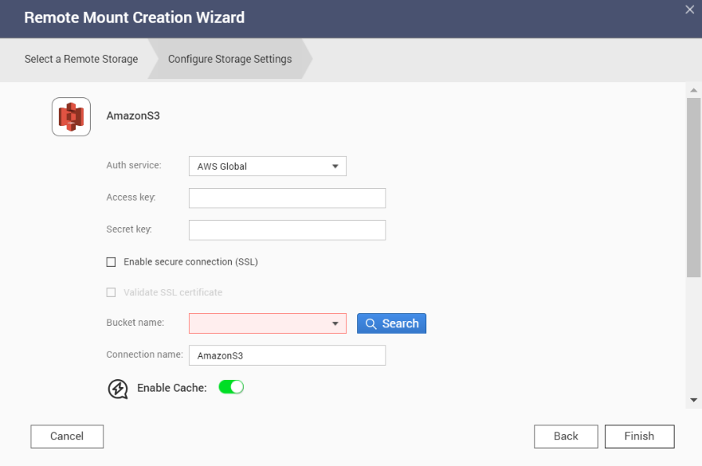
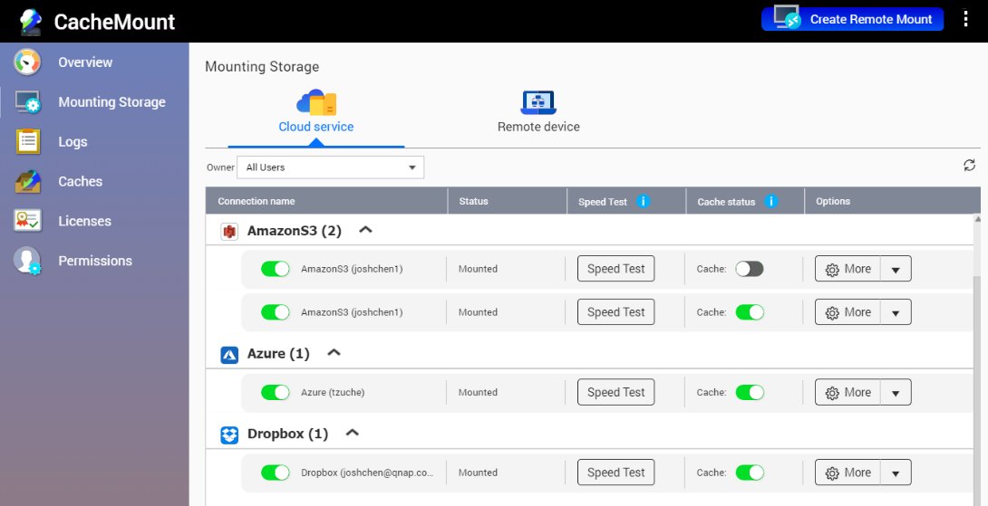
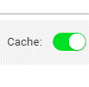
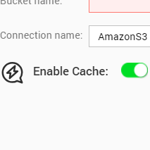
3 Steps To Create Cache Connections
3
Enable Cache
Method 1: In the step of creation wizard
Method 2: In Mounting Storage page

Slide 35
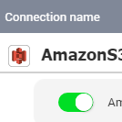
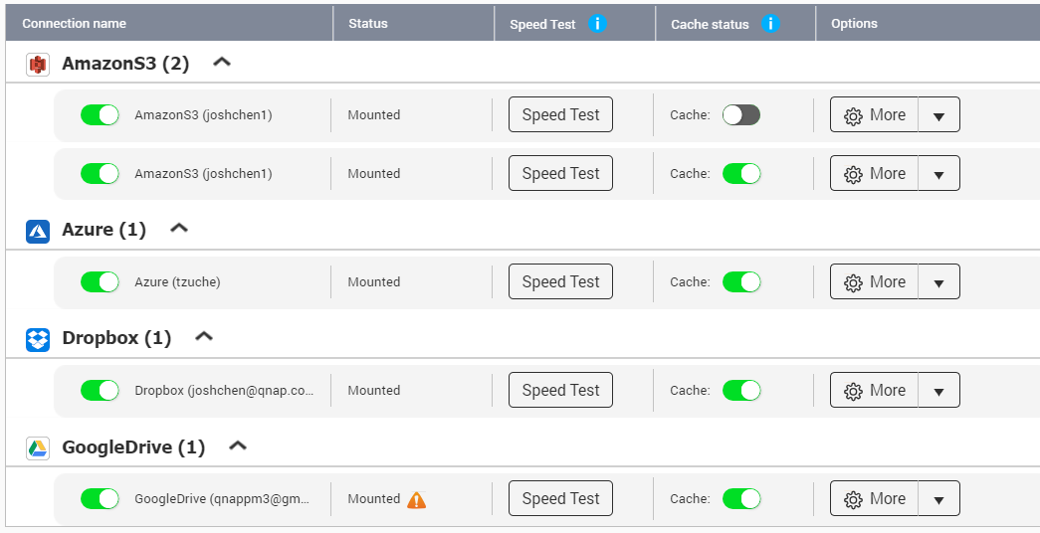
4 Tips To Manage Cache Connections
1
View all connections status
Classify by cloud providers
Cache Status
View Connection Status
Mounting: after creating, wait to be successfully mounted
Mounted: successfully mounted and ready to access
Failed to Connect:: failed to connect to the cloud temporarily
Disabled: disabled manually
Invalid: configuration invalid and need to remount

Slide 36
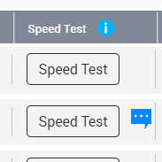
4 Tips To Manage Cache Connections
2
Speed test helps to select a bucket
Test the upload and download speed to the specific connection.
Take Amazon S3 as the example:
Bucket can be created in any region. Select a bucket with higher speed by testing the speed from your place.
Test Time: 2019/01/21 14:07:51
Upload: 13.54 MB / Download: 14.77 MB

Slide 37
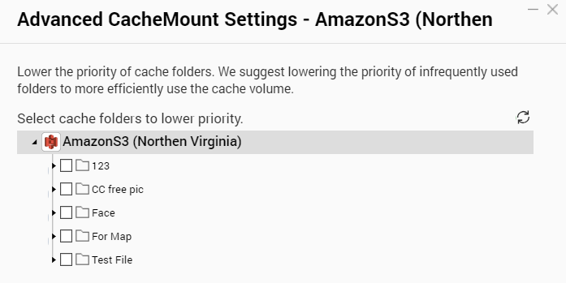
4 Tips To Manage Cache Connections
3
Customize cache folders to wisely use cache volume
We suggest lowering the priority of infrequently used folders to efficiently use the cache volume.

Slide 38
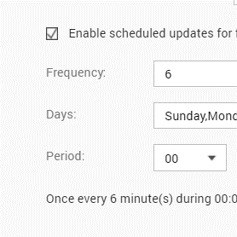
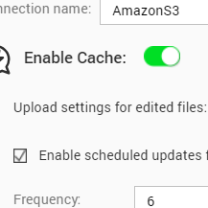
4 Tips To Manage Cache Connections
4
Manage cost of object storage service
Scheduled updates for file list
Enable scheduled updates for file metadata to control the cost form cloud request.
We suggest you only update in the time period you access frequently.
Upload settings for edited files
Select whether system checks the file version on the cloud or not when the file is edited in local to prevent accidental overwriting of files. Also help to control the cost form cloud request.
We suggest you not to check the cloud if you only access the cloud with one CacheMount connection.

Slide 39
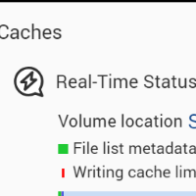
Visible Usage Status of Cache Volume
Use the usage status to help adjustment
Real-time Status
Ratio of local writing cache storage
The ratio is set to maintain a fixed storage ratio to avoid the sudden huge writing data ruling out the cache data.
➔ We suggest you to adjust by the experience.
History Record

Slide 40
How To Manage The Cache Volume?
QUICK
TIP
Frequently insufficient space may reduce cache efficiency
Insufficient writing cache with sufficient free cache space. ➔ cannot upload files
Situation 1
Suggest to higher the local writing cache ratio.
Insufficient writing cache free cache space. ➔ cannot upload and download files
Situation 2
File list metadata
Suggest to expanse cache volume.
Writing Cache
Insufficient reading cache space. ➔ cannot upload and download files
Reading Cache
Writing cache limit
Situation 3
Free cache space
Suggest to expanse cache volume.

Slide 41
User Whitelist for CacheMount

Slide 42
Demo Environment:
NAS Model: TBS-453DX
RAM: 8GB
Storage Pool: 256GB M.2 SSD *4, RAID 5
CacheMount Cache Volume：200GB Thick Volume
Location: QNAP Headquarter in Taipei, Taiwan

Slide 43
A New Hybrid Cloud Solution: CachMount
Support 20 Cloud Services
4 New experiences
File-base Storage
Cache Function:
More smoothly access
PC can access cloud storage through SMB/AFP
Object-base Storage
Share files between multiple site office on time
CacheMount
Horizontal integrate QTS APPs to use cloud data

Slide 44
Copyright © 2019 QNAP Systems, Inc. All rights reserved. QNAP® and other names of QNAP Productsareproprietarymarks or registered trademarks of QNAP Systems, Inc. Other products and company names mentioned herein are trademarks of their respective holders.

