Slide 2
QNAP x Xeams Perfect Combination
Solve more problems when setting up a mail server by yourself
Use Xeams to create a mail server
Easily set up Xeams on QNAP NAS
Upgraded version of enterprise features
Utilize QNAP NAS features to enhance your Xeams mail server

Slide 3
Solve more problems when setting up a mail server by yourself

Slide 4
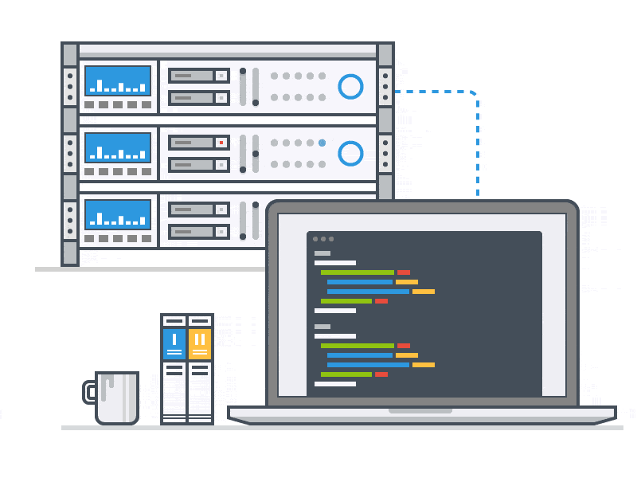
When setting up a company mail server...
No need to purchase additional equipment.
Simple set up without complicated instructions.
Follow-up mail server maintenance.
Hackers invade through server
Mail with virus
AD and spam
Maintain the host not to drop mail or not to stop

Slide 5
Use Xeams to create a mail server
Over 1 million users worldwide have selected Xeams to help them manage their mail server. What are you waiting for ?

Slide 6
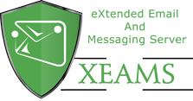
Xeams Features
Xeams uses many technologies that are considered best practices in the industry such as STARTTLS, SPF, DKIM, DMARC and others.
Simple to use
3 modes of operation
Blocks 99% of junk messages
Live monitoring
Integration with Active Directory or LDAP

Slide 7
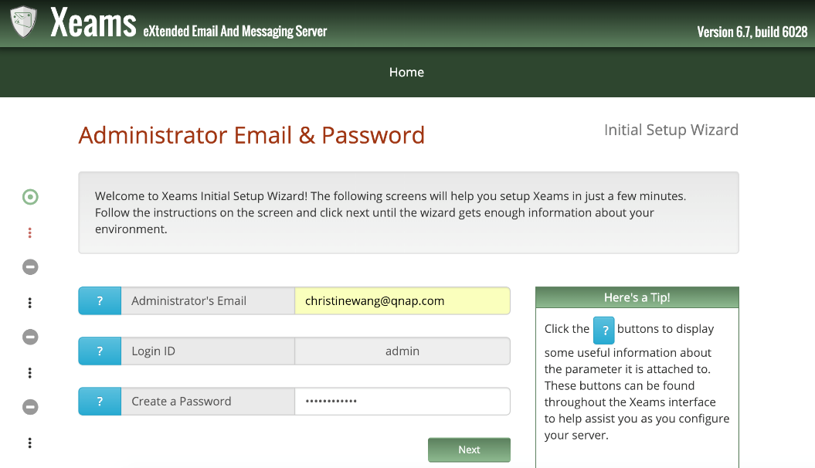
Simple to use
Interactive interface, you can create a mail server without coding!

Slide 8
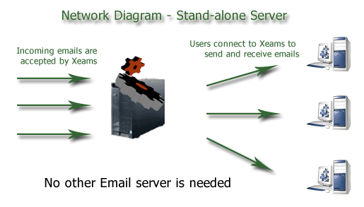
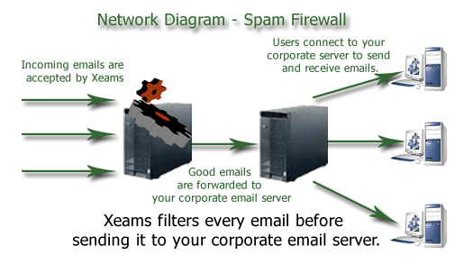
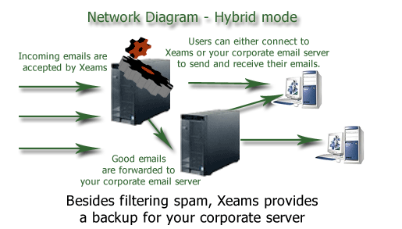
3 modes of operation
Stand Alone Mode
Spam Firewall
Hybrid Mode
Xeams runs as a full email server in this mode, supporting SMTP, IMAP and POP3 protocols.
In this mode Xeams acts like a firewall that sits in front of your corporate email server. Every in-bound email is checked by Xeams before it is forwarding the message to the actual email server. Similarly, every outbound message is checked before delivering it to its final destination.
This is a combination of mode 1 and 2. User's inboxes are created on two locations: Xeams and your corporate email server.

Slide 9
Blocks 99% of junk messages
Xeams provides an excellent junk mail filtering solution：
1. User defined rules.
2. Self-learning rules.
Internet
All incoming
emails
Spam Filters
Good Email
Your Mail Server
*Email filtering is available in the Community Edition only if both of the following conditions are met:
1. You have up to 5 users
2. You are using Xeams in your home and is NOT being used for your business

Slide 10
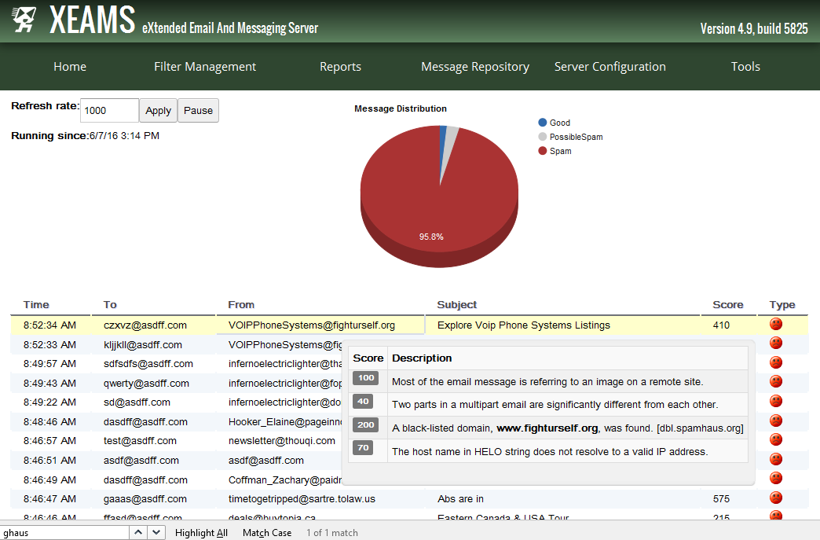
Live Monitor
Administrators watch emails as they arrive in the system. It provides a very efficient and easy method of troubleshooting incoming as well as outgoing emails in Xeams.

Slide 11
Integration with Active Directory or LDAP
Integrating Active Directory or any LDAP server has several benefits:
Reject invalid users when accepting inbound emails
To confirm if an incoming email belongs to a valid user
A new user needs to be created
To authenticate existing users

Slide 12
How to set up Xeams on QNAP NAS?
5 Simple Steps

Slide 13
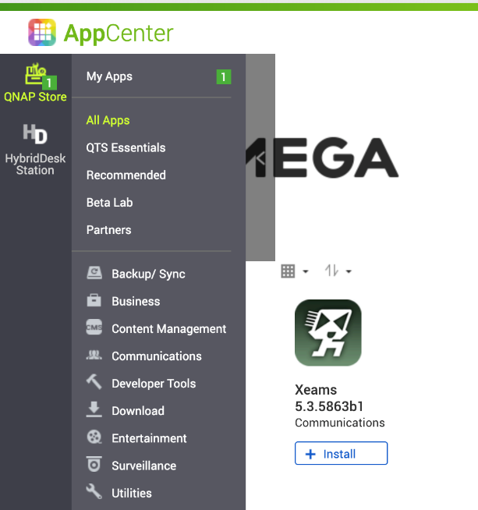
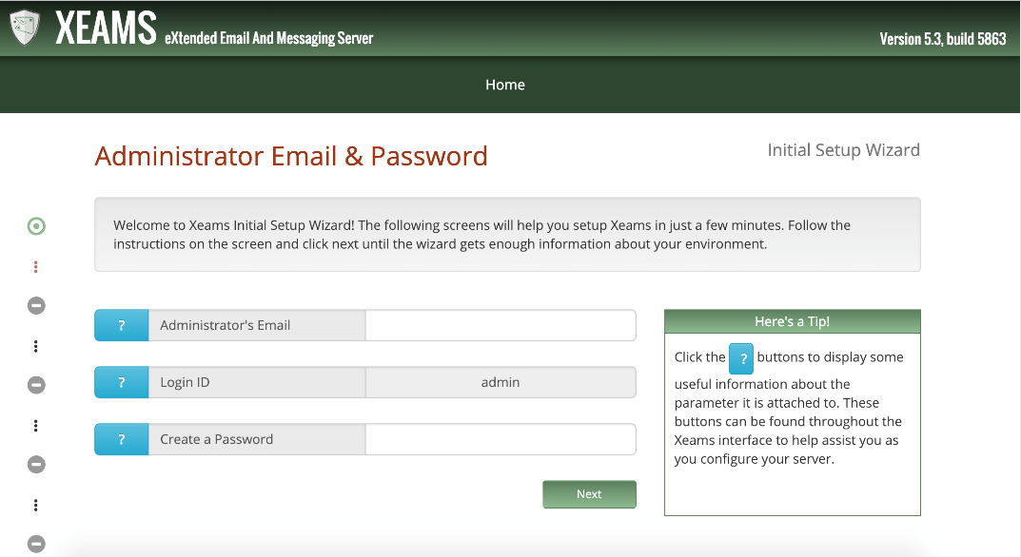
5 Steps to set up Xeams on NAS
Step
1
Install Xeams and open the App page.

Slide 14
5 Steps to set up Xeams on NAS
Step
2
Enter ”Administrator’s Email” and ”Admin” Password.

Slide 15
5 Steps to set up Xeams on NAS
Step
3
Xeams has 3 models of operation. Set up a new mail server please select “Stand-alone server”.

Slide 16
5 Steps to set up Xeams on NAS
Step
4
Enter an applied Domain Name.

Slide 17
5 Steps to set up Xeams on NAS
Step
5
When setting completed. Please check server information.

Slide 18
QNAP NAS + Xeams Demo

Slide 19
Upgraded version of enterprise features

Slide 20
For enterprise users, Xeams provides more
Available if you have purchased a license.
End-to-end emails encryption
Clustering
(5 free users for home/hobbiest)
Email Campaigns & Mail Merge

Slide 21
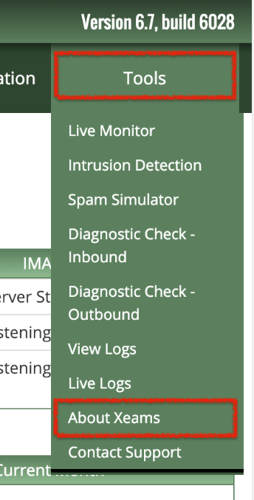
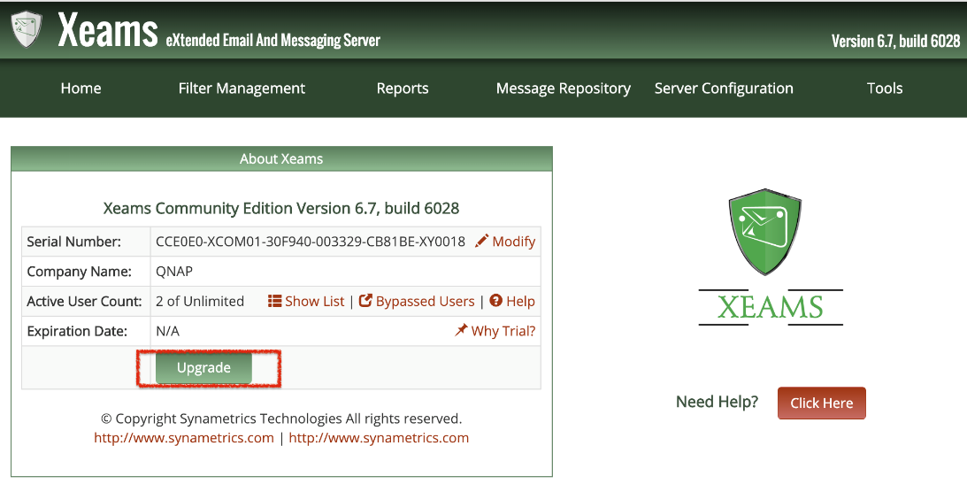
How do I purchase Licenses?
Step
1
Go to the About Xeams under Tools and click the Upgrade button.
1
3
2

Slide 22
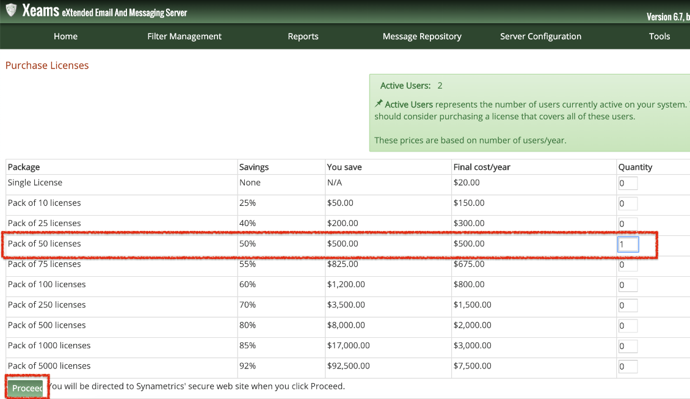
How do I purchase Licenses?
Step
2
Choose an option of licenses.
1. Enter quantity
2. Click Proceed

Slide 23
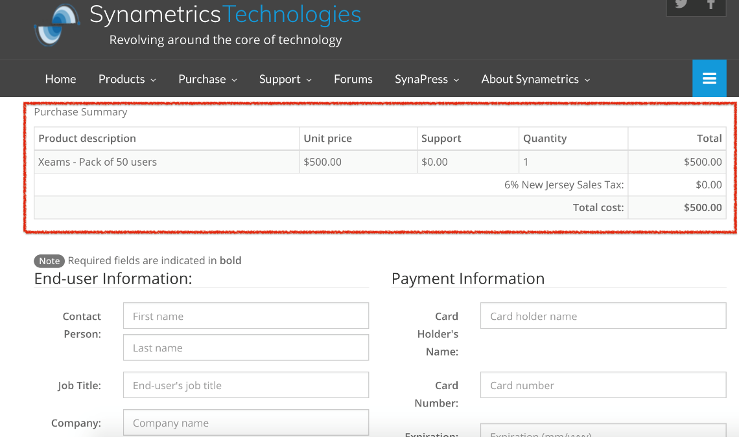
How do I purchase Licenses?
Step
3
Confirm the purchase and enter the payment information to complete the purchase.

Slide 24
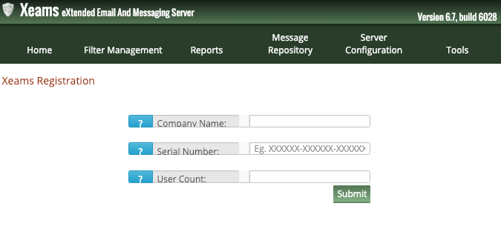
How do I enable licenses？
Go to the About Xeams under Tools and click the Modify link to enter these values.
1
3
2
4

Slide 25
End-to-End Email Encryption
Privacy：No one but the intended recipient should be able to open the emails. Not even administrators or a junk filtering email system.
*Available if you have purchased a license for 50 users or more. ​
Xeams
Intermediate
Recipient’s SMTP
Sender Client
Email gets encrypted into a PDF file
Emails stay encrypted all the way to the user
Recipient Client

Slide 26
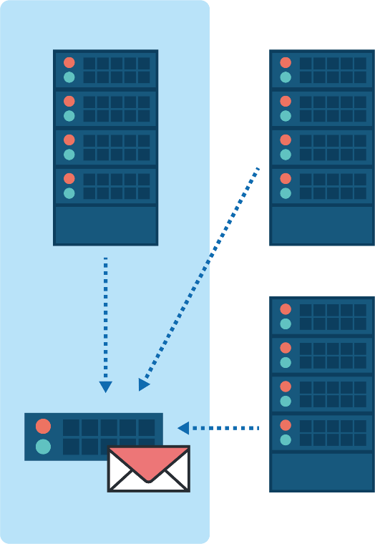
Clustering
Priority 10 MX MASTER
Priority 20 MX SLAVE
Consider a scenario where you have more than one Xeams installed to filter junk emails. Xeams server cluster can be used to spread server loading.
You have 3 MX records to process incoming emails.
You are running Xeams on all 3 servers, that filter junk emails.
The highest priority MX refers to a Xeams instance that is on the same network as your actual email's server.
Xeams running on secondary MX are somewhere on the Internet.
LAN
Your actual email server
Priority 20 MX SLAVE
*You must use version 5.3 or newer

Slide 27
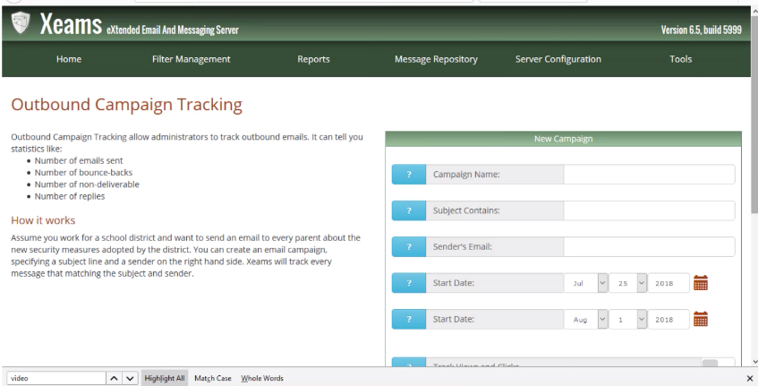
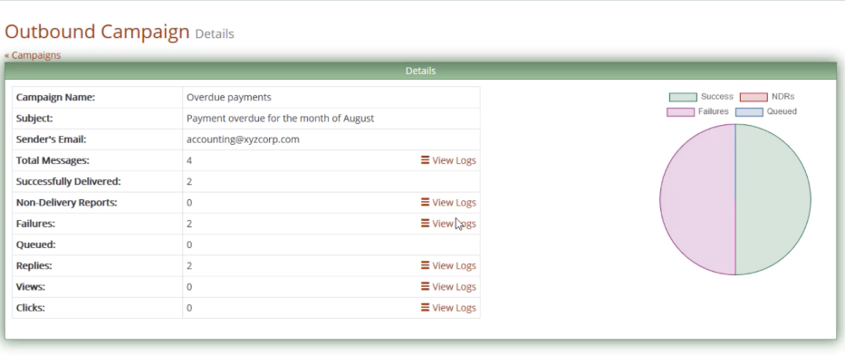
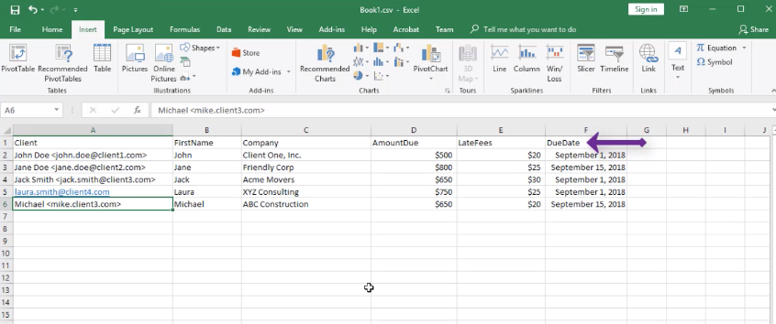
Email Campaigns & Mail Merge
If you send a lot of customized emails and would like to track how many clients viewed the emails, replied to your original emails or resulted in a non-deliverable because their emails address was incorrect mail merge is the perfect features.
*Available if you have purchased a license for 50 users or more.

Slide 28
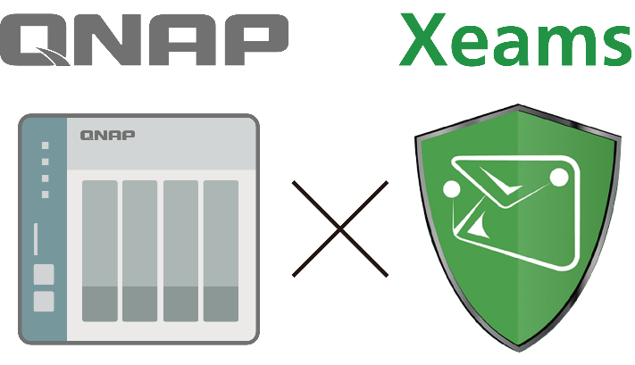
QNAP NAS features to enhance your Xeams mail server
Use NAS file management to create email retention policy.
QNAP QmailAgent improve email management efficiency.
From setup to remote backup, QNAP NAS has it all.
Full email archiving and instant access anytime.

Slide 29
Use NAS file management to create email retention policy
Mail Server
Instant indexing
Sync
Back up
Disaster recovery to server
Email files folder
Remote backup

Slide 30
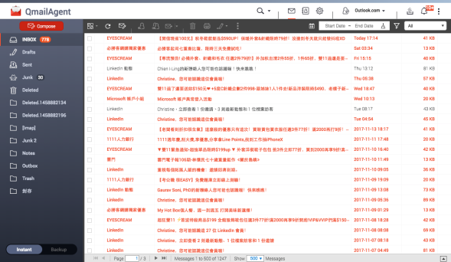
QNAP QmailAgent improve email management efficiency
With QmailAgent send and receive emails
3 Steps to set up Xeams+QmailAgent
Import
Mail Server
QmailAgent

Slide 31
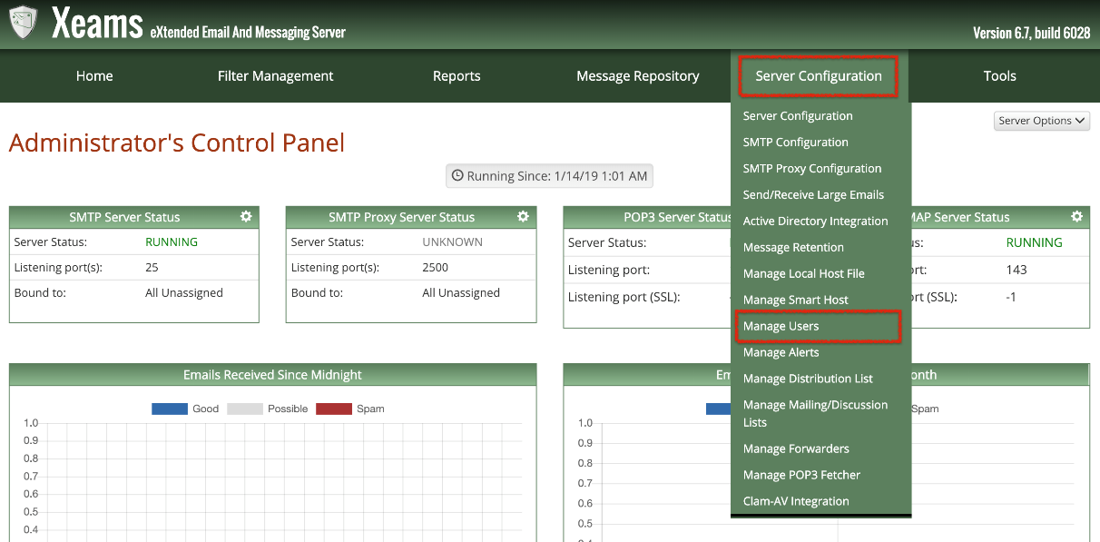
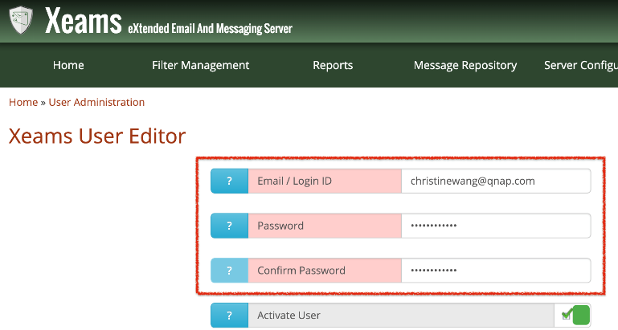
QNAP QmailAgent improve email management efficiency
Step
1
Create a user's email account in Xeams.
1
3. Enter Account Information
2

Slide 32
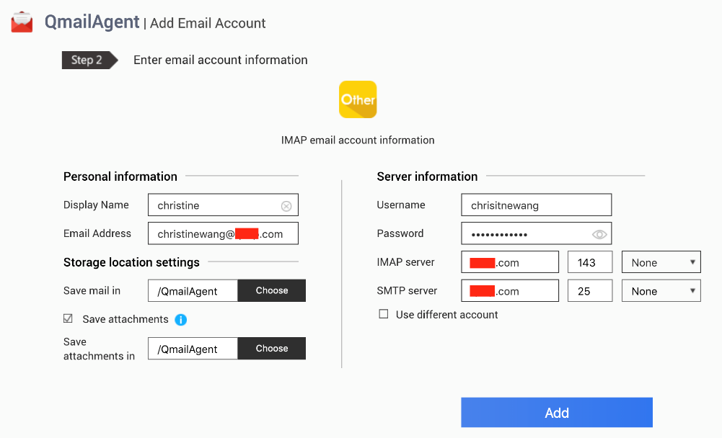
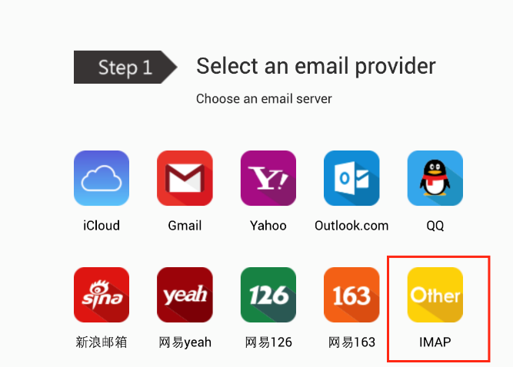
QNAP QmailAgent improve email management efficiency
Step
2+3
Open QmailAgent Click IMAP account.
Enter IMAP account information and Add.

Slide 33
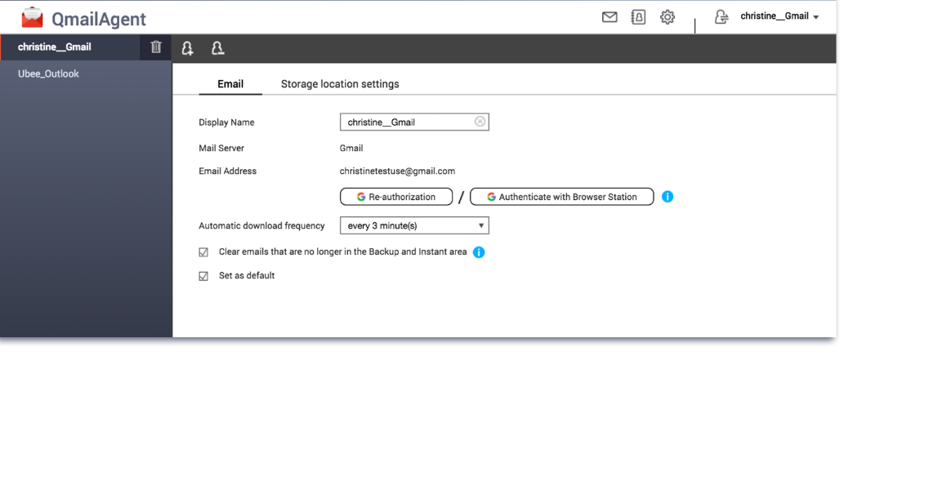
From setup to remote backup, QNAP NAS has it all
Automatically back up all email with flexible configuration of automatic download intervals.
Create a Complete Backup Plan with Hybrid Backup Sync.
Cloud
Remote
Local
Hybrid Backup Sync

Slide 34
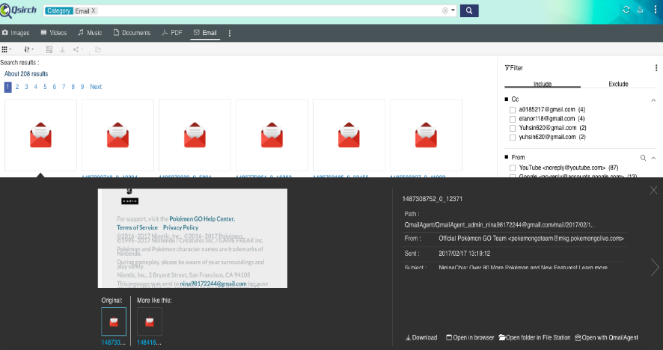
Full email archiving and instant access at anytime
Full-text searching for email contents
With Qsirch
Find emails quickly
Custom filters
Install Qsirch
Indexing, search emails
Preview, reply and forward
Preview
Reply and forward emails directly

Slide 35
Demo

Slide 36
There are so many ways to set up a mail server. Which one to choose?

Slide 37
Comparison of solution of Mail Server
 | Set up by yourself | QNAP NAS x Xeams | 100% Outsourced
Cost | Hardware costs | Hardware costs (NAS) | Charge by traffic and space requirements
Software/hardware expansion | Supported | Supported | Not support
Controllability | Full control | Full control | Low (Unexpected ad appears on page)
Security | High | High | Low (Third party)
File management software | Not support | Supported (Qmail / Qsirch / HBS) | Not support
Maintain cost | High （need a technical person） | Low | Low

Slide 38
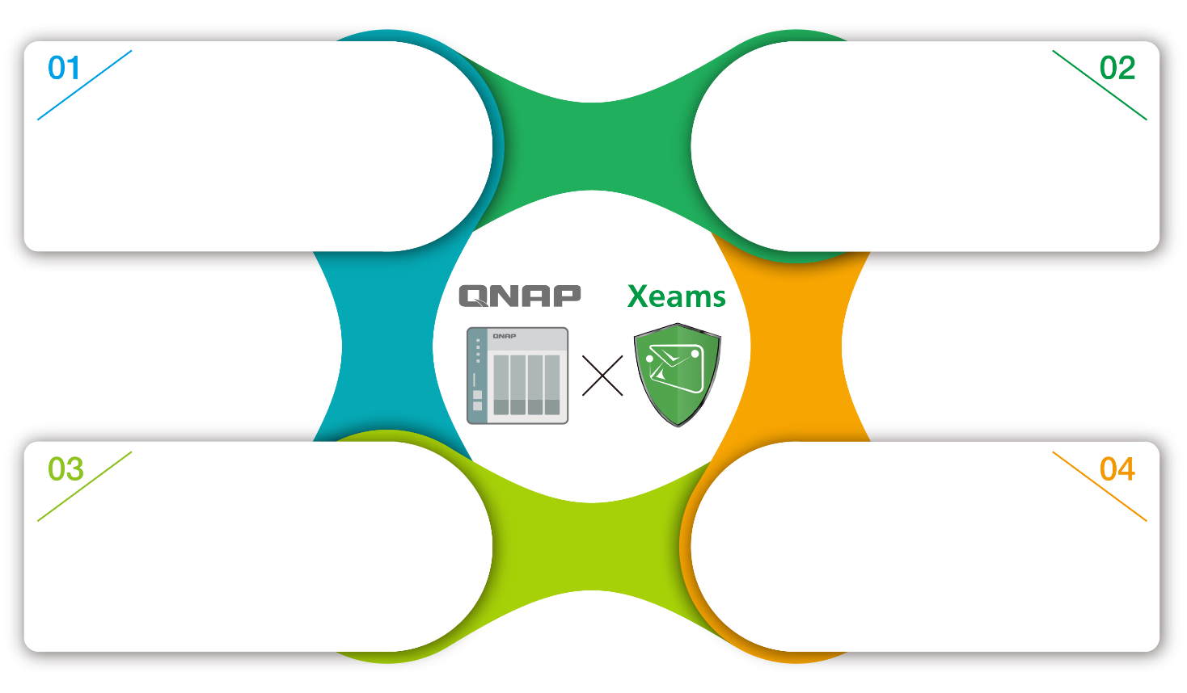
4 benefits of using QNAP NAS with Xeams
Easy and simple to install mail server. The management cost is greatly reduced.
High privacy and security.
Email retention to the remote backup server through Hybrid Backup Sync.
Flexible to expand software and hardware anytime.

Slide 39
Copyright © 2019 QNAP Systems, Inc. All rights reserved. QNAP® and other names of QNAP Products are proprietary marks or registered trademarks of QNAP Systems, Inc. Other products and company names mentioned herein are trademarks of their respective holders.

