Slide 2
超越 10GbE：QNAP 25GbE 網卡
Mellanox SN2010 簡易部署25GbE/100GbE 網管型交換器
QNAP NAS 搭配高速網卡與 25GbE 交換器

Slide 3
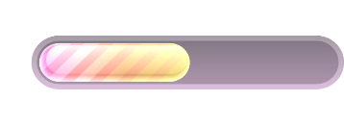


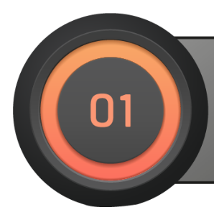

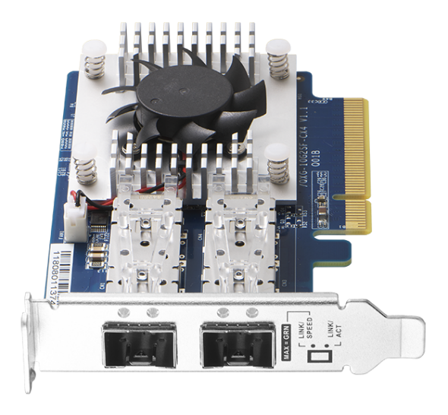
超越 10GbE：
QNAP 25GbE 網卡

Slide 4
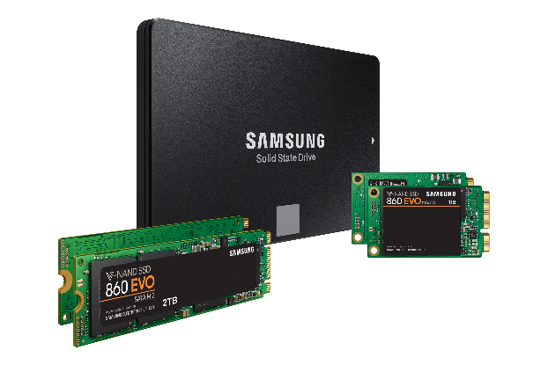
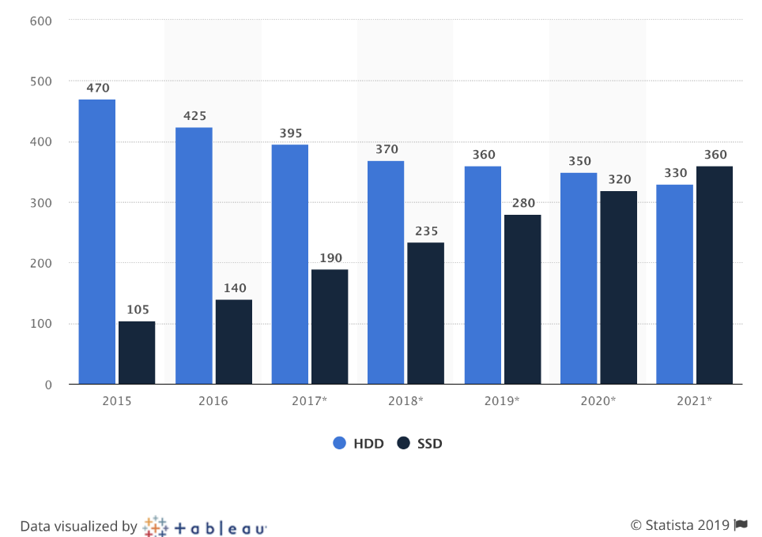

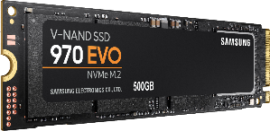
SSD 市場與效能大躍進
Shipments of hard disk and solid state (HDD/SSD) drives worldwide from 2015 to 2021 (in millions)
SAMSUNG 860 EVO
讀取速度550MB/s，寫入速度520MB/s
SAMSUNG 970 EVO
讀取速度3,500MB/s，寫入速度2,300MB/s
https://www.statista.com/statistics/285474/hdds-and-ssds-in-pcs-global-shipments-2012-2017/
Notes:
https://www.google.com/search?q=860+EVO&rlz=1C5CHFA_enTW756TW756&source=lnms&tbm=isch&sa=X&ved=0ahUKEwiqxICksOzfAhWMw7wKHSeOA28Q_AUIDigB&biw=1440&bih=638#imgrc=jaMWZRESGrmRbM:

Slide 5
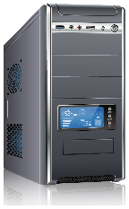
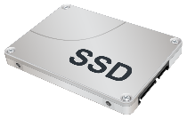
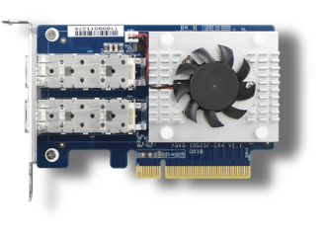





多使用者在 10GbE 高速傳輸的瓶頸
10GbE 傳輸
(1) NVMe SSD 或 (2) 企業級 SATA SSD (SLC/MLC)
10GbE 網卡
瓶頸
10GbE 傳輸
10GbE 傳輸
SSD 快取
Qtier
PC/workstation
Notes:
標題: 當大家都步入10G高速傳輸的世界時, 瓶頸反而卡在NAS端的網路.
發揮高速傳輸的必要條件: 高速的SSD / 高速的網卡

Slide 6

超越 10GbE 以後？
25GbE 以上高速傳輸市場佔有率預計由 22% (2017) 成長兩倍至55% (2018 後)
因應未來雲端應用、大數據、高速儲存、虛擬運用與人工智慧
High Speed Adapters 2017
25G+ Segment Growing at 38% CAGR
2%
2%
2%
11%
22%
21%
55%
7%
Of total
Market
Of total
Market
15%
45%
78%
2%
15%
來源：Mellanox
Notes:
83xu round2 P.47

Slide 7
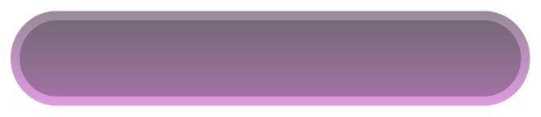
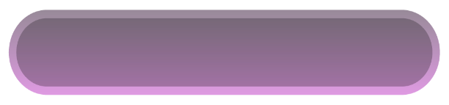
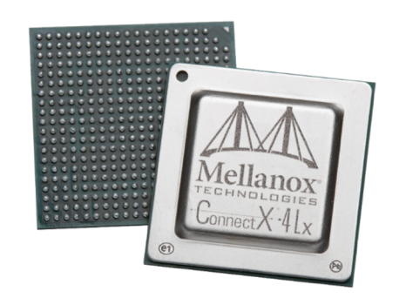

QNAP 10GbE/25GbE 高速網卡
QXG-10G2SF-CX4
雙埠 10GbE SFP+ 半高網卡
QXG-25G2SF-CX4
雙埠 25GbE SFP28 半高網卡
Mellanox
ConnectX®-4 Lx 網路晶片
2 x SFP+ 接口
支援 10GbE 傳輸速度
2 x SFP28 接口
支援 25GbE / 10GbE 雙速
支援 iSER / RoCE 卸載能力
106.83 mm
68.9 mm

Slide 8
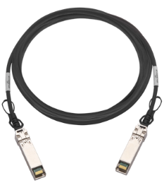
硬體詳解
雙埠 25GbE / 10GbE 傳輸接口
晶片散熱模組與風扇
25GbE SFP28 網路線
10GbE SFP+ 網路線
預裝半高 Low profile 支架
附贈全高 Full height 及QNAP 專用平板支架
PCIe Gen3 x8 傳輸介面
提供最高 64Gbit/s 頻寬

Slide 9








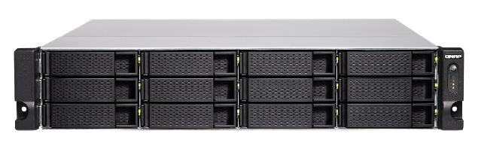

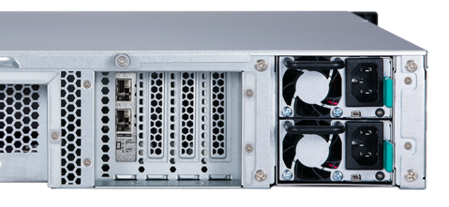
搭配 QNAP 高階機種感受高速傳輸
TS-x83XU
TS-x77XU
TVS-x72XU
1U: Gen3 x16 (CPU)
2U & 3U : Slot 2 with Gen3 x8 (CPU)
4U: slot 4 with Gen3 x8 (CPU)
1U: Gen3 x16 (CPU)
2U & 3U : Slot 2 and 4 with Gen3 x8 (CPU)
4U: slot 2 and 3 with Gen3 x8 (CPU)
1U: Gen3 x16 (CPU)
2U & 3U : Slot 2 with Gen3 x8 (CPU)
4U: slot 4 with Gen3 x8 (CPU)
PCIe x8
(CPU)
PCIe x4
PCIe x4
PCIe x4
TS-1283XU
#4
#3
#2
#1
*TS-x77XU 若相鄰插槽有插卡則頻寬降為 Gen3 x4
Notes:
x72XU可能根本跑不上25G

Slide 10
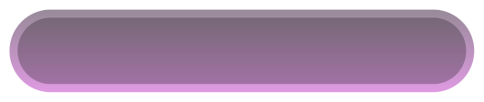
支援機種
QXG-10G2SF-CX4
QXG-25G2SF-CX4
QNAP x86 機種含至少 PCIe Gen2 x2 以上插槽
(建議使用配備 Gen3 x4 以上機種)
QNAP x86 機種含至少 PCIe Gen3 x4 以上插槽
(建議使用配備 Gen3 x8 以上機種)
TS-x73
TVS-x73e
TS-x83XU
TVS-x72XU
TS-x77XU
TVS-x82
TS-x77
支援作業系統
QTS 4.3.6 以後版本
Window/Linux: 須下載驅動程式
*更多支援機種請以相容性列表為準

Slide 11

iSER 讓你的 NAS 更輕鬆
25GbE 搭配 iSER
直播即將登場!
iSER 協定 (iSCSI Extensions for RDMA) 與傳統的 iSCSI 協定不同，允許傳輸的資料繞過網路驅動程式和傳輸層，直接進入伺服器或 NAS 的記憶體緩衝區。
增加傳輸效能，降低 NAS 與伺服器的 CPU 負載。
Without iSER
With iSER
Notes:
2月份有有這個25G + iSER的live broadcast

Slide 12


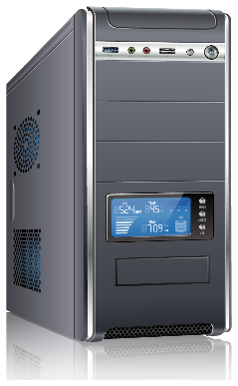
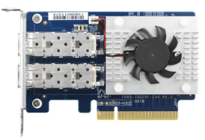
25GbE 效能實演 - AJA
TS-x83XU
PC:
Intel® CoreTM i7-6700 3.40GHz.
Windows 10, 64GB RAM, QXG-25G2SF-CX4 on board,
Samsung SSD 960 PRO 1TB NVMe
NAS:
1283XU. Intel® Xeon® E-2124 CPU @ 3.30GHz.
QTS 4.3.6.0805, 4GB RAM, QXG-25G2SF-CX4 on board,
Samsung SSD850 Pro 512GB*12 (RAID 0)
Notes:
CPU bound

Slide 13

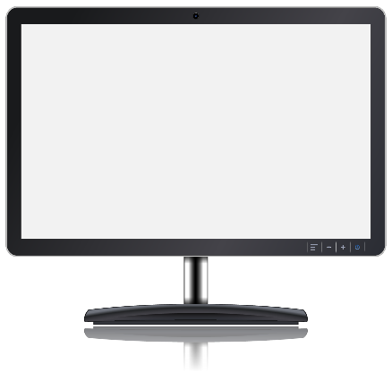

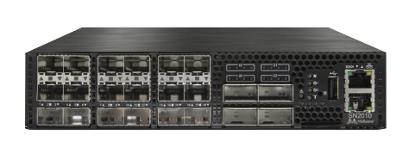


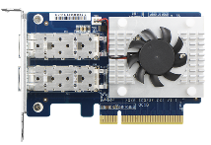
發揮 25GbE 高速傳輸 - 檔案拖放
Speed : 962 MB/s
Speed : 0.98 GB/s
Speed : 940 MB/s
建議 PC/workstation 規格
Intel x86 i5/i7 以上
基礎頻率 3.3 GHz以上
PCIe NVMe SSD
2.9GB/s
建議 Server 規格
QNAP Intel x72 以上 / AMD x77 以上
12 x 企業級 SATA SSD，RAID5 或 RAID10
Notes:
提一下從進入10G高速傳輸後, 往往最常客訴反映效能上不去的情況被我們分析後, 結果是客戶用1~2顆HDD

Slide 14
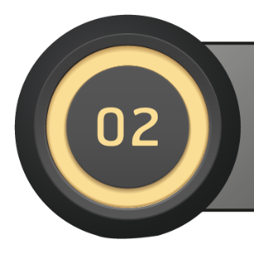
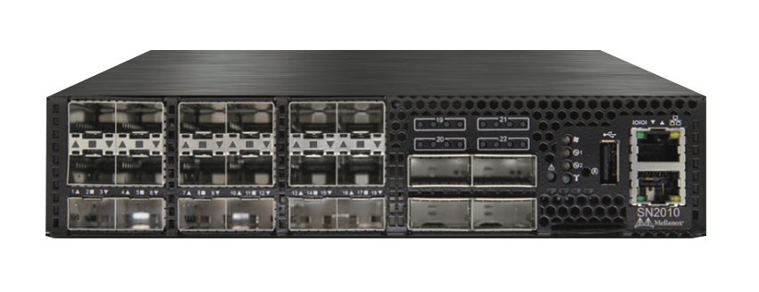
Mellanox SN2010
簡易部署 25GbE/100GbE
網管型交換器

Slide 15
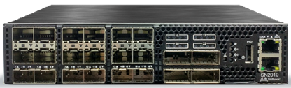



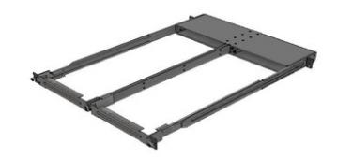
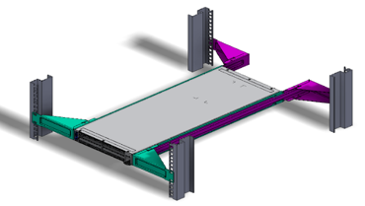
Spectrum the Best ESF Switch – SN2010
Ethernet Storage Fabric needs dedicated ESF switches
Management Ports
Physical
  18 x SFP+/SFP28 ports
  4 x QSFP/QSFP28 ports
  ½ 19’’ width, 1RU height
  57W typical power consumption (ATIS)
  Weight: 4.5Kg
  Power supply redundancy
  Management port
  Rail kit for 2 x SN2010 in 1RU, 19’’
  x86 Quad core Atom CPU
  8GB RAM, 16GB SSD
Performance
  2.52Bpps -> Zero Packet Loss
  300ns latency
Network OS
  Mellanox Onyx
  Cumulus Linux
  ONIE Version for coming Oss
18 *10/25GbE
SFP+/SFP28Ports
4*40/100GbE
QSFP+/QSFP28 Ports
Port LED indications
½ 19” width
½ 19” width

Slide 16
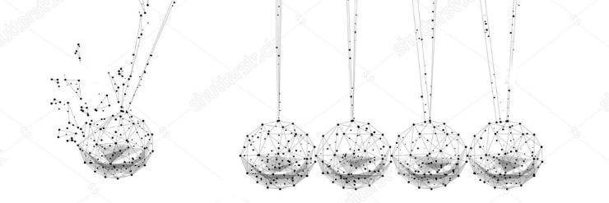
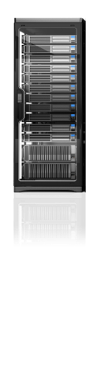
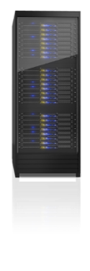

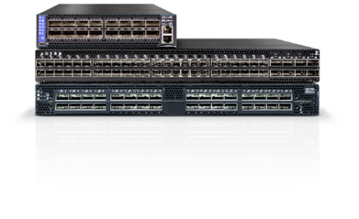




Leading Supplier of End-to-End Interconnect Solutions
Switch /
Gateway
Virtual Protocol
Interconnect
Virtual Protocol
Interconnect
56/100/200G InfiniBand
56/100/200G InfiniBand
Storage
Front /
Back-End
Server /
Compute
10/25/40/50/
100/200/400GbE
10/25/40/50/
100/200/400GbE
Notes:
16
16

Slide 17

Today’s Storage Landscape
PRIMARY STORAGE
STORAGE
Traditional SAN
20% of capacity
ICEBERG
File Shares
Archiving
Test/Dev
Backups
Analytics
Cloud
SECONDARY
STORAGE
80% of capacity
Rapid growth
Diverse data types
Scale-out, Ethernet-based
Tiered storage

Slide 18
The Storage World is Changing
Changes
Flash, Faster servers
Social/Mobile/Video
Hyperconverged
Cloud
Big Data
Distributed applications
Effects
Faster networking; 10/25/40/50/100GbE
Huge data growth; more file and object content
Distributed “Server-SAN” on Ethernet
Virtualization, software-defined, price pressure
File and distributed storage
More east-west traffic
Bottom Line: More Ethernet Storage Traffic

Slide 19

ESF Re-defining the Modern Data Centers
Predictable Performance, Deterministic & Secure Fabrics
cost
Servers
Risk
Complexity
Fabrics
Storage
Block, file, and object storage
Faster, more predictable performance
Simplified security and management
High bandwidth, low latency, zero packet loss
Higher processing capability
High-density virtualization
Move to All-flash
Faster protocols – NVMe-oF
Data Center modernization requires a faster, lossless Ethernet Storage Fabric

Slide 20
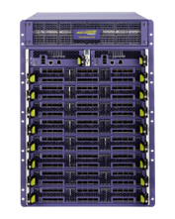
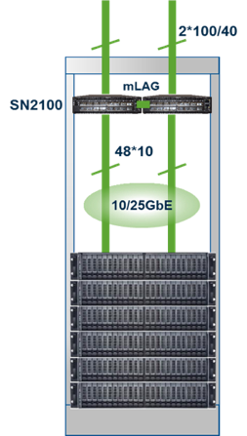

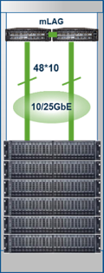

From Chassis to Leaf/Spine
Same Cable/Optic/Port Count
Superior Price & Performance
Full Rack
Multiple Racks
SN2700
SN2700
2*100
100GbE
100GbE
SN2100
ToR Switches
10/25GbE
Server Nodes
1 rack = 24 nodes
Leaf /Spine
Scale Out Network
Scale Up Network

Slide 21








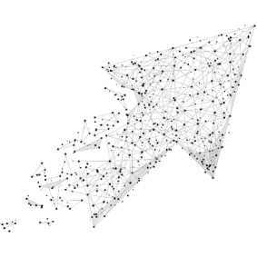




Why Cloud Data centers move to 25GbE?
Storage Nodes
40GbE
100GbE
Storage Nodes
10GbE
10GbE
25GbE
25GbE
East-West Traffic
East-West Traffic
VM
Migration
VM
Migration
10/40GbE Challenges
25/100GbE Value
Cloud Data Center need larger pipes
  Access to Storage
  Increase of East-West Traffic
  VM (Virtual Machine) migration is data intensive
Delivers 2.5 MORE
  2.5X higher throughput
  2.5X the bandwidth for 1.25X the price
For 2.5X lower CAPEX
    Fewer optics/cables
    Fewer spine switches
Future proof
Similar Cost / Power

Slide 22
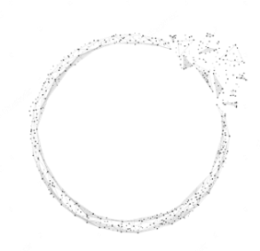

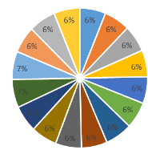
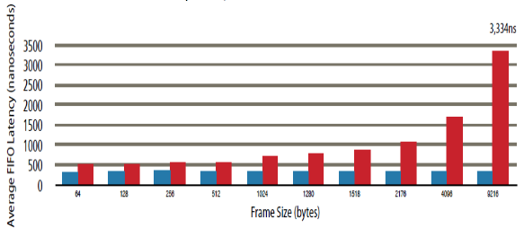
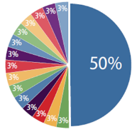
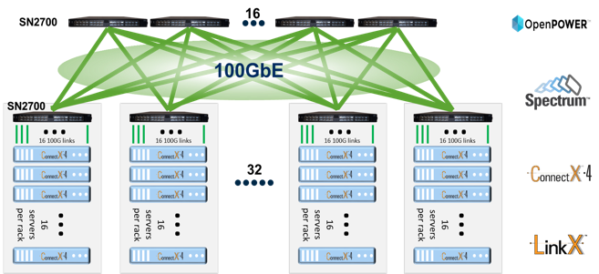
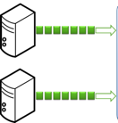


Spectrum - Fair & Predictable High Performance Switch
Fairness & QoS
Guaranteed Low Latency
Congestion Management
Microburst Absorption Capability
9.6
9.7
3,334ns
8.4
5.2
Max Burst Size (MB)
Average FIFO Latency (nanoseconds)
0.3
0.9
1.0
1.1
Spectrum
Competition
64
128
256
512
1024
1280
1518
2176
4096
9216
64B
512B
1.5B
9KB
Frame Size (bytes)
Packet Size
Spectrum
Competition
Spectrum
Competition
Worker
Parameter Server
Worker
Parameter Server
NIC + Software latency: TCP -> 6us; RDMA -> 1us
Spectrum latency @ 3 hops: < 1us
Other switch latency @ 3 hops: > 10us
Many to One
Many to Many

Slide 23
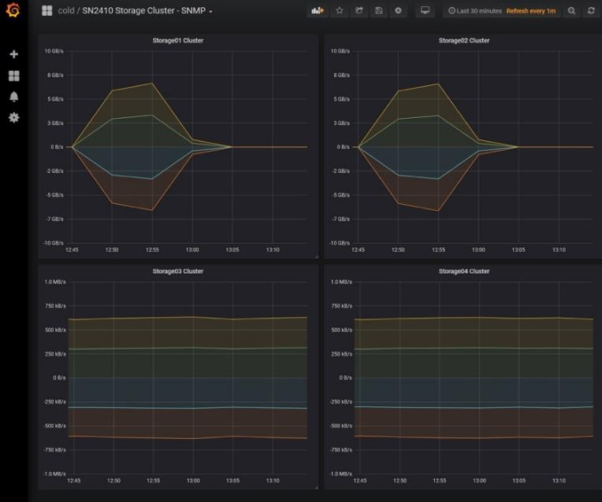
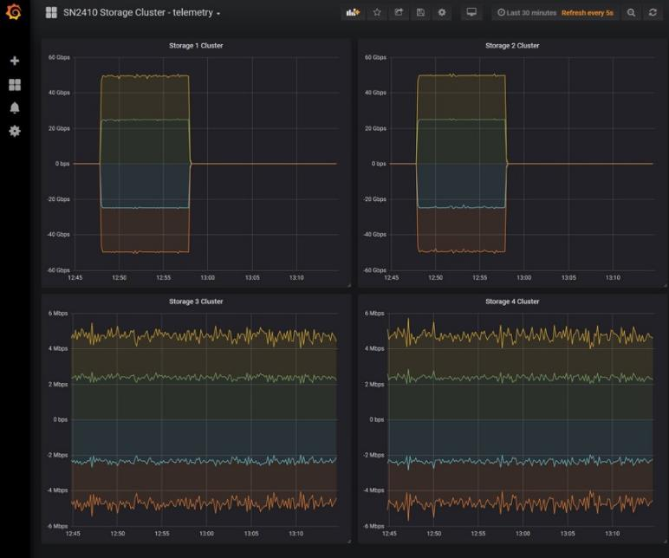
Why Network Telemetry?
Before data flow
Real time Data flow
SNMP
Telemetry

Slide 24
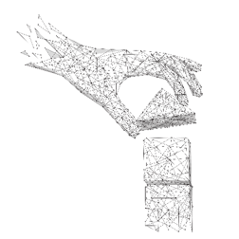
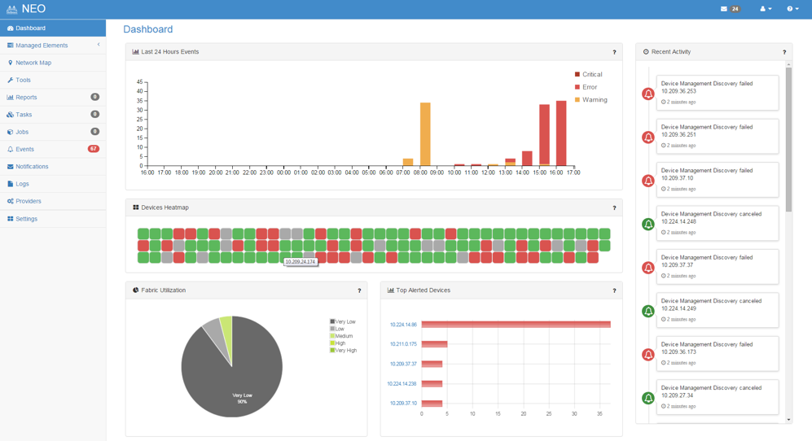
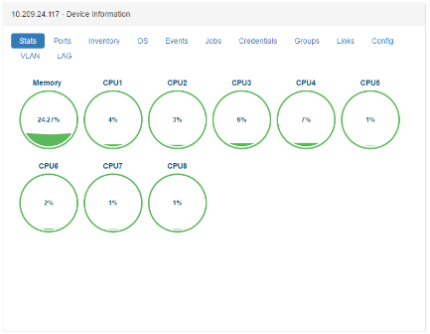
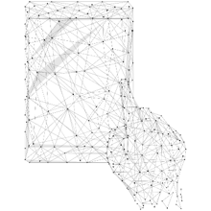
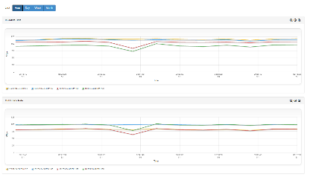
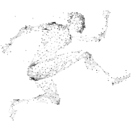
Mellanox NEO
Simplified deployment
Diagnostics and troubleshooting
Stay Competitive

Slide 25
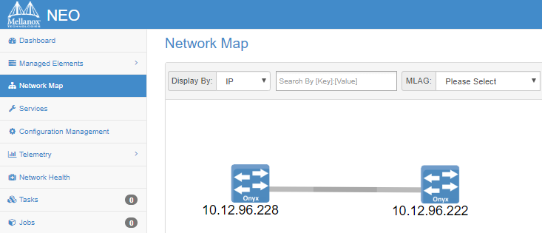
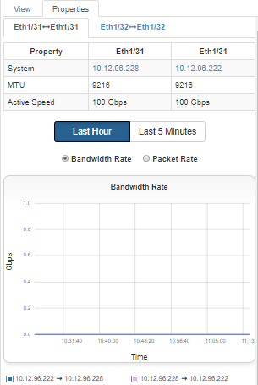

Mellanox NEO - at a glance
Extended NEO visibility with Mellanox cables information, including cable’s serial number, part number, type, length and revision.

Slide 26



Invisible Infrastructure with QNAP and Mellanox
+
Mellanox Ethernet Storage Fabric
Management Software
  Zero-touch Network Provisioning
  Enhanced Network Security
  Efficient Enterprise Cloud Networking

Slide 27

QNAP NAS 搭配
高速網卡與交換器

Slide 28




10GbE 傳輸您滿足了嗎
僅能滿足10GbE以下速度
10G SFP+
網路介面的NAS
10G 網路筆電
TS-932X
MSI GT75VR
QSW-1208-8C
10G
網路介面 PC
10G BASE-T
網路介面的 NAS
TVS-951X
Apple iMac Pro

Slide 29







QNAP 讓傳輸速度更上一層樓
18x 10/25GbE SFP+/28 ports
4x 40/100GbE QSFP+/28 ports
再次利用您的 QNAP 40GbE 網卡
25/40Gbe
10/25 GbE
10/25 GbE
10/25 GbE
QNAP 高階 NAS
OR 白牌伺服器
虛擬機
多媒體工作站
Notes:
我們有能對應40G的NAS??

Slide 30






完整的 10GbE / 25GbE / 40GbE 配件
10GbE SFP+ DAC
CAB-DAC15M-SFPP-DEC02
CAB-DAC30M-SFPP-DEC02
CAB-DAC50M-SFPP-DEC02
QXG-10G2SF-CX4
QXG-25G2SF-CX4
25GbE SFP28 DAC
10GbE SR Transceiver
CAB-DAC30M-SFP28-DEC01
TRX-10GSFP-SR-MLX
40GbE QSFP+ DAC
CAB-NIC40G30M-QSFP
LAN-40G2SF-MLX

Slide 31









即刻升級 25GbE 套組
QXG-25G2SF-CX4
QNAP
高階 NAS
Mellanox SN2010 25/100 GbE 交換器
OR 白牌伺服器
CAB-DAC30M-SFP28-DEC01
即刻升級 25GbE / 100GbE 高速傳輸

Slide 32
QNAP
是您最好的選擇！
©2019著作權為威聯通科技股份有限公司所有。威聯通科技並保留所有權利。威聯通科技股份有限公司所使用或註冊之商標或標章。檔案中所提及之產品及公司名稱可能為其他公司所有之商標。

