Slide 2
QNAP 25GbE PCIe Expansion Card
Mellanox SN2010 25GbE/100GbE Management Switch
QNAP NAS X 25GbE card X 25GbE/100GbE switch

Slide 3





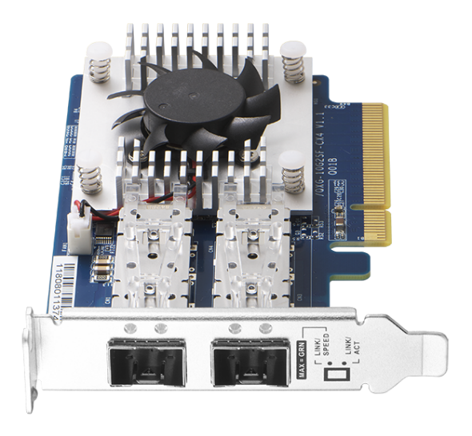
Over 10GbE:
QNAP 25GbE PCIe expansion card

Slide 4
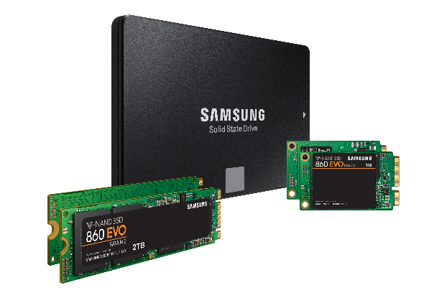
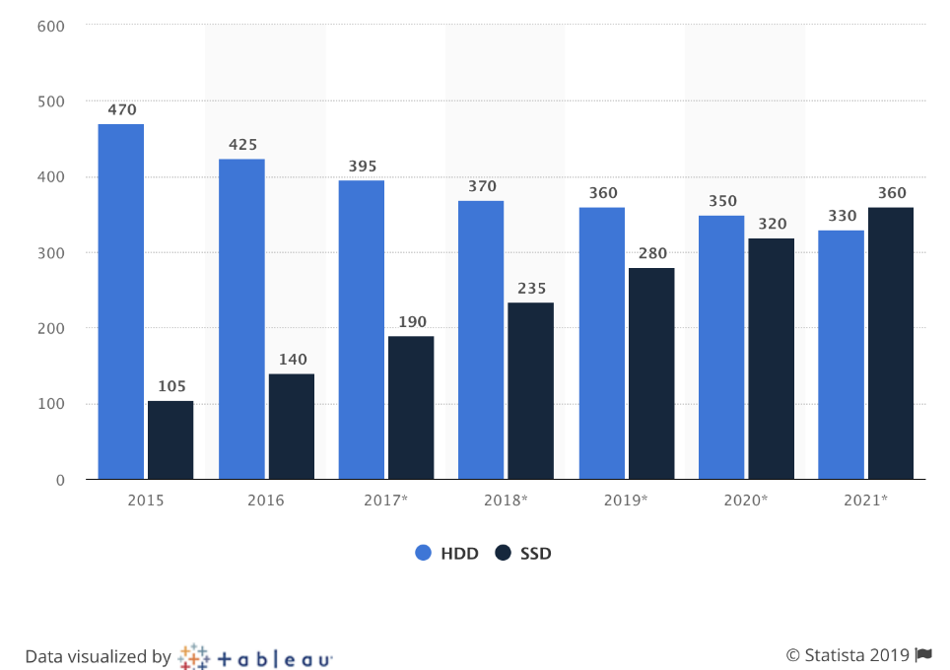

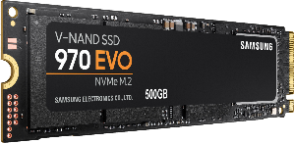
Fast Growing market and technology of SSD
Shipments of hard and solid state disk (HDD/SSD) drives worldwide from 2015 to 2021 (in millions)
SAMSUNG 860 EVO
Read: 550MB/s，Write: 520MB/s
SAMSUNG 970 EVO
Read: 3,500MB/s，Write: 2,300MB/s
https://www.statista.com/statistics/285474/hdds-and-ssds-in-pcs-global-shipments-2012-2017/
Notes:
https://www.google.com/search?q=860+EVO&rlz=1C5CHFA_enTW756TW756&source=lnms&tbm=isch&sa=X&ved=0ahUKEwiqxICksOzfAhWMw7wKHSeOA28Q_AUIDigB&biw=1440&bih=638#imgrc=jaMWZRESGrmRbM:

Slide 5
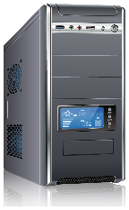
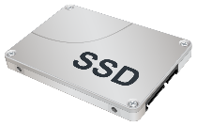
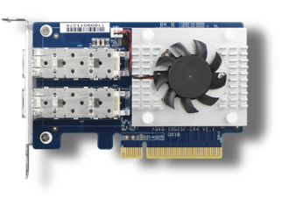





10GbE is not enough for Multi users
10GbE throughput
(1) NVMe SSD or (2) Enterprise SATA SSD (SLC/MLC)
10GbE Card
10GbE throughput
bottleneck
10GbE throughput
SSD cache
Qtier
PC/work station
Notes:
標題: 當大家都步入10G高速傳輸的世界時, 瓶頸反而卡在NAS端的網路.
發揮高速傳輸的必要條件: 高速的SSD / 高速的網卡

Slide 6

25GbE+ networking card market
25GbE above market is estimatted to grow up from 22%(2017) to be doubled to 55%(after 2018)
For future cloud applications, Big data, High speed storage, Virtualization technologies and A.I.
High Speed Adapters 2017
25G+ Segment Growing at 38% CAGR
2%
2%
2%
11%
22%
21%
55%
7%
Of total
Market
Of total
Market
15%
45%
78%
2%
15%
Source: Mellanox
Notes:
83xu round2 P.47

Slide 7
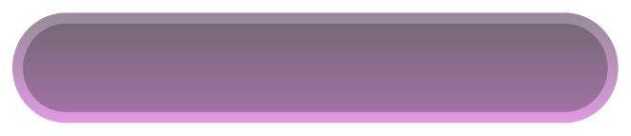
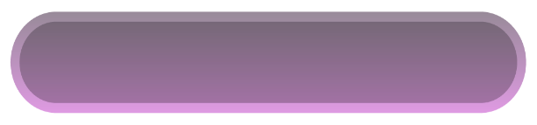

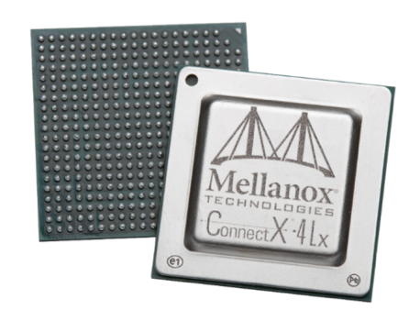
QNAP 10GbE/25GbE High speed card
QXG-10G2SF-CX4
Dual port 10GbE SFP+ Half-height card
QXG-25G2SF-CX4
Dual port 25GbE SFP28 half-height card
Mellanox
ConnectX®-4 Lx networking chip
2 x SFP+ connectors
Supports 10GbE Transmission
2 x SFP28 connectors
Supports 25/10GbE Transmission
Supports iSER/RoCE
106.83
68.9

Slide 8
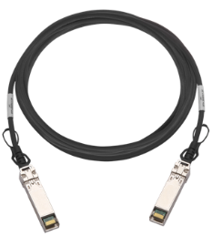
Hardware specification
Dual port 25GbE/10GbE connectors
Cooling heatsink and fan
25GbE SFP28 DAC cable
10GbE SFP+ DAC cable
Low profile bracket is installed when ship
Full height and QNAP flat bracket is bundled
PCIe Gen3 x8 interface
Provides maximum 64Gbit/sec bandwidth

Slide 9








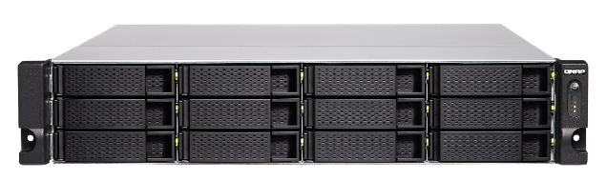

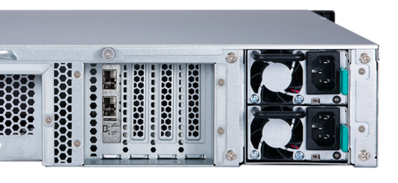
Go with QNAP high end NAS to experience high speed throughput
TS-x83XU
TS-x77XU
TVS-x72XU
1U: Gen3 x16 (CPU)
2U & 3U : Slot 2 with Gen3 x8 (CPU)
4U: slot 4 with Gen3 x8 (CPU)
1U: Gen3 x16 (CPU)
2U & 3U : Slot 2 and 4 with Gen3 x8 (CPU)
4U: slot 2 and 3 with Gen3 x8 (CPU)
1U: Gen3 x16 (CPU)
2U & 3U : Slot 2 with Gen3 x8 (CPU)
4U: slot 4 with Gen3 x8 (CPU)
PCIe x8
(CPU)
PCIe x4
PCIe x4
PCIe x4
TS-1283XU
#4
#3
#2
#1
*The PCIe bandwidth will drop to Gen3 x4 when
another card is installed on next slot
Notes:
x72XU可能根本跑不上25G

Slide 10
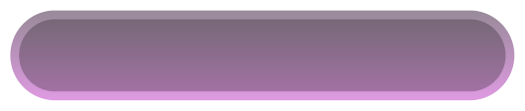
Supporting QNAP models
QXG-10G2SF-CX4
QXG-25G2SF-CX4
QNAP X86 models which attaches at least one PCIe Gen2 x2 above PCIe slot
(Suggest to install on models with Gen3 x4 )
QNAP X86 models which attaches at least one PCIe Gen3 x4 above PCIe slot
(Suggest to install on models with Gen3 x8 )
TS-x73
TVS-x73e
TS-x83XU
TVS-x72XU
TS-x77XU
TVS-x82
TS-x77
Supporting O.S.
QTS 4.3.6 and latter
Window/Linux: Driver is required to install on your PC/workstation
*Please check the compatibility list

Slide 11

Offload tasks from CPU with iSER
25GbE X iSER Broadcast is coming soon!
iSER allows data to bypass general network drivers, the socket layer, and to directly enter memory buffers of the server and storage.
Increasing performance, lower CPU loading
Without iSER
With iSER
Notes:
2月份有有這個25G + iSER的live broadcast

Slide 12


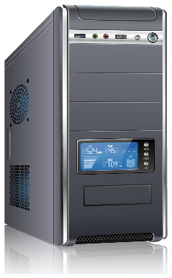
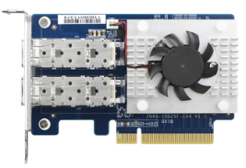
25GbE Performance Demo-AJA
TS-x83XU
PC:
Intel (R) Core(TM) i7-6700 3.40GHz.
Windows 10, 64GB RAM, QXG-25G2SF-CX4 on board,
Samsung SSD 960 PRO 1TB NVMe
NAS:
1283XU. Intel(R) Xeon(R) E-2124 CPU @ 3.30GHz.
QTS 4.3.6.0805, 4GB RAM, QXG-25G2SF-CX4 on board,
Samsung SSD850 Pro 512GB*12 (RAID 0)
Notes:
CPU bound

Slide 13



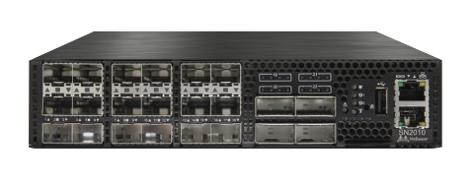

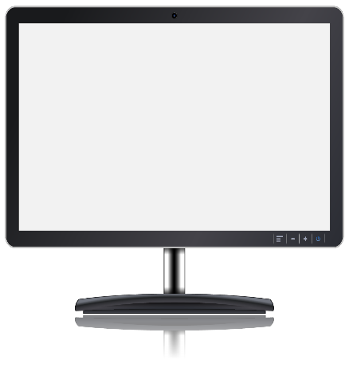
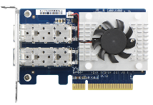
25GbE High speed throughput-File drag and drop
Speed : 962 MB/s
Speed : 0.98 GB/s
Speed : 940 MB/s
Recommended PC/ Workstation spec
Intel x86 i5/i7(or same level) above
Minimum Basic clock rate :3.3 GHz
NVMe SSD
2.9GB/s
Recommended Server spec
QNAP Intel X72 / AMD x77 above
12 x enterprise SATA SSD, RAID5 or RAID10
Notes:
提一下從進入10G高速傳輸後, 往往最常客訴反映效能上不去的情況被我們分析後, 結果是客戶用1~2顆HDD

Slide 14
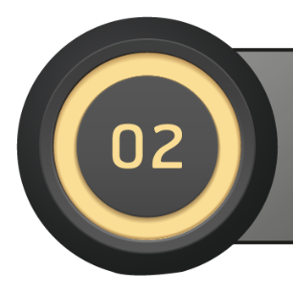
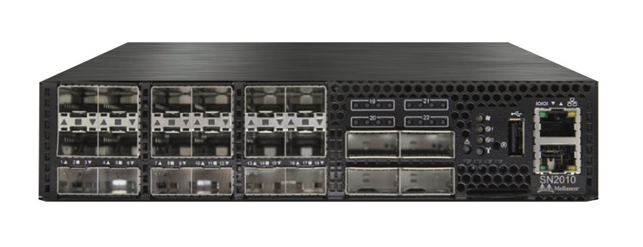
Mellanox SN2010
25GbE/100GbE
Management Switch

Slide 15
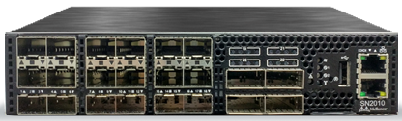



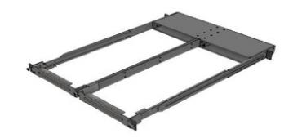
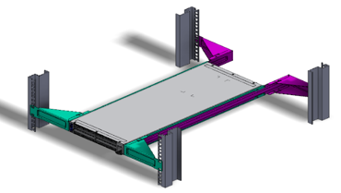
Spectrum the Best ESF Switch – SN2010
Ethernet Storage Fabric needs dedicated ESF switches
Physical
  18 x SFP+/SFP28 ports
  4 x QSFP/QSFP28 ports
  ½ 19’’ width, 1RU height
  57W typical power consumption (ATIS)
  Weight: 4.5Kg
  Power supply redundancy
  Management port
  Rail kit for 2 x SN2010 in 1RU, 19’’
  x86 Quad core Atom CPU
  8GB RAM, 16GB SSD
Performance
  2.52Bpps -> Zero Packet Loss
  300ns latency
Network OS
  Mellanox Onyx
  Cumulus Linux
  ONIE Version for coming Oss
Management Ports
18 *10/25GbE
SFP+/SFP28Ports
4*40/100GbE
QSFP+/QSFP28 Ports
Port LED indications
½ 19” width
½ 19” width

Slide 16
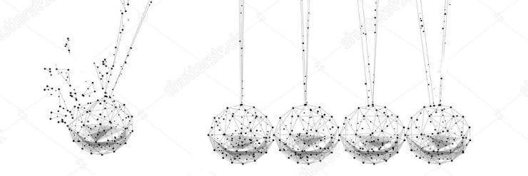
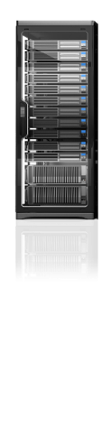
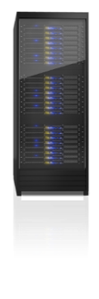

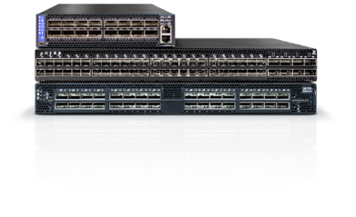




Leading Supplier of End-to-End Interconnect Solutions
Switch /
Gateway
Virtual Protocol
Interconnect
Virtual Protocol
Interconnect
56/100/200G InfiniBand
56/100/200G InfiniBand
Storage
Front /
Back-End
Server /
Compute
10/25/40/50/
100/200/400GbE
10/25/40/50/
100/200/400GbE
Notes:
16
16

Slide 17

Today’s Storage Landscape
PRIMARY STORAGE
STORAGE
Traditional SAN
20% of capacity
ICEBERG
File Shares
Archiving
Test/Dev
Backups
Analytics
Cloud
SECONDARY
STORAGE
80% of capacity
Rapid growth
Diverse data types
Scale-out, Ethernet-based
Tiered storage

Slide 18
The Storage World is Changing
Changes
Flash, Faster servers
Social/Mobile/Video
Hyperconverged
Cloud
Big Data
Distributed applications
Effects
Faster networking; 10/25/40/50/100GbE
Huge data growth; more file and object content
Distributed “Server-SAN” on Ethernet
Virtualization, software-defined, price pressure
File and distributed storage
More east-west traffic
Bottom Line: More Ethernet Storage Traffic

Slide 19

ESF Re-defining the Modern Data Centers
Predictable Performance, Deterministic & Secure Fabrics
cost
Servers
Risk
Complexity
Fabrics
Storage
Block, file, and object storage
Faster, more predictable performance
Simplified security and management
High bandwidth, low latency, zero packet loss
Higher processing capability
High-density virtualization
Move to All-flash
Faster protocols – NVMe-oF
Data Center modernization requires a faster, lossless Ethernet Storage Fabric

Slide 20
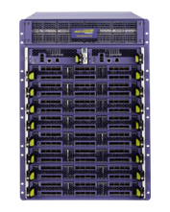
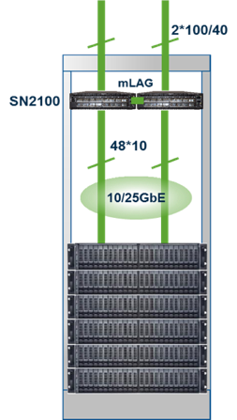

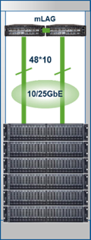

From Chassis to Leaf/Spine
Same Cable/Optic/Port Count
Superior Price & Performance
Full Rack
Multiple Racks
SN2700
SN2700
2*100
100GbE
100GbE
SN2100
ToR Switches
10/25GbE
Server Nodes
1 rack = 24 nodes
Leaf /Spine
Scale Out Network
Scale Up Network

Slide 21








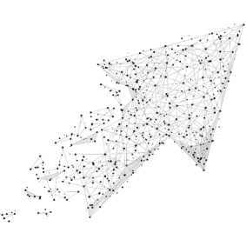




Why Cloud Data centers move to 25GbE?
Storage Nodes
40GbE
100GbE
Storage Nodes
10GbE
10GbE
25GbE
25GbE
East-West Traffic
East-West Traffic
VM
Migration
VM
Migration
10/40GbE Challenges
25/100GbE Value
Cloud Data Center need larger pipes
  Access to Storage
  Increase of East-West Traffic
  VM (Virtual Machine) migration is data intensive
Delivers 2.5 MORE
  2.5X higher throughput
  2.5X the bandwidth for 1.25X the price
For 2.5X lower CAPEX
    Fewer optics/cables
    Fewer spine switches
Future proof
Similar Cost / Power

Slide 22
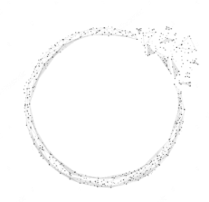

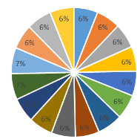
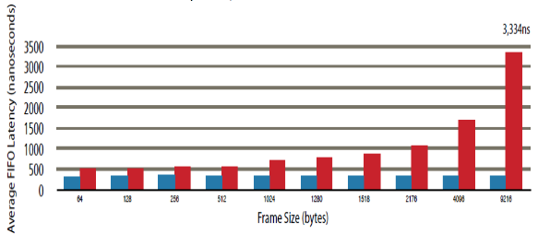
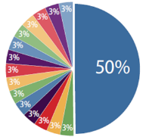
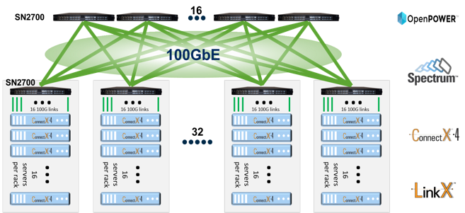
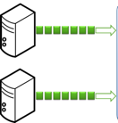


Spectrum - Fair & Predictable High Performance Switch
Fairness & QoS
Guaranteed Low Latency
Congestion Management
Microburst Absorption Capability
9.6
9.7
3,334ns
8.4
5.2
Max Burst Size (MB)
Average FIFO Latency (nanoseconds)
0.3
0.9
1.0
1.1
Spectrum
Competition
64
128
256
512
1024
1280
1518
2176
4096
9216
64B
512B
1.5B
9KB
Frame Size (bytes)
Packet Size
Spectrum
Competition
Spectrum
Competition
Worker
Parameter Server
Worker
Parameter Server
NIC + Software latency: TCP -> 6us; RDMA -> 1us
Spectrum latency @ 3 hops: < 1us
Other switch latency @ 3 hops: > 10us
Many to One
Many to Many

Slide 23
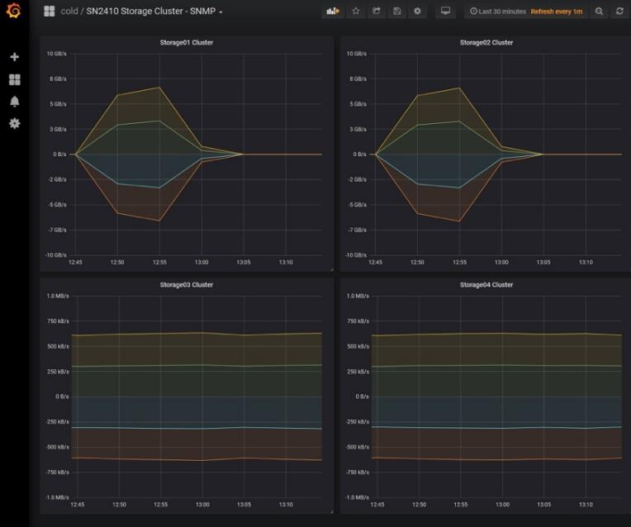
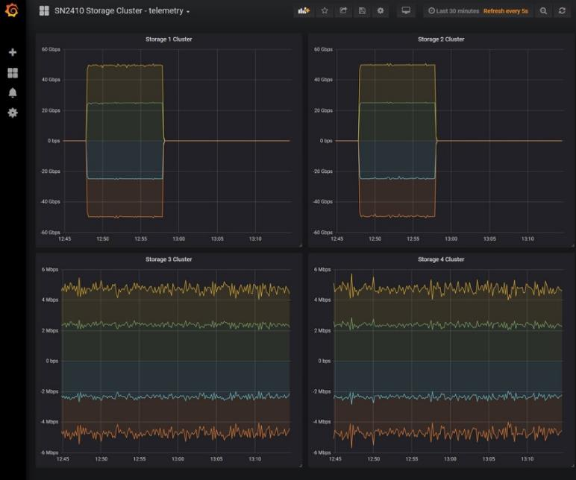
Why Network Telemetry?
Before data flow
Real time Data flow
SNMP
Telemetry

Slide 24
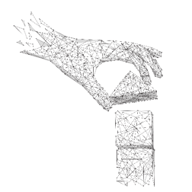
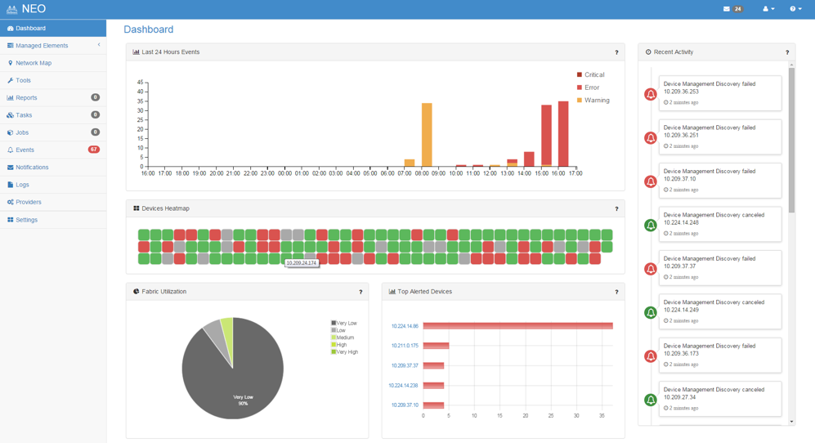
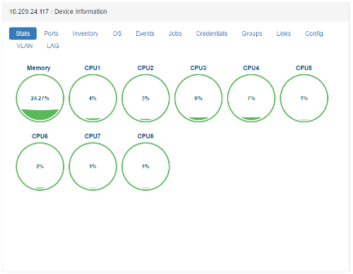
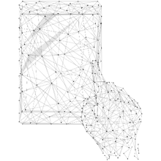
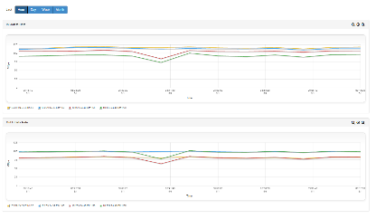

Mellanox NEO
Simplified deployment
Diagnostics and troubleshooting
Stay Competitive

Slide 25
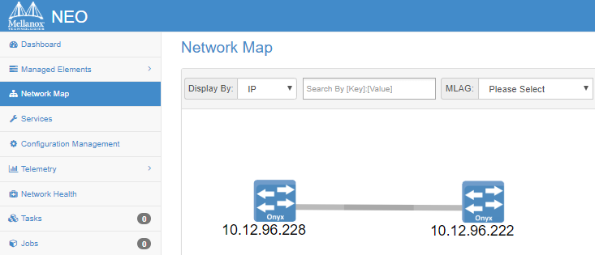
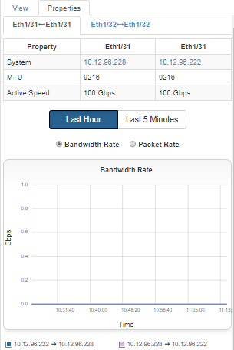
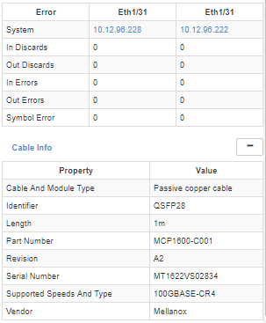
Mellanox NEO - at a glance
Extended NEO visibility with Mellanox cables information, including cable’s serial number, part number, type, length and revision.

Slide 26


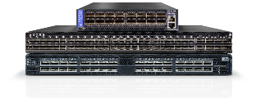
Invisible Infrastructure with QNAP and Mellanox
+
Mellanox Ethernet Storage Fabric
Management Software
  Zero-touch Network Provisioning
  Enhanced Network Security
  Efficient Enterprise Cloud Networking

Slide 27
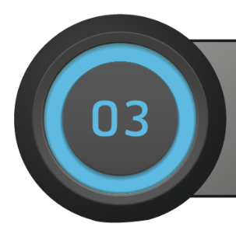
QNAP NAS X 25GbE card X 25GbE/100GbE switch

Slide 28




10GbE Workflow is insufficient for growing data
Supports maximum 10GbE speed
10GbE SFP+ NAS
10GbE Laptop
TS-932X
MSI GT75VR
QSW-1208-8C
Apple iMac Pro
10GbE PC
10GbE BASE-TNAS
TVS-951X

Slide 29







QNAP promotes the speed to 25GbE
Supports maximum 25GbE speed
18x 10/25GbE SFP+/28 ports
4x 40/100GbE QSFP/28 ports
Reuse your QNAP 40GbE card
25/40Gbe
10/25Gbe
10/25Gbe
10/25Gbe
OR
White box server
Virtual Machine
Media workstation
Notes:
我們有能對應40G的NAS??

Slide 30






Complete 10GbE/25GbE/40GbE aaccessories
10GbE SFP+ DAC
CAB-DAC15M-SFPP-DEC02
CAB-DAC30M-SFPP-DEC02
CAB-DAC50M-SFPP-DEC02
QXG-10G2SF-CX4
QXG-25G2SF-CX4
25GbE SFP28 DAC
10GbE SR Transceiver
CAB-DAC30M-SFP28-DEC01
TRX-10GSFP-SR-MLX
40GbE QSFP+ DAC
CAB-NIC40G30M-QSFP
LAN-40G2SF-MLX

Slide 31









QNAP’s 25GbE upgrade kit
QXG-25G2SF-CX4
QNAP
High end NAS
Mellanox SN2010 25/100 GbE switch
OR
White box server
CAB-DAC30M-SFP28-DEC01
Instantly upgrade to 25GbE/100GbE high speed transmission

Slide 32
QNAP
is your best choice!
Copyright © 2019 QNAP Systems, Inc. All rights reserved. QNAP® and other names of QNAP Products are proprietary marks or registered trademarks of QNAP Systems, Inc. Other products and company names mentioned herein are trademarks of their respective holders.

