Slide 2
Peer-to-Peer Synchronization
1
Purpose & Sync Methods
2
Peer-to-Peer Solution Resilio Sync
3
Resilio Sync & QNAP NAS
4
Resilio Sync Installation & Setup
5
Live Demo – Data Sync

Slide 3
Purpose & Sync Methods

Slide 4
Purpose & Sync Methods
Simple Use
File Sync
Rapid Share
Cloud Access
Team Work
Partner
Laptop
Office
Mobile Device
Desktop
Share Folder
File Share Link
Notes:
In modern society, we generate a lot of files every day. Photos in your smart phone or the working document. These files come from different devices. How do we access them efficiently and conveniently?
We need a mechanism of synchronization allows us to access all the files in a device.
For the synchronization, we hope it has the five features: Simple sue, file sync, rapid share, cloud access, and team work.
On the bottom side, it’s a simple application. We can sync all the files from office, home, laptop, or our own mobile devices. We are able to share the document to partners, or share the interesting photos to our friends.

Slide 5
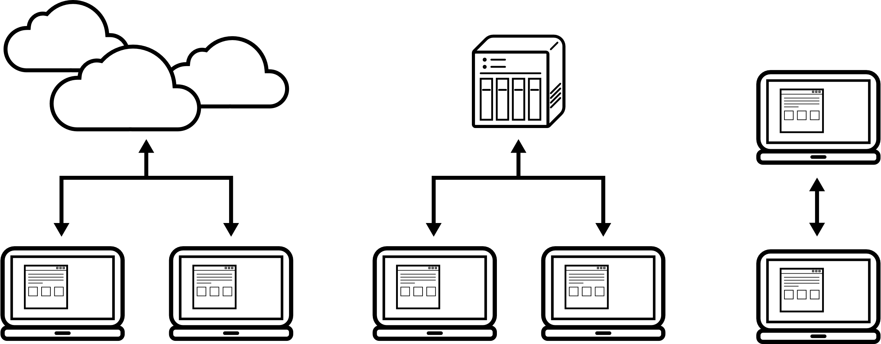
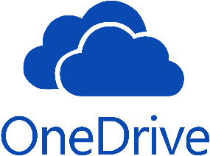
Sync Methods
Cloud Sync
Server Sync
Device Sync
Notes:
The common 3 ways that we synchronize our files. One is cloud sync. The other one is private server. The last one is device sync.

Slide 6
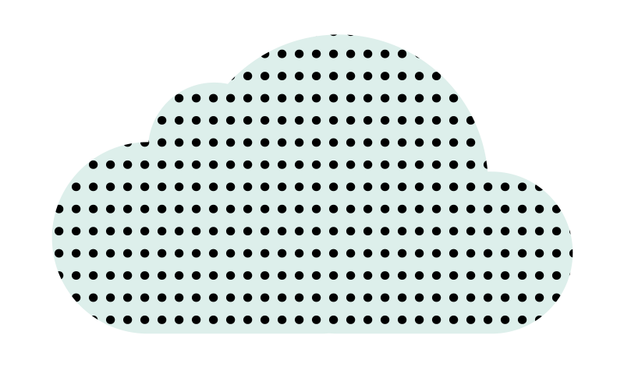
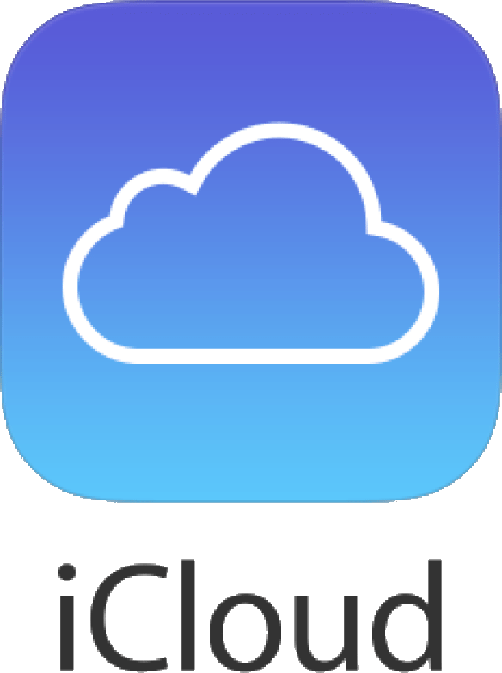
Cloud Sync
Cloud service providers
Free Space | 15GB | 6GB | 2GB | 5GB
Subscription （monthly） | 100GB/USD 1.99 | 50GB/NT$60 | 1TB/USD 8.25 | 50GB/NT$30
 | 200GB/USD 2.99 | 1TB/NT$1,920 (year) | 2TB/USD 16.58 | 200GB/NT$90
 | 2TB/USD 9.99 | No limit /NT$3,840 (year) |  | 2TB/NT$300
 | 10TB/USD 99.99
 | 20TB/USD 199.99
 | 30TB/USD 299.99
Single file size limit | 5GB | 10GB（free） | No limit | No limit
 |  | 15GB（paid）
Main Features:
Sync & Backup
Centralization
File Sharing
Preview
Mobile access
Subscription
Notes:
We all hear the companies, Google, OneDrive, Dropbox, or iCloud. The main feature is: All your synchronization behavior have to connect to the central cloud server.
The advantage is that you can remote access the files and share files with link. But no matter free or subscription, it still has limitations. Like total space or single file size limit.

Slide 7
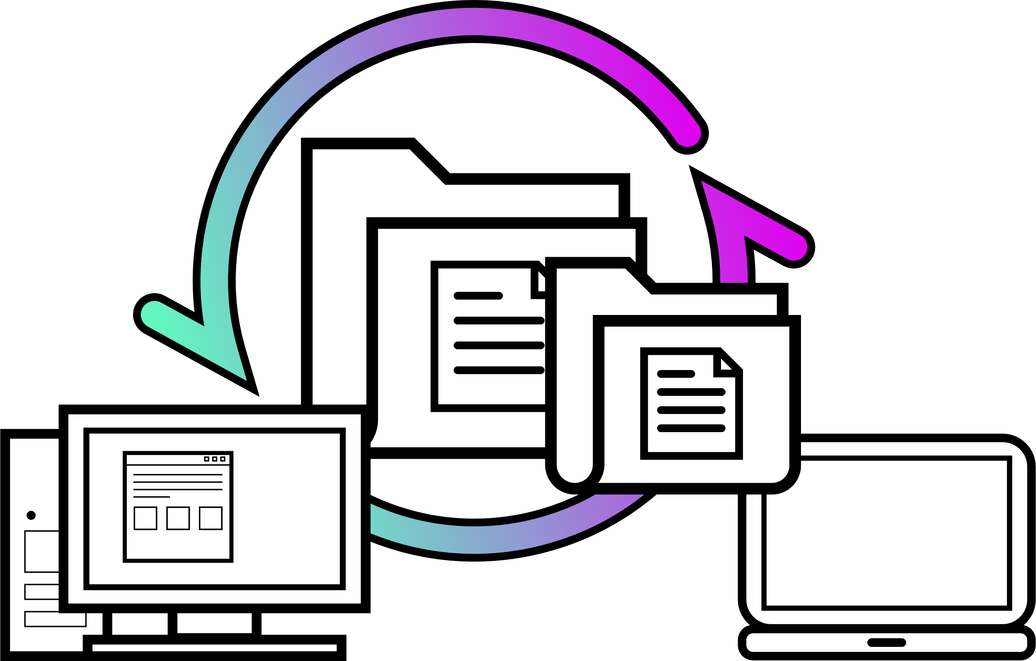
Server & Device Sync
Main Features:
Sync & Backup
Centralization
One time purchase
Sync software
File exchange is performed on points with the sync software
Notes:
Following is the server and device sync. It still a centralized architecture to do the synchronization. Compare with the cloud service, the file sharing is not so convenient. But it is good on privacy and data security.
The common software we know: Allway Sync, Good Sync, FreefileSync, rsync, and MS Sync toy.

Slide 8
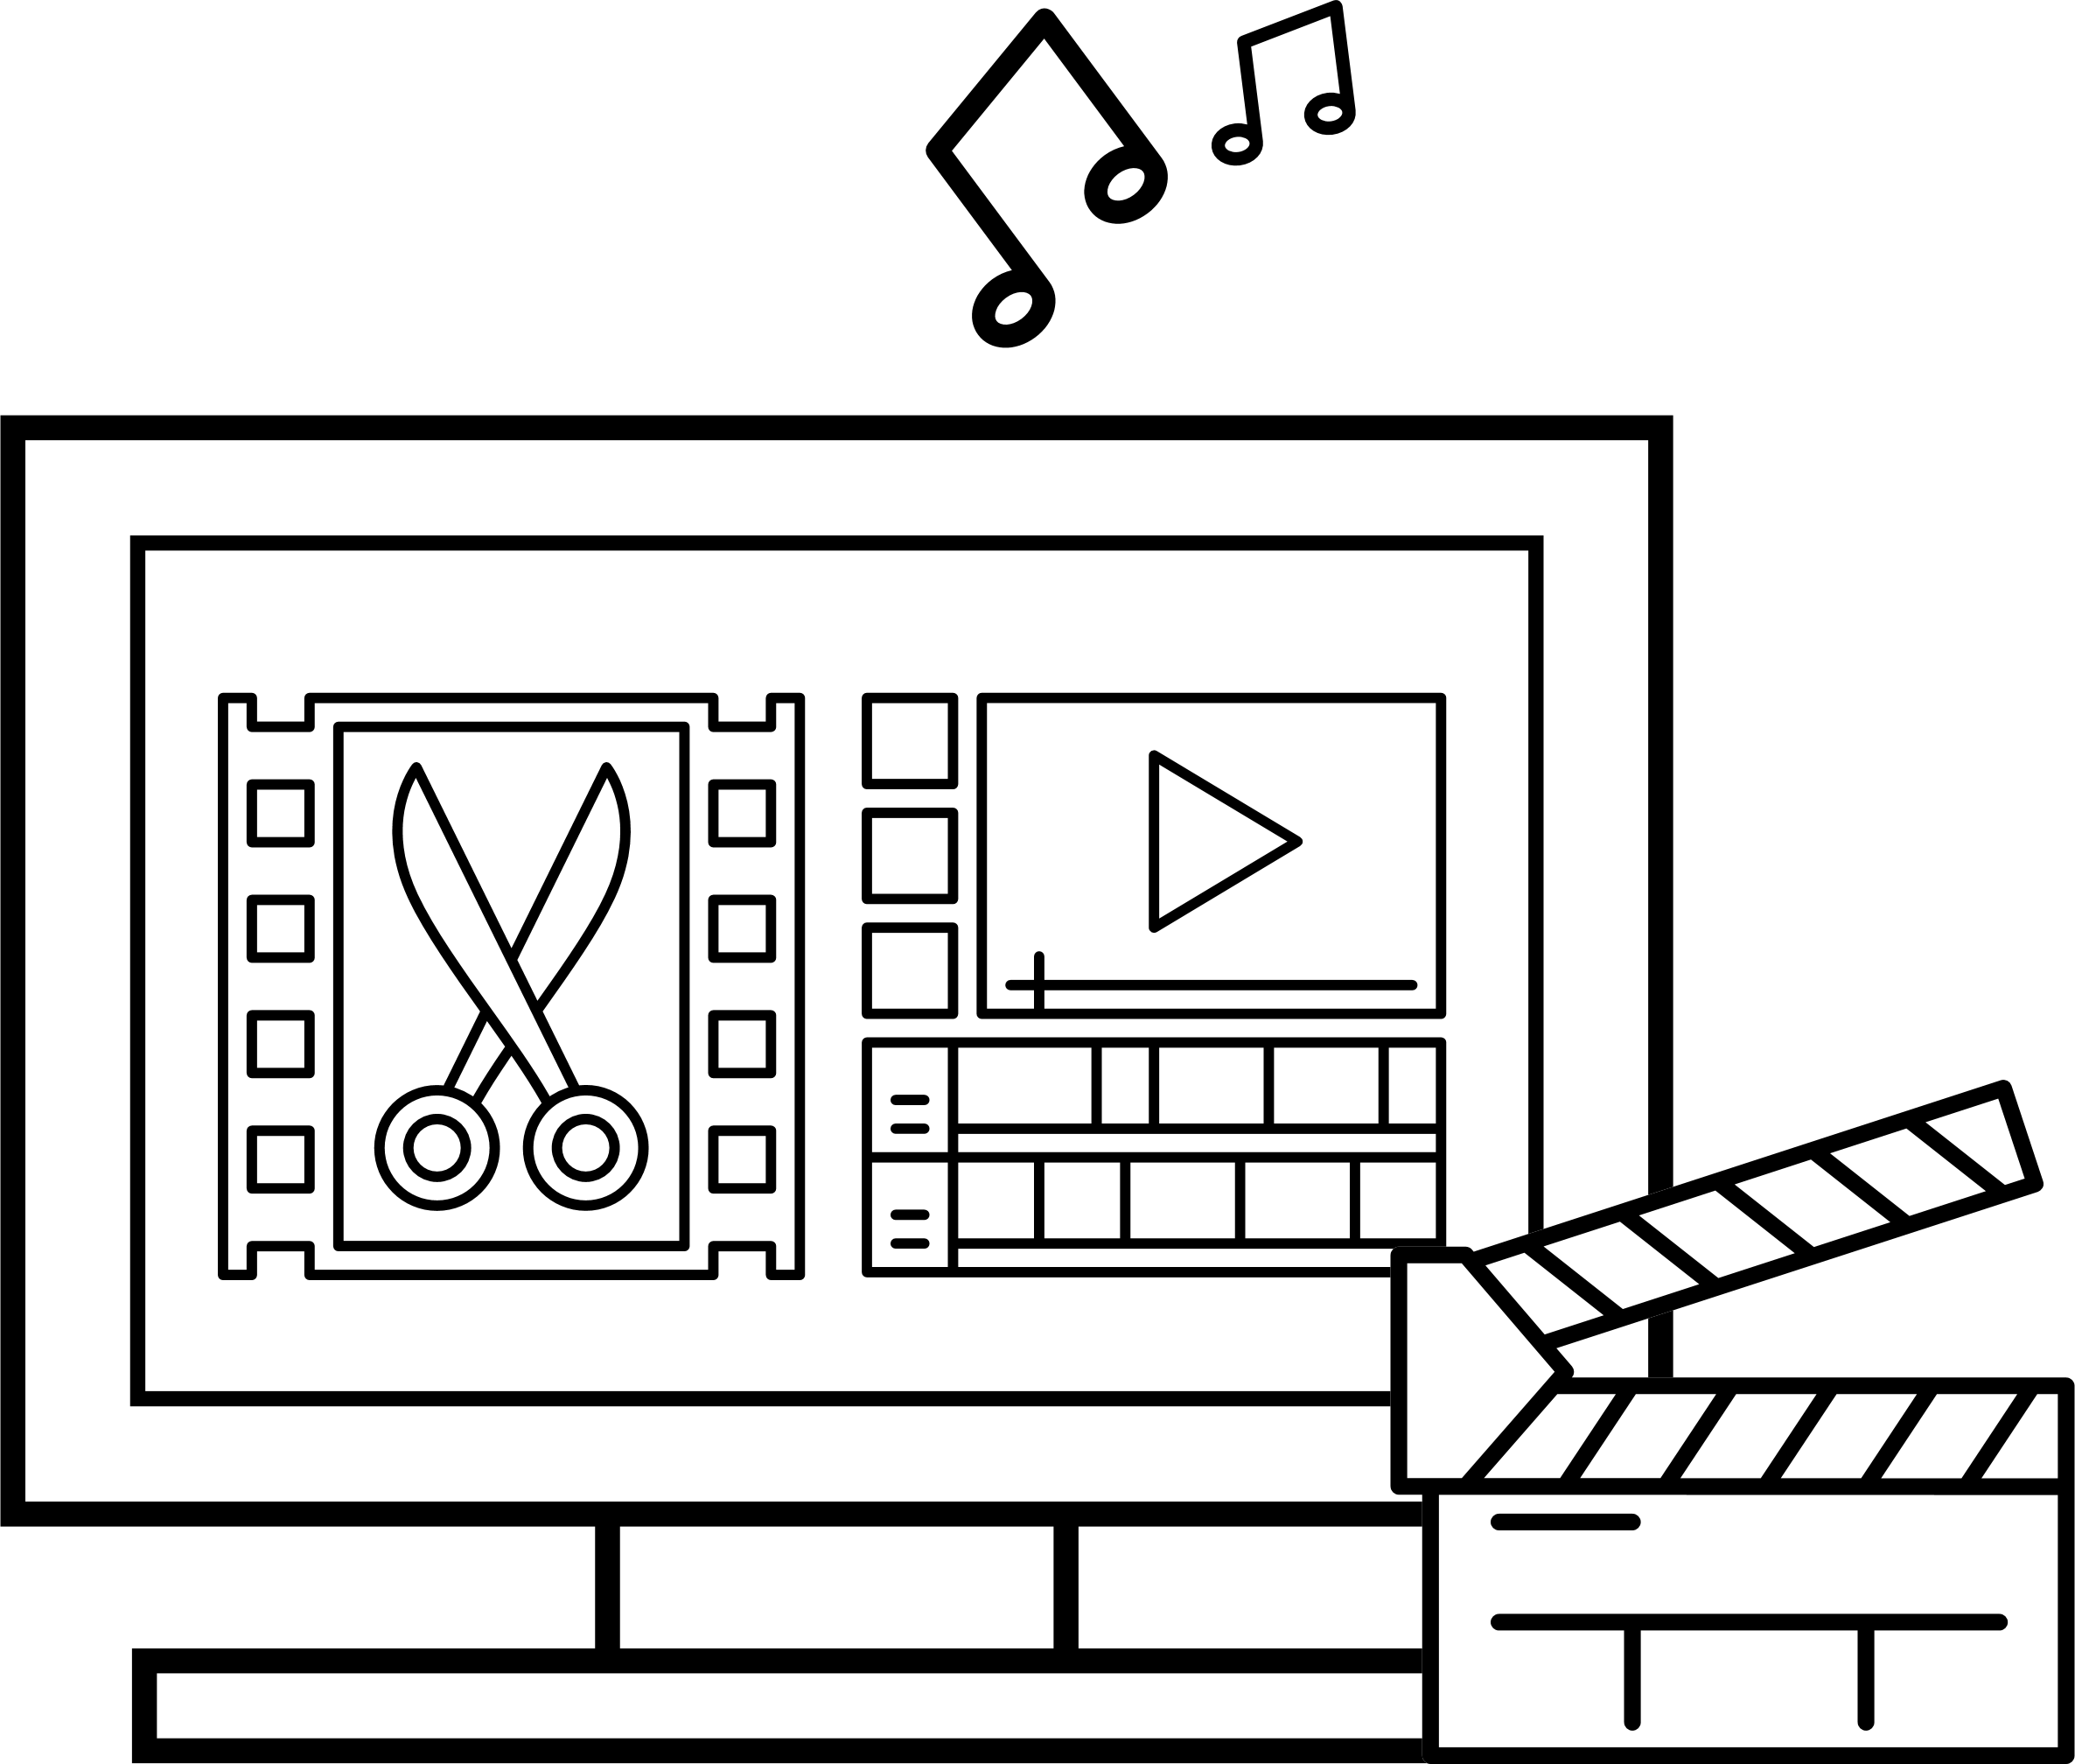
Large Files Exchange Application
Common points：
Limited WAN bandwidth
Large files exchange
Privacy & security concern
AV studio
Environment:
LAN & limited WAN bandwidth
Require：
Large AV files exchange frequently
Security concerns, not preferred to access public servers
Notes:
As above mentioned, most of our needs are fulfilled by above service. But in some scenarios, we may encounter some difficulties.
For some users like AV working studio, software company, or surveillance service,
They have big files exchange frequently, or need to distribute files to multi points, and they don’t want to put their files on public server due to security concern.
In view of these reasons, the traditional synchronization may not be perfect for them.
Now, we will go to the main subject today: peer to peer synchronization solution. Resilio Sync

Slide 9
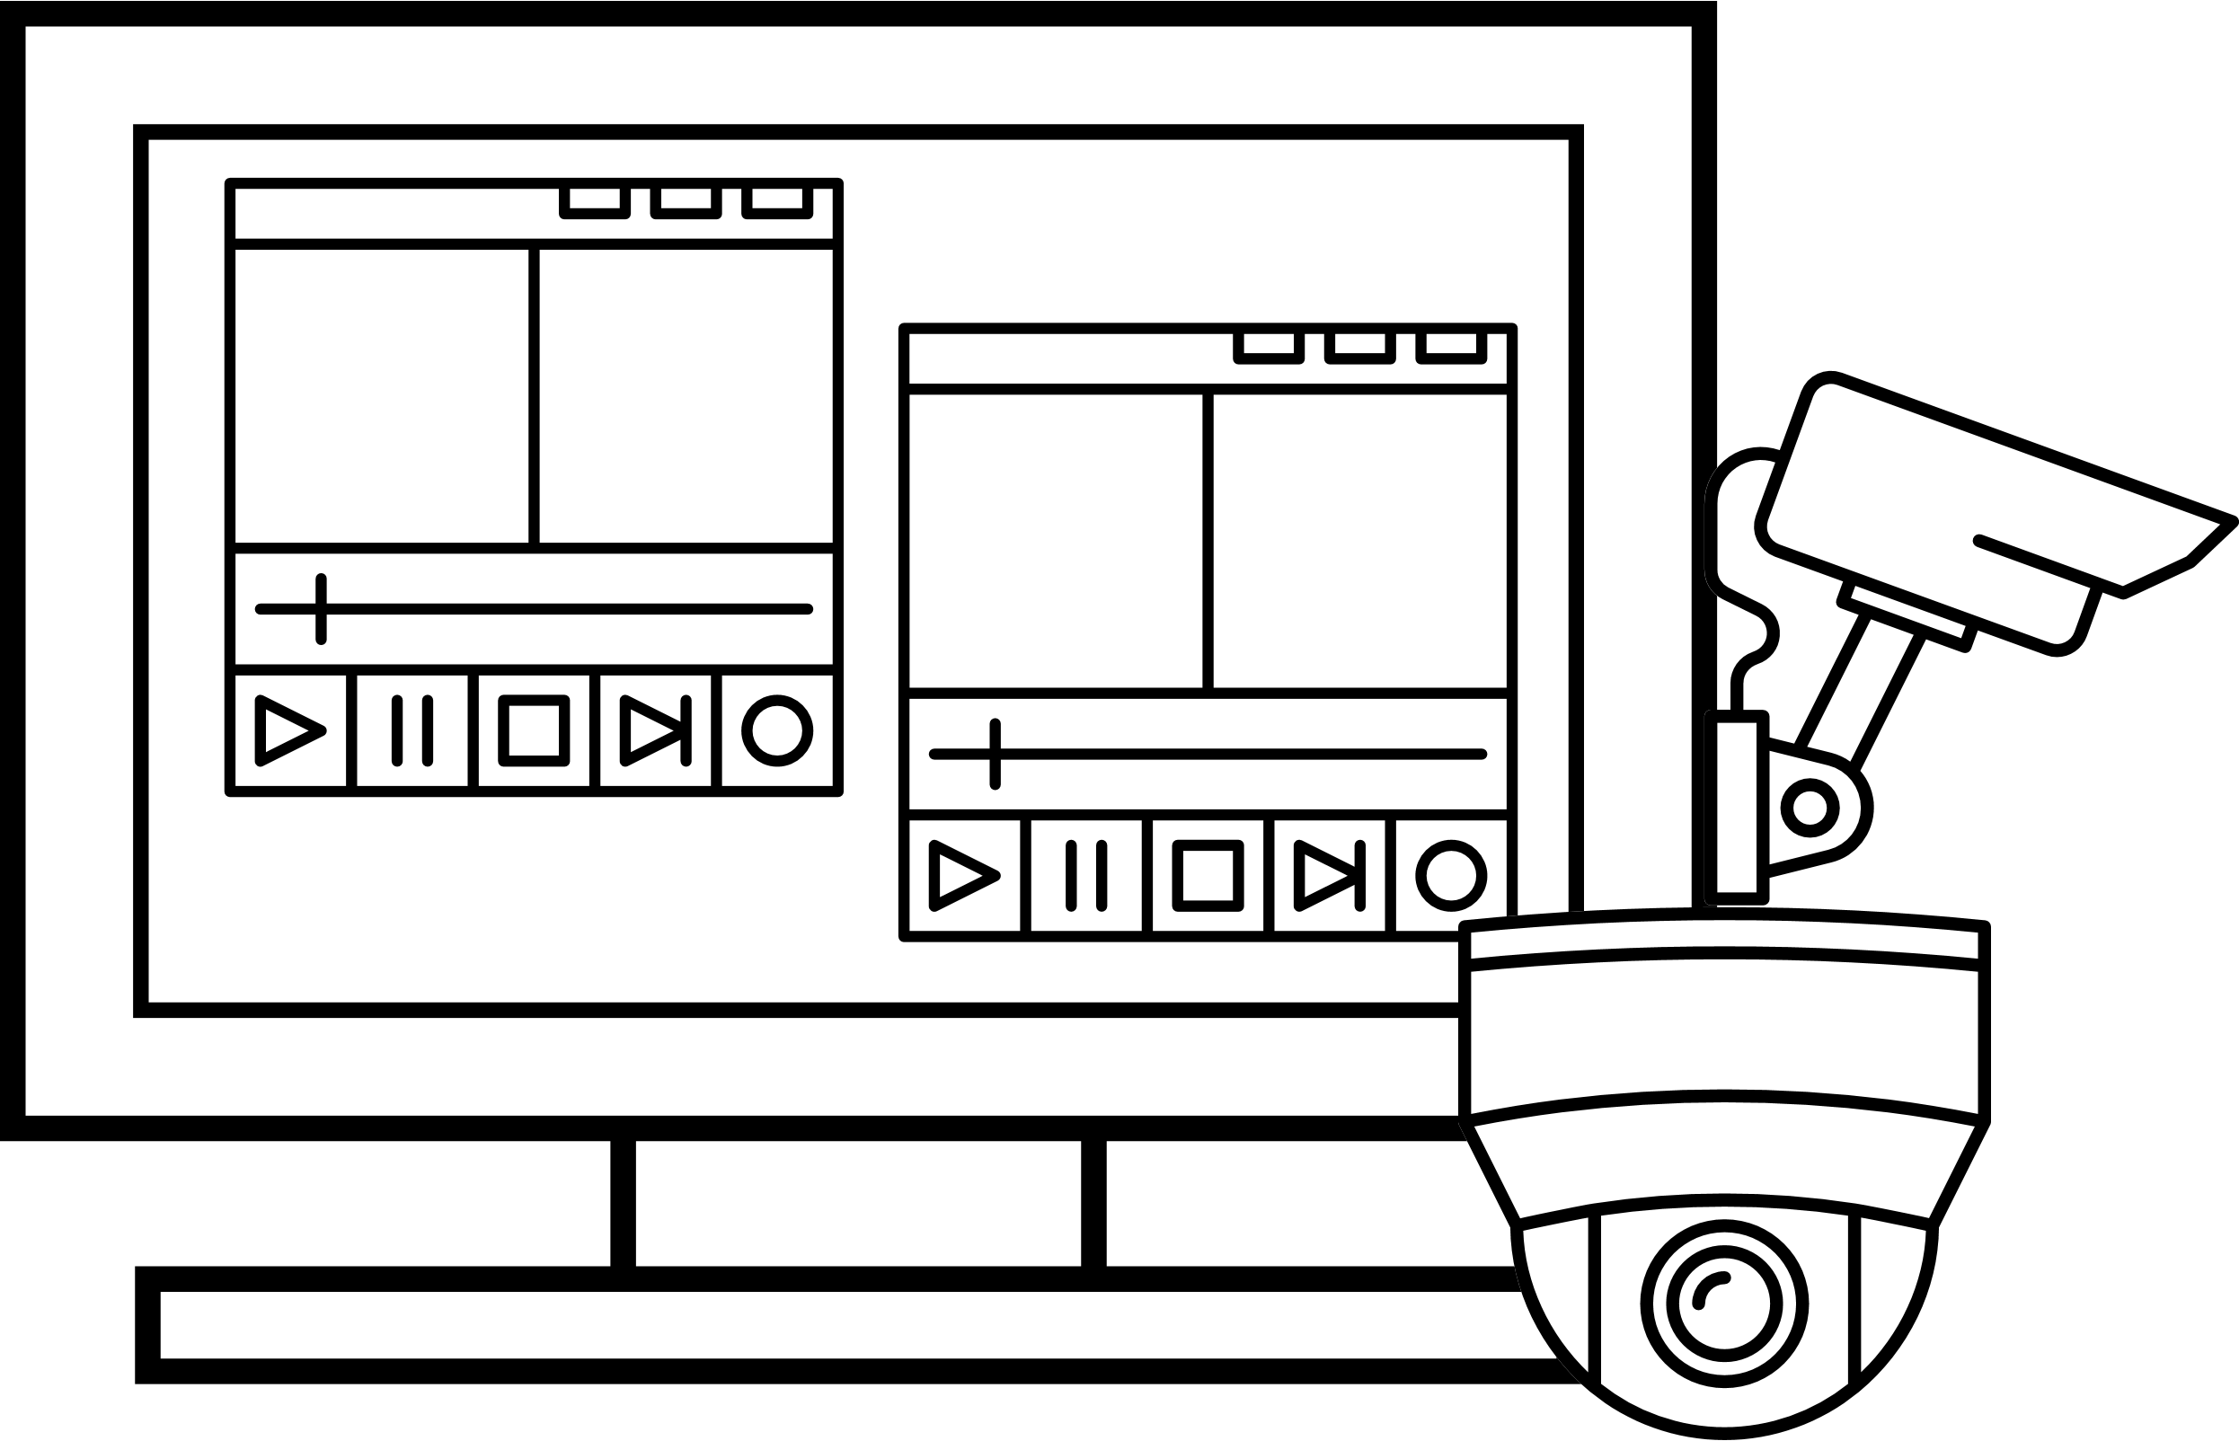
Large Files Exchange Application
Main points：
It takes time to upload and download.
Consumes out the WAN bandwidth and affects the other services
Privacy & Security concerns
Software Team
Surveillance
Environment：
LAN
Environment：
LAN & limited WAN bandwidth
Require：
Large source code or SDK distribution
Security concerns, not preferred to access public servers
Require：
Large video file sync or backup
Privacy concerns, not preferred to access public servers
Notes:
As above mentioned, most of our needs are fulfilled by above service. But in some scenarios, we may encounter some difficulties.
For some users like AV working studio, software company, or surveillance service,
They have big files exchange frequently, or need to distribute files to multi points, and they don’t want to put their files on public server due to security concern.
In view of these reasons, the traditional synchronization may not be perfect for them.
Now, we will go to the main subject today: peer to peer synchronization solution. Resilio Sync

Slide 10
Peer-to-Peer Solution Resilio Sync

Slide 11
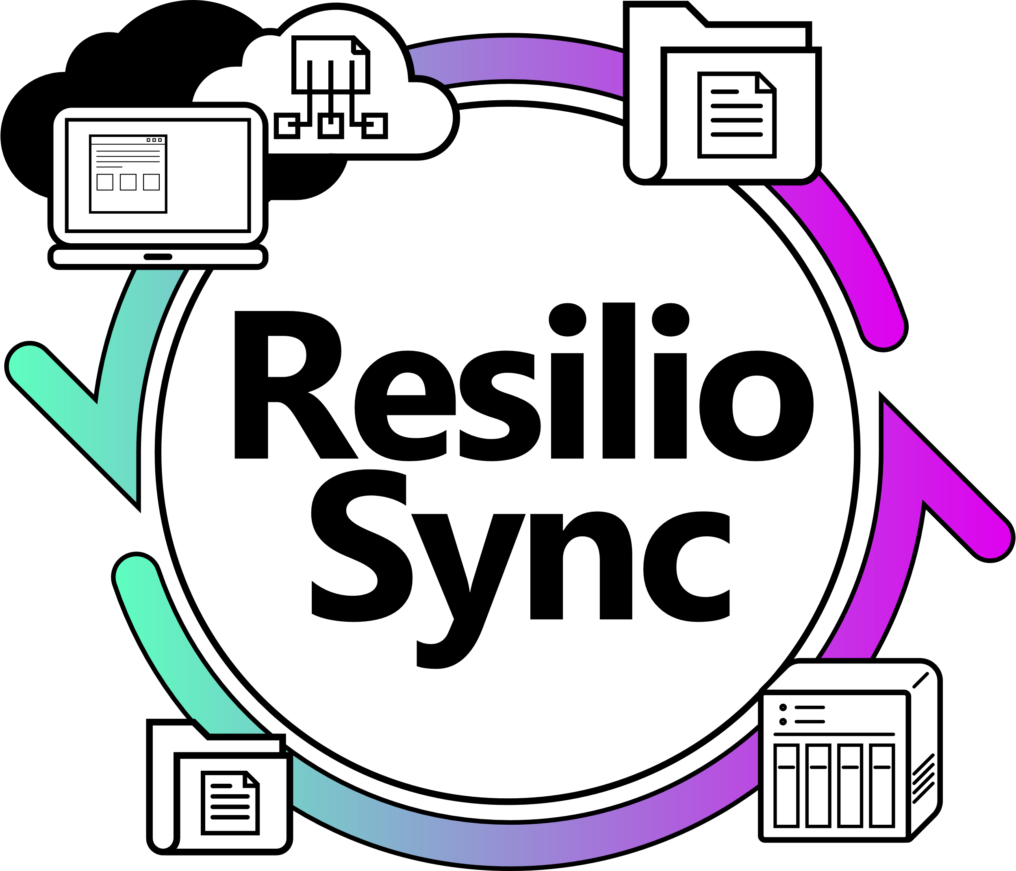
Resilio Sync
Resilio Inc
1
San Francisco
2
Spun out BitTorrent Inc
in 2016
3
Leader in P2P technology
Notes:
Resilio Inc is located in San Francisco and is spun out from Bittorrent Inc in 2016. Both of them are good at P2P technology.
Following, we will see a short video from Resilio Sync to introduce their product application.
~play the video~

Slide 12
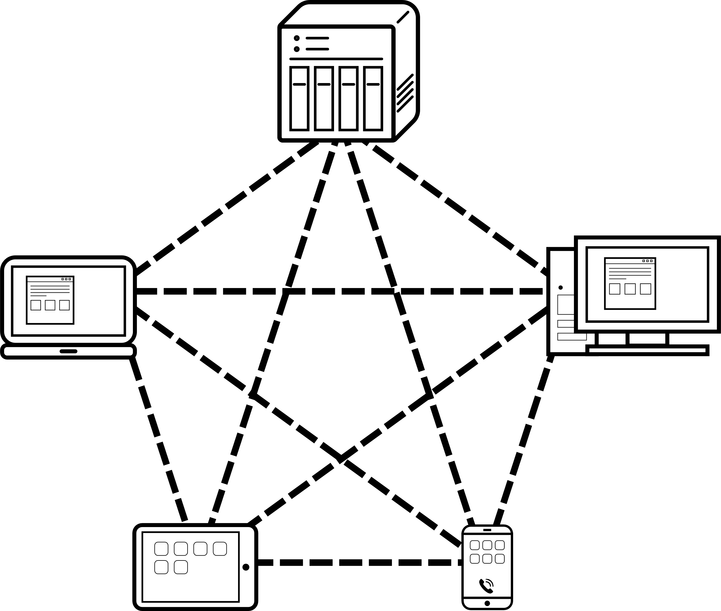
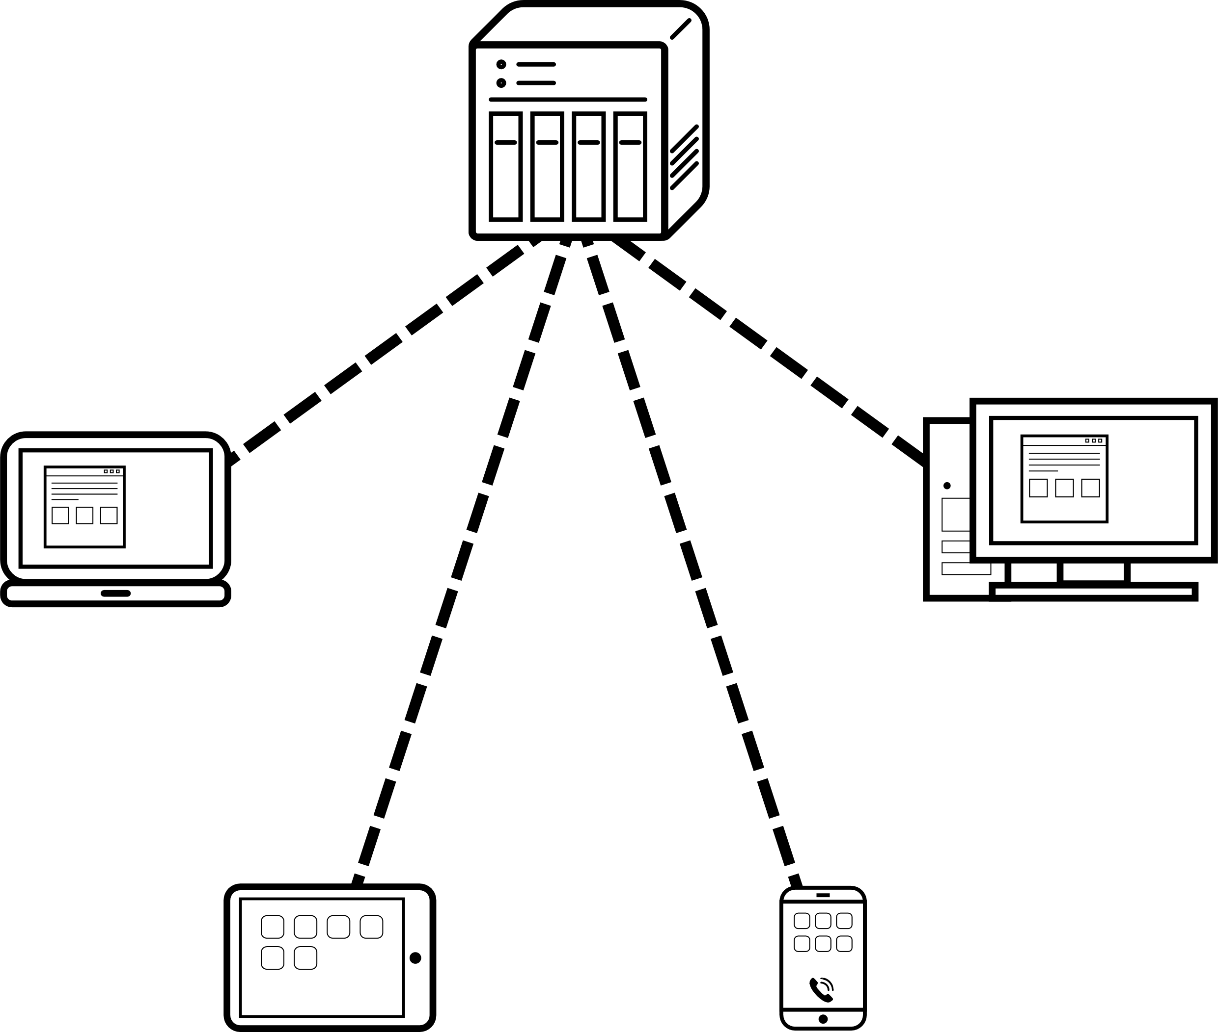
Centralization & Peer-to-Peer
BT, Resilio Sync
Public/ Private Cloud
Notes:
Before the introduction, Let’s see what is centralization and what is peer to peer.
Peer to peer, it means all the points are connected each other. It’s like a net as the left side.
Centralization. All the device connection accounts on the server.

Slide 13
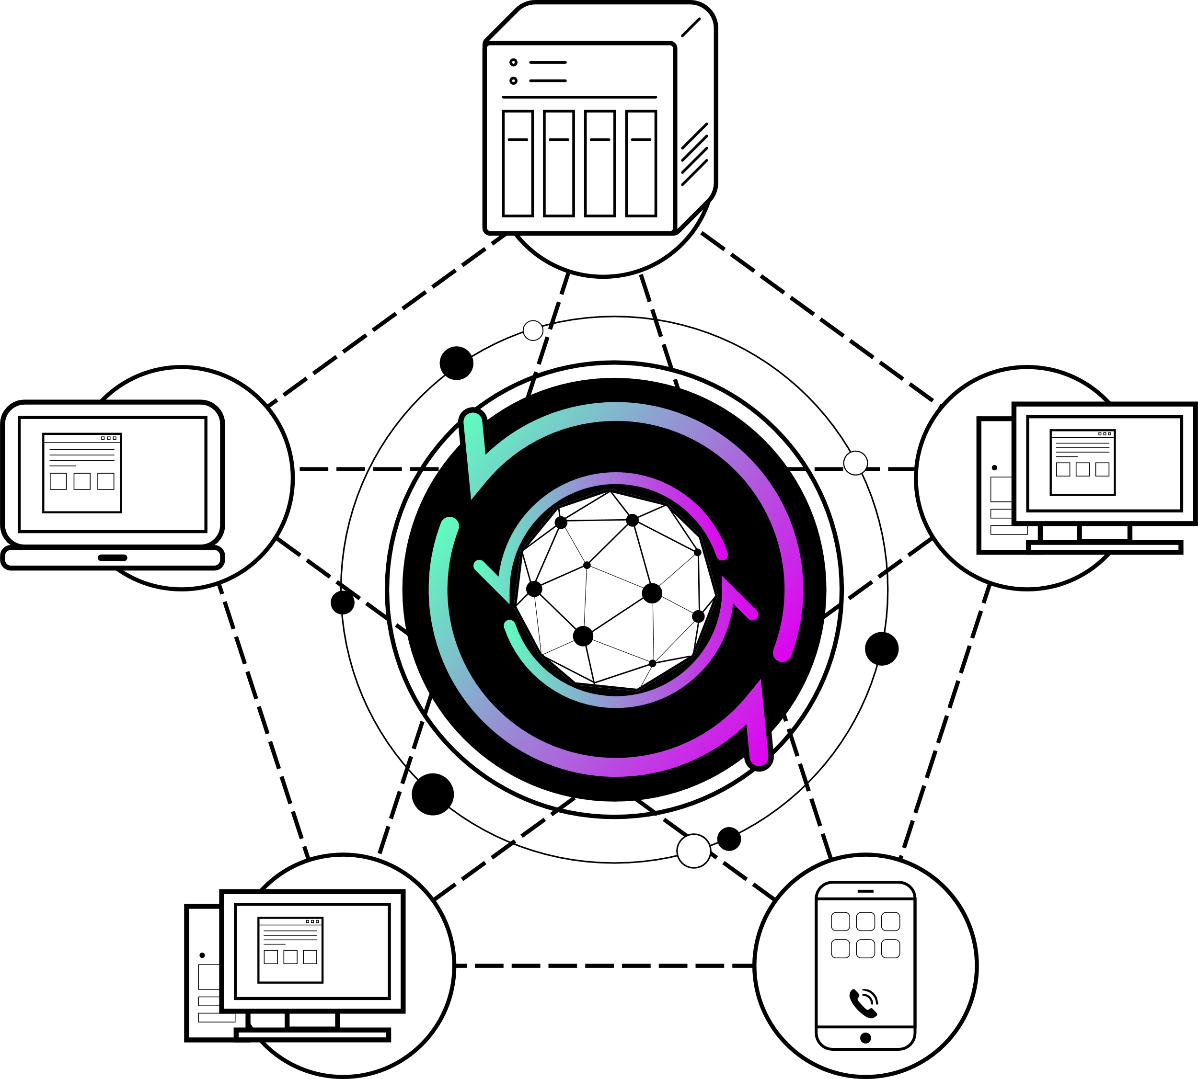
The Merits of Peer-to-Peer
Sync available in LAN
No file size and total space limits
No transmission speed limit
Release the server loading
Secure & private
Notes:
So what are the merits of peer to peer.
I summarize to 5 items and will go for the details.
Sync available LAN
No transmission speed limit
Secure and private
No file size and total space limits
Release the server loading

Slide 14
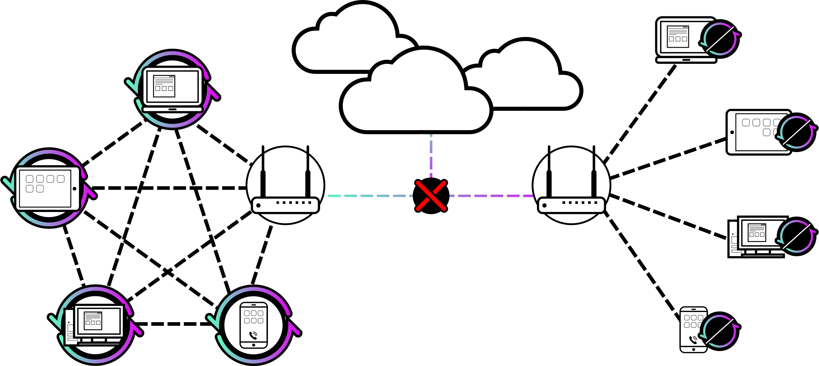
Sync Available in LAN
Peer to peer
Centralization
Unable to connect to the Internet!!
Notes:
Public cloud service, all the activities need to connect the cloud. Once the public server shut down, or fail to access the internet, we are also unable to sync or share the files.
But for Rsilio Sync, each point has direct connection with the other points. The sync is not affected by outside server or the internet assess.

Slide 15
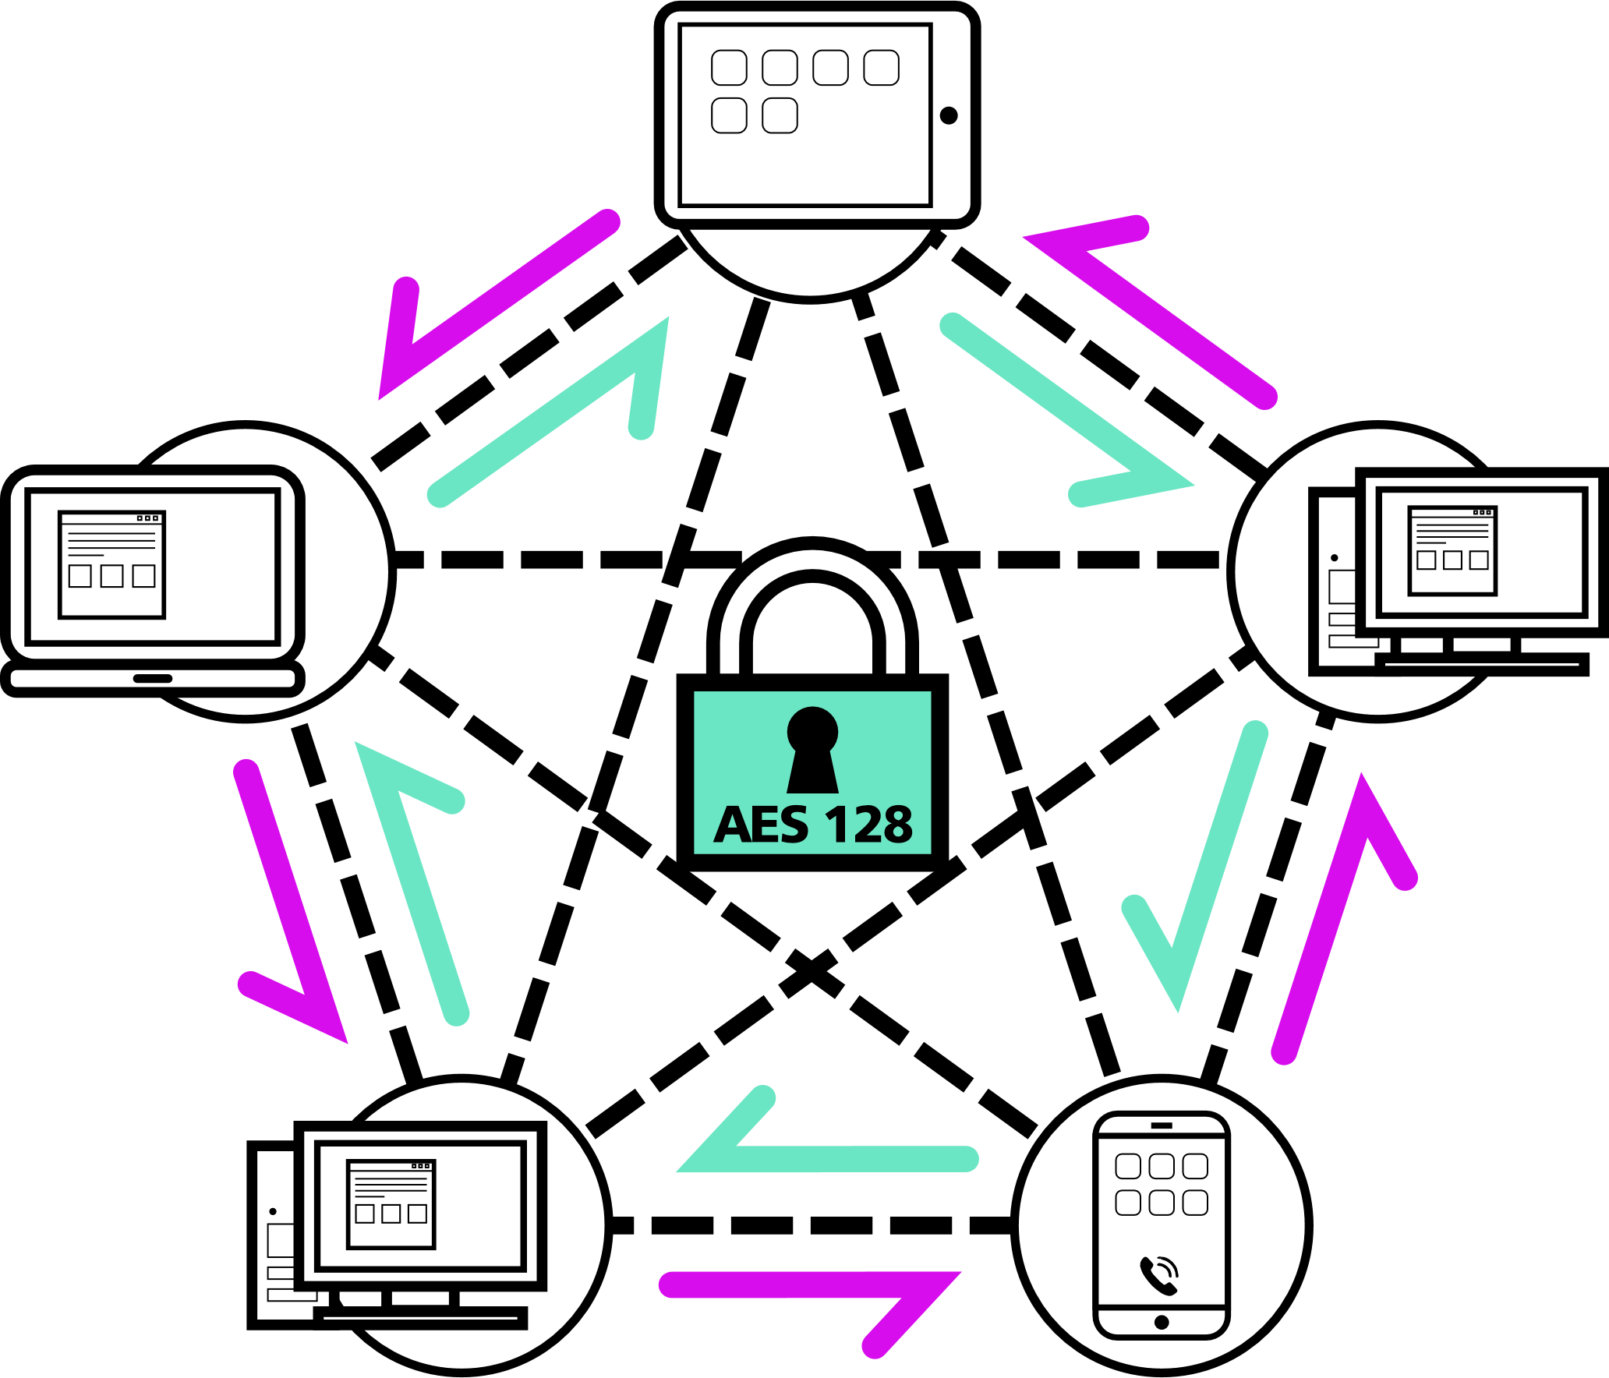
Secure & Private
1
Point to point direct connection with AES 128 Encryption
2
No login, data information in public servers
3
Ensure your folder will be shared with the right people.
Notes:
In view of privacy and security, Resilo Syncn has 3 main features.
peer to peer architecture is direct connection, and files transferred are encrypted with AES 128.
2nd, all data are kept in the points. There are no any account information or data stay in public servers.
And the third one, when you share the folder, you can see which device or person try to connect with you. You can allow or refuse the connection.

Slide 16
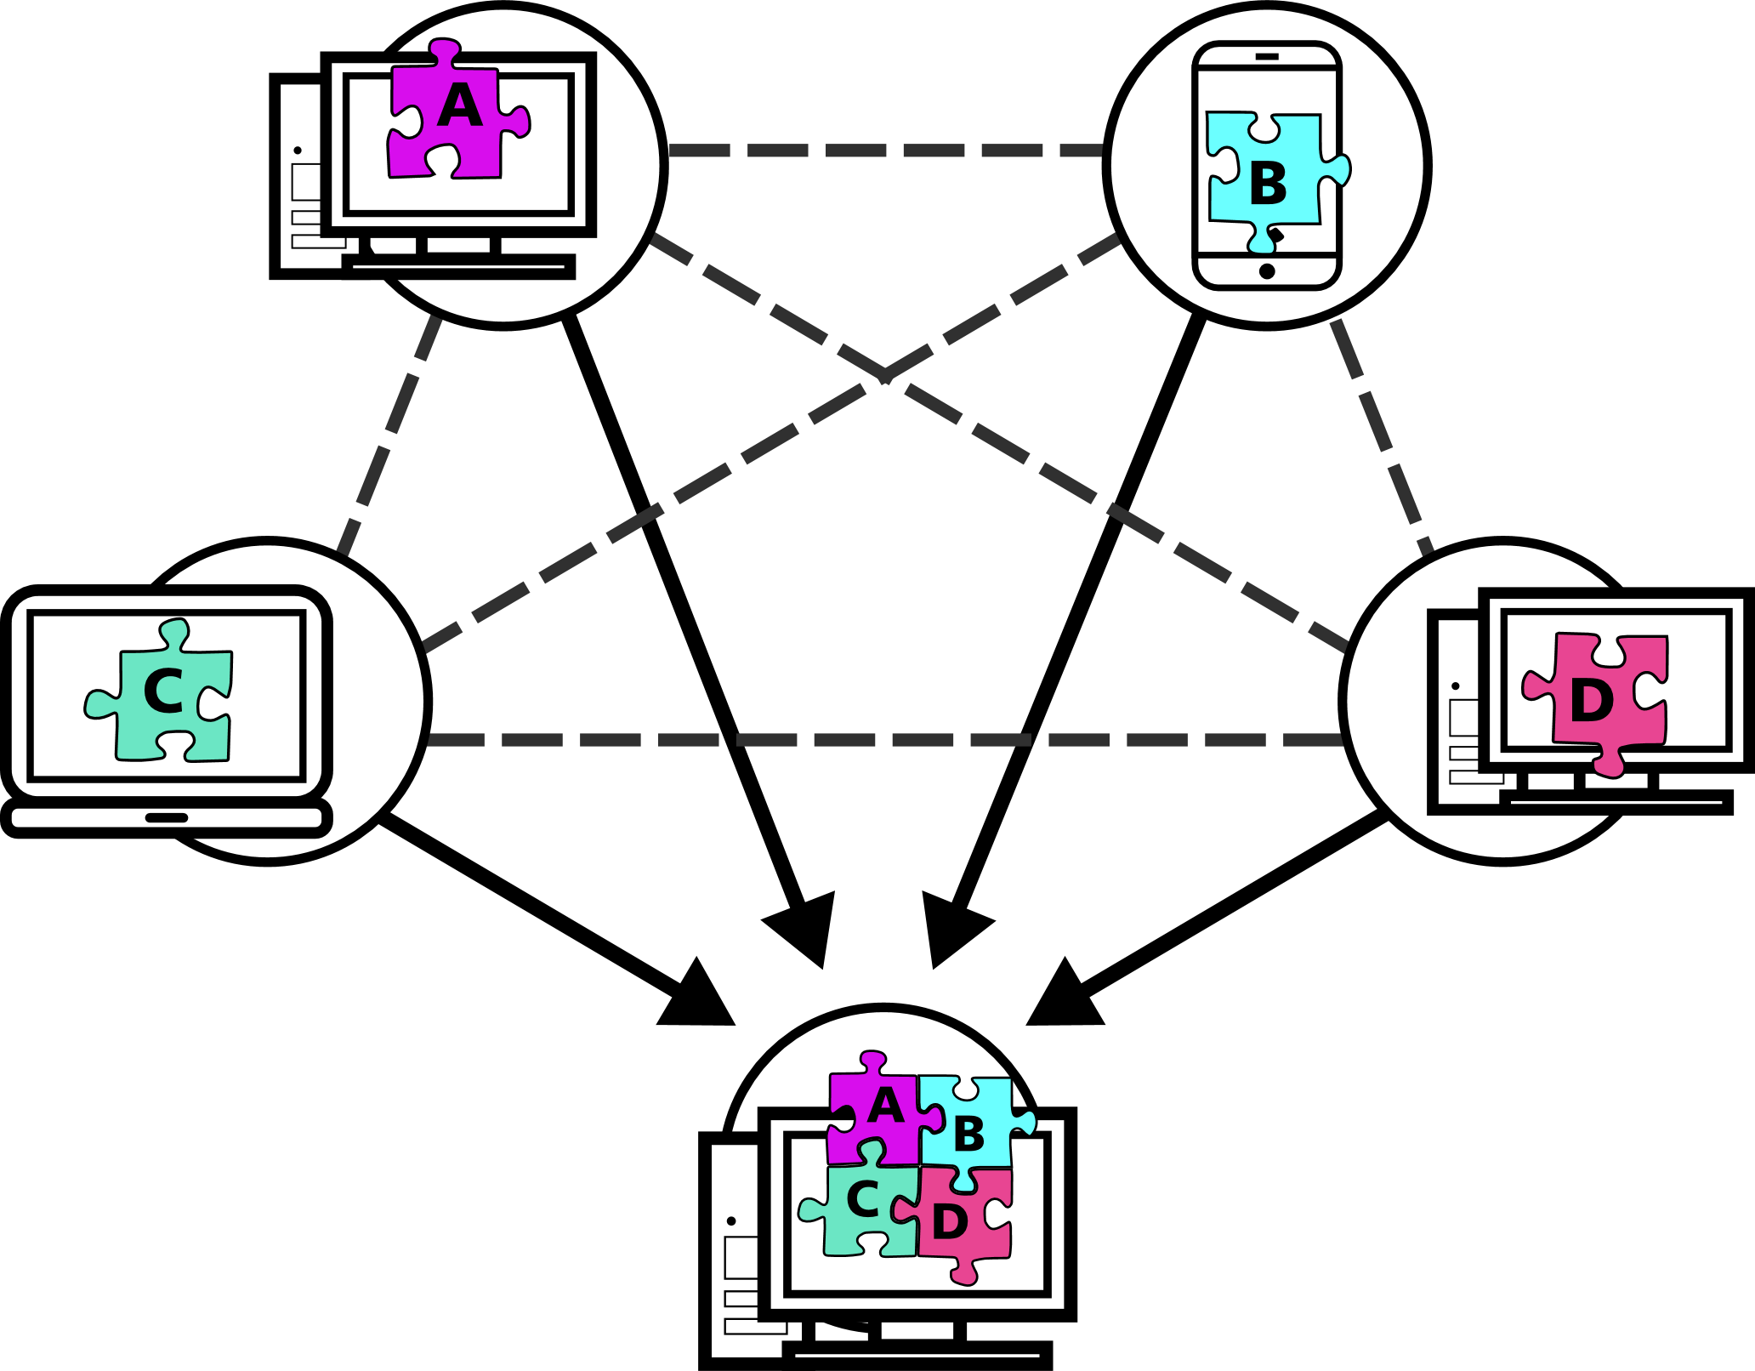
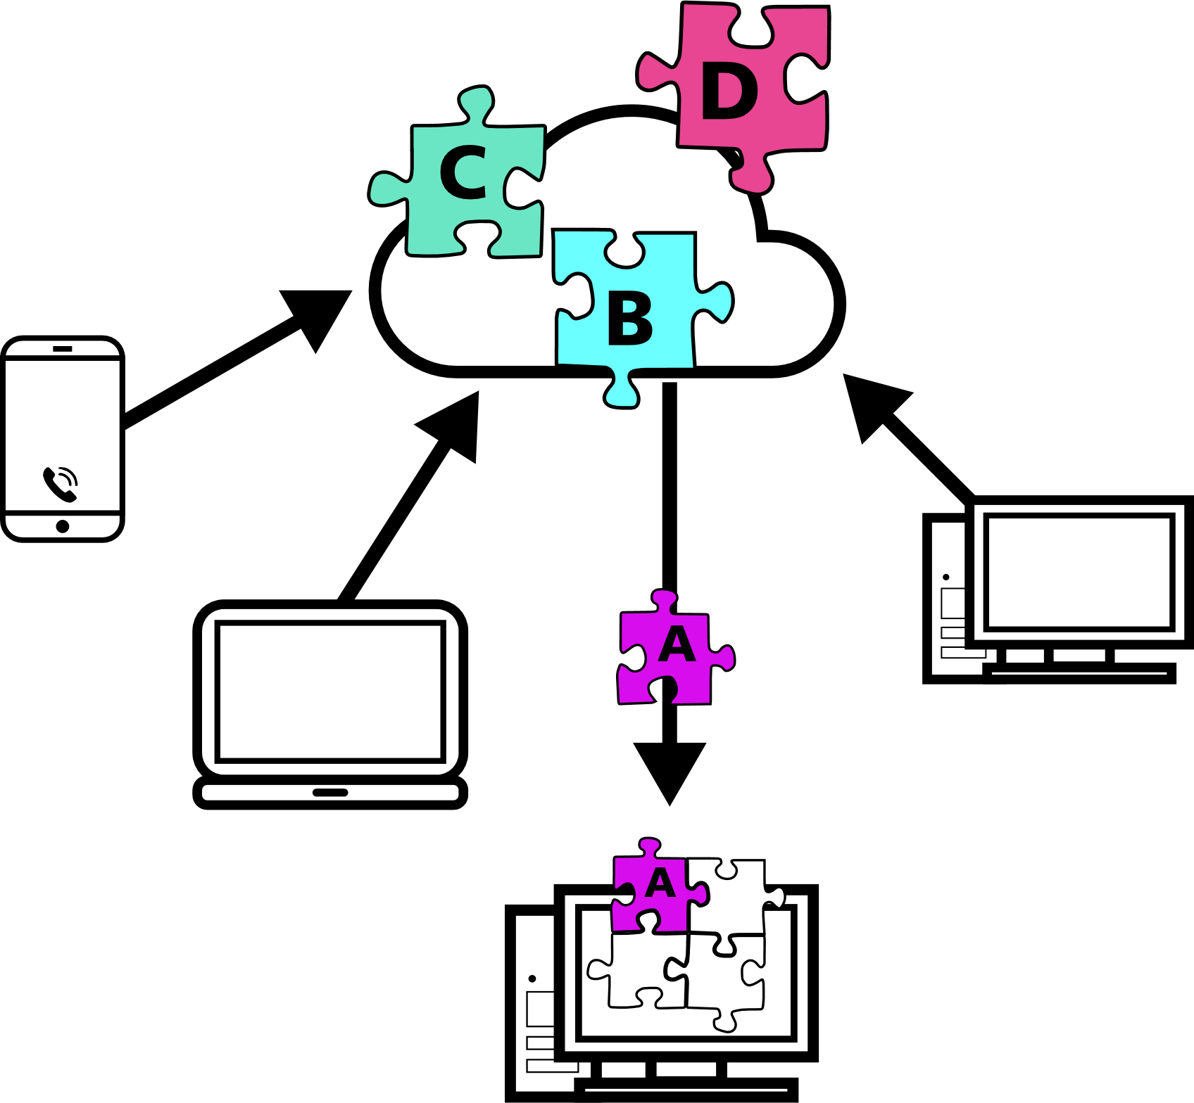
No Transmission Speed Limit
Download different parts from each sync node at the same time
Download parts sequentially from the single cloud
Notes:
This is a unique advantage of Resilio Sync. If I want to sync the files, I can connect with all the on-line points and download the all the files from them. It’s very fast especially the synchronization is under the LAN.
But in traditional service, you have to wait to the files uploaded to the server, then you can start to download it.

Slide 17
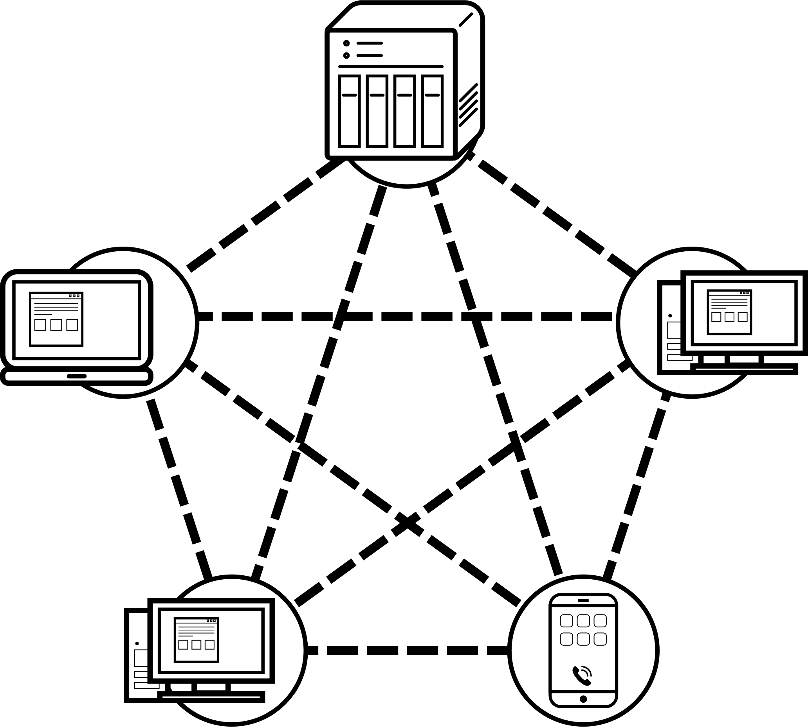
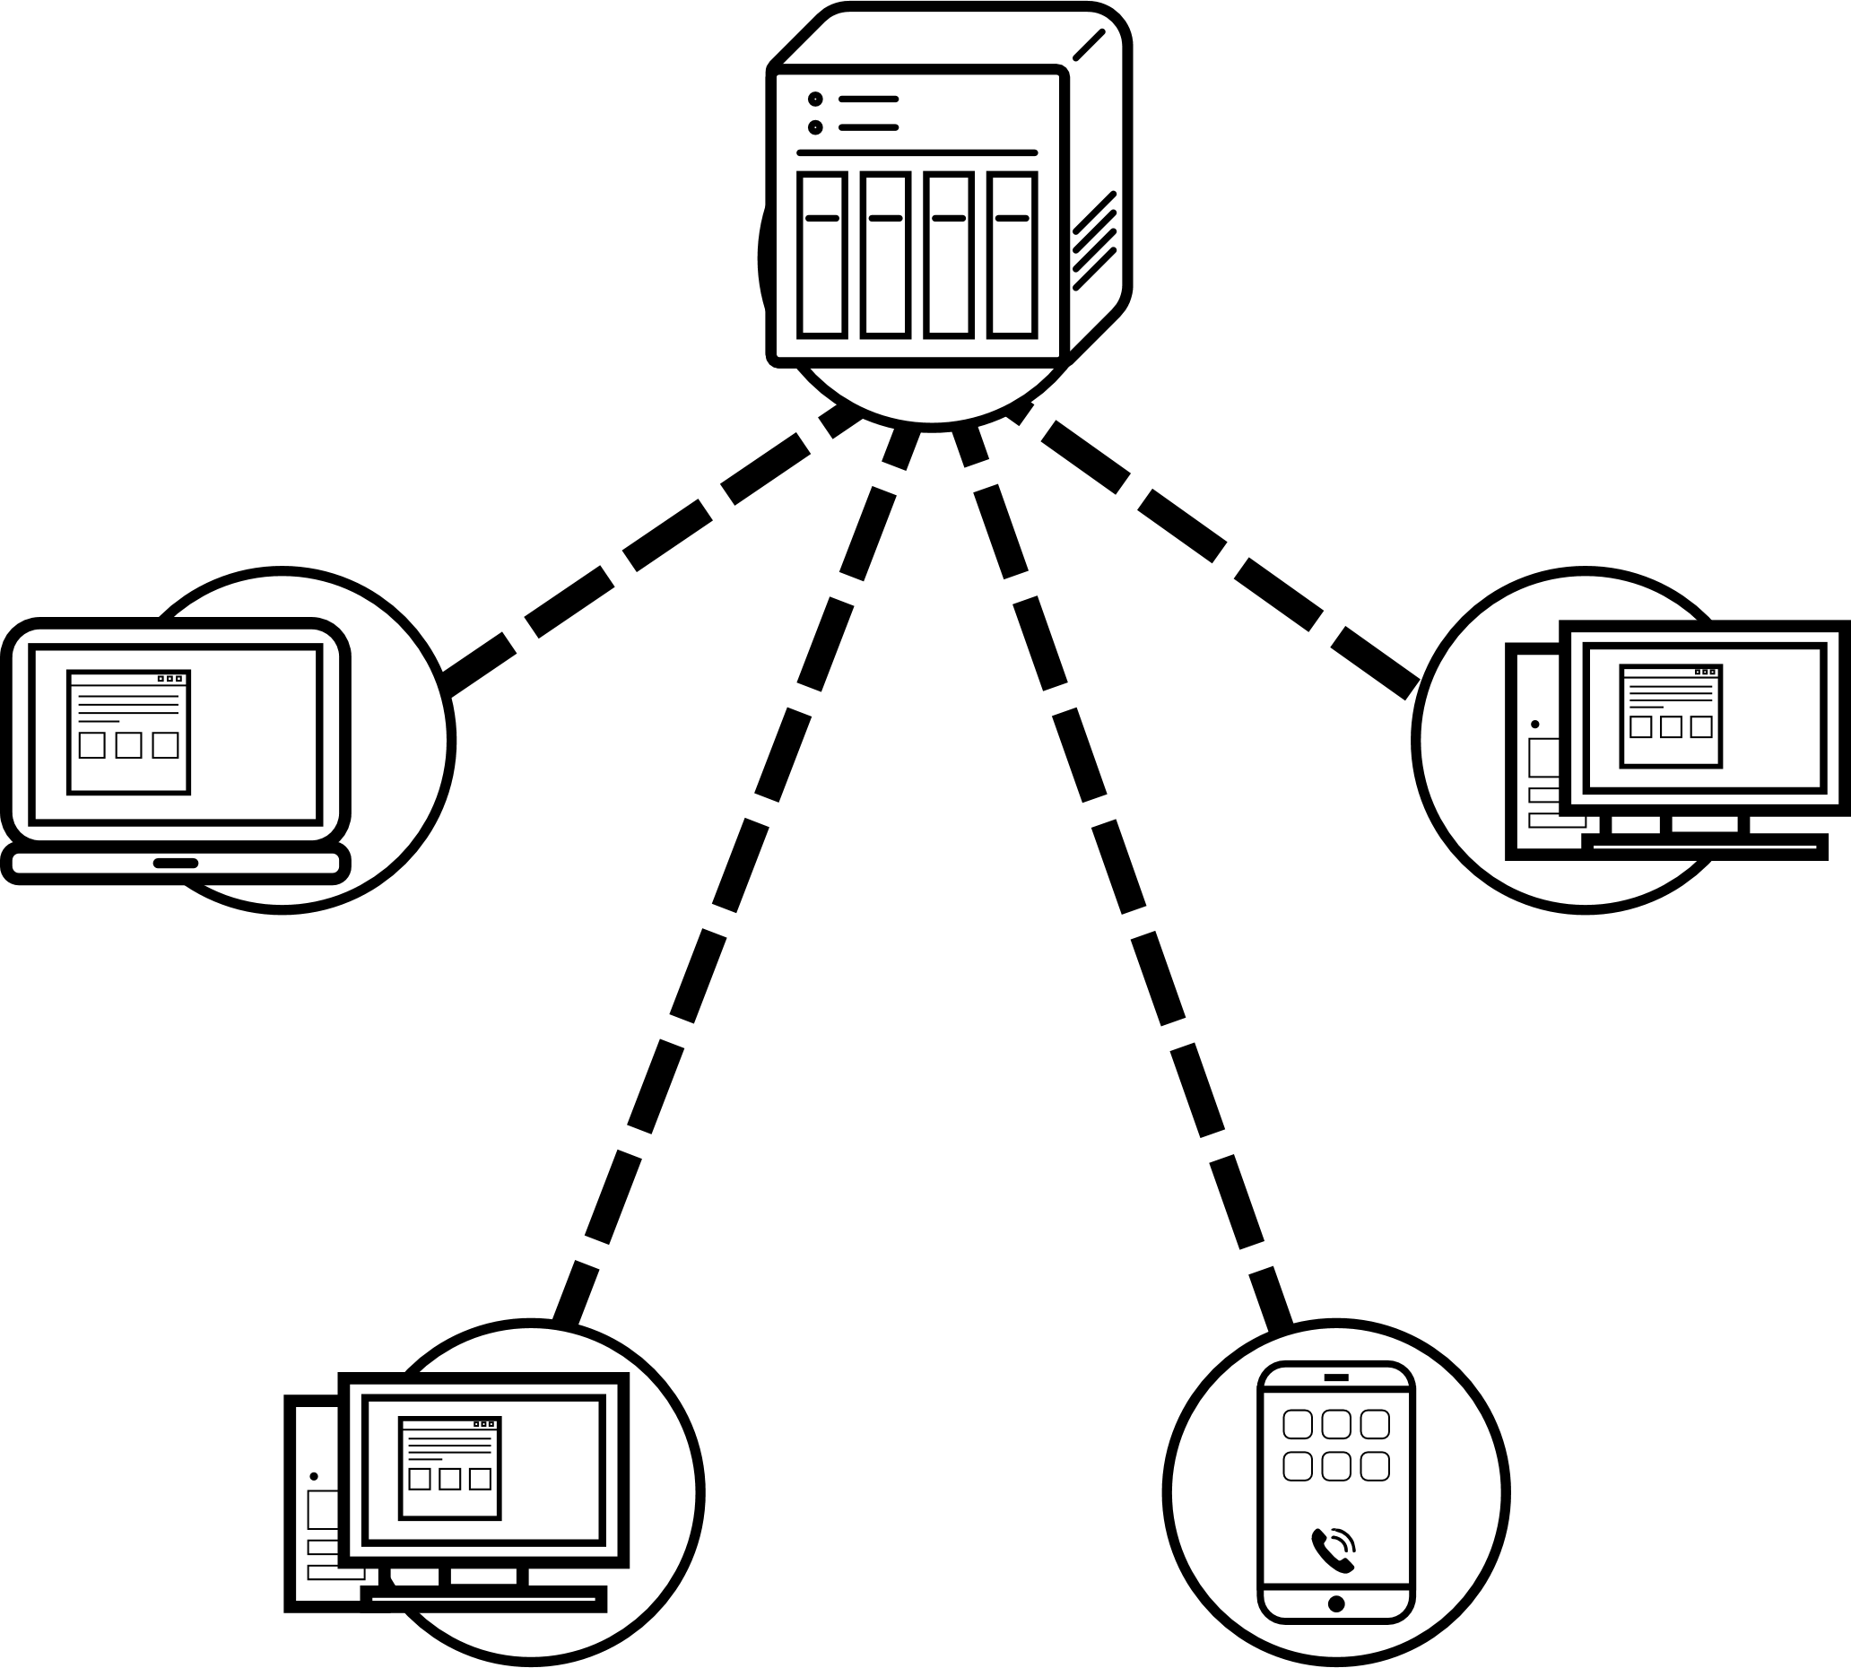
Release the Server Loading
Users are also servers
Multiple points access the server simultaneously, resources will be quickly exhausted.
Server A
Server A
User A
Server B
Server E
User B
User E
User B
User E
Server C
User C
Server D
User D
User D
User C
Notes:
In Resilio Sync, each user also plays the role of server. There is no central device to host the synchronization.
But centralization, it has a host to handle the synchronization. If the multi-points access the files at the same time, the server resource will be exhausted and respond very slow. The situation will become more serious as more people access it.

Slide 18
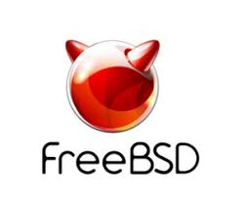
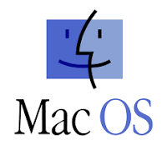
Platform Support
Notes:
Resilio Sync is supported in many platforms. Windows, Mac, Linux, even the mobile device IOS or Android. The synchronization covers all your devices.

Slide 19
Resilio Sync Home Free & Pro Comparison
Features | Free | Professional
Standard folder
Advanced folder
Selective synchronization
Sync from all devices by identity
Change the permissions on-the-fly
Notes:
Now, we can download Resilo Sync home free version on the website. If you want to use the advance function, you can order the pro version on the official web.
Let’s find what the advance functions in pro version.
It adds advanced folder. You have the owner role. The share folder is only can be shared by you. The other person can not share the folder.
Selective synchronization. It only sync the index in your device. When you need it, the files will start to download.
Via the identity function, you can sync all your device one time. You don’t need to create folder share link one by one.
The final one. Change the permissions on-the-fly. It can allow you change the authority of share folder.
No matter free, pro or the other versions, they don’t have folder size, folder number, or speed limits.

Slide 20
The Advantages of Resilio Sync & QNAP NAS

Slide 21
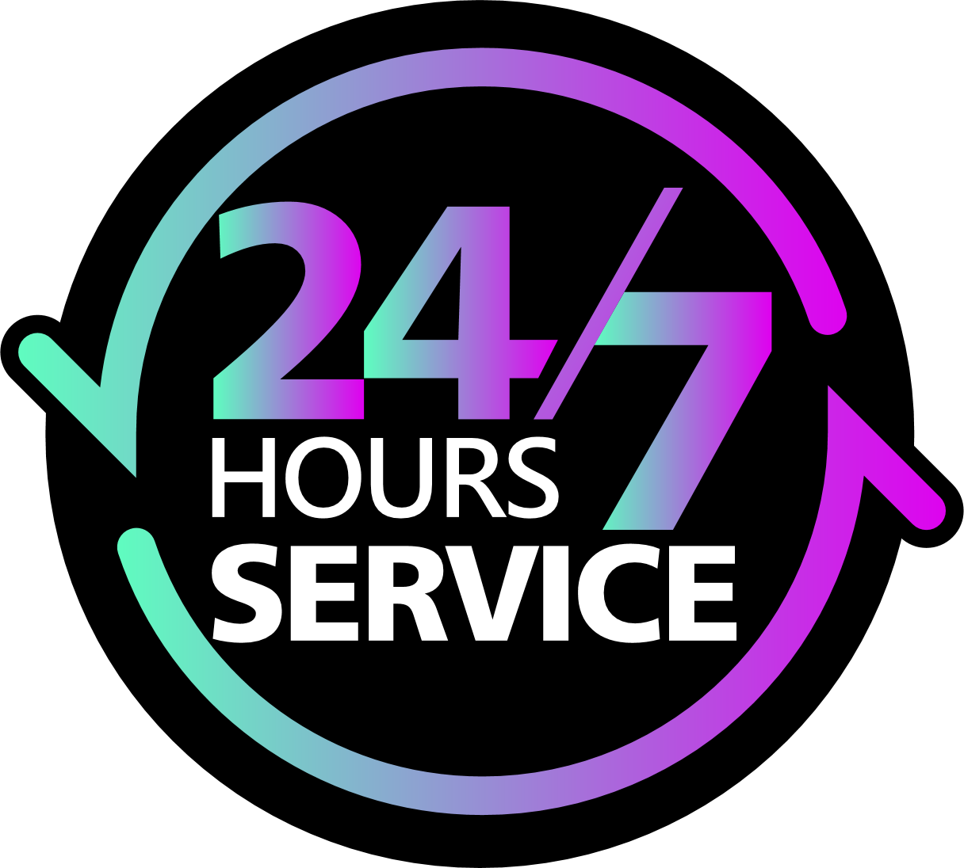
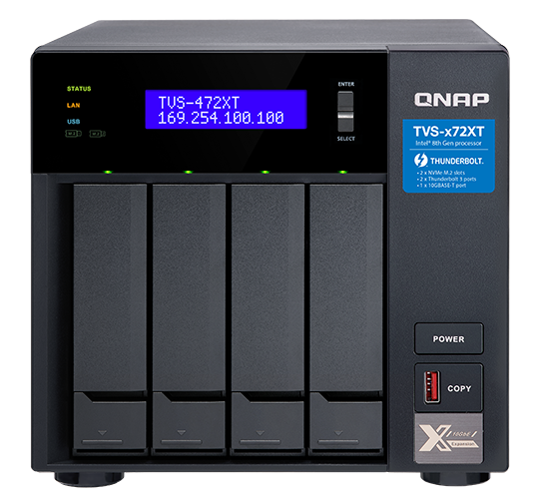
Persistent Service
1
Limitations of peer-to-peer architecture:
Sync is available at least 2 points on-line
2
With QNAP NAS:
Offer 24/7 service
Notes:
Resilio Sync is a peer to peer architecture. If you want to sync files, you need 2 points on-line. Synchronization is not workable on a single computer, so how do we fix it.
We can set QNAP NAS as one point of Resilio Sync, and it will offer 24 hours and 7 days service.
It always keep you get the latest update.

Slide 22
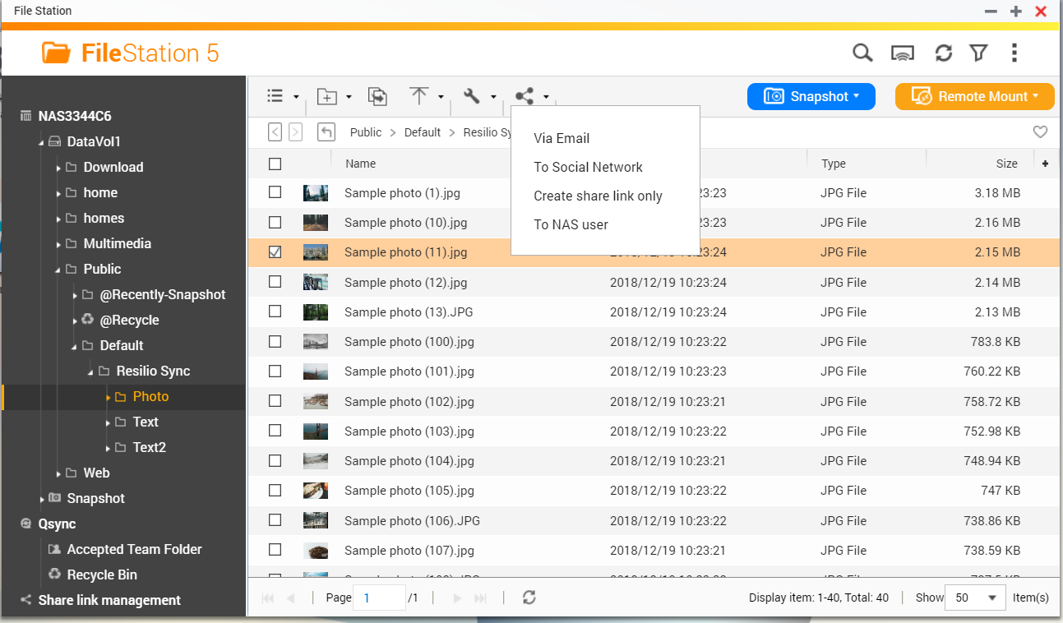
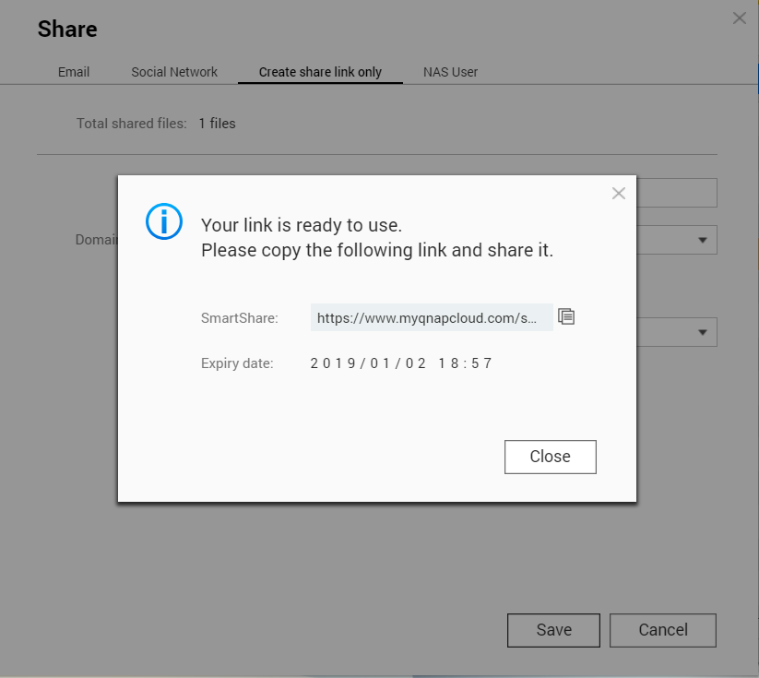
Rapid File Share
Create SmartShare link in QNAP NAS File Station
0
Resolve the following limitations:
Peer-to-peer sharing is not allowed in the network environment of the recipient.
Installation of third-party software is prohibited due to security policy.
Notes:
File sharing is a very important element of synchronization. Resilio Sync has link to share files.
But in some scenarios, it may not so convenient.
If the target user is under an environment doesn’t allow p2p protocol, or the user can not install the software due to security issue.
In case of this, we can generate a Smartshare link via QNAP NAS. This function is available in Filestation. We can create and share it.

Slide 23
Use with QNAP Hybrid Backup Sync Backup Solution
Cloud Backup
Remote Backup
Local Backup
Set the target folder of the HBS as another shared folder of Resilio Sync. The backup files are able to be stored in another server/PC
Data Sync
Data Backup
Notes:
QNAP has a very powerful backup solution we called Hyper Backup Sync. We can adopt Resilio Sync in the front end for the rapid file synchronization.
But at the same time, we also back up the share folder in QNAP NAS periodically. We can backup the data to cloud, remote NAS, local NAS. Furthermore, we can still use Rsilio Sync to transfer the backup to the other server or PC.
In this scenario, we keep the fast synchronization. If the user delete files accidently or files get malicious encryption, we are able to restore all the files.

Slide 24
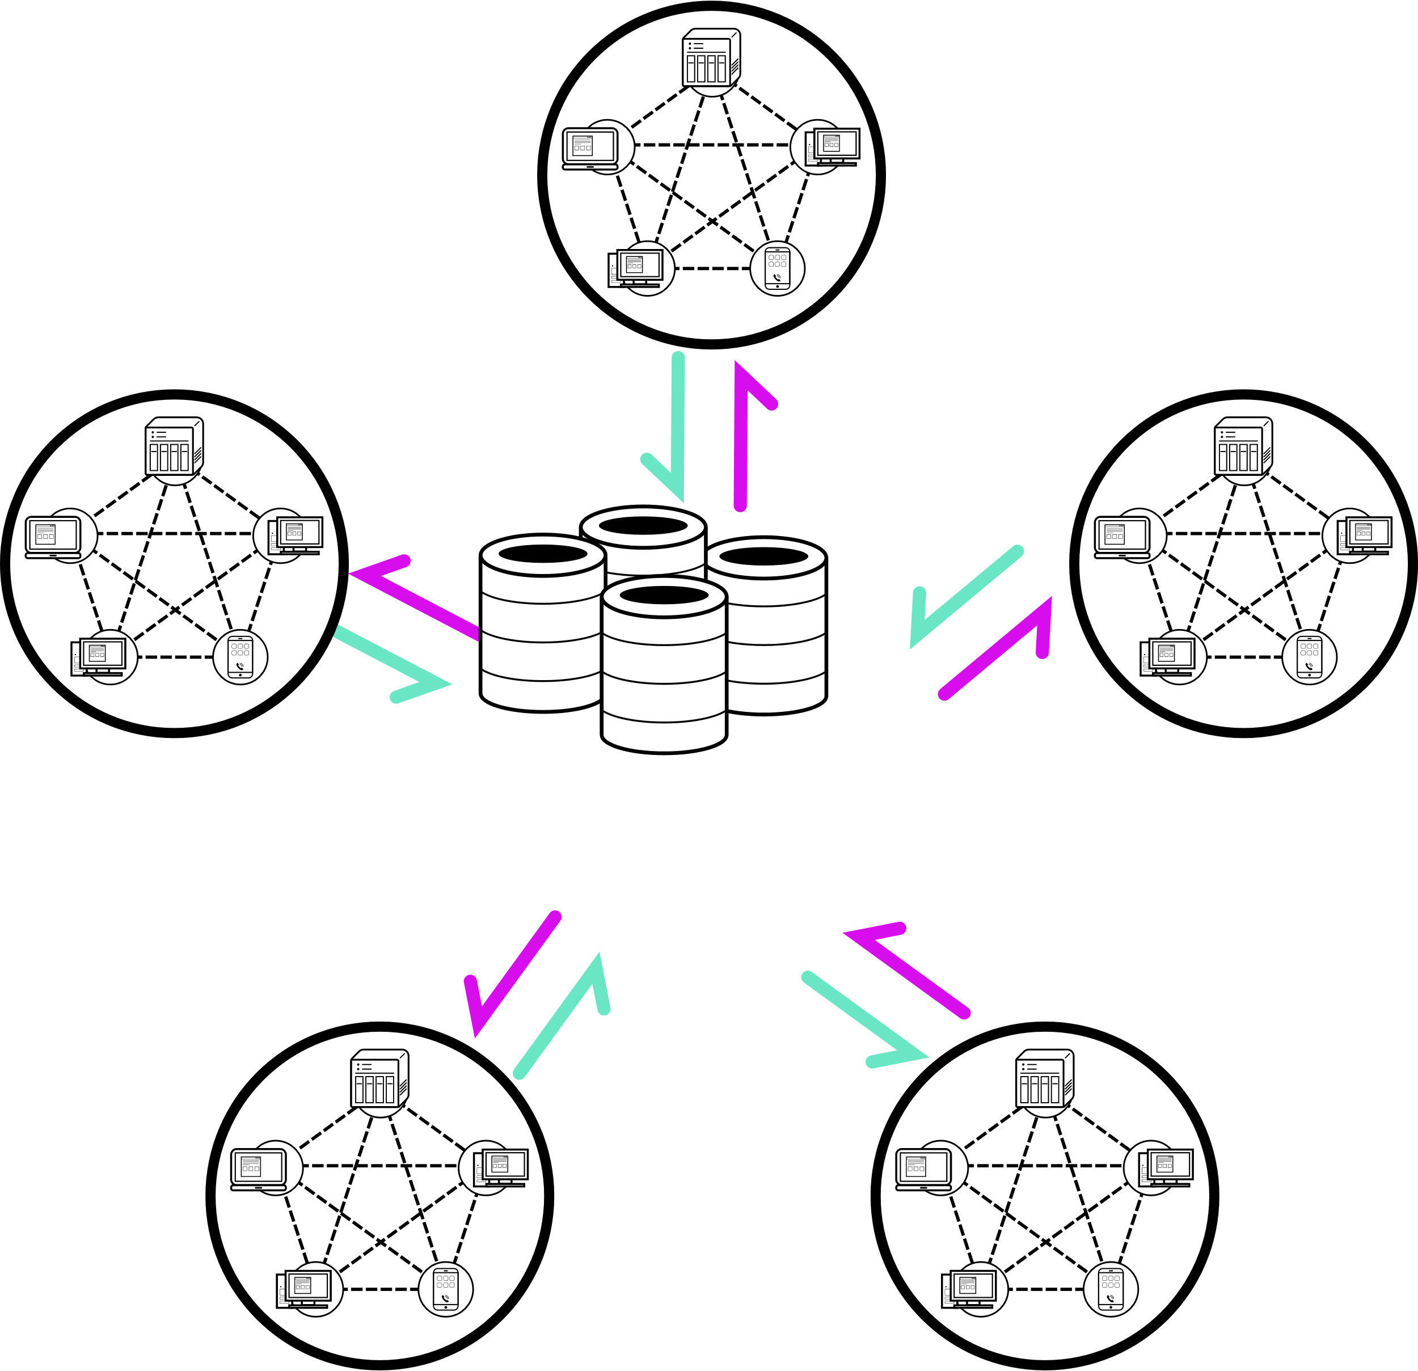
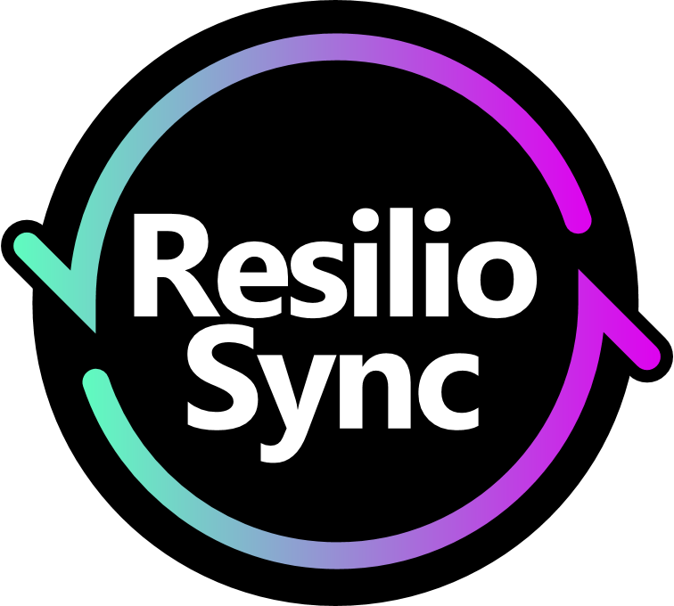
Giant Capacity of QNAP NAS
Sales Dept.
NAS giant storage capacity:
It is able to accommodate different synchronization schemes with speed, storage capacity, and deployment flexibility.
Personnel Dept.
Service Dept.
NOTE:
Multi-users or business application, please order accordingly “Pro” or “Business” version.
Marketing Dept.
R&D Dept.
Notes:
The last one is the giant capacity of NAS. The space of personal device is limited.
We can implement several Sync schemes in QNAP NAS. Let the NAS become the data backup center of all the synchronization.
Of course, this kind of application is regarding pro or business functions. If you have the needs, please purchase pro or business version accordingly.

Slide 25
Synchronization Solution Comparison
Features | Sync Software | Public Cloud | QNAP NAS + Resilio Sync
Sync available in LAN | Yes | Most don't support it | Yes
Security & privacy | High | Normal | High
Transmission speed limit | No | Yes | No
Single size limit | No | Yes | No
File share link | No | Yes | Yes
File recovery | Limited | Limited | Complete
Sync speed | Normal | Slow | Fast
Notes:
Last, Let’s see the comparison table.
Obviously, we find we get all the edge of sycn software and cloud.
Of course, our sync speed is the most excellent.

Slide 26
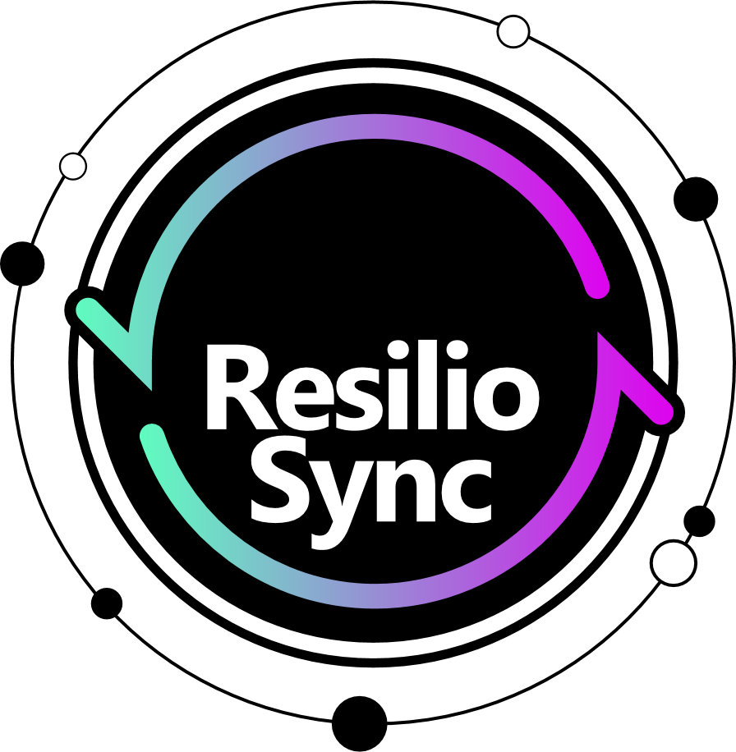
The Best Solution of Synchronization
Rapid sync of peer-to-peer
File share of cloud
Safety of direct connection
Complete backup of NAS
Giant storage space of NAS
Notes:
Let me summarize the advantage of Resilio sync and QNAP NAS.
It has file share of cloud
Complete backup of NAS
Giant storage of NAS
Rapid sync of peer to peer and the safety of direct connection

Slide 27
Resilio Sync Installation & Setup

Slide 28
Installation & Setup
Installation
Operation Instruction
Sync Setup
NAS / Windows
Notes:
I will show the installation and setup.
Later, we will demo how to sync folder and file.
First, it’s NAS and Windwos version installation, operation, and sync setup.

Slide 29
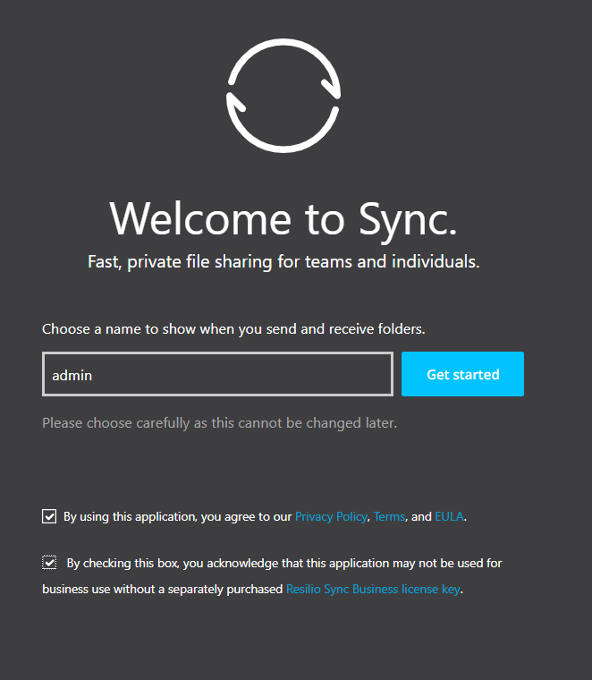
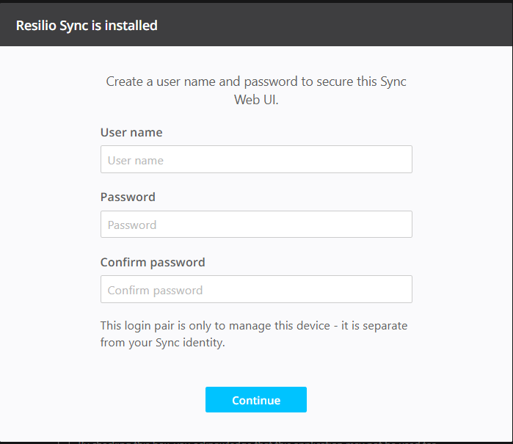
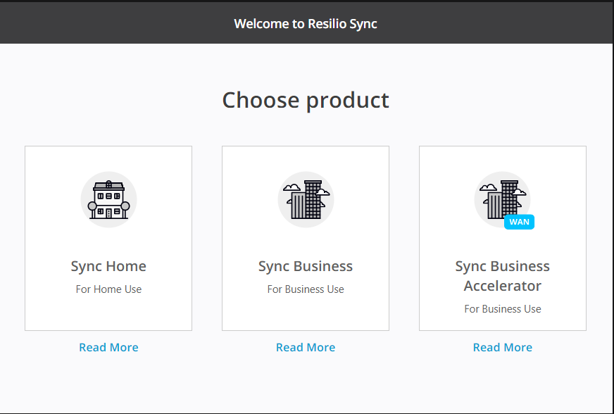
Installation of NAS Version
Name the device then tick the two boxes and get started
Create an account and password for the first use
Choose Sync Home
Notes:
We can down load the app form QNAP NAS app center. When you first use it.
Create an account and password for the first use
Choose Sync Home
Name the device then tick the two boxes and get started

Slide 30
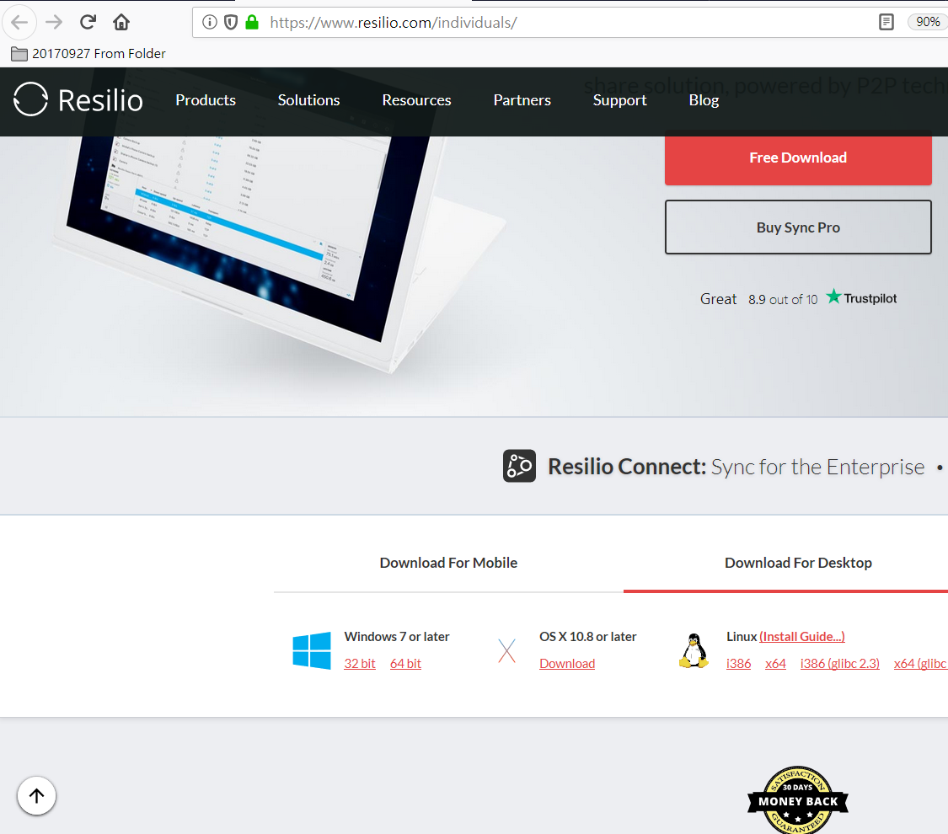
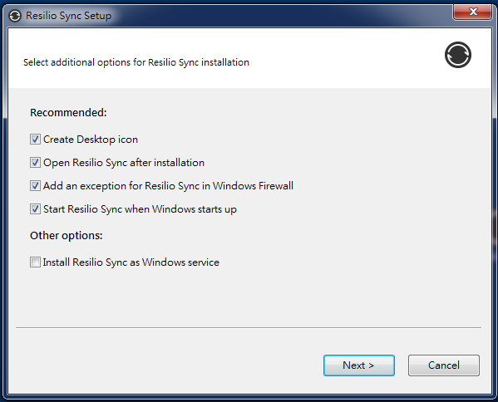
Installation of Windows Version
Name the device then tick the two boxes and get started
Download the right version from official website
Use default setting, and press “next”
Notes:
Download the right version from official website
Use default setting, and press “next”
Name the device then tick the two boxes and get started

Slide 31
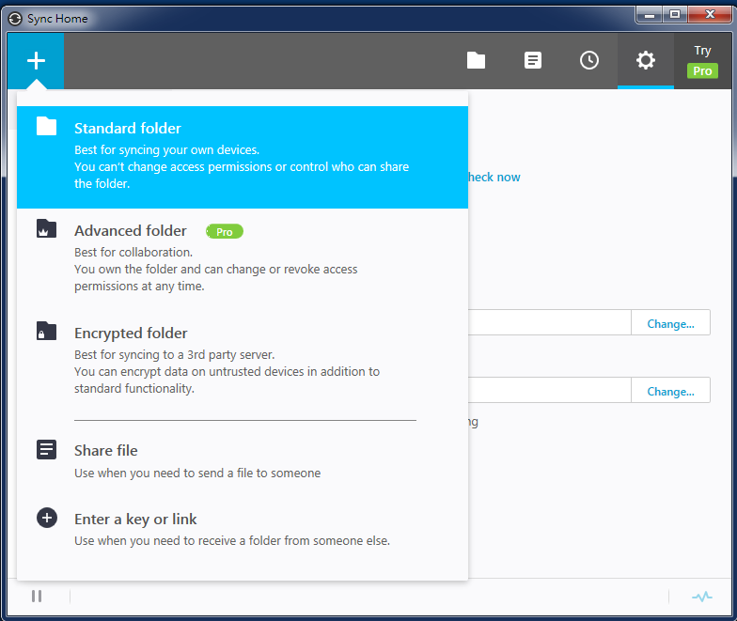
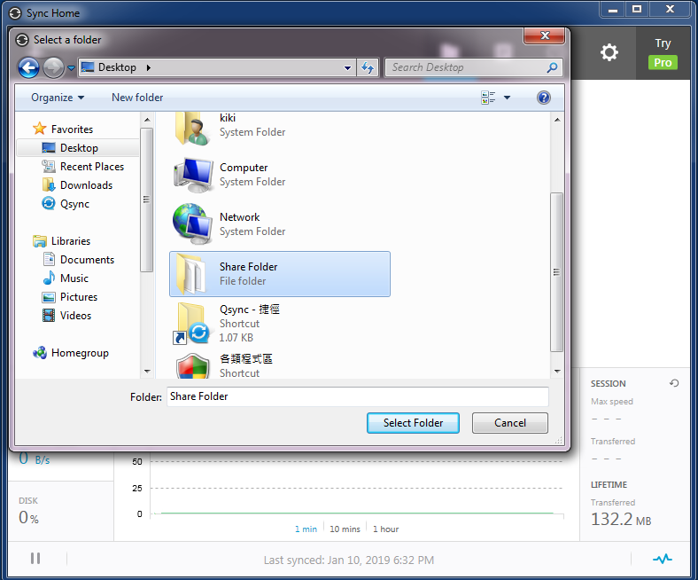
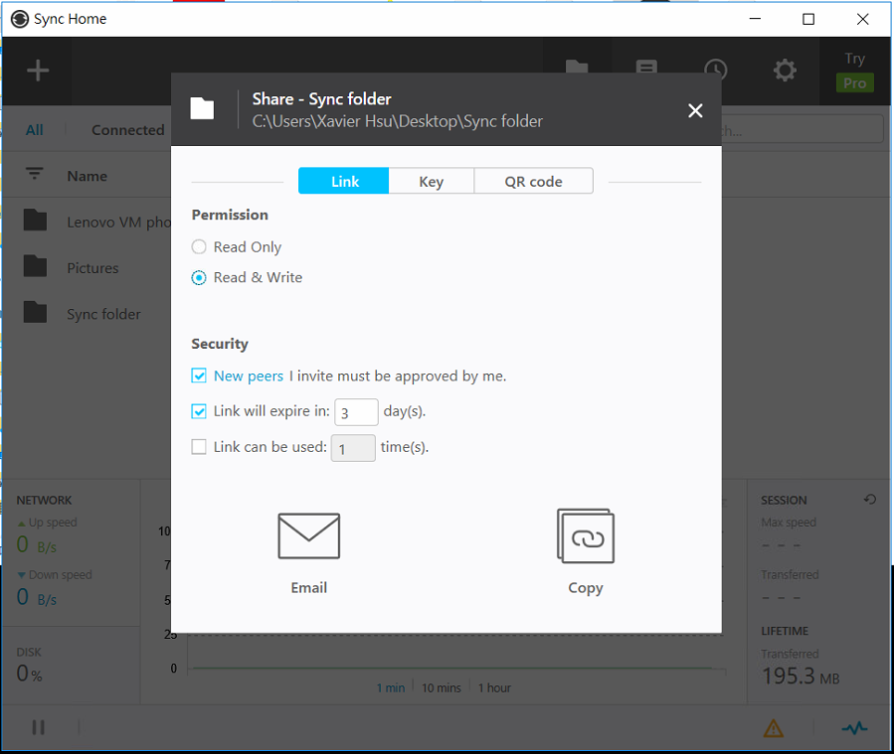
Sync Setup(computer) – Source(1)
Besides the permissions for sharing, you can also add security limits, such as permission before synchronization, the expiry time and number of uses of the key.
Choose “Standard” folder
Choose the share folder
Notes:
Choose the standard folder
Choose the share folder
Besides the permission for sharing, you can also add the security limits. Such as advance permission or link valid or number of use.

Slide 32
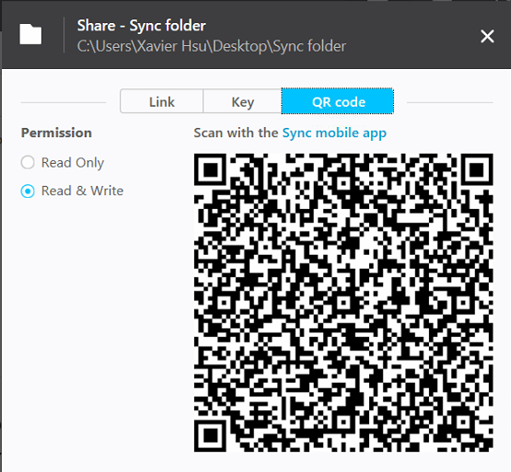
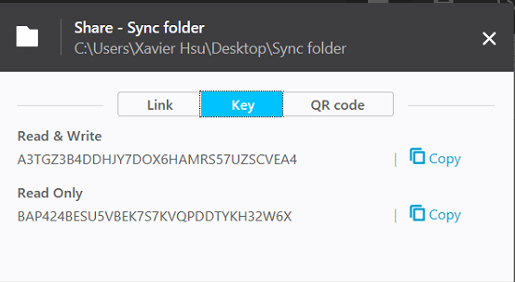
Sync Setup(computer) – Source(2)
Click on the key, and the two sets of keys for "read & write" and "read only" will be generated below. Based on the requirements, click the “Copy” and pass it to the remote device.
You can also click on “QR code” for the mobile device authentication
Notes:
Click on the key, you will find 2 sets of keys. Copy one and pass it to the remote side.
You can also click on the option of QR code for the mobile device synchronization.

Slide 33
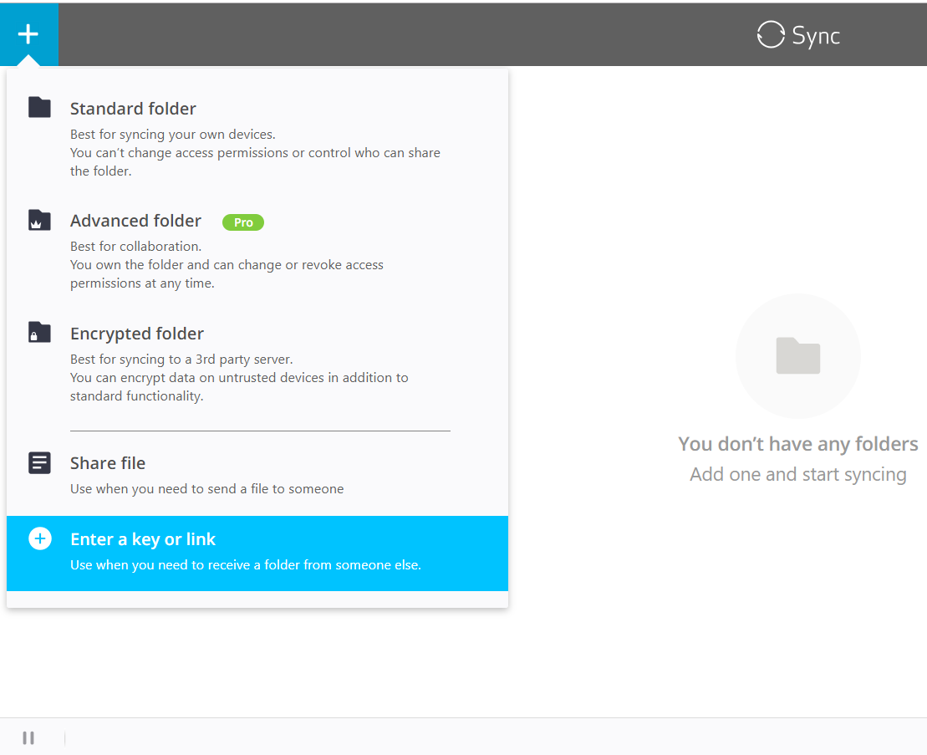
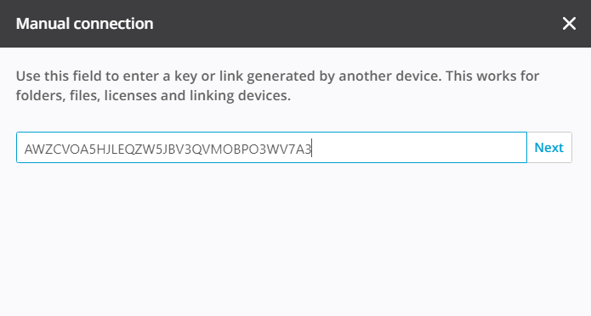
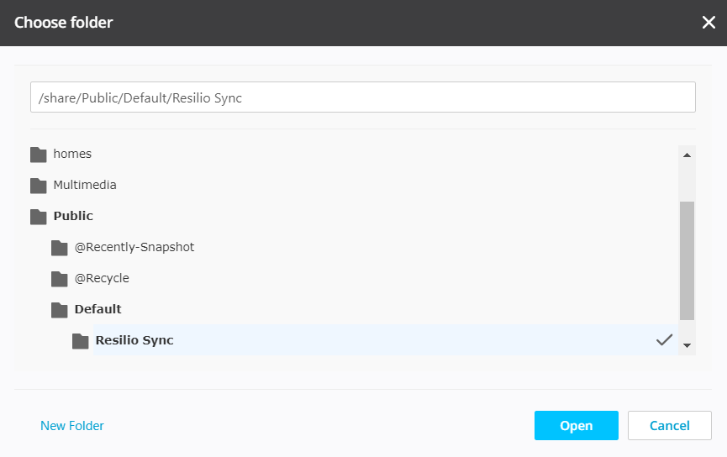
Sync Setup(NAS) – Target
Select “Enter a key or link” when you get the key via mail or copy.
Type the key and click “Next”
Select backup destination folder
Notes:
Here, we will sync the files from computer side. We chose the last option” enter a key or a link”.
Type or paste the key from the computer side., then we select the destination folder.

Slide 34
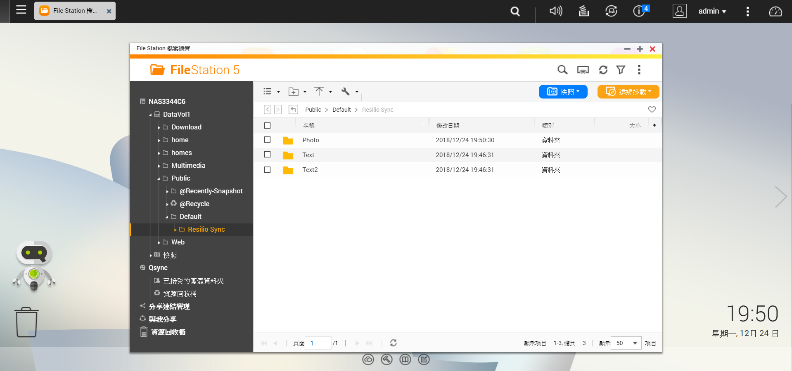
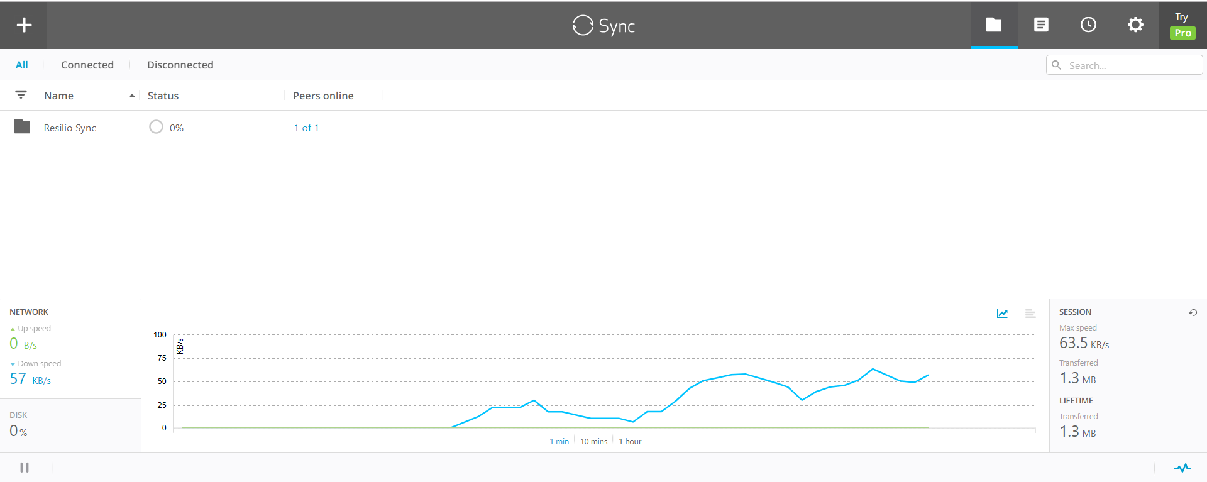
Sync Setup – Sync Result Check(NAS)
Corresponding sync files and folders are shown in the NAS FileStation.
Click the menu and find that the synchronization is still processing
Notes:
We can see the synchronization is processing.
Then we go to the NAS to check whether the synchronization is succesful or not.

Slide 35
Resilio Sync Data Sync

Slide 36
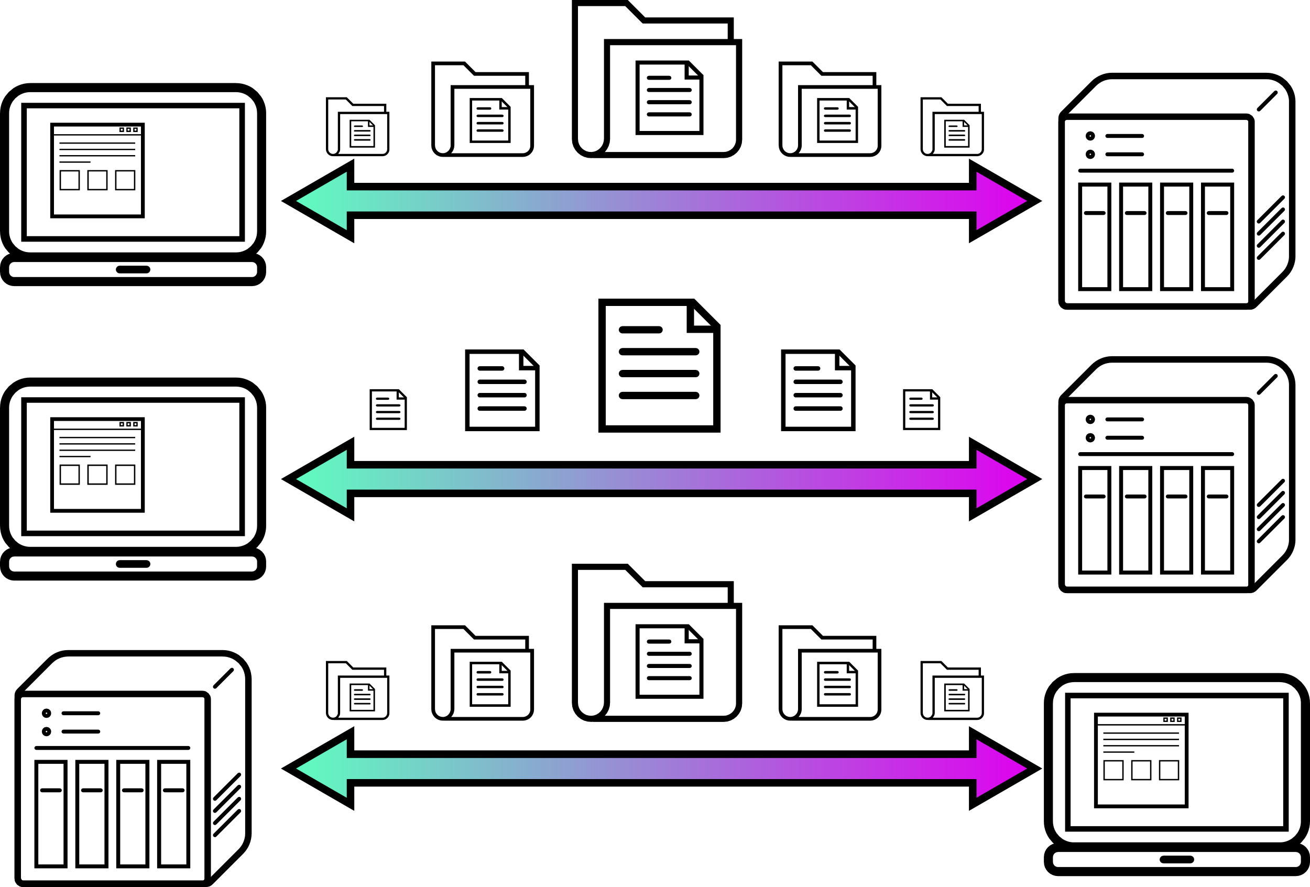
Demo
A
Sync computer folder to NAS
B
Share computer file to NAS
C
Sync NAS folder to computer

Slide 37
Special Offer
Version | HOME PRO (Single User) (One-Time) | BUSINESS (5+1) (Monthly) | BUSINESS (5+1) (Yearly)
Regular | $59.99 | $108 | $994.5
Special Offer | $30 | $54 | $596.7
 | 50% off | 50% off for 6 month | 40% off for one year
 | Code: QNAPSYNCHOME50 | Code: QNAPSYNCB50M | Code: QNAPSYNCB40Y
 | Valid until 02/03/2019 | Valid until 02/03/2019 | Valid until 02/03/2019
Notes:
Before the end, I would like to announce a good news for the friends watching the introduction.
Resilio Sync specially offer a gift to us. For the people watching the introduction are able to get discount by 2/3.
Copy and paste the discount code on the payment website, then get the discount.
We will put the discount code on the text introduction.
Thank you for your watching.

Slide 38
is your best choice! ​
Copyright© 2019 QNAP Systems, Inc. All rights reserved. QNAP® and other names of QNAP Products are proprietary marks or registered trademarks of QNAP Systems, Inc. Other products and company names mentioned herein are trademarks of their respective holders.​
​

