Slide 2

QNAP x Dropbox the perfect combination
Massive growth of data cause many preservation problems
Use Dropbox to keep your data in sync with your life
QNAP NAS paves the way for your data stream
Demo
QNAP NAS liberates hybrid cloud potential

Slide 3
Massive growth of data cause many preservation problems
Notes:
資料海量成長 資料保存問題多

Slide 4


FAQ of Data Preservation
Duplicated data disperse to devices cause low storage efficiency
Uploading large quantities of data on the cloud takes lot of time
How to access data anytime from any device
How to easily share data
How to preserve data in a more secured way
Adopt the hybrid cloud storage solution to meet the above mentioned needs
Notes:
人類活動被無時無刻記錄的同時，資料的量級爆炸性的成長，資料儲存及存取的問
資料保存 使用者常見問題
重複資料分散各裝置，儲存空間運用效益低
海量資料，資料上傳至雲端費時
如何在各個裝置隨時存取資料
資料如何便利分享
資料如何保存才安心
混和雲儲存方案可滿足上述資料保存需求

Slide 5


Comparison of data preservation between NAS and Public Cloud
 | NAS | Public Cloud
Storage protection | Complete protection | Complete protection
Data Security | Higher | Lower
Access Speed via Intranet | Fast | Slow
Access Speed via Internet | Depends on internet bandwidth to NAS | Fast
Storage Capacity | Large | Expand on demand

Slide 6

Adopt hybrid cloud architecture to accelerate your workflow
Centralized data management – NAS direct access to Dropbox makes file management more convenient
Flexible storage configuration – Adjust data storage location according to file access frequency
High speed data access – Use NAS to accelerate the cloud data access
Upload data to cloud more easily – Use NAS to automatically upload data one the cloud
Data sharing and processing without restrictions everywhere – Dropbox provides convenient file sharing and editing functions
Keep data safe – Adjust the storage strategy according to the characteristics of data and develop a backup plan
Notes:
讓混和雲架構補足加速您的工作流程
資料集中管理 - NAS直通Dropbox讓檔案管理更便利
儲存空間靈活配置 - 依照檔案存取頻率調整儲存位置(NAS, Dropbox)
資料高速資料存取 - NAS加速本地端檔案存取
資料上雲更便利 - 資料上雲交給NAS處理，不影響本機工作運行
隨處不受限的進行資料分享及處理 - Dropbox 提供便利的檔案分享及編輯功能
資料安全 - 依照資料性質調整存放策略，並制定備份計畫

Slide 7
Use Dropbox to keep your data in sync with your life
Notes:
善用 Dropbox 讓資料與生活同步

Slide 8

Dropbox provides rich features redefining cloud drive services
Cloud storage
Support multiple platforms(Windows / Mac / Linux / iOS / Android)
File sharing
Team sharing
Preview cloud files directly
File offline access
Search contents of files
File recovery with multi versions
Notes:
Dropbox 豐富功能 重新定義雲端硬碟
檔案雲端儲存
檔案歷程記錄
跨裝置及時存取
手持裝置照片備份
拍照上傳
雲端檔案線上編輯
PDF / Office / 影像編輯...
檔案協同處理
評論功能
檔案離線存取功能
檔案共享
與多家軟體服務緊密合作 讓雲端空間 不再是塵封已久的資料倉庫

Slide 9
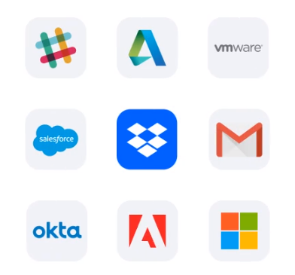
Multi-function integration, cloud space no longer just a data warehouse
Preview and edit cloud files online
File collaboration
Access the cloud files directly via integrated applications
Notes:
多方整合讓雲端空間不再只是資料倉庫
線上預覽及編輯雲端檔案
檔案協同處理
應用程式直接存取雲端檔案

Slide 10

Record life and share great moments
Upload photos right after the photo has been taken
Share your idea by comment and reply on Dropbox files
Share files easily
Shared links make file collection more convenient
Notes:
記錄生活並分享精采時刻
手機隨拍及傳，不佔用手機空間
檔案留言，讓大家分享想法
輕鬆分享檔案
共用連結讓檔案蒐集更便利

Slide 11

Powerful tool for mobile office, data can be accessed in time everywhere
Quickly access files across devices
Collaborative editing online for a smoother teamwork
File offline access
Notes:
記錄生活並分享精采時刻
手機隨拍及傳，不佔用手機空間
檔案留言，讓大家分享想法
輕鬆分享檔案
共用連結讓檔案蒐集更便利

Slide 12

Data management on cloud to keep your data safe
Storage data on cloud
Back up photos on your mobile device
Restore files from version history
Notes:
記錄生活並分享精采時刻
手機隨拍及傳，不佔用手機空間
檔案留言，讓大家分享想法
輕鬆分享檔案
共用連結讓檔案蒐集更便利

Slide 13
QNAP NAS paves the way for your data stream
Notes:
QNAP NAS 為您的資料流造橋鋪路

Slide 14

Variety of applications to simplify the cloud process
Hybrid Backup Sync
    Multi-site backup
  Instant recovery
  Flexible synchronization
Remote Mount
  Manage all spaces in one place
Cache Mount
  Data migration to cloud
  Accelerate local access to cloud files
Notes:
豐富的軟體支援 簡化上雲流程
Hybrid Backup Sync
多點備份，即時回復，彈性同步
Remote Mount
讓NAS直通雲端服務，雲端檔案集中管理更便利
Cache Mount
遷移本地端資料至雲端
加速本地端存取雲端資料

Slide 15


QNAP Hybrid Backup Sync
3-2-1 backup strategy
Instant data synchronization
Flexible use of hybrid cloud spaces
        Keep 3 copies
        Keep the files on 2 different media types
    Store 1 copy offsite
Notes:
QNAP Hybrid Backup Sync
資料備份 3-2-1
資料即時同步，靈活運用混和雲空間

Slide 16



Hybrid Backup Sync user scenario
Improve work efficiency
Flexible use of the storage space
Data backup
  Two-way file synchronization keep the latest data, can be accessed both inside and outside the office.
  Actively sync your Dropbox data to instantly save your Dropbox updates on the NAS
  Follow the backup 3-2-1 strategy to keep an additional copy on Dropbox
  Only synchronize the latest and working data to Dropbox and store the expired and less-accessed data on the NAS to maximize cloud usage space and reduce expenses.
Notes:
Hybrid Backup Sunc 使用者情境
辦公達人
檔案雙向同步功能，不論在公司內部還是外部，皆可存取到最新資料，工作資料不中斷
Data backup
主動同步Dropbox資料，即時保存Dropbox更新資料，讓資料在地留存。
遵循備份3-2-1法則，除了本地NAS存放資料，更將資料同步至Dropbox保存
空間達人
將過期及較少存取的資料存放於NAS，僅同步較新且工作中使用的資料，將雲端空間做最大活用，也可減少支出

Slide 17







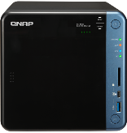








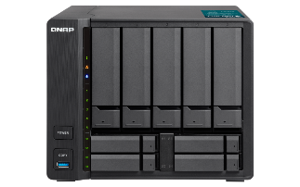



QNAP Remote Mount
Access multiple accounts in one NAS
Hybrid Cloud Management
Use cloud services without any restriction
Multi-site file sharing and management
China
R&D Department
Log in to NAS in other location
Connect to Cloud Drive
Design
Department
Other Location
Customer
Notes:
混和雲空間使用與管理
在世界各地不受限的使用雲端空間
多點間互相共享及管理檔案

Slide 18



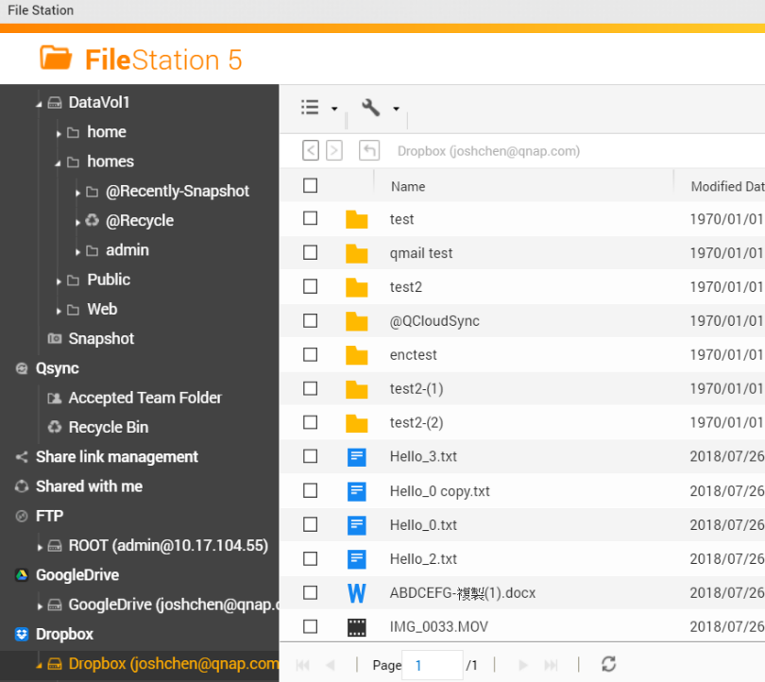

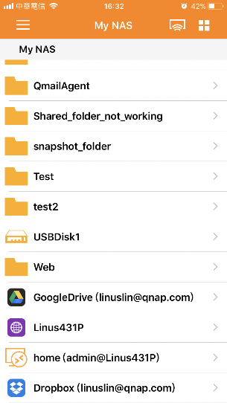
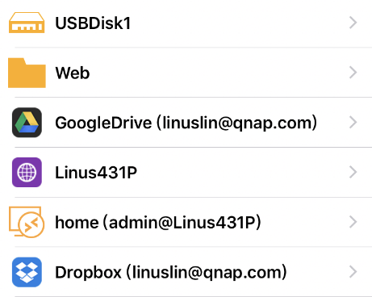



Convenient File Access Interfaces
Qfile
File Station
Web
Mobile
Local NAS
Remote NAS
Cloud Storage
Notes:
便利的檔案存取介面

Slide 19

Demo

Slide 20
QNAP NAS liberates hybrid cloud potential

Slide 21

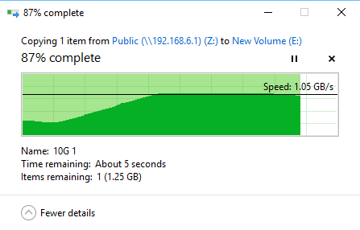
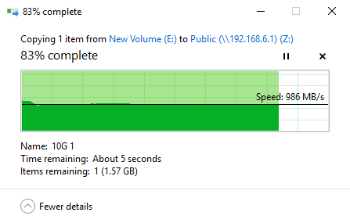

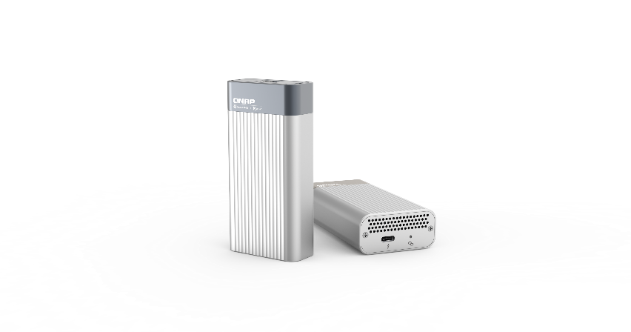
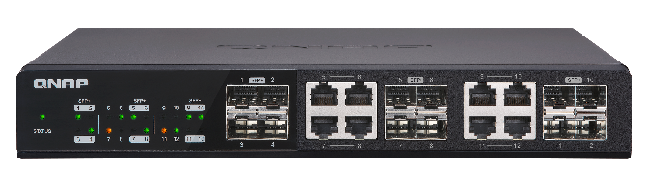
QNAP NAS high-speed transmission interface to accelerate data access
Download (from NAS) Upload (to NAS)
10 GbE Switch
Thunderbolt 3

Slide 22
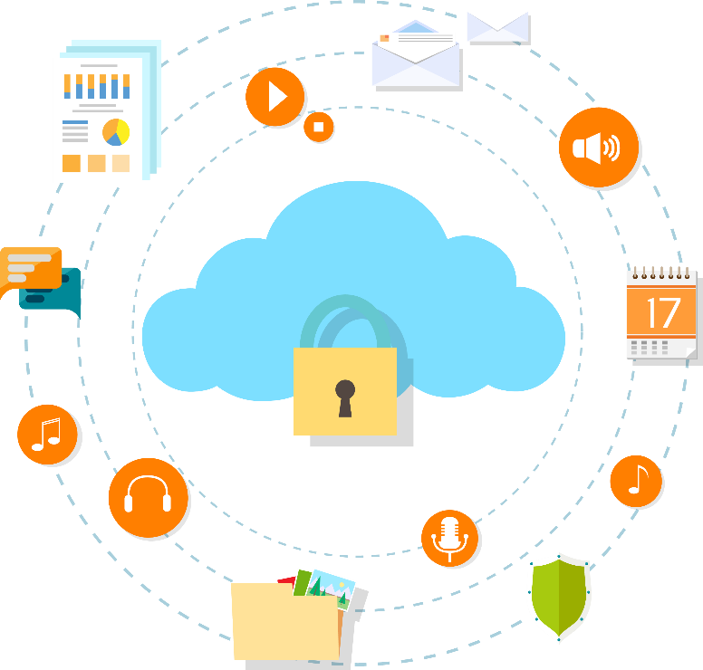
More secured data preservation is required to comply with GDPR
Data cannot be accessed by unauthorized personnel
Data access right management
Secure data transmission
Secure data storage
Notes:
因應GDPR 資料保存需要更安全
備份端資料不能被未授權人員存取
資料存取權限管理
資料傳輸加密
資料加密機制

Slide 23

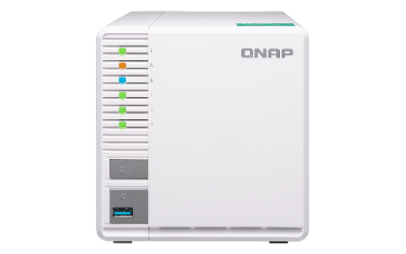
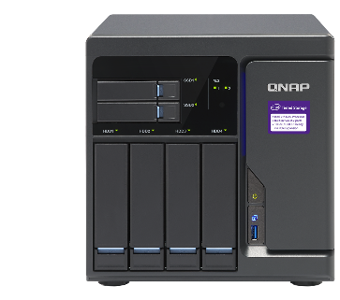
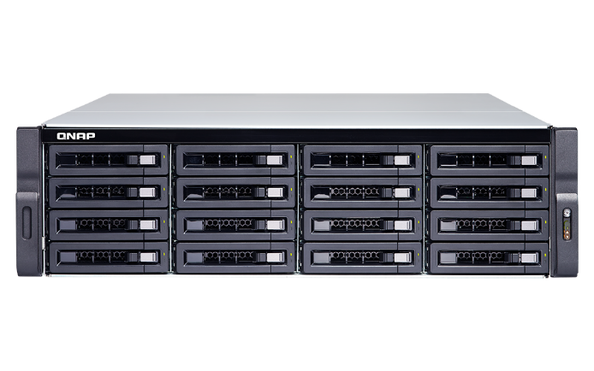
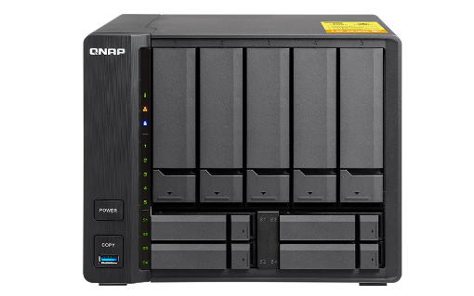
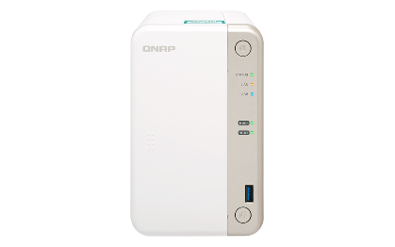
High scalability of storage space
Multi-bay models for expanding the number of disks
VJBOD(Virtual JBOD) allows usage of storage resources
External hard drive with USB 3.0
Expansion enclosures from QNAP
Notes:
高彈性空間擴充術
多 Bay 機型讓硬碟數量彈性擴充
VJBOD 彈性活用閒置 QNAP NAS 空間
USB 3.0 連接外接裝置
QNAP NAS 專屬儲存擴充設備

Slide 24



Convenient for your life and your work
x
Copyright © 2019 QNAP Systems, Inc. All rights reserved. QNAP® and other names of QNAP Productsareproprietarymarks or registered trademarks of QNAP Systems, Inc. Other products and company names mentioned herein are trademarks of their respective holders.

