Slide 2
4 phases to understand ownCloud
Cross-
platform
Support
Basic
Features
App
Ecosystem
Introduction

Slide 3
Outline
Cross-
platform
Support
Basic
Features
App
Ecosystem
Introduction

Slide 4
Introduction: Team Collaboration Story
Imagine a typical office environment
Working in team? Requires everyone's inputs?
Need collaboration for frequent changes
All documents must be centralized
Edit your Docs, Slides or Sheets from the
same interface
Don't want to use public cloud solutions
due to privacy constraints

Slide 5
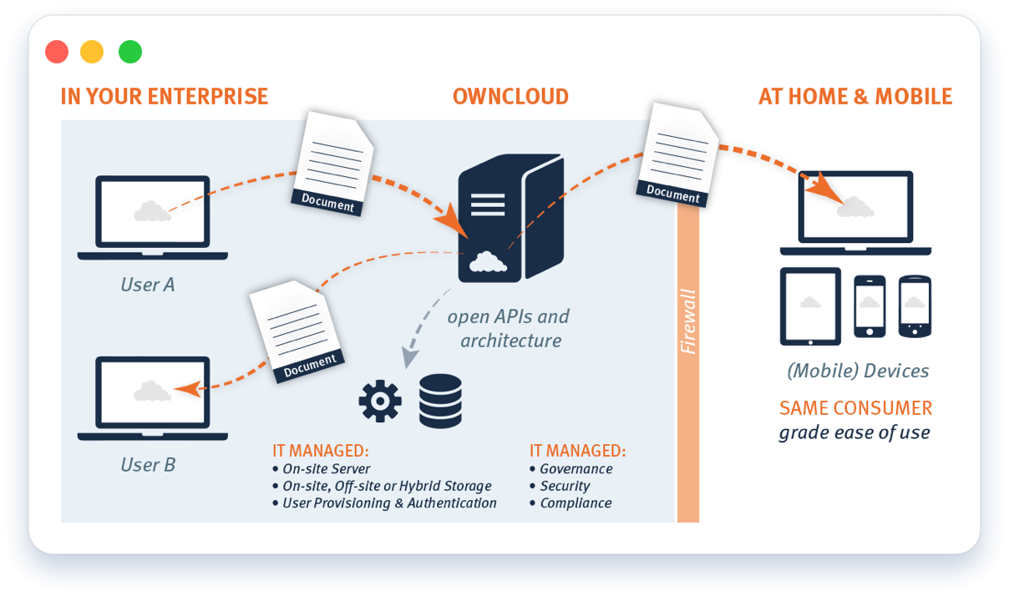
Introduction
Secure file sharing for enterprises
Privately hosted
Boosts productivity and security

Slide 6
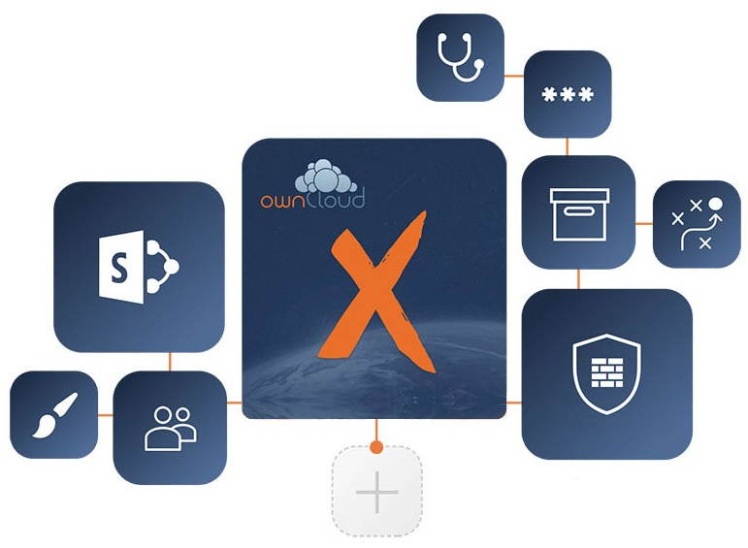
Introduction
Extended functionalities with numerous free apps
Community driven apps
Customize ownCloud to specific needs

Slide 7
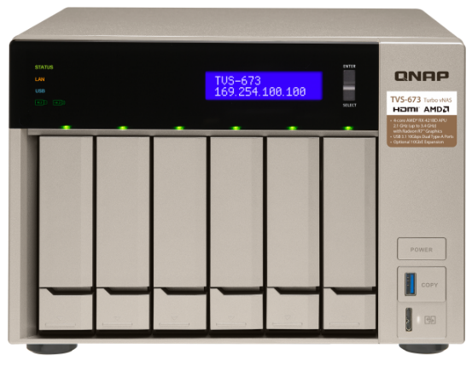
QNAP + ownCloud
Perfect file collaboration solution for teams

Slide 9
Mount external Storage services
Access your external storage directly from the NAS
Google Drive, Dropbox, Amazon S3, FTP
Local Storage

Slide 10
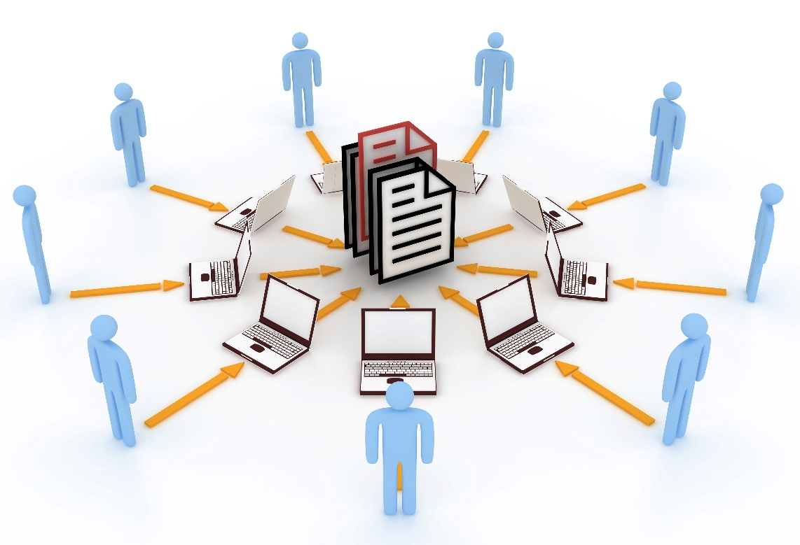
Collaborative file sharing
Easily share your file with other users
View shared files
Collaborate with other
ownCloud users and
make your NAS more
productive

Slide 11
Track Activities
Keep a track of all your activities
Monitor the changes made by you like file addition, deletion, etc.
Maintain transparency within the team by watching activities of other users

Slide 12
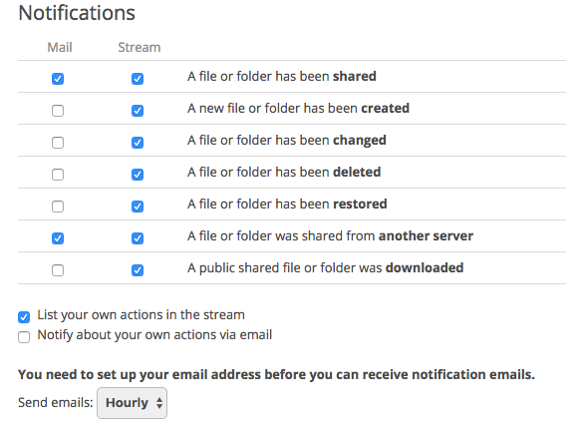
Notifications
Get notified when a folder or a file is created, changed, shared, deleted, restored, downloaded or a folder was shared from another NAS server
Get email notifications to any of your email account added in the personal info
Custom settings to get notified hourly, daily or weekly

Slide 13
User management
Create new users and assign the username and password of your choice
Create groups, and assign the users to groups
Promote a user to the admin role by adding the user to the admin group
Assign an admin for each created group
Restrict the data upload quota for
each user, almost unlimited in the
case of NAS

Slide 14
Admin
View logs for fatal issues, errors, warnings, info, debugging, etc.
Configure an email server for sending out notifications, set an email template
Enforce Https to force the clients to connect to ownCloud via an encrypted connection
Set sharing restrictions
View database performance info

Slide 15
File explorer
User Management
Admin Features
External Storage

Slide 16
File explorer
User Management
Admin Features
External Storage

Slide 17
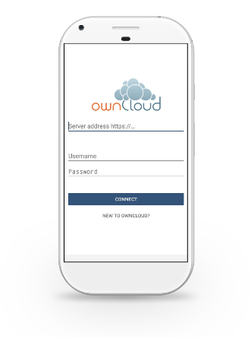
ownCloud App Ecosystem
Boost team productivity with community driven apps
Notes and
Tasks
Draw.io
Image and
PDF viewer
Polls
Only Office

Slide 18
Collaborative Teamwork
Take down meeting notes
Create task list
Draw flow diagrams
Share with other users
to collaborate
Export as jpg or pdf
View PDF files
Take poll opinions
Create and share PPTs

Slide 19
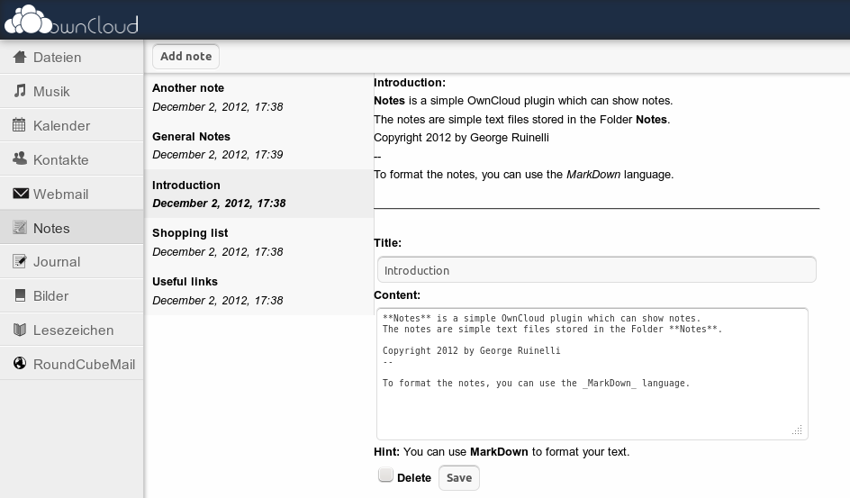
Notes and Tasks
Take down the notes from important meetings using the Notes app on ownCloud
Create tasks or action items from your nots using Tasks app on ownCloud
Share the task list with other team members

Slide 20
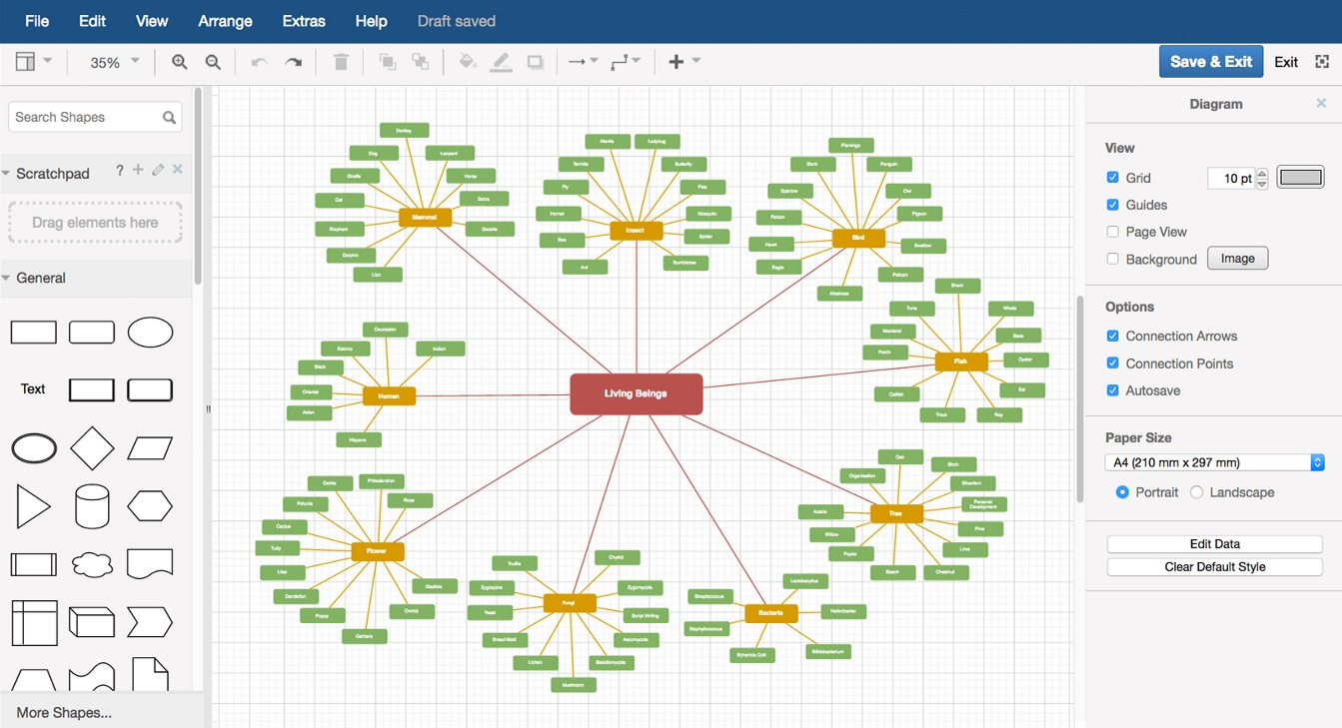
Draw.io
Using the powerful tool of draw.io, create effective software architecture diagram
Easy to use, and an intuitive design dashboard to create a presentable software architecture diagram

Slide 21
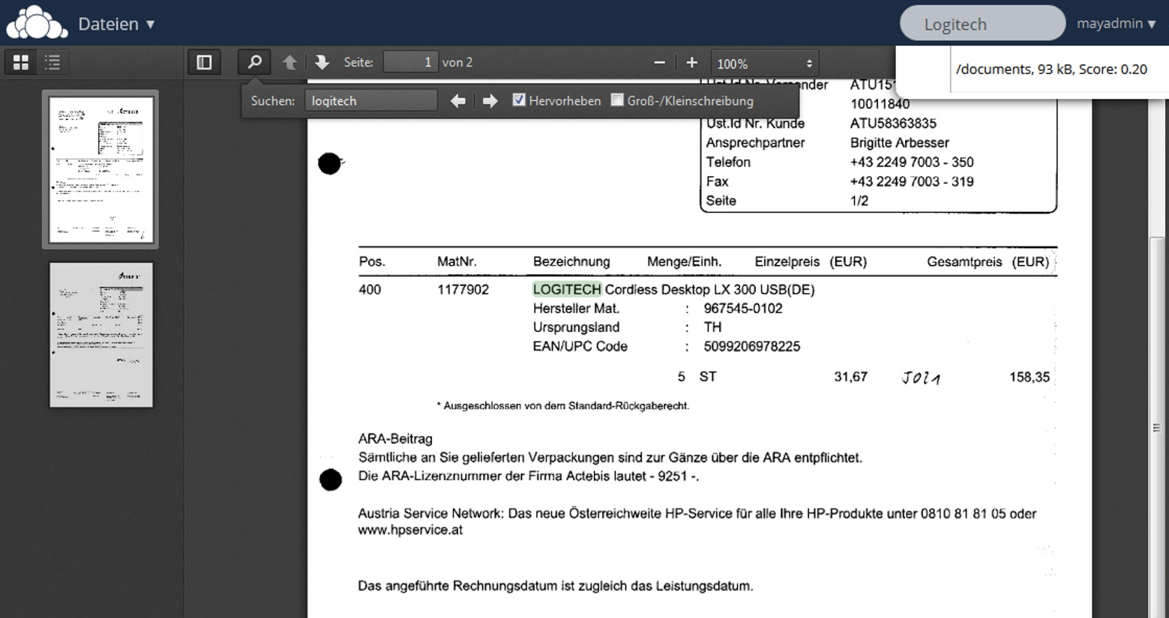
Image and PDF viewer
Export the flow diagrams as image or PDF
Use Image Viewer or PDF Viewer to view the image or PDF files stored within your ownCloud

Slide 22
Polls
Once you have shared an image or the pdf with others, create a poll about your software architecture diagram
Get feedback about your software flow architecture diagram from your teammates, manager, and other stakeholders in the projects by creating polls using the poll app in the ownCloud
Get useful comments from everyone and improve the software architecture diagram even further

Slide 23
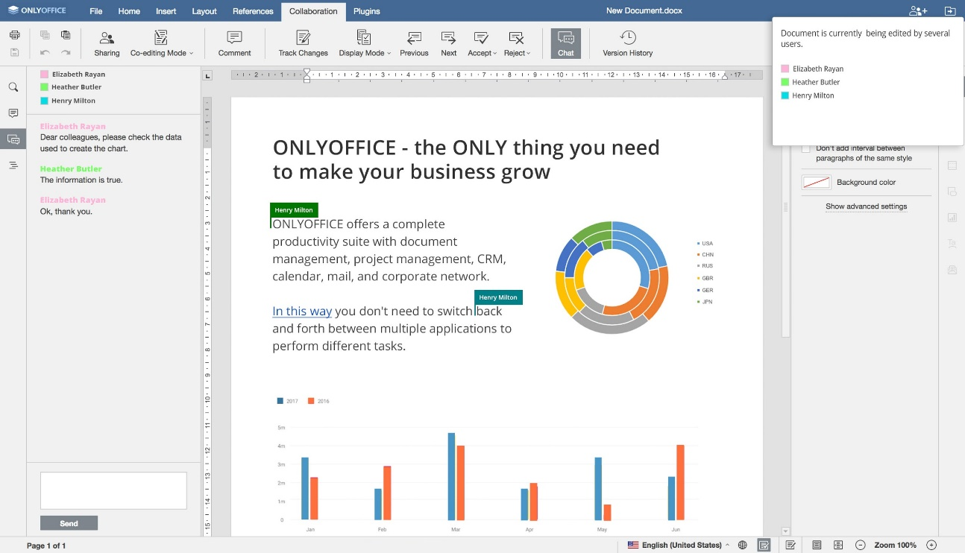
ONLYOFFICE (Documents, SpreadSheets, Presentations)
Create a software requirements document using the ONLYOFFICE document writer
Create presentation slides for explaining the software architecture to other project members and teammates using the ONLYOFFICE presentation

Slide 24
Team collaboration demo

Slide 25
Team collaboration demo

Slide 26
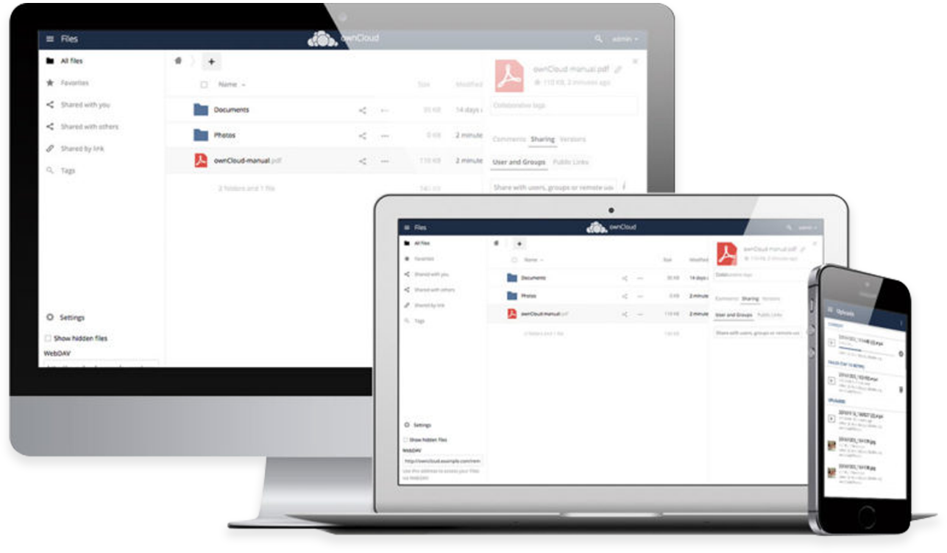
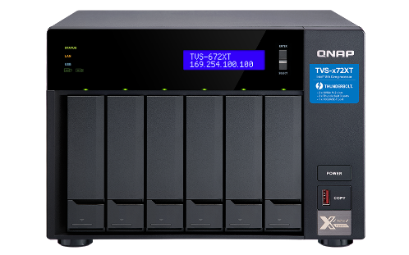
Cross Platform Support
Windows, Mac, Linux, Android and iOS clients
Upload pics and videos at ease
Trace activities and get instant notifications
Secured transfer by SSL encryption
More flexibility and
accessibility

Slide 27
Mobile apps demo

Slide 28
Copyright © 2019 QNAP Systems, Inc. All rights reserved. QNAP® and other names of QNAP Products are proprietary marks or registered trademarks of QNAP Systems, Inc. Other products and company names mentioned herein are trademarks of their respective holders.

