Slide 2
How to use Qfiling to automate your file organization

Slide 3
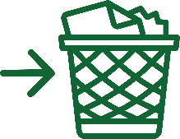
You have too much information to handle and how to properly keep it is a problem!
After traveling,
organizing
thousands of photos can become a real headache.
The storage capacity is almost full and I need quick help to remove unnecessary files!
Files scattered everywhere and it is difficult to organize them!

Slide 4
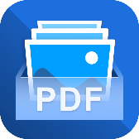
Qfiling 2.1 core competencies
Flexible
Create your Qfiling rules in 3 steps
Image2PDF
New approach to image viewing and sharing
Efficient
Scheduling for auto filing
Total control
With system logs, filing status is easily accessible
Fast
With recipes, tasks are done with one click

Slide 5
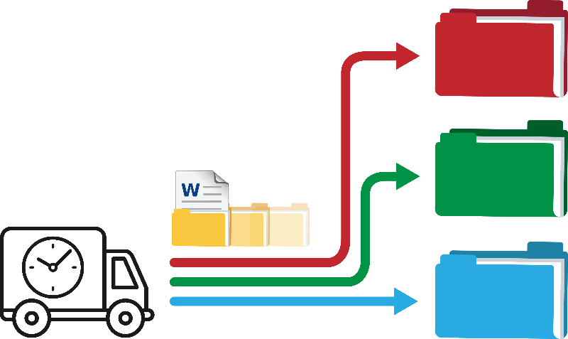
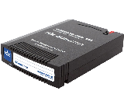
How does Qfiling work?
Select source
Set filing criteria
Select destination
Document
NAS
iSCSI
NAS
iSCSI
Image
USB
DVD
USB
Mobile
Video
RDX
Mobile
RDX

Slide 6
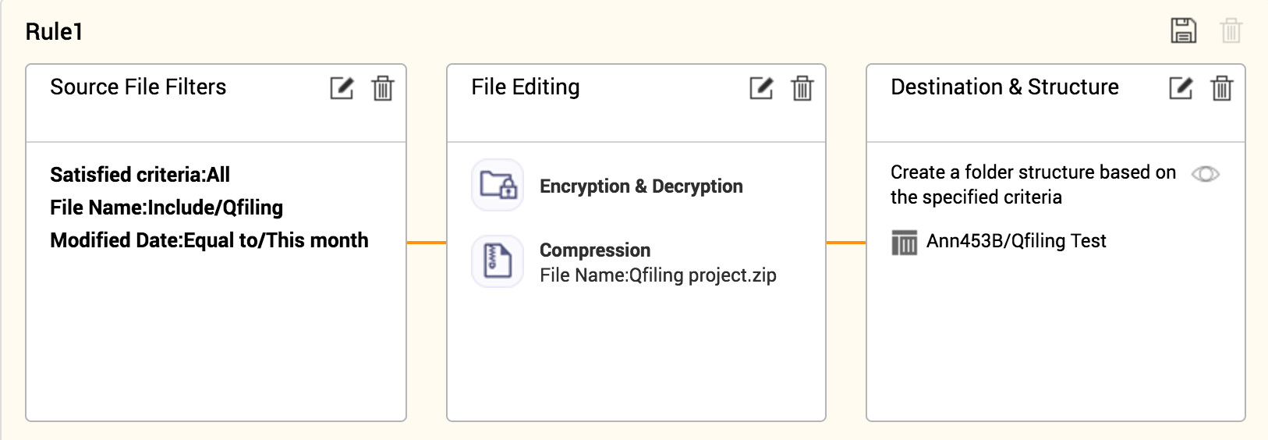
Create your Qfiling rules in 3 steps
Source file filters
File editing
Destination & Structure

Slide 7
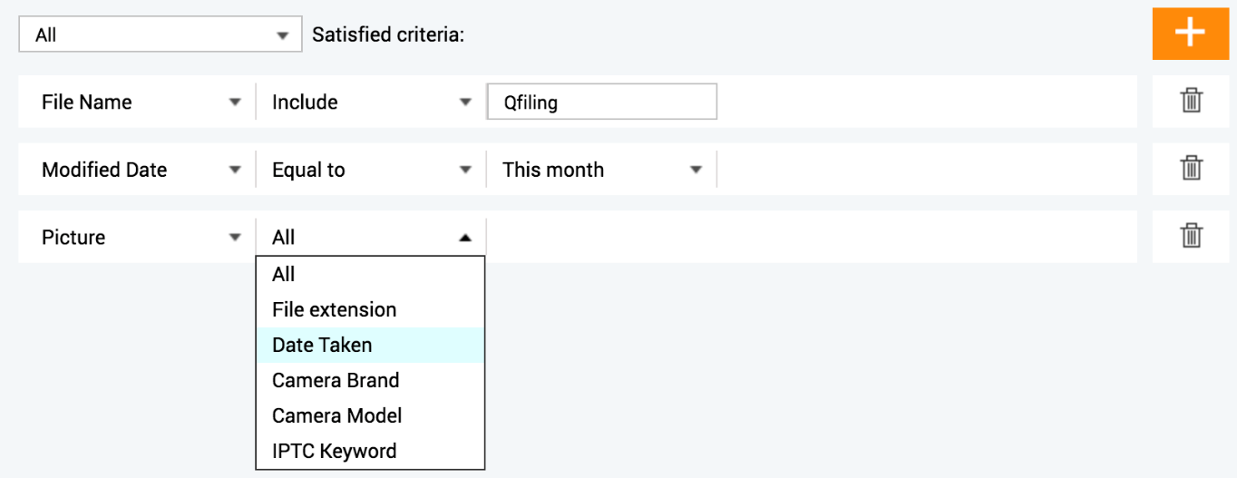
Create your Qfiling rules in 3 steps
Source file filters
File editing
Destination & Structure
20+ filter criteria to help you pick the files you need!

Slide 8
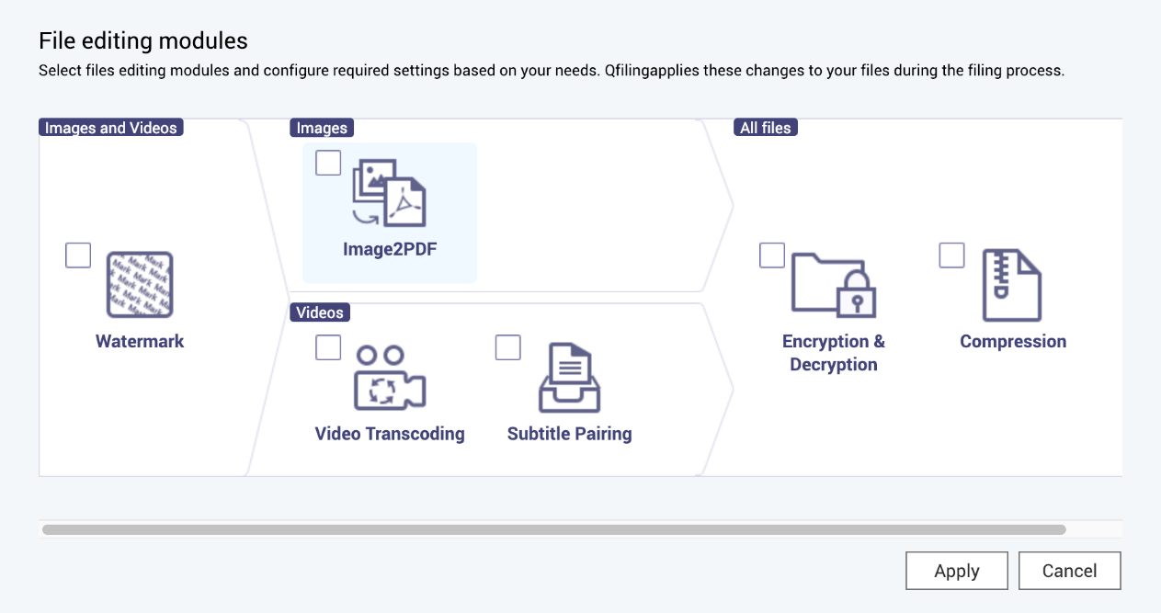
Create your Qfiling rules in 3 steps
Source file filters
File editing
Destination & Structure
Not only that it can encrypt and compress files, but can add watermarks to pictures when archiving!
New module: Image2PDF
Helps you merge the specific images into a PDF automatically.

Slide 9
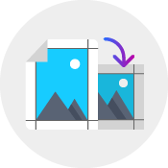
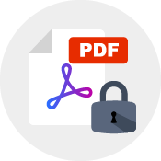
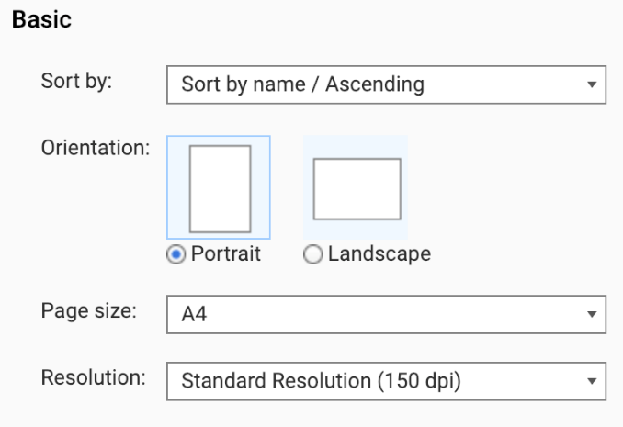
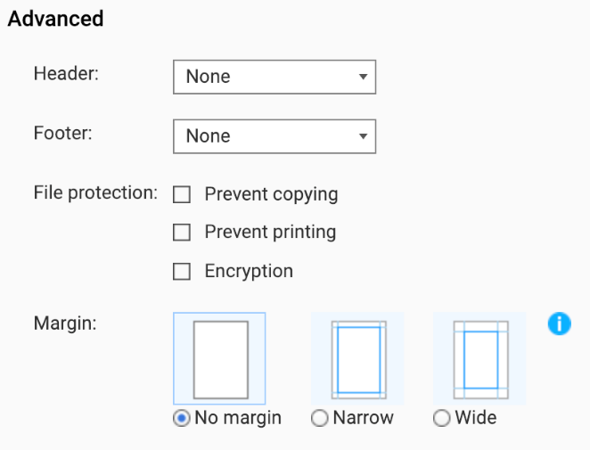
Create your Qfiling rules in 3 steps
Image2PDF
New approach to image viewing, and sharing
Create customize layout
Protect and encrypt files before sharing them
Page size and orientation
Header and footer
Margin
File protection:
Copy prevention​
Printing prevention​
File encryption
Adjusts image resolutions for faster file sharing
Low Resolution
Standard Resolution
High Resolution

Slide 10
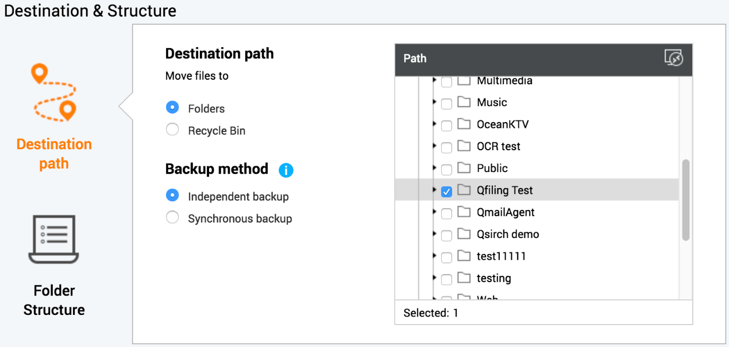
Create your Qfiling rules in 3 steps
Source file filters
File editing
Destination & Structure
Select multiple destinations: one to local, one to mounted remote NAS.
Specify "Recycle Bin" as the destination to periodically clean up files!

Slide 11
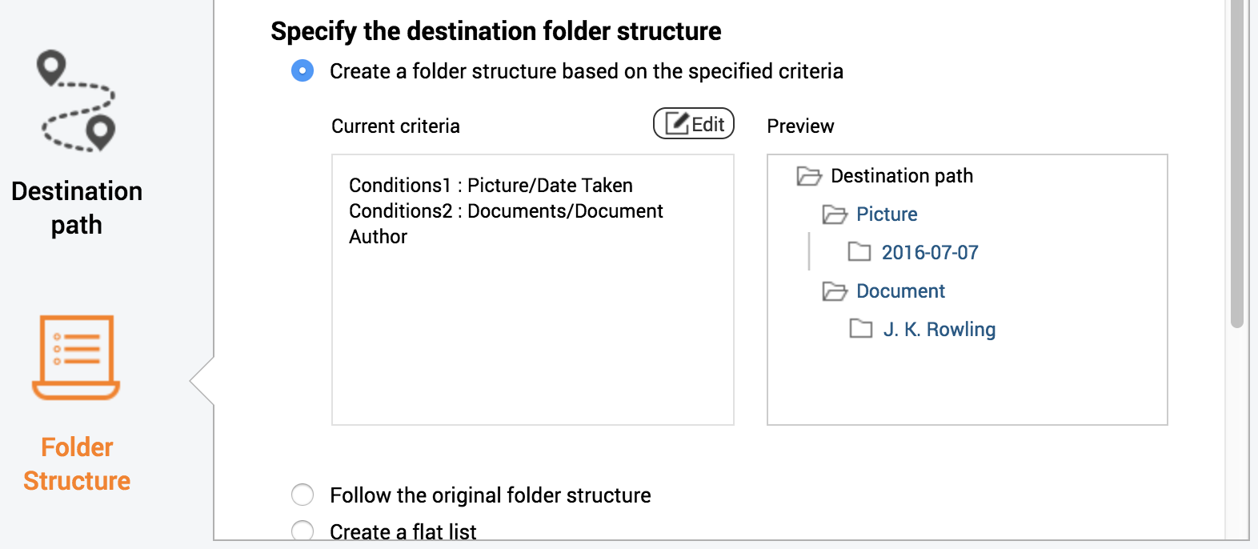
Create your Qfiling rules in 3 steps
Source file filters
File editing
Destination & Structure
Three ways to specify the destination folder structure: select the best way to organize the files!

Slide 12
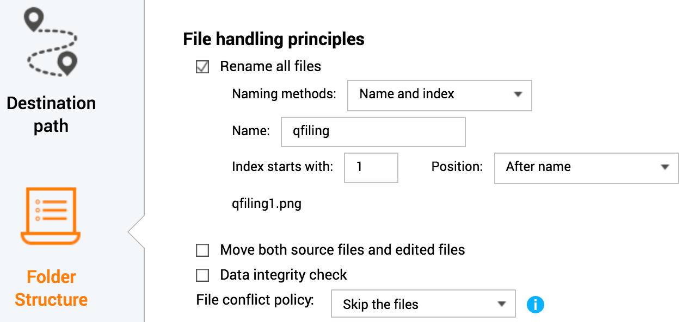
Create your Qfiling rules in 3 steps
Source file filters
File editing
Destination & Structure
Archive and rename all files at the same time. Select “File conflict policy” to only archive the same file once!

Slide 13
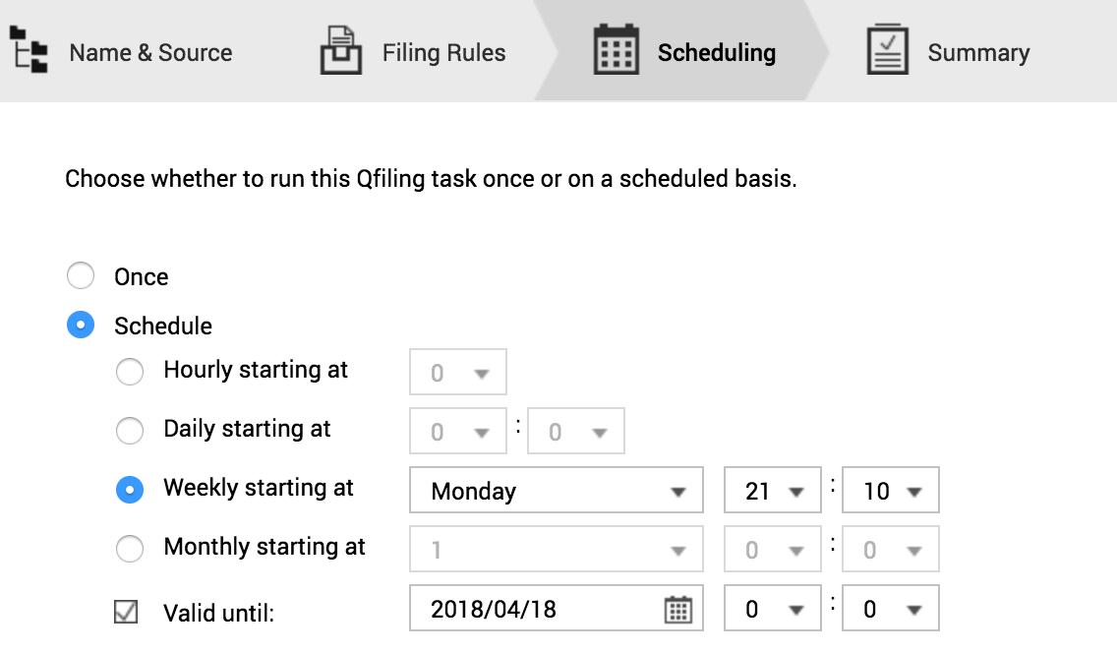
Schedule and results

Slide 14
Filing status is easily accessible
Summary
System logs
Task logs

Slide 15
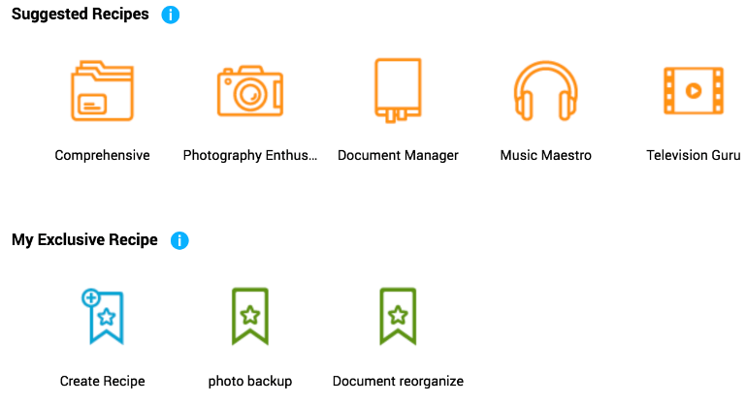
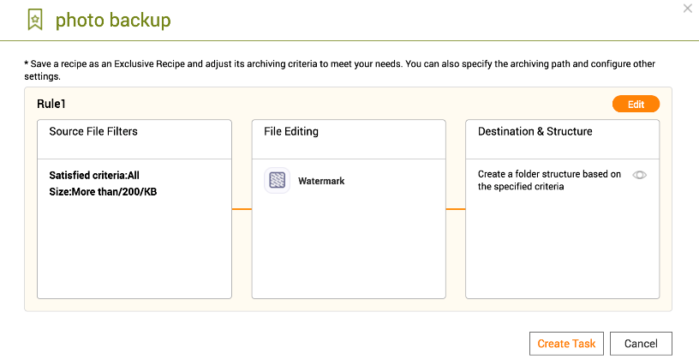
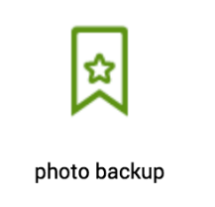
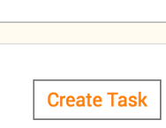
With recipes, tasks are done with just one click
Select a recipe
Create a task

Slide 16
Demo

Slide 17
Qfiling Case studies

Slide 18
The way experts use Qfiling
Best tool to organize photos
Good assistant for office workers
Easily delete unnecessary files
Simply complete cross-device file sharing
Improve
content publishing efficiency

Slide 19
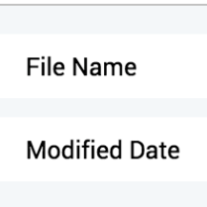
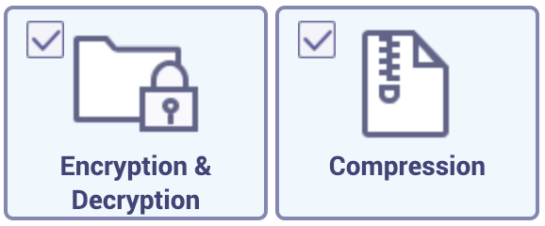
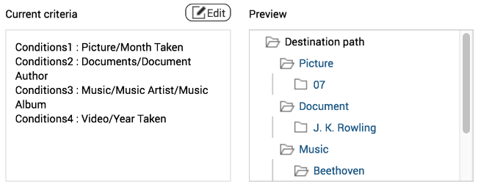
Case study
1
Good assistant for office workers
Source File Filters
01
Automatically filter out specific files from multiple source folders.
Setting encryption and compression options.
Re-classify all kinds of files in the most suitable way.
02
File Editing
03
Destination & Structure

Slide 20
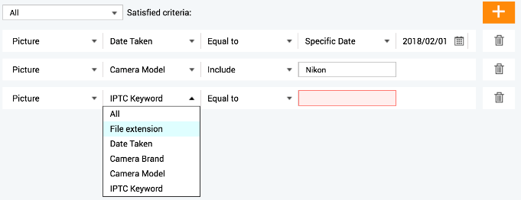
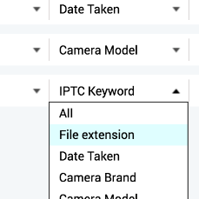
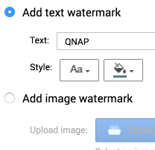
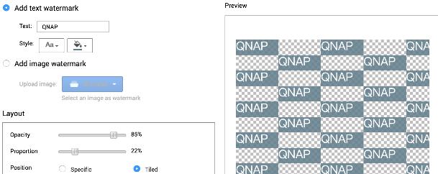
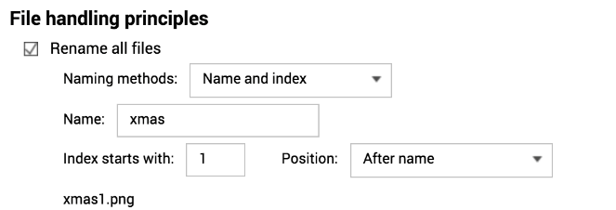
2
Case study
Best tool to organize photos
01
Source File Filters
Automatically filter out specific files from mobile/ camera.
Setting watermark option.
Duplicated files are backed up only once. Renaming files is also possible!
02
File Editing
03
Destination & Structure

Slide 21
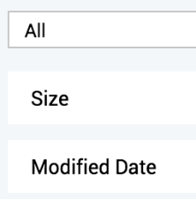
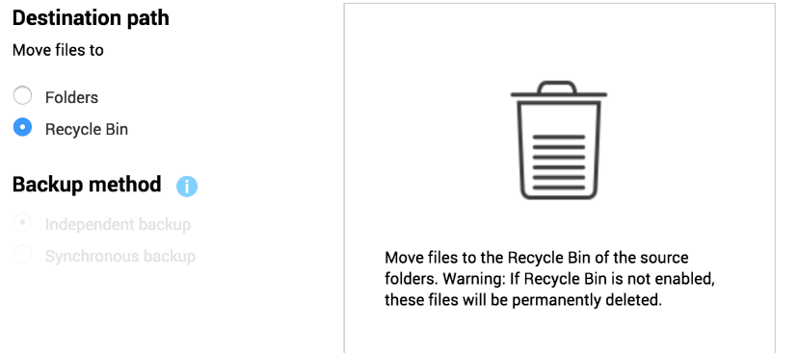
3
Case study
Easily delete unnecessary files
01
Source File Filters
Automatically filter out specific files from multiple source folders.
Move the file to recycle bin.
02
Destination & Structure

Slide 22
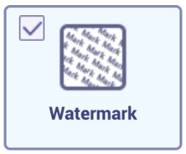
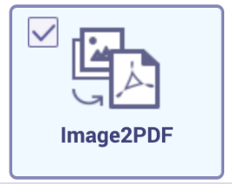
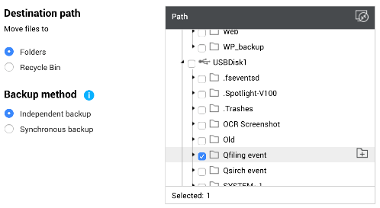
4
Case study
Simply complete cross-device file sharing
01
Source File Filters
Automatically filter out specific files from multiple source folders.
Setting watermark and Image2PDF options.
Setting USB folder as destination.
02
File Editing
03
Destination & Structure

Slide 23
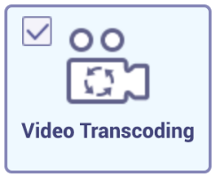
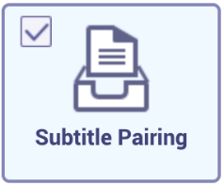
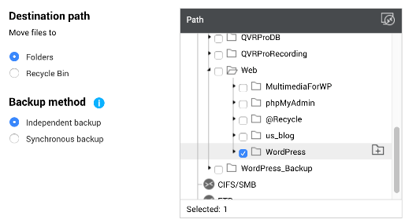
5
Case study
Improve content publishing efficiency​
01
Source File Filters
Automatically filter out specific files from multiple source folders.
Setting video transcoding option.
Setting Web folder as destination.
02
File Editing
03
Destination & Structure

Slide 24
Demo

Slide 25
A quick recap on Qfiling
Flexible
Create your Qfiling rules in 3 steps
Image2PDF
New approach to image viewing and sharing
Efficient
Scheduling for auto filing
Total control
With system logs, filing status is easily accessible
Fast
With recipes, tasks are done with one click

Slide 26
Copyright © 2019 QNAP Systems, Inc. All rights reserved. QNAP® and other names of QNAP Products are proprietary marks or registered trademarks of QNAP Systems, Inc. Other products and company names mentioned herein are trademarks of their respective holders.

