Slide 1
Notes:
Co-presenter by Don & Amol

Slide 2
Agenda
Recap: AI and QuAI
What's new with QuAI?
JupyterHub – A new addition to QuAI portfolio
Intel OpenVINO™ on QNAP NAS
Training to inference, QNAP leads the way
Case studies & demo - from training to inference on QNAP NAS...
Why QNAP NAS for AI?

Slide 3
[ Recap ]
AI
QuAI

Slide 4
AI, ML, DL…
Artificial Intelligence
Machine Learning:
Machine Learning is the practice of giving a computer a set of rules and tasks, then letting it figure out a way to complete those tasks.
Machine Learning
Deep Leaning:
A subset of machine learning which makes the computation of multi-layer neural networks feasible.
Deep Leaning
CNN:
Deep learning topology particularly effective at image classification and recognition.
Algorithms:
CNNs,
RNNs, etc.

Slide 5
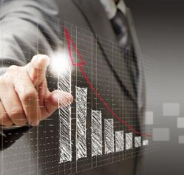
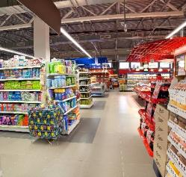
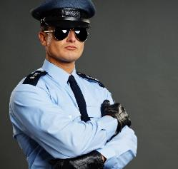
AI will transform..
Consumer
Smart Assistants
Chatbots
Search
Personalization
Augmented Reality
Robots
Health
Enhanced Diagnostics
Drug Discovery
Patient Care
Research
Sensory Aids
Finance
Algorithmic Trading
Fraud Detection
Research
Personal Finance
Risk Mitigation
Retail
Support
Experience
Marketing
Merchandising
Loyalty
Supply Chain
Security
Government
Defense
Data Insights
Safety & Security
Resident Engagement
Smarter Cities
Notes:
Don Slide
Consumer
Smart Assistants
Chatbots
Search
Personalization
Augmented
Reality
Robots
Health
Enhanced Diagnostics
Drug Discovery
Patient Care
Research
Sensory Aids
Finance
Algorithmic Trading
Fraud Detection
Research
Personal Finance
Risk Mitigation
Retail
Support
Experience
Marketing
Merchandising
Loyalty
Supply Chain
Security
Government
Defense
Data Insights
Safety & Security
Resident Engagement
Smarter Cities
Energy
Oil & Gas Exploration
Smart Grid
Operational Improvement
Conservation
Transport
Autonomous Cars
Automated Trucking
Aerospace
Shipping
Search & Rescue
Industrial
Factory Automation
Predictive Maintenance
Precision Agriculture
Field Automation
Other
Advertising
Education
Gaming
Professional & IT Services
Telco/Media
Sports

Slide 6
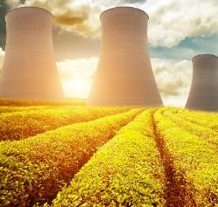
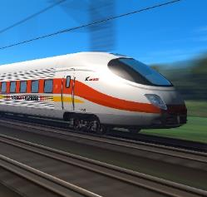
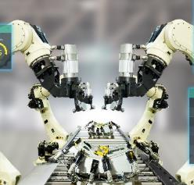
AI will transform..
Energy
Oil & Gas Exploration
Smart Grid
Operational Improvement
Conservation
Transport
Autonomous Cars
Automated Trucking
Aerospace
Shipping
Search & Rescue
Industrial
Factory Automation
Predictive Maintenance
Precision Agriculture
Field Automation
Other
Advertising
Education
Gaming
Professional & IT Services
Telco/Media
Sports
Notes:
Don Slide
Consumer
Smart Assistants
Chatbots
Search
Personalization
Augmented
Reality
Robots
Health
Enhanced Diagnostics
Drug Discovery
Patient Care
Research
Sensory Aids
Finance
Algorithmic Trading
Fraud Detection
Research
Personal Finance
Risk Mitigation
Retail
Support
Experience
Marketing
Merchandising
Loyalty
Supply Chain
Security
Government
Defense
Data Insights
Safety & Security
Resident Engagement
Smarter Cities
Energy
Oil & Gas Exploration
Smart Grid
Operational Improvement
Conservation
Transport
Autonomous Cars
Automated Trucking
Aerospace
Shipping
Search & Rescue
Industrial
Factory Automation
Predictive Maintenance
Precision Agriculture
Field Automation
Other
Advertising
Education
Gaming
Professional & IT Services
Telco/Media
Sports

Slide 7
Riding the AI wave with QNAP “QuAI”
Build
Train
Optimize
Deploy
Notes:
Build
Train
Optimize
Deploy

Slide 8
AI frameworks and tools in a nutshell..
Topology / Model architectures
Image Classification
AlexNet, VGG16, GoogLeNet, ResNet, MobileNet, etc.
Object Detection
SSD, Yolo v1/v2/v3,
R-FCN, RCNN,
Faster RCNN, etc.
Image Segmentation
SegNet, U-Net, FCN, DeepLab v1/v2, etc.
Face Detection / Recognition
MTCNN, DeepFace, Facenet, etc.
Video Classification
RNN, LSTM, etc.
Speech Recognition
DeepVoice, WaveNet, etc
Frameworks
(Caffe, Caffe2, CNTK, MXNet, Neon, PyTorch, Tensorflow …)
Training Platform
Intel® MKL
NVIDIA® CUDA
OpenCL
Inference Platform
CoreML (iOS) , OpenVINO
Tensorflow Lite (Android)
TensorRT
Container Station
NVIthroughDIA Driver (Download App Center)
IGD Driver (for OpenVINO pre-built in QTS)
QTS
Notes:
Amol slide

Slide 9
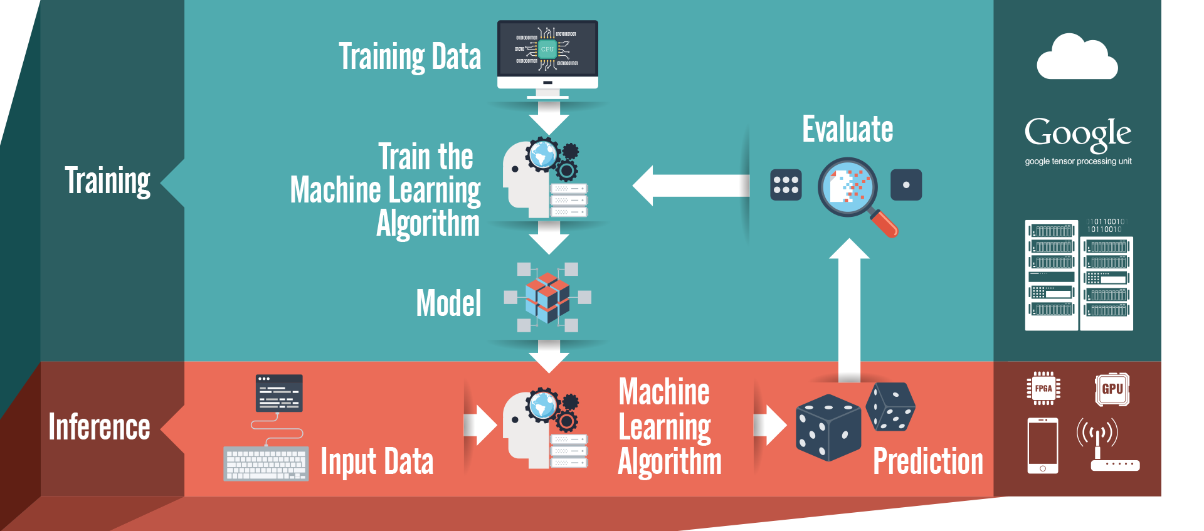
What can you do with QuAI?
Notes:
Amol slide
Where: cloud, hPC, dell
Inference ?? Where IPC....Mobile phone...inference H/W projection, ML algo needs compute -what kind of hw : FPGA/GPU/TPU
Data : connectivity/lora/BLT/ HW??? Then Move to QNAP and IEI offering ….

Slide 10
What's new with QuAI?

Slide 11
What makes QuAI possible?
QTS supports graphics cards
Notes:
Amol slide

Slide 12
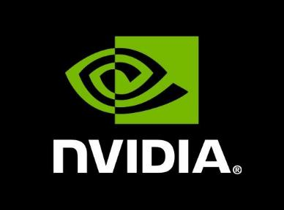
Supports mainstream acceleration cards

Slide 13
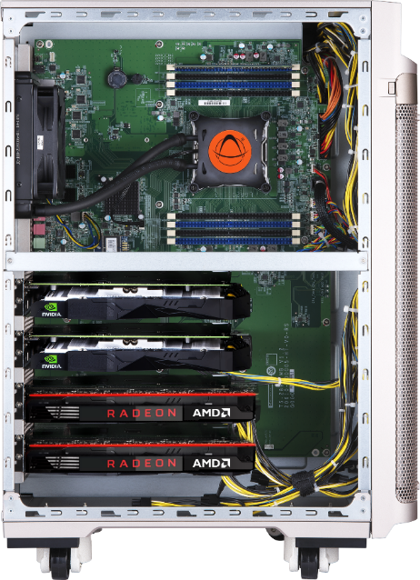
Supports multiple graphics cards
Intel Xeon W multi-core Processor
8x DDR4-2666 ECC RDIMM slots, max up to 512 GB
8 x PCIe Slot, up to 4 GPU cards
8 x PCIe power connectors
TS-2888X AI-ready NAS with powerful Xeon-W processor

Slide 14
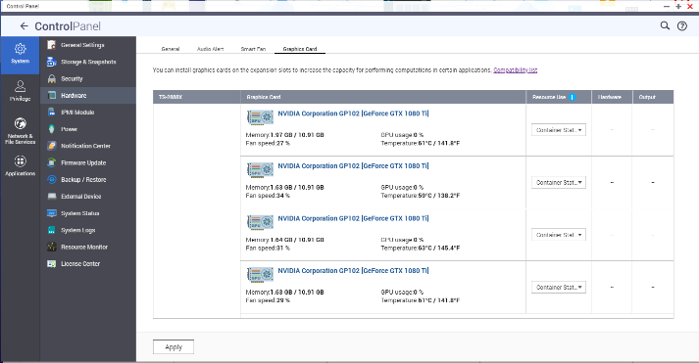
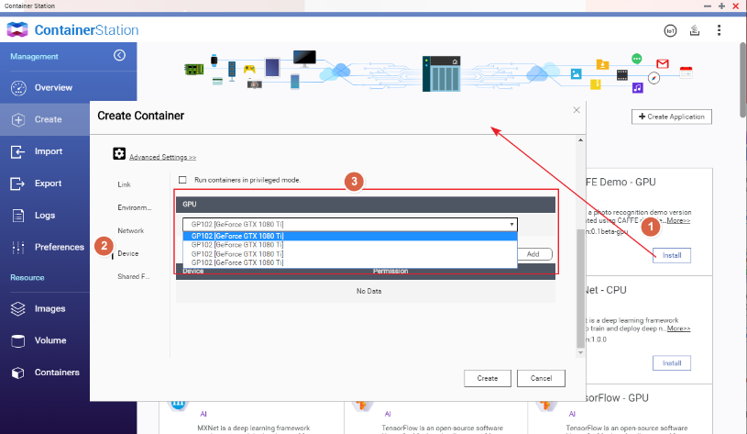
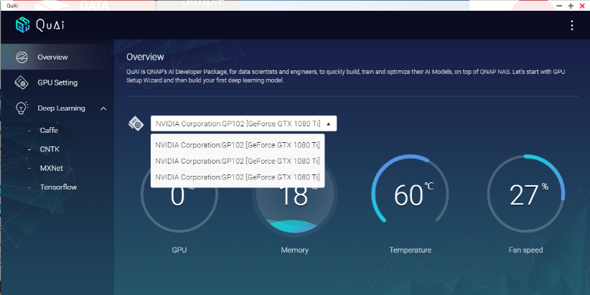
Supports multiple graphics cards

Slide 15
JupyterHub – A new addition to QuAI portfolio

Slide 16
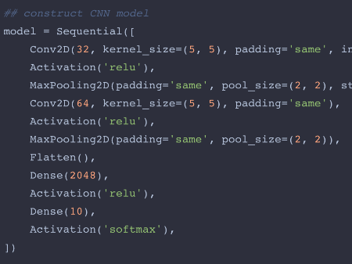
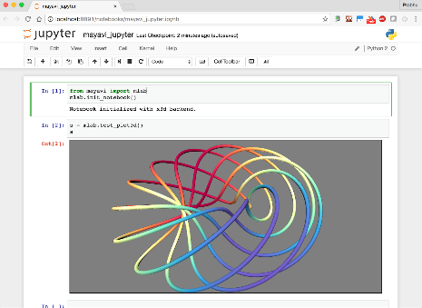
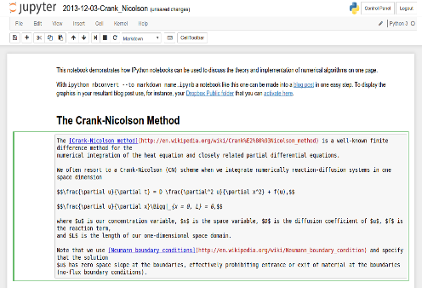
Jupyter notebook: an overview
Live Code
Visualization
Documentation​​

Slide 17
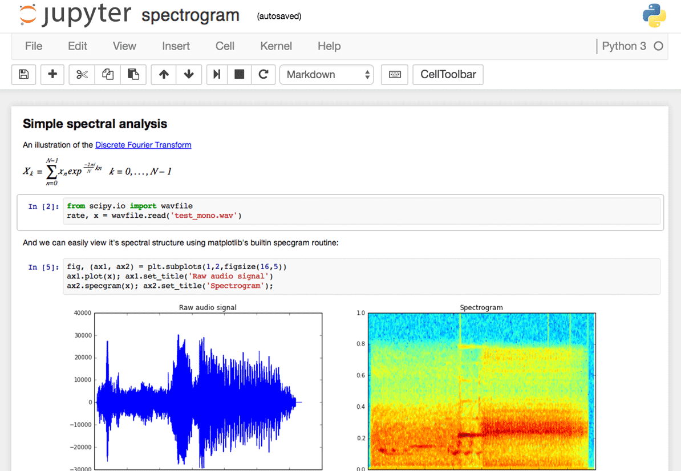
Jupyter notebook: usages
Data cleansing and transformation, Numerical simulation, statistical modeling, data visualization & machine learning

Slide 18
JupyterHub: how to manage?
How to manage:
A big group of users working on the same project?
The overall projects being created by the group members?
Policies and access rights of each member?
How to assess work done by each member of the group efficiently?
Answer: JupyterHub

Slide 19
JupyterHub
JupyterHub provides a platform to create a multiuser group
Multiple single user instances of Jupyter notebooks
Can be used by: a classroom, research group, corporate group or any group of data scientists in any other setup

Slide 20
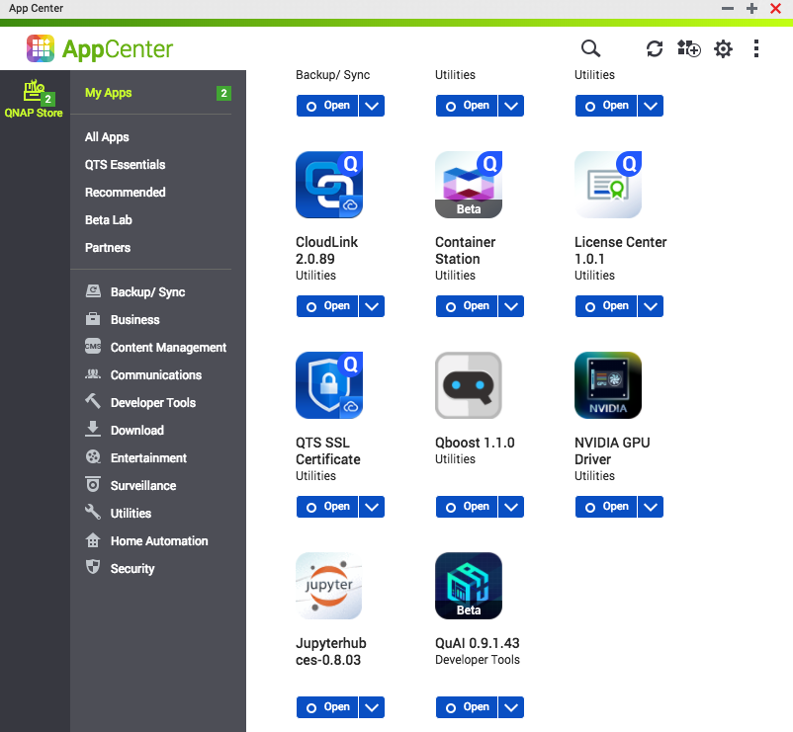
Getting started: install and run..

Slide 21
OpenVINO™ Workflow Consolidation Tool (OpenVINO™ Workflow Consolidation Tool, OWCT)
Notes:
This is new name we should be using as per Teddy: "OpenVINO workflow consolidation Tool (OWCT)"

Slide 22
What is Intel OpenVINO?
Accelerate computer vision with OpenVINO™ toolkit
(Open Visual Inference & Neural Network Optimization) -Formerly Intel® Computer Vision SDK
What it is​
A toolkit to fast-track development of high performance computer vision and deep learning into vision applications. It enables deep learning on hardware accelerators and easy heterogeneous execution across Intel® platforms. Components include:​
Intel® Deep Learning Deployment Toolkit (model optimizer, inference engine)​
Optimized functions for OpenCV* and OpenVX*
Why important​
Demand is growing for intelligent vision solutions. Deep learning revenues is estimated to grow from $655M in 2016 to $35B by 2025¹. This requires developer tools to integrate computer vision, deep learning and analytics processing capabilities into applications, so they can help turn data into insights that fuel artificial intelligence.​
Users​
Software developers, data scientists working on vision solutions for surveillance, robotics, healthcare, office automation, transportation & more.
Notes:
Accelerate Computer Vision with OpenVINO™ toolkit (Open Visual Inference & Neural Network Optimization) -Formerly Intel® Computer Vision SDK
What it is
A toolkit to fast-track development of high performance computer vision and deep learning into vision applications. It enables deep learning on hardware accelerators and easy heterogeneous execution across Intel® platforms. Components include:
▪Intel® Deep Learning Deployment Toolkit (model optimizer, inference engine)
▪Optimized functions for OpenCV* and OpenVX*
Why important
Demand is growing for intelligent vision solutions. Deep learning revenue is estimated to grow from$655M in2016 to $35B by 2025¹. This requires developer tools to integrate computer vision, deep learning, and analytics processing capabilities into applications, so they can help turn data into insights that fuel artificial intelligence.
Users
Software developers, data scientists working on vision solutions for surveillance, robotics, healthcare, office automation, transportation, & more.

Slide 23
How does OpenVINO work?
Model Optimizer
What it is: preparation step -> imports trained models
Why important: Optimizes for performance/space with conservative topology transformations; biggest boost is from conversion to data types matching hardware.
Inference Engine
What it is: High-level inference API
Why important: Interface is implemented as dynamically loaded plugins for each hardware type. Delivers best performance for each type without requiring users to implement and maintain multiple code pathways.
待補上圖片出處
Notes:
Model Optimizer
▪What it is: Preparation step -> imports trained models
▪Why important: Optimizes for performance/space with conservative topology transformations; biggest boost is from conversion to data types matching hardware.
Inference Engine
▪What it is: High-level inference API
▪Why important: Interface is implemented as dynamically loaded plugins for each hardware type. Delivers best performance for each type without requiring users to implement and maintain multiple code pathways.
Inference Engine
Common API (C++)
Optimized cross-platform inference

Slide 24
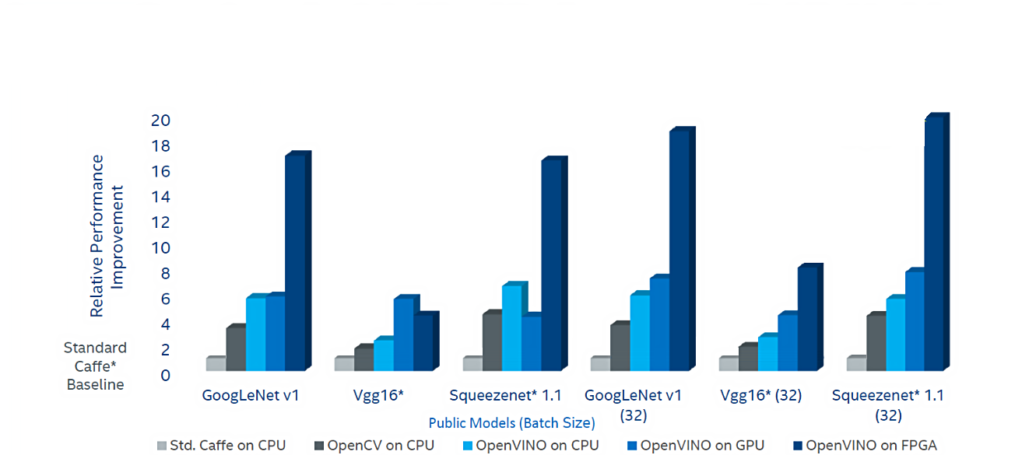
Benchmarks…
Increase deep learning workload performance on public models using OpenVINO™ toolkit & Intel® Architecture
19.9X¹
Comparison of Frames per Second (FPS)
Notes:
Increase Deep Learning Workload Performance on Public Models using OpenVINO™ toolkit & Intel® Architecture
Comparison of Frames per Second (FPS)

Slide 25
What's in the package?
Samples​
Image classification​
Image segmentation​
Object detection​
Object detection for Single Shot Multibox Detector (SSD)​
Neural style transfer​
Validation application
Pre-Trained Models​
Age - gender​
Security barrier​
Crossroad​
Head pose​
Mobilenet SSD​
Face Mobilenet reduced SSD with shared weights​
Face detect with SQ Light SSD​
Vehicle attributes
Notes:
Samples
▪Image Classification
▪Image Segmentation
▪Object Detection
▪Object Detection for Single Shot Multibox Detector (SSD)
▪Neural Style Transfer
▪Validation Application
Pre-Trained Models
▪Age –Gender
▪Security barrier
▪Crossroad
▪Headpose
▪MobilenetSSD
▪Face mobilenetreduced SSD with shared weights
▪Face detect with SQ Light SSD
▪Vehicle Attributes

Slide 26
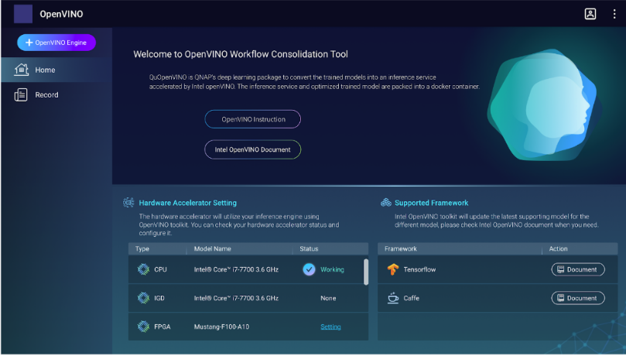
QNAP OWCT - preview (OpenVINO™ Workflow Consolidation Tool )
Intermediate Representation format (IR)
OpenVINO (OWCT)
QuAI
Inference Engine
Optimize the model
Build/train
Caffe, TensorFlow, MXNet, etc…
Inference
CPU/IGD/Intel FPGA/Intel VPU
Trained model files/label file, etc...

Slide 27
Training to inference with QuAI

Slide 28
Training and inference

Slide 29
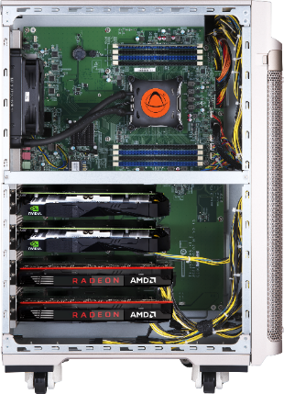
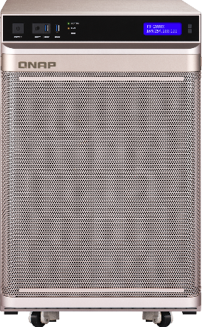
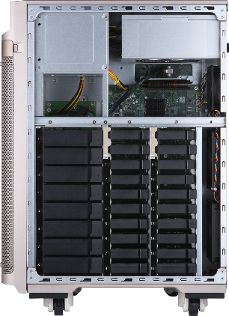
Hyperconverged AI-ready NAS – powerhouse for training
Computing in your storage
Reduce the performance bottleneck due to network
Provide low latency, high speed data flow.
TS-2888X AI-ready NAS with Powerful Xeon-W Processor
Computing zone (left side)
Front side
Storage zone (right side)

Slide 30
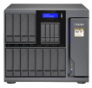
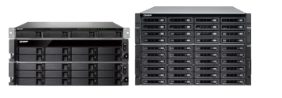
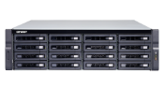
Offerings – From training to inference
 | Training
Entry-level models |  | Single accelerator card
Advanced models |  | Multiple accelerator cards
 | Inference
Entry-level models |  | CPU or single accelerator card
Advanced models |  | Multiple accelerator cards
TS-x77
TVS-x82
TS-x77
TS-1677X
TS-x77XU
TVS-x82
TES-x85U
TS-x77
TS-1685
TS-2888X
TDS-16489U
TANK-860/870
TVS-x82
Notes:
Amol slide

Slide 31
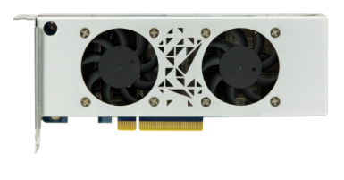
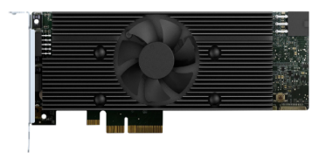
2018 IEI AI accelerator cards
Mustang-200
Mustang-F100-A10
Mustang-V100-MX8
Two Intel Core/Celeron ULT
4 DDR4 UDIMM
2 PCIe NVMe SSDs
10GbE based
PCIe 2.0 x4
Intel Arria 10 GX 1150 FPGA
PCIe 3.0 x 8
Low profile , half size, double slot
Intel Movidius solution
8 x Myriad X VPU
PCIe 2.0 x4
Low profile , half size, single slot
Intel FPGA
Intel VPU
Intel Kaby Lake ULT

Slide 32
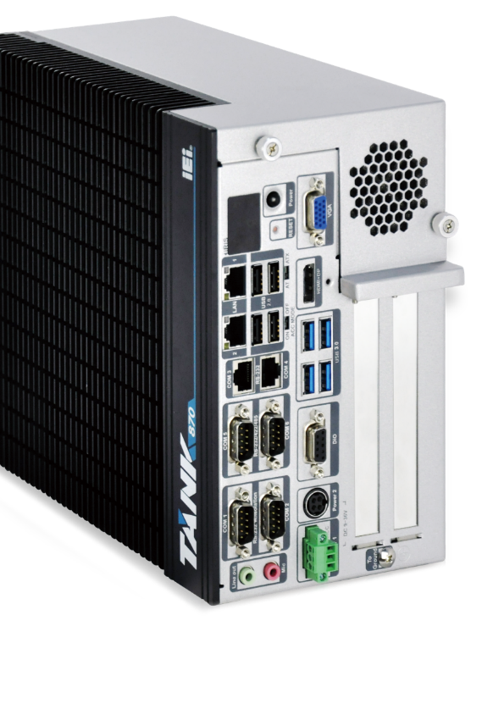
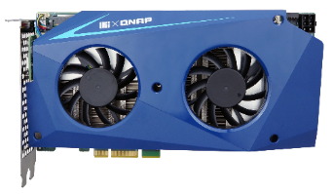
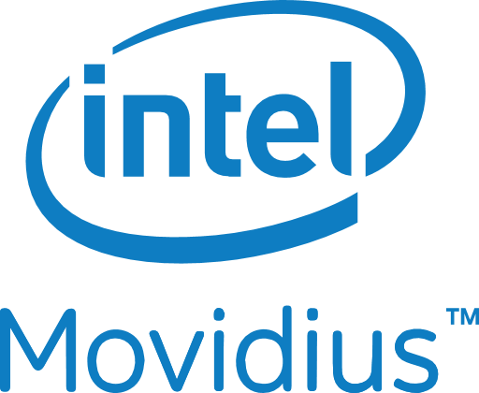
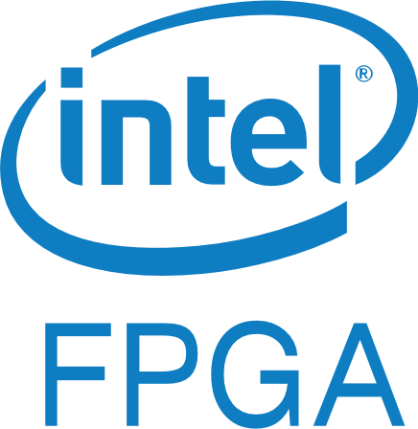
Ready for industry
IEI CPU acceleration card
TANK-870AI Deep learning inference ready. CPU VPU FPGA accelerating.

Slide 33
Ready for industry

Slide 34
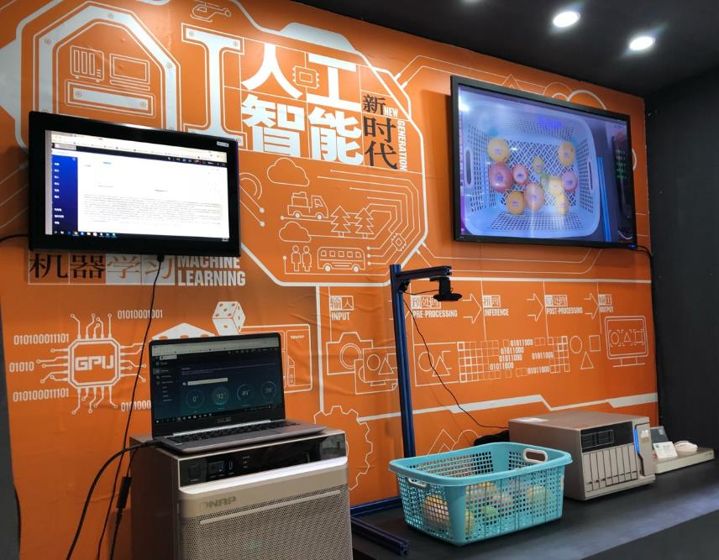
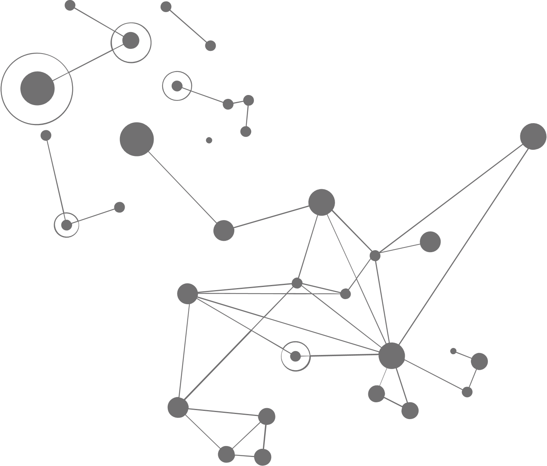
Case Study
Fruit detection & size metering
Image classification

Slide 35
From training to inference
Build
Train
Optimize
Deploy

Slide 36
Build
Train
Optimize
Deploy

Slide 37
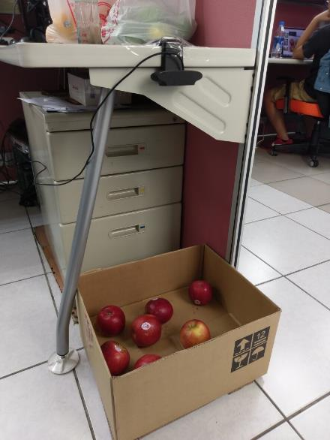
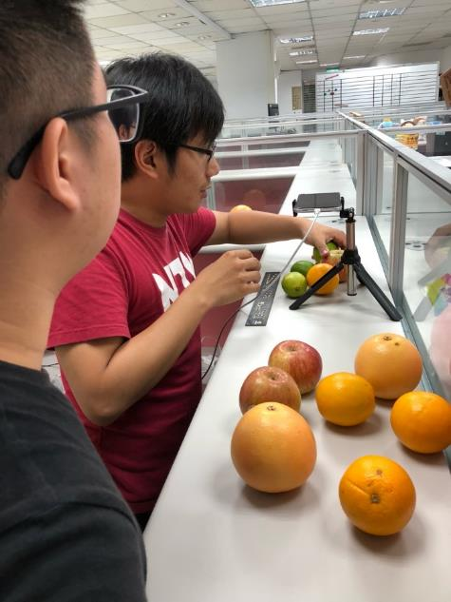
Capture the images
We bought a lot of apple, orange and lemon from the market. And capture images as more as possible while still fresh…

Slide 38
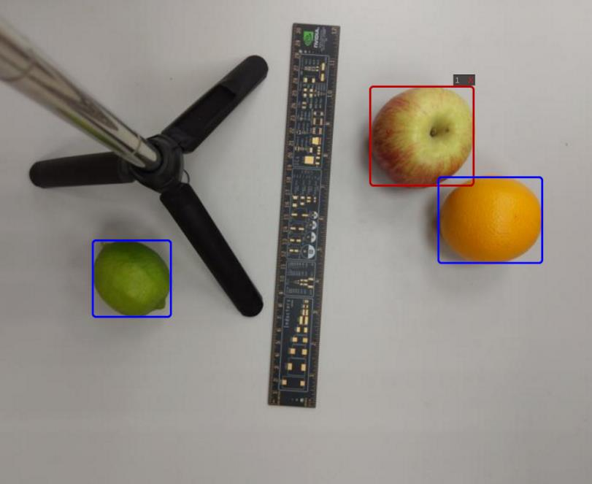
Labeling tool
Popular labeling tools:
BBox-Label-Tool
LabelMe
LabelImg
VoTT
(Most of these tools are open source)
Main Features:
Image annotation for polygon, rectangle, circle, line and point.
Image flag annotation for classification and cleansing.
Video annotation.
GUI customization (predefined labels / flags, auto-saving, label validation, etc.).
Exporting VOC-like dataset for semantic/instance segmentation.
Using one of labeling tool to label the images.

Slide 39
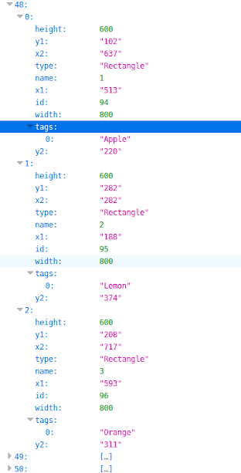
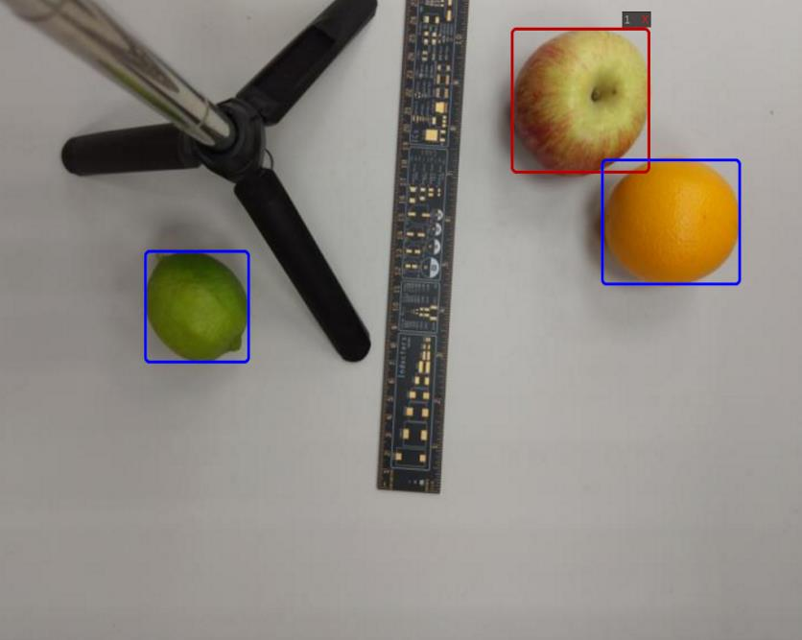
The data format
The labeled data is shown as above.
PS: Some labeling tools generate CSV, some are json.

Slide 40
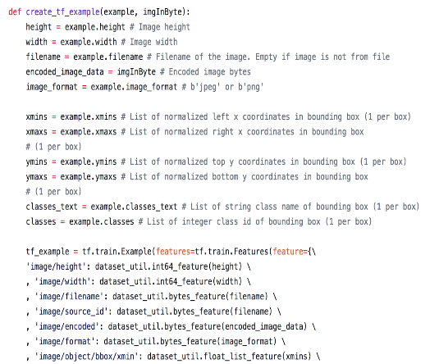
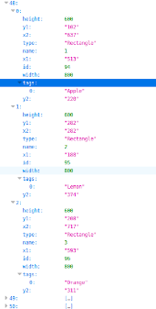
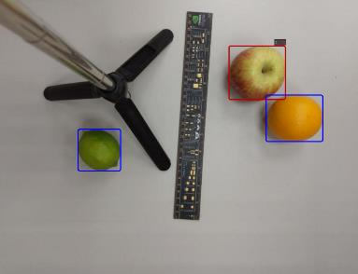
Generate tfrecords
Image
Label
Code
For this model, we use TensorFlow framework, and TensorFlow using tfrecords as data source. So we develop a program to prepare it.

Slide 41
Build
Train
Optimize
Deploy

Slide 42
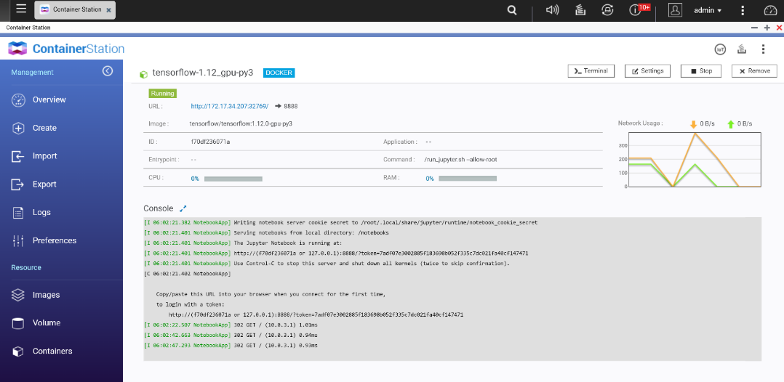
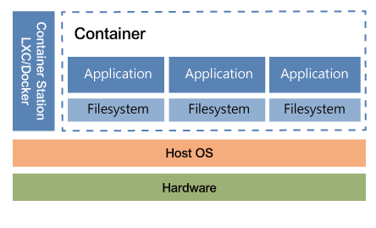
Create a container with GPU support
Deep learning & machine learning applications
Container Station (gpu-docker)
Simply using Container Station to create a TensorFlow docker with GPU support.

Slide 43
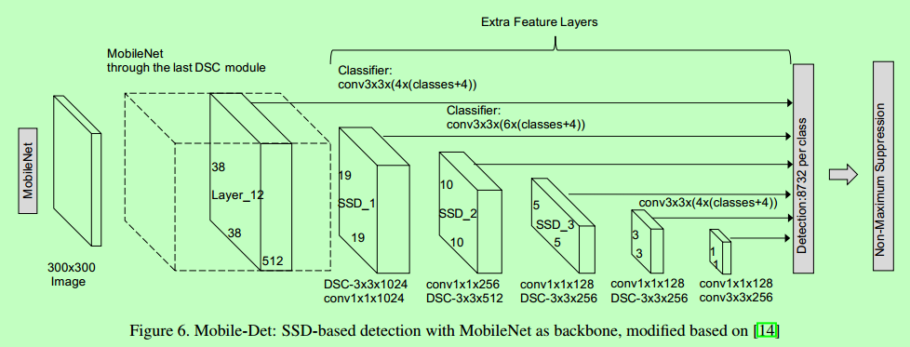
The selected framework & topology
Framework: TensorFlow
Topology: MobileNet-SSD
Model optimizer & inference engine: OpenVINO™

Slide 44
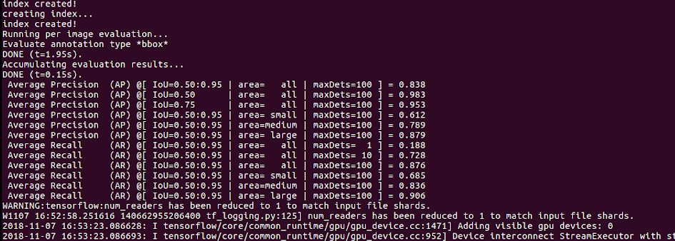
Start training

Slide 45
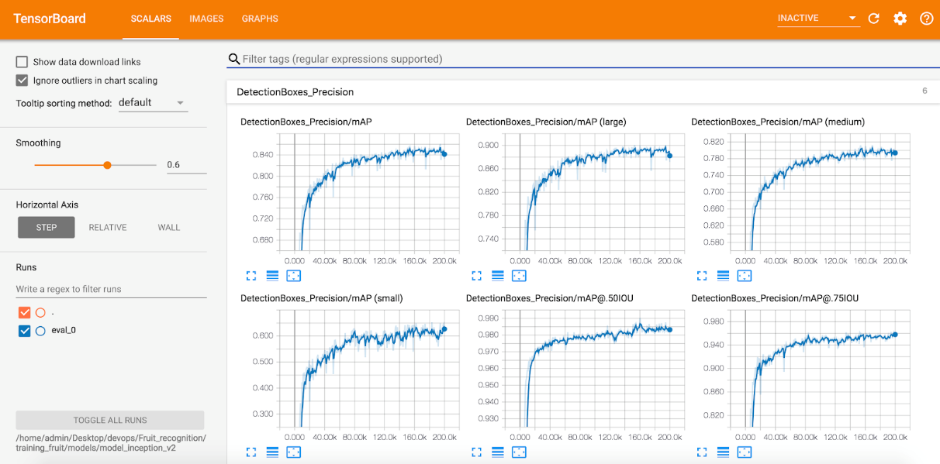
Monitor the training progress
The value of mAP (mean average precision) continues to increase and then slows down, indicating that the model has converged.

Slide 46
Validate the result using TensorBoard
The actual prediction results show that the position and classification of the fruits are correct.

Slide 47
Save the model files
The generated model weights files by each epoch.
We can also inference the image using above command. But it’s not optimized.

Slide 48
Build
Train
Optimize
Deploy

Slide 49
Using OpenVINO model optimizer
python3 mo_tf.py
--input_model mobilenet-ssd-fruit/frozen_inference_graph.pb
--model_name mobilenet-ssd-fruit
--tensorflow_use_custom_operations_config extensions/front/tf/ssd_v2_support.json
--tensorflow_object_detection_api_pipeline_config mobilenet-ssd-fruit/pipeline.config
--reverse_input_channels --output="detection_boxes,detection_scores,num_detections“
--output_dir mobilenet-ssd-fruit/FP16 --data_type FP16
[ SUCCESS ] Generated IR model.
[ SUCCESS ] XML file: /root/mobilenet-ssd-fruit/FP16/mobilenet-ssd-fruit.xml
[ SUCCESS ] BIN file: /root/mobilenet-ssd-fruit/FP16/mobilenet-ssd-fruit.bin
[ SUCCESS ] Total execution time: 19.97 seconds.
The .xml and .bin files are generated once the model is optimized successfully.

Slide 50
Build
Train
Optimize
Deploy

Slide 51
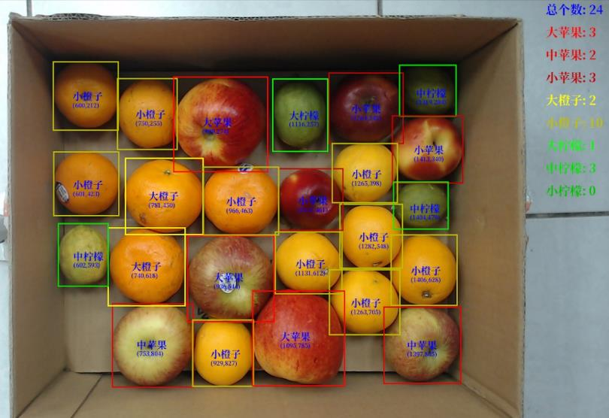
Inference
Before we deliver, we developed a custom application with meter function and tested it in lab.

Slide 52
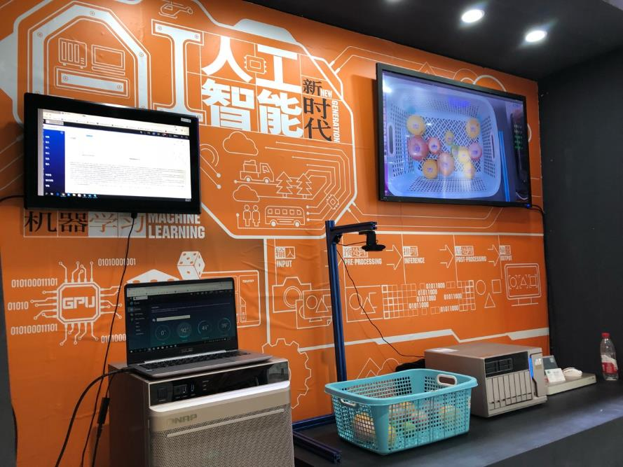
Integrated solutions
Final Solution Demo.

Slide 53
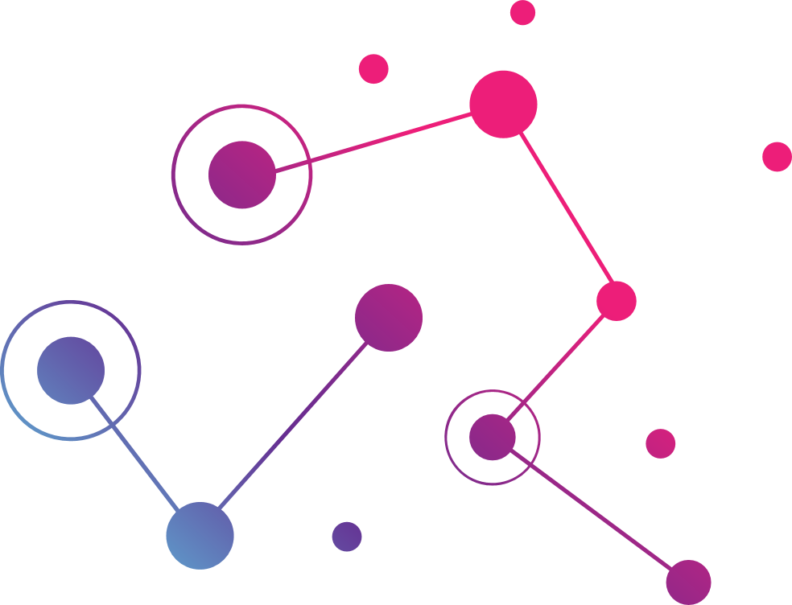
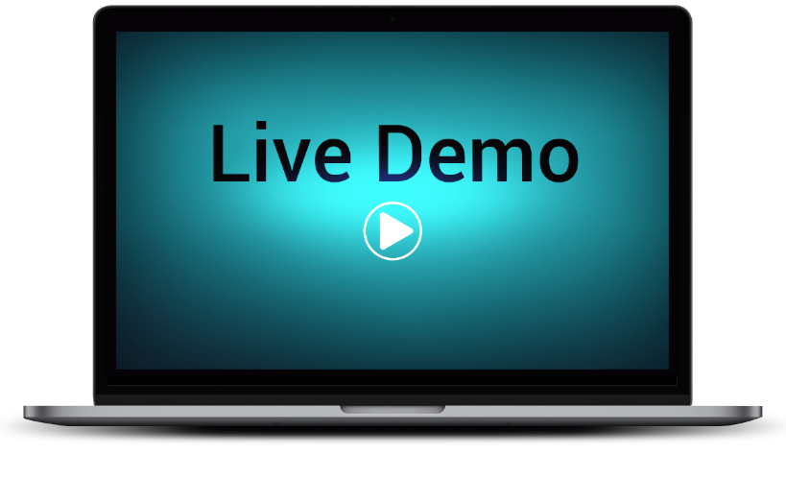
Notes:
Don : Let's see some real demo should we Amol ?

Slide 54
How we develop image classification model
Image Classification
Image Classification
Single Label
Multi Labels
Start from business requirement: (Multi) Label those photos automatically for user uploaded photos.

Slide 55
The model/framework we’re using
Framework: Pytorch
Topology: ResNet50
Model optimizer & inference engine: OpenVINO™
arXiv:1512.03385v1

Slide 56
Summary
Dataset ~= 2,000,000
Dataset cleansing & preprocessing
Final dataset: 100,966 images
Model trained: >300 models
Overall F1 score: > 90%
No Tag
Lotus
https://en.wikipedia.org/wiki/F1_score

Slide 57
Why QNAP NAS for AI ?

Slide 58
Three pillars for success…
Notes:
Amol slide
SSD Cache qtier
Compute : Xeon W/
Algo : Acceleration, Transcoding, encode-decode, FPGA acce to support
10G – connectivity. Need creation for New HW
Data:
Labels Data was hard to collect.
Several entities (for ex, ImageNet, Kaggle) provide training data sets and request for best models.
130 GB for 1k categories image classification training data
1.7 TB for video theme classification training data.
Google search, flickr, Youtube are also good ways to collect (crawl) training data sets.
Data scientist, labs & startups already using NAS or similar solutions to store their (training, test, validation) data sets.
We may preload public training data sets if no license issue.
Computing:
The GPUs increase the speed of deep learning systems by about 10 ~ 100 times.
Example: MNIST CNN
1282 (i7) need 148 sec to training 60k examples for 1 round.
1050 Ti need only 11 sec.
NAS now support GPU card(s).
Existing customers purchase separate servers as GPU servers, and spend more money for high-speed switch / network.
Lan: 10Gb
PCIE: 16GB
We may proposed the Machine Learning training appliance concept to market.
Algorithm:
Almost all Deep Learning models are open sourced
AlexNet
GoogLeNet
ResNet
Data scientists can fine-tune the models, and easily repeat the research result in their own environment
Application is the key when developing the models
A platform / tools for data scientist to quickly and easily discovery the data, fine-tune the models, try-errors, sharing & education are required
Jupyter is the most famous one

Slide 59
Why QNAP NAS for AI?
Low investments and high gains
It's FAST, EASY, and it is QuAI.
Designed to manage huge data
High IOPS
Multiple layers of data protection
Notes:
Amol slide

Slide 60
Diverse set of AI Projects
Image classification for photos and videos
Defect detection for
AI factory
MediQPACS with
Medical AI integration
Smart personal
assistant
Surveillance
solutions

Slide 61
Image classification for photo and video
Image Classification
Image Classification
Single Label
Multi Labels

Slide 62
Defect detection using AI

Slide 63
MediQPACS with medical AI integration
DICOM images with label (from doctors)
DICOM REST API
Remote viewing e.g.: on-call Doctors
TS-2888X
Xeon-W AI-ready NAS
Update new model
Inference API
Mobile
viewer
Pre-trained Model
OpenVINO Inference Engine
Hardware Accelerator
Inference Server
DICOM images are transferred from PACS server to NAS for smart management
*Picture Archiving and Communication System (PACS)

Slide 64
Smart surveillance – a BIG picture
QNAP AI Marketplace
QNAP AI Apps
IEI Hardware
QNAP NAS
3rd
Publish
Gateway
Apps
Train
+
TS-x77
Public cloud
AI services
3rd
OR
QuAI
TANK-860/870
Models
Import
horizontal
vertical
TVS-x82
QNAP AI Open API
+
Multiple acceleration cards
result
(metadata, events)
video stream
QNAP cloud AI services
video stream
video stream
HDMI
KVM
QUSBCam2
QVR Pro
IP camera
video server
RTSP/RTMP/… sources
IEI
Video Box
+
+
video conferencing
HDMI
USB / LAN
Under NAS QTS Protection
QNAP NAS
QNAP NAS

Slide 65
Smart surveillance
AI model: deep learning model
Features: face detection, face recognition, gender/age detection, emotional state estimation, pose estimation and pedestrian attribute detection.

Slide 66
AfoBot – AI Powered smart assistant
Control smart home devices
Home caring
Home security
Call taxi
Prescription ordering & delivery
Preventive health caring
Online shopping
Order food delivery
Hotel or restaurant reservation
Music: KKBOX, Spotify
Video: YouTube, LiTV, Netflix
Education: eNewton, encyclopedia
Alarm
Timer
Calendar/Reminder
Picture taking
Video recording
Album
News
Weather
Stock
Voice control TV
Real-time translation
Emergency call
Group call
Auto answering (optional)
Remote control of camera rotation
Face tracking
Auto record child
Public mode
WiDi/DLAN/Miracast
Recording video call

Slide 67
QNAP is your best choice!
Copyright © 2018 QNAP Systems, Inc. All rights reserved. QNAP® and other names of QNAP Products are proprietary marks or registered trademarks of QNAP Systems, Inc. Other products and company names mentioned herein are trademarks of their respective holder ​
​

