Slide 1


Slide 2
Agenda
What is container technology?
QNAP NAS is your best companion for containerized application development
Basic concepts for Container Station
Live Demo
Well-known containers
FAQ
Joining development of QNAP's applications

Slide 3
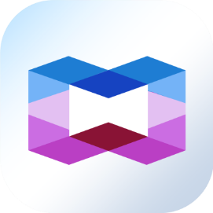
What is container technology?

Slide 4


Container 101
Container-based virtualization is an application-level virtualization technology that multiple virtual environments share the same kernel of the host operating system to reduce resource consumption and achieve rapid migration across different platforms.
APP 1
APP 2
bins/libs
bins/libs
APP 1
APP 1
APP 1
Guest OS
Guest OS
bins/libs
bins/libs
bins/libs
Hypervisor
Container Engine
Host Operating System
Host Operating System
infrastructure
infrastructure
Virtual Machines
Containers

Slide 5










Containers becoming prominent
Container is a popular technology used among software developers and DevOps.
  It only takes a few seconds to restart one container.
  Container can be instantly launched, deployed, and migrated to different platforms.
  Container technology improves efficiency and reduce cost.
Enjoy the same container service platform as with big enterprises.

Slide 6



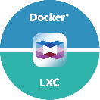





QNAP NAS is your best companion for innovative developments
QNAP NAS provides all you need!
Exclusive
01
03
LXC & Docker Dual Support
Flexible Network Settings
02
04
Efficient, Privacy-protective
Supports GPU Computing

Slide 7




QNAP NAS is your best companion for innovative developments
Exclusive
01
03
LXC & Docker Dual Support
Flexible Network Settings
02
04
Efficient, Privacy-protective
Supports GPU computing

Slide 8

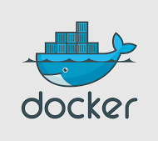



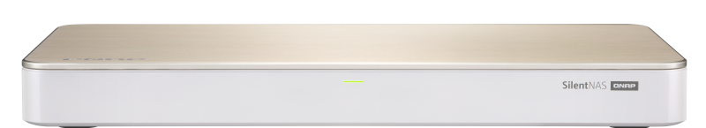
LXC & Docker dual support
Exclusive
Get all you need in one platform
One-click installation wizard for LXC containers: Debian, Fedora and Ubuntu
Built-in Docker Hub
Container Station

Slide 9


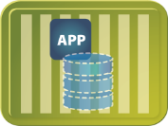
Structure of LXC and Docker containers
Linux Containers
Docker 1.10 (and later)
Containerd
liblxc
Differences
Docker Engine
namespaces
cgroups
Same
namespaces
cgroups
Linux kernel
Linux kernel
Notes:
Namespaces 做環境隔離 (ex, 網路, Process, mount, etc)
cgroups 做資源限制 (ex, CPU, Memory)

Slide 10
Differences between LXC and Docker containers
LXC Containers
Docker Containers
OS-level virtualization.
Compatible with all Linux applications and tools.
Each container is an image with a readable/writable layer on top of multiple read-only layers.
Different layer carries different files.
Support deployments in different environments.
HOST
Base Image
Ubuntu
Base Image
Ubuntu
Container
file1
file2
file3
file4
file5
HOST
VM1
Layer 1
Layer 1
file2
file5
PHP
Apt-gen install Nginx
VM1
VM2
VM2
Layer 2
Debian 64
PHP
Mysql
Nginx
Wordpress
Ubuntu 64
Ruby
Postgresql
Nginx
Wordpress
Mysql
Nginx Config
Layer 2
file3
file5
VM3
Nginx
Mysql
Layer 3 Nginx Container
Layer 3
file1
file2
file4
file5
VM4
Wordpress
Container
Storage
Volume

Slide 11


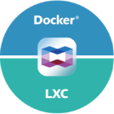

QNAP NAS is your best companion for innovative developments
Exclusive
01
03
LXC & Docker Duel Support
Flexible Network Settings
02
04
Efficient, Privacy-protective
Supports GPU computing

Slide 12

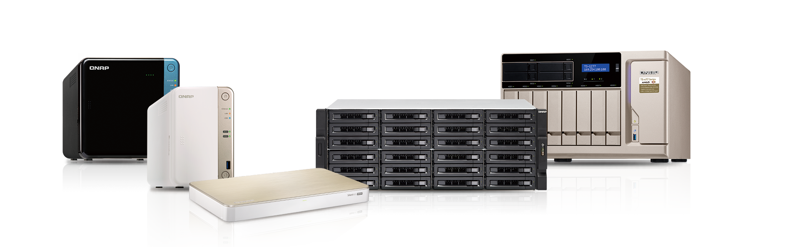
Efficient and privacy-protective
Well protected privacy in a private cloud
  Confidential development process and data are well preserved and protected in private cloud.
  Avoid complex payment issues and privacy regulations from public clouds.
Comprehensive control over containers and operation
  Efficiently allocate resources between hardware and software
Optimized storage efficiency and flexible data management
  Snapshots, Qtier, etc.

Slide 13
QNAP NAS is your best companion for innovative developments
Exclusive
01
03
LXC & Docker Dual Support
Flexible Network Settings
02
04
Efficient, Privacy-protective
Supports GPU computing

Slide 14
Flexible network settings
Basic Network Concept
Host Network
  The container directly uses the local host's network and has full host network interface access.
Bridged Network
  Connect to the virtual switch on NAS
  Able to use DHCP or static IP
NAT mode Network
  Able to set port forwarding between container and host.
10.0.3.5
10.0.3.7
10.0.3.22
Container
Container
Container
vethD
vethE
vethF
vethA
vethB
vethC
Virtual Switch 10.0.3.1/24
NAT
QTS Firmware
eth0

Slide 15

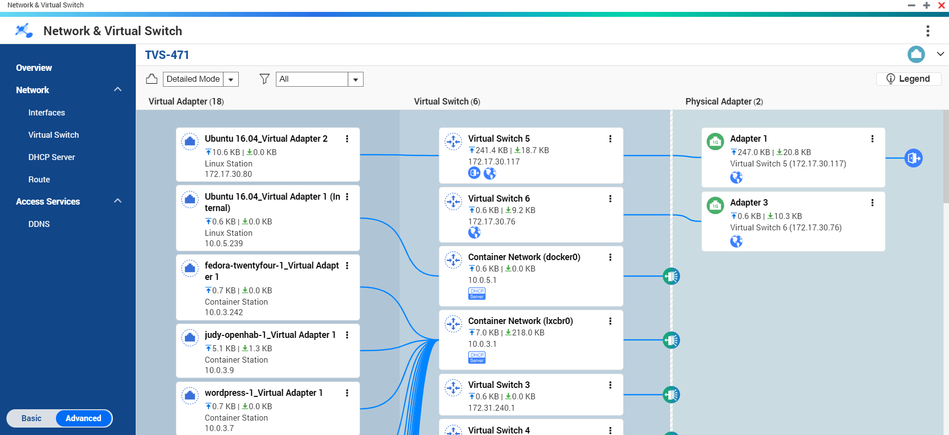
Network & Virtual Switch
Clear overview of container networking

Slide 16
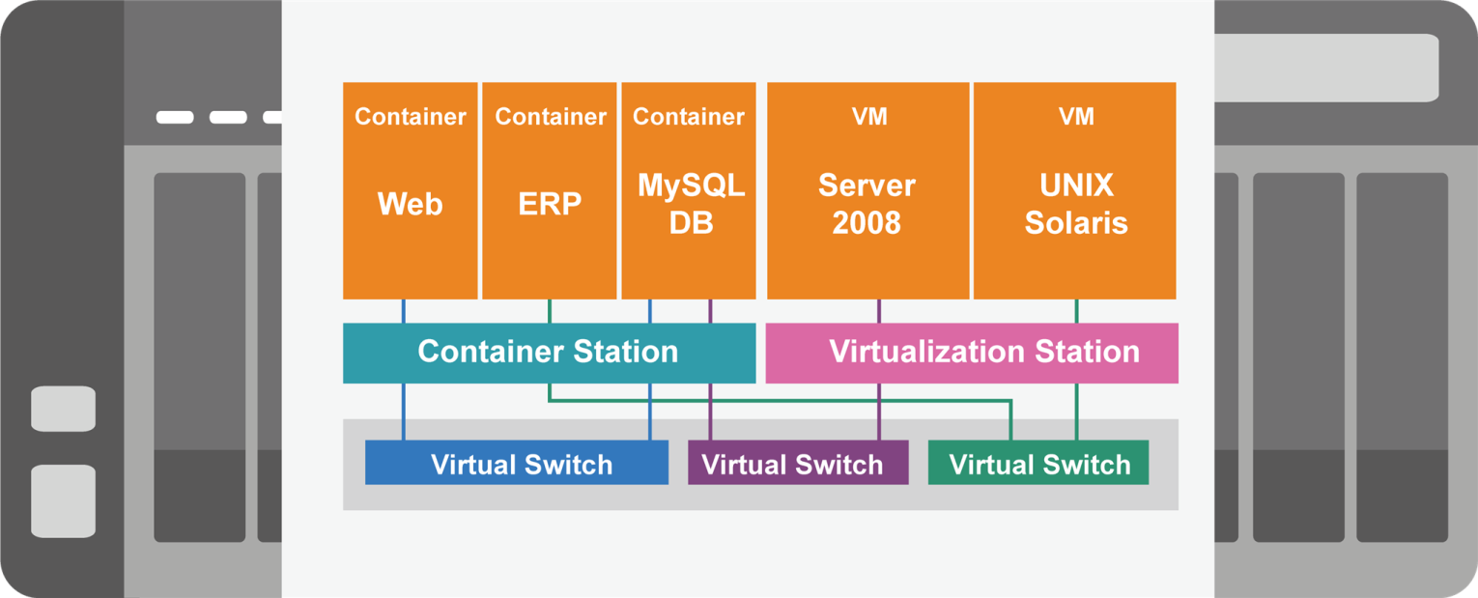
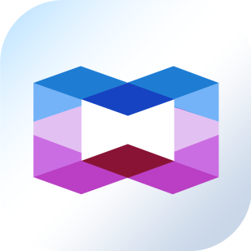
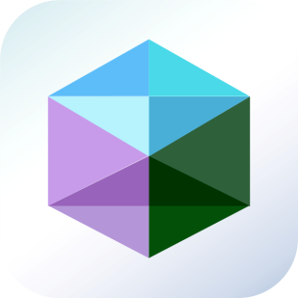
Flexible network settings
Using virtual switches to customize network environments for containers and VMs.

Slide 17
QNAP NAS is your best companion for innovative developments
Exclusive
01
03
LXC & Docker Dual Support
Flexible Network Settings
02
04
Efficient, Privacy-protective
Supports GPU Computing

Slide 18
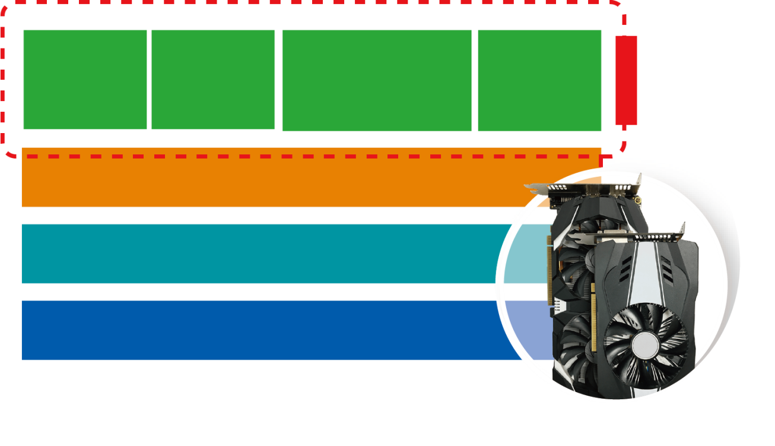

GPU-acceleration
QNAP NAS supports graphic cards to empower performance of QuAI-related containerized applications.
CNTK
MXNet
TensorFlow
Caffe
QuAI Containers
Container Station 1.9
GPU Card
QTS 4.3.5
QNAP NAS + GPU
Support models： TS-x77, TS-1685, TDS-16489U

Slide 19
Welcome to Container Station!
Welcome

Slide 20



Basic concepts of Container Station
Three main roles of Docker container technology
Registry
Store images
Read-only layers for Docker engine that include file system
Image
Container
Instance of an image with a writable layer.

Slide 21
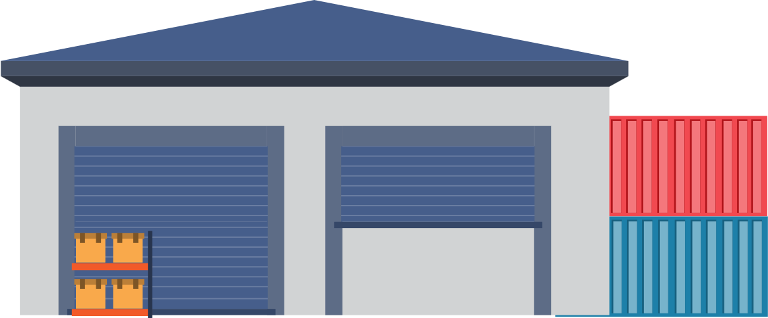


Basic concepts of containers
Pull
Create
Container
Image
Push
Commit
Registry
B
Docker-compose:
A tool for defining and running multiple container applications
Create multiple containers
C
D

Slide 22
Advanced operation of containers
commit
Container
images
create
rmi
start
Stop
run
Running
tag
Kill, stop
history
Use Dockerfile to create image
File storage allocation
Export / Import container
Set network between containers
files/
folders
cp
files/
folders
HOST
logs
i
inspect
ps
diff
attach
port
rm
>_
exec
export
import
version
images
load
Tar files
filesystem
i
Image(S)
info
save
events
build
Dockerfile
Engine
pull
push
Registry
search
login
logout

Slide 23




Operate Container Station in four steps
Pull image from registry
Use image to create container
A
Infrastructure
Container overview and management

Slide 24



Multiple options for pulling image
DEMO
Pull image and create container
via recommended applications
Import images from PC or local host
Search and pull image from built-in Docker Hub
Pull image from private registry

Slide 25
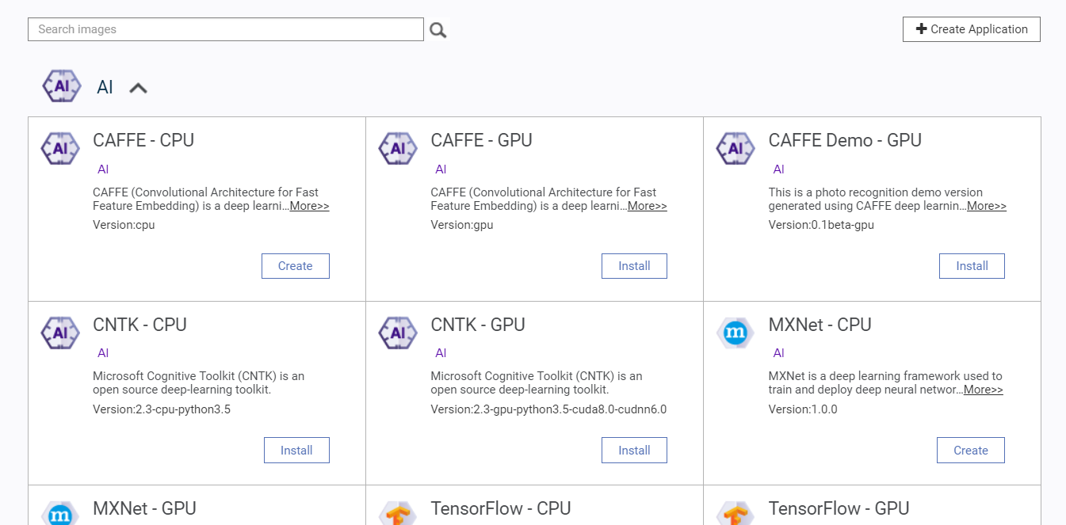
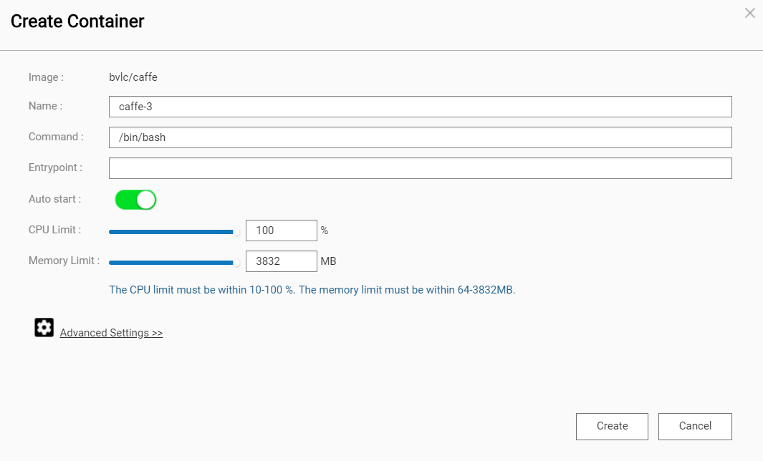

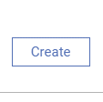

User image to create container
One-click installation wizard for quick parameter setup
Support Docker Compose YAML format to create
applications
Import image from PC or NAS
DEMO

Slide 26
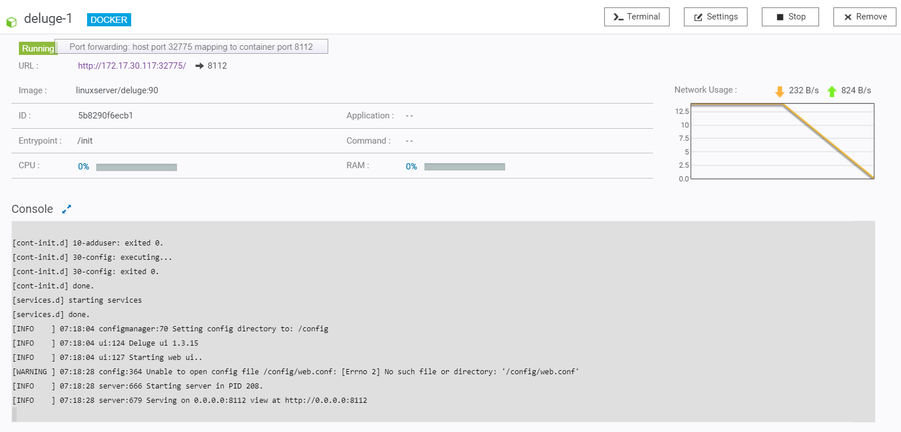
Build personal infrastructure
Connect to container via URL and operate through Web UI
Open container terminal
Intuitive and visualized management for customized network settings
DEMO

Slide 27



Container overview
Intuitive & visualized management
DEMO
  Overview of all containers, images and volumes
  NAS resource allocation display
Export containers
  Export containers or images to NAS for backup
Network settings of virtual switches
  Provide network connections for containers built in Container Station
  Provide network connections for containerized applications from App Center

Slide 28



One-click installation of popular containers
AI
Containers
Complete storage solution with GPU computing makes your NAS a powerful AI computing platform. Ex: CAFFE
IOT
Containers
Quickly customize your IoT application management. Ex, openHab
Well-Known
Containers
Selections of Docker or LXC containers
Ex, Ubuntu 18.04 with VNC desktop

Slide 29

AI containers
Provide four well-known machine learning system containers : CNTK, CAFFE, MXNet, TensorFlow
Deep learning
Machine Learning
One NAS to fulfill all you need
Predictive Analysis
Data storage and backup
GPU acceleration support
Model training
Driver installation and container deployment
AI
Container
Language
Translation
Image recognition
Vision Learning
Machine vision

Slide 30

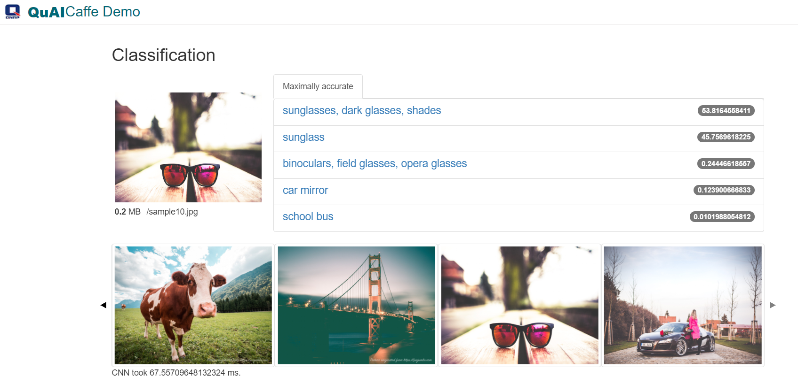
AI container – CAFFE
Use CAFFE for image recognition

Slide 31
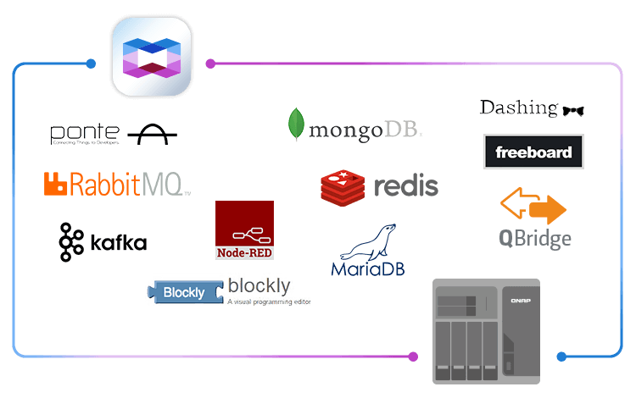
IOT containers
Developers can quickly start a smart home project by connecting a development board (e.g. Raspberry Pi) to a temperature or humidity sensor.
Integrate smart appliances, sensors and mobile devices over the Internet to effectively integrate automation and security management in your home environment, including indoor temperature and lighting control.
Personal health information can be effectively collected and analyzed. Therefore, appropriate health management advice can be given when needed.

Slide 32
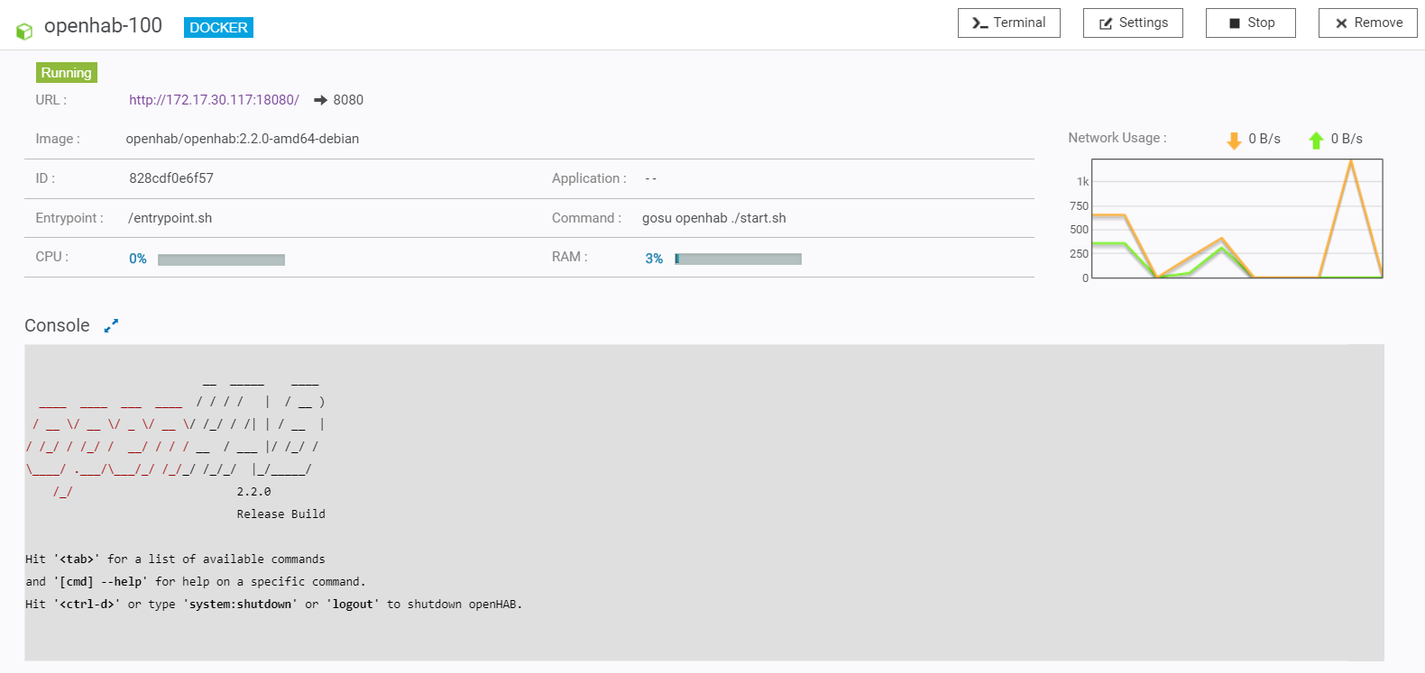

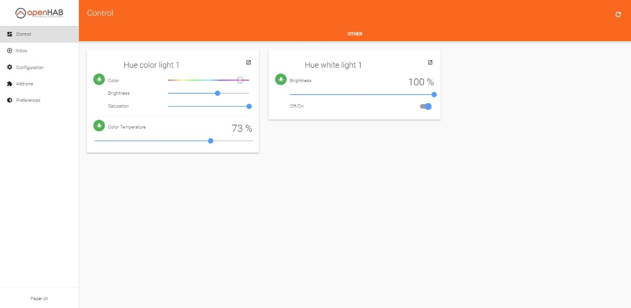
IOT container - openHAB
Remote operation for smart home

Slide 33
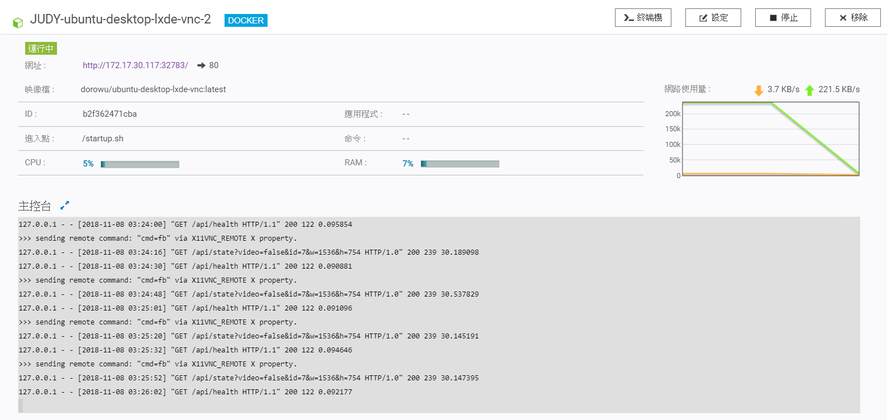
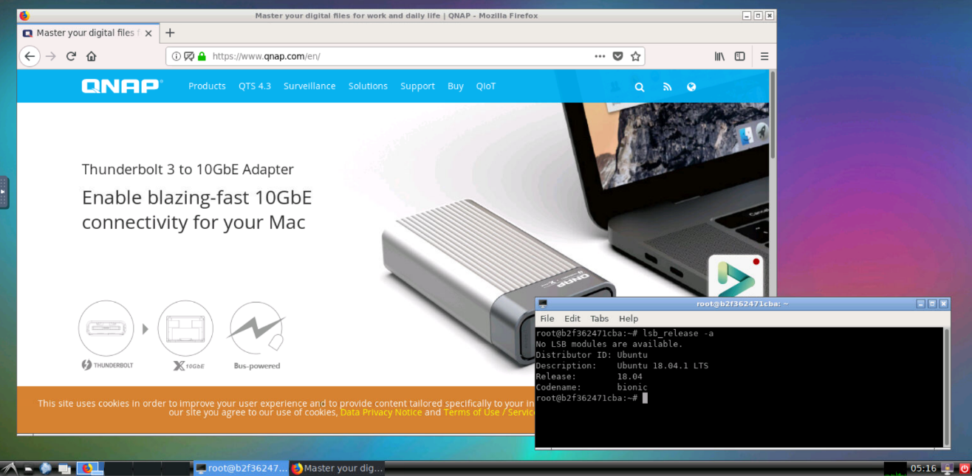
Ubuntu 18.04 with a VNC desktop
Multi-operation between the terminal or a simple VNC desktop

Slide 34
Q & A

Slide 35


FAQ
Q1
Why can't I use Container Station when the “container-station-data” folder is encrypted ?
A1
As some system data access and Container Station settings are stored in the “container-station-data” shared folder, this folder cannot be encrypted while Container Station is running.

Slide 36




FAQ
Q2
What's the reason that some QTS apps won't function properly after I enable “System” > “Security” > “Allow/Deny List” > “Allow connections from the list only”?
QTS blocks connections at IP layer 3. This might limit the network connections of apps that run on their own network segment within QTS, such as apps that use Container Station.
To fix these issues, go to “Network & Virtual Switch” > “Virtual Switch” and check which network segments are used by each virtual switch. Then add these network segments to your IP allowed list.
For NAS models that do not support “Network & Virtual Switch”, go to “App Center” > “Container Station” > “Preferences” > “Network”, and then add the network segments shown here to your IP allowed list. You will usually need to add 10.0.3.0/24 and 10.0.5.0/24.
A2

Slide 37


FAQ
Q3
Why is Container Station required for some applications?
A3
These applications are containerized applications.
Container Station provides two platforms for:
Containers running in Container Station that use lxcbr0 bridge for network connection.
Containerized applications running on system docker that use docker0 bridge for network connection.

Slide 38

Supported NAS models
x86
Model
TS-x51、TS-x51+、TS-x51A、TS-x53、TS-x53A、TS-x53B、TBS-453A、 TS-x55、TS/TVS-x63、TVS-x70、TVS-x71、TS-x73、TS/SS-x79、TS/TVS-x80、TVS-x82、TVS-x77 、TS-1685 and TDS-16489U 、HS-453DX
ARM
Model
TS-x31P、TS-x31X、TS-1635、TS-x31+ 、TS-X32X

Slide 39

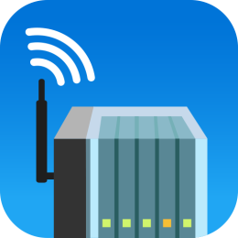
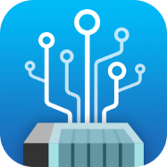
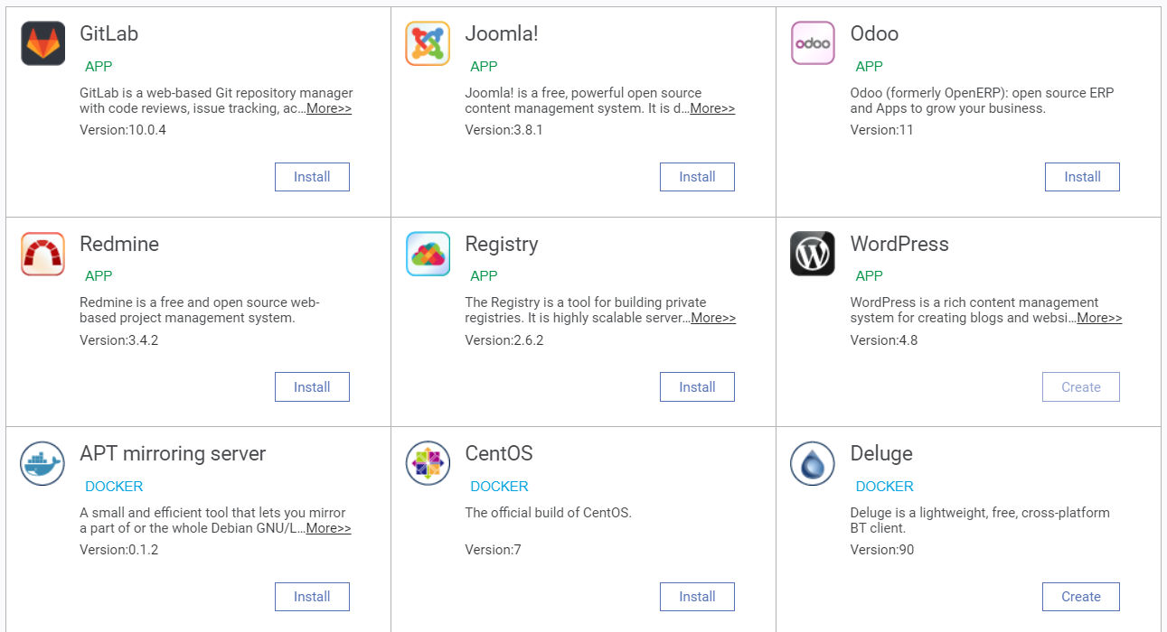

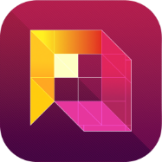

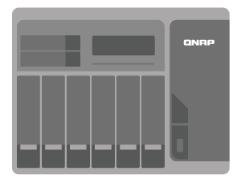

Join the development
Build applications on a QNAP NAS:
Download self-developed apps from recommended app list
Share self-developed containerized apps via App Center
Notes:
1. QNAP App Center 本身已經有 Containerized Apps。外部開發者可使用 NAS 開發以及提供 Containerized Apps。可以放在 Recommended App or App Center
2. CS 有提供 QDK 打包工具
3. 原本提供 NAS API 文件。二次開發文件。

Slide 40

Comprehensive development support
Doc / Support Resource
QTS QDK
File Management
Account and User right management
System setup
SDK/API
Guidelines
Toolchains for x86/ARM
FAQ
Support

