Slide 1
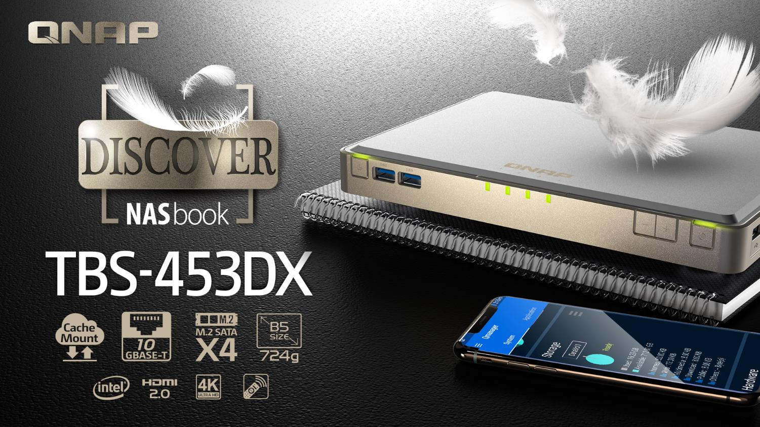

Slide 2
Maker x Backup x Sharing x Work x Entertainment everywhere
Thin & light; use it everywhere
724g / 1.60lbs
Light weight for portability
B5 size
25 x 230 x 165 mm
0.98 x 9.06 x 6.50 inch (H x W x D)

Slide 3
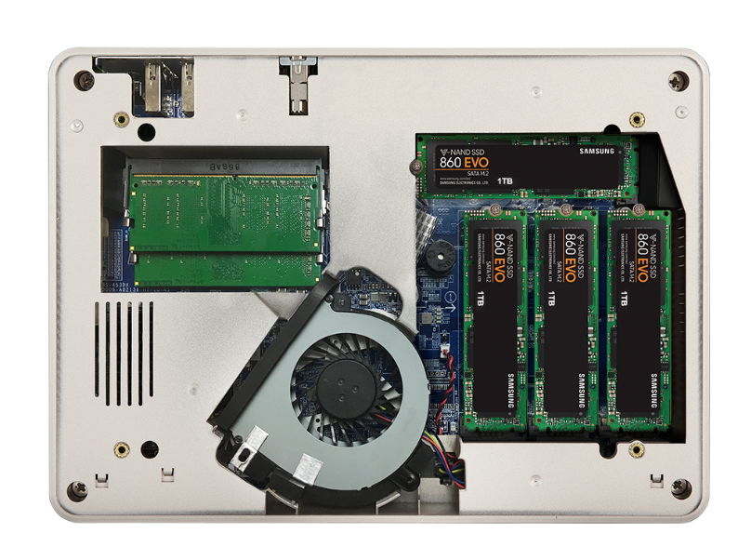
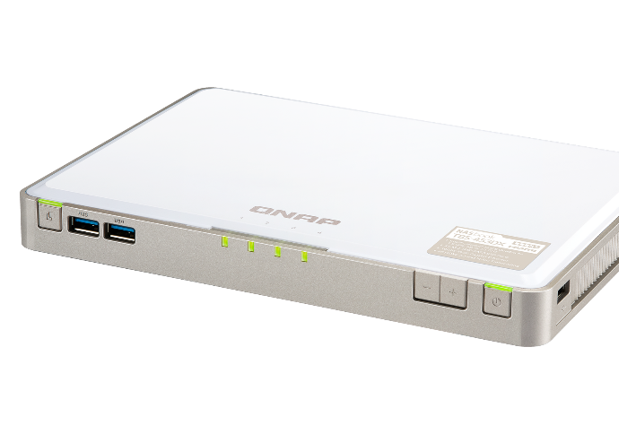
M.2 SSD for the best performance
4 x M.2 2280 SATA 6Gb/s SSD slots
(optional SSD purchase)

Slide 4
QTS 4.4.0 + new Linux kernel 4.14
To provide the best performance of Intel® Celeron® J4105, TBS-453DX is shipped with QTS 4.4.0,using the new long-term supported (LTS) Linux kernel 4.14. QTS 4.4.0 optimizes overall system and support SSD extra over-provisioning & Cache Mount to enhance TBS-453DX functionality.
AES-NI encryption
Volume & folder support
GPU up to 750 MHz
UHD Graphics 600
J4105
Gemini Lake SoC
4-core
4-thread
1.5GHz
Base
2.5GHz
Burst
10 watt
TDP

Slide 5


Different SSD has different performance
In QNAP Lab, engineers use FIO to test different SSDs, and all SSDs have showed consisted write performance degrade.
Different SSDs' controllers and Garbage Collection algorithms will affect the long term performance.
How can storage vendors help to ensure SSD has expected performance?
Different SSD in QNAP NAS’s FIO consisted performance (IOpattern: RW-4K)

Slide 6



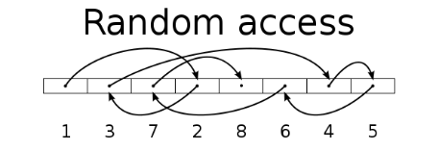
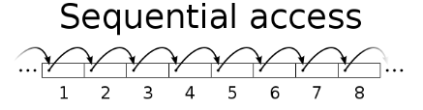
SSD usage in Network Attached Storage
SSD can provide high random IOPS for multi-client sync and business applications that cannot be achieved with HDD.
In 2018, SSD price also comes close to the sweet spot.
You need not only choose the right SSD, but also choose the right NAS!
SanDisk estimates the
256 GB SSD per GB price in 2018 is only 30% compared to that of 2013
Drive Type | Sequential Access (MB/s) | Random Access (IOPS)
HDD | 100 | 350
SSD | 300 | 60,000
SanDisk's Statistic for Global SSD/HDD Price Trend
Source: https://www.sandisk.com/business/datacenter/resources/white-papers/the-ssd-enabled-pc-total-cost-of-ownership

Slide 7
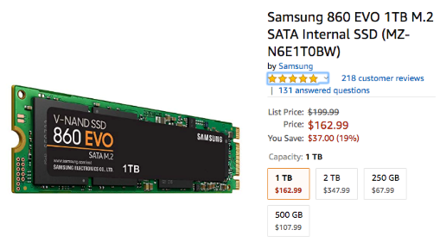
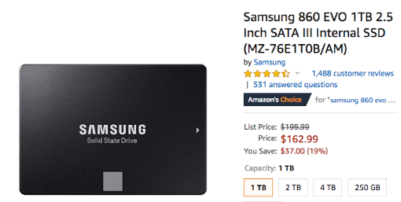
Hot pick: Samsung 860 EVO M.2 SSD
550 MB
Seq. read
520 MB
Seq. write
3.0 - 4.5 W
Lower heat & power
1 TB 2.5” & M.2 at the same price
-2018/11/06 Amazon.com
5-year
Warranty
2018 Q1 SSD market share
Source: https://www.digiliant.com/the-leader-in-ssd-shipments-2017-samsung-pid-36.html

Slide 8

What is SSD over-provisioning
SSD Over-provisioning reserves space in the SSD to decrease write amplification & increase consisted performance and endurance.
Reason: to avoid Garbage Collection in any giving point of time
With limited OP, 4 more write is needed. With more OP the GC is not required.
N | New Data
D | Valid Data
 | Invalid Data
 | OP
 | OP
N | N
N | N
N | N
D | D
D | D
D
D
D | D
D | D
D | D
D | D
N | N
N | N
N | N
6 pages of new data cannot all be stored to the SSD
Unless the SSD conduct GC internally first
With more reserved block, the GC is not required

Slide 9
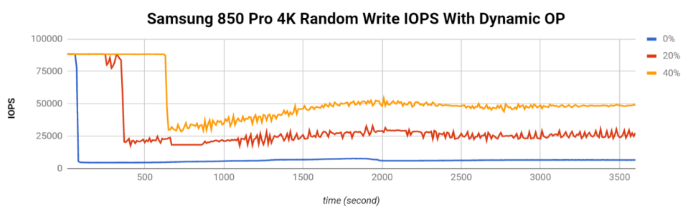
The advantage of software-defined SSD extra over-Provisioning
With QTS, user can assign more OP to the SSD RAID.
At QNAP Lab, the effect of over-provisioning can not only be observed on single consumer-level Samsung 850 PRO (reaching almost the same performance as data center SSD), but also be seen on SSDs as a RAID.
Above: Samsung 850 Pro as Single Disk
Below: Micron M1100 as RAID 1
FIO configuration: runtime=1800 ioengine=libaio direct=1 rw=randwrite bs=4k numjobs=1 iodepth=32
資料級 SSD 以 Intel S4500 為例，持續隨機寫入 IOPS 為 30,000

Slide 10

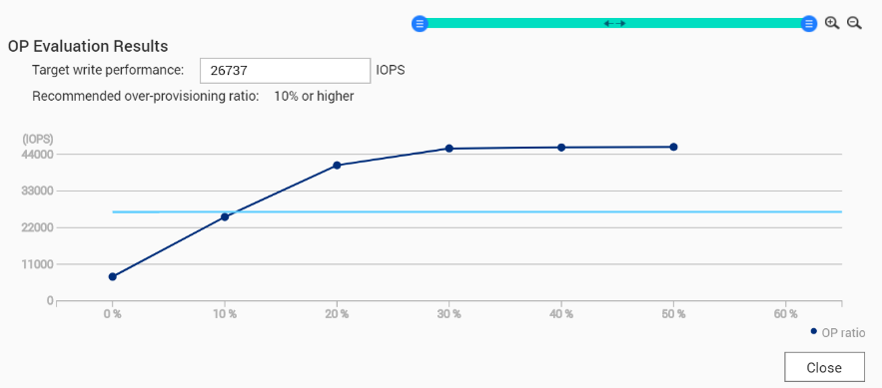
Choosing SSD is hard, choosing QNAP is simple
SSD consisted performance can only be observed after long time of usage.
QNAP has provided the unique SSD Profiling Tool to help user measure the performance difference with different over-provisioning amounts.
Not just IT manager, home user can also evaluate the capability of SSD.
Using SSD Profiling Tool to identify the best OP amount.
資料級SSD 以 Intel S4500 為例，持續隨機寫入 IOPS 為 30,000

Slide 11







Create a tighter hybrid cloud system
Light storage in NAS + Unlimited storage in Cloud
= Everything is Possible
Capacity
CacheMount
VJBOD Cloud
Unlimited Expansion
QNAP is going to release the following services to enable a closer integration
File-level Gateway
Block-level Gateway
CacheMount
VJBOD Cloud
*Will be released in QTS 4.4.1
Notes:
TBS-453DX搭配SSD讓效能更優化，但總體能配置的容量可能少於一般傳統HDD配置的NAS，這時候就可以透過無邊無際無限大的雲端空間來補除空間稍少的問題
因此QNAP即將推出兩個與雲端更緊密結合的服務，分別是文件型Gateway的CacheMount以及區塊型Gateway的VJBOD Cloud
TBS-453DXcan have better performance with SSD. However, the total storage mighr less the other NAS with HDD. Therefore, you can expand the storage with the unlimited cloud storage.
QNAP is going to release the services to embrace cloud services : File-lavel gateway CacheMount and Block-lavel gateway VJBOD Cloud.

Slide 12

























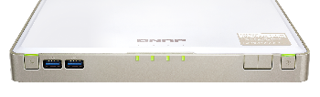











CacheMount: enable cache to enhance cloud experience
Mount space of 20 cloud providers​​
Enjoy QTS applications with your cloud data
File Management
Editing Tool
Multimedia
Application
Access with
Network Protocol
*Details of the services will be announced later.
Notes:
We redesign the remote mount function to a new APP CacheMount. It will support to mount more than 20 cloud providers. In addition, with enabling cache function, you will have a better cloud access experience like in local. And you will enjoy the QTS applications with your data in Cloud. Also it cloud be a gateway for you to access cloud service on your PC.

Slide 13
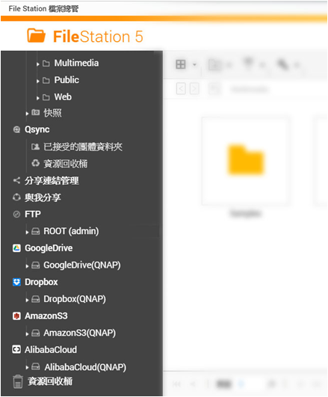
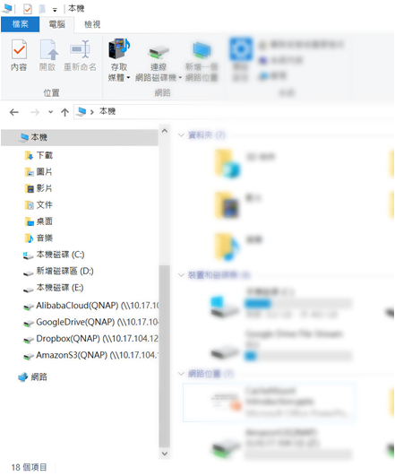
CacheMount: manage all storage together
File Station
PC (mounting through Samba)
Local Storage
Remote NAS
Mount on PC by network protocol
Cloud Storage
*Details of the services will be announced later.
Notes:
For example, with CacheMount, you can see all data in different storage within File Station. It can help you to manage all your data. And you can also access the cloud service through network protocol on your PC. You don't have to install lots of utility of Cloud providers on PC.

Slide 14
The core of CacheMount
EdgeCache volume
Any transfers between cloud and local client go through EdgeCache.
- Optimized Cloud Storage Experience: Cache the cloud read and write operations and experience the high speed local transferring.
- Versatile Configuration:
Using SSD Static Volume, SSD Cache or even Qtier to build 3- or even 4-tier EdgeCache solutions.
Application/Service IO
SSD Cache
Volume
EdgeCache Volume
Qtier Storage Pool
Cloud Storage Spave
SSD
SAS
HDD
HDD
Notes:
為什麼 QNAP 需要將 Remote Mount 重新打造為 CacheMount? 因為要透過 NAS 作為邊緣快取磁碟區加快從雲端空間存取檔案的效能。邊緣快取磁碟區的建立和一般磁碟區無異，但其專門用來存放準備寫入雲端或從雲端讀取的檔案。透過此暫存空間存取雲端將能衝雲破霧的效果，享受如本地儲存般的讀寫效能。
更進一步，這類的磁碟區不僅可以再一般HDD儲存池上建立，更可以啟用 SSD 快取或是在 Qtier 自動儲存分層儲存池上建立。達到騰雲駕霧，依照使用者配置有 SSD 、 HDD 到 Cloud 三層，甚至 SSD，SAS HDD，HDD，Cloud 四層的分層配置。

Slide 15


VJBOD Cloud + public cloud frees the private cloud from its limitations
Using the public cloud storage space just like a volume (or iSCSI LUN) on the NAS.
Compared to file-level CacheMount, the block-level VJBOD Cloud increase the efficiency of transferring random data and large files to the cloud to provide business-level gateway solution.
Oringial Data
In file-level, a modified file need to be re-upload in full.
Modified Data
In block-level, only the modified block needs to be uploaded to the cloud.
With Block-level solution， the uploaded data cannot be recongized by the cloud or its applications
Notes:
除了 CacheMount ，QNAP 也正在積極規畫進一步利用 NAS 邊緣運算優勢加入企業雲端儲存生態系。並將提出 VJBOD Cloud 雲端虛擬擴充櫃的新架構。VJBOD Cloud 不同於 CacheMount 將採用區塊層級方式讓 NAS 運用雲端空間，也就是說使用者將可以用連接的物件儲存空間 Bucket 直接建立儲存池和磁碟區。
使用區塊層級的優勢，在於寫入多個小檔到雲端時，首先雲端伺服器可以區塊處理資料而不用一個檔案一個檔案溝通讀寫需求，而在編輯單一大檔時，效益更明顯是如下圖所示，在一個大檔僅有變動的區塊需要做上傳，有效的節省了頻寬和雲端傳輸費用。這個優勢使相比 CacheMount VJBOD Cloud 更適合做 NAS 擴充給虛擬機鏡像檔或備份情境使用，以公有雲解放私有雲的儲存空間。而缺點就是區塊層級的 Volume 或 LUN 中的檔案在雲端暫時還無法被其他應用直接識別。

Slide 16


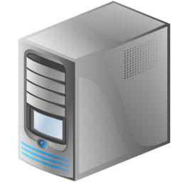

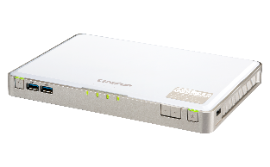


Using VJBOD Cloud to create a reliable database
Even the best RAID protection cannot stand again physical shock!
For files, they can be upload to cloud, how about iSCSI LUN?
With VJBOD Cloud, an iSCSI LUN can be created at Cloud and shared via NAS. Using the edge solution to accelerate performance while allowing new device to connect & share the LUN at any time!
Using Different NAS to share the LUN when needed
Cloud LUN as Object
Having a reliable database backup solution for your application
One Cloud LUN can only be connected by one NAS at a time
Notes:
QNAP 之所以推出VJBOD Cloud ，最重要的原因是為了解決用戶重要資料庫上雲的需求。我們知道在企業情境中，應用程式的檔案都是以 iSCSI LUN 的形式存放在 NAS 中，但這種區塊裝置在 NAS 中資料無法被識別，除了透過 LUN 匯出匯入，也就難以用一般的備份軟體持續備份、甚至以同步方式傳到雲端。當本地 NAS 遭遇到 RAID 失效或是機器損壞時，重要的資料庫資料就有毀損的風險。
而現在透過 VJBOD Cloud 雲端虛擬擴充櫃，使用者將可以輕鬆在雲端建立一個 Cloud LUN 並透過 NAS 分享給本地的企業應用程式或是 Hypervisor ，當 NAS 上的 RAID 或是 NAS 自身有任何損壞時，不需要擔心從損壞到復原中間的營運損失，只要您有另外一台 NAS，直接透過 VJBOD Cloud 即可重新連上 Cloud LUN ，並且再次提供給本地應用程式伺服器，透過雲端達具完全保護，持續可用的資料庫儲存架構。

Slide 17

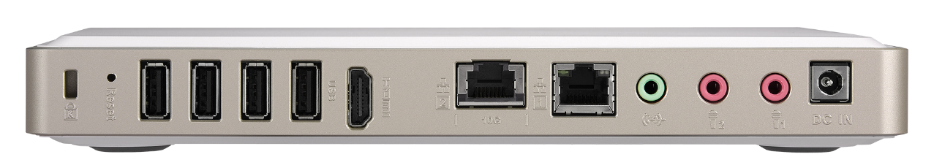
Multi-Gig 10GBASE-T brings out SSD potential
1 x 10GbE port: save cost with NBASE-T
 | CAT 5e | CAT 6 | CAT 6A & CAT 7
1G | Yes | Yes | Yes
2.5G | Yes | Yes | Yes
5G | Yes | Yes | Yes
10G | X |  | Yes
Your existing wiring infrastructure may already support > 1Gbps!
Max 55 meters / 180 feet

Slide 18
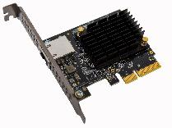
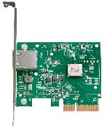
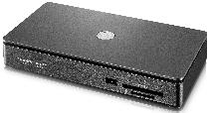
Based on Aquantia’s AQC107 10G IC
Multi-Gig IC
Used by many industry leaders

Slide 19















Aquantia at a glance
A Global Company
A Leader in Multi-Gig Ethernet ICs
HQ: San Jose, CA
Global Operations:
Canada
  India
  Netherlands
  Russia
  Taiwan
250+ employees
170+ design wins across our core markets
10+ Million of ports shipped to Tier-1 OEMs
Successful IPO on November 3, 2017
Diversified Markets
Announced Customers and Partners
  Auto
Customers
  Access
Partners
  Enterprise
  Data Center
Distributors
2017

Slide 20
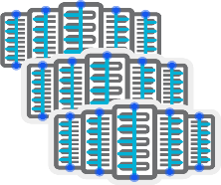







Aquantia drives the infrastructure upgrade
Data Center – Corporate
10GbE
Data Center – Hyperscale
25/100GbE
Enterprise Infrastructure
2.5/5/10GbE
Access
2.5/5/10GbE
Automotive
2.5/5/10GbE

Slide 21
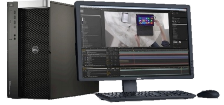
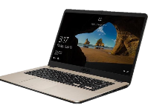







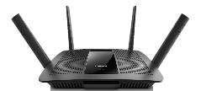
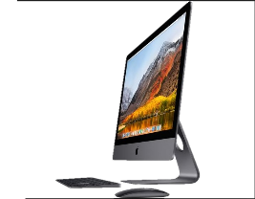



Applications
TB/USB Dongle
Internet / Cloud
PC
5G Enabled
802.11ax
Laptop
10G Enabled
Switch
TB Dock
Carrier Gateway
10G/5G/2.5G Enabled
802.11ax
10G Enabled
10G Enabled
Gaming PC
NAS
iMac
Pro
Retail Router
10G/5G/2.5G Enabled
10G Enabled
10G Enabled
10G Enabled

Slide 22


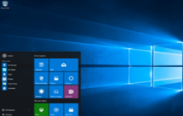
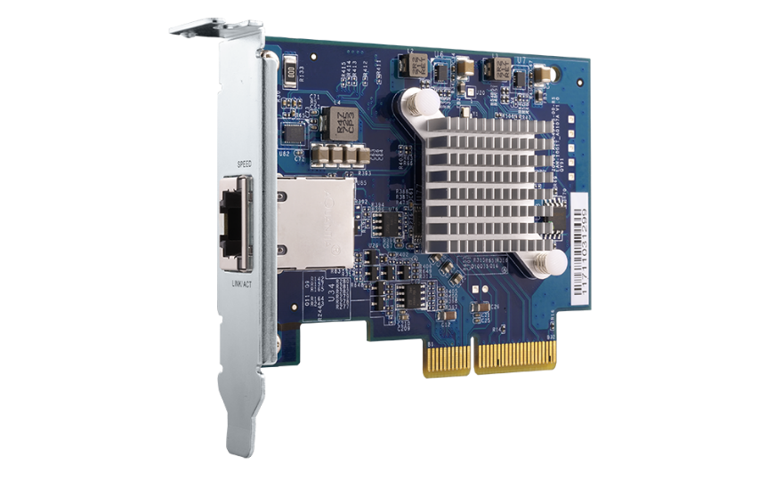


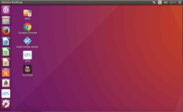
Install a 10GbE adapter to PC
  Windows® 10, 8.1, 8, 7 (32/64 bit)
QNAP QXG-10G1T
1-port 10G network adapter
10G/5G/2.5G/1G/100M
PCIe 3.0 x4 interface
  Linux 3.2, 3.10, 3.12, 4.2 & 4.4

Slide 23
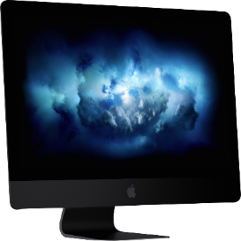

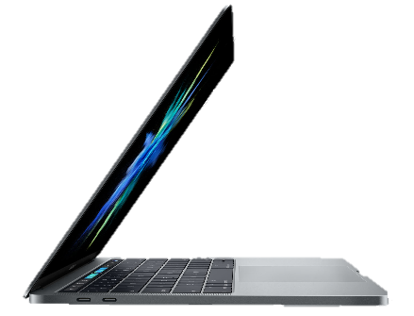
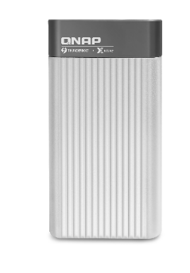
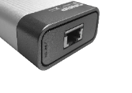
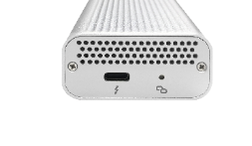
Mac users can now connect to 10GbE
2018 iMac Pro
1 x NBASE-T for 10GbE
Mac with Thunderbolt 3 can connect to 10GbE with the QNAP QNA-T310G1T Thunderbolt 3 to 10GBASE-T adapter
QNA-T310G1T
NBASE-T
Specs
Controller: AQC107S-B1-C + AQX-N3F10-DRE-U3C
Interfaces: 1 x Thunderbolt 3, 1 x 10GbE 10GBASE-T port (10G/5G/2.5G/1G)*
LAN cable: CAT 6a/ CAT 7
USB 3
Thunderbolt 3
(USB-C)
10GbE
Ethernet
SDXC card slot
Ethernet
*Mac with macOS 10.13.3 (or newer) is required.

Slide 24

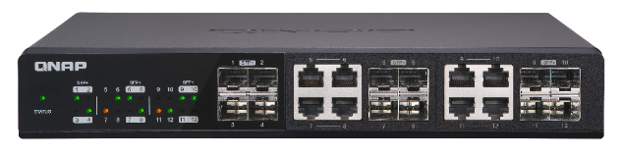
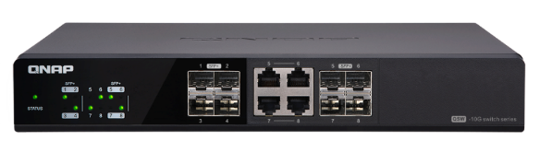
Accessories – 10GbE network switch
12
Ports
Up to 12 x
10Gbps ports
8
Ports
Up to 8 x
10Gbps ports
QSW-1208-8C
QSW-804-4C
12-port 10GbE switch
4 x SFP+ ports
8 x RJ45/ SFP+ combo ports
8-port 10GbE switch
4 x SFP+ ports
4 x RJ45/ SFP+ combo ports

Slide 25
10GbE performance
700
825
600
686
667
500
685
400
300
200
100
0
(MB/s)
Upload
Download
Upload
Download
1 x 10GbE
1 x 10GbE
encrypted volume
Test environment: TBS-453DX: 2 x M.2 2280 SATA 1TB Samsung 860 EVO SSD, RAID 5, QTS 4.4.0, 4GB RAM, thick volume
Client PC: Windows 10 Pro, Intel Core-i7 4770 3.4GHz, 16GB RAM, LAN-10G2T-X550 MTU 9000

Slide 26

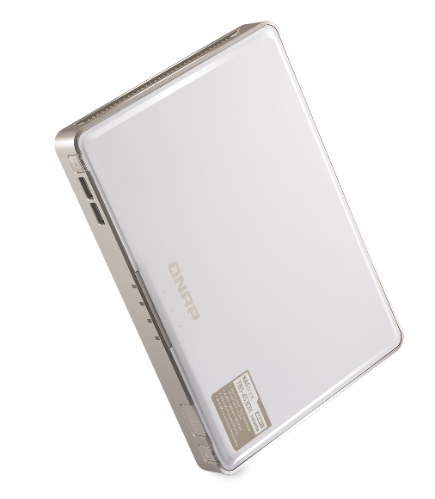
Live Demo
10GbE performance demo

Slide 27
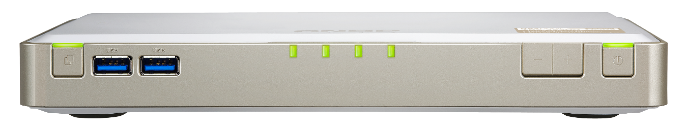
TBS-453DX front view
Volume up/down
Power button and status LED
USB OTC button
M.2 SSD status LEDs with adjustable brightness
USB 3.0 port
IR receiver

Slide 28
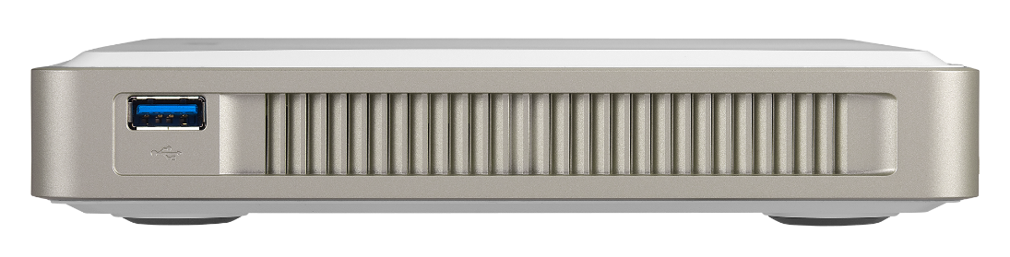
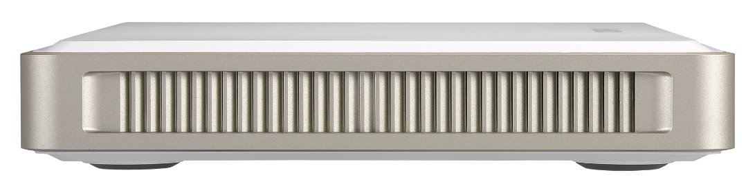
TBS-453DX side views
USB 3.0 port
Right side
Stereo speakers
Left side

Slide 29
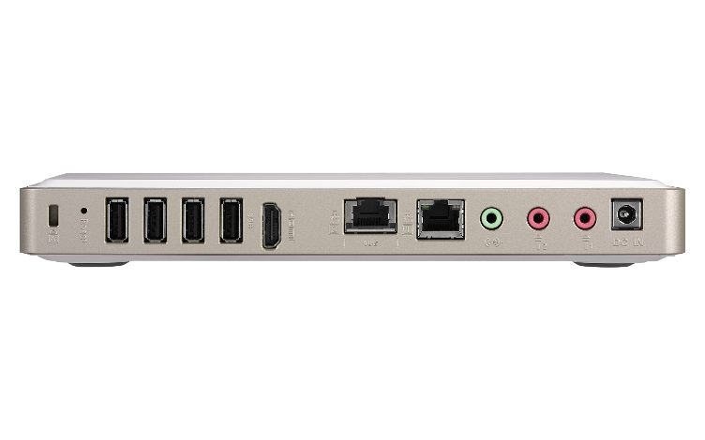




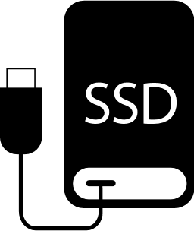

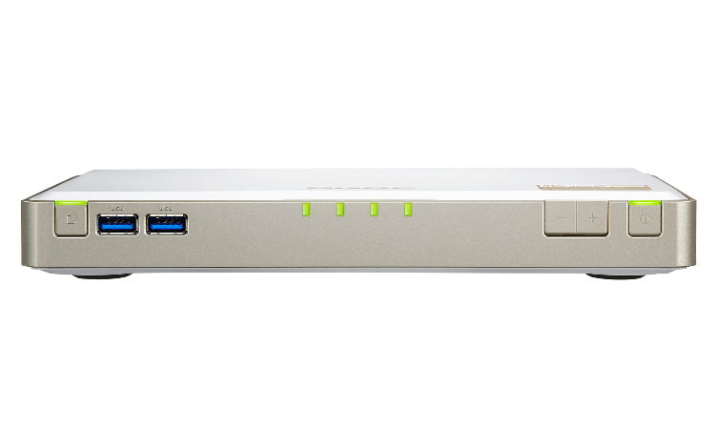



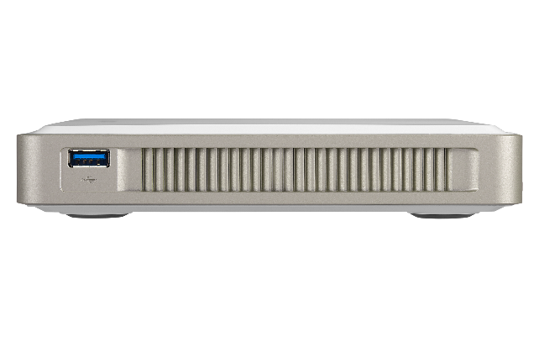
Multiple USB ports, versatile applications
4 x USB 2.0
3 x USB 3.0 (front: 2, rear: 1)

Slide 30
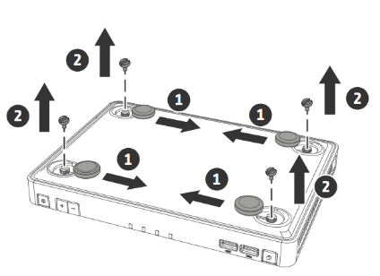
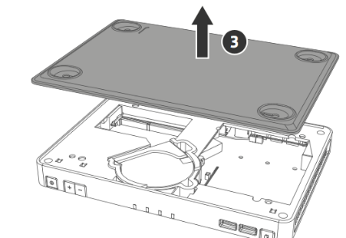
M.2 SSD & memory installation
2 x DDR4 SO-UDIMM
RAM slots, up to 8 GB
4 x M.2 2280 SATA
SSD slots
(SSDs not included)
HS-453DX-4G: 2 x 2GB
HS-453DX-8G: 2 x 4GB

Slide 31
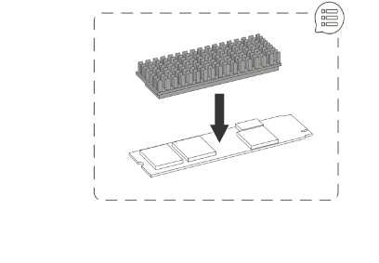
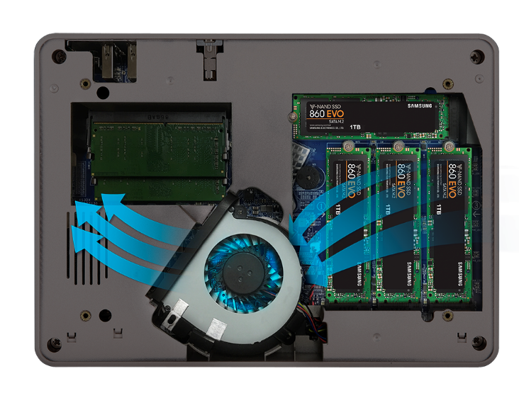
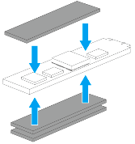
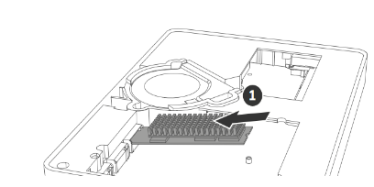
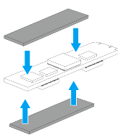
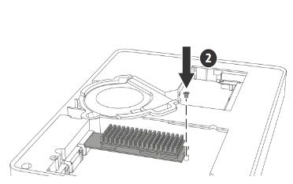
Smart ‘n quiet fan with optimal thermal design
Include thermal pads for single & dual-sided M.2 SSD
Air flow brings out excessive heat
Brand new M.2 SSD heatsink

Slide 32
Live Demo
Memory upgrade
M.2 SATA SSD installation

Slide 33
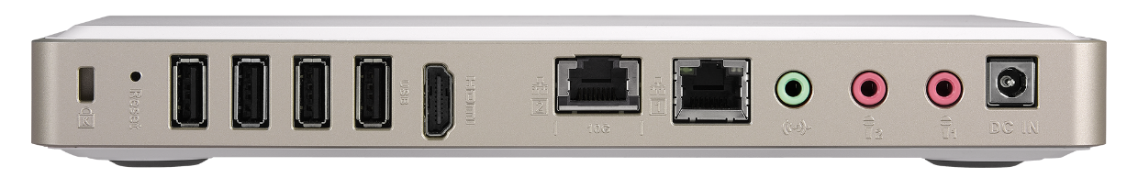
10 - 20V DC wide voltage input
Provided with a 65W 19V compact AC adapter and supports a DC power supply of 10 - 20V for maximum flexibility, making TBS-453DX suitable for industrial, factory and other environments that need a wide range of input voltages.

Slide 34


HDMI 2.0 4K 60FPS sharp picture quality

Slide 35







HybridDesk Station for various A/V needs
USB
HDMI
Mouse &
Keyboard
Network
Audio
Qremote App

Slide 36


Versatile HybridDesk Station apps
System Mgmt.
Surveillance
Comm. & Social
QTS
File Station HD
Surveillance Station
QVR Pro Client
Skype
Facebook
Browser & Productivity
Multimedia
Multimedia Mgmt.
HD Player
OceanKTV
YouTube
Clementine
Plex Home Theater
Spotify
TuneIn Radio
Photo Station HD
Video Station HD
Music Station HD
Chrome
Firefox
LibreOffice

Slide 37





Qbutton: customize remote button actions
Play your favorite music playlist with a single button or set other buttons to play the previous or next song
Optional purchase of QNAP RM-IR004
IR remote control
View pre-selected channels on Surveillance Station for quick surveillance monitoring
Set a button to restart or power off your NAS for greater convenience

Slide 38


Linux Station turns NAS into a Ubuntu PC
1
HDMI output from NAS to a monitor
Multi-version Ubuntu
Ubuntu 14.04
Ubuntu 16.04
Ubuntu Kylin (Chinese)
2
Connect a USB keyboard and a mouse to the NAS to start using Ubuntu

Slide 39











Linux Station + KODI to play everything
Use KODI to play contents on NAS
Install ’n use
Video HD
Install the KODI plug-in: Video HD
Support the same Video Station functions such as
progress, categorization, subtitle

Slide 40









OceanKTV for the home karaoke
Dual dynamic microphone inputs

Slide 41






Management & playback in OceanKTV
TV
Mobile
Web
Song library
Singing & YouTube playlist
iOS/Android
remote control
3 ways to play a song

Slide 42





Streaming & accelerated transcoding
4K H.264 decoding & encoding for real-time or offline 4K video transcoding on various client players for smooth playback and support more clients
HDMI output for 4K Ultra HD (3840 x 2160, 60FPS) content
Stream content through DLNA, AirPlay, Chromecast and Plex

Slide 43









Use PLEX to stream media collections
Players
TV & PC
SmartTV
PC
Mobile
Phone
Tablet

Slide 44








Cinema28 for the complete home streaming
Cinema28 allows for single-interface management of all your media files and can stream files to every connected device throughout your home
HDMI
(Audio)
Line Out
USB DAC
Bluetooth
HDMI
(HD Player)
Chromecast
DLNA
AirPlay

Slide 45

Enjoy Roon without a PC
All M.2 SATA SSD slots
for higher performance

Slide 46



Backup or sync data at your choice
macOS
Protection against ransomware!
Time Machine
Qsync
Windows
NetBak Replicator
Qsync
Scheduled or real-time backup/sync

Slide 47



Business-level snapshot
≥
4GBRAM
Snapshot # per NAS
1024
---------------------------------------------------------
Snapshot # Volume/LUN
256
Less space,
less
risk!

Slide 48















Backup the NAS data
Hybrid Backup Sync
Remote
Local
Cloud

Slide 49
Notification Center: stay informed at all times

Slide 50




QVR Pro 24/7 surveillance solution
6,000+ IP cameras
8 ch free recording channels
128 ch max channels (license)
QUSBCam2 webcam recording

Slide 51



Expand storage via VJBOD
Max 8 remote NAS
iSCSI
10GbE / 1GbE mount
VJBOD
Use other NAS capacity to expand own capacity via network connection

Slide 52









TR-004 RAID box for expansion or data sharing
Two use cases:
1. NAS, Windows, macOS & Linux cross-platform external device mode
2. QNAP NAS capacity expansion mode
Two modes
USB 3.0
USB 3.0
External
device
Pool
TBS-453DX
TR-004

Slide 53
Compact. Light.
Packs a bunch.
Copyright© 2018 QNAP Systems, Inc. All rights reserved. QNAP® and other names of QNAP Products are proprietary marks or registered trademarks of QNAP Systems, Inc. Other products and company names mentioned herein are trademarks of their respective holders.

