Slide 2

Your Challenges, Our Solutions
The NAS and/or laptop storage are not enough; how can I upgrade once and expand all?
Notes:
50744223

Slide 3
So many choices, but which one is the best?
While personal data is growing in both notebook and NAS, is it possible to expand capacity for both sides and allow file exchange between different platforms?
When NAS capacity is nearly full, how to expand its space without purchasing a new NAS and throwing away the old one?
Notes:
70996463, 10965498

Slide 4

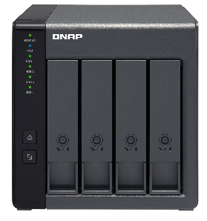


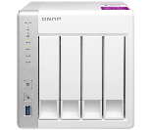




The TR-004 external RAID device
1+1 > 2
QNAP knows! The first QNAP external RAID device is here!
An external RAID device that supports both
1. Windows/macOS/Linux external storage mode
2. QNAP NAS expansion storage mode to use as an QNAP NAS expansion unit!
USB 3.0
USB 3.0
External
devices
Storage pool
NAS

Slide 5







What is External (Hardware) RAID ?
A software RAID uses CPU resources to distribute the IO on different disk to form a RAID protection. The operation of such RAID cannot go beyond the main system.
An external (Hardware) RAID is working independently from CPU, using the standalone microchip to distribute IO, offloading the CPU and allowing operation in different platform.
Client
Client
System
System
CPU
CPU
Software RAID
Hardware RAID as a single disk
TR-004
USB 3.0
USB 3.0
JBOD
External RAID

Slide 6


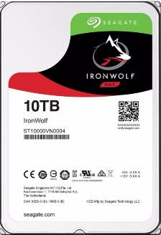
QNAP Go Beyond NAS for Your Needs
The TR-004 4-bay USB 3.0 RAID expansion enclosure supports RAID 5 acceleration and protection for replacing your existing USB 3.0 & USB 2.0 single-disk external drives.
Same compatibility standard as NAS to support large capacity HDD.
Easily trasnfer huge amount of data between devices.
Theoretical speed
Tested speed
TR-004 supports Seagate 10 TB IronWolf drive!
USB 3.1 Gen 1
(USB 3.0)
4.8 Gb/s
3.2 Gb/s
0.48 Gb/s
USB 2.0
0.32 Gb/s
0
5
Source: https://www.everythingusb.com/speed.html
Notes:
42962139

Slide 7
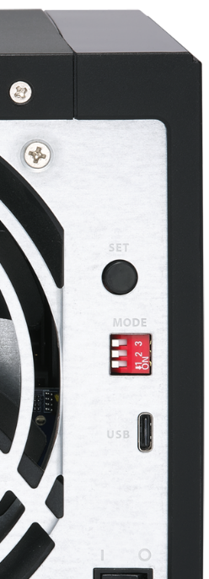
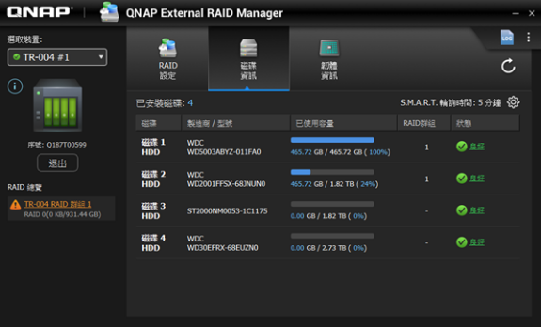
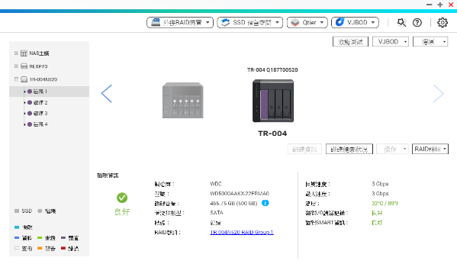
QNAP Go Beyond NAS for Your Needs
Traditional RAID device may only have hardware switch
QNAP unique RAID Manager allow software-managing
Single/JBOD/RAID 0/1/5/10 modes and disk health
Integrate with QTS Storage & Snapshot, in NAS storage mode
support Storage Pool, Snapshot, Qtier, Qsirch and more!

Slide 8
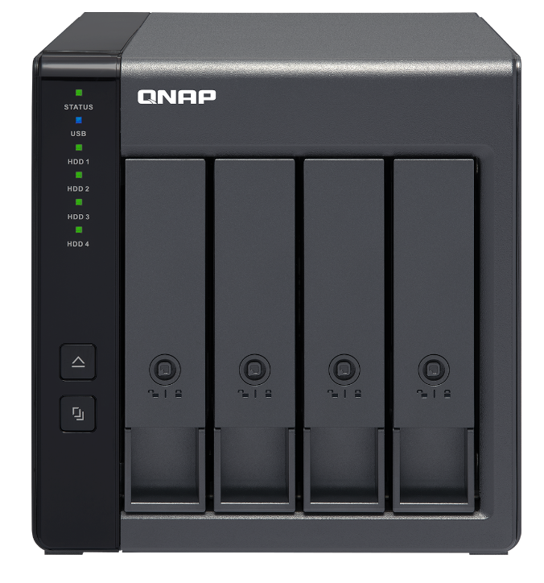
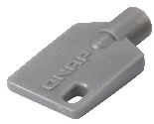

TR-004 front view
4 x 3.5”/2.5”
SATA 3Gb/s HDD/SSD bays
(w/ lockable trays)
(compatible with SATA 6Gb/s HDD/SSD)
System status LED
USB status LED
HDD 1~4 LED
Eject button
(works with QTS and QNAP Windows/macOS utility)
2 x tray keys
Copy button
(works with QTS)

Slide 9


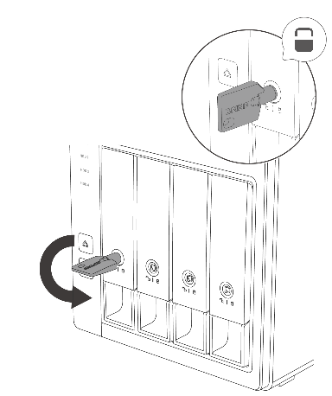
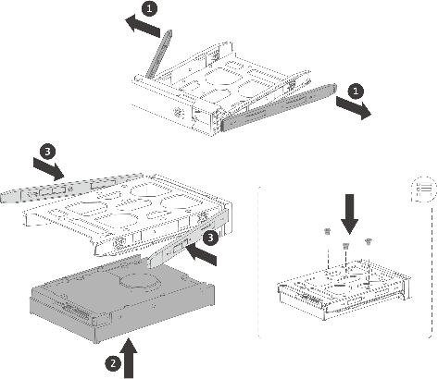
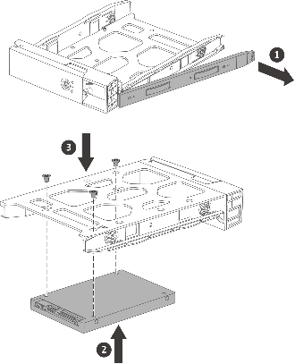
Drive installation and tray locks
01
3.5-inch HDD
2.5-inch HDD / SSD
02

Slide 10
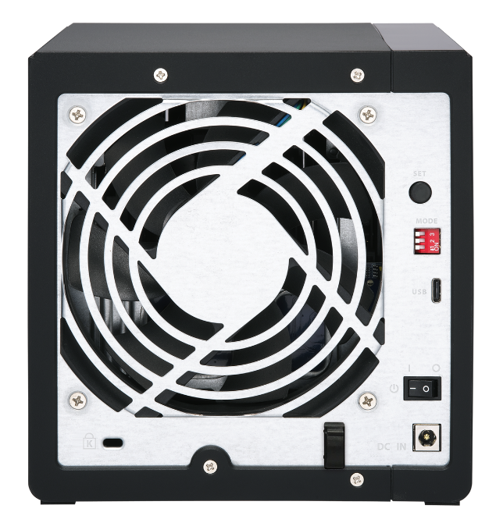
TR-004 rear view
SET/Confirm button
Press ‘n hold for 3 seconds until a beep to switch between modes
12CM smart fan
5-speed automatic fan control based on drive and system temperatures
Disk mode dip switch
Individual, JBOD, RAID 0/1/5/10,
Software Control (default)
Kensington security slot
USB 3.0 Type-C
For USB-C or USB-A host
Power switch
USB cable clip
Self-installation with included clip
DC 12V power input

Slide 11


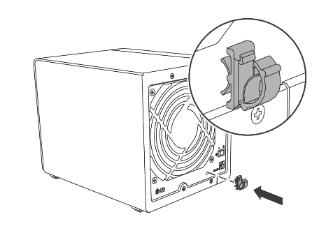
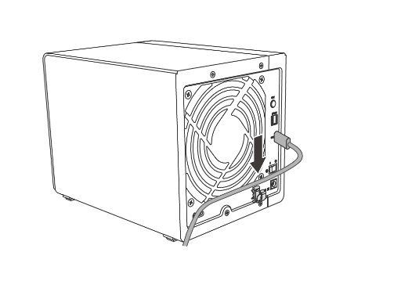
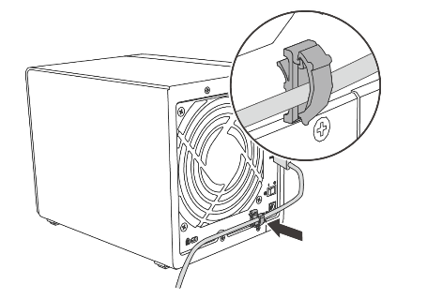
Installing the USB cable clip
01
02
03

Slide 12
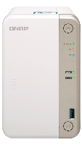
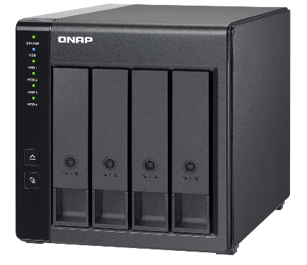


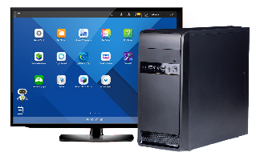
USB Type-C supporting more host types
TS-251B
1-meter (3-foot)
USB-C to USB-A cable included
Windows PC
Optional USB-C to USB-C
cable for USB-C host
Macbook Pro

Slide 13






Switching between modes (with dip switch)
Individual
JBOD
RAID 0
● Any number of drives
● Each drive capacity separated
● Minimum two drives
● Combined capacity but no fault tolerance
● Minimum two drives
● Combined capacity, best performance
but no fault tolerance
Software control
(factory default)
RAID 1/10
RAID 5
● 2 or 4 drives
● RAID 1:
Losing 1-drive capacity
for redundancy
RAID 10:
Losing 2-drive capacity
(1 for each group) for redundancy
● Minimum 3 drives
● Losing 1-drive capacity for redundancy,
enhanced performance
● Any number of drives
● Allows QTS & Windows/macOS
utility to control the configuration

Slide 14






Change disk mode from factory default
The factory default mode is Software Control
Change mode with the dip switch
Note: To change the disk mode with QTS/the utility, the switch needs to remain in the Software Control mode.
Press ‘n hold the “SET” button for 3 seconds until a beep to switch the mode*
*All data on drive(s) will be erased
Software control
(Factory default)
Individual | JBOD
RAID 1/10 | RAID 5

Slide 15






Switching between modes (with dip switch)
In any mode other than the “Individual” mode (Factory default is Software Control)
Change the dip switch mode to the “Individual” mode
Press ‘n hold the “SET” button for 3 seconds until a beep to switch the mode to individual (reset)*
*All data on drive(s) will be erased
Change the dip switch mode to any other mode
Press ‘n hold the “SET” button for 3 seconds until a beep to switch the mode*
*All data on drive(s) will be erased
Note: To change the disk mode with QTS/the utility, the switch needs to remain in the Software Control mode.

Slide 16

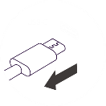
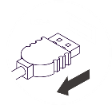

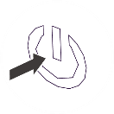
Save energy & reduce noise w/ sleep mode
TR-004 can enter the sleep mode with just 4.17 watt when these occur:
or
USB cable removal
The host enters sleep/hibernation*
The host is shut down
*depends on host support

Slide 17
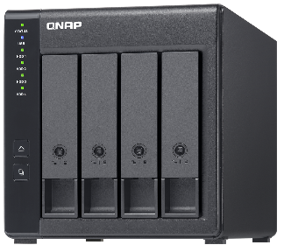



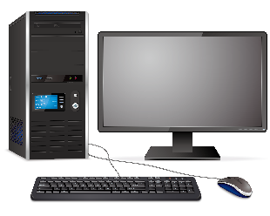


Backward compatible with USB 2.0 port
TR-004 can be supported via a USB 2.0 port on NAS or computers !

Slide 18
Using TR-004 On Personal Computer
Notes:
分頁要改

Slide 19

Configure your TR-004 on Windows/macOS -
QNAP External RAID Manager
Supported platforms and OS version
Windows: Windows 7 (or later)
Mac: macOS 10.11 (or later)
With TR-004, you can create a disk array by the hardware dip switch or the QNAP External RAID Manager app on your PC/Mac.
Monitor TR-004, RAID, and disk status with this utility

Slide 20

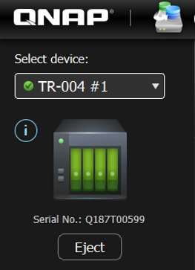
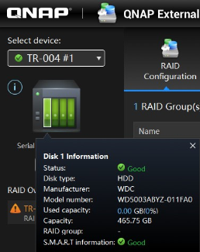
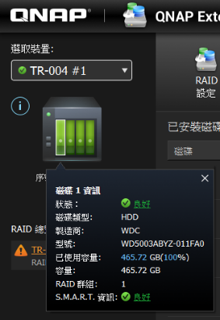
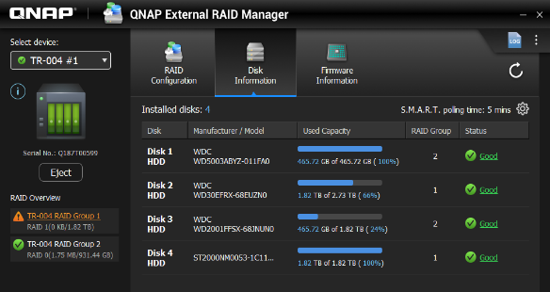
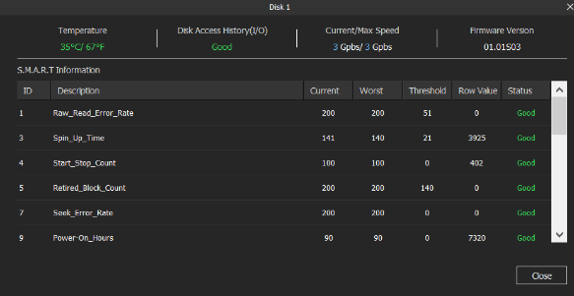
Monitor disk health
Quick overview
Check information
The disk color on the TR device shows disk's status. Click each of them to check the disk information
Show all disks in "Disk Information". Click status to get advanced info of disk's S.M.A.R.T information.

Slide 21
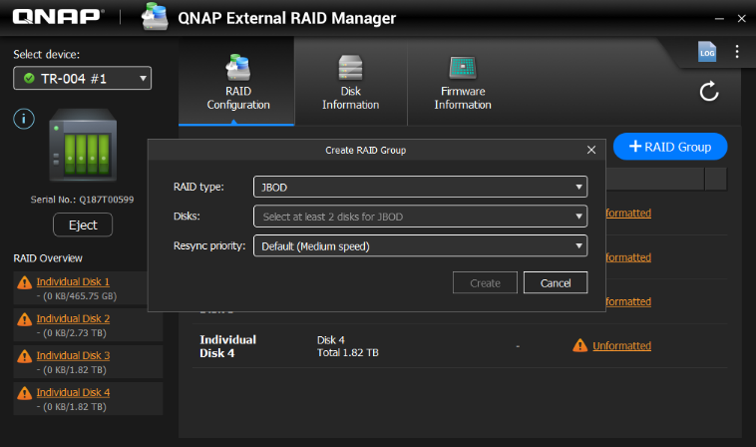


Creating RAID group in two steps
Various RAID types for users to create, multiple RAID are also available in QNAP External RAID Manager
Intuitive settings: create RAID group in just two steps
In "RAID Configuration" page,
click "+RAID Group" to start
Choose RAID type, disks you want to use, and resync priority
RAID types:
JBOD, RAID 0, RAID 1, RAID5, RAID 10 Disks
Resync priority:
Service First, Default, Resync First

Slide 22
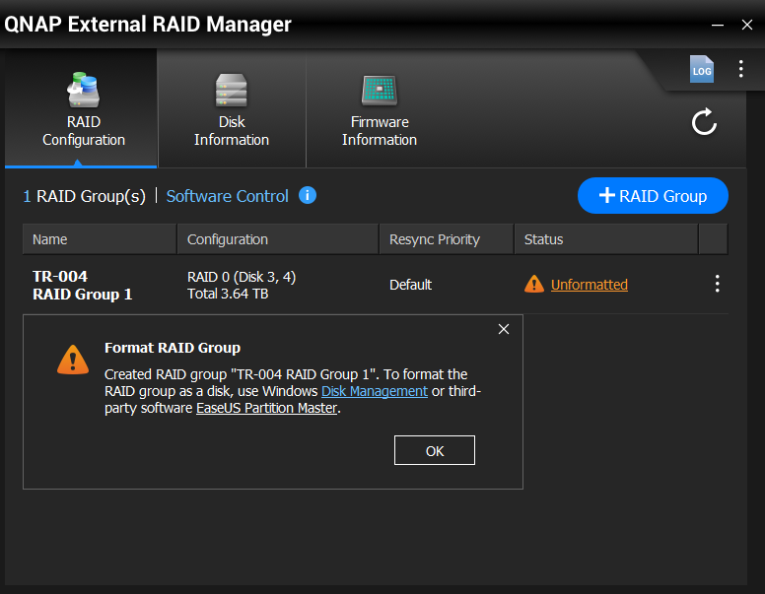
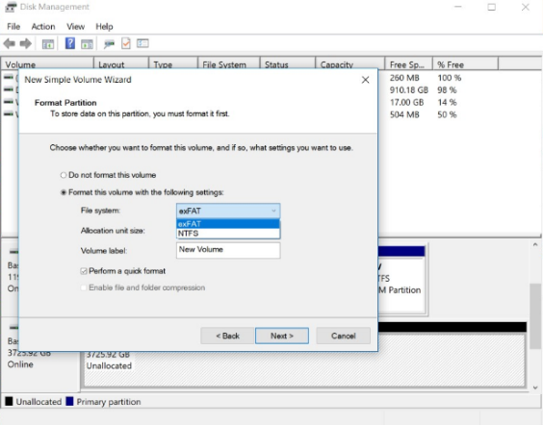

Format RAID group
Once the RAID is set up, format the RAID to begin storing files to the disk
Choosing exFAT file system allows your files be exchanged between Windows, Mac & NAS without problem!
Direct to operating system
interface for formatting
Windows: Disk Management
Mac: Disk Utility
Note: to use TR-004 in exFAT format with QNAP NAS, optional exFAT license is required.

Slide 23
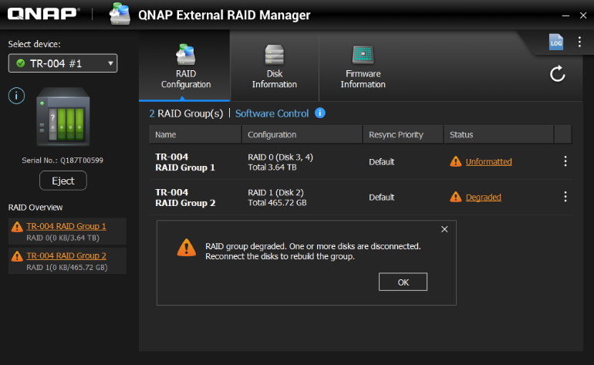

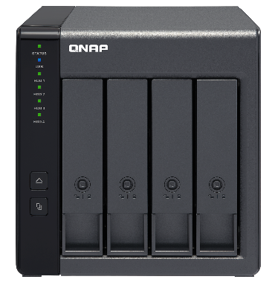

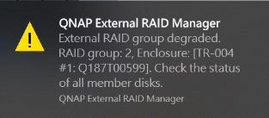
Instant notification when RAID is abnormal
When RAID degraded or failed, users will be notified by the UI, with desktop notification and with device beep.

Slide 24
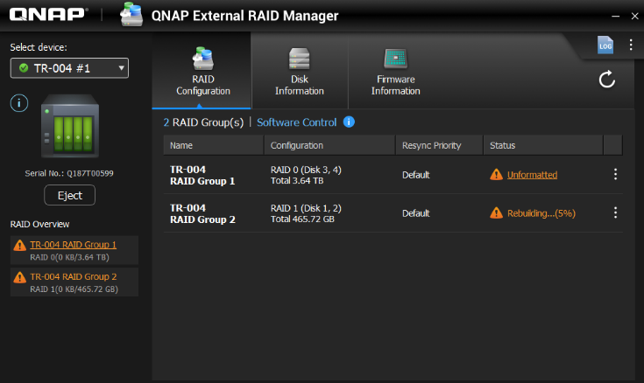
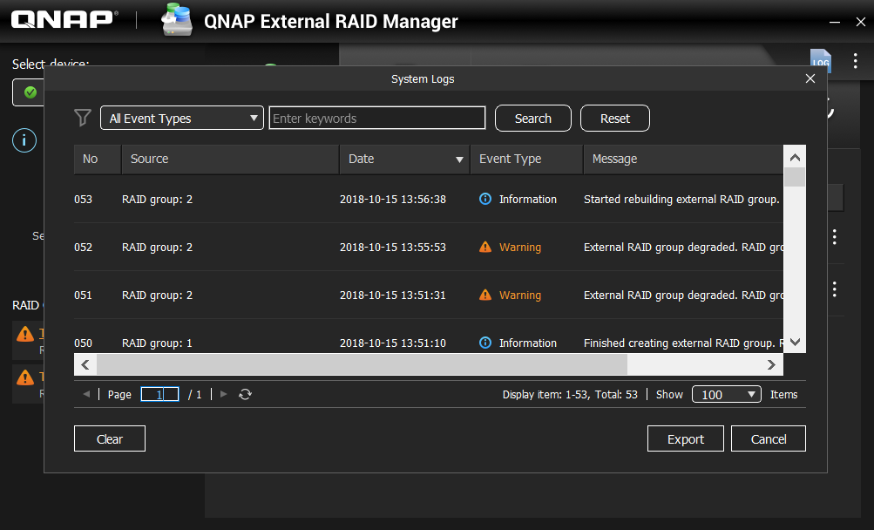
RAID protection mechanism with system events logs
Same as NAS, when RAID is degraded, insert new disk to start rebuilding while shows progress percentage
Any idle disk can be used as the spare disk without any setting while the RAID is in degrade
Logs are independent from operating system, quickly know and export events

Slide 25
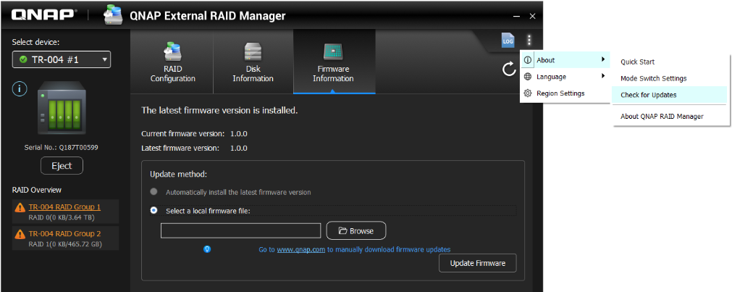
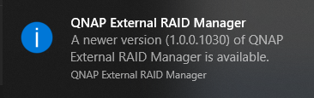
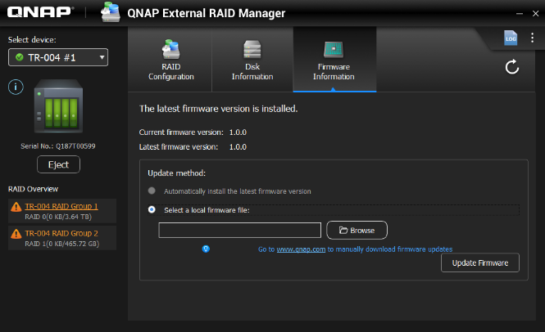
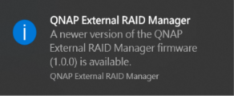
Notification for new version of firmware and application
Check utility and firmware versions
When there is a new version, pop-up notifications will inform users

Slide 26
Use RAID Manager to create RAID group on Windows, and copy a 5GB file

Slide 27




Using TR-004 with exFAT to transfer media file between platforms
Scenario 1
A TR-004 external RAID can operate on different platforms
But the FAT32 format can only support single file up to 4GB.
With QNAP exFAT license, large files can be transferred between Windows/Mac/QNAP NAS
Notes:
https://tw.123rf.com/%E7%B4%A0%E6%9D%90%E5%9C%96%E5%BA%AB/gamer.html?imgtype=0&oriSearch=save+the+money&sti=mkdchaommjirpvme6i|&mediapopup=51967685

Slide 28
How to choose the TR-004 partition format?
File system support status on different platforms:
File System | QNAP QTS | Windows | macOS | Linux
exFAT | V (License needed) | V | V | V(Manually install needed)
NTFS | V | V | V (Read-only) | V
APFS | - | - | V | -
HFS+ | V | - | V | -
EXT4 | V | - | - | V
FAT32 | V (4GB file limitation) | V (4GB file limitation) | V (4GB file limitation) | V (4GB file limitation)
*It is possible for an OS to install third party software to recognize unsupported file systems

Slide 29




Advantages of QNAP External RAID Manager
System events for troubleshooting
Intuitive and easy
Creating RAID group in two steps
Record all device events and find out the info by filter or typing the keyword
Overview device, disk, and RAID info and status
Export to .csv file
Instant notification, quickly control
RAID rebuild, data protection
Desktop notification to inform abnormal status
When RAID is degraded, insert new disk to rebuild RAID
Notification for new version of firmware and application
Show the progress percentage of rebuilding

Slide 30
Using TR-004 on QNAP NAS
Notes:
分頁要改

Slide 31
Replacing UX-500P with TR-004
Function | QNAP TR-004 | UX-500P | Other external RAID device
Connection Type | USB 3.0 | USB 3.0 | By device
Slots | 4 | 5 | By device
Supported systems | QNAP QTS, Windows, Mac, Linux etc... | QNAP QTS | QNAP QTS, Windows, Mac, Linux etc...
Disk health monitoring | Supported | Supported | Not Supported
External RAID protection | Supported | Not Supported | Supported
Expand Storage Pool | Supported | Supported | Not Supported
RAID migration, replacing disk | Not Supported | Supported | Not Supported
Notes:
截圖看這兒 ：https://www.asus.com/tw/Motherboards/X99-E-10G-WS/

Slide 32


Performance comparison between TR-004 and UX-500P
In QNAP lab, TR-004 & UX-500P with 4 Samsung SSD RAID 5 to compare the sequential performance.
TR-004 external RAID performance is same as UX-500P but NAS CPU usage is reduced for 5%.
400
40%
Especially suitable to be used on the ARM-based model to release CPU resource
353
300
306
30%
28%
200
211
20%
23%
24%
204
19%
100
10%
0
0
(MB/s)
R
W
R
W
(%)
Read
Write
Read
Write
UX-500P
TR004
UX-500P
TR004
Test standard ：
fio --direct=1 --rw=write --bs=1M --runtime=180 --size=32G --name=test-write --ioengine=libaio --iodepth=1
fio --direct=0 --rw=randwrite --bs=4K --runtime=180 --size=32G --name=test-write --ioengine=libaio --numjobs=1 --iodepth=1 --refill_buffers --group_reporting
Test standard:

Slide 33
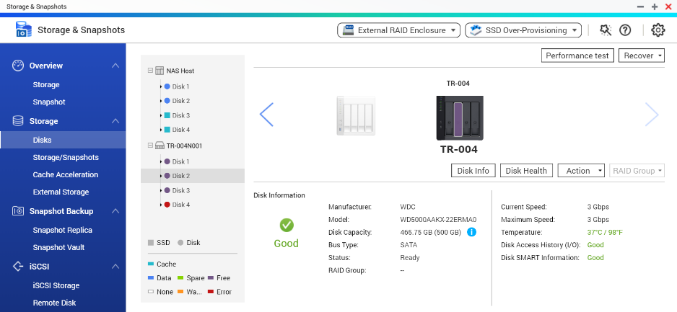
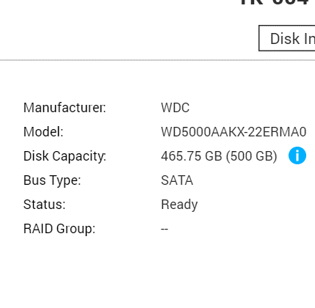




Official External RAID device provide better protection
When using third party external RAID device to expand NAS, the disk health cannot be monitored.
TR-004 disk can be monitored in Storage & Snapshot for best protection.
Functions:
- QTS Disk monitoring
- External RAID monitoring
- Disk S.M.A.R.T.
- Customized temperature
alert
- Notification Center
push notification and more!
Notes:
截圖看這兒 ：https://www.asus.com/tw/Motherboards/X99-E-10G-WS/

Slide 34
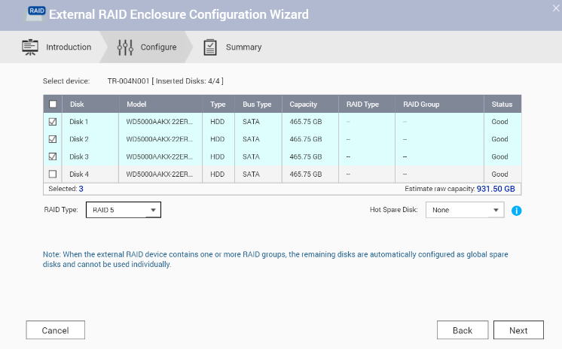

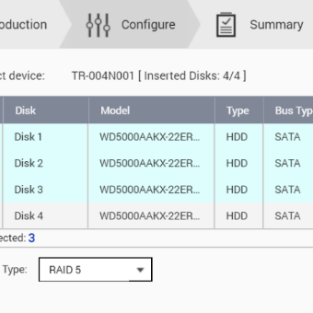

Create Storage Pool with TR-004
3 Steps
The TR-004 is in external storage mode until a storage pool or static volume is created.
01
Disk/VJBOD > Select a
TR-004 Disk > Configure
02
Change the external RAID
type in the wizard
03
Storage/Snapshot > Create
Storage Pool > Select TR-004 external RAID
When configuring the external RAID type with QTS, the hardware dip switch at TR-004 needs to be switched to software control first to prevent data loss due to misconfiguration.
Notes:
截圖看這兒 ：https://www.asus.com/tw/Motherboards/X99-E-10G-WS/

Slide 35
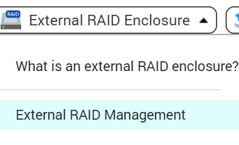
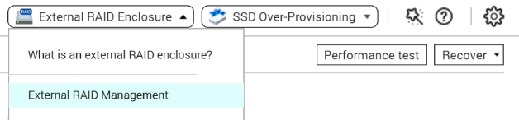
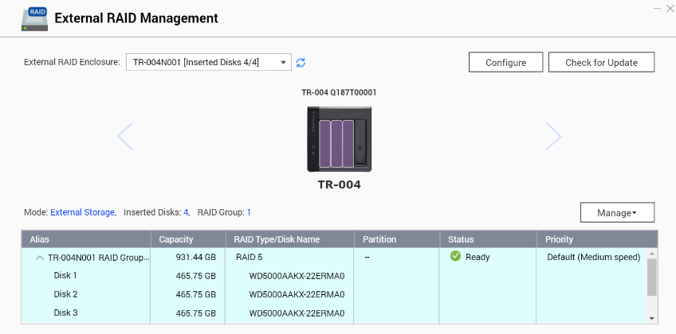
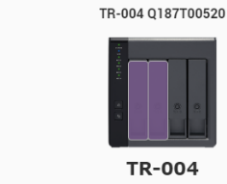

Easily Manage External RAID
With the integration from QTS, a new external RAID management page is provided for below operations:
- Monitoring external RAID
- Setup Spare Disk
- Configure Disk Resync Priority
- Change RAID Mode
- Remove External RAID
- Update External RAID Device
- Firmware Version
An External RAID can only be removed when its
associated Storage Pool and Volume are removed.
Notes:
截圖看這兒 ：https://www.asus.com/tw/Motherboards/X99-E-10G-WS/

Slide 36
Transfer data from TR-004 to NAS, and change mode to expand the NAS

Slide 37
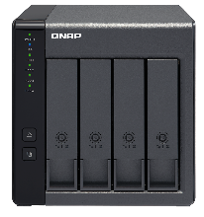
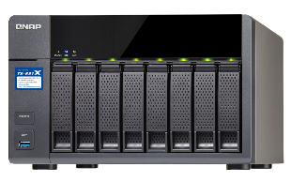






Using TR-004 as NAS expansion or backup space
Scenario 2
The TR-004 can be used to create storage pool and volume to store data while using Qsirch and Qfiling to move data around.
Or be used as a backup or snapshot replica destination for data protection.
Expanding the NAS with new volume
Work as backup destination for snapshot replica
Notes:
截圖看這兒 ：https://www.asus.com/tw/Motherboards/X99-E-10G-WS/

Slide 38








Transfer the snapshot exported file
Scenario 3
While in external storage mode, the TR-004 can store exported snapshot image file.
Transfer the image file manually to clone volume or LUN without using the network.
Using TR-004 to transfer data when network is not stable or not fast enough
Notes:
截圖看這兒 ：https://www.asus.com/tw/Motherboards/X99-E-10G-WS/

Slide 39

QNAP TR-004 A new generation of NAS expansion unit
QTS 4.3.5 with TR-004 support will be released soon.
External RAID with extra protection
Fully integration with QTS to use just like JBOD
A NAS that cannot be upgraded to 4.3.5 dose not support
TR-004 NAS Storage Mode, TS-128, TS-228 also does not support such mode.
External storage/ NAS storage mode
Complete disk monitoring

Slide 40
Copyright © 2018 QNAP Systems, Inc. All rights reserved. QNAP® and other names of QNAP Products are proprietary marks or registered trademarks of QNAP Systems, Inc. Other products and company names mentioned herein are trademarks of their respective holders.

