Slide 2
Upgrade to QTS 4.3.5 for more storage & computing benefits
Software-defined extra SSD over-provisioning
Measure & set unique over-provisioning amount on the NAS
SSD global cache & Qtier™
Using cache or Tiered storage to maximum SSD ROI
Remote snapshot vault restore and export
Using 10GbE network to reduce RTO

Slide 3
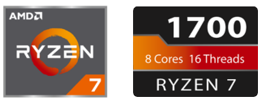
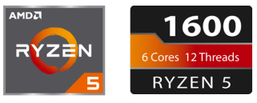

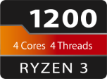
Powerful w/ just 65W TDP
8 cores, 16 threads | 3.0 GHz / 3.7 GHz
6 cores, 12 threads | 3.2 GHz / 3.6 GHz
4 cores, 4 threads | 3.1 GHz / 3.4 GHz

Slide 4


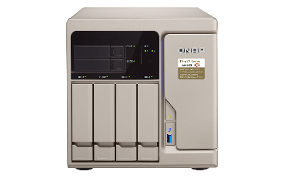
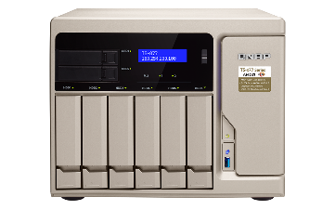
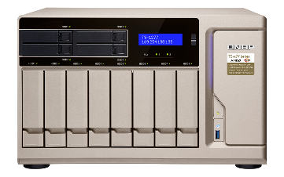
TS-x77 6~12-bay models
TS-1277-1600-8G
Ryzen 5 1600, 8 GB RAM (2 x 4 GB)
TS-677-1600-8G
Ryzen 5 1600, 8 GB RAM (2 x 4 GB)
TS-1277-1700-16G
Ryzen 7 1700, 16 GB RAM (2 x 8 GB)
TS-1277-1700-64G
Ryzen 7 1700, 64 GB RAM (4 x 16 GB)
TS-877-1600-8G
Ryzen 5 1600, 8 GB RAM (2 x 4 GB)
TS-877-1700-16G
Ryzen 7 1700, 16 GB RAM (2 x 8 GB)

Slide 5
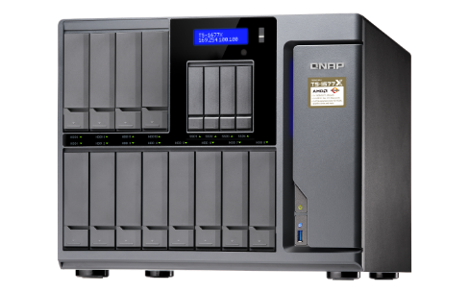
TS-1677X 16-bay models
TS-1677X-1700-16G
Ryzen 7 1700, 16 GB RAM (2x 8GB)
TS-1677X-1200-4G
Ryzen 3 1200, 4 GB RAM (1x 4GB)
TS-1677X-1700-64G
Ryzen 7 1700, 64 GB RAM (4x 16GB)
TS-1677X-1600-8G
Ryzen 5 1600, 8 GB RAM (2x 4GB)

Slide 6
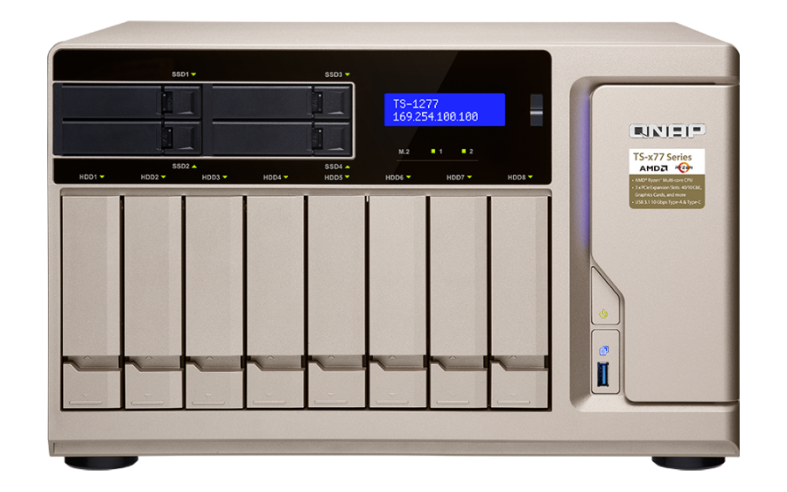


TS-677/877/1277 front view
LCD w/ Enter & Select buttons
LED indicators w/ adjustable brightness:
HDD, SSD, M.2 SSD
Power button
USB 3.0 & Copy button
IR receiver*
2, 4 x 2.5” SSD trays for Qtier auto tiering &
SSD caching
4, 6, 8 x 3.5” HDD trays w/ support for 2.5” drives
*for use with a graphics card & RM-IR004 remote control

Slide 7
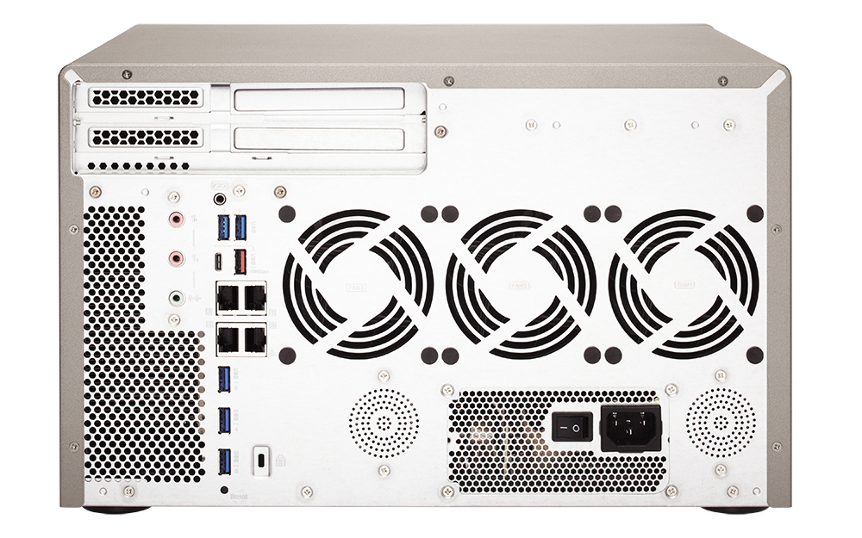
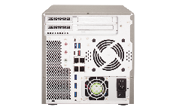
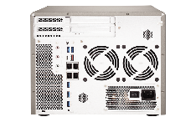
TS-677/877/1277 rear view
1 x USB 3.1 Gen2
10G Type-A
1 x PCIe 3.0 x8
1 x USB 3.1 Gen2
10G Type-C
1 x PCIe 3.0 x4
1 x PCIe 2.0 x4
2 x dynamic MIC in 1 x Line out
2 x speakers
4 x GbE LAN
5 x USB 3.0 5G Type-A

Slide 8

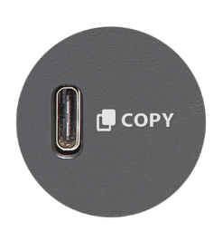
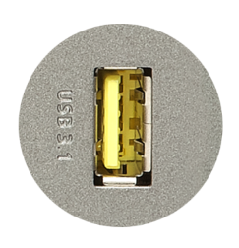
More Efficient Backup with USB 3.1 Gen 2
2X
USB 3.1
TYPE-C
SPEED UP
10Gb/s
TYPE-A
5Gb/s
USB 3.0
USB 3.1

Slide 9
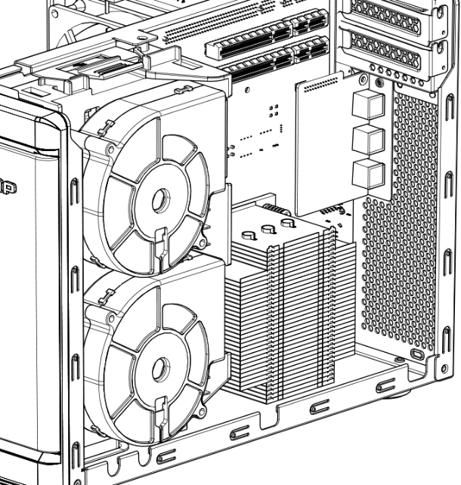
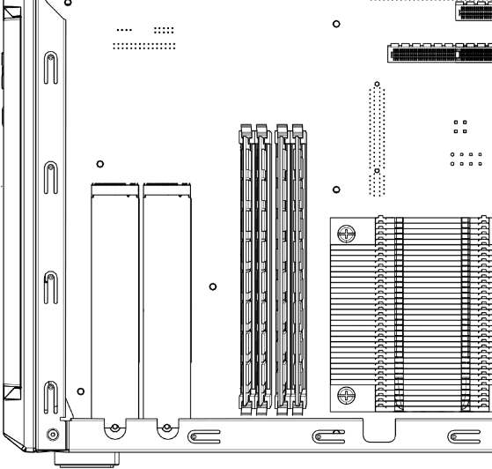
TS-677/877/1277 internal view
4 x DDR4 UDIMM RAM slots, max 64 GB
2 x M.2 22110/2280/2260/
2242 SATA SSD slots
Dual fan modules

Slide 10
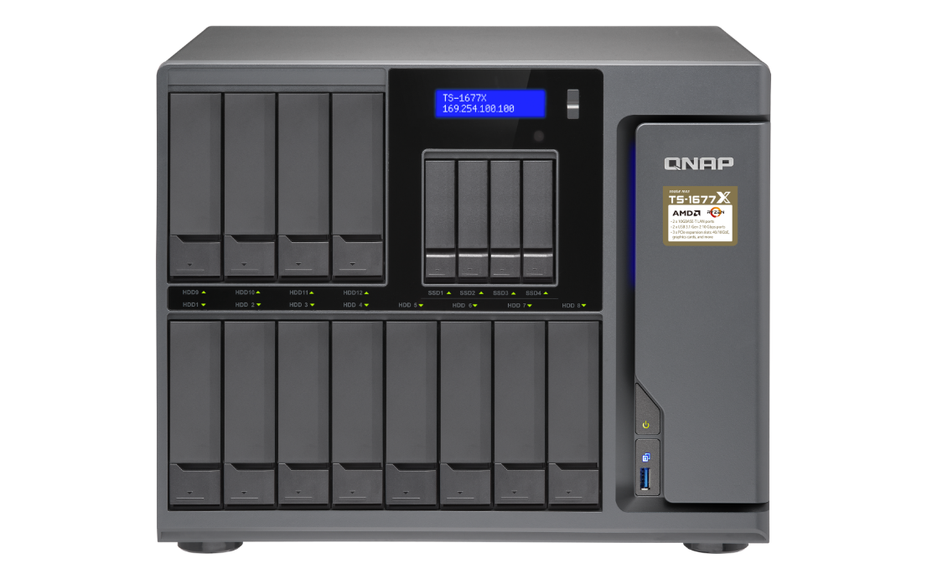
TS-1677X front view
IR receiver
(w/ optional PCIe graphics card and RM-IR-004 remote control)
LCD monitor with Enter & Select buttons
4 x 2.5”SSD drive bays, supporting Qtier auto tiering and SSD cache
Power button
LEDs with adjustable brightness
USB 3.0 &
Copy button
12 x 3.5”/2.5” drive bays

Slide 11
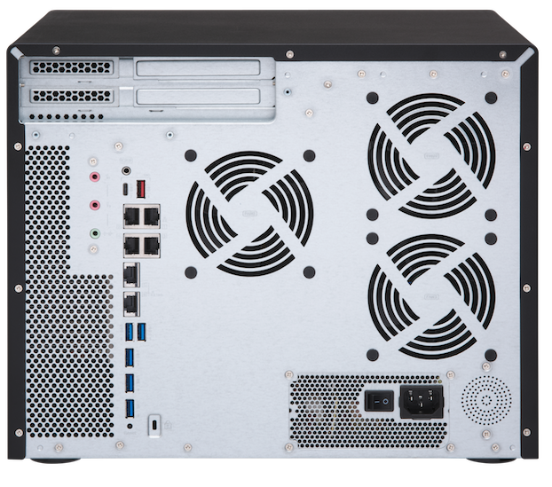
TS-1677X rear view
1 x PCIe 3.0 x8
1 x USB 3.0
Type-A
1 x PCIe 3.0 x4
1 x PCIe 2.0 x4
1 x USB 3.0
Type-C
speaker
2 x dynamic MIC in
1 x Line out
550W PSU
(w/ 8pin+6pin
graphics card power connector)
4 x GbE LAN
2 x 10GBASE-T
5 x USB 3.0 Type-A

Slide 12
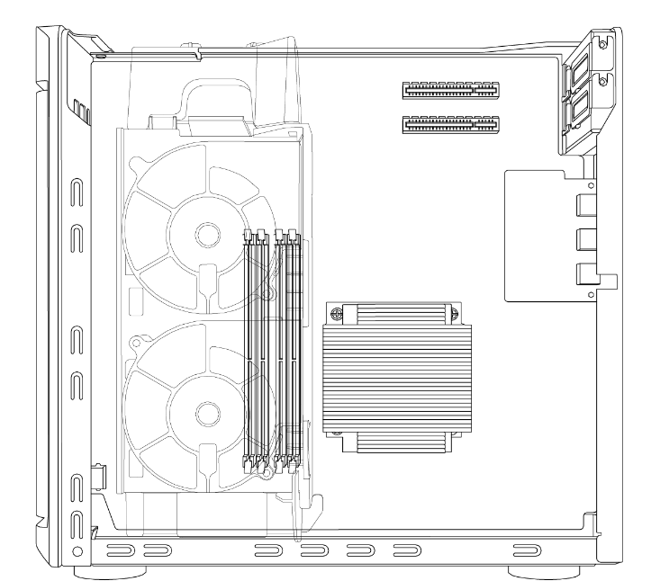
TS-1677X internal view
Compartmentalized smart cooling
Separately detects the CPU & hard drive temperatures to dynamically control fan speeds for quieter operations
Max 64 GB RAM
4 x DDR4 UDIMM dual-channel memory slots

Slide 13
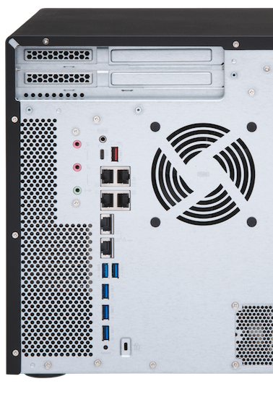
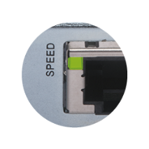
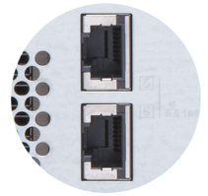
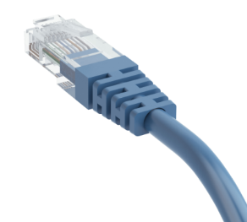
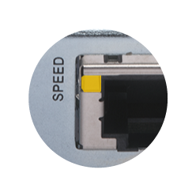
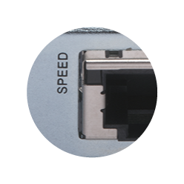
Dual Multi-Gigabit 10GBASE-T port
 | CAT 5e | CAT 6 | CAT 6A & CAT 7
100M | ✔ | ✔ | ✔
1G | ✔ | ✔ | ✔
2.5G | ✔ | ✔ | ✔
5G | ✔ | ✔ | ✔
10G | X | ✔(55m) | ✔
Don't throw away your old cables yet!
Multi-Gigabit NBASE-T technology supported
Five speeds
10G
5G/2.5G/1G/100M
Disconnected

Slide 14
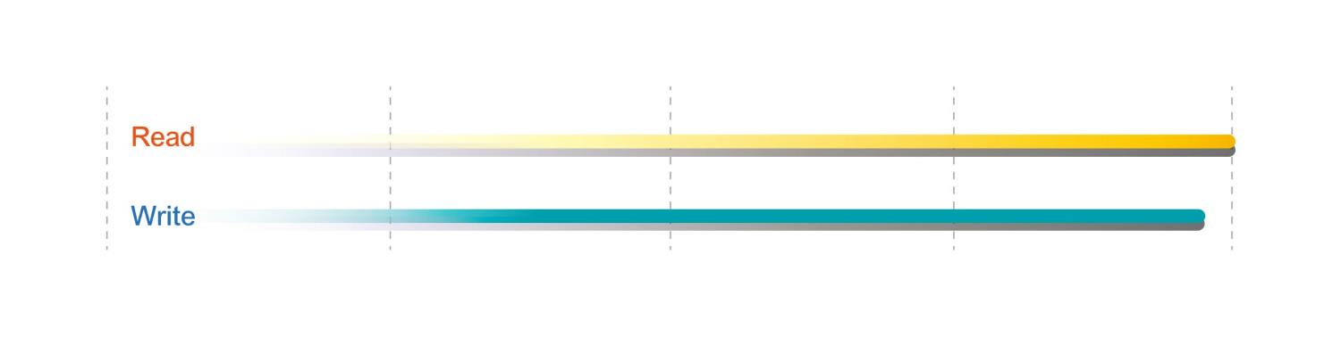
Born with 2 fast 10GBASE-T
TS-1677X integrates 2 x 10GBASE-T without additional costs
Compatible with 40GbE and 10GbE 10GBSE-T or SFP+ cards
Live test of 2 x 10GbE transfer performance
2001 MB/s
2009 MB/s
Tested in QNAP Labs. Figures may vary by environment.
2 x 10GbE Transfer
Test environment:
NAS: TS-1677X-1700-16G
OS: QTS 4.3.4
Volume type: RAID 5; 16 x Intel SSDSC2BB240G4 SSD
Client PC: Windows 10, Intel Core i7-6700 3.4 GHz, 32GB RAM, QNAP QXG-10G1T NIC, IOMeter sequential read and write

Slide 15
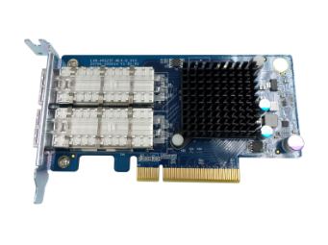
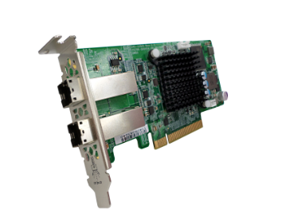
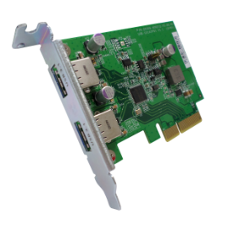




Industry-leading 3 PCIe slots
QM2
40GbE/10GbE
/wireless
USB 3.1 Gen2
SAS 12Gbs
QM2 provides 2 x M.2 SSD slots and 10GBASE-T port for SSD cache or Qtier auto tiering for optimized storage performance.
USB 3.1 Gen 2 expansion cards provide 10Gb/s with external USB devices．Type-A port is also backward compatible with USB 3.0/2.0 devices
SAS expansion card is for adding support of REXP expansion units for up to 40 additional SAS/SATA drives.
40GbE/10GbE and wireless network expansion cards
provide high bandwidth, low latency, or wireless AP.

Slide 16
TS-x77 live demo
Memory upgrade
M.2 SSD installation
Graphics card installation

Slide 17
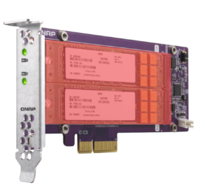
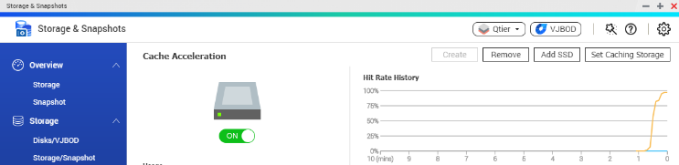
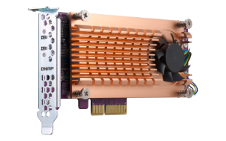
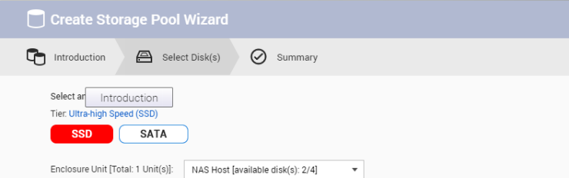

Add M.2 SSD slots with QM2
Accelerates random IOPS
SSD cache
+
QM2 SSD RAID 0/1
QM2-2S
QM2-2S-220A
SSD tier
Performance and storage capacity
2 x M.2 SATA 2280 6Gb/s
QM2-2P-244A
2 x M.2 PCIe NVMe 2280

Slide 18
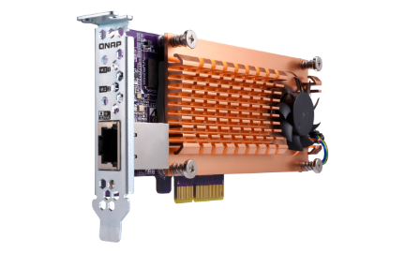
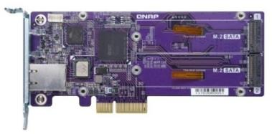
2 x M.2 NVMe SSD + 10GBASE-T
QM2-2S10G1T
QM2-2P10G1T
2 x M.2 2280 SATA 6Gb/s SSD +
1 x 10GBASE-T (10G/5G/2.5G/1G/100M)
2 x M.2 2280 PCIe NVMe SSD +
1 x 10GBASE-T (10G/5G/2.5G/1G/100M)
10GBASE-T
10GBASE-T

Slide 19
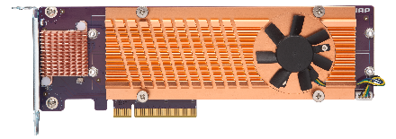
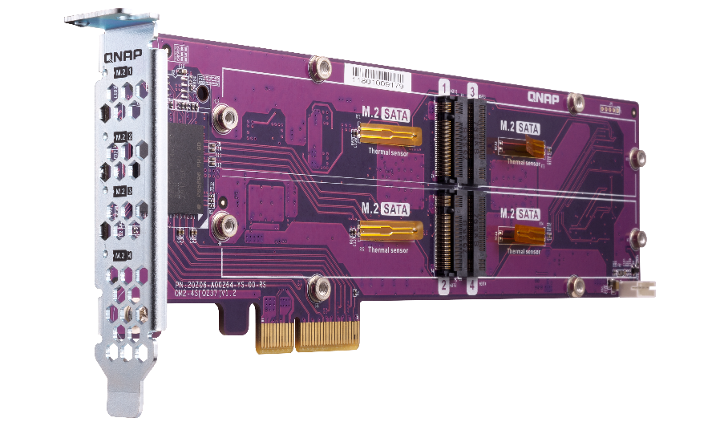
Add 4 x M.2 SSD slots
Bundled with heatsink and brackets that can be used on all NAS models
QM2-4S-240
4 x M.2 2280 SATA SSD ports
QM2-4P-284
4 x M.2 2280 PCIe NVMe SSD ports
Create a RAID protection
RAID 5/RAID 6/RAID 10
Adding four M.2 SSDs with one PCIe slot
PCIe 2.0 interface

Slide 20
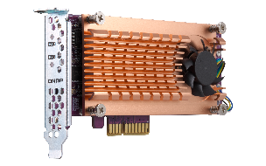
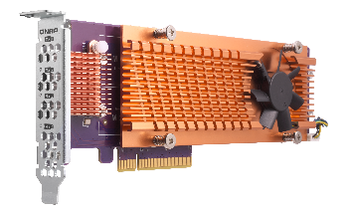
High-speed PCIe 3.0 interface
2 x
M.2 PCIe NVMe SSD ports
QM2-2P-344
(3.0 x4)
QM2-2P-384
(3.0 x8)
4 x
M.2 PCIe NVMe SSD ports
QM2-4P-342
(3.0 x4)
QM2-4P-384
(3.0 x8)

Slide 21

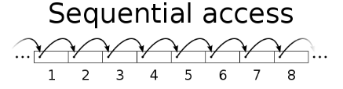
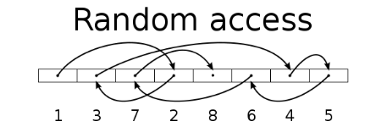
SSD Usage In Network Attach Storage
SSD can provide high random IOPS for multi-clients sync and business applications that can not be achieved by HDD.
In 2018, SSD price also comes close to the sweet spot.
Besides choosing the right SSD, you should also choose right NAS!
SanDisk evaluate the
256 GB SSD per GB price in 2018 is only 30% compare to 2013
Drive Type | Sequential Access (MB/s) | Random Access (IOPS)
HDD | 100 | 350
SSD | 300 | 60000
https://www.sandisk.com/business/datacenter/resources/white-papers/the-ssd-enabled-pc-total-cost-of-ownership
SanDisk‘s Statistic for Global SSD/HDD Price Trend

Slide 22
QNAP SSD Global Cache and Qtier
IT manager can have different SSD configurations.
For real-time performance boost, deploy SSD Global Cache or All flash storage.
For continued data tiering between hot and cold data, deploy the Hybrid Storage Qtier™ Auto Tiering.
SSD Cache let all data enter cache and read hot data from the storage in real time
Qtier utilizes SSD space and let data block be reallocated based on hot or cold in the storage
SSD Cache
Volume
Block-based LUN
Volume
Block-based LUN
Qtier Pool SSD Tier
Qtier Pool HDD Tier
Block-based LUN
SSD
SSD
HDD
HDD
HDD
HDD
HDD
HDD

Slide 23


Different SSD has Different Performance!
SSD Write amplification cause performance degradation
In QNAP Lab, engineer use FIO to test different SSD, and all SSD have showed consisted write performance degrade.
Different SSD's controller and Garbage Collection Algorithm will effect the long term performance
Different SSD in QNAP NAS’s FIO consisted performance (IOpattern: RW-4K):
How can storage vendors help to ensure SSD has expected performance?
Notes:
23

Slide 24

What is SSD Over-provisioning
SSD Over-provisioning reserves space in the SSD to decrease write amplification & increase consisted performance and endurance.
Reason: to avoid Garbage Collection in any giving point of time
N | N
N | N
N | N
With limited OP, 4 additional write is needed. With more OP the movement is not required.
N | New D
D | Valid D
 | Invalid D
 | OP
 | OP
D | D
D | D
D
D
D | D
D | D
D | D
D | D
N | N
N | N
N | N
6 pages of new data cannot all be stored to the SSD
Unless the SSD conduct GC internally first
With more reserved block, the GC is not required
Notes:
24

Slide 25
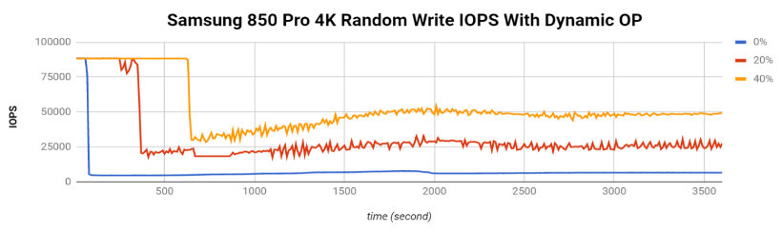
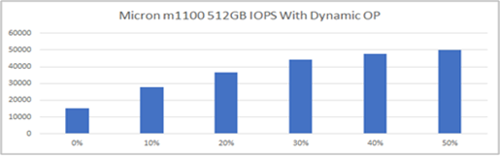
The Advantage of Software-defined SSD Extra Over-provisioning
With QTS System, user can assign more OP to the SSD RAID.
At QNAP Lab, the effect of over-provisioning can not only be observed on single consumer-level Samsung 850 Pro to gain the performance same as data center SSD, but also be seem on SSDs as a RAID.
Above: Samsung 850 Pro as Single Disk
Below: Micron M1100 as RAID 1
FIO configuration: runtime=1800 ioengine=libaio direct=1 rw=randwrite bs=4k numjobs=1 iodepth=32
2*Micron M1100 RAID 1 Random Write IOPS with Dynamic OP
Notes:
25

Slide 26

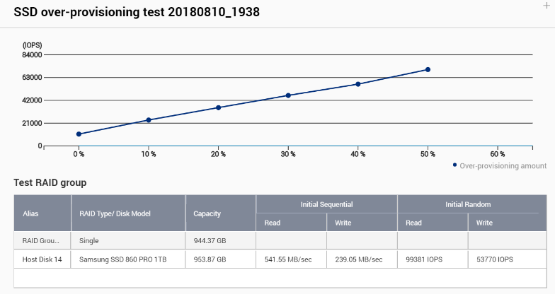
Choose SSD is Hard, Choose QNAP is Simple
IT managers' biggest challenges in deploying SSD is to measure the SSD performance and how it can solve storage bottleneck.
With QNAP SSD Profiling Tool, users can not only set OP, but further test SSD RAID performance with different OP amount.
IT managers can decide the best practice directly on production sites
Notes:
26

Slide 27

QNAP Global SSD Cache
The QNAP SSD Cache can be applied to multiple volume / LUN
Read-Only ➔Copy frequently used data to SSD
Read-Write ➔Not only copy data, new data can also be temporarily stored in SSD
(New) Write-Only ➔ Only new data will be written into the cache
How Read-write Cache work:
Data from clients and storage will both be cached
Write
Write
Read
Read
SSD
IO Intensive
Application
When SSD Space not enough
HDD

Slide 28

The Write-only Cache Increase ROI of
SSD Cache with high Writing Demand
Write-only cache is promoted by Microsoft
for endurance control.
QNAP believe Write-only Cache can increase the ROI of purchasing SSD in below scenario:
Writes
are cached
Reads
are NOT
File Server focusing on write operations
Database with more write operation (Such as IOT monitoring server)
Use high endurance SSD (Intel Optane™) with other SSD
NVMe
NVMe
SSD
SSD
SSD
SSD
https://docs.microsoft.com/en-us/windows-server/storage/storage-spaces/understand-the-cache
Notes:
28

Slide 29
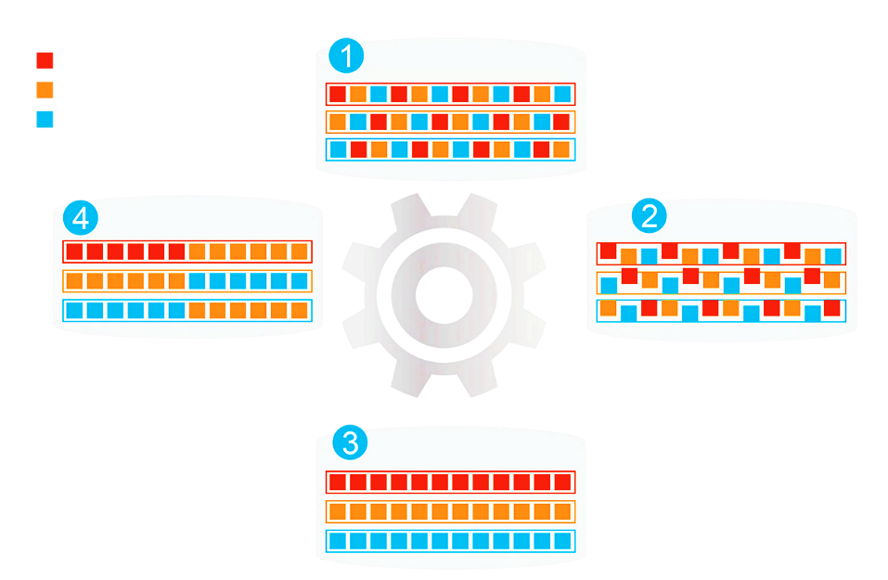
Qtier (Auto-Tiering) Increase Capacity and
Performance at the Same Time
Before Tiering
Data place not optimized
Hot Data
Beside SSD Cache, Qtier™ can migrate data between SSD and HDD directly.
SSD capacity can be utilized with limited memory requirement.
Warm Data
Cold Data
Access Pattern Change
Start Tiering
Qtier
Engine
After Tiering
Performance optimized
Notes:
29

Slide 30
Qtier 2.0 IO Aware tiering for real time performance boost
Beside tiering on schedule, Qtier now can simulate SSD Cache behavior.
It can utilize SSD capacity while boost performance in real time thus increase SSD ROI.
Data
Blank
C、D data block be written to HDD due to SSD full
D data block be promoted as access frequency increase
A
B
A
B
D
SSD Tier
SSD Tier
C
D
C
HDD Tier
HDD Tier
Block | Hit
C | 50
D | 50
Block | Hit
C | 50
D | 200
Notes:
30

Slide 31
TS-x77 SSD Multiple Configurations
In addition to acting as a backup server, SSD Over-provisioning, Global Cache and Qtier let the NAS be deployed as production server.
With 2.5”
SATA 6Gb/s SSD and M.2 SATA SSD
ports
Scenario1 | File Server | Web, Application, Virtualization Server | Synchroni-zation, Vi-deo Editing | Surveillance, Backup, Log Server | Business-Critical Database
SSD Config. | Qtier™ | Qtier™ | Read-Write Cache | Write-Only Cache | SSD RAID
SSD RAID | RAID 6 | RAID 10 | RAID 5 | RAID 10 | RAID 10
SSD OP | 10% | 20% | 20% | 30% | 30%
QM2 SSD RAID tier
Notes:
31

Slide 32
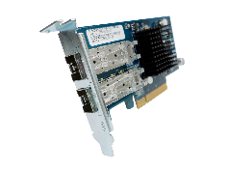
10GBASE-T & SFP+ adapters
10GbE x 2
(Sequential)
10GbE x 2
(Sequential, encrypted volume)
2250
2346
2250
2323
1500
1859
1500
1725
750
750
0
0
Download
Upload
Download
Upload
(MB/s)
(MB/s)
Tested in QNAP Labs. Figures may vary by environments.
Test environment:
NAS: TS-1277-1700-16G with QTS 4.3.4
Volume type: RAID 5; 12 x Intel S3500 240GB SSDs (SSDSC2BB240G4)
Client PC:
Intel® Core™ i7-4770 3.40GHz CPU; 16GB RAM; QNAP LAN-10G2SF-MLX 10GbE NIC ; Windows® 10 64-bit, IOMeter 64KB

Slide 33


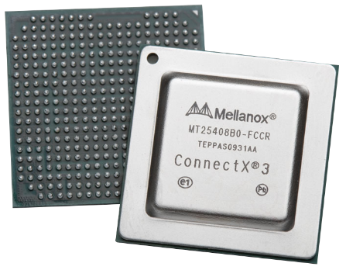
10GbE SmartNIC with offload function
QNAP LAN-10G2SF-MLX network adapter is based on Mellanox ConnectX-3 10GbE smart NIC
Supports iSER

Slide 34
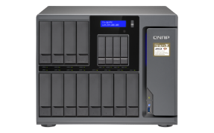
Offload tasks from CPU with iSER
iSER allows data to bypass general network drivers, the socket layer, and to directly enter memory buffers of the server and storage, increasing performance and lowering CPU loading.
Without iSER
With iSER

Slide 35
iSER makes VMware Faster
When VMware Server and NAS are iSER ready:
  Random read/write performance is 60% higher than iSCSI
  Latency is 50% lower than iSCSI

Slide 36

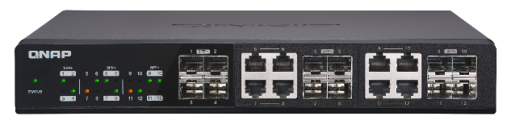
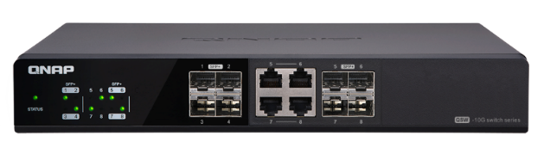
Accessories - 10GbE Switches
Is your networking infrastructure 10GbE ready?
12
Ports
Up to 12 x
10GbE ports
8
Ports
Up to 8 x
10GbE ports
QSW-1208-8C
QSW-804-4C
12-port 10GbE unmanaged switch
4 x SFP+ port
8 x RJ45/ SFP+ combo ports
8-port 10GbE unmanaged switch
4 x SFP+ port
4 x RJ45/ SFP+ combo ports

Slide 37
TS-x77 10GbE performance demo
2 x 10GbE
QM2 card
Qtier

Slide 38
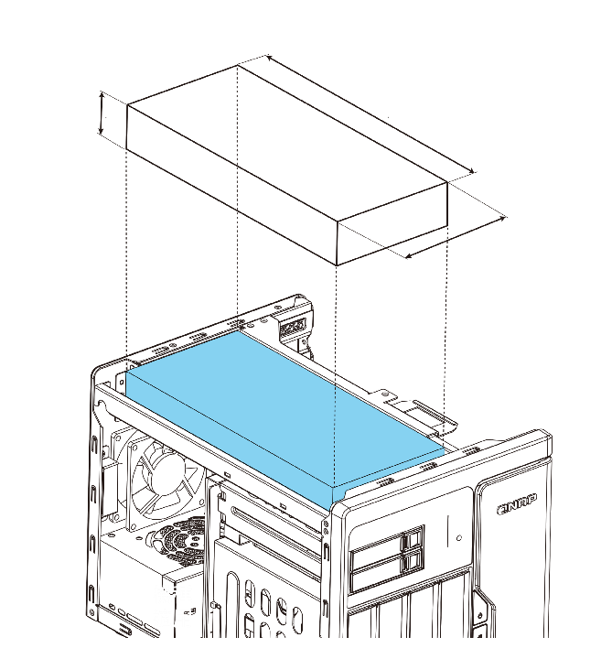

Do more with a graphics card
40 mm
261 mm
TS-677
45 mm
266 mm
TS-877/1277
117 mm
Support 6-pin and 8-pin graphics card power cables
122 mm
550W PSU
TS-1277
250W PSU
TS-677
450W PSU
TS-877

Slide 39





Do more with a graphics card
QuAI
Support 6-pin and 8-pin graphics card power cables
550W PSU
TS-1677X

Slide 40




Add-on GPU Card Applications
AI
Computing Acceleration
QTS/vQTS
Computing Acceleration
VM
GPU Passthrough

Slide 41










Ride the AI wave with "QuAI"
QNAP QuAI
>> AI Developer Package
QuAI is intended for data scientists and developers to quickly build, train, and optimize their AI models on QNAP NAS.
+
+
=
TS-1677X
GPU accelerated computing
QuAI
AI

Slide 42


Smooth Video Experience
Virtualization Station
HybridDesk Station, Linux Station
QVR Pro Client (HD Station)
Video Station

Slide 43









GPU Passthrough & QTS support
Virtualization Station: Supports AMD & NVIDIA graphics cards
HybridDesk Station, Linux Station, video transcoding:
Supports NVIDIA GTX 1050/1060/1070, P2000 etc.
Optional QButton supported RM-IR004 remote control

Slide 44





GPU boosts image/video processing
For OpenGL, DirectX applications
H/W accelerated with GPU to lower CPU usage.
w/ GPU
w/o GPU
Tested at QNAP Lab. Results vary by actual environments.
NAS：TS-1677X Ryzen 1700
QTS 4.3.4, Seagate ST4000VN0001
nVIDIA GeForce GTX 1060 6GB

Slide 45


QTS & virtualization increase productivity
QTS 4.3.5
Storage & Snapshot Manager, and new virtualization network functions
Supports Windows/Linux VMs and containers
Virtualization
Station
Container
Station

Slide 46








Running vQTS via Virtualization Station
Conventional VM: Windows,
Linux, UNIX
Virtual QTS - vQTS
Virtualization Station

Slide 47





One NAS for many
It allows IT admins to flexibly allocate system resources to different departments or groups for different privileges and applications.
Management
Accounting
Engineers
Customer
service

Slide 48





Dedicated resource allocation
Allocation of dedicated HW resources (CPU, RAM, storage space, and Internet) ensures performance quality.
Quad-
core
4 GB
250 GB
1
Octa-
core
8 GB
500 GB
2

Slide 49





The best platform for vQTS
Numbers of allowed vQTS instances are based on the numbers of cores of the physical CPU:
2
AMD Ryzen™ 5 1600, 6-core =
AMD Ryzen™ 7 1700, 8-core =
4
TS-677
TS-877
TS-1277
TS-1677X

Slide 50


Businesses need lower RTO
In the survey of 300 Enterprises and SMBs at Taiwan:
60% has used Remote Replication as Backup Plan.
50% of businesses expected the recovering time should be within 1 Hour.
But also 50% of businesses experience actual recovering exceed 1 Day!
Can businesses only manually transfer data back from the remote end when disaster happen?
Data Backup Time
Disaster Happen
Server Online
TIME
Recover Point Objective
Recover Time
Objective
Taiwan IThome survey 2017
Notes:
50

Slide 51



Restore From Remote Snapshot Vault
The Snapshot Manager is now actively connected to Snapshot Vault
Support monitor and restore selected folders and files from the source NAS directly!
Both the source and destination NAS must be upgraded to 4.3.5 to support this function
Notes:
51

Slide 52






Drastically Reduce Recover Time
With 10GbE Network
The Remote Snapshot Vault Recovering is based on Ethernet service.
Using 1GbE network, recovering large data still takes hours.
Pair the Snapshot Replica Solution with 10GbE or even faster interfaces to increase both the backup and recovery speed !
Using QNAP 10GbE Switch to replace old 1GbE for reducing RTO dramatically
Notes:
52
更新筆記: 「快照備份保險庫來源端還原」 (by Teresa)

Slide 53




Snapshot Export/Import
Export a snapshot from snapshot manager or snapshot vault
Using external storage device, the exported imaged can be imported to another NAS to create new volume or LUN
The same image can also be used to revert source volume or LUN
When network speed is limited, user can still import snapshots for reverting
Restore

Slide 54


High-capacity intelligent surveillance
Surveillance Station 5.1
Free: 8 channels
Max: 80 ch. (optional license)
QVR Pro
Free: 8 channels
Max: 128 ch. (optional license)
QUSBCam2
Max 1080p USB Webcam recording
* 在 QVR Pro 正式發行時，正式頻道授權數請參閱 QNAP 官網．

Slide 55
Copyright © 2018 QNAP Systems, Inc. All rights reserved. QNAP® and other names of QNAP Products are proprietary marks or registered trademarks of QNAP Systems, Inc. Other products and company names mentioned herein are trademarks of their respective holders.

