Slide 2
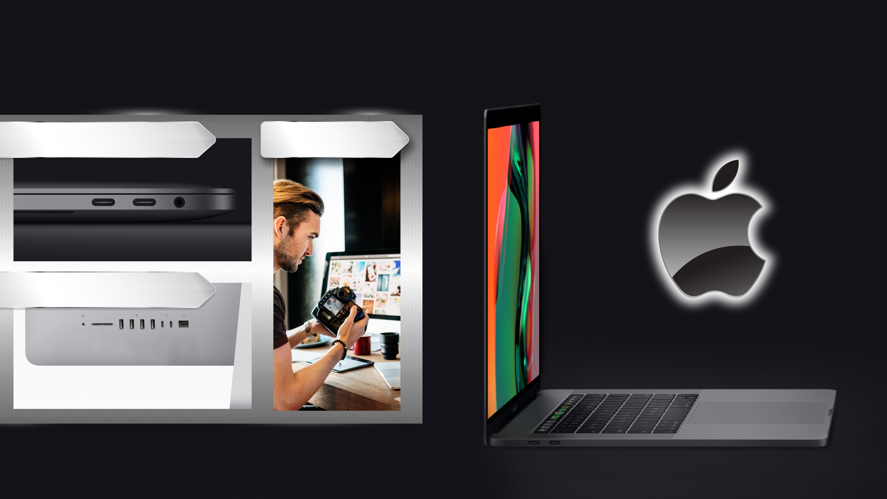

Thunderbolt 3 super fast transfer
MacBook Pro
4 x Thunderbolt 3 ports
Video Editing
iMac
2 x Thunderbolt 3 ports
Notes:
https://www.apple.com/tw/macbook-pro/
https://www.apple.com/tw/imac/specs/
https://www.dell.com/tw/p/xps-13-9370-laptop/pd
https://www.msi.com/Laptop/GT83VR-6RF-Titan-SLI.html

Slide 3
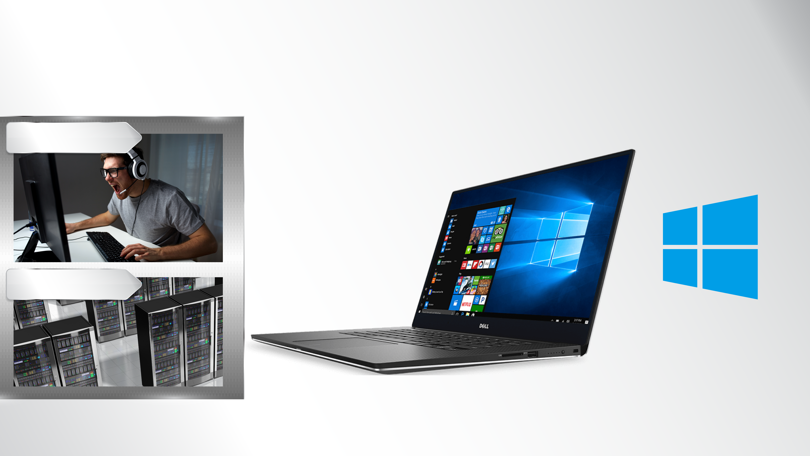
Thunderbolt 3 super fast transfer
Gaming
Workstation
Notes:
https://www.apple.com/tw/macbook-pro/
https://www.apple.com/tw/imac/specs/
https://www.dell.com/tw/p/xps-13-9370-laptop/pd
https://www.msi.com/Laptop/GT83VR-6RF-Titan-SLI.html

Slide 4


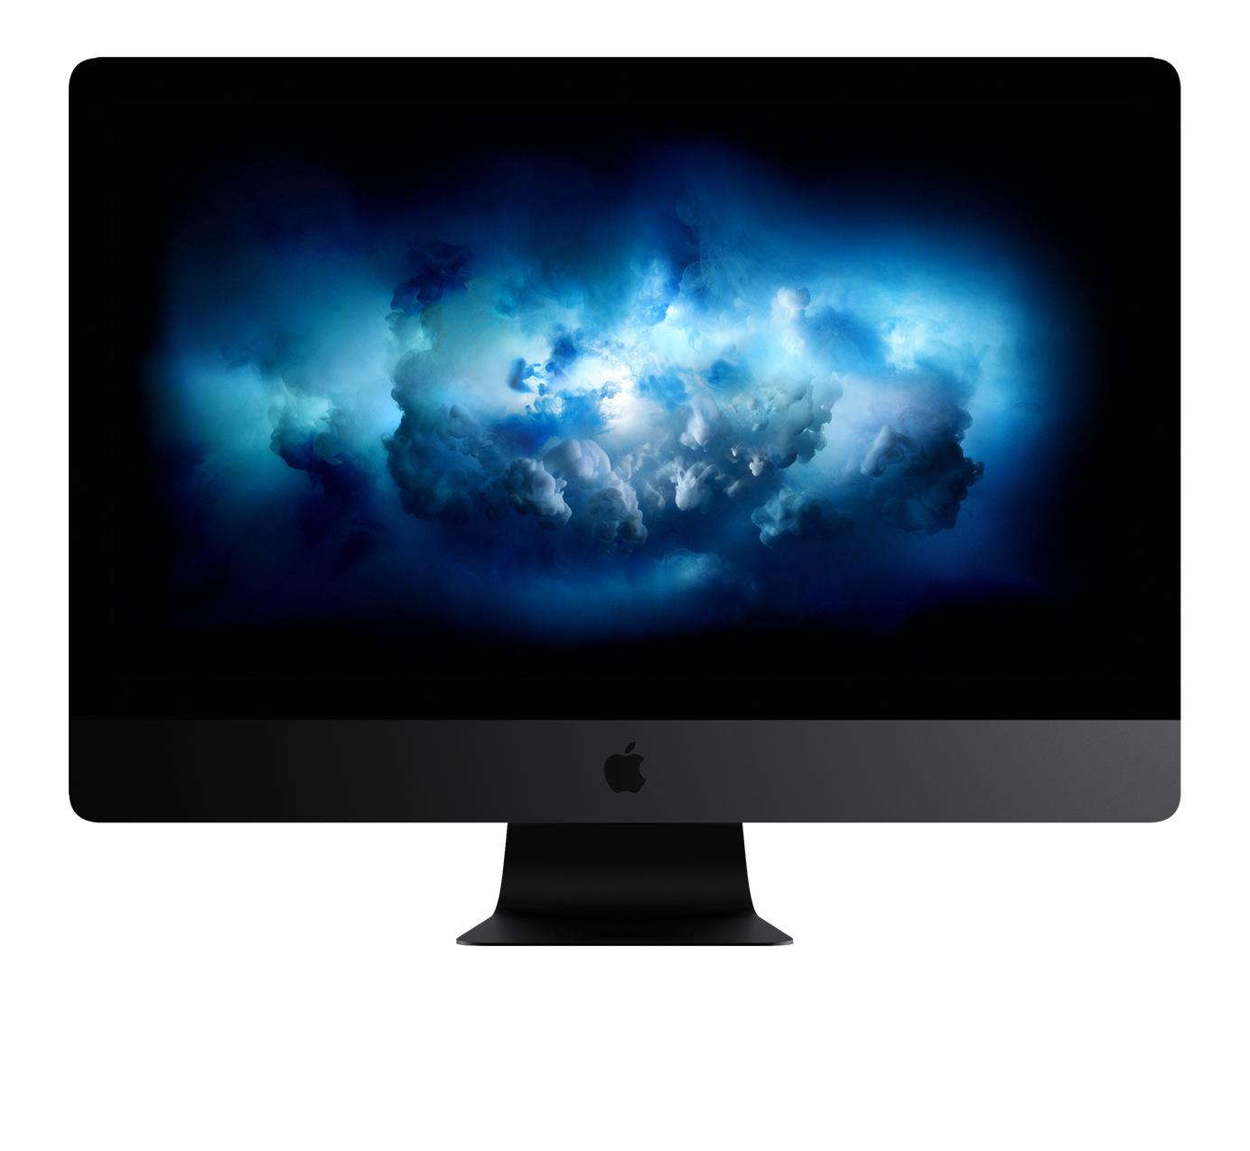
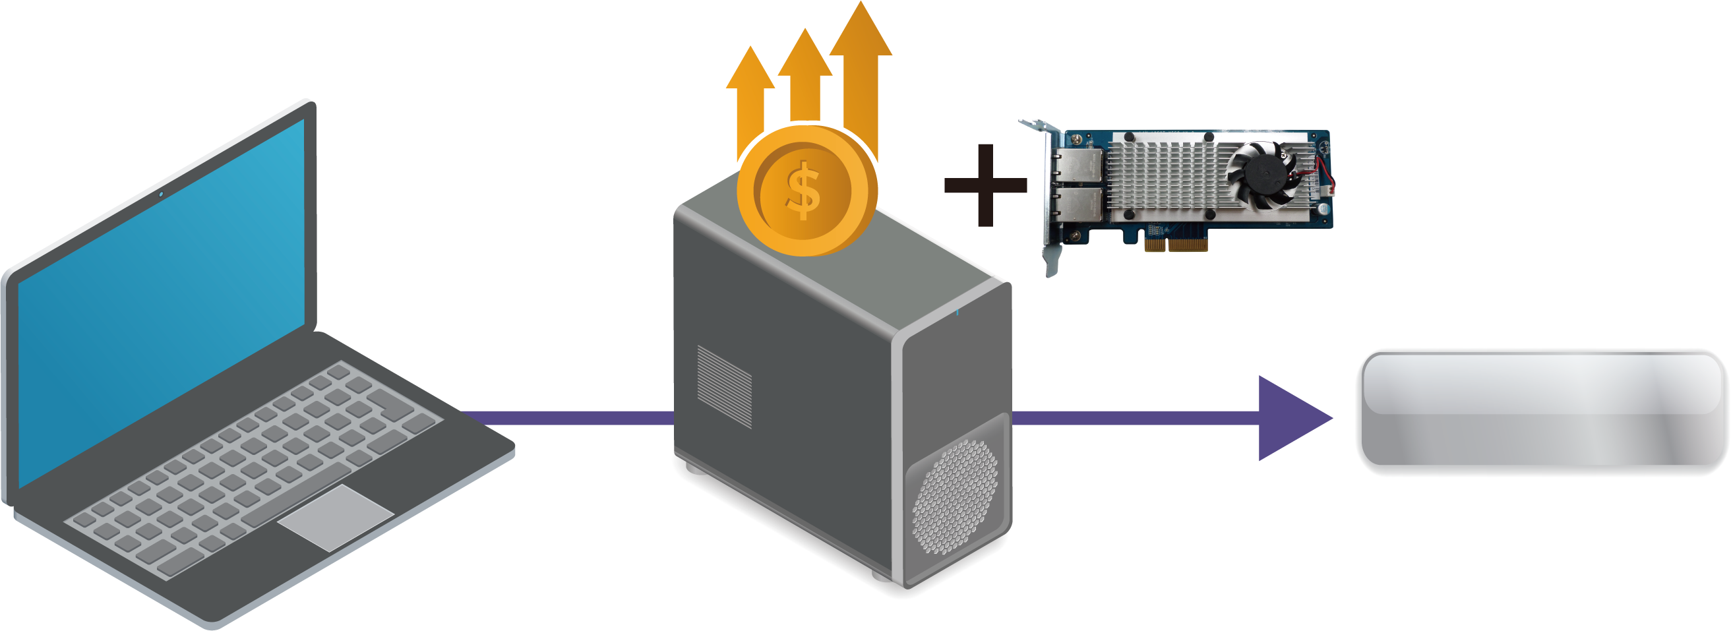
Thunderbolt 3 with 10GbE transfer
Before
iMac Pro
Thunderbolt 3 to PCIe expansion enclosure
10GbE NIC
10GbE NIC
10GbE Network
Thunderbolt 3
PC/laptop
Thunderbolt 3 PCIe
expansion enclosure
Expensive
Costly and not portable
Notes:
https://www.apple.com/tw/imac-pro/specs/
http://www.akitio.com.tw/thunderbolt3-series

Slide 5
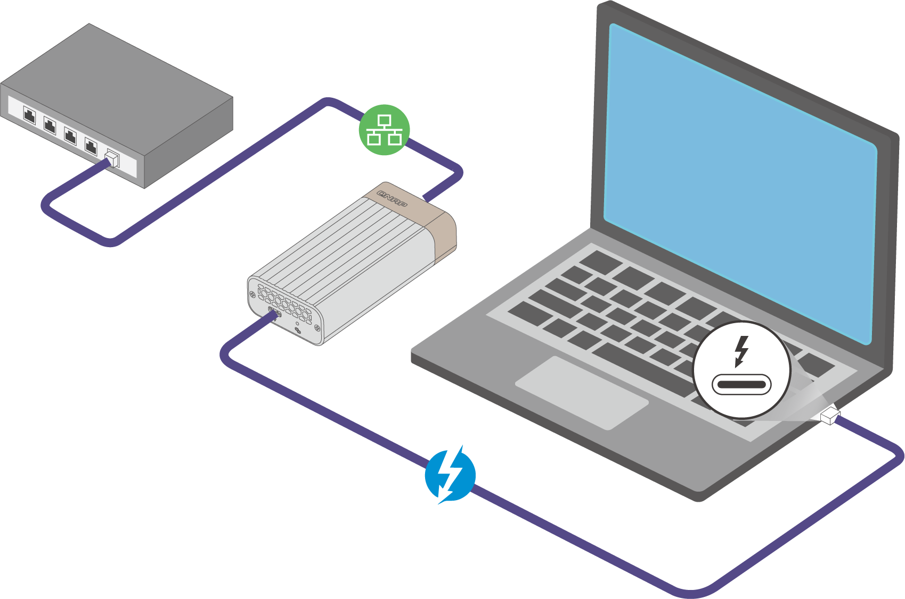
Combine Thunderbolt 3 and 10GbE
We
provide
QNA-series
Portable and integrated
Reduce the cost for building 10GbE environment
Portable design meets the flexible working conditions
Sleek design
* QNA adapters will not work when connected to PC via Thunderbolt 2 to Thunderbolt 3 adapters.
Notes:
圖要重ren
加上連接線 Thunderbolt3 and 10GbE 網路線
QNA需要換方向讓Thunderbolt3 接頭朝前面

Slide 6
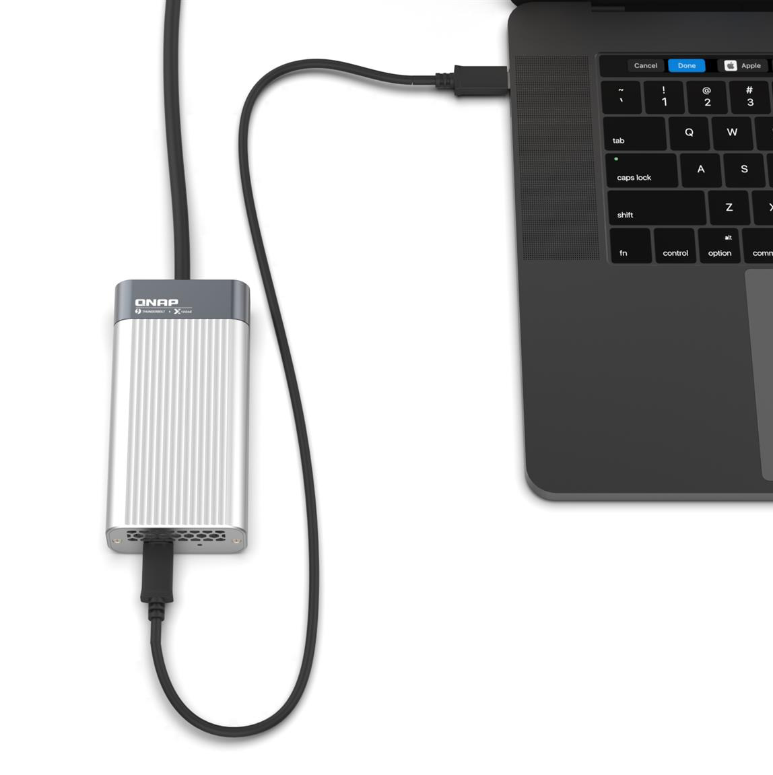
Thunderbolt 3 + 10GbE integration
QNAP QNA adapter
Cost-effective Thunderbolt 3 to 10GbE adapter that empowers your Mac® or Windows® computers with blazing-fast 10GbE network connectivity using a Thunderbolt 3 Type-C port
Notes:
圖要重ren
加上連接線 Thunderbolt3 and 10GbE 網路線
QNA需要換方向讓Thunderbolt3 接頭朝前面

Slide 7


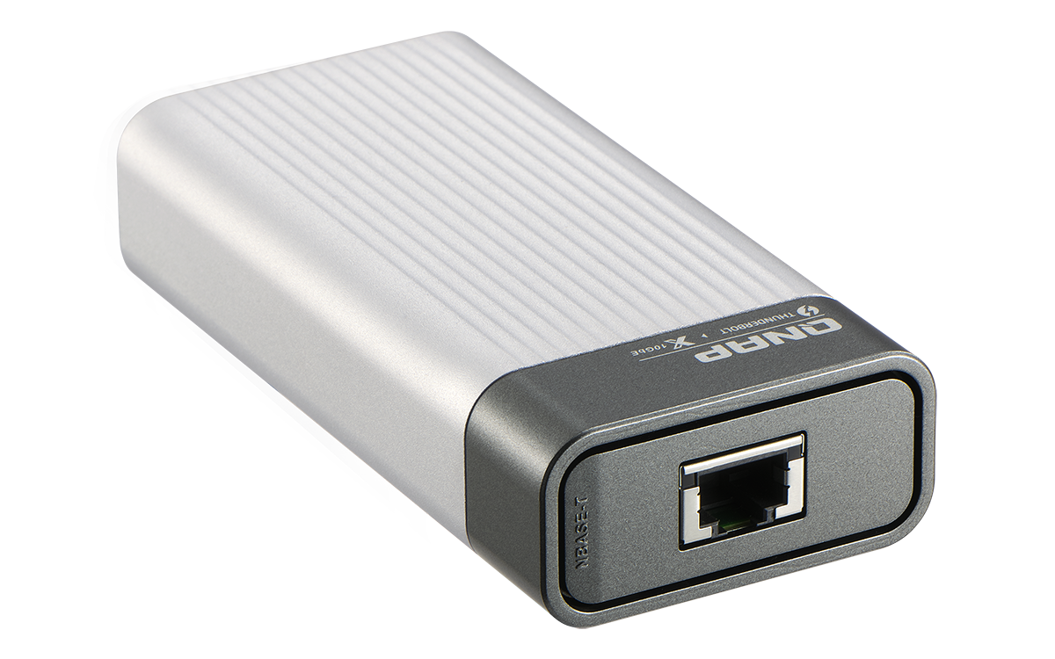
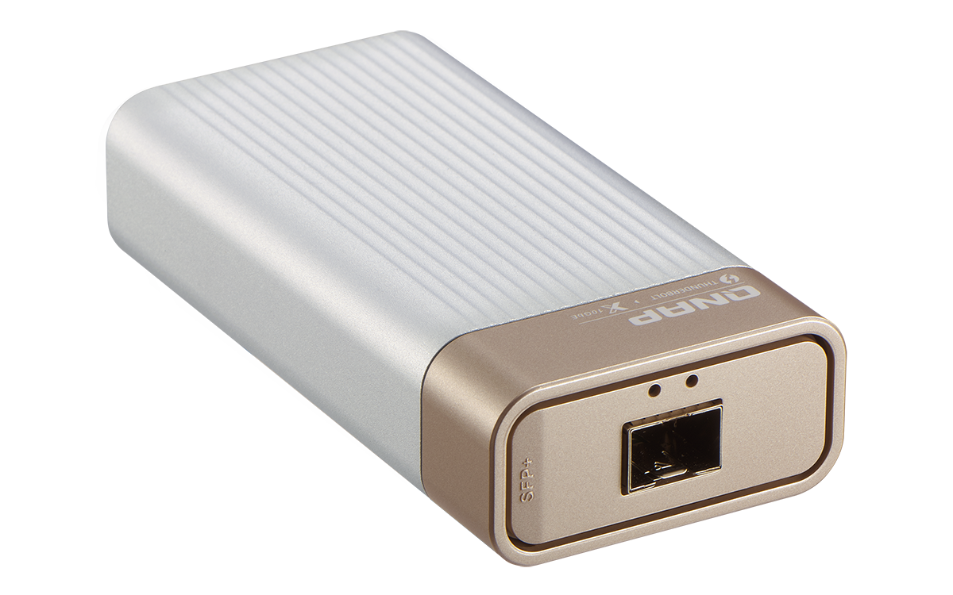
QNA series
10GbE NBASE-T port
Supported speeds:
10Gbps/5Gbps/2.5Gbps/1Gbps/100Mbps
10GbE SFP+ Port
Supported speed:
10Gbps
Notes:
網路接口放大

Slide 8
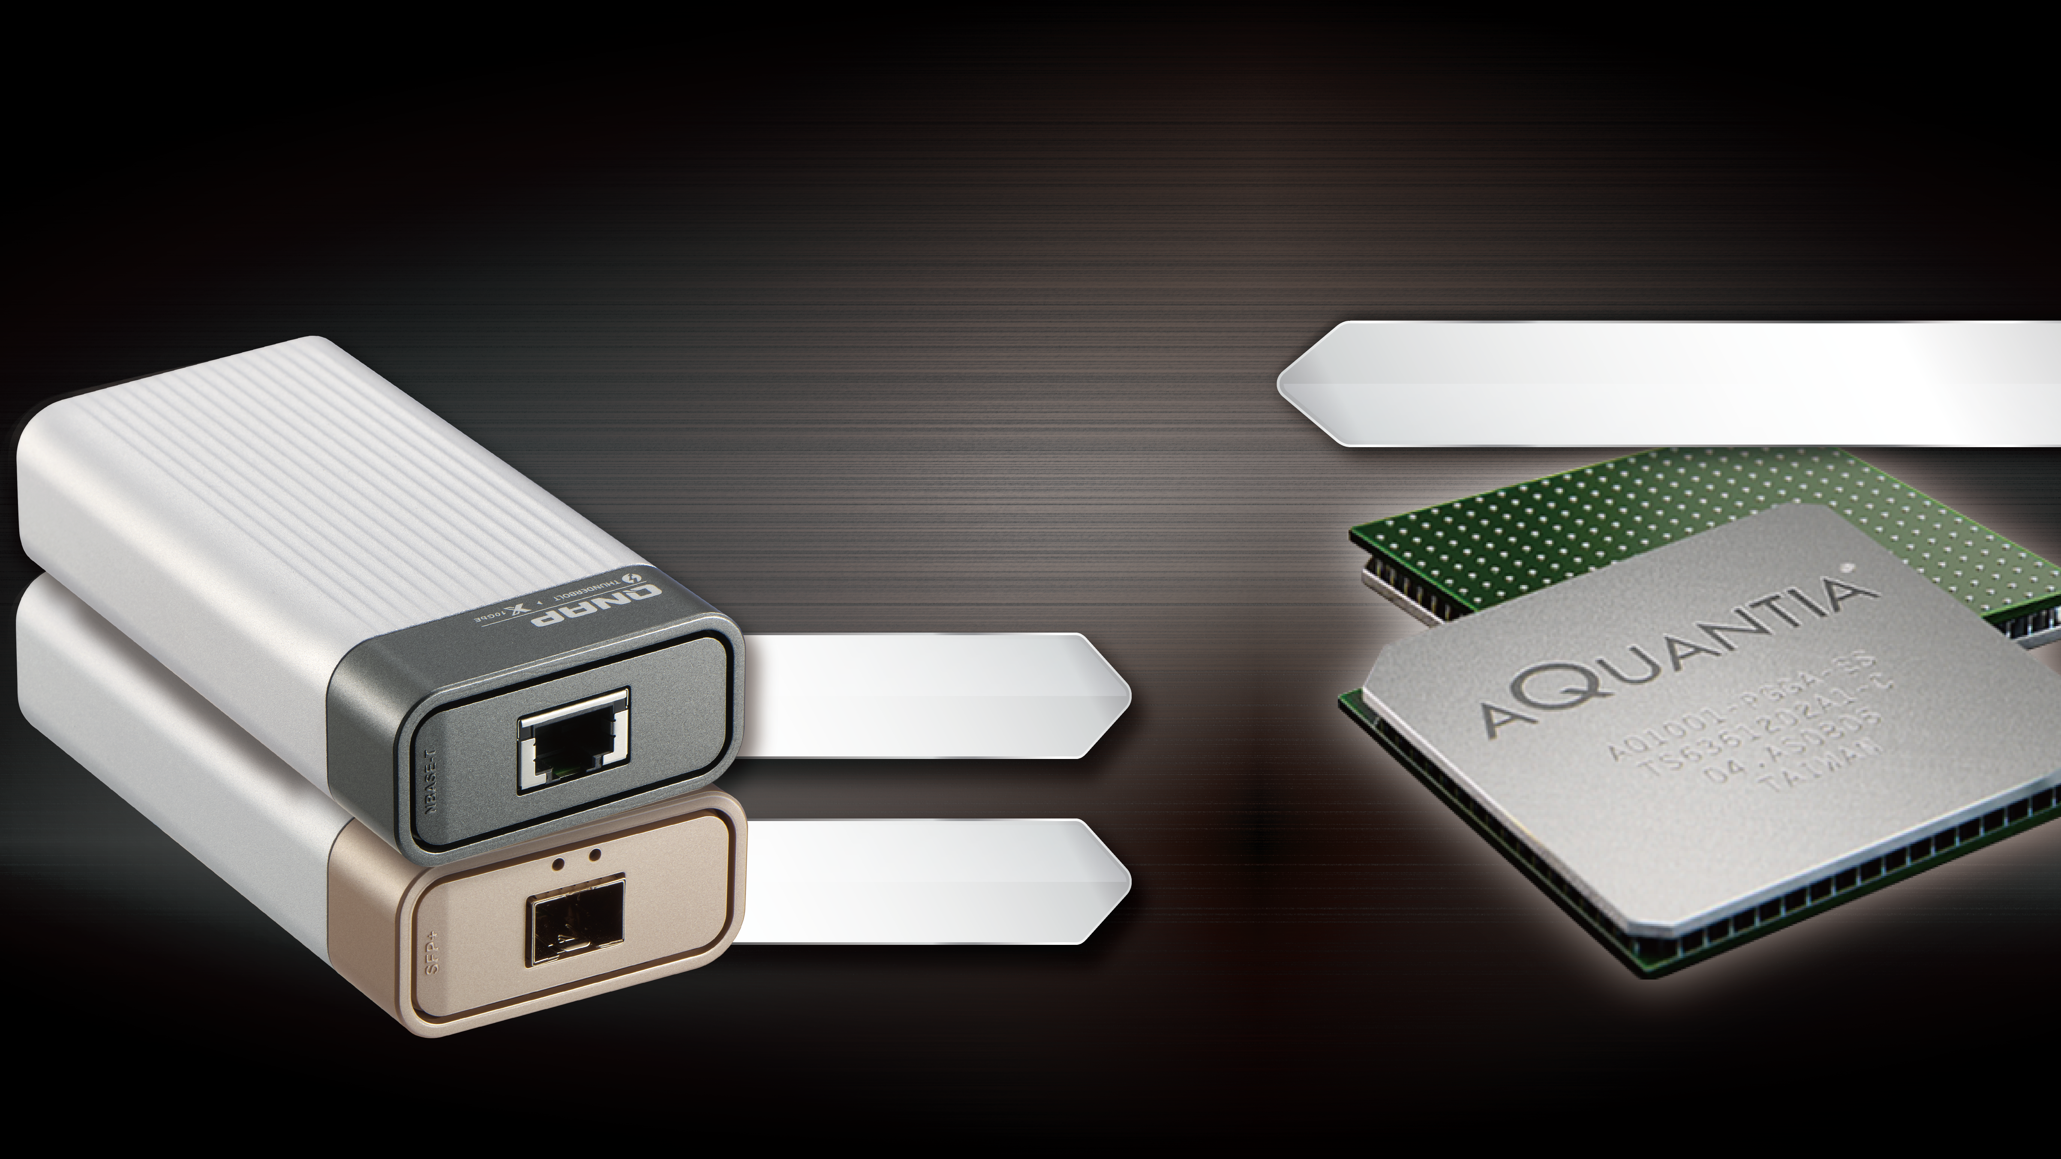
The Aquantia 10 GbE technology
The latest AQC-107S/ AQC-100S
Compatible with Windows & macOS
Thunderbolt3
+ AQC-107S
Thunderbolt3
+ AQC-100S

Slide 9

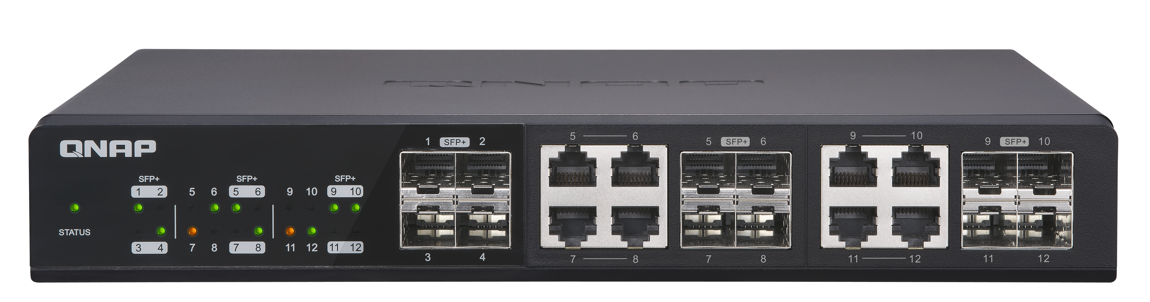
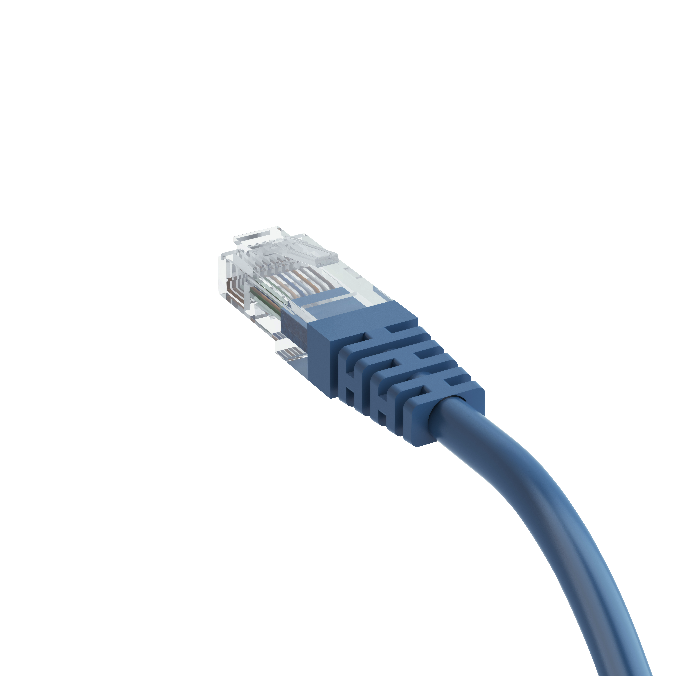
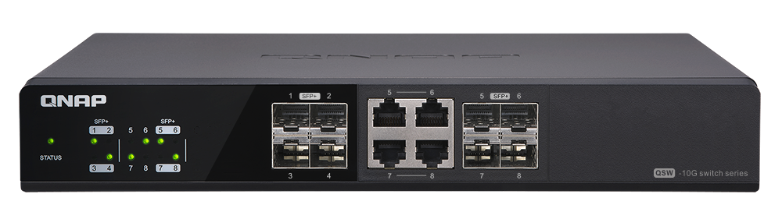
QNA-T310G1T supports five speeds
Supports Multi-Gigabit NBASE-T
With QNAP 10G switch, existing RJ45 cables can be used for faster speeds!
 | CAT 5e | CAT 6 | CAT 6a & CAT 7
100 M | ✓ | ✓ | ✓
1G | ✓ | ✓ | ✓
2.5G | ✓ | ✓ | ✓
5G | ✓ | ✓ | ✓
10G | ✘ | ✓ (55 m) | ✓
QSW-1208-8C
Provides 12 ports of 10Gbps transfer
QSW-804-4C
Provides 8 ports of 10Gbps transfer
Notes:
63XU簡報P.5

Slide 10
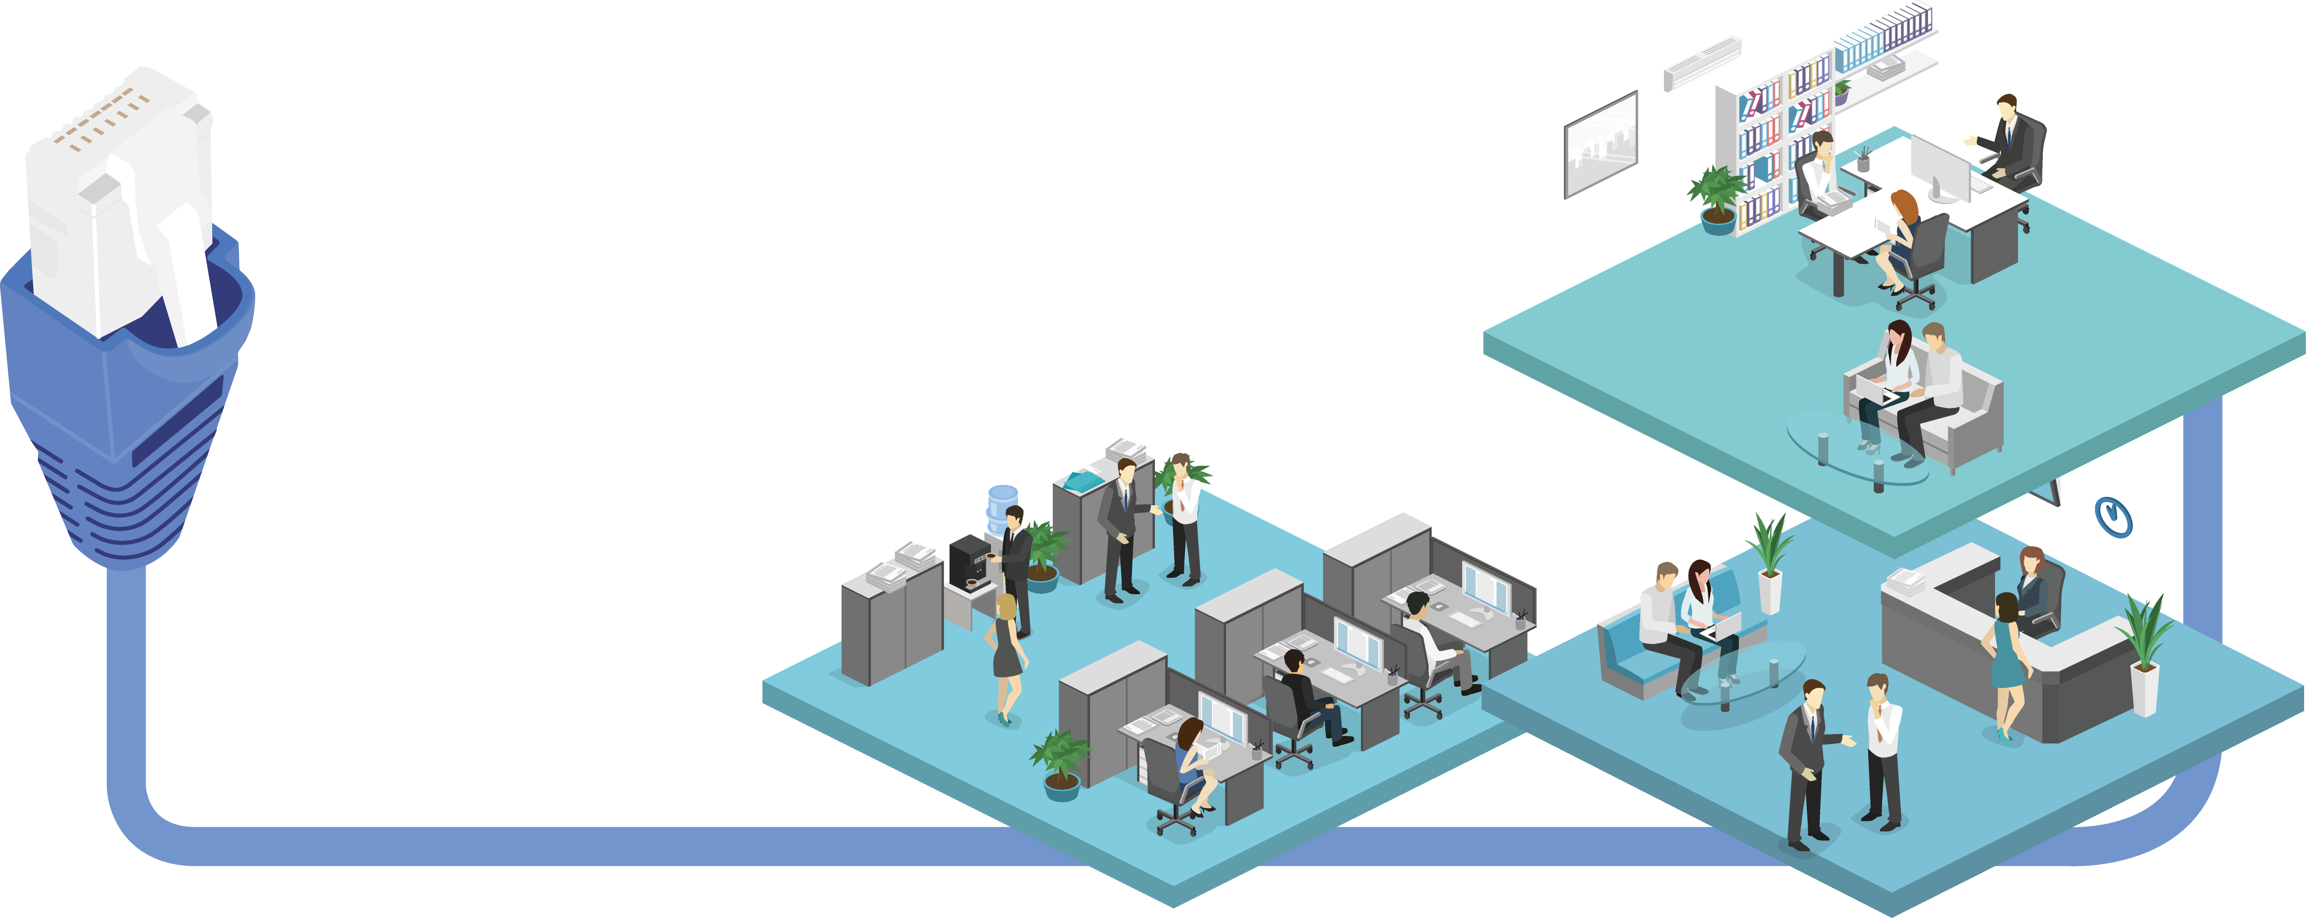
Long distance transmission
Supports max. 50 m CAT 6a transmission under 40°
Supports max. 100 m CAT 6a transmission under 35°
The actual transmission distance may be influenced by the spec of switch
Notes:
https://www.sonnettech.com/product/solo-10g-tb3.html
圖要改

Slide 11

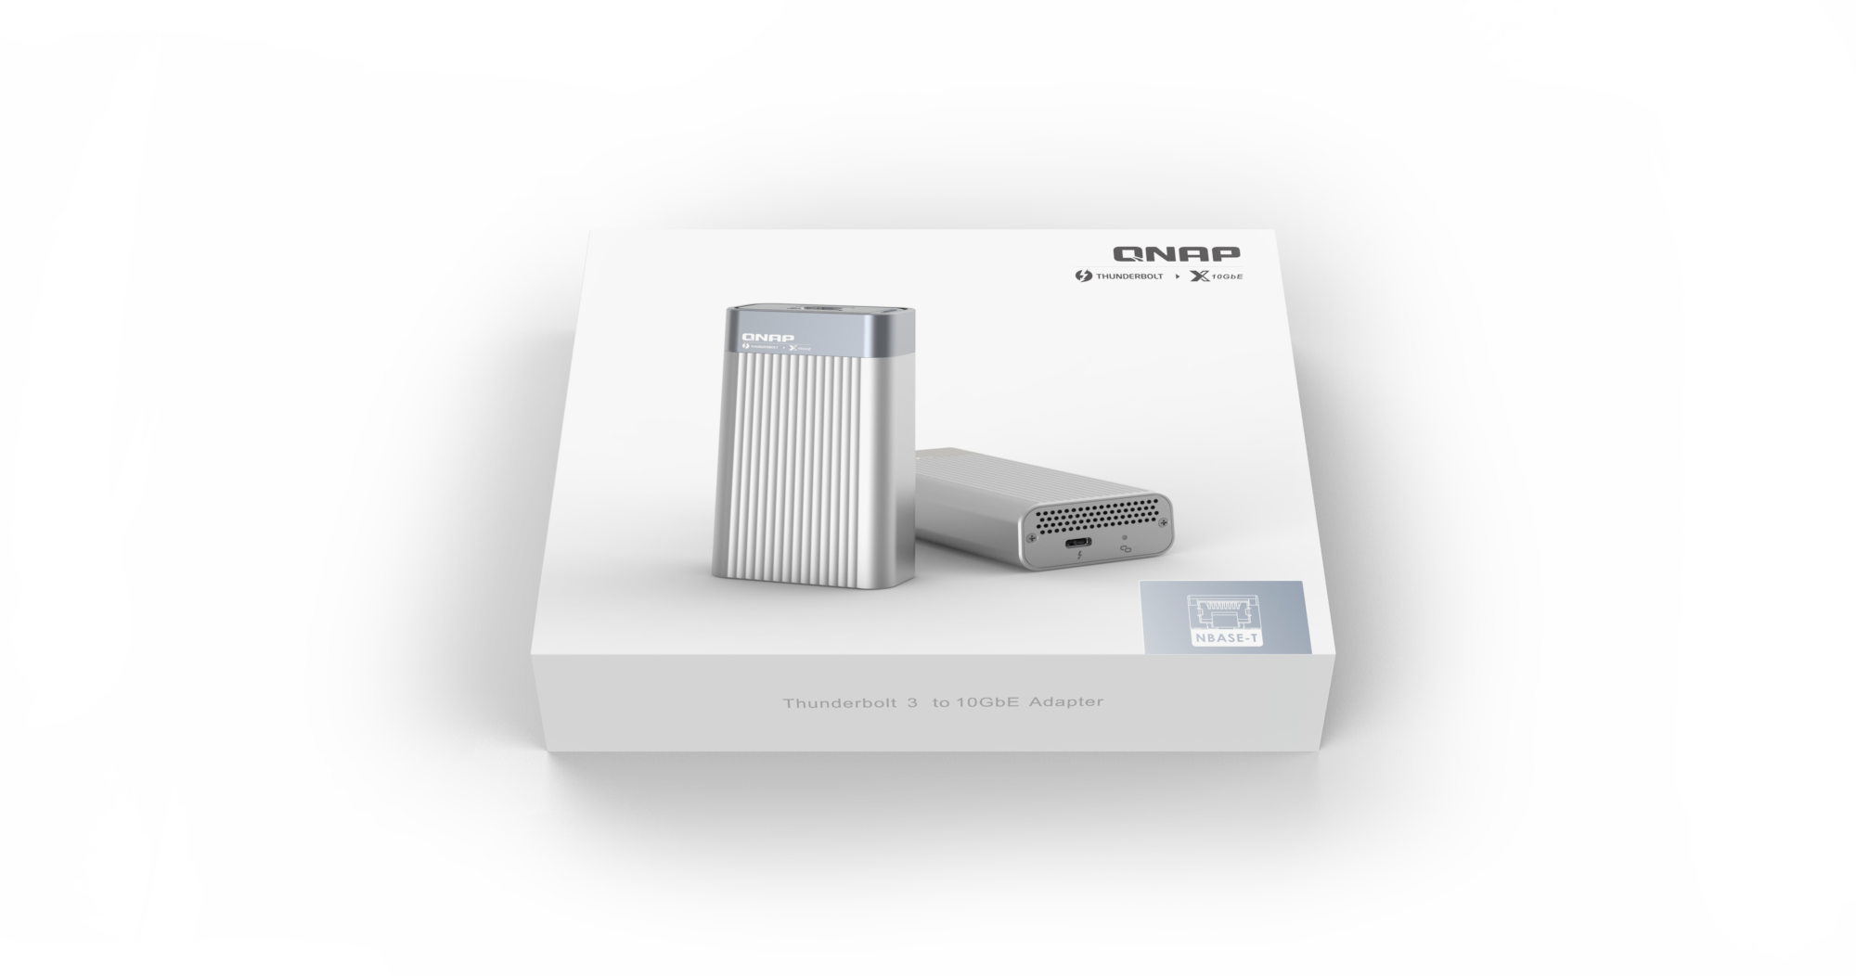

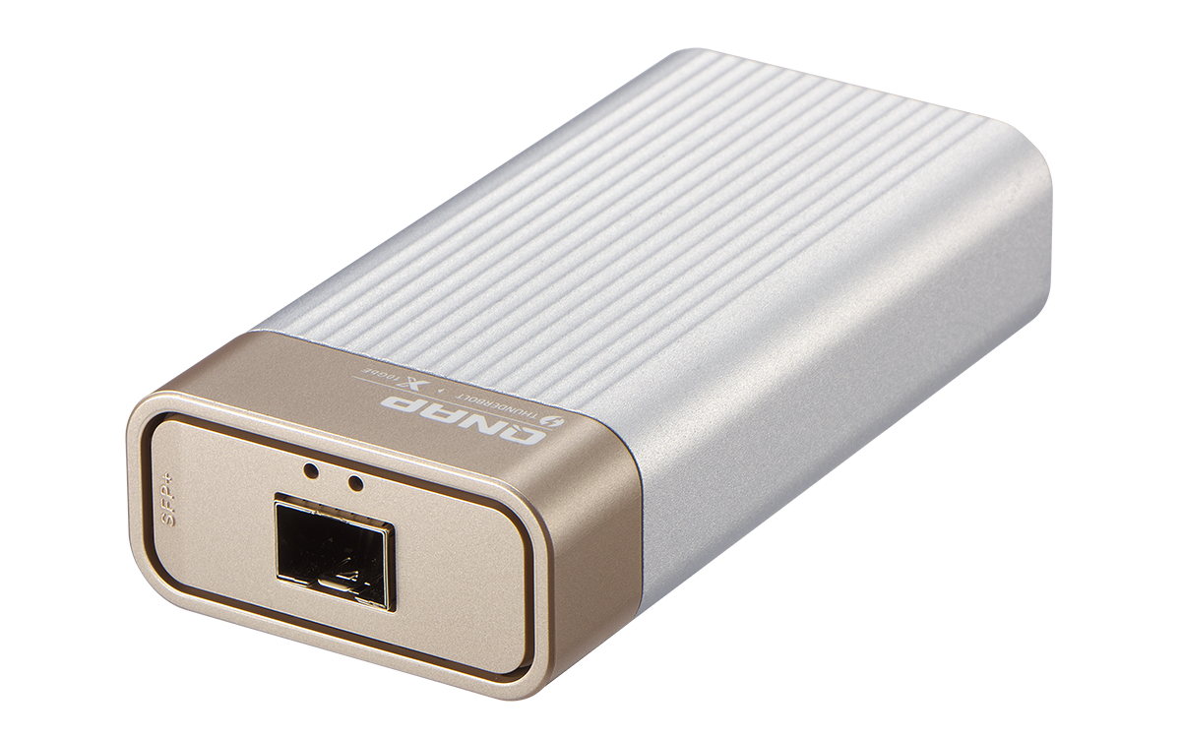
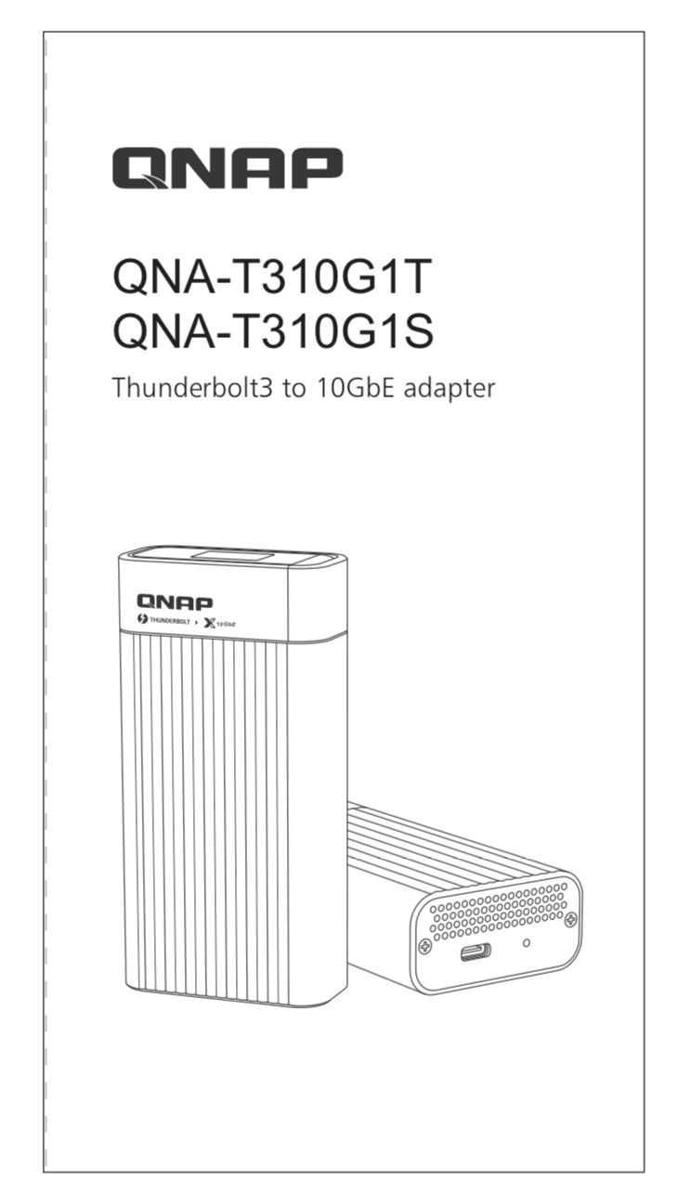
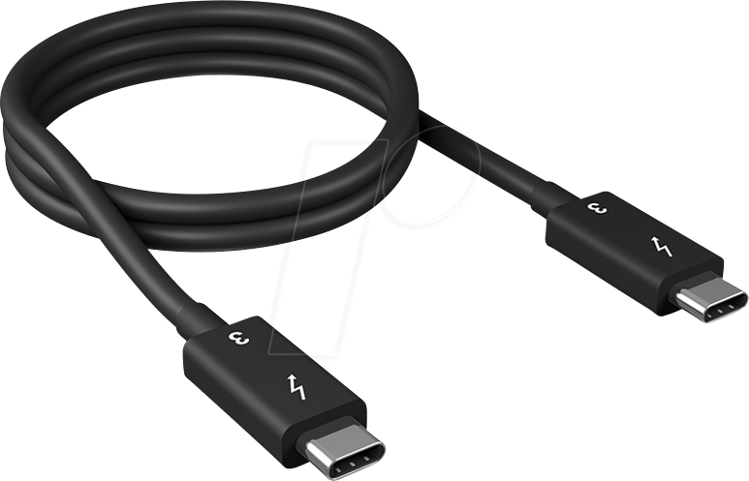
No additional power required
Travel light; easy to carry around
QNA-T310G1T /
QNA-T310G1S
Cable (included)
1 x 0.5M Thunderbolt3 40Gb/s
Quick Installation Guide
Notes:
要不要用實際照片？

Slide 12
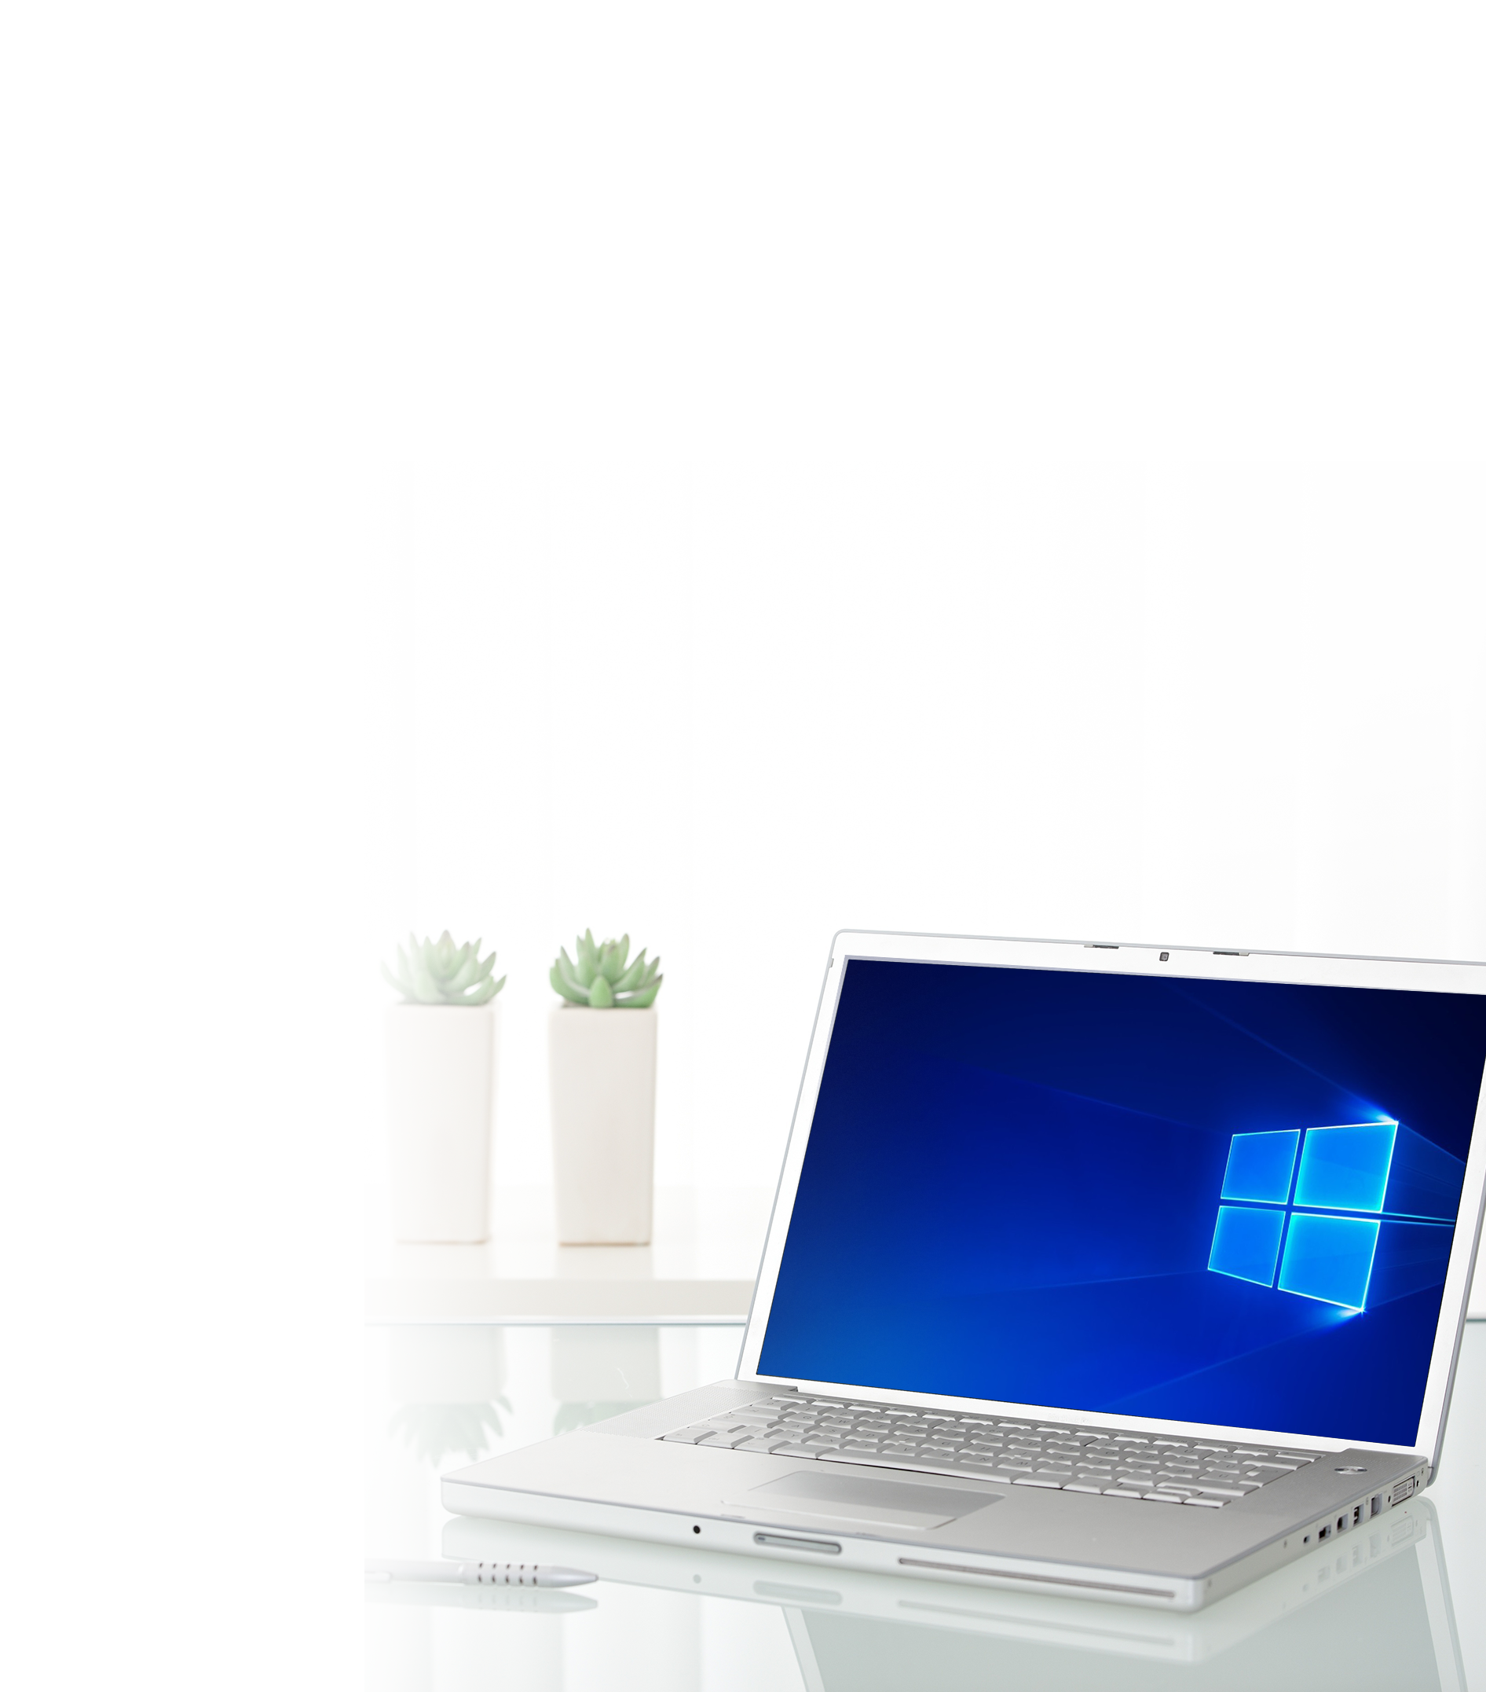



Driver built-in for macOS - plug & play
macOS 10.13.3 (or later)
Built-in driver for plug & play
MacBook Pro
Driver installation required
QNA-T310G1T: AQC107
QNA-T310G1S: AQC100
Windows
*QNAP NAS support to be added by the end of 2018 (est.)

Slide 13

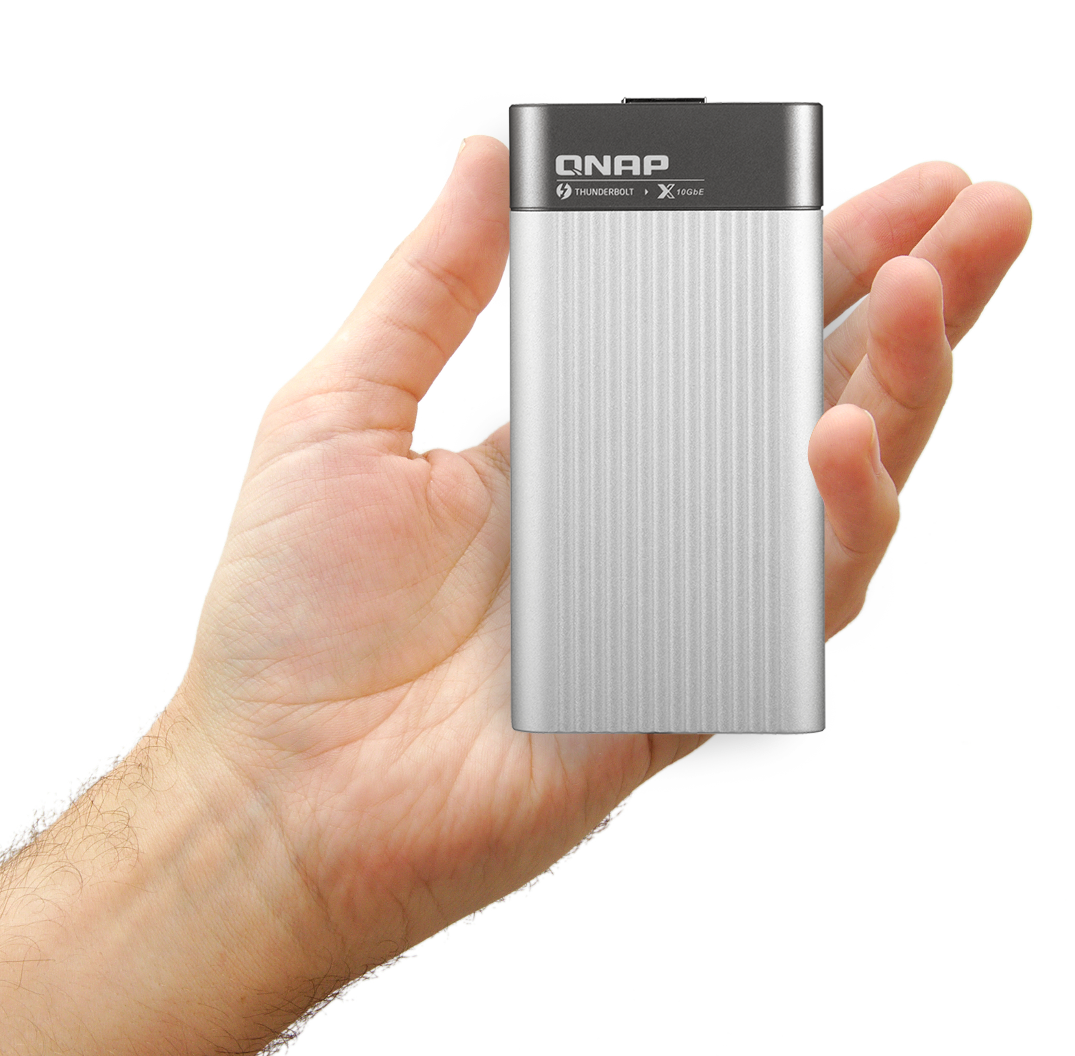
Portable, effective heat dissipation
56 mm
112 mm
The QNA series adopts aluminum alloy for the case for providing effective heat dissipation.
Notes:
https://www.sonnettech.com/product/solo-10g-tb3.html

Slide 14
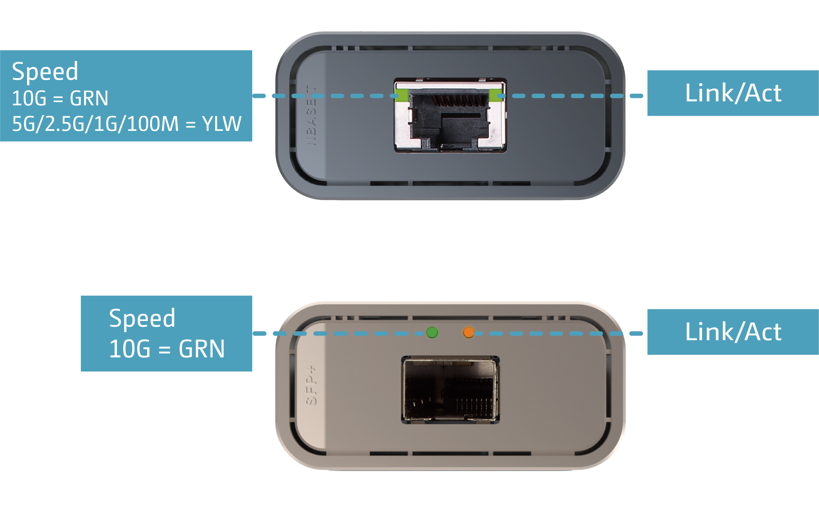
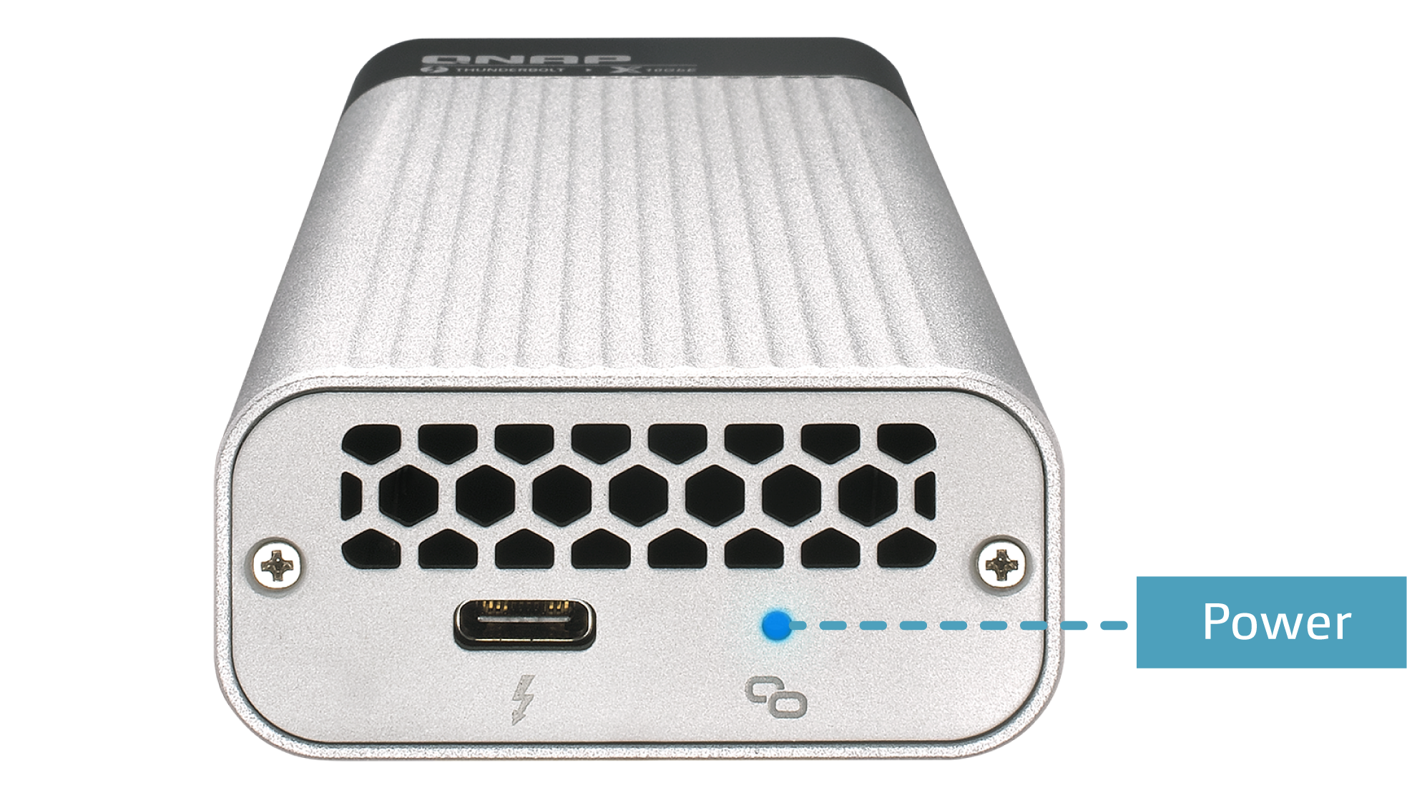
Power and speed indicators

Slide 15
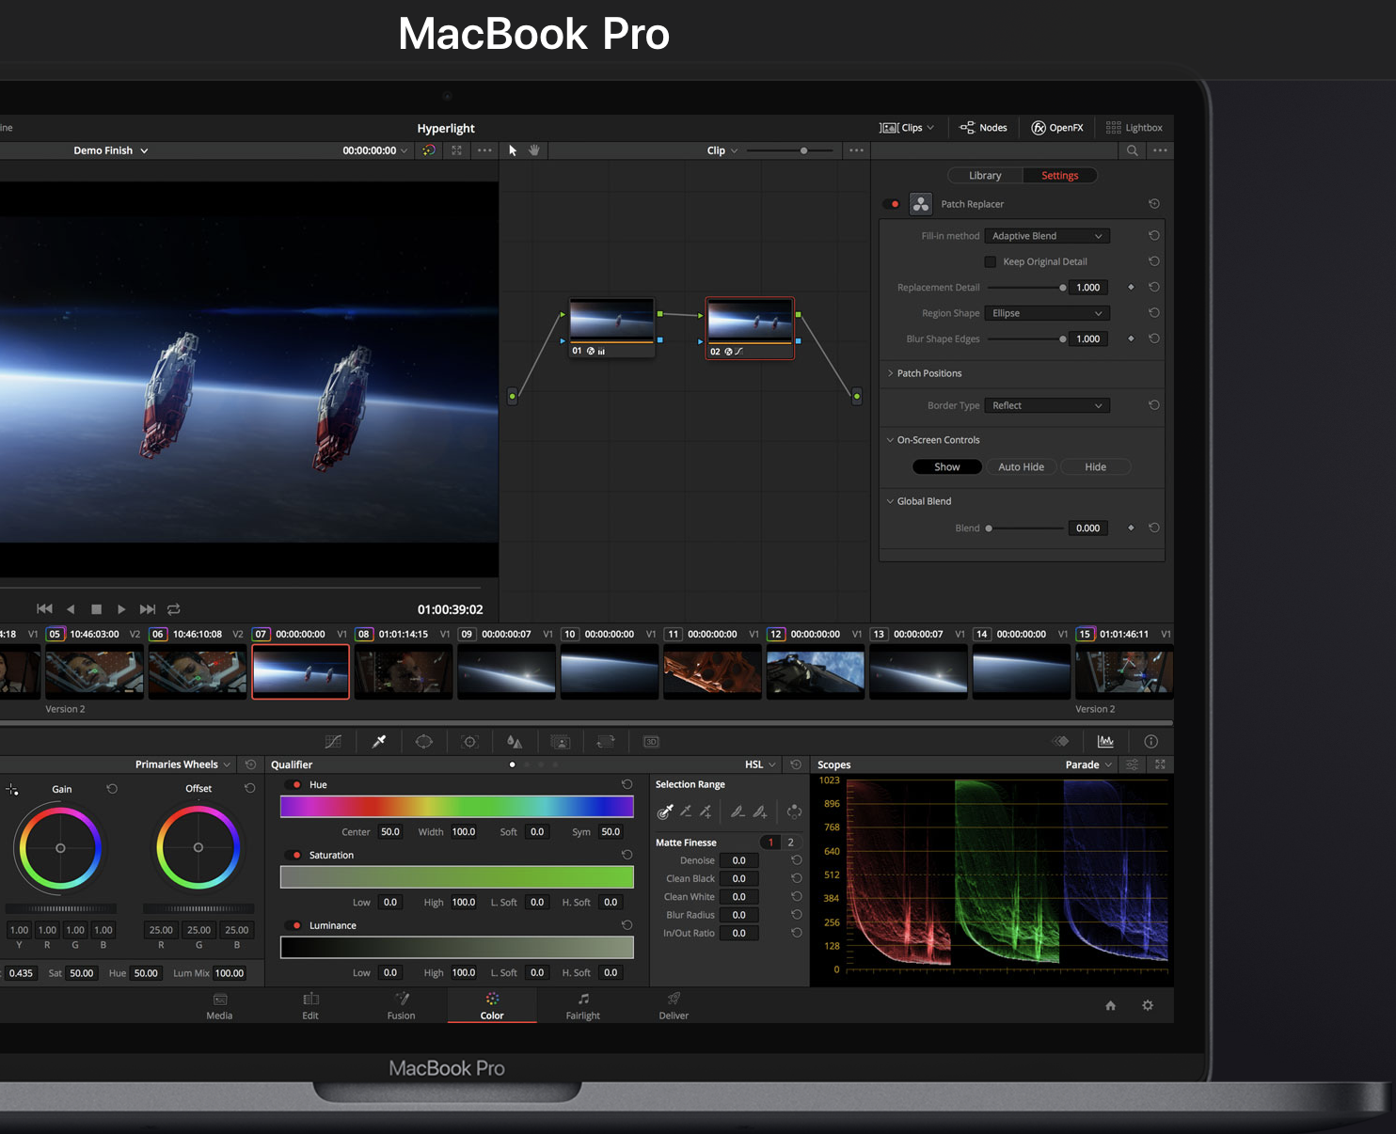
Thunderbolt 3 + 10GbE environment for data backup
Back up to
QNAP 10GbE NAS
Video Editing workstation
Back-up your masterpiece
QNAP 10GbE NAS
TS-963X
10GbE
Thunderbolt3
10GbE
TS-332X
Find more QNAP 10GbE NAS
https://www.qnap.com/en/product/?conditions=2-4,2-5

Slide 16
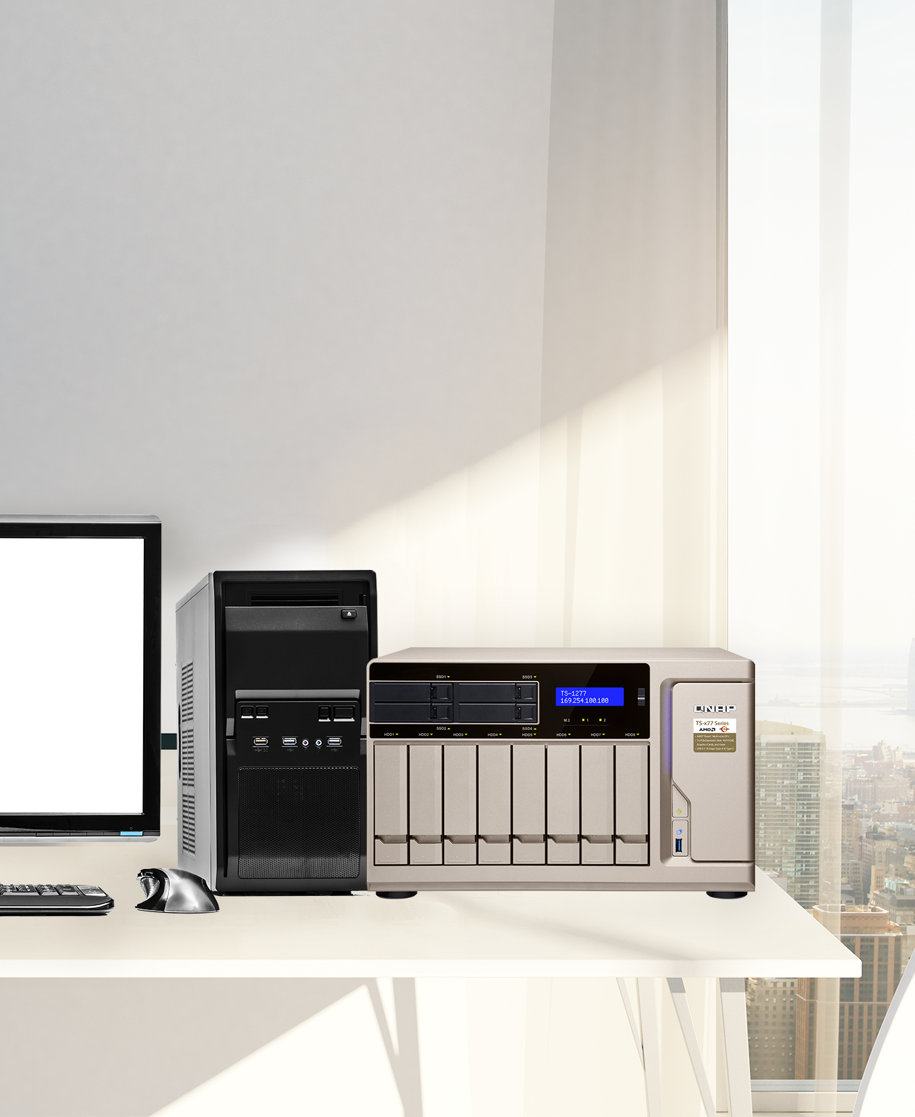
Easily upgrade to
10GbE PC/NAS
PCIe expansion slots
PCIe expansion supported NAS
QM2-2S10G1T
QM2-2P10G1T
Dual M.2 2280 SATA/PCIe MVMe SSDslots + single port 10GbE expansion card
QXG-10G1T
Single port five speed 10GbE network expansion card
PC
TS-1277
More NAS with PCIe expansion slots : https://www.qnap.com/zh-tw/product/?conditions=2-5

Slide 17
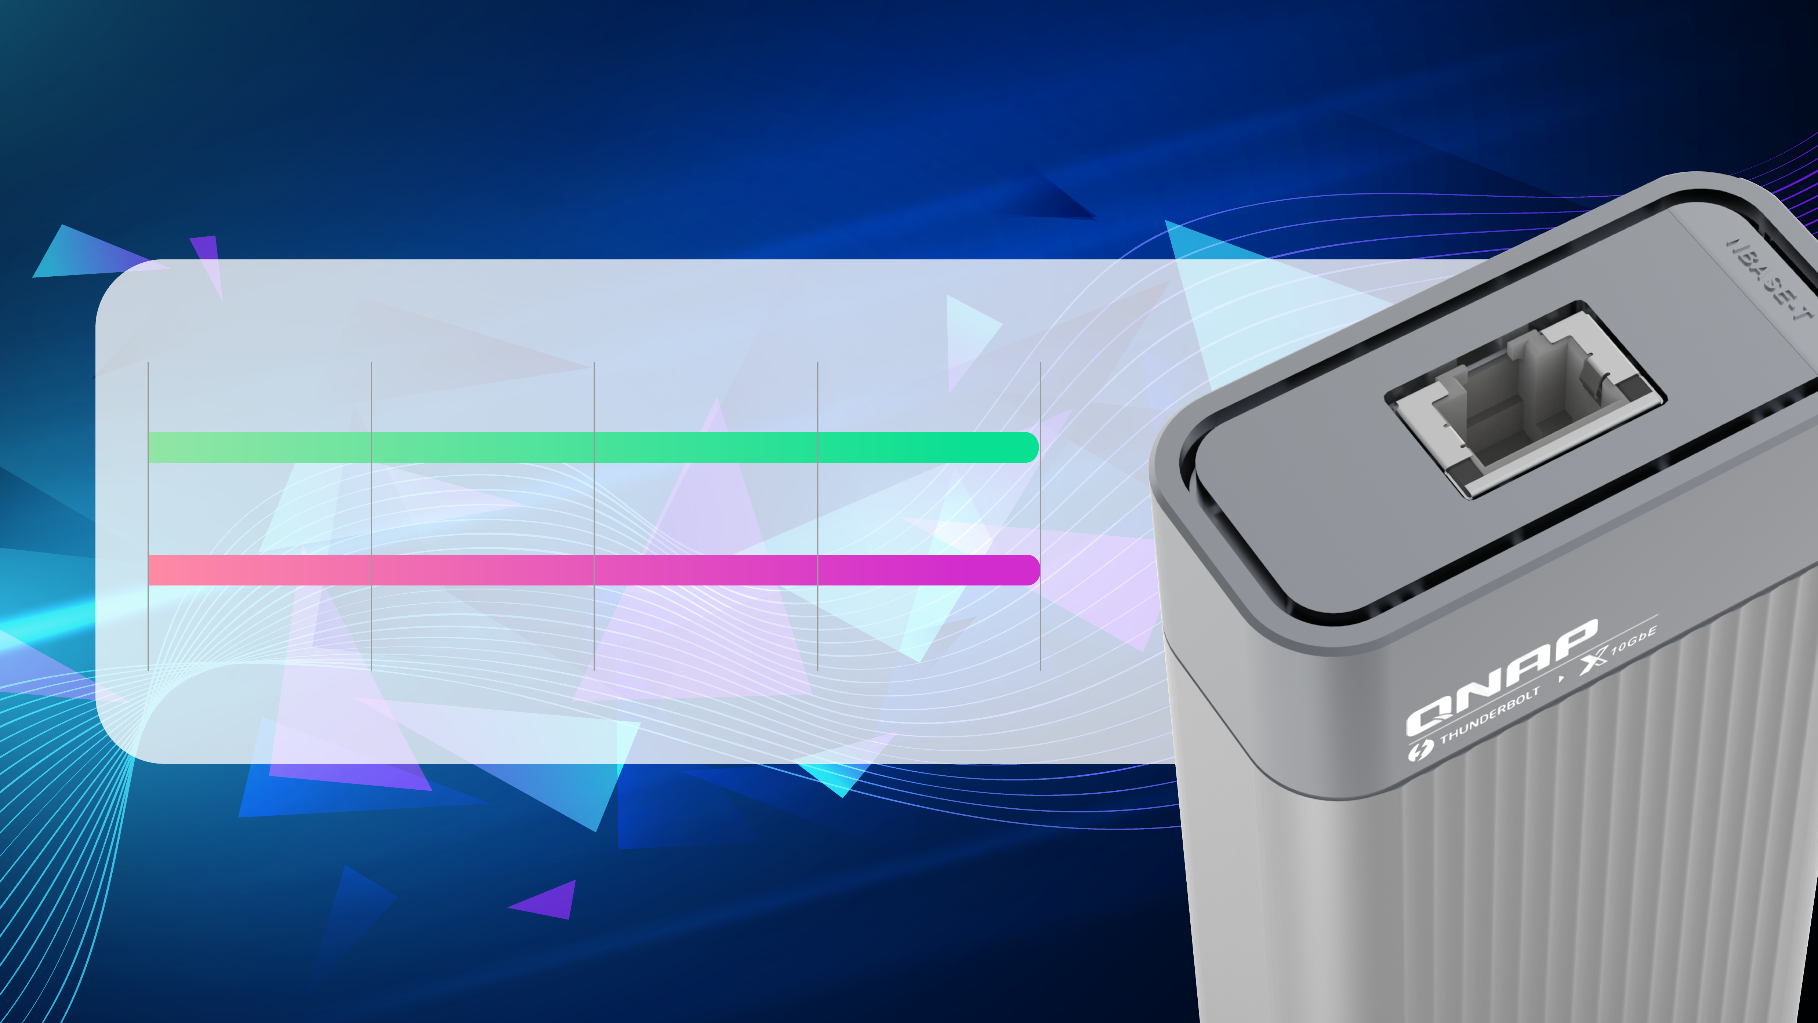
Enable blazing-fast 10GbE connectivity
File Transfer (1 x 10GbE)
Windows Download
1068 MB/s
Windows Upload
1069 MB/s
*Please set Jumbo Frame to MTU 9000 for optimal performance
10GbE Transfer
Test environment：
Server NAS：TS-677, QTS 4.3.4, , AMD Ryzen 5 2600, 3.40 GHz, 8GB RAM, RAID5, Samsung SSD 850 PRO 512GB *6, QXG-10G1T & LAN-10G2SF-MLX,
Ｃlient PC：Windows 10, Intel Core i7-4770 3.40GHz, 32GB RAM, LAN: Thunderbolt 3, MTU9000

Slide 18

Demo
Unboxing and data transfers

Slide 19

QNA Series
Your Best Choice!
©2018著作權為威聯通科技股份有限公司所有。威聯通科技並保留所有權利。威聯通科技股份有限公司所使用或註冊之商標或標章。檔案中所提及之產品及公司名稱可能為其他公司所有之商標 。

