Slide 1


Slide 2
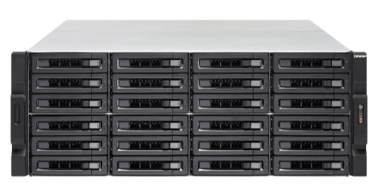
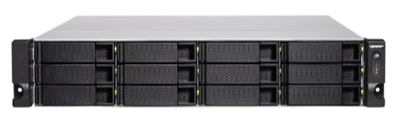

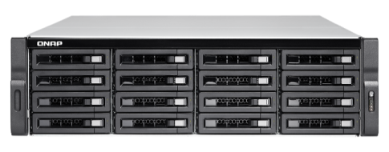

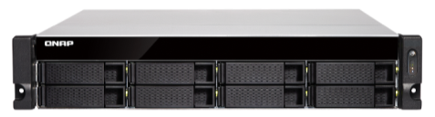
Intel Xeon CPU 10GbE NAS
TS-x83XU NAS Series
E-2124
4-core
E-2124
4-core
TS-983XU-E2124-8G
TS-983XU-RP-E2124-8G
TS-1283XU-RP-E2124-8G
TS-2483XU-RP-E2136-16G
E-2136
6-core
E-2124
4-core
E-2124
4-core
TS-883XU-E2124-8G
TS-883XU-RP-E2124-8G
TS-1683XU-RP-E2124-16G

Slide 3

企業級處理器的代名詞 Xeon
Processors
Intel® Turbo Boost Technology

Slide 4

ECC Memory (Error Correcting Code)
Running reliably without data corruption
Intel Xeon processors support ECC which can automatically detects and repairs single-bit error on-the-fly.

Slide 5
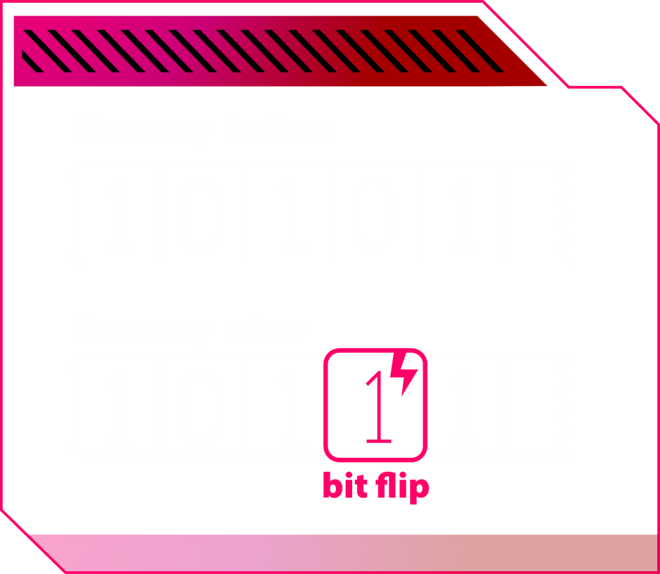
The majority of single-event errors in memory chips
Electrostatic discharge
Electromagnetic interference (EMI)
Lowering voltage
Background radiation

Slide 6
How ECC Works
Data read from memory
Detect and repair
Send to applications
Data
Newly generated ECC Code
ECC code generated
ECC Code
Repair and send
Compare ECC code

Slide 7


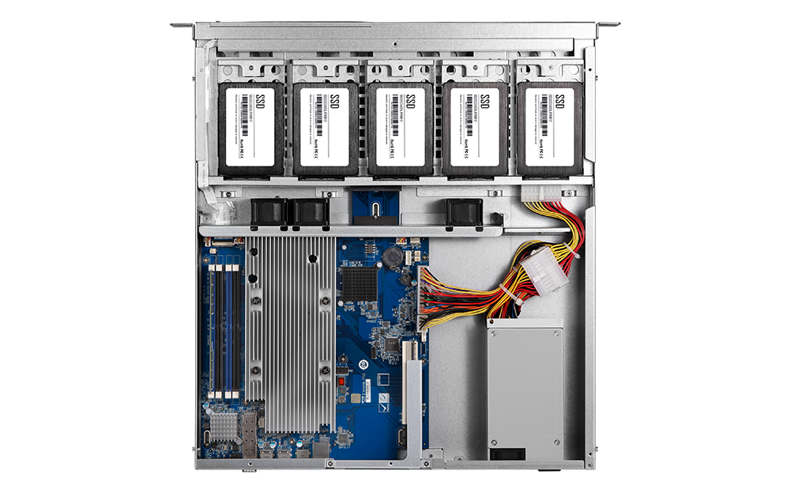
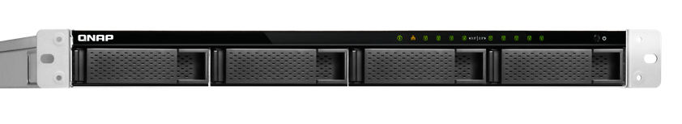
Complete Product Lines- 1U 9-bay
Redundant PSU
2x300W
Single PSU
250W
TS-983XU-RP-E2124-8G
Intel® Xeon® E-2124 4-core 3.3 GHz processor, max boost to 4.3 GHz
8GB DDR4 ECC RAM (2x 4GB)
TS-983XU-E2124-8G
Intel® Xeon® E-2124 4-core 3.3 GHz processor, max boost to 4.3 GHz
8GB DDR4 ECC RAM (2x 4GB)
9-bay
5 x 2.5-in ports (inside)
4 x 3.5-in ports

Slide 8
Complete Product Lines- 2U 8-bay
Redundant PSU
2x300W
Single PSU
350W
TS-883XU-RP-E2124-8G
Intel® Xeon® E-2124 4-core 3.3 GHz processor, max boost to 4.3 GHz
8GB DDR4 ECC RAM (2x 4GB)
TS-883XU-E2124-8G
Intel® Xeon® E-2124 4-core 3.3 GHz processor, max boost to 4.3 GHz
8GB DDR4 ECC RAM (2x 4GB)
8-bay

Slide 9
Complete Product Lines- 2U 12-bay
Redundant PSU
2x300W
TS-1283XU-RP-E2124-8G
Intel® Xeon® E-2124 4-core 3.3 GHz processor, max boost to 4.3 GHz
8GB DDR4 ECC RAM (2x 4GB)
12-bay

Slide 10

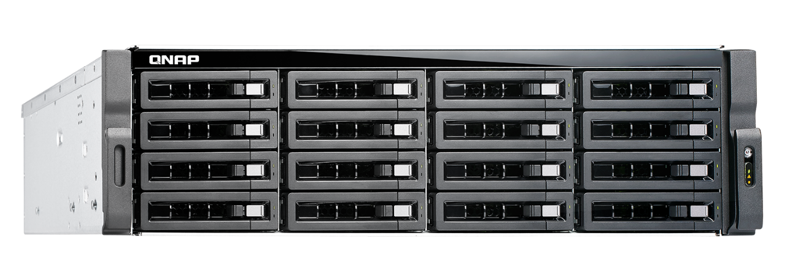
Complete Product Lines- 3U 16-bay
TS-1683XU-RP-E2124-16G
Intel® Xeon® E-2124 4-core 3.3 GHz processor, max boost to 4.3 GHz
16GB DDR4 ECC RAM (2x 8GB)
Redundant PSU
2x500W
16-bay

Slide 11
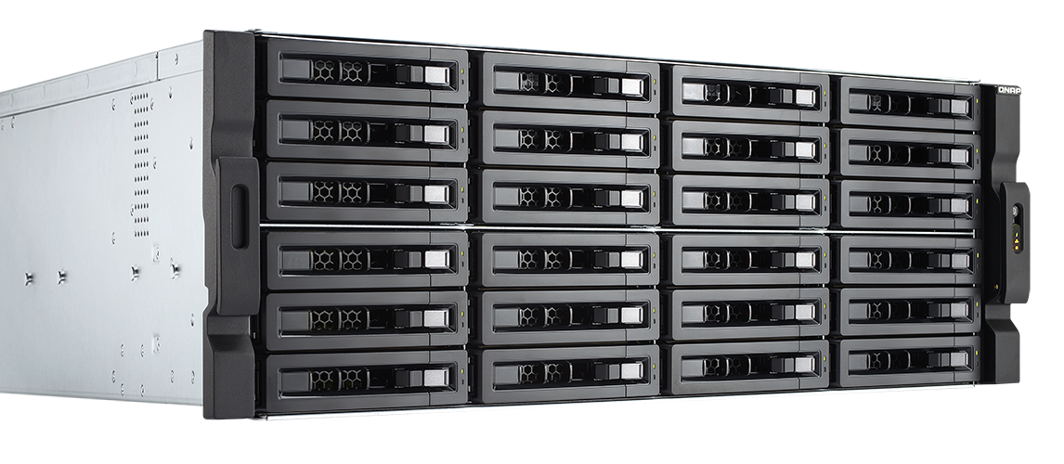
Complete Product Lines- 4U 24-bay
Redundant PSU
2x800W
TS-2483XU-RP-E2136-16G
Intel® Xeon® E-2136 6-core 3.3 GHz processor, max boost to 4.5 GHz
16GB DDR4 ECC RAM (2x 8GB)
24-bay

Slide 12


Hardware
Introduction

Slide 13
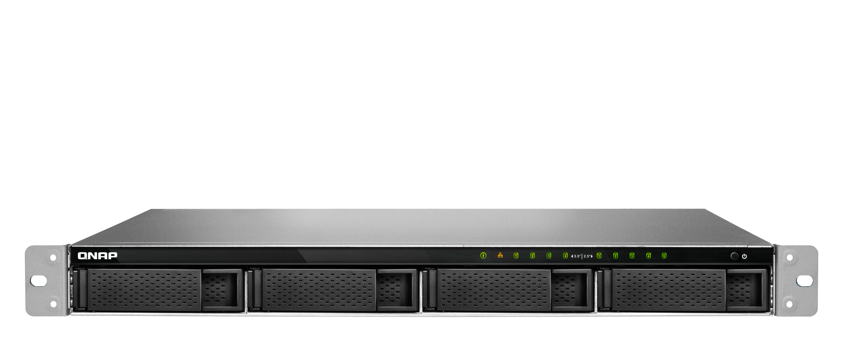
Enjoy Qtier and SSD cache in a 1U NAS
LED indicators:
System status, network, disks
5 x 2.5”
SATA 6Gb/s SSD ports
4 x 3.5”SATA 6Gb/s HDD/SSD ports

Slide 14
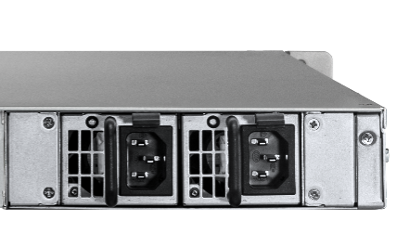
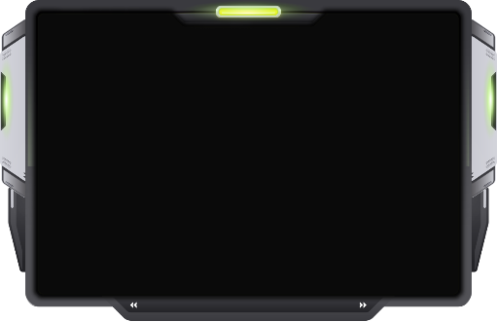

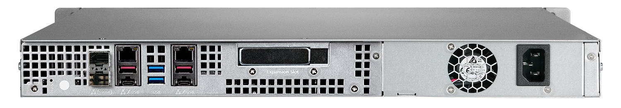
TS-983XU/TS-983XU-RP Rear View
2 x 10GbE SFP+ ports
2 x GbE RJ45 ports
1 x low profile PCIe slot
Redundant
PSU
Single PSU
2 x USB 3.0 (5G) ports
250W
2 x 250W
4 x USB 3.1 Gen2 (10G) port
Notes:
白手起家款

Slide 15


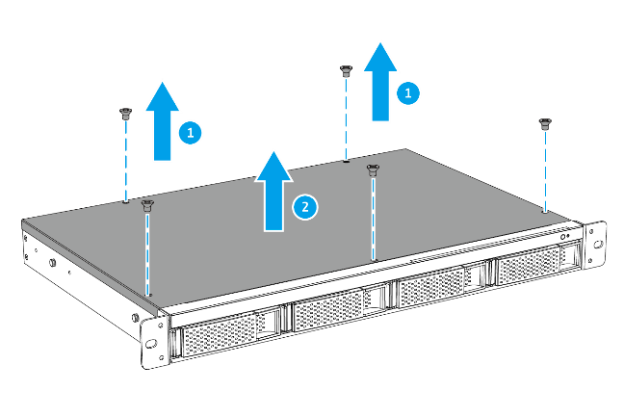
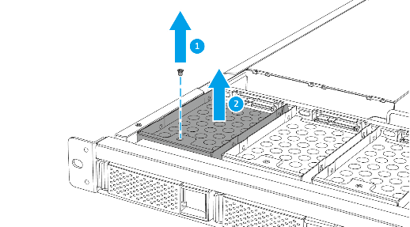
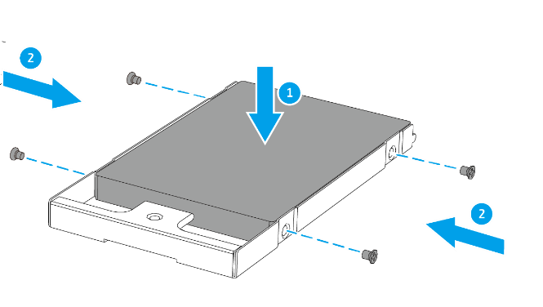
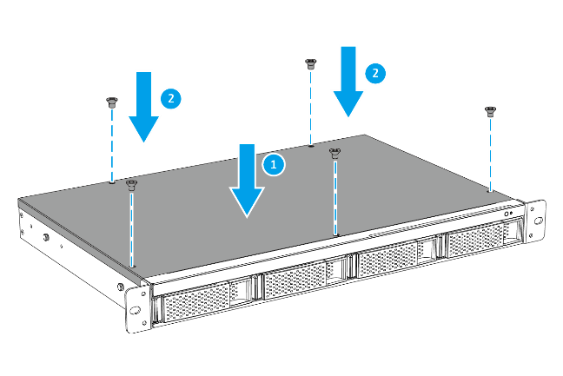
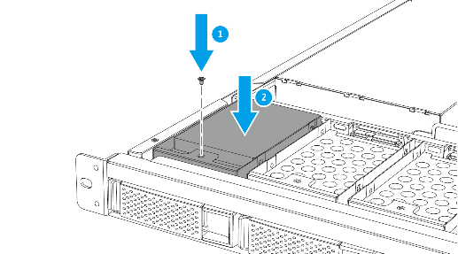
TS-983XU SSD Installation
01
02
03
04
05

Slide 16

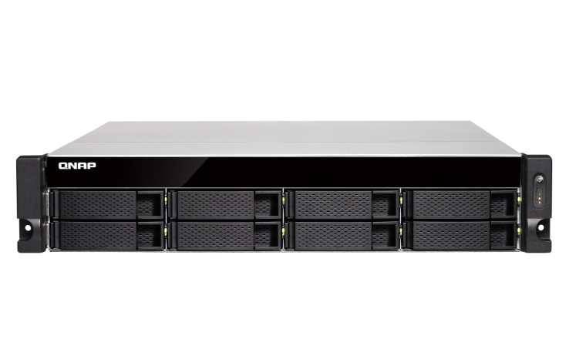
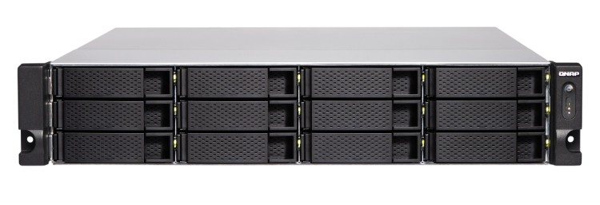
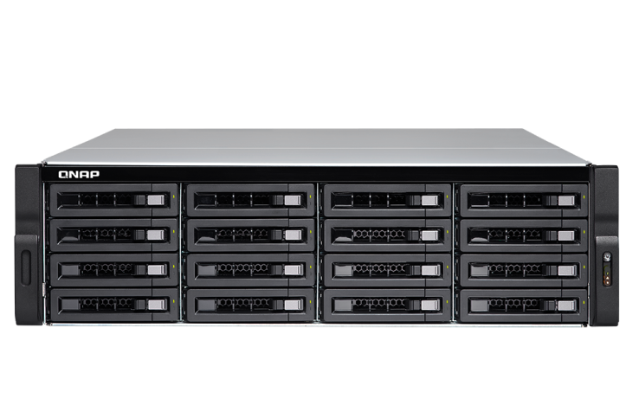
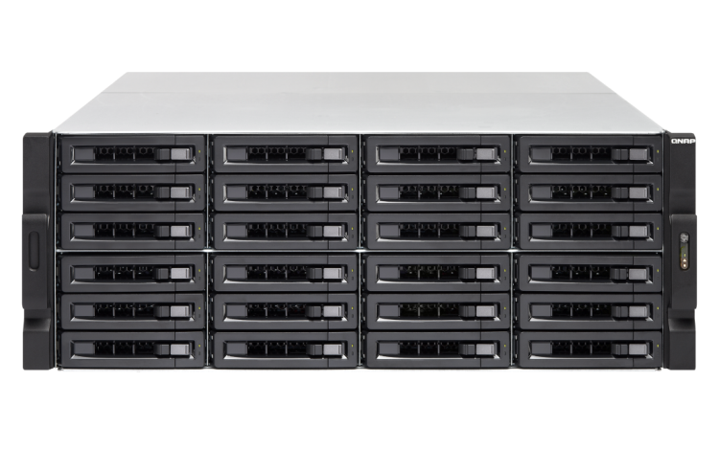

2U/3U TS-x83XU Front View
24/ 16/ 12/ 8 x 3.5”SATA 6Gb/s HDD/SSD ports
TS-1283XU-RP
TS-883XU / TS-883XU-RP
TS-2483XU-RP
TS-1683XU-RP
Notes:
白手起家款

Slide 17


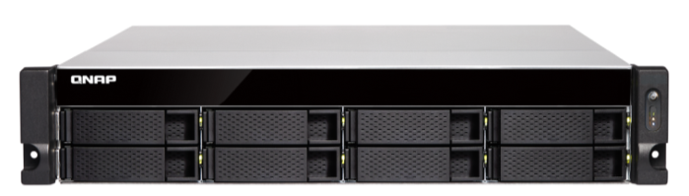

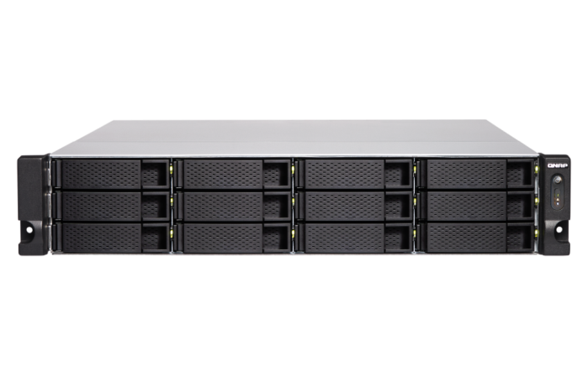
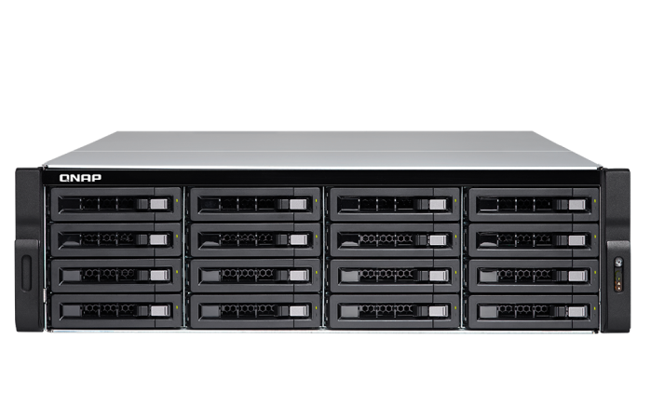

2U/3U/4U TS-x83XU Front View
2U
Power switch
LED indicators: system status, network, external expansion enclosures, disks
4U
3U
Notes:
白手起家款
2U/3U

Slide 18
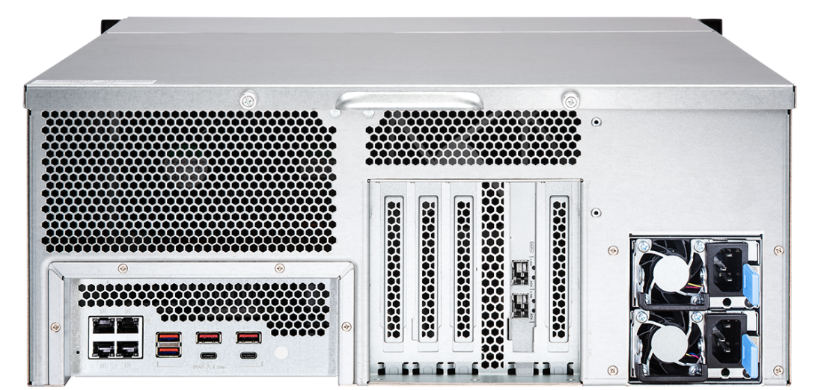

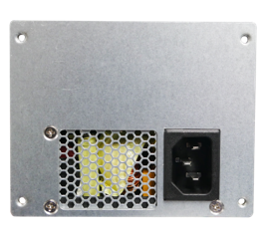

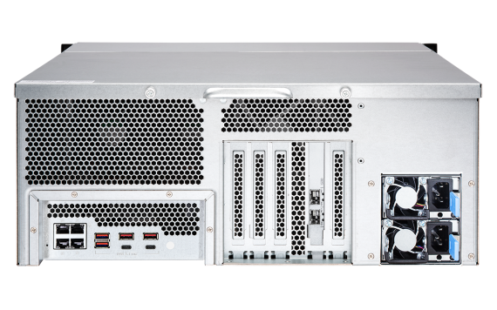
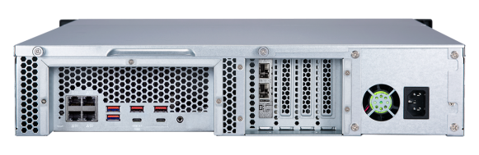
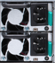
2U/3U/4U TS-x83XU Rear View
4 x 1Gb ports
2 x 10Gb SFP+ SmartNIC ports
Single PSU
Redundant
PSU
USB 3.1 Gen2 (10G) Type-A & Type-C port
8-bay
12-bay
Single PSU
24-bay
Redundant PSU
Redundant PSU

Slide 19





Industry-leading PCIe expansion options
QM2 provides 10GBASE-T port and/or M.2 SSD slots for SSD cache or Qtier tiered storage for optimized storage performance.
40GbE/10GbE and wireless network expansion cards
provide high bandwidth, low latency, or wireless AP functionality.
USB 3.1 Gen 2 expansion cards provide 10Gb/s for external USB devices．Type-A port is also backward compatible with USB 3.0/2.0 devices.
SAS expansion card is for adding support of REXP expansion units for up to 40 additional SAS/SATA drives.

Slide 20
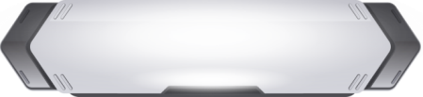
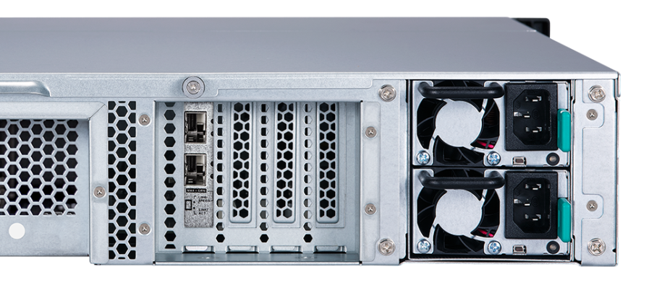
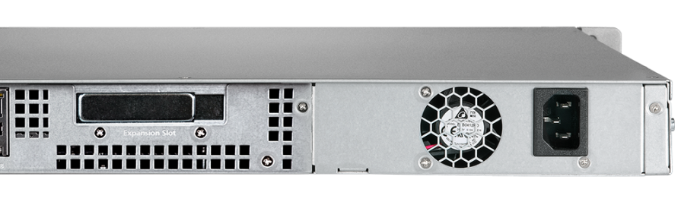
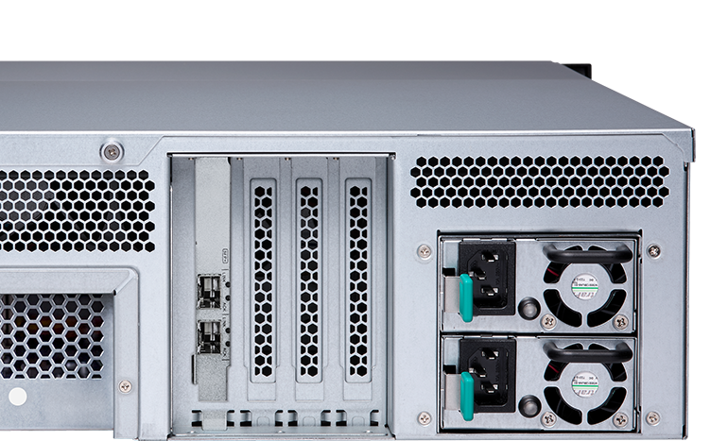

TS-x83XU PCIe Slots
1U/2U: low profile
4
3
2
1
1
3U/4U: full height
4
3
2
1
5
4
3
2
1
Notes:
這頁需要

Slide 21


PCIe Slot Specifications (2U/3U)
PCIe 3.0
PCIe x8
(CPU)
PCIe x4
(CPU)
PCIe x4
(CPU)
PCIe x4
(PCH)
#4
#3
#2
#1

Slide 22

PCIe Slot Specifications (4U)
PCIe 3.0
PCIe x8
(CPU)
PCIe x4
(CPU)
PCIe x4
(PCH)
PCIe x4
(PCH)
PCIe x4
(PCH)
#5
#4
#3
#2
#1

Slide 23

GPU card slots and supported dimensions
NAS | Slot | Dimension W x H x L (mm)
TS-983XU TS-983XU-RP | Slot 1 | 19 x 68.9 x 257
TS-883XU TS-883XU-RP | Slot 2 | 37 x 68.9 x 214
 | Slot 4 | 37 x 68.9 x 214
TS-1283XU-RP | Slot 2 | 37 x 68.9 x 214
 | Slot 4 | 37 x 68.9 x 214
TS-1683XU-RP | Slot 2 | 38.5 x 111 x 214
 | Slot 4 | 38.5 x 111 x 214
TS-2483XU-RP | Slot 2 | 55 x 138 x 312
 | Slot 4 | 55 x 138 x 312
W
H
L

Slide 24
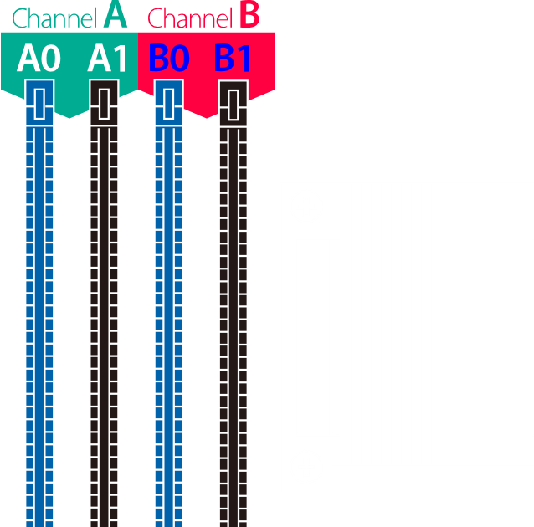
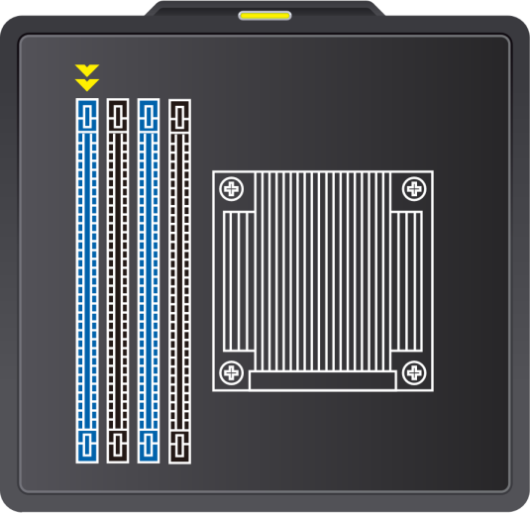

Supports up to 64 GB Memory
Supports Dual-channel and Long-DIMM x4
Installing memory in pair to take advantage of dual-channel
One module
Tow module
Install in A0 slot
Install in A0 and B0 slots

Slide 25
TS-x83XU Memory Accessories
Ordering P/N | Specification
RAM-4GDR4ECA0-UD-2666 | DDR type: ECC DDR4(288PIN) Capacity: 4GB Manufacturer: Apacer Frequency: DDR4-2666 Manufacturer P/N: 78.B1GSB.4050B
RAM-8GDR4ECA0-UD-2666 | DDR type: ECC DDR4(288PIN) Capacity: 8GB Manufacturer: Apacer Frequency: DDR4-2666 Manufacturer P/N: 78.C1GSC.4050B
RAM-16GDR4ECA0-UD-2666 | DDR type: ECC DDR4(288PIN) Capacity: 16GB Manufacturer: Apacer Frequency: DDR4-2666 Manufacturer P/N: 78.D1GSC.4010B

Slide 26

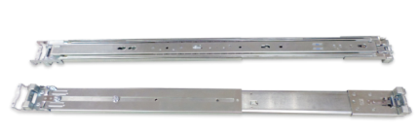

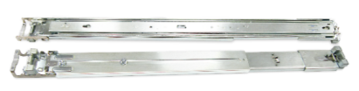
Tool-less Rail Kit
RAIL-B02
RAIL-A03-57
RAIL-A02-90
Supported NAS:
TS-883XU/1283XU
Max. Load: 20kg
Supported NAS:
TS-1683XU
Max. Load:57kg
Supported NAS:
TS-2483XU
Max. Load: 90kg

Slide 27

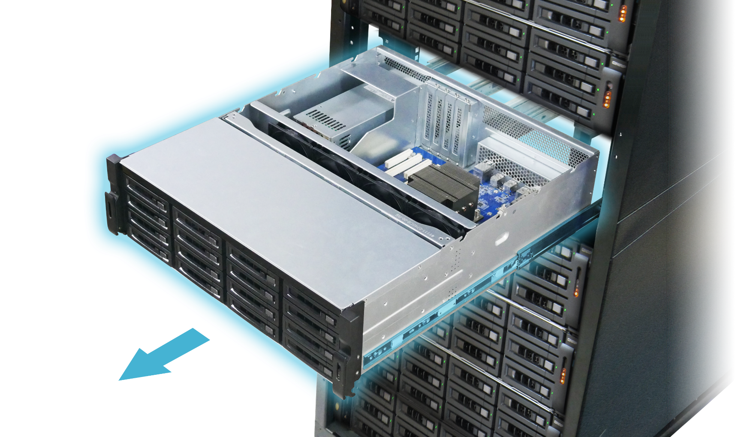
Hardware upgrade made easy
Pull it out and lift
up the cover

Slide 28

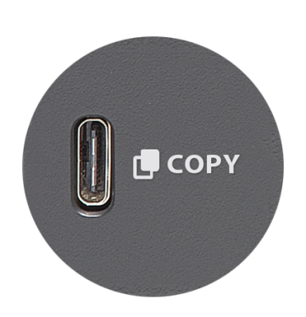
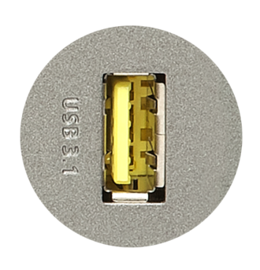
More Efficient Backup with USB 3.1 Gen 2
2X
USB 3.0
TYPE-C
SPEED UP
10Gb/s
TYPE-A
5Gb/s
USB 3.0
USB 3.1
Notes:
Type-A是紅色的

Slide 29
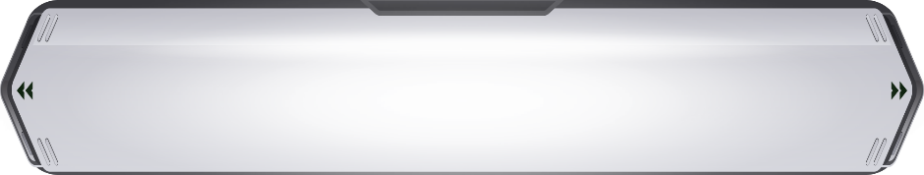



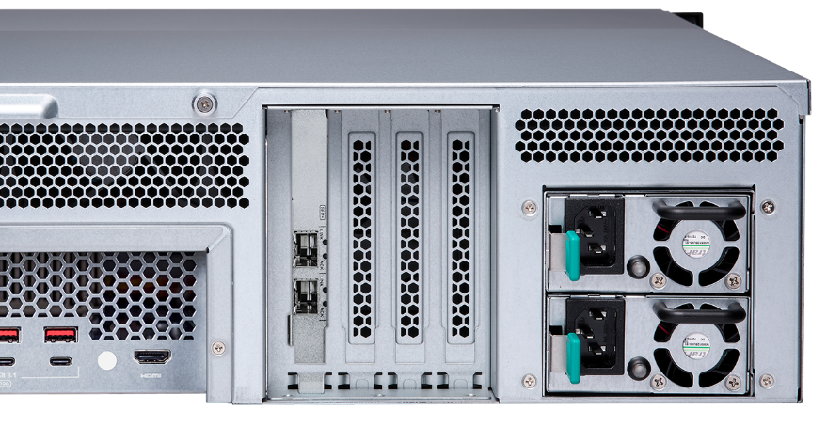

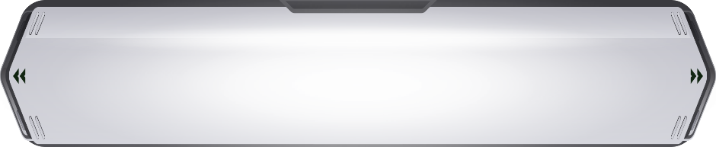
Do more with graphics cards
Support full-high GPU card which required external power
3U/4U NAS 500W+ power supply
QuAI
TS-1683XU-RP
Support half-height GPU cards that require no external power: NVIDIA GT1030, etc.
2U NAS 350W/300W power supply

Slide 30



Add-on GPU Card Applications
QTS
Transcoding Acceleration
Virtualization Station
GPU Passthrough
AI
Computing Acceleration

Slide 31








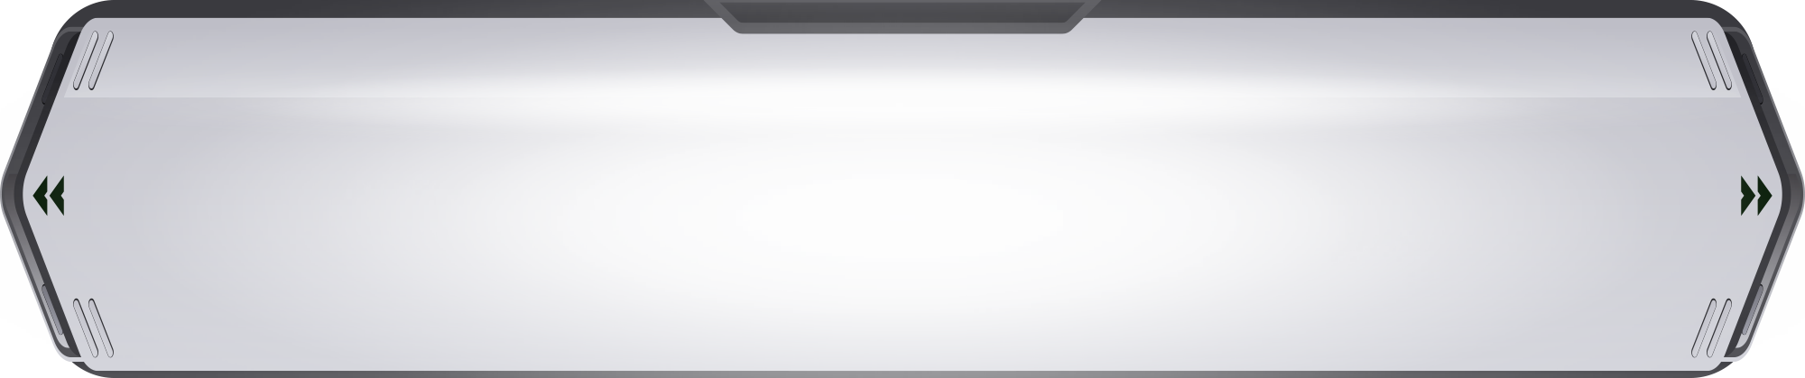
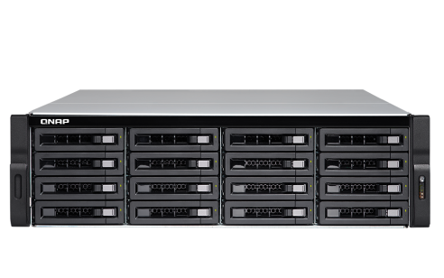

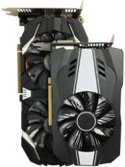
Ride the AI wave with "QuAI"
QNAP QuAI
AI Developer Package
QuAI is intended for data scientists and developers to quickly build, train,
and optimize their AI models on QNAP NAS.
+
+
=
AI
QNAP NAS
GPU accelerated
computing
QuAI

Slide 32



Smooth Video Experience
Virtualization Station
HybridDesk Station, Linux Station
QVR Pro Client (HD Station)
Video Station
Plex Media Server

Slide 33
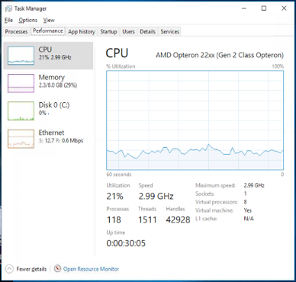
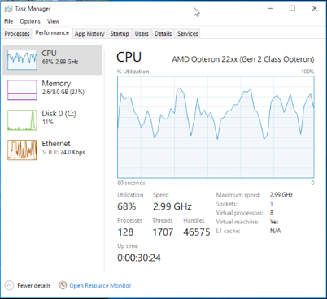
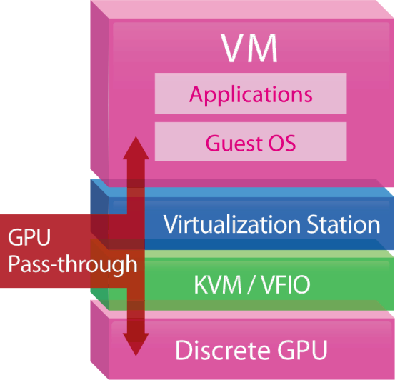


GPU boosts image/video processing
For OpenGL & DirectX applications
H/W accelerated with GPU to lower CPU usage.
w/ GPU
w/o GPU

Slide 34





Super high capacity surveillance
Surveillance Station 5.1
Default: 8 free channels
Max: 80 Ch. (optional license)
QVR Pro
Default: 8 free channels
Max: 128 Ch. (optional license)
QUSBCam2
Up to 1080p USB Webcam recording

Slide 35



10/25/40 GbE SmartNIC with offload function
Buit-in Mellanox ConnectX-4 Lx 10GbE SmartNIC
Supports 25/40GbE expansion
Supports iSER
Notes:
更新筆記: "內建" 與 Mellanox 間加一空格 (By Teresa)

Slide 36
Offload tasks from CPU with iSER
iSER allows data to bypass general network drivers, the socket layer, and to directly enter memory buffers of the server and storage.
Increasing performance, lower CPU loading
Without iSER
With iSER

Slide 37
iSER makes VMware Faster
When VMware Server and NAS are iSER ready:
  Random read/write performance is 60% higher than iSCSI
  Latency is 50% lower than iSCSI

Slide 38

Built-in dual 10GbE SFP+ ports
10GbE x 2 (Throughput)
2500
2000
2358
2286
1500
0
Read
Write
(MB/s)
Tested in QNAP Labs. Figures may vary by environments.
Test environment:
NAS: TS-1283XU-RP-E2124-4G with QTS 4.3.5
Volume type: RAID 5; 16 x Intel S3500 240GB SSDs (SSDSC2BB240G4)

Slide 39




QTS & virtualization increase productivity
QTS 4.3.5
Storage & Snapshot Manager, and new virtualization network functions
Supports Windows/Linux VMs and containers
Virtualization
Station
Container
Station

Slide 40
Release full potentials of SSD
SSD Over-provisioning, Snapshot Remote Restore

Slide 41





SSD Usage In Network Attach Storage
SSD can provide high random IOPS for multi-clients sync and business applications that can not be achieved by HDD.
In 2018, SSD price also comes close to the sweet spot.
Besides choosing the right SSD, you should also choose right NAS!
SanDisk evaluate the
256 GB SSD per GB price in 2018 is only 30% compare to 2013
Drive Type | Sequential Access (MB/s) | Random Access (IOPS)
HDD | 100 | 350
SSD | 300 | 60000
https://www.sandisk.com/business/datacenter/resources/white-papers/the-ssd-enabled-pc-total-cost-of-ownership
SanDisk‘s Statistic for Global SSD/HDD Price Trend

Slide 42
QNAP SSD Global Cache and Qtier
IT manager can have different SSD configurations with TS-x77XU
For real-time performance boost, deploy SSD Global Cache or All flash storage
For continued data tiering between hot and cold data, deploy the Hybrid Storage Qtier™ Auto Tiering
SSD Cache let all data enter cache and read
hot data from the storage in real time
Qtier utilizes SSD space and let data block be reallocated based on hot or cold in the storage
SSD Cache
Volume
Block-based LUN
Volume
Block-based LUN
Qtier Pool SSD Tier
Qtier Pool HDD Tier
Storage Pool
SSD
SSD
HDD
HDD
HDD
HDD
HDD
HDD

Slide 43


Different SSD has Different Performance!
SSD Write amplification cause performance degradation
In QNAP Lab, engineer use FIO to test different SSD, and all SSD have showed consisted write performance degrade.
Different SSD's controller and Garbage Collection Algorithm will effect the long term performance
Different SSD in QNAP NAS’s FIO consisted performance (IOpattern: RW-4K):
How can storage vendors help to ensure SSD has expected performance?
Notes:
43

Slide 44


What is SSD Over-provisioning
SSD Over-provisioning reserves space in the SSD to decrease write amplification & increase consisted performance and endurance.
Reason: to avoid Garbage Collection in any giving point of time
N | New D
D | Valid D
 | Invalid D
 | OP
 | OP
N | N
N | N
N | N
With limited OP, 4 additional write is needed. With more OP the movement is not required.
D | D
D | D
D
D
D | D
D | D
D | D
D | D
N | N
N | N
N | N
6 pages of new data cannot all be stored to the SSD
Unless the SSD conduct GC internally first
With more reserved block, the GC is not required
Notes:
44

Slide 45


The Advantage of Software-defined SSD Extra Over-provisioning
With QTS, user can assign more OP to the SSD RAID.
At QNAP Lab, the effect of over-provisioning can not only be observed on single consumer-level Samsung 850 Pro to gain the performance same as data center SSD, but also be seem on SSDs as a RAID.
2*Micron M1100 RAID 1 Random Write IOPS with Dynamic OP
Above: Samsung 850 Pro as Single Disk
Below: Micron M1100 as RAID 1
FIO configuration: runtime=1800 ioengine=libaio direct=1 rw=randwrite bs=4k numjobs=1 iodepth=32
Notes:
45

Slide 46


Choose SSD is Hard, Choose QNAP is Simple
IT managers' biggest challenges in deploying SSD is to measure the SSD performance and how it can solve storage bottleneck.
With QNAP SSD Profiling Tool, users can not only set OP, but further test SSD RAID performance with different OP amount.
IT managers can decide the best practice directly on production site
Notes:
46
73652517

Slide 47

QNAP Global SSD Cache
The QNAP SSD Cache can be applied to multiple volume / LUN
Read-Only ➔Copy frequently used data to SSD
Read-Write ➔Not only copy data, new data can also be temporarily stored in SSD
(New) Write-Only ➔ Only new data will be written into the cache
Cache Type
How Read-write Cache work:
Data from clients and storage will both be cached
Write
Write
Read
Read
SSD
IO Intensive
Application
When SSD Space not enough
HDD

Slide 48


The Write-only Cache Increase ROI of
SSD Cache with high Writing Demand
Write-only cache is promoted by Microsoft
for endurance control.
QNAP believe Write-only Cache can increase the ROI of purchasing SSD in below scenario:
Writes
are cached
Reads
are NOT
File Server focusing on write operations
Database with more write operation (Such as IOT monitoring server)
Use high endurance SSD (Intel Optane™) with other SSD
NVMe
NVMe
SSD
SSD
SSD
SSD
https://docs.microsoft.com/en-us/windows-server/storage/storage-spaces/understand-the-cache
Notes:
48

Slide 49

Qtier (Auto-Tiering) Increase Capacity and
Performance at the Same Time
Beside SSD Cache,
Qtier™ can migrate
data between SSD and
HDD directly
SSD capacity can be
utilized with limited
memory requirement.
Hot Data
Before Tiering
Data place not optimized
Warm Data
Cold Data
Access Pattern Change
Start Tiering
Qtier
Engine
After Tiering
Performance optimized
Notes:
49
93325809

Slide 50
Qtier 2.0 IO Aware tiering for real time performance boost
Beside tiering on
schedule, Qtier now
can simulate SSD
Cache behavior
It can utilize SSD
capacity while boost
performance in real
Time thus increase SSD
ROI
Data
Blank
C、D data block be written to HDD due to SSD full
D data block be promoted as access frequency increase
A
B
A
B
D
SSD Tier
SSD Tier
C
D
C
HDD Tier
HDD Tier
Block | Hit
C | 50
D | 50
Block | Hit
C | 50
D | 200
Notes:
50
93325809

Slide 51
TS-x83XU SSD Multiple Configurations
In addition to acting as a backup server, SSD Over-provisioning, Global Cache and Qtier let TS-x83XU be deployed as production server
Scenario | File Server | Web, Application, Virtualization Server | Synchroni-zation, Vi-deo Editing | Surveillance, Backup, Log Server | Business-Critical Database
SSD Config | Qtier™ | Qtier™ | Read-Write Cache | Write-Only Cache | SSD RAID
SSD RAID | RAID 6 | RAID 10 | RAID 5 | RAID 10 | RAID 10
SSD OP | 10% | 20% | 20% | 30% | 30%
With 5 x 2.5”
SATA 6Gb/s SSD
1U Rackmount can
use SSD too!
Notes:
51

Slide 52


Businesses need lower RTO
In the survey of 300 Enterprises and SMBs at Taiwan:
60% has used Remote Replication as Backup Plan.
50% of businesses expected the recovering time should be within 1 Hour.
But also 50% of businesses experience actual recovering exceed 1 Day!
Can businesses only manually transfer data back from the remote end when disaster happen?
Data Backup Time
Disaster Happen
Server Online
TIME
Recover Point Objective
Recover Time
Objective
Taiwan IThome survey 2017
Notes:
52
39094200

Slide 53



Restore From Remote Snapshot Vault
The Snapshot Manager is now actively connected to Snapshot Vault
Support monitor and restore selected folders and files from the source NAS directly!
Both the source and destination NAS must be upgraded to 4.3.5 to support this function
Notes:
53

Slide 54





Drastically Reduce Recover Time
With 10GbE Network
The Remote Snapshot Vault Recovering is based on Ethernet service.
Using 1GbE network, recovering large data still takes hours.
Pair the Snapshot Replica Solution with 10GbE or even faster interfaces to increase both the backup and recovery speed !
Using QNAP 10GbE Switch to replace old 1GbE for reducing RTO dramatically
Notes:
54

Slide 55






The Forth Way: Snapshot Export / Import
Export a snapshot from snapshot manager or snapshot vault
Using external storage device, the exported imaged can be imported to another NAS to create new volume or LUN
The same image can also be used to revert source volume or LUN
When network speed is limited, user can still import snapshots for reverting
Snapshot
Reverting
Notes:
36588464

Slide 56


With QTS 4.3.5 Power of Storage:
Software-defined SSD Extra OP
Measure & set unique over-provisioning
amount on the NAS
01
SSD Global Cache & Qtier™
Using Cache or Auto Tiering to maximum SSD ROI
02
Remote Snapshot Restore
Using 10GbE network to reduce RTO
03
Notes:
36588464

Slide 57


is your best choice!
Copyright© 2018 QNAP Systems, Inc. All rights reserved. QNAP® and other names of QNAP Products are proprietary marks or registered trademarks of QNAP Systems, Inc. Other products and company names mentioned herein are trademarks of their respective holders.
©2018著作權為威聯通科技股份有限公司所有。威聯通科技並保留所有權利。威聯通科技股份有限公司所使用或註冊之商標或標章。檔案中所提及之產品及公司名稱可能為其他公司所有之商標 。

