Slide 1
Notes:
Add 10GBASE-T, 畫面要有速度感

Slide 2
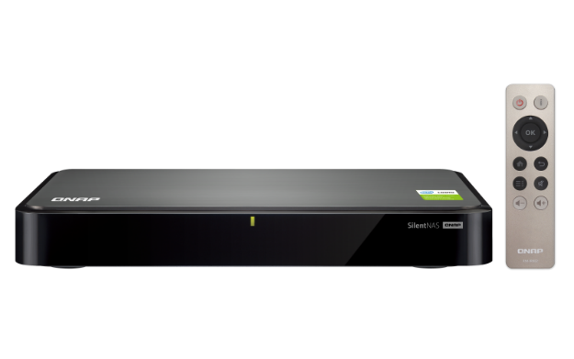

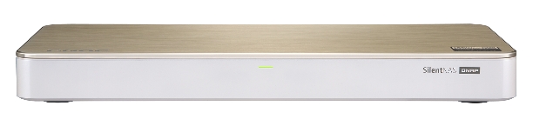




SilentNAS family w/ 0 dB & high performance
Quad-core Intel Celeron J1900
2 GB DDR3L RAM (not expandable)
1080p HDMI output and transcoding
2 x 1GbE LAN ports
2 x SATA 3Gb/s HDD ports
Quad-core Intel Celeron J4105
4 GB/8 GB DDR4 RAM (expandable to 8 GB)
4K HDMI output and transcoding
1 x 10GbE LAN (10G/5G/2.5G/1G) +
1 x 1GbE LAN port
2 x SATA 6Gb/s HDD ports +
2 x M.2 SATA 2280 6Gb/s SSD slots
HS-251+
HS-453DX
*The noise level will vary based on the drive used.

Slide 3
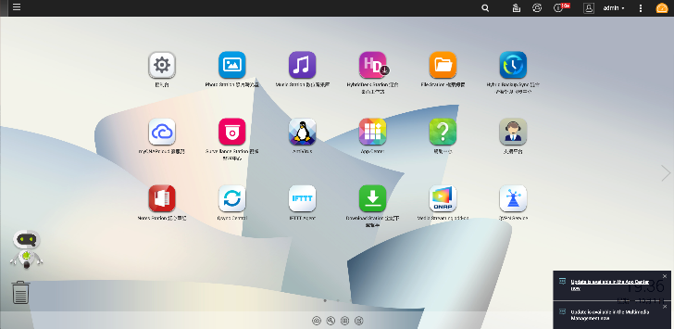
QTS 4.4.0 w/ Linux kernel version 4.14
Ships with QTS 4.4.0 and the newer LTS(Long Term Support) Linux kernel 4.14
Graphics drivers
    Gemini Lake (QNAP HS-453DX)
    Coffee Lake (QNAP TVS-472XT,
    TVS-672XT, TVS-873XT)
Major advantages of 4.14 over 4.2
    Scalability & performance
    improvements for ext4

Slide 4
Intel 4C J4105 Gemini Lake SoC
4 cores
4 threads
2.5GHz
Burst
J4105
Gemini Lake SoC
14nm
Power saving
AES-NI encryption
Volume & folder support
GPU up to 750 MHz
UHD Graphics 600
1.5GHz
Base
10 watt
TDP

Slide 5
DDR4 2400 MHz SO-DIMM memory
Available models:
HS-453DX-8G:
2 x 4GB
HS-453DX-4G:
2 x 2GB
HS-453DX
2 x SO-DIMM
DDR4-2400
Dual-channel
HS-251+
DDR3L-1333

Slide 6
HDMI 4K 60fps fluid motions
Notes:
支持新一代HDMI 4K @60Hz影像输出规格，动态分辨率更高，人物在高速移动之下的动态表现看起来便更加流畅、无残影，享受让你耳目一新的的高清影像。

Slide 7
Dual HDMI ports for optimal quality
TV
Video
Amplifier
Audio

Slide 8
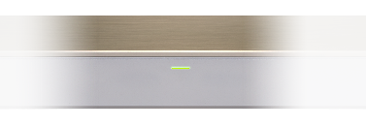
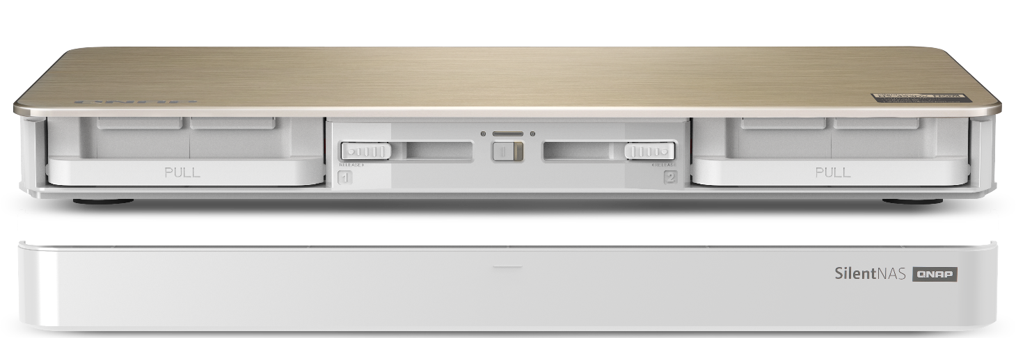
NAS front view and configurations
Status LED
HDD LED
HDD LED
*Minimalist, non- intrusive design
Left tray latch
Right tray latch
Power button
IR receiver
Magnetic front cover
Notes:
需要有一個前蓋合上的圖. Show 前蓋的 LED. 可以把下面的圖去掉, 只留前蓋說明可拆

Slide 9
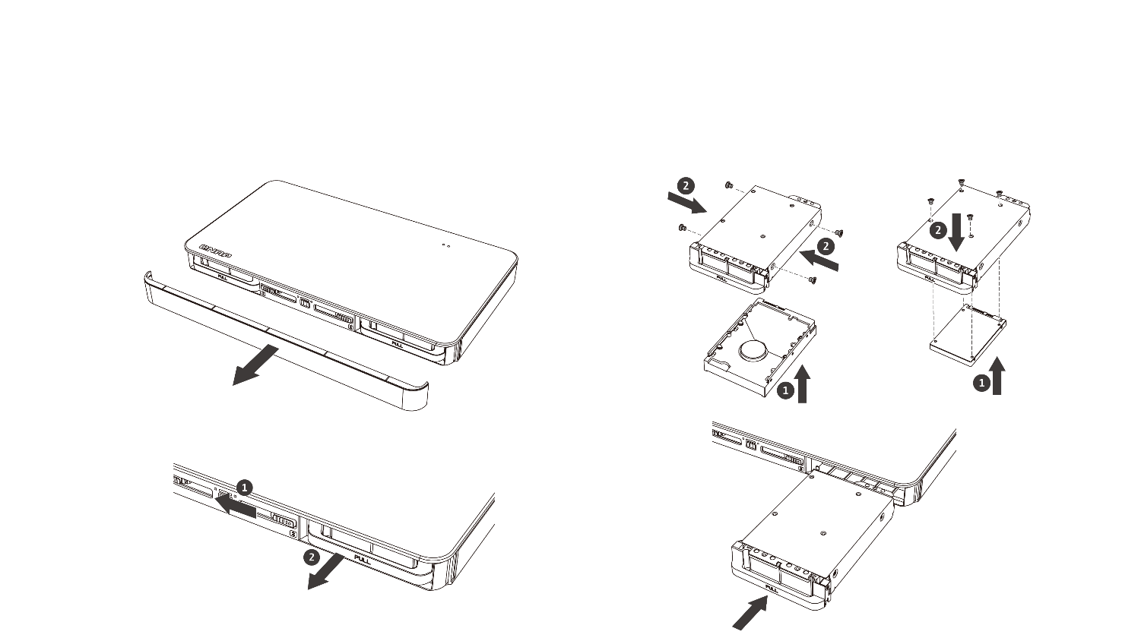

Hot-swappable 3.5”/2.5” HDD/SSD
3.5-inch HDD
2.5-inch HDD / SSD
1.
3.
2.
4.
Notes:
拆前蓋
拔出 HDD tray
Show 3.5” & 2.5” 安裝方式
QIG 有線稿

Slide 10


Reduce the heat in a hot environment
Keep it ventilated
Pick 5400/5900 RPM drives
No object on top
2.5”
3.5”
Notes:
放 3.5" HDD & 2.5" HDD 的圖各一張代表.
線稿 ok

Slide 11
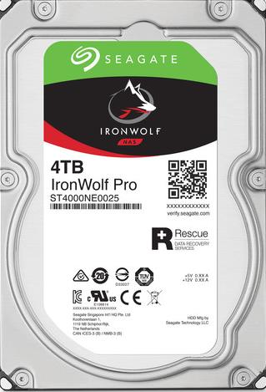
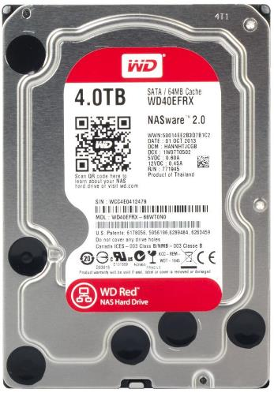
The best match 24x7 NAS HDDs
Quiet
Lower power
Lower temp

Slide 12
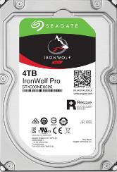
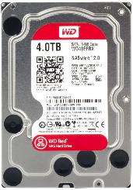
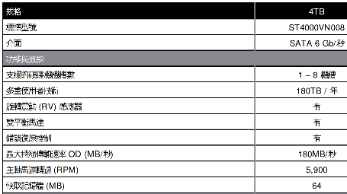
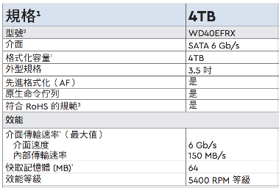
How to pick the right drives
Specifications | 4TB
Standard Model Numbers | ST4000VN008
Interface | SATA 6Gb/s
Features and Performance
Drive Bay Supported | 1-8 Bays
Multi-User Technology | 180TB/year
Rotational Vibration (RV) Sensor | Yes
Dual-Plane Balance | Yes
Error Recovery Control | Yes
Max. Sustained Transfer Rate OD (MB/s) | 180MB/s
Spindle Speed (RPM) | 5900
Cache (MB) | 64
Specifications | 4TB
Model Number | WD40EFRX
Interface | SATA 6Gb/s
Formatted Capacity | 4 TB
Form Factor | 3.5”
Advanced Format (AF) | Yes
Native command queuing | Yes
RoHS compliant | Yes
Performance
Interface transfer rate (max) Interface speed Internal transfer rate | 6 Gb/s 150 MB/s
Cache (MB) | 64
Performance Class | 5400 PRM Class
Source: 2018/10/01 www.Seagate.com & www.wdc.com

Slide 13
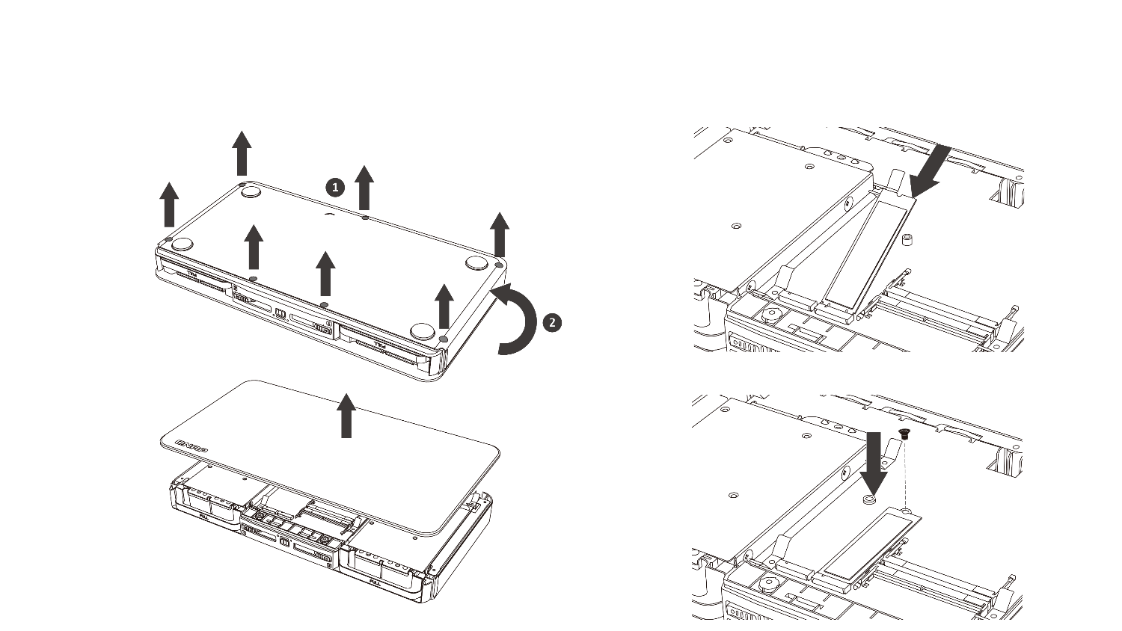
Easy to install M.2 SATA SSDs
1.
3.
2.
4.
Notes:
拆底部螺絲 (QIG 有線稿)
Show M.2 SSD & RAM

Slide 14
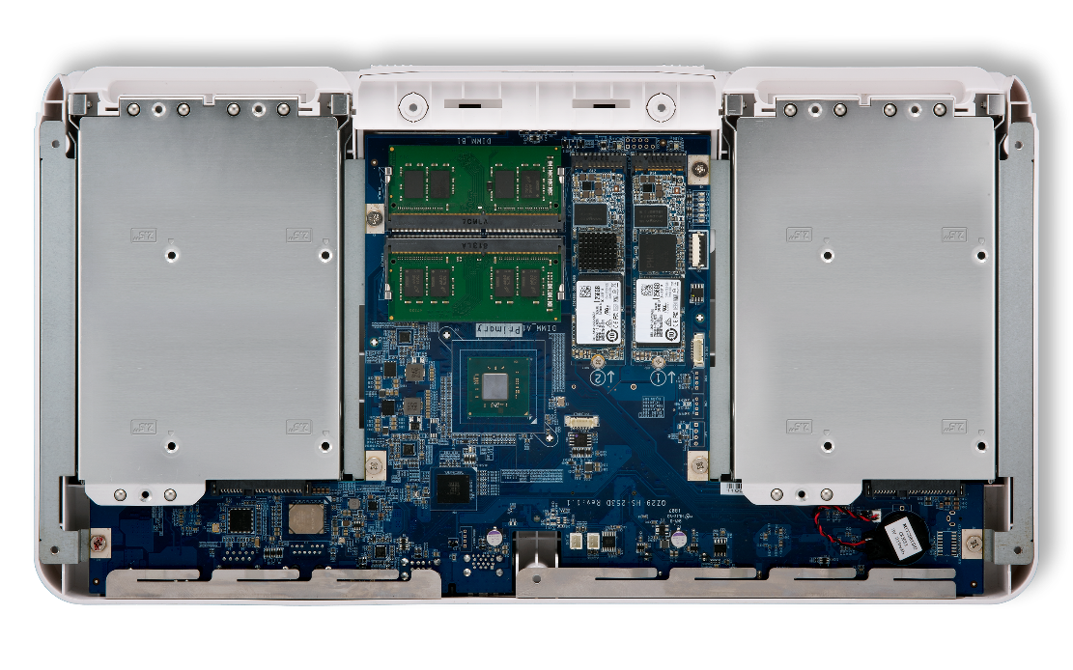
Dual HDDs & dual M.2 SATA SSDs
2 x DDR4-2400 SODIMM slot (max 2 x 4 GB)
2 x M.2 SATA 2280 6Gb/s SSD slots
2 x 3.5"/2.5" HDD/SSD ports

Slide 15
All solid capacitors for longevity!
Japan-quality conductive polymer aluminum solid capacitors and over-current protection for high reliability and longevity.
Notes:
日系電容
SANYO
PANASONIC
NIPPON CHEMI-CON

Slide 16

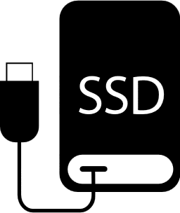



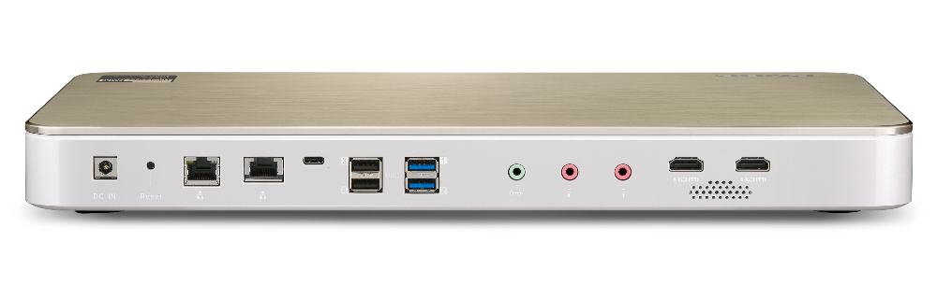



USB Type-C & Type-A hyper connectivity
1 x USB 3.0 Type-C
2 x USB 3.0 Type-A
2 x USB 2.0 Type-A
Icons: USB-C 隨身 SSD/隨身碟
Icons: 外接硬碟, 隨身碟, iphone 手機
Icons: UPS, keyboard, mouse

Slide 17
Live Demo
Upgrade memory
Install M.2 SATA SSD

Slide 18

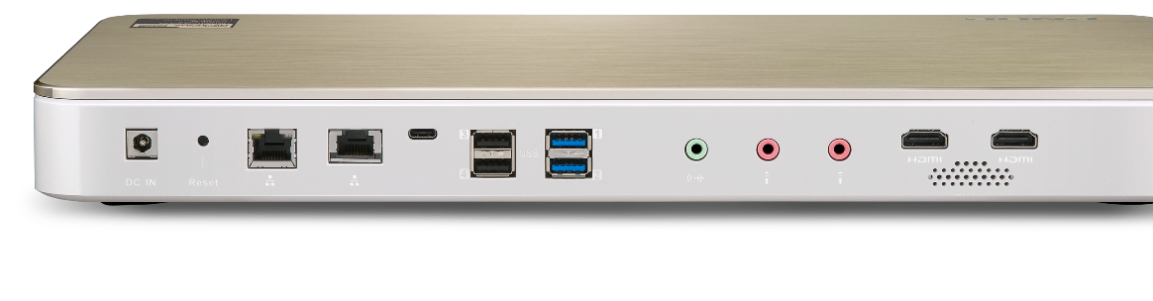
10G/5G/2.5G/1G LAN speeds
Save cost with NBASE-T standard
Your existing wiring infrastructure may already support > 1Gbps!
 | CAT 5e | CAT 6 | CAT 6A & CAT 7
1G | ✔ | ✔ | ✔
2.5G | ✔ | ✔ | ✔
5G | ✔ | ✔ | ✔
10G | X |  | ✔
Max 55 meters

Slide 19
Based on Aquantia’s AQC107 10GbE NIC
Aquantia
Investors
Multi-Gig IC
Better compatibility

Slide 20
10GbE performance
700
600
677
676
648
500
520
400
300
200
100
0
(MB/s)
Read
Write
Read
Write
1 x 10GbE
1 x 10GbE
encrypted volume
Environment:HS-453DX: 2 x 2.5" 240GB SSD + 2 x M.2 SSD, RAID 5, QTS 4.4.0, 4GB RAM, thick volume
Client PC: Windows 10 Pro, Intel Core-i7 4770 3.4GHz, 16GB RAM, LAN-10G2T-X550 MTU 9000
Notes:
1 x 10GbE
Windows download: 677 MB/s
Windows upload: 648 MB/s
- 1 x 10GbE encrypted volume
Windows download: 676 MB/s
Windows upload: 520 MB/s

Slide 21

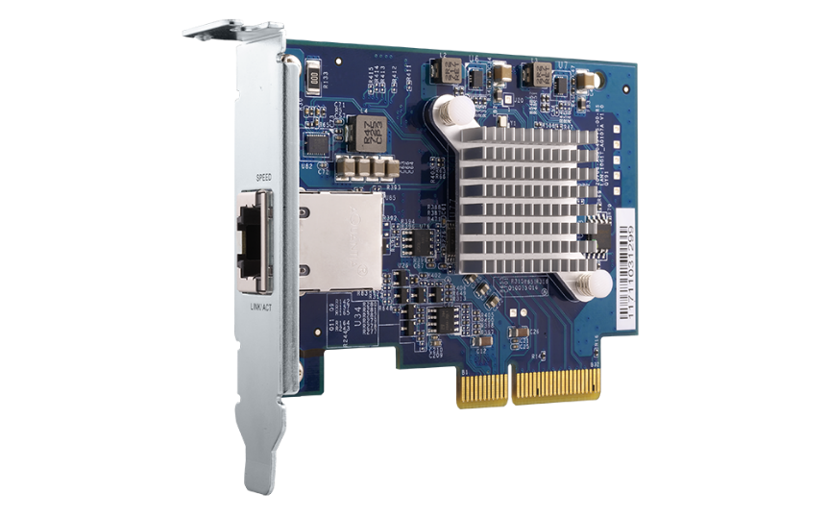

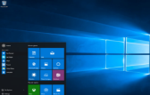


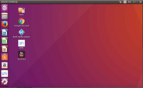
Install a 10GbE adapter to PC
QNAP QXG-10G1T
1-port 10G network adapter
  Windows® 10, 8.1, 8, 7 (32/64 bit)
10G/5G/2.5G/1G/100M
PCIe Gen 3 x4 interface
  Linux 3.2, 3.10, 3.12, 4.2, 及 4.4

Slide 22
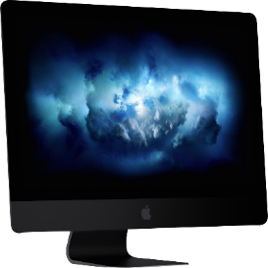

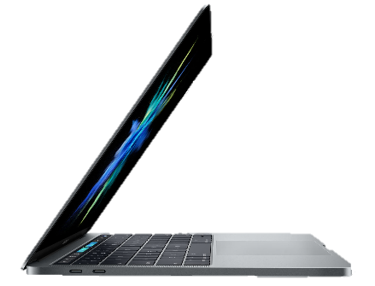
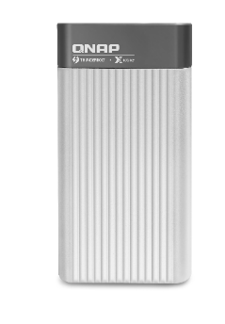
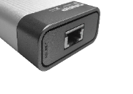
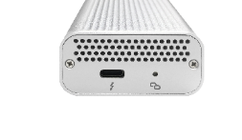
Mac users connect to 10GbE
Mac with Thunderbolt 3 can connect to 10GbE with the QNAP QNA-T310G1T Thunderbolt 3 to 10GBASE-T adapter
2018 iMac Pro
1 NBASE-T port with 10GbE
QNA-T310G1T
NBASE-T
Specs
Controller： AQC107S-B1-C + AQX-N3F10-DRE-U3C
Interfaces：1 x Thunderbolt 3, 1 x 10GbE 10GBASE-T 埠(10G/5G/2.5G/1G)*
LAN cable：CAT 6a/ CAT 7
3.5mm
headphone
USB 3
Thunderbolt 3
(USB-C)
10GbE
Ethernet
SDXC card slot
Ethernet
*Mac with macOS 10.13.3 (or newer) is required.

Slide 23

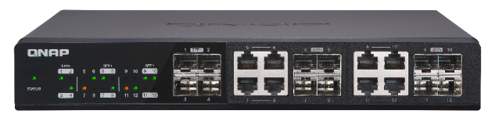
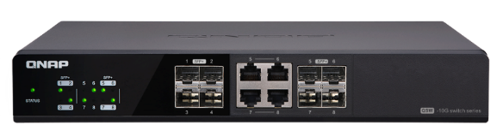
Accessories- 10GbE Network Switch
12
Ports
Up to 12 x
10GbE ports
8
Ports
Up to 8 x
10GbE ports
QSW-1208-8C
QSW-804-4C
12-port 10GbE switch
4 x SFP+ port
8 x RJ45/ SFP+ combo ports
8-port 10GbE switch
4 x SFP+ port
4 x RJ45/ SFP+ combo ports

Slide 24
Live Demo
10GbE performance
& Qtier

Slide 25

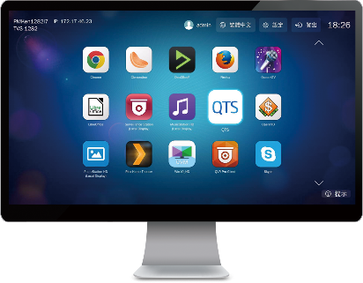


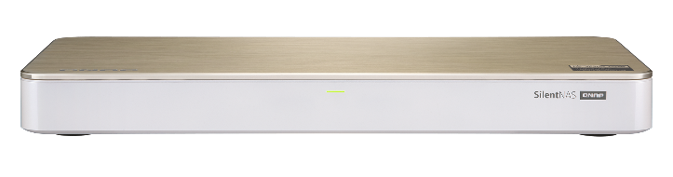

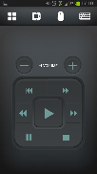
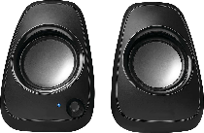
HybridDesk Station for various A/V needs
USB
HDMI
Mouse &
Keyboard
Network
Audio
Qremote App

Slide 26

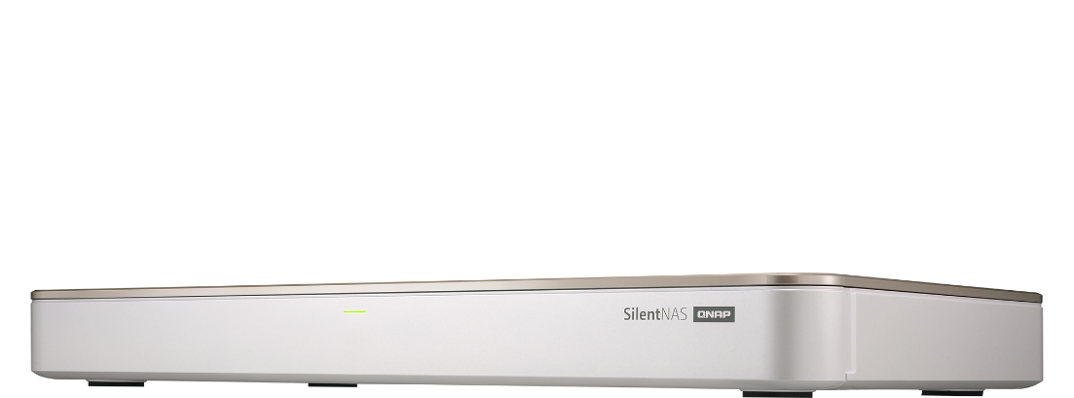

Various HybridDesk Station apps
System Mgmt.
Surveillance
Comm. & Social
QTS
File Station HD
Surveillance Station
QVR Pro Client
Skype
Facebook
Browser & Productivity
Multimedia
Multimedia Mgmt.
HD Player
OceanKTV
YouTube
Clementine
Plex Home Theater
Spotify
TuneIn Radio
Photo Station HD
Video Station HD
Music Station HD
Chrome
Firefox
LibreOffice

Slide 27
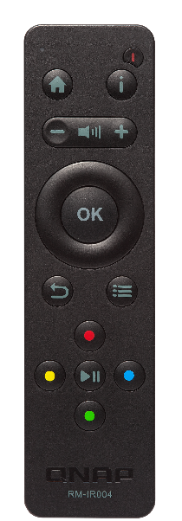




Customize actions of buttons with QButton
QNAP RM-IR004
IR remote control included
Play your favorite music playlist with a single button or set other buttons to play the previous or next song
View pre-selected channels on Surveillance Station for quick surveillance monitoring
Set a button to restart or power off your NAS for greater convenience

Slide 28
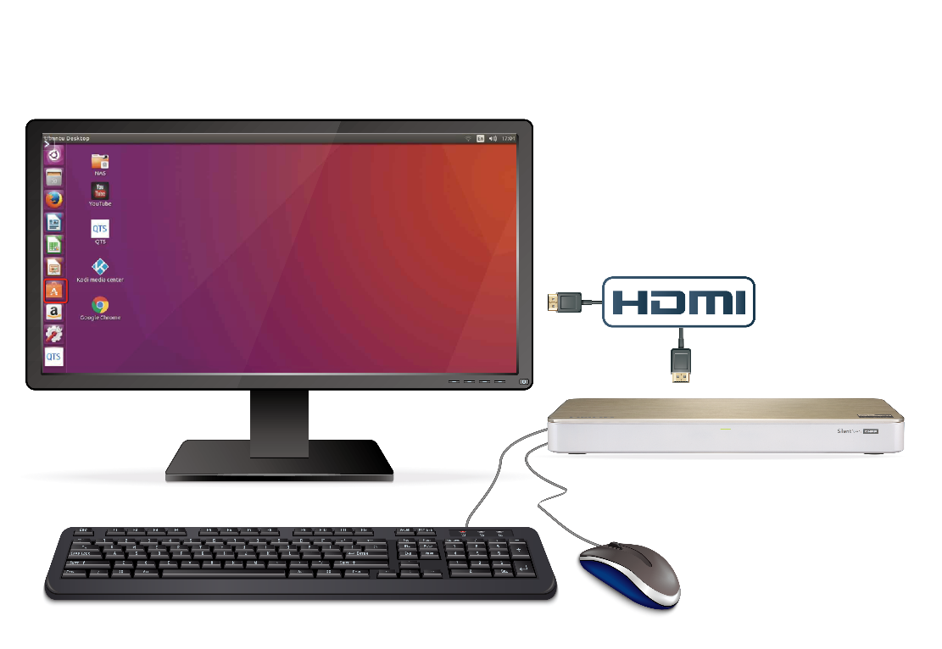

Linux Station turns NAS into a Ubuntu PC
1
HDMI output from NAS to a monitor
Multi-version Ubuntu
Ubuntu 14.04
Ubuntu 16.04
Ubuntu Kylin (Chinese)
2
Connect a USB keyboard and a mouse to the NAS to begin the Ubuntu operation

Slide 29
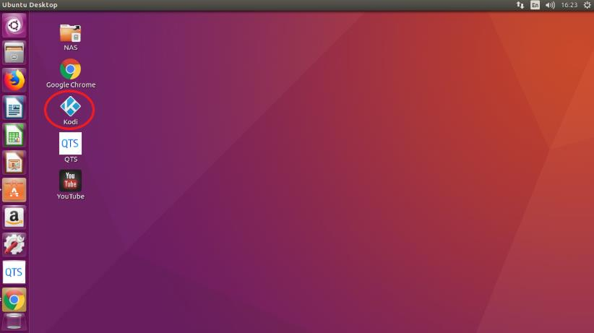

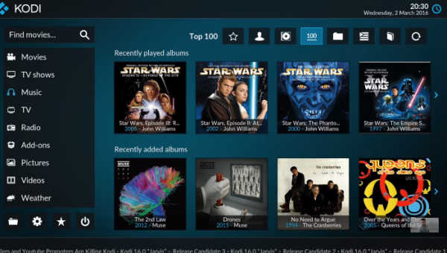



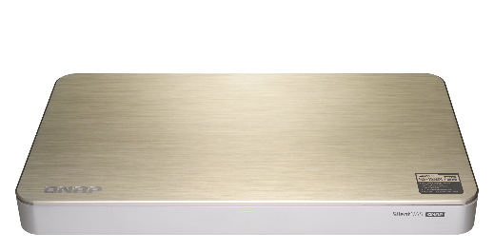





Linux Station + Kodi to play everything
Use Kodi to play contents on NAS
Install ’n use
Video HD
Install Kodi plug-in Video HD
Support the same Video Station functions such as
progress, categorization, subtitle

Slide 30


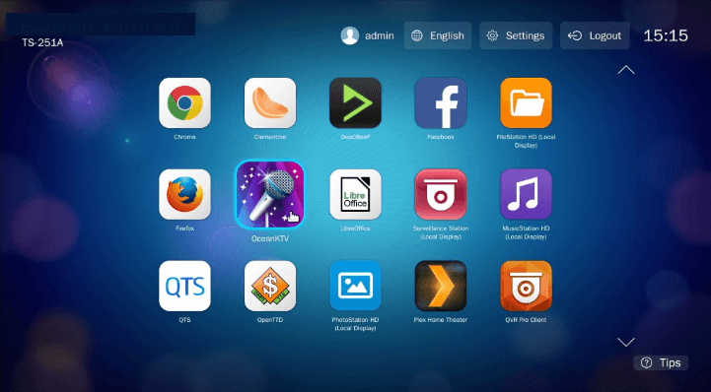
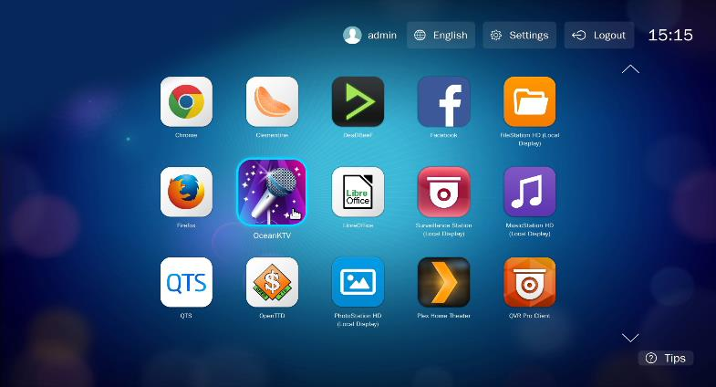
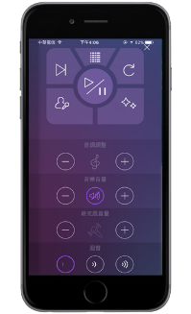
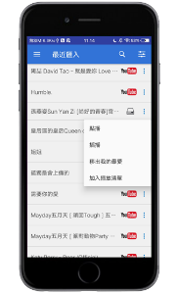
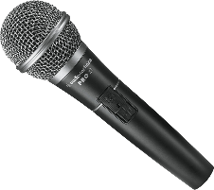

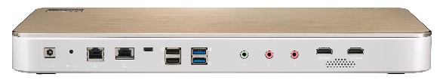
OceanKTV for the home karaoke
Dual dynamic microphone inputs

Slide 31

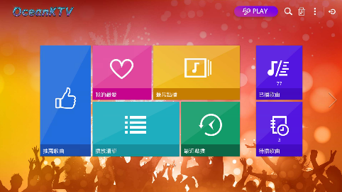
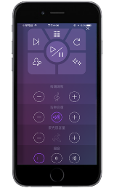


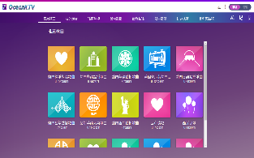
Management & playback in OceanKTV
TV
Mobile
Web
Song library
Singing & YouTube playlist
iOS/Android
remote control
3 ways to play a song

Slide 32





Streaming & accelerated transcoding
4K H.264 decoding & encoding for real-time or offline 4K video transcoding on various client players for smooth playback and support more clients
HDMI output for 4K Ultra HD (3840 x 2160, 60FPS) content
Stream content through DLNA, AirPlay, Chromecast and Plex

Slide 33


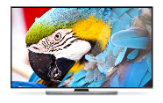





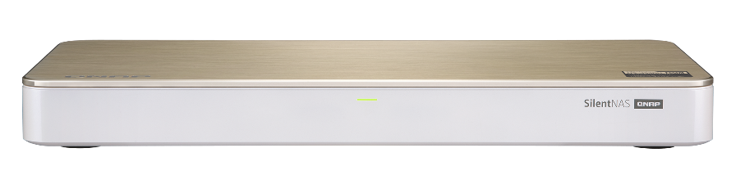

Use PLEX to stream media collections
Stream
Stream
Smart TV
PC
Stream
Phone
Tablet

Slide 34
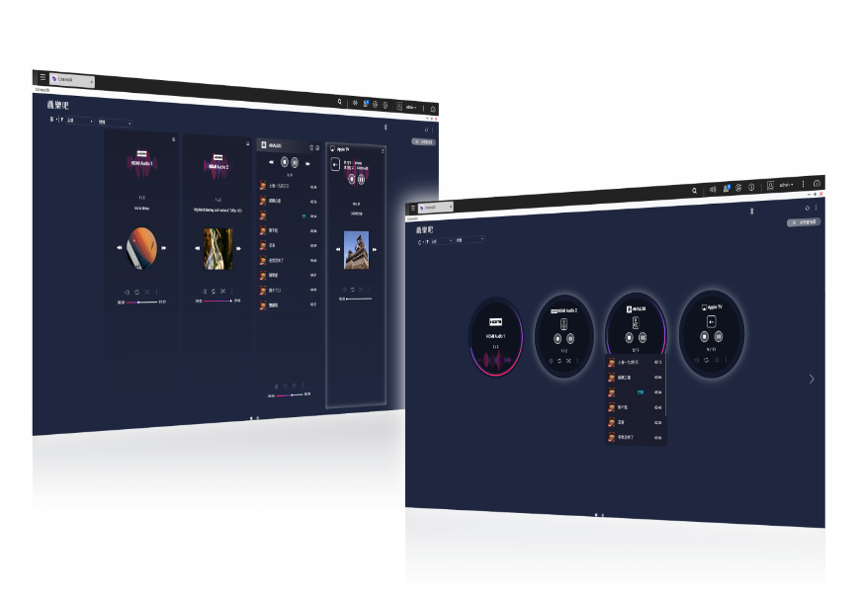







Cinema28 for the whole home streaming
Cinema28 allows for single-interface management of all your media files and can stream files to every connected device throughout your home.
HDMI
(Audio)
Line Out
USB DAC
Bluetooth
HDMI
(HD Player)
Chromecast
DLNA
AirPlay

Slide 35
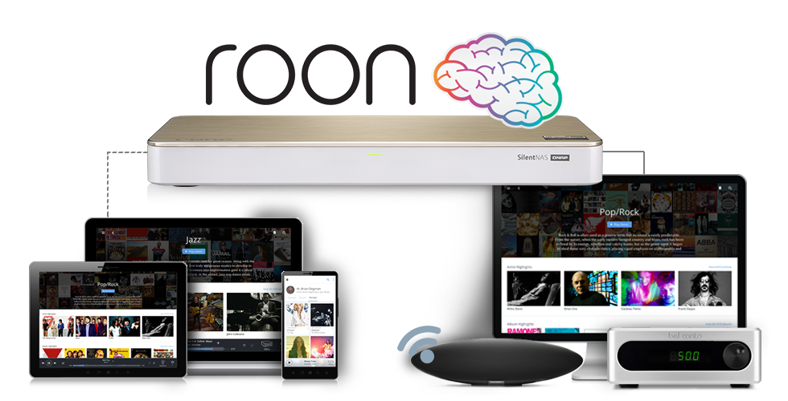
Enjoy Roon without a PC
Two M.2 SATA SSD slots
for higher performance

Slide 36


Different SSD has Different Performance
In QNAP Lab, engineer use FIO to test different SSD, and all SSD have showed consisted write performance degrade.
Different SSD’s controller and Garbage Collection’s Algorithm will effect the long term performance
Different SSD in QNAP NAS’s FIO consisted performance (IOpattern: RW-4K):
How can storage vendors help to ensure SSD has expected performance?

Slide 37

What is SSD Over-Provisioning
SSD Over-provisioning reserves space in the SSD to decrease write amplification & increase consisted performance and endurance.
Reason: to avoid Garbage Collection in any giving point of time
N | N
N | N
N | N
With limited OP, 4 additional write is needed. With more OP the movement is not required.
N | New Data
D | Valid Data
 | Invalid Data
 | OP
 | OP
D | D
D | D
D
D
D | D
D | D
D | D
D | D
N | N
N | N
N | N
6 pages of new data cannot all be stored to the SSD
Unless the SSD conduct GC internally first
With more reserved block, the GC is not required

Slide 38

The Advantage of Software-defined SSD Extra Over-Provisioning
With QTS, users can assign more OP to the SSD RAID.
At QNAP Lab, the effect of over-provisioning can not only be observed on single consumer-level Samsung 850 Pro to gain the performance same as data center SSD, but also be seem on SSDs as a RAID.
Above: Samsung 850 Pro as Single Disk
Below: Micron M1100 as RAID 1
FIO configuration: runtime=1800 ioengine=libaio direct=1 rw=randwrite bs=4k numjobs=1 iodepth=32
Take Intel S4500 as an example, The continuous random write is 30,000

Slide 39


Choosing SSD is hard, choosing QNAP is simple
SSD consisted performance can only be observed after long time of usage
QNAP has provided the unique SSD Profiling Tool to help user measure the performance difference with different over-provisioning amount.
Not just IT manager, home user can also evaluate the capability of SSD.
Using SSD Profiling Tool to identify the best OP amount.
Take Intel S4500 as an example, The continuous random write is 30,000

Slide 40
QNAP SSD Global Cache and Qtier
Two options for users to utilize SSD on HS-453DX with M.2 SSD slots
For real-time performance boost, deploy SSD Global Cache or All flash storage
For continued data tiring between hot and cold data, deploy the Hybrid Storage Qtier™ Auto Tiering
SSD Cache lets all data enter cache and read hot data from the storage in real time
Qtier utilizes SSD space and let data block be
reallocated based on hot or cold in the storage
SSD Global
Volume
Block-based LUN
Volume
Block-based LUN
Qtier SSD Tier
Qtier HDD Tier
Storage pool
SSD
SSD
HDD
HDD
HDD
HDD
HDD
HDD

Slide 41

QNAP Global SSD Cache
On HS-453DX, SSD global cache is for all volumes and LUNs:
Read-Only ➔Copy frequently used data to SSD
Read-Write ➔Not only copy data, new data can also be temporarily stored in SSD
Write-Only ➔ Only new data will be written into the cache
How Read-write Cache work:
Data from clients and storage will both be cached
Write
Write
Read
Read
SSD
IO Intensive
Application
When SSD Space not enough
HDD

Slide 42




Backup or sync data at your choice
macOS
Time Machine
Qsync
Protection against ransomware!
Windows
NetBak Replicator
Qsync
Scheduled or real-time backup/sync

Slide 43



Enterprise-grade snapshot protection
≥
4GBRAM
Snapshot # per NAS
1024
---------------------------------------------------------
Snapshot # Volume / LUN
256
Less space
Less risk!

Slide 44














Backup the NAS data
Hybrid Backup Sync
Remote
Local
Cloud

Slide 45
Notification Center: stay informed at all times

Slide 46




QVR Pro 24/7 surveillance solution
6,000+ IP cameras
8 ch free recording channels
128 ch max channels (license)
QUSBCam2 webcam recording

Slide 47


Expand storage via VJBOD
Max 8 remote NAS
iSCSI
10GbE / 1GbE mount
VJBOD
Use other NAS capacity to expand own capacity via network connection

Slide 48



The QNAP SilentNAS lineup
 | HS-453DX | HS-251+
Processor | Intel Celeron J4105 quad-core 1.5GHz, burst to 2.5GHz (Gemini Lake) | Intel Celeron J1900 quad-core 2.0GHz, burst to 2.42GHz (Baytrail)
Graphics | UHD Graphics 600 | HD Graphics
Encryption acceleration | Yes (AES-NI) | ---
Memory | Max 8GB DDR4-2400 (2 x 4GB SODIMM) | 2GB DDR3L-1333 (non-expandable)
HDD/SSD | 2 x 3.5"/2.5" SATA 6Gb/s | 2 x 3.5"/2.5" SATA 3Gb/s
M.2 SATA SSD | 2 x M.2 2280 SATA 6Gb/s SSD | ---
10GbE network | 1 (10G/5G/2.5G/1G/100M) | ---
HDMI | 4K (1 x HDMI 2.0 + 1 x HDMI v1.4b) | 1080P (1 x HDMI v1.4a)
Speaker | Yes | ---
USB Type-C | Yes (USB 3.0) | ---

Slide 49
HS- 453DX
10GbE SilentNAS
Copyright© 2018 QNAP Systems, Inc. All rights reserved. QNAP® and other names of QNAP Products are proprietary marks or registered trademarks of QNAP Systems, Inc. Other products and company names mentioned herein are trademarks of their respective holders.

