Slide 2


A Faster and Bigger Storage for the 4K Era
Format | Date Rate
HD 1080P (PrRes 422) | 220 Mb/s
4K (PrRes 422) | 880 Mb/s
BlackMagic 4K | 1.4 Gb/s
Canon 4K | 2.3 Gb/s
Phantom Flex 4K | 2.3 Gb/s
Red 4K | 2.4 Gb/s
ARRI Alexa 6K | 6.6 Gb/s
Notes:
修改筆記: 中英文字間加上空格

Slide 3

2018 New iMac Pro
40Gb/s Thunderbolt 3
Four Thunderbolt 3 ports. Supports USB 3.1 Gen 2
and DisplayPort video output over USB-C.
10Gb Ethernet
Also supports NBASE-T industry-standard 1Gb, 2.5Gb, 5Gb, and 10Gb link speeds.

Slide 4


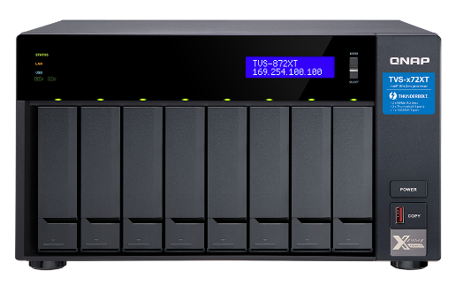

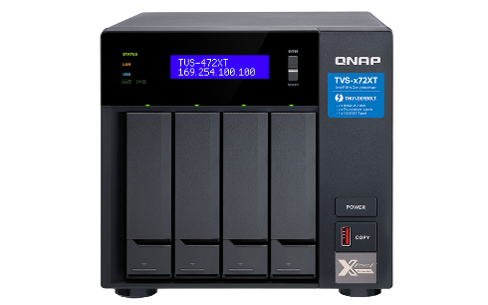
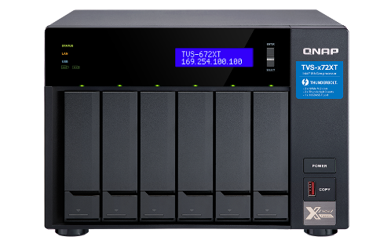


8th Gen Intel Core CPU Thunderbolt NAS
Pentium Gold G5400T /Core i3-8100T/ Core i5-8400T
TVS-872XT-i5-16G
Core i5-8400T(6C) 1.7GHz,
DDR4 16GB RAM (2x 8GB)
Thunderbolt 3 port x2
10GbE port x1
TVS-472XT-PT-4G
Pentium Gold G5400T(2C) 3.1 GHz,
DDR4 4GB RAM (2x 2GB)
Thunderbolt 3 port x2
10GbE port x1
TVS-672XT-i3-8G
Core i3-8100T(4C) 3.1 GHz,
DDR4 8GB RAM (2x 4GB)
Thunderbolt 3 port x2
10GbE port x1
Notes:
修改筆記: 中英文字間加上空格; Pentium 後面加上 Gold

Slide 5

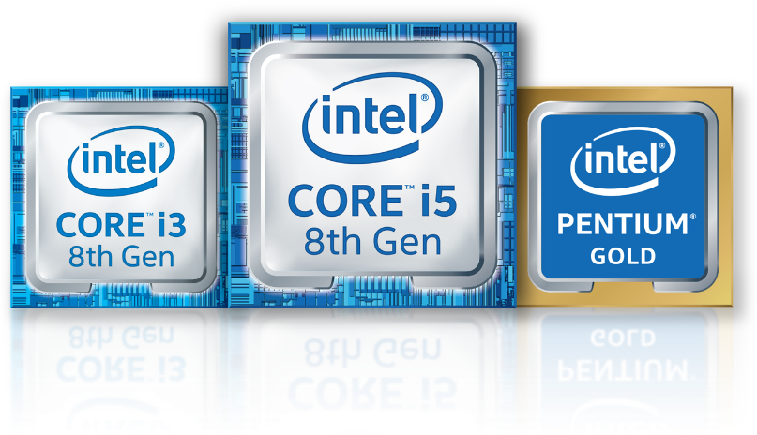
8th Gen Intel Core Processors
AMAZING PERFORMANCE & RESPONSIVENESS
IMMERSIVE ENTERTAINMENT
Stream Premium
33%
4K
Up to
faster
FAST CONTENT CREATION
FLUID GAMING
Intel® Turbo Boost Technology
Up to
Up to
25%
32%
Faster 4K video editing
More FPS
Notes:
修改筆記: “加快”改成 “提升”; 中英文字間加空格;優質串流
適用於 Intel® 通路夥伴的第 8 代 Intel® Core™ 處理器

Slide 6
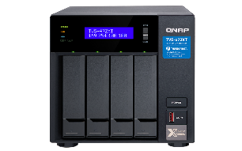
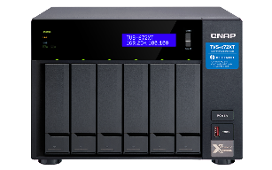
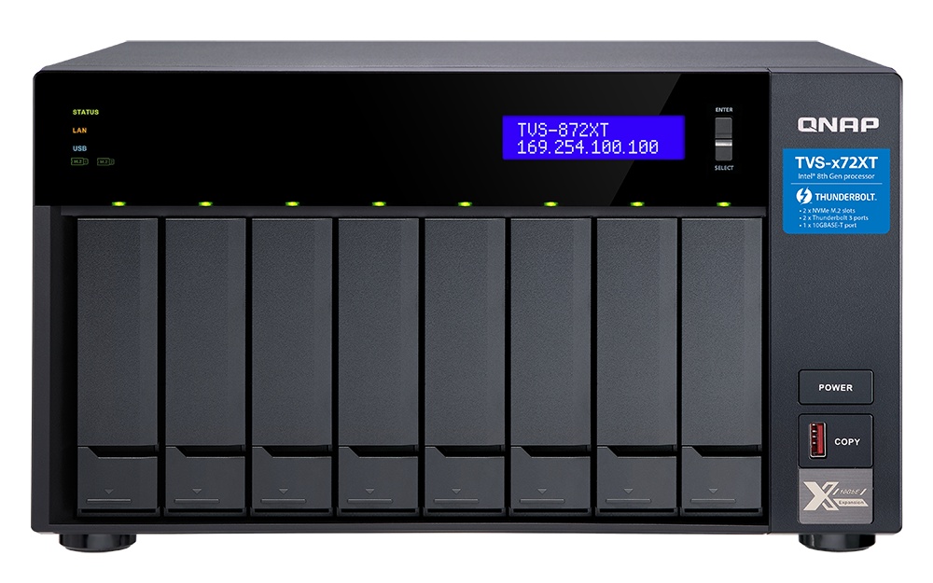
TVS-x72XT Front View
LCM
System Status Display
LEDs with adjustable brightness:
HDD, Status, LAN、USB, M.2
TVS-472XT
TVS-672XT
Power button
3.5"/ 2.5”SATA
6Gb/s HDD/SSD bays
USB 3.1 Gen 2 port & One Touch Copy button
Notes:
修改筆記: TVS-472XT ; TVS-672XT

Slide 7
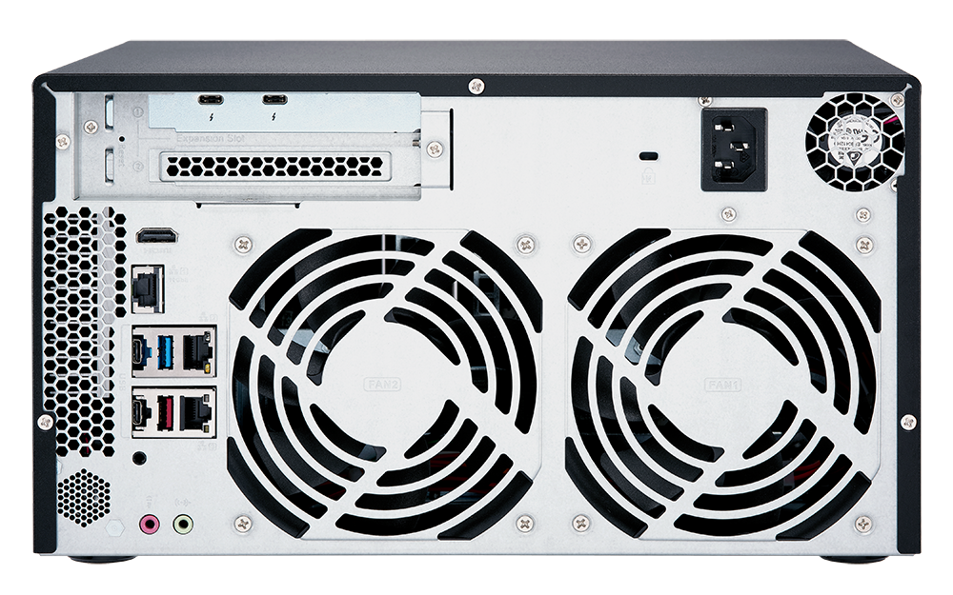
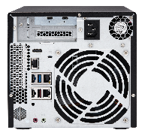
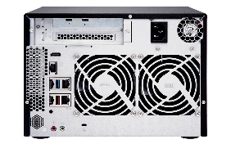
TVS-x72XT Rear View
2 x Thunderbolt 3 port
1 x PCIe slot
1 x 4K HDMI
v2.0a
TVS-472XT
TVS-672XT
1 x 10GBESE-T port
250W PSU
2 x Gigabit
LAN port
Smart cooling fan(s)
4 x USB port：
3 x USB 3.1 Gen 2
(Type-C & Type-A)
1 x USB 3.0 (Type-A)
2 watt speaker
System event
Audio playback
1 x 3.5mm Microphone input
1 x 3.5mm line out
Notes:
修改筆記: TVS-472XT ; TVS-672XT; PCIe; 10GBESE-T; Gigabit

Slide 8
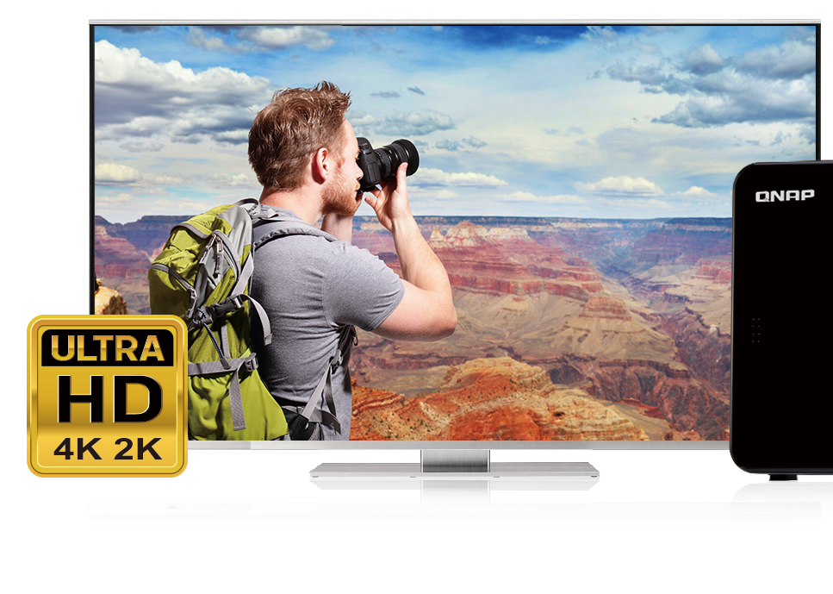
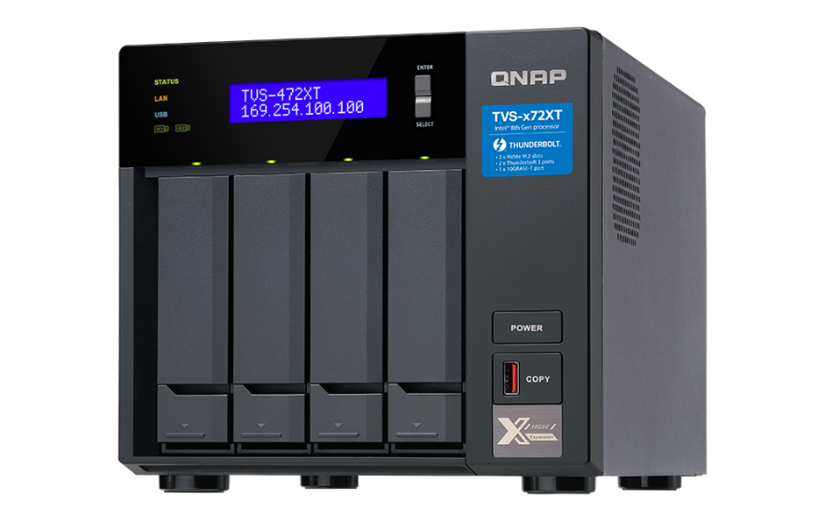

Output 4K@60Hz video via HDMI
1.10 GHz
Intel UHD
Graphics 610/630
4K UHD
1 x HDMI v2.0a
3840 x 2160, 60Hz
H.264
Up to 8-bit 4K
Playback & transcoding
The supported video and audio may vary depending on the software, hardware, and the environments.
附贈支援 QButton
客製按鍵功能的遙控器！
Notes:
8
修改筆記:直接輸出 HDMI 4K@60Hz 影片

Slide 9
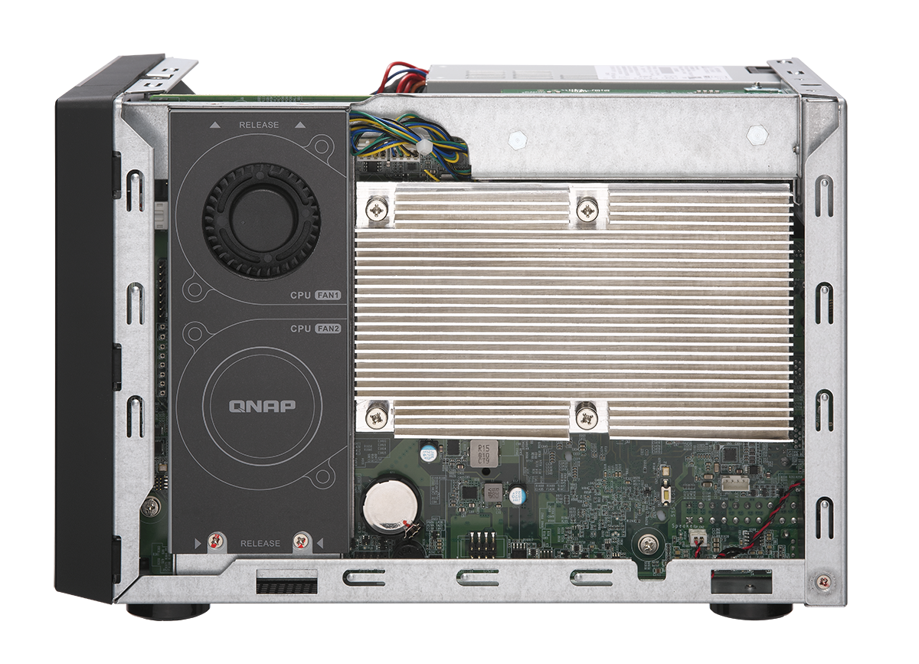

TVS-x72XT Internal View
Intel 8th Gen Processor
TVS-472XT
Intel® Pentium® Gold G5400T
TVS-672XT
Intel® Core™ i3-8100T
TVS-872XT
Intel® Core™ i5-8400T
2 x 6cm
centrifugal blower
CPU heat sink
Notes:
修改筆記: 中英文數字間加空格

Slide 10
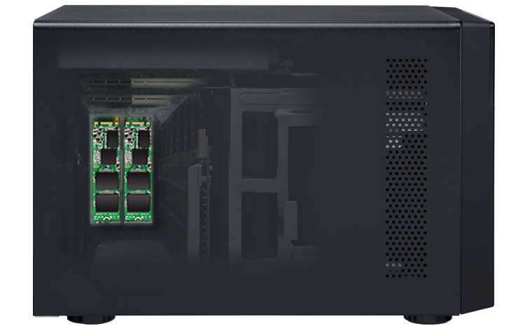

Built-in Two PCIe Gen3 x2 M.2 Slots
Supports PCIe Gen3 x2 M.2 SSD. Provides up to 1.97 GB/s bandwidth
Low latency cache and storage tiering.
Sequential Read(MB/s)
Sequential Write (MB/s)
Notes:
10
David Sequential Read(MB/s), Sequential Write (MB/s)

Slide 11
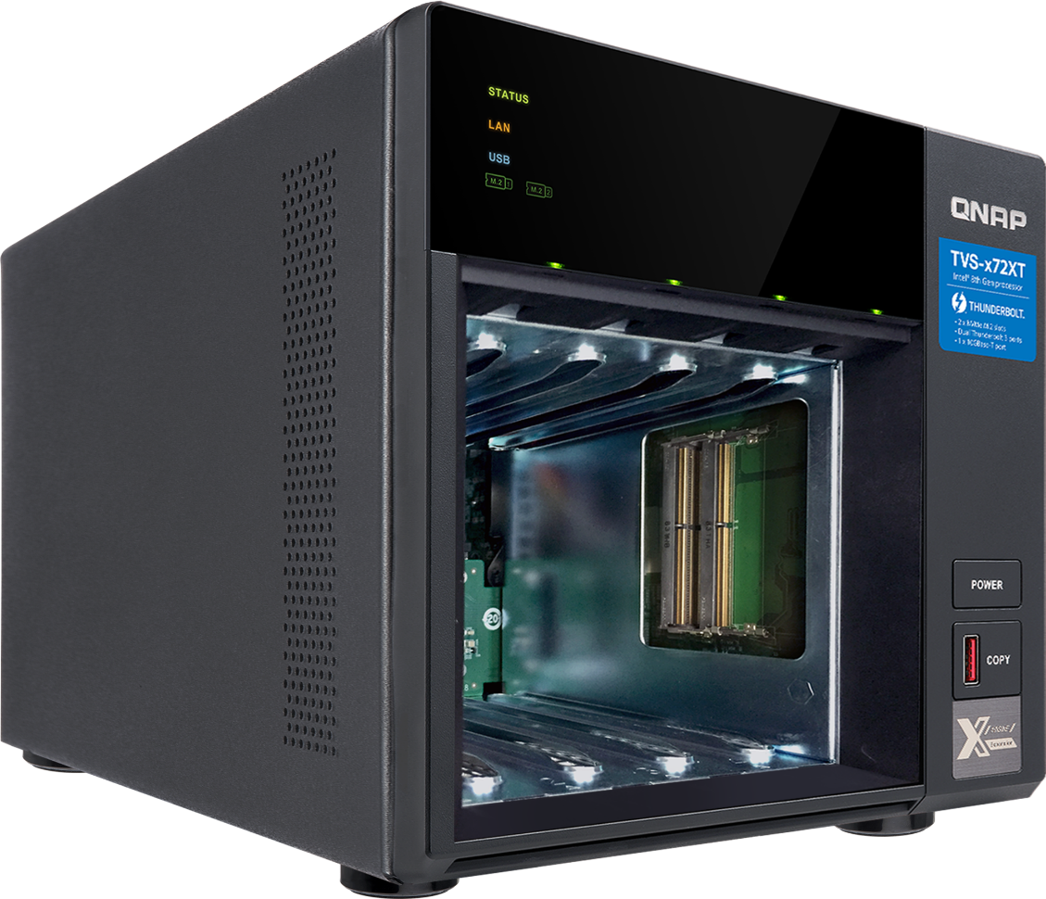
Memory Upgrade
Support Dual-channel and SODIMM x2
DDR4 2400/2666MHz
Memory Accessories
Ordering P/N | Specification
RAM-2GDR4P0-SO-2400 | DDR type: 2GB DDR4-2400 Form(PIN): SO-DIMM, 260PIN Manufacturer: APACER Manufacturer P/N: 78.A2GF7.4000B
RAM-4GDR4K0-SO-2666 | DDR type: 4GB DDR4-2666 Form(PIN): SO-DIMM, 260PIN Manufacturer: KINGSTON Manufacturer P/N: CBD26D4S9S1ME-4B
RAM-8GDR4K0-SO-2666 | DDR type: 8GB DDR4-2666 Form(PIN): SO-DIMM, 260PIN Manufacturer: KINGSTON Manufacturer P/N: CBD26D4S9S8ME-8
RAM-16GDR4T0-SO-2666 | DDR type: 16GB DDR4-2666 Form(PIN): SO-DIMM, 260PIN Manufacturer: Transcend Manufacturer P/N: TS2GSH64V6B
Notes:
11
修改筆記: 中英文數字間加上空格
4-bay (2GB): Apacer
6-bay (4GB): Kingston/ Apacer
8-bay (8GB): Kingston/ Transcend

Slide 12


Integrated Multi-Gigabit 10GBASE-T
Built-in 1 x 10GBASE-T Port
PC Environment:
1. CPU: Intel (R) Core(TM) i7-6700 3.40GHz.
2. OS: Windows 10.
3. Memory: 64 GB.
4. 1GbE:On board
5.10GbE:X550
TVS-872XT information:
1. F/W: 4.4.0.0649 Bulid 20180801
2. CPU: Intel(R) core™ i3-8100T CPU@3.10GHz
3. SSD:SSDSC2BB240G4 * 8 (RAID 5)
4. RAM: 4 GB *2
5. Thick volume; Block-based LUN
6. 1GbE:On board * 2
7.10GbE:X550
8. Thunderbolt
Write
Read
Notes:
修改筆記: 10GBASE-T
https://docs.google.com/spreadsheets/d/1SkCe0F-8n8vc7DsaYI56qIkJjZAPN9wxM_pGDicz2JU/edit#gid=0
David:
Write, Read

Slide 13

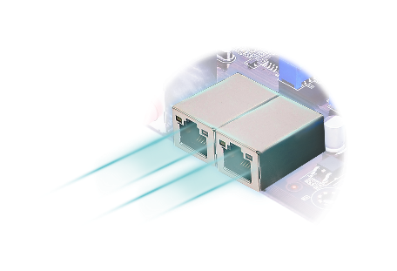


Soulmate of 2018 New iMac Pro
10GbE / Thunderbolt 3
Choose your high speed connections
2018 New iMac Pro
support one 10GbE Ethernet
and four Thunderbolt 3 ports
10GbE/Thunderbolt 3 NAS
TVS-872XT
3.5mm
headphone
USB 3
Thunderbolt 3
(USB-C)
10GbE
Ethernet
SDXC card slot
Ethernet

Slide 14


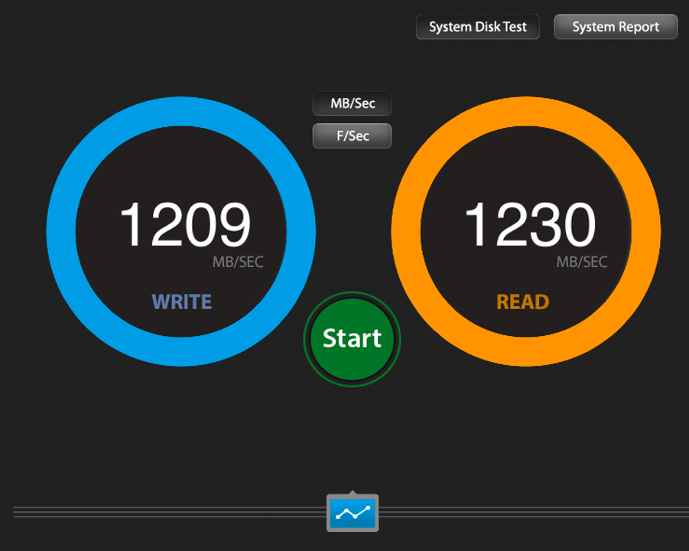
Thunderbolt 3 Exceptional Performance
Built-in two Thunderbolt 3 ports
Up to 1,230 MB/s
Notes:
14

Slide 15
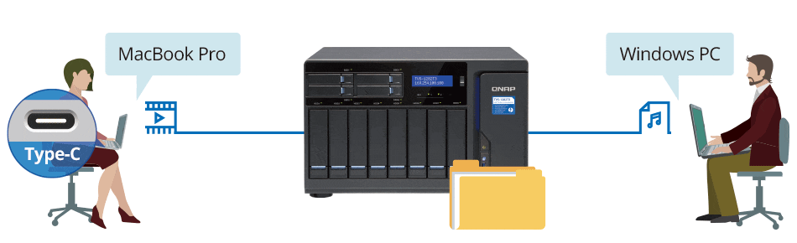



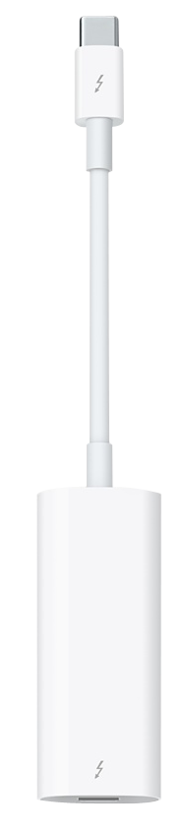

Highly-efficient media collaboration for Mac and Windows
Thunderbolt
Ethernet
Apple Thunderbolt 3 to Thunderbolt 2 Adapter

Slide 16
Performance
DEMO

Slide 17
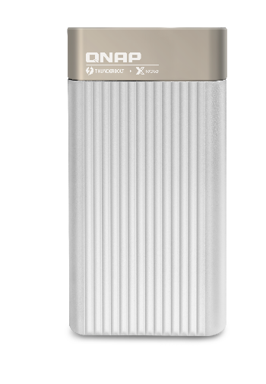
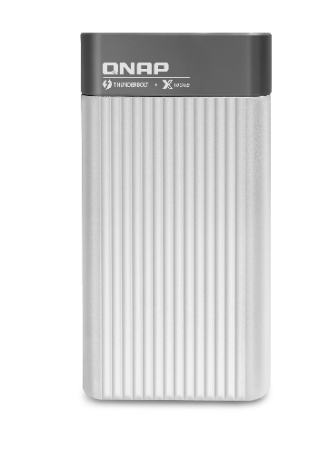

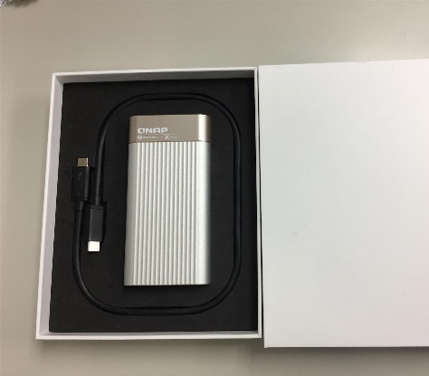
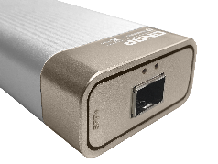
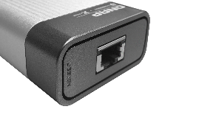
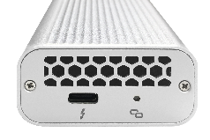
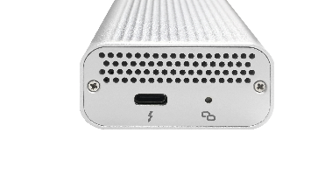
Accessories-Thunderbolt 3/10GbE Converter
SFP +
NBASE-T
QNA-T310G1S
QNA-T310G1T
QNAP QNA-T310G series is a Thunderbolt 3 to 10GbE converter which allows your Mac/ Windows PC can enjoy the 10GbE network with built-in Thunderbolt 3 ports.
Specefications
Controller：AQC107S-B1-C + AQX-N3F10-DRE-U3C
Interface：1 x Thunderbolt 3, 1 x 10GbE SFP+ port
Cable：SFP+ DAC cable
Specefications
Controller： AQC107S-B1-C + AQX-N3F10-DRE-U3C
Interface：1 x Thunderbolt 3, 1 x 10GbE SFP+ port
Cable：CAT 6a/ CAT 7
Note:
1. Aquantia AQC107 driver is required before using the QNA-T310G converter.
1. Mac OS 10.13.3 (or later) is required.
Notes:
David: Coming Soon

Slide 18
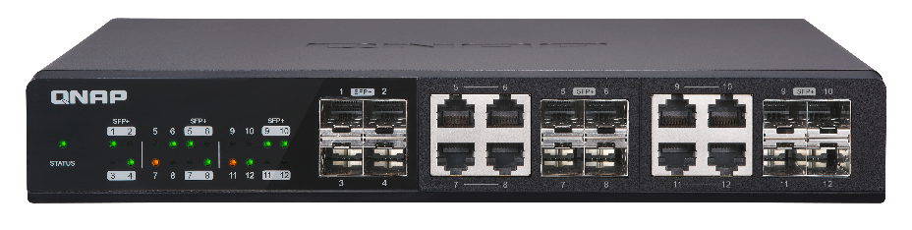
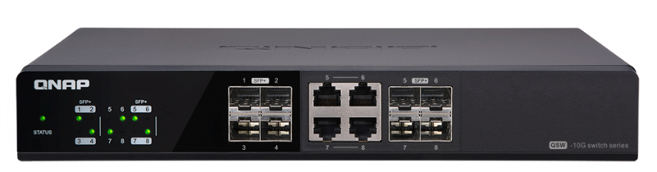
Accessories- 10GbE Network Switch
12
Ports
8
Ports
Up to 12 x 10GbE port
Up to 8 x 10GbE port
QSW-1208-8C
QSW-804-4C
Specifications：
12-port 10GbE network switch
4 x SFP+ port
8 x RJ45/ SFP+ combo port
Specifications：
8-port 10GbE network switch
4 x SFP+ port
4 x RJ45/ SFP+ combo port
Notes:
修改筆記: 交換器; 中英文數字間加空格

Slide 19

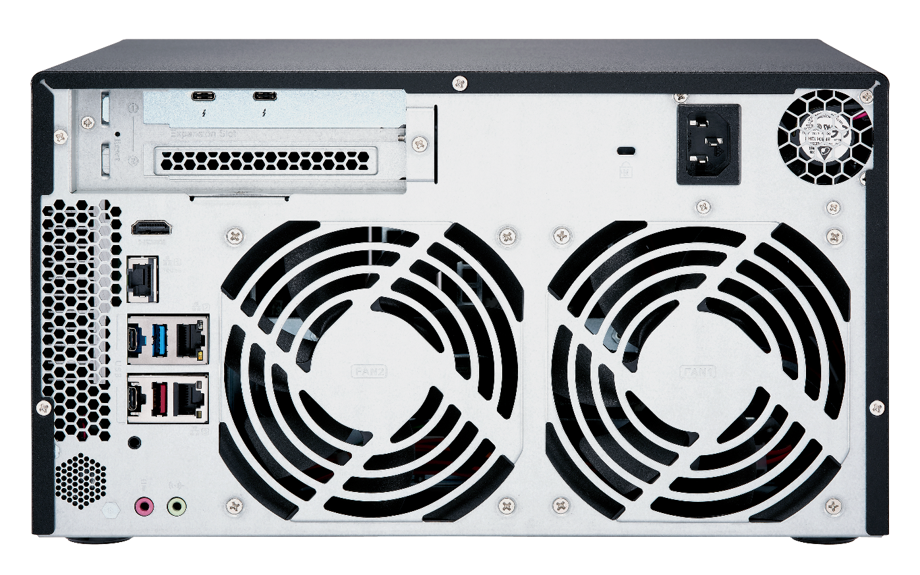
PCIe Expansion Slot
Provides PCIe Gen 3 x4, up to
3.94 GB/s bandwidth
Expands network bandwieth
Increases NVMe SSD capacity
Notes:
修改筆記:中英文數字間加空格

Slide 20

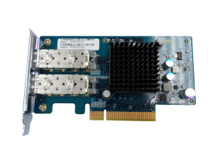
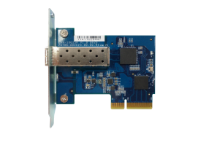
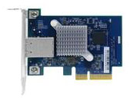
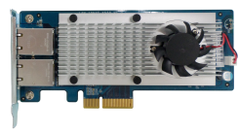


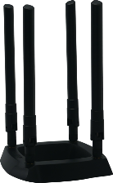
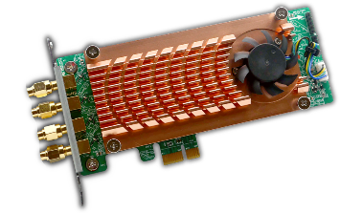
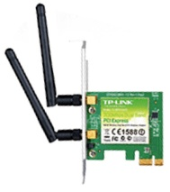
Versatile Network Accessories
10GbE/1GbE NICs
LAN-10G2SF-MLX
LAN-10G2T-X550
LAN-10G1SR
LAN-10G1TA
LAN-1G2T-I210
Wireless NICs
NEW
TL-WDN4800 N900
TL-WDN3800 N600
TL-WN881ND N300
TL-WN781ND N150
QWA-AC2600
TP-Link

Slide 21
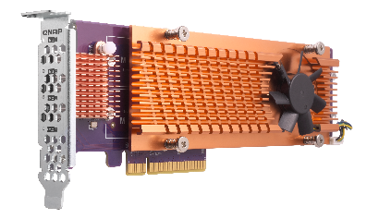
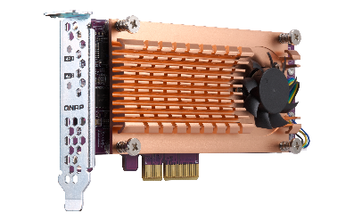

Add More NVMe SSDs to NAS with QM2 cards
Keep existing configurations &
easily boost performance!
QM2-4P-384
(Gen 3 x8 card)
4 x M.2 2280 PCIe Gen 3 x4 NVMe SSD slots
QM2-2P-384
(Gen 3 x8 card)
2 x M.2 22110/2280 PCIe Gen 3 x4 NVMe SSD slots
QM2-2P-344
(Gen 3 x4 card)
2 x M.2 22110/2280 PCIe Gen 3 x4 NVMe SSD slots
Notes:
修改筆記:利用 QM2 卡擴展 NVMe SSD 應用; 中英文數字間加空格
David:
Without changing existing configurations

Slide 22
Double the ROI of purchasing SSDs
Software-defined SSD extra over-provisioning,
advanced SSD cache and snapshots
Notes:
修改筆記: SSD 外掛預留空間配置

Slide 23





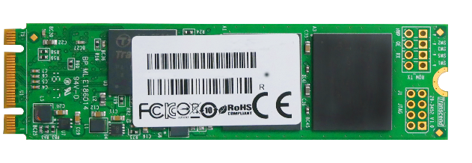


The SSD Works Differently from HDD
When HDD write new data: Overwrite the existed sector directly.
When SSD write new data: SSD need to clear whole block first.
Result: The SSD must collect valid page and rewrite them into new block before new data can be written (Garbage Collection).
Block X
Block X
Valid Data
block
C
page
A
Invalid Data
B
Block Z
A
B
C
D
Block Y
E
F
G
Block Y
F
D
E
G
Notes:
Valid Data
Invalid Data

Slide 24
Software Defined Extra Over-Provisioning
Having more over-provisioning is proven to be beneficial.
Besides SSD built-in Over-provisioning, QTS introduces the extra
Over-provisioning setting that can be adjusted based on usage.
Usable Space
Data
Over-provisioning Space
SSD Free Space (Can also be deemed as OP with Trim)
QNAP Software-defined, RAID Level, SSD Additional Over-Provisioning
Additional OP 0%~28+%
Additional OP 0%~28+%
Additional OP 0%~28+%
SSD internal OP 7.37%
SSD internal OP 7.37%
SSD internal OP 7.37%

Slide 25
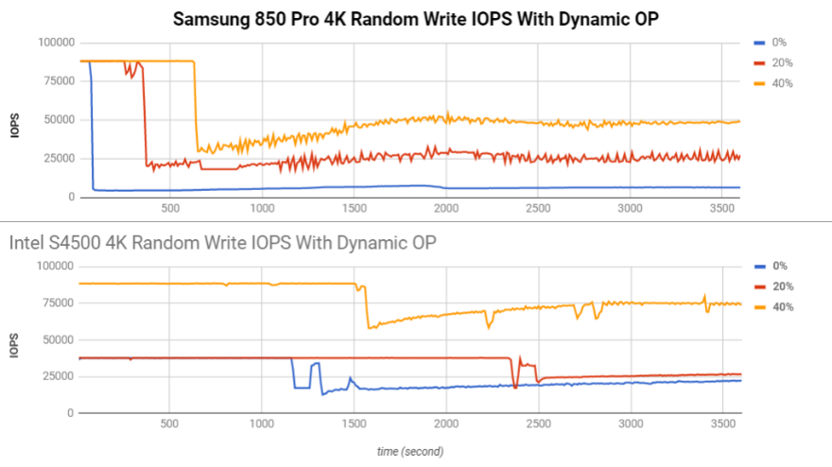
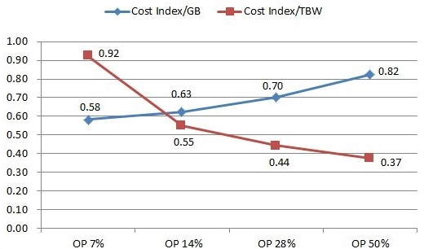
The Advantage of Software-defined Over-provisioning
Performance and endurance of SSD can be increased.
Let consumer SSD reach enterprise SSD performance, and further enhance enterprise SSD advantage, reduce TCO (Total Cost of Ownership)
(Although usable space is reduced, actual used space is unchanged.)
Reference: http://www.atpinc.com/technology/ssd-over-provisioning-benefits-configure

Slide 26
QNAP Global SSD Cache
The QNAP SSD Cache can be applied to multiple volume / LUN：
Cache Type:
  The QNAP SSD Cache can be applied to multiple volume / LUN
  Allow new data be written. (Read-write Cache)
RAID configuration: Single, RAID 0, RAID 1, RAID 10
Compatible SSD: SATA, SAS, M.2 SATA & PCIe NVMe
How Read-write Cache work:
Data from clients and storage will both be cached
Write
Write
Read
Read
SSD
IO Intensive
Application
When SSD Space not enough
HDD
Notes:
修改筆記: 中英文間加空格

Slide 27


The Write-only Cache Increase ROI of
SSD Cache with high Writing Demand
Write-only cache is promoted by Microsoft for endurance control.
QNAP believe Write-only Cache can increase the ROI of purchasing SSD in below scenario:
Writes
are cached
Reads
are NOT
1. File Server focusing on write operations
2. Database with more write operation
(Such as IoT monitoring server)
3. Use high endurance SSD (Intel Optane™)
with other SSD
NVMe
NVMe
SSD
SSD
SSD
SSD
Notes:
修改筆記:導入唯寫快取 (Write-Only)，有效提高 SSD
應用的性價比

Slide 28



Businesses Need Shorter RTO!
In the survey of 300 Enterprise and SMB at Taiwan:
60% have used Remote Replication as Backup Plan.
50% of business expected the recovering time should be within 1 Hour.
But also 50% of business experience actual recovery time > 1 Day!
Can business only manually transfer data back from the remote end when disaster happen?
Data Backup Time
Disaster Happen
Server Online
TIME
Recover Point Objective
Recover Time Objective
Reference： Taiwan IThome survey 2017

Slide 29
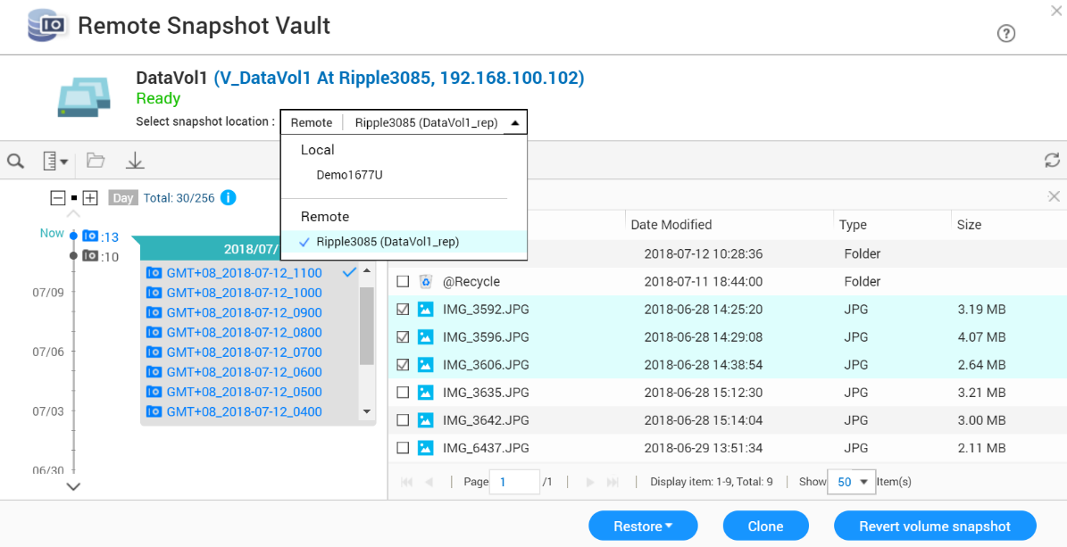

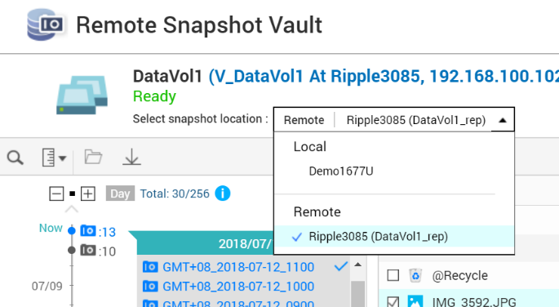
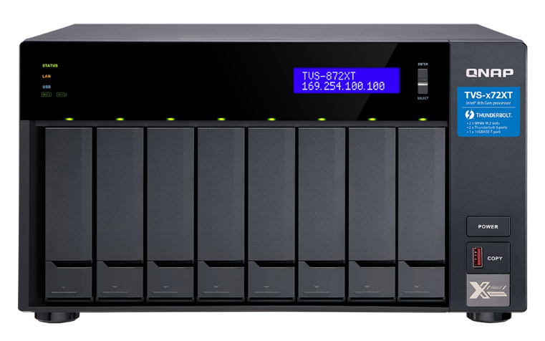
Restore From Remote Snapshot Vault
The Snapshot Manager now actively connected to Snapshot Vault
Support Monitor and restore select folder and files at the Source NAS directly!
Both the source and destination NAS must be
upgraded to 4.3.5 to support this function

Slide 30





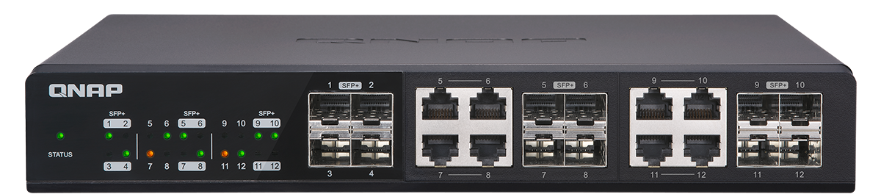

Drastically Reduce Recover Time With 10GbE Network
The Remote Snapshot Vault Recovering is based on Ethernet service.
Using 1GbE network, recovering large data still takes hours.
Pair the Snapshot Replica Solution with 10GbE or even faster interfaces to increase both the backup and recovery speed !
Using QNAP 10GbE Switch to replace old 1GbE for reducing RTO dramatically

Slide 31

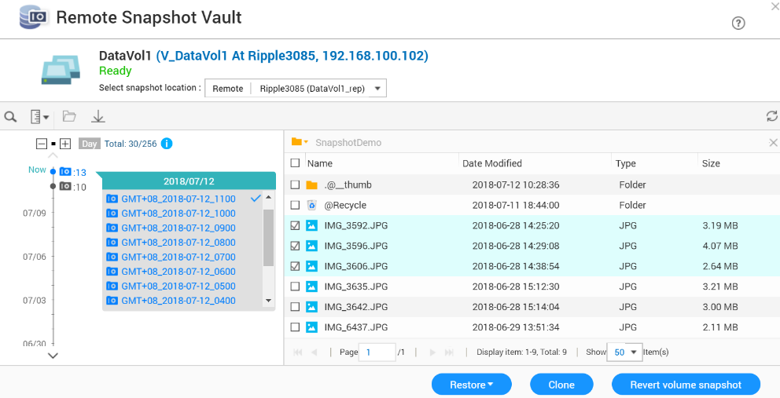
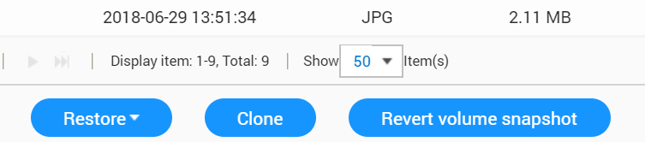

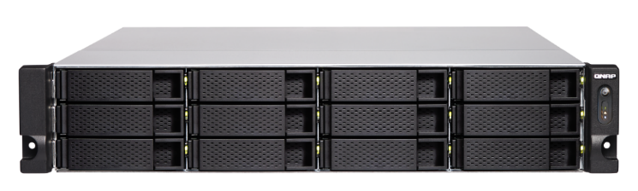

Support 3 Types of Restoring
From the source snapshot manager, user can
1. Select file and folder to restore back to source
2. Select and clone remote snapshot as new volume/LUN
3. Select snapshot and revert the whole volume or LUN from remote
The restore, clone and revert speed is highly depended on the network speed and conditions

Slide 32





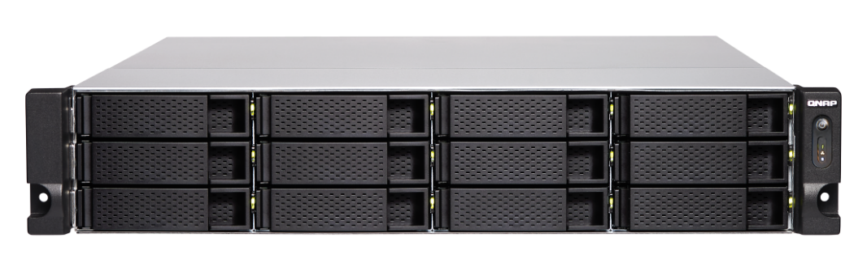
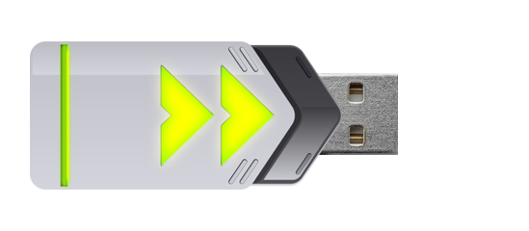
The Forth Way: Snapshot Export/Import
Export a snapshot from snapshot manager or snapshot vault
Using external storage device, the exported imaged can be imported to another NAS to create new volume or LUN
The same image can also be used to revert source volume or LUN
When network speed is limited, user can still import snapshots for reverting
Snapshot
Reverting

