Slide 2
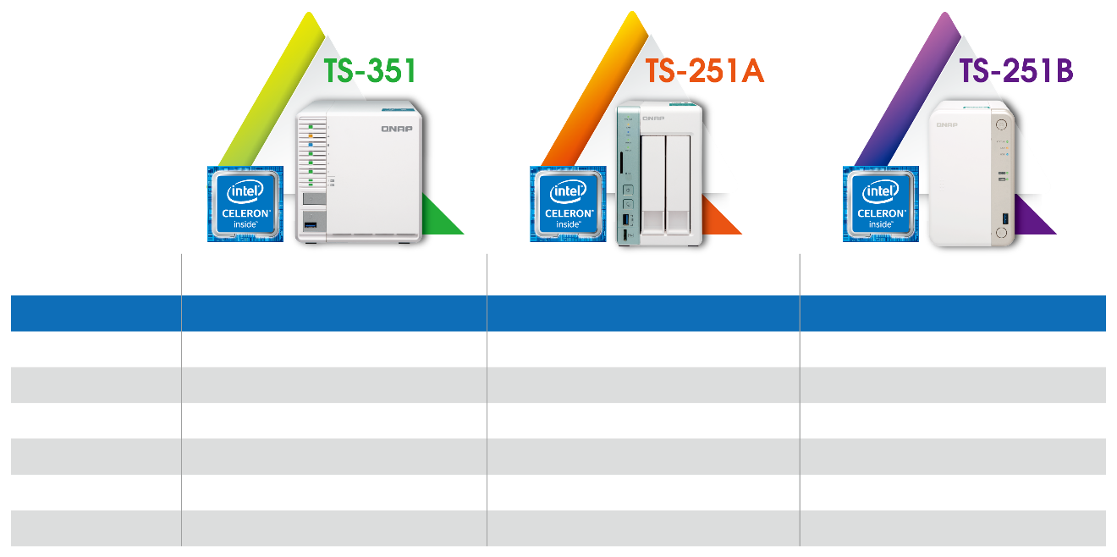
Long-term supported dual-core processors
Intel® Celeron® Processor J1800
Intel® Celeron® Processor N3060
Intel® Celeron® Processor J3355
Code name
Bay Trail
Braswell
Apollo Lake
Product Collection
Intel® Celeron® Processor J Series
Intel® Celeron® Processor N Series
Intel® Celeron® Processor J Series
Status
Long term supported
Launched
Launched
Launch date
Q4'13
Q1'16
Q3'16
Number of cores
2
2
2
Base Frequency
2.41 GHz
1.60 GHz
2.00 GHz
Burst Frequency
2.58 GHz
2.48 GHz
2.50 GHz

Slide 3
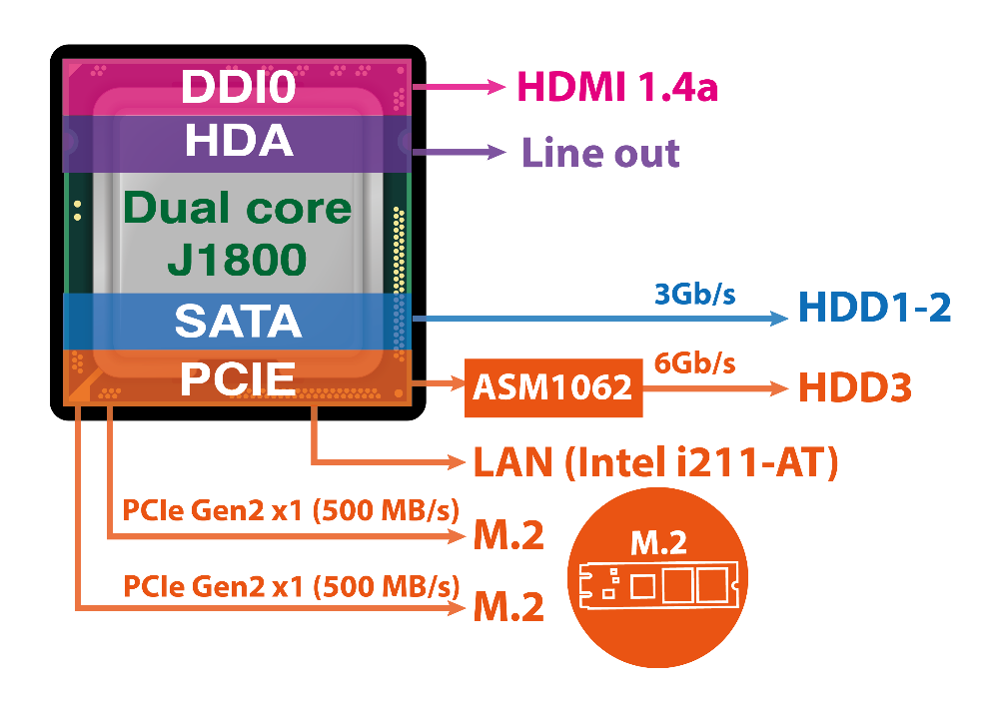
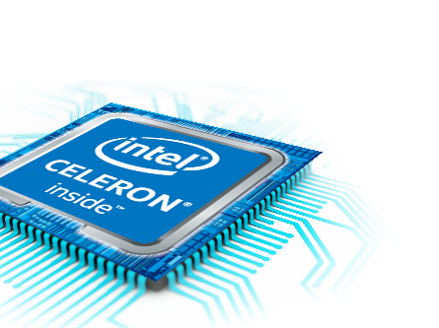
Reliable and trusted
Utilize full potentials of
the processor
3 x HDD
2 x M.2 NVMe Gen2 x 1 SSD slots
speaker
Dual channel RAM slots (SODIMM DDR3L)
HDMI output

Slide 4
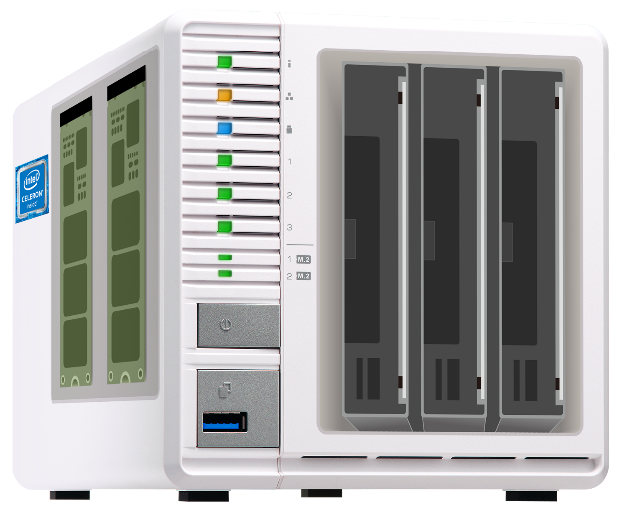

Ideal choice for light workloads
X86 intel Celeron J1800
Long term supported
X86 architecture provided high performance on multi-tasking
2 x M.2 PCIe 2.0 x1 NVMe SSD slots
Support SSD cache or Qtier
Enhance SSD’s performance and life with SSD extra OP
HDMI full HD output
Play HD videos via HD station
Use TS-351 as PC via Linux Station
3-bay
RAID5 storage
Improve HDD’s usage
Protect data by RAID5

Slide 5
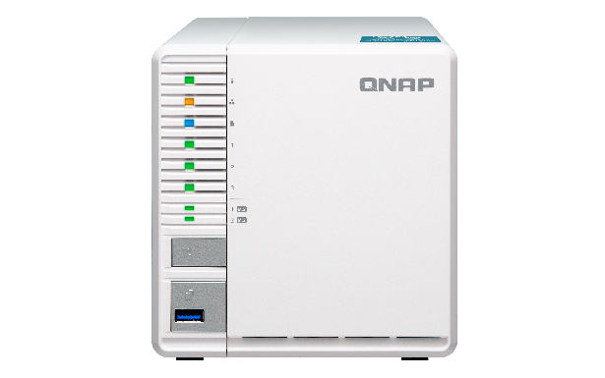




The QNAP 3-bay NAS family
TS-328
TS-332X
TS-351
ARM Cortex®-A53,
Realtek 4C 1.4 GHz
ARM Cortex®-A57,
Annapurna Labs 4C 1.7 GHz
X86 14nm,
Intel® Celeron J1800 2C 2.41 GHz
3 x HDD (optional 2.5" SSD)
4K hardware transcoding
3 x HDD + 3 x M.2 SATA 6Gb/s SSD slots
10GbE SFP+
(R: 1085, W:526 MB/s)
3 x HDD + 2 x M.2 PCIe 2.0 x1 NVMe SSD slots
HDMI 1080P output & hardware transcoding
SATA
NVMe

Slide 6
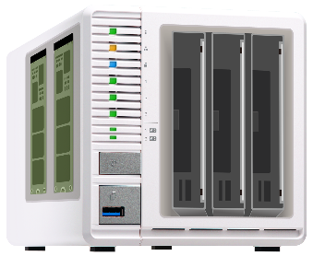
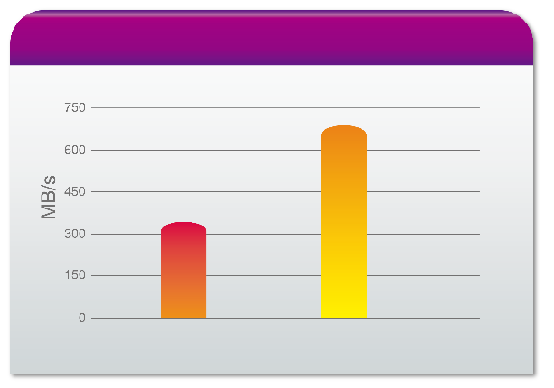

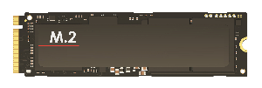
Burst Read/Write performance by M.2 SSD
Save more cost by using low price M.2 PCIe 3.0 x2 NVMe SSDs
NAS internal R/W (RAID 1)
689 MB/s
328 MB/s
PCIe 2.0 x1
NVMe
Write
Read
Test environment:
TS-351, QTS 4.3.4
2 x Samsung 960 1TB M.2 NVMe SSD (RAID 1)
DD write: dd if=/dev/zero of=/share/Public/10G bs=1M count=10240
PCIe 2.0 x1
NVMe

Slide 7

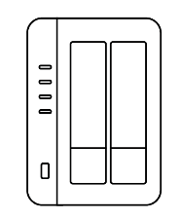
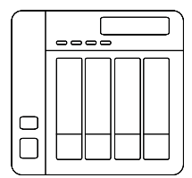

Cost effectively secures data with RAID5
2-Bay NAS
4-Bay NAS
RAID 1:
Space: 1 x HDD
RADI 5:
Space: 2 x HDD
RAID 5:
Space: 3 x HDD
HDD utilization: 67%
HDD utilization: 50%
Budget concern

Slide 8

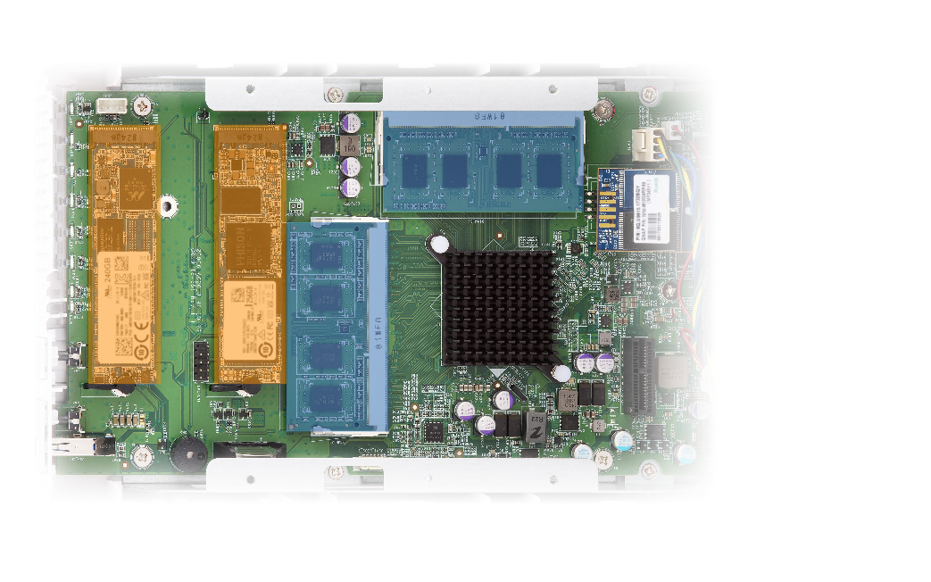
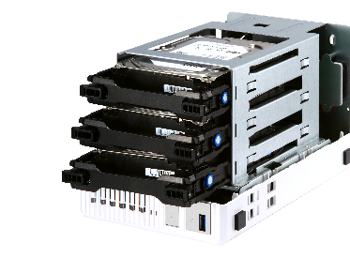
3 HDD bays & 2 M.2 PCIe NVMe SSD slots
Dual-channel DDR3L SODIMM memory slots, up to 8GB (2 x 4GB)
3 x SATA HDD/SSD* bay
Optimized design
2 x M.2 2280
PCIe 2.0 x1
NVMe SSD slots
*
*
HDD3: 6Gb/s
HDD1-2: 3Gb/s
RAM slot#1 for single RAM module configuration
*2.5" drive requires an optional tray base

Slide 9

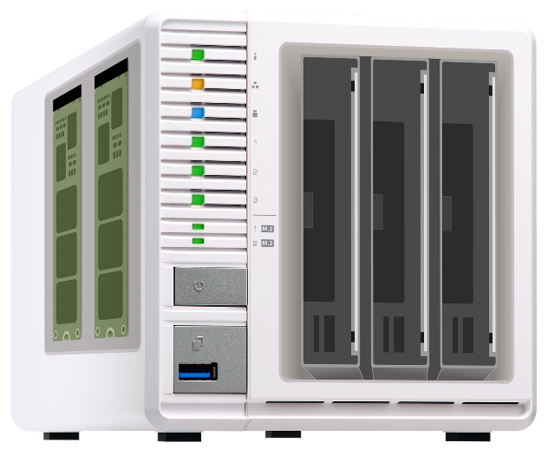


Flexibly use SSD cache or Qtier
RAID
1
RAID
5
2 x 512GB
M.2 PCIe NVMe SSD
(2.0 x2 or 3.0 x2)
3 x 10TB HDD
Use Qtier for hot data tiered storage
20TB Cold data on big storage space

Slide 10



Intel ® Celeron ® Dual core Processor
Intel ® Celeron ® Processor J Series
Base Frequency：2.41 GHz, burst up to 2.58 GHz
Dual channel DDR3L SO-DIMM RAM
Support H.264 transcoding and Full HD output

Slide 11





Hardware transcoding and multimedia streaming
Full HD output and on-the-fly transcoding
H.264 hardware decoding and real-time transcoding allow you to convert videos to universal file formats that can be smoothly played across various devices
Playback Full HD (1920*1080, 60fps) media contents via HDMI
stream media files to mobiles devices and media streaming devices (including DLNA®, Roku®, Apple TV®, Amazon Fire TV® and Chromecast™)

Slide 12



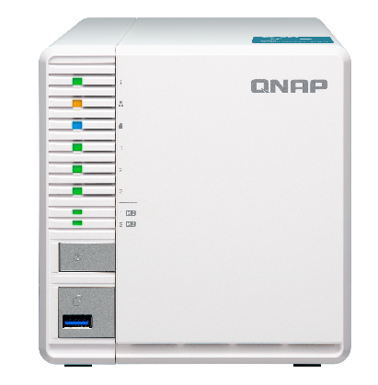








PLEX Server for your home media center
Streaming
Streaming
Smart TV
PC
Streaming
Phone
Tablet
Local playback
HDMI
TV / Monitor

Slide 13
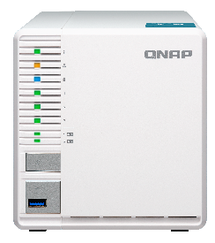
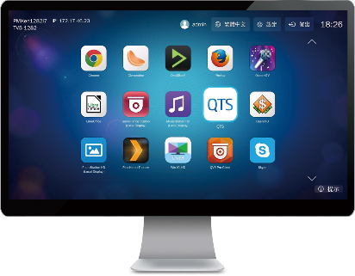



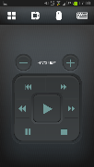
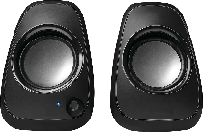
HD Station turns NAS into a PC
USB
HDMI
Mouse &
Keyboard
Network
Audio
Qremote App

Slide 14


Apps and utilities available in HD Station
System tools
Monitoring tools
Communication tools
QTS
File Station HD
Surveillance Station
QVR Pro Client
Skype
Facebook
Multimedia applications
Multimedia data management
Browser & office tools
HD Player
OceanKTV
YouTube
Clementine
Plex Home Theater
Spotify
TuneIn Radio
Photo Station HD
Video Station HD
Music Station HD
Chrome
Firefox
LibreOffice

Slide 15




Build-in HD Player
HD Player allows you to watch multimedia contents on TV directly
Photo Station
Video Station
Music Station
HD Player
Play directly on TV

Slide 16
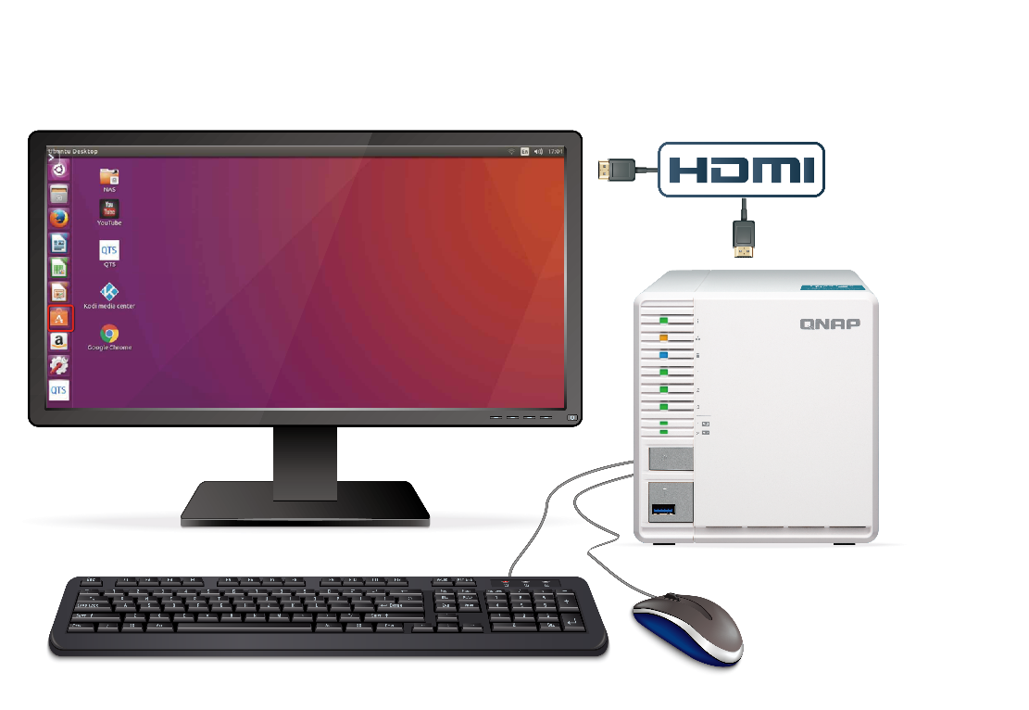

Transform NAS into your personal Ubuntu computer
1
Connect NAS and monitor through HDMI output
Multiple Ubuntu versions
Ubuntu 14.04
Ubuntu 16.04
Specially support Ubuntu Kylin
(Chinese version)
2
Connect mouse and keyboard to NAS and start using Ubuntu like your PC.

Slide 17
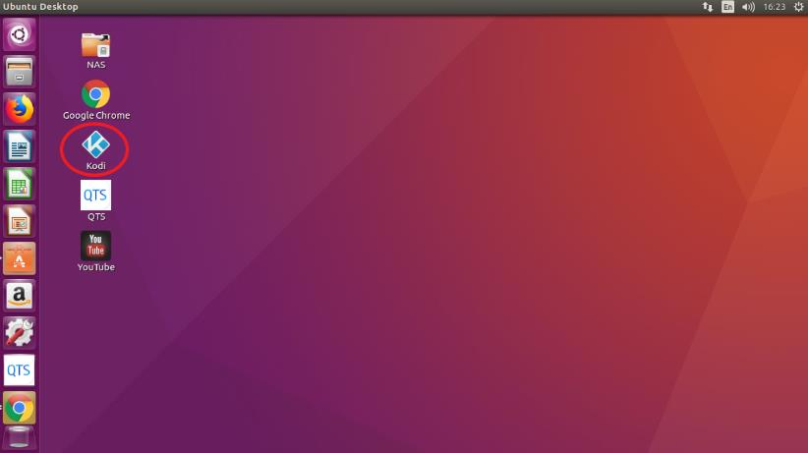

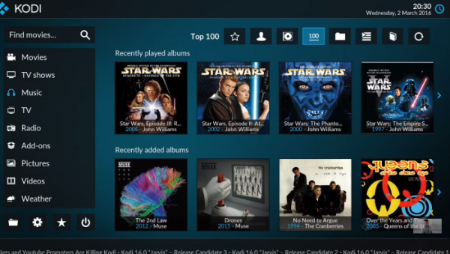
Advantages of Linux Station
Use KODI to play media files on NAS
KODI is ready after
Ubuntu installation.

Slide 18
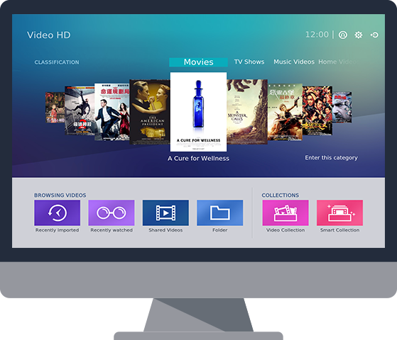







Video HD supports multiple devices
Video HD
Video HD is a free KODI add-on. With KODI's streaming and video decoding capabilities, you can directly access and stream NAS files to computers or set-top boxes. Video HD also fully supports Video Station's features, including current play time, video type, online subtitle lookup and more, allowing you to enjoy high-quality multimedia entertainment.

Slide 19
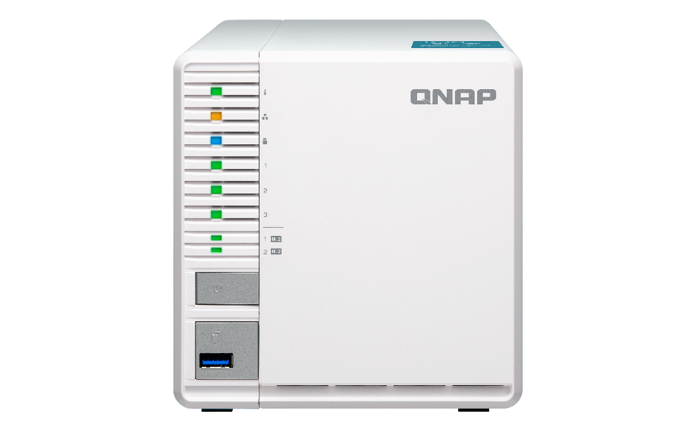
Front view
LED indicator: Status, LAN, USB, HDD1-3
LED indicator:
M.2 SSD 1-2
Power
USB 3.0 One Touch Copy button

Slide 20
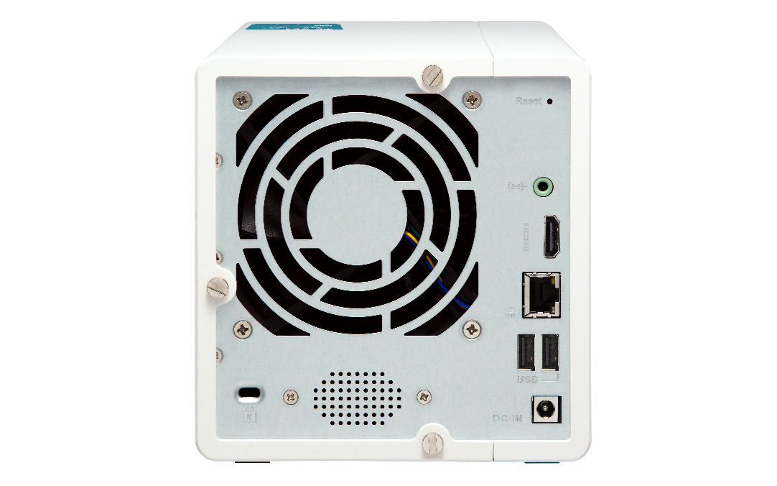
Rear view
Reset
One 9 cm smart fan
3.5mm line out jack
HDMI v1.4a
1 x GbE RJ-45 port
Security slot
2 x USB 3.0 ports
Built-in speaker
DC 12V power input

Slide 21
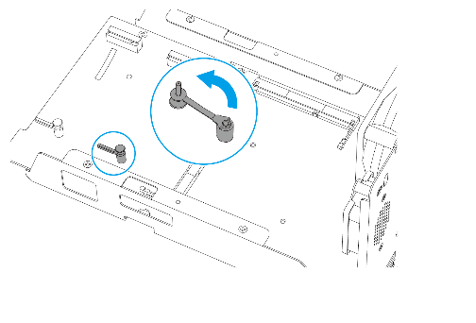
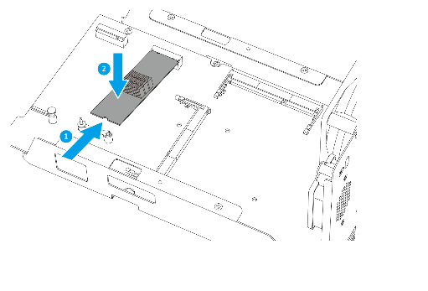
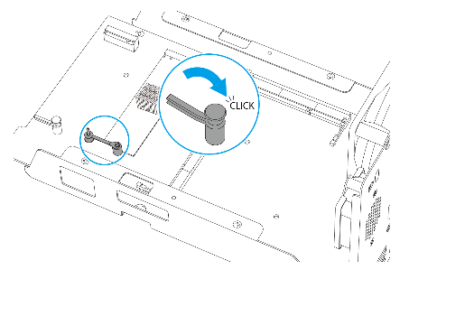

Tool less M.2 SSD fast installation
1
2
3
M.2 heatsink is included

Slide 22


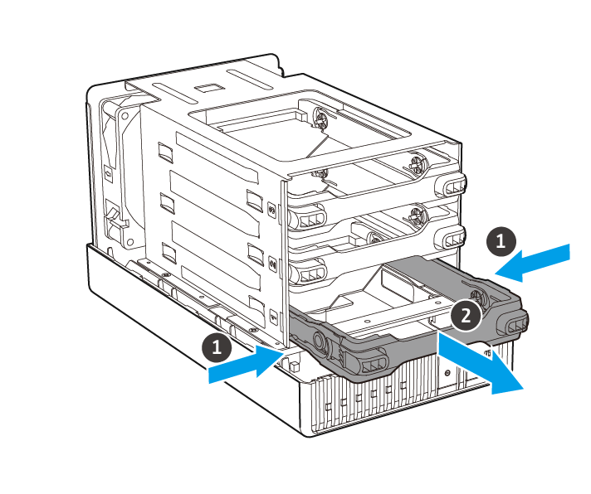
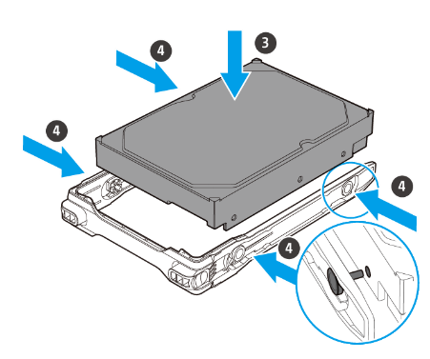
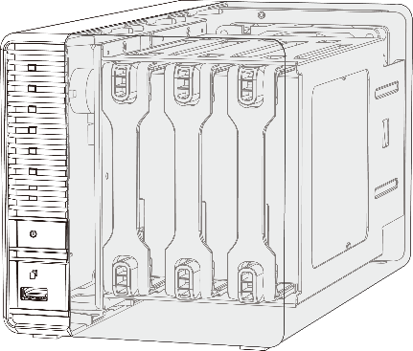
Hot swappable and invisible slots
Prevent HDD mishandling
Anti-theft
Tool less installation

Slide 23
DEMO
Install M.2 SSD and upgrade RAM

Slide 24
SSD Cache
Software-defined SSD Extra Over-Provisioning

Slide 25

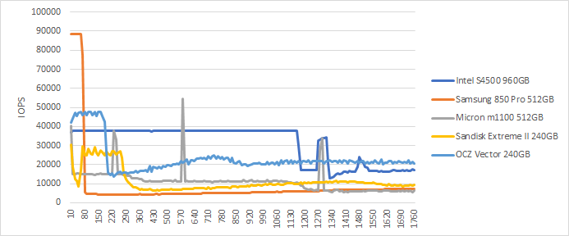
Different SSD has Different Performance
In QNAP Lab, engineer use FIO to test different SSD, and all SSD have showed consisted write performance degrade.
Different SSD’s controller and Garbage Collection’s Algorithm will effect the long term performance
Different SSD in QNAP NAS’s FIO consisted performance (IOpattern: RW-4K):
How can storage vendor help to ensure SSD has expected performance ?

Slide 26

What is SSD Over-Provisioning
SSD Over-provisioning reserves space in the SSD to decrease write amplification & increase consisted performance and endurance.
Reason: to avoid Garbage Collection in any giving point of time
N | N
N | N
N | N
With limited OP, 4 additional write is needed. With more OP the movement is not required.
N | New Data
D | Valid Data
 | Invalid Data
 | OP
 | OP
D | D
D | D
D
D
D | D
D | D
D | D
D | D
N | N
N | N
N | N
6 pages of new data cannot all be stored to the SSD
Unless the SSD conduct GC internally first
With more reserved block, the GC is not required

Slide 27
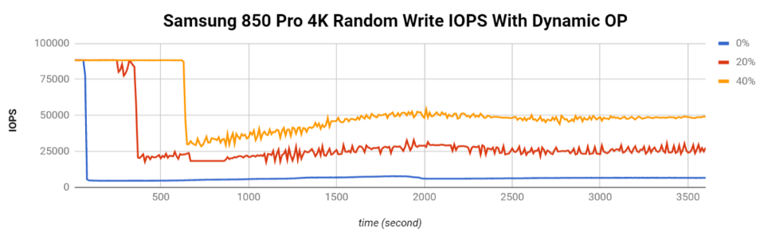
The Advantage of Software-defined SSD Extra Over-Provisioning
With QTS System, user can assign more OP to the SSD RAID.
At QNAP Lab, the effect of over-provisioning can not only be observed on single consumer-level Samsung 850 Pro to gain the performance same as data center SSD, but also be seem on SSDs as a RAID.
Above: Samsung 850 Pro as Single Disk
Below: Micron M1100 as RAID 1
FIO configuration: runtime=1800 ioengine=libaio direct=1 rw=randwrite bs=4k numjobs=1 iodepth=32
Take Intel S4500 as an example, The continuous random write is 30,000

Slide 28
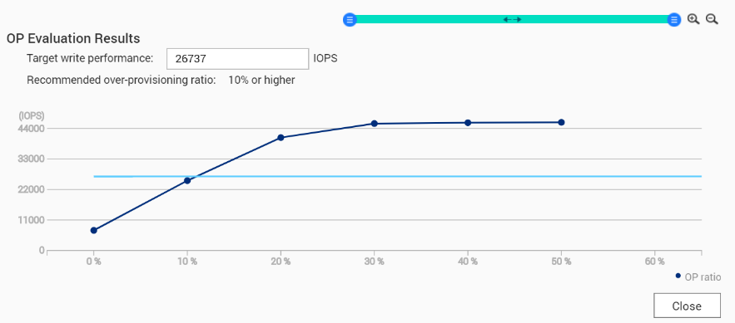

Choosing SSD is hard, choosing QNAP is simple
SSD consisted performance can only be observed after long time of usage
QNAP has provided the unique SSD Profiling Tool to help user measure the performance difference with different over-provisioning amount.
Not just IT manager, Home user can also evaluate the capability of SSD.
Using SSD Profiling Tool to identify the best OP amount.
Take Intel S4500 as an example, The continuous random write is 30,000

Slide 29
QNAP SSD Global Cache and Qtier
Two options for users to utilize SSD on TS-351 with M.2 SSD slots
- For real-time performance boost, deploy SSD Global Cache or All flash storage
- For continued data tiring between hot and cold data, deploy the Hybrid Storage Qtier™ Auto Tiering
SSD Cache lets all data enter cache and read hot data from the storage in real time
Qtier utilizes SSD space and let data block be
reallocated based on hot or cold in the storage
SSD Global
Volume
Block-based LUN
Volume
Block-based LUN
Qtier SSD Tier
Qtier HDD Tier
Storage pool
SSD
SSD
HDD
HDD
HDD
HDD
HDD
HDD

Slide 30

QNAP Global SSD Cache
The QNAP SSD Cache can be applied to multiple volume / LUN
Read-Only ➔Copy frequently used data to SSD
Read-Write ➔Not only copy data, new data can also be temporarily stored in SSD
(New)Write-Only ➔ Only new data will be written into the cache
How Read-write Cache work:
Data from clients and storage will both be cached
Write
Write
Read
Read
SSD
IO Intensive
Application
When SSD Space not enough

Slide 31

The Write-only Cache Increase ROI of SSD Cache with high Writing Demand
Writes
are cached
Reads
are NOT
Write-only cache is promoted by Microsoft
for endurance control.
QNAP believe Write-only Cache can increase the ROI of purchasing SSD in below scenario:
1. File Server focusing on write operations
2. Database with more write operation
(Such as IOT monitoring server)
3. Use high endurance SSD (Intel Optane™)
with other SSD
NVMe
NVMe
SSD
SSD
SSD
SSD
https://docs.microsoft.com/en-us/windows-server/storage/storage-spaces/understand-the-cache

Slide 32
TS-351 SSD Multiple Configurations
In addition to backup server scenarios, SSD Over-provisioning, Global Cache and Qtier let TS-351 be deployed as a production server
Scenario | File Server | Web, Application | Synchroni-zation, Vi-deo Editing | Surveillance, Backup, Log Server
SSD Config | Qtier™ | Qtier™ | Read-Write Cache | Write-Only Cache
SSD OP | 10% | 20% | 20% | 30%

Slide 33
Data Backup
Snapshots provide a complete data backup solution

Slide 34

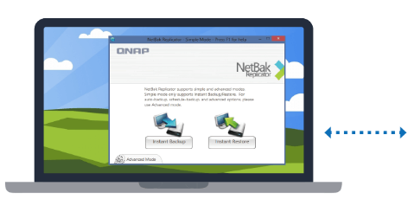
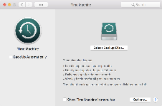
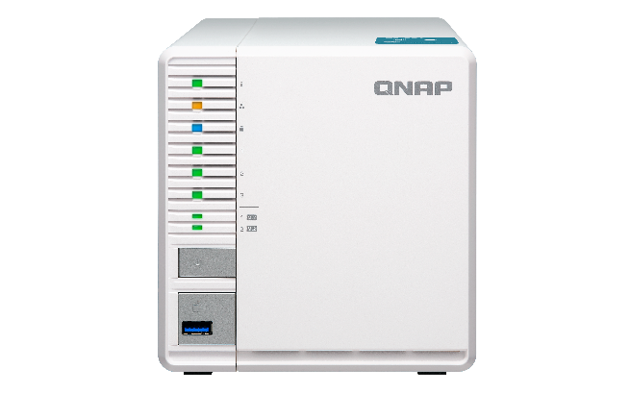
A complete backup solution
Data backup is the most effective
way against ransomware
macOS
Time
Machine
Real-time or scheduled back up to the TS-351 easily.
Windows
NetBak
Replicator

Slide 35



Protect your backup with QNAP Snapshot
2GBRAM
≥
4GBRAM
For the
whole NAS
64
256
----------------------------------------------
For a single volume/LUN
32
256
The best choice for backup

Slide 36












Multi-layer protection for the backup
Remote
Backup
Hybrid Backup Sync
Remote
Local
Cloud

Slide 37
Surveillance Solution and VJBOD
Secure your environment / expand capacity

Slide 38
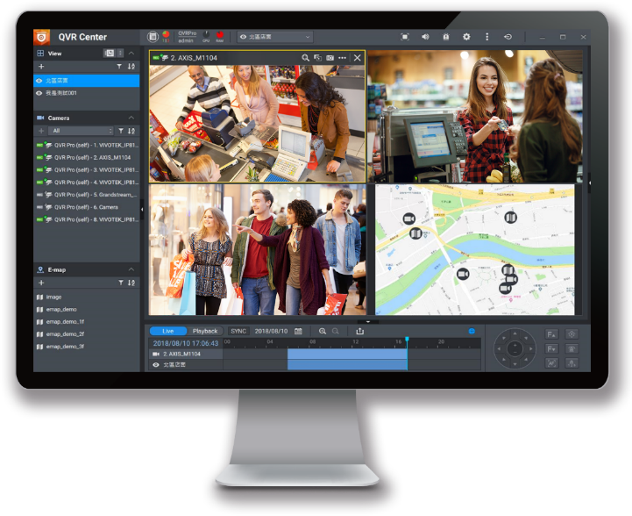


QVR Pro surveillance solution
6,000+ compatible IP cameras
8 free IP camera channels
128 max. IP camera channels
QUSBCam2 record from USB webcams

Slide 39


Use VJBOD to extend capacity
iSCSI
Up to 8 QNAP NAS can be mounted as local disks on the TS-351.
TS-351
VJBOD
expand the storage space of another QNAP NAS

Slide 40


TS-351 provides numerous benefits
Home entertainments and Linux Station
  - HD station playback
  - Use your NAS as PC via
  Linux station
HDMI output and transcoding
  - Playback HD videos via HDMI
  - Video file transcoding
M.2 SSD supported RAID 5 NAS
  - Enhance HDD’s usage
  - install M.2 to use cache
  and OP
Data security
  - Snapshot
  - Time Machine &
  Netback Replicator backup
  - Cloud backup

Slide 41
Copyright © 2018 QNAP Systems, Inc. All rights reserved. QNAP® and other names of QNAP Products are proprietary marks or registered trademarks of QNAP Systems, Inc. Other products and company names mentioned herein are trademarks of their respective holders.

