Slide 2
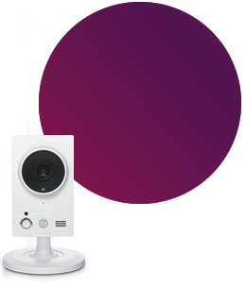
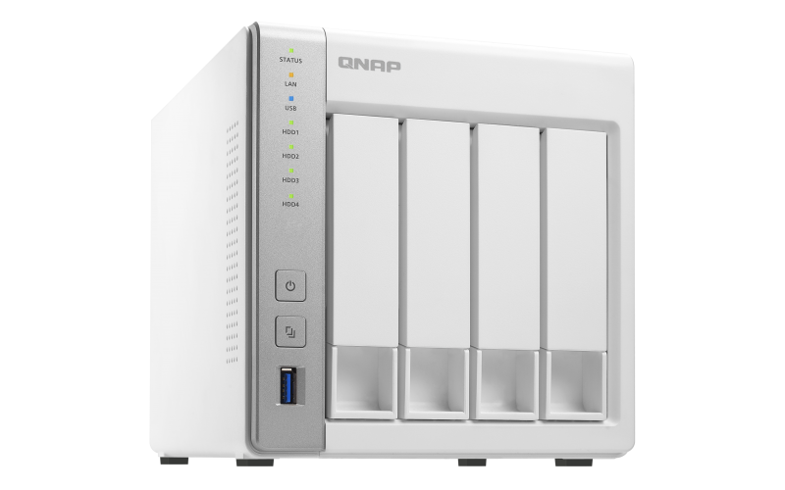
Agenda
Home security requirement
Home security Demo Video
Home security solution
8 build-in channels

Slide 3
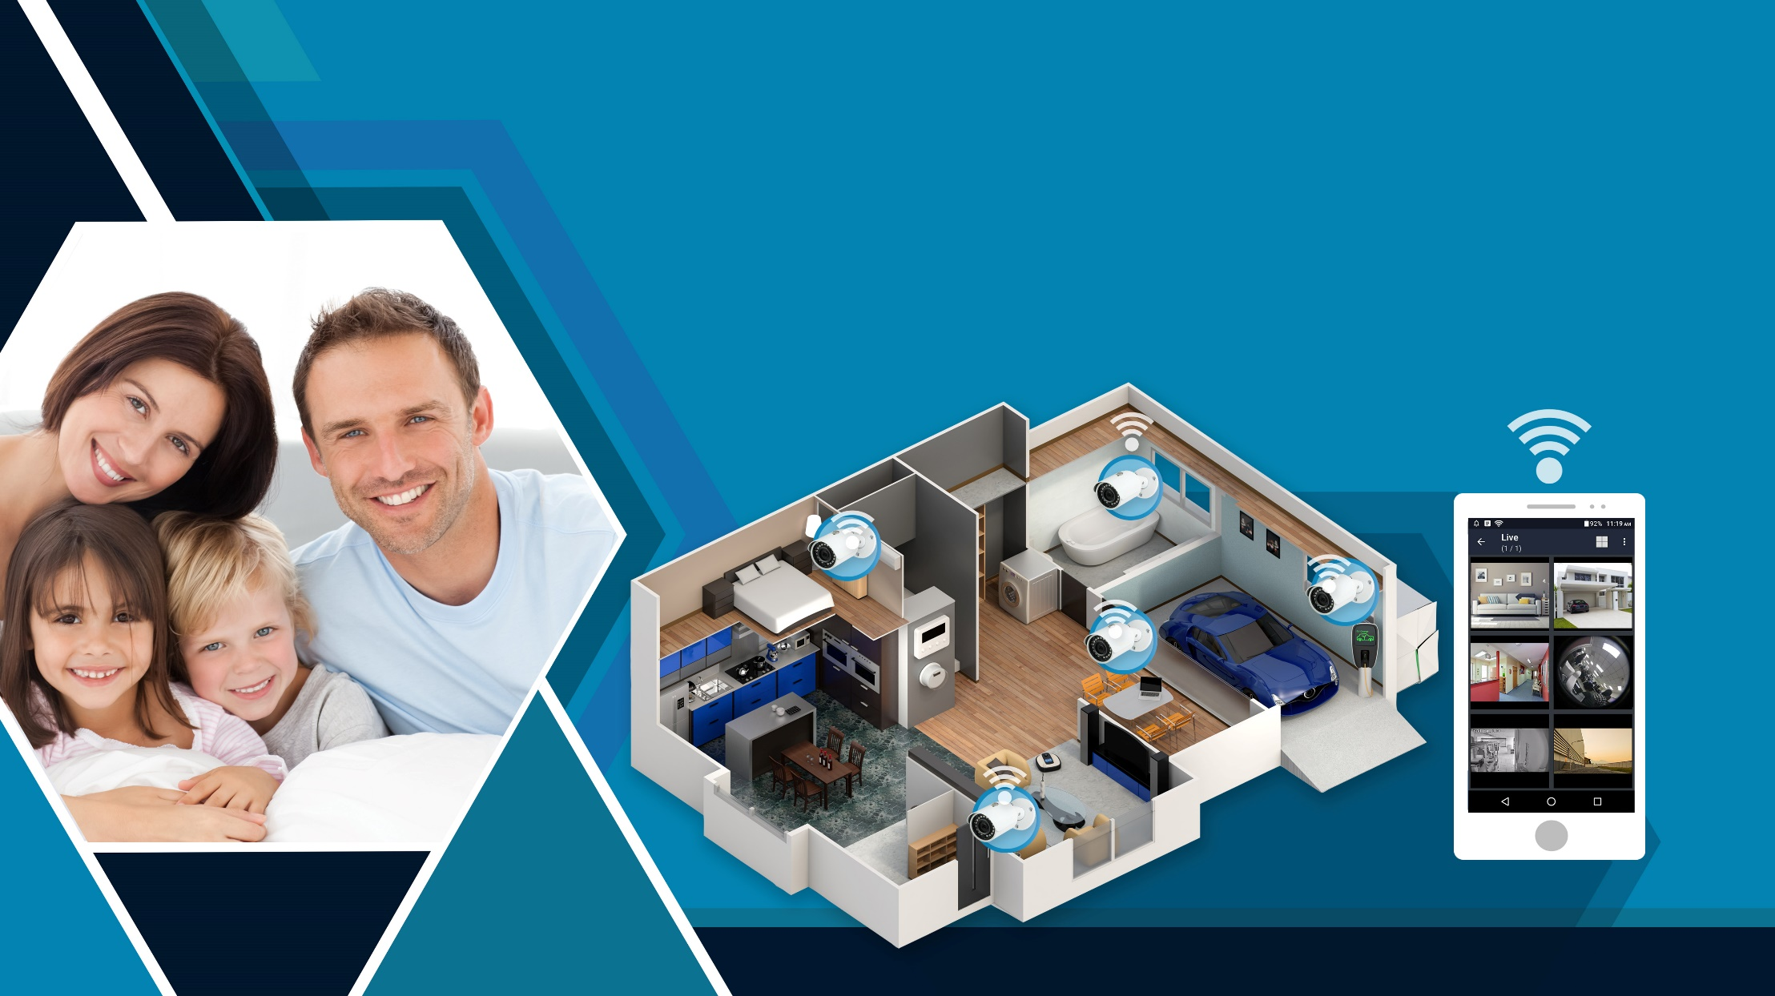
Home security requirement

Slide 4
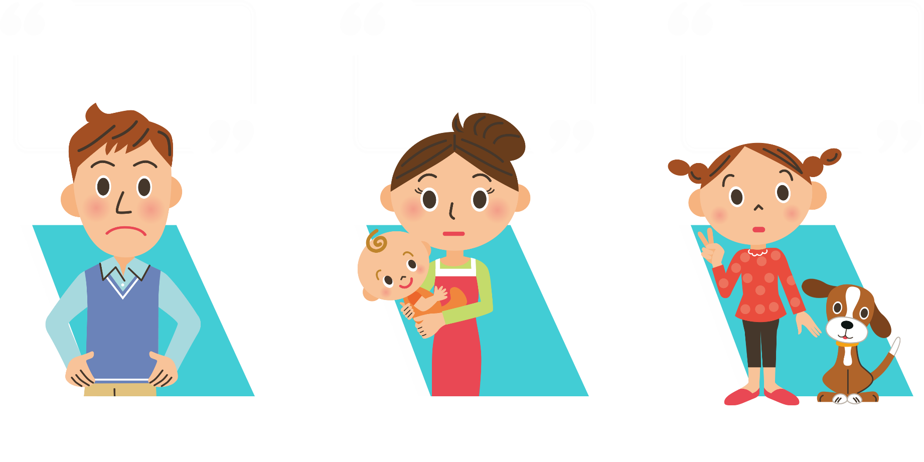
Questions from family members
Does the surveillance system cost a lot?
Can I see my baby brother and pet even when I'm not home?
Does it fit my need?
Dad, who is pragmatic and loves to try out new electronic devices
Mom, a thrifty housewife
Daughter, who loves
her pet the most

Slide 5
Pragmatic dad has something to say
“There are plenty features, but are they suitable for me? My point is to have a practical surveillance product.”
Dad cares about the completeness of features, and wishes to have all needed functions in one product, such as recording the video & viewing the recording and notifications.
Notes:
5

Slide 6
Thrifty mom has something to say
“Budgets are tight for the family. I heard that cameras for surveillance are quite expensive. I need something that are affordable and nice”
Mom focuses on the “price” and wishes to have a good deal. That can help her take good care of her family.
Notes:
6

Slide 7
Sweet daughter has something to say
“I wish to see my baby brother and pet even when I’m not home. It would be even better if I can share the video with my friends” Daughter cares about ”simplicity” and wishes to have the easiest way to check the video and recording playback.
Notes:
7

Slide 8
The family members have something to say
Dad:
- Video record at the front door, living room, kitchen and baby's room.
- When there is an abnormality, notify me immediately.
- Monitor only when my family leaves the house.
- Permission control for different users.
Mom:
- I hope to minimize the cost, but required functions are still needed.
Daughter:
- I hope I can see the video from my phone and tablet. Also, I want to share it with my friends and family.
Notes:
8

Slide 9
Home
Live
Live

Slide 10
Home security solution

Slide 11
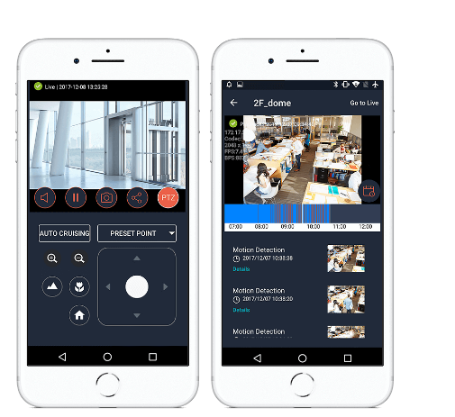
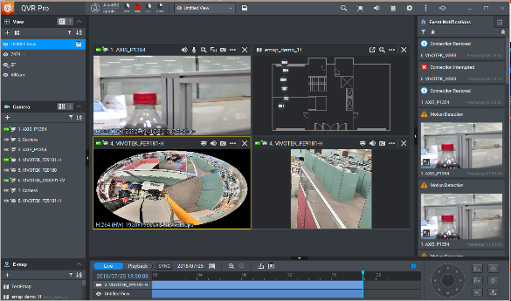
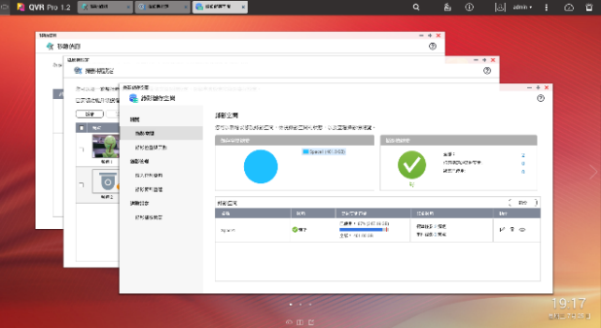
Home security solution
QVR Pro Client
QVR Pro
QVR Pro Client

Slide 12
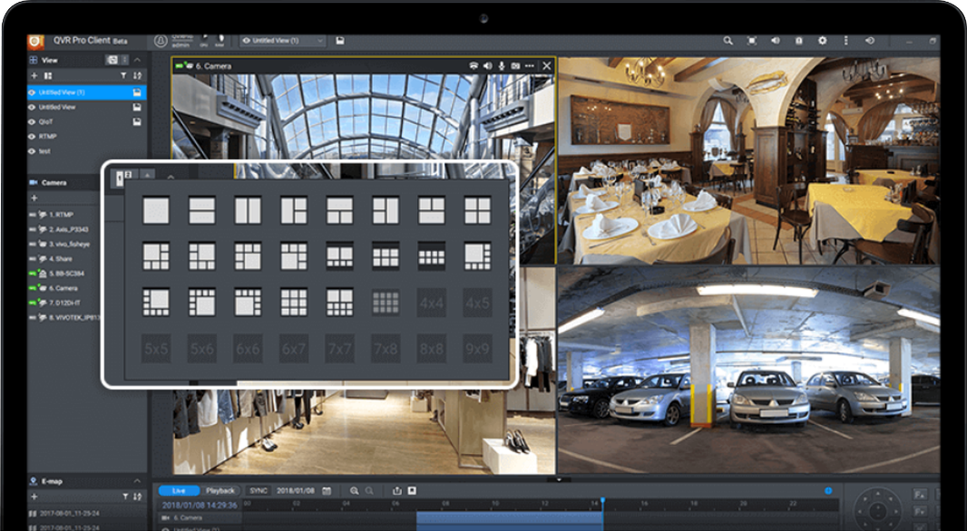
Home security solution – fully functional for dad
1. Record and surveillance
QVR Pro records the video and you can view the video by using QVR Pro Client. It utilizes unified UI interface on different platforms (Windows, Mac, Ubuntu and HDMI Local Display).

Slide 13
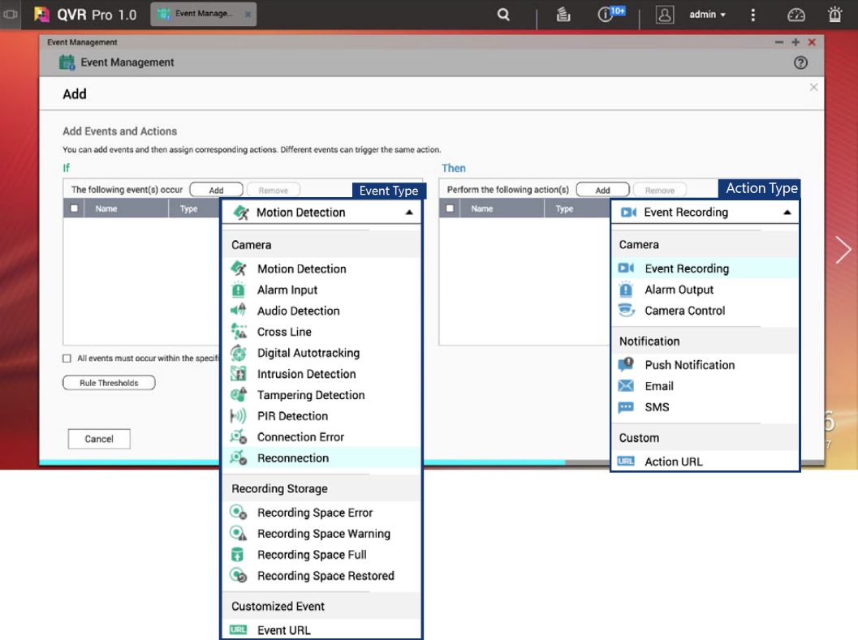
Home security solution – fully functional for dad
2. Smart event engine
Face the camera to the front
door and set up motion detection, alarm input.. etc. When none of the family members are at home but the alarm is triggered, Dad can check the video see if someone breaks in.

Slide 14
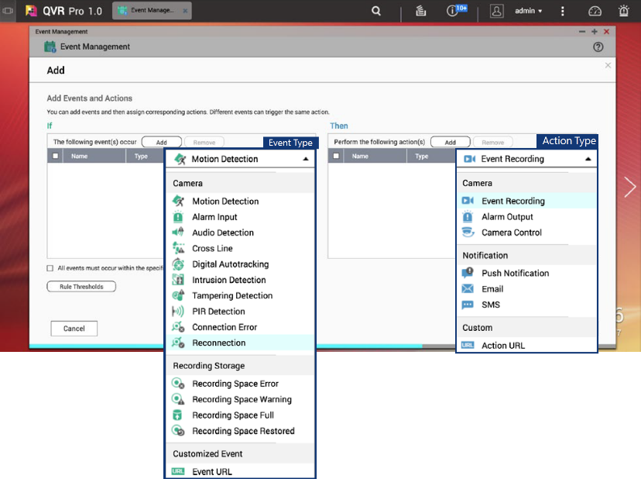
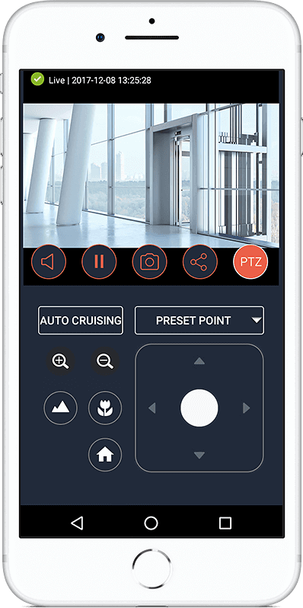
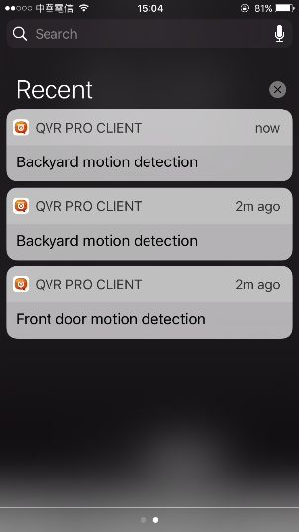
Home security solution – fully functional for dad
3. Various notification methods
With the QVR Pro event engine, you can set up various notifications methods such as mobile push notification, Email & SMS.
If necessary, set up the rule “IF motion detection THEN alarm output” to deter the intruder.

Slide 15
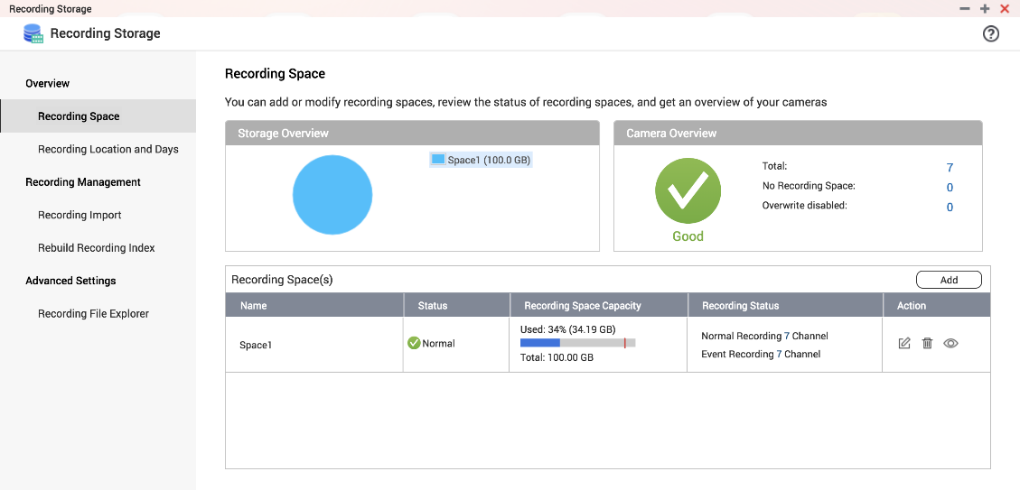
Home security solution – fully functional for dad
4. Flexible Custom Settings (Video Mode)
If the capacity of the hard disk allows, select ”normal recording
“ in case you don’t want to miss
any second.
If the hard disk capacity is
not large but you still want
to record when things
happened, select
"Event Recording".

Slide 16
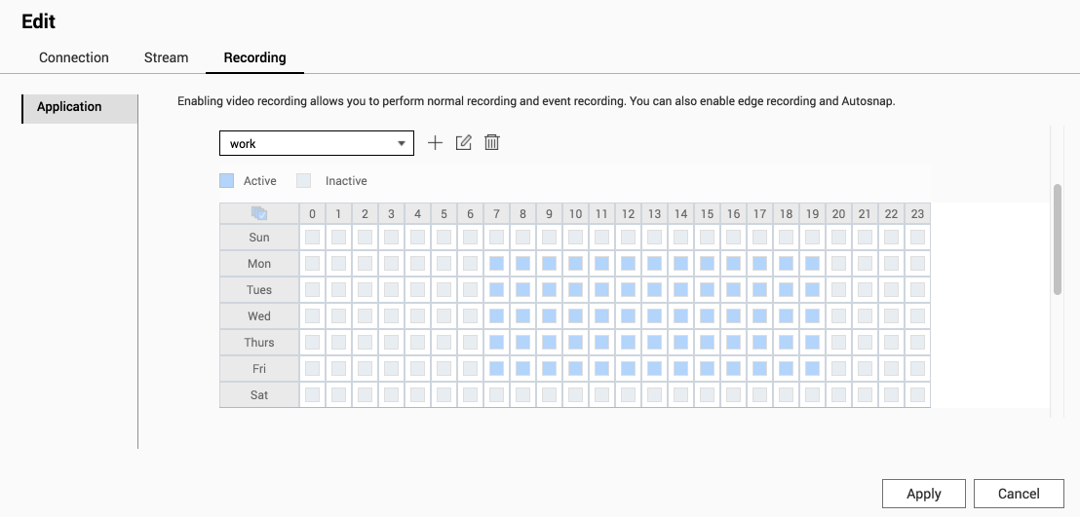
Home security solution – fully functional for dad
4. Flexible settings (schedule recording)
QVR Pro can set up schedule recording. Dad can set up recording from 7am to 7pm. The schedule can be detailed to hour, making sure the privacy of your family.

Slide 17
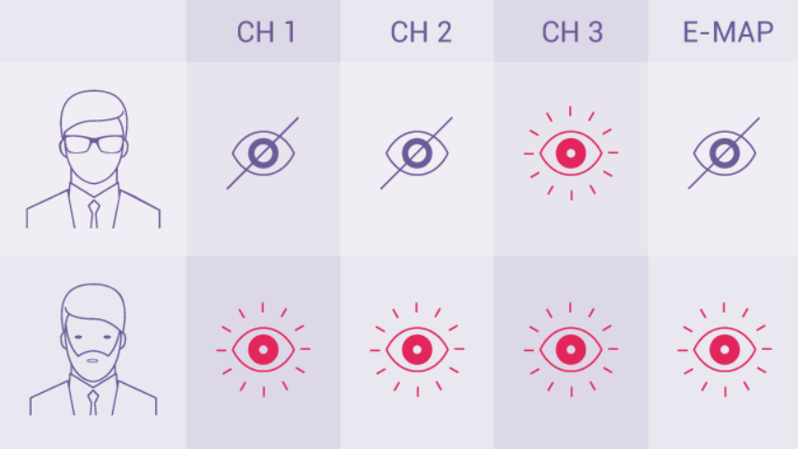
Home security solution – fully functional for dad
4. Flexible settings (privilege setting)
To avoid settings being unnecessarily changed, Dad, who is familiar with electronic products, can use the privilege feature to limit available operations of mother and daughter.

Slide 18
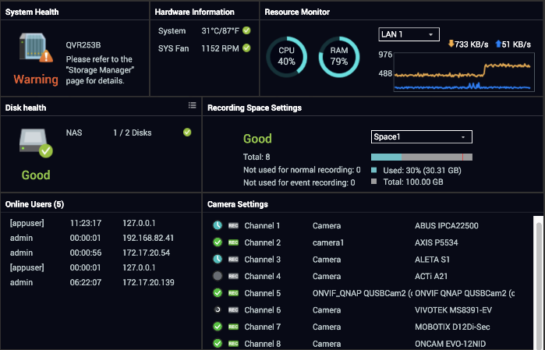
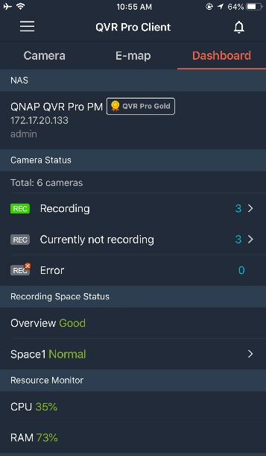
Home security solution – fully functional for dad
5. Clear dashboard interface
Through the dashboard, you can clearly control the current system/hard disk health, hardware usage, camera status.

Slide 19
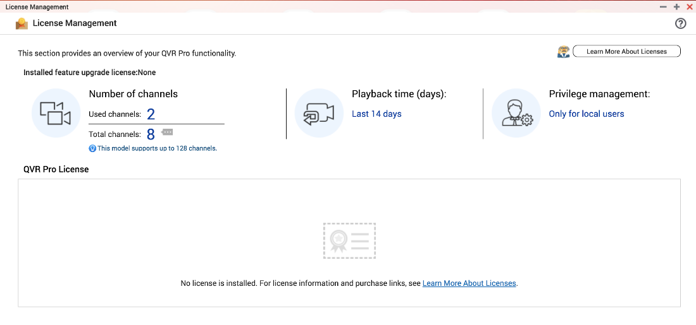
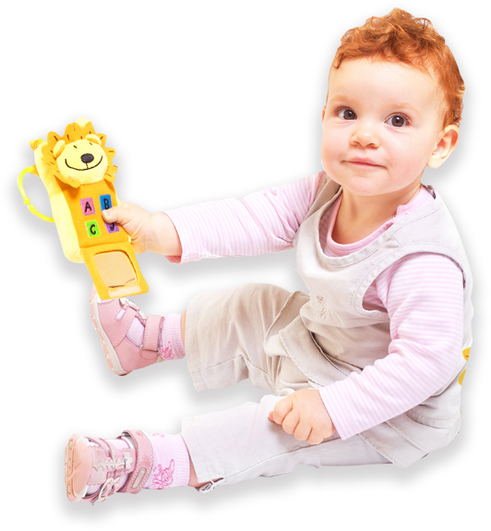
Home security solution – a great deal for mom
1. Eight default channels for free
QVR Pro can be installed on QNAP NAS , saving the expensive cost of an additional surveillance system. Mom can playback within 14 days recordings of the 8 built-in camera channels at no extra cost. Absolutely enough for the home scenario.
8 build-in channels

Slide 20
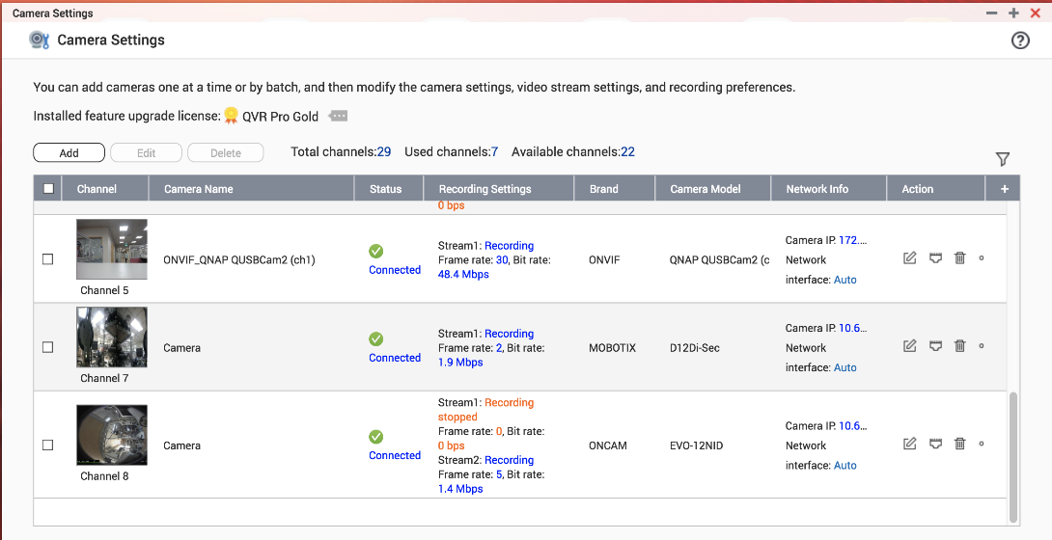
Home security solution – a great deal for mom
2. Webcams can be used with QVR Pro
Buying HD webcam will be less expensive than buying an IP camera.
Just connect the webcam directly to the USB port of the QNAP NAS. Through the QUSBCam2 this camera can be added into QVR Pro for the surveillance.

Slide 21
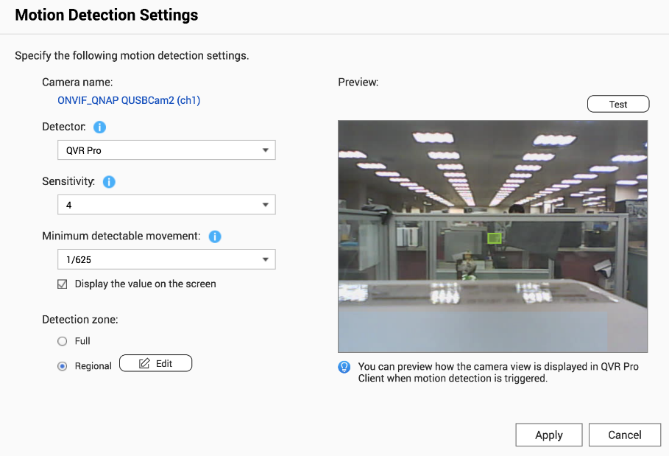
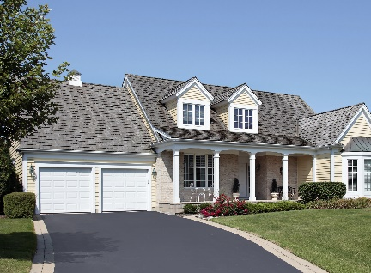
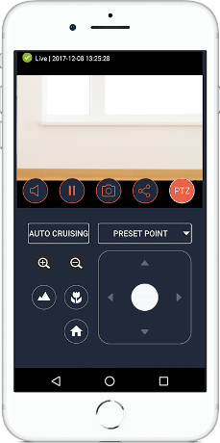
Home security solution – a great deal for mom
3. Motion detection with webcam
The webcam, which is easy-to-buy and affordable, does not support motion detection by itself. But with QVR Pro video analysis you can still set up motion detection rules.
Motion Detection
Event Management

Slide 22
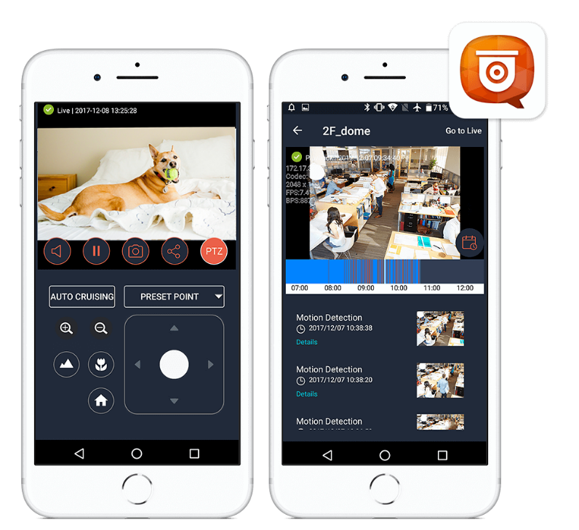
Home security solution – convenient for daughter
1. Monitor with mobile device
Just use QVR Pro Client for iOS and Android on your mobile device, and you can watch the live video or playback anytime, anywhere.

Slide 23
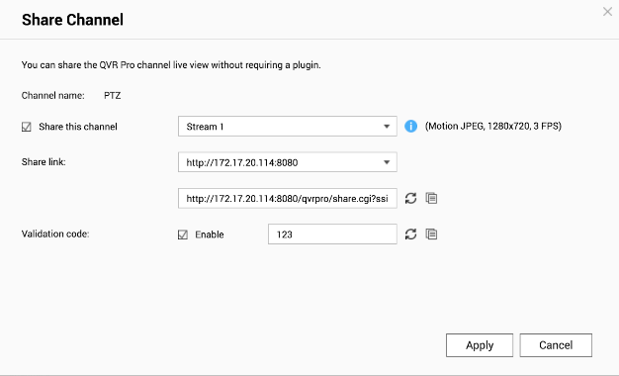
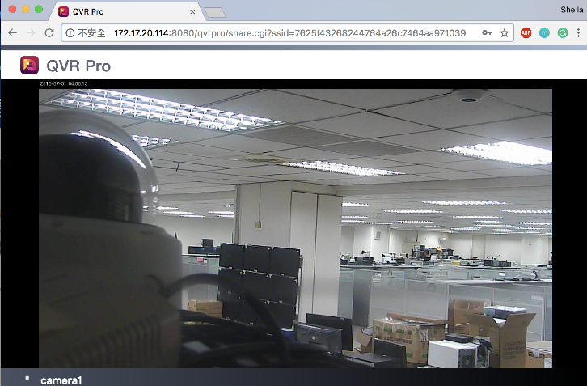
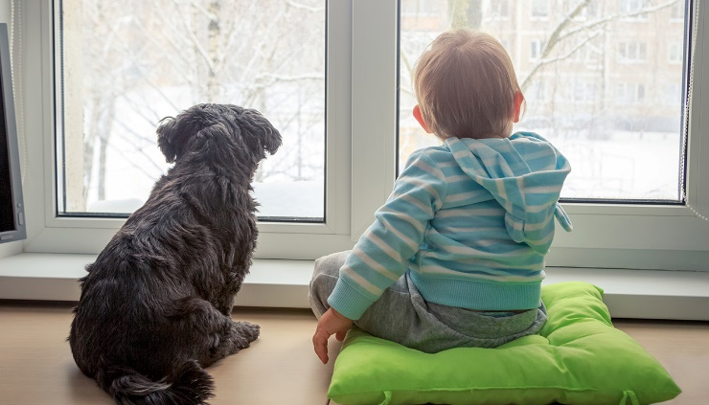
Home security solution – convenient for daughter
2. Easy to share
Just provide a short URL to your friends and family. They can immediately enjoy the cute look of your younger brother and pet with just web browsers.

Slide 24
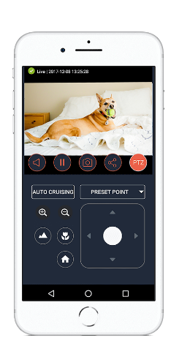
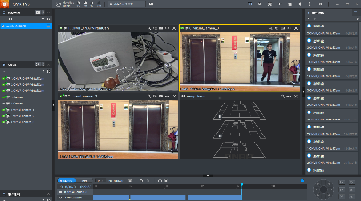
Home security solution – architecture
Home (With QNAP NAS)
QUSBCam2
QVR Pro Client (Mobile)
IP camera
QVR Pro
QVR Pro Client (PC)

Slide 25
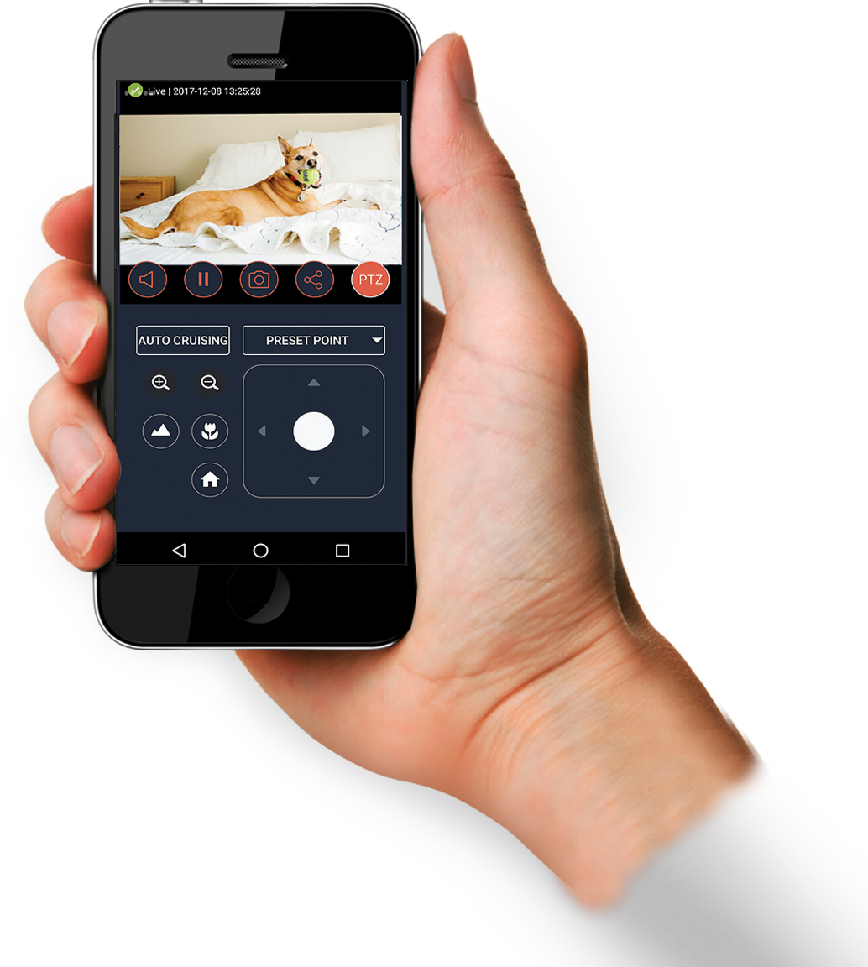
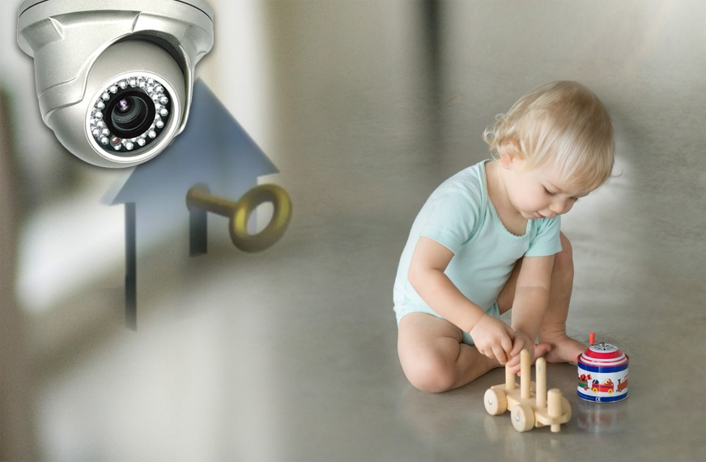
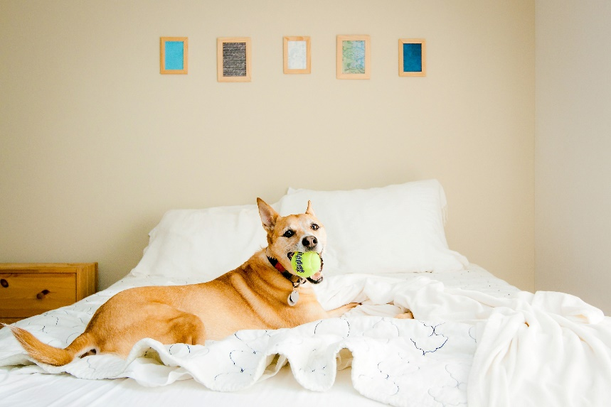
Home security solution – other scenarios
Record the life of your kid or pet with the camera in the playroom or the living room. Not only the recording will become a good memory in the future, but also you can check what's happening in the house when you are out.

Slide 26
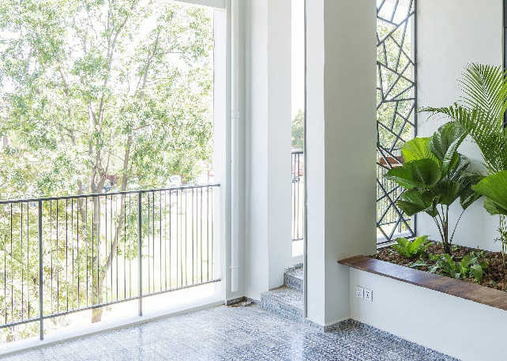
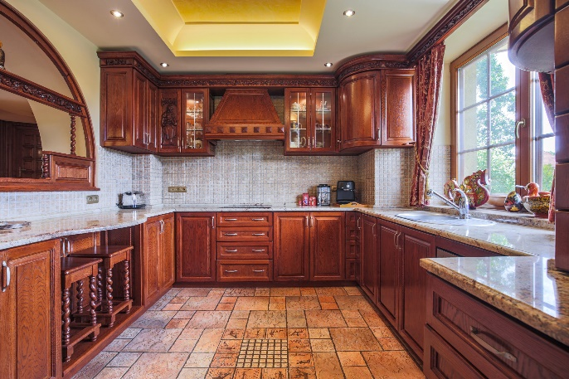
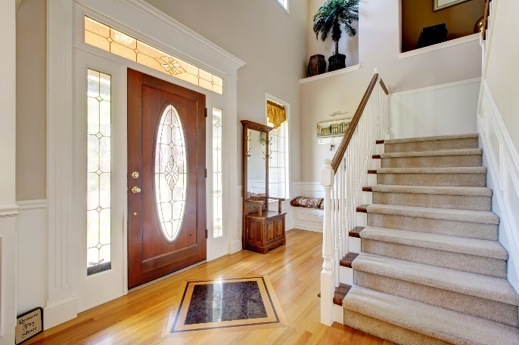
Home security solution – other scenarios
Balcony, kitchen, and stairs are places where accidents happen easily on children and elders. To avoid accidents, set up detection area and use the mobile phone with event push notifications.

Slide 27
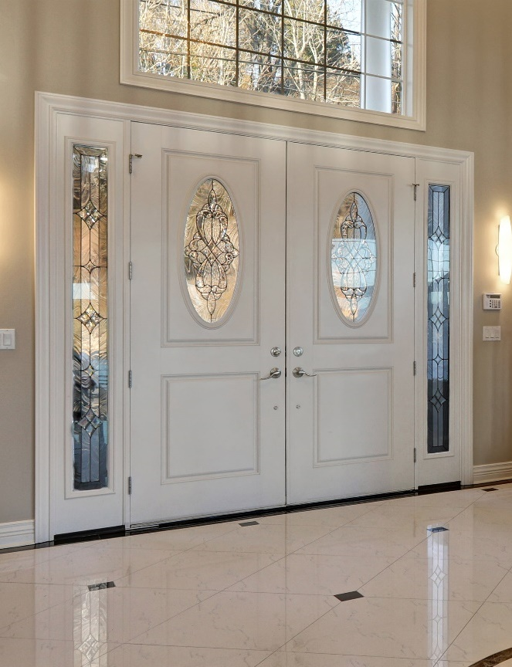
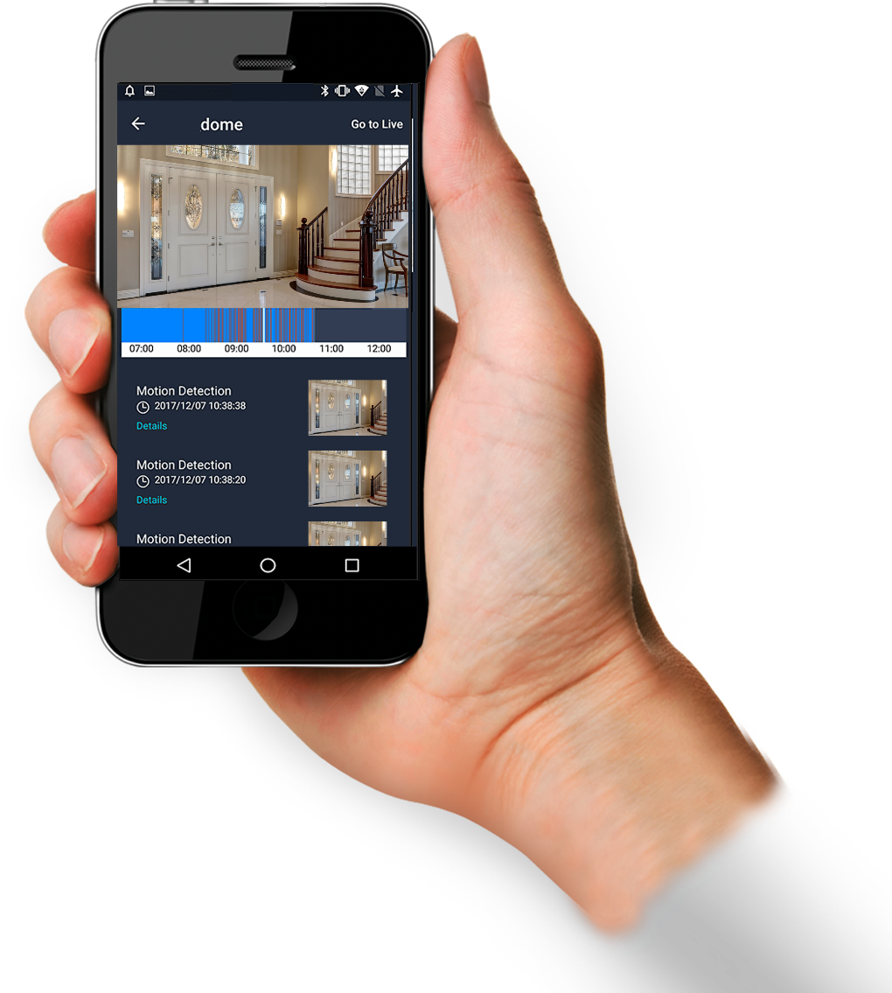
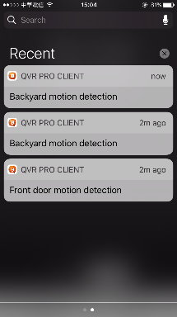
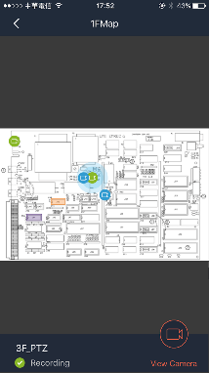
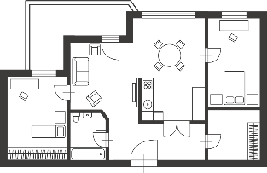
Home security solution – other scenarios
To prevent the child from running out without your attention, set the gate as the alert zone of motion detection.

Slide 28
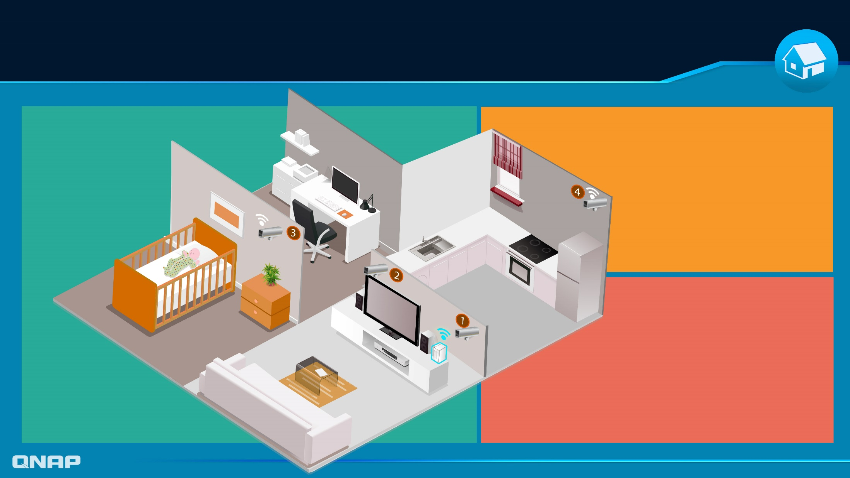
Home security solution – demo
Camera03：
Camera04：
The baby's room requires a higher level of security. Use IP cameras with IR LED for 24/7 recording.
To prevent children from coming close to dangerous items, use an IP camera to monitor the kitchen. Then, set up event recording and mobile push notifications.
Camera01 & Camera02：
Since it is closer to the QNAP NAS, use webcams and set 24/7 recording or event recording (motion detection), with mobile push notifications.
QNAP
NAS

Slide 29
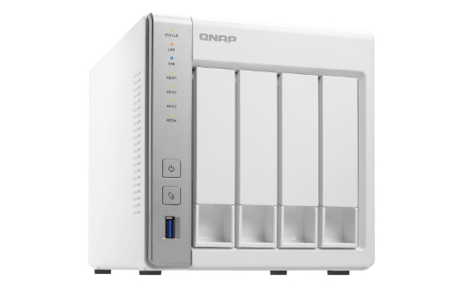
QNAP surveillance solution vs conventional surveillance solution
 | Installation Difficulty | Cost | Features | Maintain
Conventional IP cam+ Surveillance system | Difficult (For professional user, not easy for family users) | high (A lot of equipment) | less (only for surveillance) | hard (complicated to maintain, hard to control system status)
QNAP NAS (With QVR Pro App) | Easy (Easy to set up! Just go and download at QTS App Center) | low (Just a single QNAP NAS is enough) | versatile (NAS features+ surveillance) | easy (QNAP NAS has it 's own dashboard to control the system status)
8 build-in channels

Slide 30
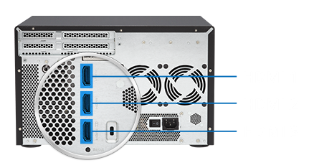
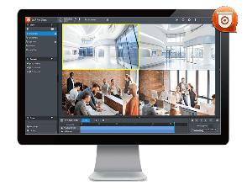
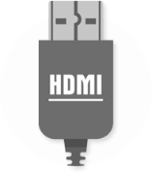
NAS for your home surveillance
The best entry level NAS for QVR Pro
Build-in HDMI
View live feeds directly from NAS
3 x HDMI ports
Small-scale surveillance TV wall
TS-332X-4G
TVS-951X-8G
TVS-1282-i7-64G
RAID5
RAID5

Slide 31
Copyright © 2018 QNAP Systems, Inc. All rights reserved. QNAP® and other names of QNAP Products are proprietary marks or registered trademarks of QNAP Systems, Inc. Other products and company names mentioned herein are trademarks of their respective holders.

