Slide 1
*

Slide 2
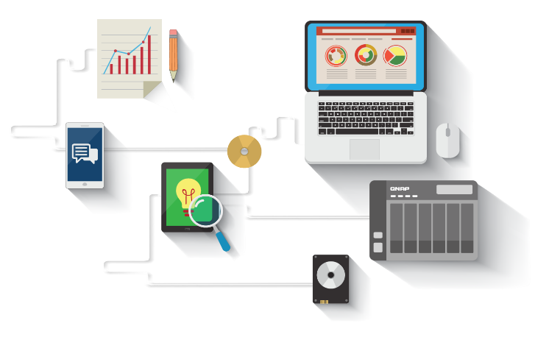
Workflow Automation
The Internet has changed our lives
Plenty of web services
Software automators
Connect all services
？
？
？

Slide 3
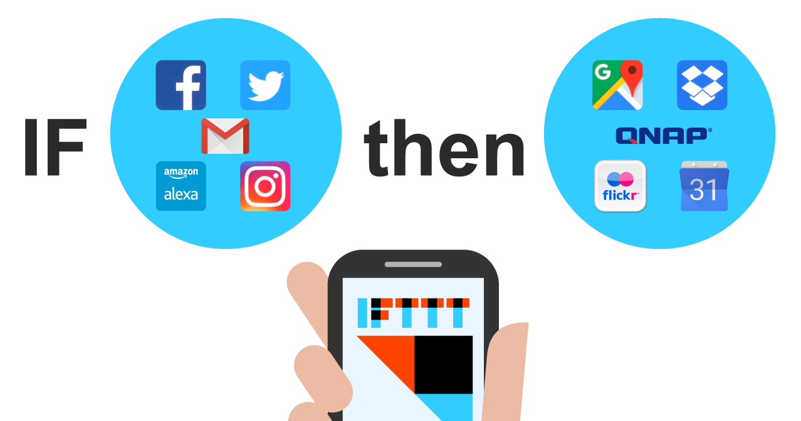
What is IFTTT

Slide 4
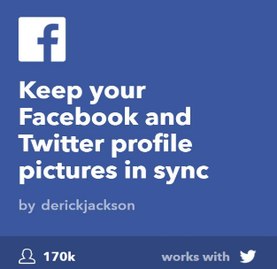
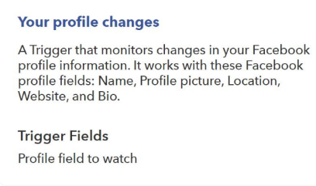
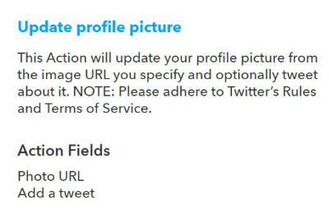
What is IFTTT
IF This Then That
Trigger is the THIS part in IFTTT
Action is the THAT part in IFTTT

Slide 5
About IFTTT Agent
An app on QNAP NAS that communicates with IFTTT via myQNAPCloud
myQNAPcloud
Authenticate with QID
Connect IFTTT account with QNAP
All NAS registered
with QID
Ensures execution of NAS related triggers and actions
Display logs of triggers and actions executed on the NAS
QNAP Service

Slide 6
Prerequisites
How to begin
An IFTTT account
A QNAP NAS with QTS 4.2.2 and newer
IFTTT Agent installed on your NAS
A myQNAPcloud account (QID)
NAS registered with your myQNAPcloud account (QID)

Slide 7
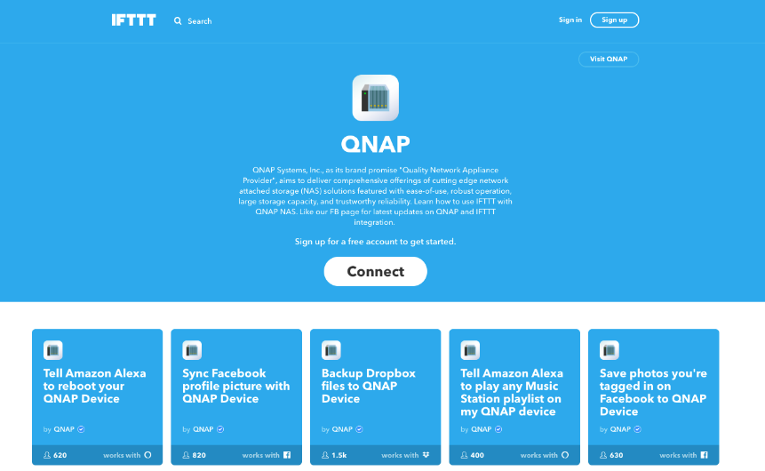
How to begin: QNAP service
How to begin
01
Go to https://ifttt.com/qnap
02
Click on the Connect button

Slide 8
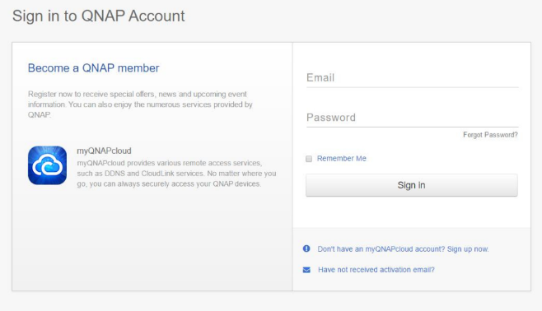
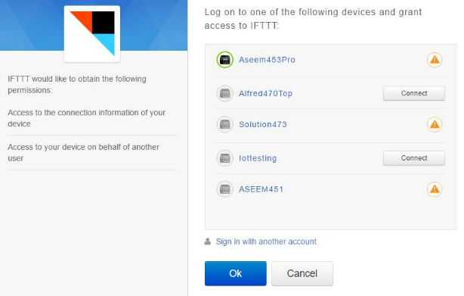
myQNAPcloud authentication
How to begin
02
Login with QID
01
myQNAPcloud authentication
03
List of NAS registered with this QID

Slide 9
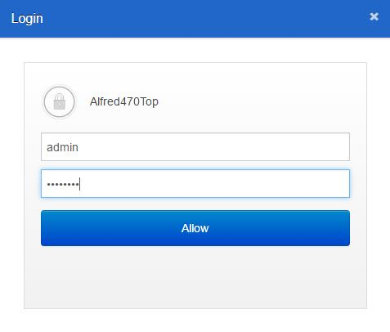
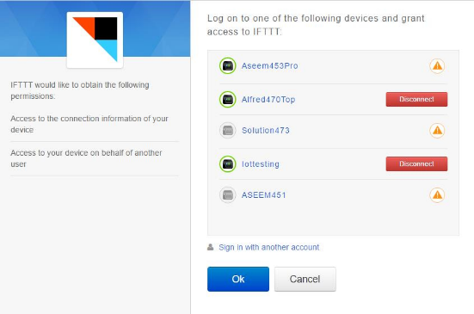
myQNAPcloud authentication
How to begin
04
06
List of NAS connected with IFTTT
Connect with any NAS
05
07
Click OK to complete connection
Enter NAS credentials

Slide 10
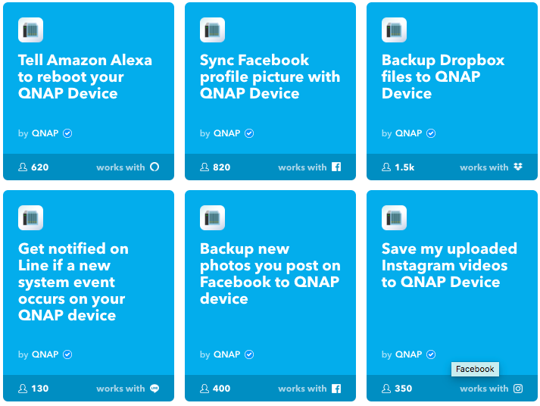
Configure applets
How to begin
01
Directly use QNAP published applets
02
Check on QNAP service page
03
Select any applet

Slide 11
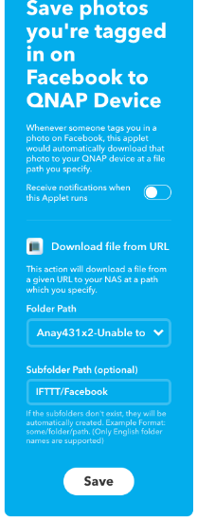
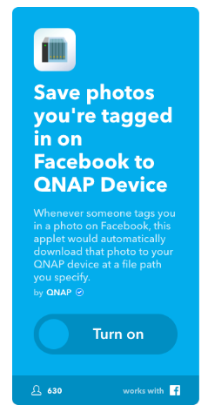
Configure applets
How to begin
04
05
Turn the applet on
Configure

Slide 12
About IFTTT Agent
One IFTTT account can link with many NAS under the same QID
NAS 1
User A
NAS 2
myQNAPcloud
IFTTT
QID
User A
User A
User A
NAS 3
User A

Slide 13
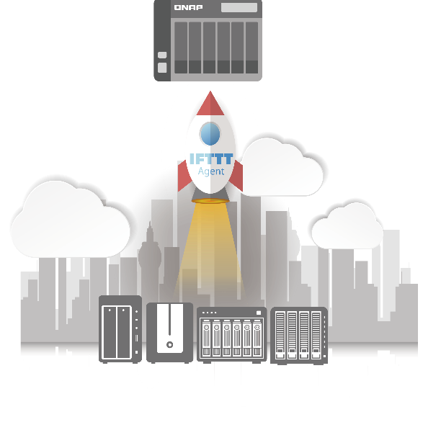
Purposes of IFTTT Agent
Automate daily menial tasks on NAS
Save your precious time
Skyrocket NAS productivity
Best NAS in the market

Slide 14
User Scenarios for IFTTT Agent

Slide 15
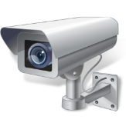
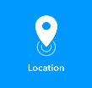
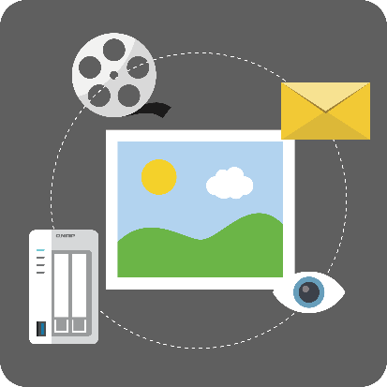
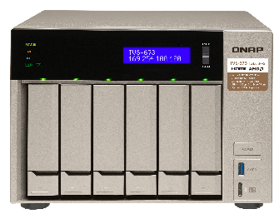
User Scenarios for IFTTT Agent
SMARTer and SAFEr Surveillance Experience
If motion is detected outside my door using motion sensor (via Webhooks) or ManyThing, then
Take a picture of that moment using Surveillance Station camera
Save this photo on the NAS
Send the photo to me via email
Start recording using my Surveillance Station

Slide 16
User Scenarios for IFTTT Agent
SMARTer and SAFEr Surveillance Experience
Whenever I leave home, start recording my surveillance station camera
Whenever I enter home, stop recording my surveillance station camera

Slide 17
User Scenarios for IFTTT Agent
USER COOL Music Station experience for your SMART HOME
Tell Amazon Alexa to start party mode
Start playing the music station playlist named ‘Party’
Change the color of your Philips Hue light bulb to change to party ambience
Switch to the next song using Amazon Alexa
Stop playing the music if I have to make a call

Slide 18
User Scenarios for IFTTT Agent
USER COOL Music Station experience for your SMART HOME
Every morning set an alarm using Music Station to wake you up
Every morning play yoga music playlist on my Music Station

Slide 19
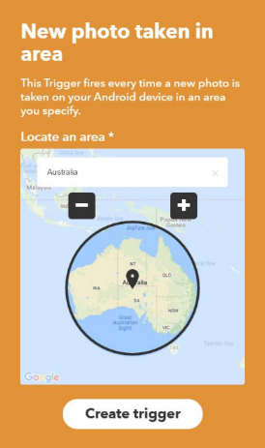
User Scenarios for IFTTT Agent
Make the most of your vacation. Take photos and smartly back up on the NAS
Select your area using Locations service on IFTTT
Save all photos of one area into one folder on NAS
Automatically categorize
your photos based on location

Slide 20
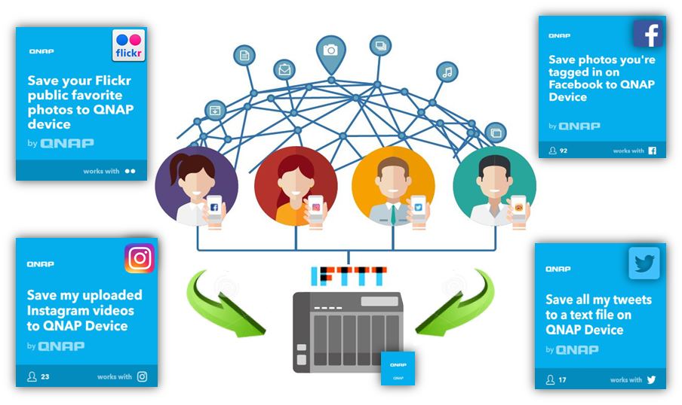
User Scenarios for IFTTT Agent
Effortlessly archive your Social Media data
Notes:
We will demo two scenarios here:
If a user uploads photos or videos on Instagram, they will be automatically backed up to his NAS
If a user is tagged in any photo on the FB, the photo will be saved to the NAS

Slide 21
QNAP x IFTTT
Copyright © 2018 QNAP Systems, Inc. All rights reserved. QNAP® and other names of QNAP Products are proprietary marks or registered trademarks of QNAP Systems, Inc. Other products and company names mentioned herein are trademarks of their respective holders.

