Slide 2
Demand increases for storage and computing
Add Storage
Purchase large capacity disks and/or storage devices
Enhance Computing
Purchase more powerful servers

Slide 3
But resource is limited. What can we do?
Different departments in the company require their own independent storage environments, but the budget is tight. How can these demands be met ?
New equipment is needed but the physical space is limited.
The NAS computing capacity needs a boost while the storage space is still sufficient. Is there a way to deliver what's really in need?

Slide 4
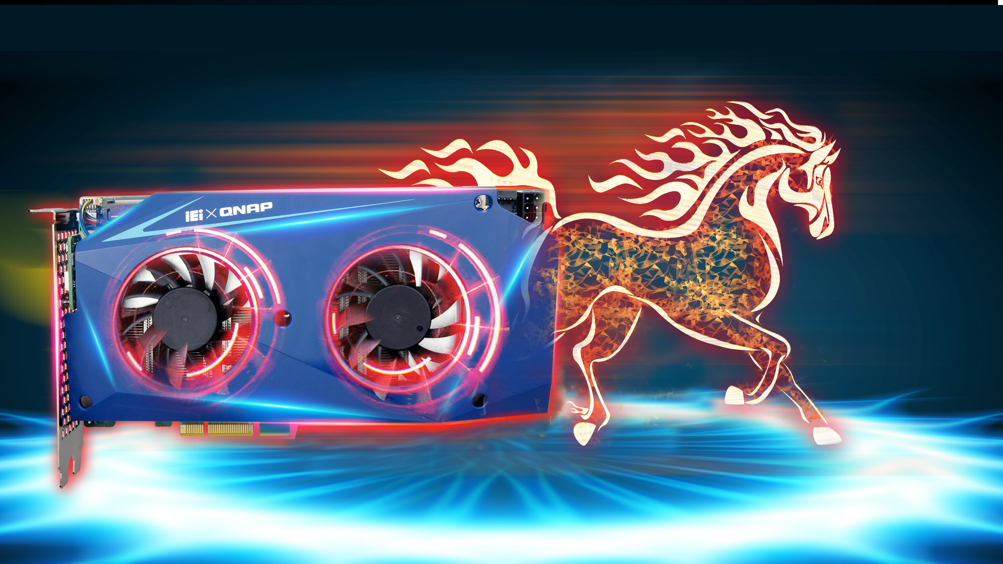
Multiple advanced technologies in one card : Mustang-200
QNAP Software
IEI Hardware
Mustang-200 solves your problems in a compact single expansion card design.

Slide 5
A quick look at NAS architecture
QuAI
QVR Pro
Apps
Apps
NAS Services
Versatile Applications
FTP
Samba
iSCSI
SQL/Web
Apps
Win
VM
Win
VM
Container Station
Virtualization Station
Operation System
QTS
NAS Hardware
CPU
Memory
Storage
Network

Slide 6
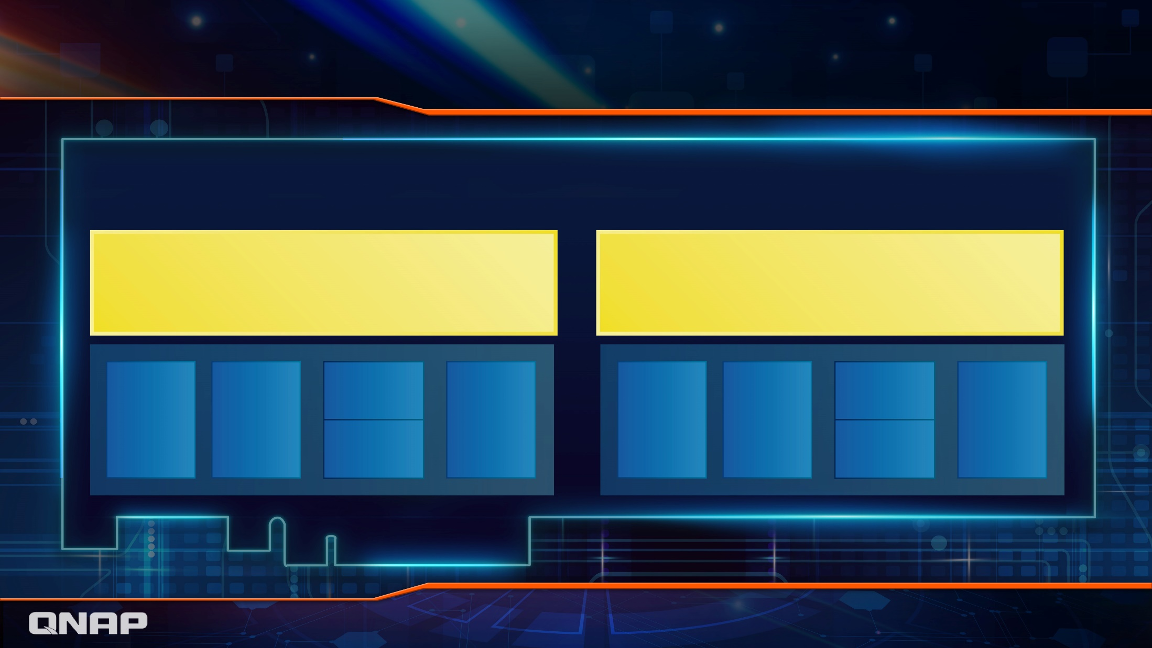
Mustang-200 houses 2 independent nodes
mQTS
mQTS
M.2
Storage
M.2
Storage
CPU
Memory
Network
CPU
Memory
Network
iSCSI/
VJBOD
iSCSI/
VJBOD
PCIe 2.0 x 4
PCIe

Slide 7
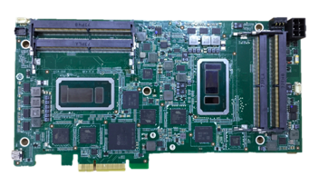
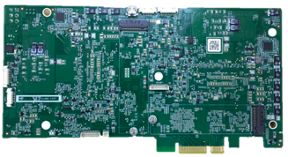
Mustang-200 card design
SO-DIMM slot x2
Intel ULT CPU
6-pin external power supply
M.2 PCIe NVMe slots
Intel ULT CPU
10GbE x2
10GbE x2
SO-DIMM slot x2

Slide 8
Interfaces
Each miniature physical NAS has its independent IP address
Choose any interface at host NAS as the gateway port
網路交換機

Slide 9
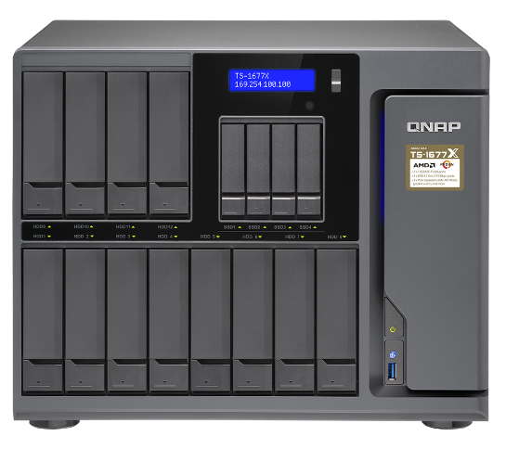
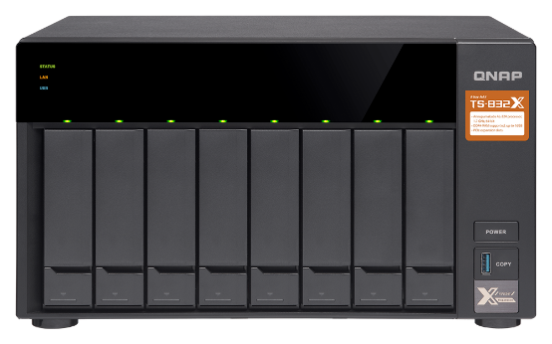
Storage and expansion
Built-in M.2 PCIe NVMe SSD slots (per CPU)
PCIe 3.0 x4
VJBOD expansion
space
Connect to iSCSI LUN or shared folder
LUN
LUN

Slide 10
High efficiency cooling mechanism
Bracket &
Card number display
CPU thermal module:
Heat shield, radiator, fan
Motherboard:
CPU, Memory, 10G LAN, M.2, HDMI, USB
M.2 thermal module:
aluminum alloy radiator, thermal pad
Note: HDMI and USB ports are for debug purposes only.

Slide 11
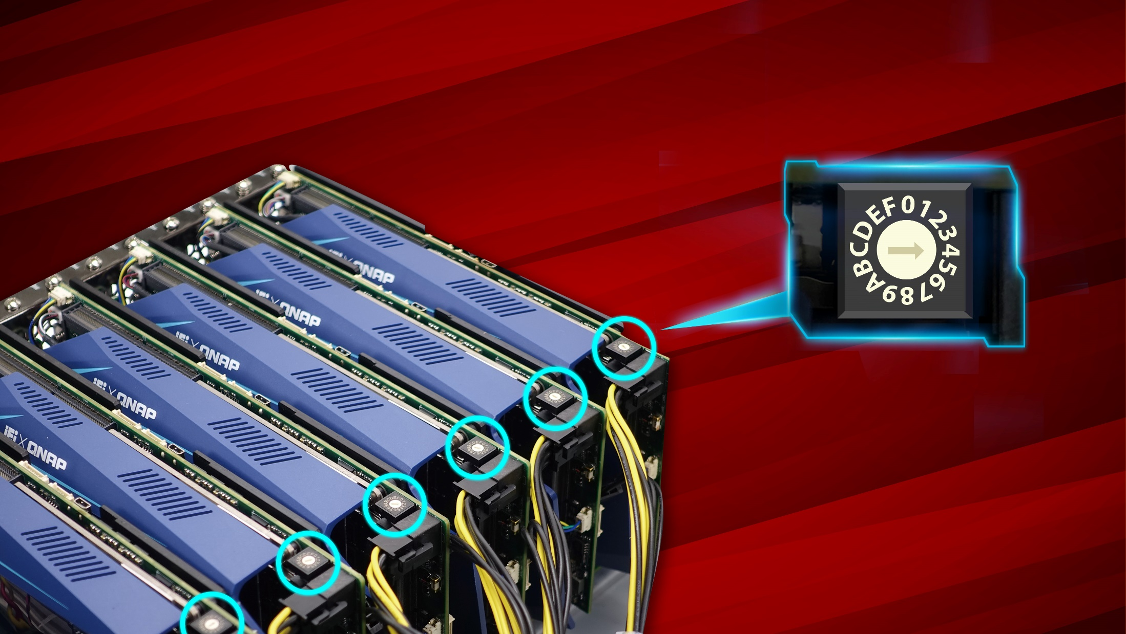
Install multiple Mustang-200 as needed
Set a unique ID for each card
Use rotary switch to set ID

Slide 12
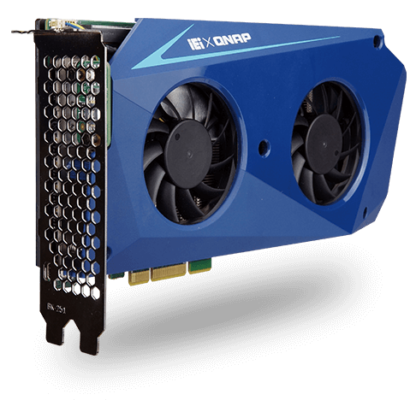
IEI x QNAP Mustang-200
Mustang-200-i7-1T/32G-R10
Intel® Core™ i7-7567U 3.5GHz x2
Intel® 600P 512GB SSD per CPU
16GB(8GB x2) DDR4 per CPU
PCIe x4 interface
Mustang-200-i5-1T/32G-R10
Intel® Core™ i5-7267U 3.1GHz x2
Intel® 600P 512GB SSD per CPU
16GB(8GB x2) DDR4 per CPU
PCIe x4 interface
Mustang-200-C-8G-R10
Intel® Celeron® 3865U 1.8GHz x2
4GB (2GB x2) DDR4 per CPU
PCIe x4 interface

Slide 13
Mustang-200 intro
Mustang-200 setup

Slide 14
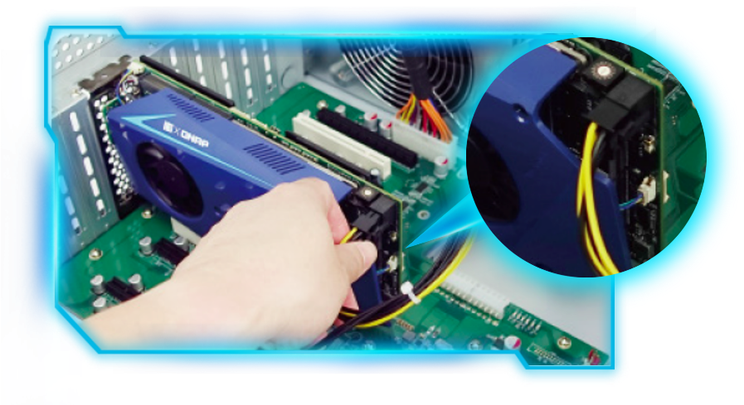
Required NAS models and QTS versions
NAS | Form factor | QTS Ver. | Note
TS-877 TS-1277 TS-1677X | Desktop | 4.3.5
TVS-882 TVS-1282 | Desktop | 4.3.5 | 450 W power supply models only
TS-1685 | Desktop | 4.3.5 | 550 W power supply models only
TS-1677XU/TS-1677XU-RP TS-2477XU/TS-2477XU-RP | Rackmount | 4.3.5
6-pin additional
power

Slide 15
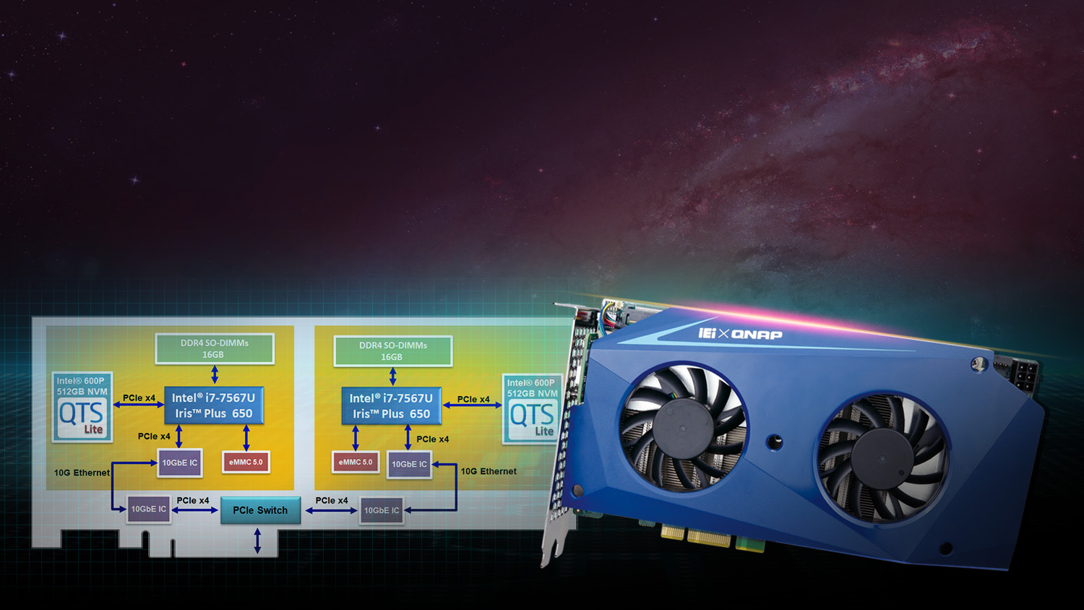
Dual independent QTS system is coming!
Bring up your productivity!
Notes:
讓您的生產力更上一層樓

Slide 16
Five major benefits for upgrading your NAS now
Buy one card and get two NAS
Economical and affordable
Dedicated Card Manager app
For card management on host NAS
Massive apps in QNAP App Center
Easy to learn and use
Independent and friendly development environment
For resource segregation
Powerful security protection
Your safety is our duty

Slide 17
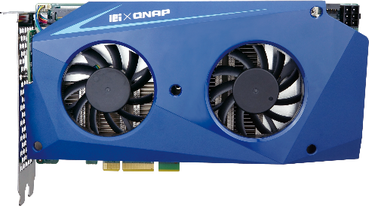
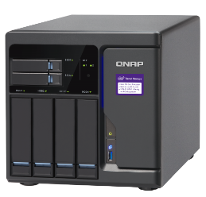
Buy one card and get two NAS
Dual system on one card
Two independent systems for resource assignments
Lightweight Design
Only takes one PCIe slot
Prices at a good value
Three configuration options to choose from
＝
+

Slide 18
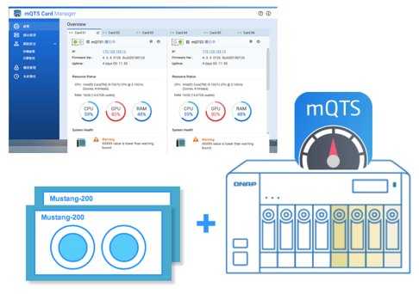
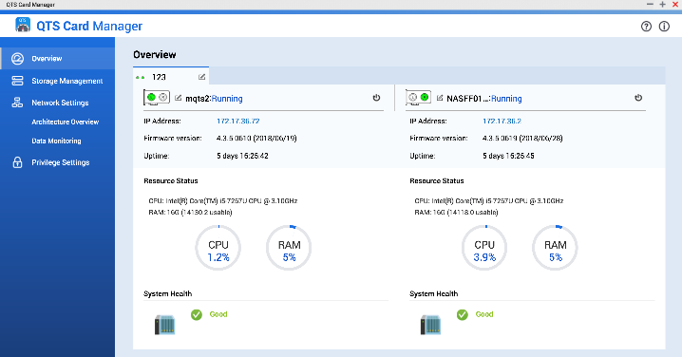
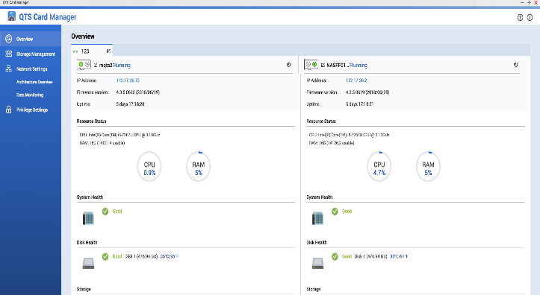
QTS Card Manager on QNAP NAS
QNAP NAS
exclusive
QTS Card Manager is a new app for host NAS users to manage subsystems.
Automatic network setup
Subsystem overview
Configure subsystem storage space
Subsystem network settings

Slide 19
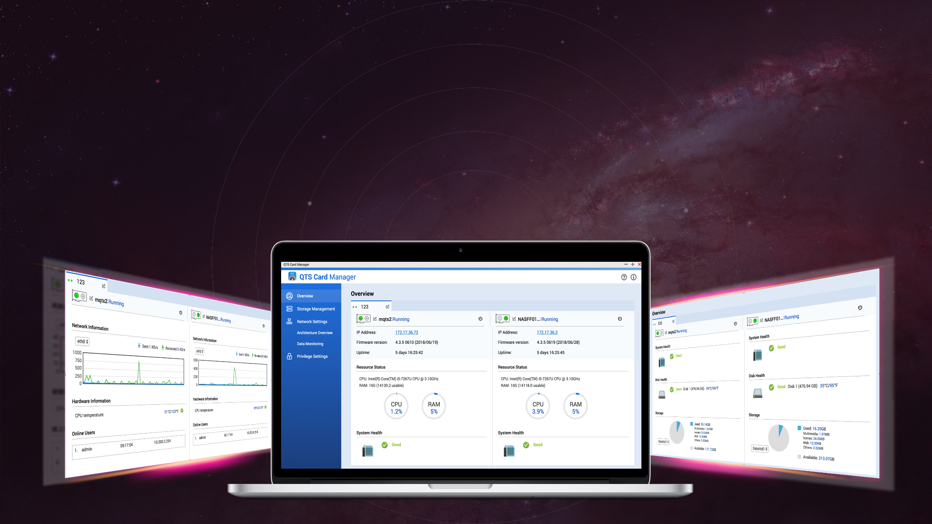
QTS Card Manager - Overview
Intuitive operation of system resource management
Firmware version and hardware resource usage monitoring
Remote control power on and off
One-click to load subsystem management interface
View online users
Notes:
1. 開關機，效能狀態檢視

Slide 20
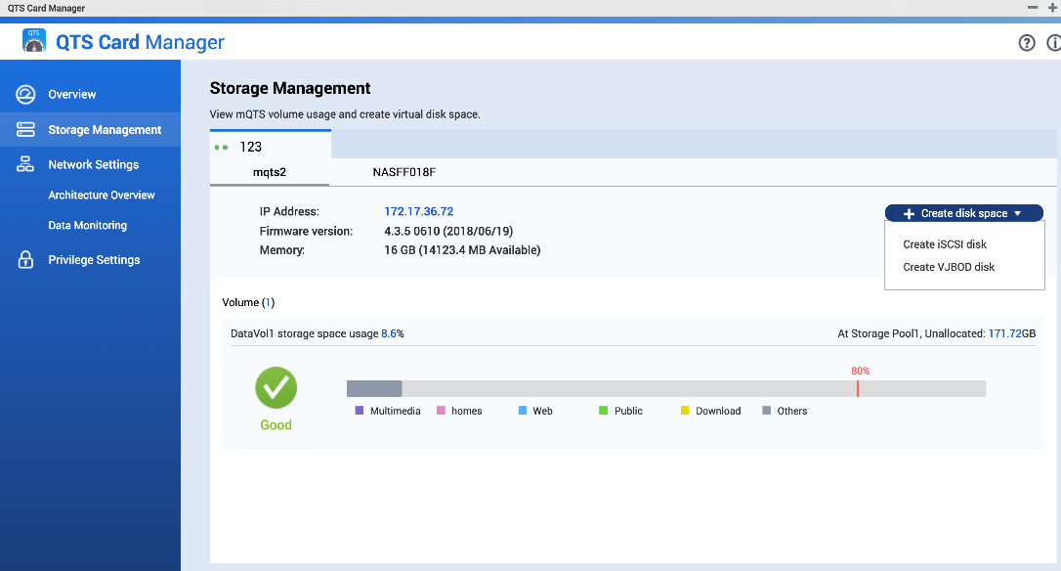
QTS Card Manager - Storage Management
Storage space monitoring and expansion is very simple!
Hard Disk usage monitoring
Help mount (iSCSI VJBOD) host storage space quickly and easily
Notes:
直接在 host掛載 透過精靈一次設置完整
Accroding to the ..... you only need few clicks, then your new storage area is coming！！！！ It's quite simple for user.

Slide 21
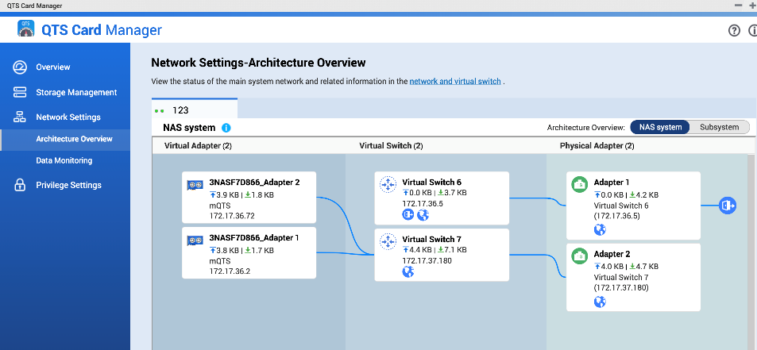
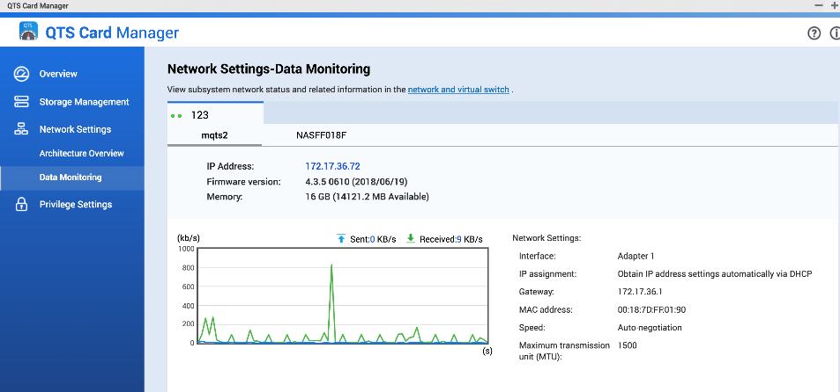
QTS Card Manager - Network Settings
Network topology
Intuitive and clear network topology, for understanding network configuration
Subsystem network settings for flexible configuration of network environments
Network traffic monitoring
Clearly monitors all network activity and traffic changes, and review network bandwidth usage
Notes:
直接在 host掛載 透過精靈一次設置完整

Slide 22
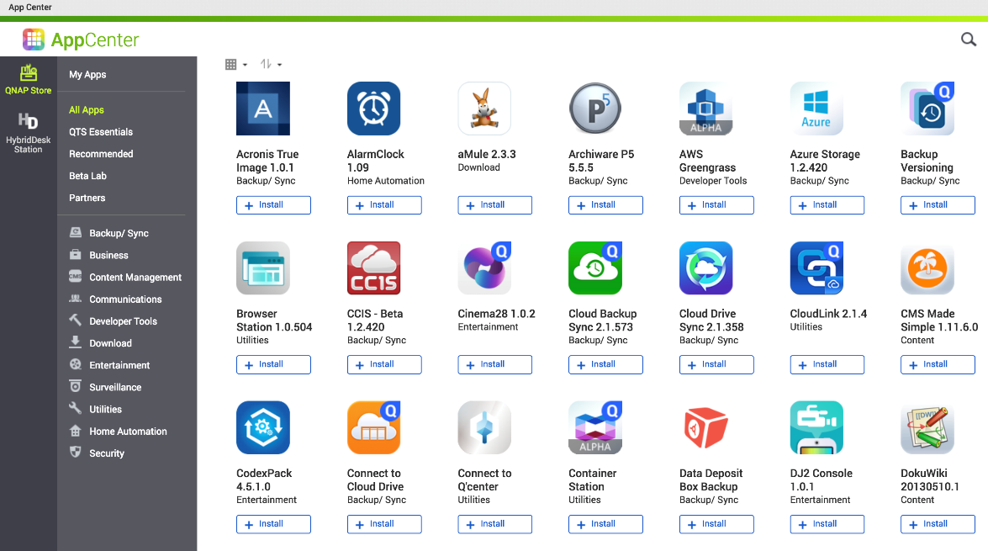
Versatile apps in QNAP App Center
Hundreds of apps to choose from
Importing from third-party app stores
Develop your own application is also possible!

Slide 23
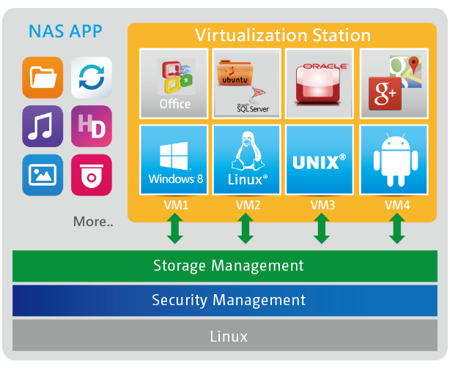
Further expansion: virtualization
Utilize the advantages of independent hardware resources to enable virtualization on miniaturized physical machines!
Virtualization Station
Container Station
Container
App A
App A’
App B
App B’
App B’
App B’
Bins/Libs
Bins/Libs
Docker Engine
mQTS
Mustang-200
Lightweight Linux®-based OS and app virtualization solution
Supports LXC and Docker® containers
Easy deployment, portable and efficient
Complete OS virtualization solution
Supports Windows®, Linux®, UNIX® and Android™
Secure, isolated computing environment
Notes:
Provide a service
Meet the needs

Slide 24
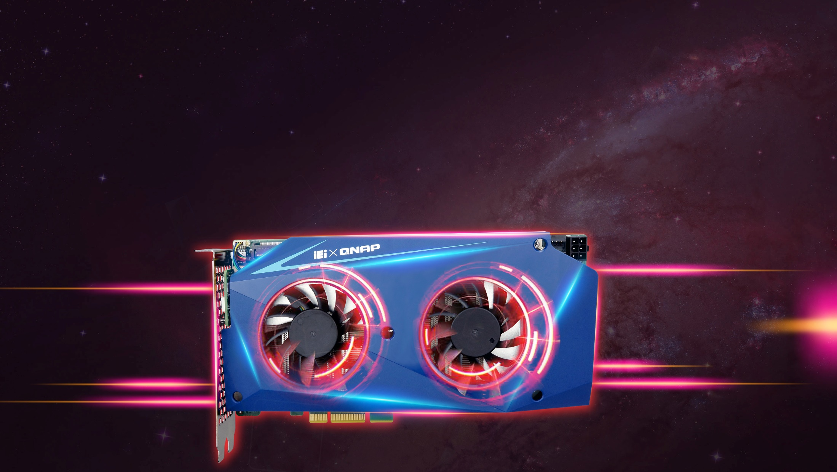
The system is independent and segregated
Subsystems and host NAS run independently of each other
Share with different people and the users may have their own QTS system
Responsible for different application services to ensure that applications do not affect each other

Slide 25
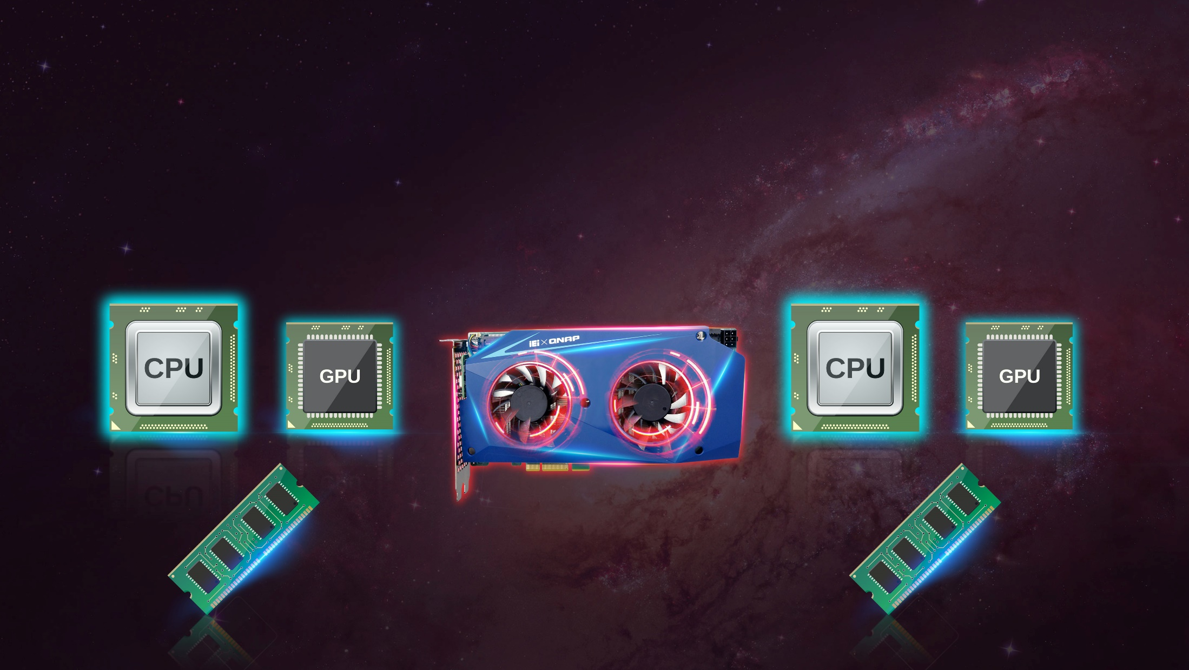
Independent physical hardware resources are more efficient than virtual machines
Each mQTS system has its own independent hardware resources, such as processors and memory. No need to share host system resources. Application and performance configuration is more flexible
RAM
RAM
Notes:
資源區隔在此處 與上述虛擬機之差異化
vQTS 77 82 85

Slide 26
Mustang-200 Data Security
Push Notification
Email Notification
System
Notification
Network
Environment
Connection Management
IM Notification
SMS Notification
VPN Server
Connection
Security
Account
Security
VPN Client
Data
Security
2-step Authentication
Anti-
Virus
Communication
Encryption
Network Communication Encryption
AntiVirus Protection
Data
Encryption
Folder Encryption
hard Drive Encryption

Slide 27
QTS Card Manager

Slide 28
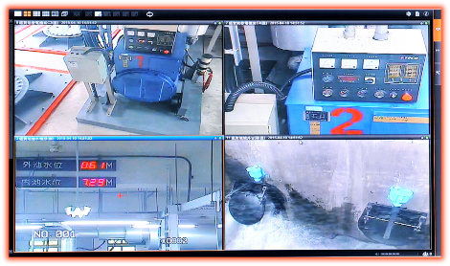
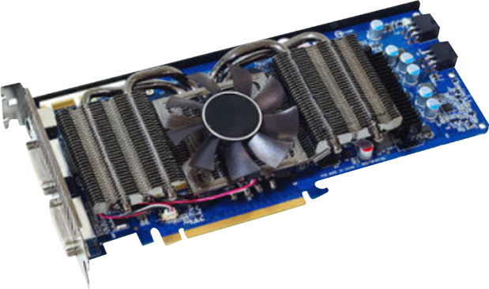
QVR Pro surveillance performance bottlenecks
4K IP camera
Performance bottlenecks
Network switch
4K image decode
4K image resize
Resize, then encode
4K monitor
Network switch
PC
QVR Pro

Slide 29
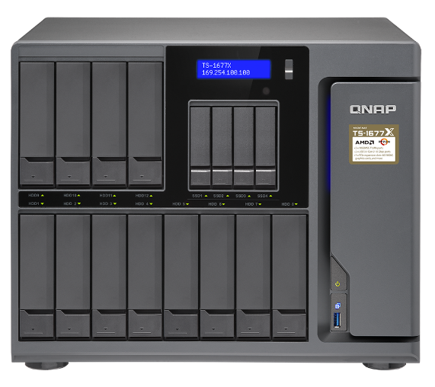
QVR Pro surveillance accelerated
4K IP camera
MVT image transcoding
MVT image
transcoding
Network switch
PCIe 2.0 x 4
4K monitor
Network switch
PC
QVR Pro

Slide 30
Greatly improves image processing capability
Installation of a Mustang-200 (i7 configuration) can increase the image processing capability of twelve 4K IP cameras
 |  | w/o Mustang-200 | w/ Mustang-200
Environment | GPU | 2 x NVIDIA GTX 1060 GAMING VR X 6G PCI-E
 | HDMI | 8 Port (Each GPU provides 4 ports)
 | Number of output monitors | 8
Efficiecy | Image processing capability | Twelve 4K IP cameras | Twenty-four 4K IP cameras

Slide 31
Your best choice!

