Slide 2
How many users?
Maximum user account count
NAS local user accounts: 600 to 4,096
NAS domain (AD/LDAP) user accounts: unlimited. For more powerful NAS, more users can be supported.

Slide 3
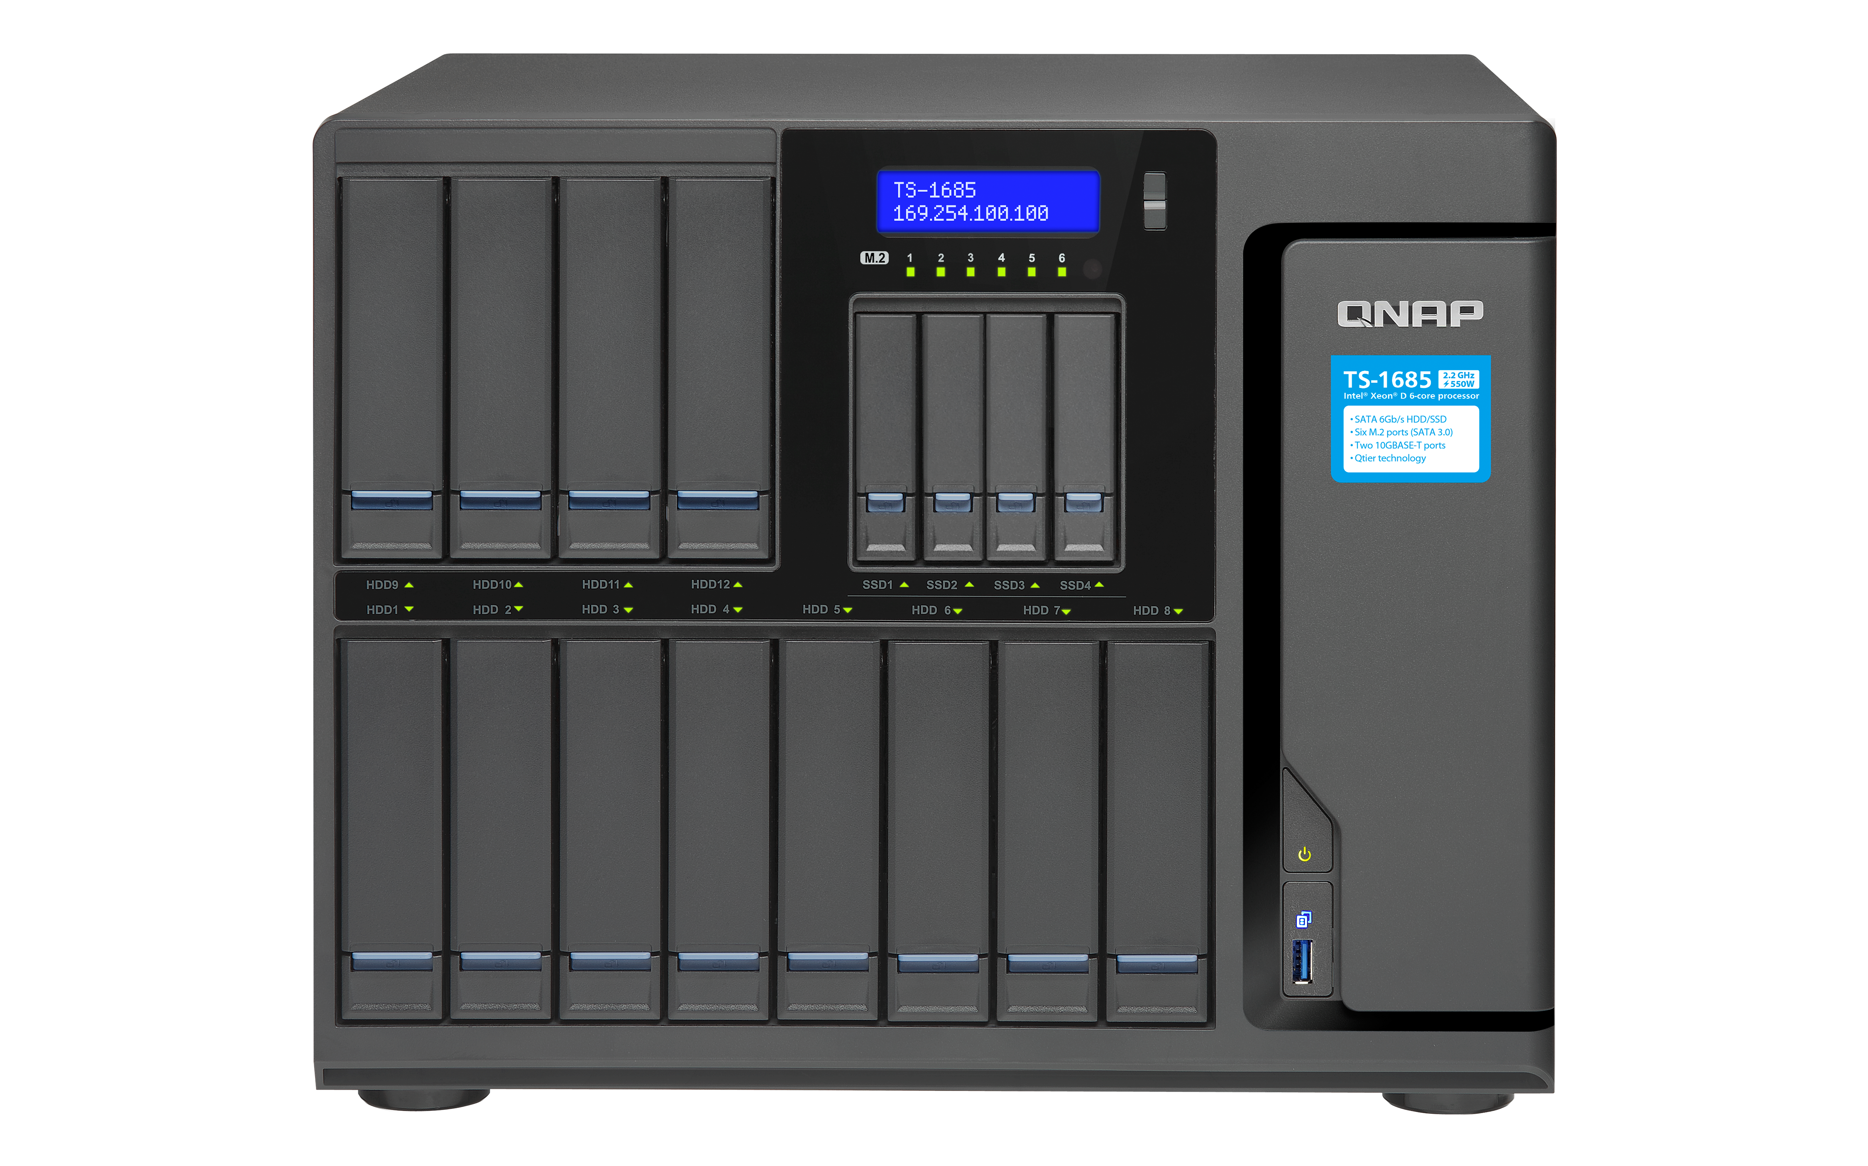
How much capacity?
Capacity: GB? TB?
Additional expansion unit needed?
RAID configuration?
=N-1 drive capacity: RAID 1/5
=N-2 drive capacity: RAID 6
>=N-2 drive capacity: RAID 10/50/60

Slide 4
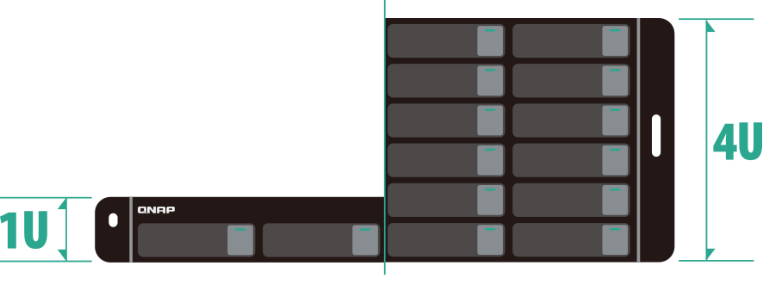
Which form factor?
Rackmount
Desktop
1U (1.75 inch/44 mm) to 4U height, 19 inch (480 mm) width
Single & redundant power options
Low noise level with versatile exterior designs
Multifunction & value

Slide 5
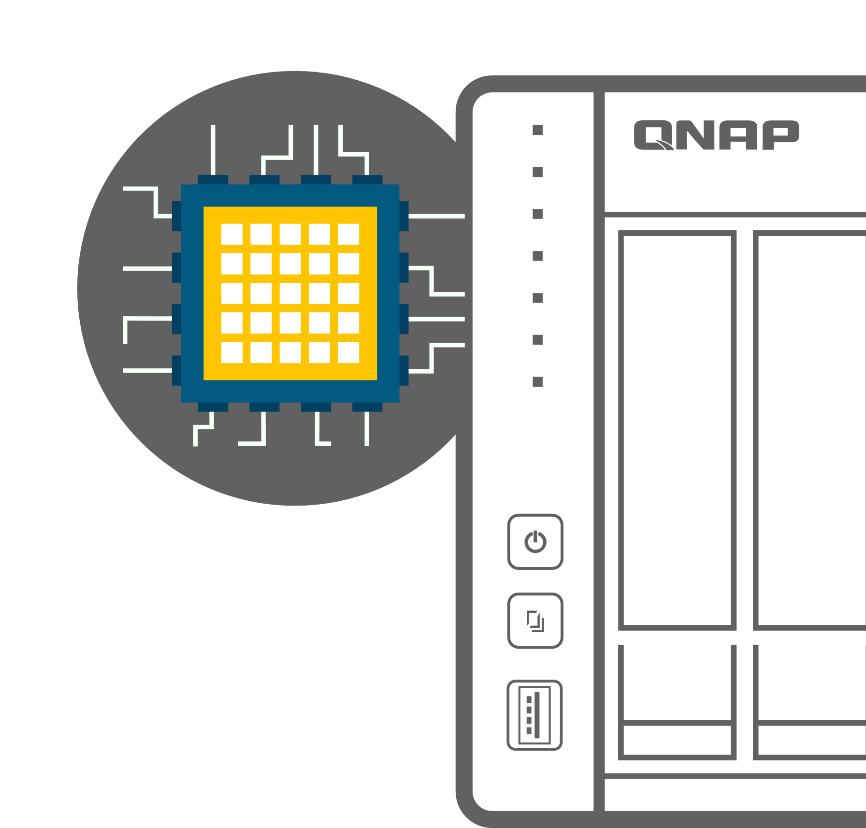
Which processor? It matters!
64-bit x86 processors
Intel Xeon, Core i7/i5/i3, Celeron multi-core 1.5 GHz+
AMD Ryzen, R-series, G-series multi-core 2.0 GHz+
64-bit & 32-bit ARM processors
64-bit Marvell 8040 quad-core 1.6 GHz
64-bit Annapurna Labs AL-324 quad-core 1.7 GHz
32-bit Annapurna Labs AL-314 quad-core 1.7 GHz / AL-212 dual-core 1.7 GHz
64-bit Realtek RTD1295/1296 quad-core 1.4 GHz

Slide 6
How much memory do I need?
For every snapshot of an 1 TB volume/LUN, 0.5 MB of RAM is needed to mount each snapshot.
CPU | RAM size | Maximum snapshots (NAS overall) | Maximum snapshots (single volume/LUN)
AMD/Intel (x86) | 4 GB or more | 1,024 | 256
Annapurna Labs/ Marvell/Realtek (ARM) | 4 GB or more | 256 | 64
Any | 2 GB | 64 | 32
Any | 1 GB | 32 | 16
TS-x51/x51+ total snapshot count is 256 only instead of 1,024. For ARM models to use snapshots, you need to update to QTS 4.3.4 (and later) and re-create the storage pool.

Slide 7
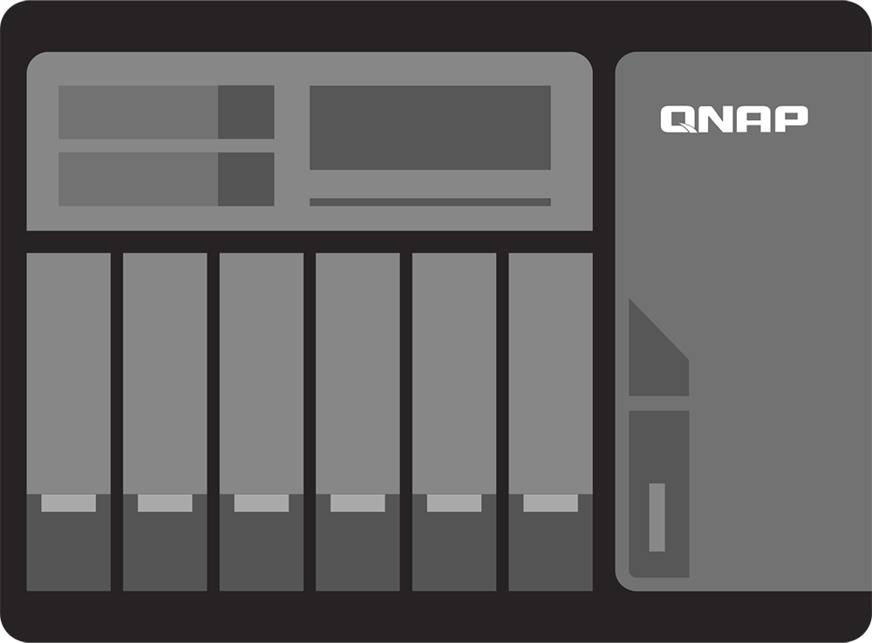
Which kind of connection?
NAS
DAS (External Storage)
USB QuickAccess
USB 3.0 USB 3.1 Gen 2
Thunderbolt 2 / Thunderbolt 3
Thunderbolt 2 / Thunderbolt 3

Slide 8
Go faster! Upgrade to 10GbE
Use QNAP NAS with the QNAP QSW unmanaged 10GbE switch series (optional; sold separately) and upgrade your network infrastructure to enjoy faster transfer speeds and to accelerate bandwidth-demanding applications.

Slide 9
Multi-Gigabit 10GBASE-T
Mutiple speeds
Enjoy faster speeds with existing cables with Multi-Gigabit NBASE-T standard support

Slide 10
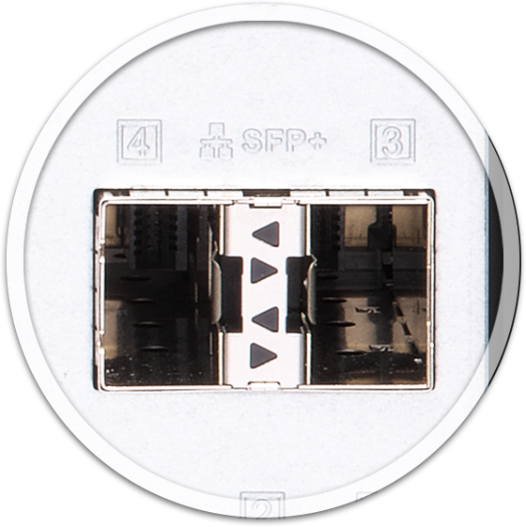
10GbE SFP+ ports
Supports 10GbE fiber-optic transceiver or use 1.5M/3M/5M SFP+ direct attached copper (DAC) cables

Slide 11
USB QuickAccess direct connection to your PC/Mac
1st time installation
QNAP Qfinder Pro for Windows & Mac
for quick connection
Direct data access
Dedicated USB cable between PC/Mac & NAS
Max
100MB/s !

Slide 12
M.2 2280 & 2.5-inch SATA SSD ports
SSD cache or storage space
Qtier tiered storage solution
Multiple M.2 2280 /2260 SATA 6Gb/s SSD slots
Multiple 2.5-inch SATA 6Gb/s SSD ports

Slide 13
SSDs for auto-tiered hybrid architecture
Performance & cost efficiency
5 x 3.5-inch HDD Large capacity
Capacity & performance
All in one for SMB
2 x SSD for caching
High capacity file and
media server
RAID1
RAID5
Boost application's random IO
access performance!
Boost both sequential and random
access performance!

Slide 14
Display 4K content via HDMI
Supports QNAP RM-IR004 remote control with QButton application!
The best compatibility with HDMI certification

Slide 15
4K video real-time transcoding
Provide multiple channels of H.264 video playback and transcoding via integrated GPU or a PCIe graphics card*
*model depedent

Slide 16
PCIe slot for versatile expansion
With 1 or more PCIe slots for various expansion cards
10G/1G network card
USB 3.1 Gen2 10G card
QM2 M.2/10G card
SAS 12G card
QWA-AC2600 wireless card
Graphics card

Slide 17
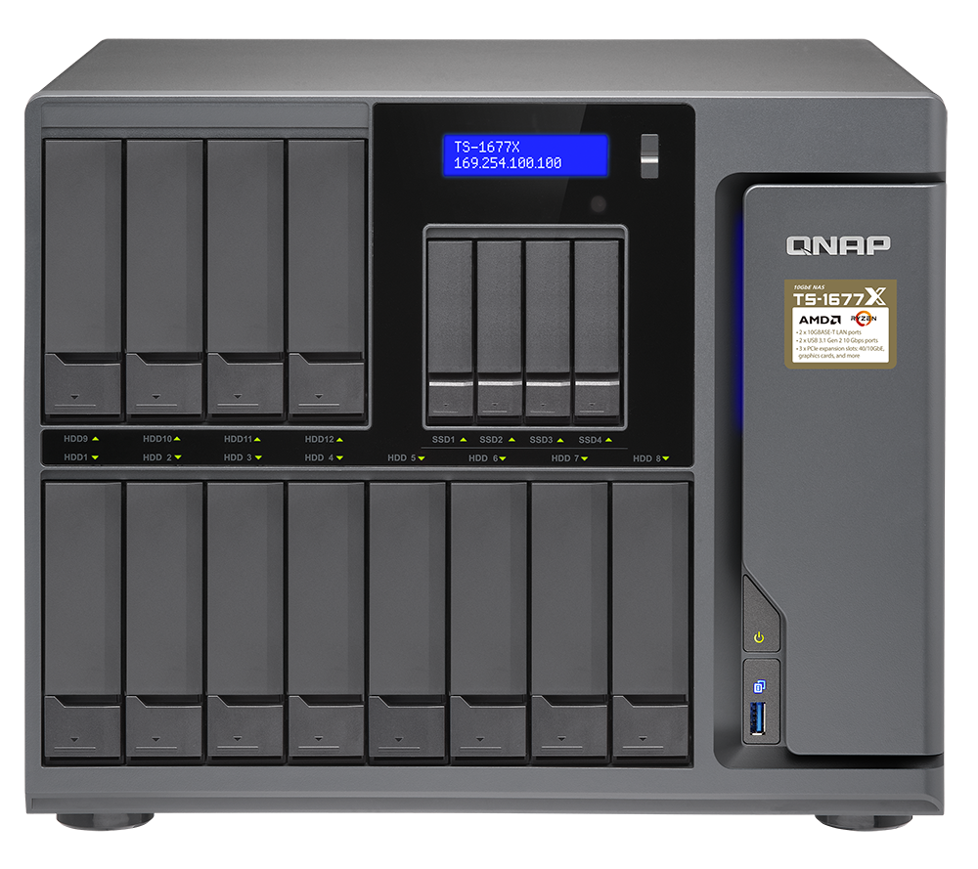
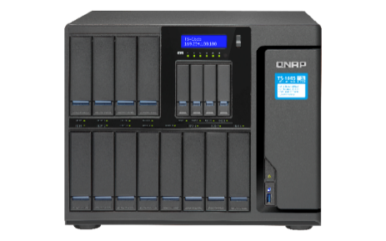
Enterprise 16-bay NAS
Multi-core for running many virtual machines
Optional PCIe graphics card for Virtual Machine GPU passthrough or QTS HDMI output & transcoding
Hugh capacity
2 x 10GbE
3 x PCIe slots
4 x
SAS expansion units
AMD Ryzen 1200/1600/1700 up to 8 cores, 3GHz+
2 x 10GbE 10GBASE-T
Up to 64 GB (4 x DDR4) RAM
4 x 2.5” SATA SSD bays
12 x 3.5" SATA HDD bays
3 x PCIe slots
TS-1677X
Intel® Xeon® D-1531/D-1521 up to 6 cores, 2.2~2.4GHz
2 x 10GbE 10GBASE-T
Up to 128 GB (4 x DDR4) RAM
6 x M.2 SATA SSD slots + 4 x 2.5” SATA SSD bays
12 x 3.5" SATA HDD bays
3 PCIe slots
TS-1685

Slide 18
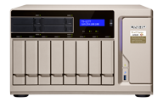
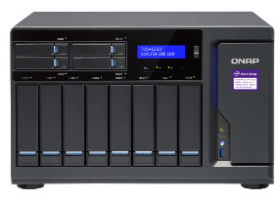
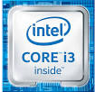
SMB 6~12-bay NAS
Multi-core for running many virtual machines
Optional PCIe graphics card for Virtual Machine GPU passthrough or QTS HDMI output & transcoding
Optional 10GbE
2 or 3 x PCIe
4 x SAS
expansion units
AMD Ryzen 1600/1700 up to 8 cores, 3.0 ~ 3.7 GHz
Optional PCIe 10GbE card
Up to 64 GB (4 x DDR4 2400) RAM
2 x M.2 SATA SSD slots + 2/4 2.5” SSD slots
Up to 3 PCIe slots
TS-x77
Intel® Core™ i3/i5/i7 up to 4 cores, 3.4 ~ 4.2 GHz
Optional PCIe 10GbE card
Up to 64 GB (4 x DDR4 2400) RAM
2 x M.2 SATA SSD slots + 2/4 2.5” SSD slots
Intel® HD Graphics (3 x HDMI)
Up to 3 PCIe slots
TVS-x82

Slide 19
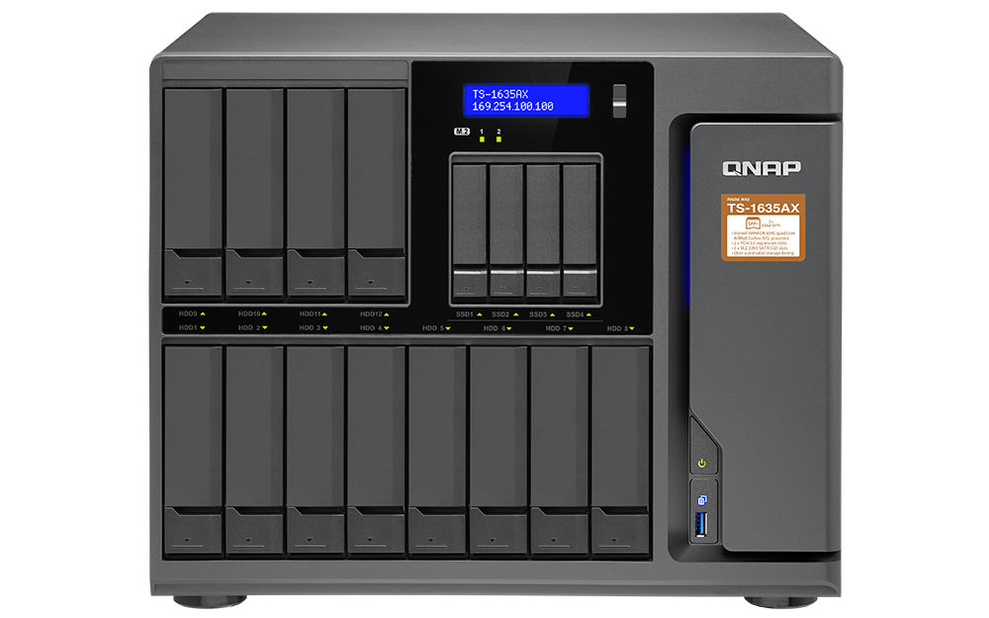
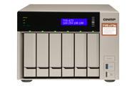
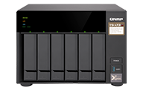
SMB 6~12-bay NAS
Marvell® ARMADA® 8040 ARMv8 Cortex-A72 4-core 1.6 GHz
2 x 10GbE SFP+
Up to 16 GB (1 x DDR4) RAM
2 x M.2 SATA SSD ports
2 x PCIe Gen.3 x2/x1 slots
Large capacity with 2 x 10GbE SFP+ at an affordable price
10GbE exp.
Quad cores
2 x PCIe
SAS/USB
Expansion
TS-1635AX
AMD RX-421BD 4-core 2.1GHz, up to 3.4GHz
Optional PCIe 10GbE card
Up to 64 GB (4 x DDR4) RAM
2 x M.2 SATA SSD ports
2 x PCIe Gen.3 x4 slots
AMD Radeon™ R7 Graphics (2 x HDMI)
Integrated GPU with dual HDMI outputs
TVS-x73e
Optional PCIe graphics card for QTS HDMI output & transcoding
AMD RX-421ND 4-core 2.1GHz, up to 3.4GHz
Optional PCIe 10GbE card
2 x M.2 SATA SSD ports
Up to 64 GB (4 x DDR4 2400) RAM
2 x PCIe Gen.3 x4 slots
TS-x73

Slide 20
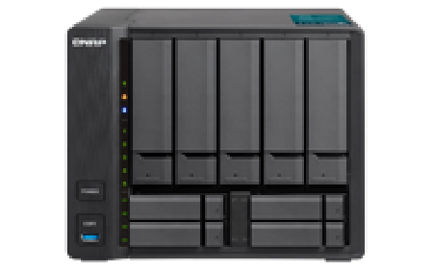
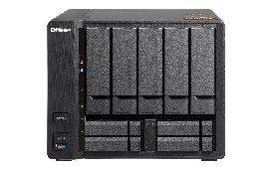
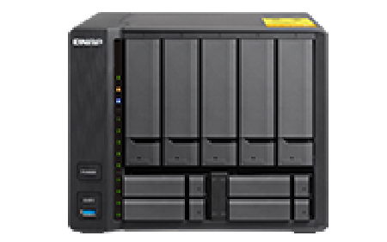
SMB 9-bay NAS
x86 performance with HDMI and integrated GPU for transcoding
Intel Kaby Lake Celeron 3865U 2-core 1.8GHz
1 x 10GbE 10GBASE-T
Up to 32 GB (2 x DDR4 2133) RAM
4 x 2.5” SSD Slots + 5 x 3.5” HDD/SDD Slots
1 x 4K HDMI v1.4b
10GbE
5 x 3.5" HDD
plus
4 x 2.5" SSD
hybrid design
Ready to use
Qtier & SSD cache
TVS-951X
4-core performance with a x86 CPU for more apps
AMD GX-420MC 4-core 2.0GHz
1 x 10GbE 10GBASE-T
Up to 16 GB (2 x DDR3L 1600) RAM
4 x 2.5” SSD Slots + 5 x 3.5” HDD/SDD Slots
TS-963X
Affordability with 2 x 10GbE SFP+ and 4-core performance
Annapurna Labs AL-324 4-core 1.7GHz
2 x 10GbE SFP+
Up to 16 GB (1 x DDR4 2133) RAM
4 x 2.5” SSD Slots + 5 x 3.5” HDD/SDD Slots
TS-932X

Slide 21
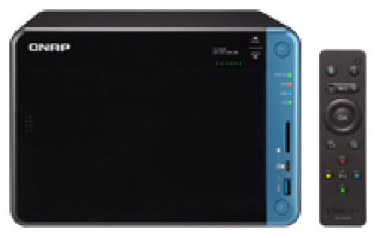
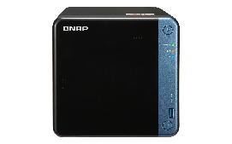
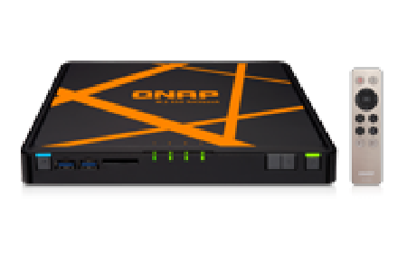
SMB 2~6-bay NAS
Intel Celeron J3455 4-core 1.5GHz, up to 2.3GHz
Up to 8 GB (2 x DDR3L 1866) RAM
1 x PCIe Gen.2 x2 slot (10GbE)
1 x 4K HDMI v1.4b
OLED, USB QuickAccess, SD card slot, remote
Fully loaded and highly upgradeable with a PCIe slot
X86 Intel
Quad cores
Transcoding
HDMI
TS-x53B
Highly upgradeable with a PCIe slot with affordability
Intel Celeron J3455 4-core 1.5GHz, up to 2.3GHz
Up to 8 GB (2 x DDR3L 1866) RAM
1 x PCIe Gen.2 x2 slot (10GbE)
1 x 4K HDMI v1.4b
TS-x53Be
Compact B5-sized NASbook with a 4-port GbE LAN switch.
Intel Celeron N3150 4-core 1.6GHz, up to 2.08GHz
Up to 8 GB (2 x DDR3L 1600) RAM
4 x M.2 SATA SSD slots
1 x GbE + 4 port GbE switch
2 x 4K HDMI v1.4b
TBS-453A

Slide 22
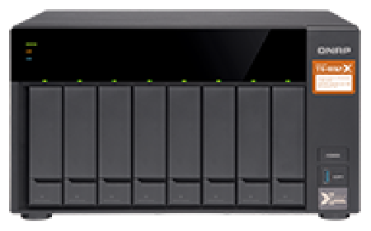
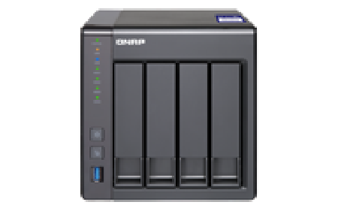
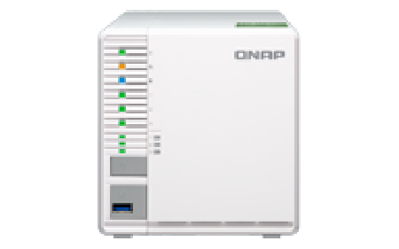
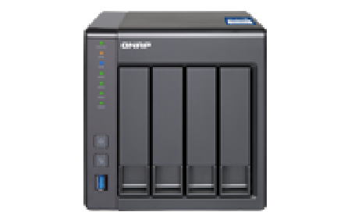
SMB 3~8-bay NAS
Annapurna Labs 64-bit AL-324 4-core 1.7GHz
2 x 10GbE SFP+
Up to 16 GB (1 x DDR4) RAM
2 x PCIe Gen.2 x2/x1 slots
10GbE quad-core ARM NAS with PCIe slots
TS-832X
Performance
Affordability
ARM CPU
10GbE
10GbE quad-core ARM NAS
Annapurna Labs 32-bit AL-314 4-core 1.7GHz
1 x 10GbE SFP+
Up to 8 GB (1 x DDR3) RAM
TS-431X2
Annapurna Labs 64-bit AL-324 4-core 1.7GHz
1 x 10GbE SFP+
Up to 16 GB (1 x DDR4) RAM
3 x 3.5"/2.5" HDD/SSD + 3 x M.2 SATA SSD slots
10GbE quad-core ARM NAS with triple M.2 SATA SSD acceleration
TS-332X
10GbE dual-core ARM NAS
Annapurna Labs 32-bit AL-212 2-core 1.7GHz
1 x 10GbE SFP+
Up to 8 GB (1 x DDR3) RAM
TS-431X

Slide 23
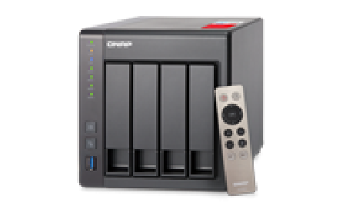
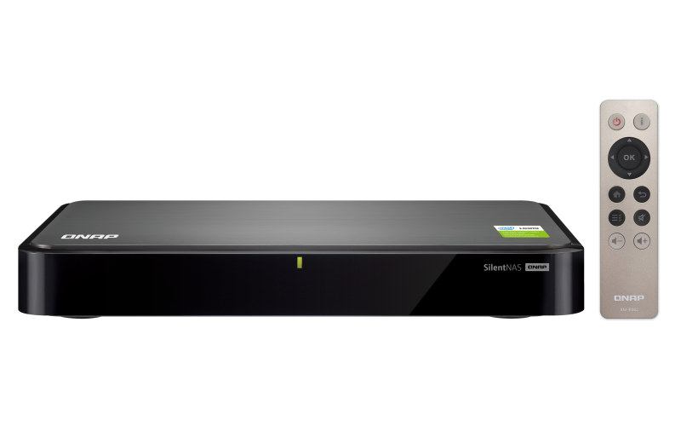
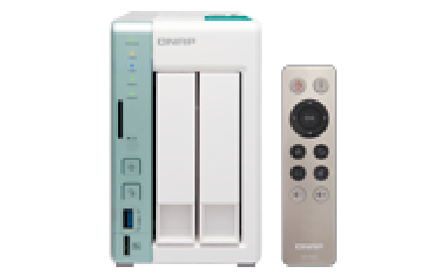
SOHO 2~4-bay NAS
x86 NAS with 1080p HDMI & transcoding
Intel Celeron J1900 4-core 2.0GHz​, up to 2.42GHz
Up to 8 GB (2 x DDR3L 1600) RAM​
2 x GbE​
1x 1080p HDMI
TS-251+/451+
X86 Intel
Transcoding
HDMI
Silent x86 fanless NAS with 1080p HDMI & transcoding
Intel Celeron J1900 4-core 2.0GHz​, up to 2.42GHz
2GB fixed DDR3L RAM​
2 x GbE​
1x 1080p HDMI
HS-251+
Dual-core x86 NAS with USB access, 4K HDMI & transcoding
Intel Celeron N3060 2-core 1.6GHz​, up to 2.48GHz
Up to 8 GB (2 x DDR3L 1600) RAM​
2 x GbE​
1x 4K HDMI, USB QuickAccess, SD card slot
TS-251A

Slide 24
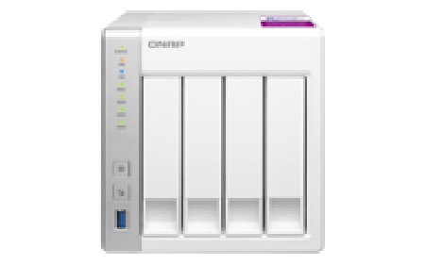
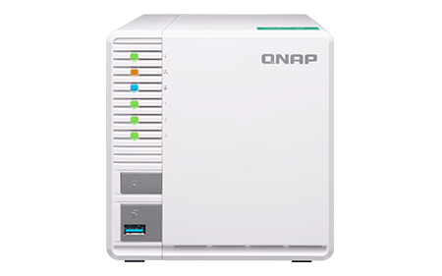
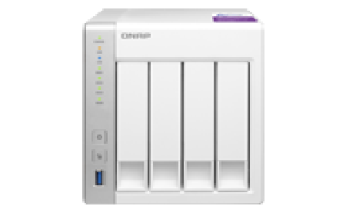
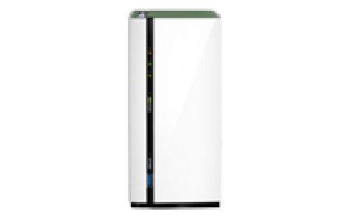
Home & SOHO 1~4-bay NAS
Quad-core personal cloud for containerized apps
Annapurna Labs 32-bit AL-314 4-core 1.7GHz
2 x GbE
Up to 8 GB (1 x DDR3) RAM
TS-231P2/431P2
3-bay personal cloud with 4K transcoding
Realtek 64-bit RTD1296 4-core 1.4GHz
2 x GbE
Fixed 2 GB DDR4 RAM
4K video transcoding
Power saving
Affordable
TS-328
Up to 220MB/s performance
Annapurna Labs 32-bit AL-212 2-core 1.7GHz
2 x GbE
Up to 8 GB (1 x DDR3) RAM
TS-131P/231P/431P
Up to 110MB/s performance
Realtek 64-bit RTD1295 4-core 1.4GHz
1x GbE
Fixed 1 GB DDR4 RAM
TS-128A/228A

Slide 25
Thunderbolt NAS line up
TVS-1582TU
TVS-882ST3
TVS-1282T3 & TVS-x82T series
TS-453BT3

Slide 26
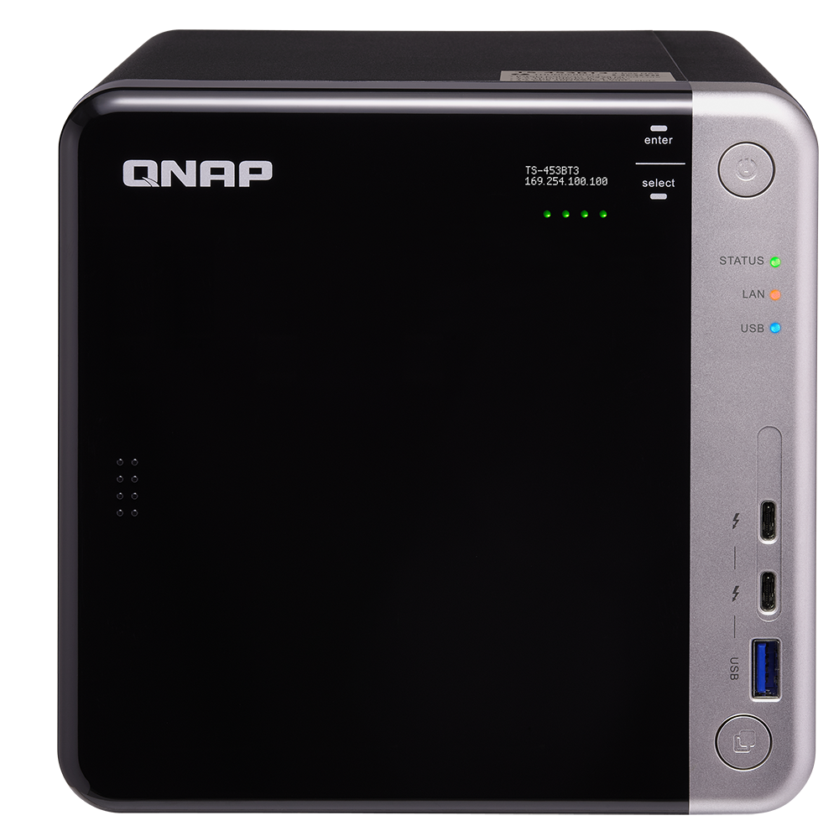
Cross-platform collaboration
Adapter for Thunderbolt 2 Ｍac/PC
Apple Thunderbolt 3 to Thunderbolt 2 adapter

Slide 27
A flawless workflow
London
New York
High-speed ingest/backup
1
Off-site colaboration
4
3
Off-site backup
(QNAP RTRR)
2
Collaboration

Slide 28
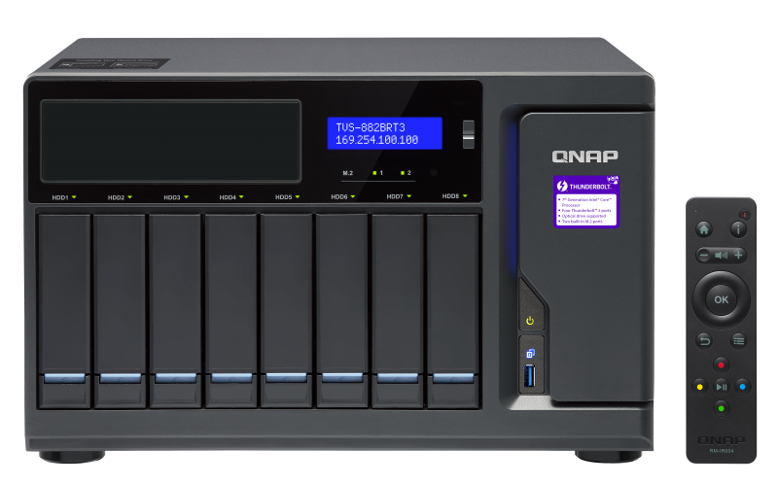
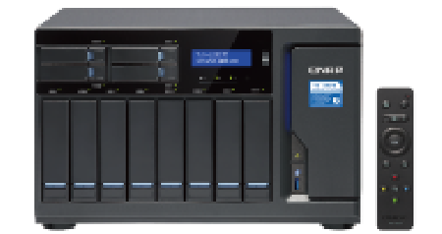
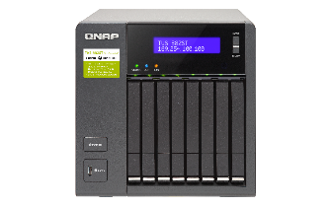
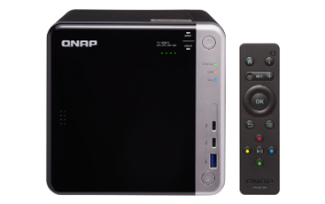
Thunderbolt 3 NAS
Intel Core i5/i7 4 core, 3.4~4.2GHz
Max 64GB (4 x DDR4) RAM, 2 x M.2 SATA SSD
8 x 3.5" HDD + 4 x 2.5" SSD
4 x Thunderbolt 3, 2 x 10GBASE-T, 3 x 4K HDMI
Optional 5.25" LG Blu-ray drive or RDX drive
Blu-ray disc drive or RDX drive backup
TVS-882BRT3
Intel Core i5/i7 4 core, 3.4~4.2GHz
Max 64GB (4 x DDR4) RAM, 2 x M.2 SATA SSD
8 x 3.5 吋 HDD + 4 x 2.5 吋 SSD
4 x Thunderbolt 3, 2 x 10GBASE-T, 3 x 4K HDMI
1500MB/s, for 4 Thunderbolt concurrent clients
Thunderbolt 3
2 x 10GBASE-T
6 x TX expansion
TVS-1282T3
Intel Core i5/i7 4 core, 1.9 ~ 2.6GHz
32GB (2 x DDR4) RAM
8 x 2.5” SATA SSDs/HDDs, 2 x Thunderbolt 3
2 x 10GBASE-T, 1 x 4K HDMI
Compact yet powerful
TVS-882ST3
Intel Celeron J3455 4 core 1.5GHz, up to 2.3GHz,
8GB DDR3L RAM, 2 x M.2 SATA SSD 埠,
2 x Thunderbolt 3
1 x 10GBASE-T, 2 x 4K HDMI
Affordability with Thunderbolt convenience
TS-453BT3

Slide 29
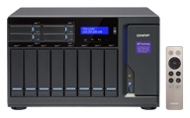
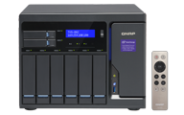
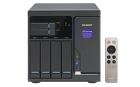
Thunderbolt 2 NAS
Intel Core i3/i5/i7, 4 core 3.4~4.2GHz
Max 64GB (4 x DDR4) RAM
2 x M.2 SATA SSD
3.5" SATA HDD + 2.5" SATA SSD hybrid design
2 x Thunderbolt 2
2 x 10GBASE-T
3 x 4K HDMI
TVS-1282T
Thunderbolt 2
2 x 10GBASE-T
6 x TX expansion
TVS-882T
TVS-682T

Slide 30
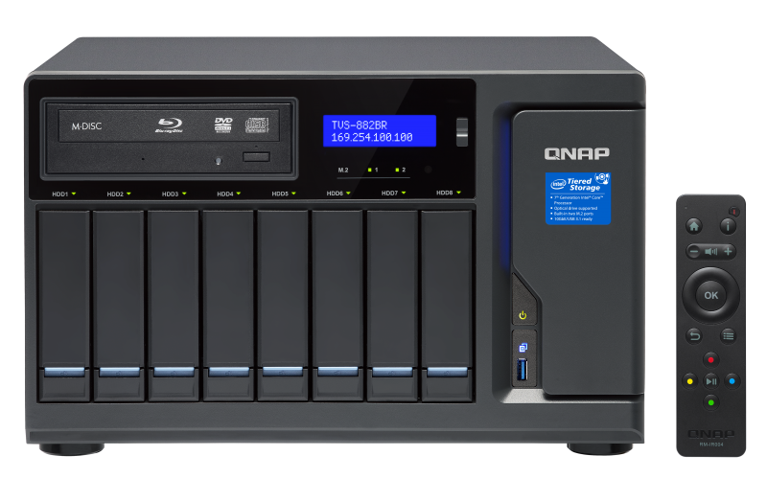
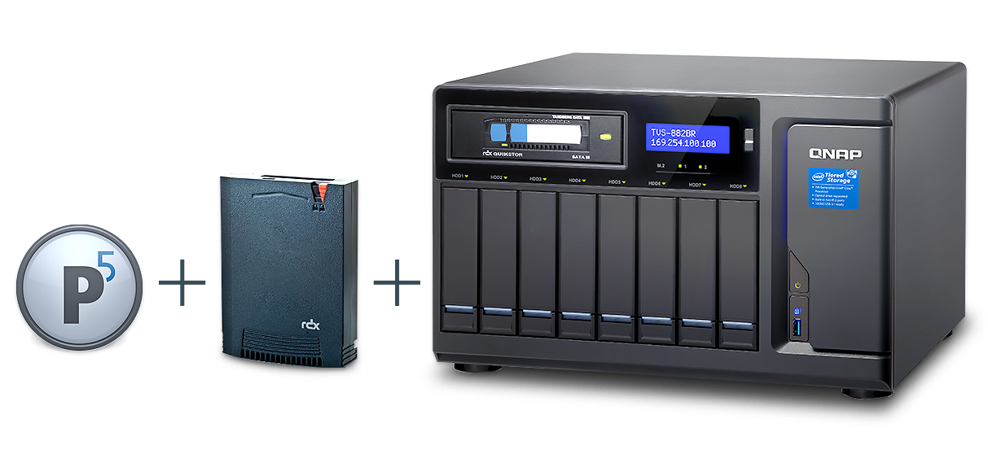
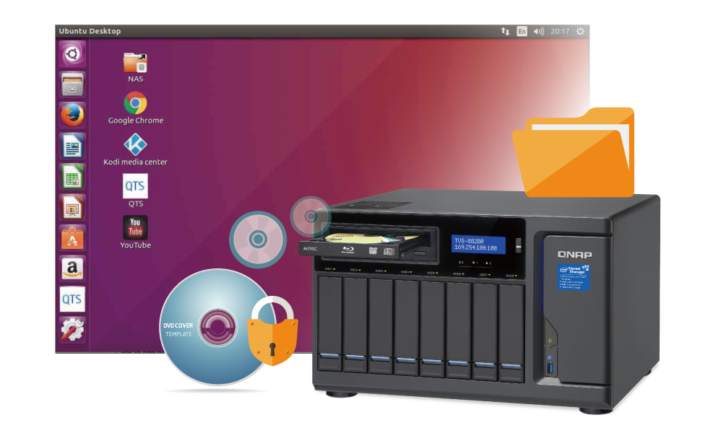
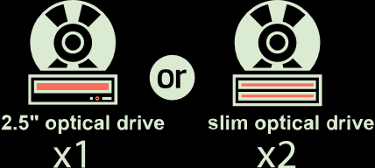
Blu-ray & RDX NAS
Intel Core i5/i7 quad-core up to 3.6 GHz
Max. 64 GB (4 x DDR4) RAM, 2 x M.2 SATA SSD
8 x 3.5" HDD + 1 x 5.25" drive slots
5.25" SATA port for optional Blu-ray or RDX support
3 x 4K HDMI
3 x PCIe Gen.3 slots
4 x Thunderbolt 3 (TVS-882BRT3)
Optional
Blu-ray
writer or RDX drive
TVS-882BR
TVS-882BRT3

Slide 31
Thank you for choosing
Copyright © 2018 QNAP Systems, Inc. All rights reserved. QNAP® and other names of QNAP Products are proprietary marks or registered trademarks of QNAP Systems, Inc. Other products and company names mentioned herein are trademarks of their respective holder ​

