Slide 1
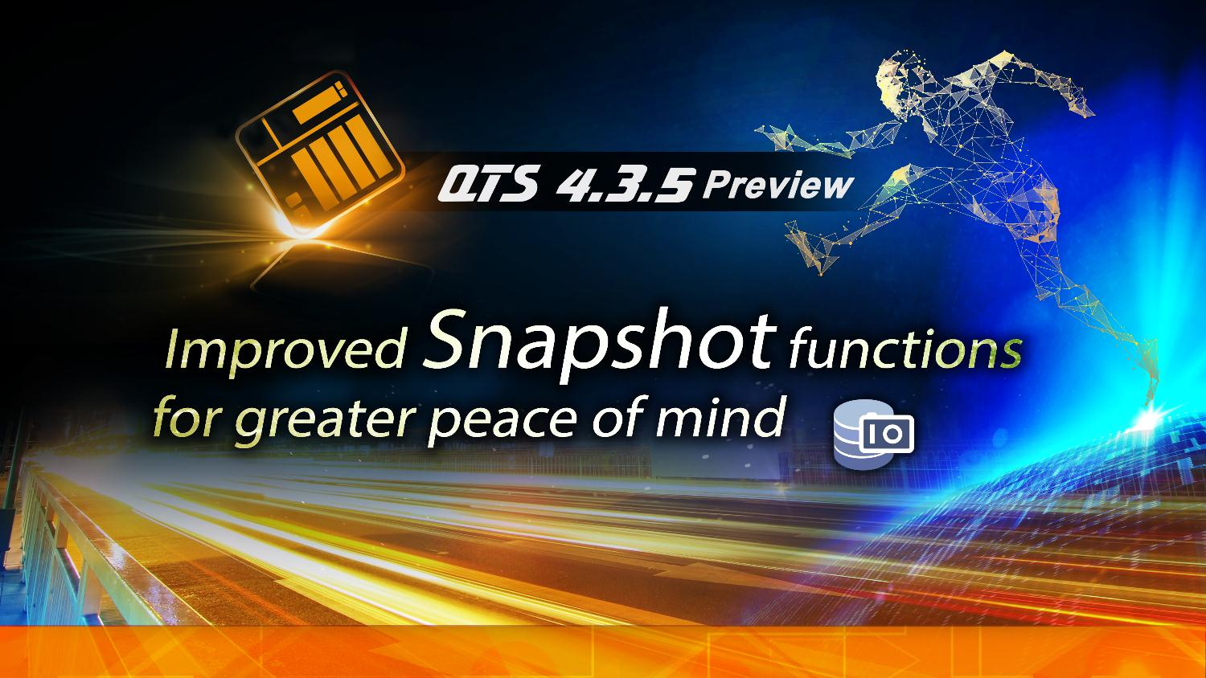


Slide 2
Using QNAP Local and Remote Snapshot To Fully Protect Your Data
Local Snapshot Introduction and Usage
Snapshot Space Allocation and Advanced Features
Snapshot Replica and Restoration From Remote NAS

Slide 3
Introduction to Snapshot
- How Snapshot Works and
Its Advantages
- Use Local Snapshot For
Data Restoration

Slide 4


QNAP “Out of Volume“ Snapshot
QNAP Snapshot is stored at the Storage Pool level, and supports Thick/Thin volume and Block-based LUN.
The Snapshot will be using free Storage Pool space, or “Guaranteed Snapshot Space” if thin allocation is used.
File-based
iSCSI LUN
Block-based
Thin LUN
Thick Volume
Encrypted Volume
Snapshot
Guaranteed Snapshot Space
Storage Pool
RAID
Encrypted thick or thin volume can also use snapshots, but password input before data recovery is required.

Slide 5


The Reason of Using Snapshot: RTO
In the survey of 300 Enterprise and SMB at Taiwan:
60% have used Remote Replication as Backup Plan.
50% of business expected the recovering time should be within 1 Hour.
But also 50% of business experience actual recovery time > 1 Day!
Restoration time matters for both
personal and business users.
Taiwan IThome survey 2017
Data Backup Time
Disaster Occurred
Server Online
TIME
Recover Point Objective
Recover Time
Objective
Notes:
5
39094200

Slide 6


How Snapshots Help Reduce RTO (1)
Snapshots are different from conventional data backup methods. It freezes data blocks from further modifications instead of copying the data.
When data is modified, in the back-end, new data is written to different blocks, instead of over-writing existing blocks.
Blocks froze by snapshots
Original Data
Modified Data
Pool Space
File-level
Volume with snapshots
Volume w/o snapshots
Block-level
A
B
C
D
E
A’
B’
C’
D
E
A’
B’
C’
Storage Pool

Slide 7
How Snapshots Help Reduce RTO (2)
When a volume/LUN needs to be recovered, instead of moving data back, the file system can easily use snapshots to mount original data blocks.
A 300 GB volume needs 30 min to move all its data, but local snapshot revert only takes 3 min.
QNAP Snapshot revert processes
Original Data
Modified Data
Block-level
Volume with modified data
Original data block is frozen and kept
When reverting, mount the frozen data block directly

Slide 8




How Snapshots Help Reduce RPO
Freezing data block is much faster than copying data to different location.
Snapshot is a differential backup solution: additional space will only be used when data is modified.
Work both ways for local data protection and file version control.
With snapshot, the backup frequency can be increased while required space is reduced.
10Gb
Snapshot 1
Snapshot 2
0.5Gb
Data Modified
Backup 1
Backup 2
Backup 2 Size
Snapshot 2 Size

Slide 9







How Snapshots Protect Data From Ransomware Attack
Snapshots are stored out of volume and cannot be seem normally at the file system level
This not only keeps snapshots from accidental modifications, but
further from ransomware attacks
Ransomware cannot overwrite snapshots which are stored out of volume
File Level
Removable Drives
Block Level
A’
B’
C’
D’
E’
Local Drives
Cloud / NAS
A
B
C
D
E

Slide 10
QNAP Snapshot Features
1. Fully supports all storage configurations at the storage pool level.
2. Easily take, manage and restore snapshots.
3. Using the mature Ext4 file system for “out of volume” snapshots
4. Supports all latest QNAP with flexible snapshot number.
(Every 1 TB of Volume/LUN need 0.5 MB of RAM for mounting each Snapshot)
CPU | RAM Size | Maximum Total Snapshot Number | Maximum Snapshot Number per Volume/LUN
All | 1 GB | 32 | 16
All | 2 GB | 64 | 32
Annapurna Labs/ Marvell/Realtek (ARM) | < 4 GB | 256 | 64
AMD/Intel (x86) | < 4 GB | 1,024 | 256
TS-x51/x51+ total snapshot count is 256 only instead of 1,024. For ARM models to use snapshots, you need to update to QTS 4.3.4 (and later) and re-create the storage pool.

Slide 11
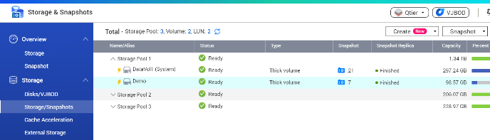
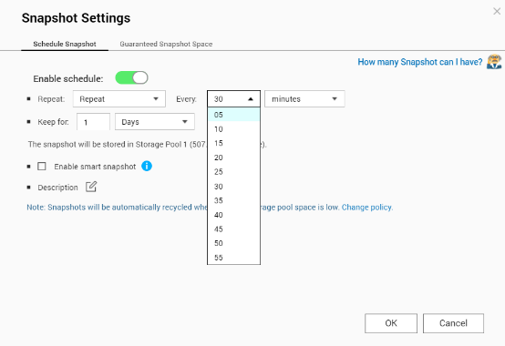
Easily take snapshots in 3 steps
QNAP Snapshot is a built-in function and does not required additional app installations
1
Storage & Snapshot > Storage / Snapshot
1
2
2
Select a volume or LUN then take snapshot
3
Or enter Snapshot Manager to configure up to 5 min auto snapshot schedule protection
3

Slide 12
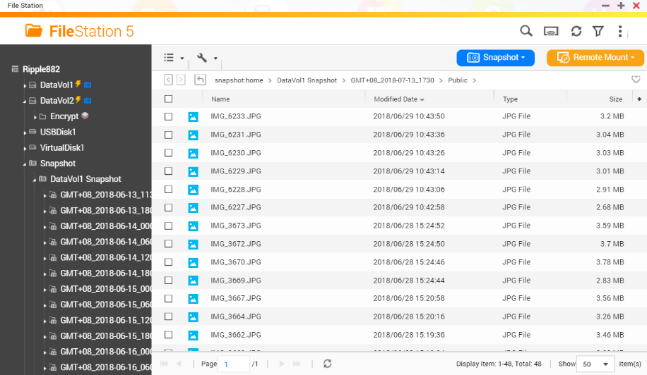

Manage Snapshot n File Station
With the built-in support,
QNAP snapshot can do more!
Using File Station to browse different version of snapshots
Using drag and drop to retrieve files from snapshots.

Slide 13
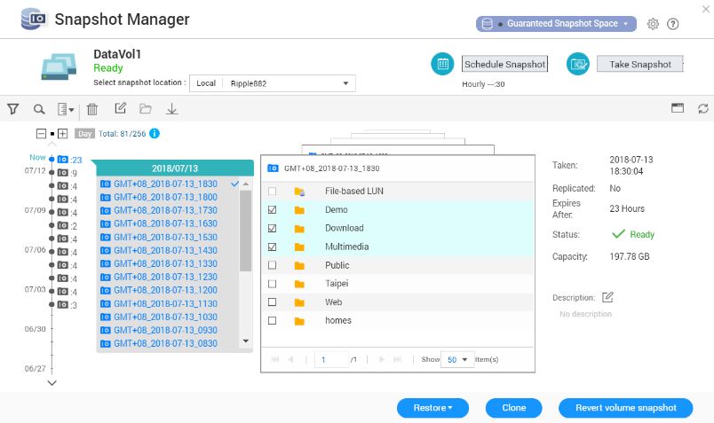
3 Ways to Recover from Local Snapshots
Select file/folder and restore in place/new path or remote mount location.
Restore
Create a new volume or
LUN from snapshot for
build test environment.
Clone
Using Snapshot to quickly recovery volume or LUN in extremely short time.
Revert

Slide 14

Demo
Snapshot creation, management and restoration in QNAP NAS
Notes:
36521380

Slide 15
Space Allocation & Advanced Snapshot functions
- Space allocation best practice for snapshots
- Windows previous versions
- Snapshot Shared Folder
- Snapshot Agent

Slide 16




Why “Out of Volume” Snapshots?
QNAP Snapshot Design: Conservative but Completed
When snapshot is enabled, volume space will not be released unless the snapshot is deleted.
Without proper monitoring, volume space may be not enough with snapshot!
Volume
File
Observation
QTS Default Snapshot Preservation Time: 1 Week
Block level
A
B
C
Data Block
A
B
C
DSM NAS Default Snapshot Reserve Time: Forever
Data Link

Slide 17




When Snapshots Take Too Much Space
Application/Service Might Stop Accidentally!
Snapshot is not all beneficial, when free block cannot be found to write new data, application and service will stop abnormally.
Without proper design, even IT manager can be easily confused since space used by snapshots is "hidden"
File System Displayed Free Space
Can IT manager do something else?
Application Data
Deleted Data
Actual usable space

Slide 18
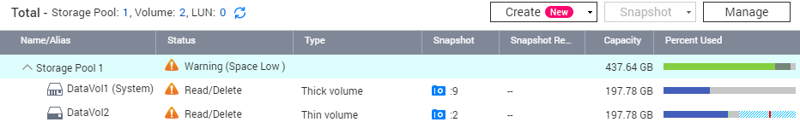
The Advantages of Out of Volume Snapshot
Snapshot used space (Changed data) is place outside of volume
The snapshot used space can be identify easily.
Multiple volume and LUN can share same space to store snapshots.
Volume and LUN can detect pool space usage and enter protected “Read/Delete”
mode for warning in advance.
The shortage of space can be identify in UI right away

Slide 19
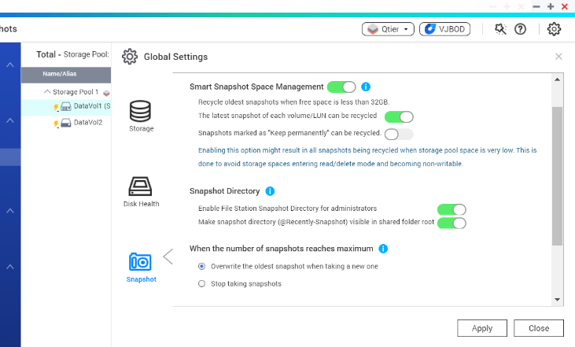
Snapshot “Space” & “Quality” Management
Same as Time Machine for Mac, the Smart Snapshot Management can let the system automatically recycle snapshots until enough space is recovered.
Smart Snapshot Management:
Older, latest and permanently snapshot can all be configured to auto be recycled
when pool space is not enough.
When Snapshot Reach Number limitation: Stop taking snapshot or replace oldest snapshot.

Slide 20














Plan Storage Space in Advance for Snapshot Protection
When all storage pool space
is used, snapshot cannot be
taken.
Reserve space in advance for snapshot usage and expanding when needed!
Free reserved space
Snapshot

Slide 21




Introducing the Resize Volume Wizard in QTS 4.3.5
The Thick and Thin Volumes now support Resize Volume Wizard.
Reduce the allocated thick volume space to free space for the storage pool, other volumes, LUN or Snapshot.
Reduce the planned thin volume space to avoid risk of "Oversubscription" or taking to much snapshot space.
Oversubscription
Thin Volume
Think Volume
Oversubscription
The space that thin volume has planned but its storage pool cannot currently provide.
Thin Volume
Oversubscription
Think Volume
Thick Volume
Storage Pool

Slide 22
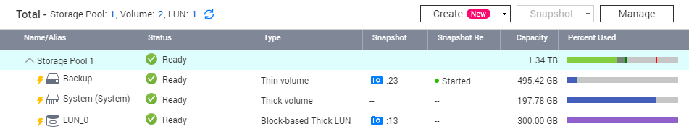
QNAP NAS Space Allocation
Best Practice For Snapshot
1
Separate system volume from files, and disable snapshots on system volume
When using thick volumes, reserve space in advance for snapshots
When space is insufficient, reduce thick volume size or convert it to thin volume
Using Snapshot Replica to store more snapshot versions
2
3
4
3
4
1
2

Slide 23



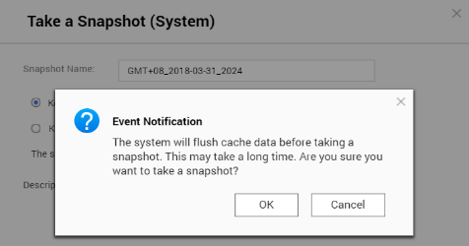
Storage Structure Change
For Snapshot to Include Cache Content
Old SSD Cache: Taking Snapshot must flush SSD Cache data first and may take up to 30 min.
New SSD Cache: Taking Snapshot no longer required data flushing. High frequency snapshot be possible with SSD cache.
Old SSD Cache
Storage Pool
Volume
iSCSI LUN
Storage Pool
New SSD Cache
Volume
iSCSI LUN

Slide 24
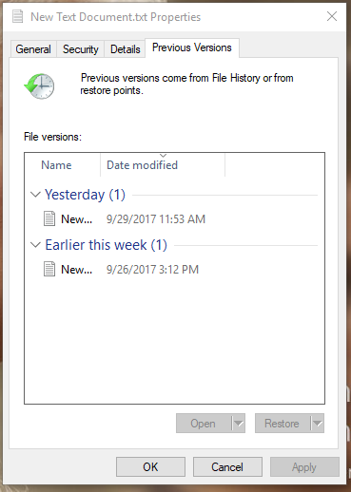
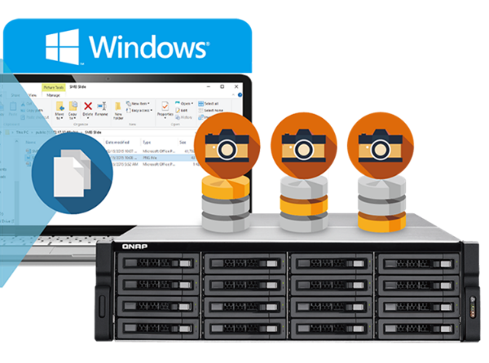
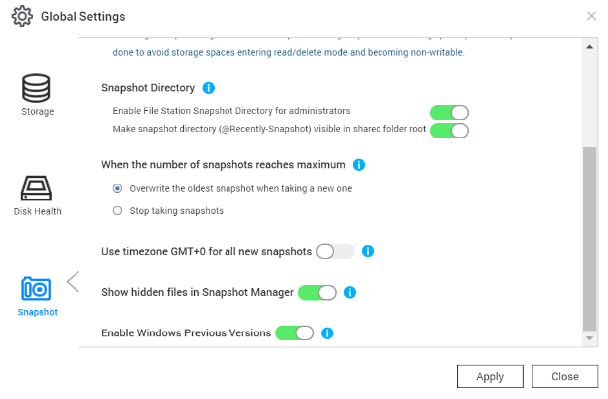
Snapshot Advance Function 1：
Windows Previous Version
User can see snapshot folder under SMB/CIFS/AFP/NFS
Windows user can also use the "Pervious version" for restoring
Under permission, users can also recover file from snapshots!
IT manager have the right to turn off “windows previous versions” for individual or all folders.

Slide 25
Use Windows Previous Versions to easily restore files from snapshots with the client OS
Demo
Notes:
36521380

Slide 26





Snapshot Advanced Function 2：
Snapshot Shared Folder
Using File Station to quickly create single share with dedicated folder.
When a folder need to be restored frequently, this function let the folder to use revert function without affect other folders.
300 GB folder recover speed comparison: restore and snapshot revert
7m 45s
6m 17s
5 Folders in system volume
5 Folders in data volume
System stop : 1m
4074 MB/s
300GB
30m 15s
3m 58s
Folder recover time
Restore single folder
Revert Folder-based snapshot volume
169 MB/s
6219 MB/s

Slide 27



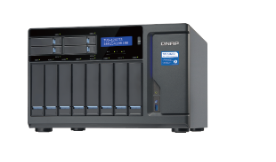






Snapshot Advanced Function 3：
Snapshot Agent
2
Snapshot agent inform Windows VSS, Hyper-V or VMware to flush data
１
NAS preparing to take a snapshot
For Virtualization Usage
or Windows VSS
Snapshot Agent report back to the NAS
NAS start to take snapshot
iSCSI
3
4
This tool allow NAS to
communicated with Windows,
Hyper-V and VMware, to flush
memory to the iSCSI LUN
before taking a NAS
snapshot
１
Backup software need to backup LUN data
NAS receive Agent notification
to take snapshot
3
2
Windows use VSS to write data back to LUN
4
Backup software use the NAS snapshot for backup
iSCSI

Slide 28
Snapshot Replica and
Remote Restore：
- Restore from Remote Snapshot Vault
- Snapshot Export/Import
- Export Snapshot In first
Snapshot Replica Task

Slide 29



Create a Fast Backup Solution for Your Production Site
In survey, 30% IT mangers are not satisfied with long time data backup
Snapshot Replica backup snapshot to remote QNAP NAS
A differential backup solution that support restore from source solution directly with QTS 4.3.5.
Snapshot
Snapshot
Snapshot with modified data
Snapshot Vault’s Snapshot
Thick Volume
Snapshot Vault
Source Storage Pool
Remote Storage Pool
Notes:
29

Slide 30
What is Snapshot Replica
Use at least 2 Storage Pool to create a Snapshot Replica Task
Snapshot Vault Size will be same as the allocated space of the source thick volume/LUN, or used space for thin volume/LUN
Snapshot Replica
Snapshot
Vault
Backup
Snapshot Vault
Incremental Backups
Allow to restore snapshot from remote
Snapshot Vault can also be backup
To use all the snapshot features mentioned in this slide, both NAS must use latest QTS 4.3.5 OS
Notes:
30

Slide 31
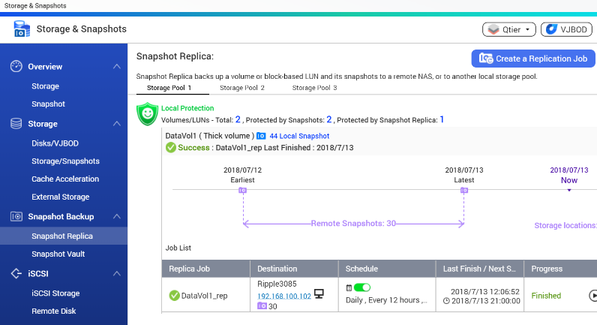
Easily Create Snapshot Replica
Job In 3 Steps
1
Storage & Snapshot > Snapshot Replica > Create a Job
2
Using the wizard to identify suitable remote NAS
3
Setup backup plan and start the replica job
Notes:
31

Slide 32
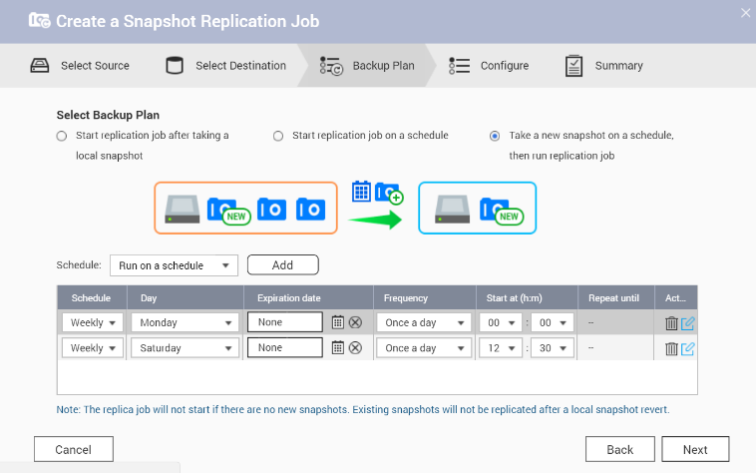

3 Different Backup Plans For Selection
Users can use different backup plans and flexible schedule to ensure the backup consistence of snapshot.
Run Snapshot Replica
Job after snapshot be
took locally
Transport new snapshot
in fixed yet flexible schedule
When running snapshot
replica job, taking a new snapshot
Notes:
32

Slide 33
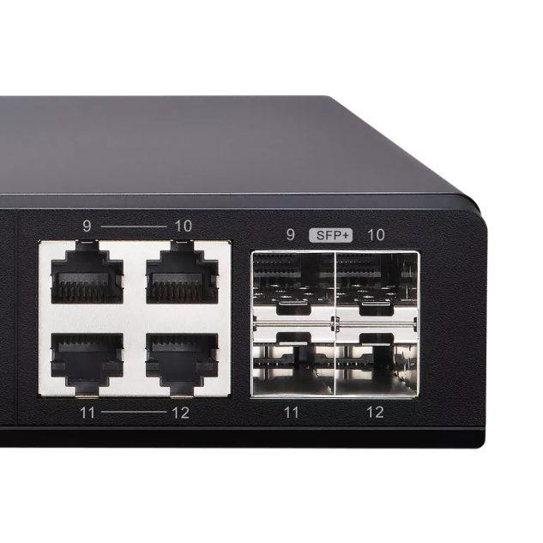


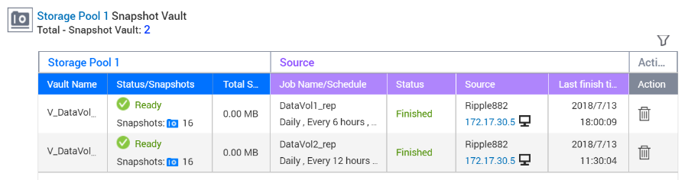
Work Faster in the Age of 10G
When transport 50GB file, 1GbE 110Mbps need 8 min
With 10GbE Switch, transport the same file only take 2 min
With 10GbE becoming mainstream in 2018, speed up applications now!
Your first
10GbE switch
QSW-1208-8C
Using the latest 4.3.5 features to transport snapshot vault back to source.

Slide 34
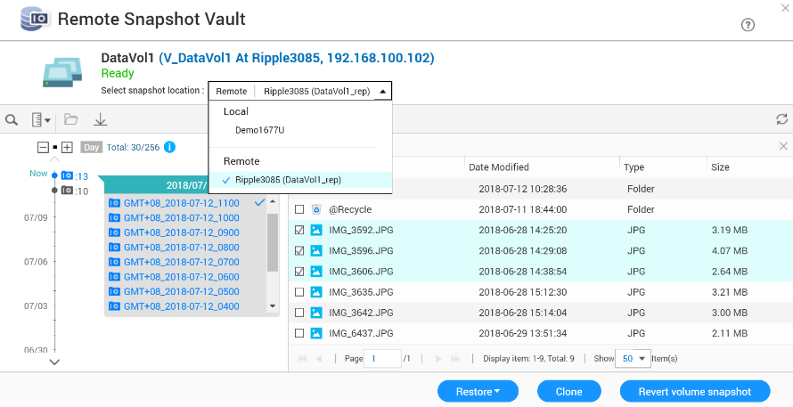
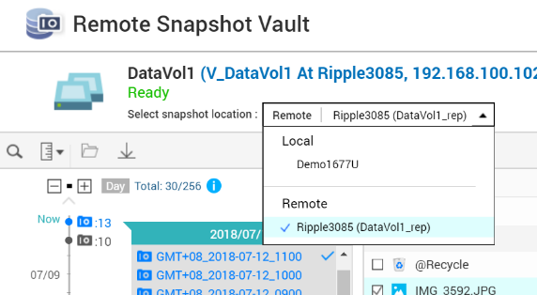


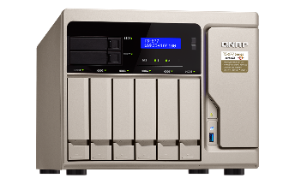
Restore From Remote Snapshot Vault
The Snapshot Manager now actively connected to Snapshot Vault
Support Monitor and restore select folder and files at the Source NAS directly!
Both the source and destination NAS must be upgraded to 4.3.5 to support this function
Notes:
34

Slide 35


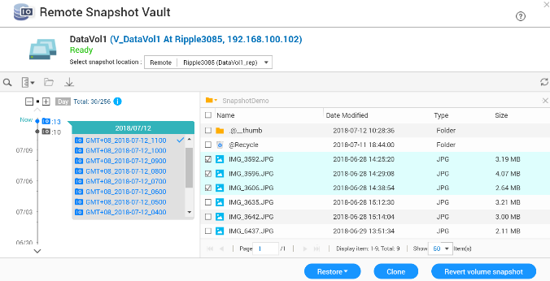
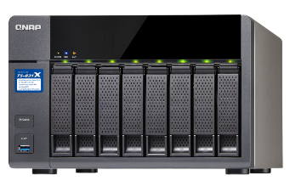
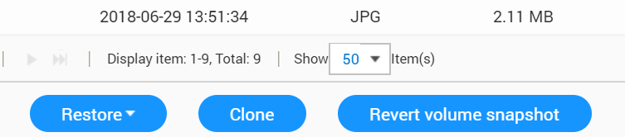



Support 3 Types of Restoration Methods
From the source snapshot manager, user can
1. Select file and folder to restore back to source
2. Select and clone remote snapshot as new volume/LUN
3. Select snapshot and revert the whole volume or LUN from remote
The restore, clone and revert speed is highly dependent on the network speed and conditions

Slide 36
Demo
Use the Remote Restore to recover files through 10GbE connection
Notes:
36521380

Slide 37




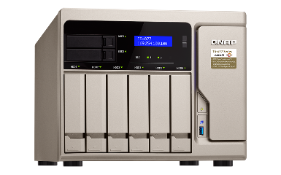

The Forth Way: Snapshot Export/Import
Export a snapshot from snapshot manager or snapshot vault
Using external storage device, the exported image can be imported to another NAS to create new volume or LUN
The same image can also be used to revert source volume or LUN
When network speed is unstable, external disk can also be utilized.
The exported image file size is same as the source volume or LUN
Notes:
36588464

Slide 38
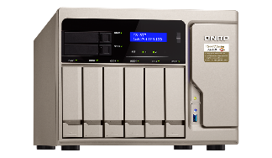






Multiple Restore Solutions
For File Server or iSCSI Storage
File Server: Restore selected data from remote snapshot vault directly
iSCSI Storage Server: Revert the iSCSI LUN from remote or clone the LUN at remote end for fast remount.
File-level file restoration from remote
Block-level remote restoration or clone the LUN directly at remote end
Or using the LUN export/import funciton
Notes:
38

Slide 39






Drastically Reduce Recover
Time With 10GbE Network
The Remote Snapshot Vault Recovering is based on Ethernet service.
Using 1GbE network, recovering large amount of data still take hours.
Pair the Snapshot Replica Solution with 10GbE or even faster Network to increase both the backup and recovery speed !
Time required for recovering
QNAP 10GbE
Switch
Using QNAP 10GbE Switch to replace old 1GbE to reduce RTO dramatically
Disaster Occurred
1GbE
Switch
Notes:
39

Slide 40


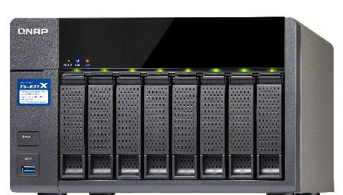
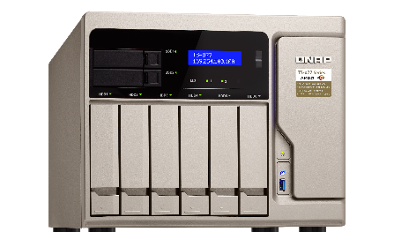
QNAP High ROI Backup Solution
QTS 4.3.4, QNAP NAS with AL processors can also use Snapshot, allowing user to use low cost ( 1,000 USD*) for creating a high ROI backup solution
With 4.3.5 Remote Restore, user can enjoy enterprise level backup and restoration experience.
4.3.4 Backup
TS-x31X model pair with Seagate 2TB drives
TS-831X
4.3.5 Restore
TS-877
Notes:
40

Slide 41
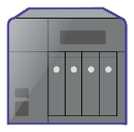
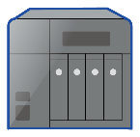



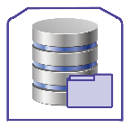

Use Remote Snapshot as
Local Snapshot With VJBOD
The Storage Pool create by VJBOD also support Snapshot.
The Snapshot will utilize the source NAS RAM.
Further increase the Backup Snapshot Number Limitation.
Remote NAS
Host NAS
+
Network
(TCP or iSER)
Virtual Disk
iSCSI LUN
Storage Pool 02
Storage Pool 01

Slide 42

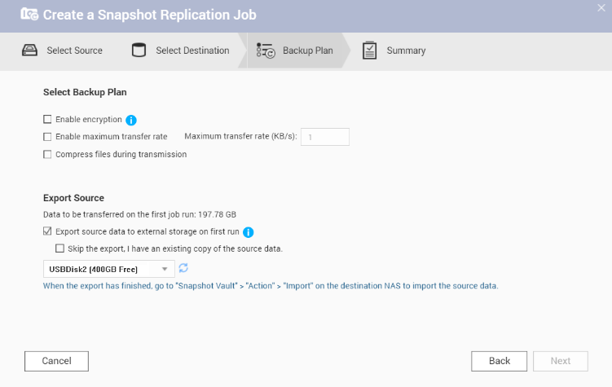

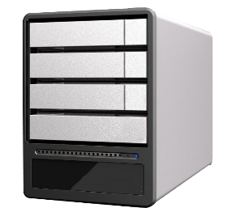
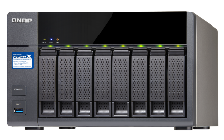



Snapshot Replica Support Export/Import
Snapshot Replica support options to Export Source to External Storage
Once exported, go to remote side and import image file to the vault
Use External RAID Storage with Snapshot Replica Export to quickly setup multiple backup site.
Thick Volume
Both the source and destination NAS must be at QTS version equal to or above 4.3.5 to use this function.
Notes:
42

Slide 43

Work Smart With the Snapshot Replica
With Remote Snapshot Vault Restore, Snapshot Replica is the best option to backup whole volume for file server
Backup Solution | Snapshot Replica | RTRR | Rsync
Backup Method | Block-level snapshot-based | File-level file-based | Block-level file-based
Backup Type | Differential backup (Only Transfer difference) | Overwrite different file (Transfer whole file) | Differential backup (Only Transfer difference)
Backup Time | Schedule | Real time/Schedule | Schedule
Recovery Solution | Remote recovery/Source recovery/ Import recovery | Remote recovery/ Synchronizing | Remote recovery
Backup Destination | NAS | NAS | Rsync Server
Using Scenario | Backup whole volume/LUN with many small files | Data synchronizing | Backup specified large files such as VM images

Slide 44

QNAP NAS Snapshot Recap
Local Snapshot
Using QNAP NAS to easily create, manage and restore your file with snapshot.
1
Snapshot Space Management
The “Out of volume” snapshot allows a Conservative but Completed snapshot protection.
2
3
Snapshot Replica
Backup your snapshot to a remote NAS and enjoy a fast restoration experience with remote restore and 10GbE solution.
Both the source and destination NAS must be at QTS version equal to or above 4.3.5 to use this function.
Notes:
44

Slide 45
QNAP NAS
Is Your Best Choose
Copyright © 2018 QNAP Systems, Inc. All rights reserved. QNAP® and other names of QNAP Products are proprietary marks or registered trademarks of QNAP Systems, Inc. Other products and company names mentioned herein are trademarks of their respective holders.

