Slide 1


Dive Deep Into Storage Technology
Preview
Software-defined Additional SSD Over-provisioning and
Advanced SSD Cache
Storage Space Management and Monitoring
Remote Snapshot Vault Restore and Export

Slide 2
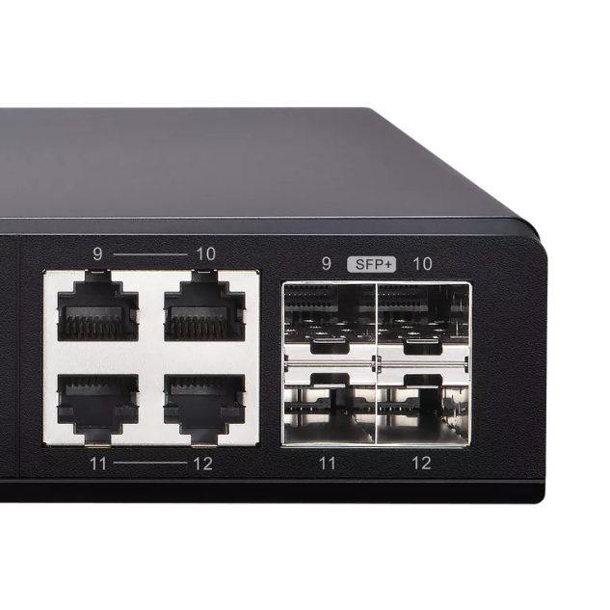

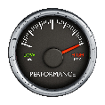



Boost efficiency with 10GbE Networking
When transferring a 50 GB file with 1GbE (110MBps) = 8 min.
With 10GbE, < 2 min.
With 10GbE around the corner, are you fully ready?
Your first 10GbE switch:
QSW-1208-8C
Is your SSD Cache fast enough for 10GbE?
Is your storage space flexible and safe enough to store all the files?
Is your backup and recovery plan utilizing 10GbE?

Slide 3
Software-defined Additional SSD Over-provisioning and
Advanced SSD Cache
Preview

Slide 4
SSD Awareness Storage:
Software-defined SSD Additional Over-provisioning
SSD Write-only Cache
SSD Cache Supports
Single/RAID
0/1/5/6/10

Slide 5

Challenge
SSD Cache performance is not as expected in 10GbE or Thunderbolt environments?
Notes:
70993439

Slide 6

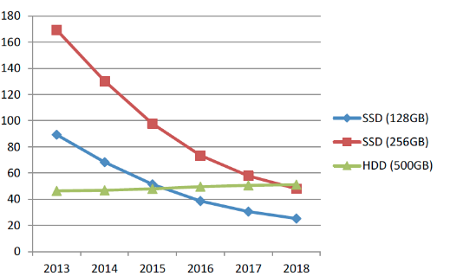
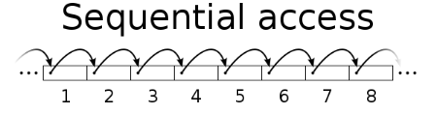
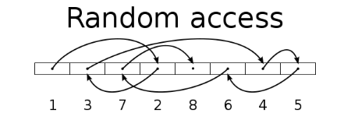
SSD Usage in Network Attach Storage
SSD can provide high random IOPS for multi-client sync and business applications that can not be achieved with HDD.
In 2018, SSD price also comes close to the sweet spot.
You need not only choose the right SSD, but also choose right NAS!
Drive Type | Sequential Access (MB/s) | Random Access (IOPS)
HDD | 100 | 350
SSD | 300 | 60000
SanDisk estimates the
256 GB SSD per GB price in 2018 is only 30% compared to that of 2013
https://www.sandisk.com/business/datacenter/resources/white-papers/the-ssd-enabled-pc-total-cost-of-ownership
SanDisk's Statistic for Global SSD/HDD Price Trend

Slide 7
QNAP SSD Global Cache and Qtier
For real-time performance boost, deploy SSD Global Cache or All flash storage
For continuous data tiering between hot and cold data, deploy the Hybrid Storage Qtier™ Auto Tiering
SSD Cache lets all data enter cache and
read hot data from the storage in real time
Qtier utilizes SSD space and let data block be
reallocated based on hot or cold in the storage
SSD Global
Volume
Block-based LUN
Volume
Block-based LUN
Qtier SSD Tier
Qtier HDD Tier
Storage Pool
SSD
SSD
HDD
HDD
HDD
HDD
HDD
HDD

Slide 8
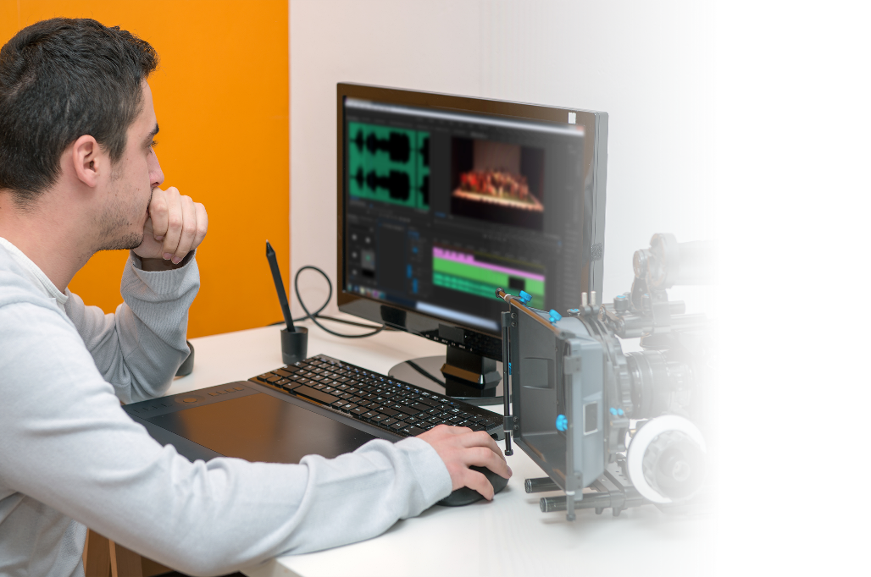
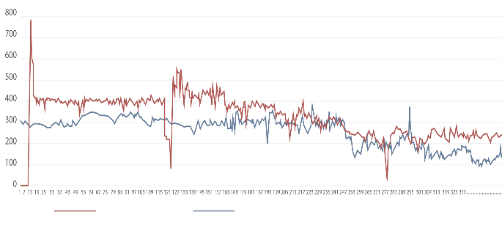
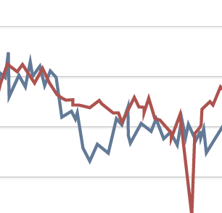
When SSD Cache Performance Degraded
True user story:
Spain TV Stations use SSD Cache to increase the material upload speed for multiple workstations while editing at the same time for urgent news.
After writing actions started, editing stations can’t have a smooth editing work. what happened?
Read throughput become lower in this time!
Write bandwidth
Read bandwidth
Notes:
8
93325809

Slide 9




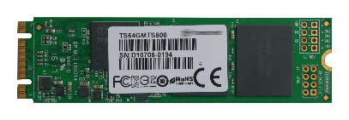


The SSD Works Differently from HDD
When HDD write new data: Overwrite the existed sector directly.
When SSD write new data: SSD need to clear whole block first.
Result: The SSD must collect valid page and rewrite them into new block before new data can be written (Garbage Collection).
Block X
Block X
Valid Data
Block
C
Page
A
Invalid Data
B
Block Z
A
B
C
D
Block Y
E
F
G
Block Y
F
D
E
G
Notes:
9

Slide 10


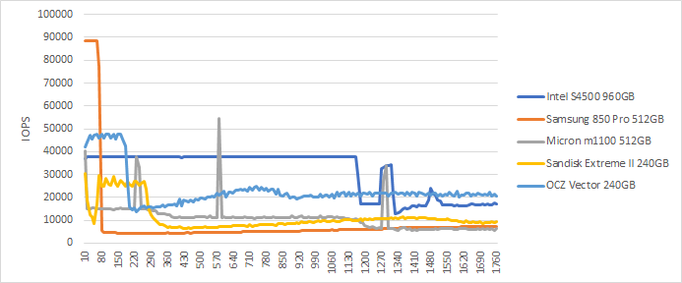
Different SSDs have Different Performance!
In QNAP Lab, engineers use FIO to test different SSDs, and all SSD have showed consistent write performance degrade.
Different SSD controllers' algorithm and Garbage Collection mechanism will affect the long term performance
Different SSD in QNAP NAS’s FIO consistent performance
(IOpattern: RW-4K):
How can storage vendor help to ensure SSD has expected performance ?
Notes:
10

Slide 11
SSD Internal Over-provisioning
SSD as Flash storage, it capacity should be presented with Gibibyte (GiB)
2^30 = 1,073,741,824 Bytes。
As storage device, SSD actually report it's capacity back with Gigabyte (GB)
10^9 = 1,000,000,000 Bytes。
Every GB in SSD contain 73,741,824 Bytes(7.37%) for the Garbage Collection operation, and enterprise SSD may reserved more!
SSD actual size (GiB) | SSD present size (GB) | Vendor designed OP % | Actual internal OP % | Size show in the NAS (GiB)
256 GB | 256 GB | 0% | 7% | 238 GB
256 GB | 240 GB | 7% | 15% | 223 GB
256 GB | 200 GB | 28% | 37% | 186 GB
In the NAS system, all capacity are actually be calculated and showed in the GiB format
https://www.seagate.com/tw/zh/tech-insights/ssd-over-provisioning-benefits-master-ti/
Data Source: https://www.kingston.com/us/ssd/maintaining
Notes:
11

Slide 12

How Over-provisioning can Affect SSD Performance and Endurance (1)
In below simplified example, SSD contains 1 block as OP and 3 blocks contain both valid and invalid data.
If 4 pages of new data are directly written to the last OP block first, the remaining 2 pages cannot be written anymore.
N | New data
D | Valid data
 | Invalid data
 | OP
N | N
N | N
N | N
N | N
D | D
D | D
D | D
D | D
D | D
D | D
N | N
N | N
New data incoming to the SSD
2 pages cannot be written
Notes:
12
P10>>動畫示意>播完會停留在完整畫面

Slide 13
How Over-provisioning can Affect SSD Performance and Endurance (2)
To write all new data into SSD, the SSD must conduct GC first.
During the GC, more write actions need to be taken, and this is known as “Write Amplification.”
OP with
Invalid data
N | N
N | N
N | N
To write 6 pages with 1 GC, the SSD need write 10 pages.
This type of data will be rearranged using SSD Trim
D | D
D | D
D | D
D | D
N | N
N | N
N | N
D | D
D | D
D | D
D | D
D | D
D | D
D | D
D | D
D | D
D | D
D | D
D | D
New data incoming to the SSD
SSD must conduct GC internally first
Write new data after GC completed
https://en.wikipedia.org/wiki/Write_amplification
Notes:
13
展開狀態圖非動畫

Slide 14
How Over-provisioning can Affect SSD Performance and Endurance (2)
To write all new data into SSD, the SSD must conduct GC first.
During the GC, more write actions need to be taken, and this is known as “Write Amplification.”
To write 6 pages with 1 GC, the SSD need write 10 pages.
OP with invalid
data
N | N
N | N
N | N
This type of data will be rearranged using SSD Trim
D | D
D | D
D | D
D | D
N | N
N | N
N | N
D | D
D | D
D | D
D | D
D | D
D | D
D | D
D | D
New data incoming to the SSD
SSD must conduct GC internally first
Write new data after GC completed
https://en.wikipedia.org/wiki/Write_amplification
Notes:
14
展開狀態圖非動畫

Slide 15
How Over-provisioning can Affect SSD Performance and Endurance (3)
When more space is reserved for Over-provisioning, data can be written directly without Garbage collection.
Write Amplification has be reduced.
N | N
N | N
N | N
Without GC, the total write actions required can be reduced back to 6.
D
D
D
D
N | N
N | N
N | N
OP with invalid
data
This type of data will be rearranged using SSD Trim
New data incoming to the SSD
Write all new data without GC
Notes:
15
P13>>動畫示意

Slide 16




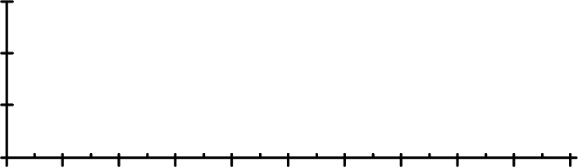
How Over-provisioning can Effect SSD Performance and Endurance (4)
With the additional Over-provisioning, the Write Amplification can be reduce dramatically. And with reduced write actions, SSD endurance can be increased.
14
WAF reduced
SSD life (TBW) increase
12
10
8
128G
256G
512G
1024G
10000
6
4
1000
2
100
0
WAF
0
20
40
60
80
100
TBW
10
Percent Filled
0
10
20
30
40
50
60
70
80
90
100
WAF vs. OP on Micron M600
Percent Filled
TBW vs. OP on Micron M600
https://www.micron.com/~/media/documents/products/technical-marketing-brief/over_provisioning_m600_for_data_center_tech_brief.pdf
Notes:
16
75027278
資料回寫的起始空間將會降低

Slide 17
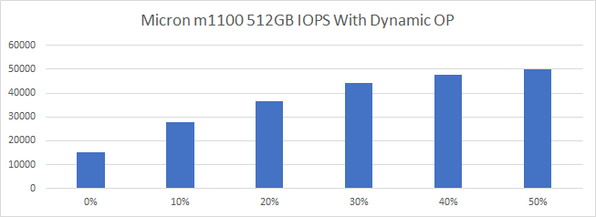
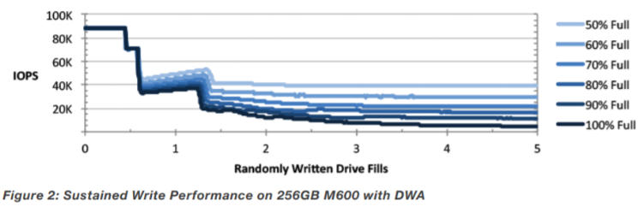
SSD Additional Over-provisioning effect on performance
In QNAP Lab, a TVS-882 uses 2 Micron1100
512GB SSD as Cache with RAID 1.
Random IOPS can increase to 300%
This result can also apply to different brand of SSD
Test condition: Configure SSD RAID with different additional OP and test its performance when cache is filled.
Using FIO for the test with --direct=0 --bs= 4k(random)1M(sequential), --io depth=1(random) 32(sequential), --file size= 90G
Notes:
17

Slide 18
QNAP Software-defined SSD Additional
Over-Provisioning
Having more over-provisioning is proven to be beneficial.
Besides SSD internal Over-provisioning, QTS introduces the additional Over-provisioning that can be adjusted based on usage.
Data
Usable Space
Over-provisioning Space
SSD Free Space (Can also be deemed as OP with Trim)
QNAP Software-defined, RAID Level, SSD Additional Over-Provisioning
Additional OP 0%~28+%
Additional OP 0%~28+%
Additional OP 0%~28+%
SSD internal OP 7.37%
SSD internal OP 7.37%
SSD internal OP 7.37%
Notes:
18
75027278
資料回寫的起始空間將會降低

Slide 19
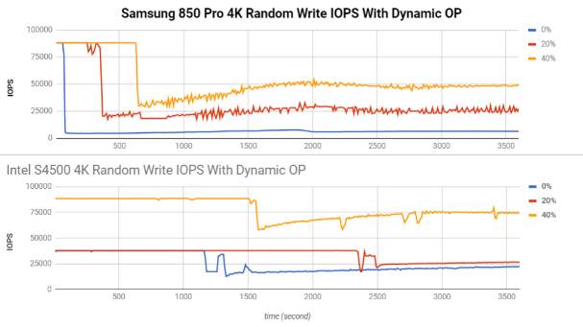
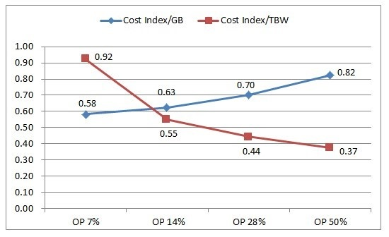
The Advantage of Software-defined Over-provisioning
Performance and endurance of SSD can be increased.
Let consumer SSD reach enterprise SSD performance, and further enhance enterprise SSD advantage, reduce TCO (Total Cost of Ownership)
  (Although usable space is reduced, actual used space is unchanged.)
http://www.atpinc.com/technology/ssd-over-provisioning-benefits-configure
Notes:
19

Slide 20
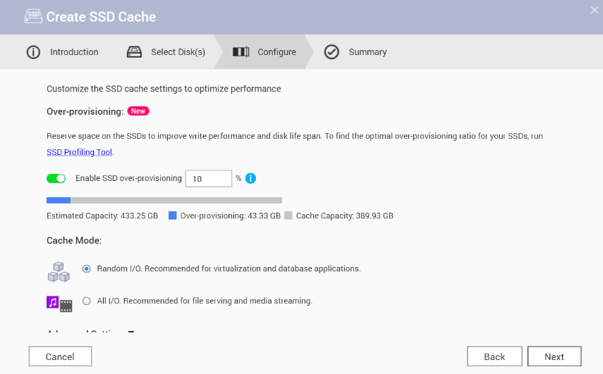
Configure the Software-defined
SSD Additional Over-provisioning
After QTS 4.3.5, user can decide OP amount for SSD cache, Qtier pool and static volume.
A number between 1% to 60% in addition to vendor defined amount
Note:
The over-provisioning can only be configured when a storage space is created and cannot be enabled for existing cache/volume unless recreating the storage.
Notes:
20

Slide 21


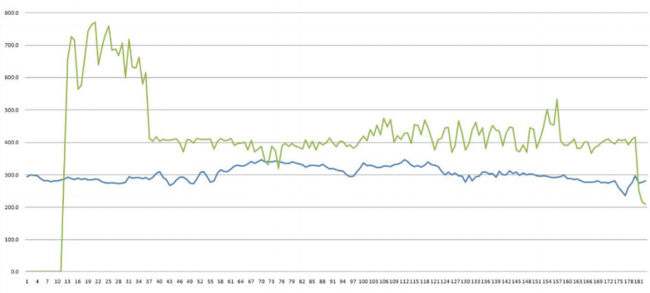
Choose SSD is Hard, Choose QNAP is Simple
SSD sustained performance can only be observed after used over time
With the SSD additional Over-provisioning, the TV station editors
gain a smooth editing experience
Achieve the goal of investing 10GbE and SSD
In 10GbE environment, the total throughput reach a stable 750MB/s
Write performance average: 450MB/s
Read performacne average: 300MB/s
Notes:
21
73652517

Slide 22
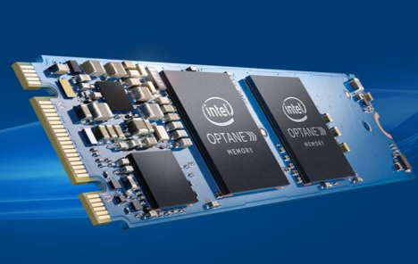
Is All SSD Support / Require The additional Over-provisioning?
Not all SSDs' performance are increased in QNAP Lab test.
SSD with higher internal over-provisioning or special controllor design, additional over-provisioning may not be needed.
Intel® Optane™: With 3D Xpoint™ technology, the M.2 SSD can reach a sustained performance higher than data center SSD.
Model | Size | Random Read IOPS (100% Span) | Random Write IOPS (100% Span)
Intel® Optane™ M.2 SSD | 16GB | 240K | 65K
Intel® SSD DC S4600 2.5 SSD | 240GB | 72K | 38K
https://ark.intel.com, https://www.intel.com.tw/content/www/tw/zh/architecture-and-technology/optane-memory.html
Notes:
22

Slide 23

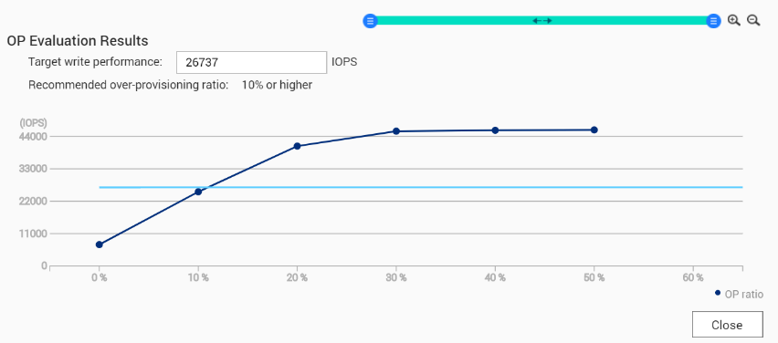
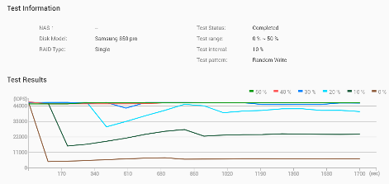
Use SSD Profiling Tool to measure the
Best Additional OP Amount On Your NAS
Capacity still matters! For example, more space in the read cache mean more data can be boosted at the same time
The upcoming App will give advice for the best configuration based on your required IOPS
Intel® SSD
DC S4600 2.5 SSD
Notes:
23

Slide 24

Demo
Use SSD Profiling Tool to Measure the Best SSD Additional Over-provisioning amount
Notes:
36521380

Slide 25
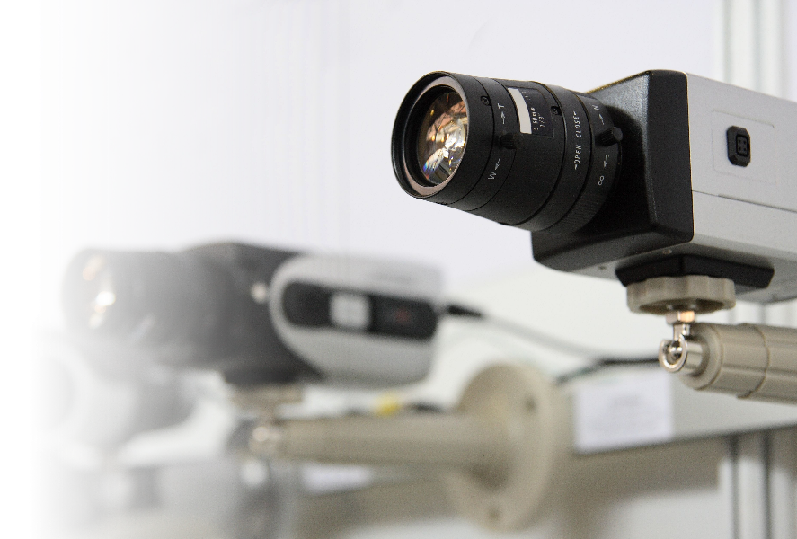
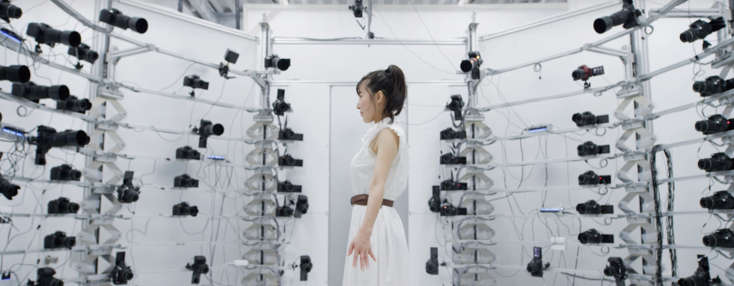
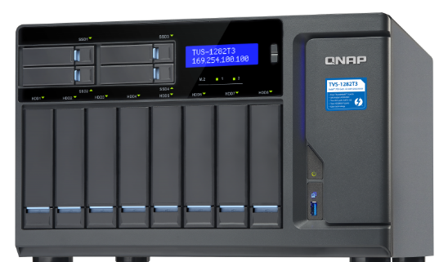
In Intensive Write Environment,
SSD Over-provisioning is a Must
Multi-Cams 3D Scanning With Thunderbolt NAS
Ensure multi-client combined write IOPS requirement can be met.
Ensure the SSD lifespan in high workload environment.
https://portal.jp-seagate-mktg.com/user_testimonials/rowland_kirishima/
Notes:
25
38377240

Slide 26
QNAP Global SSD Cache
The QNAP SSD Cache can be applied to multiple volume / LUN
- Cache Type:
  Store hot data for accessing (Read-Cache)
  Allow new data be written. (Read-write Cache)
- RAID configuration: Single, RAID 0, RAID 1, RAID 10
- SSD type: SATA, SAS, M.2, PCIe SSD
How Read-write Cache work:
Data from clients and storage will both be cached
Write
Write
Read
Read
IO Intensive
Application
SSD
When SSD Space not enough
HDD

Slide 27

The Write-only Cache Increase ROI of
SSD Cache with high Writing Demand
Write-only cache is promoted by Microsoft
for endurance control.
QNAP believe Write-only Cache can increase the ROI of purchasing SSD in below scenario:
1. File Server focusing on write operations
2. Database with more write operation
(Such as IoT monitoring server)
3. Use high endurance SSD (Intel Optane™) with other SSD
Writes
are cached
Reads
are NOT
NVMe
NVMe
SSD
SSD
SSD
SSD
https://docs.microsoft.com/en-us/windows-server/storage/storage-spaces/understand-the-cache
Notes:
27

Slide 28
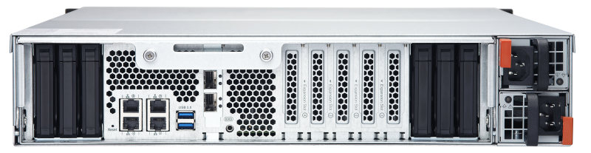

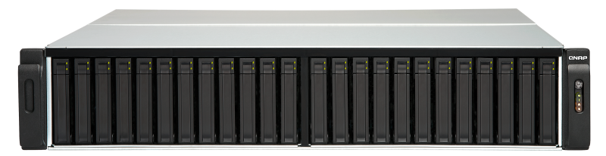

Combining Write-only Cache &
Over-provisioning with All Flash Storage
In RAID 5/6 All Flash Storage, Add Write-only cache to avoid write penalty
For example, The TES-3085U with all flash RAID 60 can pair with RAID 10 SSD Write-only Cache.
Add the SSD additional Over-provisioning on the RAID 10 to create a 3H (high capacity, high performance, high endurance) all flash storage array.
RAID 10 SSD Write-only Cache
Double the random write IOPS to 45,000
TES-3085U
Random read
250,000 IOPS
RAID 60 SSD Data RAID
Using Samsung 850 Pro, FIO For the test: --direct=0 --bs= 4k(random)1M(sequential), --io depth=1(random) 32(sequential), --file size= 90G
Notes:
28

Slide 29






SSD Cache Support RAID 5/6
Increase ROI for Read-only Cache
What is RAID 5/6 write penalty？ RMW (Read Modify Write)
1 Write= Read Parity+Read Data+Calculate Parity+Write Parity+Write Data
However, if the SSD will only be used as Read-only Cache, the write action will be limited and RAID 5/6 can increase Cache capacity
RAID 10 Capacity = N/2
RAID 5 Capacity = N-1
A1
M
A2
M
A1
A2
A3
P
B1
M
B2
M
B1
B2
B3
P
C1
M
C2
M
C1
P
C2
C3
Also, the write penalty is proved to be less obvious on sequential access, in which not all chunk will need to be checked.
Notes:
29

Slide 30
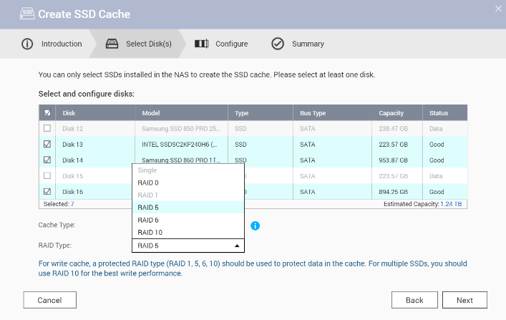
Create SSD Cache With RAID 5/6
In QNAP Lab，four 240GB Samsung SSD 850 Pro is used as Cache
Compare the performance between RAID 5 and RAID 10 with 100% Cache hit rate*
SSD RAID 5
throughput can
match with
RAID 10
Sequential Cache
Performance (MB/s)
Capacity (GB)
Cache Sequential Performance (MB/s)
800
1600
700
1400
600
1200
500
1000
400
800
300
600
200
400
Write
100
200
Write
Read
0
0
Read
RAID 10
RAID 5
RAID 10
RAID 5
*The performance for data be written into the RAID 5 Read-only cache can still be lower than RAID 10
Notes:
30

Slide 31
QNAP NAS Provide the
Most Flexible SSD Cache Settings
Scenarios | File/ Application Server | Web Server | Online Media Editing Station | Media Material Storage | Business Database Storage
Cache Mode | Read-write C | Read-Only | Read-write | Write-only | Read-write
Cache RAID | RAID 10 | RAID 5 | RAID 5 | RAID 10 | RAID 10
SSD additional Over-provisioning | 20% | 10% | 30% | 30% | 30%
Recommended/ reference model | TS-877 | TS-963X | TVS-1282T3 | TS-1685 TS-1635 | TS-EC2480U R2
Notes:
31

Slide 32
SSD Cache or Qtier™, Which is Better?
Global SSD Cache
Sequential Performance (MB/s)
Random Performance (IOPS)
Real time performance boost
1. Burst read and write requirement such as news editing.
2. The cache can be disabled and adjusted at any time.
1400
80000
1200
70000
1000
60000
800
50000
600
40000
Qtier 2.0
400
30000
200
20000
Fully utilize the SSD capacity
1. For data with hot and cold access pattern to conduct tiering
2. Pair with Qtier IO-aware can also be used on databases.
0
10000
Cache
Qtier
Write
0
Cache
Qtier
Read
TVS-871T-i7-16G with QM2 2P Card ADATA SX8000NP 512GB as SSD Cache and Qtier
Notes:
IO Aware and Tiering On Demand

Slide 33


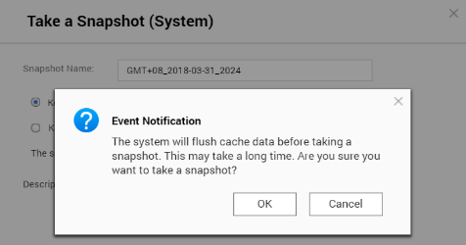

Storage Structure Change
For Snapshots to Include Cache Content
Old SSD Cache: Taking Snapshot must flush SSD Cache data first and may take up to 30 min.
New SSD Cache: Taking snapshots no longer require flushing, enabling high frequency snapshots with SSD cache included.
Old SSD Cache
Storage Pool
Volume
iSCSI LUN
Storage Pool
New SSD Cache
Volume
iSCSI LUN
Notes:
33
35967978

Slide 34
Storage Space Management and Monitoring
Preview

Slide 35
Flexibility Storage Management
Volume Shrink and Convert
VJBOD Support iSER
Seagate IronWolf Health
Management

Slide 36

Challenge
My storage space is not enough to store both data & snapshots?
My HDD become abnormal but the status still shows good?
Notes:
36496673

Slide 37


QNAP Flexibility Storage Configuration
Already support various configurations with storage pool
Guaranteed Space：Think volume and Block-based iSCSI LUN
Thin-provisioning：Thin Volume and Block-based iSCSI LUN
Other functions：Encryption of Thick/Thin Volume and File-based iSCSI LUN
Thin Volume
File-based LUN
Thick Volume
Block-based LUN
Thin Volume
Encrypted Volume
Storage Pool
RAID
HDD
HDD
HDD
HDD
HDD
HDD
HDD
HDD

Slide 38







In the Past, Space Allocation Need to be Careful
Allocate all space to thick volume: free space cannot be utilized
Over-subscripted space to thin volume: some volume cannot be used
When Storage Pool Space is limited, snapshot can be auto recycled
One thick volume: Free space is still allocated
快照
Multiple Thin Volume: Some volumes space will be limited
Thick Volume
Thin Volume
Notes:
38

Slide 39




Introduce Resize Volume Wizard
The Thick and Thin Volumes now support Resize Volume Wizard.
Reduce the allocated thick volume space to free space for the storage pool, other volumes, LUN or Snapshot.
Reduce the planned thin volume space to avoid risk of “Oversubscription”.
Oversubscription
Thin Volume
Think Volume
Oversubscription
The space that thin volume has planned but its storage pool cannot currently provide.
Thin Volume
Oversubscription
Think Volume
Thick Volume
Storage Pool
Notes:
39
online變更, 不需要copy data出來

Slide 40
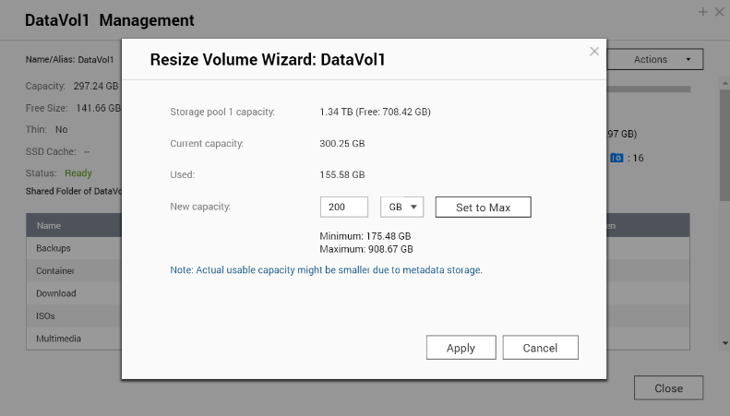
3 Three Steps to Reduce the Volume Space
Ensure all the written actions of the volumes are stopped
1
2
Storage/Snapshot > Volume Management > Resize > Input the reduced size
3
Waiting for the action to complete and continue usage!
Notes:
40

Slide 41
Demo
Shrinking Volume Capacity in 3 Steps
Notes:
36521380

Slide 42
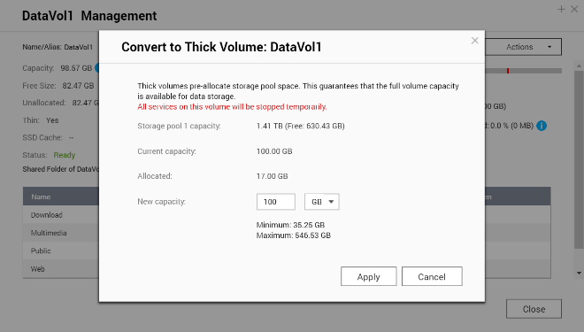
Convert Thin Volume Back to Thick
QTS 4.3.5 now support convert Thin to Thick in contrast to Thick to Thin conversion introduced in QTS 4.3.4.
The volume space can be converted to guaranteed space or flexible allocation to maximize space allocation efficiency.
Think Volume
Thin Volume
Shared Space
Thin Volume
Oversubscription
Think Volume
Shared Space
Storage Pool
Thin Volume
Think Volume
Thick Volume
Think Volume
Guaranteed
Storage Pool
Notes:
42

Slide 43
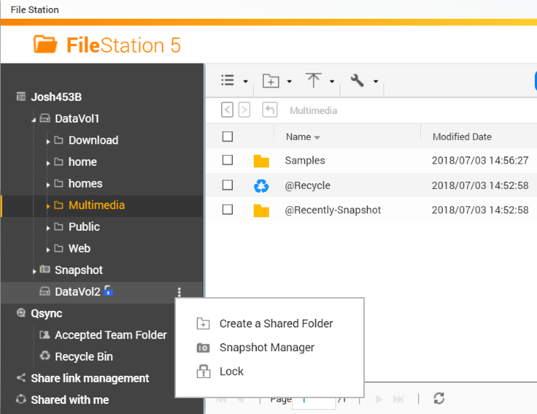
Using File Station to Control
Encrypted Volume
Use can create encrypted thick or thin volume with National Cyber Security certified (FIPS 140-2 CAVP) AES-256 bits encryption.
In 4.3.5 User can quickly lock a data volume in File Station.

Slide 44
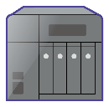
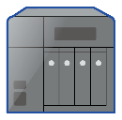



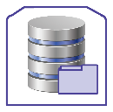

VJBOD Support RoCE-based iSER
Earlier in QTS 4.3.3 QNAP and Mellanox collaborated so the QNAP NAS iSCSI target can support RoCE iSER with VMware ESXi
At QTS 4.3.5, The VJBOD that based on iSCSI can also utilize this technology to increase the storage performance
Remote NAS
Host NAS
+
Network
(TCP or iSER)
Virtual Disk
iSCSI LUN
Storage Pool 02
Storage Pool 01
Beside from ESXi 6.0, ESXi 6.5 and latest 6.7 will also be support in the upcoming 4.3.5
Notes:
44

Slide 45
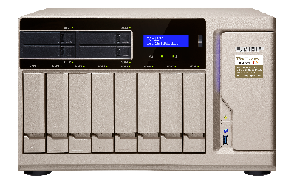

What is iSER (iSCSI Extensions for RDMA)
Based on different technologies (RoCE, iWARP, InfiniBand), the goal of iSER protocol is to allow network data to reach the memory of the systems directly
RoCE based iSER can be active when both host and remote system used the specific network card, and can increase transferring performance by more than 25%.
iSCSI
iSCSI
Socket Library
Network Driver
RDMA Lower Layer Protocol
TCP/IP
Traditional Network Card
RDMA Network Card
Tested in QNAP Lab. Figures may vary by environments.
QNAP RoEC based iSER can only be enabled with specific Mellanox NICs as well as a switch that support Priority Flow Control
Notes:
45

Slide 46

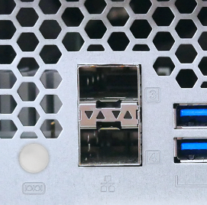
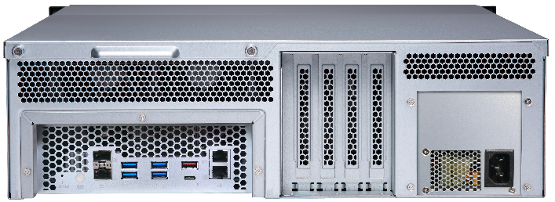
Using iSER to Increase VJBOD Performance
In QNAP Lab, the TS-1677XU with built-in Mellanox CX4 10GbE
The disk performance of Virtual Machine that mount iSER VJBOD disks can be faster than other normal VJBOD disk from the same NAS.
6000
13500
With iSER, VJBOD random write performance from the same NAS can increase by 80%
5000
13000
4000
12500
3000
12000
2000
11500
1000
11000
0
10500
4K Random Write
4K Random Read
Test condition: Mount a TES-3085 iSCSI LUN as VJBOD disk and create virtual disk image for a VM on 1677XU to test the disk performance with Iometer, 64GB 4 Outstanding, Standard 4K random read/write test
iSER
No iSER
iSER
No iSER
Notes:
46

Slide 47

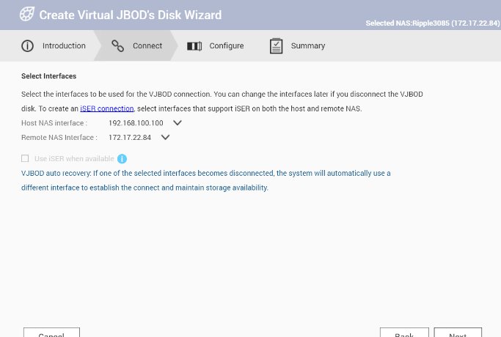
Easily Enable iSER Connection For VJBOD
Use iSER in VMware might be hard, but it is one click to go in QTS
VJBOD connection wizard can easily identify which interface supports iSER for user to select from
Auto reconnection is also supported in iSER
Check VJBOD connection
When reconnect is finished, auto remount the VJBOD disk
Enter protection mode after disconnected in
15 sec
Try to reconnect in the order of iSER > TCP
Notes:
47

Slide 48
Demo
Use iSER VJBOD to create a local VM disk and test its performance
Notes:
36521380

Slide 49
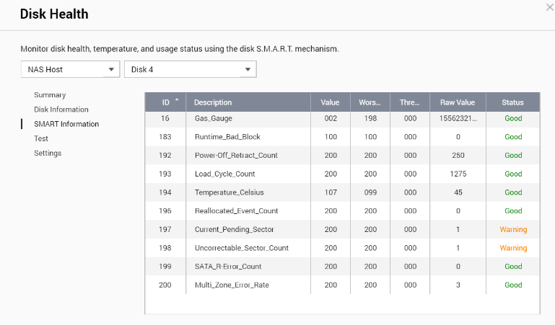
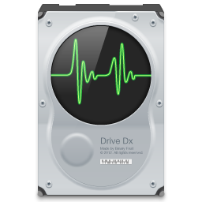
How to Intelligently Monitor Disk Condition
Disk issue is generally reported by S.M.A.R.T., but S.M.A.R.T. only reported error after it has been detected.
Is there a way to actively analyze disk conditions, to prevent errors from happening such as:
Bad connection between NAS & Disk
Cause continuous reset
Excessive vibration on the HDD
Cause future bad sector
Notes:
49

Slide 50
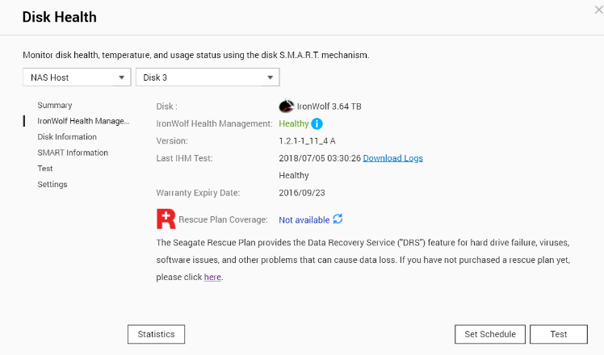
Seagate IronWolf Health Management
IronWolf Health Management is incorporated in QTS 4.3.5
Using the Seagate Official Analysis Tool to find potential risk that might lead to disk abnormality
aaa
The risk that IHM can help to detect:a
Excessive host resets have been detected.
Connection issues on NAS and hard drive interface.
Excessive physical shock to the hard drive.
Excessive vibration on the hard drive.
Abnormally high operating temperature.
Analysis S.M.A.R.T. values for future failurea
Notes:
50

Slide 51
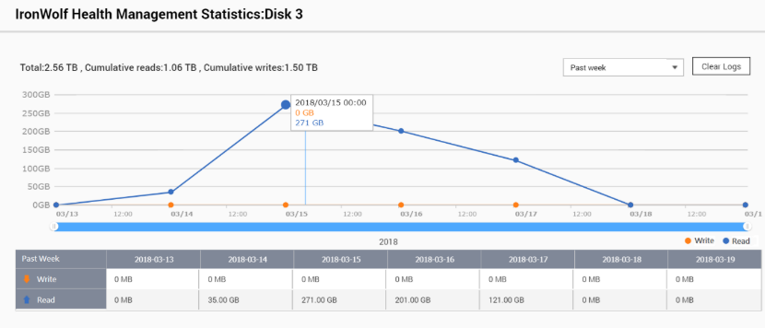
QNAP X Seagate Exclusive Functions
QNAP and Seagate are committed to provide more advanced features to protect customer data
Default Warranty Expiry Day
Provide info on the out of factory warranty for reminding early replacement
- Workload statistic
Determine warranty based on
total data write while monitoring application workload at disk level
Notes:
51

Slide 52
Snapshot Remote Restore and Export/Import
Preview

Slide 53
Snapshot Replica
Remote Restore：
Restore from Remote Snapshot Vault
Snapshot Export/Import
Export Snapshot In first
Snapshot Replica Task
LUN Export/Import

Slide 54

Challenge
Backup data recovery can not be completed in time when disaster happens?

Slide 55



Business Need Shorter RTO!
In the survey of 300 Enterprise and SMB at Taiwan:
60% have used Remote Replication as Backup Plan.
50% of business expected the recovering time should be within 1 Hour.
But also 50% of business experience actual recovery time > 1 Day!
Can business only manually transfer data back from the remote end when disaster happen?
Data Backup Time
Disaster Happen
Server Online
TIME
Recover Point Objective
Recover Time
Objective
Taiwan IThome survey 2017
Notes:
55
39094200

Slide 56
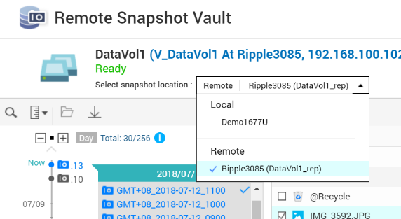
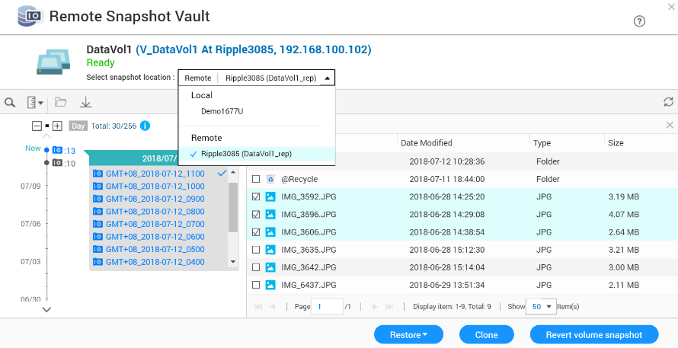

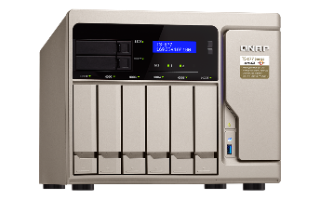
Restore From Remote Snapshot Vault
The Snapshot Manager now actively connected to Snapshot Vault
Support Monitor and restore select folder and files at the Source NAS directly!
Both the source and destination NAS must be upgraded to 4.3.5 to support this function
Notes:
56

Slide 57

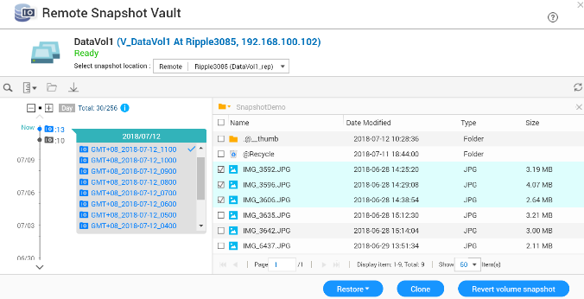
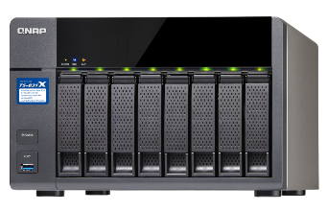
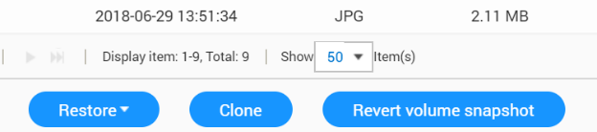

Support 3 Types of Restoring
From the source snapshot manager, user can
1. Select file and folder to restore back to source
2. Select and clone remote snapshot as new volume/LUN
3. Select snapshot and revert the whole volume or LUN from remote
The restore, clone and revert speed is highly depended on the network
speed and conditions

Slide 58
Demo
Using QNAP 10GbE Solution to
Restore File From Remote
Notes:
36521380

Slide 59


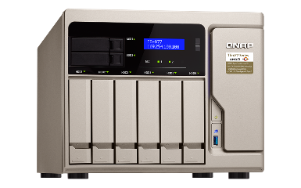

The Forth Way: Snapshot Export/Import
Export a snapshot from snapshot manager or snapshot vault
Using external storage device, the exported imaged can be imported to another NAS to create new volume or LUN
The same image can also be used to revert source volume or LUN
When network speed is unstable, external disk can also be utilized.
The exported image file size is same as the source volume or LUN
Notes:
36588464

Slide 60
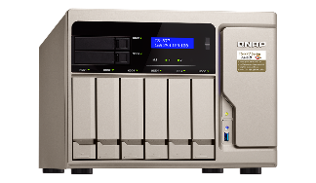

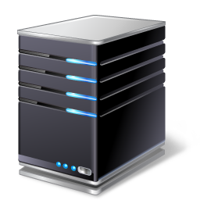




Multiple Restore Solutions
For File Server or iSCSI Storage
File Server:
Restore selected data from remote snapshot vault directly
iSCSI Storage Server:
Revert the iSCSI LUN from remote or clone the LUN at remote end
for fast remount.
File-level file restoration from remote
Block-level remote restoration or clone the LUN directly at remote end
Notes:
60

Slide 61





Drastically Reduce Recover
Time With 10GbE Network
The Remote Snapshot Vault Recovering is based on Ethernet service.
Using 1GbE network, recovering large amount of data still take hours.
Pair the Snapshot Replica Solution with 10GbE or even faster Network to increase both the backup and recovery speed !
Recover Time (RTO)
Using QNAP 10GbE Switch to replace old 1GbE to reduce RTO dramatically
QNAP 10GbE
Switch
Disaster Happened
1GbE
Switch
Notes:
61

Slide 62




Why First Snapshot Replica Take Longer Time?
In the survey, 30% of IT managers do not feel comfortable with the long backup time.
For Snapshot Replica, the whole Volume and LUN need to be transferred first before snapshot can be backup*
Without faster network, setting up a backup can take days.
Snapshot
Snapshot with data difference
Backup Source
Backup Destination
Thick Volume
Snapshot Vault
Source Storage Pool
Remote Storage Pool
Thin volume or LUN are not limited by this as space will only be allocated after data usage.
Notes:
62

Slide 63






Snapshot Replica Support Export/Import
Snapshot Replica support options to Export Source to External Storage
Once exported, go to remote side and import image file to the vault
Use External RAID Storage with Snapshot Replica Export to quickly setup multiple backup site.
Thick Volume
Both the source and destination NAS must be at QTS version equal to or above 4.3.5 to use this function.
Notes:
63

Slide 64




iSCSI LUN Support Export/Import
Besides using QNAP NAS to do Snapshot Replica, iSCSI LUN can also be exported to an Windows/Linux server
The exported image can be later imported to same or different NAS
Even when only 1 QNAP NAS present, iSCSI LUN can still be properly backup
Both the source and destination NAS must be at QTS version equal to or above 4.3.5 to use this function.
Notes:
64

Slide 65
Work Smart With the Snapshot Replica
With Remote Snapshot Vault Restore, Snapshot Replica is the best option to backup whole volume for file server
Backup Solution | Snapshot Replica | RTRR | Rsync
Backup Method | Block-level snapshot-based | File-level file-based | Block-level file-based
Backup Type | Differential backup (Only Transfer difference) | Overwrite different file (Transfer whole file) | Differential backup (Only Transfer difference)
Backup Time | Schedule | Real time/Schedule | Schedule
Recovery Solution | Remote recovery/Source recovery/ Import recovery | Remote recovery/ Synchronizing | Remote recovery
Backup Destination | NAS | NAS | Rsync Server
Using Scenario | Backup whole volume/LUN with many small files | Data synchronizing | Backup specified large files such as VM images
Notes:
65

Slide 66

Work Smarter in the Age of Speed!
Software-defined SSD Additional Over-provisioning / SSD Write-only cache / RAID 5, 6 Cache
1
2
Volume Shrink and covert / VJBOD support RoCE based iSER/ Seagate IronWolf Health Management
3
Remote Snapshot Vault Restoration / Snapshot Export and Import
Notes:
66
38377240

Slide 67
QNAP NAS
Is Your Best Choose
Copyright © 2018 QNAP Systems, Inc. All rights reserved. QNAP® and other names of QNAP Products are proprietary marks or registered trademarks of QNAP Systems, Inc. Other products and company names mentioned herein are trademarks of their respective holders.

