Slide 1
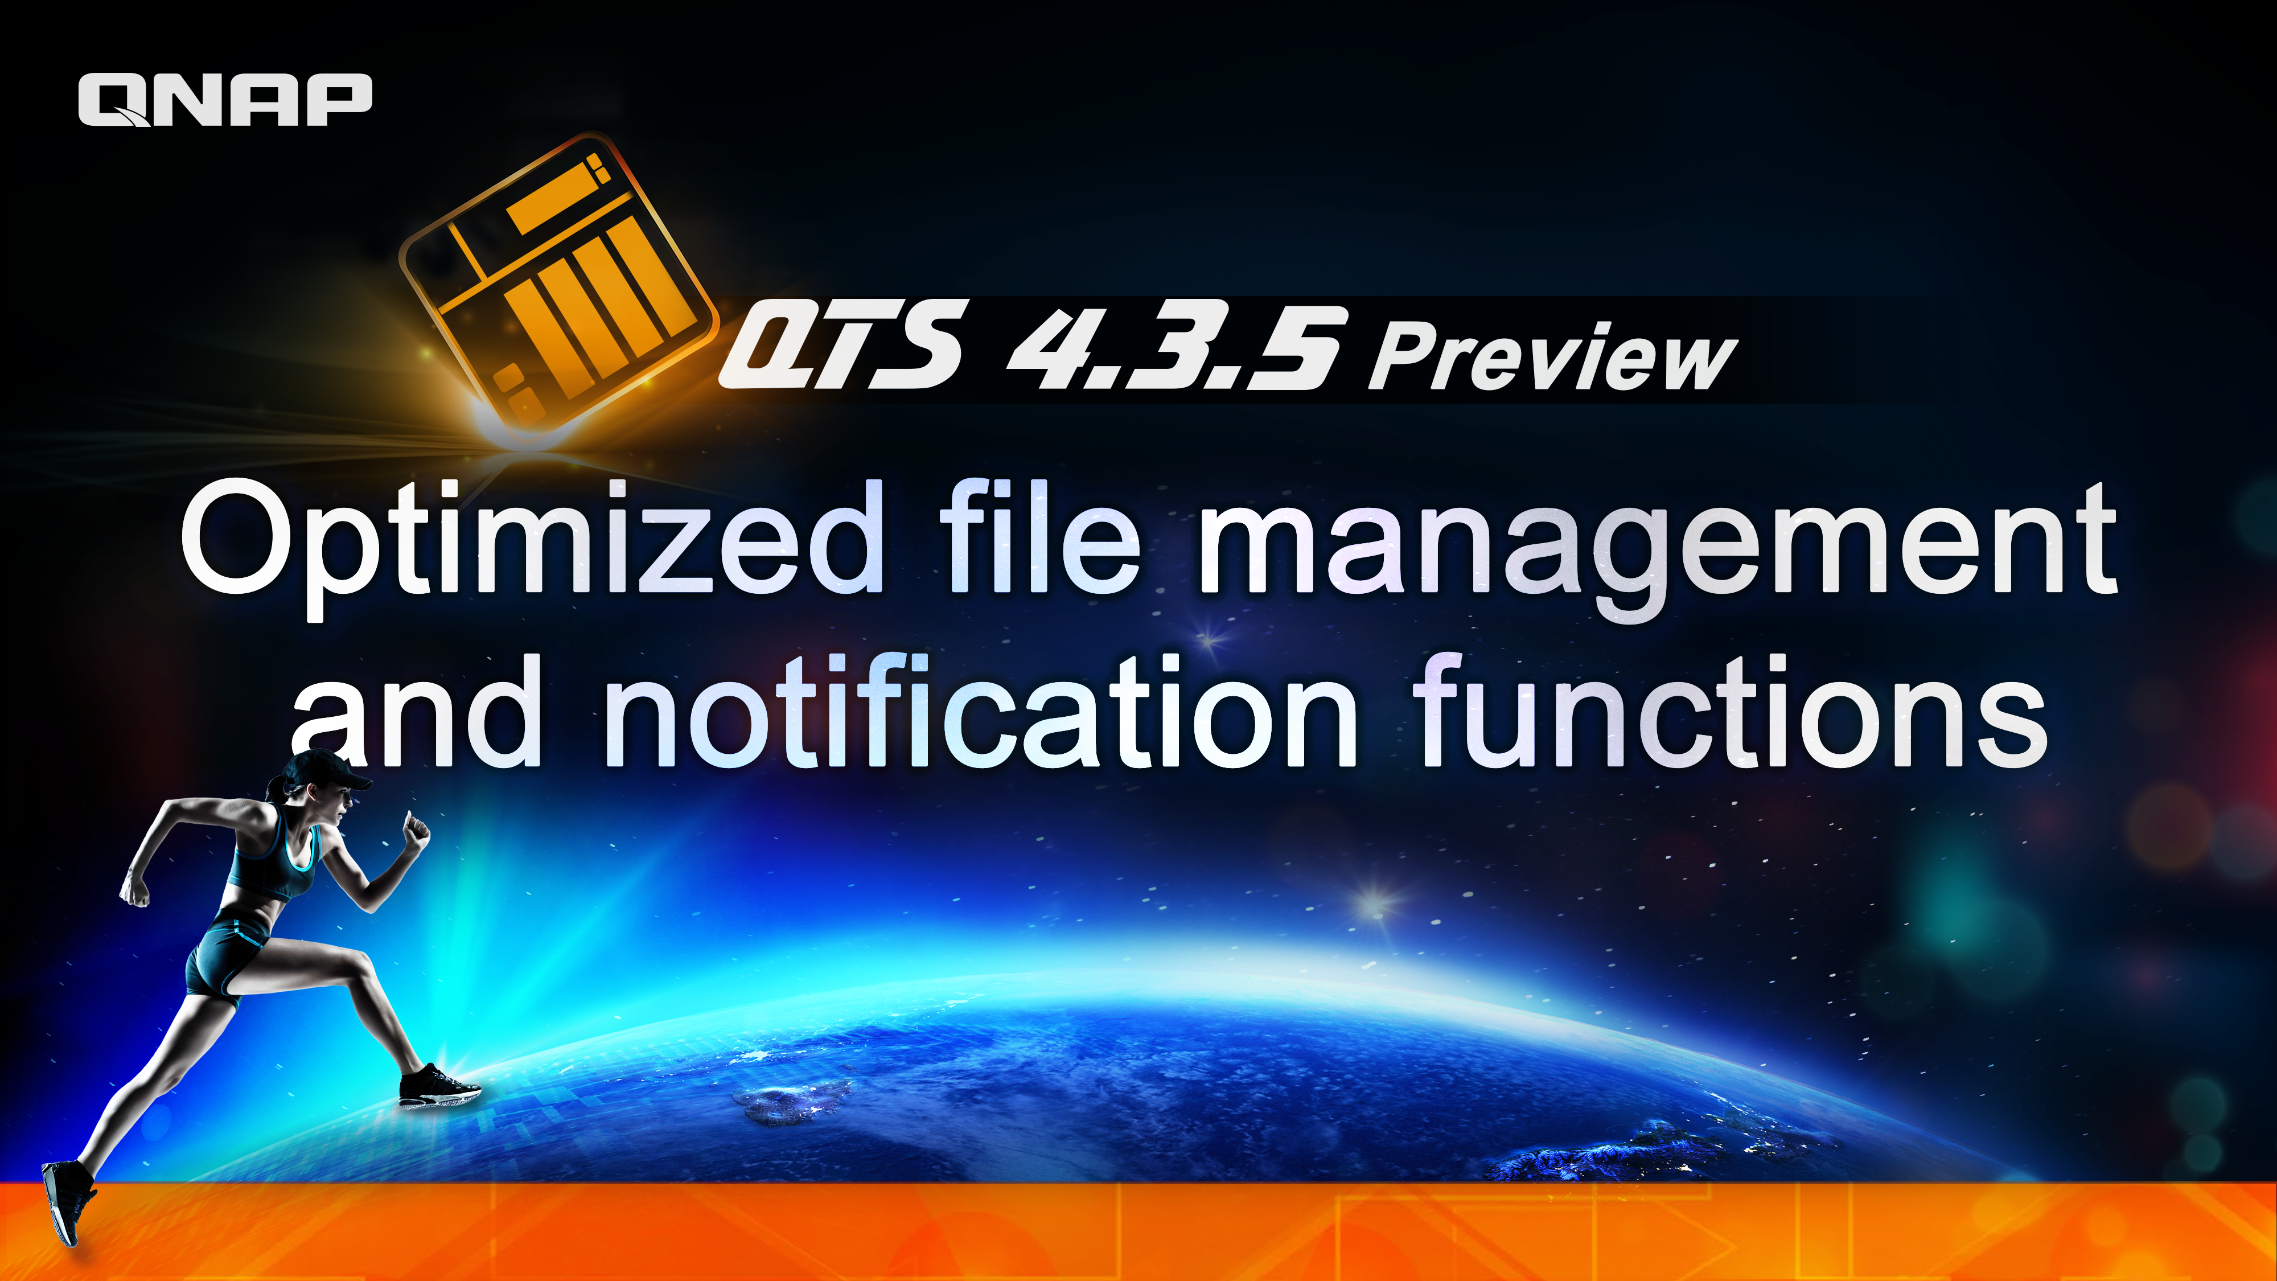

Slide 2



Make File Management More Efficiently
Preview
Useful Tips in File Station

Slide 3
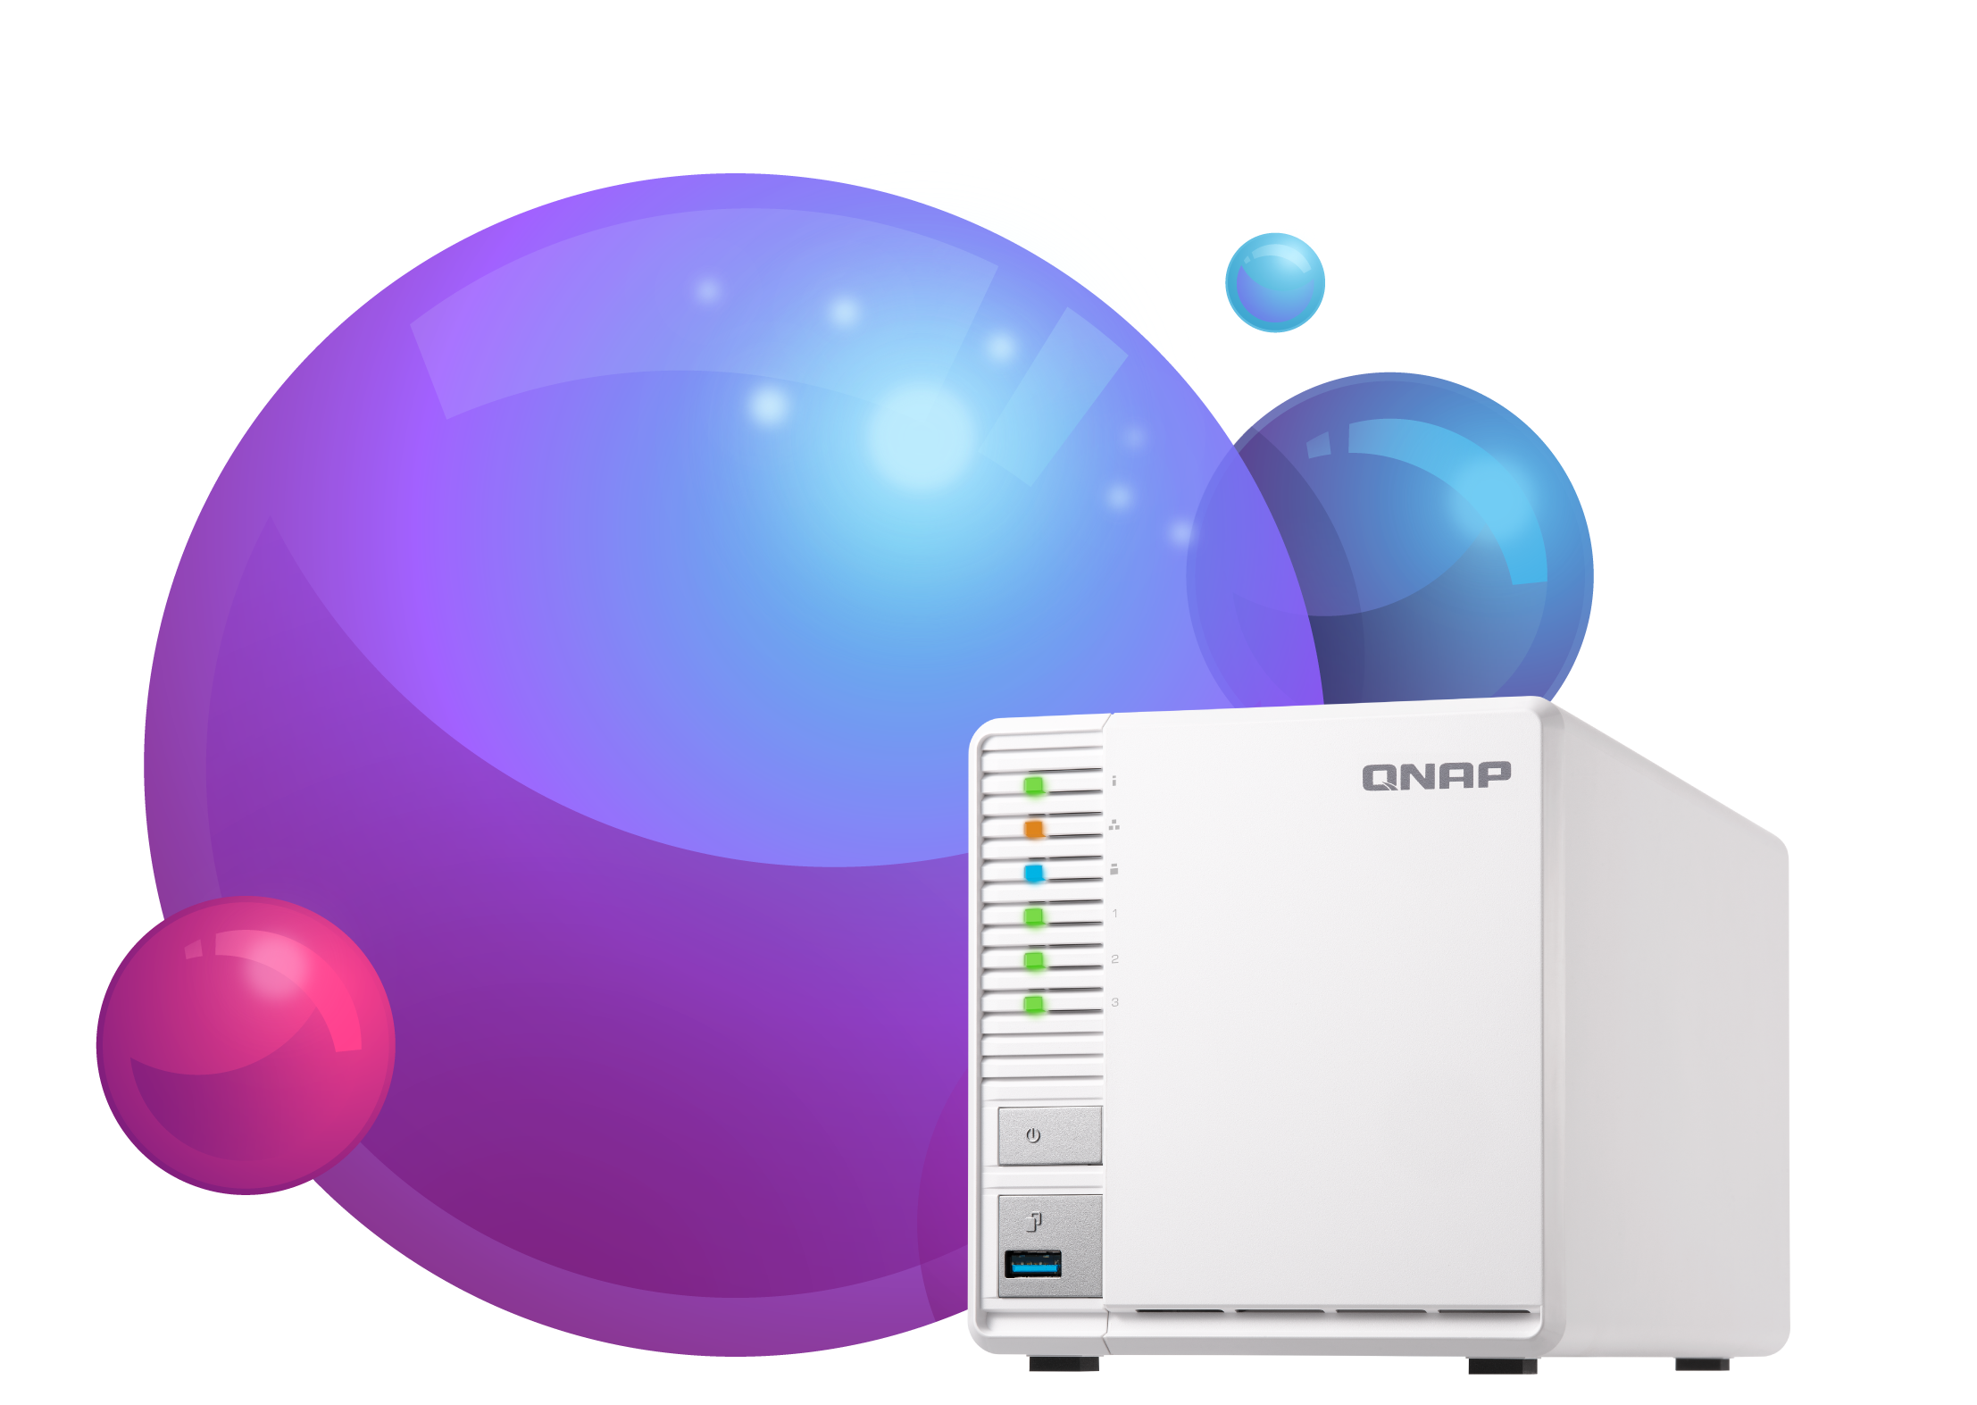
part
1
Handy Tool for Image Management

Slide 4

Have you ever had those concerns?
It's not easy to create a photo collection.
There are security/copyright concerns for sharing photo to others.
It is hard to arrange massive amount of photos in the order you need.

Slide 5


Image2PDF is your helper!
Easy image selection and fast creation.
Easy to arrange the order of images.
Three security measures.
Multiple customizable options.

Slide 6

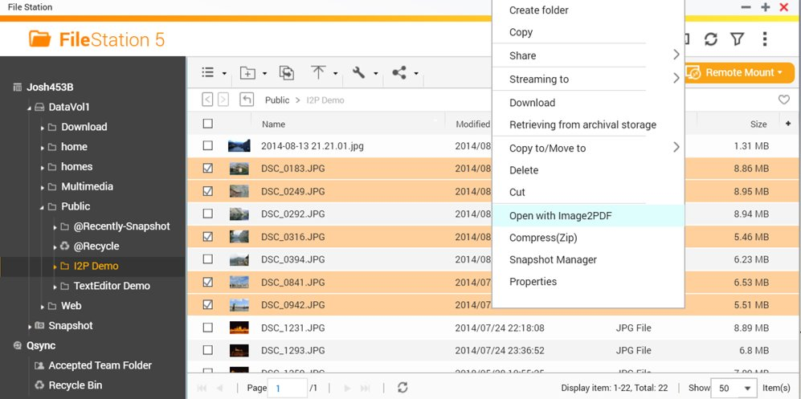
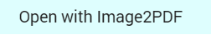

Easy image selection and fast creation
Choose images in File Station, and open with Image2PDF

Slide 7
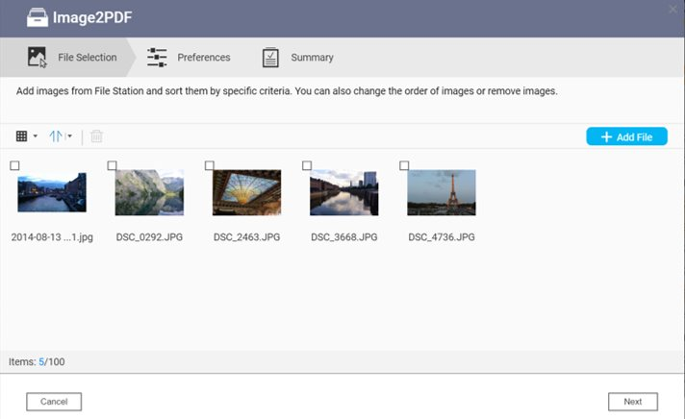
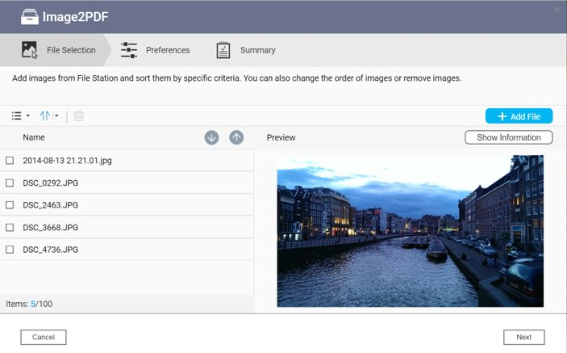
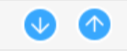
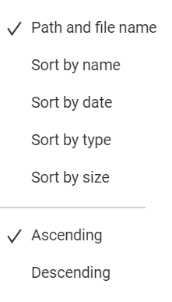



Easy to arrange the order of images
Thunbnail Mode
List Mode
Drag to arrange order.
Multiple sorting criteria

Slide 8
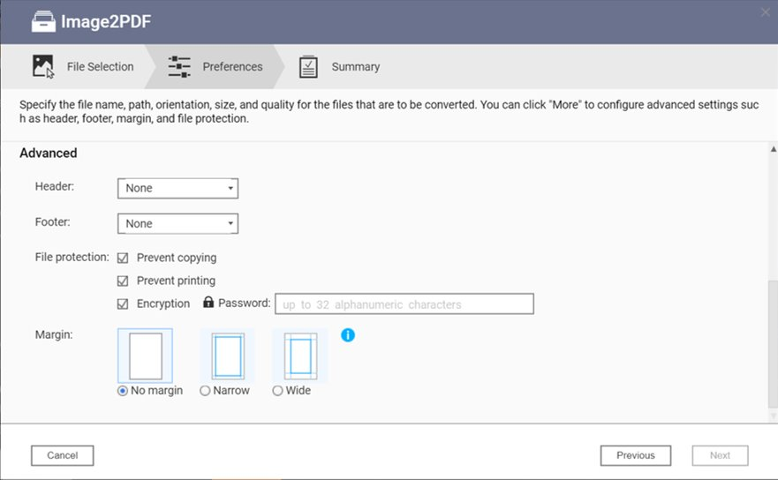
Three security measures
Prevent copying, printing; then encrypt.
Finally, share it!!

Slide 9
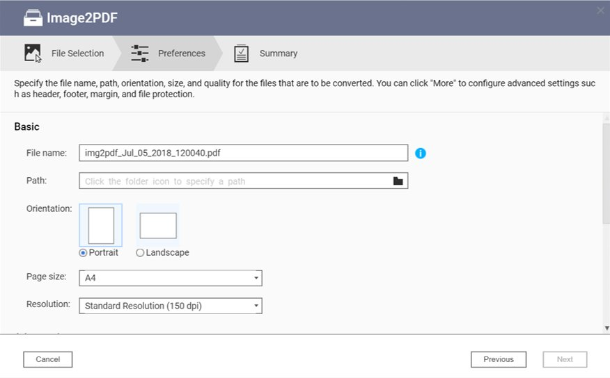

Multiple customizable options
Page, Date, Custom text

Slide 10
DEMO

Slide 11
part
2
Handy Tool for Text Editing

Slide 12



Have you ever had those concerns?
You encounter an emergency case that you have to connect to remote server to modify settings.
Install a new editor ?
That is waste of time.
You find that there is no editor installed on the server.
Windows notepad?
Not easy to use.

Slide 13


You back up important files to
NAS. Have you ever thought about...
Need to fix some code.
But I have to download and upload again...
How to view or modify code files that are backed up to NAS?
Just want to quickly view,
but downloading takes time...

Slide 14







Text Editor helps you easily edit
code/program on the NAS.
No installation required
Save back to File Station
Convenience

Slide 15



You can choose to…
Download then Upload | Connect with Samba | TextEditor 1.1.0
Complicated | Convenient to use (Need SMB support) | Convenience to use
no editor installed on the server | no editor installed on the server | Familiar operation
When edited by multiple users, the latter might overwrite the former | When edited by multiple users, the latter might overwrite the former | Newly added warning function to notity when multiple users are editing.
Text Editor 1.1.0 is your best choice.

Slide 16





Text Editor 1.1.0 is even smarter
Split-screen mode to edit different files at the same time.
File status notification
Warning for concurrent editing

Slide 17
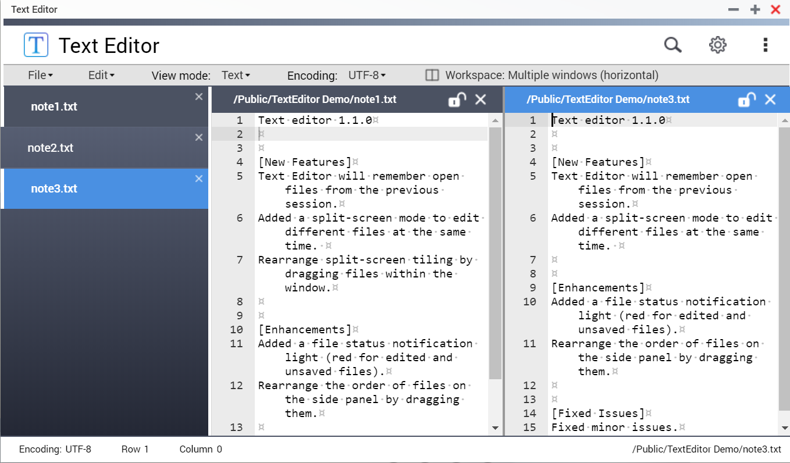
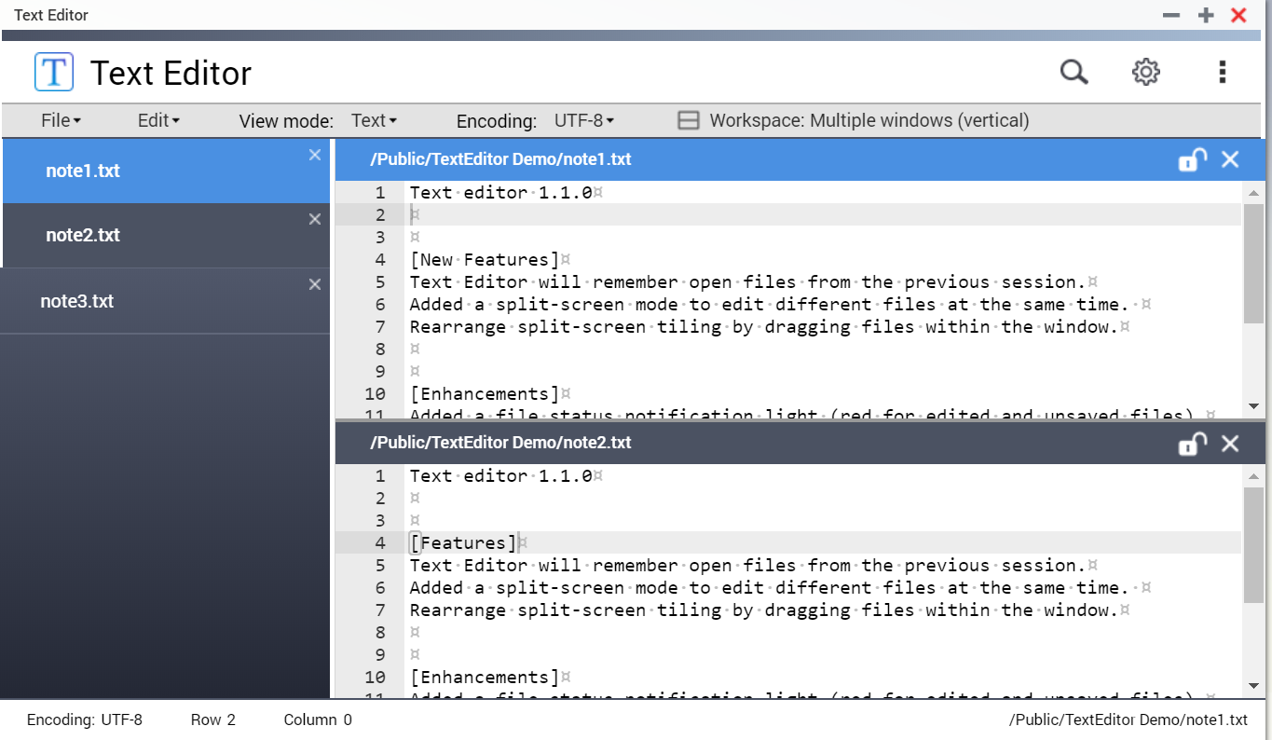

Split-screen mode
Horizontal or Vertical
Drag to open file

Slide 18
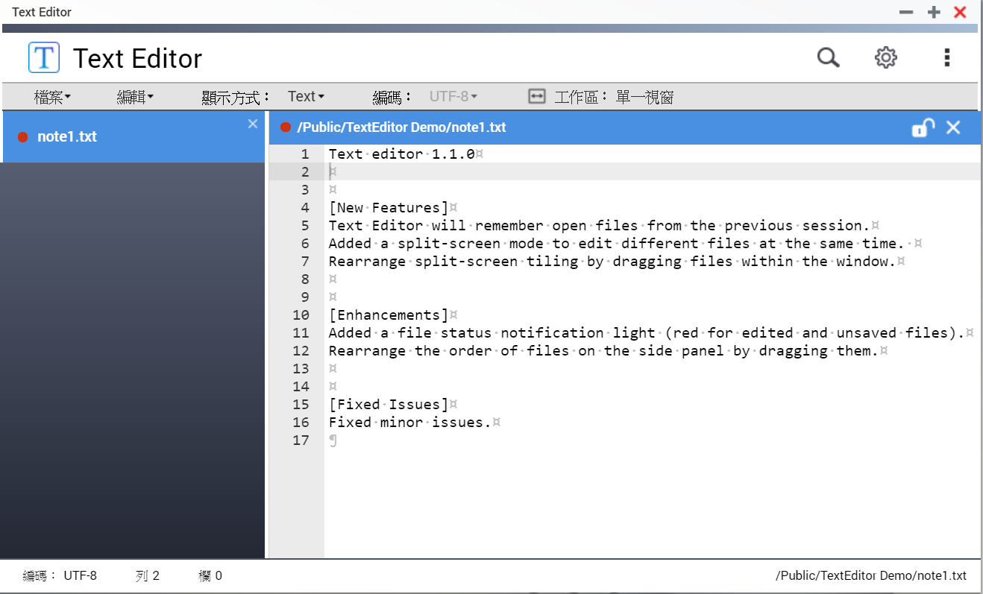
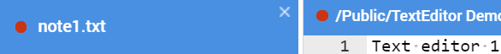
File status notification
Indicates the file is modified.

Slide 19
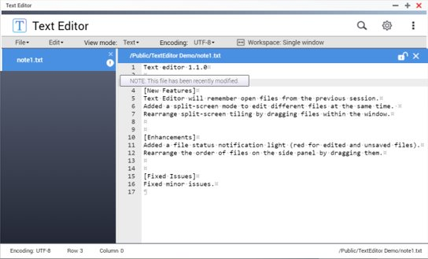
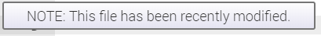
Warning for concurrent editing
Prevent accidental overwritting

Slide 20
DEMO

Slide 21
part
3
Small tips that make a big difference

Slide 22

Have you ever had those concerns?
Spending too much time to locate the file through folders
Looking for right file from massive number of files
Finding files in different folders

Slide 23
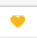
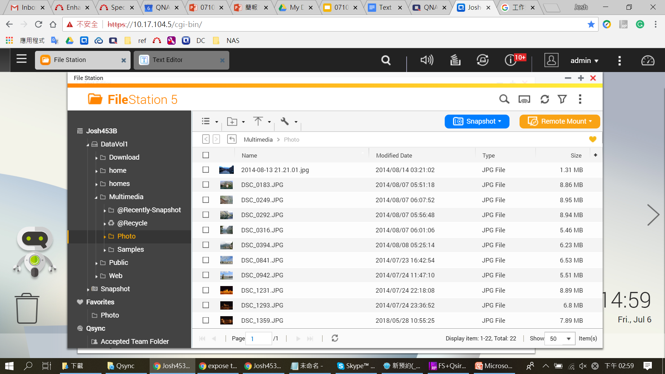
Tip 1: One-click add to favorites

Slide 24
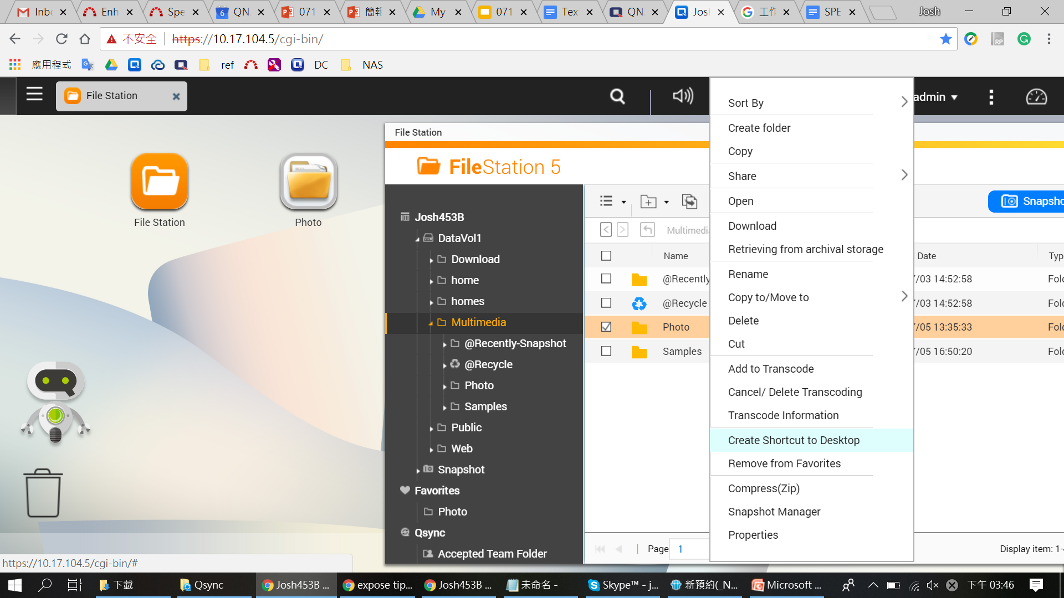
Tip 2: Desktop shortcut

Slide 25
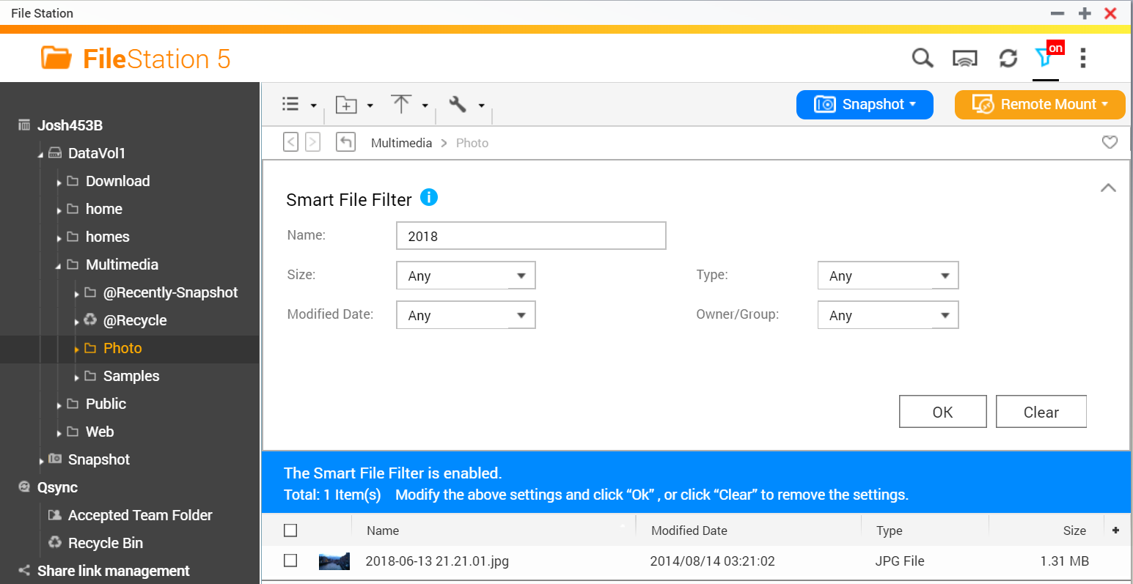
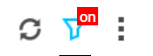
Tip 3: Search files with Smart File Fliter
Multiple options to set
Clear Switch icon
One setting to search in different folders

Slide 26
DEMO

Slide 27





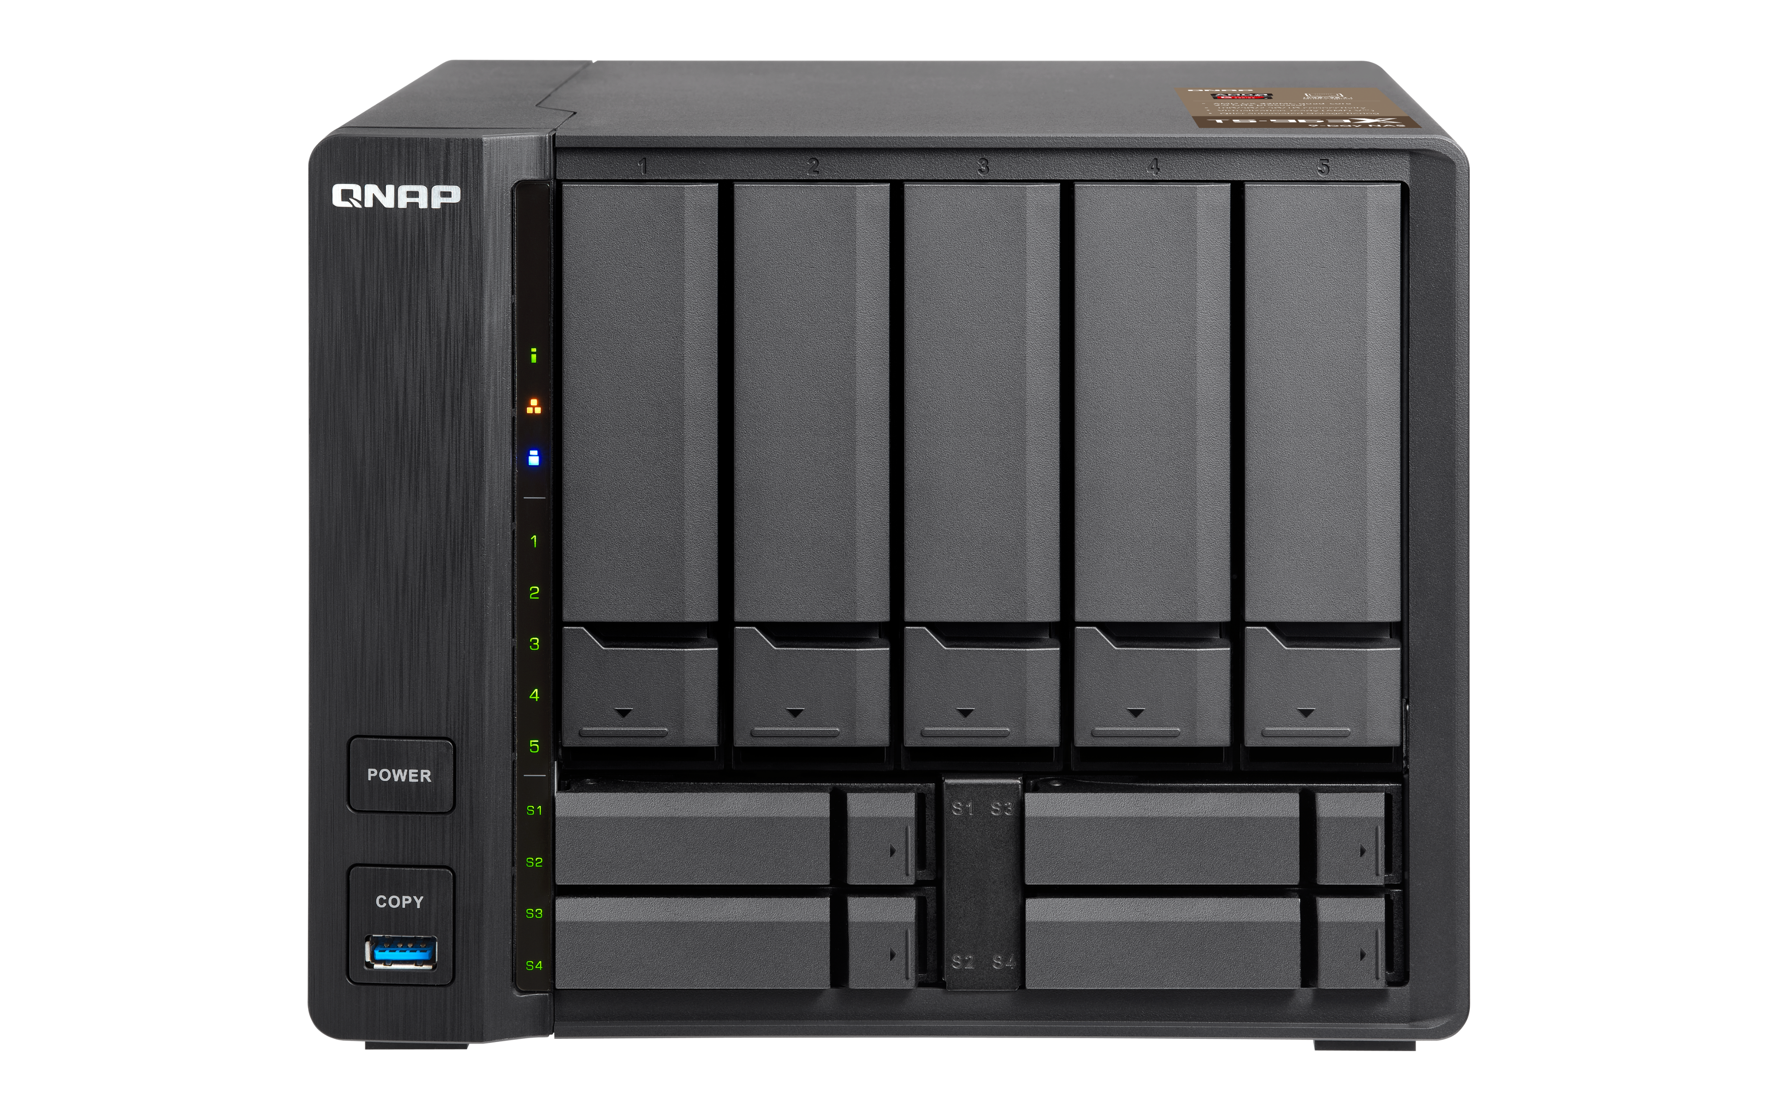
Image2PDF
Text Editor
Useful tips
Choose and create
Arrange sort order
File protection
Customize options
Split-screen mode
File status
notification
Warning for concurrent editing
Add to Favorites
Shortcut on Desktop
Smart File Fliter

Slide 28

File Station
Make good use of these tips to work more efficiently!
Copyright © 2018 QNAP Systems, Inc. All rights reserved. QNAP® and other names of QNAP Pr oducts are proprietary marks or registered trademarks of QNAP Systems, Inc. Other products and company names mentioned herein are trademarks of their respective holders.

