Slide 1


Slide 2

Specific topic for OceanKTV's new and old users
For New
For Old
Easily get the hang of OceanKTV
User feedbacks of OceanKTV
OceanKTV solution
How to use OceanKTV
Introduction of OceanKTV platforms
User feedbacks of OceanKTV
What OceanKTV did for users' needs

Slide 3
Easily get the hang of OceanKTV

Slide 4
As a person who loves to sing, you must did...
Go to Karaoke
Sing with YouTube & music software
Build a KTV box by yourself
E.g. use Karaoke software on website, or use your computer as the music database
Buy a Karaoke machine

Slide 5

But...here comes the concerns
Go to Karaoke
Sing with YouTube & music software
No rooms are available
Sing with the singer's voice
Build a KTV box by yourself
E.g. use Karaoke software on website, or use your computer as the music database
Buy a KTV machine
You really don't use it that often
Hard to manage music database

Slide 6
Turns your home into a karaoke room easily!

Slide 7
QNAP OceanKTV meets your needs
Easily build a karaoke room！
High Capacity
Can store thousands of 1080p karaoke songs on the NAS
Free for everyone
No extra cost. Use it as you want
OceanKTV Database Management
Simple importing rules to help users easily import and manage lots of songs
RAID Data Protection
Create RAID to protect songs. No worries for disk damage on RAID1/RAID5. A copy is always there.
Multiple platforms
Can operate on TV, computer and/or mobile device
Notes:
No worries for disk damage on RAID1/RAID5. A copy is always there.
You can store thousands of 1080p music videos on the NAS and easily turn your home into a karaoke room by playing them through OceanKTV app.
QNAP NAS offers high-capacity storage for accommodating and easily managing up to thousands of 1080p karaoke songs.
QNAP NAS 的海量儲存空間可以收藏成千上萬首 1080p 的高清 KTV 歌曲，完全不需擔心容量不足的問題！
蒐藏在您的 NAS 裡的 KTV 歌曲可透過 HDMI 直接輸出至大螢幕 HDTV 欣賞。
部分 QNAP NAS 配有音源輸入孔(3.5 mm 或 6.3 mm)，連接動圈式麥克風後即可開始歡唱。無音源輸入孔的機種亦可使用 Audio Box 以享受歌唱功能。

Slide 8
Which model can OceanKTV be used on?

Slide 9
Which model can OceanKTV be used on?
NAS Requirements!
Models with Intel or AMD processor
At least 2 GB RAM
At least 1 HDMI out
Line-out jack (or buy USB soundcard)
Mic-in jack (or buy Audio Box)

Slide 10
After installing OceanKTV,
then we can start to sing?

Slide 11

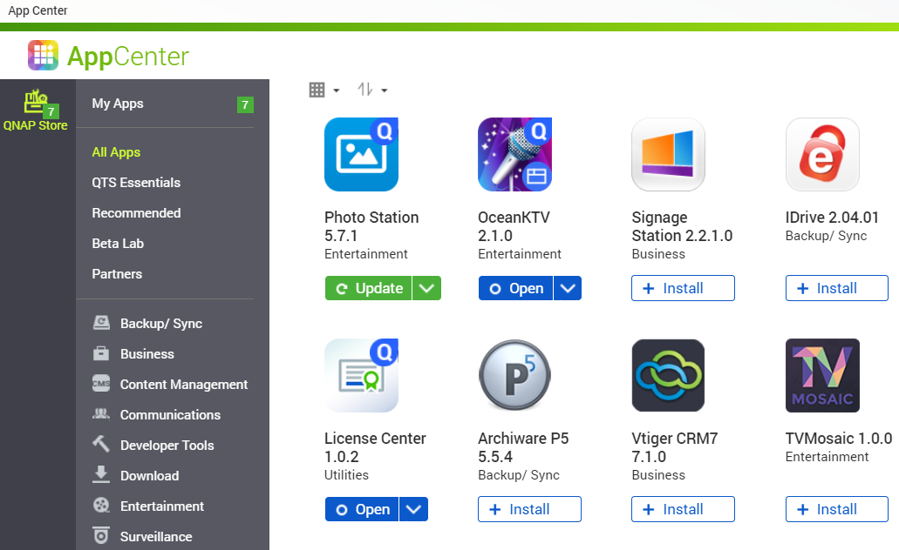
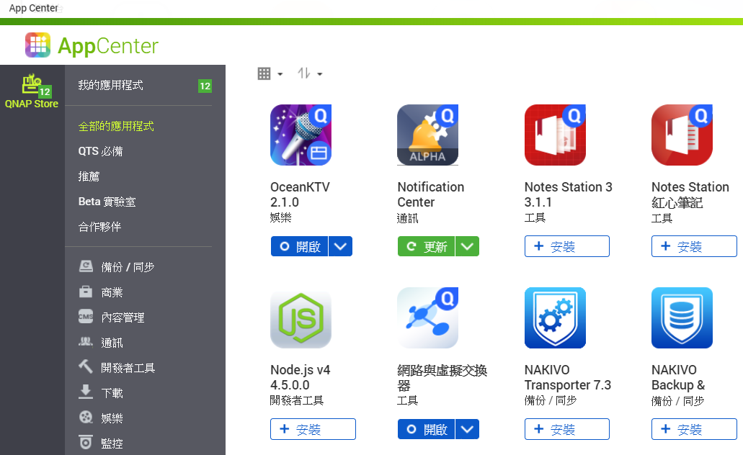

Two steps to start singing
01
After installing OceanKTV, go to the app and do some setup

Slide 12
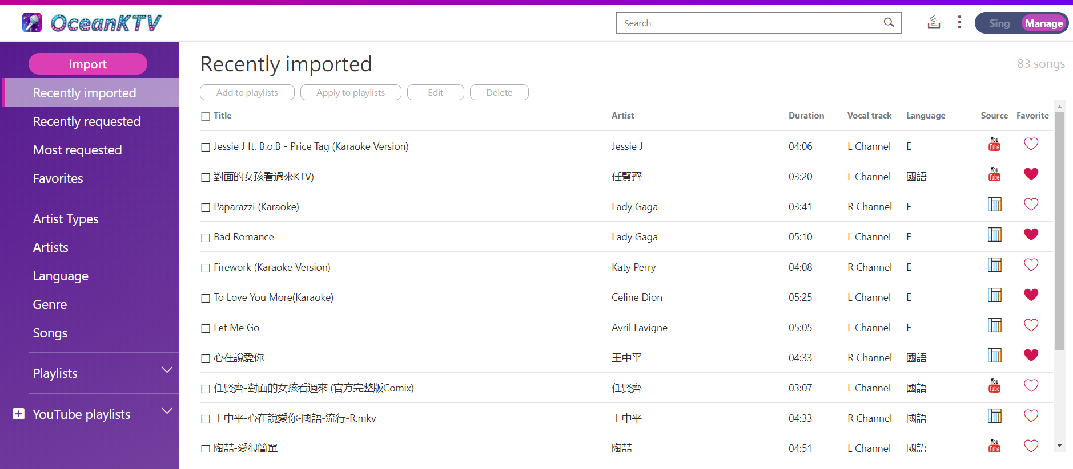
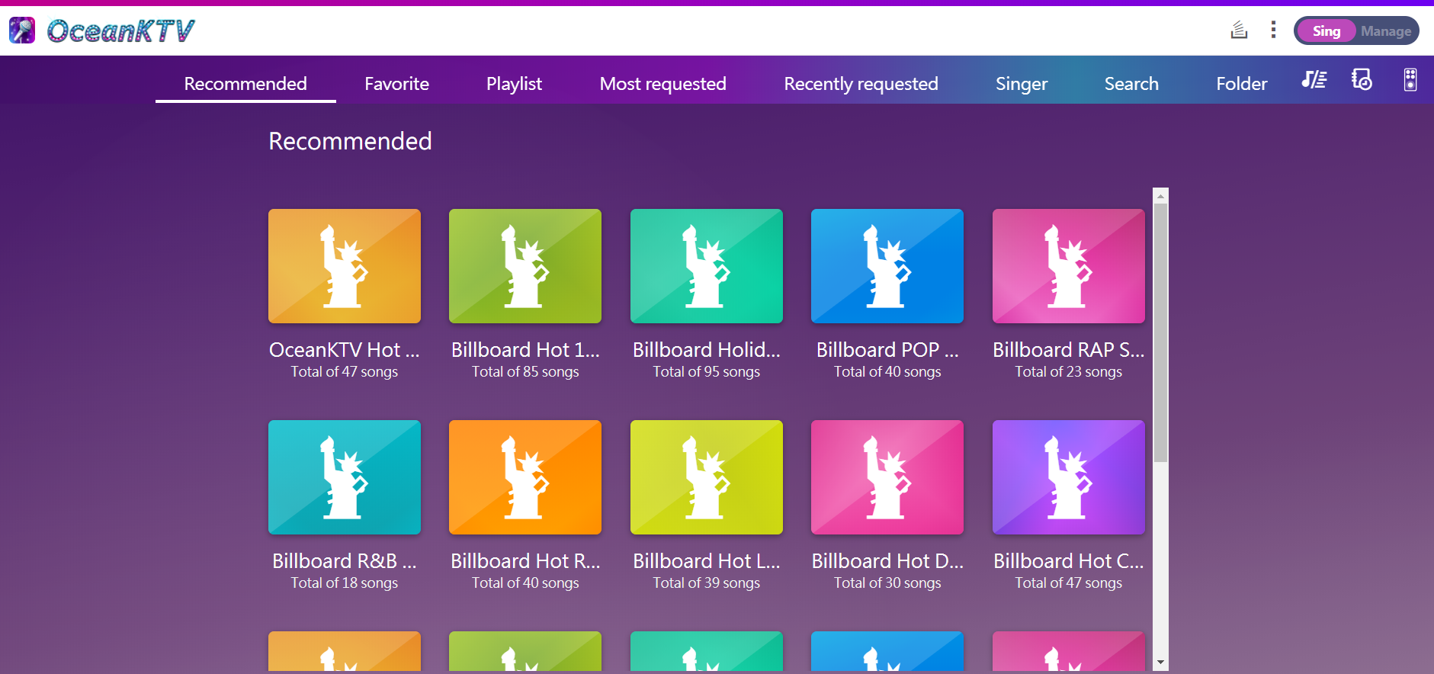
Web OceanKTV- Database management
& Request songs all in one
Import and manage your songs in Web OceanKTV
Freely switch to [Manage] or [Sing] modes
[Manage]- Import songs, edit song's information
[Sing]- Various categories for you to instantly find and request songs

Slide 13

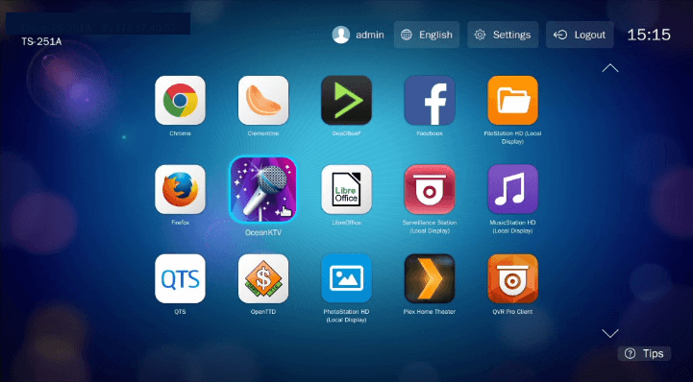
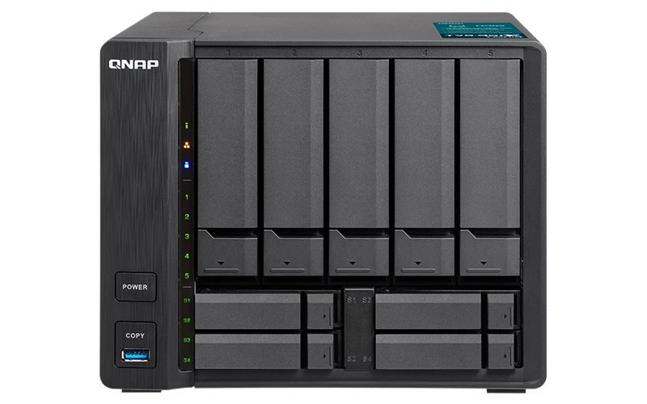

Two steps to start singing
02
Connect NAS & TV via HDMI to start singing

Slide 14
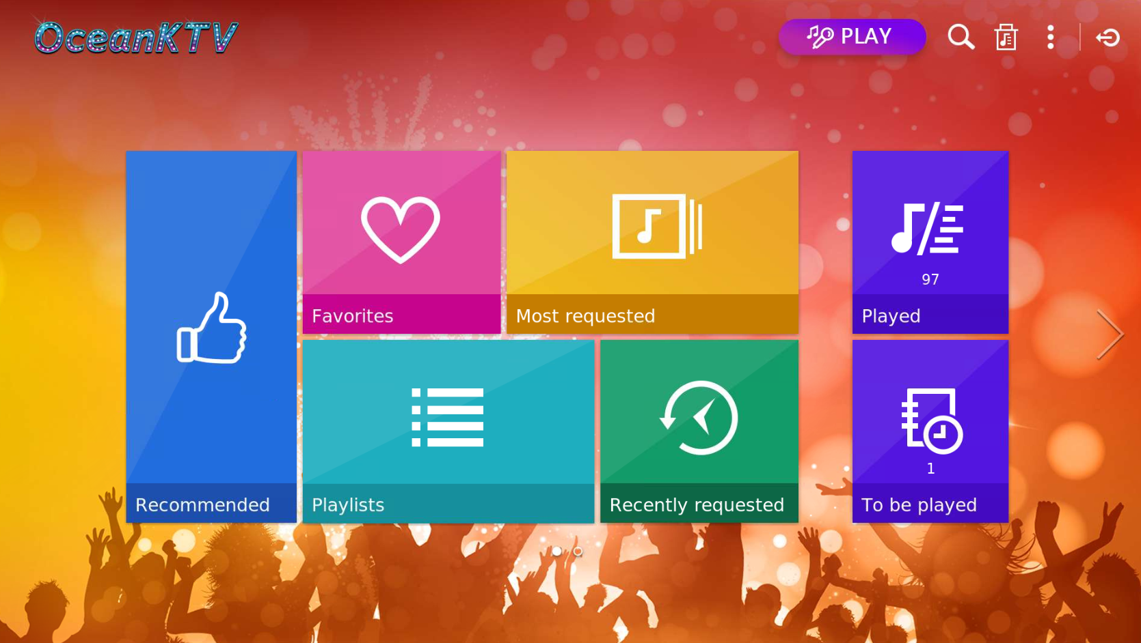
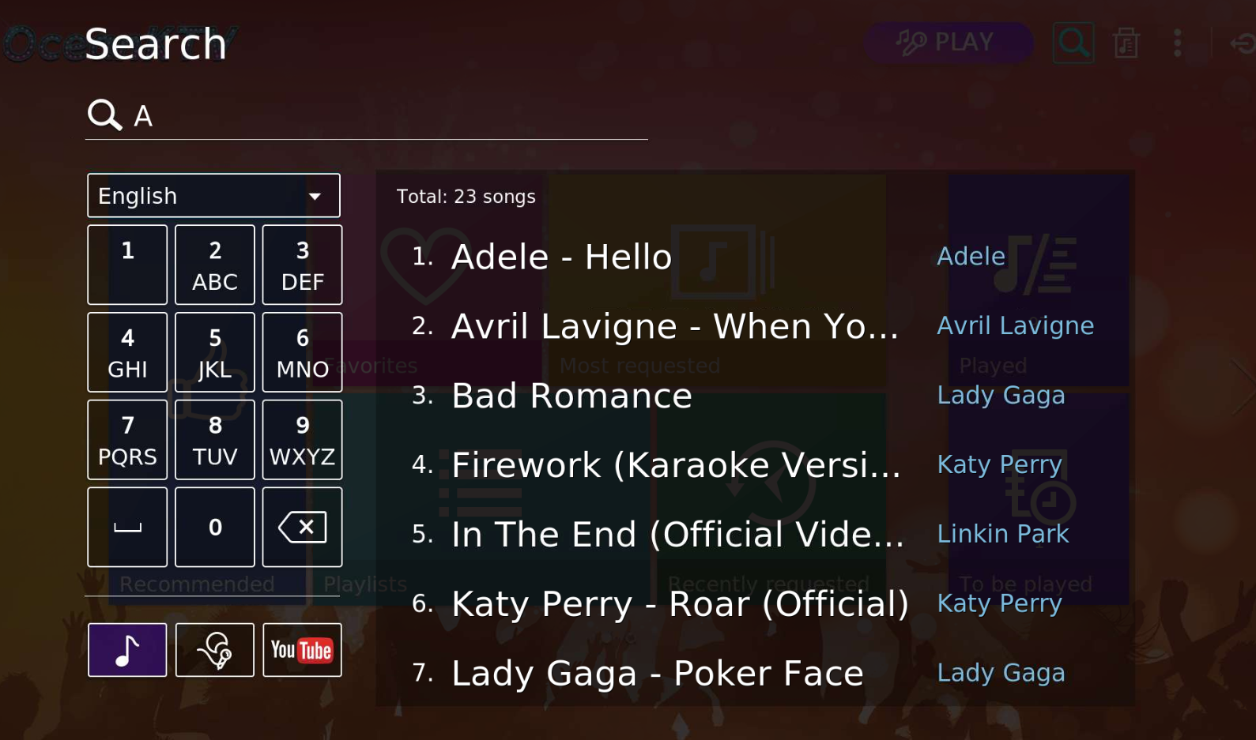
Request, Singing songs are all on TV
On TV page, intuitive interfaces are available, or use Search function to find the song!
Give it a try on requesting songs with NAS remote!

Slide 15
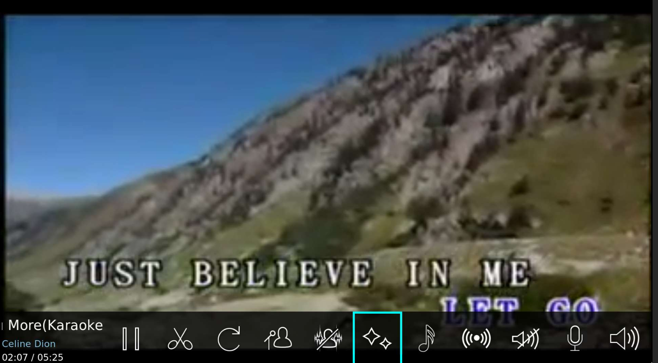
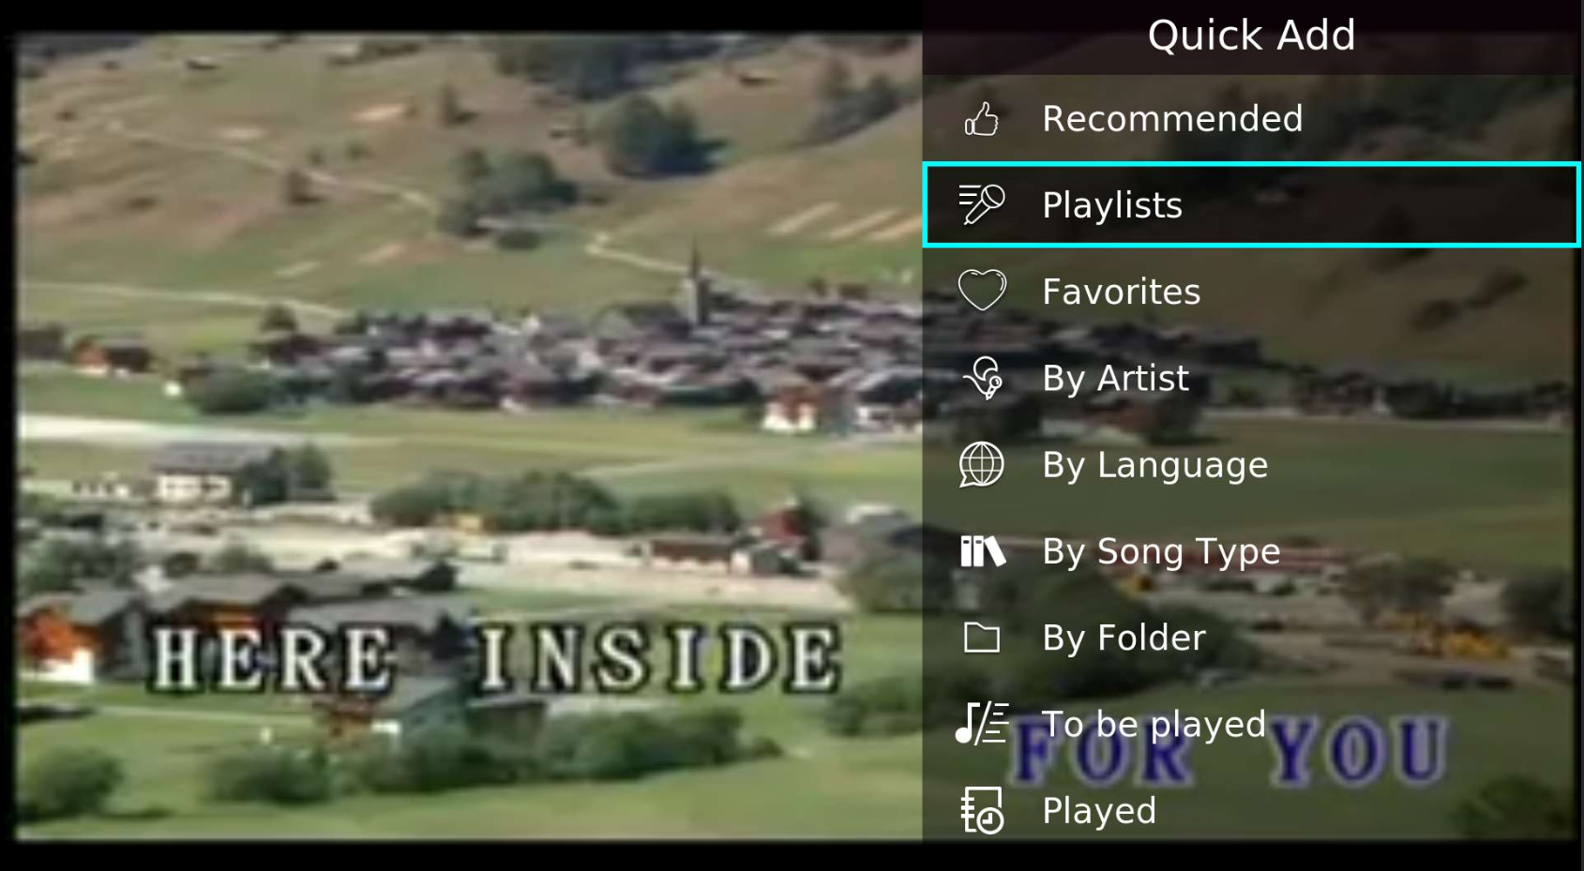
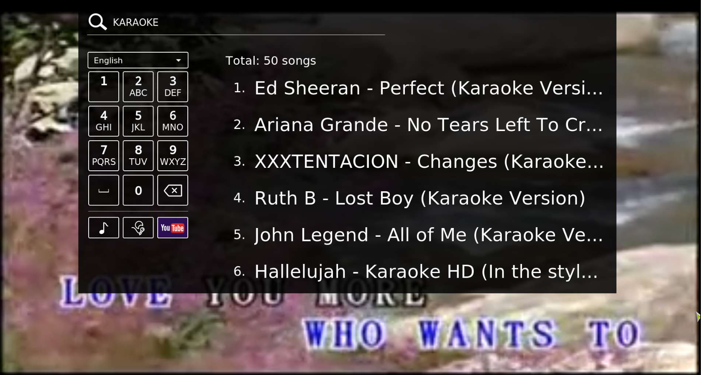
Enjoy singing on big screen
Complete karaoke features
Search or request songs while singing
Pause, cut, tune-tuning, volume controls, pitch-tuning, echo cancelling, sound effects, and more
Each categories in homepage are also presented in "Quick Add". You can easily request songs while singing.
Besides "Quick Add", search function can also be used when singing.
Notes:
song requests, inter-cut, cut, sound effects, vocal suppression, tone-tuning, echo cancelling, volume controls, pitch-tuning, and more.

Slide 16
What can we do when there is only one remote, and it is not enough for multiple people to request songs?

Slide 17
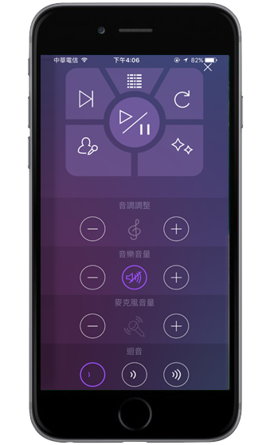
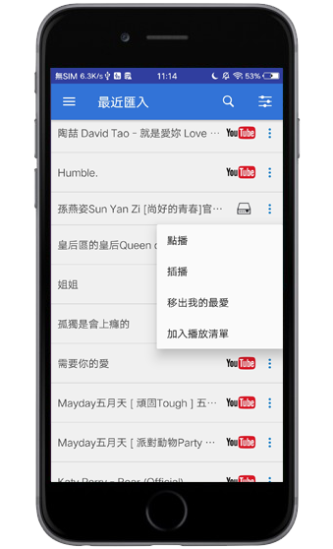
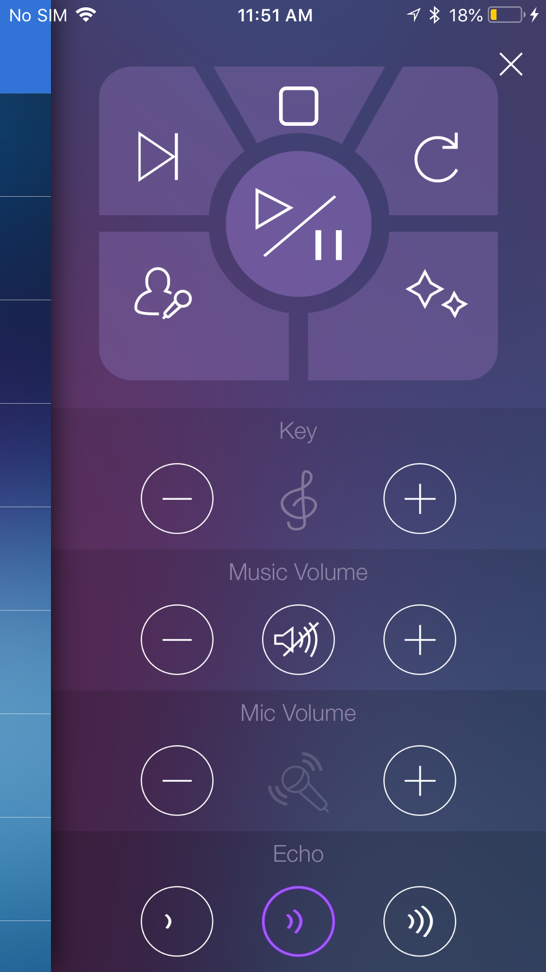
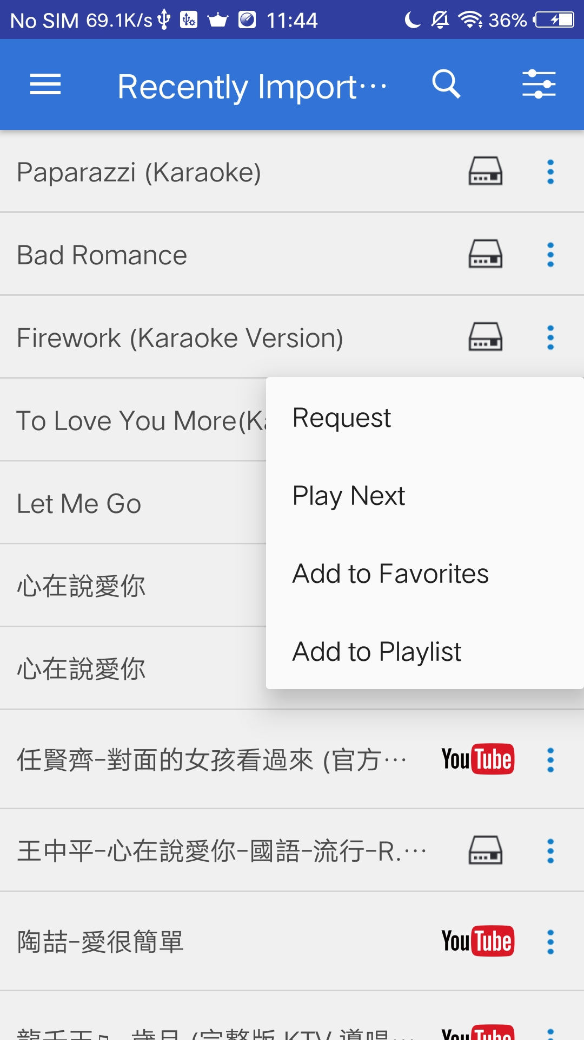

OceanKTV Client- Turn your mobile device into remote controls
OceanKTV Client supports iOS & Android devices
As a KTV remote control
Requesting songs

Slide 18
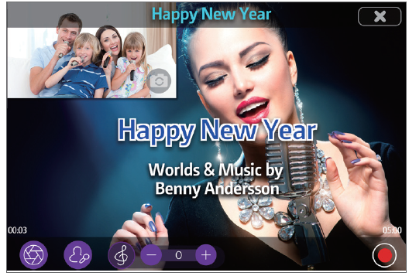
OceanKTV Client-
Karaoke To Go
Karaoke To Go
Use the Karaoke To Go function in OceanKTV Client, sing the downloaded song that you import to NAS, then record the video while singing. You can also share the recorded video to your friends.

Slide 19
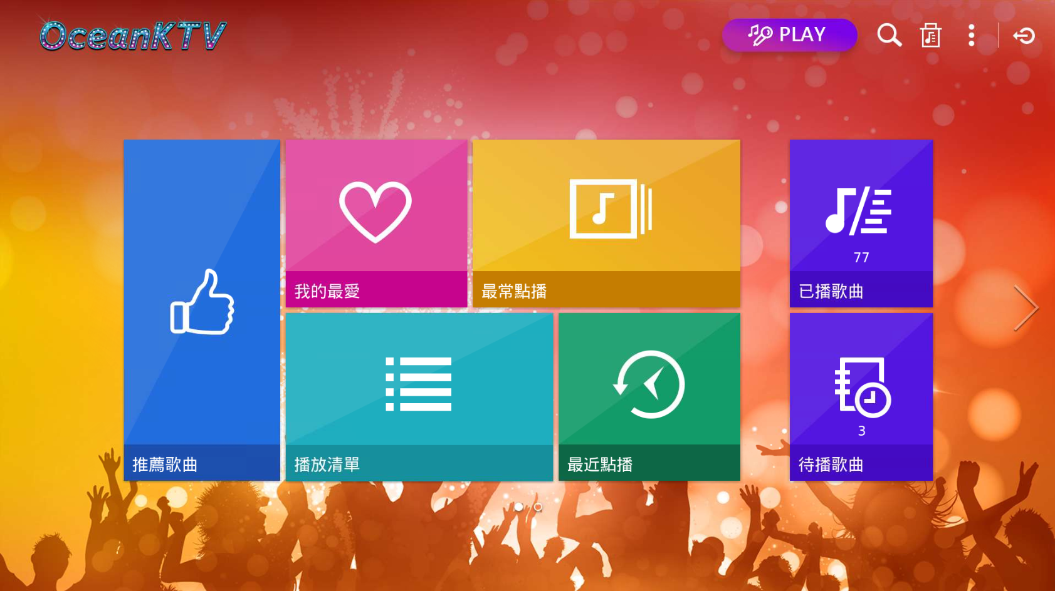
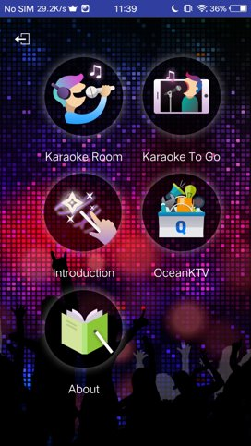
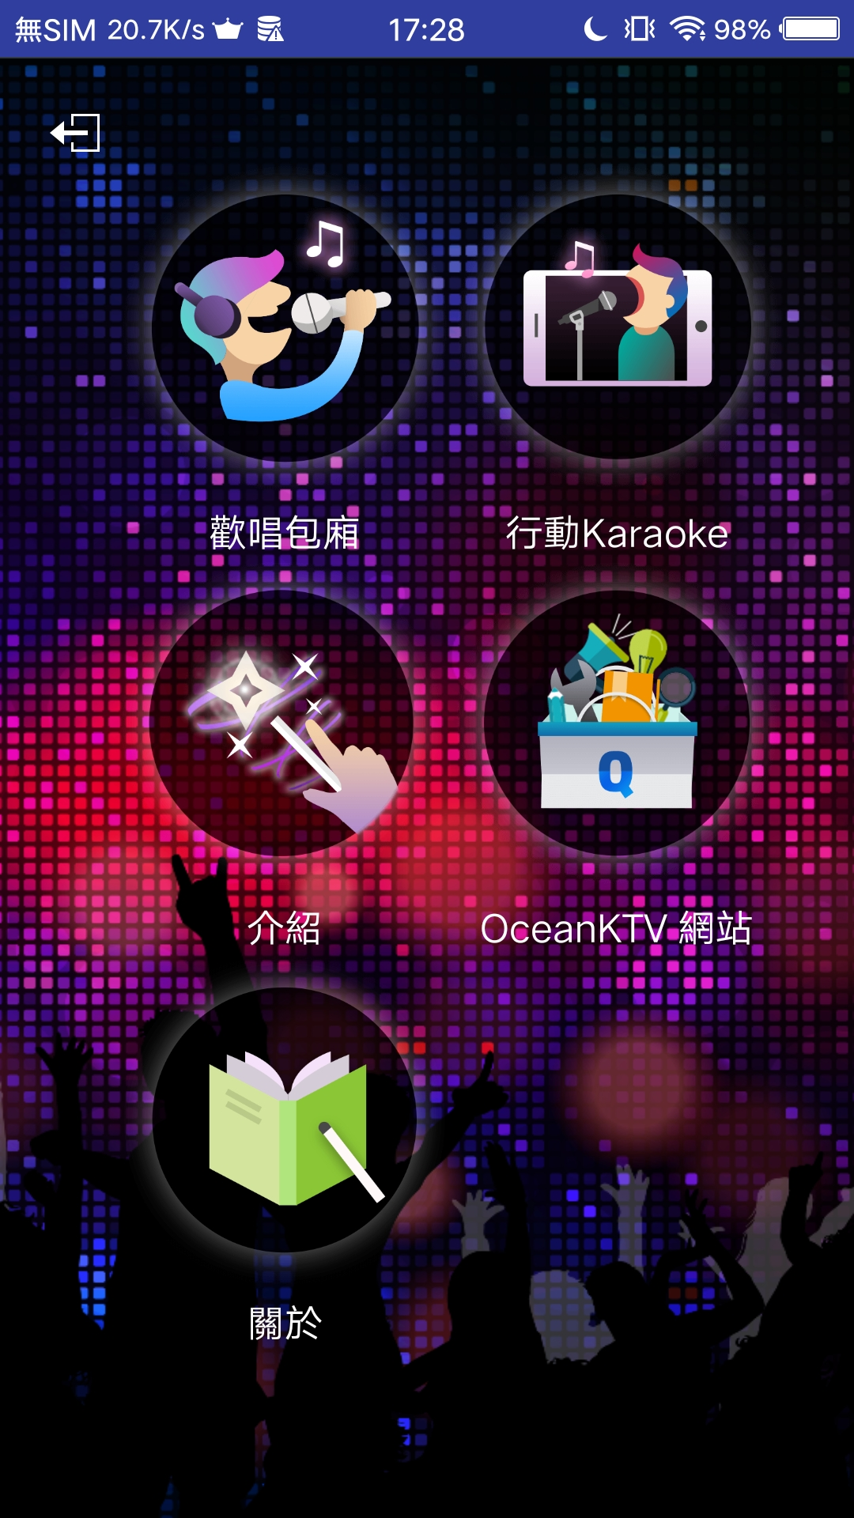
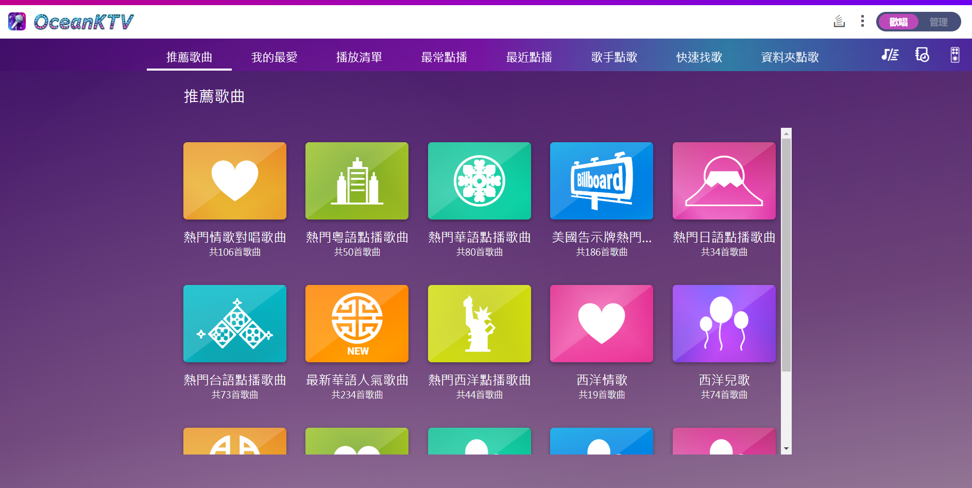
Each platform of OceanKTV has its main features
TV
Mobile device
Web
Database management
Sing songs
Remote control
All of them can request and operate songs
Notes:
Each platform has its specific feature, but

Slide 20
User feedbacks of OceanKTV

Slide 21

Since its launch in January 2016,
OceanKTV has been downloaded 91K times
iOS downloads: 14K
Android downloads: 8.52K
Users extend all over the world

Slide 22



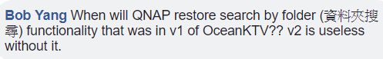





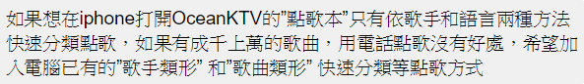
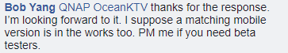

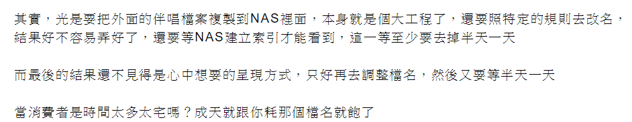


Worldwide OceanKTV users give different suggestions and feedbacks

Slide 23
Top feedback from OceanKTV users
Collaborated from FB fan page, forum, support system & App review
1. Optimize the way to import songs
2. Show and edit photos in Artist page
3. Request songs by Folder
Web
Mobile device
1. Request songs by Folder
2. Request songs by Artist Type and Genre
1. Disabling microphone's echo
2. Stretch video
3. Optimize the passing time
TV

Slide 24
An easy and quick way to import lots of KTV songs, so that I can request songs in each categories

Slide 25
I have lots of KTV songs...
Edit one by one is so time-consuming
It won't bring me down
Song titles are required to follow the naming rule. Then the song can be found in [Songbook]
e.g. Adele[F]_Someone Like You[E][L][Karaoke].mp4
As long as the songs' name in the folder are same, system can import all the songs by the rules you set at once!

Slide 26
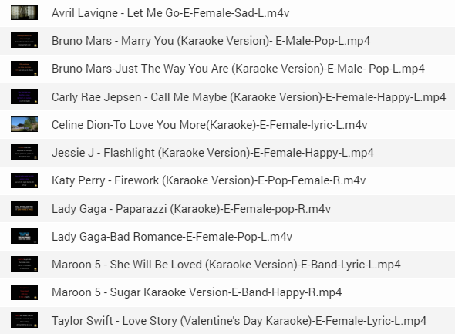

Simple importing rules
Collaborate songs
in the folder
Three steps to import songs
The file names' format are consistent
Select folder
Define rules
Preview
According to your habit to organize the file name
e.g. Artist name - Song title - Language- Artist type - Genre - Vocal track
KTV Songs

Slide 27
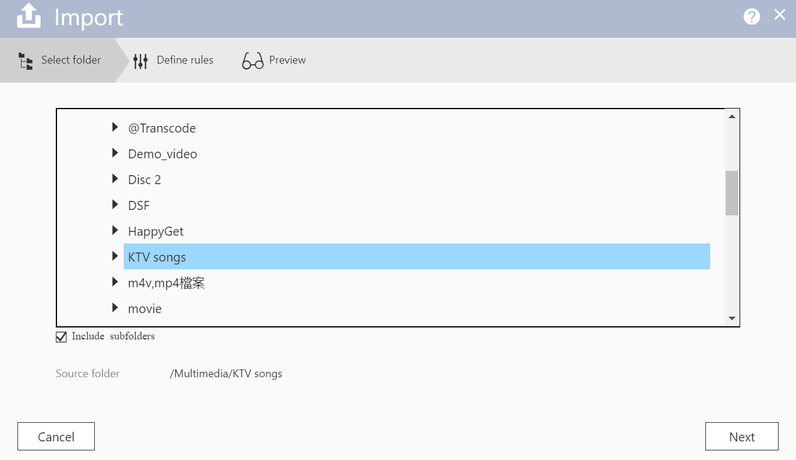
Simple importing rules
Collaborate songs
in the folder
Three steps to import songs
The file names' format are consistent
Select folder
Define rules
Preview
Any NAS shared folder can be the souce of importing songs
"Include subfolders" is optional

Slide 28
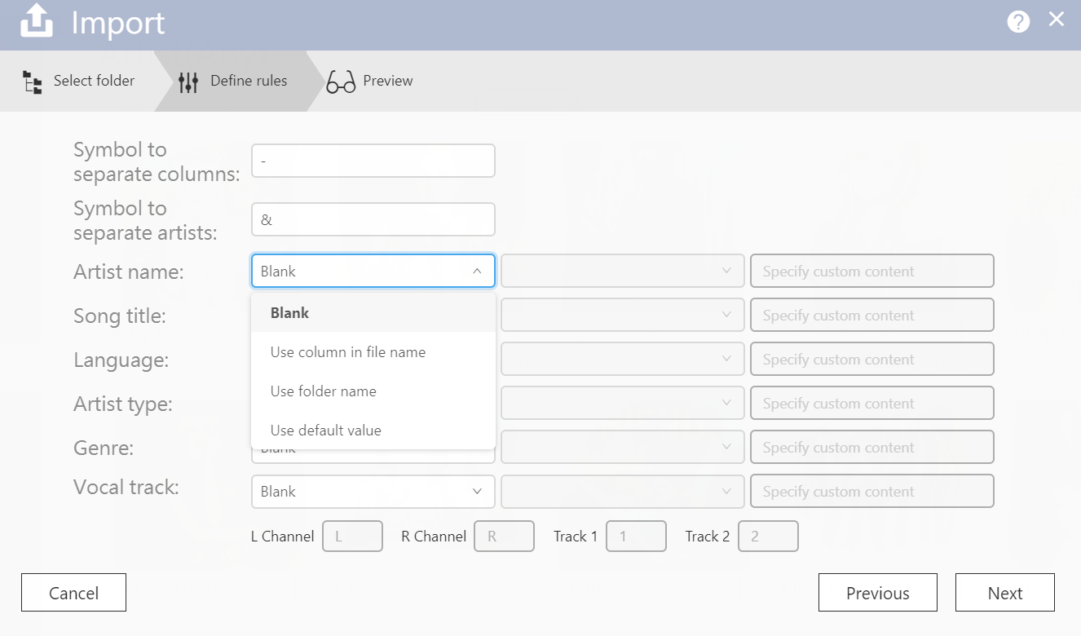
Simple importing rules
Collaborate songs
in the folder
Three steps to import songs
The file names' format are consistent
Select folder
Define rules
Preview
Define importing rules according to the file name
Symbol to separate columns
Four options to specify the source of information:
Blank
Use column in file name
Use folder name
Use default value

Slide 29
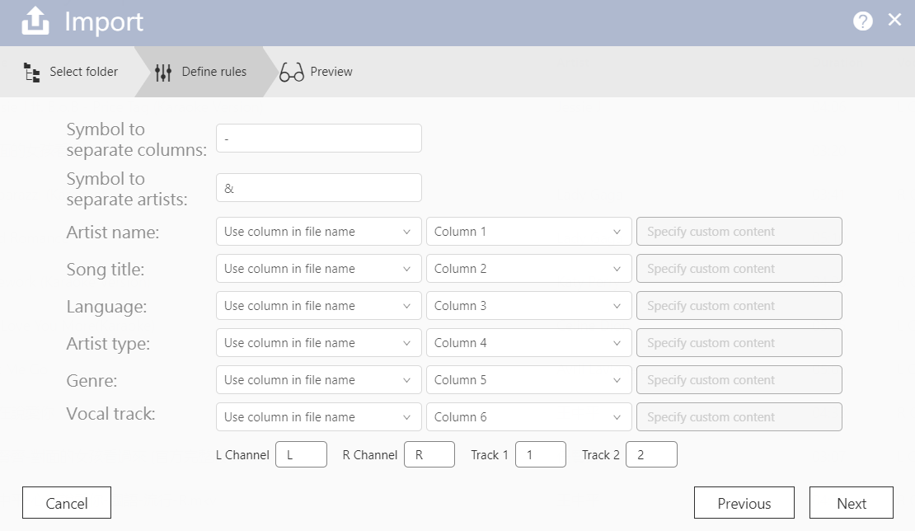
Simple importing rules
Collaborate songs
in the folder
Three steps to import songs
The file names' format are consistent
Select folder
Define rules
Preview
For example,
File name: Claire&Joyce-Love yourself-English-Group-Lyric-L.mkv
Symbol to separate columns: -
Symbol to separate artists: &
Option: Use column in file name
Specify the location of the information in file names
Notes:
specify the location of the information in file names.

Slide 30
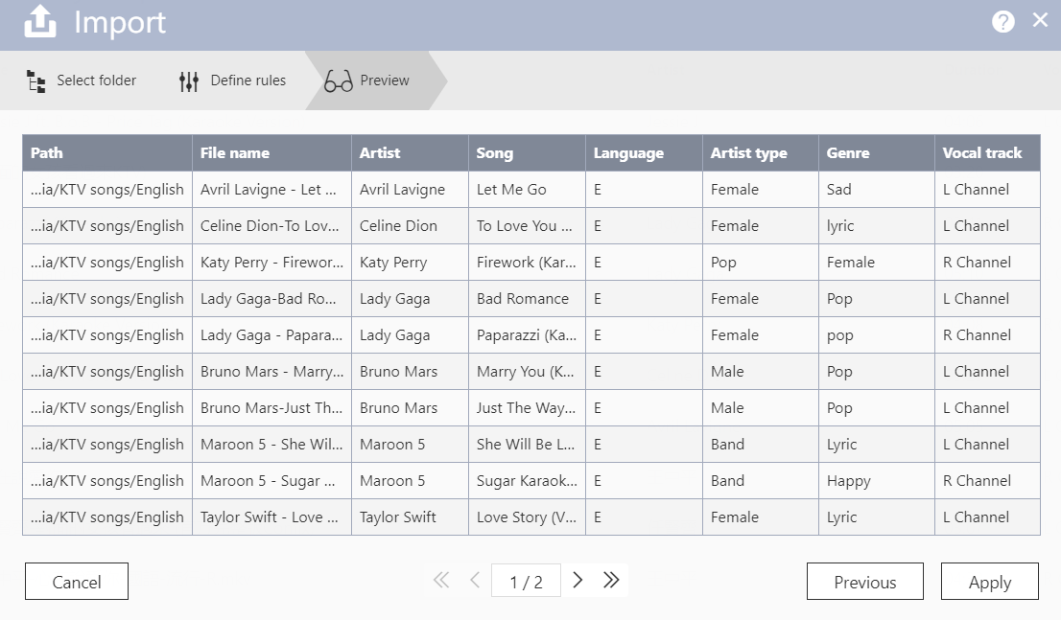
Simple importing rules
Collaborate songs
in the folder
Three steps to import songs
The file names' format are consistent
Select folder
Define rules
Preview
Preview the information of songs is correct or not
Modify the data directly

Slide 31
I can not use OceanKTV to sing?
I don't have
KTV files

Slide 32
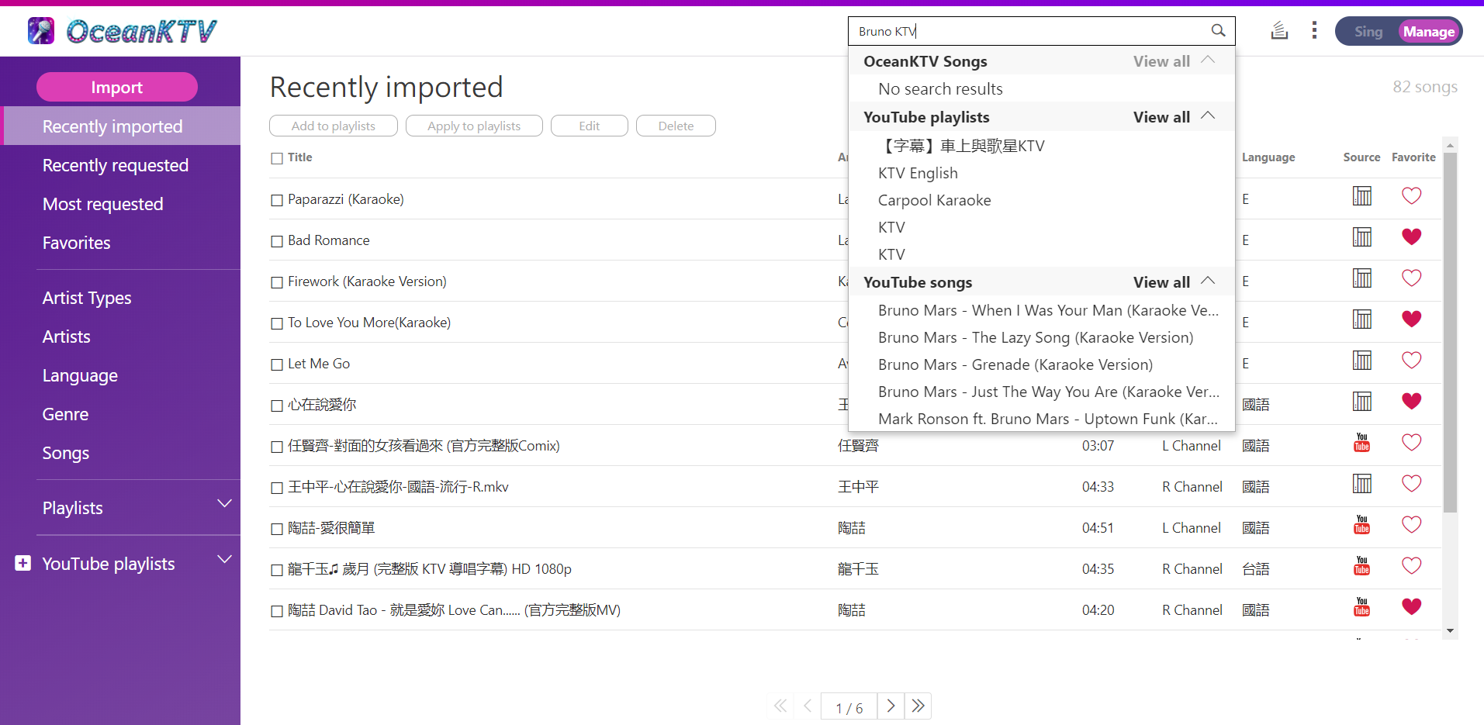
Do not worry if you do not have KTV files!
In OceanKTV [Manage] mode, type the keyword in search bar, then you can easily get the result of songs and playlists on YouTube™
Tips: add "KTV" in keyword

Slide 33
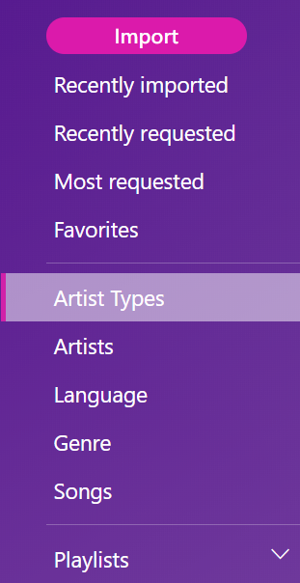
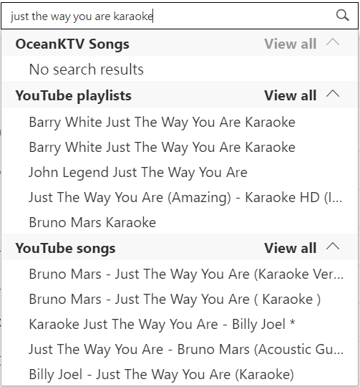
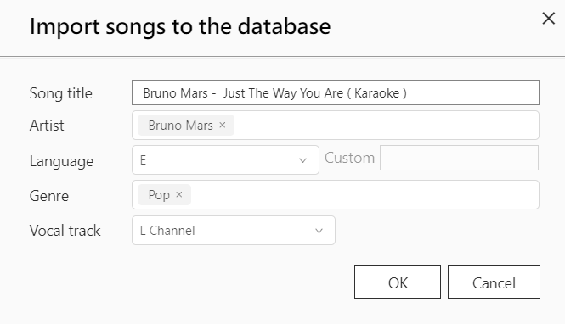

Edit song information, then categorized to left column
Select the YouTube song that you want to import
Categorize to each items
Edit song information

Slide 34
How to import songs

Slide 35
Show and edit photos in Artist page

Slide 36
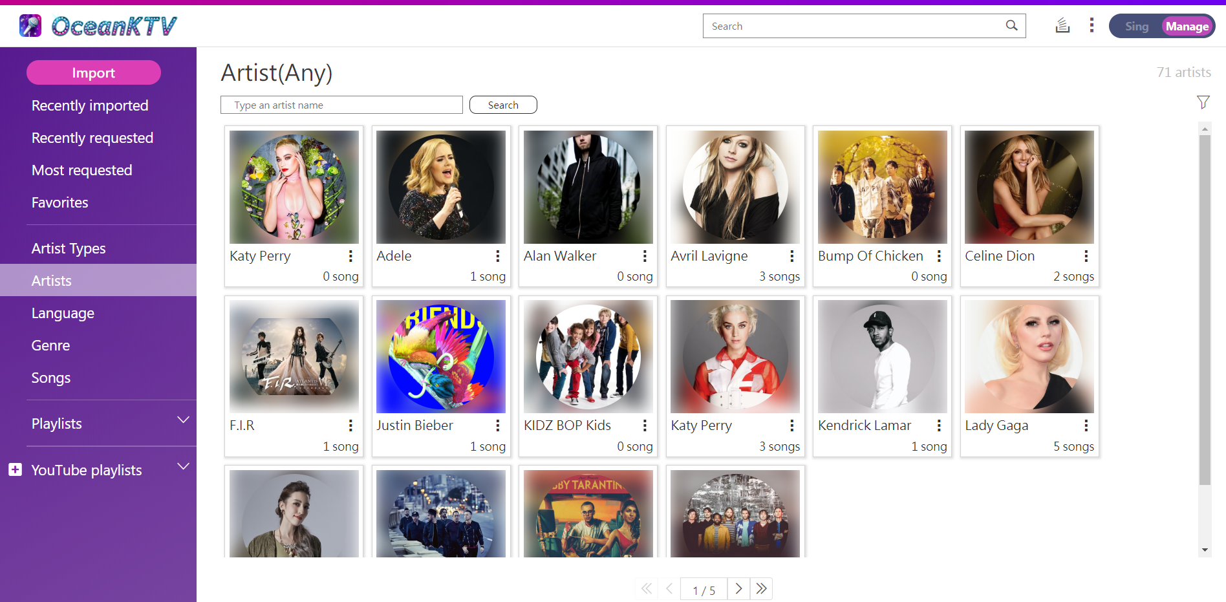
Show Artist's photo
System will search and display each artist's photo!
* OceanKTV use hyperlink instead of saving the photos in system

Slide 37
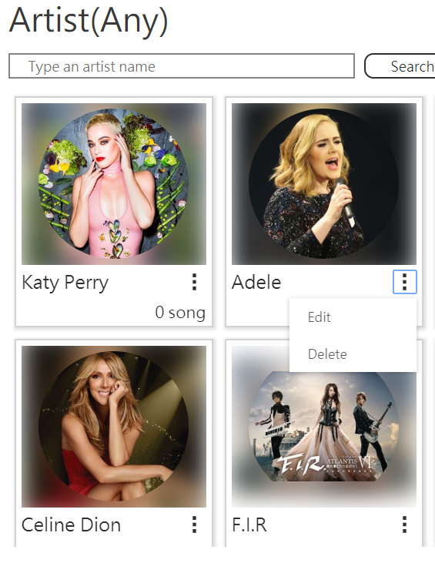
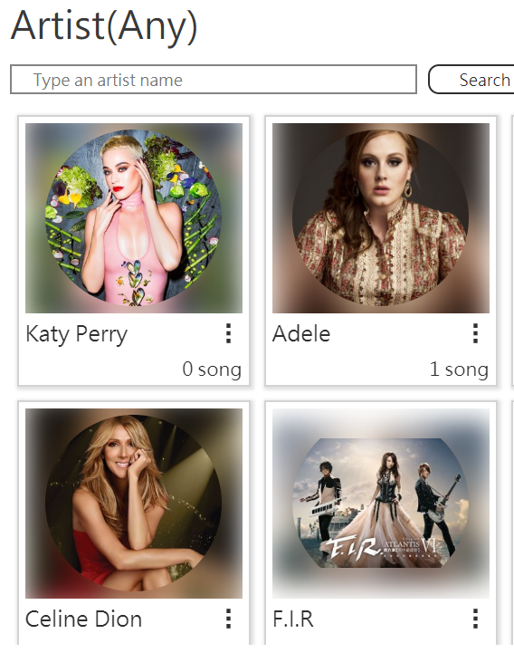
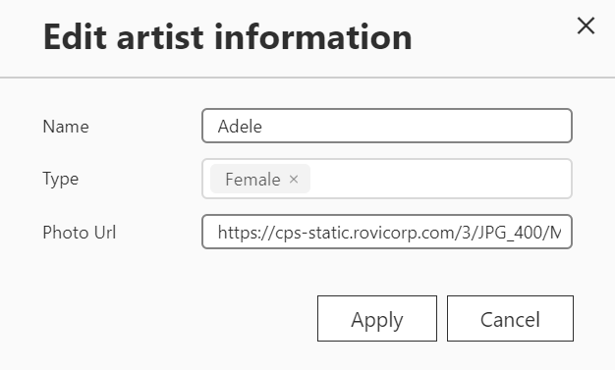
Do not like the photo?
You can change it by yourself!
If there is no artist's photo, or you want to change it, it is OK!
Click Edit
Changed successfully!
Paste the Photo's URL

Slide 38
More categories to request songs
(Folder/Artist Type/Genre)

Slide 39

Are these problems that you have on web and mobile...
Want to request songs by the folder that you have organized, but there are no "By Folder" option
Have edited songs' information, and want to request songs "By Artist Type", "Genre" on mobile device

Slide 40
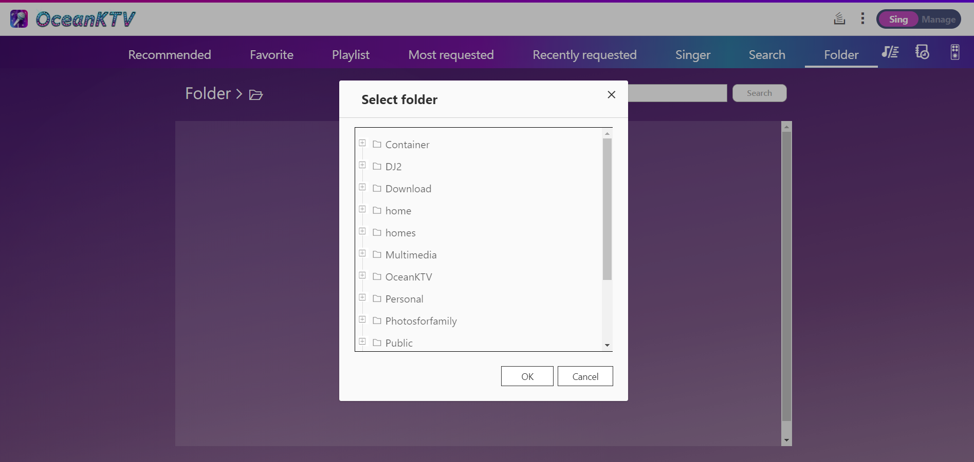
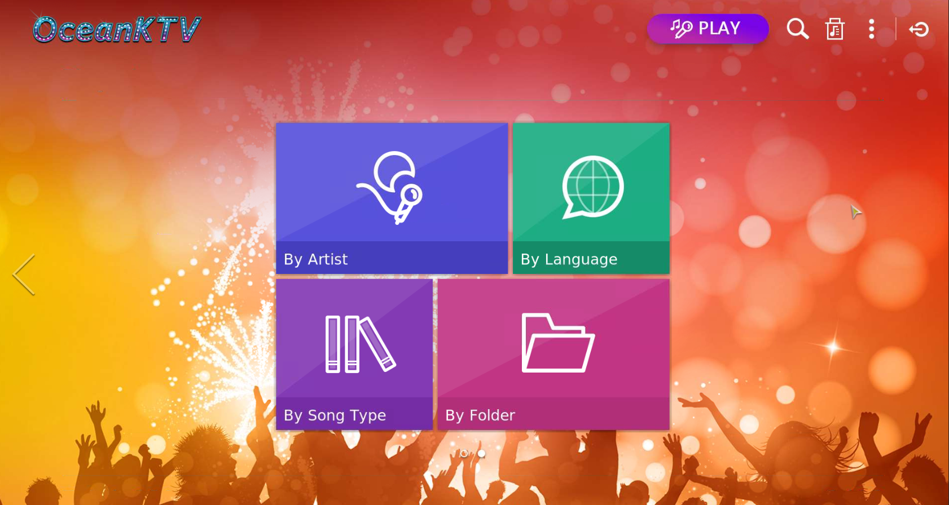

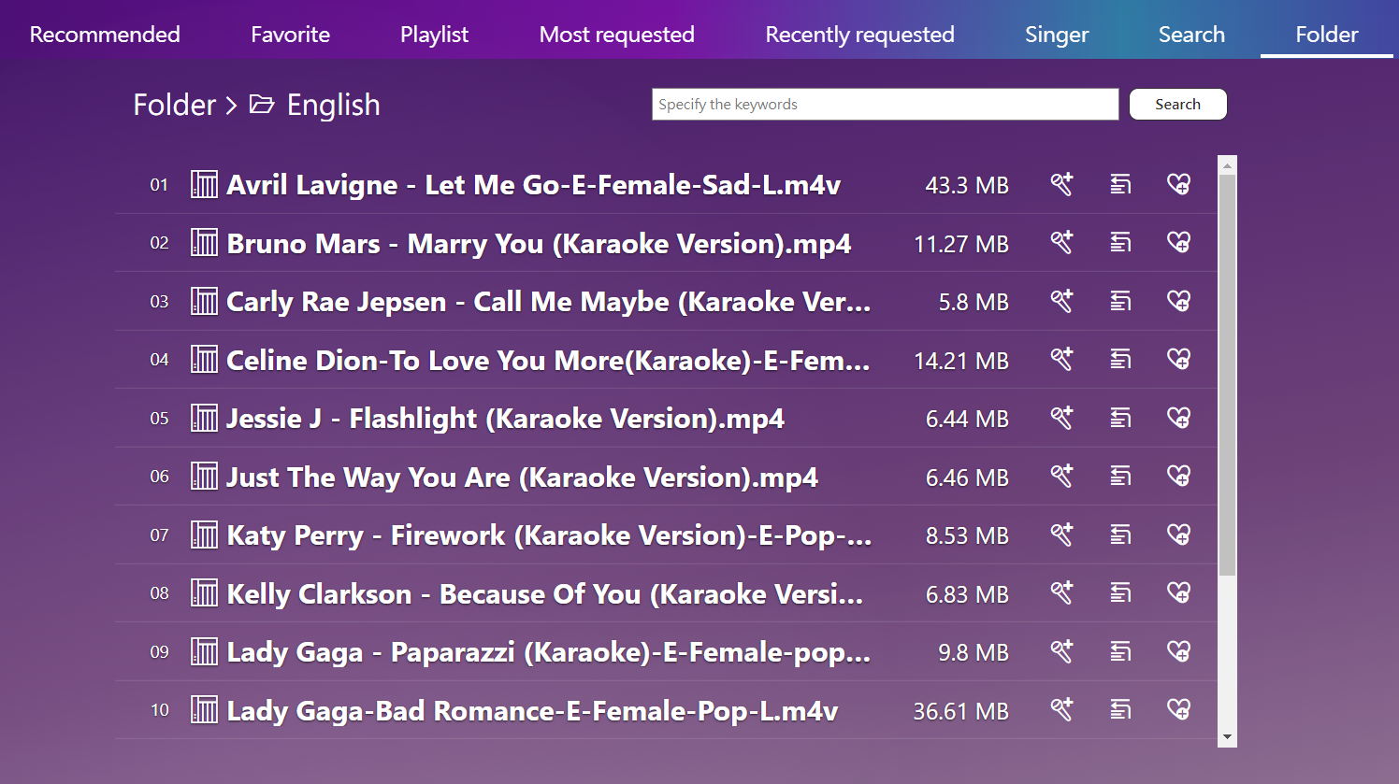
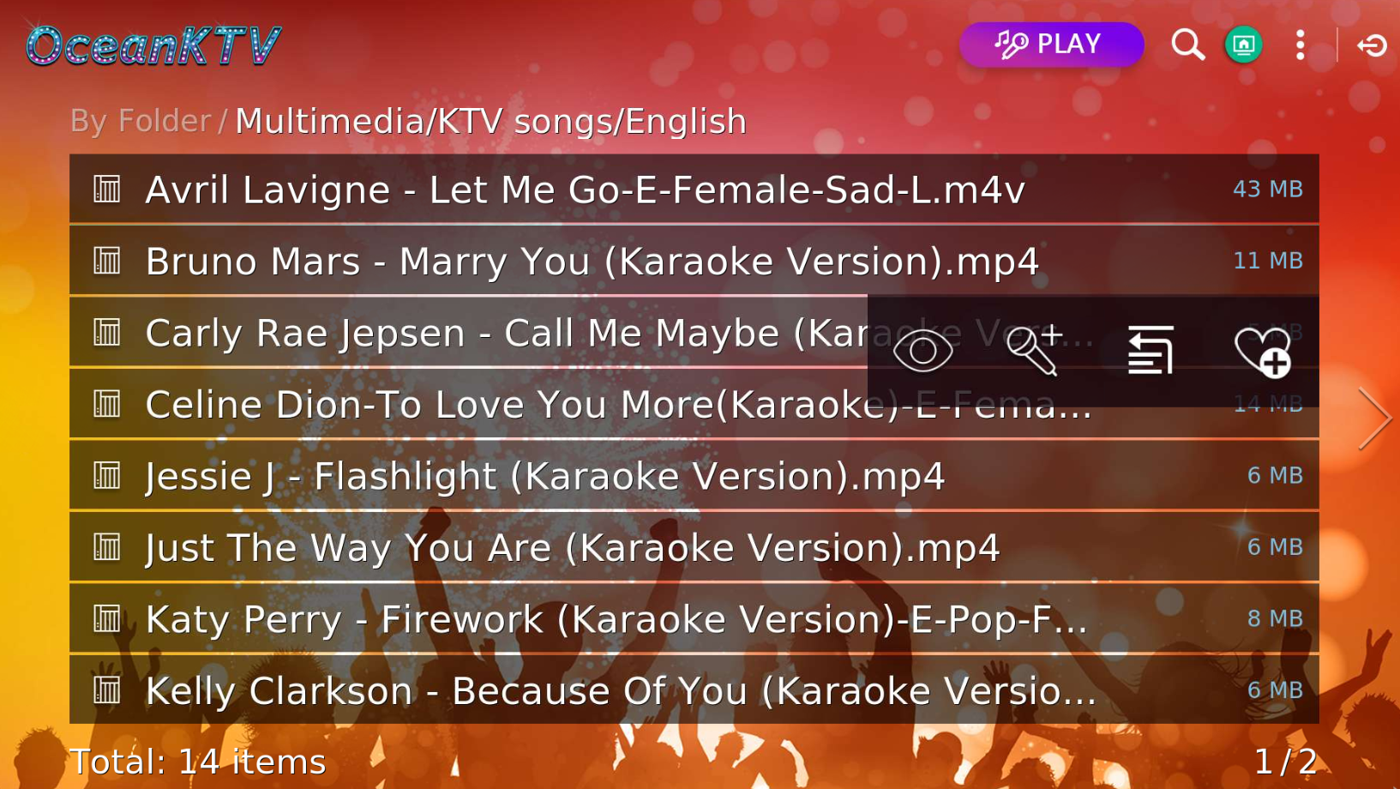
We've made it!
Request "By Folder" can be used in Web and TV
For mobile devices, it's under development!

Slide 41
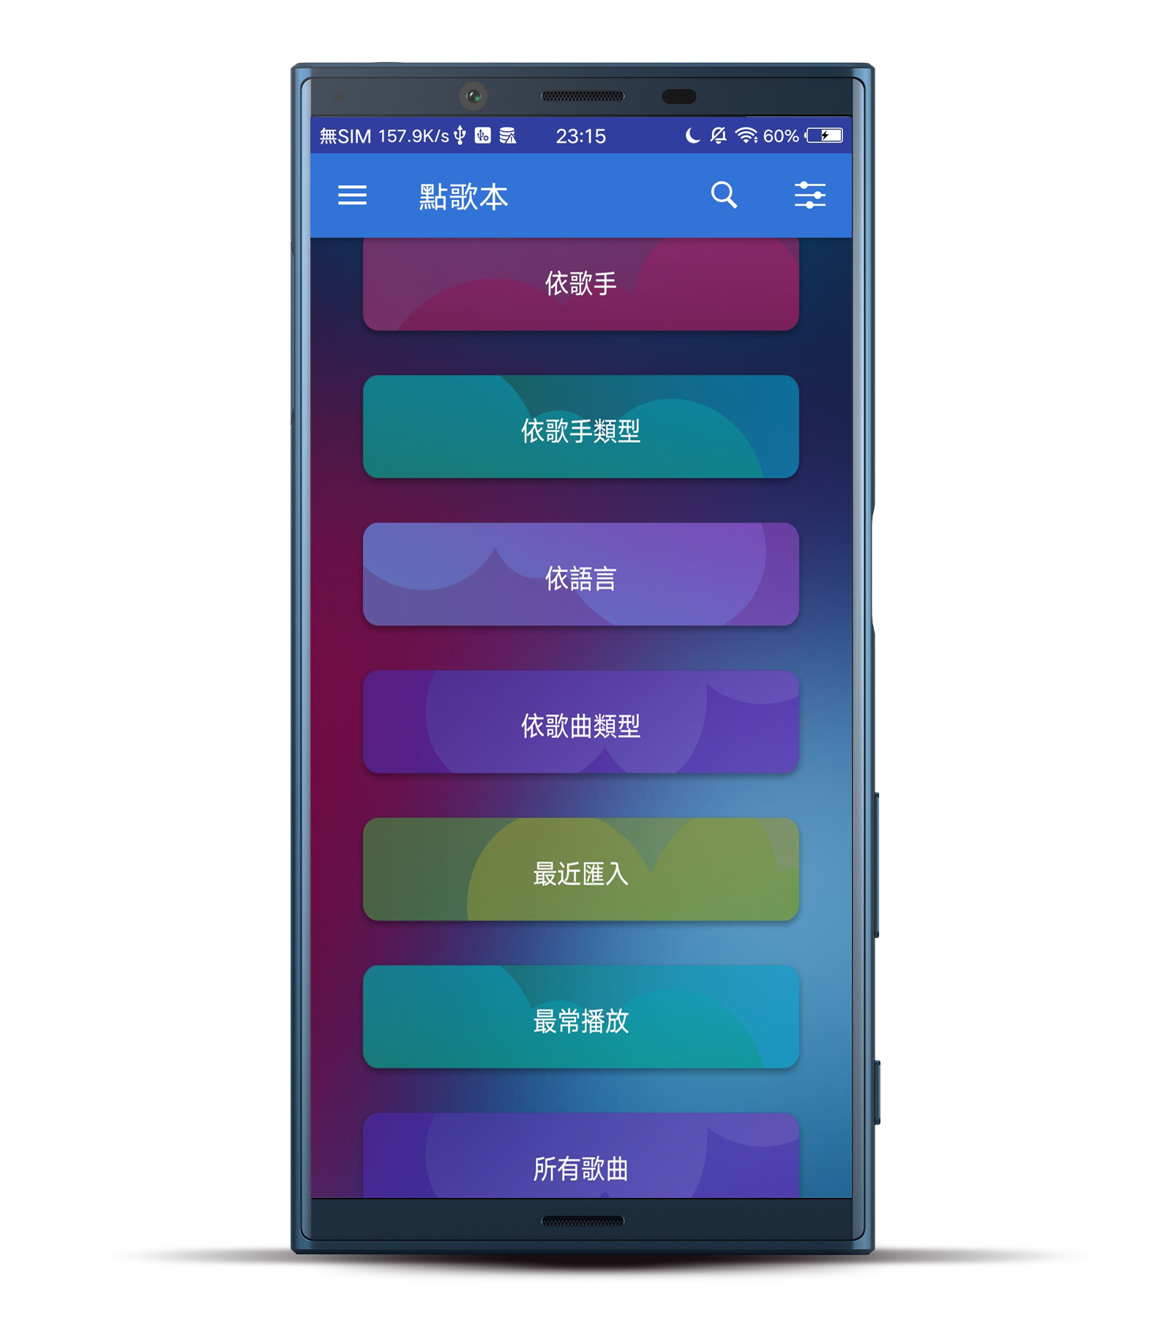
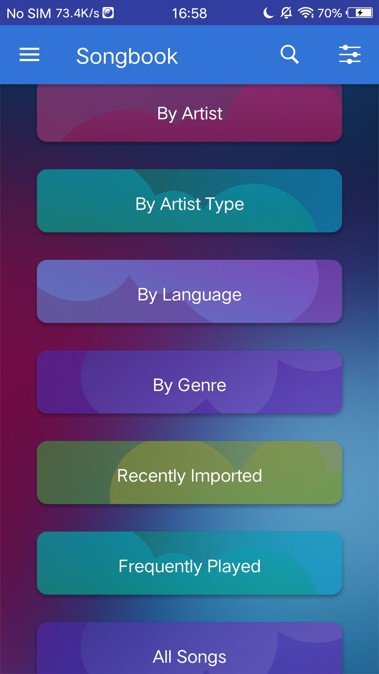
We've made it!
Request "By Artist Type " and "By Gnere" can be used in Android version
iOS version is under development!

Slide 42
Improvement of TV platform

Slide 43
Are these problems
that you have on TV...
I am so good at singing, I do not want the microphone's echo
Some videos are not played in full screen
If the video is not 16:9, it can not be stretched to full screen! The view is not well!
Can not wait to sing next song, but the passing time is quite long

Slide 44
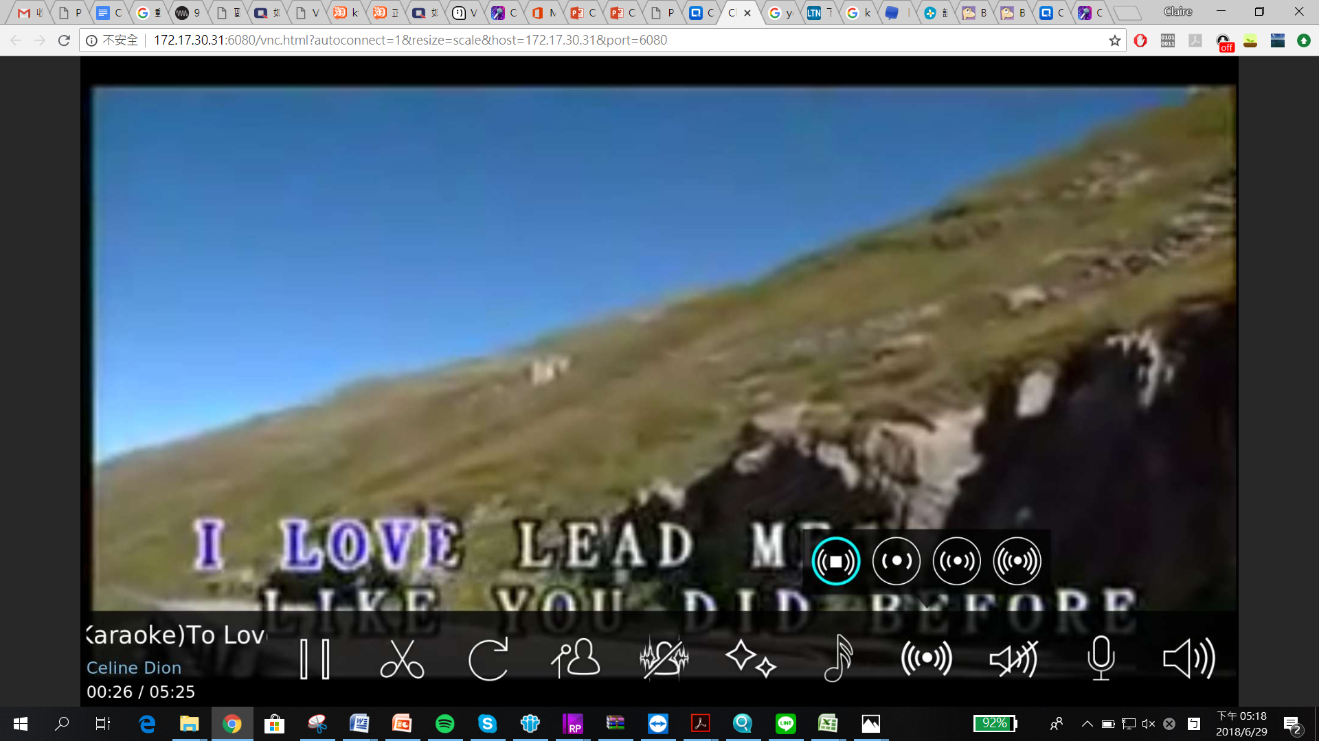
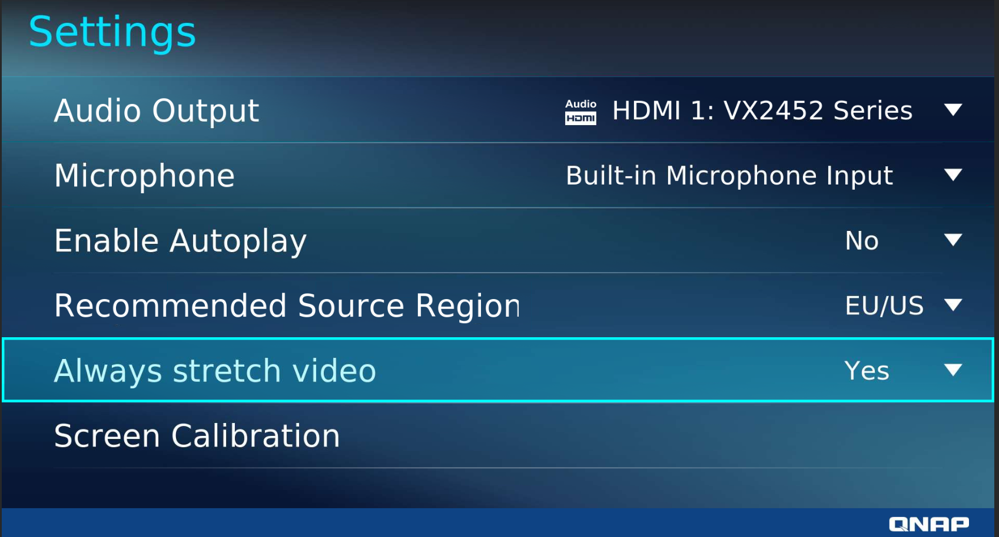
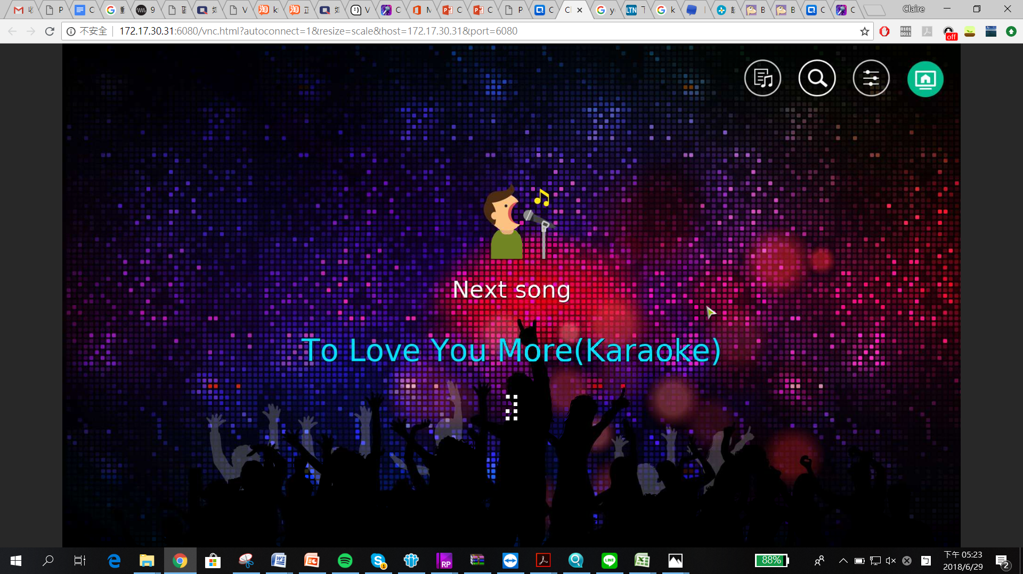
We have solved it!
Provide option for removing microphone's echo on TV
﹝Setting﹞For users to choose to stretch video or not when play the video
Optimize the passing time

Slide 46



We heard what you want
Web
TV
Mobile device
Import songs easily
Remove microphone's echo
Request songs by artist type, genre
Simple importing rules
Can choose use the echo effect or not
Android version has developed done
Show photos in Artist page
Stretch video to full screen
Request songs by folder
Show and edit artist's photo
Non 16:9 videos can also be stretched to full screen
In development
Request songs by folder
Optimize the passing time
Provide the option of request "By Folder"
Shorten the passing time

Slide 47
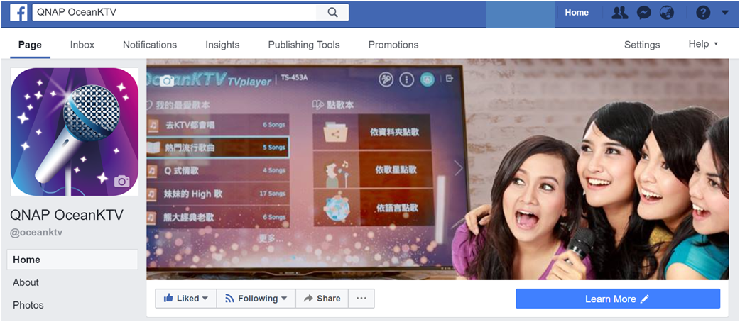
Anything else？
Keep using OceanKTV, and provide your suggestions for us
FB fanpage：QNAP OceanKTV

Slide 48
is your best choice!
Copyright © 2018 QNAP Systems, Inc. All rights reserved. QNAP® and other names of QNAP Products are proprietary marks or registered trademarks of QNAP Systems, Inc. Other products and company names mentioned herein are trademarks of their respective holder ​

