Slide 2
Agenda
Introduction to QNAP BlueGlacier Tiering Archive Storage
What is BlueGlacier?
Product configuration
Live demo: BlueGlacier at the core of your data life cycle management
Advantages of the BlueGlacier solution
Special guest: Vic Tsai,
Supervisor, Panasonic Industrial Devices Sales Taiwan
Introduction to optical storage
Advantages of Panasonic freeze-ray
The future of Panasonic Archive Disc

Slide 3



What is BlueGlacier ?
  QNAP and Panasonic working together to jointly develop this BlueGlacier tiering archive storage.
Integrates QNAP enterprise NAS, Panasonic freeze-ray optical disc library, and special build software applications.
Satisfies user requirements from primary hot & warm data storage (SSD/HDD) to cold data storage and off-line storage (Archive Disc).
BlueGlacier is the core across you data life cycle management and solves the problems of security and reliability while providing a better efficiency.
x
=
Enterprise NAS
Powered by
Panasonic
Notes:
QNAP and Panasonic working together to jointly develop this BlueGlacier tiering archive storage. It integrates QNAP enterprise NAS, Panasonic freeze-ray optical disc library, and special build software applications.
We can say BlueGlacier is a one-stop solution with the best-in-class enterprise NAS user interface eliminates your data storage obstacles.
It’s a sustainable storage, the optical discs maintain your critical and valuable data for 100 years. Also it is a native write once medium and it meets 3-2-1 data protection rules by nature.
BlueGlacier is the core across you data life cycle management and solves the problems of security and reliability while providing a better efficiency.

Slide 4
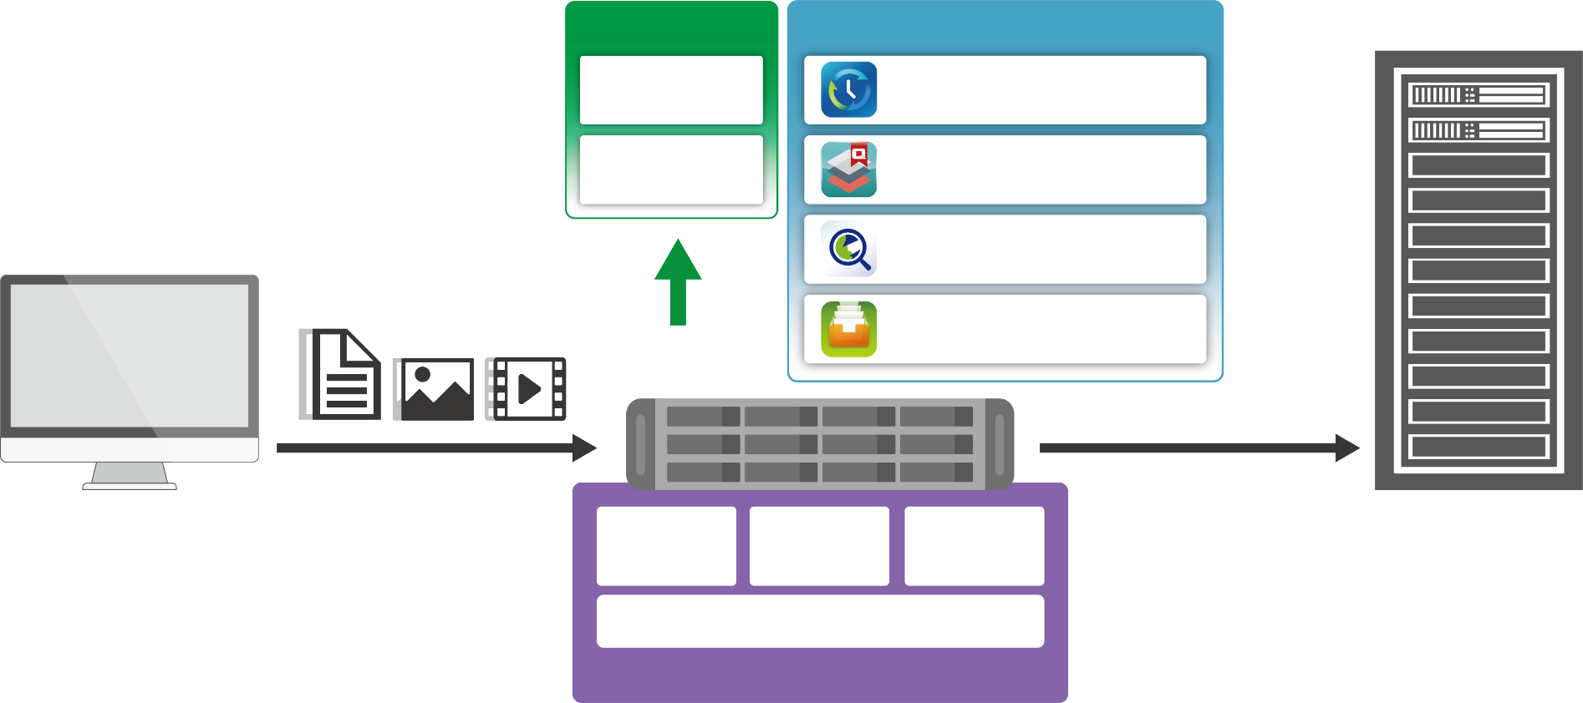
Solution Architecture
Ecosystem
QNAP Applications
Optical Disc Library
3rd Party App
Hybrid Backup Sync
3rd Party App
Qtier
Client
Qsirch
Qfiling
APIs
SMB/NFS/FTP
Web UI
Cold & Archival Data
File Station
QHAM
DAFS
QTS
BlueGlacier Building Blocks
TES-1885U Enterprise NAS
Notes:
BlueGlacier has a best-in-class enterprise NAS platform with abundant native applications and productivity tools to enhance the manageability of files and data.
With QTS, File Station, QNAP Hybrid Archival Manager (QHAM),and Data Archival File System (DAFS), the building blocks of BlueGlacier deliver an easy-to-use data storage and archiving workflow.

Slide 5
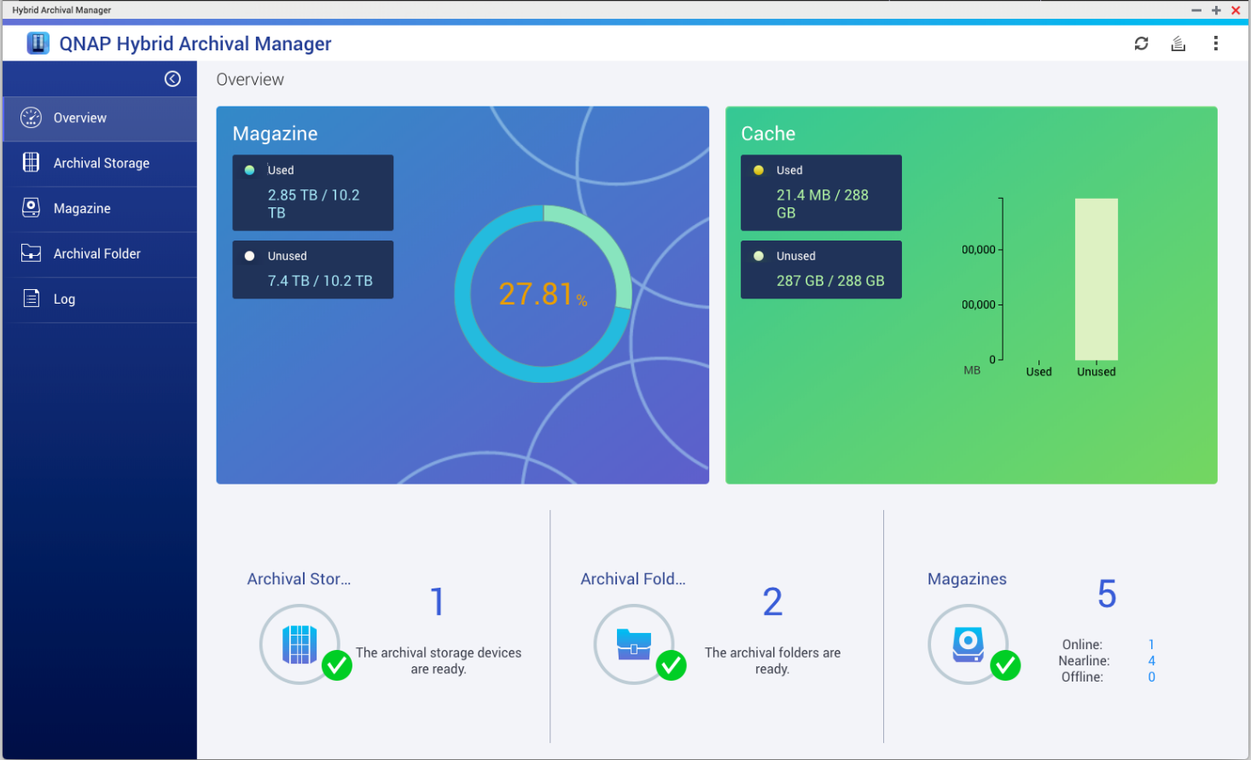

QNAP Hybrid Archival Manager (QHAM)
A friendly UI helps users manage their optical disc library.
Notes:
QNAP Hybrid Archival Manager simplifies and streamlines management operations of an optical drive library.
With just a few clicks you can finish system configurations, magazine management, folder settings, and log tracking

Slide 6
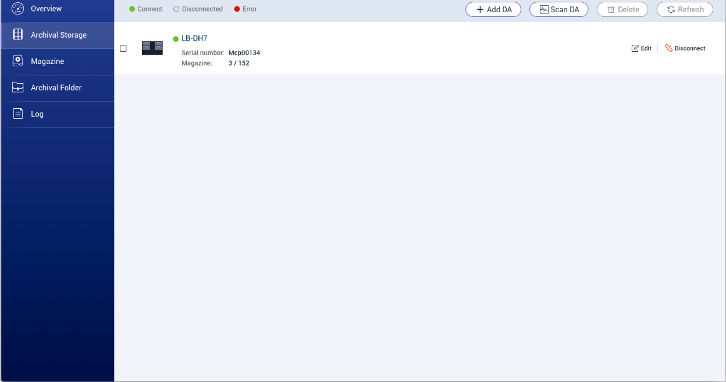
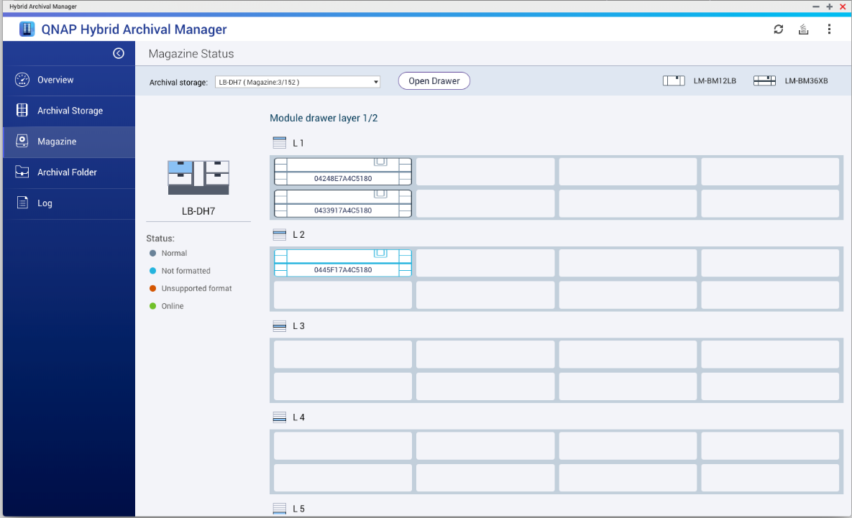
QHAM UI – Module and Magazine Management
Utilize the optical module and magazine management pages to run system operations.

Slide 7
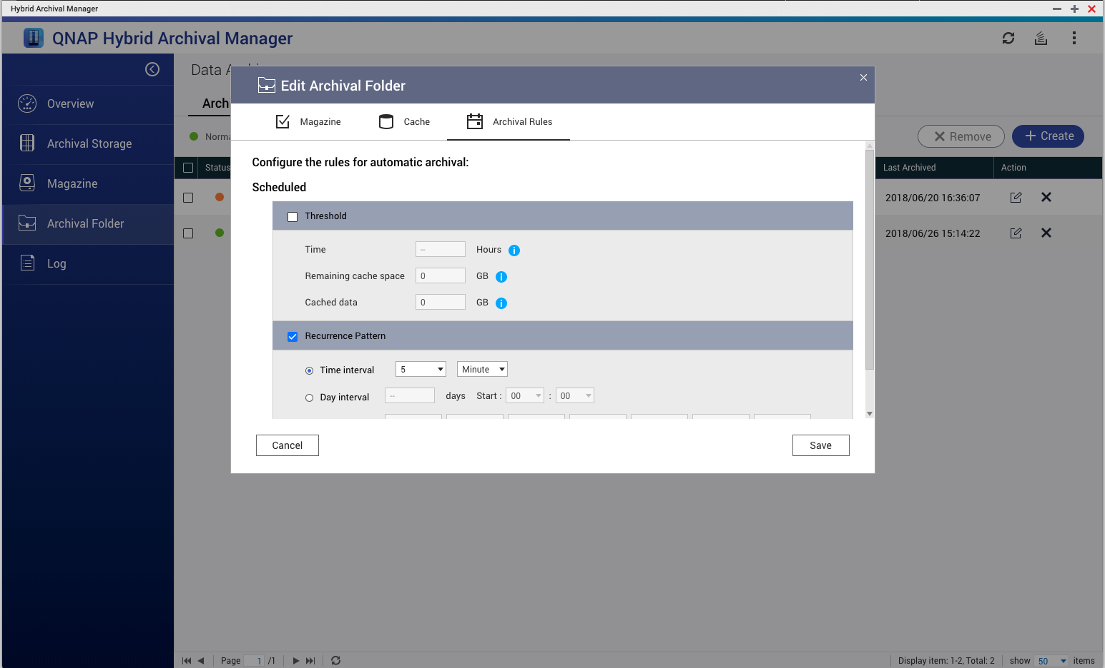
QHAM Archive Scheduler
Use the Scheduler to implement archive automation and increase your productivity.

Slide 8
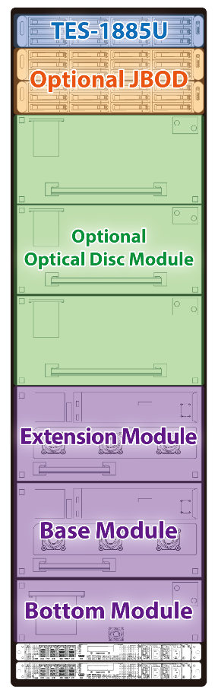
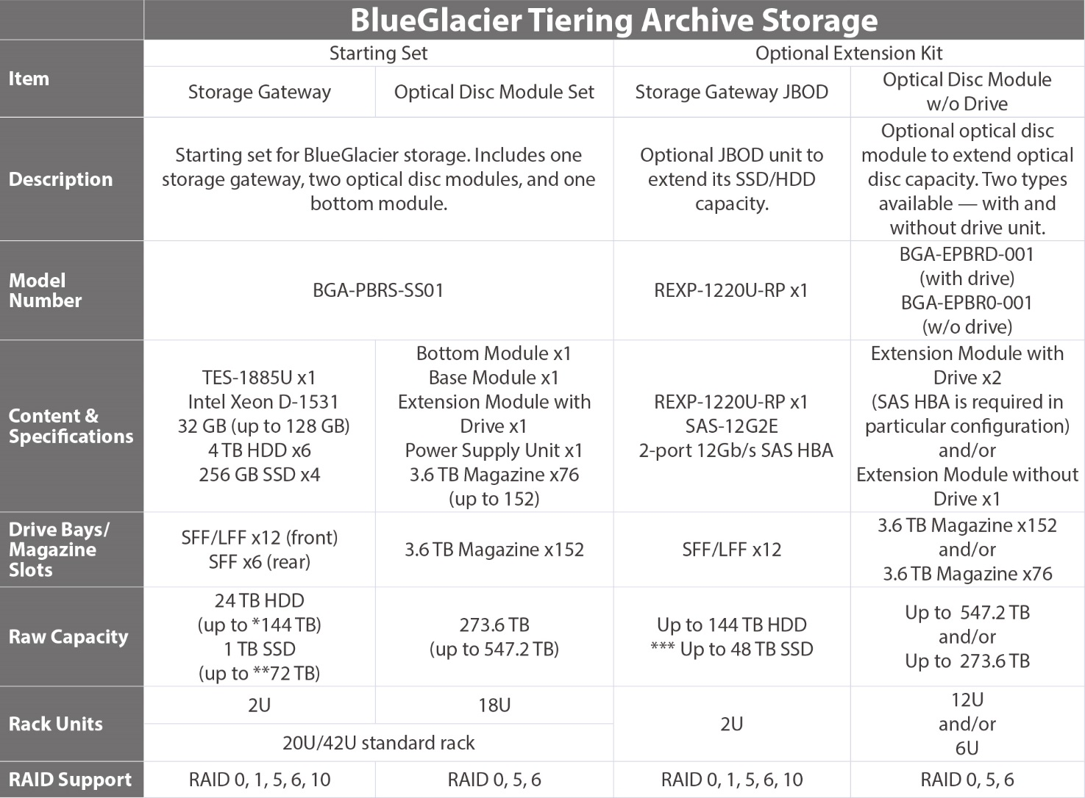
Product Configuration
BlueGlacier includes an QHAM application license, which is not included in QTS nor its App Center.
42U

Slide 9

Product Configuration
42U

Slide 10
Live Demo
Core of Your
Data Life Cycle Management

Slide 11
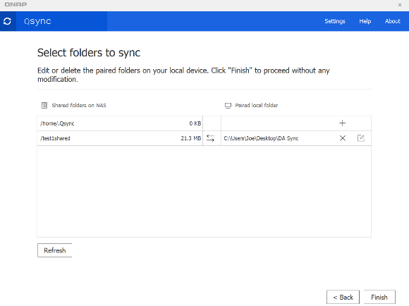
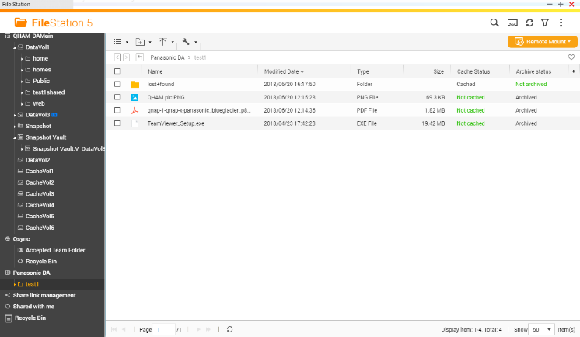
Manage Data Life Cycle Through QNAP Applications
Data Life Cycle
Data Generated
File Mgmt.
QNAP
Applications
Qsync
Sync client data to NAS.
File Station
Manage files on SSD, HDD and/or optical discs.

Slide 12
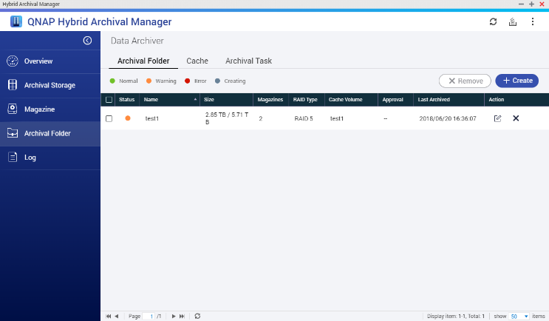
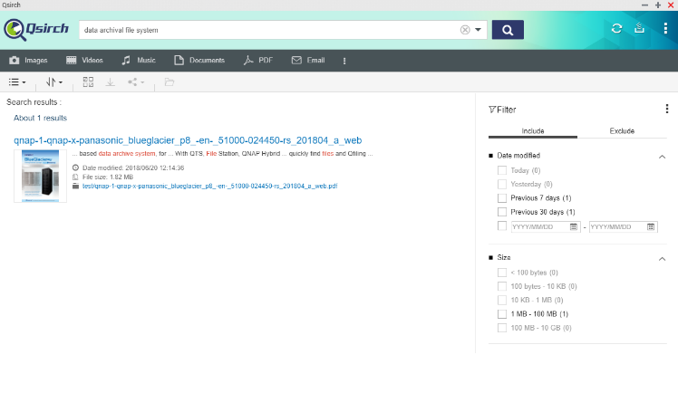
Manage Data Life Cycle Through QNAP Applications
Data Life Cycle
Cold Data/Archive Settings
Bulk Data
File Mgmt.
QNAP
Applications
QHAM
Manage your archive folder and optical disc library.
Qsirch
Search desire information from accumulating files.

Slide 13

Advantages of the
BlueGlacier solution

Slide 14
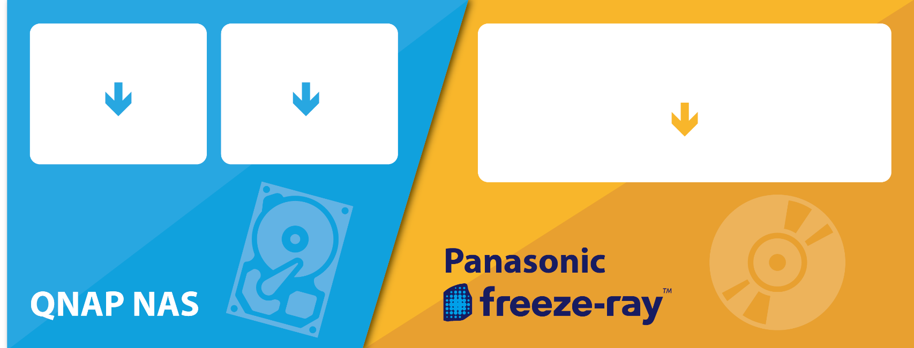
Satisfies All Data Storage Needs
SSD for high-I/O operations, HDD for general-purpose applications, and optical discs for storing cold data and archiving long-term data.
Built-in 10 GbE interfaces provides highs peed connectivity for heavy workloads.
Hot Data
Warm Data
Cold Data
Archives
Offline Archives
SSD + HDD
HDD
Optical disc
Notes:
BlueGlacier is designed to fulfill different read/write patterns — SSD for high-I/O operations, HDD for general-purpose
applications, and optical discs for storing cold data and archiving long-term data. The built-in 10 GbE interfaces provides highspeed
connectivity for heavy workloads.
We can say, it satisfies all your data storage needs in one stop.

Slide 15

Uncompromised Data Protection
3-2-1 data protection rule from United States Computer Emergency Readiness Team (US-CERT).
QNAP
Hybrid Backup Sync
Keep the file on 2 different media types
Make 3 copies of
any important file
Store 1 copy offsite
Offsite or Cloud
Primary
Storage
Active
Archives
Deep
Archives
Magnetic Recording
(HDDs, Tapes)
Optical Recording
(Optical Discs)
Notes:
According to Data Backup Options, a United States Computer Emergency Readiness Team (US-CERT) publication, all computer
users, from home users to professional information security officers, should back up their critical data to protect against loss or
corruption. Saving just one backup file may not be enough to safeguard your information. To increase your chances of recovering
lost or corrupted data, follow the 3-2-1 rule.
▪ 3 – Keep 3 copies of any important file: 1 primary and 2 backups.
▪ 2 – Keep the files on 2 different media types to protect against different types of hazards.
▪ 1 – Store 1 copy offsite (outside your home or business facility)
For the 3-2-1 rule, BlueGlacier Tiering Archive Storage can help users establish backups effortlessly; provide optical disc storage, a
physically distinct media from hard disk; and be set up offsite easily. On top of providing easy management of data, BlueGlacier is
the perfect choice for long-term data archiving.

Slide 16
Comprehensive APIs for 3rd Party Applications
Build a Strong Enterprise Storage Ecosystem
File/folder read/write operations API.
freeze-ray system and magazine management API.
Data archival/retrieval job management API.
Data Archival File System (DAFS) management API.
NAS system management API.
Notes:
BlueGlacier offers comprehensive API support (listed below) for partners and users. With these APIs, partners can integrate
their applications into BlueGlacier as part of this strong enterprise storage ecosystem. It also provides great flexibility for
customization.

Slide 17


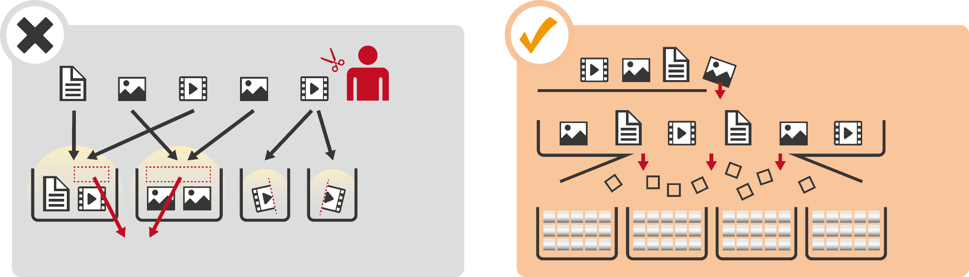
QNAP Data Archival File System (DAFS)
8K Video / Bulk Data / Engineering Drawings
WORM (Write-Once, Read-Many) 刻寫
Other Solutions
QNAP DAFS, an Advanced File System Build for Cold Data Storage
Manpower
Files
Tape/Optical Magazine
DAFS
Tape/
Optical Magazine
Waste
Notes:
BlueGlacier’s advanced Data Archival File System (DAFS) allows storage pools containing plural physical storage devices to be
created. It cuts files into blocks and consequently distributes them to grouped physical devices. This eliminates the need to
arrange files into storage devices and also enhances storage utilization. When large batches of files need to be archived/backed
up, DAFS saves you from time-consuming tasks.

Slide 18
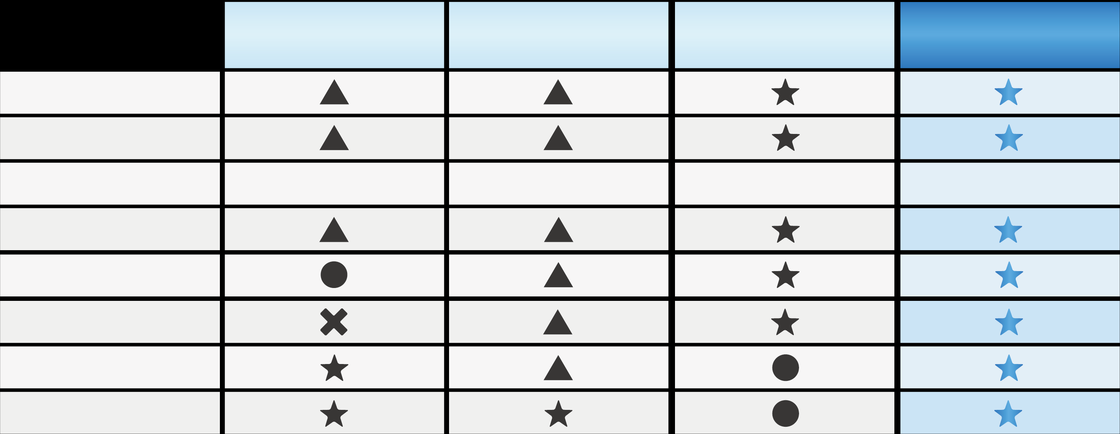
Next-Generation Storage Media
Most Superior
Superior
Rather Inferior
Inferior
HDDs
(for near line)
QNAP
BlueGlacier
Tapes
Optical Discs
Data Security
Non-Volatility
Long Life
around 4 years
10-30 years
50-100 years
50-100 years
Durability
Compatibility
*
Total Cost of Operation
(TCO)
Random Access Capability
Transfer Rate
* up to two generations back
Notes:
▪ Data security
For data security, the recording media itself needs to have a non-overwritable structure. The write-once characteristic of optical
discs uses physical changes to record data and makes overwriting impossible, so it is structurally very secure. Magnetic recording
media such as HDDs and tape can be repeatedly overwritten, so additional measures (such as software) are needed to ensure the
data security of these systems.
▪ Non-volatility
Magnetic recording media, such as HDDs and tapes, have the risk of losing recorded data when subjected to magnetic fields.
Optical discs use physical changes for recording and have non-volatile memory. Non-volatility is one of the most important
characteristics for ultra-long-term storage.
▪ Long archival life & great reliability
Usually HDDs have 5-10 years life, and 10-30 years for
tapes.
But Panasonic “Archival Disc”, an optical disc for professional use, has an estimated lifespan of 100 years.
▪ Compatibility
Unless changes are made in the fundamental principles of recording, optical discs can remain compatible with discs from
different generations from the past. For example, in the Archival Disc roadmap, as backward compatibility is maintained for drives
from different generations, no work and no cost for migration would be necessary. In the case of tapes, compatibility may be lost
due to the change of specifications to increase memory capacity. Provided that next-generation products are introduced every 2
to 3 years and the compatibility is basically supported up to the previous two generations, migration would be necessary about
once every 7 years to maintain readability of past records.

Slide 19
Special Guest
Vic Tsai
Supervisor
Panasonic Industrial Devices Sales Taiwan

Slide 20






Panasonic Leading Position of Optical Media
Almost 40 years of Optical Media Evolution and Panasonic being the core driver of format standardization.
4th Gen：2016～
1st Gen：1980～
2nd Gen：1990～
3rd Gen：2000~
300GB~
640 MB
4.7 GB
25/50GB
(single／double sided)
(500GB、1TB)
(3 layer double sided )
Infrared Laser
Red Laser
Blue Laser
Blue Laser
Music, data
Movie, data
Movie, data
Archive data

Slide 21
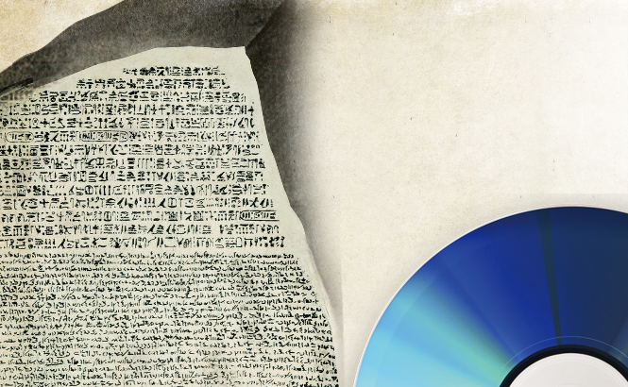
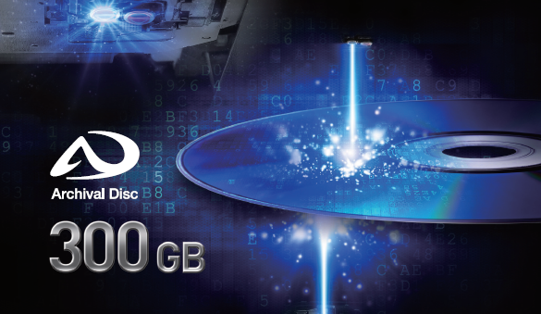


Optical Archive Disc-Physical Strength
Physically WORM
Optical Medium
No data overwrite
No physical contact
no falsification
human error free
no components damage
maintenance free

Slide 22



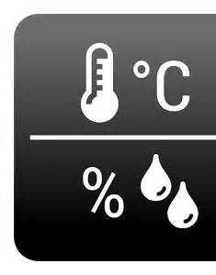
Optical Storage Advantage–Environmental Strength
Thermal Tolerant
Disaster Recovery
100 Years
30
70
Tsunami, flood
electromagnetic
wave
No media degradation
No data damage
100 years longevity
data center anywhere
business continuity
restoration free

Slide 23
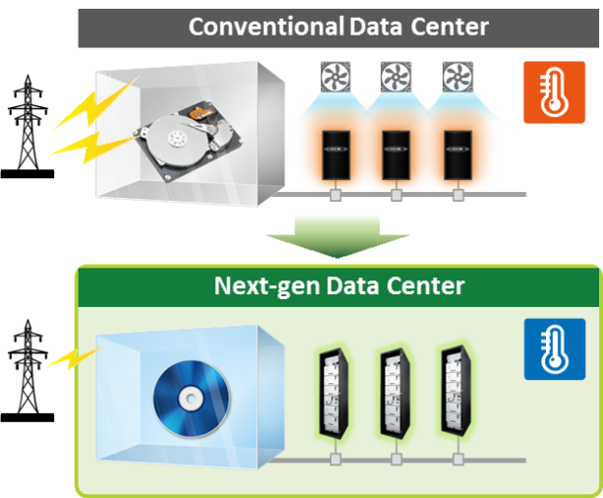
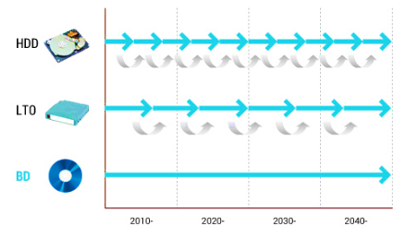
Optical Storage Advantage-Low Cost (TCO)
CAPEX
OPEX
Data Migration
Optical Storage
No media obsolescence
No power wasted
one time investment
migration free
reduced cooling cost
standby power free

Slide 24










Optical Storage Advantage-Sustainable Solution
Advancing Roadmap
Bit Cost Reduction
2020
1 TB
2013
500 GB
2013
100 GB
300 GB
2013
2016
Next Step
→
2013
2016
Next Step
→
No densification constraints
No trade-off impacts
predictive capacity planning
driving space efficiency
keeping same reliability
performance improvement

Slide 25
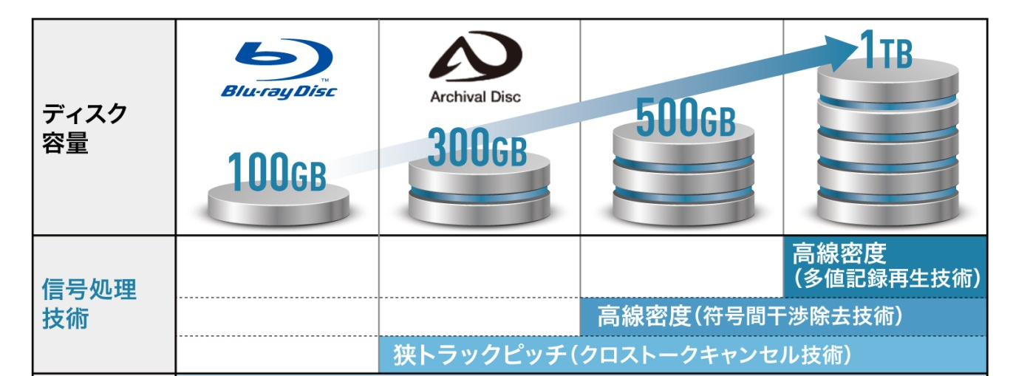
Panasonic Archive Disc Roadmap
2016～
Next Step
Disk
Capacity
Signal Processing Technology |  |  |  | High Liner Density (Multi Revel Recording Technology)
 |  |  | High Liner Density (Inter Symbol Influence Cancel Technology)
 |  | High Track Density (Crosstalk Cancel Technology)
Basic Specification | Double Side Disc Technology λ=405nm, NA=0.85, Layer Structure: 3 layer/side
Signal Processing Technology

Slide 26
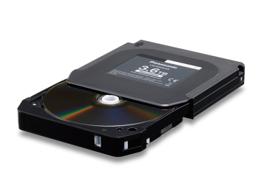



Large Capacity Optical Disc in Magazine
Upper case
3.6TB
300 GB
Storing 12
300GB Archival Discs
X12
Bottom case

Slide 27
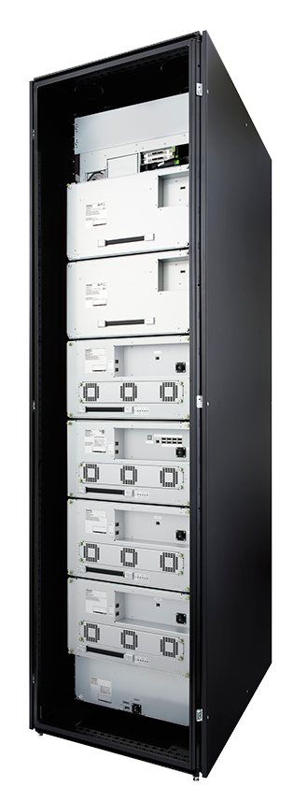
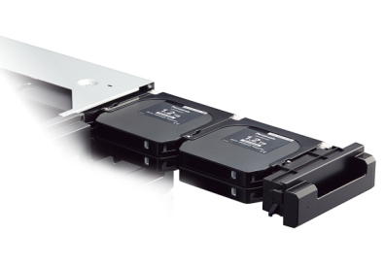
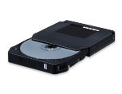
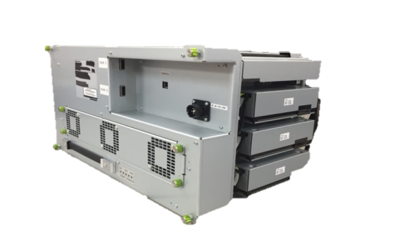
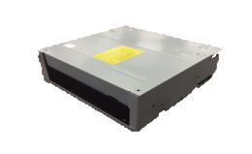
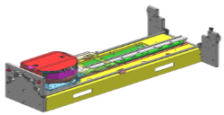
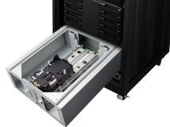
Panasonic DATA Archiver Outline
Quick and easy replacement of magazines and failed units on-site.
Magazine Replacement
Writer Unit
Able to replace magazines in each drawer easily.
Easy replacement and repair by module from the back side
Magazine
Magazine for 12 Discs
Drawer
Loadable capacity of 3.6 TB
Magazine Carrier Unit
Drive unit
Independent maintenance can be implemented for the bottom module. Magazine Carrier Unit can be fixed from the bottom module.
Transfer rate is up to 360MB/ s per 1 set of writer unit.
(max 1080MB/s with max 3 sets of writer unit)
Magazine Carrier unit

Slide 28
Copyright © 2018 QNAP Systems, Inc. All rights reserved. QNAP® and other names of QNAP products are proprietary marks or registered trademarks of QNAP Systems, Inc. Other products and company names mentioned herein are trademarks of their respective holders.

