Slide 1
Notes:
標題：超值 10GbE NAS，以 3 顆硬碟享有 RAID 5 資料備援保護，內建 3 個 M.2 SATA SSD 插槽
10GbE Logo

Slide 2





High speed transfer on PCs
High speed
Local Transfer
◆ Data migration
◆ Data management
◆ Rebuild RAID
◆ Tiering storage
High speed
Network transmission
◆ Collaboration
◆ Rapid backup
◆ Productivity
1 GbE
5 GbE
Notes:
https://tw.123rf.com/%E7%B4%A0%E6%9D%90%E5%9C%96%E5%BA%AB/gamer.html?imgtype=0&oriSearch=save+the+money&sti=mkdchaommjirpvme6i|&mediapopup=51967685

Slide 3




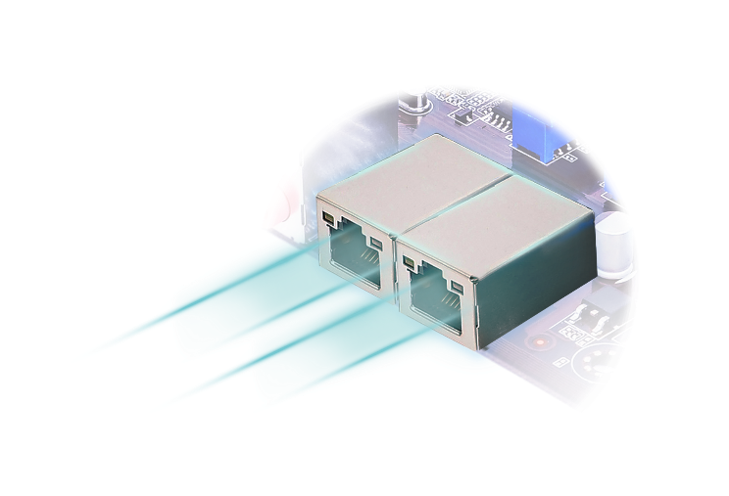
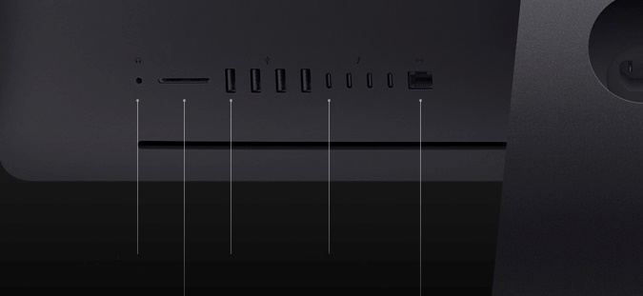

10GbE era is coming
Video editing workshop
Quickly backup your masterpiece
Gaming player
High speed on both playing games and data transmission
USB3.1 Type A
USB3.1 Type C
X10 fast
3.5mm headphone
USB 3
Thunderbolt 3
(USB-C)
10GbE
Ethernet
SDXC card slot
Ethernet
10GB File only takes about
10s
10GbE
Ethernet
Gigabit LAN
10GbE LAN
資料來源：
https://www.apple.com/imac-pro/specs/
Notes:
截圖看這兒 ：https://www.asus.com/tw/Motherboards/X99-E-10G-WS/

Slide 4

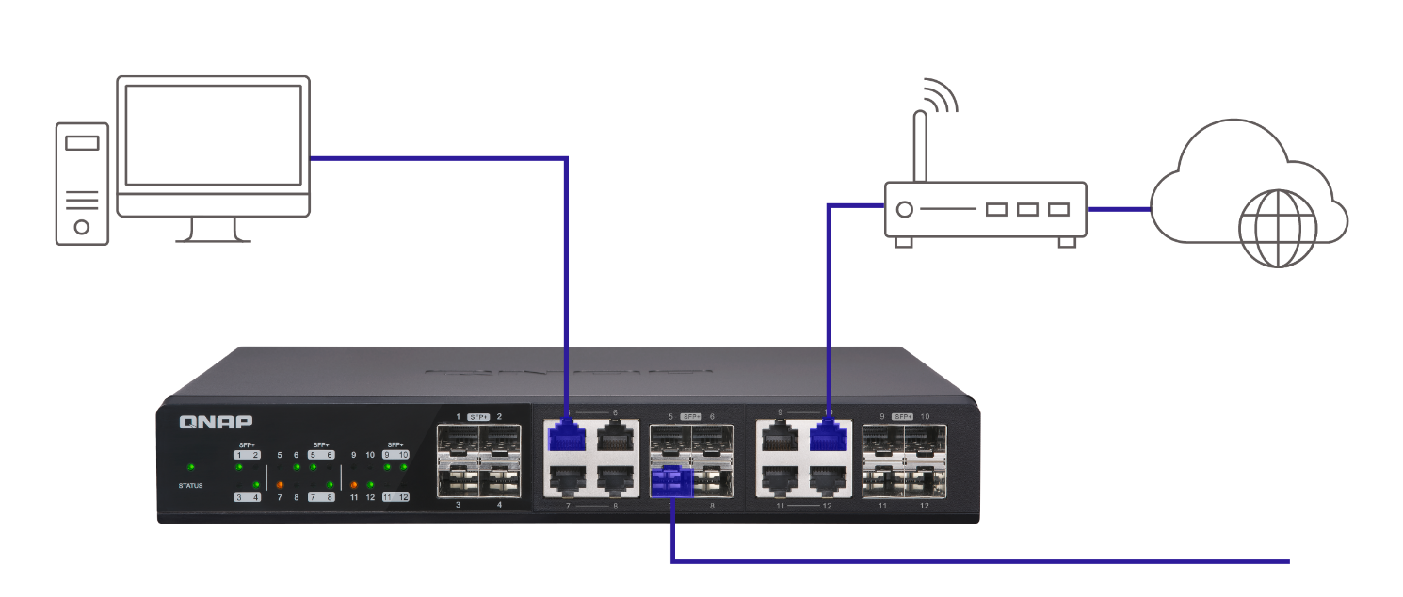
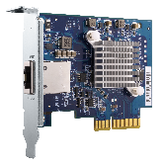
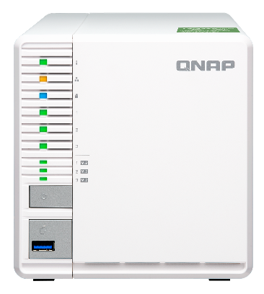
Complete 10GbE infrastructure
10GbE Nbase-T PCIe expansion card, provides Gen.3 x 4 speed and Supports 10GbE/5GbE/2.5GbE/1Gbe/100M data transmission
QXG-10G1T
RJ45 Cable
QSW-1208-8C
SFP+ Cable
QNAP combo unmanaged switch
Supports SFP+ and RJ45 10GbE transmission

Slide 5
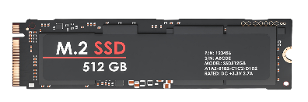


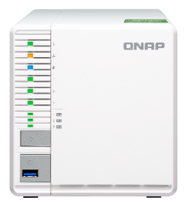
Why not start using SSD?
While HDD gets less expensive, the cost saved can be used for SSDs
Most cost-effective M.2 SSD supported NAS on ARM
M.2 SSD supported NAS for SMB and workshop on x86
TS-332X
TVS-x82
TS-x77
Notes:
https://tw.123rf.com/%E7%B4%A0%E6%9D%90%E5%9C%96%E5%BA%AB/save_the_money.html?imgtype=0&oriSearch=save+the+mpney&sti=ni7toqnflu9u50prc7|&mediapopup=37682886

Slide 6


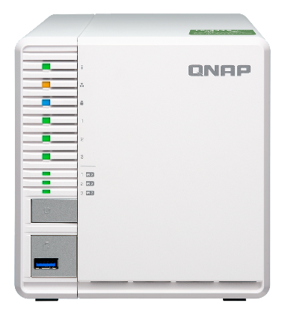


New 3-bay NAS joins AL family
TS-332X
Supports M.2 SATA SSD
*M.2 SSD sold separately
TS-832X
TS-932X
RAID 5 NAS
1 x 10GbE SFP+
Dual PCIe slots
2 x 10GbE SFP+
Hybrid 5+4 drive configuration
2 x 10GbE SFP+

Slide 7
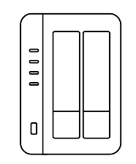
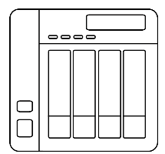

Cost effectively secures data with RAID5
2-Bay NAS
4-Bay NAS
RAID 1:
Space: 1 x HDD
RADI 5:
Space: 2 x HDD
RAID 5:
Space: 3 x HDD
HDD utilization: 50%
HDD utilization: 67%
Budget concern
Notes:
2-bay and 4-bay用線圖或卡通圖

Slide 8
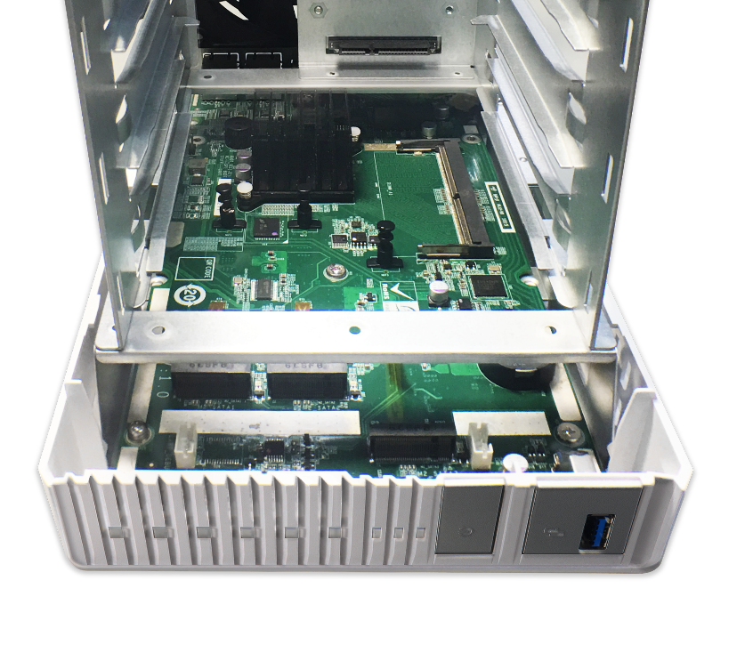
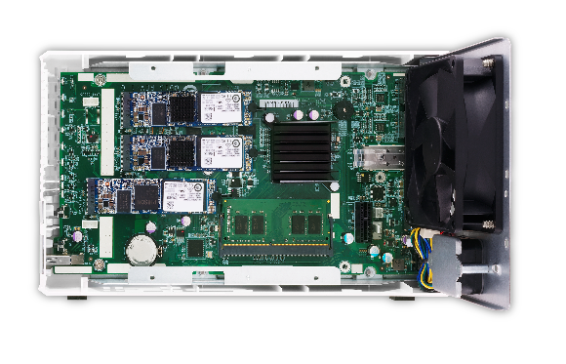
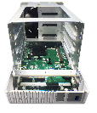
Compact NAS with 3 x M.2 SATA slots
Optimized design
3 x SATA 6Gb/s 2280 M.2 SSD slots

Slide 9
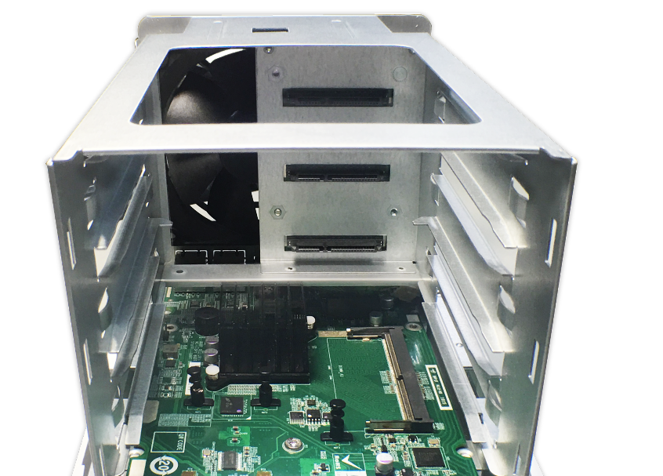
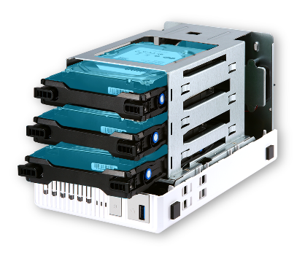
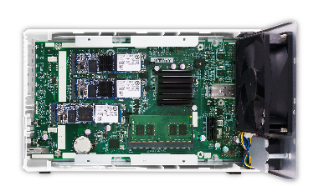
User upgradable DDR4 RAM
3 x SATA 6Gb/s HDD/SSD ports
DDR4 SO-DIMM, Up to 16GB DDR4

Slide 10

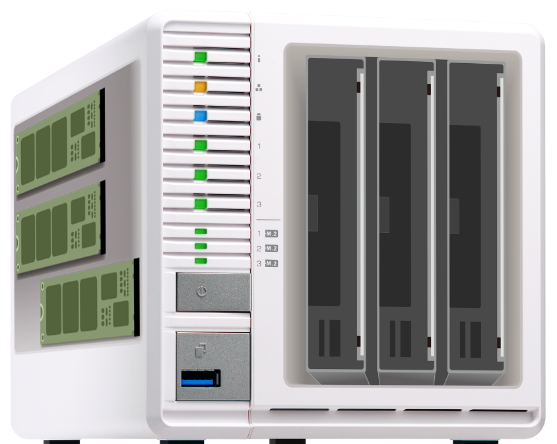


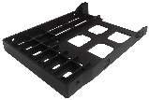
Both performance and capacity in hand
3 x 512 GB M.2 SSD
3 x 8TB HDD
Use Qtier for hot data tiered storage
16TB Cold data on
big storage space
One 2.5” tray base is bundled for first batch

Slide 11




Quad-core 64-bit Cortex-A57 CPU
AL324 4-core
64-bit 1.7 GHz CPU
Hardware Encryption Acceleration Engine
Up to 16 GB DDR4 SO-DIMM

Slide 12
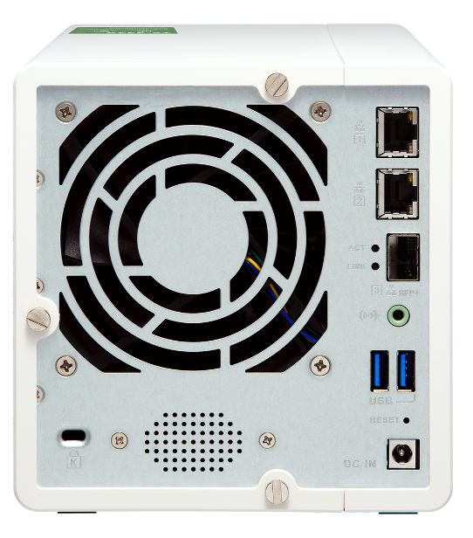
Built-in single 10GbE SFP+ port
Fully support 10GbE high-speed networks, delivering a major speed increase for virtualization tasks, fast backup & restoration, and large-data applications.
QSW-1208-8C
QSW-804-4C

Slide 13
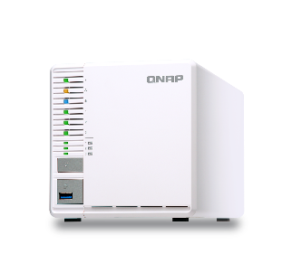


High speed transfer
1200
1000
1085
800
914
600
400
526
407
200
Test environment：
NAS: TS-332X
OS: QTS 4.3.4
RAID Group：RAID 5; 3 x INTEL SSDSC2BB240G4 240GB *3 ;
Plient PC：Windows 10, intel i7-5820K @3.3GHZ, 32GB RAM
0
(MB/s)
Download
Upload
Download
Upload
Windows File Transfer (1x 10GbE)
Windows File Transfer with Encryption (1x 10GbE)
*Tested in QNAP Labs. Figures may vary by environment.

Slide 14
Lightning fast transfers

Slide 15
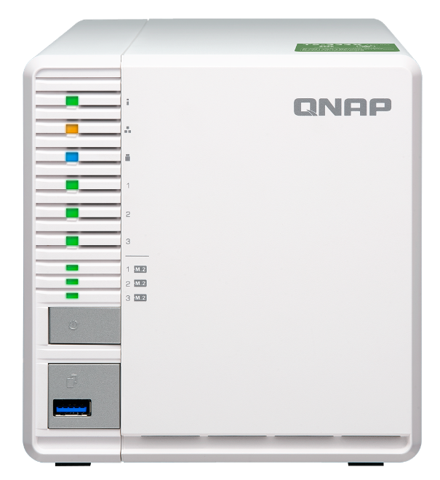
Front view
LED indicator: Status, LAN, USB, HDD1-3
LED
indicator: M.2 SSD 1-3
Power
USB 3.0 One Touch Copy button

Slide 16

Rear view
2 x GbE RJ-45 ports
One 9 x 9 cm smart fan
10GbE SFP+ port
3.5mm line out jack
Security slot
2 x USB 3.0 ports
Reset
Built-in speaker
DC 12V power input

Slide 17
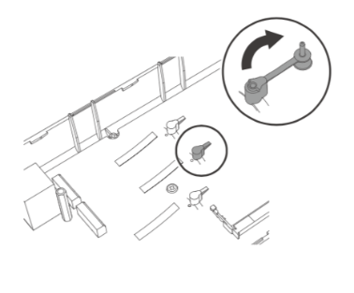
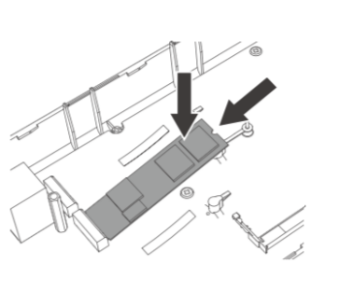
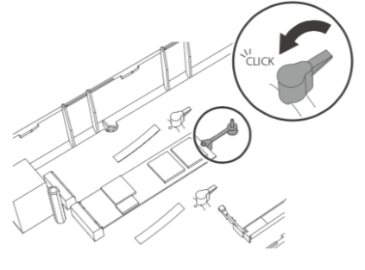
Tool less M.2 SSD fast installation
1
2
3
M.2 heatsink is bundled

Slide 18
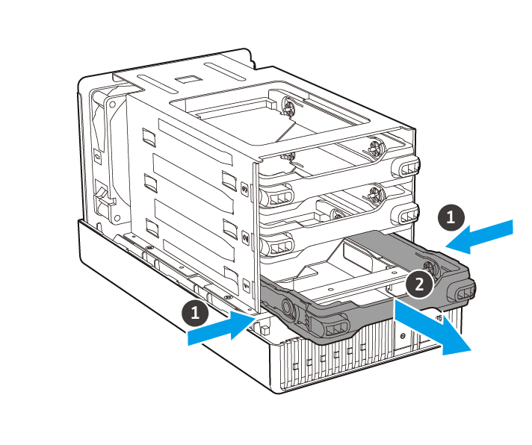
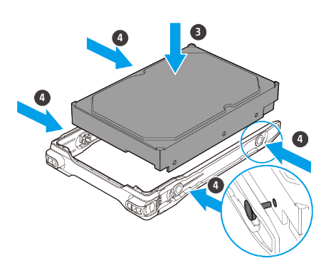
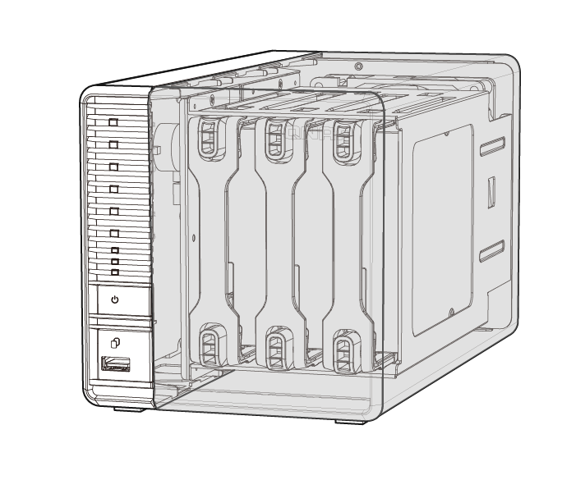
Hot swappable and invisible slots
Tool less installation
Prevent HDD mishandling
Anti-theft

Slide 19
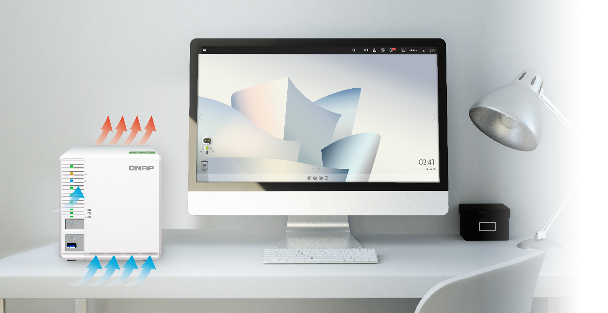

Elegant and energy saving
Effective cooling design
ARM Cortex-A57 Energy
saving architecture
Standby: 18.56 W
Operating: 26.22 W

Slide 20
Install M.2 and upgrade RAM

Slide 21

SSD Cache
Software-defined SSD Extra Over-provisioning
Notes:
分頁要改

Slide 22



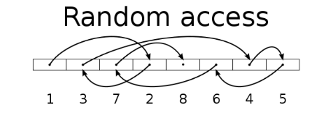
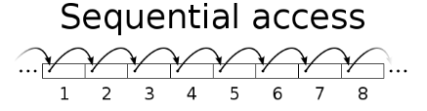
SSD Usage In Network Attach Storage
SSD can provide high random IOPS for multi-clients sync and business applications that can not be achieved by HDD.
In 2018, SSD price also comes close to the sweet spot.
Beside choose the right SSD, you should also
choose right NAS!
SanDisk evaluate the
256 GB SSD per GB price in 2018 is only 30% compare to 2013A
Drive Type | Sequential Access (MB/s) | Random Access (IOPS)
HDD | 100 | 350
SSD | 300 | 60000
Price trends collected by SanDisk, a SSD vendor
Source: https://www.sandisk.com/business/datacenter/resources/white-papers/the-ssd-enabled-pc-total-cost-of-ownership

Slide 23



Different SSD has Different Performance
In QNAP Lab, engineer use FIO to test different SSD, and all SSD have showed consisted write performance degrade.
Different SSD’s controller and Garbage Collection’s Algorithm will effect the long term performance
Different SSD in QNAP NAS’s FIO consisted performance (IOpattern: RW-4K):
How can storage vendor help to ensure SSD has expected performance ?

Slide 24

What is SSD Over-provisioning
SSD Over-provisioning reserves space in the SSD to decrease write amplification & increase consisted performance and endurance.
Reason: to avoid Garbage Collection in any giving point of time
N | New Data
D | Valid Data
 | Invalid Data
 | OP
 | OP
N | N
N | N
N | N
With limited OP, 4 additional write is needed. With more OP the movement is not required.
D | D
D | D
D
D
D | D
D | D
D | D
D | D
N | N
N | N
N | N
6 pages of new data cannot all be stored to the SSD
Unless the SSD conduct GC internally first
With more reserved block, the GC is not required

Slide 25

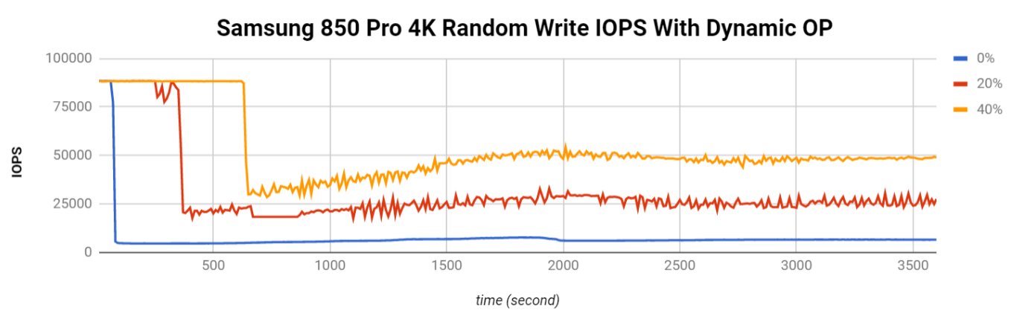
The Advantage of Software-defined SSD Extra Over-provisioning
With QTS System, user can assign more OP to the SSD RAID.
At QNAP Lab, the effect of over-provisioning can not only be observed on single consumer-level Samsung 850 Pro to gain the performance same as data center SSD, but also be seem on SSDs as a RAID.
Above: Samsung 850 Pro as Single Disk
Below: Micron M1100 as RAID 1
FIO configuration: runtime=1800 ioengine=libaio direct=1 rw=randwrite bs=4k numjobs=1 iodepth=32
Take Intel S4500 as an example, The continuous random write is 30,000

Slide 26
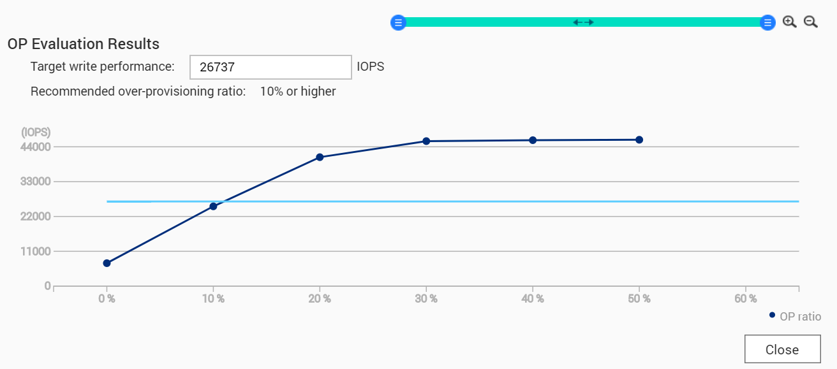

Choose SSD is Hard, Choose QNAP is Simple
SSD consisted performance can only be observed after long time of usage
QNAP has provided the unique SSD Profiling Tool to help user measure the performance difference with different over-provisioning amount.
Not just IT manager, Home user can also evaluate the capability of SSD.
Using SSD Profiling Tool to identify the best OP amount.
Take Intel S4500 as an example, The continuous random write is 30,000

Slide 27
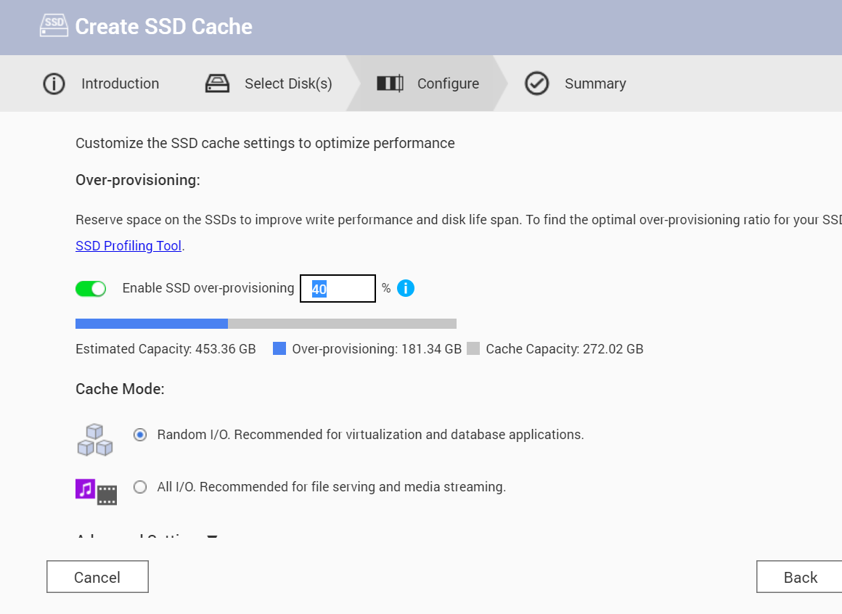
Use SSD OP on M.2 SSD
In QNAP Lab，2 x M.2 SSD are used as RAID 1 SSD Cache to compare the real constant cache performance with and without over-provisioning performance between No OP and use OP:
Cache Constant
Random Write Performance (IOPS)
SSD Capacity (GB)
300
20000
250
17500
15000
200
12500
150
10000
100
7500
5000
50
2500
0
0
No OP
Use OP
No OP
Use OP
Test environment: FIO configuration: --direct=0 --rw=randwrite --bs=4K --runtime=180 --size=32G --name=test-write --ioengine=libaio --numjobs=64 --iodepth=1

Slide 28
Create SSD cache with OP on TS-332X

Slide 29
QNAP SSD Global Cache and Qtier
Two options for users to utilize SSD on TS-332X with M.2 SSD slots
- For real-time performance boost, deploy SSD Global Cache or All flash storage
- For continued data tiring between hot and cold data, deploy the Hybrid Storage Qtier™ Auto Tiering
SSD Cache lets all data enter cache and read hot data from the storage in real time
Qtier utilizes SSD space and let data block be
reallocated based on hot or cold in the storage
SSD Global
Volume
Block-based LUN
Volume
Block-based LUN
Qtier SSD Tier
Qtier HDD Tier
Storage pool
SSD
SSD
HDD
HDD
HDD
HDD
HDD
HDD

Slide 30
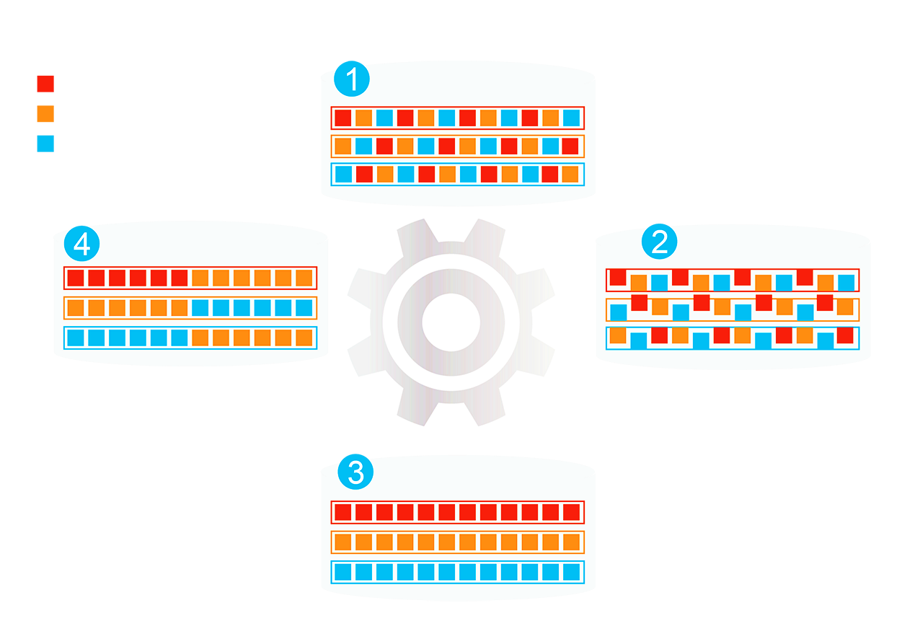
Qtier (Auto-Tiering) Increase Capacity and Performance at the Same Time
Hot Data
Before Tiering
Data place not optimized
Beside SSD Cache,
Qtier™ can migrate
data between SSD and
HDD directly
SSD capacity can be
utilized with limited
memory requirement.
Warm Data
Cold Data
Access Pattern Change
Start Tiering
Qtier
Engine
After Tiering
Performance optimized

Slide 31

QNAP Global SSD Cache
The QNAP SSD Cache can be applied to multiple volume / LUN
Read-Only ➔Copy frequently used data to SSD
Read-Write ➔Not only copy data, new data can also be temporarily stored in SSD
(New)Write-Only ➔ Only new data will be written into the cache
How Read-write Cache work:
Data from clients and storage will both be cached
Write
Write
Read
Read
SSD
IO Intensive
Application
When SSD Space not enough
HDD

Slide 32

The Write-only Cache Increase ROI of
SSD Cache with high Writing Demand
Write-only cache is promoted by Microsoft
for endurance control.
QNAP believe Write-only Cache can increase the ROI of purchasing SSD in below scenario:
1. File Server focusing on write operations
2. Database with more write operation
(Such as IOT monitoring server)
3. Use high endurance SSD (Intel Optane™)
with other SSD
Writes
are cached
Reads
are NOT
NVMe
NVMe
SSD
SSD
SSD
SSD
https://docs.microsoft.com/en-us/windows-server/storage/storage-spaces/understand-the-cache

Slide 33
TS-332X SSD Multiple Configurations
In addition to acting as a backup server, SSD Over-provisioning, Global Cache and Qtier let TS-332X be deployed as production server
Scenario | File Server | Web, Application | Synchroni-zation, Vi-deo Editing | Surveillance, Backup, Log Server
SSD Config | Qtier™ | Qtier™ | Read-Write Cache | Write-Only Cache
SSD OP | 10% | 20% | 20% | 30%

Slide 34

Data Backup
Snapshot provides a complete data backup solution
Notes:
分頁要改

Slide 35
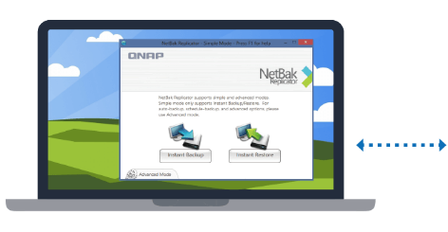


A complete backup solution
Data backup is the most effective way against ransomware
Mac O.S.
Time
Machine
Real-time or scheduled back up to the TS-332X easily.
Windows
NetBak
Replicator

Slide 36
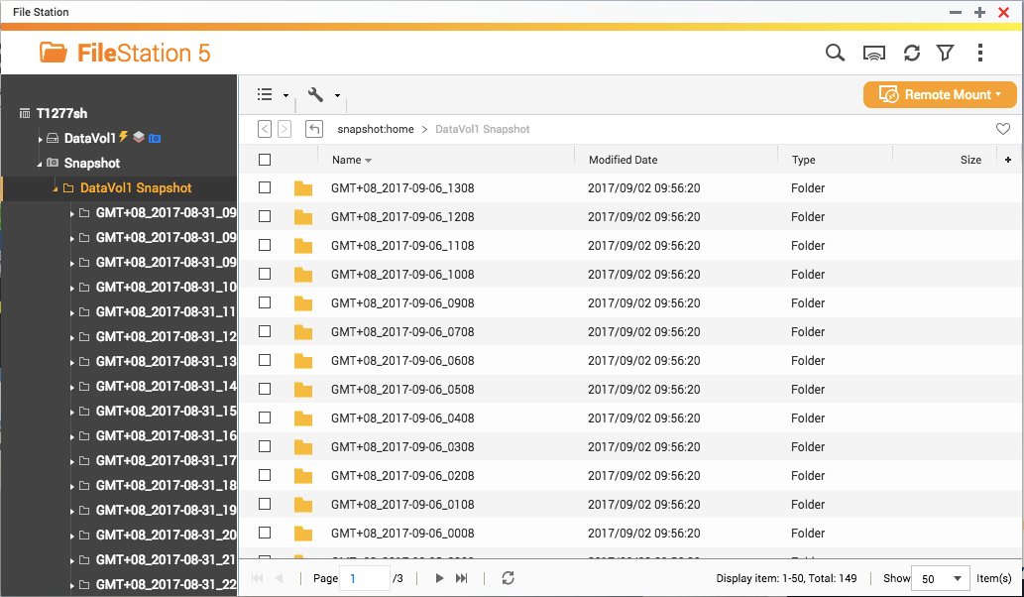



Protect your backup with QNAP Snapshot
2GBRAM
$$≥$$
4GBRAM
For the
whole NAS
64
256
----------------------------------------------
For a single volume/LUN
32
64
The best choice for backup

Slide 37












Multi-layer protection for the backup
Remote
Backup
Hybrid Backup Sync
Remote
Local
Cloud

Slide 38



Data management
Qsirch
Full text search
Qfiling
Smart filing
Notes:
分頁要改

Slide 39




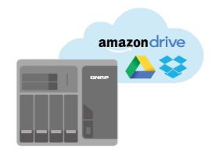

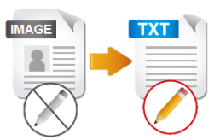



QNAP meets all needs for an office
File Station
OCR Converter
Qsirch
Qfiling
Store and backup
File Digitization
Search
Archive
With OCR Converter, Qsirch can search for image context.
Notes:
QTS4.3.4 P.58

Slide 40


Qsirch 334 core competencies
3
Search tools
◆ Advanced search for complex keyword search
◆ Category bar for quickly finding every kinds of files
◆ 35+ powerful filter conditions
3
Search aids
◆ Tags for every search criteria
◆ Highlight keywords for viewing the search result clearly
◆ Easy steps from preview to sharing
4
Search channels
◆ Web ◆ Mobile app
◆ Browser extension ◆ Mac Finder *
* This feature is going to be supported from QTS4.3.5
Notes:
QTS4.3.4 P.69

Slide 41






Qfiling 2.0 core competencies
Flexible
Efficient
Create your Qfiling rules in 3 steps
Scheduling for auto filing
Total control
Fast
With system logs, filing status is easily accessible
With recipes, tasks are done with one click
Notes:
QTS4.3.4 P.69

Slide 42

Surveillance Solution
Secure your environment
Notes:
分頁要改

Slide 43
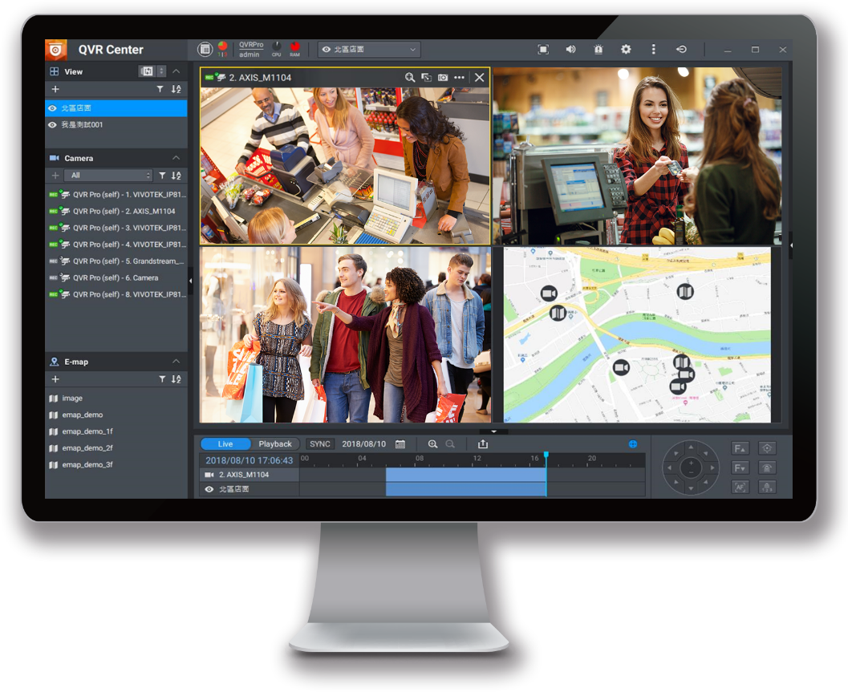

QVR Pro surveillance solution
5,000+ compatible IP cameras
8 free IP camera channels
16 max. IP camera channels
QUSBCam2 record from USB webcams

Slide 44



TS-332X provides you…
M.2 supported RAID5 NAS
  - Improve the HDD usage
  - Installing M.2 to apply auto tiering and SSD OP
VJBOD and surveillance
  - support VJBOD to arrange available
  capacity efficiently
  - support QVR Pro
Built in 10GbE SFP+
  - High speed transfer enhances the productivity
  - Building 10GbE workflow with QSW by very
  low cost
Data safety
  - Snapshot protection
  - Time Machine and Netback Replicator backup
  solution
  - Cloud service

Slide 45
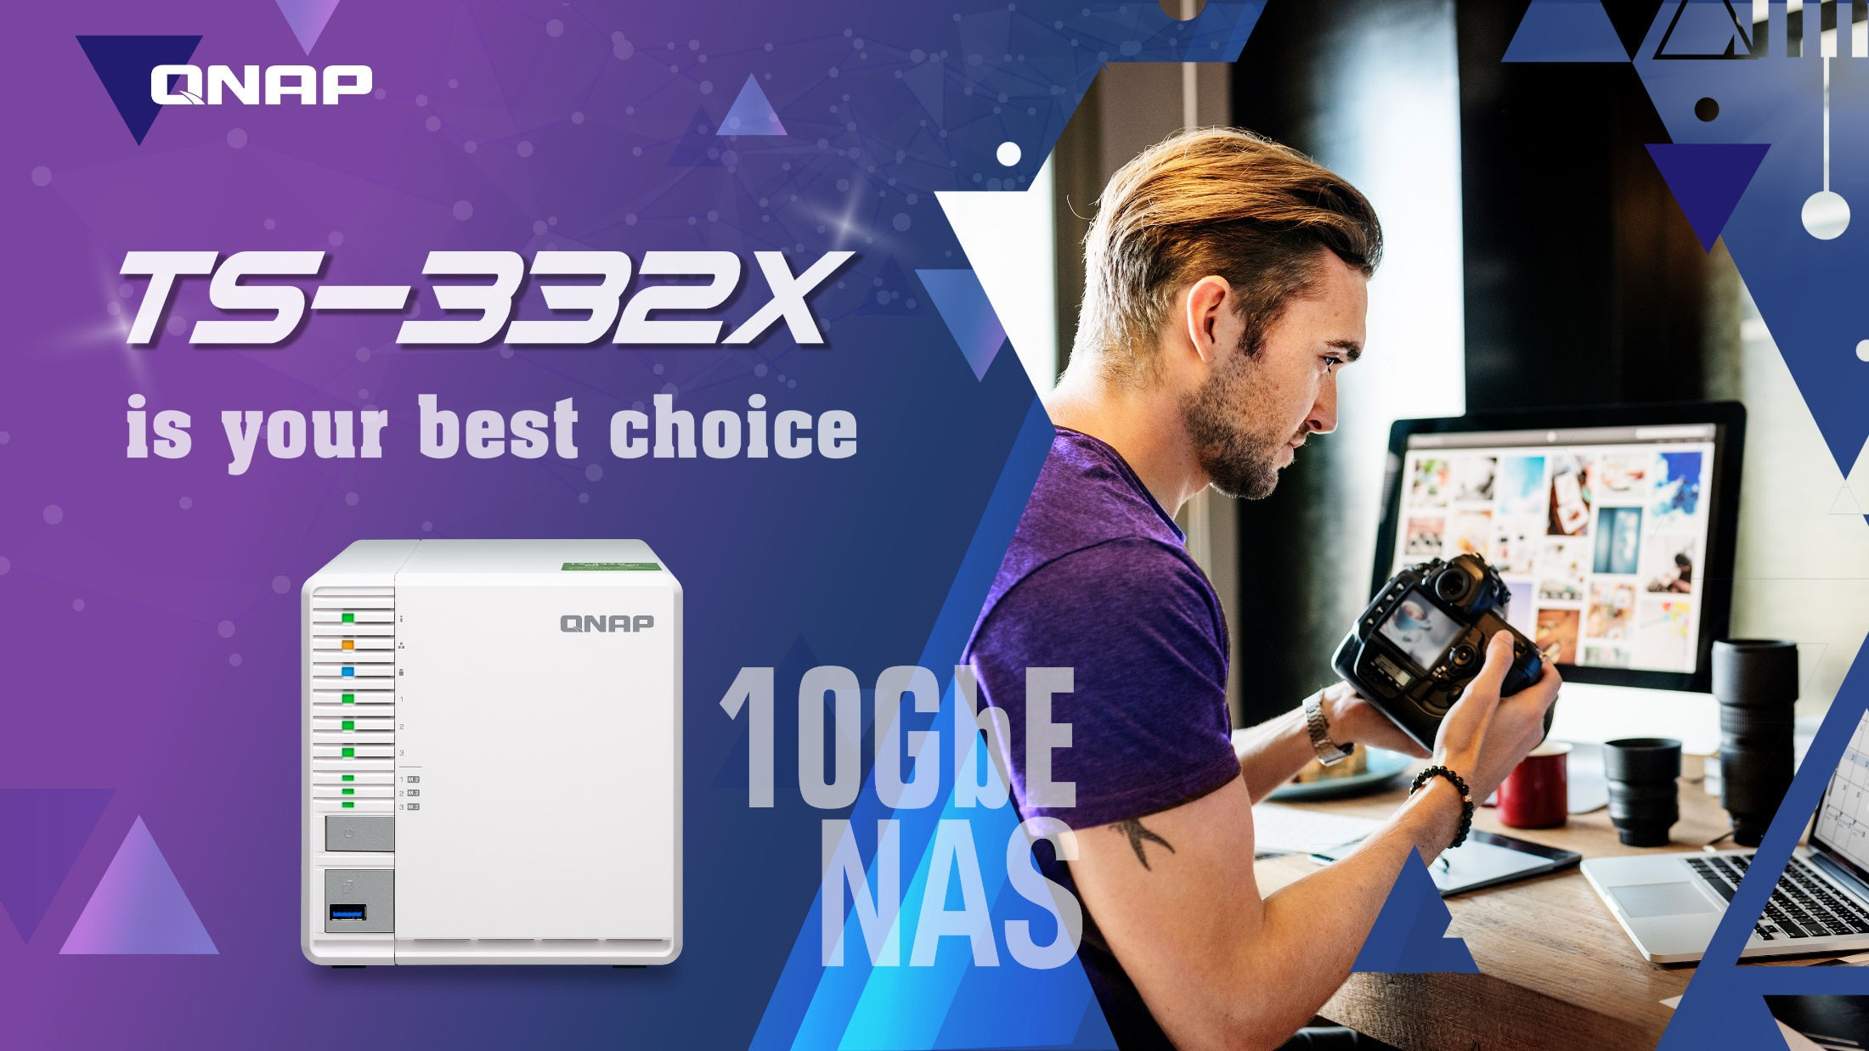
Copyright © 2018 QNAP Systems, Inc. All rights reserved. QNAP® and other names of QNAP Products are proprietary marks or registered trademarks of QNAP Systems, Inc. Other products and company names mentioned herein are trademarks of their respective holders.

