Slide 1
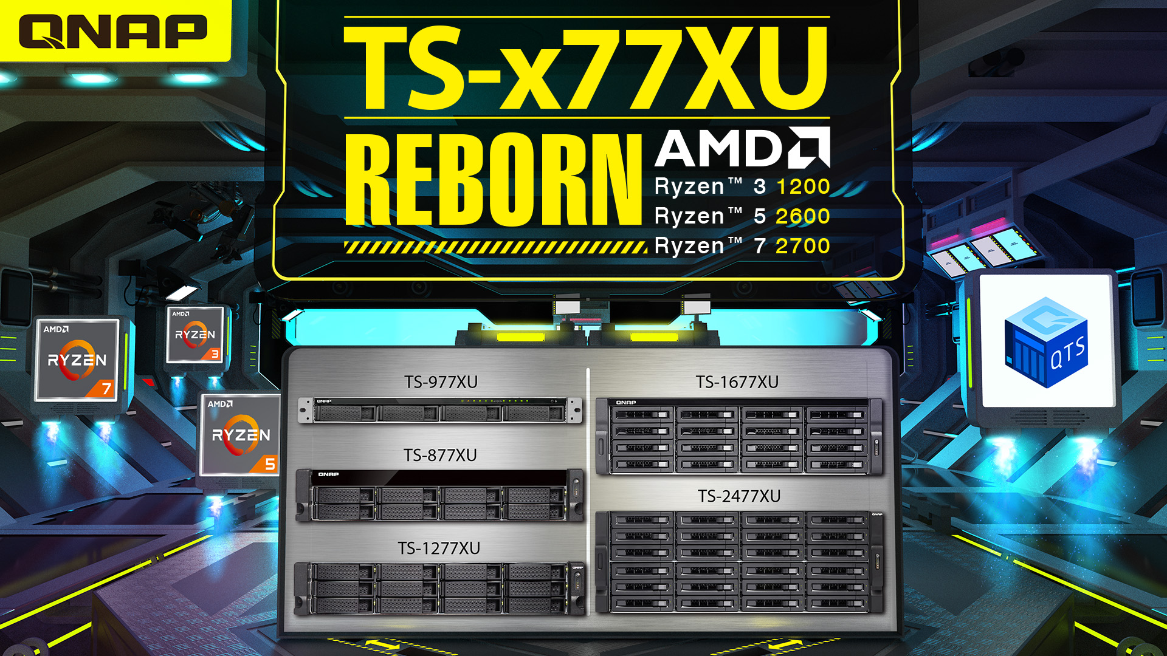

Slide 2
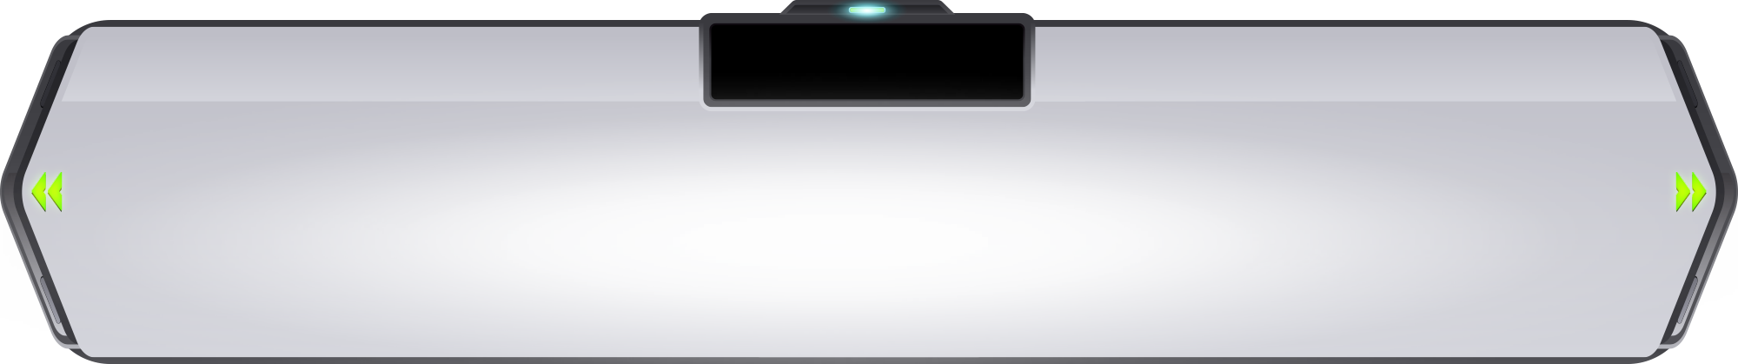
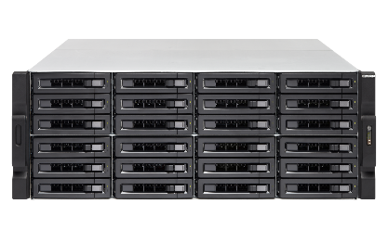
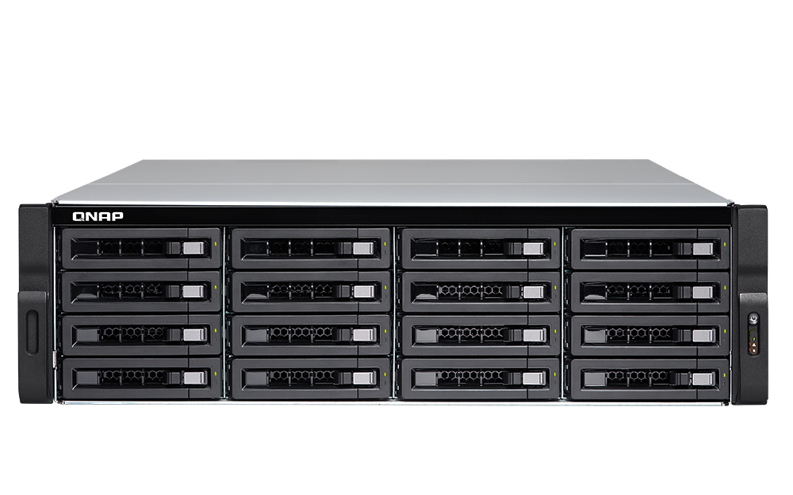




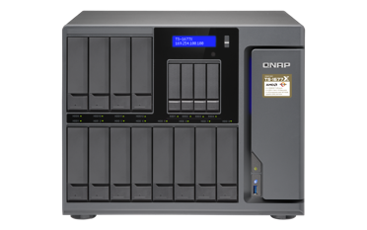
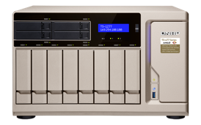
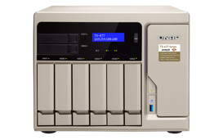
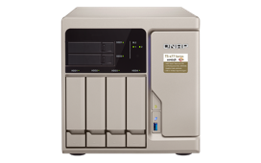
New to the Ryzen NAS Family
New
TS-x77XU rackmount NAS
2 x SFP+ 10G Mellanox CX4 SmartNIC
TS-2477XU-RP
TS-1677XU-RP
TS-1277XU-RP
TS-877XU
TS-877XU-RP
TS-977XU
TS-977XU-RP
2 x 10GBASE-T
TS-x77 desktop NAS
TS-1677X
TS-1277
TS-877
TS-677
Notes:
原標題: Ryzen 戰線成員全員到齊

Slide 3







TS-x77XU Reborn
Ryzen 1700
# of CPU Cores: 8
# of Threads: 16
Max Boost Clock: 3.7 GHz
Base Clock: 3 GHz
Default TDP / TDP: 65 W
Ryzen 2700
# of CPU Cores: 8
# of Threads: 16
Max Boost Clock: 4.1 GHz
Base Clock: 3.2 GHz
Default TDP / TDP: 65 W
Ryzen 1600
# of CPU Cores: 6
# of Threads: 12
Max Boost Clock: 3.6 GHz
Base Clock: 3.2 GHz
Default TDP / TDP: 65 W
Ryzen 2600
# of CPU Cores: 6
# of Threads: 12
Max Boost Clock: 3.9 GHz
Base Clock: 3.4 GHz
Default TDP / TDP: 65 W

Slide 4


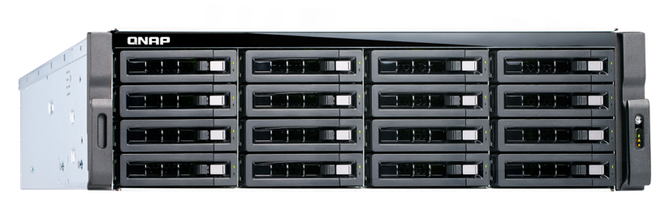
Coming Soon
TS-877XU-RP-2600-8G
Ryzen 5 2600, 8GB RAM (2x 4GB)
TS-877XU-1200-4G
Ryzen 3 1200, 4GB RAM (1x 4GB)
8-bay
TS-877XU-RP-1200-4G
Ryzen 3 1200, 4GB RAM (1x 4GB)
TS-1277XU-RP-2600-8G
Ryzen 5 2600, 8GB RAM (2x 4GB)
12-bay
TS-1277XU-RP-1200-4G
Ryzen 3 1200, 4GB RAM (1x 4GB)
TS-1677XU-RP-2700-16G
Ryzen 7 2700, 16GB RAM (2x 8GB)
TS-1677XU-RP-1200-4G
Ryzen 3 1200, 4GB RAM (1x 4GB)
16-bay
TS-1677XU-RP-2600-8G
Ryzen 5 2600, 8GB RAM (2x 4GB)

Slide 5




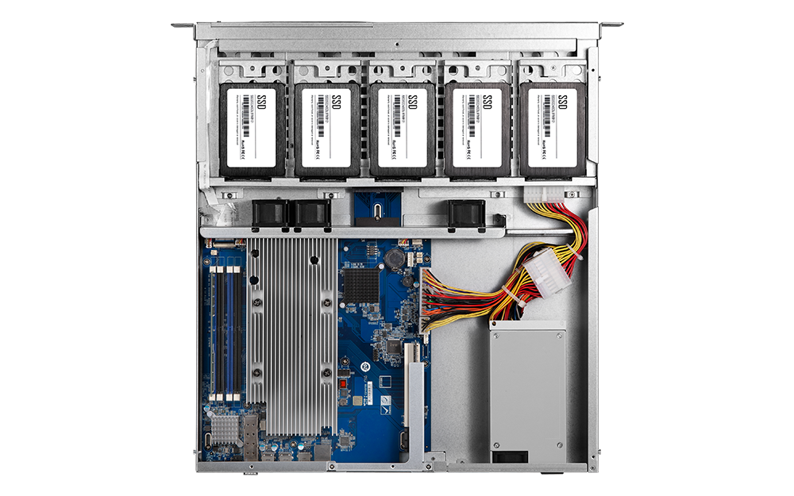

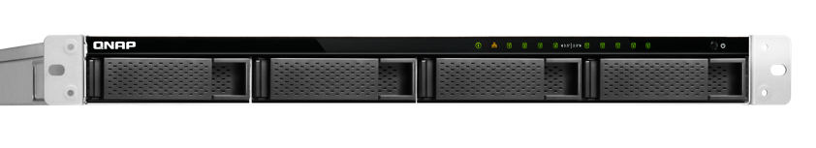
Complete product portfolio – 1U 9-bay
Single PSU
250W
Redundant PSU
2 x 300W
TS-977XU-1200-4G
Ryzen 3 1200, 4GB RAM (1x 4GB)
TS-977XU-RP-1200-4G
Ryzen 3 1200, 4GB RAM (1x 4GB)
TS-977XU-RP-2600-8G
Ryzen 5 2600, 8GB RAM (2x 4GB)
9-bay
5 x SSD (inside)
4 x HDD
Ready on Sep.- Oct.
Notes:
白手起家款

Slide 6
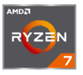
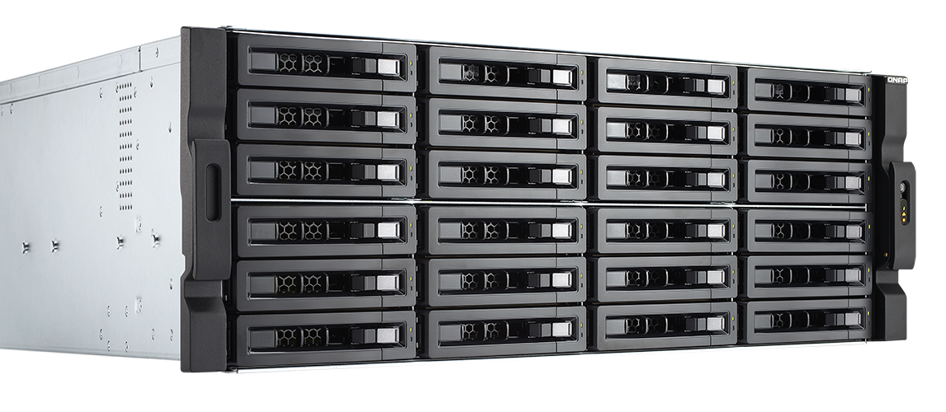
Complete product portfolio – 4U 24-bay
Redundant PSU
2 x 800W
TS-2477XU-RP-2600-8G
Ryzen 5 2600, 8GB RAM (2x 4GB)
TS-2477XU-RP-2700-16G
Ryzen 7 2700, 16GB RAM (2x 8GB)
24-bay
Ready on Sep.- Oct.
Notes:
白手起家款

Slide 7
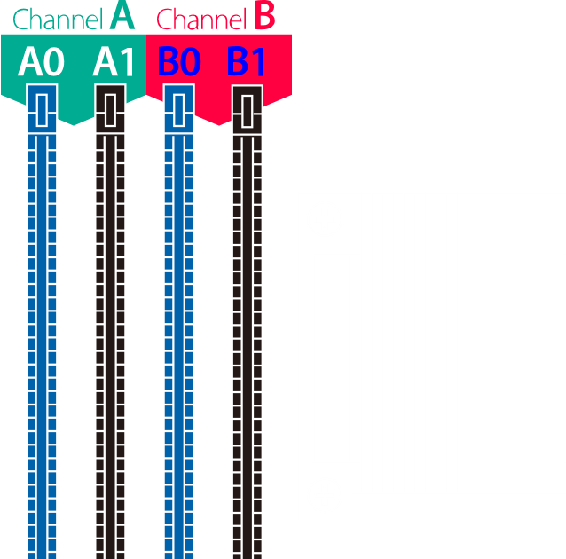
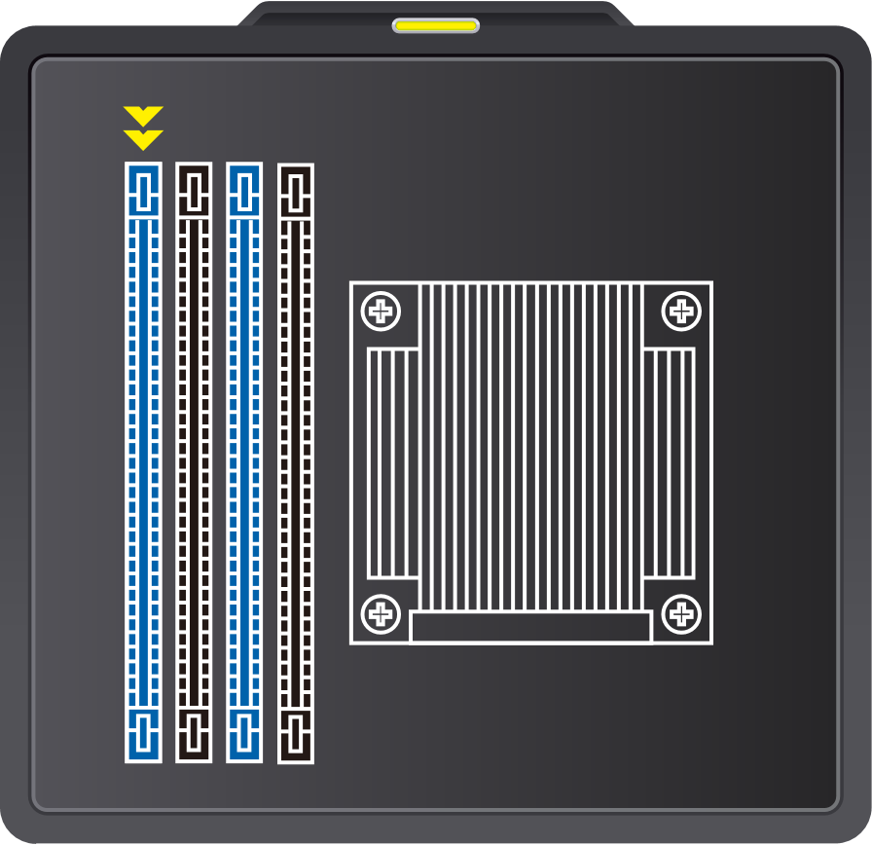
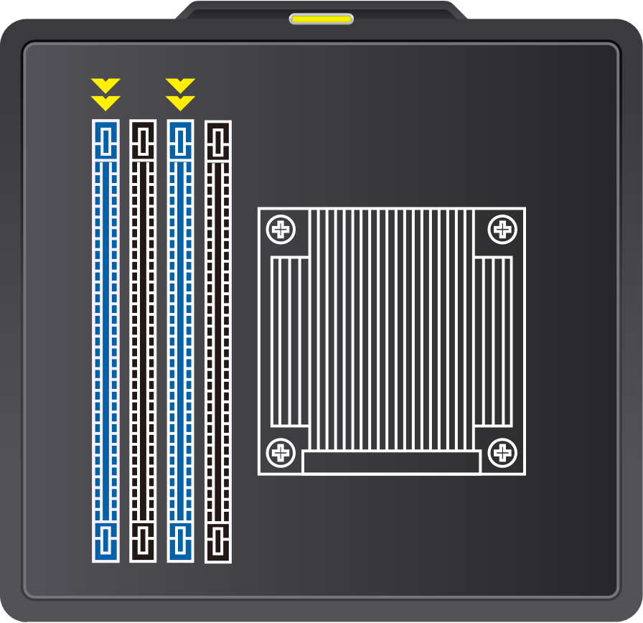
Supports up to 64 GB Memory
Supports Dual-channel and Long-DIMM x4
Installing memory in pair to take advantage of dual-channel
One module
Two modules
Install in A0 slot
Install in A0 and B0 slots

Slide 8
TS-x77XU Memory Accessories
Ordering P/N | Specification
RAM-4GDR4A1-UD-2400 | DDR type: DDR4(288PIN) Capacity: 4 GB Manufacturer: ADATA Frequency: DDR4-2400 Manufacturer P/N: AD4U2400W4G17-BSSZ
RAM-8GDR4A1-UD-2400 | DDR type: DDR4(288PIN) Capacity: 8 GB Manufacturer: ADATA Frequency: DDR4-2400 Manufacturer P/N: AD4U240038G17-BSSZ
RAM-16GDR4A1-UD-2400 | DDR type: DDR4(288PIN) Capacity: 16 GB Manufacturer: ADATA Frequency: DDR4-2400 Manufacturer P/N: AD4U2400316G17-BSSZ

Slide 9

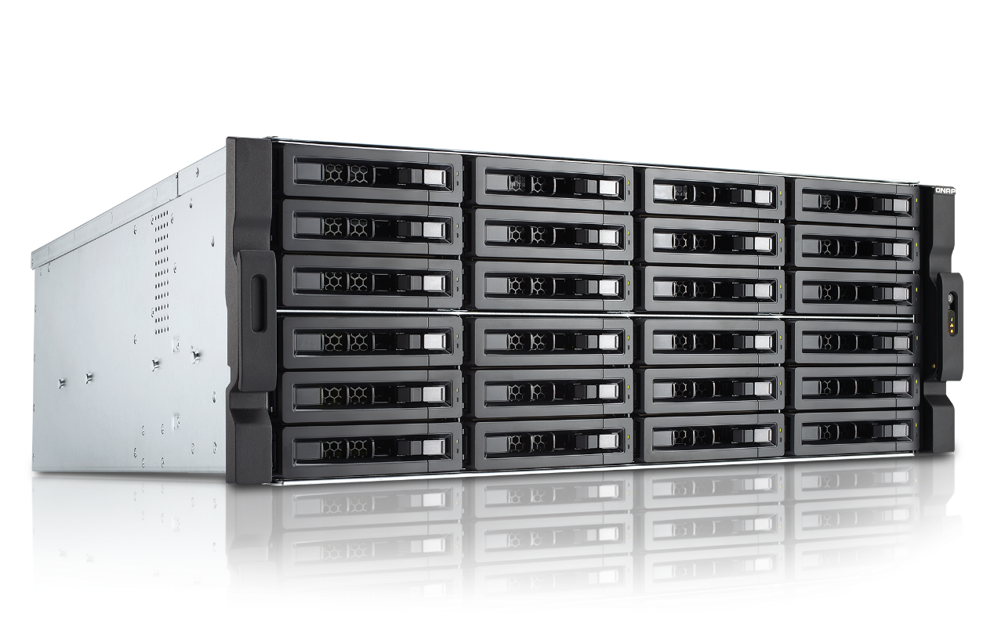
Customized Memory
High memory NAS for your project
16 GB, 32GB or 64GB for each SKUs
( 4GB x 4 )
( 8GB x 4 )
( 16GB x 4 )
16
32
64
CTO SKUs
have longer lead time

Slide 10
TS-x77XU
Hardware
Introduction

Slide 11
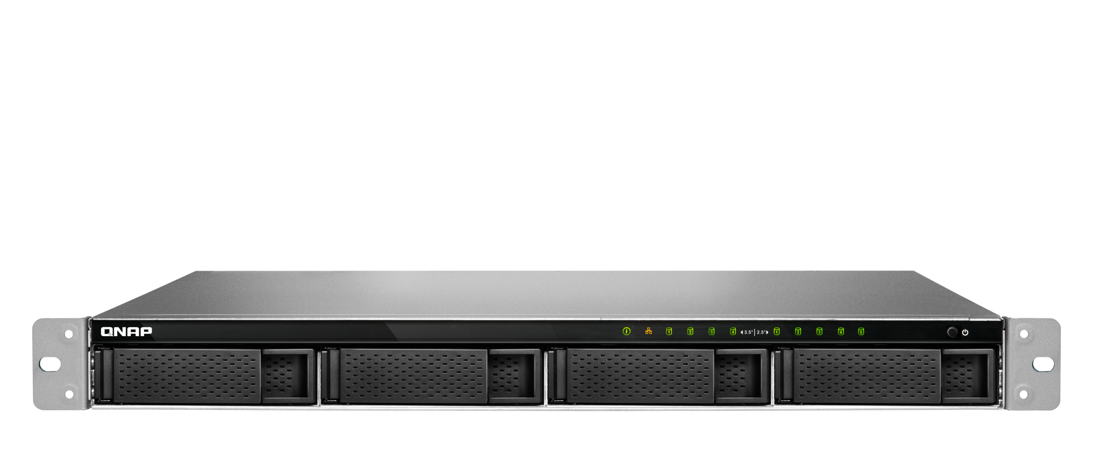
Enjoy Qtier and SSD cache in a 1U NAS
LED indicators:
System status, network, disks
5 x 2.5”
SATA 6Gb/s SSD ports
4 x 3.5”SATA 6Gb/s HDD/SSD ports
Notes:
白手起家款

Slide 12
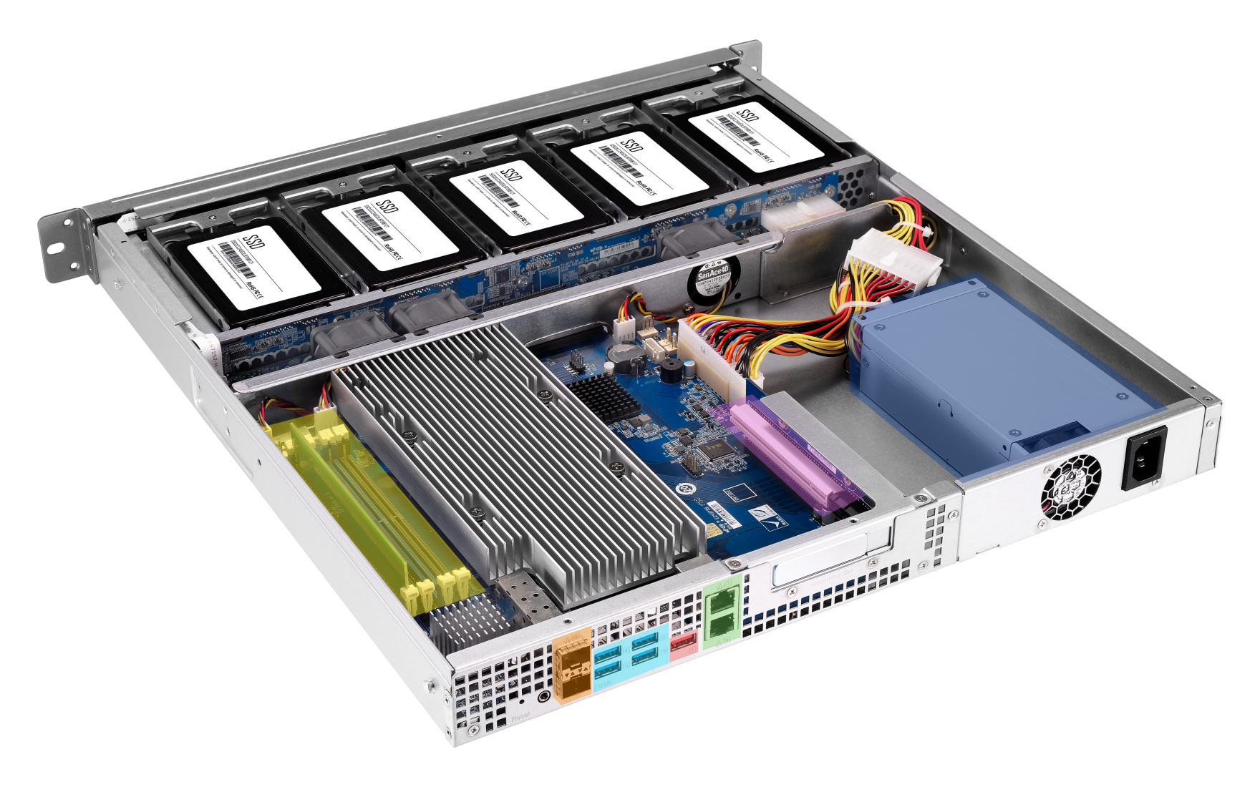
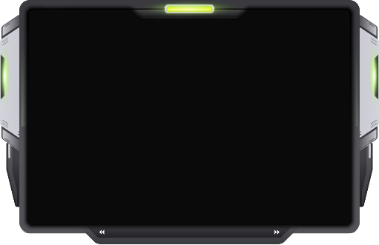
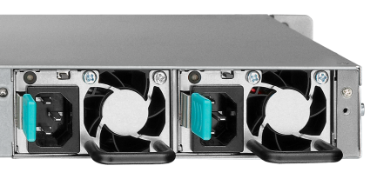


1U TS-977XU/TS-977XU-RP rear view
Low profile PCIe 3.0 x16 slot
250W or
2 x 250W
Redundant PSU
4 x DDR4
Long-DIMM slots
Single PSU
4 x USB 3.0 ports
2 x 10GbE SFP+ ports
2 x GbE RJ45 ports
USB 3.1 Gen2 (10G) port
Notes:
白手起家款

Slide 13

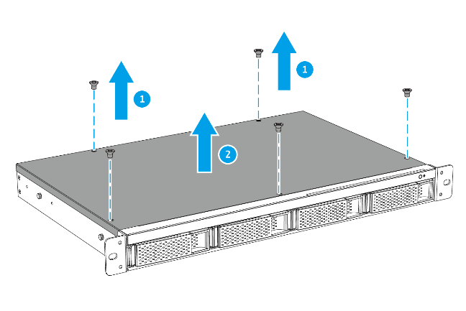
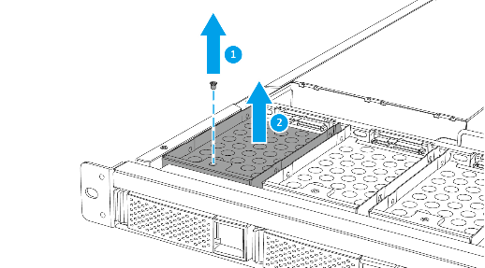
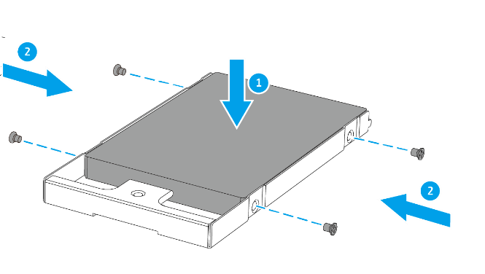
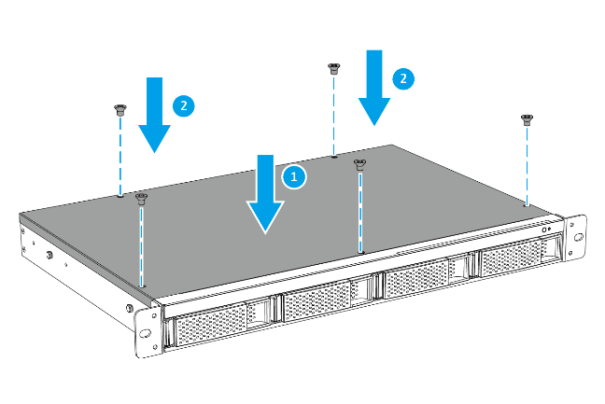
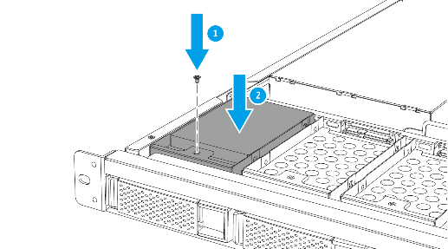
TS-977XU SSD Installation
01
02
03
04
05

Slide 14
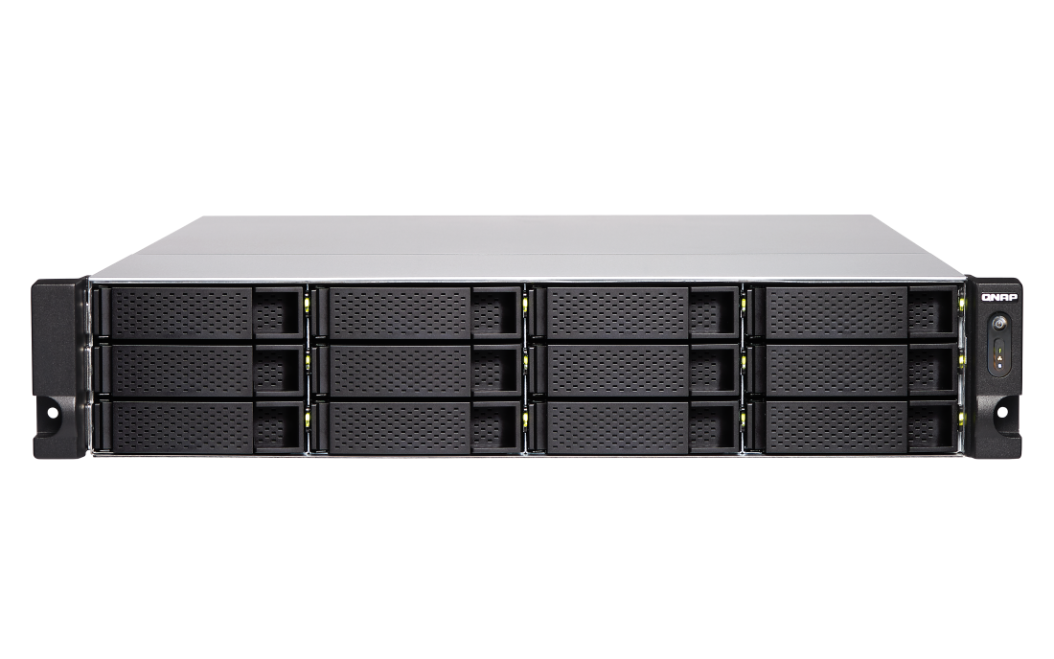
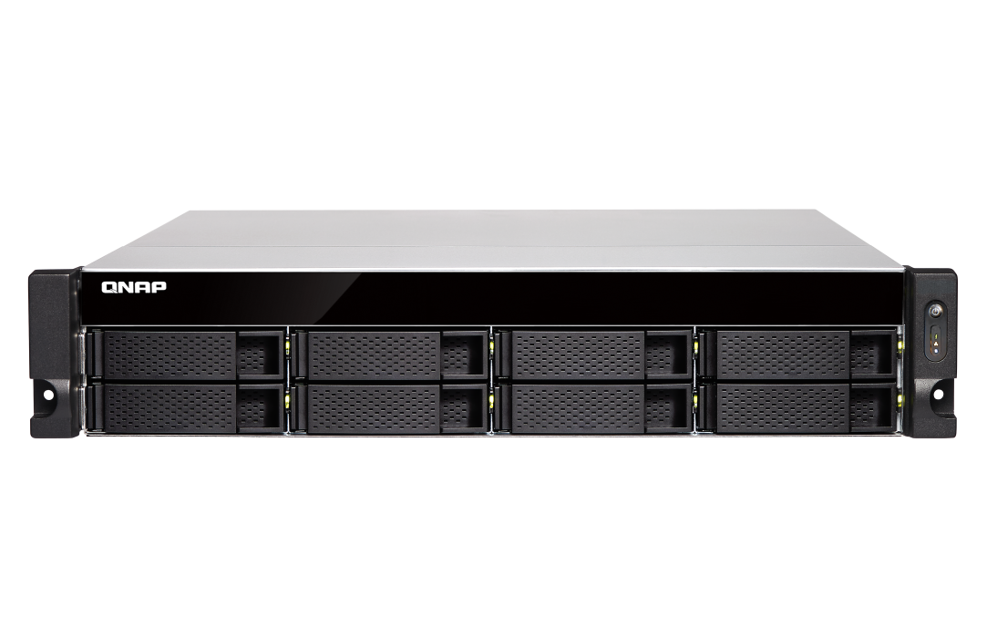
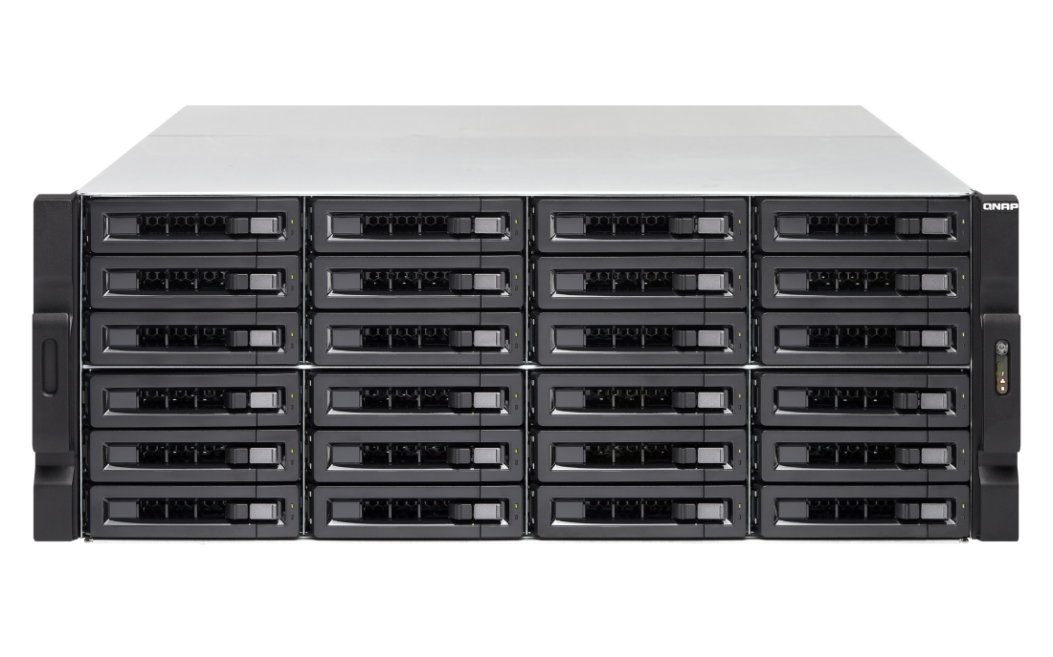
2/3/4U TS-x77XU Front View
24/ 16/ 12/ 8 x 3.5”SATA 6Gb/s HDD/SSD Ports
TS-1277XU / TS-1277XU-RP
TS-877XU / TS-877XU-RP
TS-2477XU-RP
TS-1677XU / TS-1677XU-RP
Notes:
白手起家款

Slide 15

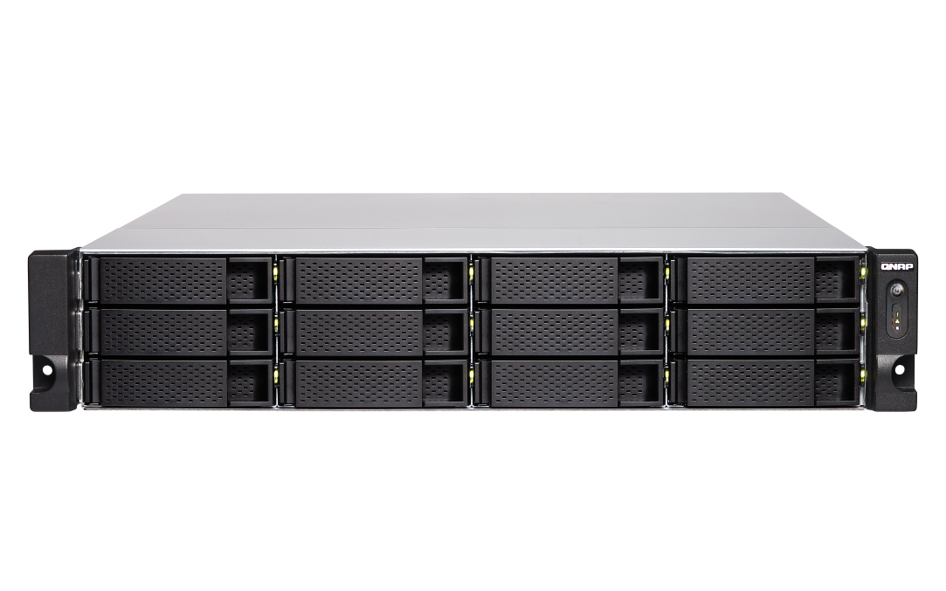

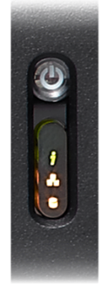
2/3/4U TS-x77XU Front View
2U
Power switch
LED indicators: system status, network, external expansion enclosures, disks
4U
3U
Notes:
白手起家款
2U/3U

Slide 16
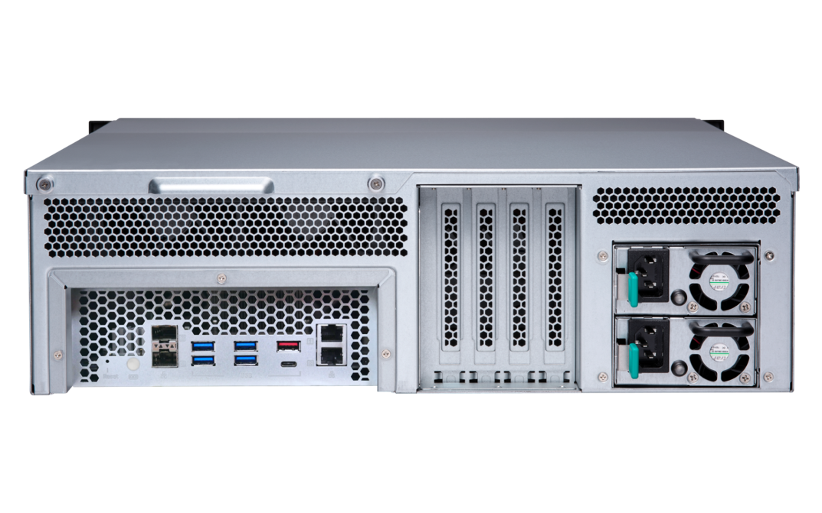

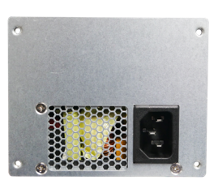
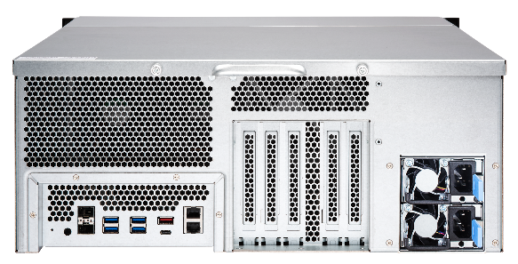
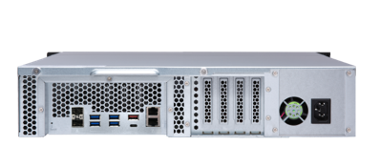
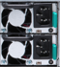
2/3/4U TS-x77XU Rear View
2 x 10Gb SFP+ SmartNIC ports
4 x USB 3.0
Type-A ports
2 x 1Gb
Network ports
Single PSU
Redundant PSU
USB 3.1 Gen2 (10G) Type-A & Type-C ports
8-bay
Single PSU
24-bay
Redundant PSU
Redundant PSU

Slide 17
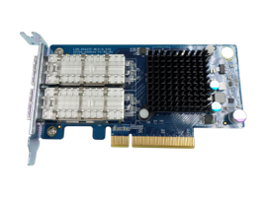
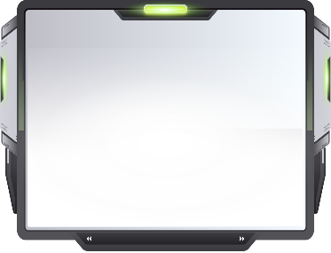

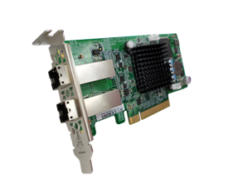
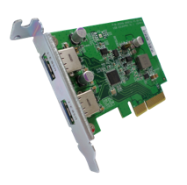
Industry-leading PCIe expansion options
QM2 provides 10GBASE-T port and/or M.2 SSD slots for SSD cache or Qtier tiered storage for optimized storage performance.
40GbE/10GbE and wireless network expansion cards
provide high bandwidth, low latency, or wireless AP functionality.
USB 3.1 Gen 2 expansion cards provide 10Gb/s for external USB devices. Type-A port is also backward compatible with USB 3.0/2.0 devices.
SAS expansion cards are for adding support of REXP expansion units for up to 40 additional SAS/SATA drives.

Slide 18
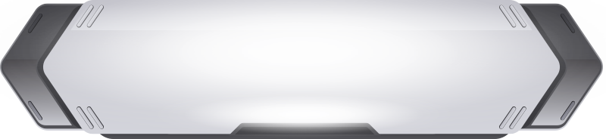
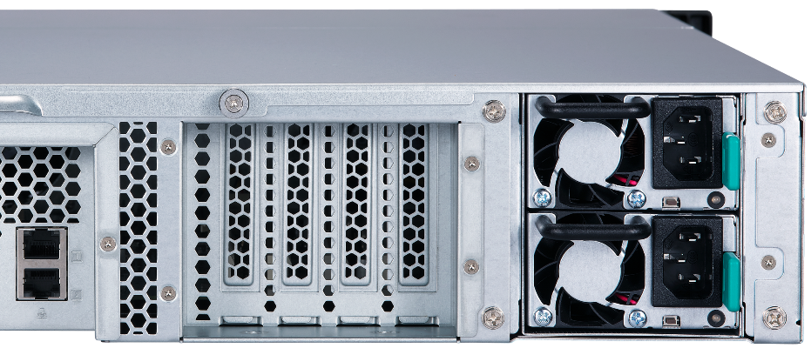
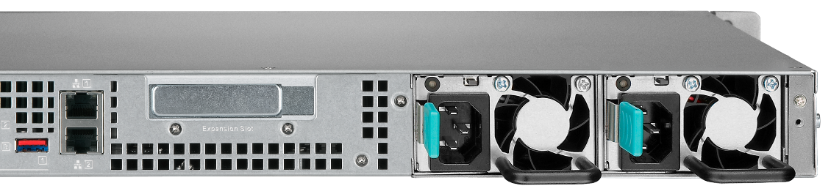
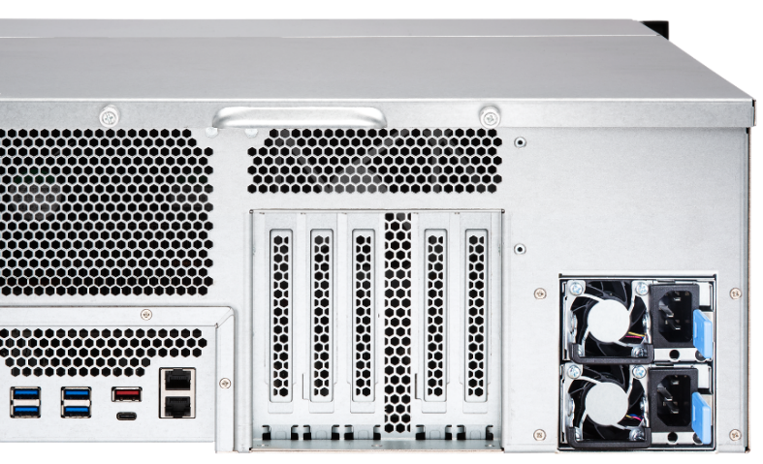
TS-x77XU PCIe slots
1/2U: : low profile
4
3
2
1
1
3/4U: full height
4
3
2
1
4
3
2
1
Notes:
這頁需要

Slide 19
Flexible PCIe Allocation (2/3U)
PCIe x8
PCIe x8
PCIe x4
PCIe x4
PCIe x4
PCIe x4
#4
#3
#2
#1
#4
#3
#2
#1
2 x PCIe x8 slot (CPU)
4 x PCIe x4 slot (CPU)
Occupied
Empty

Slide 20
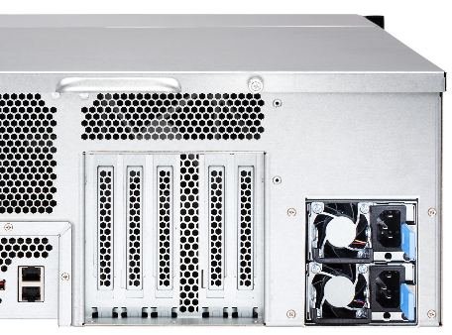
Flexible PCIe Allocation (4U)
PCIe x8
PCIe x8
PCIe x4
PCIe x4
PCIe x4
PCIe x4
#4
#3
#2
#1
#4
#3
#2
#1
2x PCIe x8 slot (CPU)
4 x PCIe x4 slot (CPU)
Occupied
Empty

Slide 21

GPU card slots and supported dimensions
 | Slot | size W x H x L (mm)
TS-877XU TS-877XU-RP | Slot 2 | 37 x 68.9 x 214
 | Slot 4 | 37 x 68.9 x 214
TS-1277XU TS-1277XU-RP | Slot 2 | 37 x 68.9 x 214
 | Slot 4 | 37 x 68.9 x 214
TS-1677XU TS-1677XU-RP | Slot 2 | 38.5 x 111 x 214
 | Slot 4 | 38.5 x 111 x 214
TS-2477XU-RP | Slot 2 | 55 x 138 x 312
 | Slot 3 | 55 x 138 x 312
W
H
L

Slide 22
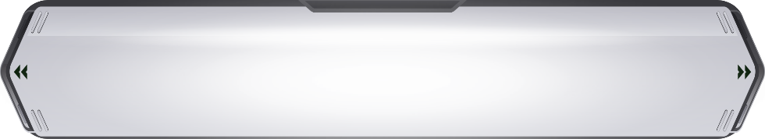
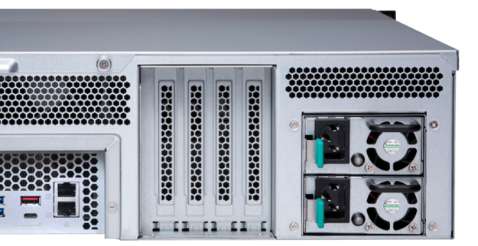



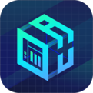
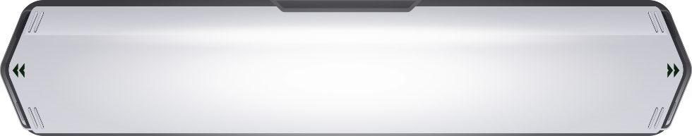
Do more with graphics cards
Support full-high GPU card which required external power
3/4U NAS 500W+ power supply
QuAI
TS-1677XU-RP
Support half-high GPU card and required no external power: NVIDIA GT1030, etc.
2U NAS 250W/300W power supply

Slide 23








Add-on GPU Card Applications
QTS/vQTS
Computing Acceleration
Virtualization Station
GPU Passthrough
AI
Computing Acceleration

Slide 24








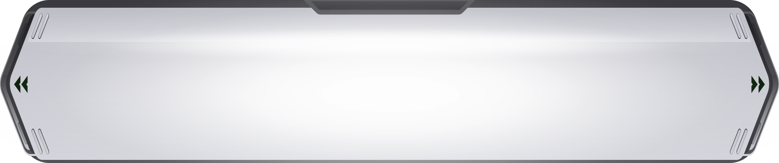


Ride the AI wave with "QuAI"
QNAP QuAI
AI Developer Package
QuAI is intended for data scientists and developers to quickly build, train, and optimize their AI models on QNAP NAS.
+
+
=
AI
QNAP NAS
GPU accelerated computing
QuAI

Slide 25



Smooth Video Experience
Virtualization Station
HybridDesk Station, Linux Station
QVR Pro Client (HD Station)
Video Station
Plex Media Server

Slide 26





GPU boosts image/video processing
For OpenGL & DirectX applications
H/W accelerated with GPU to lower CPU usage.
w/ GPU
w/o GPU
Tested at QNAP Lab. Results vary by actual environments.
NAS：TS-1677X Ryzen 1700
QTS 4.3.4, Seagate ST4000VN0001
nVIDIA GeForce GTX 1060 6GB

Slide 27



Tool-less rail kit
RAIL-B02
RAIL-A03-57
RAIL-A02-90
Supported NAS:
TS-877XU/1277XU
Max. Load: 20kg
Supported NAS:
TS-1677XU
Max. Load: 57kg
Supported NAS:
TS-2477XU
Max. Load: 90kg

Slide 28


Hardware upgrade made easy
Pull it out and lift
up the cover

Slide 29


More Efficient Backup with USB 3.1 Gen 2
2X
USB 3.1
TYPE-C
SPEED UP
10Gb/s
TYPE-A
5Gb/s
USB 3.0
USB 3.1 Gen 2
Notes:
Type-A是紅色的

Slide 30




Super high capacity surveillance
Surveillance Station 5.1
Default: 8 free channels
Max: 80 CH (optional license)
QVR Pro
Default: 8 free channels
Max: 128 CH (optional license)
QUSBCam2
Up to 1080p USB Webcam recording

Slide 31



10GbE SmartNIC with offload function
Buit-in Mellanox ConnectX-4 Lx 10GbE SmartNIC
Supports iSER

Slide 32

Offload tasks from CPU with iSER
iSER (iSCSI Extension for RDMA)
Without iSER
Socket Layer and Network Drivers
Socket Layer and Network Drivers
Memory
Ethernet
Ethernet
Memory
With iSER
Socket Layer and Network Drivers
Socket Layer and Network Drivers
Memory
Ethernet
Ethernet
Memory

Slide 33

Comes with two 10GbE Ports
10GbE x 2 (Sequential)
1800
Tested in QNAP Labs. Figures may vary by environments.
Test environment:
NAS: TS-1677XU-1700-16G with QTS 4.3.4
Volume type: RAID 5; 16 x Intel S3500 240GB SSDs (SSDSC2BB240G4)
1200
1561
1560
600
0
Read
Write
(MB/s)

Slide 34

Virtual QTS
vQTS
One-for-many

Slide 35







Running vQTS via Virtualzation Station
Conventional VM:
Windows, Linux, UNIX
Virtual QTS - vQTS
Virtualization
Station

Slide 36





One-for-many
It allows IT admins to flexibly allocate system resources to different departments or groups for different privileges and applications.
Management
Finance
Customer
service
Engineers

Slide 37



Dedicated resource allocation
Allocation of dedicated HW resources
(CPU, RAM, storage space, and Internet) ensures performance quality.
Quad-core
4 GB
250 GB
1
Octa-core
8 GB
500 GB
2

Slide 38



The best platform for vQTS
Numbers of allowed vQTS instances are based on the numbers of cores of the physical CPU.
AMD Ryzen™ 5 2600 6-core =
2
4
AMD Ryzen™ 7 2700 8-core =

Slide 39




QTS & virtualization increase productivity
QTS 4.3.5
Storage & Snapshot Manager, and new virtualization network functions
Supports Windows/Linux VMs and containers
Virtualization
Station
Container
Station

Slide 40
Double the ROI of purchasing SSDs
QTS 4.3.5
SSD Over-provisioning, Snapshot Remote Restore

Slide 41





SSD Usage In Network Attach Storage
SSD can provide high random IOPS for multi-clients sync and business applications that can not be achieved by HDD.
In 2018, SSD price also comes close to the sweet spot.
Besides choosing the right SSD, you should also choose right NAS!
SanDisk evaluate the
256 GB SSD per GB price in 2018 is only 30% compare to 2013
Drive Type | Sequential Access (MB/s) | Random Access (IOPS)
HDD | 100 | 350
SSD | 300 | 60000
https://www.sandisk.com/business/datacenter/resources/white-papers/the-ssd-enabled-pc-total-cost-of-ownership
SanDisk‘s Statistic for Global SSD/HDD Price Trend

Slide 42
QNAP SSD Global Cache and Qtier
IT manager can have different SSD configurations with TS-x77XU
For real-time performance boost, deploy SSD Global Cache or All flash storage
For continued data tiering between hot and cold data, deploy the Hybrid Storage Qtier™ Auto Tiering
SSD Cache let all data enter cache and read hot data from the storage in real time
Qtier utilizes SSD space and let data block be reallocated based on hot or cold in the storage
SSD Cache
Volume
Block-based LUN
Volume
Block-based LUN
Qtier Pool SSD Tier
Qtier Pool HDD Tier
Storage Pool
SSD
SSD
HDD
HDD
HDD
HDD
HDD
HDD

Slide 43


Different SSD has Different Performance!
SSD Write amplification cause performance degradation
In QNAP Lab, engineer use FIO to test different SSD, and all SSD have showed consisted write performance degrade.
Different SSD's controller and Garbage Collection Algorithm will effect the long term performance
Different SSD in QNAP NAS’s FIO consisted performance (IOpattern: RW-4K):
How can storage vendor help to ensure SSD has expected performance ?
Notes:
43

Slide 44


What is SSD Over-provisioning
SSD Over-provisioning reserves space in the SSD to decrease write amplification & increase consisted performance and endurance.
Reason: to avoid Garbage Collection in any giving point of time
N | N
N | N
N | N
With limited OP, 4 additional write is needed. With more OP the movement is not required.
N | New D
D | Valid D
 | Invalid D
 | OP
 | OP
D | D
D | D
D
D
D | D
D | D
D | D
D | D
N | N
N | N
N | N
6 pages of new data cannot all be stored to the SSD
Unless the SSD conduct GC internally first
With more reserved block, the GC is not required
Notes:
44

Slide 45


The Advantage of Software-defined SSD Extra Over-provisioning
With QTS System, user can assign more OP to the SSD RAID.
At QNAP Lab, the effect of over-provisioning can not only be observed on single consumer-level Samsung 850 Pro to gain the performance same as data center SSD, but also be seem on SSDs as a RAID.
2*Micron M1100 RAID 1 Random Write IOPS with Dynamic OP
Above: Samsung 850 Pro as Single Disk
Below: Micron M1100 as RAID 1
FIO configuration: runtime=1800 ioengine=libaio direct=1 rw=randwrite bs=4k numjobs=1 iodepth=32
Notes:
45

Slide 46


Choose SSD is Hard, Choose QNAP is Simple
IT managers' biggest challenges in deploying SSD is to measure the SSD performance and how it can solve storage bottleneck.
With QNAP SSD Profiling Tool, users can not only set OP, but further test SSD RAID performance with different OP amount.
IT managers can decide the best practice directly on production site
Notes:
46
73652517

Slide 47

Using SSD Profiling Tool on TS-x77XU

Slide 48

QNAP Global SSD Cache
The QNAP SSD Cache can be applied to multiple volume / LUN
Read-Only ➔Copy frequently used data to SSD
Read-Write ➔Not only copy data, new data can also be temporarily stored in SSD
(New)Write-Only ➔ Only new data will be written into the cache
Cache Type
How Read-write Cache work:
Data from clients and storage will both be cached
Write
Write
Read
Read
SSD
IO Intensive
Application
When SSD Space not enough
HDD

Slide 49


The Write-only Cache Increase ROI of
SSD Cache with high Writing Demand
Write-only cache is promoted by Microsoft
for endurance control.
QNAP believe Write-only Cache can increase the ROI of purchasing SSD in below scenario:
Writes
are cached
Reads
are NOT
File Server focusing on write operations
Database with more write operation (Such as IOT monitoring server)
Use high endurance SSD (Intel Optane™) with other SSD
NVMe
NVMe
SSD
SSD
SSD
SSD
https://docs.microsoft.com/en-us/windows-server/storage/storage-spaces/understand-the-cache
Notes:
49

Slide 50

Qtier (Auto-Tiering) Increase Capacity and
Performance at the Same Time
Beside SSD Cache,
Qtier™ can migrate
data between SSD and
HDD directly
SSD capacity can be
utilized with limited
memory requirement.
Hot Data
Before Tiering
Data place not optimized
Warm Data
Cold Data
Access Pattern Change
Start Tiering
Qtier
Engine
After Tiering
Performance optimized
Notes:
50
93325809

Slide 51
Qtier 2.0 IO Aware tiering for real time performance boost
Beside tiering on
schedule, Qtier now
can simulate SSD
Cache behavior
It can utilize SSD
capacity while boost
performance in real
Time thus increase SSD
ROI
Data
Blank
C、D data block be written to HDD due to SSD full
D data block be promoted as access frequency increase
A
B
A
B
D
SSD Tier
SSD Tier
C
D
C
HDD Tier
HDD Tier
Block | Hit
C | 50
D | 50
Block | Hit
C | 50
D | 200
Notes:
51
93325809

Slide 52
TS-x77XU SSD Multiple Configurations
In addition to acting as a backup server, SSD Over-provisioning, Global Cache and Qtier let TS-x77XU be deployed as production server
With 5 x 2.5”
SATA 6Gb/s SSD
1U Rackmount can
use SSD too!
Scenario | File Server | Web, Application, Virtualization Server | Synchroni-zation, Vi-deo Editing | Surveillance, Backup, Log Server | Business-Critical Database
SSD Config | Qtier™ | Qtier™ | Read-Write Cache | Write-Only Cache | SSD RAID
SSD RAID | RAID 6 | RAID 10 | RAID 5 | RAID 10 | RAID 10
SSD OP | 10% | 20% | 20% | 30% | 30%
Notes:
52

Slide 53


Businesses need lower RTO
In the survey of 300 Enterprises and SMBs at Taiwan:
60% has used Remote Replication as Backup Plan.
50% of businesses expected the recovering time should be within 1 Hour.
But also 50% of businesses experience actual recovering exceed 1 Day!
Can businesses only manually transfer data back from the remote end when disaster happen?
Data Backup Time
Disaster Happen
Server Online
TIME
Recover Point Objective
Recover Time
Objective
Taiwan IThome survey 2017
Notes:
53
39094200

Slide 54



Restore From Remote Snapshot Vault
The Snapshot Manager is now actively connected to Snapshot Vault
Support monitor and restore selected folders and files from the source NAS directly!
Both the source and destination NAS must be upgraded to 4.3.5 to support this function
Notes:
54

Slide 55




Drastically Reduce Recover Time
With 10GbE Network
The Remote Snapshot Vault Recovering is based on Ethernet service.
Using 1GbE network, recovering large data still takes hours.
Pair the Snapshot Replica Solution with 10GbE or even faster interfaces to increase both the backup and recovery speed !
Using QNAP 10GbE Switch to replace old 1GbE for reducing RTO dramatically
Notes:
55

Slide 56





The Forth Way: Snapshot Export/Import
Export a snapshot from snapshot manager or snapshot vault
Using external storage device, the exported imaged can be imported to another NAS to create new volume or LUN
The same image can also be used to revert source volume or LUN
When network speed is limited, user can still import snapshots for reverting
Snapshot
Reverting
Notes:
36588464

Slide 57


With QTS 4.3.5 Power of Storage:
Software-defined SSD Extra OP
Measure & set unique over-provisioning
amount on the NAS
01
SSD Global Cache & Qtier™
Using Cache or Auto Tiering to maximum SSD ROI
02
Remote Snapshot Restore
Using 10GbE network to reduce RTO
03
Notes:
36588464

Slide 58

Copyright © 2018 QNAP Systems, Inc. All rights reserved. QNAP® and other names of QNAP Products are proprietary marks or registered trademarks of QNAP Systems, Inc. Other products and company names mentioned herein are trademarks of their respective holder ​
©2018著作權為威聯通科技股份有限公司所有。威聯通科技並保留所有權利。威聯通科技股份有限公司所使用或註冊之商標或標章。檔案中所提及之產品及公司名稱可能為其他公司所有之商標 。

