Slide 2
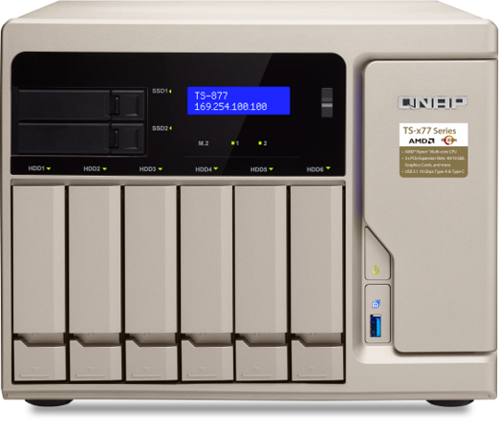
Agenda
Retail chain business surveillance requirement
Retail chain business surveillance Demo Video
Retail chain business surveillance solution
Retail chain business surveillance
Live Demo
QVR Center

Slide 3
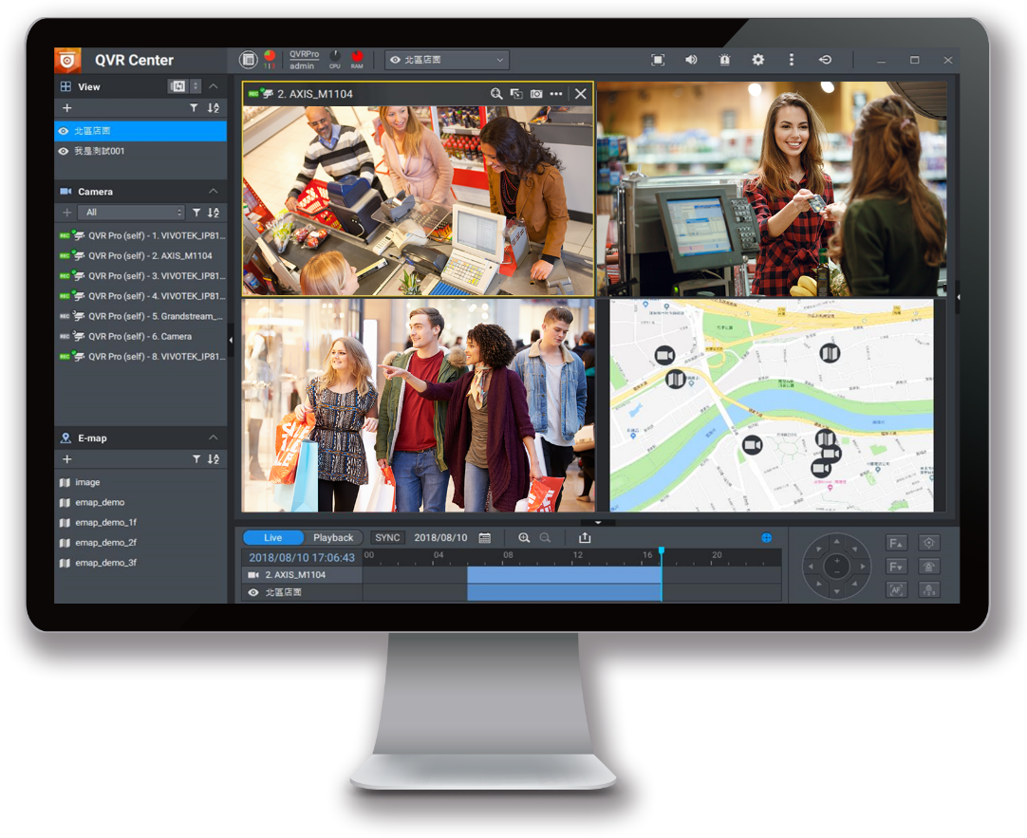
Retail chain business surveillance requirement

Slide 4
Retail chain business surveillance requirement
Can event notifications from branches be seen in time to stay ahead of the situation?
How does the HQ centrally manage multiple points?
Is integration with other systems feasible?

Slide 5
Retail chain business surveillance requirement
Can QNAP manage multiple-point
surveillance equipment maintenance?
To be able to control, manage and maintain the recording servers.
How does QNAP implement a
surveillance CMS?
For different conditions, the live and recording playback of the cameras in each retail store need to be freely configurable to make sure the flexibility of monitoring.
Can QNAP handle
Event notification
management from multiple points?
When an event occurs at the branch, the headquarters needs to know the situation in time to understand the situation of each branch. If there is an incident at a certain branch, the headquarters should consider sending extra help.
Can QNAP
Integrate with other systems?
The surveillance system should provide API and URL for integration with existing POS (point of sale) and security systems.

Slide 6
Retail chain business security
Live
Live

Slide 7
Retail chain business surveillance solution - Case study
The cameras installed in each retail store are to be monitored, receive event notifications, and have the privilege to control at the headquarters.
 | Description
HQ | Monitor the live feed and video playback of the cameras in each retail store, and freely configure the camera across the server to make sure the flexibility of monitoring. Sometimes focus on the entrance of each store to understand the flow of customer, sometimes focusing on the checkout counter to make sure the checkout speed. At the same time, event notifications help understand the status of each retail point, for adjusting the company policy in a timely manner.
Branch | Supports uninterrupted recording and monitoring. Also, supports different types of cameras.
Privilege | Head of Headquarters: View all camera feeds from all chain stores. Store manager: View images of all areas inside and outside the store, warehouses, etc. General clerk: Can only watch the images in the store.

Slide 8
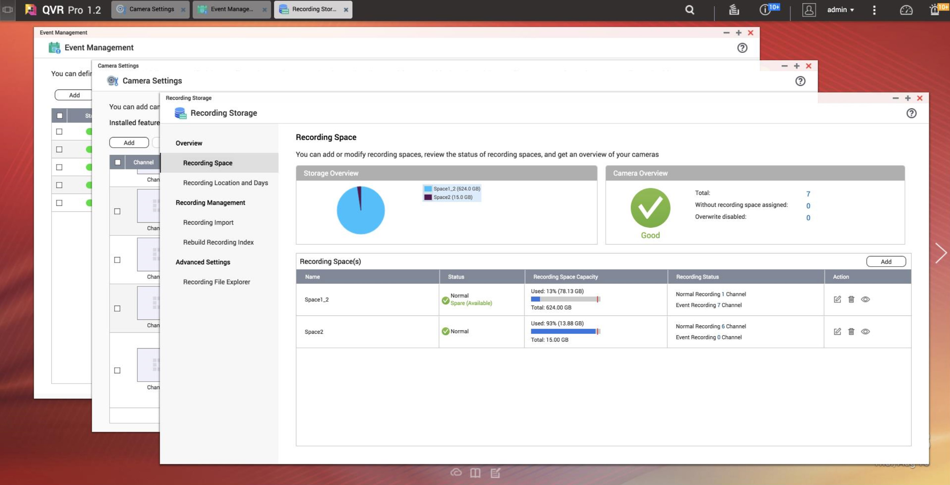
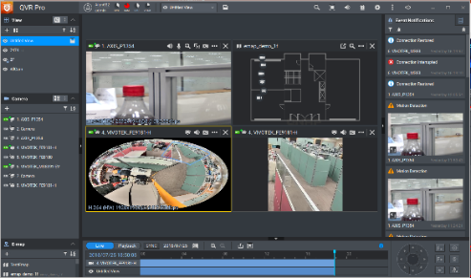
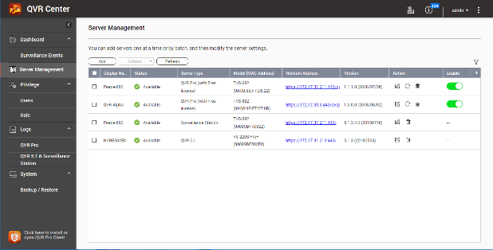
Retail chain business CMS solution
QVR Pro
QVR Pro Client
QVR Center

Slide 9
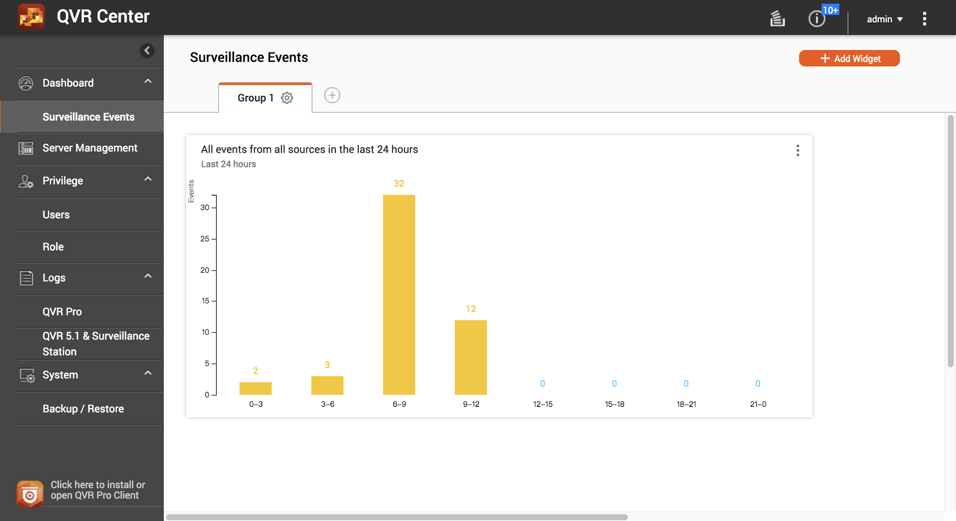
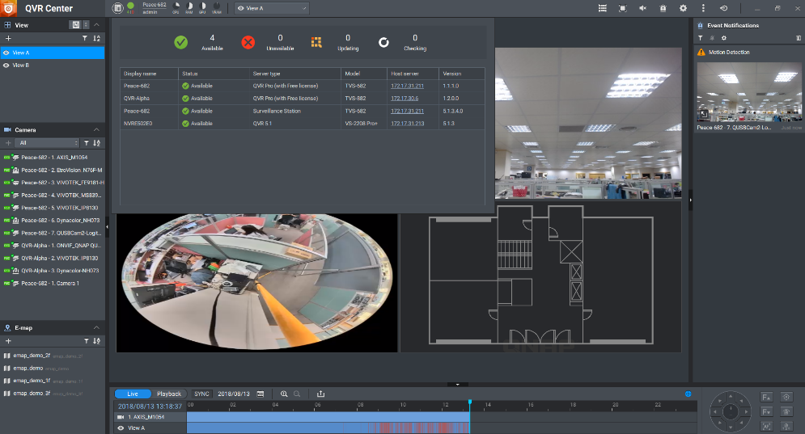
Retail chain business CMS solution
How does QNAP implement a surveillance CMS?
Dashboard
The event dashboard on the server side, as well as the server status dashboard on the client side, allows headquarters or chain store operators to learn about event information for all
stores under QVR Center or
health information for all
machines. The status is clear
at a glance, no need to check
them separately.

Slide 10
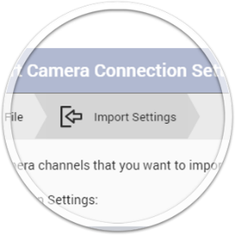
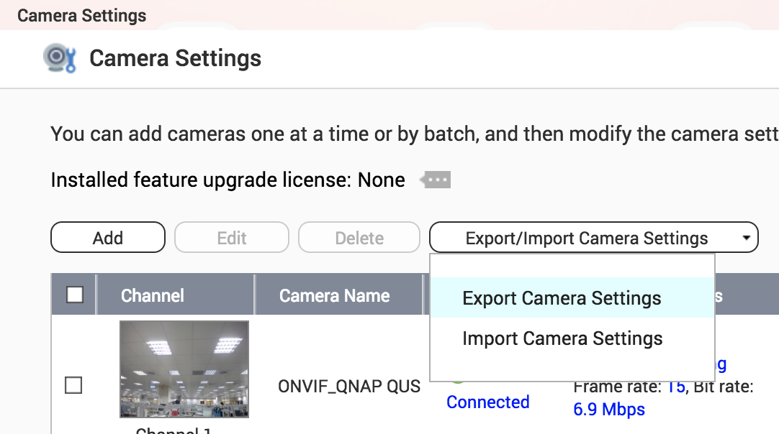
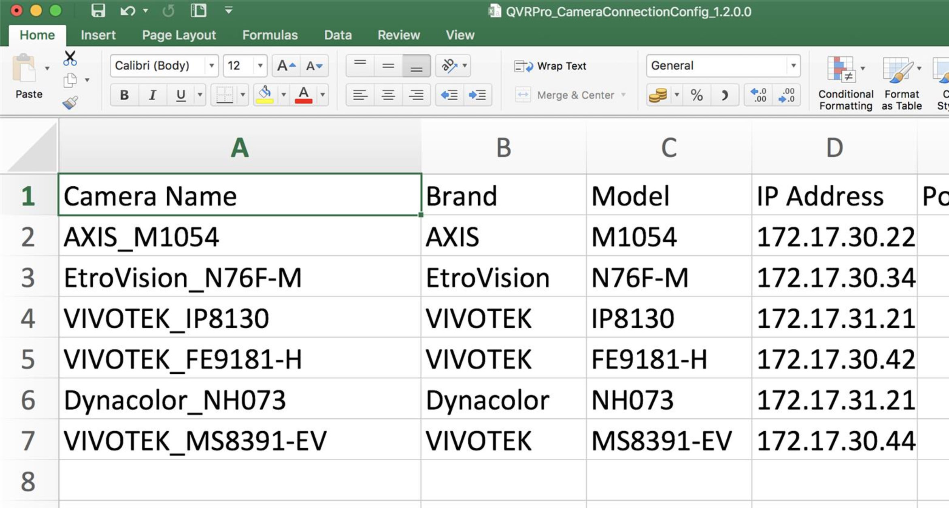
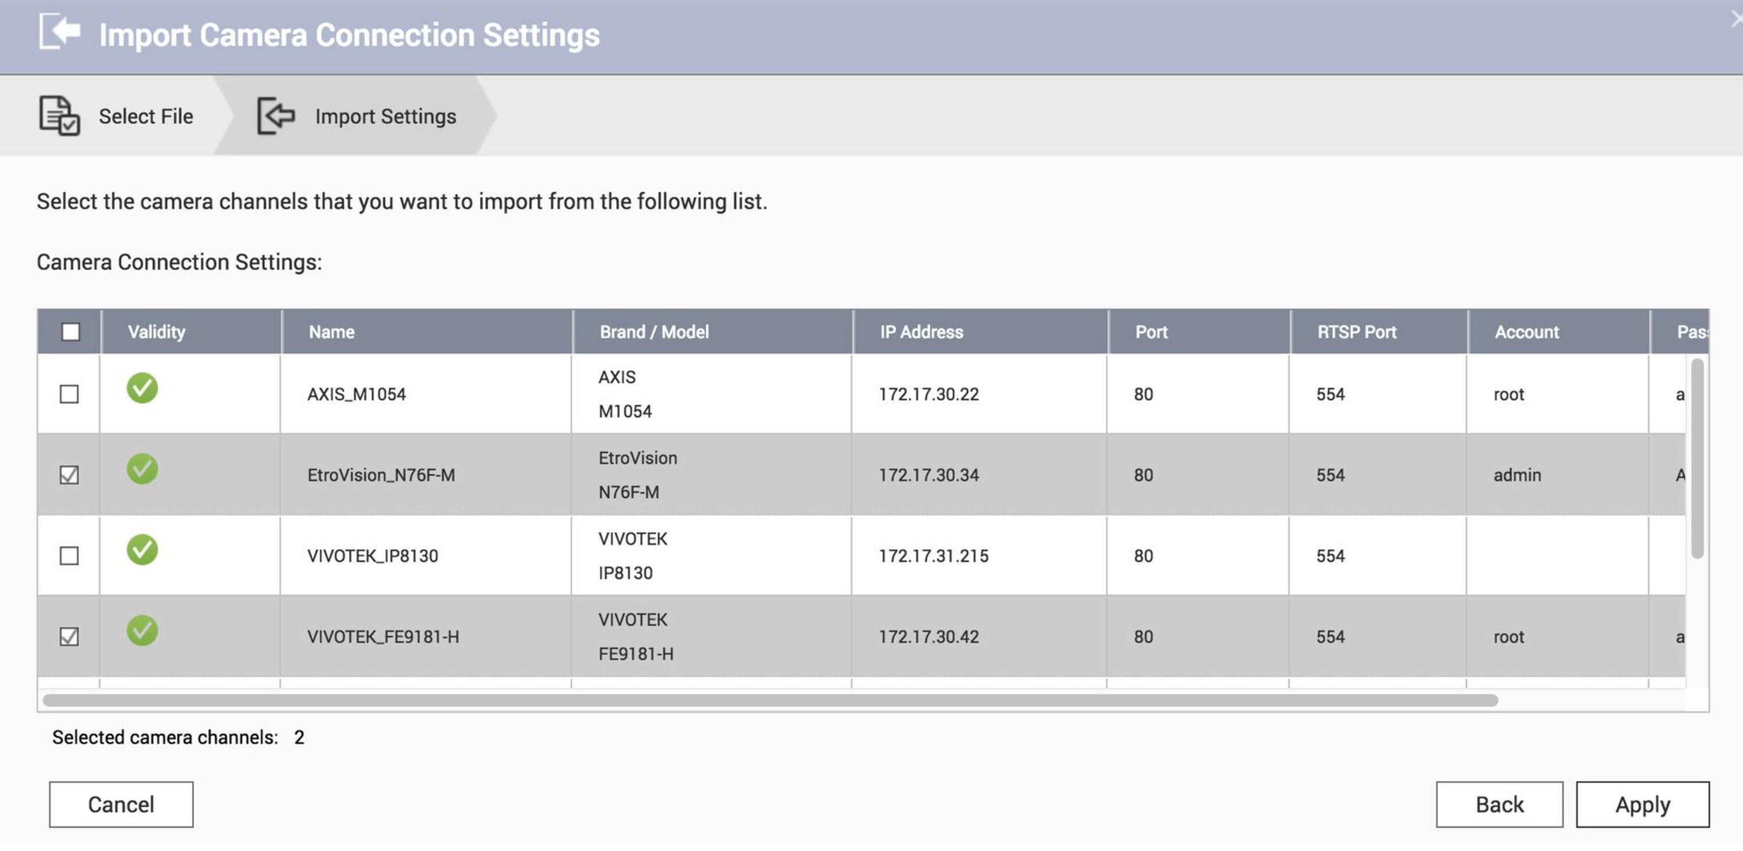
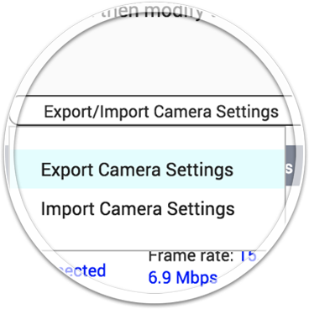
Retail chain business CMS solution
How does QNAP implement a surveillance CMS?
Easily maintain camera information
Maintain and edit
with Excel
Export
Import
Notes:
說明QVR Center 可快速連線開啟個別 QVR Pro資源監控介面

Slide 11
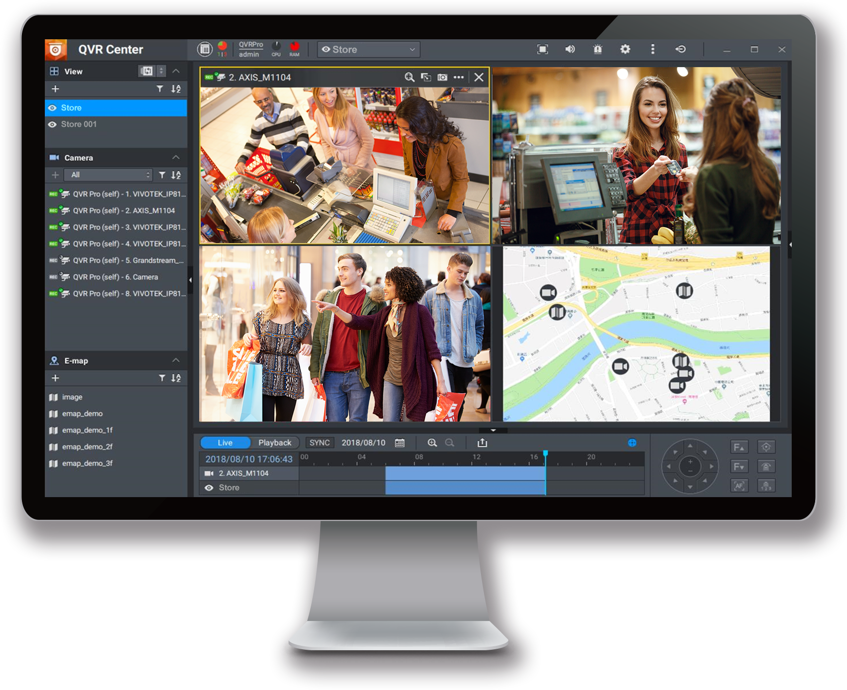
Retail chain business CMS solution
How does QNAP implement a surveillance CMS?
Compatible with early investment
QVR Center not only supports QVR Pro, but is also compatible with VioStor NVR and Surveillance Station. You don’t have to replace all existing investments if you want to use QVR Center.
Fron QVR Pro
From Surveillance
Station
From Surveillance
Station
Notes:
說明QVR Center 可快速連線開啟個別 QVR Pro資源監控介面

Slide 12
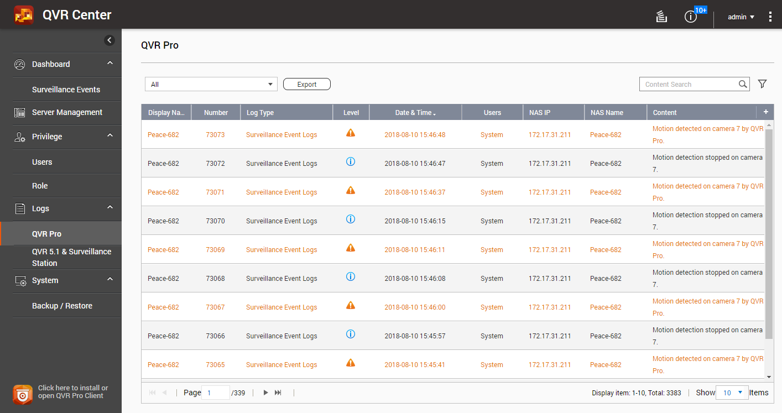
Retail chain business CMS solution
How does QNAP implement a surveillance CMS?
Easily search all QVR Pro log
The headquarters can control the recording system of all chain stores through QVR Center logs.
QVR Center records all system information, quickly and easily understand the status of all QVR Pro.
Notes:
說明QVR Center 可快速連線開啟個別 QVR Pro資源監控介面

Slide 13
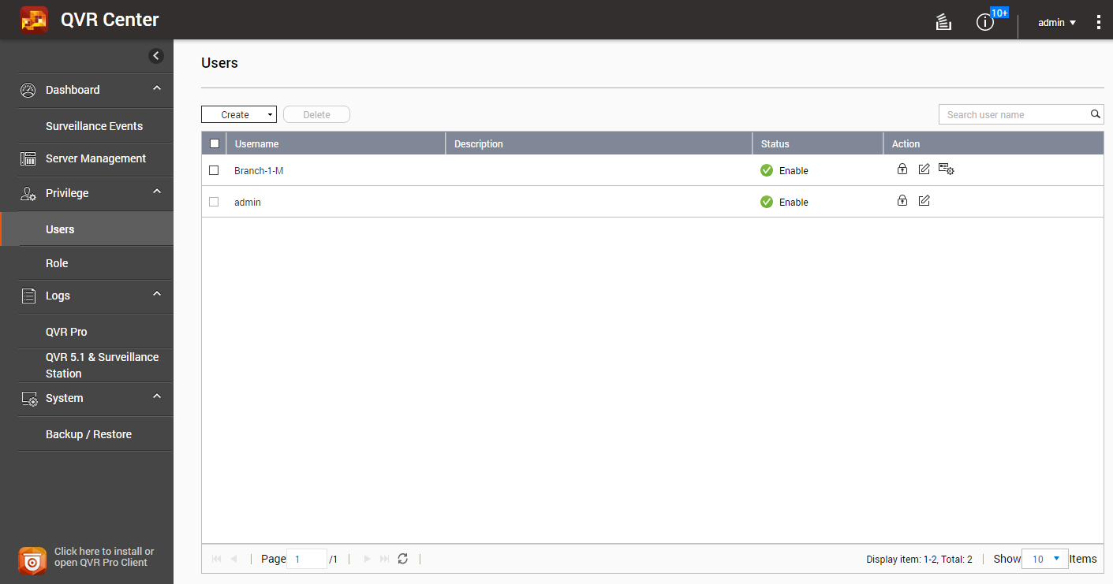
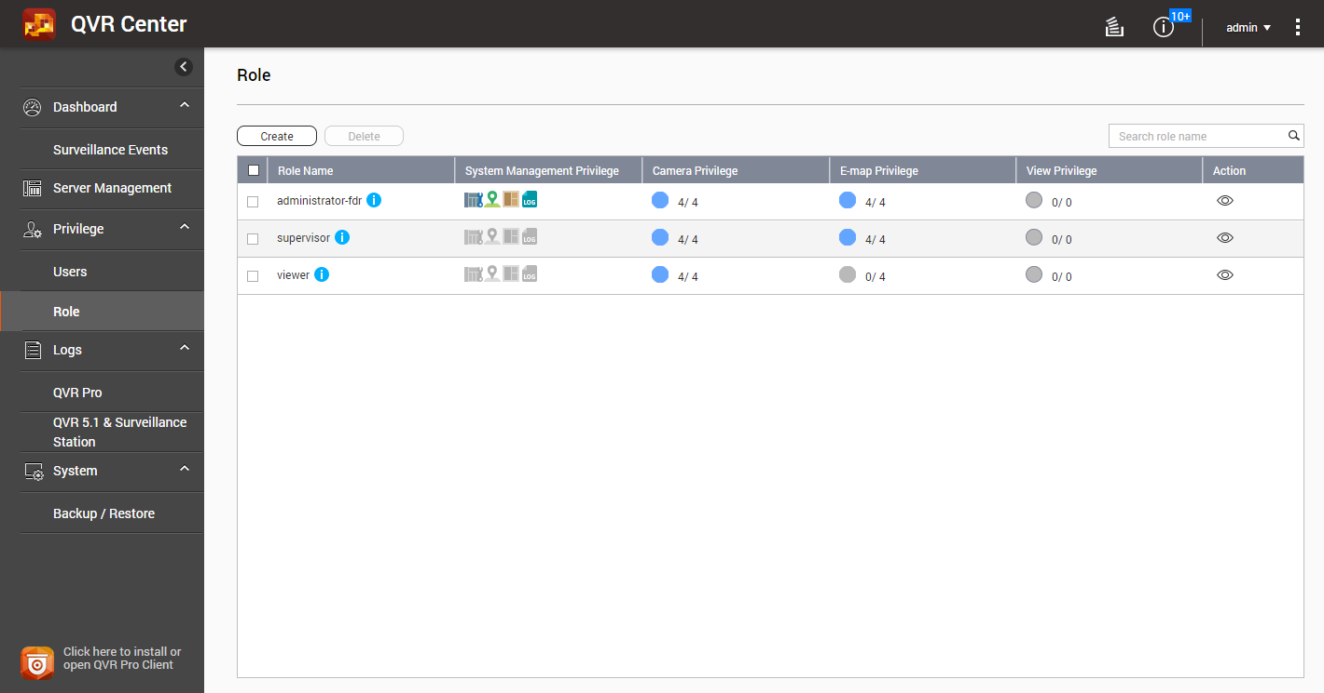
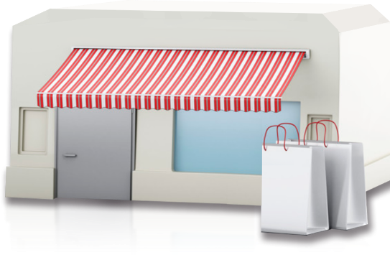
Retail chain business CMS solution
How does QNAP implement a surveillance CMS?
Central privilege control
QVR Center has an independent privilege rule set, which can set a separate account password to facilitate access control settings of each QVR Pro. Comprehensive privilege setting can be met even in a multi-managed retail environment.
Notes:
說明QVR Center 可快速連線開啟個別 QVR Pro資源監控介面

Slide 14
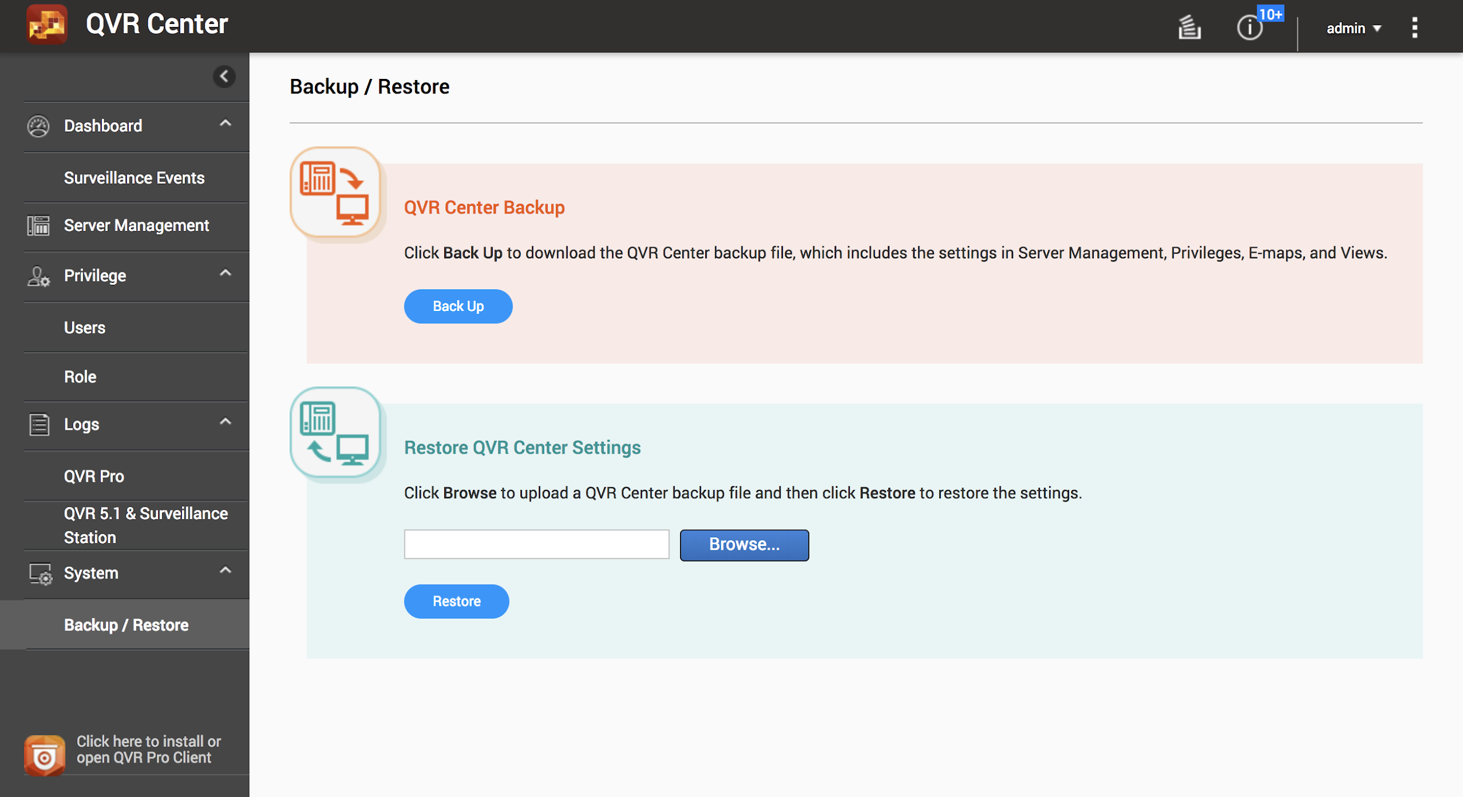
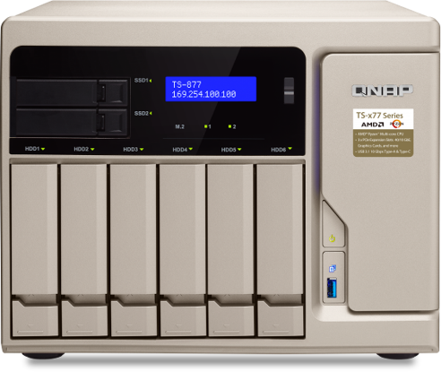
Retail chain business CMS solution
How does QNAP implement a surveillance CMS?
System restore
By using QVR Center backup/restore feature, you can backup QVR Center’s setting. When the system is down, You can restore it again at another NAS in the shortest time to resume surveillance.
Notes:
說明QVR Center 可快速連線開啟個別 QVR Pro資源監控介面

Slide 15
Retail chain business CMS solution
How does QNAP build and manage multi-point?
QVR Center license rule
Surveillance
Station
VioStor NVR
QVR Center supports free integration with Surveillance Station, VioStor NVR and 2 QVR Pro (w/o license).
If you wish to add more QVR Pro into the QVR Center for central monitoring, QVR Pro Gold license is required to activated on those QVR Pros.
QVR Center
Managed up to128 servers
QVR Pro
(with QVR Pro
Gold license)
QVR Pro
(up to 2 NAS : without any license)
Notes:
小型零售店攝影機數量在 8 路以下。
中型零售店攝影機數量在 8 ~ 20 路。
賣場攝影機數量在 20 路以上。

Slide 16
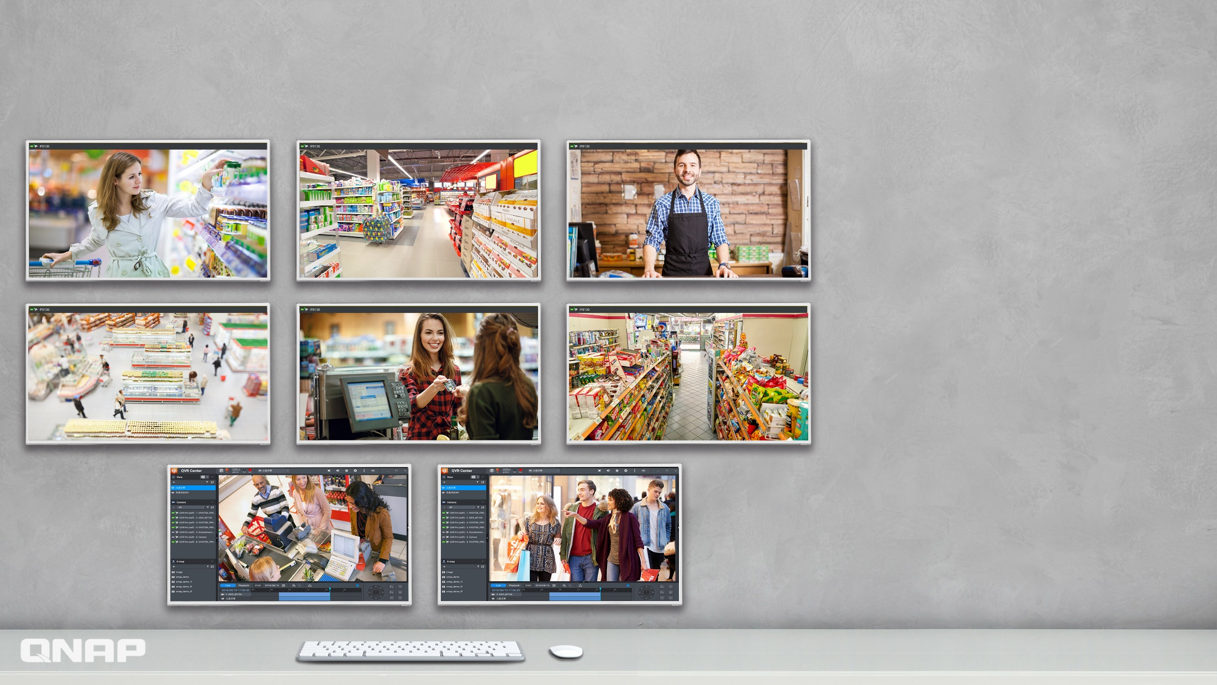
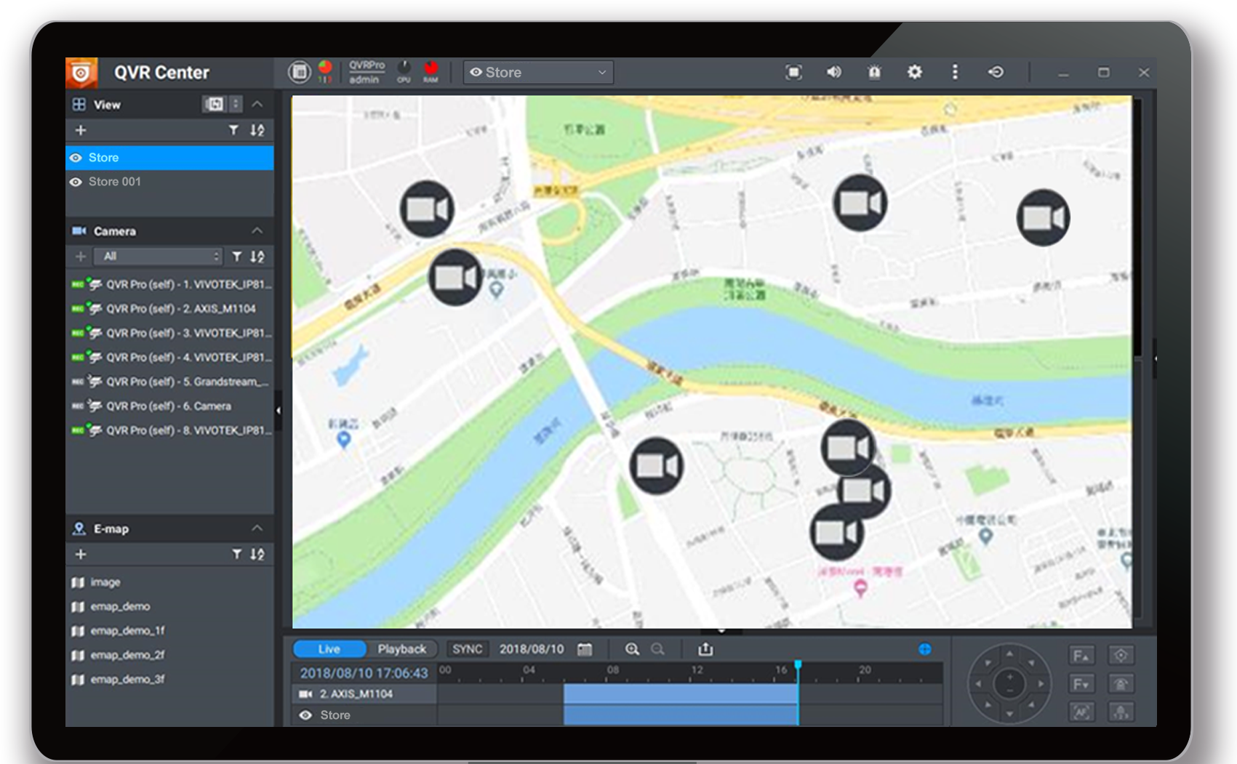
Retail chain business CMS solution
How does QNAP build and manage multi-point?
QVR Pro Client video wall supports up to 8 screens, you can monitor every branches instantly at head quarter.
3
4
5
6
7
8
1
3
4
2
5
6
7
2
1
8
Notes:
修改為多點門市 UI 示意

Slide 17
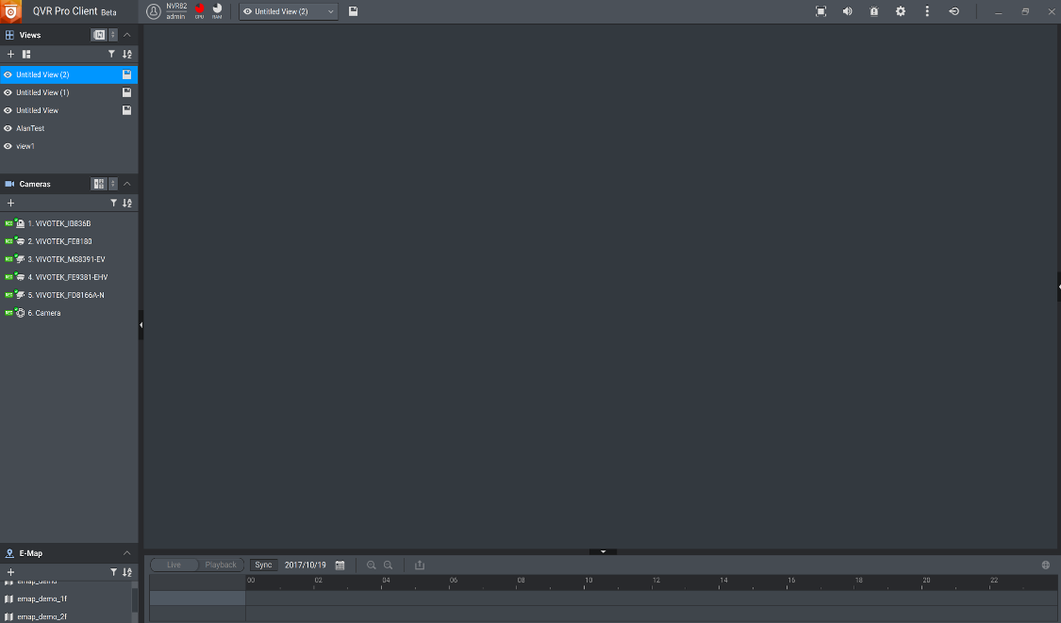
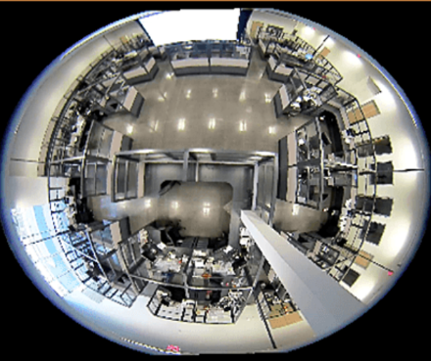
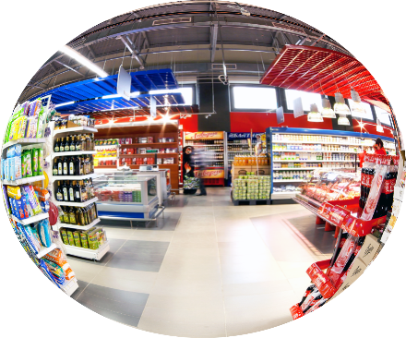
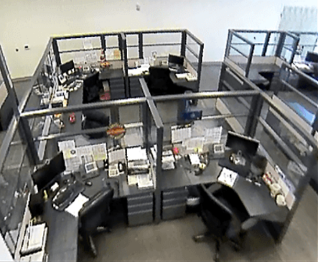
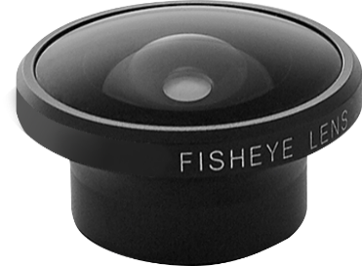
Retail chain business CMS solution
Does QNAP have other convenient features？
Fisheye de-warp technology
In a retail store with a limited budget, you only need one fisheye and it can cover the most area. QVR Pro not only supports fisheye camera models but also enables users to view standard fisheye camera recordings in proportional ratios and sizes without affecting original recordings.

Slide 18
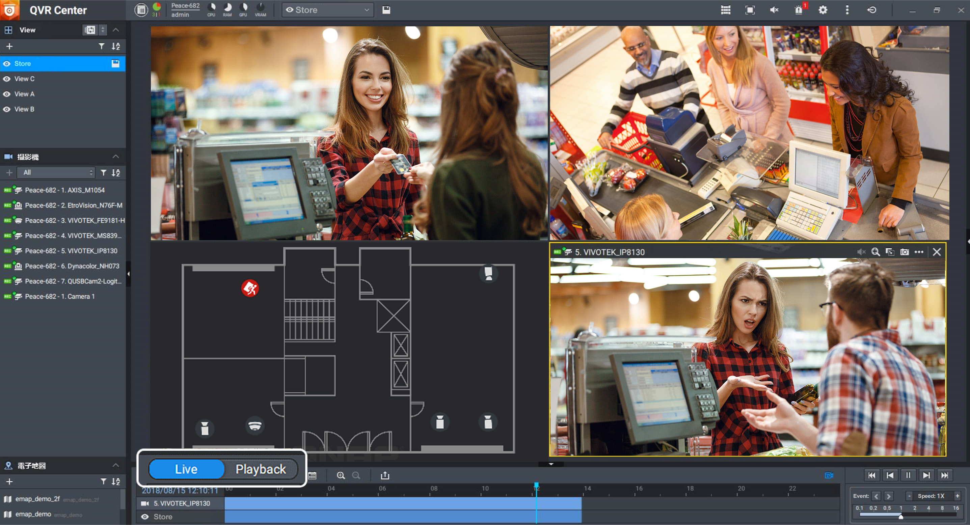
Retail chain business CMS solution
Does QNAP have other convenient features？
Monitor at the same time
Monitor the live feed or check the recordings playback ? You do not need to choose one. QVR Pro Client can monitor them at the same time in a single view.
Notes:
修改為live 與 playback 同時在一個畫面，避免因回放而看不到即時畫面

Slide 19
Retail chain business CMS solution
Can QNAP manage event notification from multiple points?
E-map
When event occurs, to ensure a timely response, you can quickly know the camera's location of every branch shops on the visualized e-map.
Notes:
修改為多點監控地圖示意

Slide 20
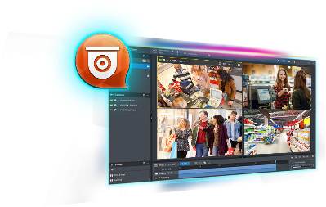
Retail chain business CMS solution
Can QNAP integrate with other systems?
QVR Pro's API and metadata supports third-party device integration. Allowing security monitoring systems bring more help to chain stores scenarios.
Headquarters central manage
POS
3rd-Party AI Engine
QVR Pro Client
Customer analysis
Product display
Metadata
Metadata URL
Live and recording playback
QVR Pro
Metadata Vault
Recording Engine
Data
combination
Online
display
Store
Event alert

Slide 21
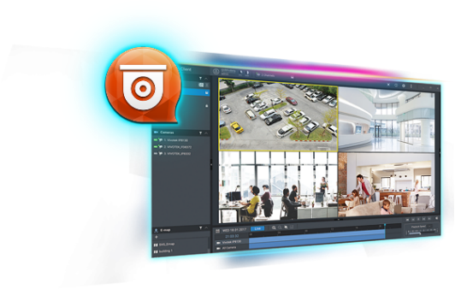
Retail chain business CMS solution- basic architecture
CMS
QVR Center
3rd-Party AI Engine
QVR Pro Client
Headquarters
RTSP
Metadata
QVR Pro API
Metadata URL
QVR Pro
Metadata Vault
Recording Engine
QVR Pro
Surveillance Station 5.1.3
QVR 5.1.3
Remote backup
Hybrid Backup Sync - RTRR
QVR Guard
Shop
Shop1
Shop2
Shop3

Slide 22
Retail chain business security
Live
Live

Slide 23
QNAP surveillance solution vs conventional surveillance solution
 | Compatibility | Features | Data security | Maintain
Conventional IP cam+ Surveillance system | Bad （Need to change all the system） | less (only for surveillance) | low (If hard disk fails, data is damaged and cannot be recovered) | hard (hard to maintain and control system status)
QNAP NAS (QVR Pro + QVR Center | Awesome (QVR Center can managed QVR 5.1 and Surveillance Station) | versatile (NAS features+ surveillance) | high (Support many backup functions, you do not need to worry even the hardware are damaged) | easy (QNAP NAS has it 's own dashboard to control the system status)
Notes:
QVR Center 向下相容的比較。

Slide 24
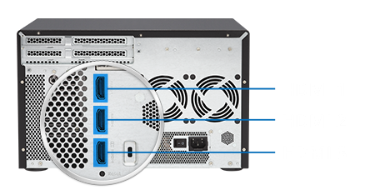
NAS model for retail chain business security
QVR Pro
2-bay model for Small shop
Built-in HDMI
Local Display
3 HDMI for small scale Video Wall solution
TS-251B-4G
TVS-951X-8G
TVS-1282-i7-64G

Slide 25
Copyright © 2018 QNAP Systems, Inc. All rights reserved. QNAP® and other names of QNAP Products are proprietary marks or registered trademarks of QNAP Systems, Inc. Other products and company names mentioned herein are trademarks of their respective holders.

